Slide 1
2023 MDP Collaboration Meeting 20 T hybrid magnet and comparative analysis
P. Ferracin
US Magnet Development Program

Slide 2
Introduction Working group
Members US MDP 20 T working group
LBNL: D. Arbelaez, L. Brouwer, P. Ferracin, L. Garcia Fajardo, M. Juchno, G. Vallone
FNAL: G. Ambrosio, E. Barzi, V. Kashikhin, V. Marinozzi, I. Novitski, A. Zlobin
NHMFL: L. Cooley
BNL: M. Anerella, J. Cozzolino, R. Gupta, F. Kurian, B. Yahia
Contributions from
Etienne Rochepault (CEA)

Slide 3
Introduction Bi-weekly meetings
47 meetings so far
https://conferences.lbl.gov/category/100/

Slide 4
Introduction Goals of working group
Conceptual design of a 20 T hybrid HTS-LTS magnet
Comparative analysis of different design options for a 20 T hybrid
Cosϑ design and its stress-management options
Block-type coil design (block with flared ends)
Common-coil design (block with racetrack coils)
Review and follow-up of current work on hybrid magnets
Collect and organize information to provide inputs for 20 T hybrid design
Design of a support structure for test HTS inserts in CCT6 and SMCT outserts
Study the possibility of using the structure for hybrid magnets towards 20T

Slide 5
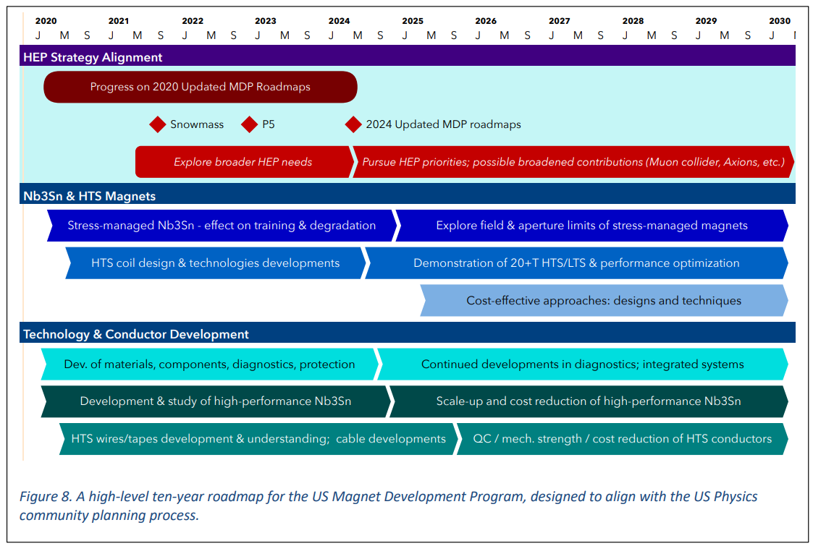
Introduction Motivations: why 20 T hybrid?

Slide 6
Introduction Goals of working group
Conceptual design of a 20 T hybrid HTS-LTS magnet
Comparative analysis of different design options for a 20 T hybrid
Cosϑ design and its stress-management options
Block-type coil design (block with flared ends)
Common-coil design (block with racetrack coils)
Review and follow-up of current work on hybrid magnets
Collect and organize information to provide inputs for 20 T hybrid design
Design of a support structure for test HTS inserts in CCT6 and SMCT outserts
Study the possibility of using the structure for hybrid magnets towards 20T

Slide 7
Design criteria
Coil and magnet parameters
Free coil aperture (diameter) 50 mm
Operational bore field 20 T
load-line fraction @ 1.9K: I_{op}/I_{ss} <= 87 %
2D Geometrical harmonics b_{n}<3 units for n<10 (at R_{ref}=17 mm)
Quench protection
All coils powered in series
Maximum hot spot temperature 350 K
Mechanics
Maximum Nb₃Sn coil stress <180 (<150) MPa at 1.9 (293) K
For the HTS <120 MPa

Slide 8
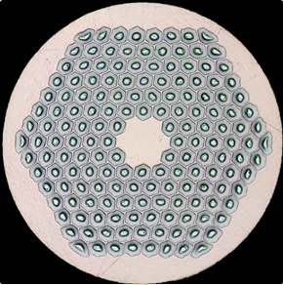
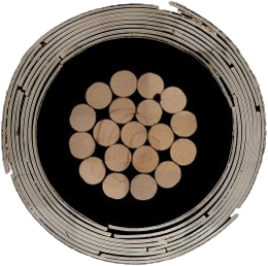
Superconducting materials Wires and cables
Nb₃Sn
0.7 – 1.1 mm strands
Typical properties of 127 or 169 (Bruker-OST) RRP stacks
Rutherford cables: 8-26 mm wide, 1.3-2.0 mm thick
Bi2212
Isotropic, round, multifilamentary
Bruker-OST architecture 19 × 36, 37 × 18 or 55 × 18 for 0.8 mm diameter wires
On paper, possible same strand and Rutherford cable dimensions as Nb₃Sn
REBCO
CORC (ATC LLC) and STAR (AMPeers) wires: tapes around Cu former
Wire diameter from 1.3 to 3.6 mm
Multi-wire cable for accelerator magnets not available yet (R&D in progress)

Slide 9
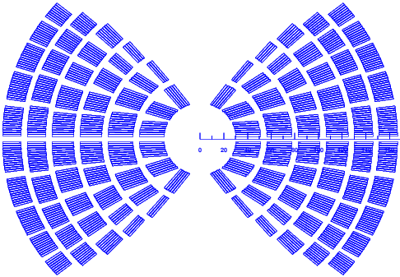
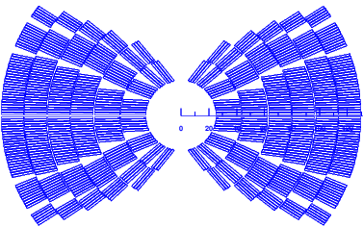
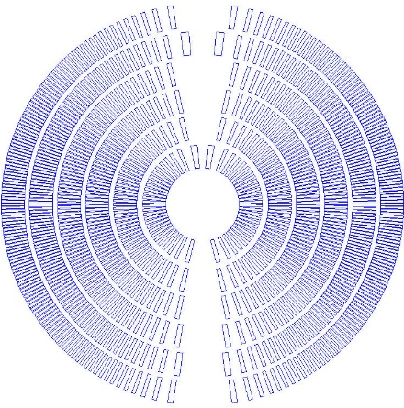
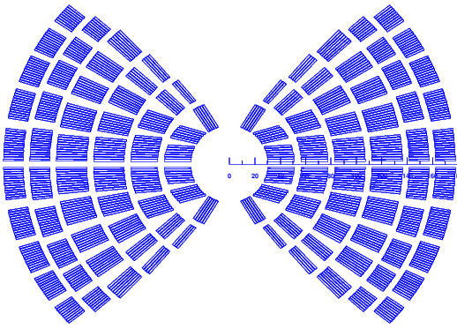
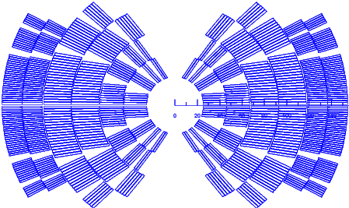
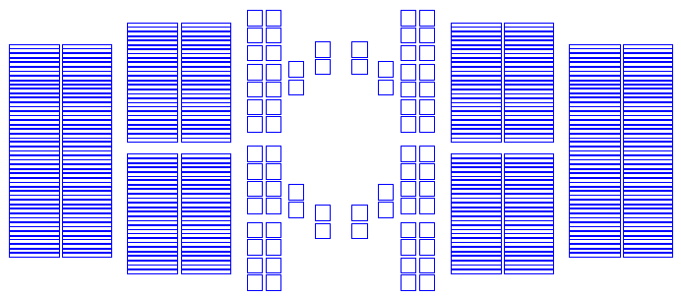
The 20 T hybrid zoo* (First iteration, presented at 2021 MT Conference)
Next steps:
Mechanics

Slide 10
…about a year later
HTS
LTS
HTS
LTS
HTS
LTS

Slide 11
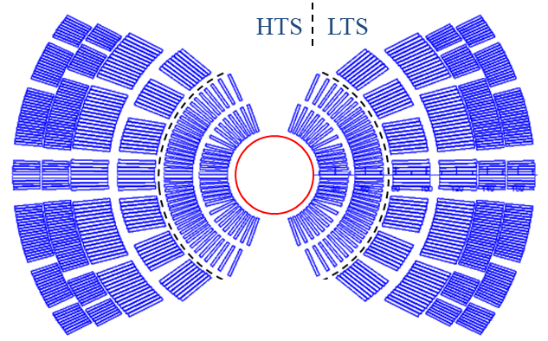
Cos-theta design Magnetic analysis
Coil inner diameter 60 mm
Internal support structure
Design constraint: double-layer coils
6 layers, with cables 18 to 24 mm wide
2 layer HTS, 4 layer LTS
HTS: CCT-like or “single turn” SMCT
LTS: SMCT design + CT
Field quality requirements met
Load-line % : 80% for HTS, 80% for LTS

Slide 12
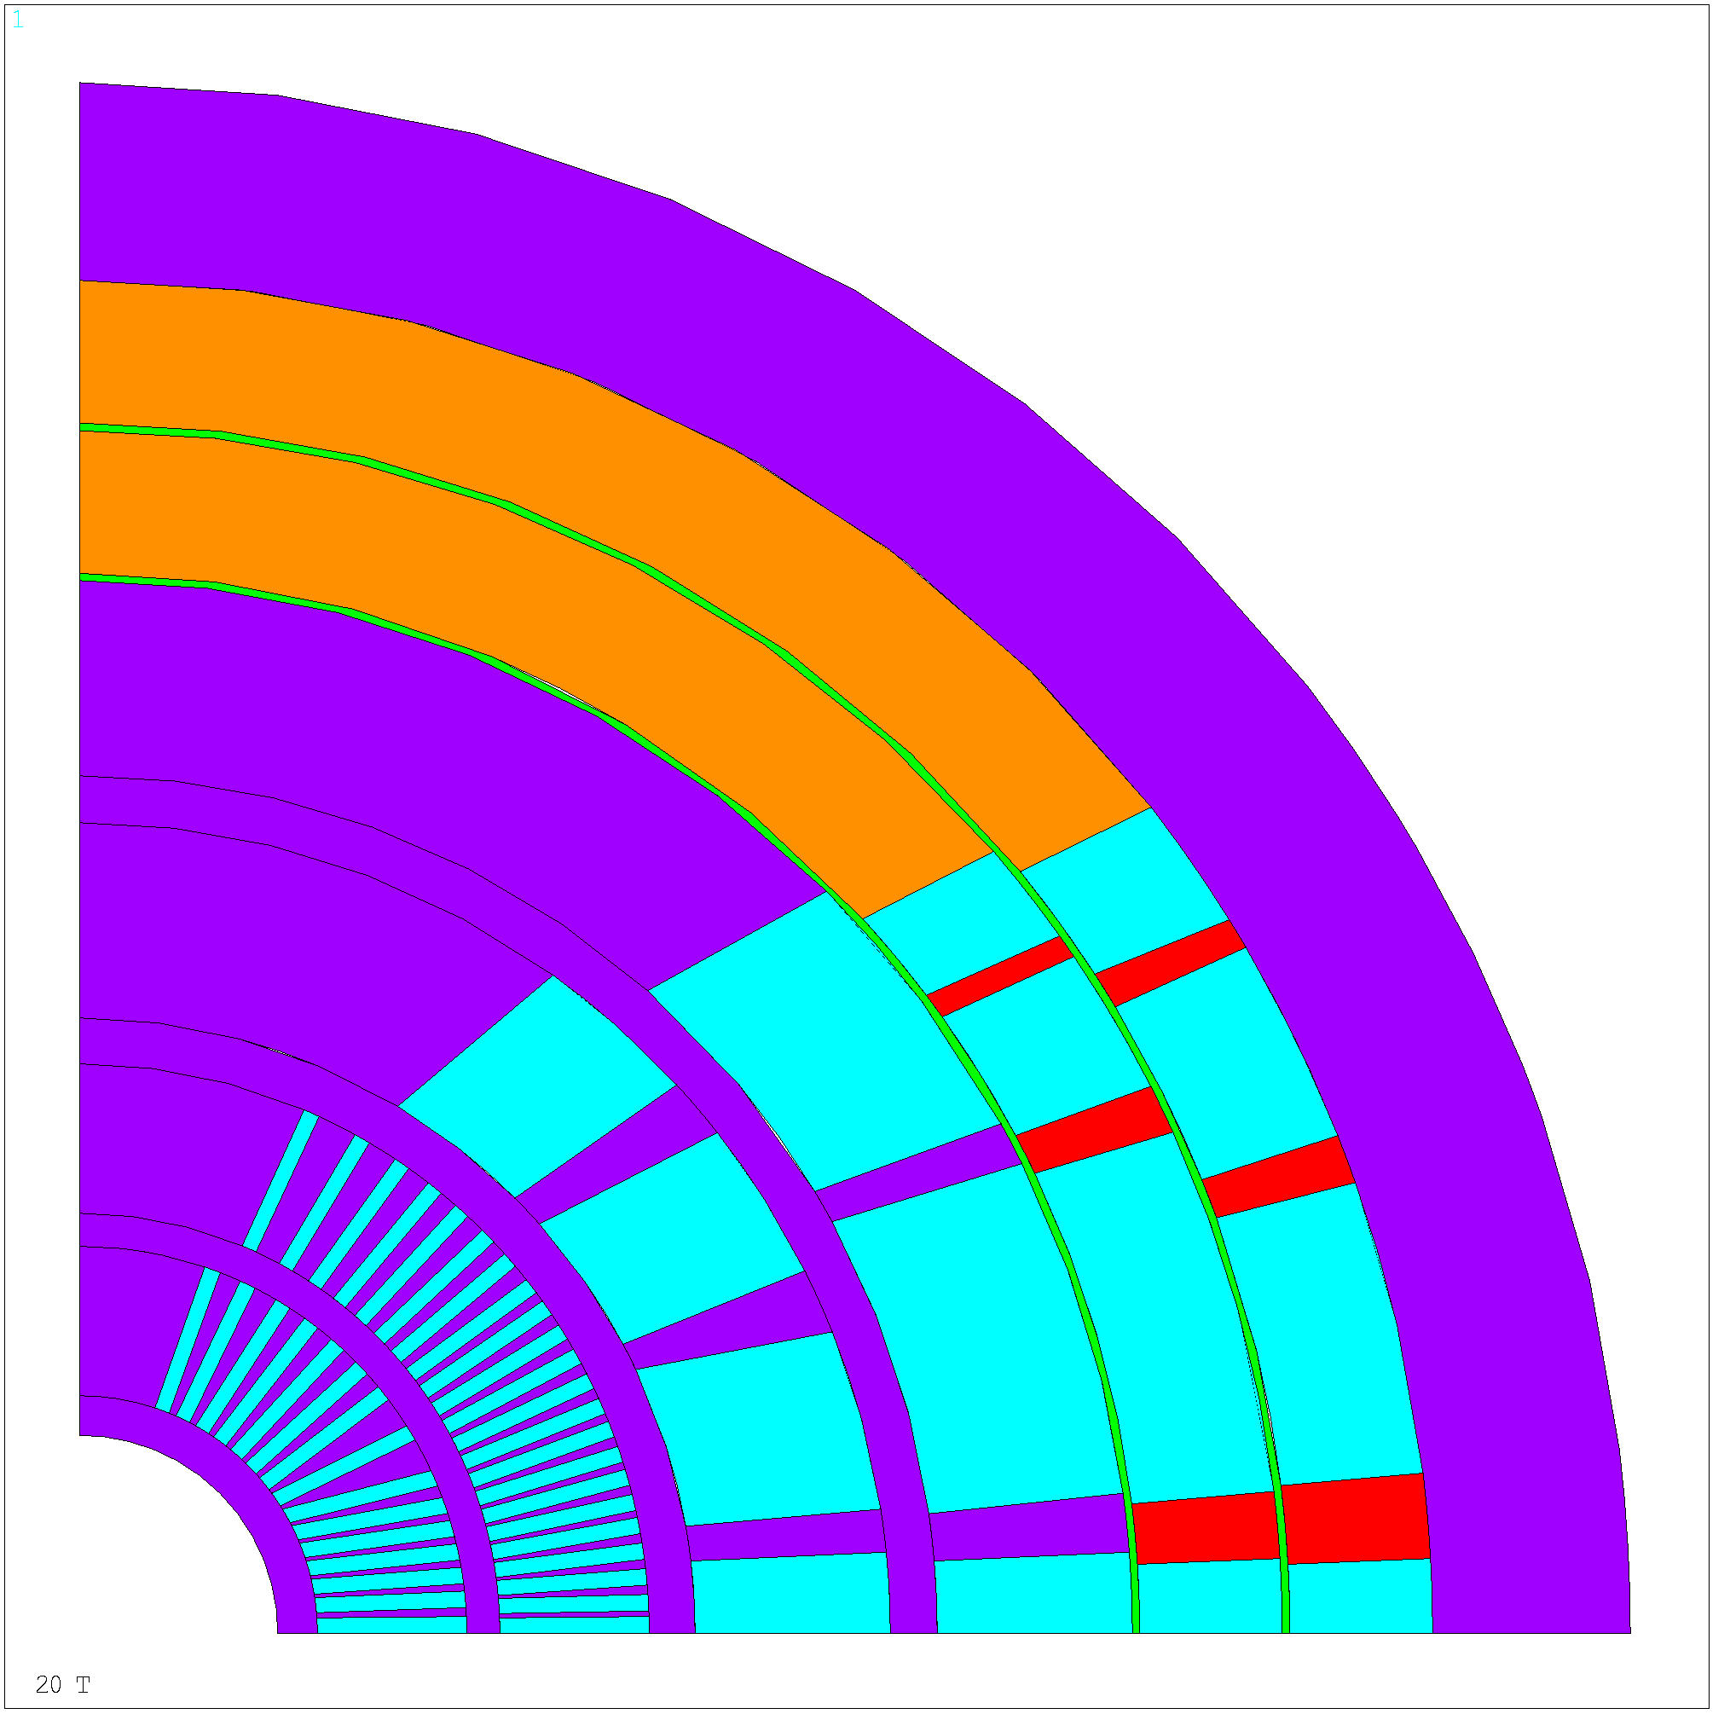
Cos-theta design Mechanical analysis
Assumptions:
Infinitely rigid yoke, deformable SS coil support parts
No pre-stress, no cool-down, only e.m. forces
Coil turn allowed to slide and separate from structure
5 mm thick spars (mandrels)
Several iterations carried out
Non need of force interception in the outermost layers
But CCT-type of interception in inner most layers

Slide 13
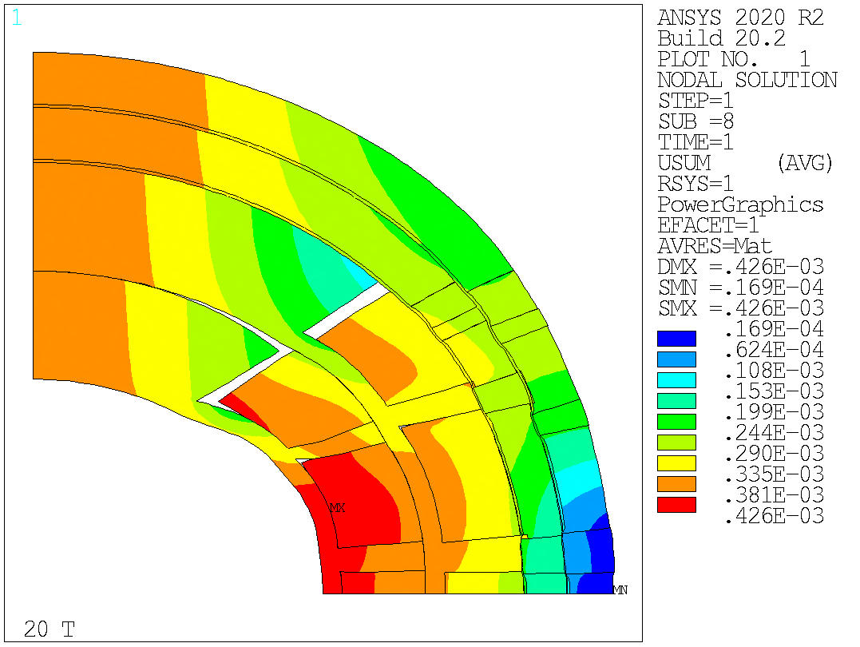
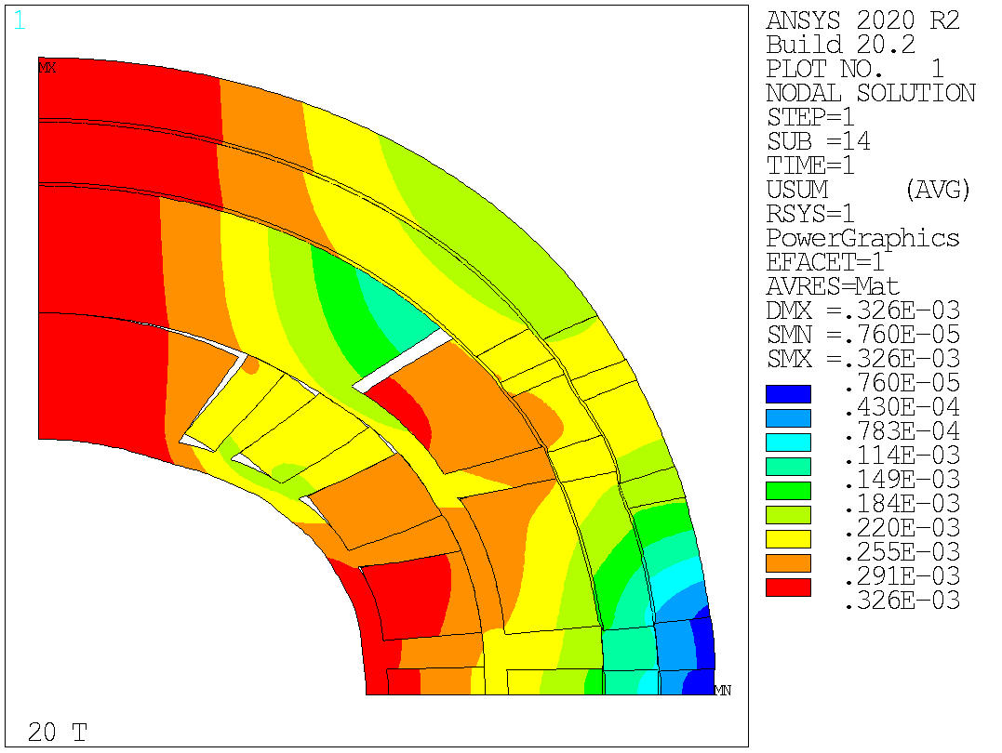
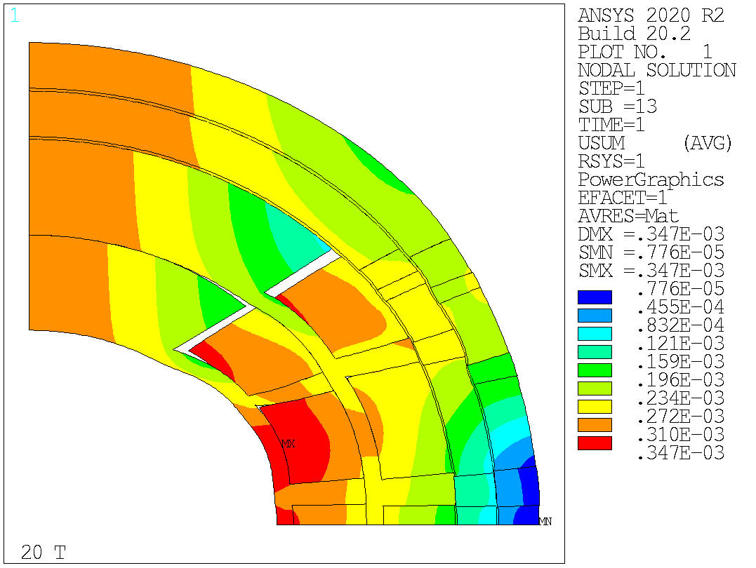
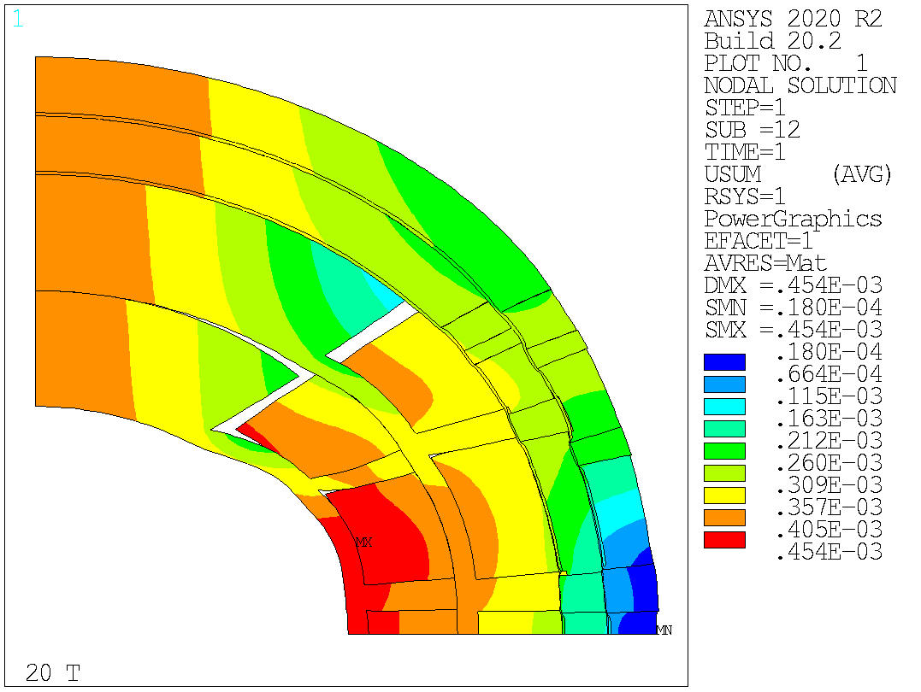
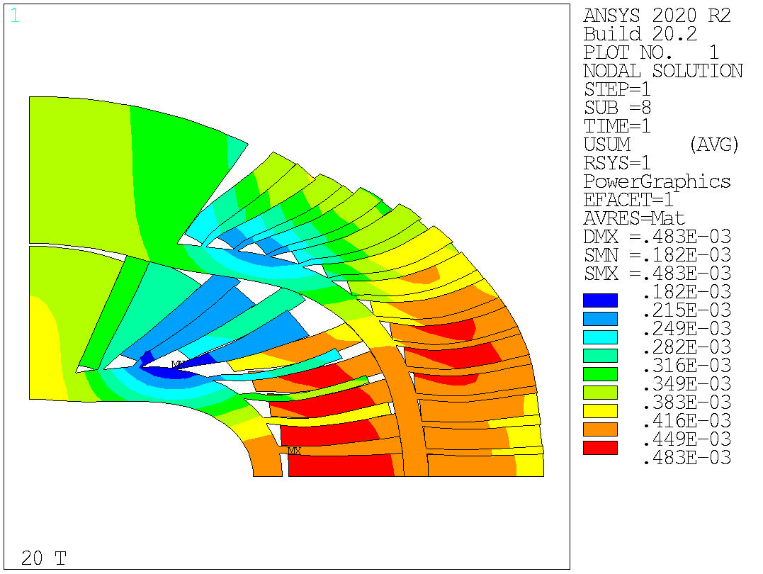
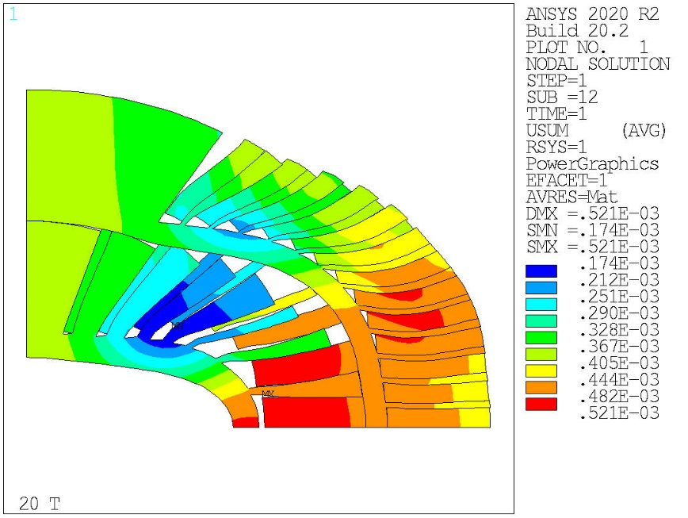
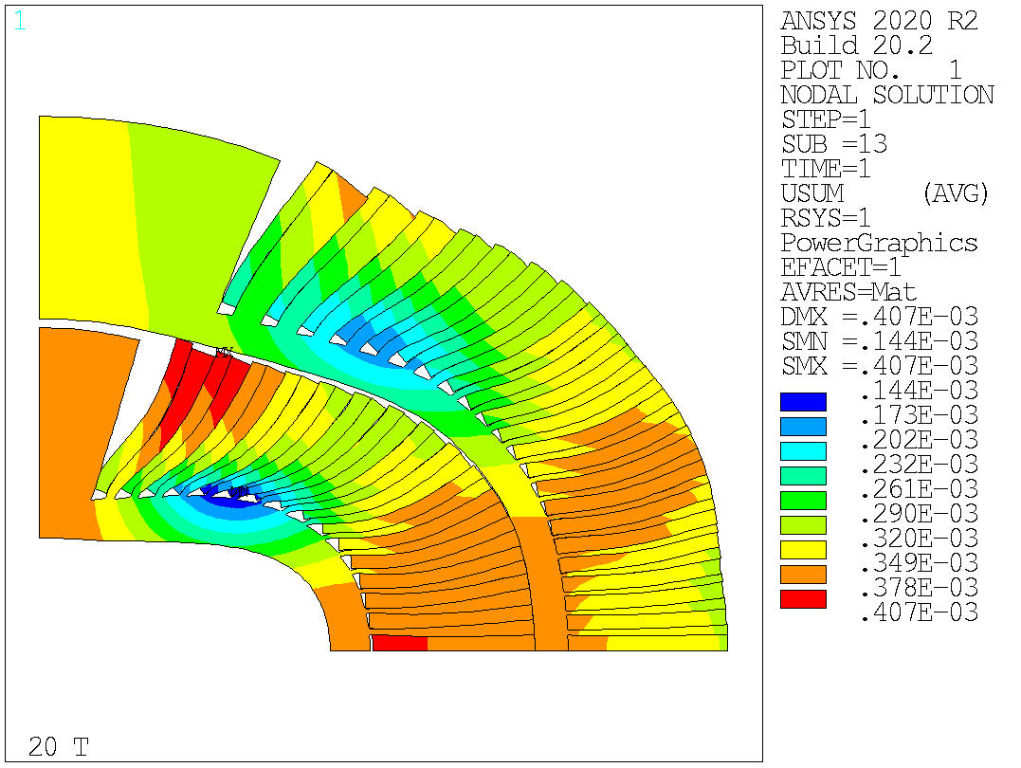
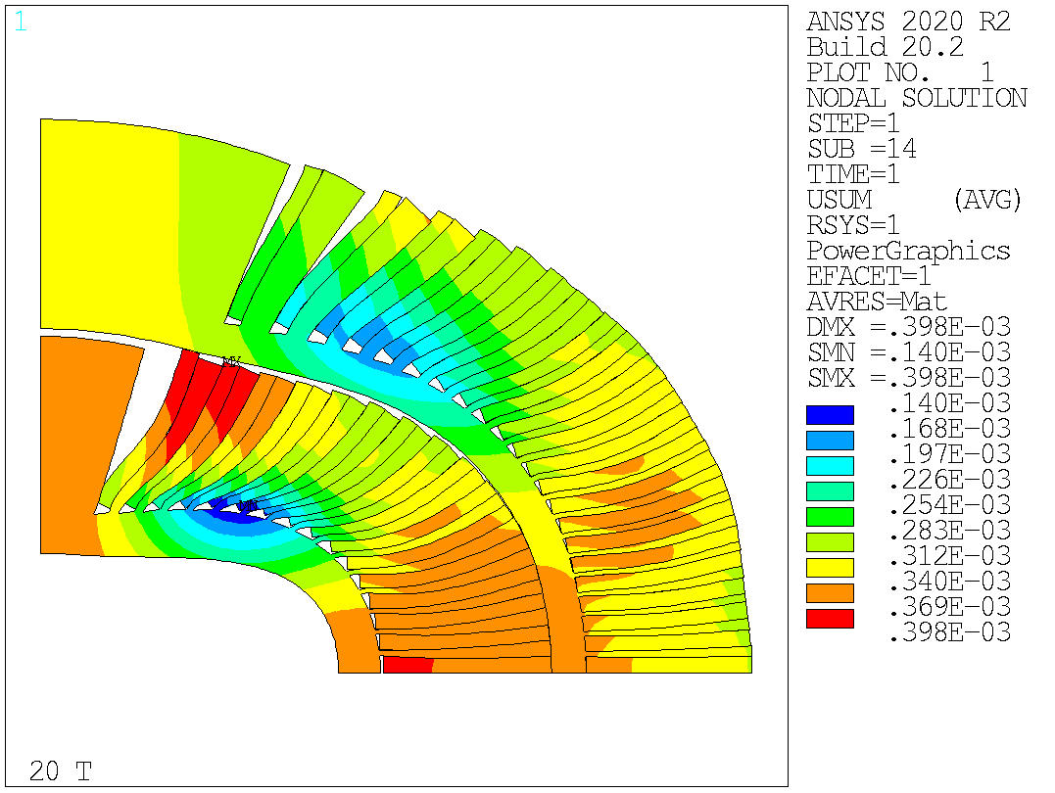
Cos-theta design Mechanical analysis
Significant deformation (large displ. scaling) of the coil support structure → induced stress on the coil blocks/turns

Slide 14
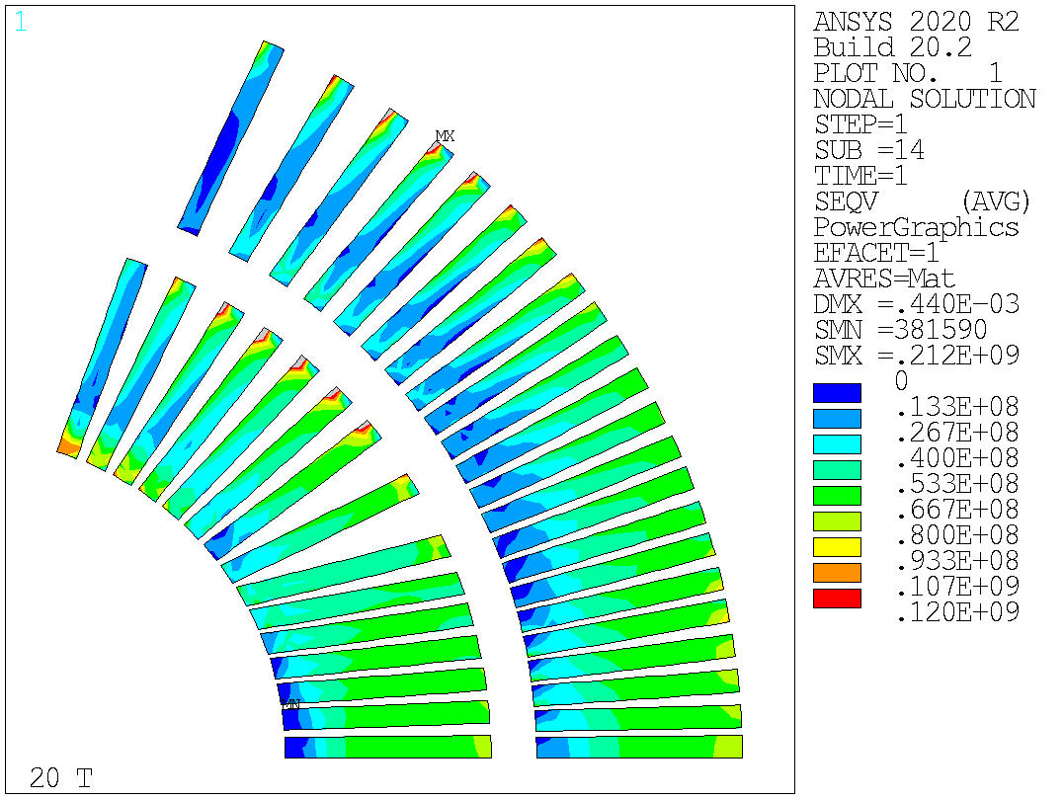
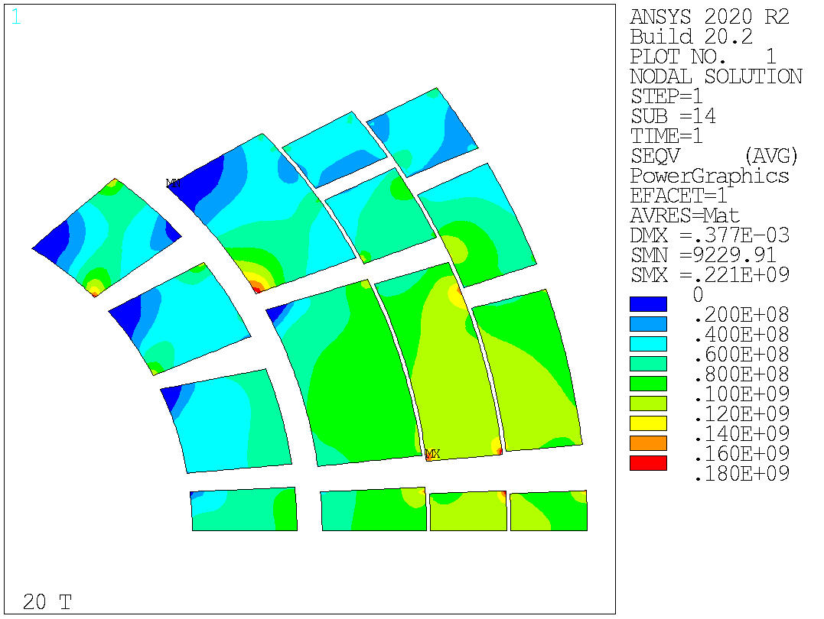
Cos-theta design Mechanical analysis
In HTS, only small areas above 120 MPa of VM stress
In LTS, stress within the 180 MPa limits (except few corner effects)

Slide 15
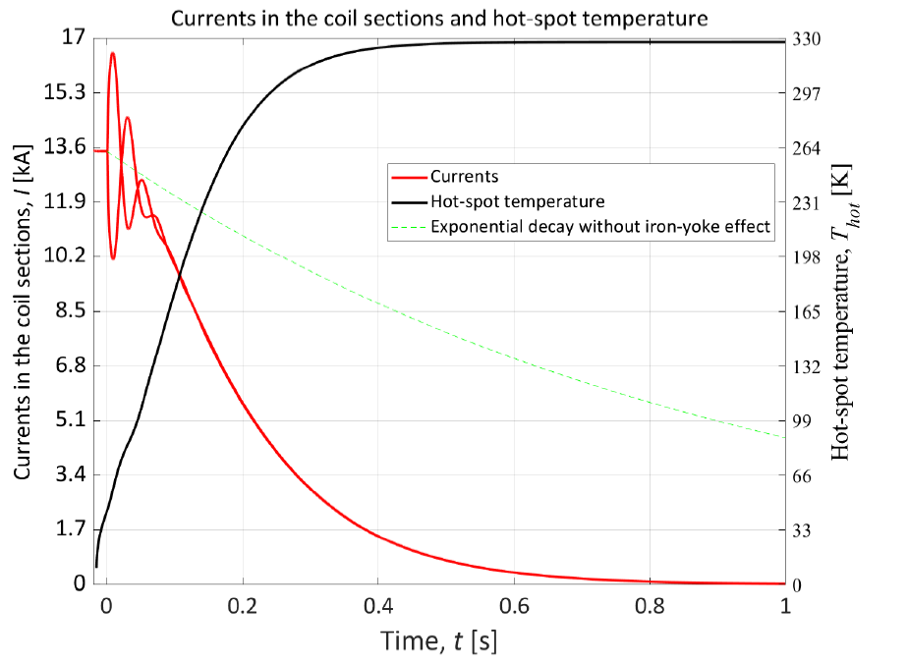
Cos-theta design Quench protection
Preliminary work done on CT
See V. Marinozzi presentation
1 m long model studied
With CLIQ and dump resistor →
400 K in the Nb₃Sn
Very challenging (like everything else with 20 T hybrids), further work needed, but not a showstopper

Slide 16
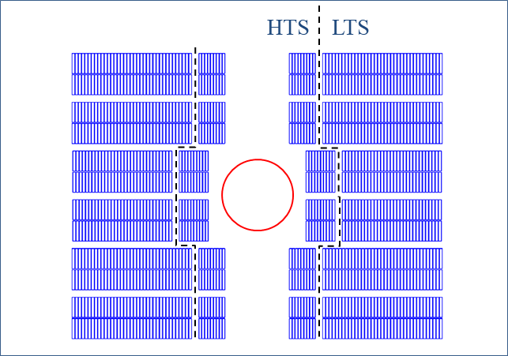
Block design Magnetic analysis
Coil inner diameter 70 mm
Internal support structure
Design constraint
double-layer coils
HD2/FRESCA2 style coil
3 double-layer coils, with 15 mm wide cable
Field quality requirements met
Load-line %: 75% for HTS, 84% for LTS
Challenges: “insertion” of HTS coil inside LTS coils, grading and splicing

Slide 17
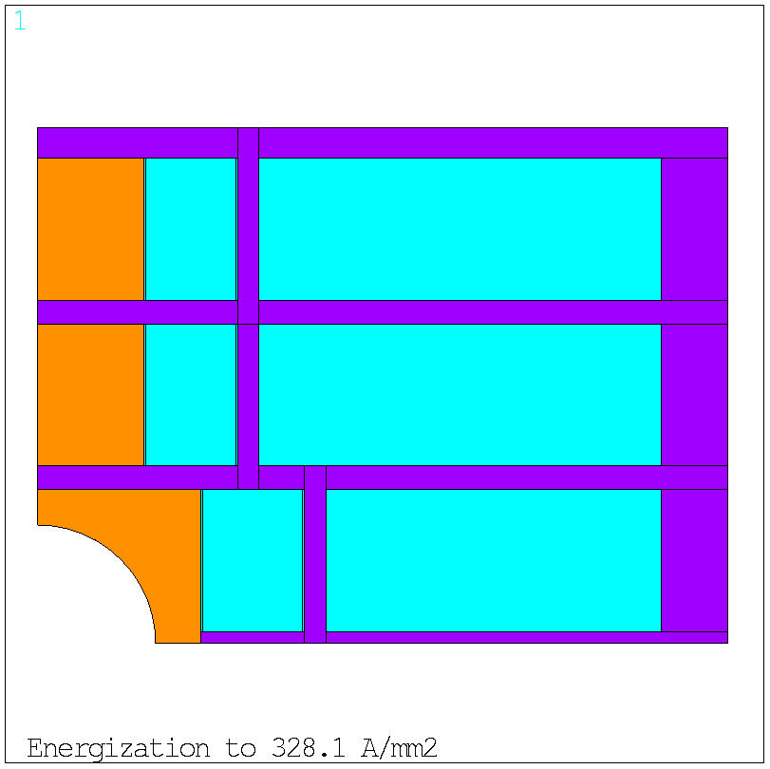
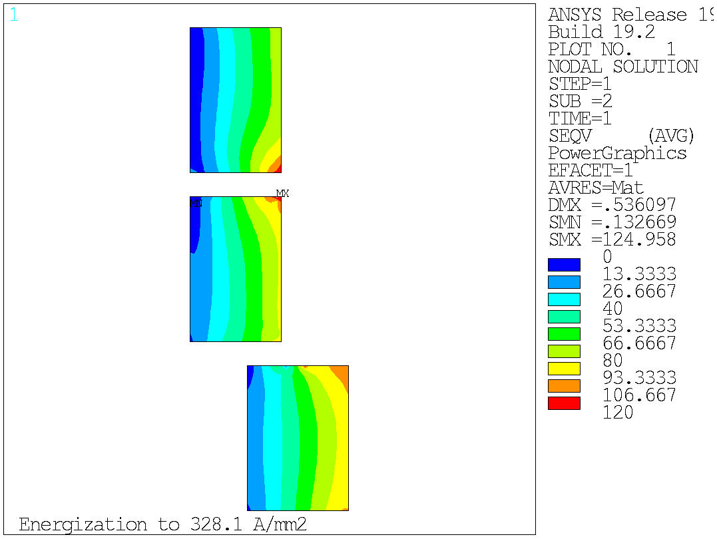
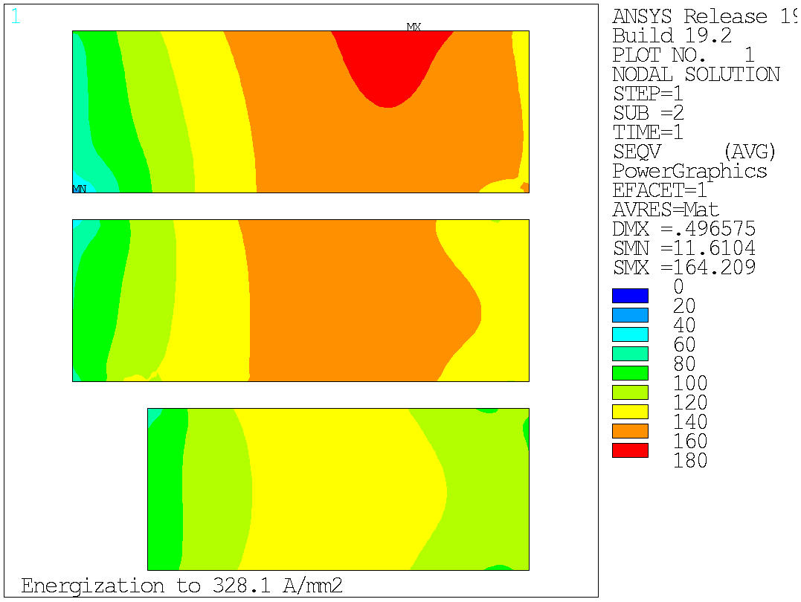
Block design Mechanical
10 mm thick winding pole
Coils vertically separated by horizontal plates
HTS and LTS separated by vertical ribs
In HTS, stress within the 120 MPa of VM stress (except a corner effect)
In LTS, stress within the 180 MPa of VM stress

Slide 18
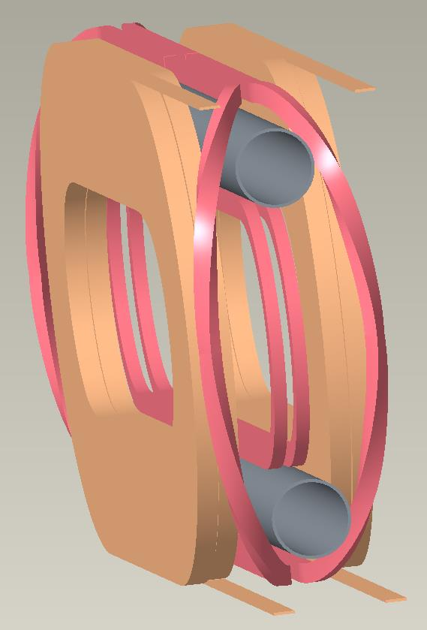
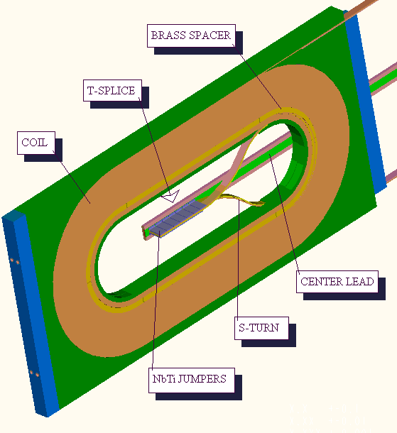
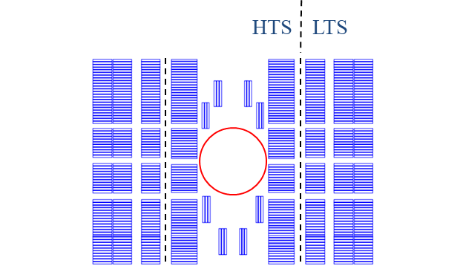
Common-coil design Magnetic analysis
Coil inner diameter 50 mm
No internal support structure
Single layer coils allowed : splice in the central pole
So, vertical and horizontal flexibility
4 layers, with cables 13 mm to 18 mm wide
1 layer HTS, 3 layer LTS
Field quality requirements met
Load-line %: 88% for HTS, 86% for LTS
Challenges: HTS field quality blocks close to the aperture

Slide 19
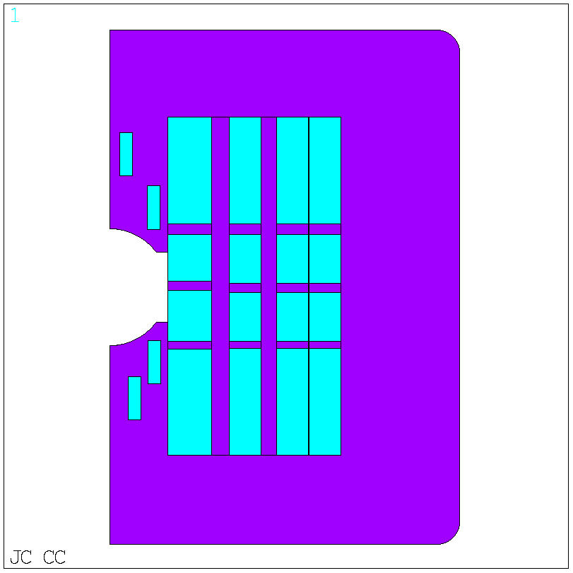
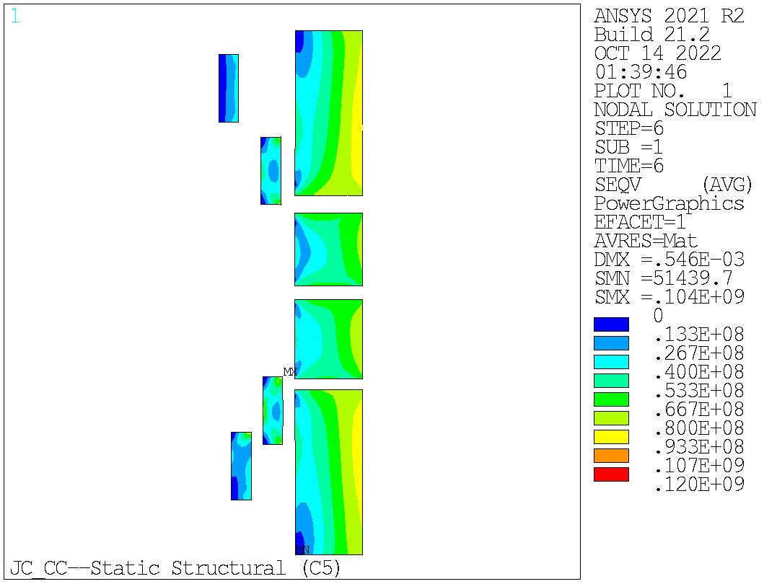
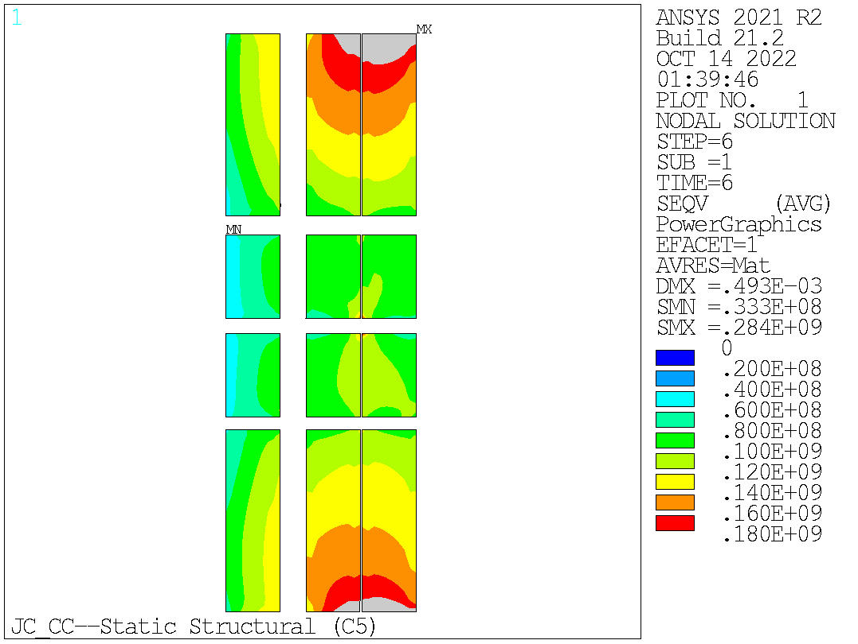
Common-coil design Mechanical analysis
No internal structure in innermost layer
Stress management only horizontally
In HTS, stress within the 120 MPa of VM stress
In LTS, area with stress above 180 MPa of VM stress
Work in progress to mitigate stress (see M. Anerella’s presentation)

Slide 20
Conclusions 2D analysis and next steps
Three design options considered: cos-theta, block, common-coil
Similar HTS conductor area in the 3 designs
Smaller LTS area for common-coil vs cos-theta and block
But lower margin (still in spec), higher stress
So far, on CT: no show stoppers but mechanics and QP challenging
Next steps
QP and “rigid” stress analysis to fine tune cross-sections → complete the 2D comparison, with all 3 meeting specs (including QP)
Move to 2D full mech analysis and 3D
Additional “stable and focused” resources would be highly beneficial

Slide 21
Publications
MT27 (published) ASC 2022 (accepted)

Slide 22
Introduction Goals of working group
Conceptual design of a 20 T hybrid HTS-LTS magnet
Comparative analysis of different design options for a 20 T hybrid
Cosϑ design and its stress-management options
Block-type coil design (block with flared ends)
Common-coil design (block with racetrack coils)
Review and follow-up of current work on hybrid magnets
Collect and organize information to provide inputs for 20 T hybrid design
Design of a support structure for test HTS inserts in CCT6 and SMCT outserts
Study the possibility of using the structure for hybrid magnets towards 20T

Slide 23
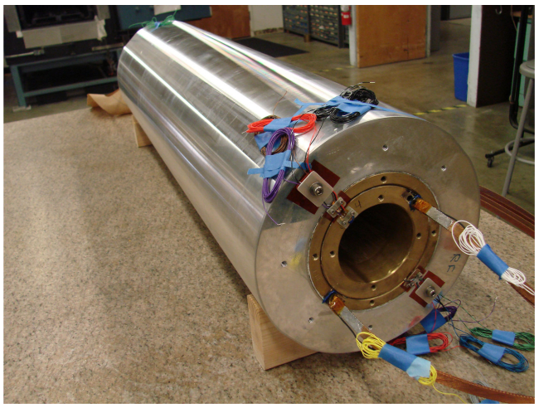
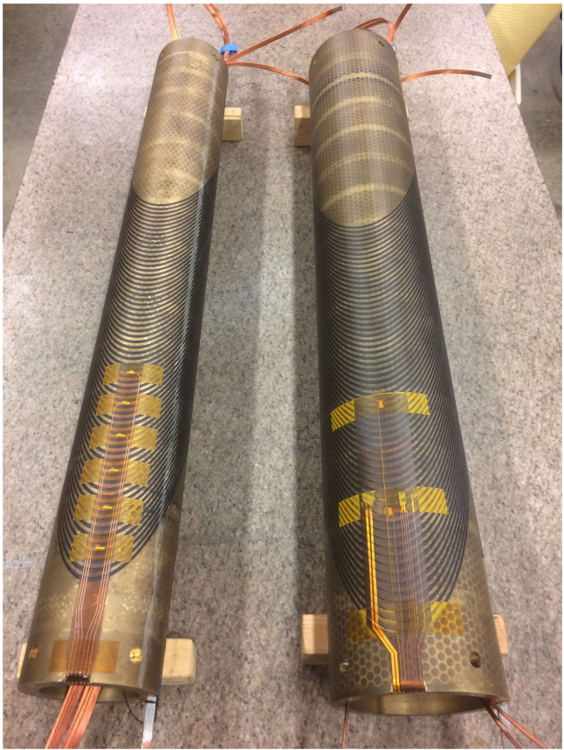
CCT Nb₃Sn insert, CCT Bi2212 insert
LBNL hybrid (expected 2023)
CCT5 as Nb₃Sn outsert
8-9 T in 90 mm aperture
B12212 CCT inserts (Bin5)
~1 T in 30 mm aperture

Slide 24
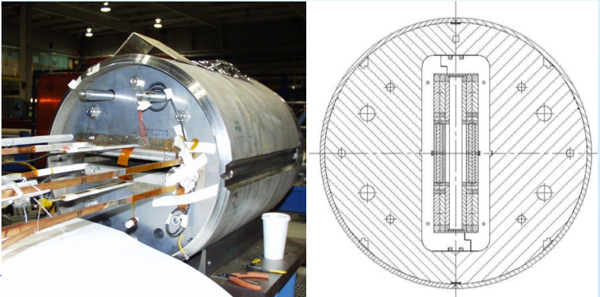
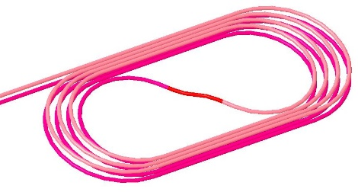
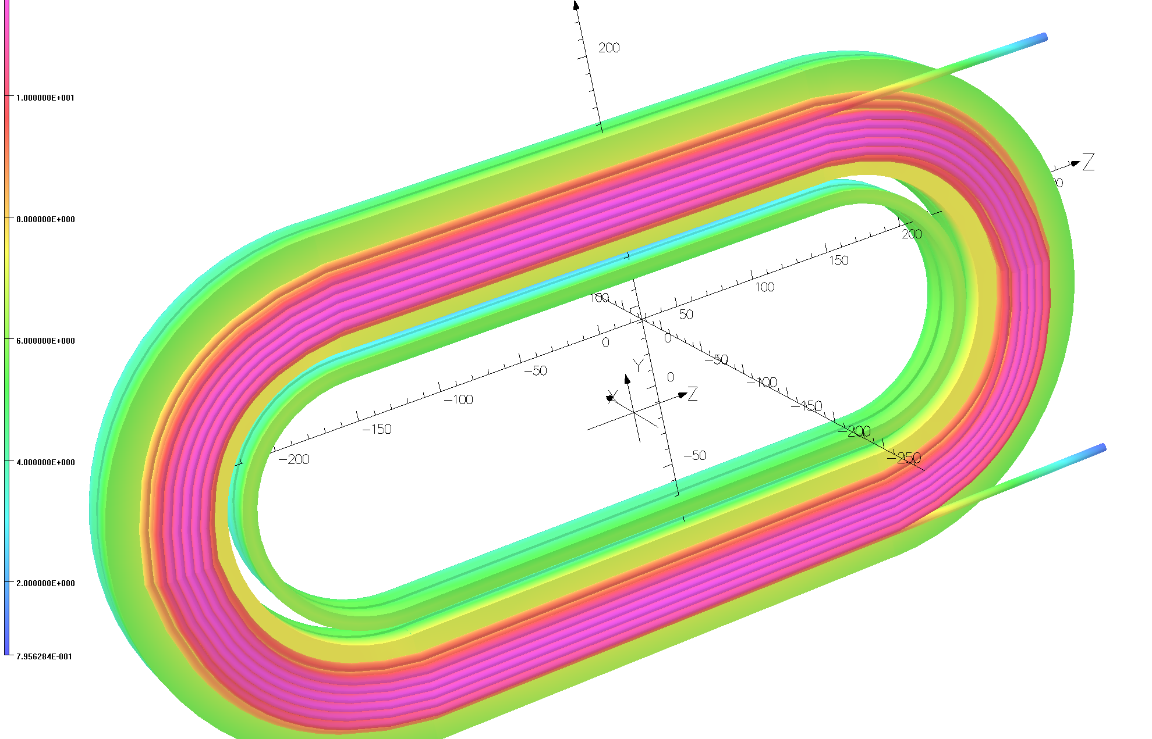
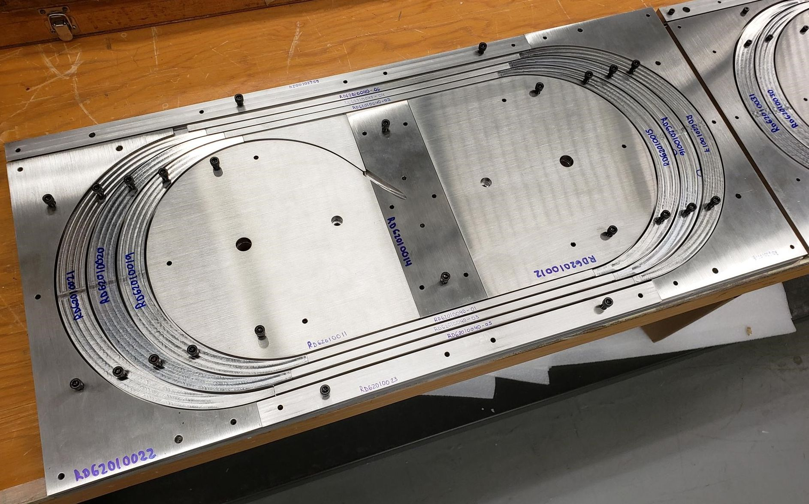
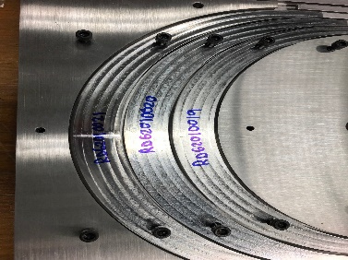
CC Nb₃Sn outsert, CC REBCO insert
BNL hybrid (expected 2023/2024)
10 T Nb₃Sn CC outsert
CORC CC MDP (1-2 T)
To be tested in CC outsert in 2023/2024
CORC CC STTR (3-5 T)
To be tested in CC outsert in 2023/2024

Slide 25
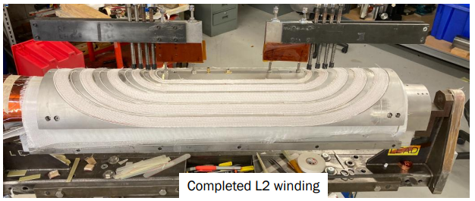
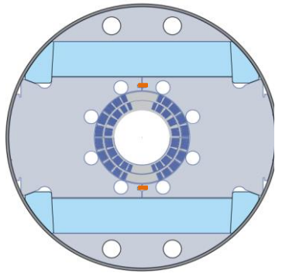
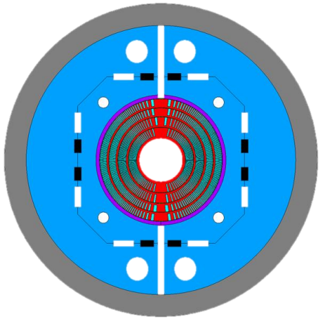
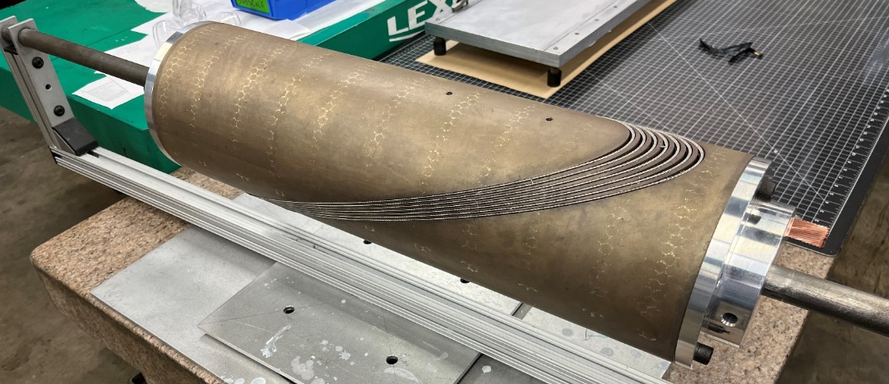
CT Nb₃Sn outserts
Large aperture (120 mm) Nb₃Sn outserts (2024/2025)
FNAL SMCT
~11 T with 2 layers
LBNL CCT
15-16 T (80-85% at 1.9 K) with 4 layers

Slide 26
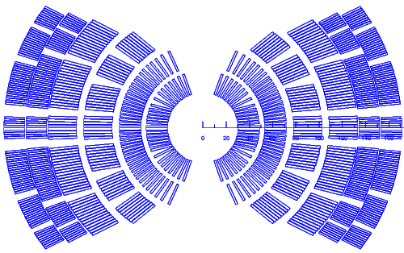
How do the compare with the 20T CT outsert?
20 T outsert, 140 mm
CCT6, 120 mm
SMCT, 120 mm
16 T, 85% 1.9 K
11 T

Slide 27
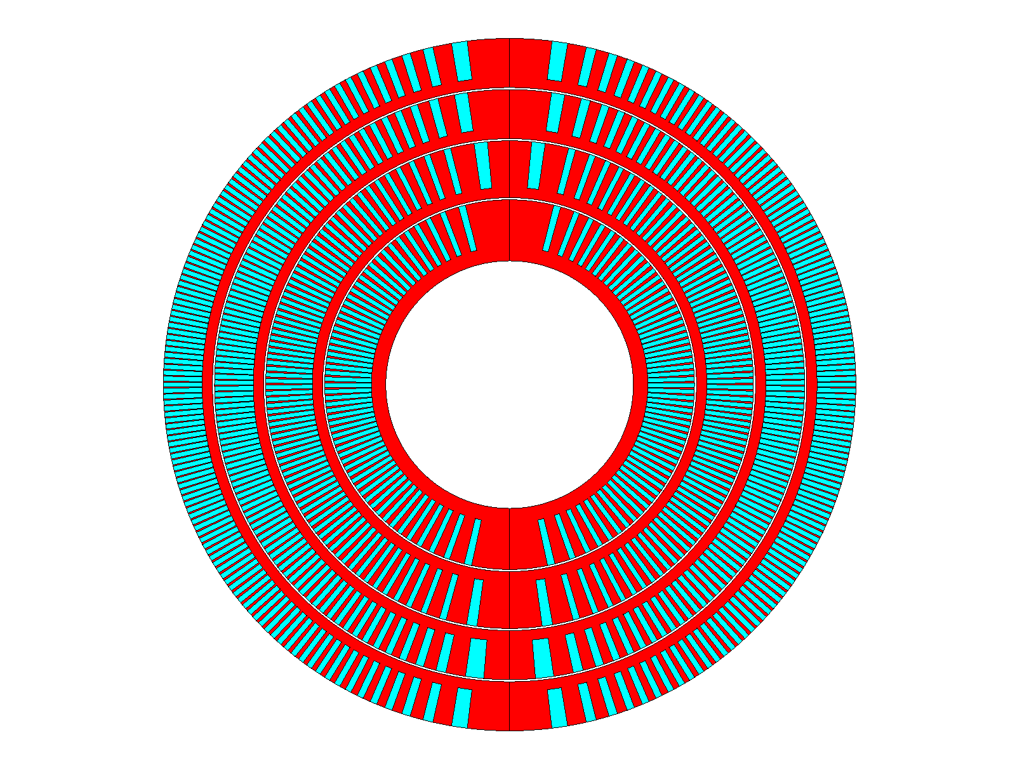
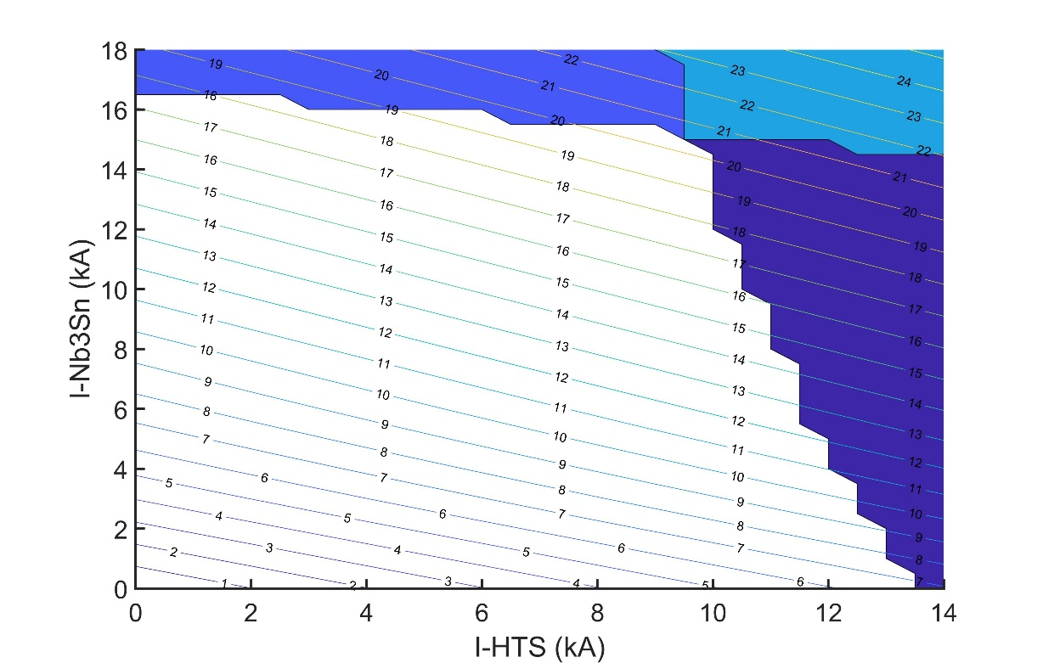
LBNL Bi2212 inserts and hybrids
LBNL Bi2212 CCT (3-5 T)
2-layers, ID/OD: 50-77 mm
To be tested in CCT6 in 2026
How high could we go with CCT6 and a Bi2212 insert (Je ~800 A/mm2 at 20 T?
B_{bore} max (short sample) of about 20 T

Slide 28
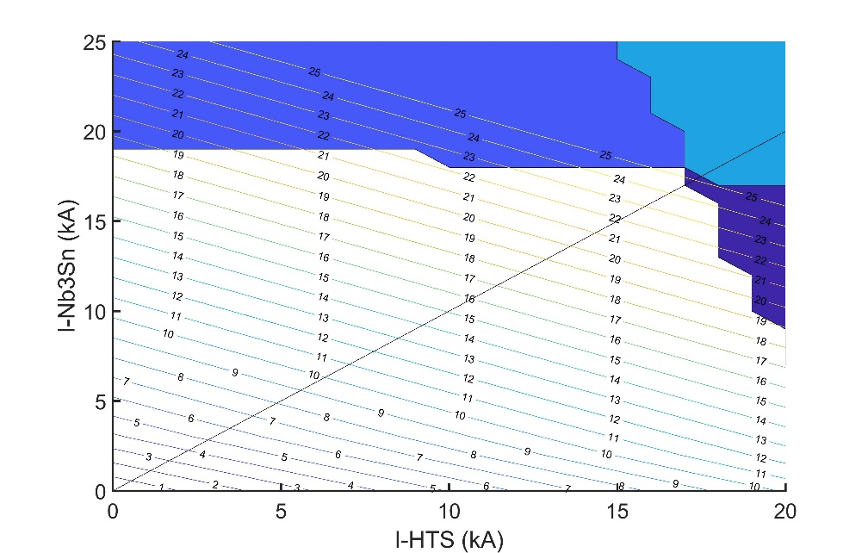
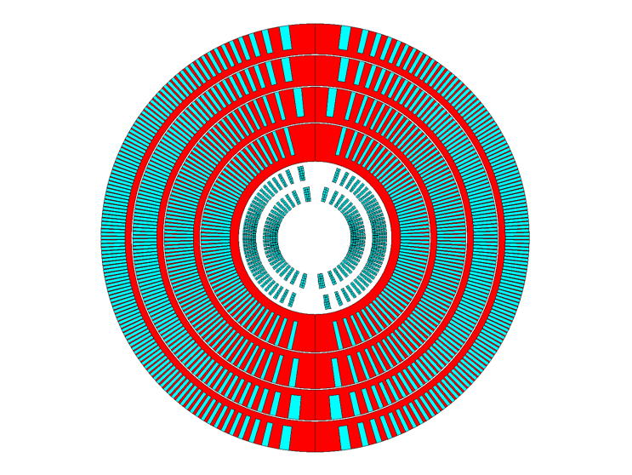
How does it compare to the 20 T CT design?
Powered in series
24 T B_{bore} at short sample
Powered indipendently
20 T B_{bore} at short sample

Slide 29
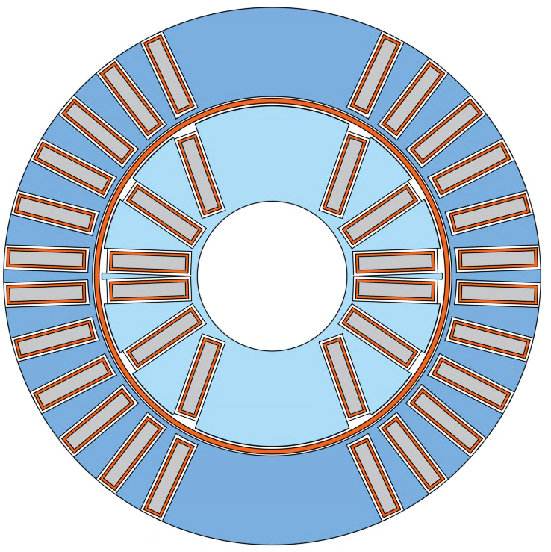
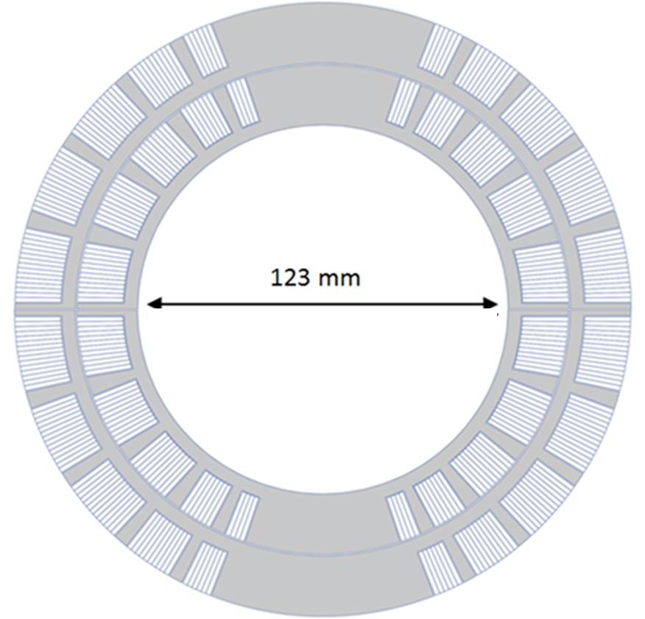
FNAL Bi2212 inserts and hybrids
FNAL Bi2212 SMCT (1-2 T)
2-layers, ID/OD: ~20-50 mm
To be tested in SMCT+MDPCT1-inner in 2025
16-18 T field range

Slide 30
Bi2212 hybrids Beyond 16 T, and towards 20 T

Slide 31
REBCO inserts
FNAL CORC COMB (~5 T, stand-alone with iron)
2-layers, ID/OD: 100-120 mm
To be tested in CCT6/SMCT in 2025
LBNL CORC CCT C3 (~5 T, stand-alone no iron)
6-layers, ID/OD: 70-150 mm
To be tested in stand-alone in 2024
LBNL STAR CCT S1 (~1-2 T)
2-layers, ID/OD: 50-77 mm
To be tested in CCT5 in 2024-2025

Slide 32
Conclusions
Good progress with a 2D comparison between 20 T designs
Still missing QP and mechanics in infinitely rigid iron for a full comparison
Next step: 2D analysis with support structure and 3D design
Looking for dedicated student/post-doc
Hybrid activities
Several 10-12 T hybrids coming up in the next 2 years
120 mm Nb₃Sn outserts with HTS inserts could bring us beyond 16 T and towards 20 T
But designs should be done in a coherent way (diameter, lengths….)

Slide 33
Appendix

Slide 34
Introduction Timeline (2020 updated roadmap)

Slide 35
Introduction Previous work
2005, P. McIntyre, et al., 24 T hybrid for LHC tripler (TAMU)
2011, 2014, E. Todesco, et al., 20 T hybrid for LHC upgrade (CERN)
2015, G. Sabbi, et al., 20 T hybrid for SPPC China and FCC (LBNL)
2015, R. Gupta, et al., 20 T hybrid for LHC upgrade (BNL)
2016, Q. Xu, et al., 20 T hybrid for SPPC China (IHEP)
2018, J. van Nugteren, et al., 20+ T HTS for LHC upgrade or FCC (CERN)
2020, D. Martins Araujo , et al., towards 20 T FRESCA2+Feather (CERN)
2021, J.S. Rogers, et al., 18 T hybrid (TAMU)
2022, P. Ferracin, et al., 20 T hybrid demonstrator (US MDP)

Slide 36
Superconducting materials: J_{e} and J_{o}
Assumptions for magnetic analysis
J_{e} = Strand current / strand area
J_{e_LTS} = 875 A/mm² (1.9 K, 16 T, 5% degrad.)
3000 A/mm² J_{c} (4.2 K, 12 T, virgin)
J_{e_HTS} = 740 A/mm² (20 T)
Bi2212 value
J_{o} = Cable current / Cable_{insulated} area
J_{o} = J_{e} ⋅ 0.67 (typical Rutherford cable)
Assumed also for HTS (Bi2212)
Nb₃Sn and HTS cross at 16.5 T
CORC wire still lower in both J_{e} (600 A/mm², 20 T) and J_{o} / J_{e} (0.54)

Slide 37
Current activities: block
Test Facility Dipole (TFD)
Collaboration LBNL/FNAL
Funded by DoE FES and HEP
Test cables and inserts in a high transverse background field
15 T in 94 x 144 mm bore
First implementation of horizontal plates for vertical stress management
By J.L. Rudeiros Fernandez, et al., 2LOr2A-06

