Slide 1
Bi-2212 Conductor and Coil Technology at ASC
David Larbalestier
on behalf of the broader ASC conductor and coil efforts with
co-PIs Eric Hellstrom, Jianyi Jiang, Fumitake Kametani (DOE Core Grant)
and
Ulf Trociewitz, Youngjae Kim and Dan Davis (NSF Core and DOE-STTR through Cryomagnetics)
Ernesto Bosque, Tomoka Brady, Lance Cooley, Lamar English, Jozef Kvitkovic, George Miller, and Chiara Tarantini with PhD students Yavuz Oz (now GE Medical), Imam Hossein (now Intel), Abiola Oloye (PhD soon), Shaon Barua (PhD soon), Emma Martin (PhD student), Ahmed Abuzar (PhD student)
Thanks to DOE-OHEP (award no. DE-SC0010421 PIs Larbalestier, Hellstrom, Jiang and Kametani), the NHMFL Core Grant support of NSF (award no. 1157490), DOE-OHEP STTR to Cryomagnetics FSU PI Trociewitz), DOE-SBIR to Engi-Mat (award no. DE-SC0018666, FSU PI Jiang) and Florida State University special allocation (DCL PI) for Bi-2212 commercialization and the US Magnet Development Program Collaboration for much context and many collaborations

Slide 2
Messages
Bi-2212 is becoming a solenoid magnet conductor after more than 10 years of coordinated university-lab-industry support through DOE-OHEP and the CDRP
  It has great advantages – genuinely multifilament with low AC loss, macroscopically isotropic, round and available in single pieces now > 1 km length in multiple architectures and variable diameters
  It has major disadvantages too – it requires a Wind and React route for HEP and lab magnets at almost 900 C and optimized Jc requires ~50 bar overpressure (1 bar O₂ and balance Ar)
  Wires have a breaking strength of ~170 MPa, well below the stresses foreseen for many magnets
Making Bi-2212 into a solenoid magnet technology required addressing these conductor, insulation, force support, and impregnation issues all together
Application to dipoles has thrown up Rutherford cable insulation issues for which we have been developing a solution but CCT force support may be easier than with our single-strand, internal force support techniques

Slide 3





Bi-2212 Wire Technology is Versatile: 10 kg scale is delivering single piece lengths of up to 1.2 km of 55 and 85 x 18 at 1 mm dia.
All wires by BOST
27$×$18
37$×$18
55$×$18
85$×$18
121$×$18
Optimum Filament Size is in the 10-15 μm range with complex tradeoffs determined by starting filament uniformity, change of shape during heat treatment – tradeoffs becoming clear with more and more coils
Some filament bonding does occur during OPHT, degrading both J_{c} and the effective filament diameter, typically half the sub-bundle diameter – AC losses about same as ITER but with 2X higher Jc (Oz et al. SuST 35, 04004 (2022) – The 2022 Jan Evetts Prize-winning paper
No diffusion barrier is needed because the Ag matrix naturally has high RRR
Although some filament coupling occurs during HT, AC losses are similar to ITER Nb₃Sn wires
The superconductor fill factor (FF) of present wires is only ~20%, allowing potentially significantly higher J_{E} just by increasing FF – filament coupling studies (Eric talk) suggest this potential

Slide 4
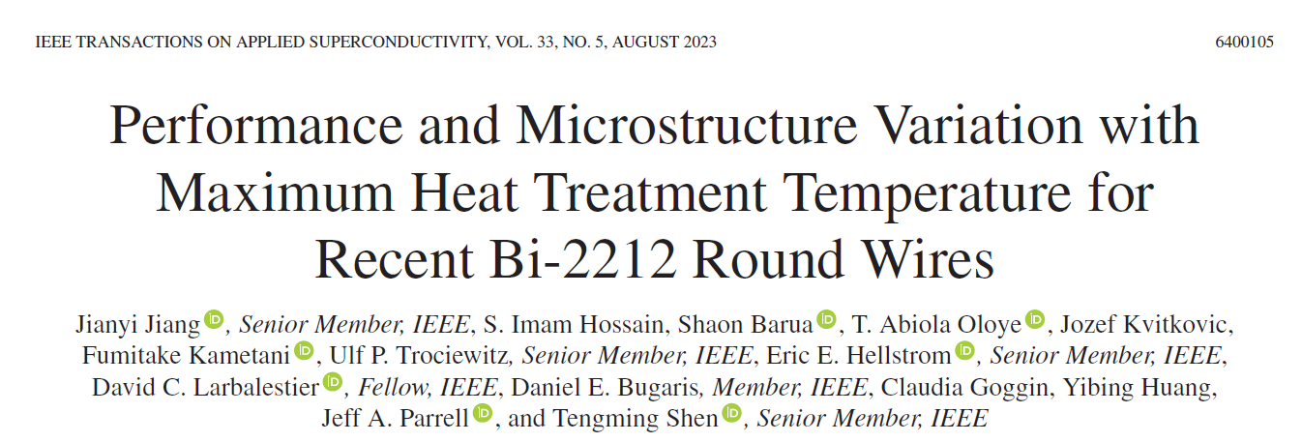
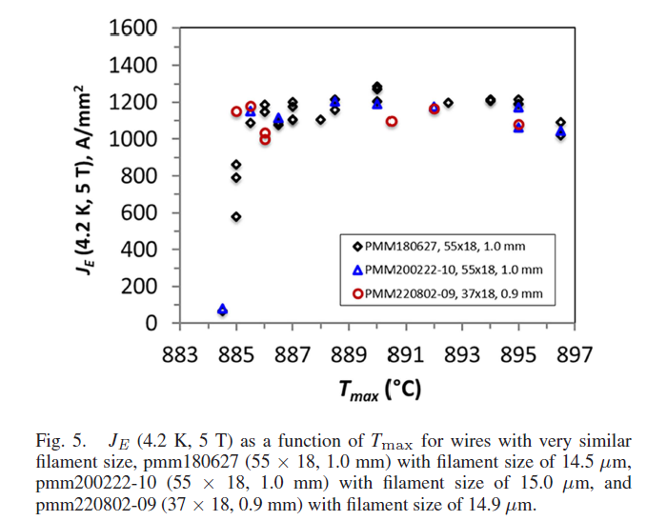
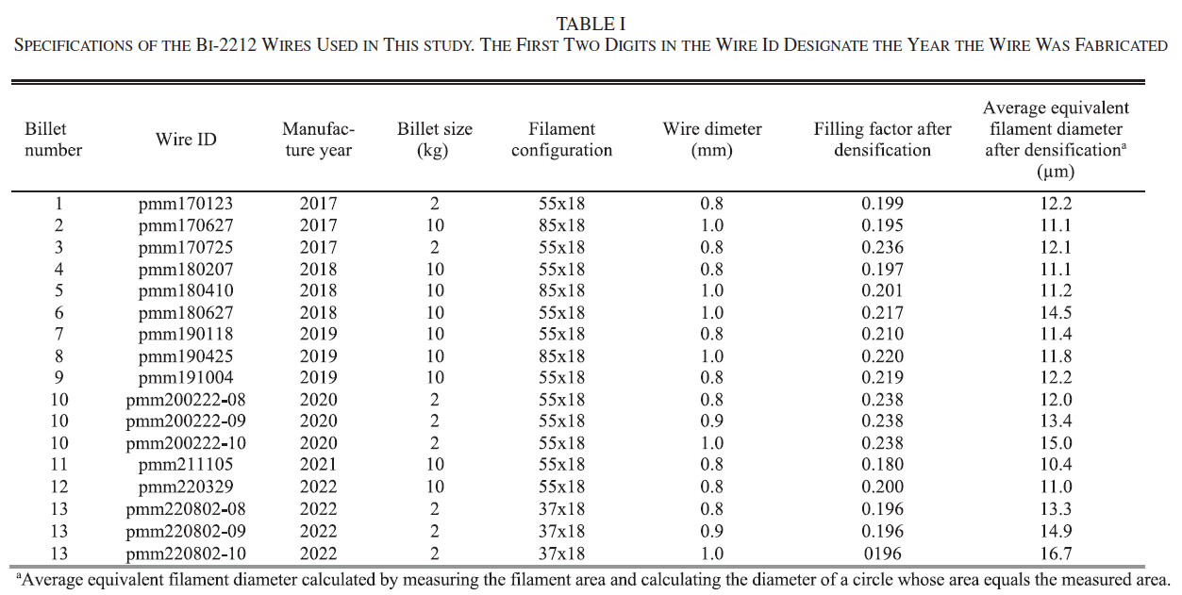
Tradeoffs of architecture, filament size and resilience to small fluctuations in T_{max} and t_{melt}
Don’t be afraid of 50 bar OP with Bi-2212!
13 billets with less variation than is normally seen in REBCO
This study has been central to the theses of several recent PhD students Yavuz Oz (Now GE MRI), Imam Hossain (Now Intel), Shaon Barua and Abiola Oloye (about to graduate)
They have enabled us to start to separate filament architecture and powder quality effects
  10-12 μm filaments have much greater sensitivity to melt conditions than 14-15 μm filaments, allowing T_{max} of 890C which gives good protection from both under- and over-temperature processing

Slide 5
Coil implications: Are short sample properties replicated over km lengths? d2V/dI2 analyses say path to 10 kg coils is open!
Shaon Barua PhD work
Barua et al., IEEE Trans. Appl. Supercond., vol. 31, no. 5, pp. 1–6, Aug. 2021, doi: 10.1109/TASC.2021.3055479, ASC 2022, PhD 2023

Slide 6
Area σ/μ of disappointing LBL 0.8 mm billet PMM191004 is higher compared to other Engi-Mat wires
Shaon Barua PhD work (wire from Tengming)
PMM191004-08
σ/μ = 18.98 %
Much sausaging is built in to as-delivered 2212 wires and is now worth a campaign to remove

Slide 7
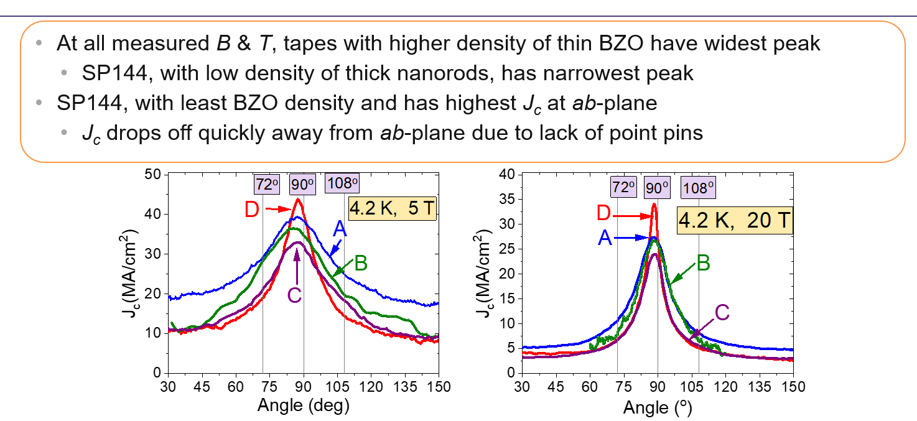
By contrast REBCO CC made to the SAME SPECIFICATION has to deal with large J_{c}(Θ,B,T) variations and large anisotropy
Ashleigh Francis unpublished

Slide 8
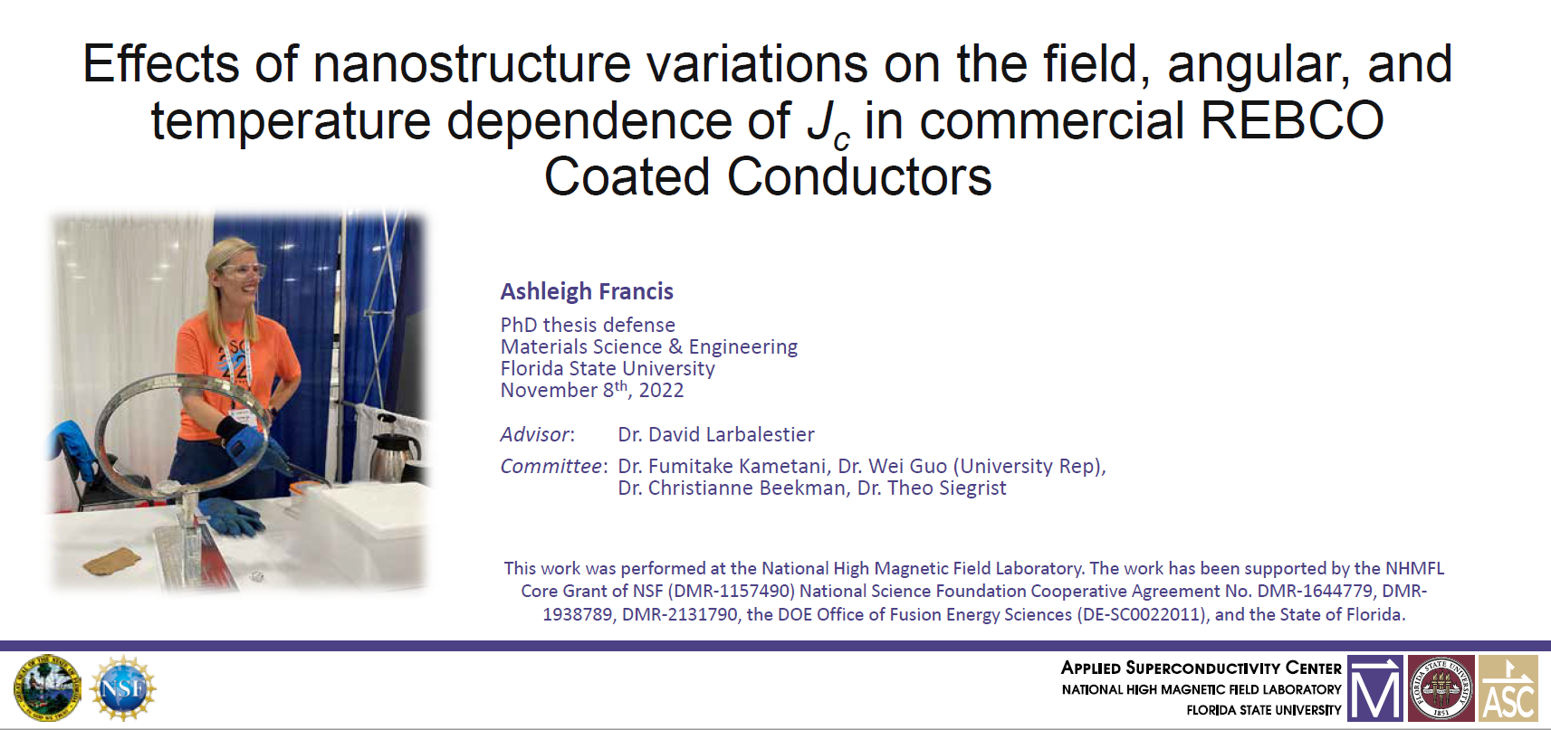
Now at Commonwealth Fusion Systems working on thse REBCO magnets

Slide 9
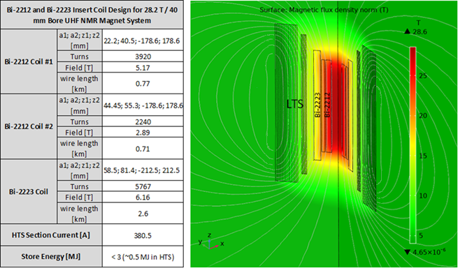

Development of Bi-2212 NMR-type Magnet Technology
Since mid 2022 we have collaborated with OI on the development of a 25 T class compact research magnet
And for longer on a 28 T 1 ppm NIH RO1:
  uses the modified 12 T, 212 mm bore OI (“IMPDAHMA”) LTS outsert magnet 12T/220 mm dia) – formerly 20 T/78mm
Specs:
Two inner coils with Bi-2212, each with ~800 m of conductor, 40 mm bore
One Bi-2223 coil using 2.6 km conductor
Will have compensation and shim coil sets to correct for field errors
HTS and LTS coil sets each powered in series (~380 A HTS and ~140 A LTS)
Trociewitz, Davis, Kim, Bosque
Goal: Demonstrate 1.2 GHz (28.2 T) 1 ppm NMR; Grand scheme: develop pathway toward 1.5 GHz
Notes:
Impdahma = Integrated Modelling Package for Designing Advanced HTS Materials Applications

Slide 10
Many test coils, many post mortems: our standard PUP has ~200m 1 mm dia wire
Highest stress case in coil test : I_{op} = 279.6 A, Background = 12 T
  JBr stress up to 260 MPa realized → Stress redistribution to reinforcement via epoxy confirmed
  Coil degraded around layer 9
  Coupled azimuthal stress/strain data indicated to be well below conductor’s limit
    But stress map shows elevated stress at Layer 9-12 agrees well with the post-mortem
What about radial stress and strain?
  Highest radial stress on wires at Layer 9 – 12
  Highest radial strain on epoxy between Layer 9 and Band 4
Notes:
We also did Finite element analysis to understand why this happened. The FEM result shown here is the case for highest stress that Pup-9 experienced in real test. You can see that JBr stress was up to 260 MPa which is way higher than conductor’s stress limit. In the coupled azimuthal stress it drops to 70 Mpa thanks to its reinforcement structure and epoxy media.
Quantitatively, there is clear discrepancy between the fully coupled FEA and the post mortem result. But the stress map here shows the highest stress occurs at Layer 9 to 12 which gives us some insight to understand Pup-9 deeper.
Since we saw the separation and cracks, we started looking at the radial stress and strain of Pup-9. And it was again confirmed that there could be stress concentration between layer 9 and band 4. And the highest strain was calculated at the epoxy between the layer 9 and band 4. between layer 9 and band 4

Slide 11
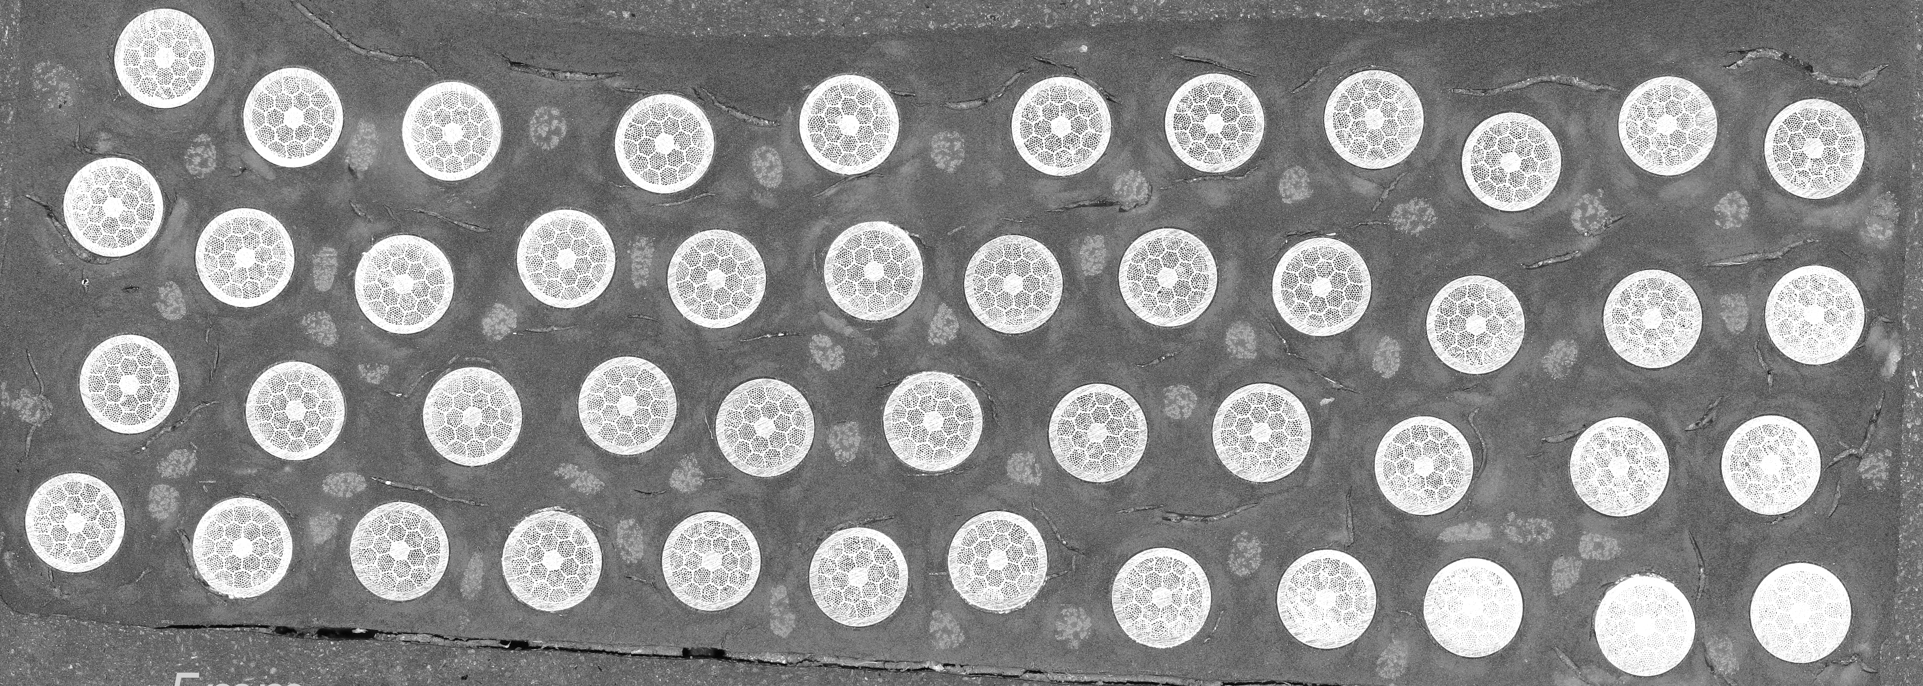
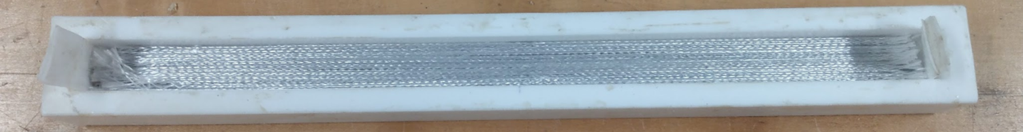
Internal cracking suggests Pup-9 Coil Partially Decoupled
An assumption: full decoupling between last band and rest of the coil
  Calculated strain (0.64% at Layer 9) where the cracking occurs makes the outer section of the coil a new free-standing section
  Layer 1 ~ 8 then become released from the outer coil which shows very low stress
Possible reasons for the cracks: Interfaces
  Epoxy bonding to reinforcement cracks near the bands
  CTE mismatch between components of the winding pack
  Local stress concentrations
Bi-2212 wire test stack
Started series of experiments emulating the mechanical properties of a Bi-2212 winding pack (Emma Martin, 2MPo1A-10)
Pup-9 came completely apart at
Band 4 after cutting for post mortem
A hypothetical case for separation of Pup-9 into two coil packs
Notes:
Based on the postmortem, we also ran a hypothetical case of pup-9 that has clean separation between last band and rest of the coil. During the post mortem process, we found one section had a clean separation as shown in the picture.
In this case, calculated strain was very high at layer 9 since it became a new free-standing section without reinforcement. And inner eight layers are now over-reinforced so their strain numbers dropped drastically.
Most important question for Pup-9 is why the cracks happened at the first place. There are some possible reasons as listed here and it might be combination of many reasons. And we are still trying to find the answer and solution for this question.

Slide 12
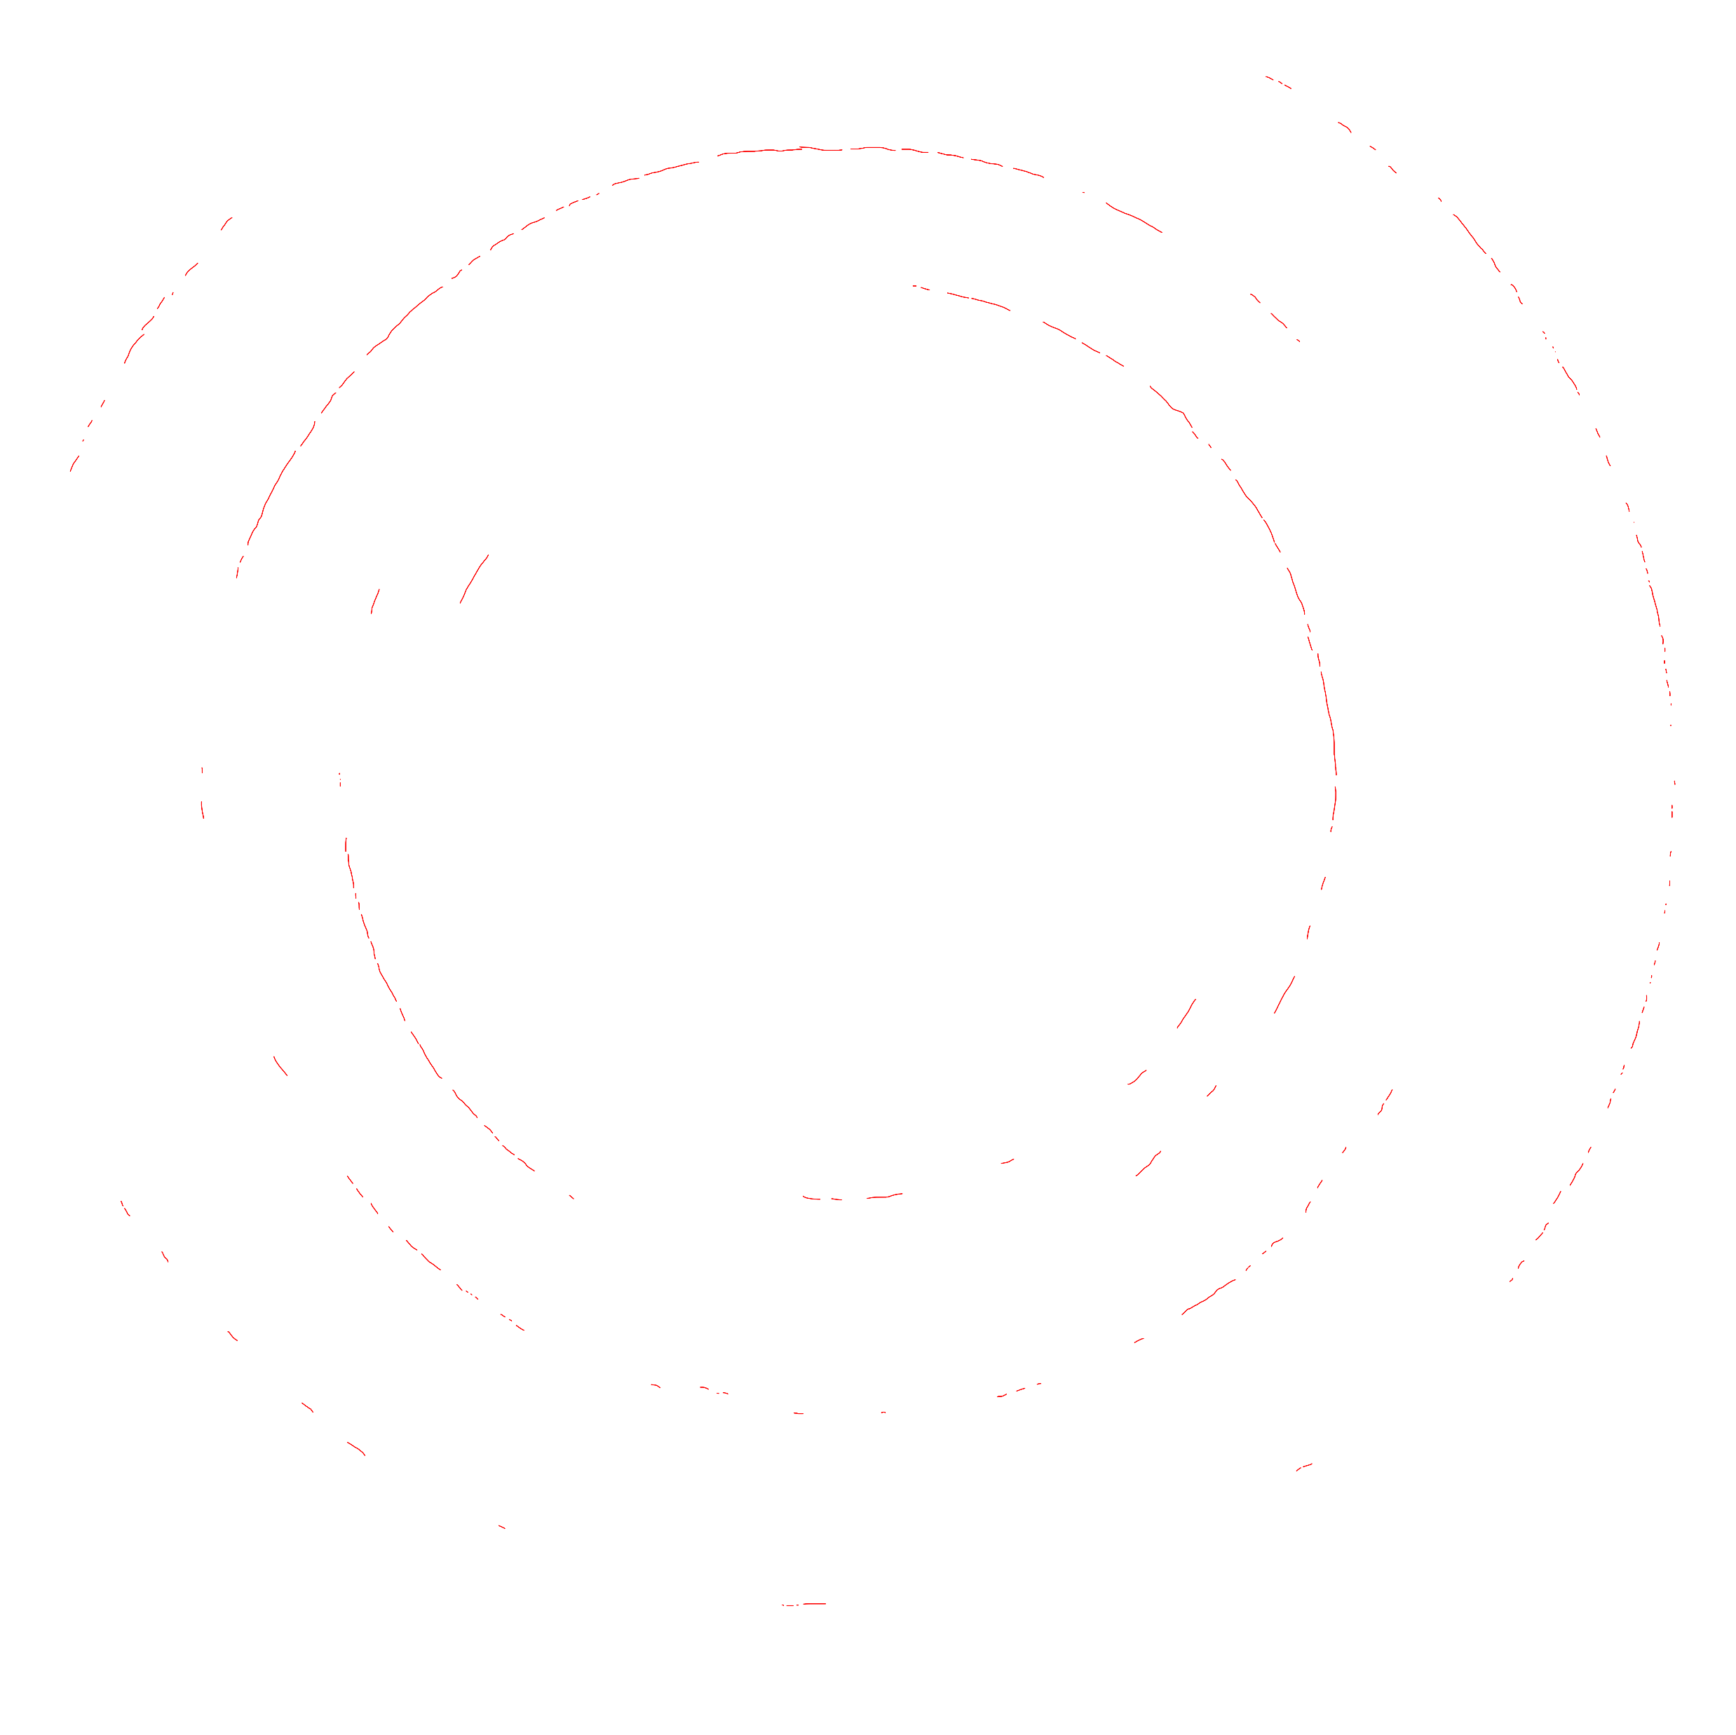
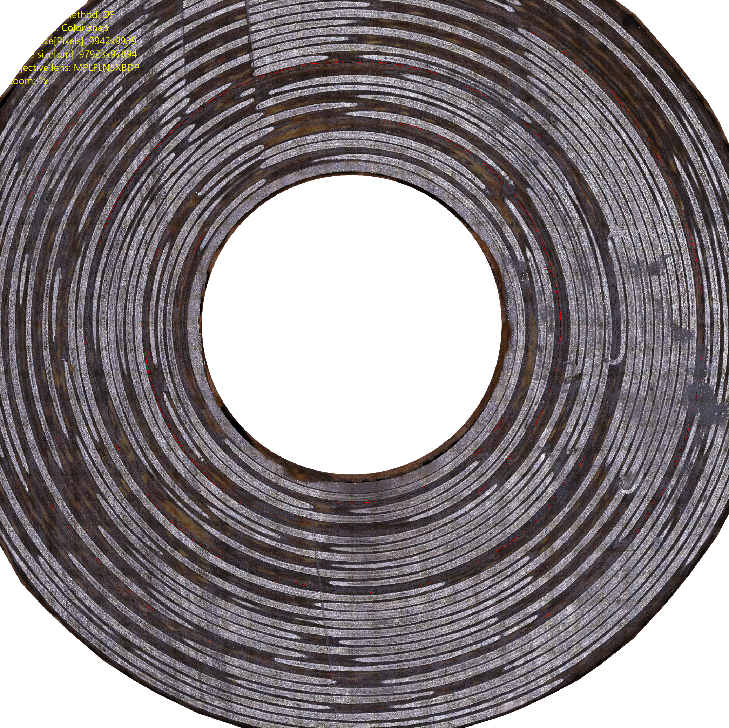
Postmortems are an Important Tool to Understand Coil Mechanics
“Pup-10” coil
4
3
2
1
Coil middle Section, transverse Cut
Nextel-to-winding pack
interface separation
In spite of the cracking there is no training in Bi-2212!

Slide 13

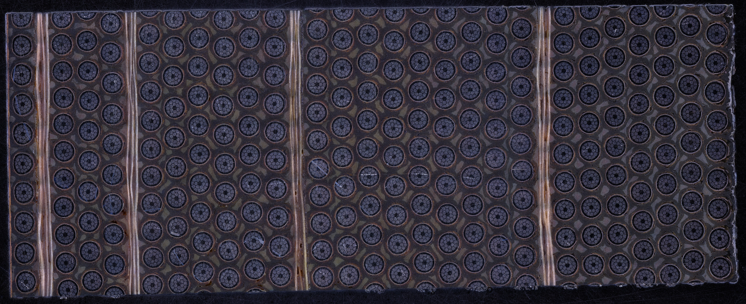
PUP 10 had a more optimum placement of the bands
Excellent performance in undamaged layers
Mid coil
Bottom flange
High J_{E} in the coil
no apparent
interface effect here
4 inner banding layers as Pup-9 but different distribution
Less degradation than in Pup-9 but some still present around 3rd reinforcement layer
Note Jc values from this Deltech reaction above those of Jiang study in smaller furnace and uniform through thick winding
2
5
11
20
3rd reinforcement layer
Coil ID
Pup-10 cross section,
bottom section
E. Bosque, Y. Kim, U.P. Trociewitz, C.L. English, D.C. Larbalestier, System and Method to Manage High Stresses in Bi-2212 Wire Wound Compact Superconducting Magnets, U.S. non-provisional patent application, FSU Ref. no. 18-063, 2019.

Slide 14
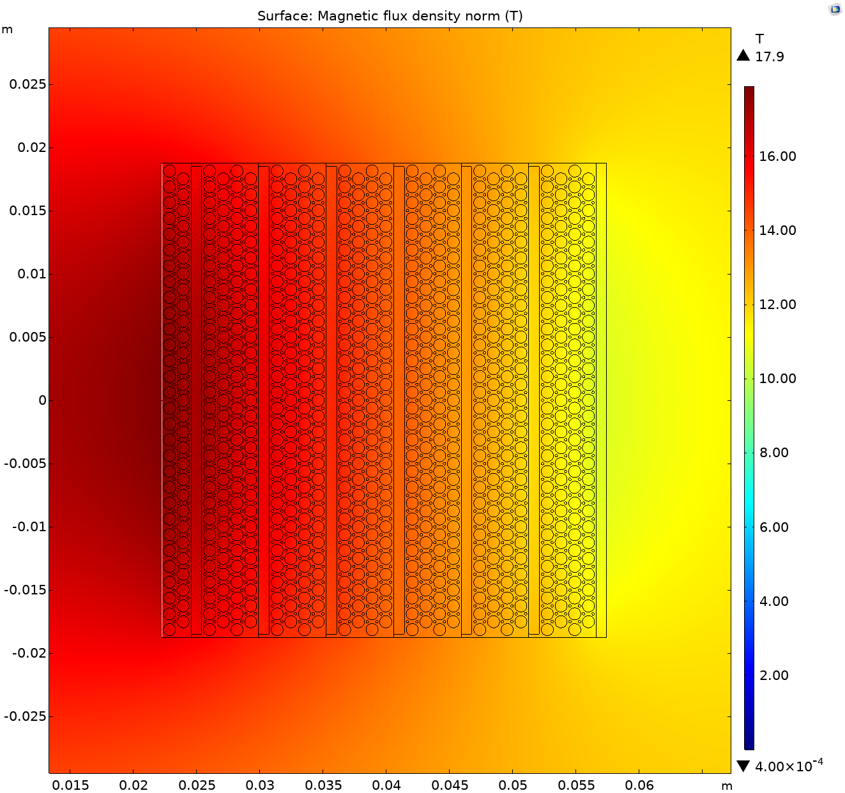
Most Recent Coil “Cryo-4” current champion coil
Day | Test | File | B_{ext} Field [T] | B_{center} [T] | Max I_{op} [A] | [A/mm²] | JBr [MPa] | Trip? | Note
1 | T01 | 1 | 0 | 4.5 | 400 | 533 |  | No
 | T02 | 2 | 5 | 9.5 | 400 | 533 |  | No
 | T03 | 1 | 10 | 14.53 | 400 | 533 |  | No
 | T04 | 1 | 12 | 16.9 | 430 | 573.3 | 386 | Yes | 71% SSL
 |  | 3 | 12 | 16.6 | 404 | 539 |  | Yes
 |  | 5 | 12 | 16.5 | 393 | 524 |  | Yes
 |  | 6 | 12 | 16.4 | 385 | 513 | 347 | No | 25 Cycles
 | T05 | 1 | 10 | 14.7 | 415 | 553 | 310 | Yes
 |  | 2 | 10 | 14.7 | 412 | 549 |  | Yes
 | T06 | 1 | 8 | 12.9 | 437 | 582 | 261 | Yes
 |  | 2 | 8 | 12.9 | 437 | 582 |  | Yes
 | T07 | 1 | 5 | 10.5 | 484 | 645 |  | Yes
 |  | 2 | 5 | 10.5 | 484 | 645 |  | Yes
~2x breaking stress!
Goal: evaluate uniformly distributed reinforcement
Stable operation at 70% SSL performance
Stable in low cycle fatigue
726 A/mm² matrix current density at quench
Limited by layers 15-16
Redistribution of reinforcement layers has significant positive impact on coil mechanics
HTS 430 A (12 T LTS)
B_{peak} = 17.9 T

Slide 15
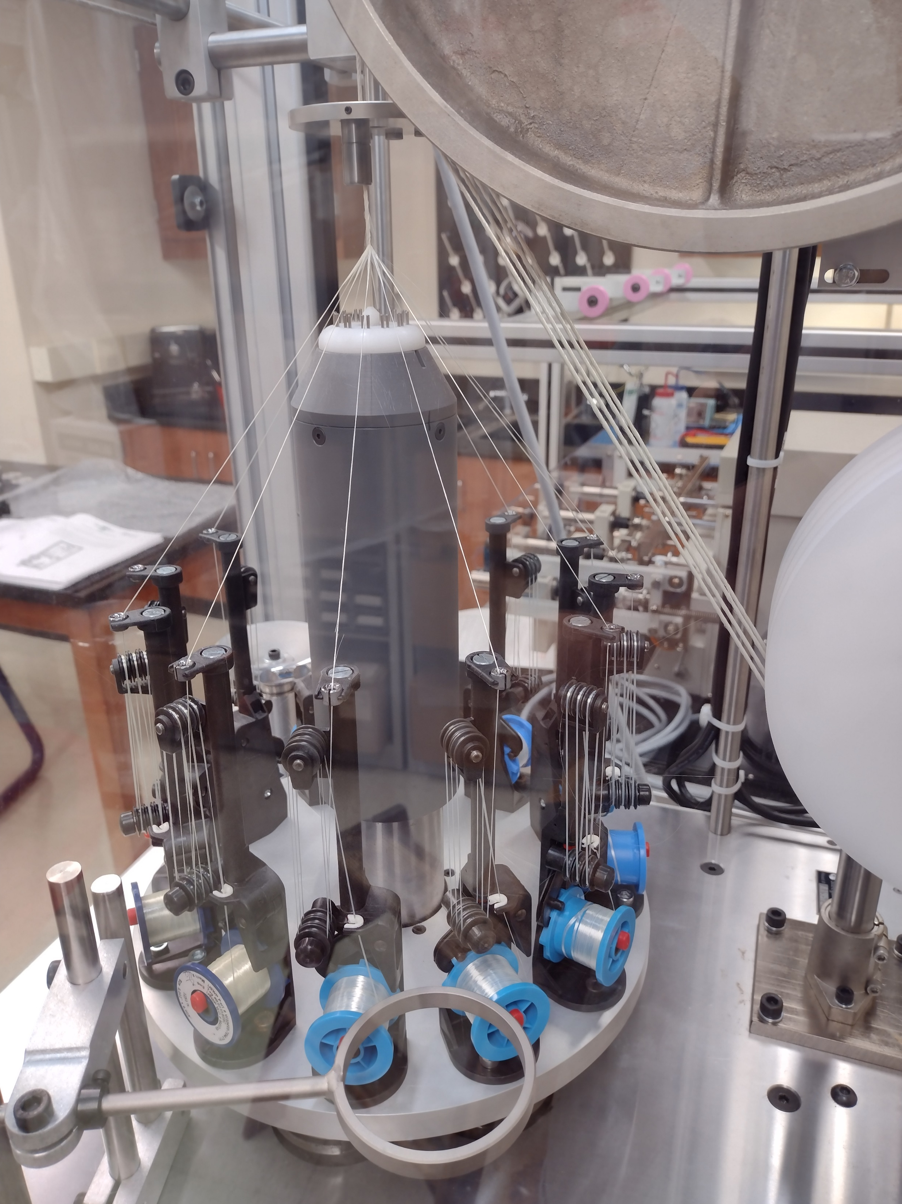
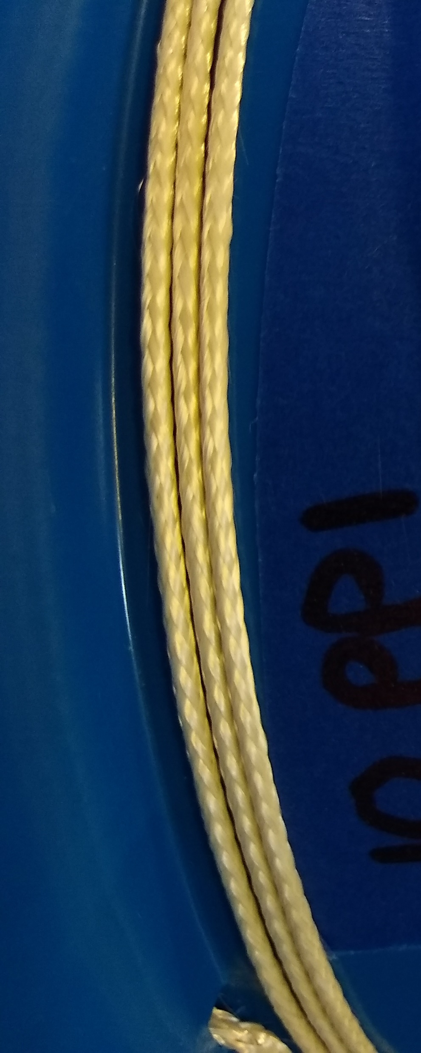
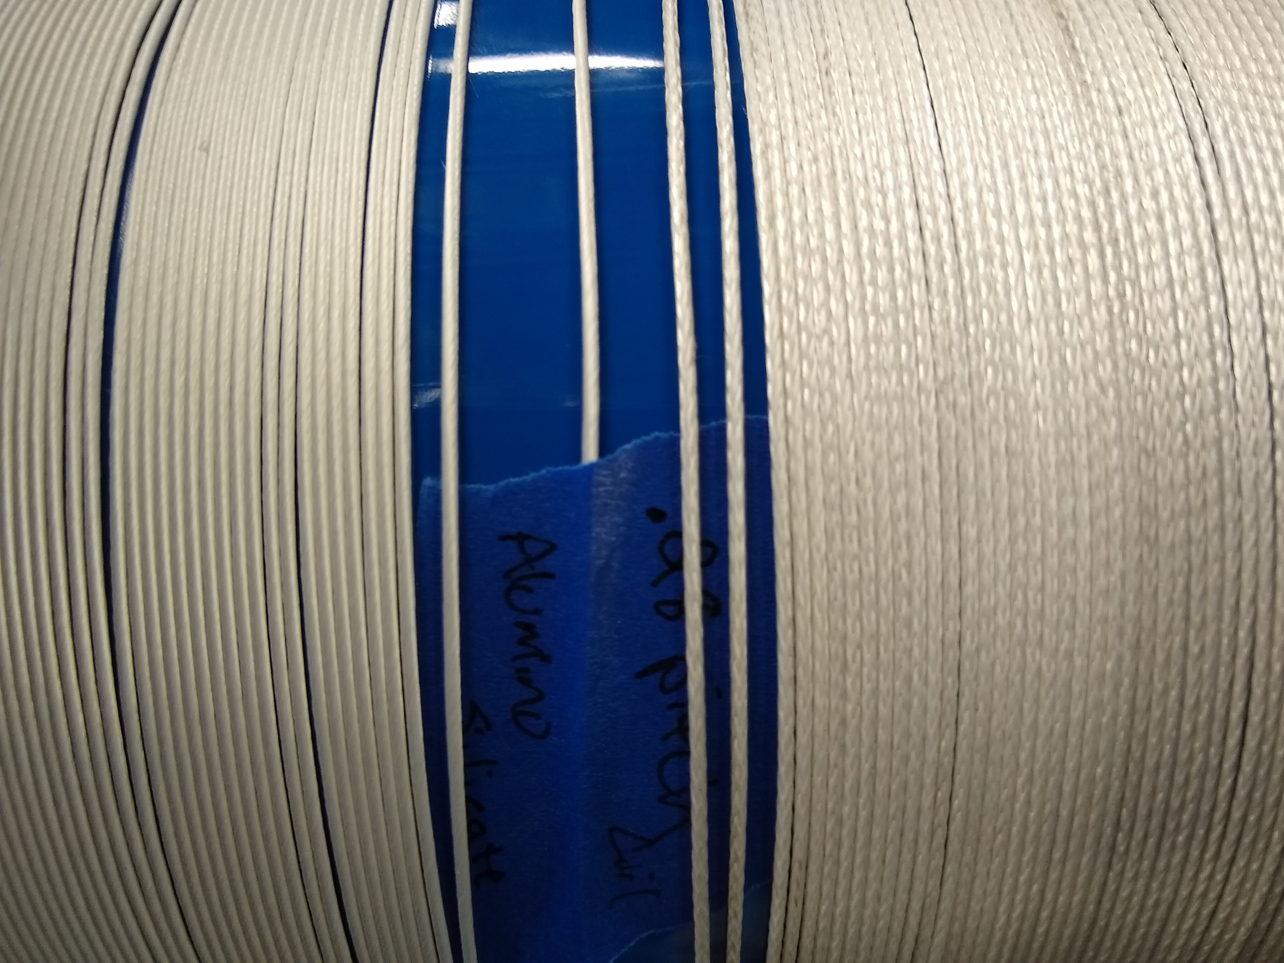
Defeating “thermodynamic” leaks: A New Braiding Machine at the ASC
Allows us to try out various ways of fiber insulation applications and materials
Pure alumina
wrap
braid
Alumino-Silicate
See fuller talk by Dan
wrap
braid
Wrap reduces fiber insulation thickness of up to 50% compared with braiding
Pure alumina does not show adverse reaction with the Ag matrix of the conductor
Fiber dia. alumino-silicate ~7 µm while pure alumina ~10-12 µm and stiffer

Slide 16
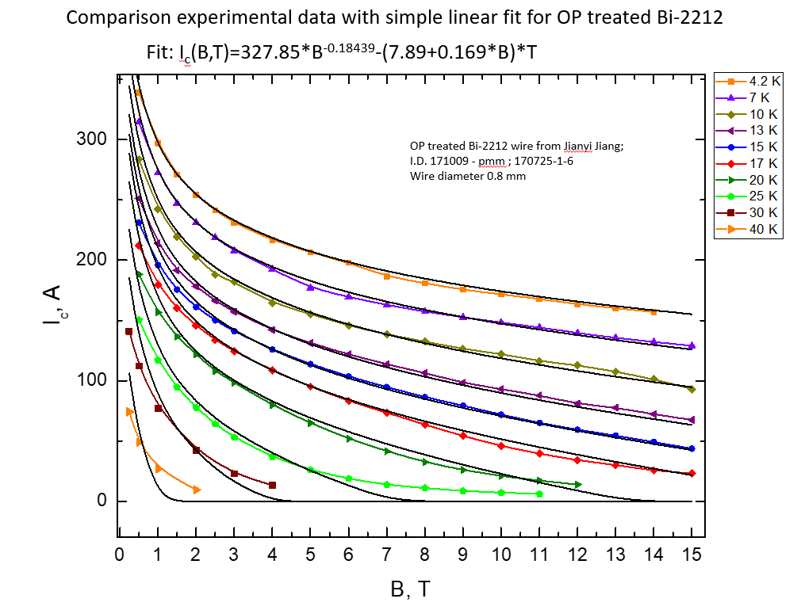
Does 2212 have to be used only at 4.2K?
Combination of VSM and AC susceptibility is enabling us to sweep out H_{irr}(T) and perhaps better optimize it
Ashleigh Francis unpublished
4.2 K
10 K
Chiara Tarantini unpublished
Certainly 10 K operation of Bi-2212 at high fields seems possible
The functional simplicity of an isotropic conductor greatly struck Ashleigh whose thesis was on angular, field and temperature dependence of REBCO

Slide 17
Future Opportunities
Commercial use of Bi-2212 pulls conductor manufacture and gets us out of present powder woes and high cost of present boutique manufacture
  The early Engi-Mat powder, not yet replicated, shows us that ~30% higher Jc is available than present wires
Thesis work of Barua shows us that better filament quality as manufactured benefits both Jc and the distribution (σ/μ) while thesis of Hossain shows that we must control filament coupling during HT
  Uniform filament architectures may help Jc greatly
  R&D billet order from us has been on hold until good (or at least consistent) powder starts to flow again
Long term DOE support has enabled us to support about 10 PhDs who have been able to work on fundamental aspects of all of Bi-2212 technology
Special support from FSU for HTS technology has allowed us to invest in wire, a braider, and a new powder capability

Slide 18
Driving questions for Bi-2212
Powder has some warning signs, so we are investing in our own ASP system (Eric talk)
Do we have a reliable wire technology?
  What lengths can wire be procured in?
Do we have a reliable insulation technology?
  For wires and for cables?
Do we have a reliable reaction technology?
  For wires
  For coils, both solenoids and for dipoles
Do we understand how to maintain mechanical integrity in coils?
YES!, 1 km of 1 mm wire, ~2 km at 0.8 mm
TiO₂/mullite works for single strand: for cable we are now braiding with pure Al₂O₃ (Dan talk)
50 bar Deltech generally works well but (unnecessary) SiC heating elements are a pain. New 1 m Renegade furnace has Kanthal windings but has been slow to commission (Dan talk)
Internal reinforcement with ceramic fibers and epoxy is enabling JBr stresses of >380 MPa, more than twice the conductor breaking strength
I am very struck by the recent PSI CCT coil that trained up to full short sample NO DAMAGE
It took 100 quenches – none of the LBL RT have trained nor have the ASC solenoids
Bi-2212 may have the right sweet spot to properly current share, remain stable against epoxy cracking and not be too stable and susceptible to local burnout as is quite common in REBCO with present imperfections

