Slide 1
Bi2212 canted-cosine-theta (CCT) coil design and fabrication
Laura Garcia Fajardo⁽¹⁾ on behalf of the Bi-2212 collaboration group from LBNL and NHMFL
¹Lawrence Berkeley National Laboratory (LBNL), Berkeley, CA, United States
Special thanks and recognition to Mechanical Technicians from LBNL:
Mark Krutulis, Chet Spencer and Derek Hochvert for their help and dedication during the fabrication process of our Bi-2212 CCT coils
U.S. Magnet Development Program Collaboration Meeting (MDP-2023)
Brookhaven National Laboratory (BNL), Upton, NY, United States
03/22/2023

Slide 2
Outline
BIN5a: first demonstration of high current in a Bi-2212 CCT coil
BIN5c: first tested Bi-2212 CCT dipole magnet
BiCCT1: first ~1m long Bi-2212 dipole magnet to be fabricated
Preliminary plans for BiCCT2

Slide 3
Outline
BIN5a: first demonstration of high current in a Bi-2212 CCT coil
BIN5c: first tested Bi-2212 CCT dipole magnet
BiCCT1: first ~1m long Bi-2212 dipole magnet to be fabricated
Preliminary plans for BiCCT2

Slide 4
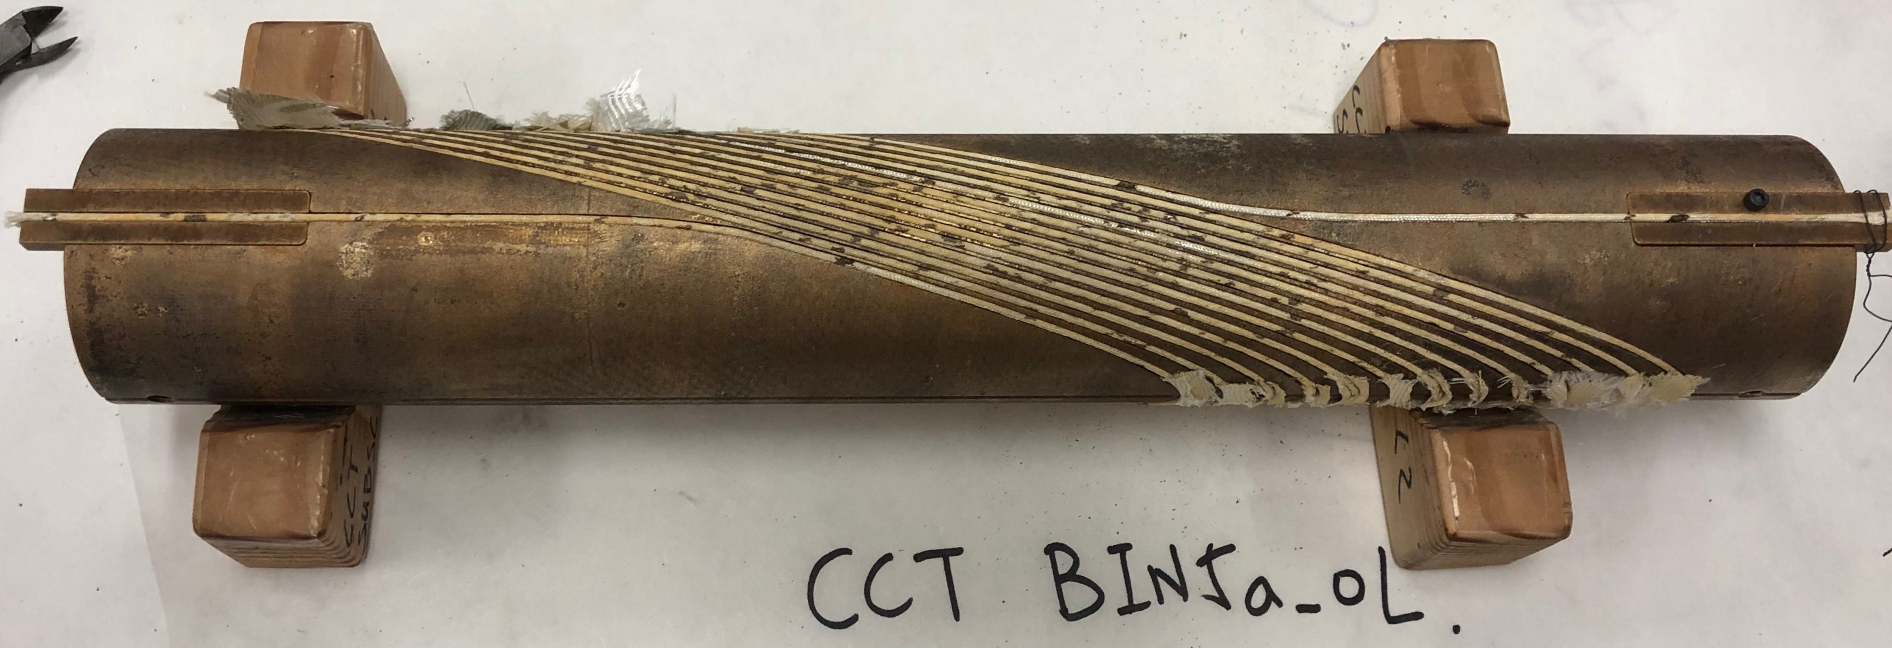
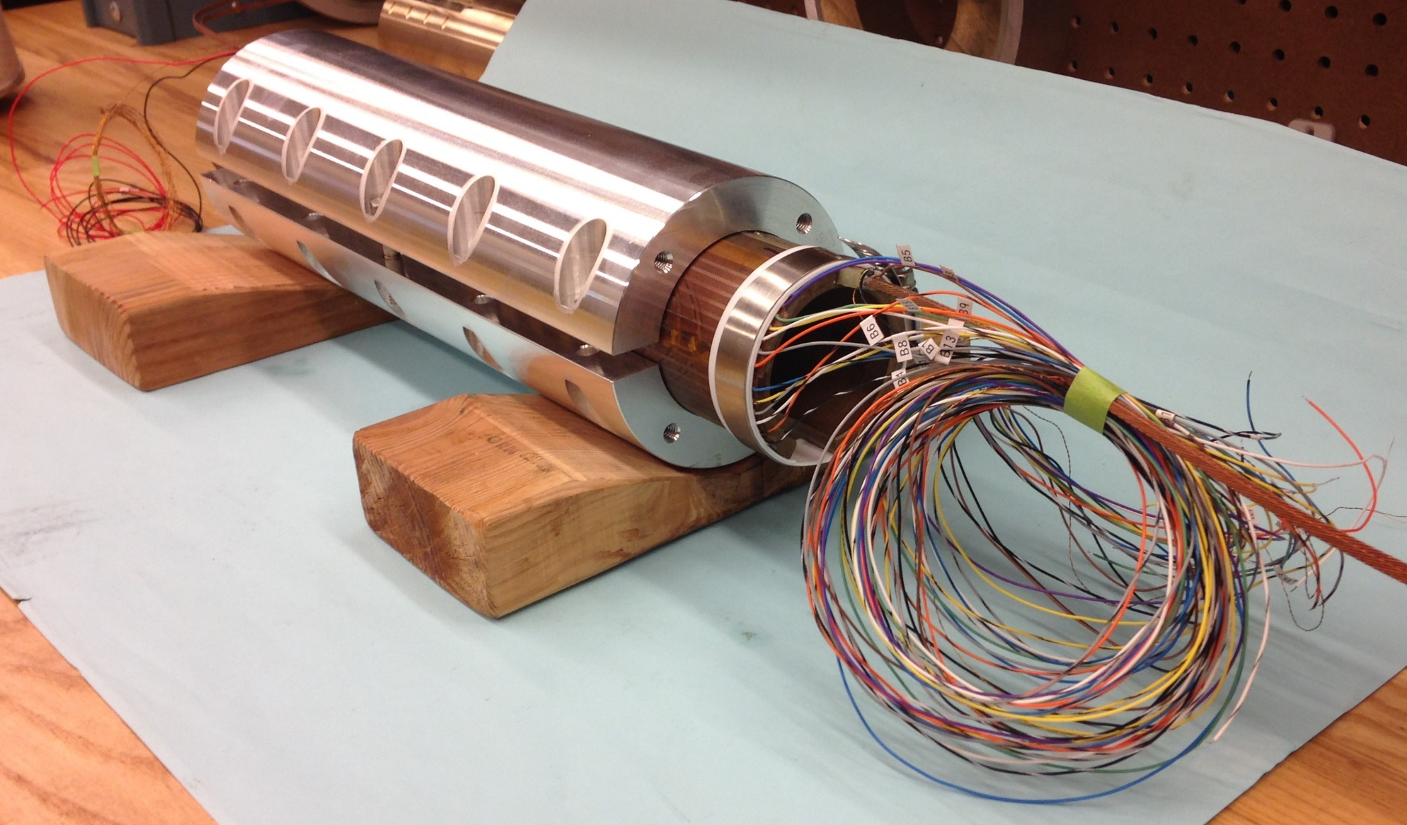
The fabrication of the BIN5a coil set the standard fabrication procedure for our 39 cm long Bi-2212 coils
Design:
Single coil, 39 cm long, 13 turns
Bore diameter ~ 53 mm
9-strand Rutherford cable 4.03 mm x 1.47 mm
Mullite braided sleeve insulation
Aluminum-bronze 954 machined mandrels
Fabrication:
Wound by hand
TiO₂ slurry applied on the insulated cable during winding to avoid electrical shorts with the mandrels
Voltage taps flags installed at every turn (pole region) during winding
Impregnated with the NHFML-Mix-61
Heat treated at 50 bar in the Deltech furnace at NHMFL
Test:
Split aluminum shell bolted around the coil
Coil reached 4.1 kA at 4.2 K (wire J_{e} of 912 A/mm²) at 64% of its short sample limit (SSL) in 02/2020
No quench training was observed
BIN5a after over-pressure heat treatment process
Bi-2212 leaks in BIN5a ➔ need improvement in the next Bi-2212 coils

Slide 5
Outline
BIN5a: first demonstration of high current in a Bi-2212 CCT coil
BIN5c: first tested Bi-2212 CCT dipole magnet
BiCCT1: first ~1m long Bi-2212 dipole magnet to be fabricated
Preliminary plans for BiCCT2

Slide 6
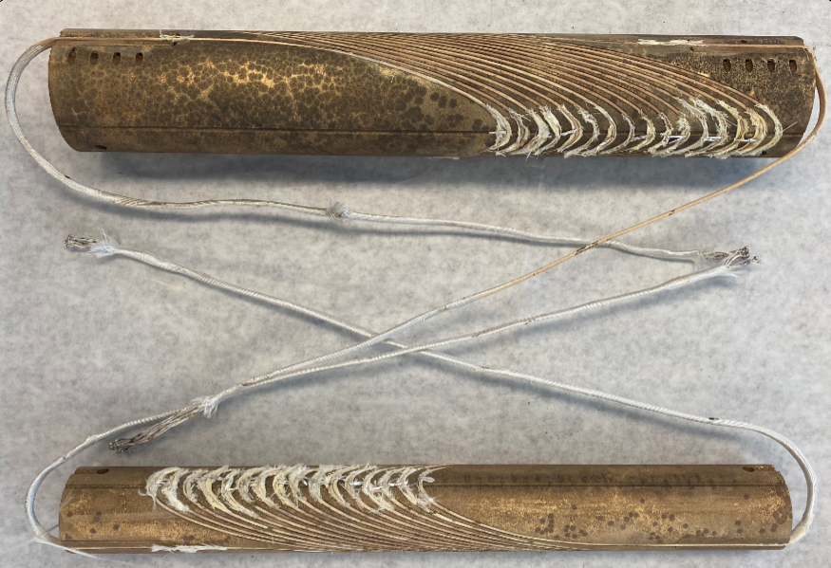
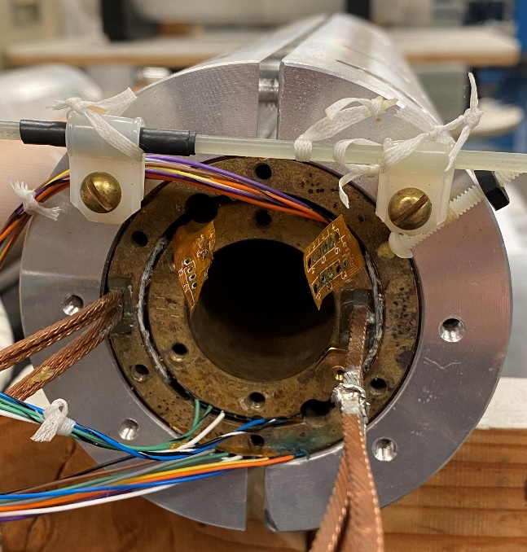
BIN5c magnet is the first tested Bi-2212 CCT dipole magnet
BIN5c magnet (Lead end view)
Design:
Two coils, 39 cm long, 16 turns
Bore diameter ~ 31 mm
Same cable size, same mullite insulation and same mandrel material as BIN5a
Fabrication:
TiO₂ applied to the bare cable to reduce Bi-2212 leaks
Wound by hand
TiO₂ slurry applied on the insulated cable during winding to avoid electrical shorts with the mandrels
Voltage taps flags installed at every turn (layer 1) and every two turns (layer 2) during winding
Heat treated at 50 bar in the Deltech furnace at NHMFL
Impregnated with the NHFML-Mix-61
Assembled using smart shims (Kapton bags filled with epoxy)
Test:
Split aluminum shell bolted around the coil
Produced 1.64 T bore field at 4.2 K at 65% of its short sample limit (SSL) in 06/2021
No quench training was observed
Split aluminum shell for the standalone test only
BIN5a after over-pressure heat treatment process
Layer 2
This coil is very similar to BIN5a
Bi-2212 were reduced with respect to BIN5a, but not eliminated
Layer 1

Slide 7
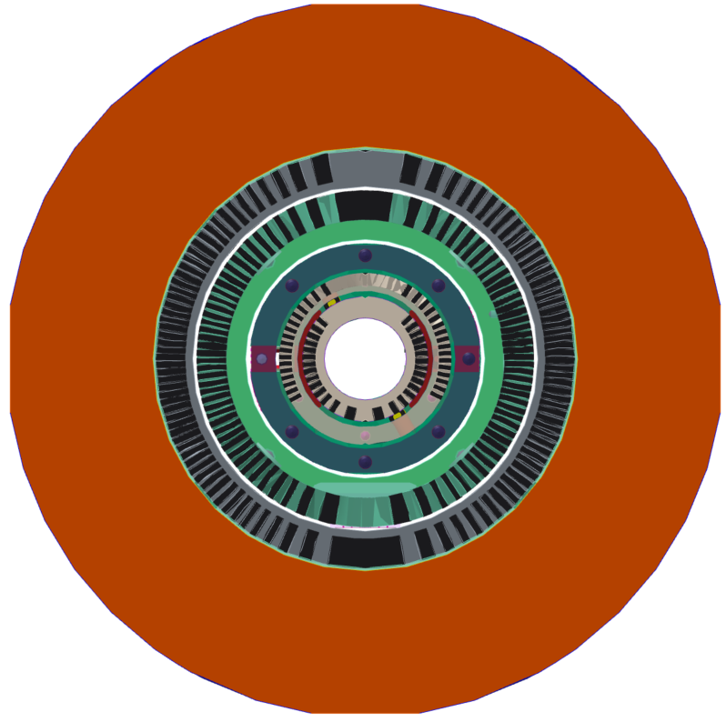
BIN5c magnet will also be tested in hybrid configuration
The outsert is CCT5:
Nb₃Sn two-layer CCT magnet, 90 mm clear bore, 1 m long
Produced ~8 T bore field at 4.2 K in standalone configuration (80% of its SSL)
CCT5/BIN5c:
The insert should increase by ~1.2 T the bore field of the outsert (at most)
CCT5 shell
BIN5c shell
CCT5 Layer 2
BIN5c Layer 2
CCT5 Layer 1
BIN5c Layer 1

Slide 8
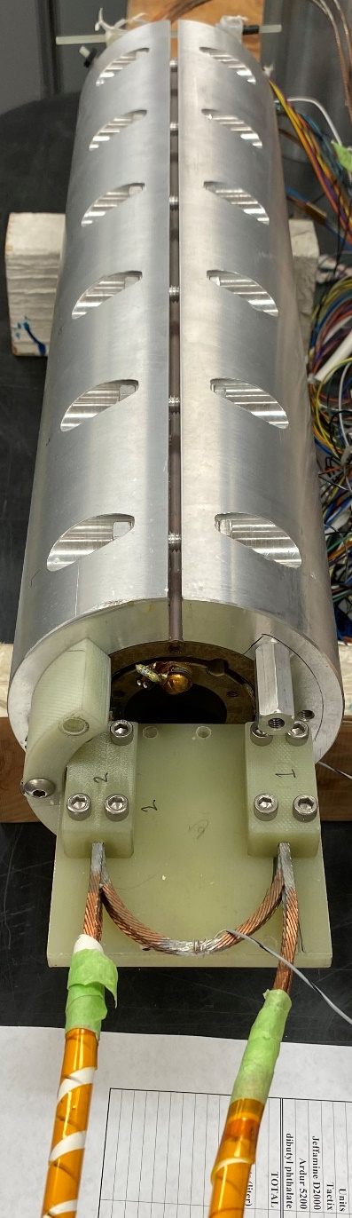
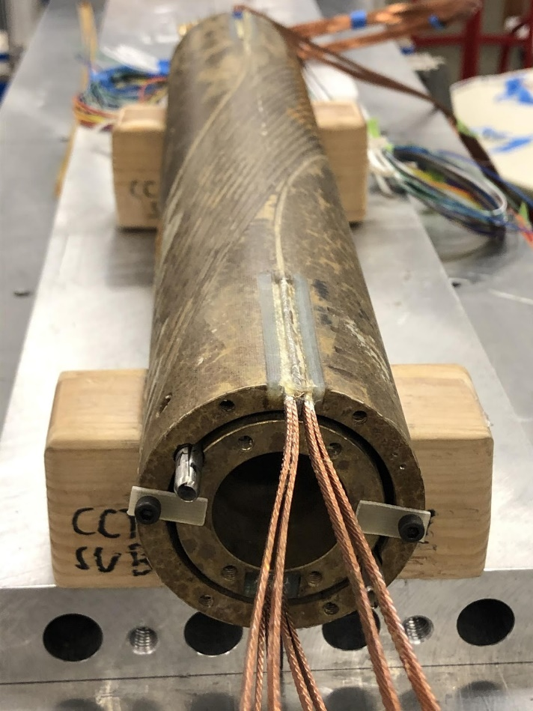
BIN5c required some design/fabrication specificities to make it compatible for the hybrid magnet test
Splices of BIN5c in the ~6 T background field region
Splices made of two pairs of Nb-Ti cables sandwiching the Bi-2212 cable
Lead end
BIN5c coils assembled
Dipole field in the bore
(BIN5c at 65% of its SSL)
Jumper at the lead-end for the standalone test
Return end

Slide 9
BIN5c required some verification of the feasibility of its design to work in a hybrid configuration inside CCT5. A gap in the midplane appears due to an increase in the forces in the outer layer (which is the less rigid layer)
Azimuthal stress (Pa) of BIN5c in hybrid configuration
Von Mises stress (Pa) of BIN5c in hybrid configuration
Radial displacement (m) of BIN5c in hybrid configuration
Note: Defining material properties of aluminum-bronze 954 and impregnated Bi-2212 Rutherford cables is one of our main limitations in the design of Bi-2212 CCT magnets

Slide 10
Outline
BIN5a: first demonstration of high current in a Bi-2212 CCT coil
BIN5c: first tested Bi-2212 CCT dipole magnet
BiCCT1: first ~1m long Bi-2212 dipole magnet to be fabricated
Preliminary plans for BiCCT2

Slide 11
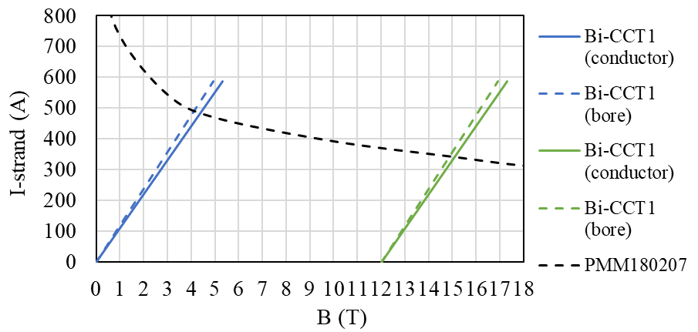
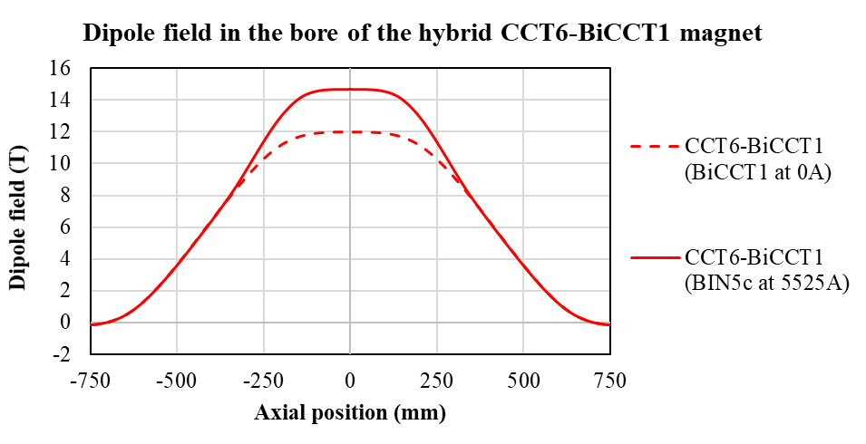
BiCCT1 is the first ~1m long Bi-2212 dipole magnet to be fabricated. One of its main goals is to be tested in a hybrid configuration inside CCT6
Design:
Bi-2212 two-layer CCT magnet, 40 mm clear bore, 85 cm long
17-strand Rutherford cable (7.8x1.44 mm), 0.8 mm diameter strand
Coils will be reacted using the RENEGADE overpressure processing heat treatment furnace at NHMFL (first time we will heat treat coils using this furnace)
Main goals:
Bi-CCT1 should produce 4 T dipole field in standalone configuration (at SSL)
Bi-CCT1 should produce additional 2.7 T (at SSL) in the 12 T background field produced by CCT6
Fabrication:
Rutherford cable is painted with TiO2 in an attempt to decrease Bi-2212 leaks during HT (like in BIN5c coils)
Rutherford cable is then insulated with Mullite sleeve
The insulated Rutherford cable painted with TiO2 slurry during the winding process (same process as BIN5a, BIN5b and BIN5c coils) to avoid electrical shorts
Approximate region where BiCCT1 is
Note: During coil testing of previous coils we have observed a maximum performance of ~65 % of SSL, which has been attributed to Bi-2212 leaks, but the cause (of the leaks and performance) is still not well understood

Slide 12
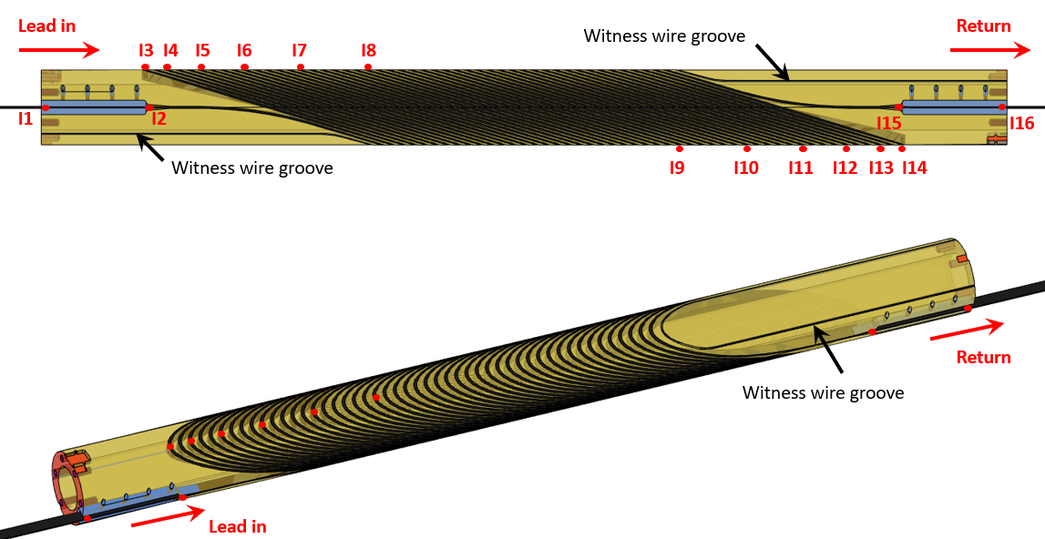
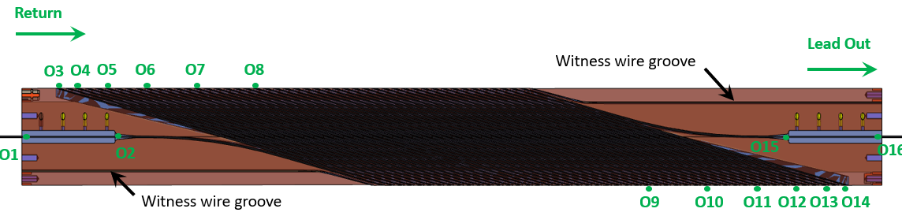
Main characteristics of BiCCT1
There will be six voltage taps at each pole side of each coil (I3 to I14 in the inner layer and O3 to O14 in the outer layer), plus two voltage taps at each splice region
Adding witness wires on the mandrel for the heat treatment is a new approach with respect to the previous coils
Mandrel characteristics
Layer | Mandrel bore diameter (mm) | Spar thickness (mm) | Coil outer diameter (mm)
Inner | 40 | 4.5 | 66.2
Outer | 70 | 4.5 | 96.2

Slide 13
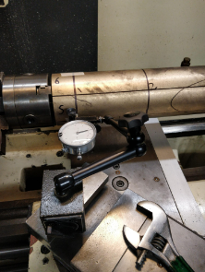
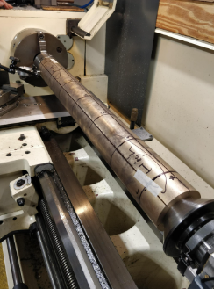
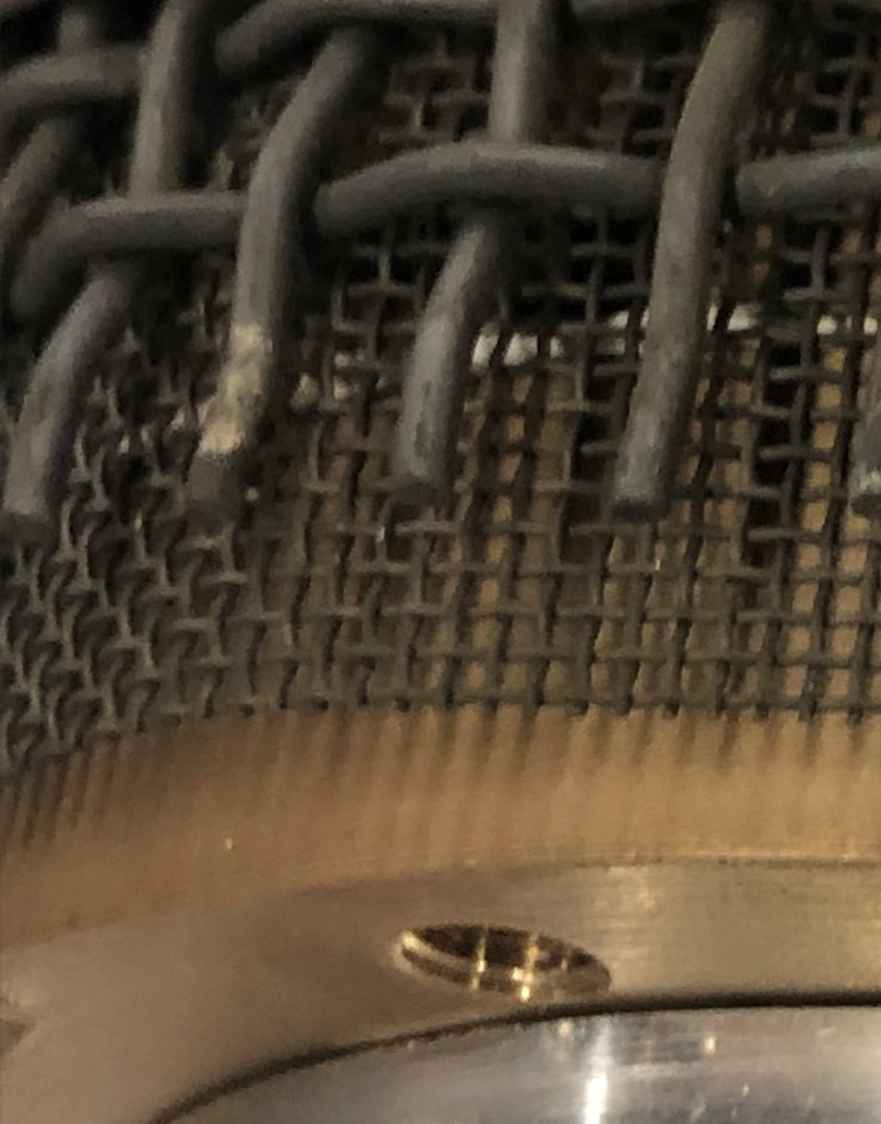
Pre-oxidation of the mandrels: Some modifications to our standard procedure were introduced after winding in order to decrease the bending of the mandrels during the pre-oxidation (and further heat treatment) process
The inner and outer layers were machined and sent to NHMFL for pre-oxidation
Upon arrival, the inner layer (ILa) showed a large bending such that it could not be inserted inside the outer layer (measurements in the next slide)
A dummy mandrel wrapped with a thin and a thick Inconel 600 mesh as structural support was oxidized
The Inconel meshes were effective for preventing the bending of the dummy mandrel
A second inner layer (ILb) was machined and sent to NHMFL for pre-oxidation using the same support approach as for the dummy mandrel
The Inconel mesh approach ensured the straightness of the mandrel (measurements in the next slide)
CCT dummy mandrel post Mellon pre-oxidation: 820 C for 4 h in flowing O₂ with a thin and thick Inconel 600 mesh
Thin and thick Inconel 600 mesh

Slide 14
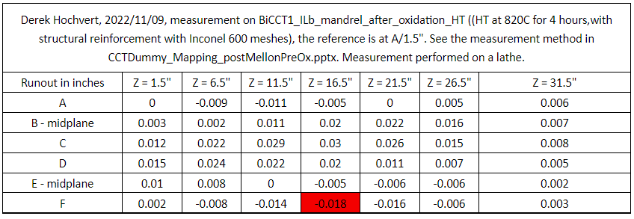
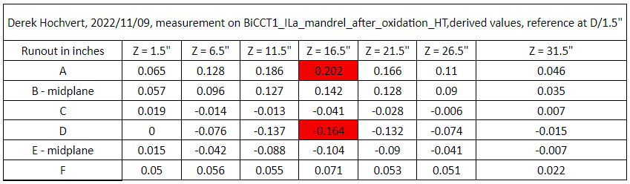
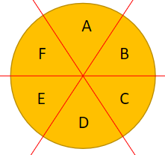
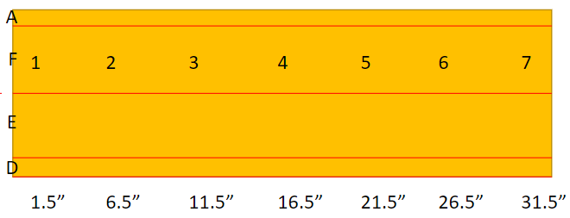
Pre-oxidation of the mandrels: The modifications prevented the excessive bending during the pre-oxidation process
Inner layer (b) after oxidation, the thin and thick Inconel 600 meshes were used as support structure
Inner layer (a) after oxidation, no Inconel support structure was used
Measurement schematics:
End gripped by lathe chuck
End supported by live center

Slide 15
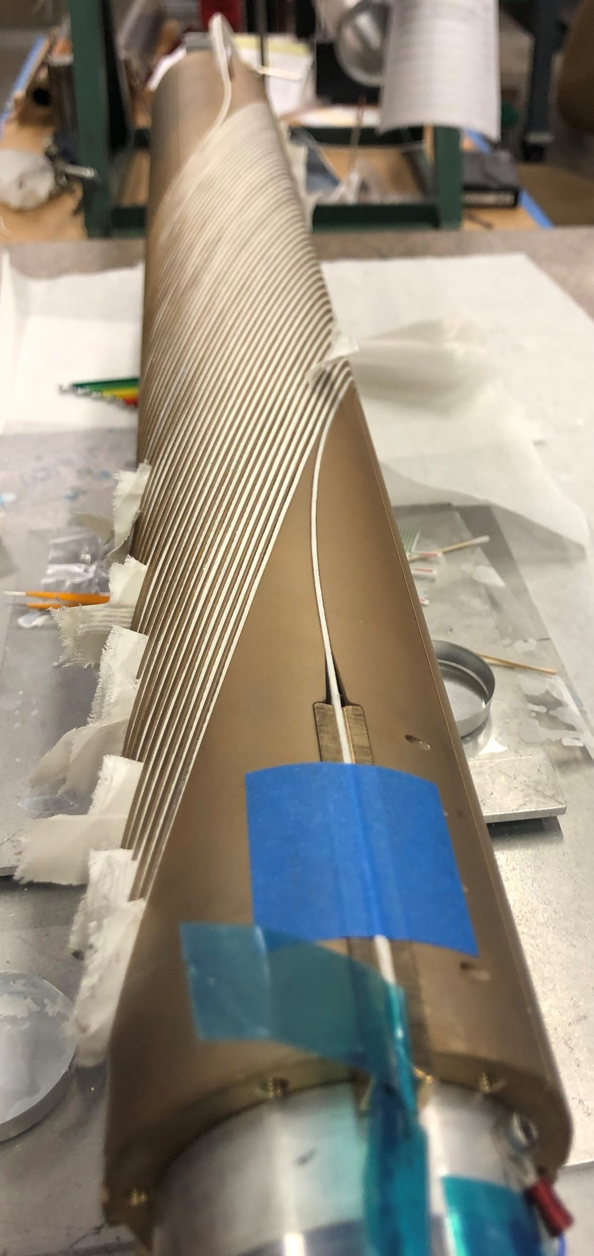
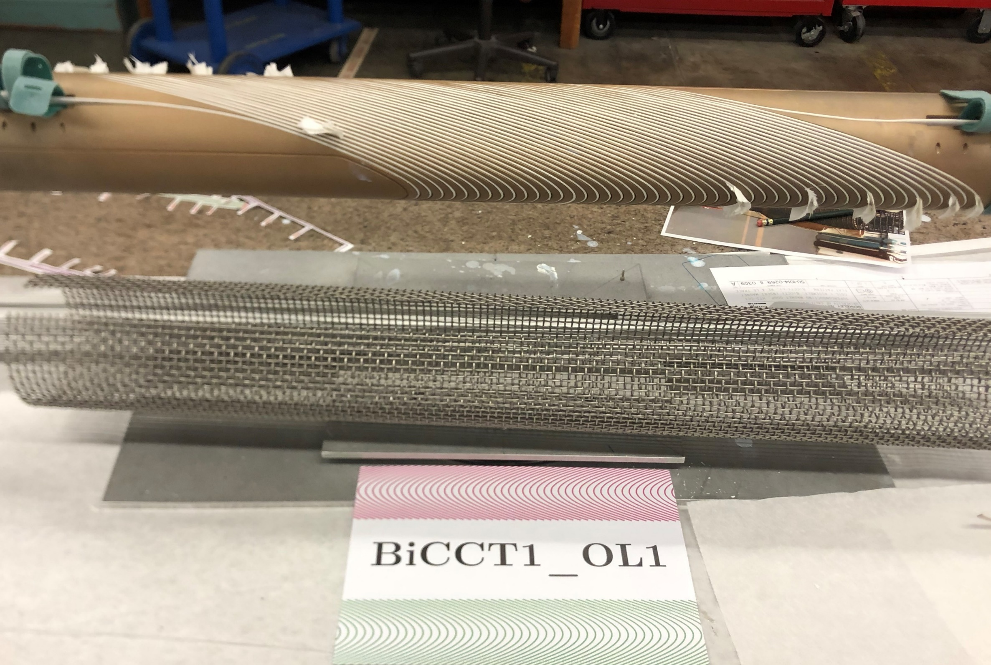
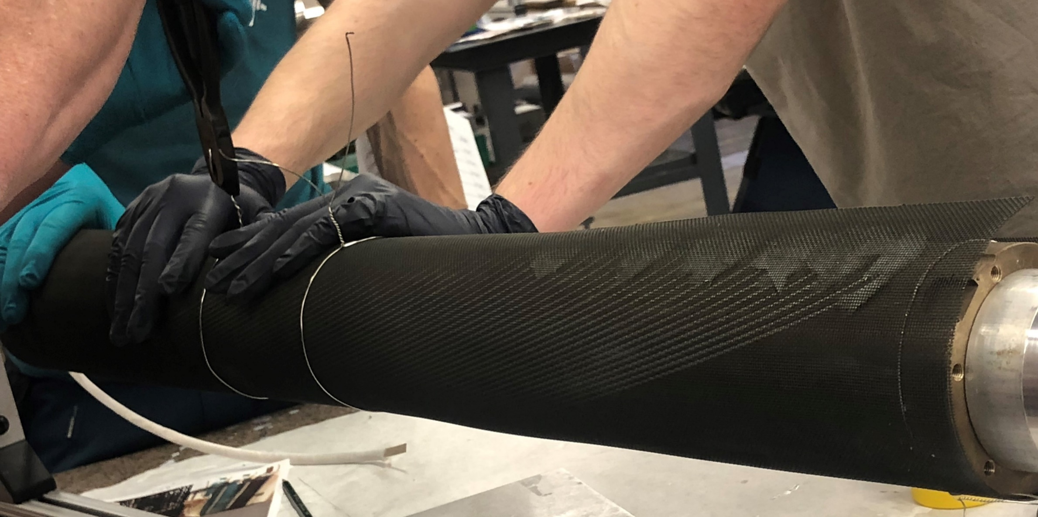
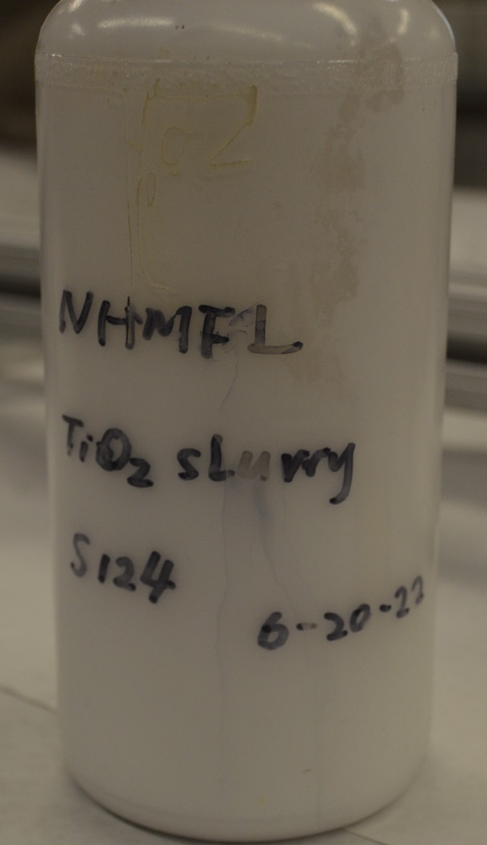
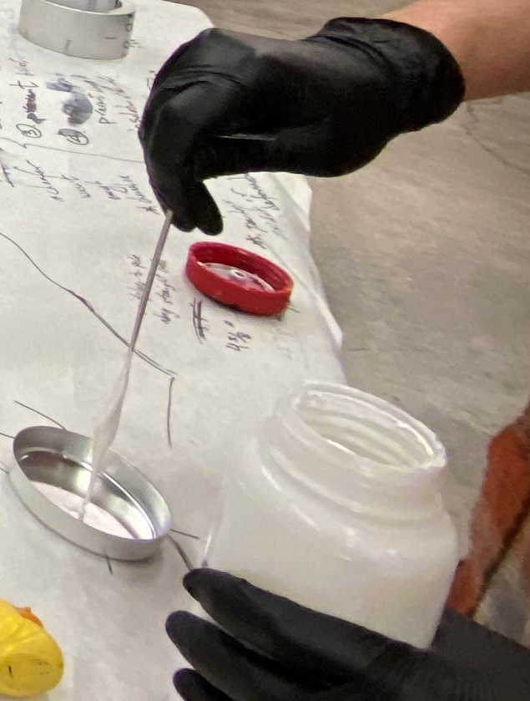
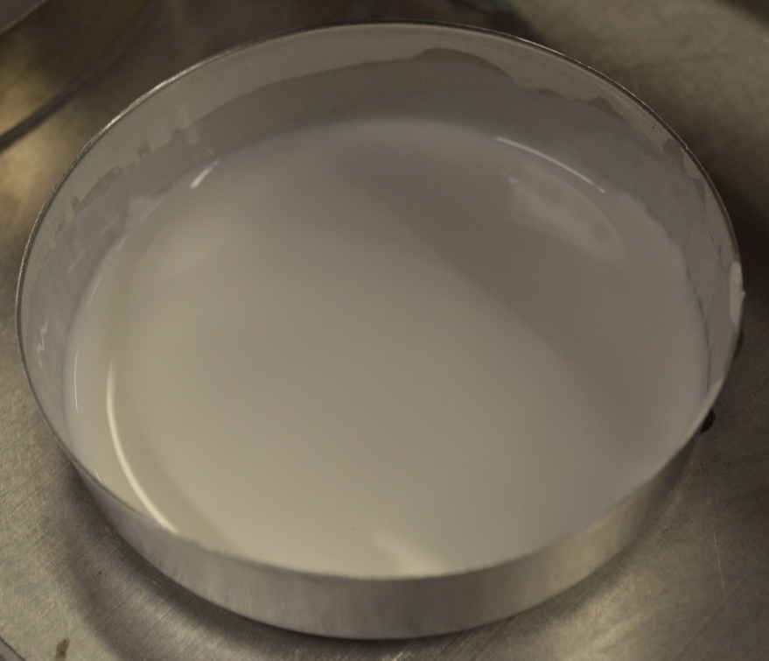
Winding of the outer layer followed our standard winding procedure used in previous Bi-2212 CCT coils. Inconel 600 meshes were added after winding to avoid the excessive bending of the mandrels during heat treatment
Outer Layer:
The outer layer was relatively easy to fabricate, nothing different from the previous BIN5a, BIN5b and BIN5c coils
The winding was done totally by hand, twisting and bending the cable with the fingers
The cable was painted with the TiO₂ slurry during the winding process for improving electrical insulation
Pure silver voltage tap flags were installed in the established locations
Witness samples were placed in the dedicated grooves
The mandrel was wrapped in oxidized thin and thick Inconel 600 meshes, and sent to NHMFL for heat treatment

Slide 16
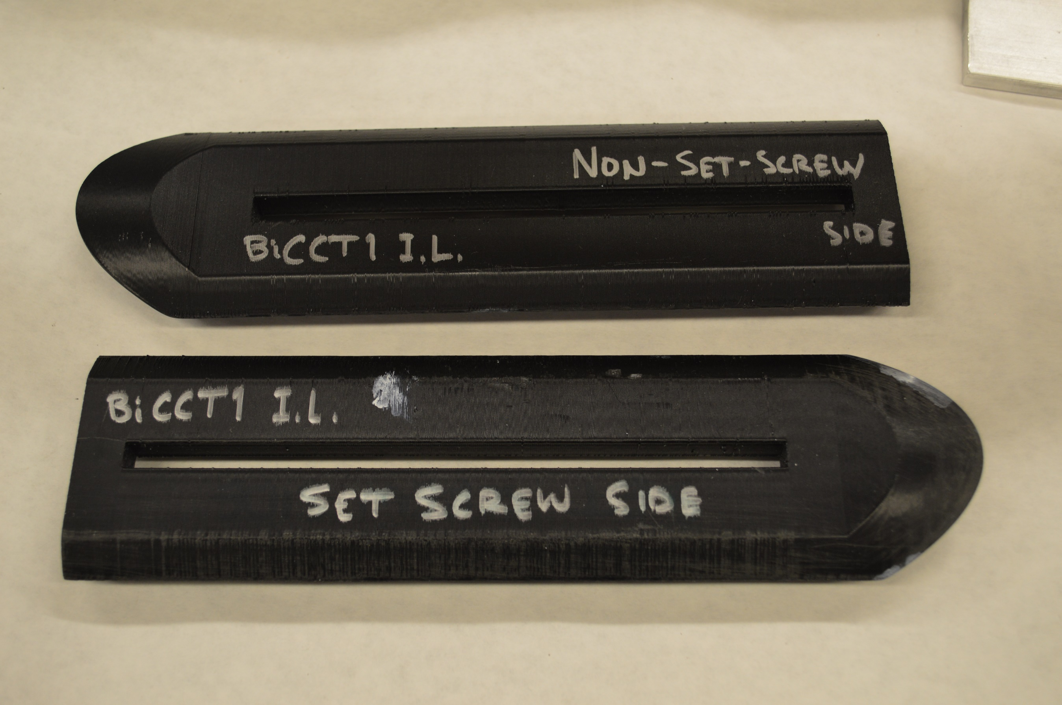
Winding of the inner layer posed many challenges due to the relatively wide (and soft) cable and the small bending radius (mainly irreversible de-cabling, but also excessive friction that caused insulation breakage) ➔ needed to introduce modifications to our winding procedure
Inner Layer:
The inner layer was more difficult to wind due to the smaller radius of the mandrel and due to tighter channels (need to check machining tolerance after machining and before pre-oxidation).
By twisting and bending the cable with the fingers, irreversible de-cabling and mullite damage would occur near the pole region. After this incidents we decided to wind first with a test cable in order to address the challenges
The test cable was slightly thicker than the real cable, which posed an additional challenge. In addition the test cable was not painted with TiO₂ before placing the mullite sleeve
The solution for the effective twisting and bending of the cable without de-cabling, was achieved by using auxiliary 3D printed pieces with the shape of the channel surface at the pole region (a technique previously used in the winding test of CCT6)
Additional winding procedure improvements were introduced that determined to the success of the task (paint and lay, tension mullite sleeve before painting, etc.)
Auxiliary 3D printed pieces that helped twisting and bending the cable at the pole region, and prevented irreversible de-cabling

Slide 17
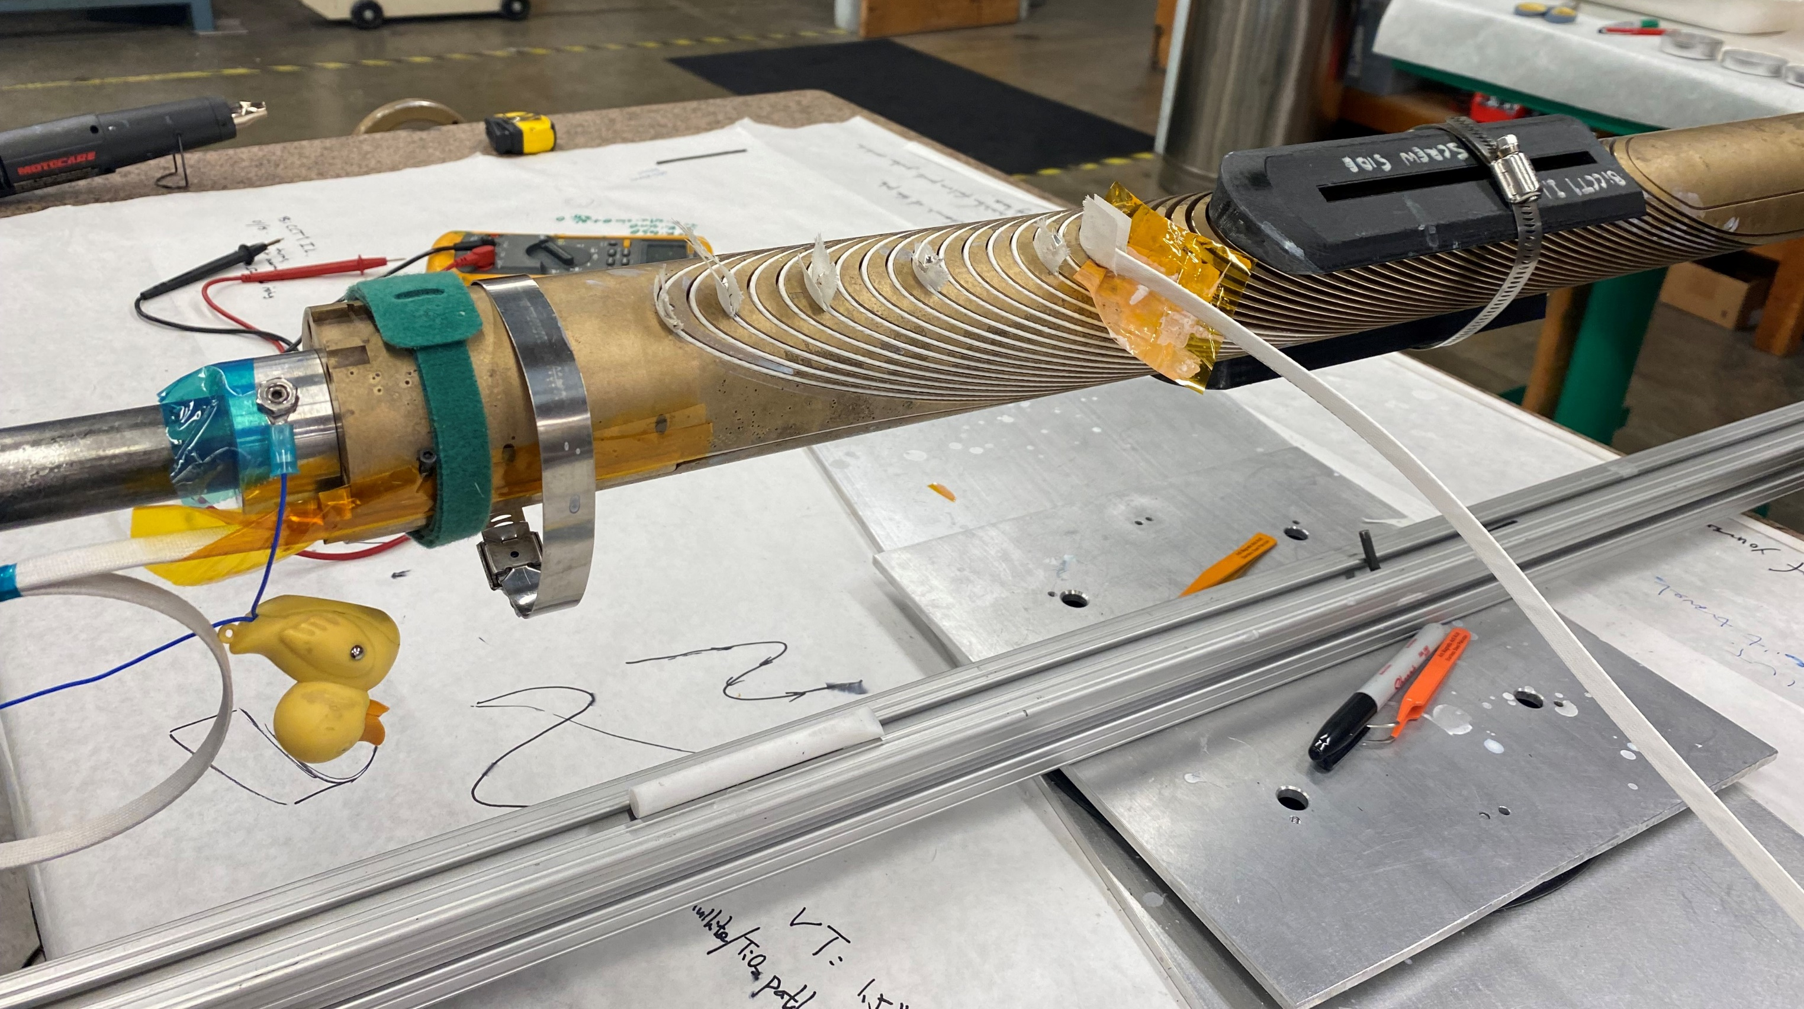
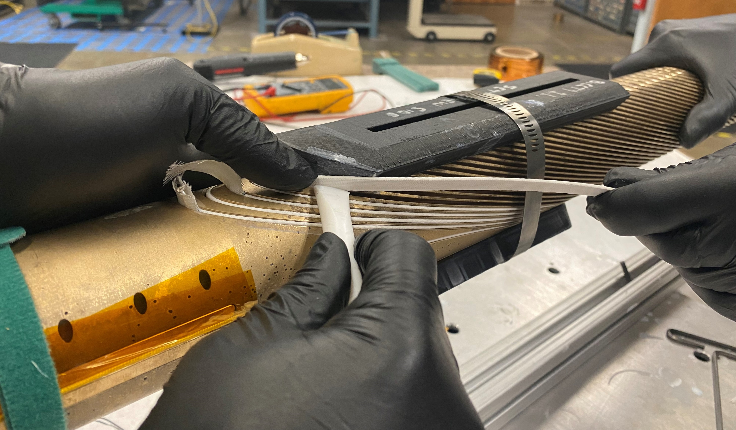
By revising our winding procedure and introducing modifications in order to better control the process, the winding of BiCCT1 IL which was previously very challenging, became successful
This Teflon piece is used to prevent the cable from being scratched by the outer edge of the channel, and to push the cable into the channel
This side of the 3D printed piece acts like an extension of the channel’s wall. By laying the cable against this wall and applying tension, the cable takes the desired shape. Then, it is progressively pushed into the channel
Tension is being applied to the cable during the winding process
(very important!!!)
When not winding, a piece of Kapton foil is placed between the cable and the mandrel to prevent damage to the mullite

Slide 18
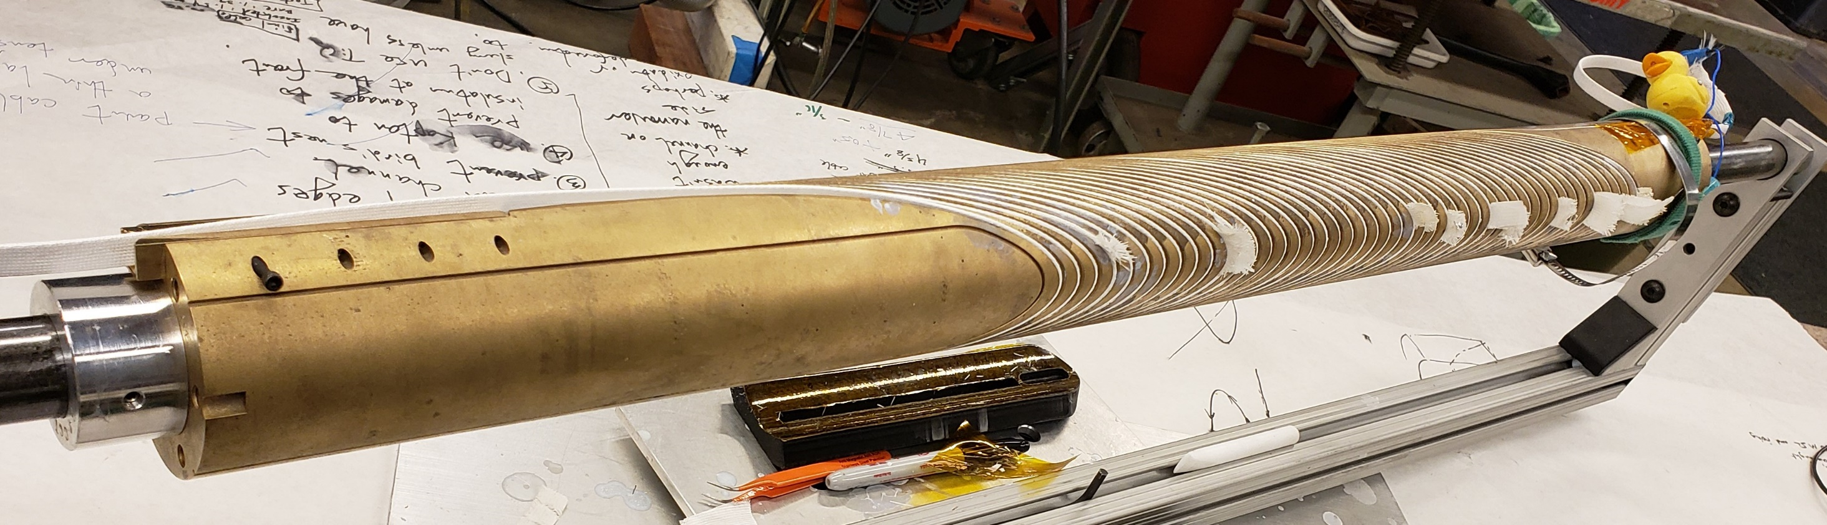
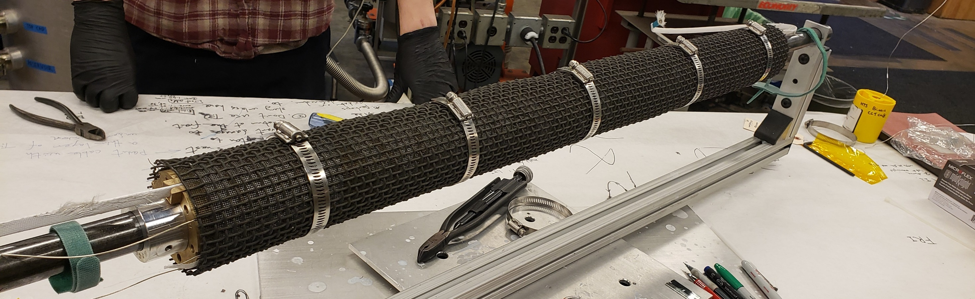
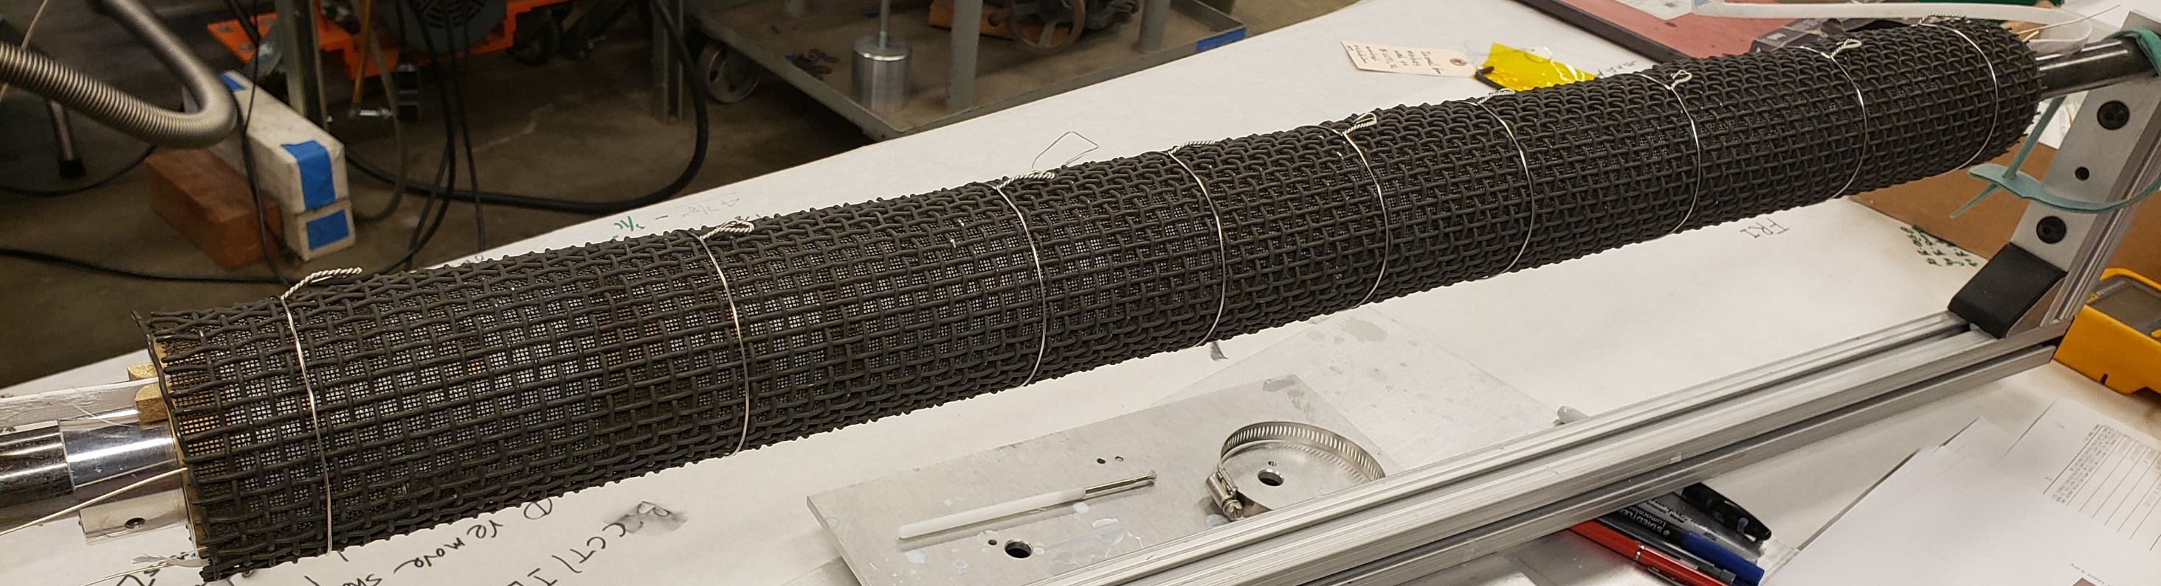
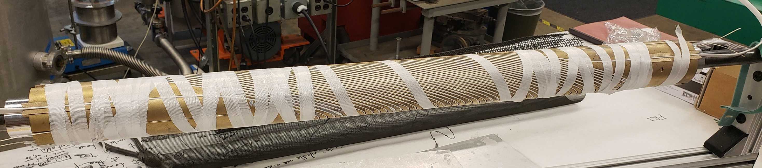
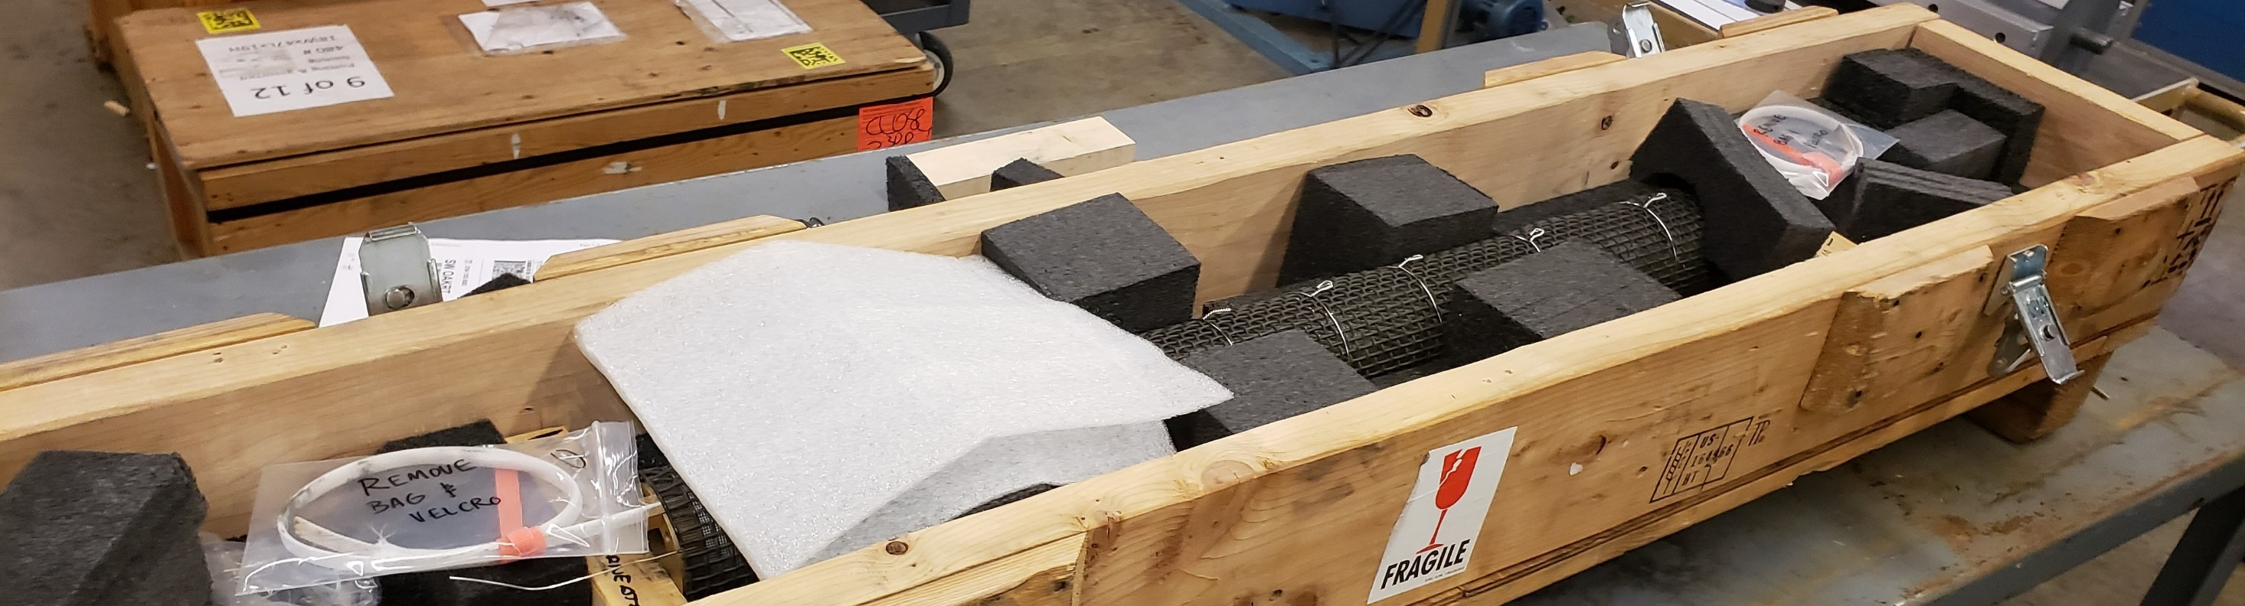
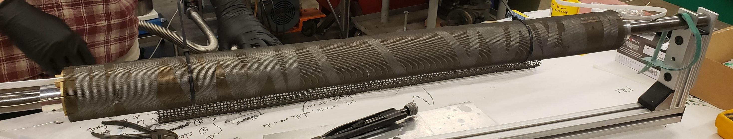
BiCCT1 IL after winding: wrapped with mullite, thin Inconel 600 mesh, coarse Inconel 600 mesh, Inconel 600 wires, and placement in the shipping crate
1
4
5
2
6
3

Slide 19
Outline
BIN5a: first demonstration of high current in a Bi-2212 CCT coil
BIN5c: first tested Bi-2212 CCT dipole magnet
BiCCT1: first ~1m long Bi-2212 dipole magnet to be fabricated
Preliminary plans for BiCCT2

Slide 20
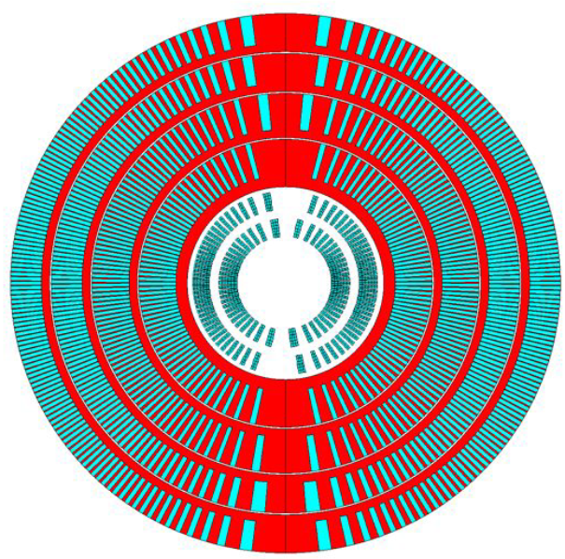
BiCCT2 would push the coil size parameters to the limit with respect to the aperture of CCT6 (i.e. wide cable, no aluminum shell in hybrid configuration)
Design:
Bi-2212 two-layer CCT magnet, 40 mm clear bore, ~1 m long (probably close to 85 cm long)
BiCCT2 should reach the maximum performance possible given the state of the art in the conductor technology, while being compatible with a standalone test inside CCT6
Main goals:
The main goal of BiCCT2 is to push the technology to the state-of-the-art limit by using the widest cable possible in a Bi-2212 magnet that can fit in the aperture of CCT6 (no aluminum shell in the hybrid configuration)
Fabrication:
The fabrication will follow the improved (previously described) procedure, with any further improvement needed after the experience of fabricating BiCCT1
Coils will be reacted using the RENEGADE overpressure processing heat treatment furnace at NHMFL
Example of possible design of BiCCT2 coils inside CCT6
BiCCT1 inside CCT6

Slide 21
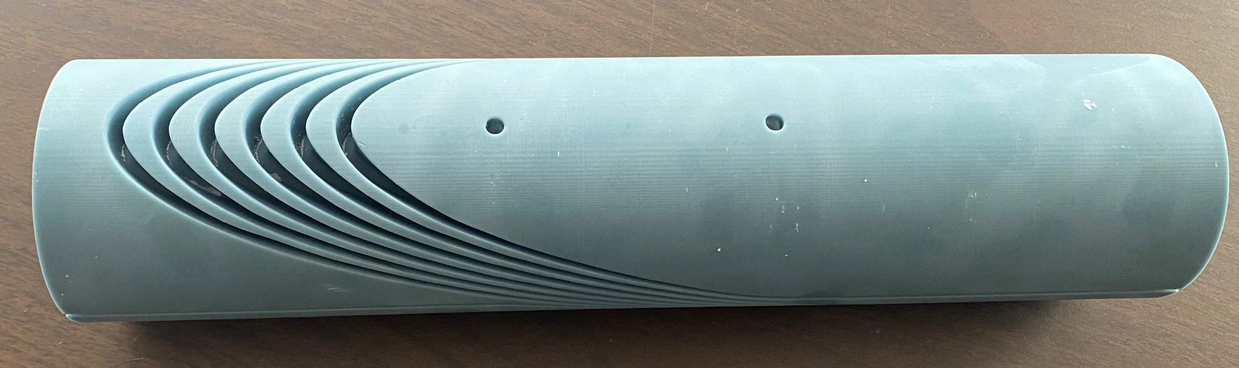
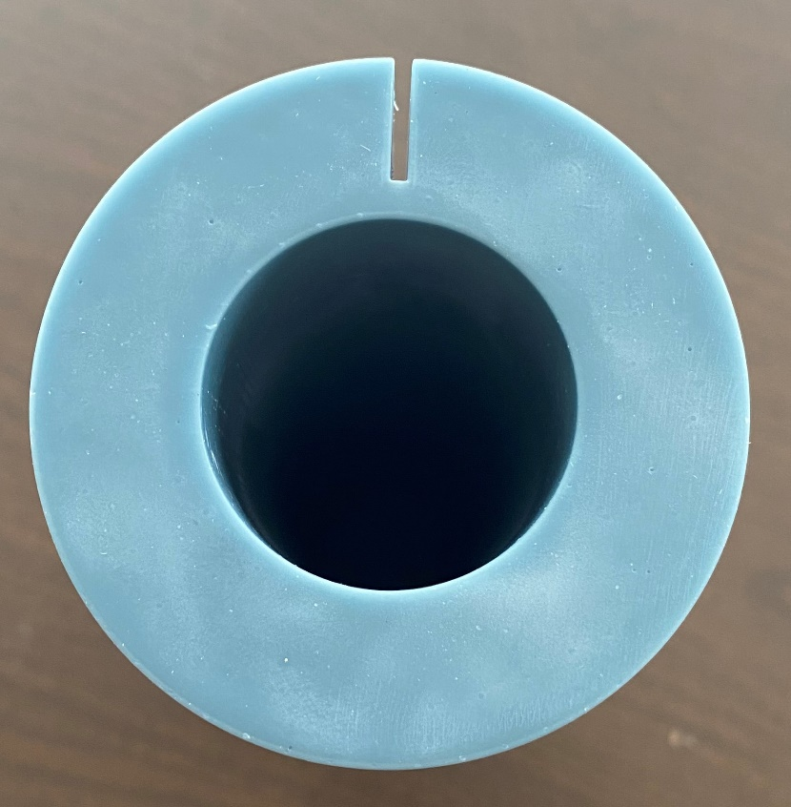
Need to verify feasibility of winding wide cables with small bending radius before defining the design of BiCCT2
After the experience of BiCCT1 IL we realize that before designing a Bi-2212 CCT coil that uses a wide cable with a small bending radius, we need to make sure it is feasible to fabricate
In this regard, we planned a six-turn winding test with a 13.28 mm x 1.54 mm, 0.8 mm diameter, using a 3d printed Acura Bluestone mandrel
Note: The winding test has not been performed yet

Slide 22
Conclusions
We have being making steady progress in the design, fabrication and test of Bi-2212 CCT coils/magnets
In terms of design, we still have some limitation in terms of material properties of aluminum-bronze 954 and impregnated Bi-2212 Rutherford cables at 4.2 K
In terms of fabrication, we have improved our procedure from the experience of our fabricated coils, with improved results
In terms of performance, we still lack some understanding about why we end up low (~65 %) with respect to the SSL. We attribute this to the Bi-2212 leaks (although there might be other reasons). We should continue to investigate how to completely remove the leaks, and how to improve the coil fabrication so that we can reach the full potential of the Bi-2212 conductor

