Slide 1





Bi-2212 Overpressure Processing Furnaces
Daniel S. Davis
U.P. Trociewitz, Y. Kim, C.L. English, J. Kvitkovic, E.E. Hellstrom, J. Jiang, F. Kametani, E.C. Martin, G. Bradford, S. Barua, G. Miller, J. Lu, J. Levitan, V. Griffin, P. Lee, L.D. Cooley, D.C. Larbalestier
2023 MDP Collaboration Meeting, March 21-24 at Brookhaven National Laboratory, NY.
Thanks to DOE-OHEP support (award no. DE-SC0010421), the NHMFL Core Grant support of NSF (award no. 1644779) and the State of Florida to FSU and the US Magnet Development Program Collaboration.

Slide 2
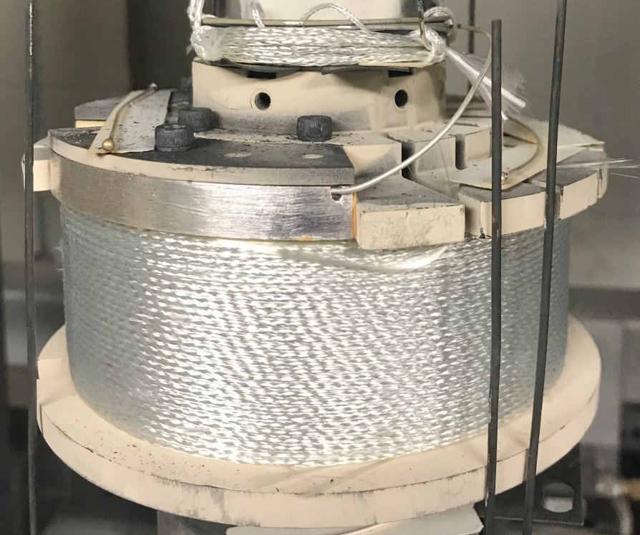
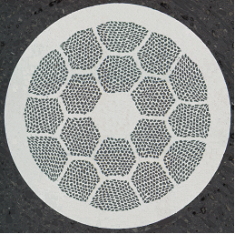
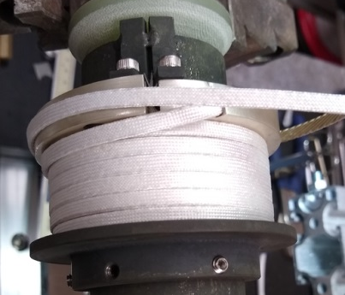
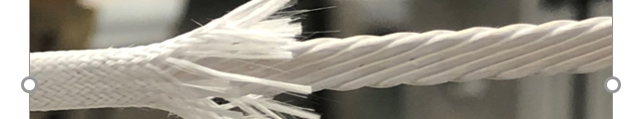
Why Bi-2212 for High Field Magnets
Bi-2212 is unique among commercial HTS:
  round, multifilament, macroscopically isotropic, can be twisted to reduce charging losses, just like Nb-Ti and Nb₃Sn
  and it can be cabled easily.
Bi-2212 conductor technology has come far:
  very high transport properties with even higher possible
  can be produced on 1 + km lengths scale
  exhibits reproducible performance over long lengths
  Insulating technologies exist for wire and cable
Specific to Bi-2212:
  It must be heat treated for s/c
  All materials in winding pack must be compatible with 890°C and 50 bar HT
Mechanical reinforcement as in any other s/c high field magnet technology is a challenge (not specific to Bi-2212)
Let’s transform peak into plateau
Bi-2212 Strand
Bi-2212 Rutherford cable (LBL)
Notes:
Pup-9, PMM180410
J_{c} (16 T, 4.2 K) ≈ 6500 A/mm² far exceeds the FCC specification of 1500 A/mm² at 16 T
Plateau J_{e}(4.2 K, 5 T) of the current production wires is in the range of 1200 to 1400 A/mm² (i.e. ~700 A/mm² at 25 T).

Slide 3
Postmortems are a Valuable Tool (Pup-9)
Pup-9
Layer Map :
Turn Map :
Flange
Flange
Winding pack is not fully decoupled from mandrel and flanges
Coil degraded below FEA predicted stresses (perhaps not even due to Lorentz forces)
Are we seeing CTE issues with the composite in these data (e.g. during cool-down)?

Slide 4
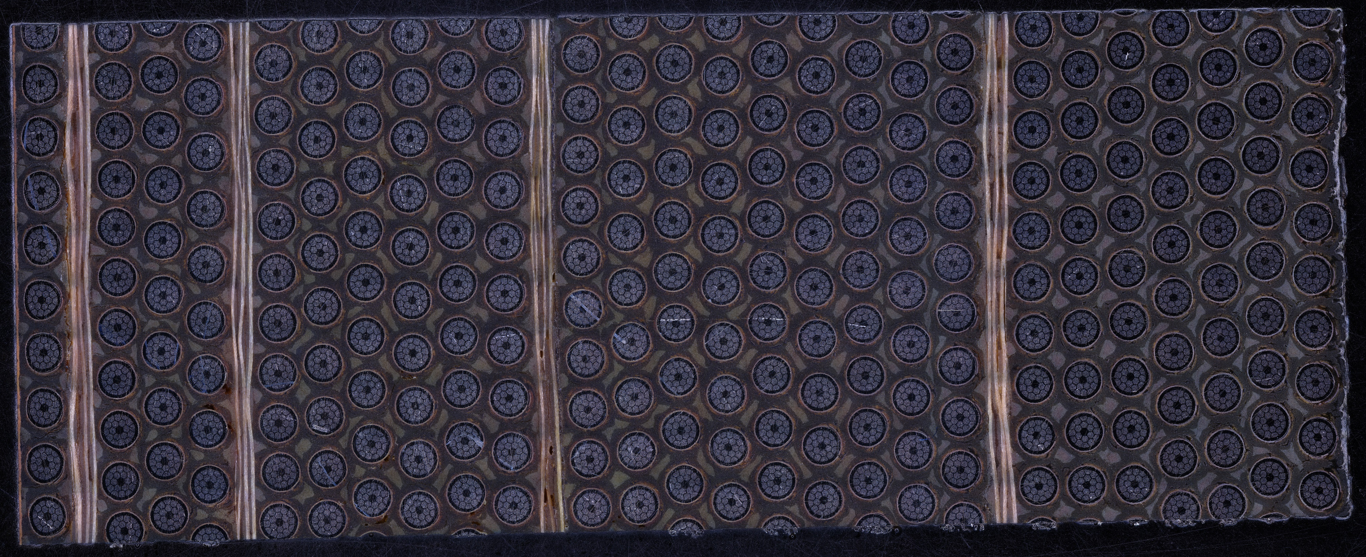
Pup-10 Postmortem
Excellent performance in undamaged layers
Mid coil
Bottom flange
no apparent
interface effect here
Same number of four inner banding layers as Pup-9 but different distribution
Less degradation than in Pup-9 observed but still present around 3rd reinforcement layer
Optimization of banding layer distribution appears to work
2
5
11
20
3rd reinforcement layer
Coil ID
Pup-10 cross section,
bottom section
E. Bosque, Y. Kim, U.P. Trociewitz, C.L. English, D.C. Larbalestier, System and Method to Manage High Stresses in Bi-2212 Wire Wound Compact Superconducting Magnets, U.S. non-provisional patent application, FSU Ref. no. 18-063, 2019.

Slide 5
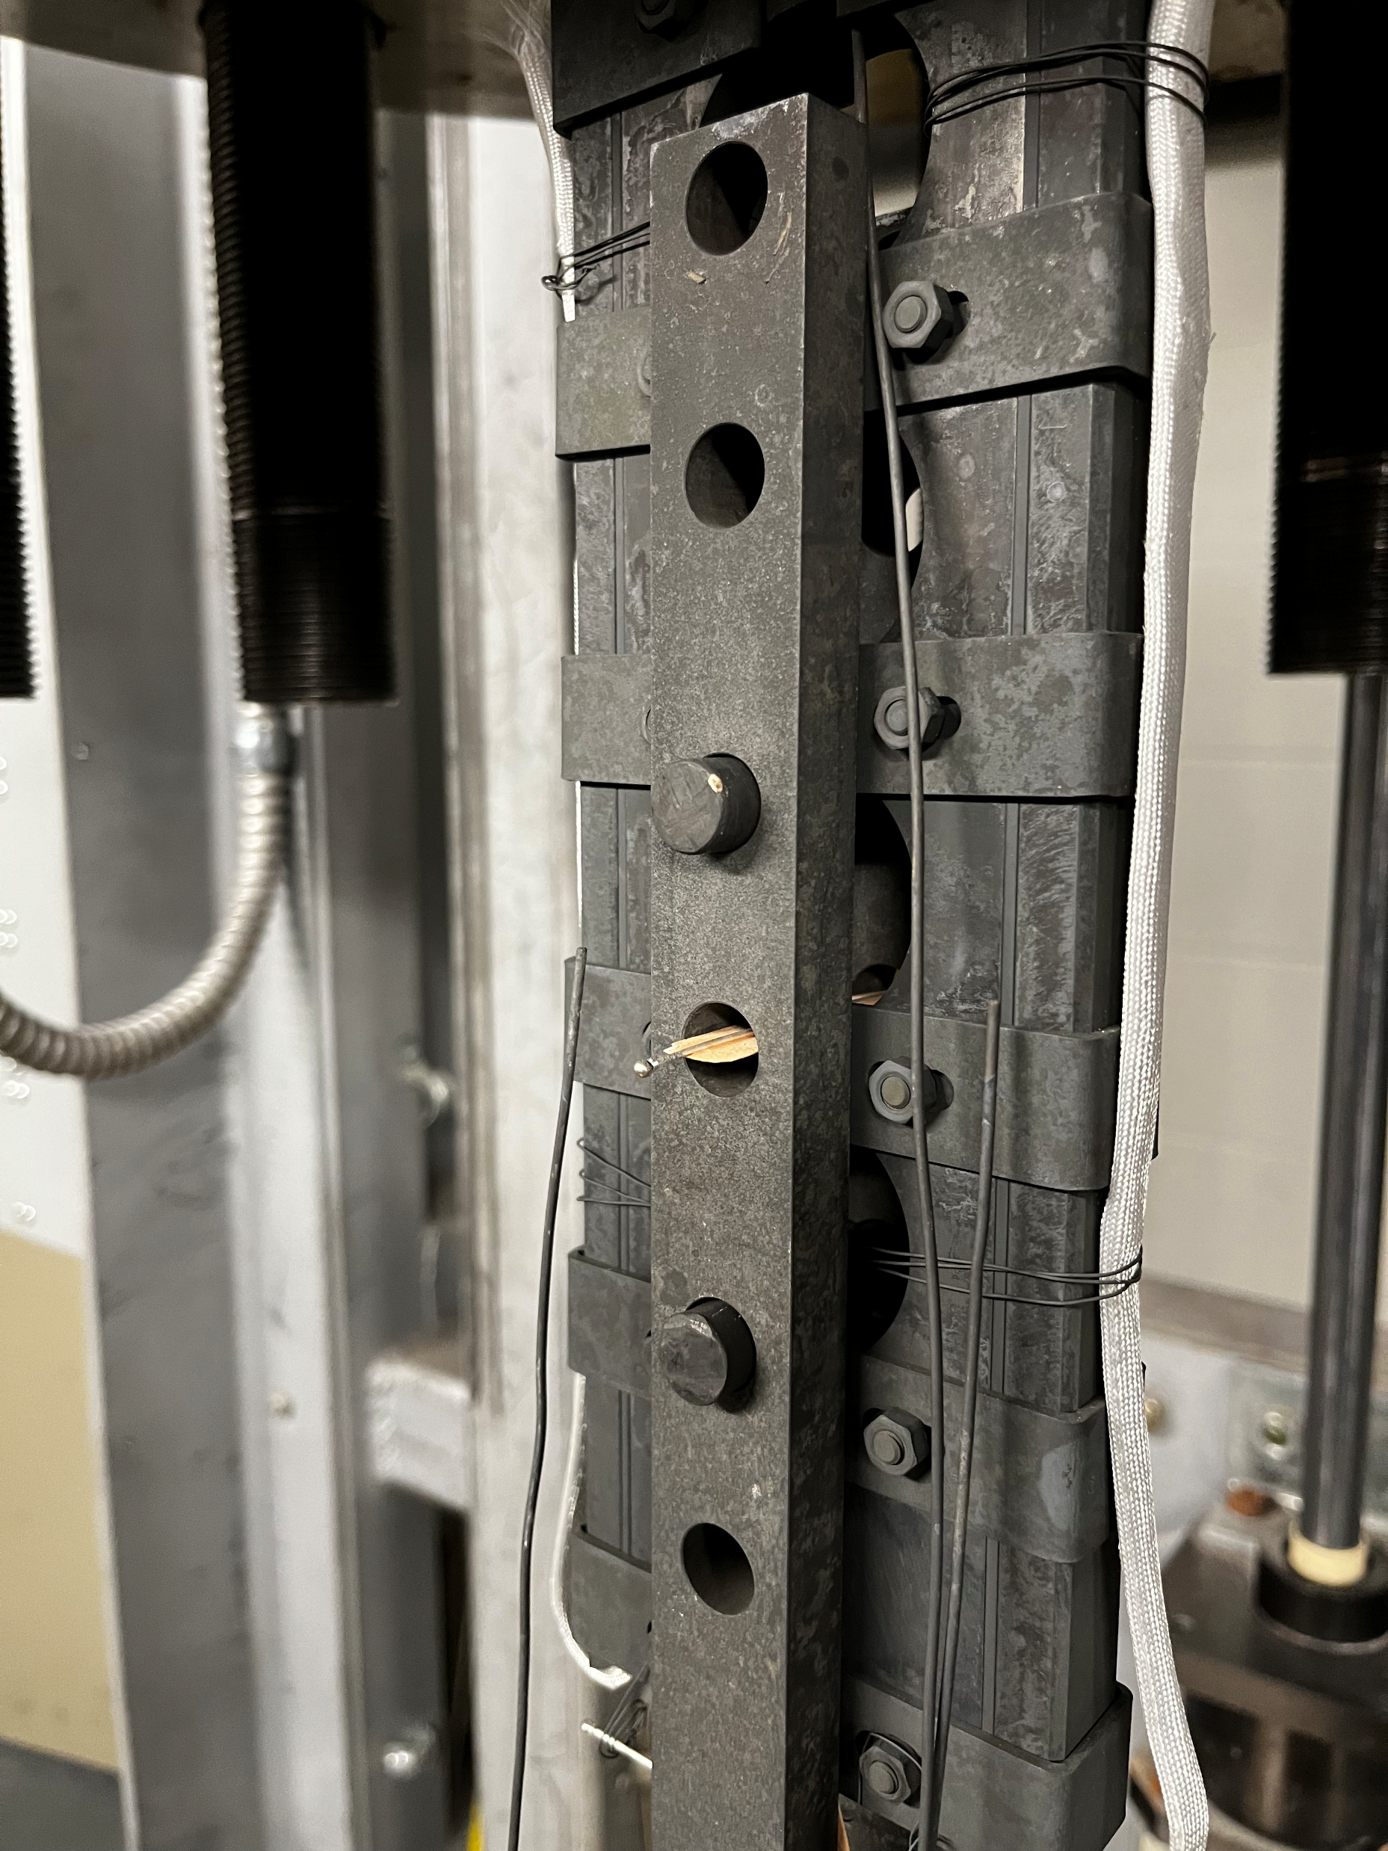
OPHT of 17-Strand LBNL Rutherford Cable for Transverse Pressure Tests
A. Kario, Twente University
1.8 m
total sample length
Cable TiO₂ coated and alumino-silicate braided
No signs of leakage after OPHT
Very promising results of test (contact A. Kario for details on test)

Slide 6
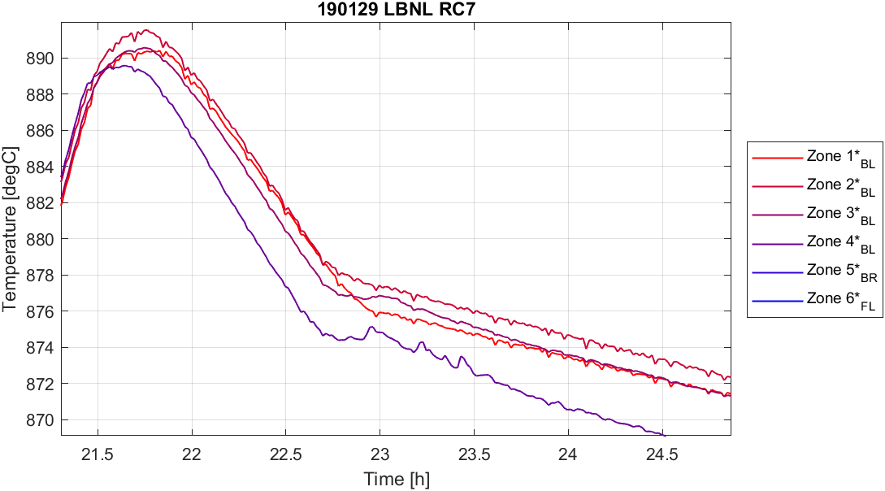
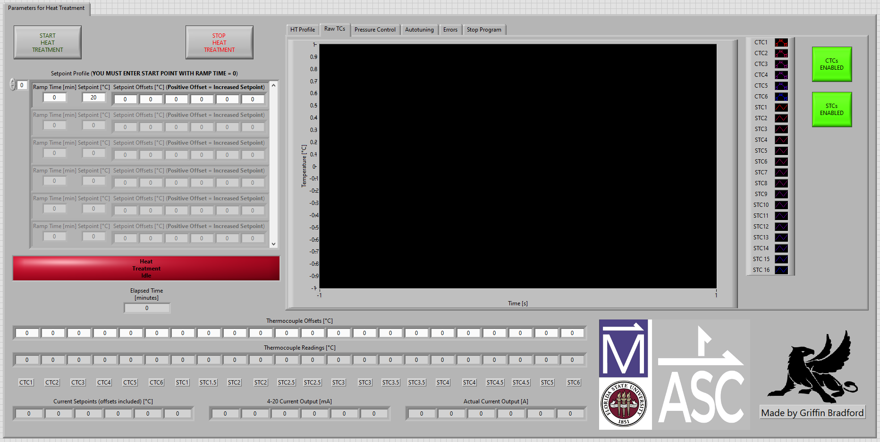
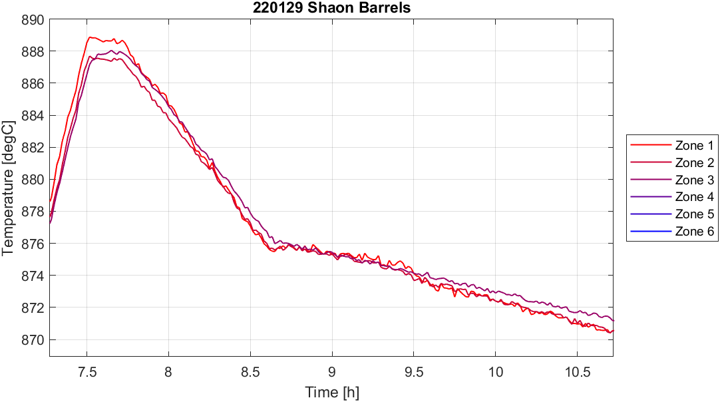
Improving OPHT Control of Our Two 6-zone Furnaces
The Deltech furnace has undergone a series of modifications to improve hot zone uniformity and furnace controls generating set of ideas to go into the larger Renegade furnace design:
Among others:
  A baffle tube was added to the bore designed to increase natural convection
  Sample (16) thermocouples recalibration (a regular occurrence)
  Improved back pressure regulation
  Furnace control program completely reworked by graduate student Griffin Bradford (migrated to full Labview control for Deltech and new Renegade)
Before
Extracts of heat treatments before (above) and after (below) furnace control modification.
6-zone furnace control software
After

Slide 7
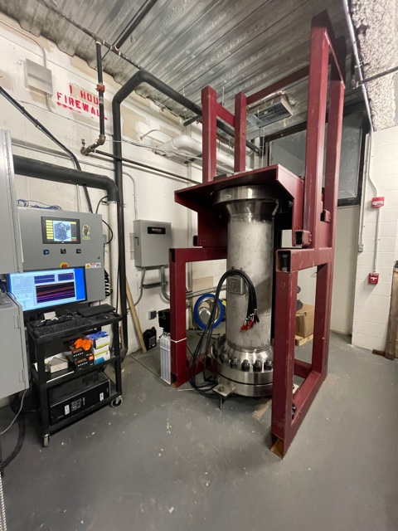
Gas-flow & pressure Control of OP-Furnaces
Gas supply
Flow Regulation
5 l/min
Renegade furnace
(or Renegade)
Pressure regulation
50 bar
Setting up a high-pressure furnace system is nothing to be fearful about

Slide 8
Furnace Modifications Have Improved Conductor J_{e} Consistency
Witness samples heat treated after addition of baffle tube and thermocouple recalibration have consistent, high J_{e} of around 950 A/mm² +/- 50 A /mm².
Results from heat treatment run with upgraded program suggest further improvements to witness sample J_{e}.
Furnace program upgraded January 2022
Low Je caused by furnace wiring issue
Low Je caused by furnace losing power
Furnace Thermocouples recalibrated August 2019
Low Je caused by furnace wiring issue
Low Je caused by damaged furnace heating elements
Graph showing the J_{e} of pmm160301 witness samples vs the date of their heat treatment. Data points of the same shape and color were heat treated together.

Slide 9
Renegade Furnace Update
The furnace has seen full pressure and a step-wise increase of temperature at pressure
  @ 600 °C & 600 PSI we found a higher-than-expected surface temperature, opened the top flange, and found that the interface insulation had degraded.
    We replaced this with the denser insulation that is used around the heating elements
  On further operation 2 fuses opened and it was found that the insulation around the heater leads had failed, damaging some of them.
    We contacted the heater manufacturer, and they provided a guaranteed repair and the addition of insulators bonded into the ceramic heater.
  We are re-assembling the system with an agreed lift-plan to account for the improved yet more delicate insulation.
  The system will then be dried-out, and the commissioning will continue toward full pressure and temperature.
  This will be followed by PID tuning and evaluation runs on the dummy-CCT mandrel with short samples.

Slide 10
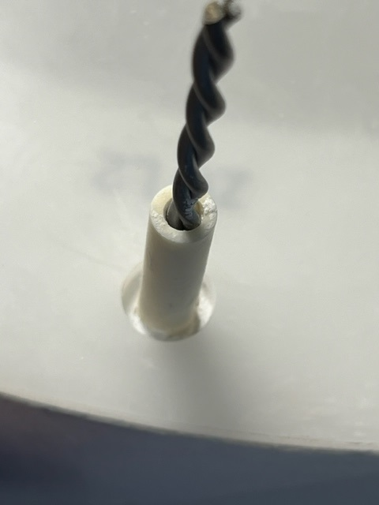
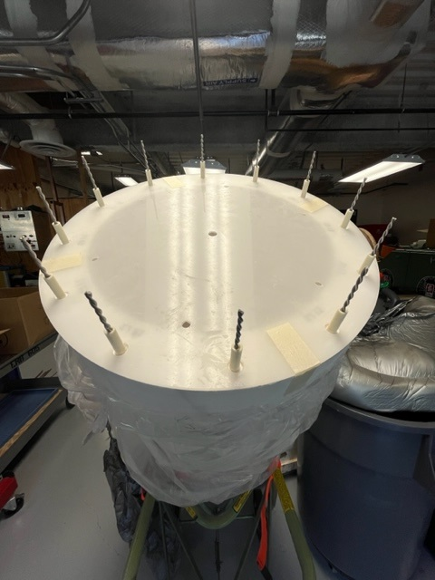
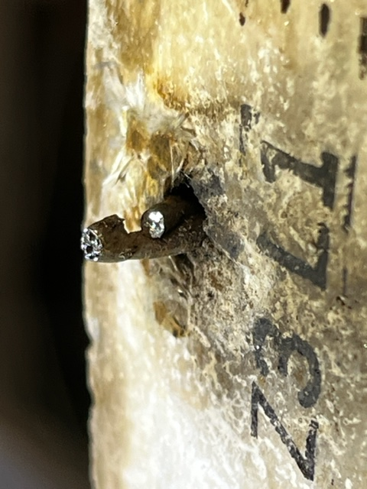
Renegade Heater Leads

Slide 11
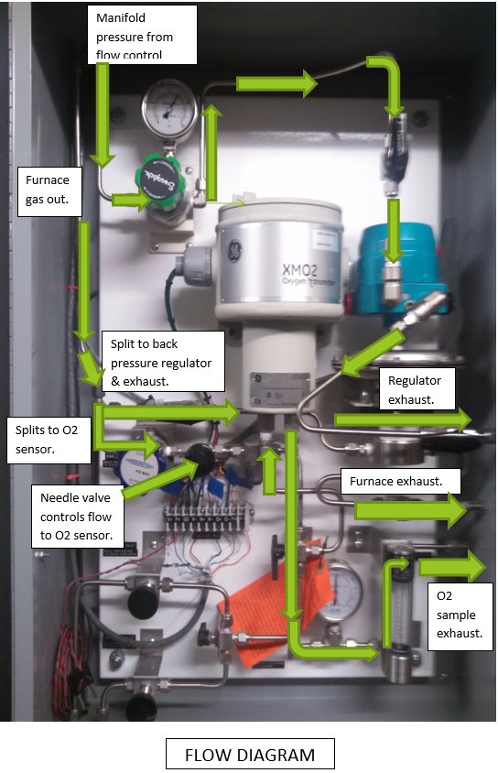
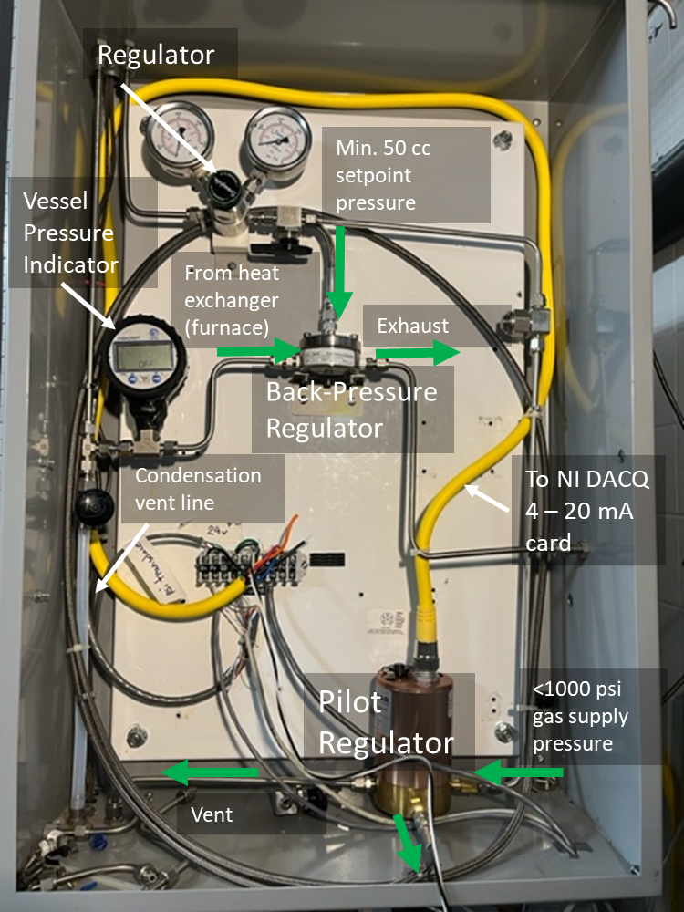
Back Pressure Regulator Replacement with Improved Technology

Slide 12
Thank You!
Daniel Davis
Lamar English
“Double-Pup”
Youngjae Kim
…and stay tuned.

Slide 13
Extra slides

Slide 14
Double-Pup
Objectives
  Target current/field (367 A/+6 T),
  Background field (B_{ext}) : 8 T (Cryomagnetics) or 14 T (Cryogenic); tbd
    Interface Separation : be tolerant to fully bonded and fully separated
    Bands layout : 2-4-4-4-4-2 (20 Layers + 5 Bands)
    Overband for outer section stress management (~1 mm)
Test Coil Specs. | Pup-10 | 6 T Mid-Scale
Dimensions (a₁; a₂; 2b) | 22.3; 56.0; 40.3 mm | 22.2; 49.0 ; 125.6 mm
No. of Layers | 26 | 20
Turns/Layer | 30 | 93
Bands | 4 | 4 ~ 5
Conductor | ~ 200 m | ~ 397 m
Field Const. | 11.35 mT/A | 16.4 mT/A
Inductance | 31.5 mH | 78.0 mH
Background Field | I_{trip} | I_{target}
5 T | 512 A | -
8 T | 418 A (+4.7 T) | 367 A (+6 T)
BJR at 8 T | 161 ~ 199 MPa | 145 ~ 170 MPa
10 T | 367 A | -
12 T | 342 A | -

Slide 15
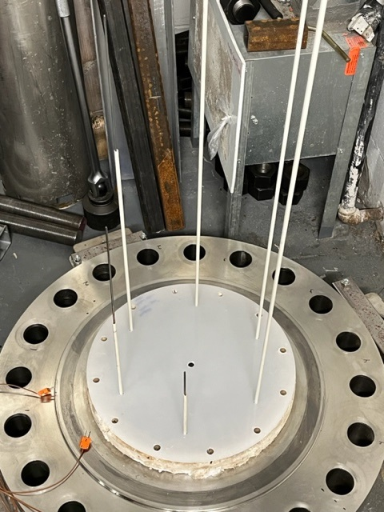
Alumina Tube
Sample TC
Plastic alignment Template

