Slide 1
Bi-2212 CCT inserts for hybrid magnets – design and integration
Laura Garcia Fajardo⁽¹⁾ on behalf of the Bi-2212 collaboration group from LBNL and NHMFL, with the collaboration of the Nb₃Sn CCT group from LBNL
¹Lawrence Berkeley National Laboratory (LBNL), Berkeley, CA, United States
U.S. Magnet Development Program Collaboration Meeting (MDP-2023)
Brookhaven National Laboratory (BNL), Upton, NY, United States
03/22/2023

Slide 2
Questions
When designing Bi-2212 CCT dipole magnets to be integrated as inserts in a hybrid magnet, we ask the following questions:
What’s important? To produce the highest field possible, to be able to assemble the magnets together, to be able to handle the forces so that the conductors are not damaged, to be able to protect the hybrid magnet during a quench
What’s doable?
What do we need?
* See also P. Ferracin’s presentation: “20 T Hybrid Magnet and Comparative Analysis: Status and Plans”

Slide 3
Boundaries that limit the design of Bi-2212 inserts for hybrid magnets
Effective size of the heat treatment furnace
Nb₃Sn outsert bore size
Bi-2212 strand Je
Insert’s longitudinal size limitation
Insert’s radial size limitation
Magnetic field generation
Structural support for stress management
Assembly/alignment of the insert inside the outsert
Handling forces between the insert and the outsert
Splices of the insert located in the high field region of the outsert

Slide 4
Limitation in the longitudinal size of the insert and consequent challenges for the hybrid magnet
Effective size of the heat treatment furnace
Nb₃Sn outsert bore size
Bi-2212 strand Je
Largest available furnace is the RENEGADE at NHMFL:
Length: 1 m
Diameter: 0.5 m (homogeneity zone ~0.25 m)
Insert’s longitudinal size limitation
Insert’s radial size limitation
Magnetic field generation
Structural support for stress management
Assembly/alignment of the insert inside the outsert
Handling forces between the insert and the outsert
Splices of the insert located in the high field region of the outsert

Slide 5
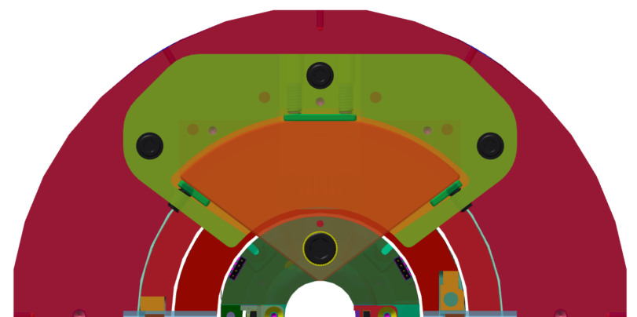
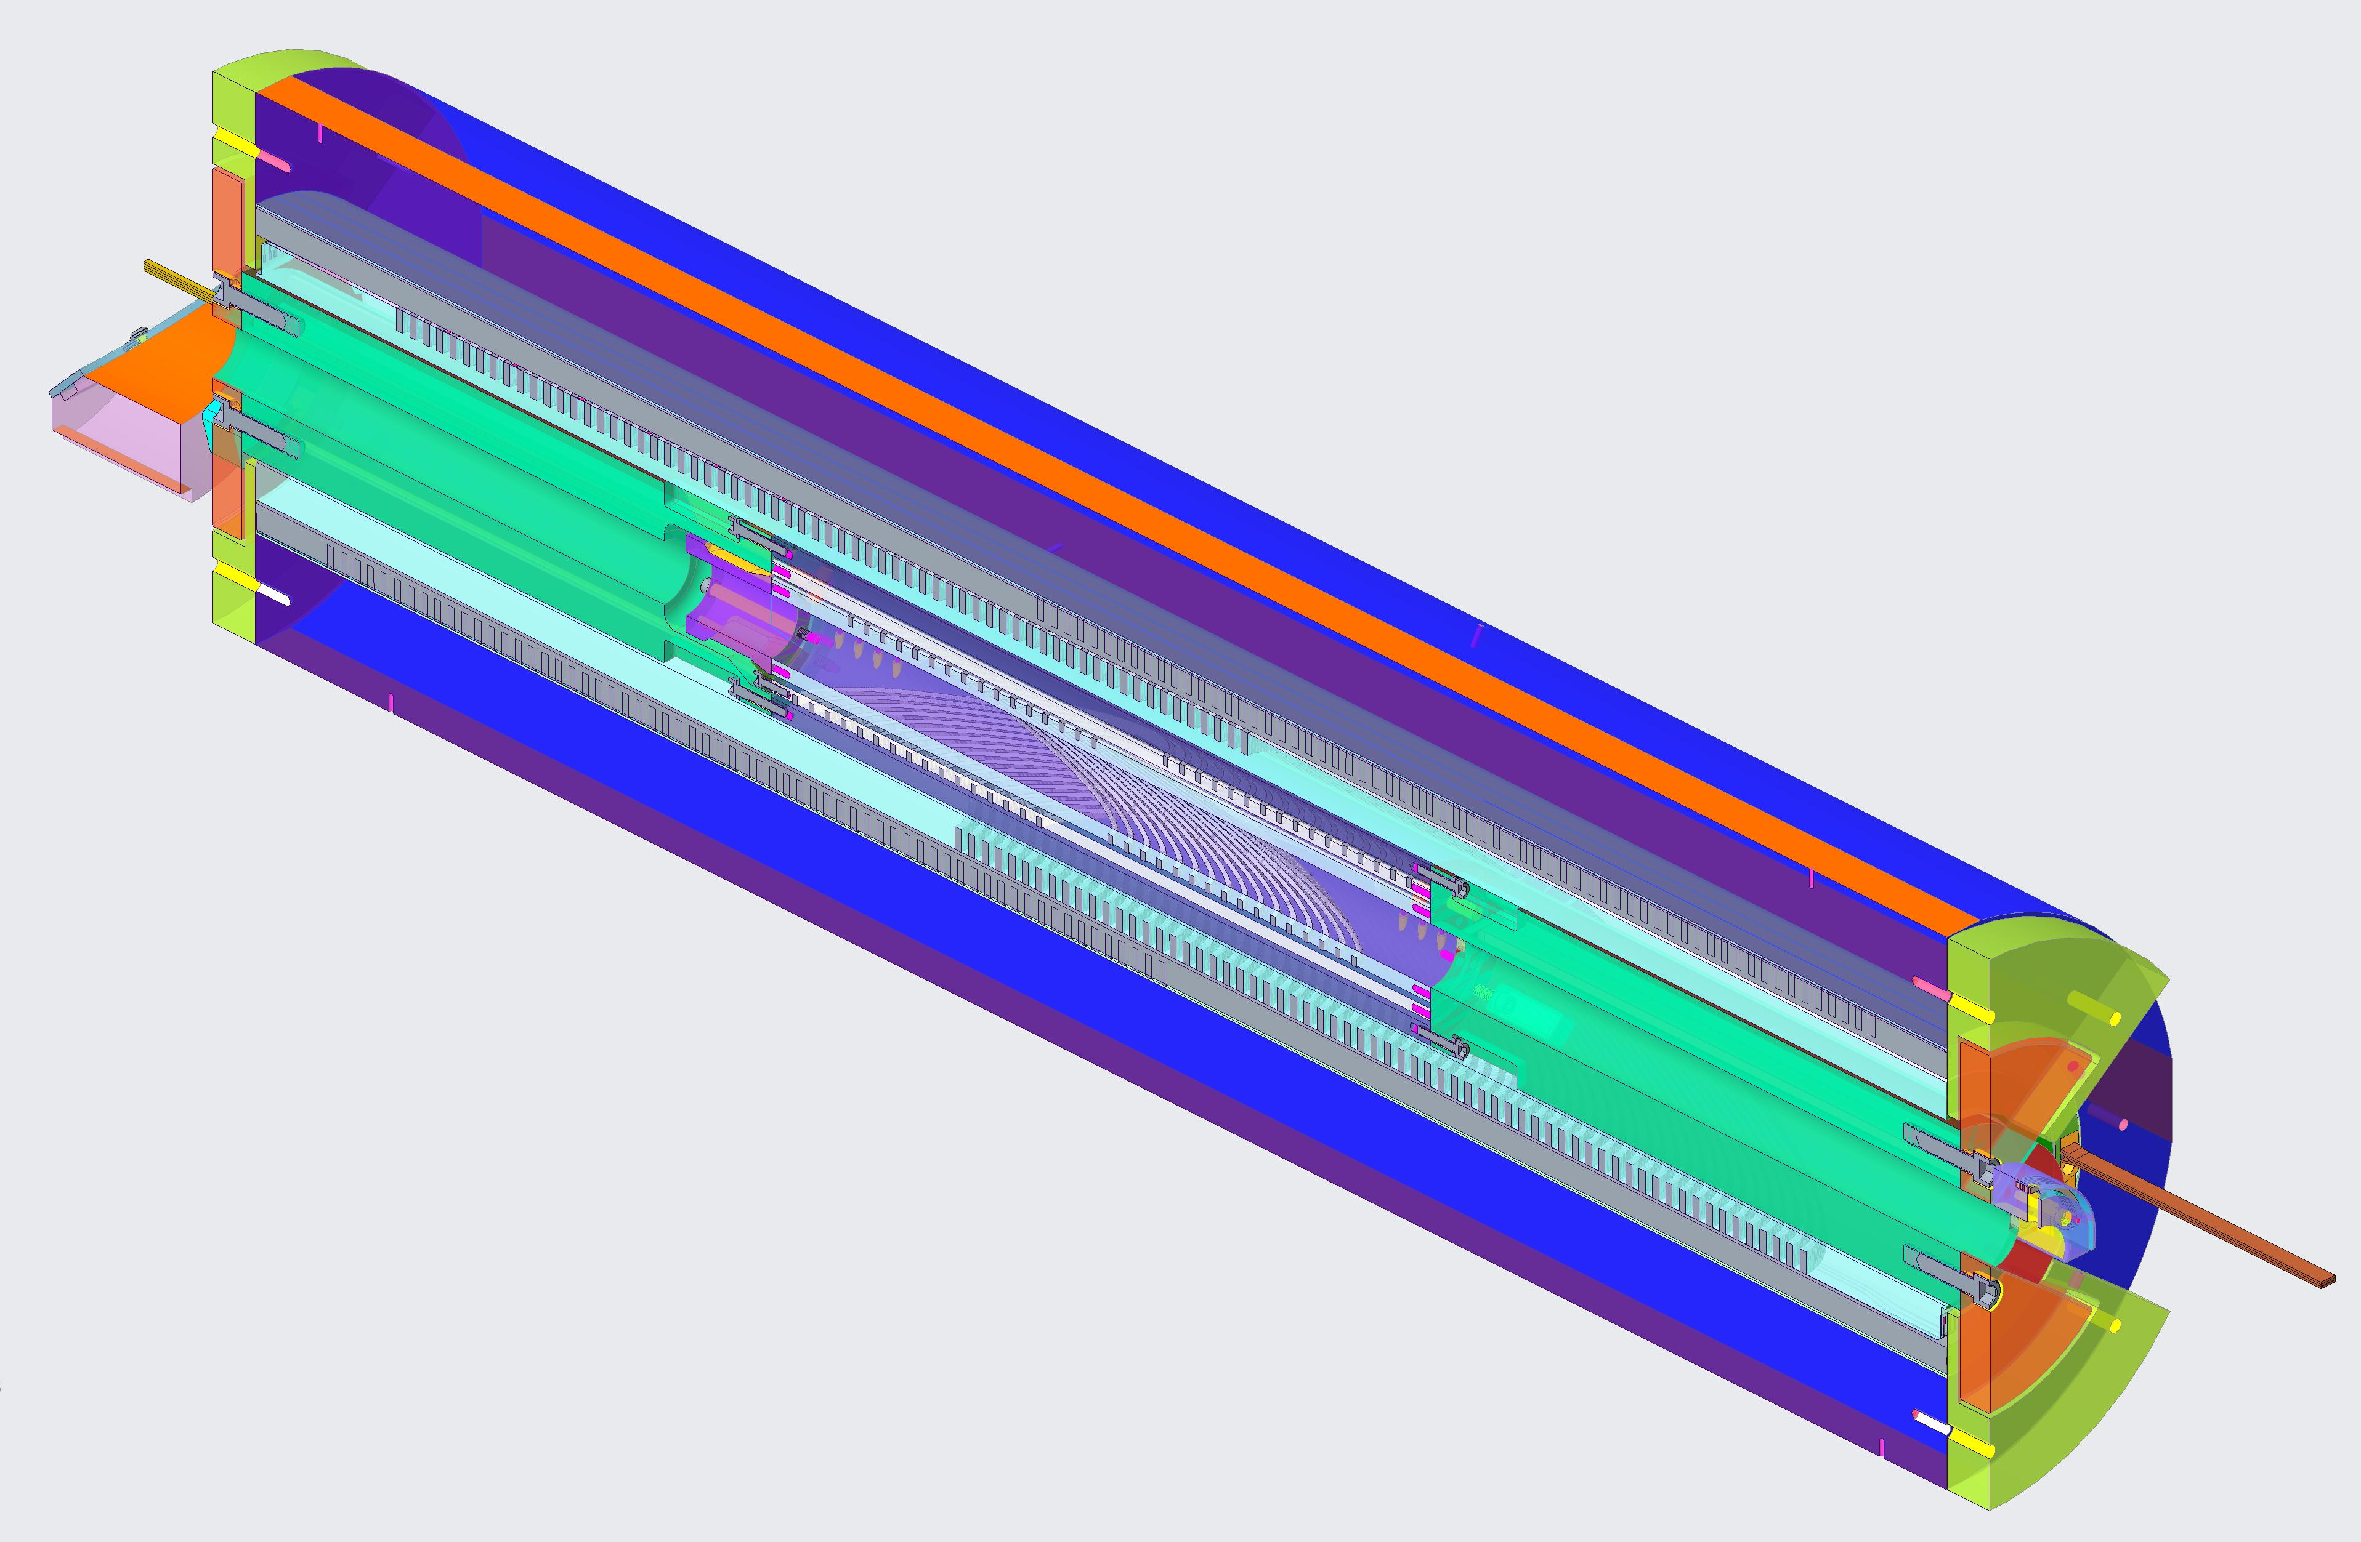
Assembly/alignment challenges due to the short length of the insert
Set screws for azimuthal alignment of BIN5c and CCT5
Effective size of the heat treatment furnace
Example of BIN5c inside CCT5
End plates electrically isolated from each other are used to align the magnets azimuthally
Need additional structure for the insert to match the length of the outsert and ease the axial and azimuthal alignment between the magnets
Insert’s longitudinal size limitation
Assembly/alignment of the insert inside the outsert
Extension aluminum tubes bolted to the shell of the insert. These extensions will carry the leads of the insert to the lead end and return end of the magnet, as well as the voltage tap wires
Note: A future insert magnet, BiCCT2, is planned not to have a shell. In this case an option is the have extension tubes bolted to the mandrels and made of aluminum-bronze 954)
Note: Since the mandrels of the coils are made of aluminum-bronze 954 and the shells are made of aluminum, stress-relieve cavities are cut in the yellow plates and in the extension tubes in order to avoid compressing the coils axially during cooldown
The magnets are mechanically decoupled
CAD models by A. Hafalia

Slide 6
Force-handling challenges due to the short length of the insert
Effective size of the heat treatment furnace
Example of BIN5c inside CCT5
When the insert and the outsert are aligned with respect to each other, there is a torque about the x-axis in each magnet with opposite direction that needs to be handled.
In addition, the axial and azimuthal misalignments during the assembly process introduce small force components that also need to be handled.
Insert’s longitudinal size limitation
The six 10-24 bolts that attach the aluminum extension tube to the aluminum shell on each side of the insert handle most of the torque
Handling forces between the insert and the outsert
Note: In CCT5/BIN5c: Tx~800 Nm, whereas in CCT6/BiCCT1 is ~10 times larger. As we go higher in magnetic field/forces, the torque is more difficult to handle with bolts.
CAD models by A. Hafalia

Slide 7
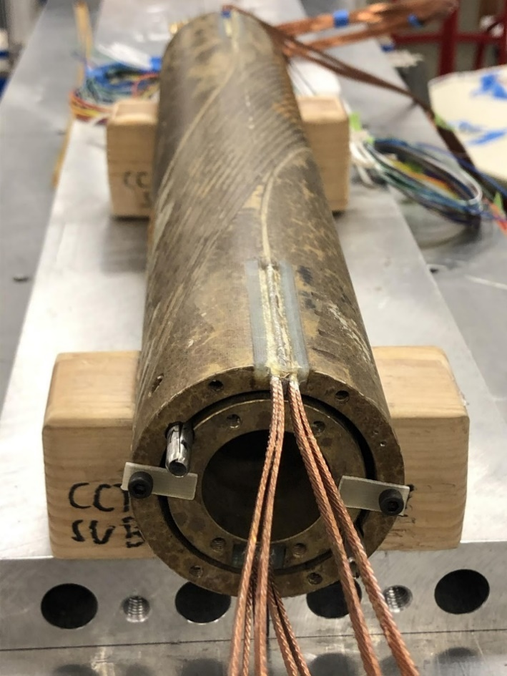
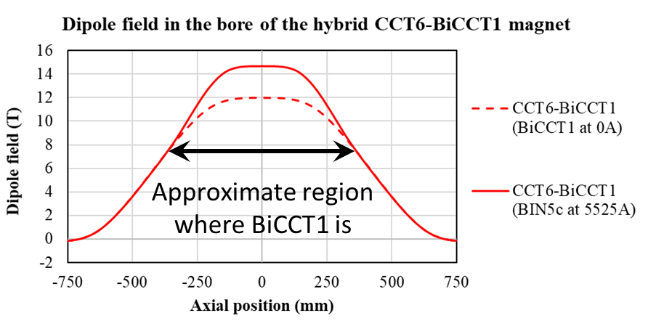
Splice design challenges and added fabrication complexity due to the short length of the insert
Dipole field in the bore
(BIN5c at 65% of its SSL)
Effective size of the heat treatment furnace
Example: CCT5/BIN5c
Splices consist of two pairs of Nb-Ti cables sandwiching the Bi-2212 cable
Insert’s longitudinal size limitation
Being the insert shorter than the outsert, its the splices lay in a high background field region.
Therefore, additional complexity is added to the design and fabrication process of the insert
Example: CCT6/Bi-CCT1
Splices will consist of a section of Nb₃Sn cables spanning from the ~8T to the ~6T background field region, soldered to the Bi-2212 cables, and then Nb-Ti cables soldered to the Nb₃Sn cables.
The Nb₃Sn cables will need heat treatment and structural support, which will add length to the insert for the standalone test (more LHe needed)
Splices of the insert located in the high field region of the outsert

Slide 8
Overpressure processing furnace development
Conclusion #1:
Increasing the effective length of the overpressure processing (OP) furnace would help reduce the complexity of the Bi-2212 inserts
Note:
Since the heat treatment of the Bi-2212 coils is one of the slow-steps in our fabrication process, having several furnaces available for OP would reduce the turnaround time (increase the number of reaction facilities)

Slide 9
Design challenges of Bi-2212 CCT inserts for a hybrid test
Effective size of the heat treatment furnace
Nb₃Sn outsert bore size
Bi-2212 strand Je
Diameter: 120 mm
Insert’s longitudinal size limitation
Insert’s radial size limitation
Magnetic field generation
Structural support for stress management
Assembly/alignment of the insert inside the outsert
Handling forces between the insert and the outsert
Splices of the insert located in the high field region of the outsert

Slide 10
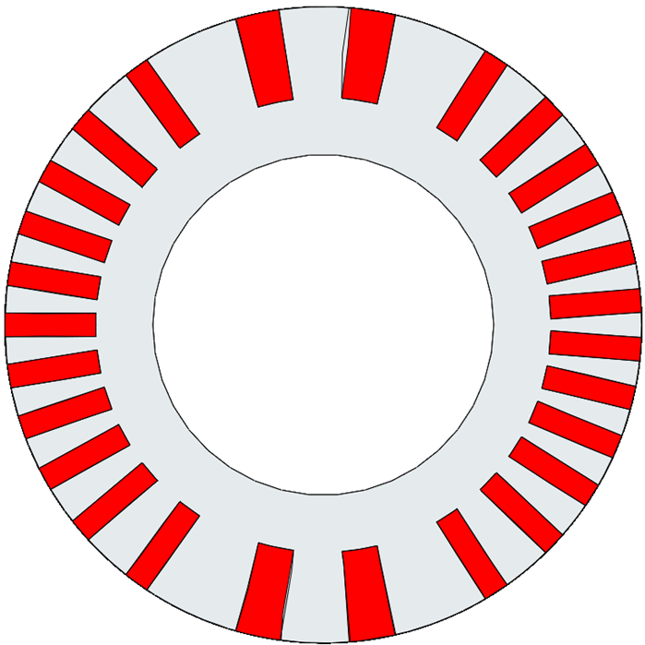
Limitation in the outer diameter of the insert and challenges to manage the stress in a hybrid magnet configuration
There is a limit regarding how close the turns can be in the mandrel, and is given by the minimum rib thickness (located at the midplane). The thicker, the less efficient the coil
Nb₃Sn outsert bore size
Radial increase of the rib thickness
In a CCT magnet there is a minimum of two layers. There is a need for radial space for:
Bore
Spar of each layer
Insulated conductor of each layer
Gap between the layers
Shell (maybe)
Gap between the outer layer and the shell (maybe)
Gap between the shell (or the outer layer) and the bore of the outsert
Ribs
Insert’s radial size limitation
Turns
(Insulated Rutherford cable)
Mid-plane
Spar
Structural support for stress management

Slide 11
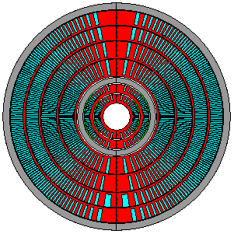
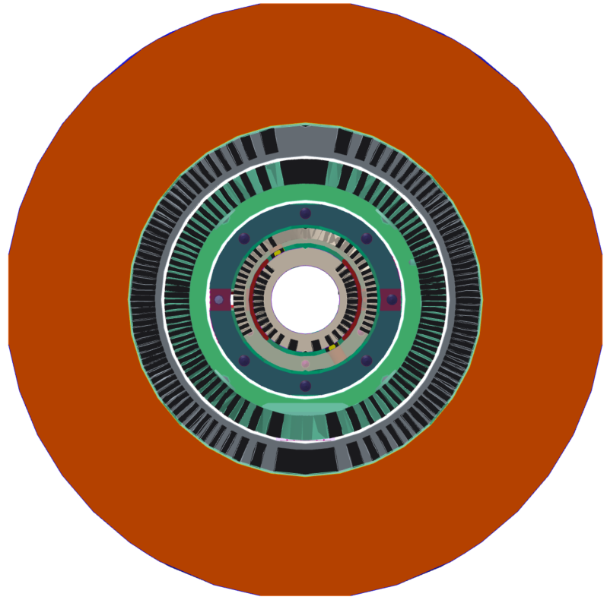
Limitation in the outer diameter of the insert and challenges to manage the stress in a hybrid magnet configuration
The insert magnet (including the shell) needs to fit in the outert
CCT6/BiCCT1 hybrid dipole magnet
Bore diameter of CCT6 is 120 mm
Nb₃Sn outsert bore size
Aluminum shell of the outsert
CCT5/BIN5c hybrid dipole magnet
Bore diameter of CCT5 is 90 mm
Aluminum shell of the insert
Insert’s radial size limitation
Structural support for stress management
Layers of the insert
Mechanical coupling needed for CCT6/BiCCT1. Apply prestress to so many layers?
CAD models by A. Hafalia

Slide 12
Structural material research
Conclusion #2:
Investigating materials for the mandrels that are stronger than aluminum-bronze-954 at cryogenic temperatures, compatible with the Bi-2212 heat treatment would help with stress management
Notes:
1. We are currently working to test low temperature mechanical properties of 954 Aluminum Bronze after a Bi-2212 heat treatment, and to test 3D printing technology of Ni-alloy based, Inconel CCT mandrels
2. Consider increasing the bore size of the outsert in the future? (Currently our insert design has a 40 mm bore)

Slide 13
Limitation in the outer diameter of the insert and influence on the magnetic field generation
Nb₃Sn outsert bore size
Radial increase of the rib thickness
The wider the cable the higher the field generation in the bore, but this would increase the radial space needed for conductor
Note: The wider the cable the less efficient the coil as well
Ribs
Turns
Insert’s radial size limitation
Mid-plane
Spar
Magnetic field generation

Slide 14
Design challenges of Bi-2212 CCT inserts for a hybrid test
Effective size of the heat treatment furnace
Nb₃Sn outsert bore size
Bi-2212 strand Je
Insert’s longitudinal size limitation
Insert’s radial size limitation
Magnetic field generation
Structural support for stress management
Assembly/alignment of the insert inside the outsert
Handling forces between the insert and the outsert
Splices of the insert located in the high field region of the outsert

Slide 15
Bi-2212 conductor development
Conclusion #3:
Continue conductor development is key for increasing the field generation without increasing the radial size of our coils (See E. Hellstrom’s presentation: “Make 2212 a Routine Long Length Predictable Conductor and Path to a Better Future Conductor”)
Understanding how to decrease Bi-2212 leaks during heat treatment would allow reaching the Bi-2212 conductor’s maximum potential (See D. Davis’ presentation: “Insulation, Leakage, and Potential Solutions”)
Note:
Continue producing longer Bi-2212 wire lengths is also a key factor when considering the future of Bi-2212 for accelerator magnets

Slide 16
Other considerations for the hybrid magnet integration
Mechanical coupling: Is necessary. Should we make a single hybrid magnet or make an outsert that can fit several inserts? Does the latter require preloading the magnet every time? (Lorentz forces will be different every time) Would preloading so many layers several time damage the coils?
Quench protection: So far we are considering electrically decoupled configuration ➔ need two independent power circuits). The strategy is to extract the energy of the insert first
Should we consider an electrically coupled option? This would be a hybrid magnets with all coils in series ➔ Nb₃Sn and Bi-2212 conductors should carry the same current (not optimized in terms of conductor)

Slide 17
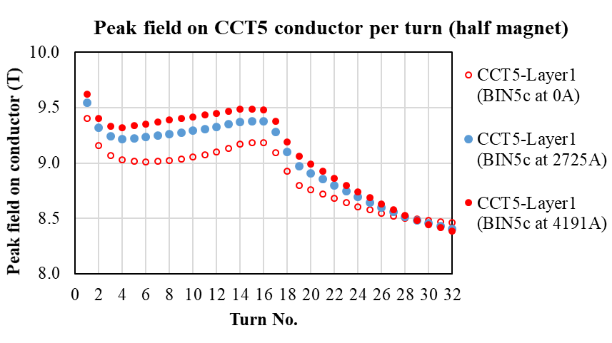
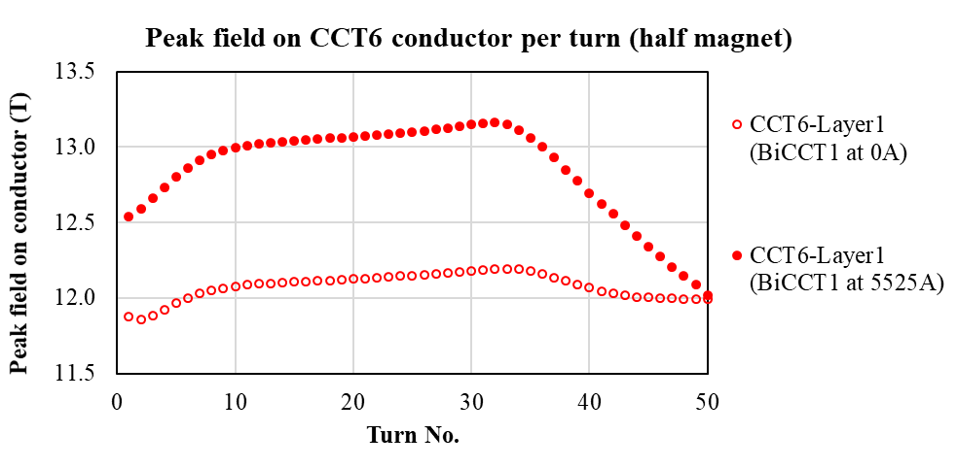
Other considerations for the hybrid magnet integration
Magnetic cross-talk between the insert and the outsert (the closer the coils of the insert to the outsert, the more margin from the loadline would the outsert need) *maybe more problematic in the electrically decoupled configuration
Example CCT5/BIN5c
Example CCT6/BiCCT1
BiCCT1 reduces the margin of CCT6 margin in 4.2%
(BIN5c at 65% of SSL)
(BIN5c at SSL)
(BiCCT1 at SSL)
Middle turn of CCT5
Middle turn of CCT6

