Slide 1
US Magnet Development Program 2023 collaboration meeting
The margin of safety of quench protection of high temperature superconducting magnets
Tengming Shen
Lawrence Berkeley National Laboratory, Berkeley, CA, USA
2023/03/22
With inputs from Dan Wang and Xiaorong Wang
This work was supported by the U.S. Department of Energy, Office of Science, Office of High Energy Physics (HEP) through the US Magnet Development Program under contract No. DE-AC02-05CH11231 and additionally by a US-Japan HEP collaboration between KEK, Kyoto University, Brookhaven National Lab, and LBNL.
We thank our colleagues at LBNL and collaborators at the National High Magnetic Field Lab who help construct magnets used in this study, in particularly Daniel Davis and Laura Garcia Fajardo.

Slide 2
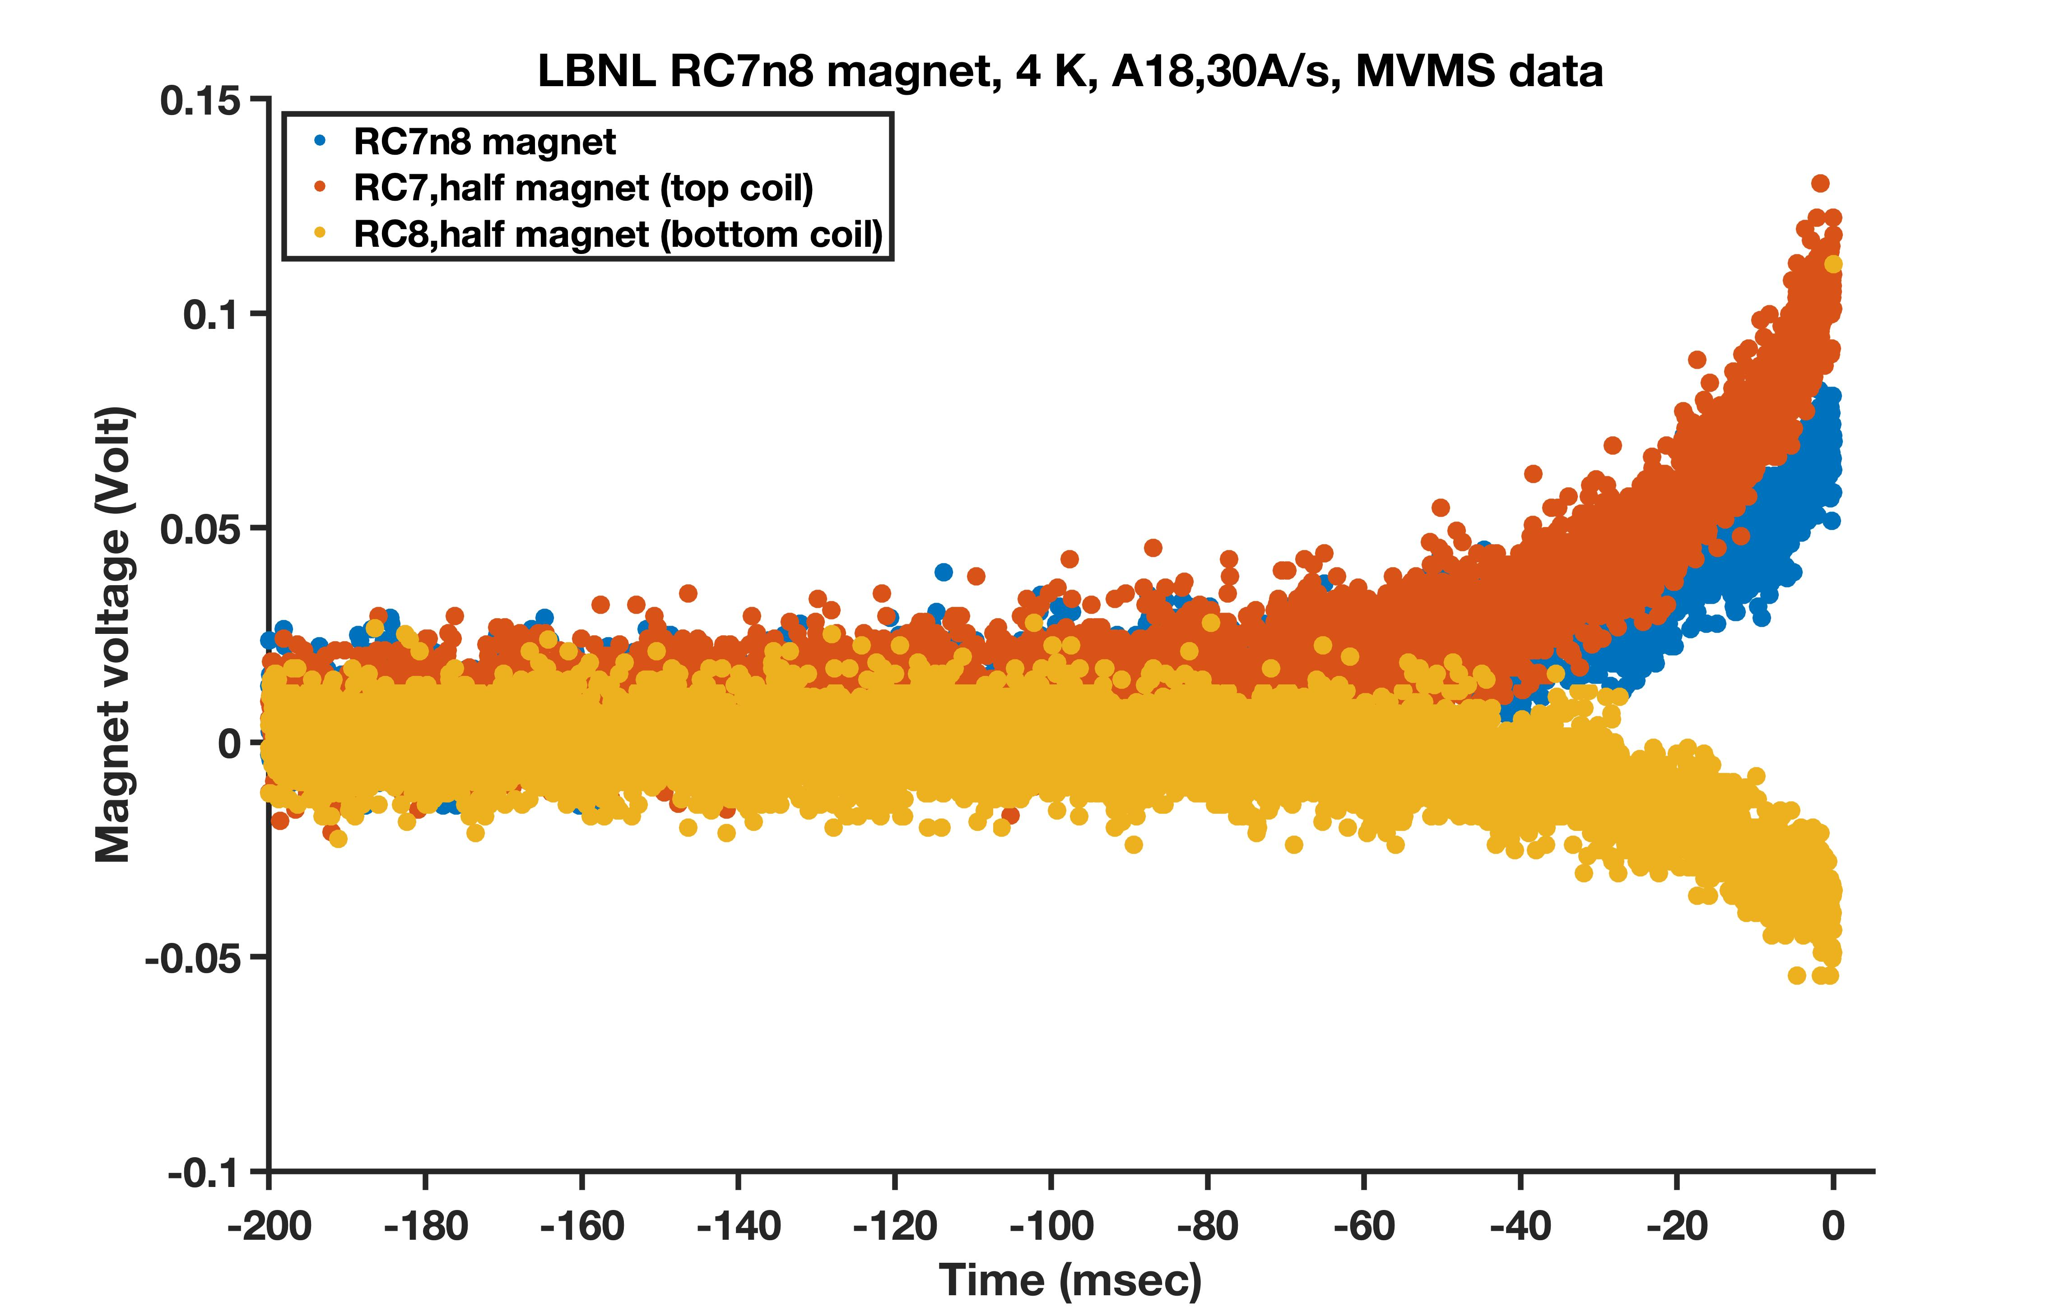
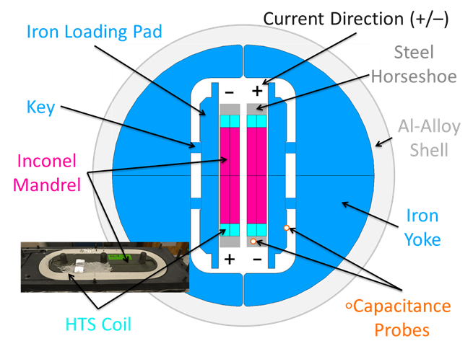
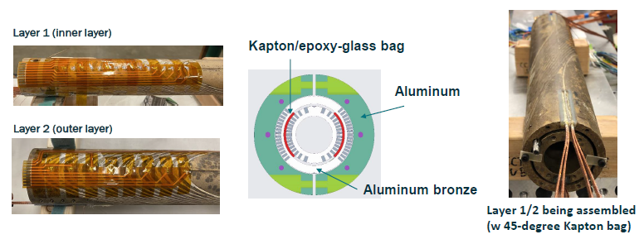
Two magnets, their quench protection, what is the margin of safety for them, how to further improve?
Known and existing: cRIO + FPGA/PXI,
LBNL MTF developed for LTS magnets
RC7n8 is a common-coil HTS (Bi-2212) dipole magnet
I = 5700 A, 4.7 T
BIN5c1 is a canted-cosine-theta
HTS (Bi-2212) dipole magnet.
I = 3600 A, 1.64 T, 3
Magnet voltage (V)
(Graph by Daniel Davis)
Time (ms)
Extraction
(Graph by Ray Hafalia)
RMS noises in 10⁻² V.
Quench detection at 50 – 100 mV.
Notes:
What is the margin of the safety of quench protection of HTS magnets made possible by the existing quench detection method?
How to improve it? What is the key parameter?
What is the limit? Can machine learning help?

Slide 3
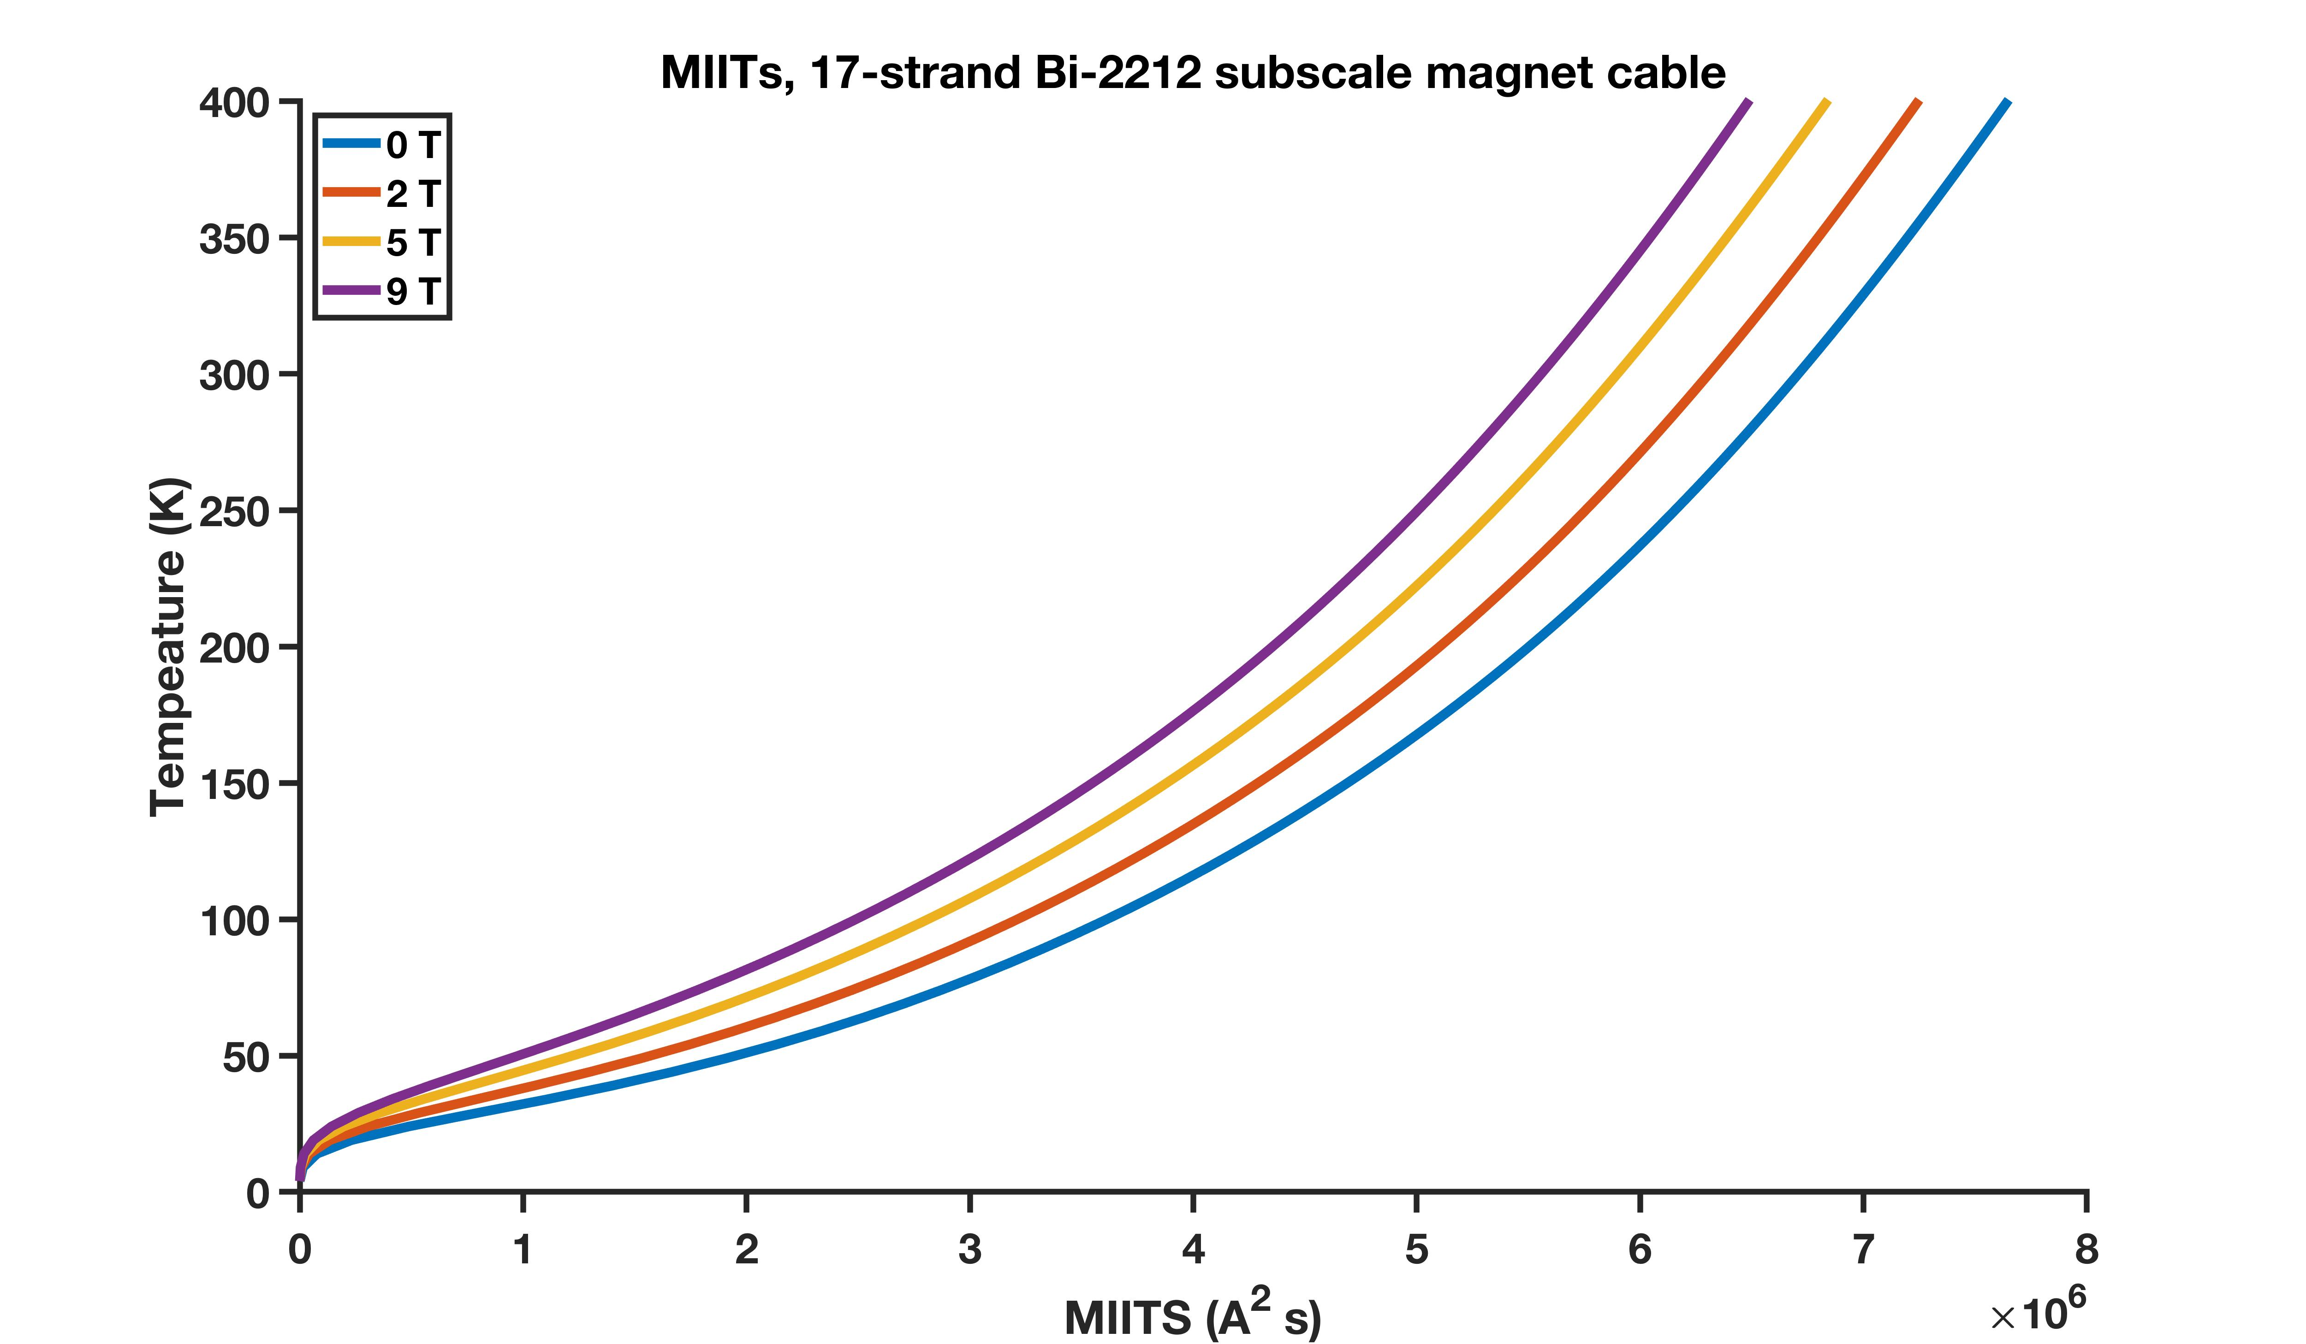
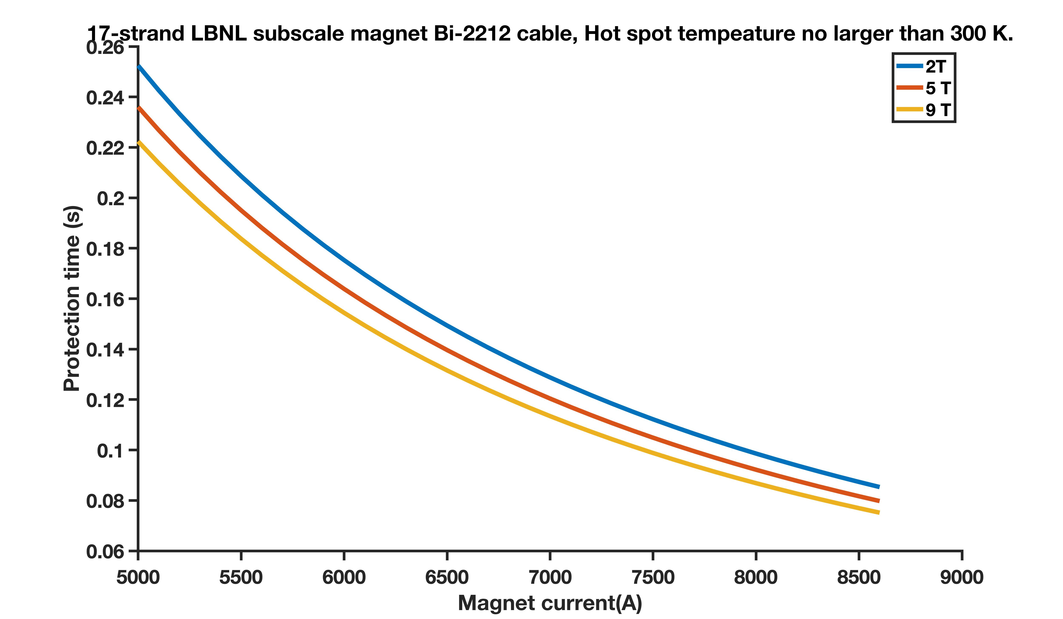
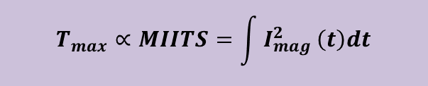
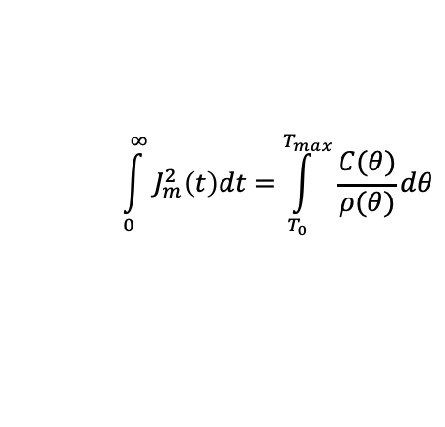
Quench protection and the MIITS method for estimating the margin of safety, applied as if it was a LTS magnet
RC7n8, 4.7 T, 5700 A,
Wire J_{E}=680 A/mm²
t < 180 ms for limit
temperature < 300 K
Temperature (K)
9 T
0 T
Protection time (s)
Magnet current (A²s)
Heat balance in a unit volume
Magnet current (A)
$$\int_{0}^{∞}{J_{m}^{2}\left(t\right)dt}=\int_{T_{0}}^{T_{max}}{\frac{C(θ)}{ρ(θ)}dθ}$$
$$T_{max}∝MIITS=\int{I_{mag}^{2}}\left(t\right)dt$$
Manuscript in preparation.

Slide 4
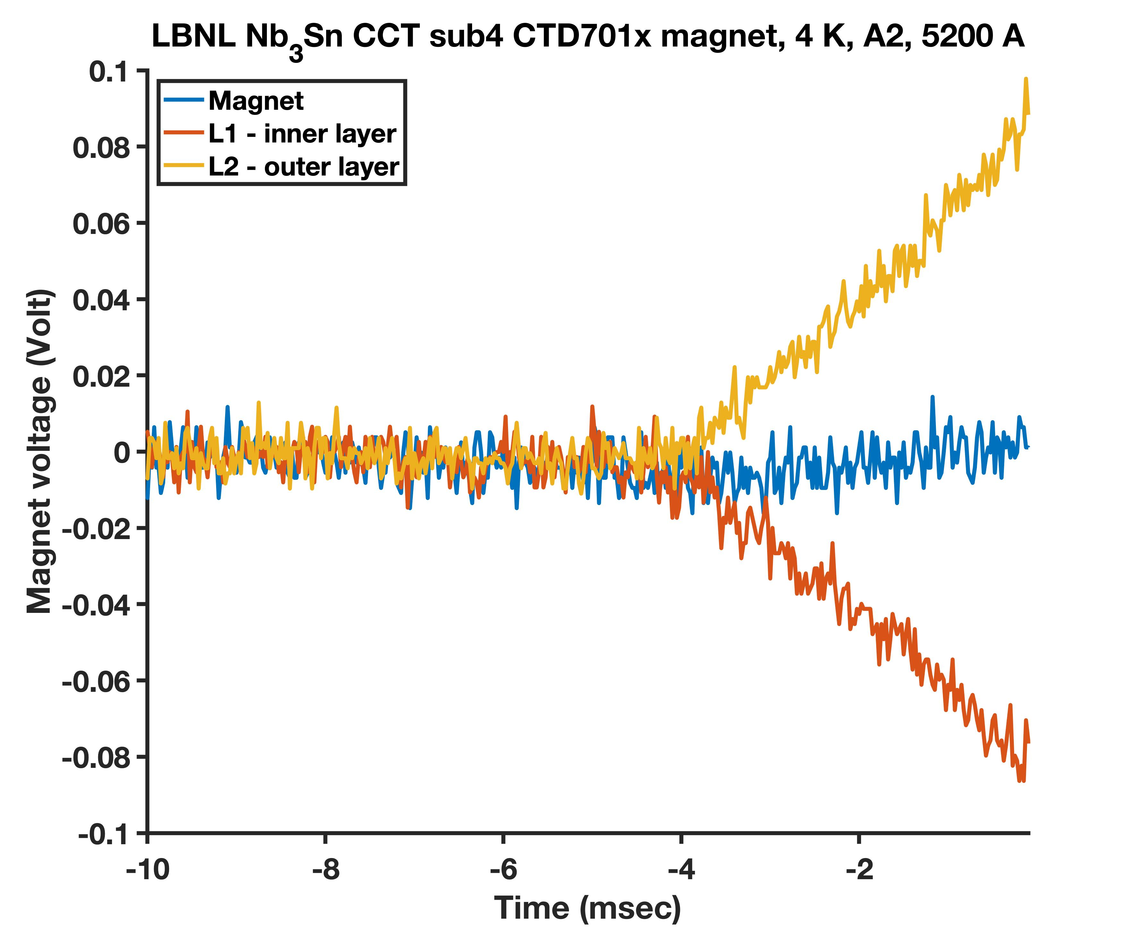
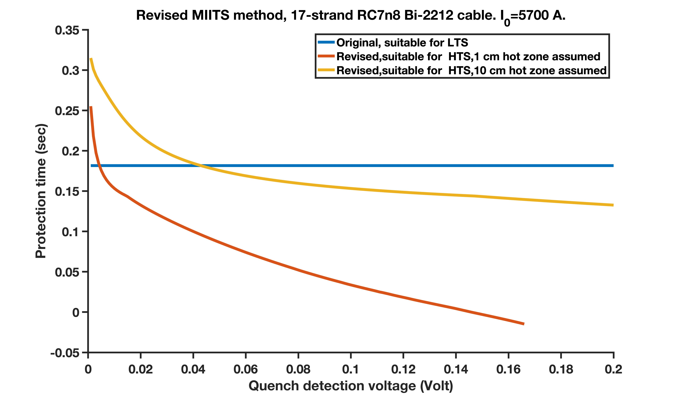
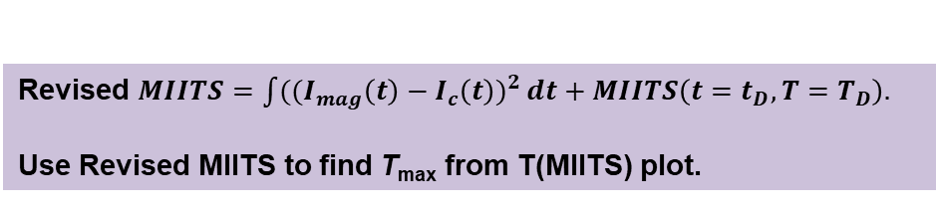
A revised MIITS method for HTS magnets and implications
Revised $MIITS=\int{({(I_{mag}\left(t\right)−I_{c}\left(t\right))}^{2}}dt+MIITS\left(t=t_{D}, T=T_{D}\right).$
Use Revised MIITS to find T_{max} from T(MIITS) plot.
100 mV
LTS - NZPV at 10s m/s.
Protection time (s)
HTS - NZPV at 1s-10s cm/s.
10 cm hot zone assumed.
HTS - NZPV at 1s-10s cm/s.
1 cm hot zone assumed.
Quench detection voltage (V)
4 ms
NZPV = normal zone propagation velocity.
Manuscript in preparation.

Slide 5

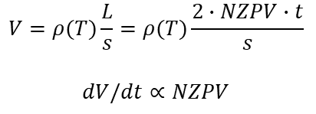

Back to the margin of safety question
LTS – Nb₃Sn CCT in this case.
HTS – Bi-2212 RC7n8 in this case.
$$Stability∝(T_{c}−T_{o})$$
100 mV
$$NZPV∝1/(T_{c}−T_{o})$$
100 mV
$$V=ρ(T)\frac{L}{s}=ρ(T)\frac{2∙NZPV∙t}{s}$$
$dV/dt$ $∝$ $NZPV$
The lack of speed is compensated by a higher
quench detection temperature and a reduced
time for protection and margin of safety.
4 ms
Extraction at t = 0 s.
>40 ms
MIITS/time budget:
MIITS/time budget:
Detection
Protection
Detection
Protection

Slide 6
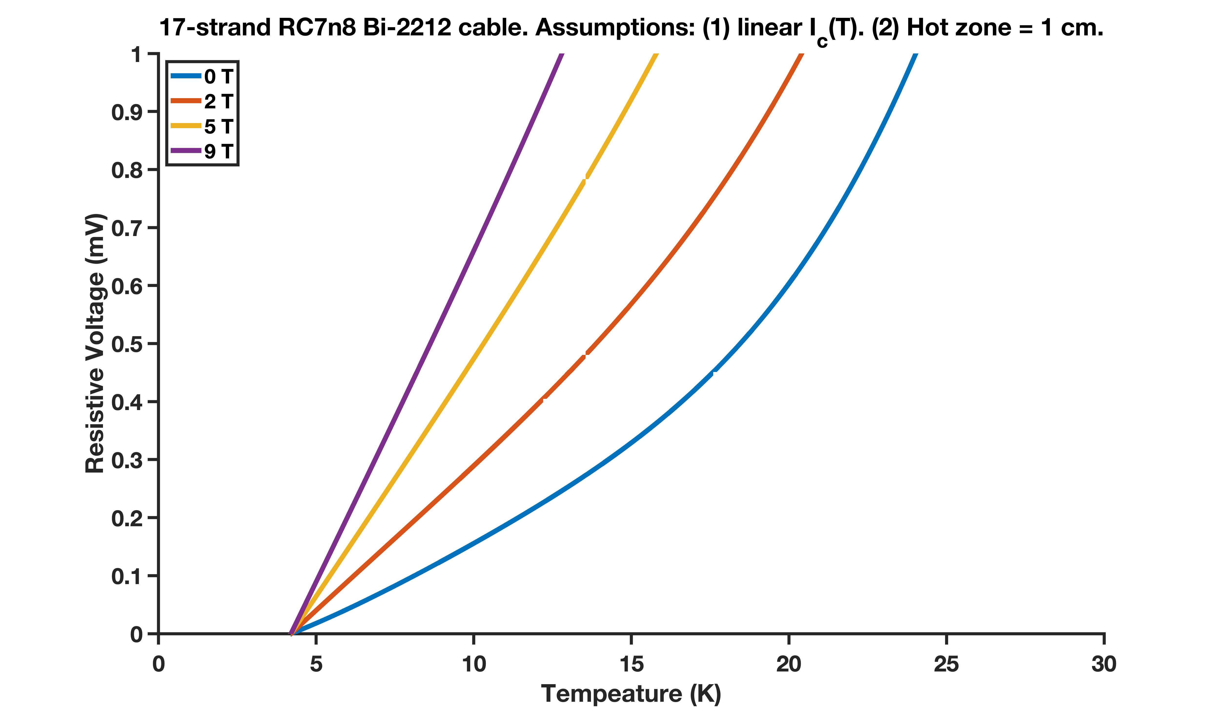
Benefit of early detection – increased margin of safety – the question is how?
RC7n8, experimentally proved,
as large as 2500 ms.
Quench detection at current sharing region.
Quench
detection
made
Resistive voltage (mV)
Increase margin
Protection time (s)
Quench detection starts
Lose margin
Temperature (K)
Quench detection voltage (V)
Manuscript in preparation.
Notes:
More time for protection – this may mean the life and death of HTS magnets.

Slide 7
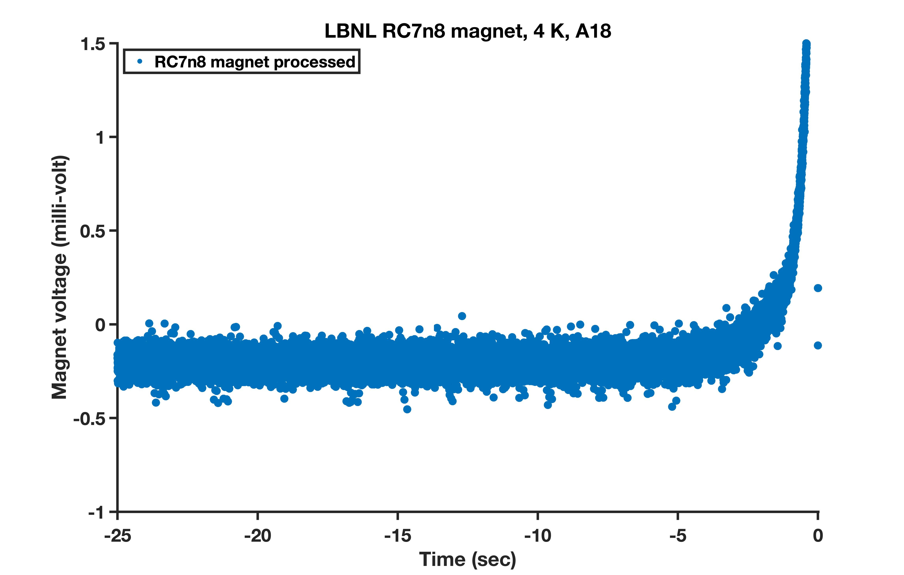
Quench detection of HTS magnets beyond the methods established for LTS magnets – what do we need?
For HTS magnets, human brains can tell that a thermal runaway quench is coming if the magnet current continues to rise.
A fast (discrimination at every 1 ms or smaller) quench detection method capable of reducing the rms noise to 100 μV or less based on real-time digital signal processing algorithms or others simple to implement.
Such method should be reliable and can be implement on a hardware-in-the-loop platform like FPGA.
Such method should work with all magnet operating scenarios including current ramps up and down and holds.
Such method should have a low rate of false alarms.
Such method should be able to raise the margin of safety for protecting HTS magnets against thermal runaway quenches above the dogma established for LTS magnets.
Such method should be verified with practical HTS magnets with local voltage or temperature measurements at or near quench spots.

Slide 8
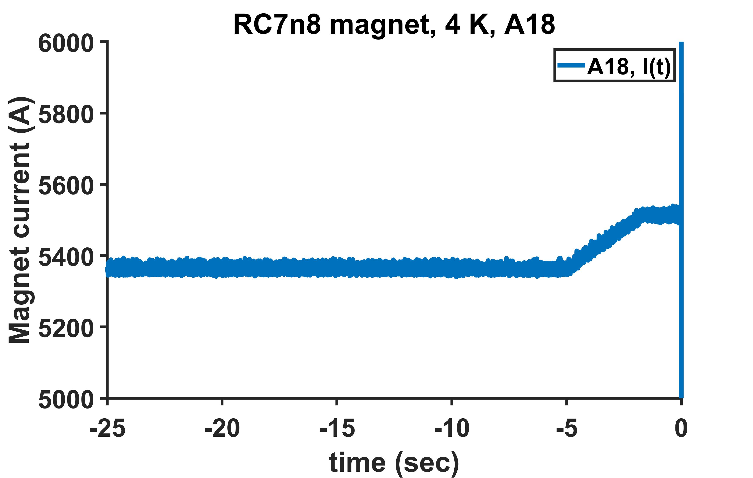
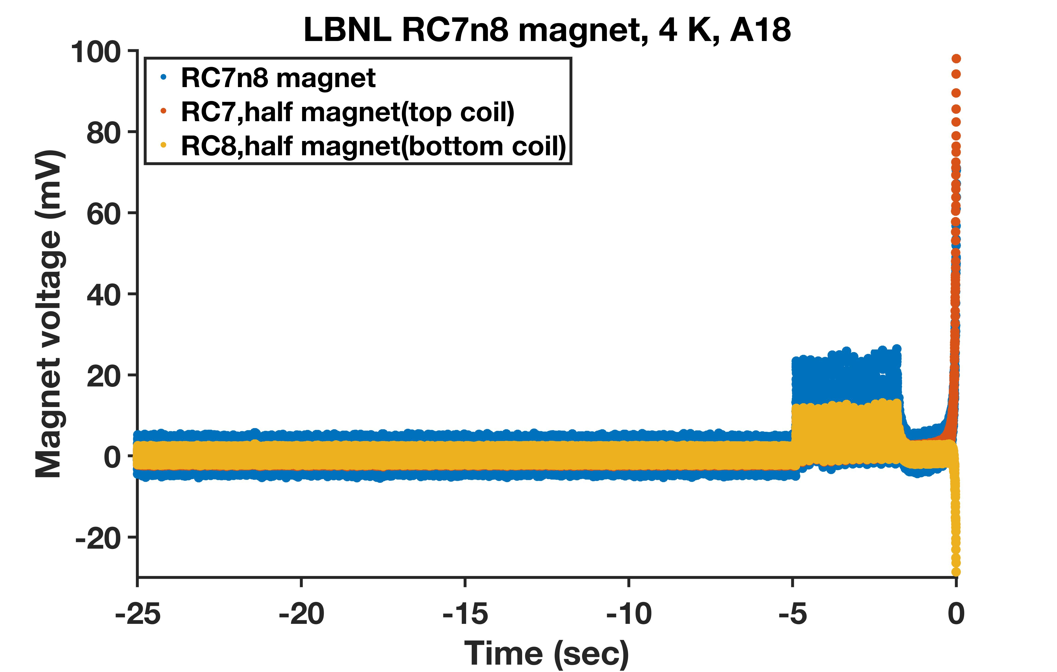
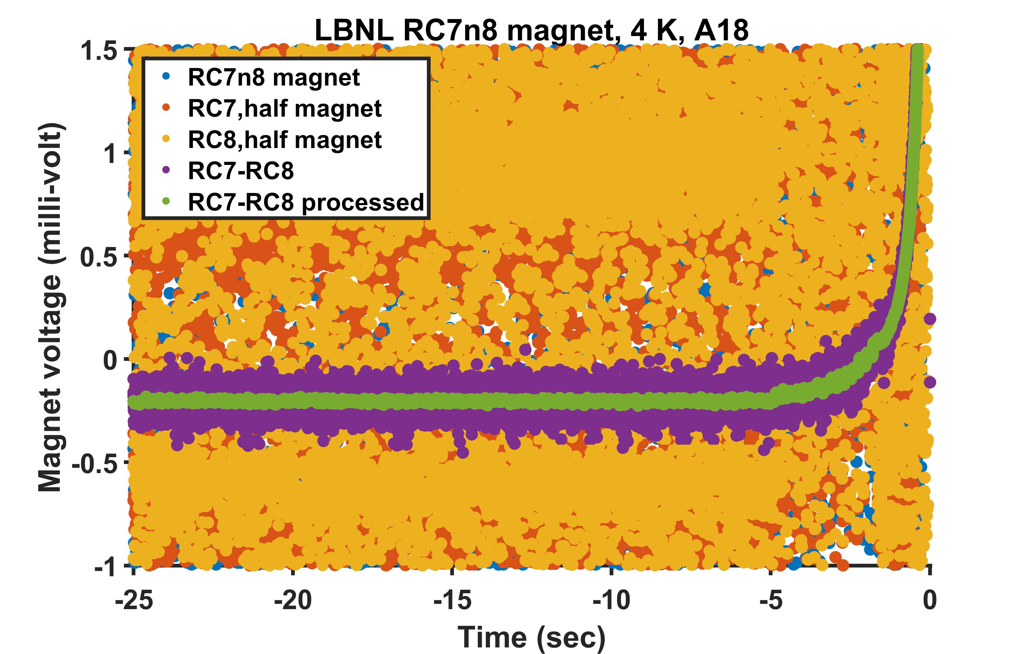
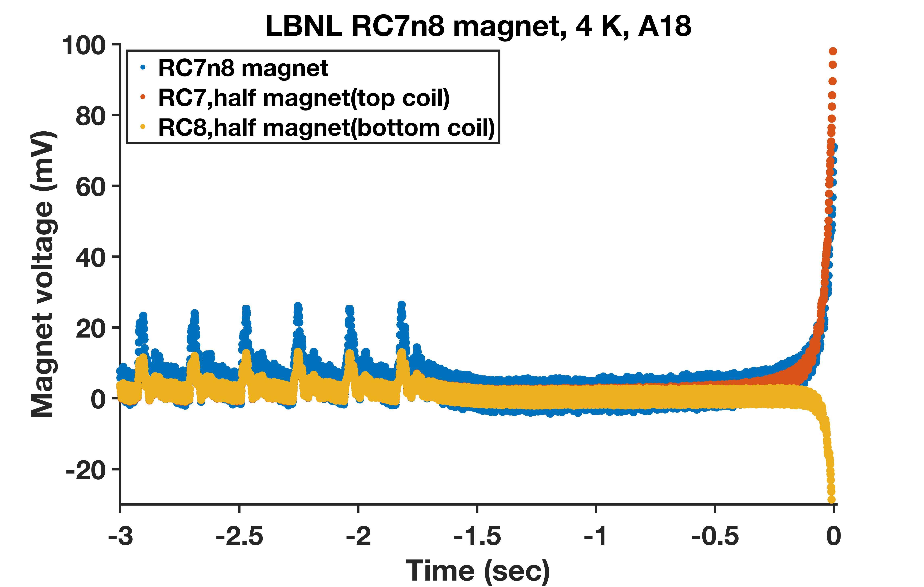
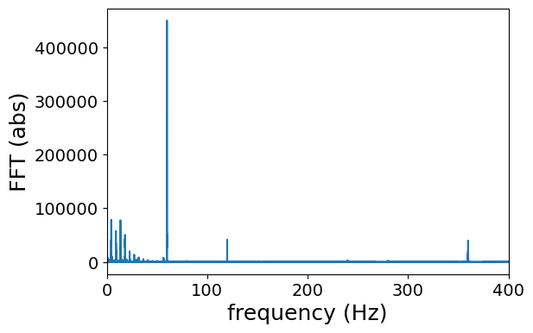
Step #1: Noise spectrum and real time noise reduction applied to a test case A18 of the RC7n8 magnet
Front-end electronics: Programmable gain amplifier and electronics for low-level measurements (signal conditioning) @ 1kHz
Followed by a smart unit: real-time, fast digital signal processing + a simple detection algorithm, and machine learning blocks.
More than conventional QDS: Monitoring and analyzing magnet behaviors, predicting and detecting quenches.
30A/s
@1kHz
@1kHz

Slide 9
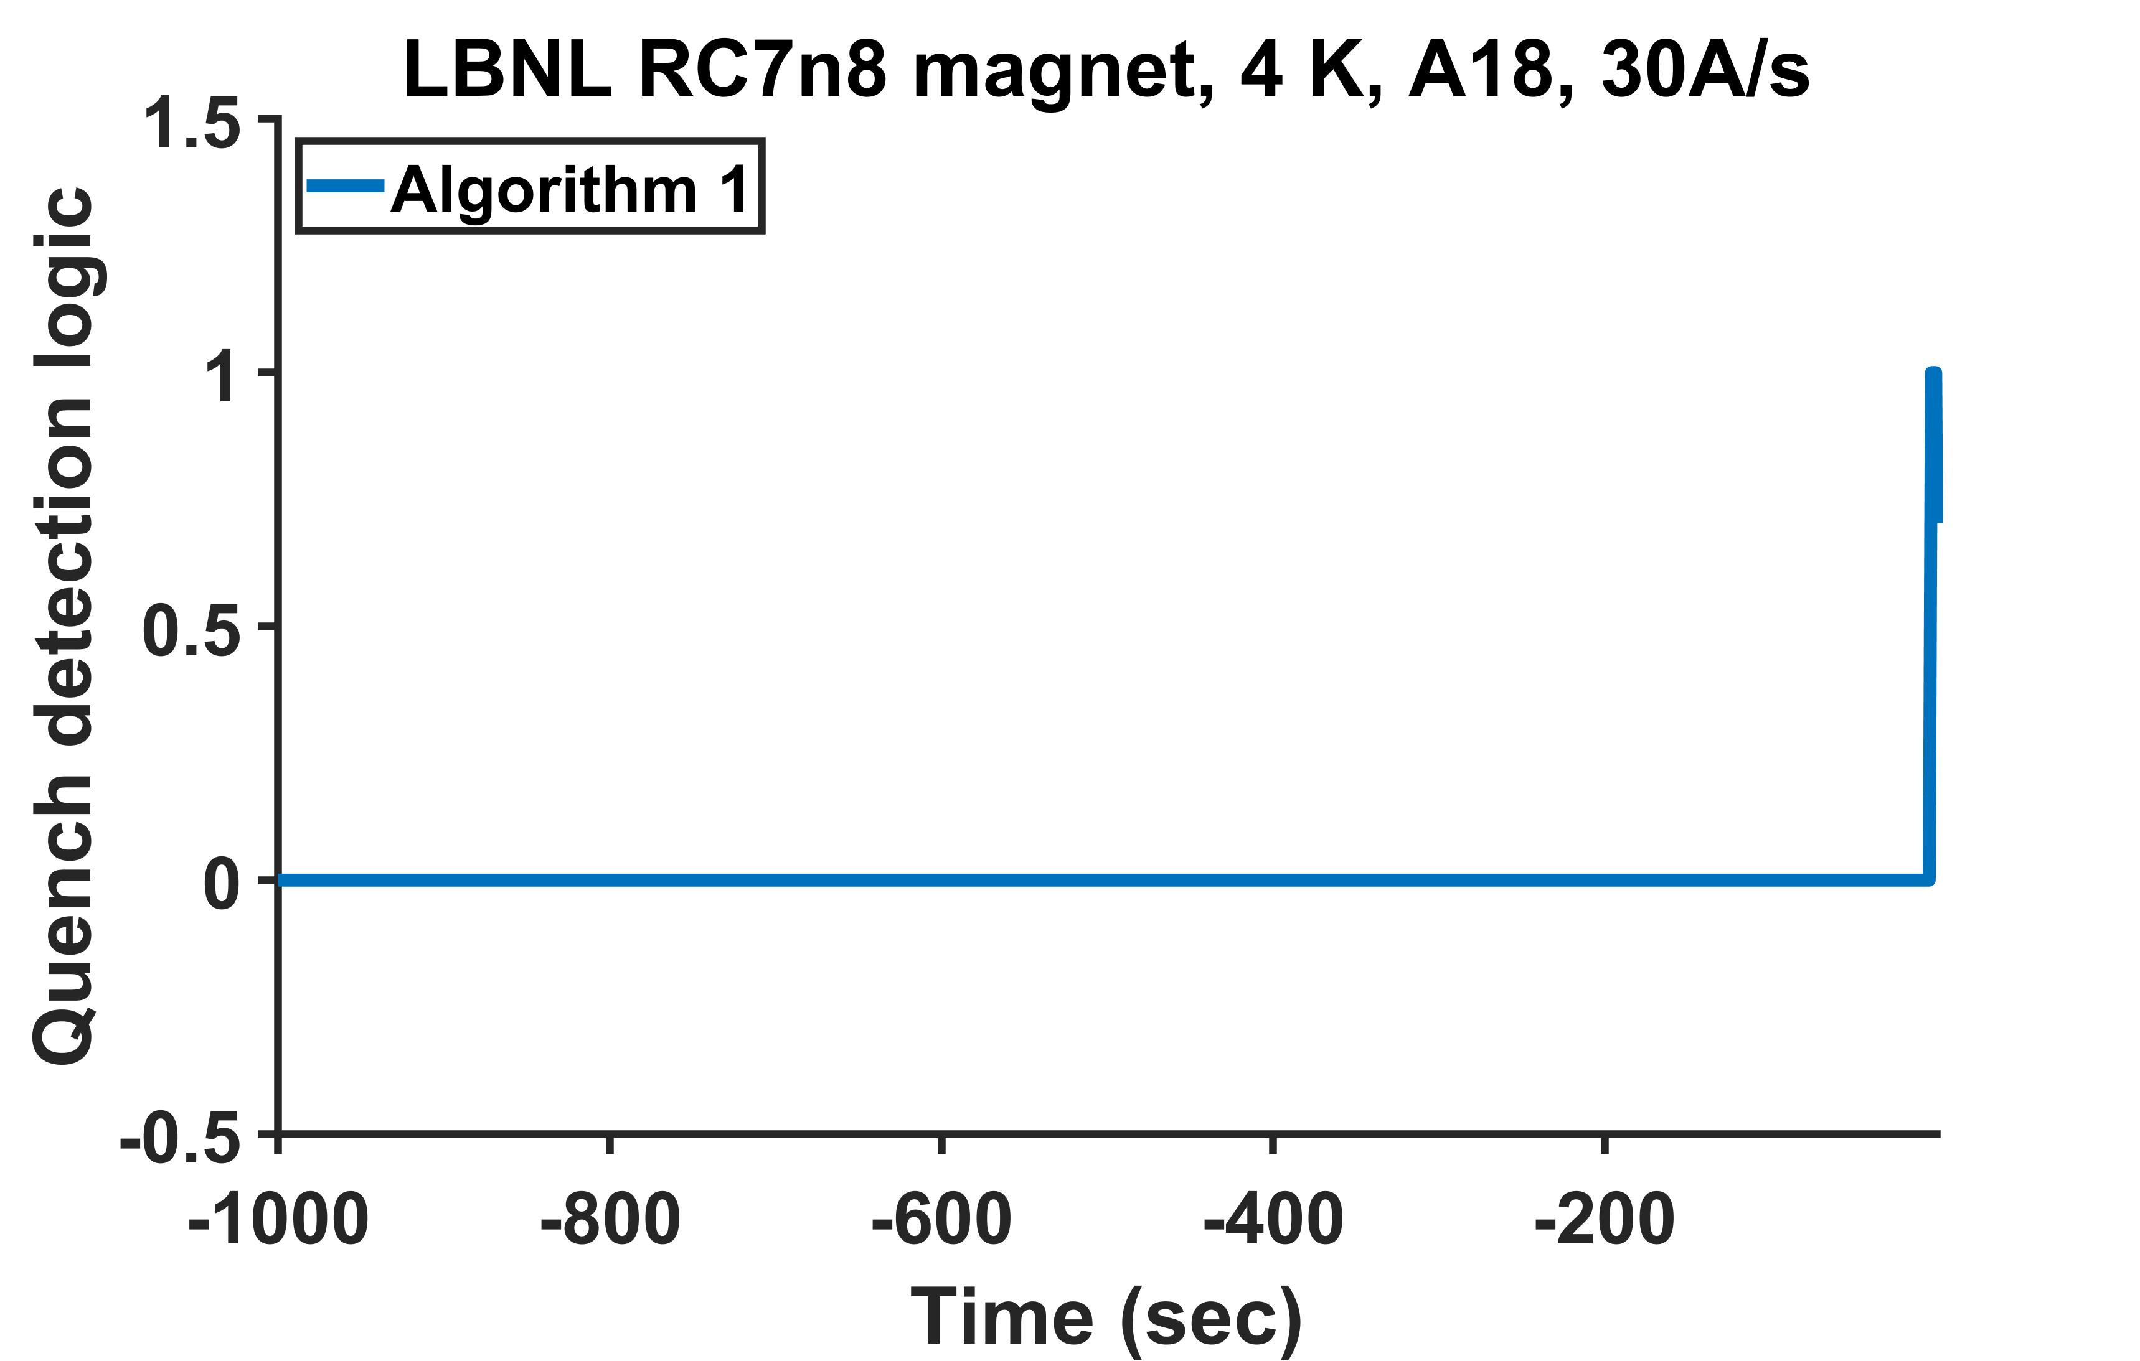
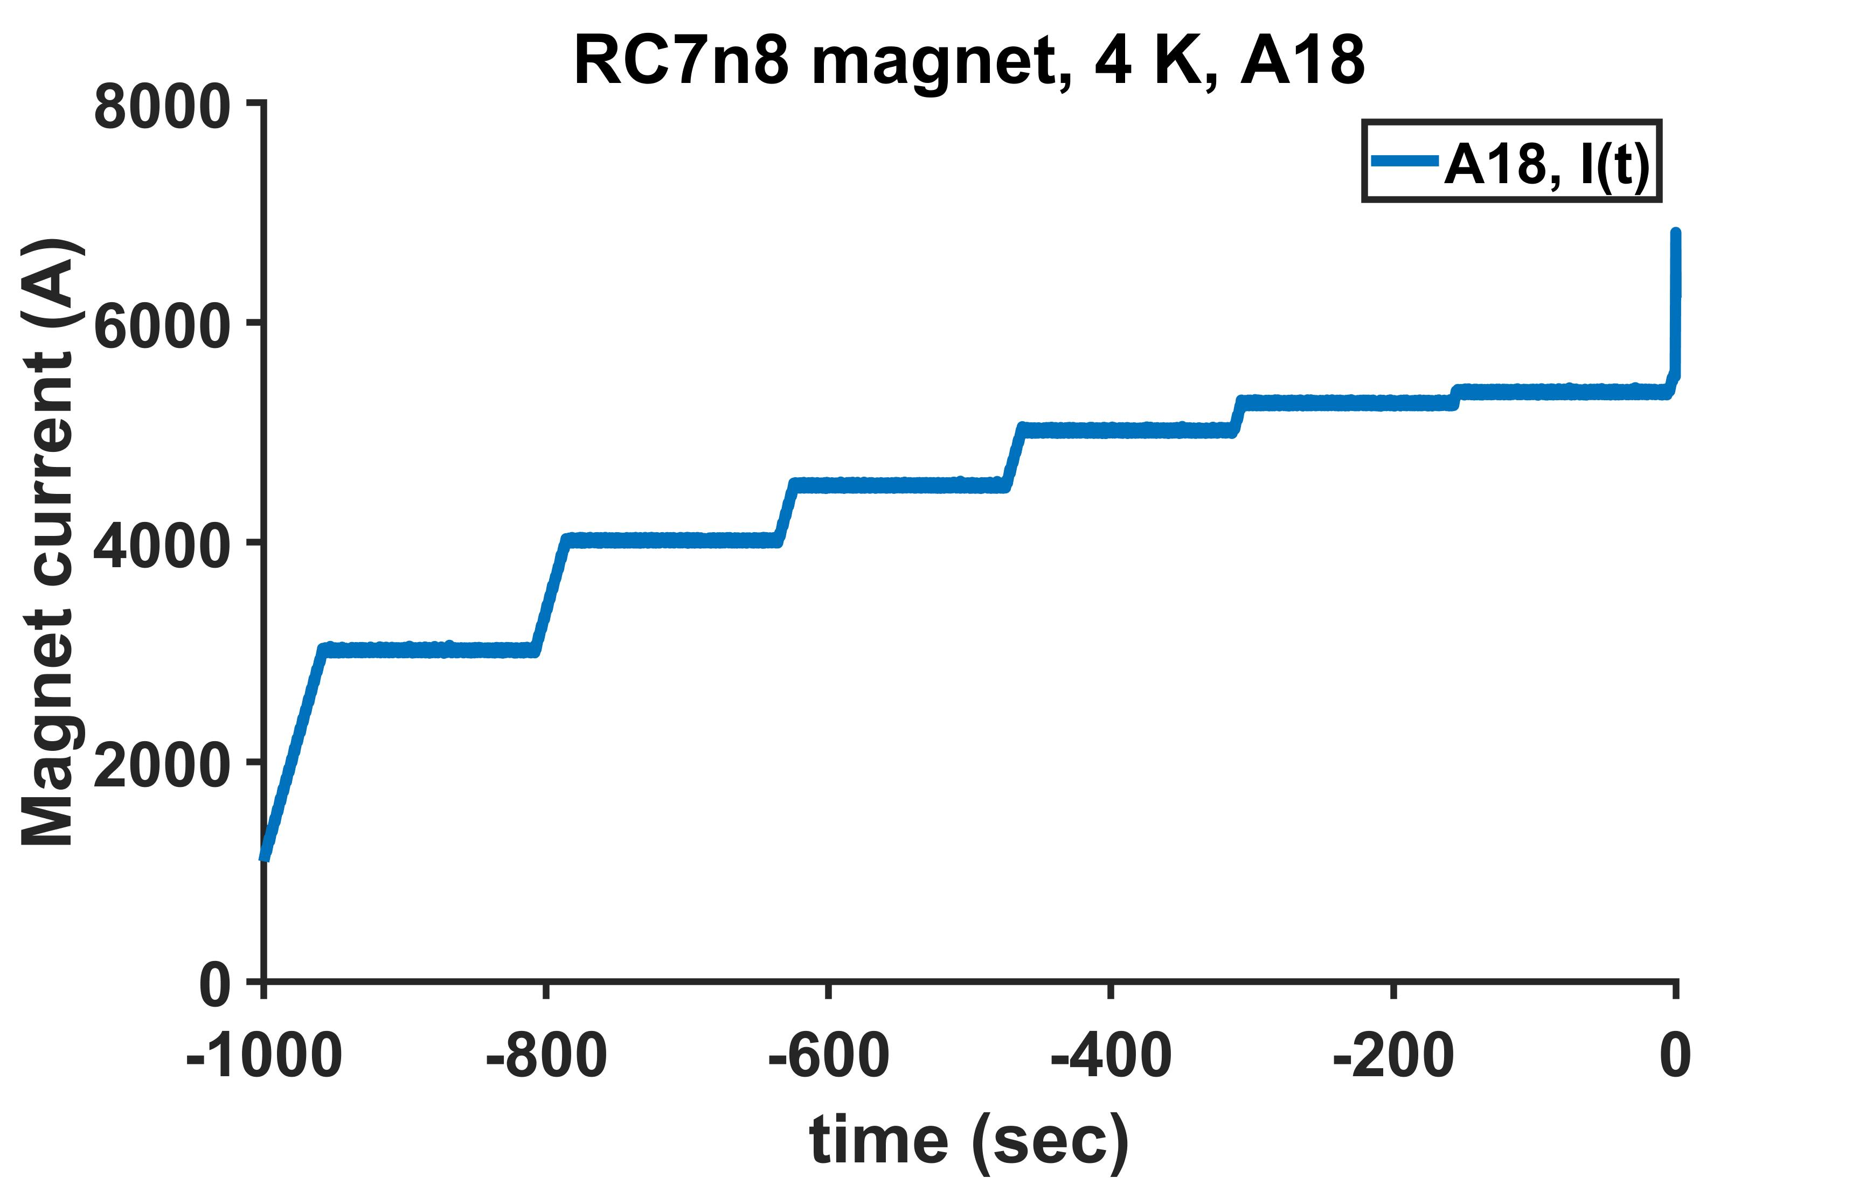
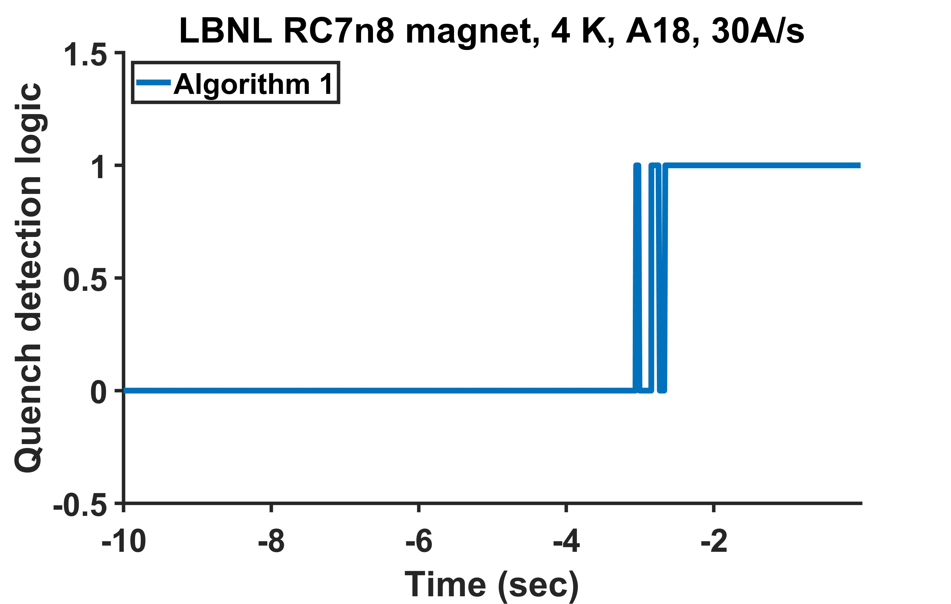
Step #2: Generating quench detection logic with a simple algorithm operating real-time (per ms) on the processed data of A18
No false detection from
-1000 s to -3.096 s
Staircase run with 30A/s ramp rate
No false detection to -3.096 s
No ambiguity after -2.652s
Time = 0 s
SCR opened
Old MIITS predicts 180 ms is what we have.

Slide 10
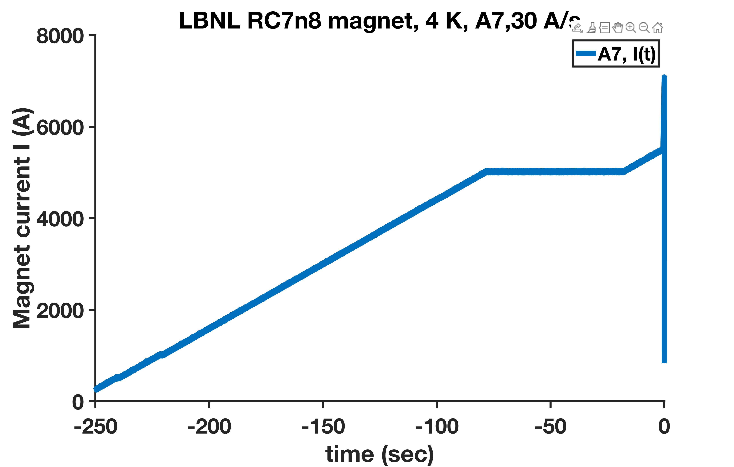
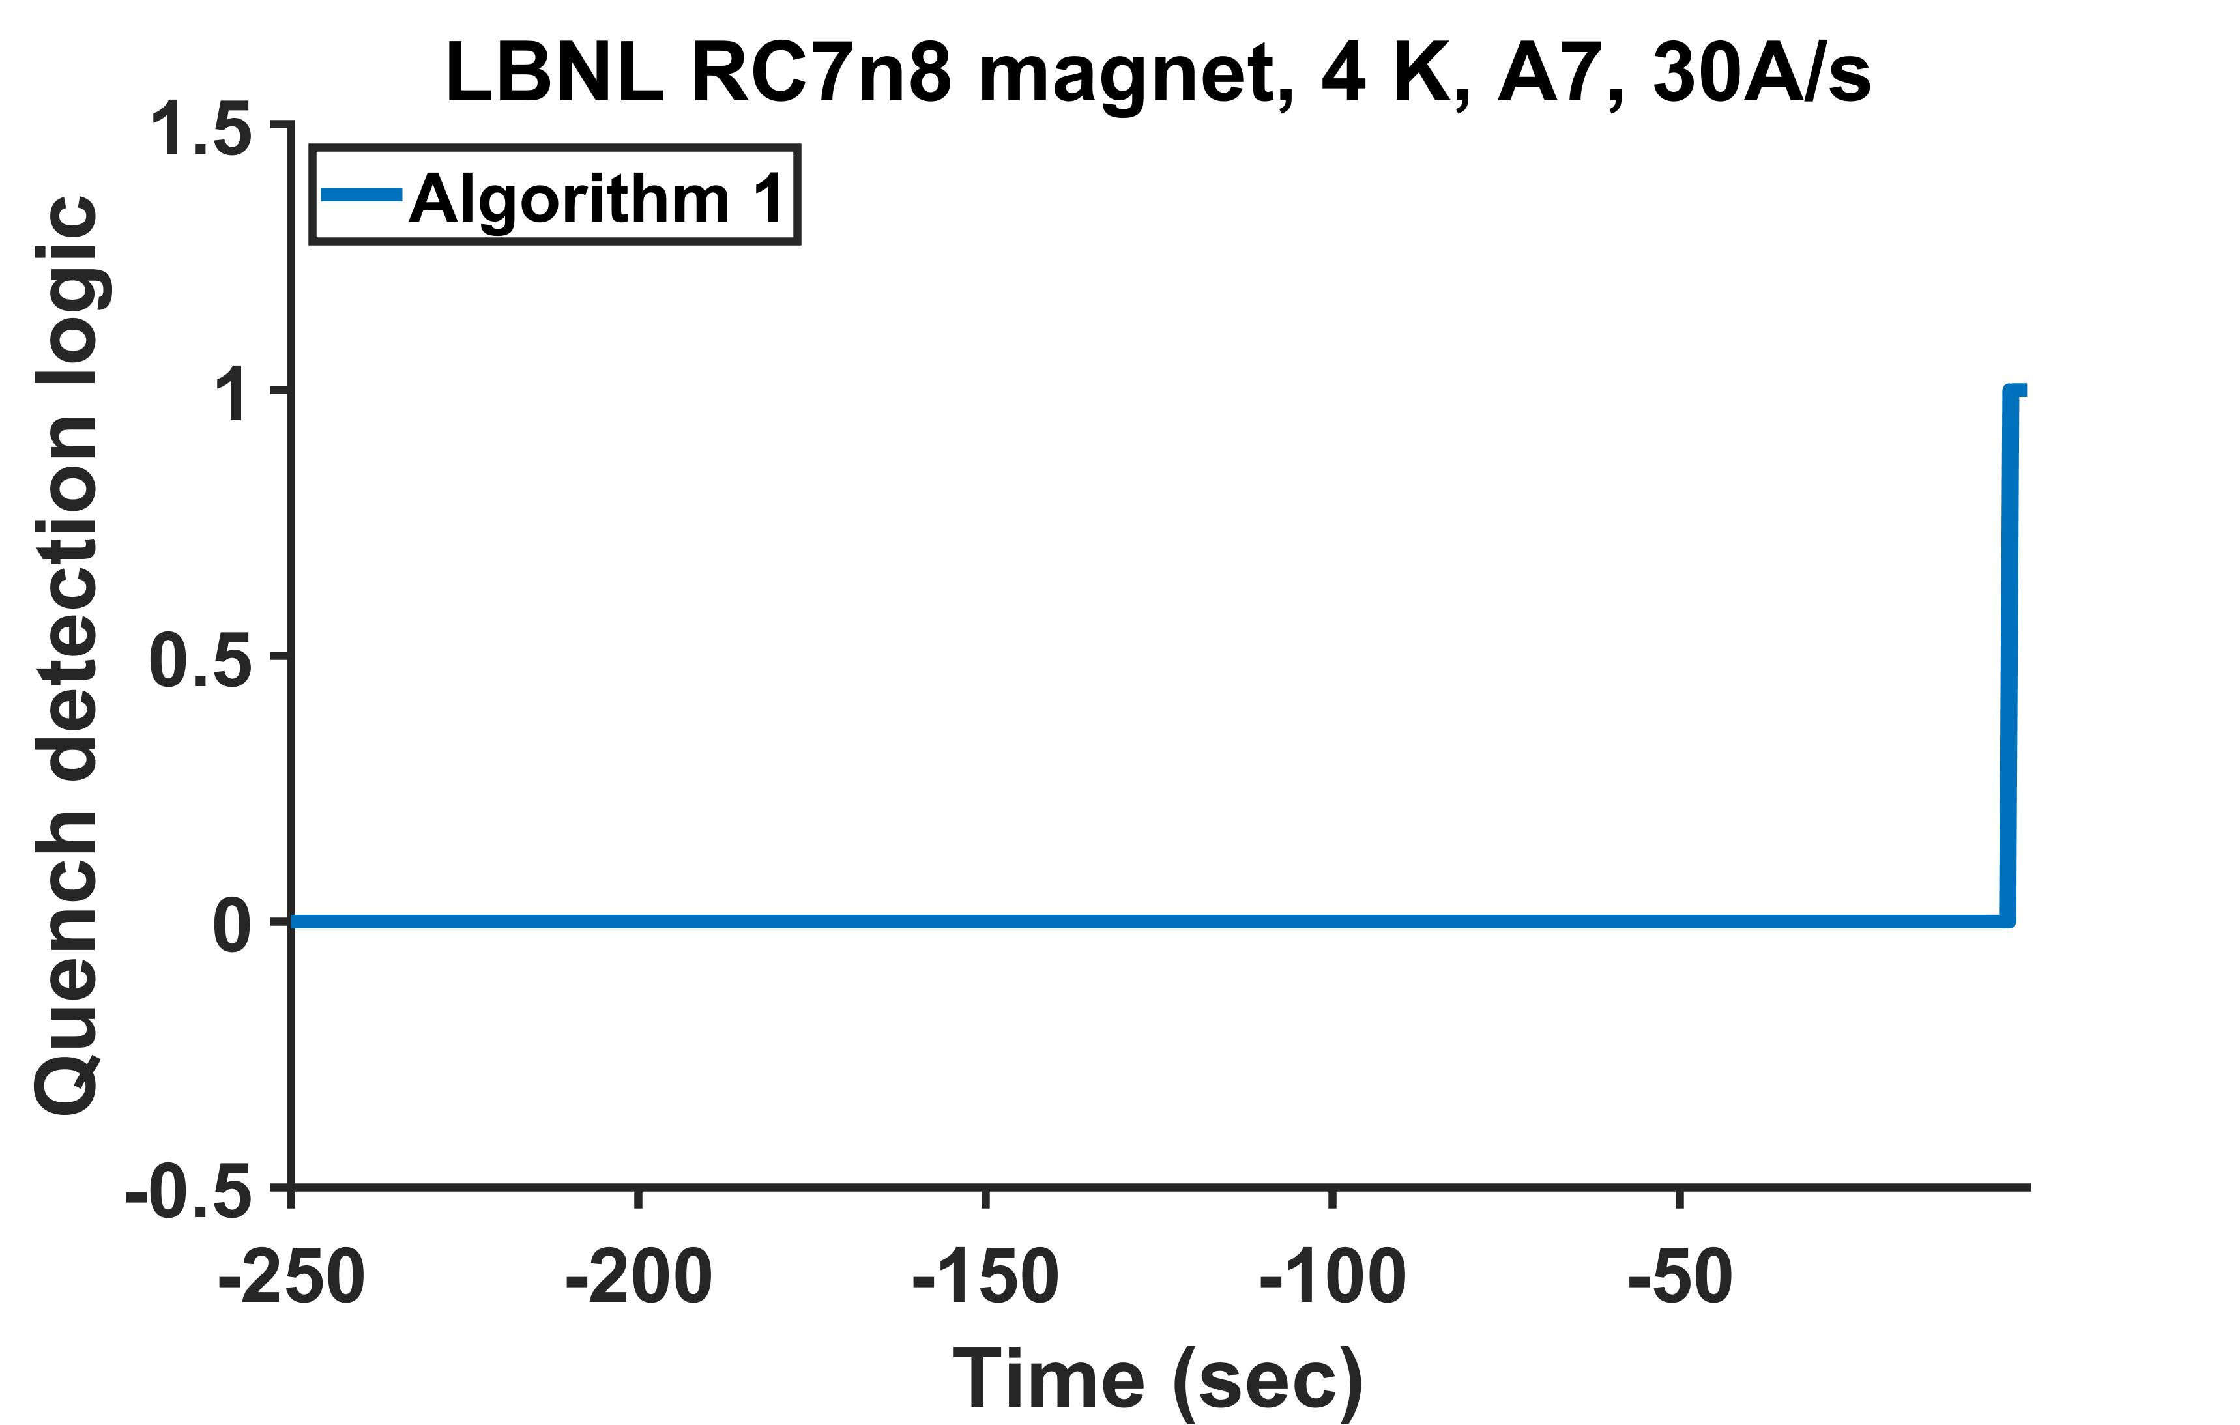
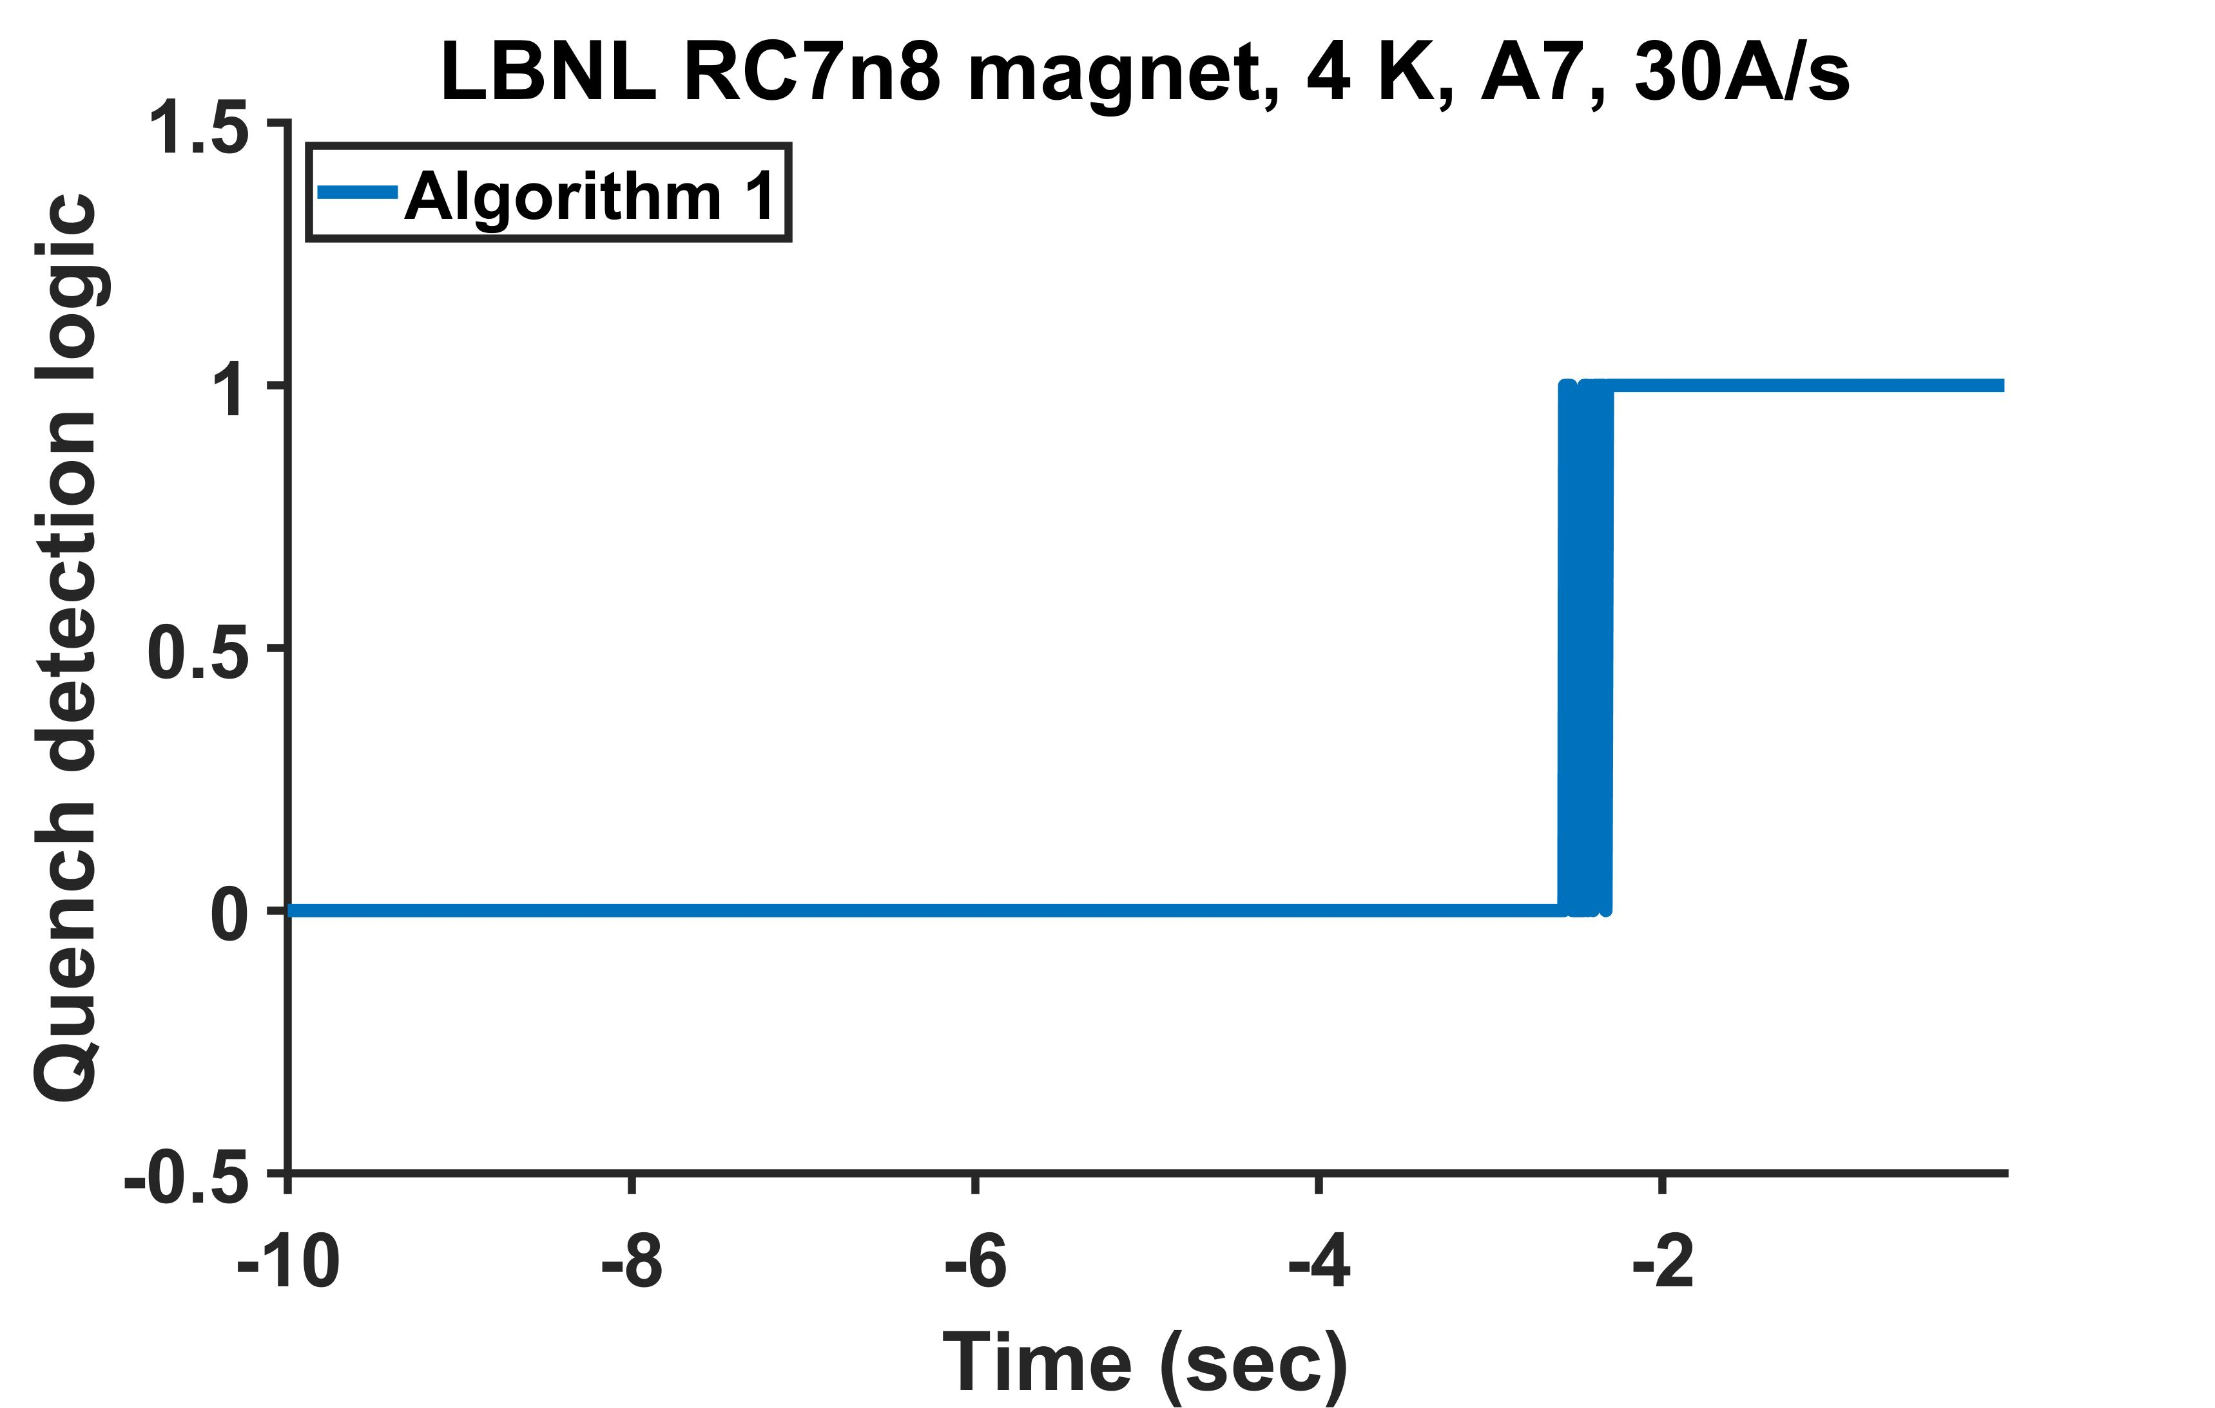
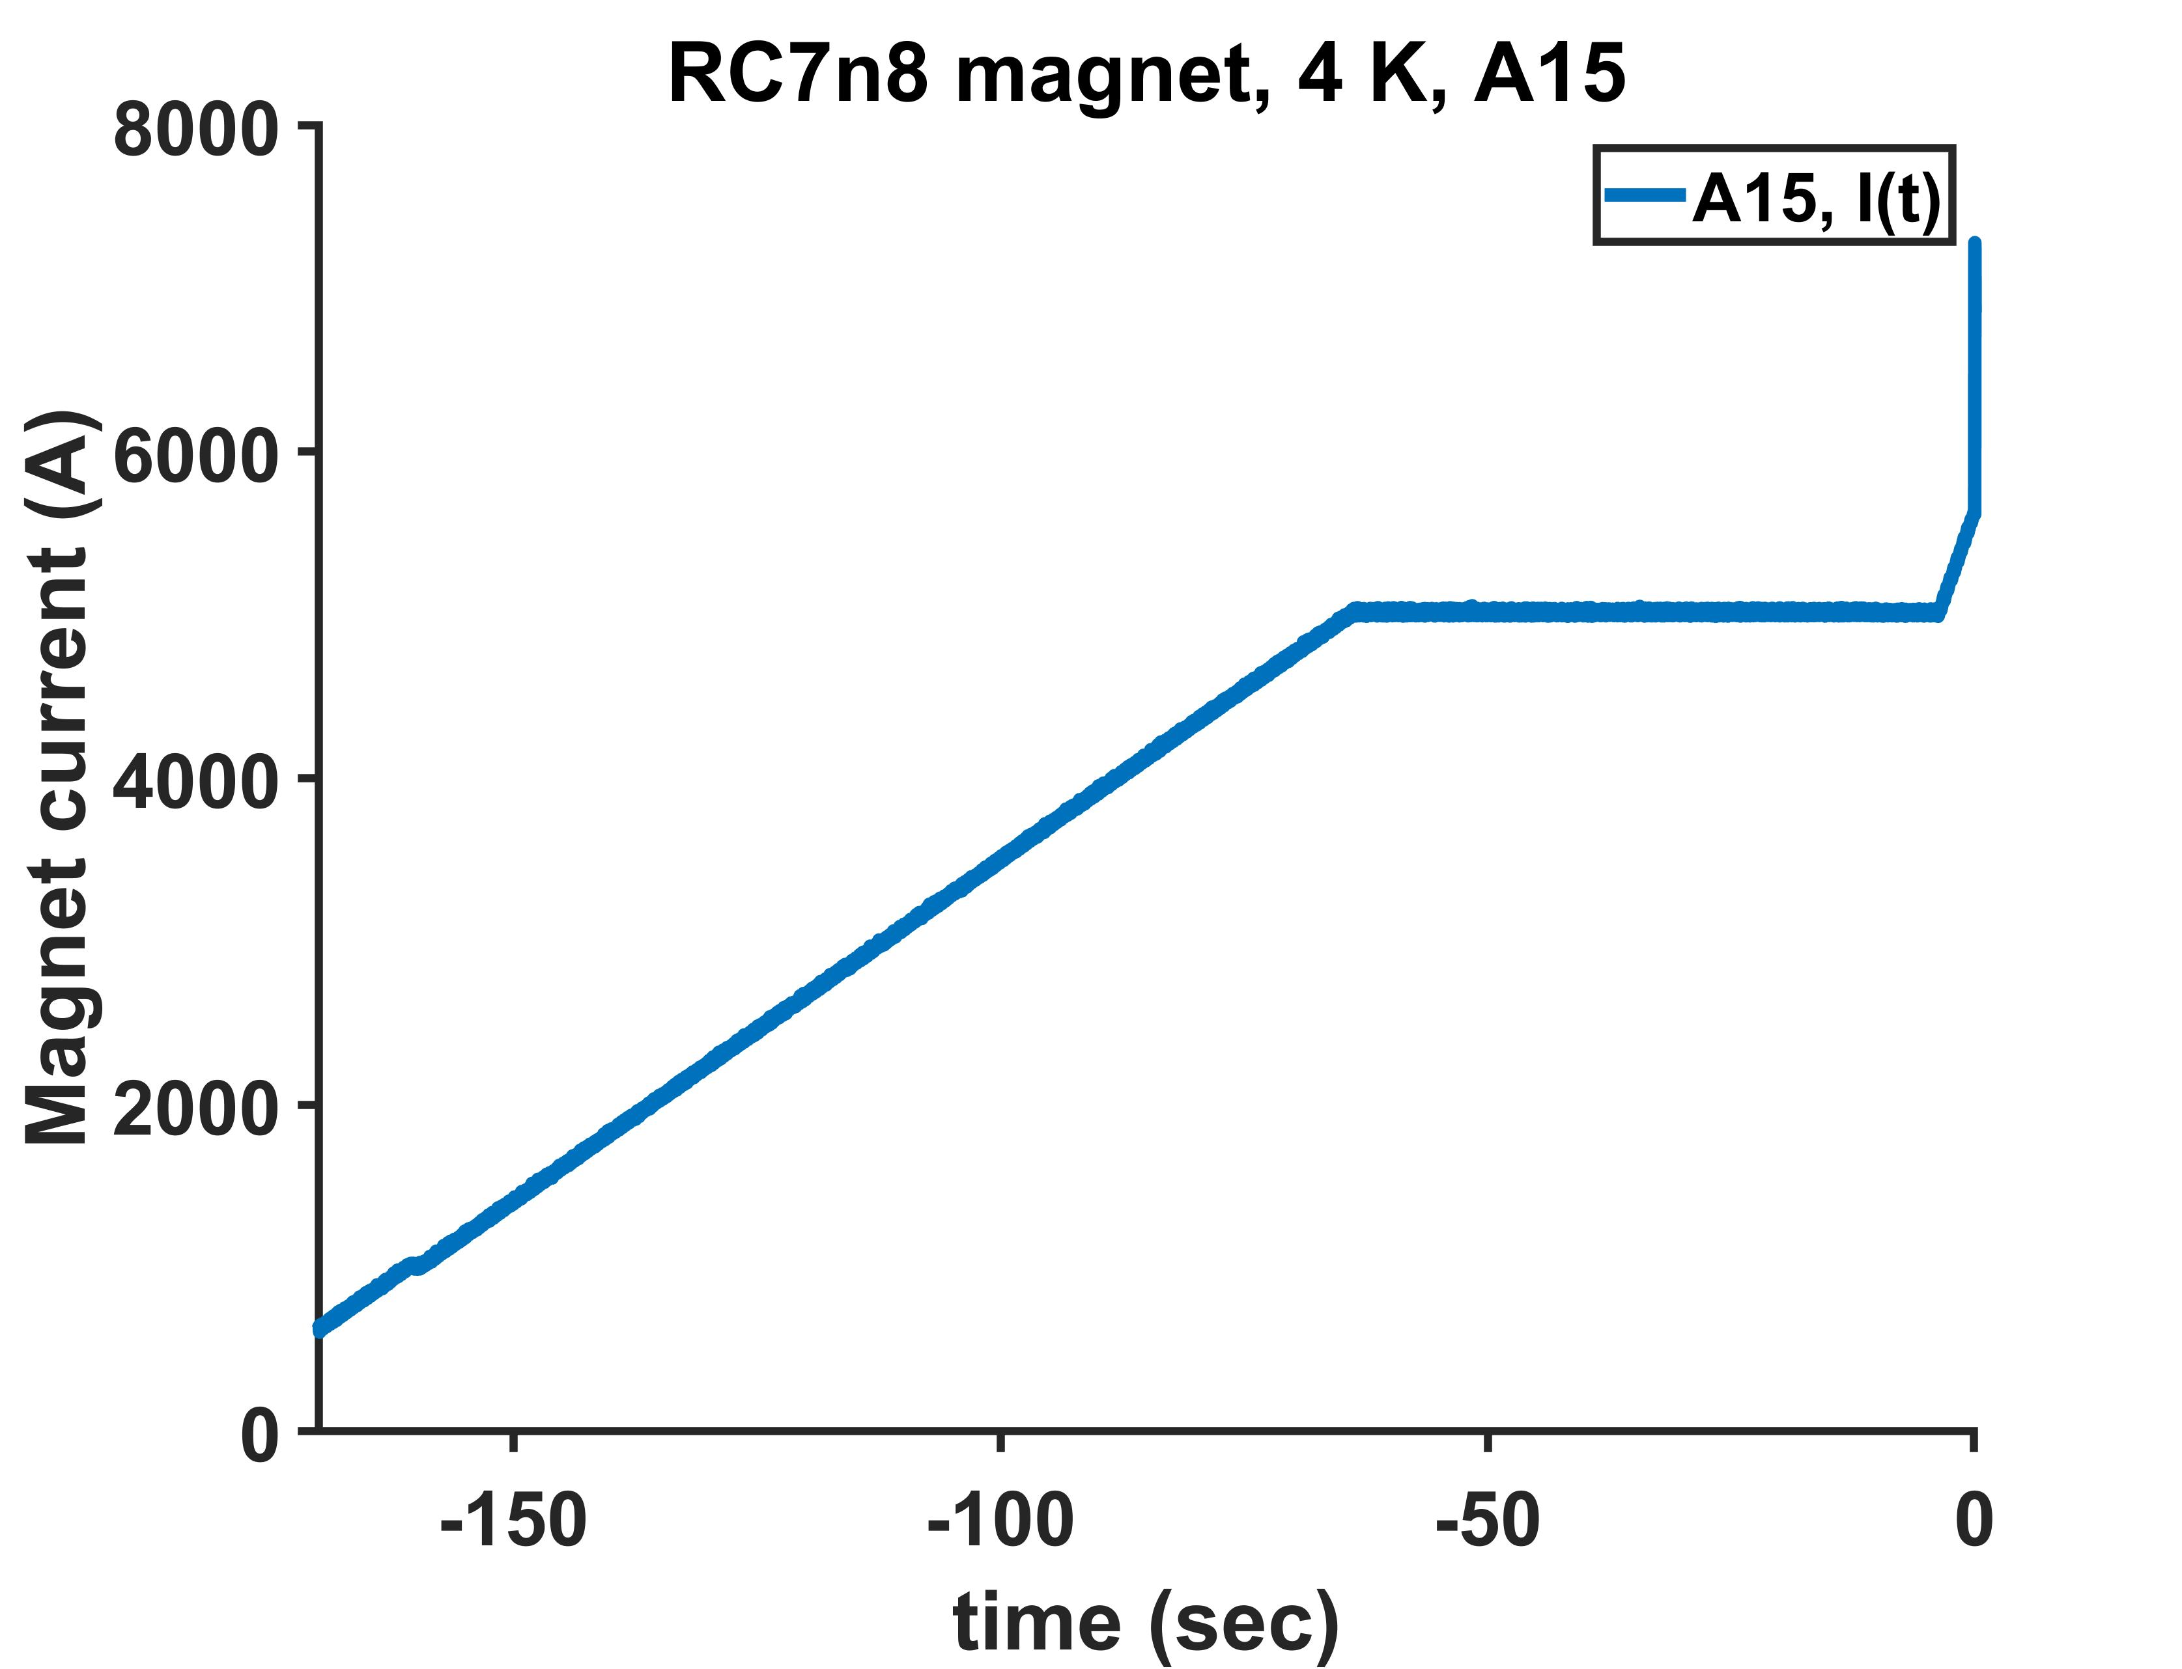
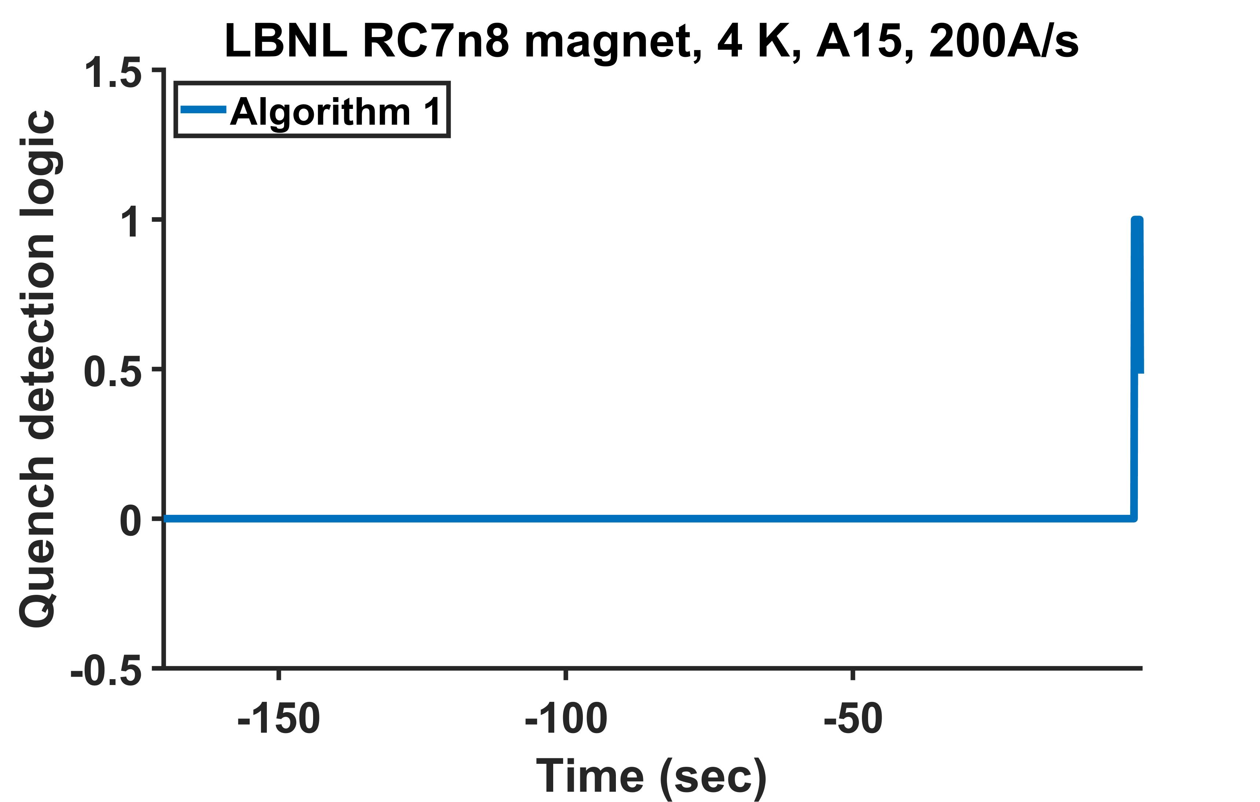
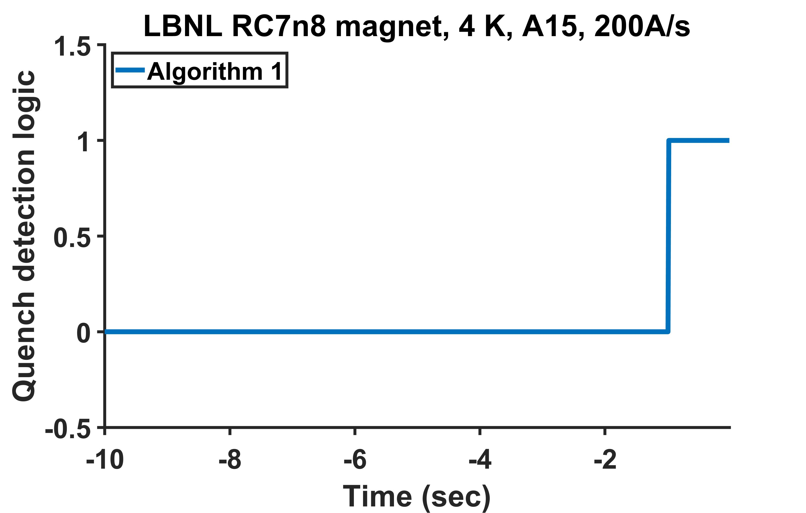
Two other cases – ramp I at 30 A/s, ramp II at 200 A/s
30A/s
No false detection from -1000 s to -2.566 s
No ambiguity at time after
-2.416s
No false detection
to -2.566 s
30A/s
200A/s
No false detection to -0.975 s
No false detection from -1000 s to -0.975 s
No ambiguity after
-0.975s
30A/s

Slide 11
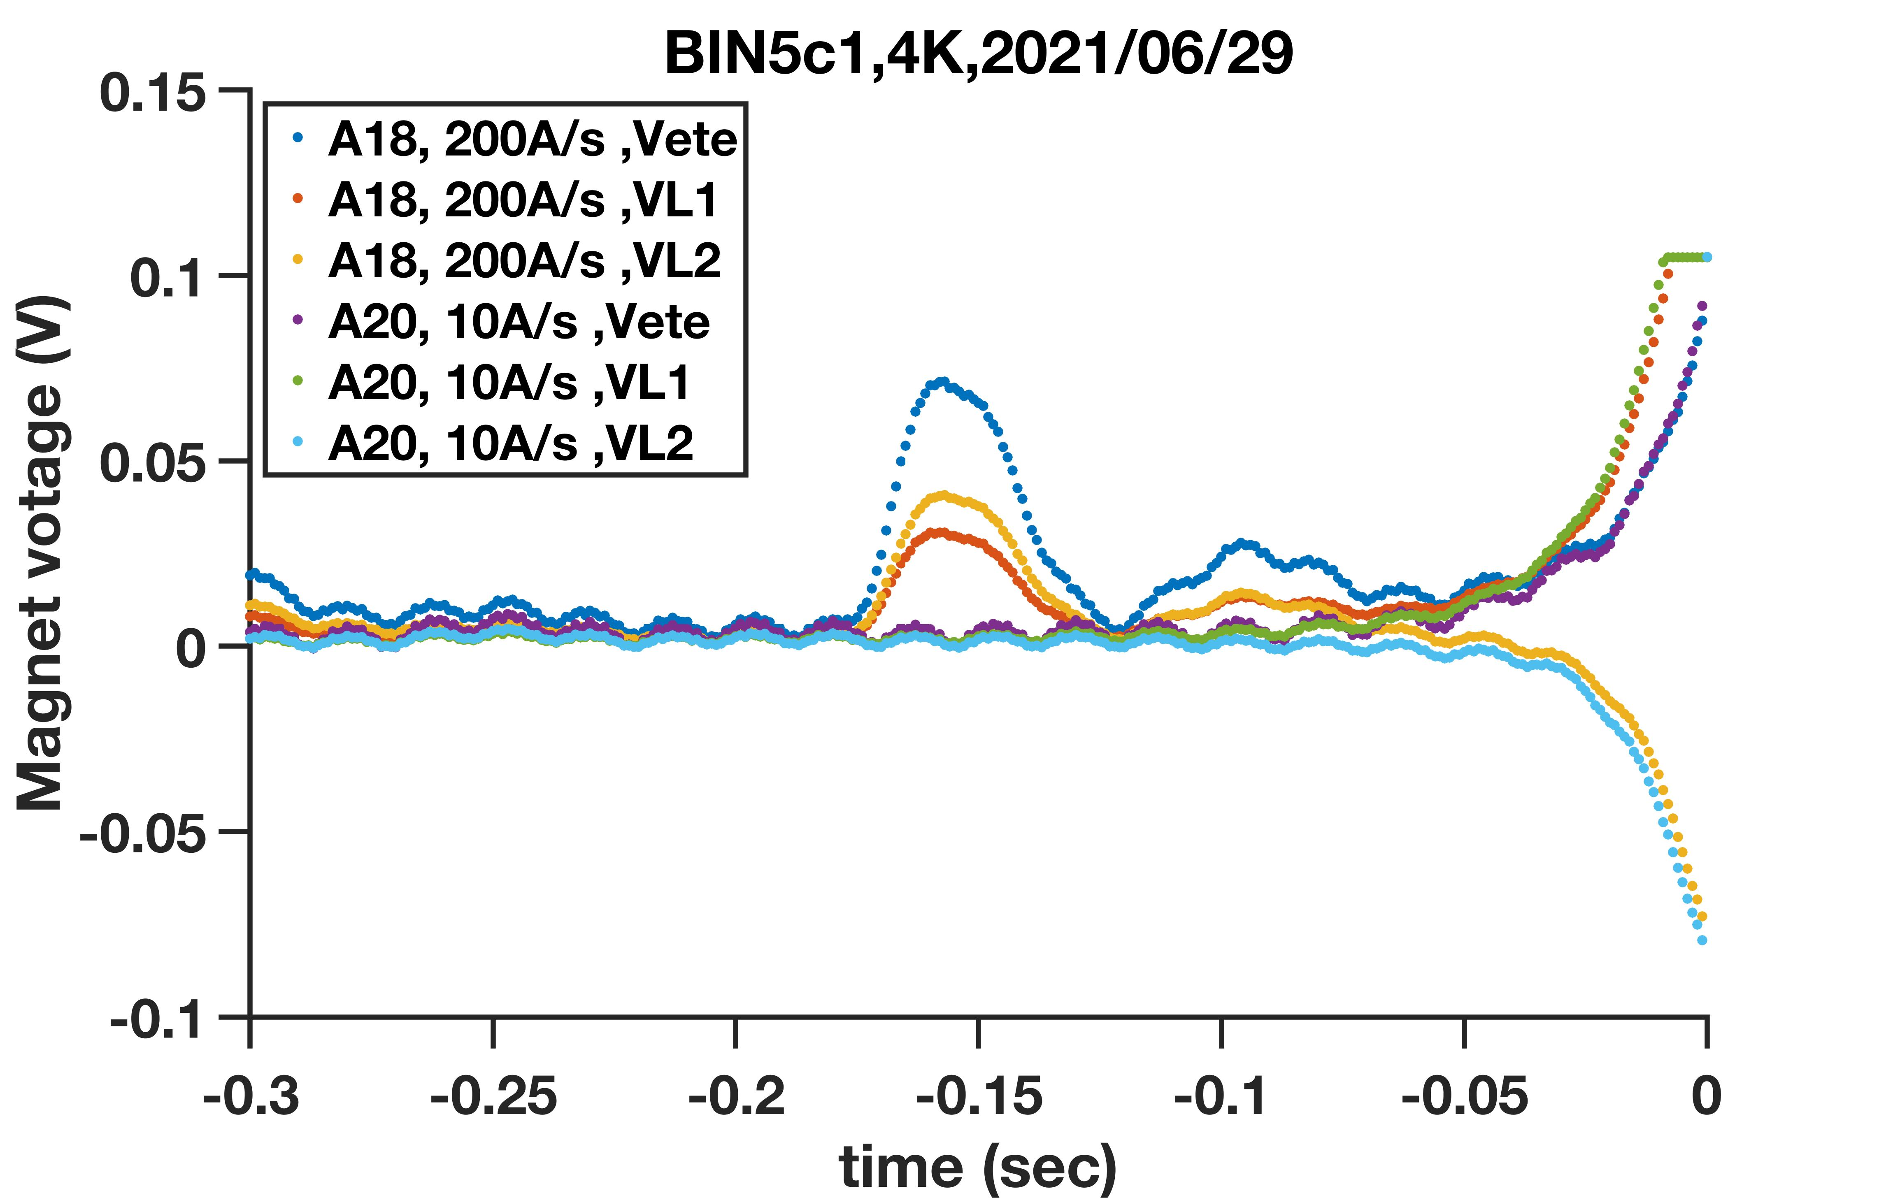
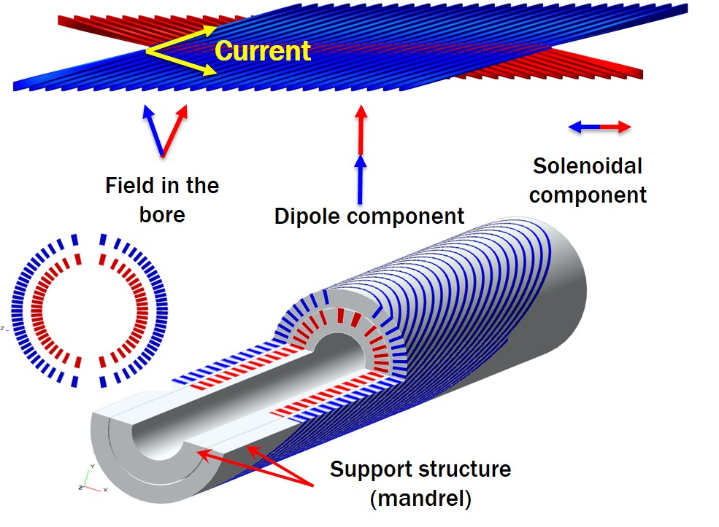
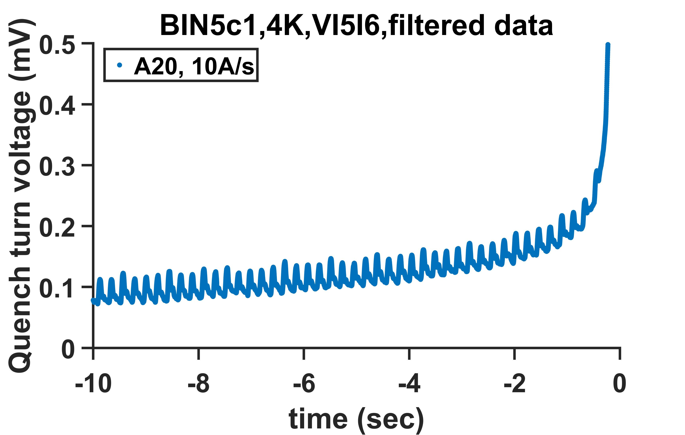
The case of CCT magnet BIN5c1, a more difficult to handle magnet
The quench turn
Inherent stress management capability.
Unique: Voltage of each turn was monitored.
Inductance and magnetic environment of two
coils are different, leading to large noise.
Fit to eyes
For fabrication and performance of this magnet, see
Shen et al., PRAB, https://journals.aps.org/prab/accepted/fc079Mf6Gc811d0311b39fe697a8ef84c27cafa4f

Slide 12
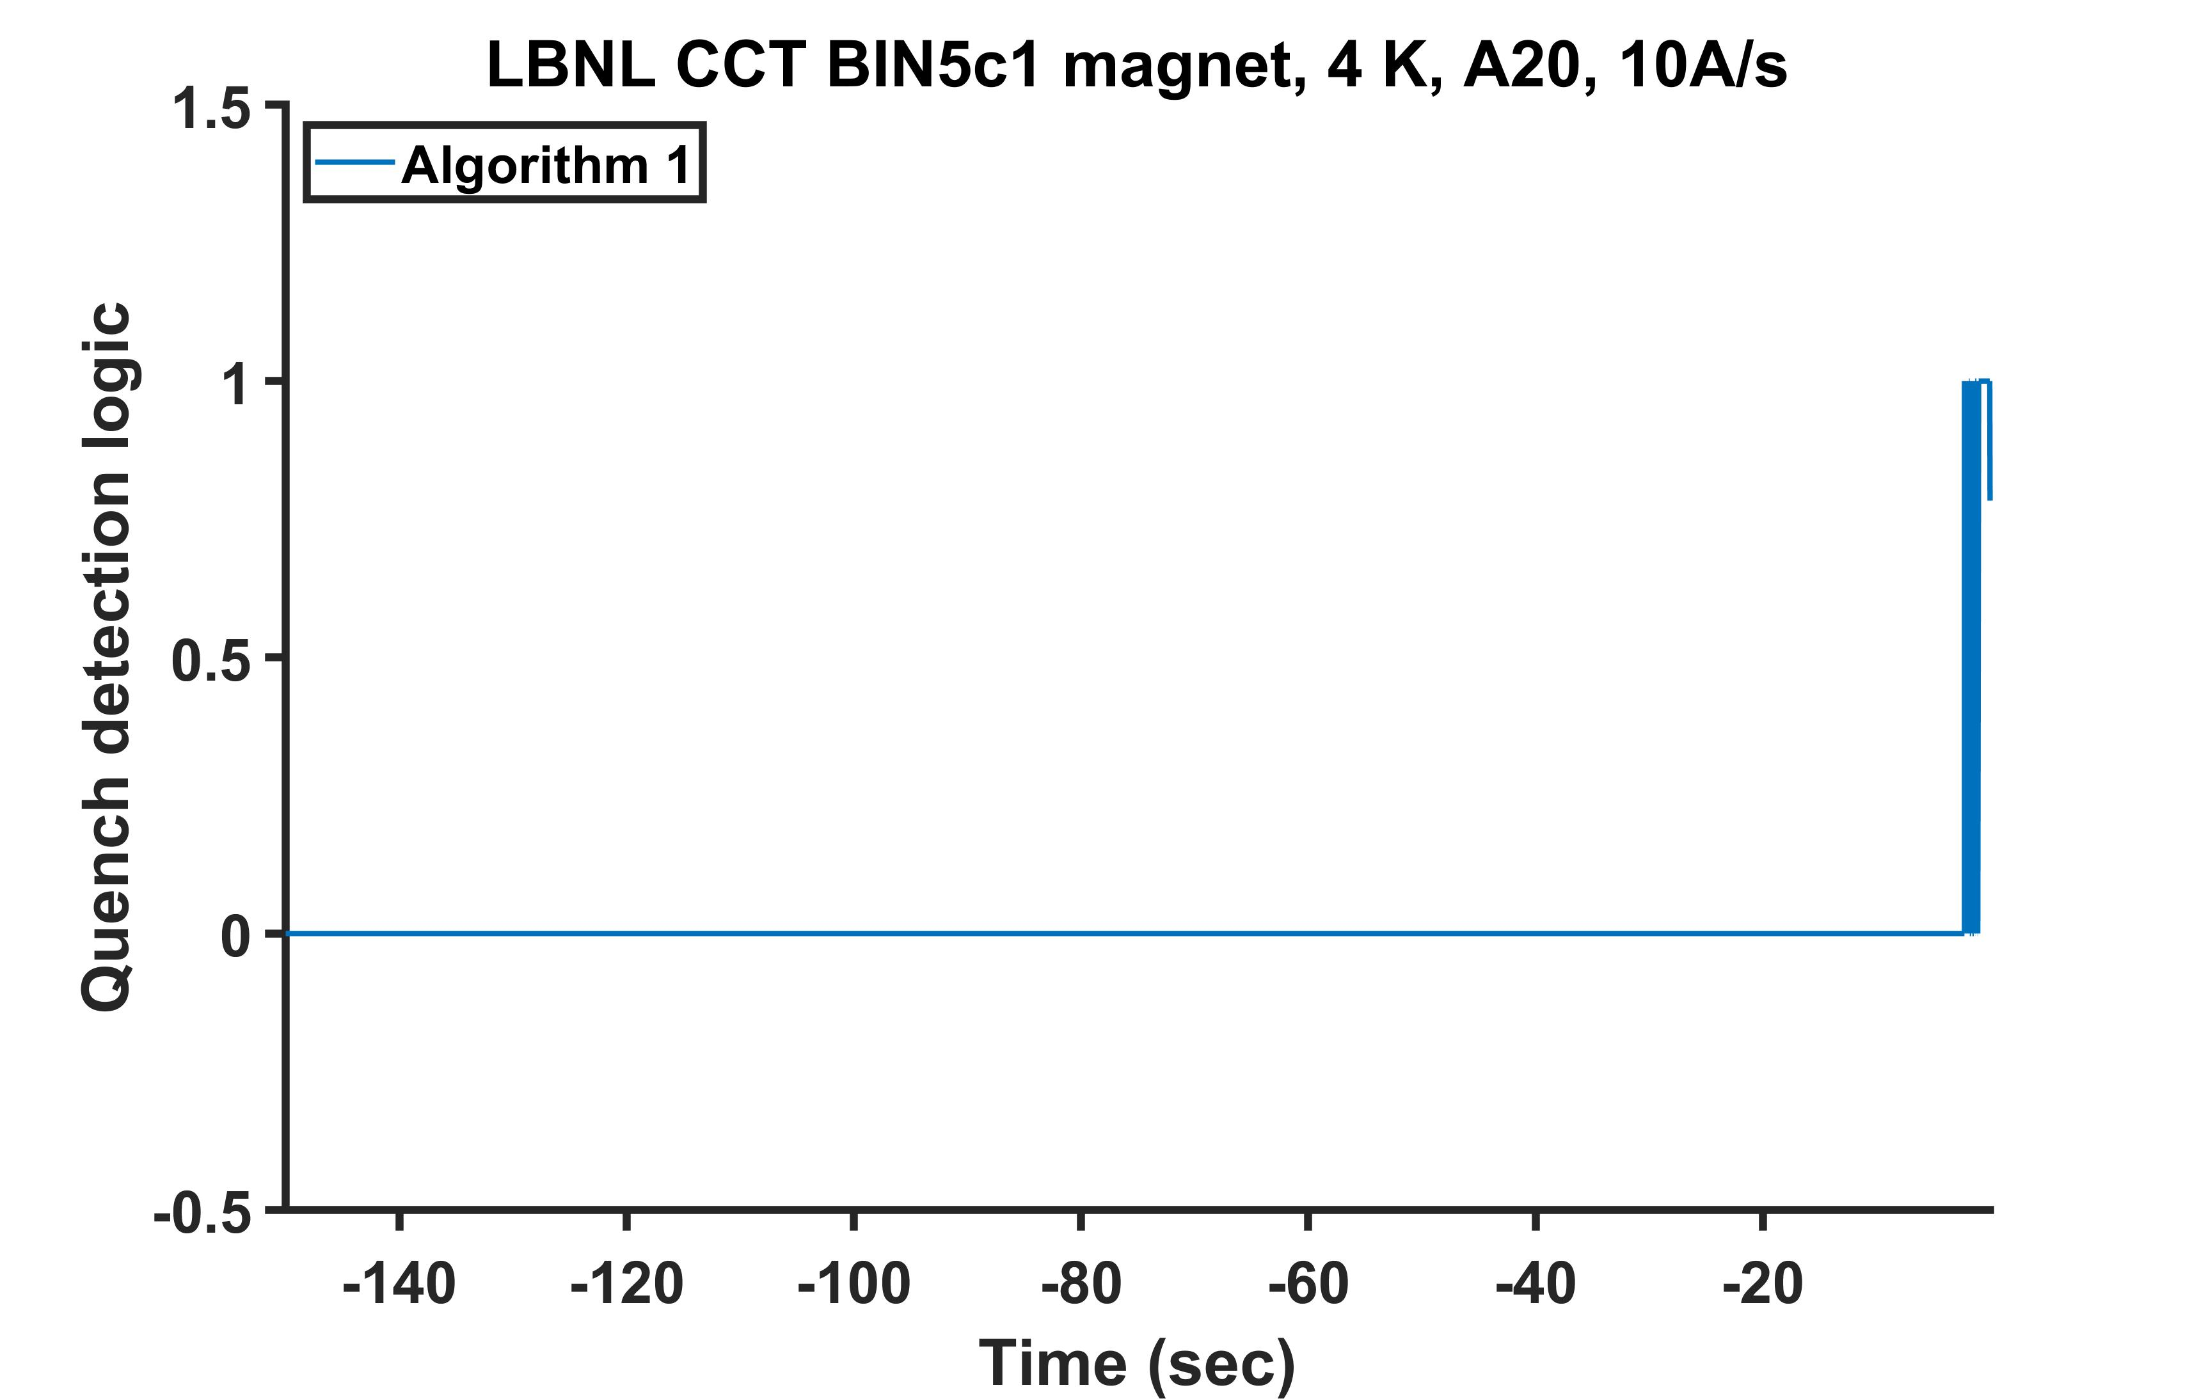
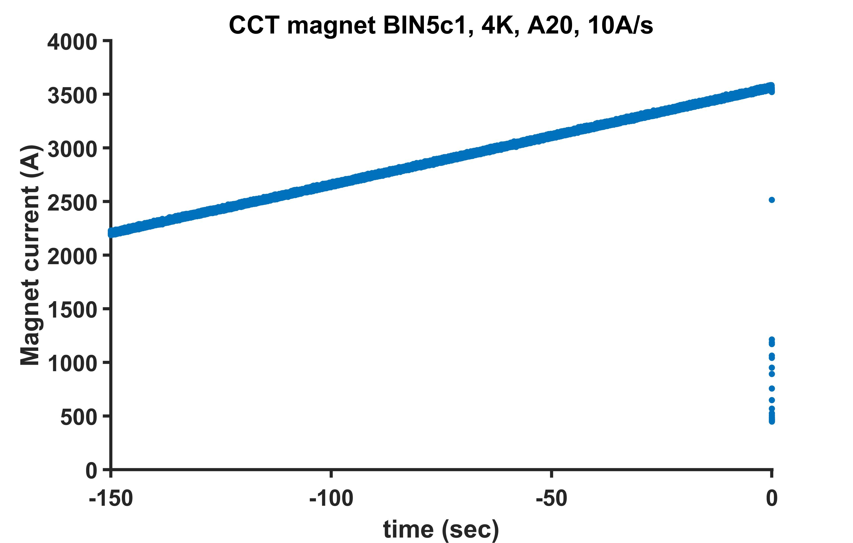
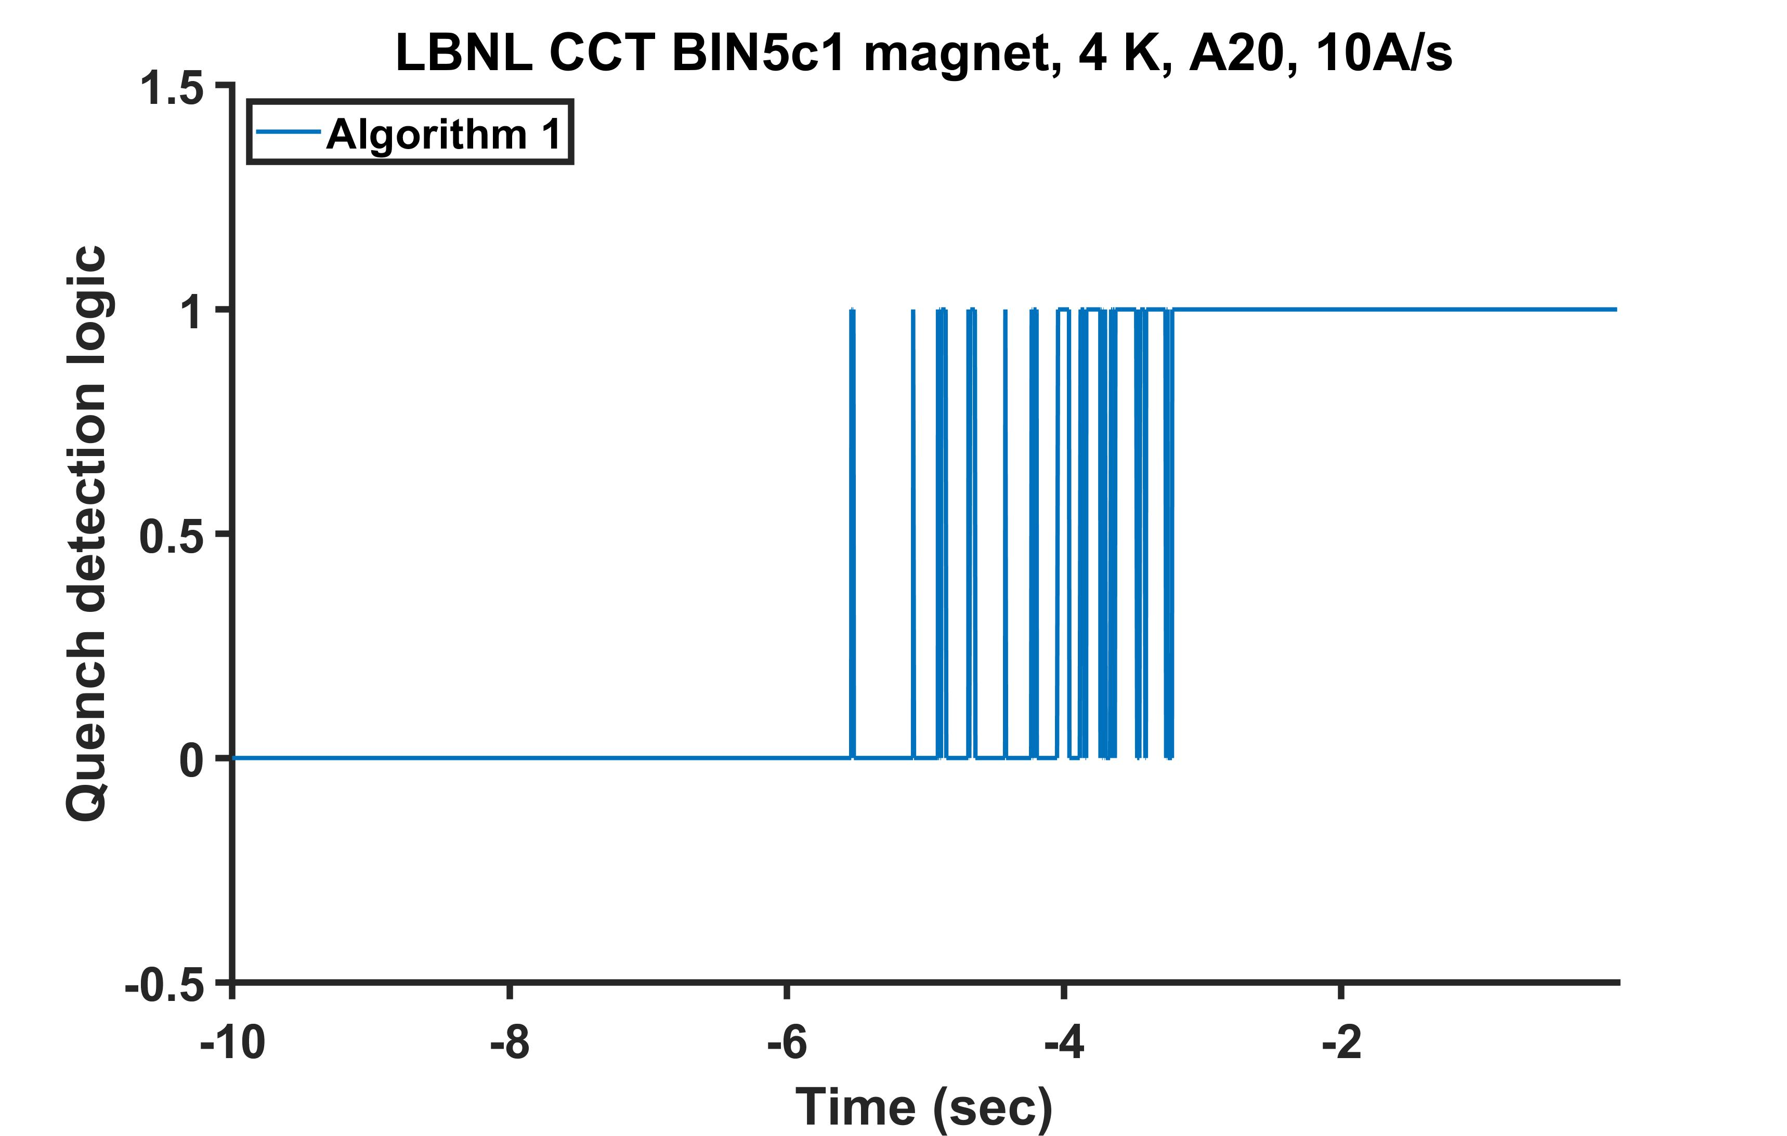
Quench detection logic as the result of a simple algorithm operating real time on the processed signal on CCT BIN5c1 dipole magnet – 10A/s case
10 A/s
No false detection till -5.534 s
No false
Detection
Till -5.534 s
No ambiguity
starting at
time = -3.219 s

Slide 13
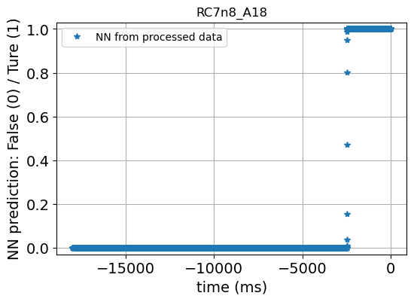
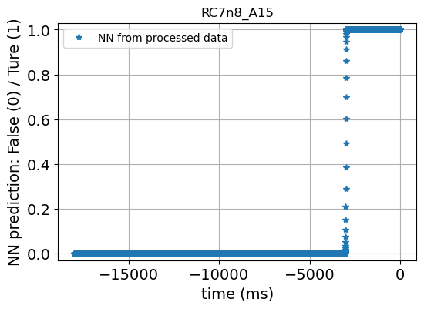
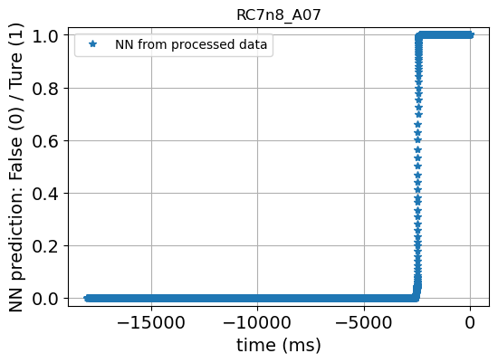
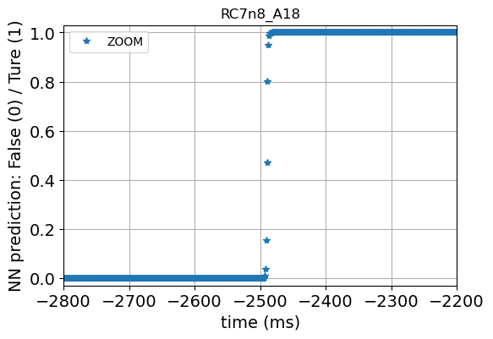
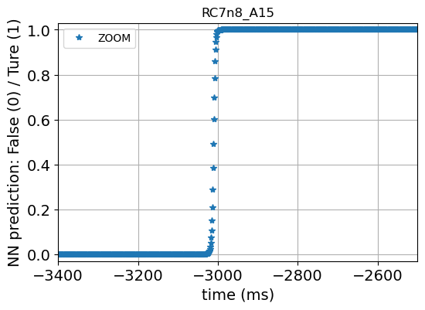
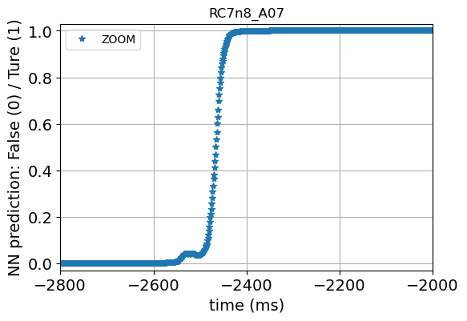
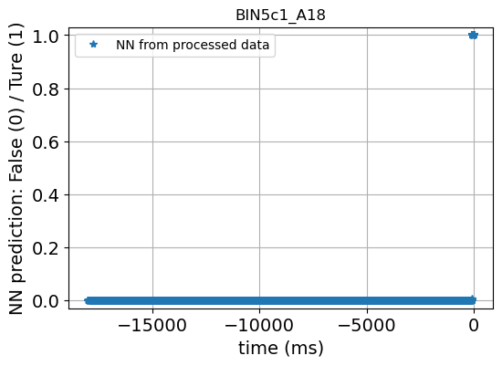

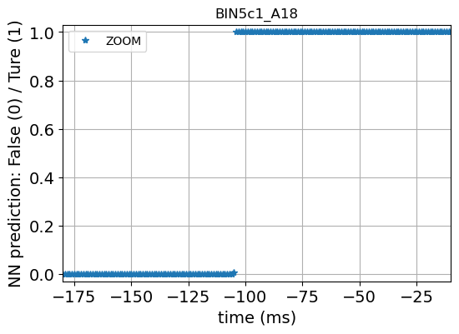
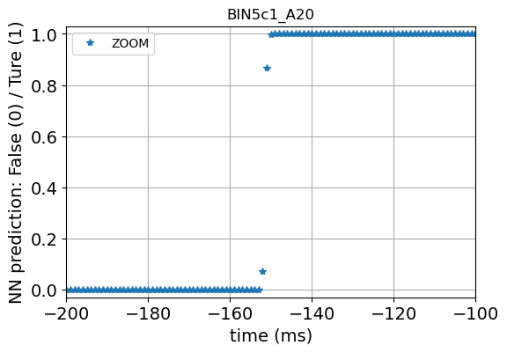
Machine learning potentially enables automatic and smart learning
Supervised training.
Trained on RC7n8_A18
Apply to all other cases.
Neutron network based.
By Dan Wang, LBNL

Slide 14
summary
Introduced a revised MIITS method for HTS magnets.
  The time budget for quench protection of HTS magnets can be either higher or lower than that predicted with the conventional MIITS method used for LTS magnets.
  It shows the uncertainty with estimating the maximum hot spot temperature and thus the margin of safety.
  Provided a wish-list of quench detection for HTS magnets and verification of a quench detection method in two HTS HEP-type magnets.
  2500 ms (experimental demonstrated) quench detection ahead of quenches possible.
  Versus
  180 ms predicted by old MIITS.
Exploration of machine learning.

Slide 15
What is next?
The uniqueness of CCT BIN5 coils – build and test CCT BIN5e, leveraging conductors from Engi-Mat SBIR program.
    Good conductor – 37 x 18, 0.8 mm strand, PMM220802-08, SBIR strand, 2 kg billet.
    Cable fab in May – Sept 2023, coil fabrication follows, test in Spring 2024.
Implement the real-time digital signal processing and detection algorithms to FPGA for experimental demo – with RC7n8/BIN5e and REBCO coils.

Slide 16
However, things do not entirely add up, do they? Then why?
RC7n8, experimentally proved,
as large as 2500 ms.
Increase margin
Protection time (s)
Lose margin
Quench detection voltage (V)

Slide 17
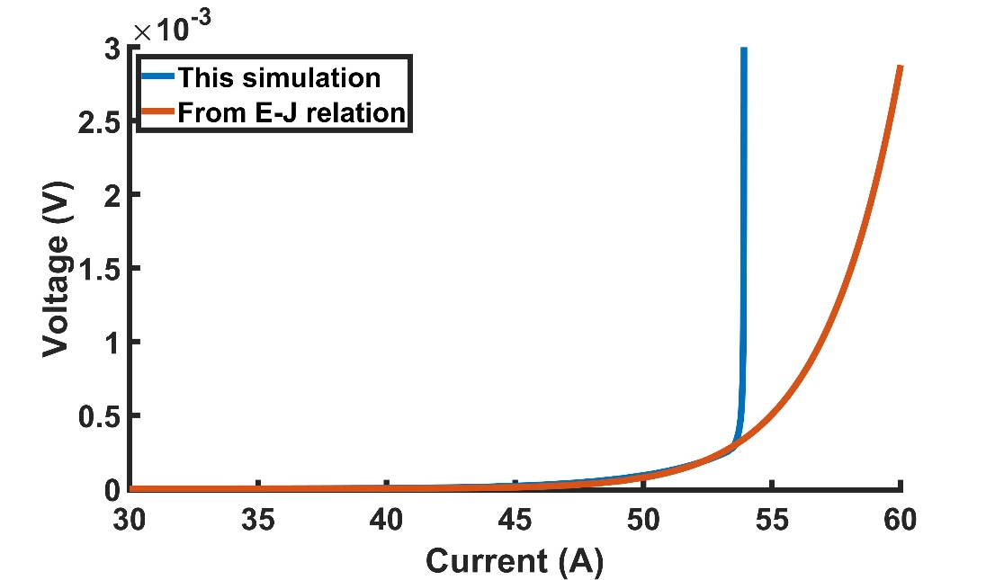
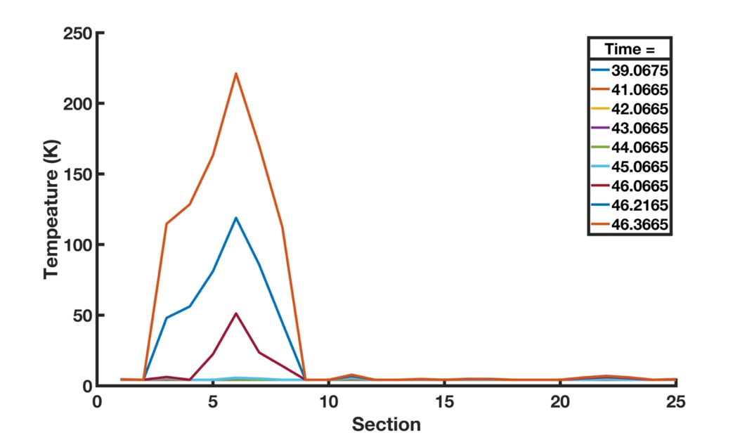
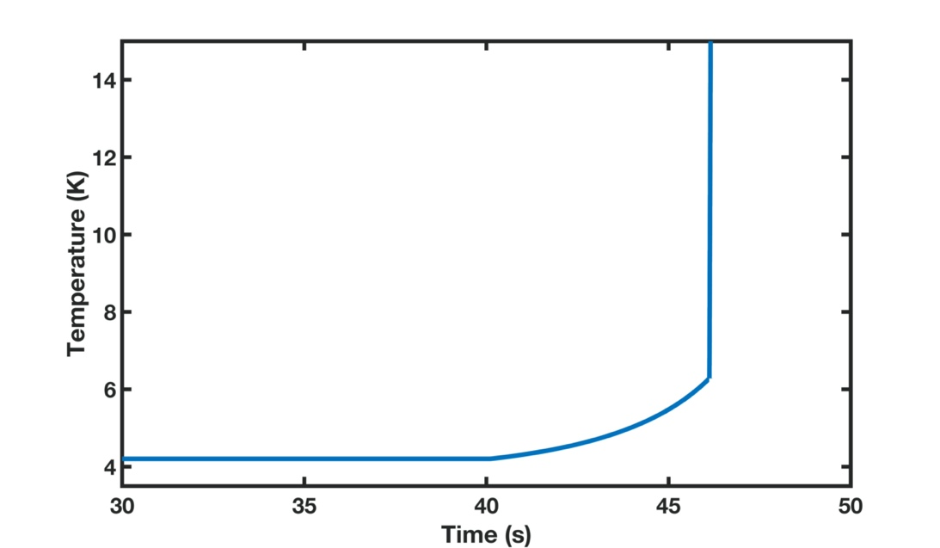
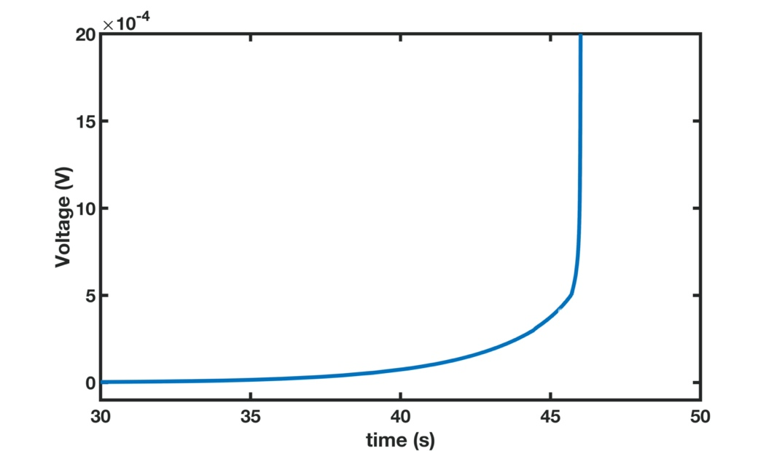
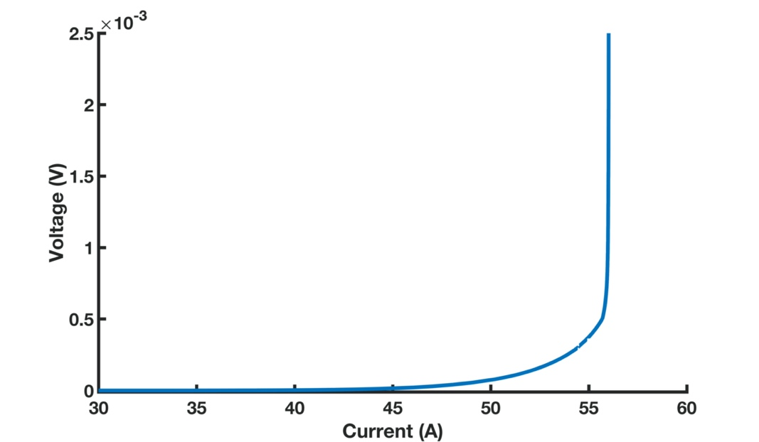
Let’s examine an 1D superconductor quench simulation of an HTS conductor
I_{c} (A) average | Variation in I_{c} (A) | n-value average | Variation in N | No. of Section | Length of a section (cm) | Cooling power (kW/m²)
50 | 2 | 15 | 2 | 25 | 3 | 0.01
T_{o} = 4.2 K.
T_{c} = 72 K.
I_{c}(T) is linear at a fixed B.
dI/dt = 1 A/s.

Slide 18
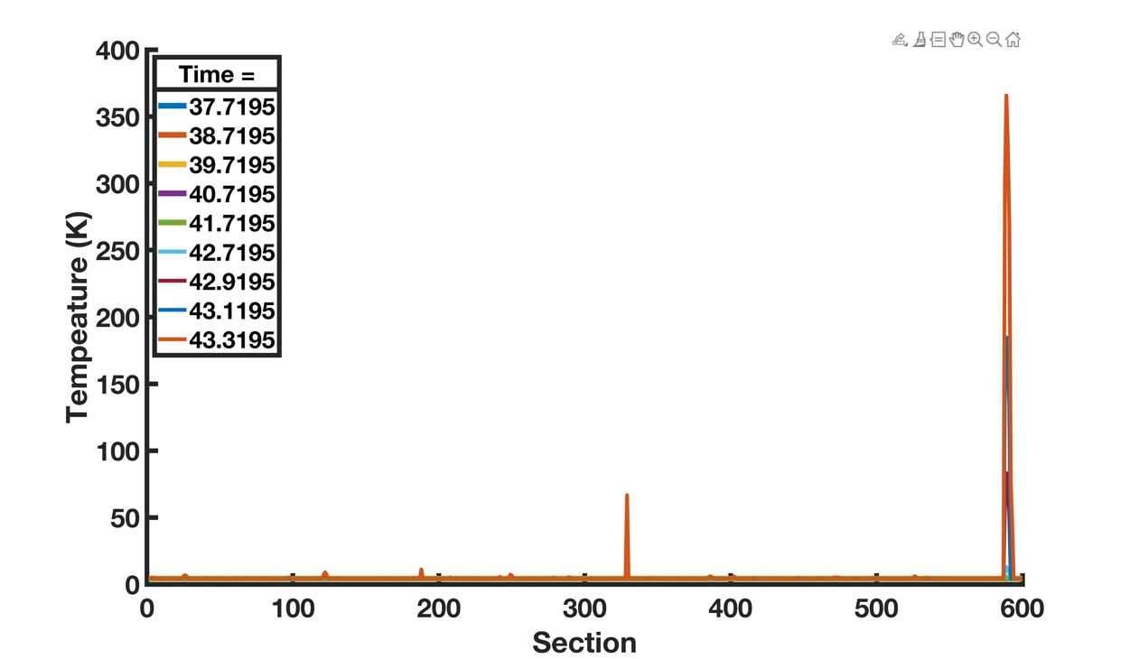
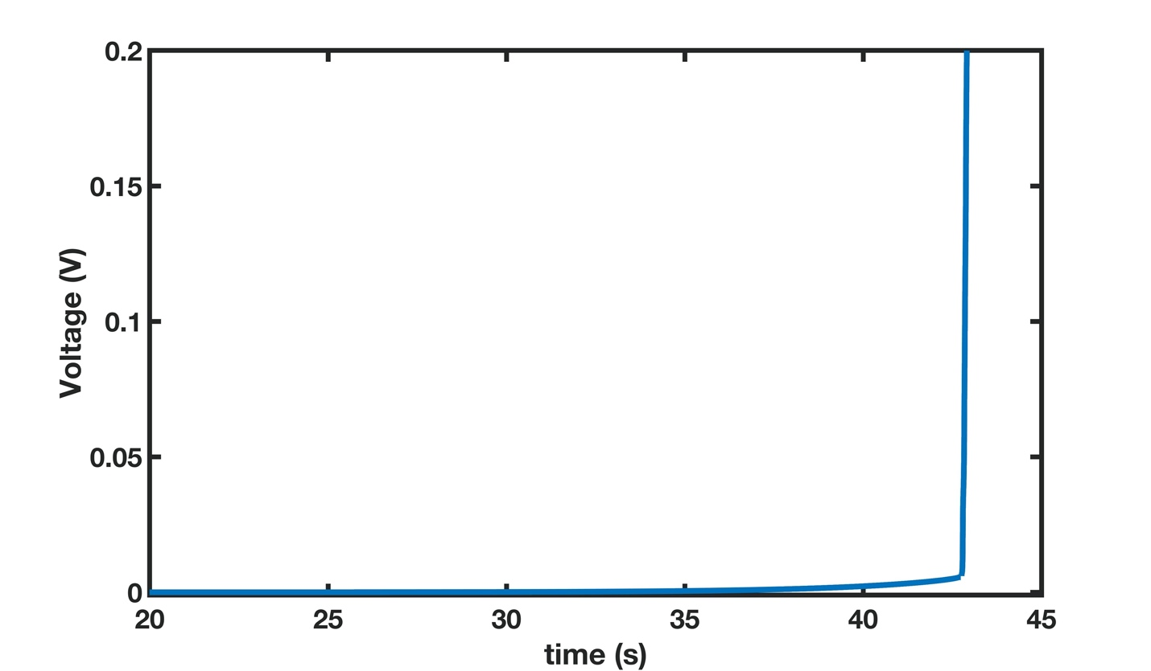
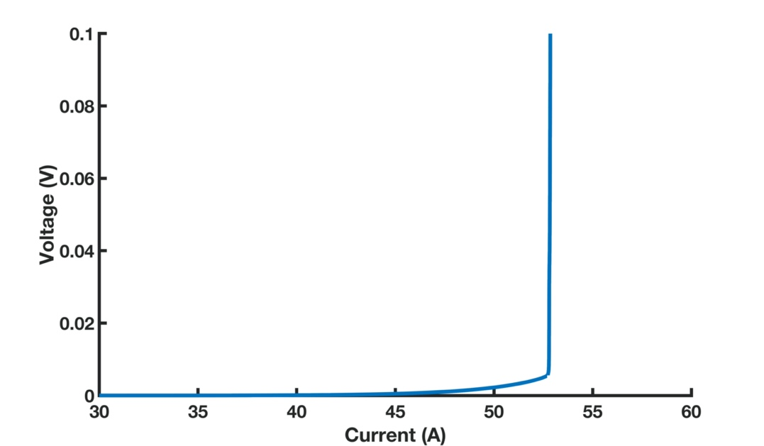



Let’s look at a longer piece (18 m)
I_{c} (A) average | Variation in I_{c} (A) | n-value average | Variation in n-value | No. of Section | Length of a section (cm) | Cooling power (kW/m²)
50 | 2 | 15 | 2 | 600 | 3 | 0.01
T_{o} = 4.2 K.
T_{c} = 72 K.
I_{c}(T) is linear at a fixed B.
dI/dt = 1 A/s.

Slide 19


Verification of the simulation provided by an experiment - sample
Xijie Luo from Kyoto Uni. contributed to this measurement. Support partially from
the US-Japan HEP collaboration.

Slide 20
Verification of the simulation provided by an experiment - results
V9 – I_{c} – 464 A, n-value=51;
V8- I_{c} – 490 A, n-value=43;
V2- I_{c}-486 A, n-value = 50;
Other sections all with I_{c} > 490 A.
@4.2 K and 15 T.
Xijie Luo from Kyoto Uni. contributed to this measurement. Support partially from
the US-Japan HEP collaboration.

Slide 21








Then back at this question and add a bit statistics in.
Statistical model (Monte-Carlo Simulation, 1000 runs for each sample and operation conditions)
$$f\left(I_{c}\right)=\frac{1}{\sqrt{2πI_{c_dev}^{2}}}exp\left[⁡−\frac{{\left(I_{c}−I_{c_aver}\right)}^{2}}{2I_{c_dev}^{2}}\right]$$
$$R_{Cu}={ρ_{Cu}L}/{wt_{Cu}}$$
$$R_{sc}={{E_{0}L\left({I_{sc}}/{I_{c}}\right)}^{n}}/{I_{sc}}$$
$$f\left(n\right)=\frac{1}{\sqrt{2πn_{dev}^{2}}}exp\left[⁡−\frac{{\left(I_{c}−n_{aver}\right)}^{2}}{2n_{dev}^{2}}\right]$$
$$\int_{t_{0}}^{t}{{(I}^{2}R−cooling)dt}=\int_{T_{0}}^{T}{CdT}$$

Slide 22


Monte Carlo experiment:
Screening and sensitivity analysis that shows the effect of n-value
I_{c} (A) | Variation in I_{c} (A) | n-value | Variation in n-value | No. of Section | Length of a section (cm) | Cooling power (kW/m²)
500 | 20 | 50 (left); 10 (right) | 2 | 25 | 3 | 1
Ave n-value = 50
Ave n-value = 10

Slide 23
What have we learned?
Before entering into a thermal-runaway quench, HTS magnets/conductors have small but detectable voltages that last multiple even tens of seconds.
They provide an opportunity with quench detection and perhaps even prevention.
  Such opportunity rarely exists for LTS magnets.
Missing this opportunity comes with a high cost: The margin of safety for quench protection drops to nearly zero, especially for large HTS magnets.

Slide 24


Apply the same perspective with another angle – the short sample limit of your HTS magnets
A schematics for determining short sample limit (quench current) for a superconducting magnet.
Now it comes with an uncertainty band for HTS magnets.
The quench current of your HTS magnet doesn’t come with an absolute value like LTS magnets.
It is modulated by I_{c} distribution, primarily $I_{c_{dev}}^{}$, cooling and operating temperature, and n-value, and comes with an uncertainty band.

Slide 25





Practical magnets – can you guess which coil quenched?
Bi-2212 RC7n8, inductive signals removed
by staircase run.
REBCO CORC C2
Co-wound voltage taps
Coil 1
Coil 2
I
I
$V_{1}={L_{1}\frac{di(t)}{dt}+R}_{sc,1}i(t)$+ $R_{NZ,1}i\left(t\right)+M_{1}\frac{di_{e}(t)}{dt}$
$V_{2}={L_{2}\frac{di(t)}{dt}+R}_{sc,2}i(t)$+ $R_{NZ,2}i\left(t\right)+M_{2}\frac{di_{e}(t)}{dt}$
Let’s only look at these components.
They can be measured.
The first component, index loss caused
voltage, only shows occasionally for LTS
magnets, e.g. Nb₃Sn magnets with cable
damages and low n-values.
Xiaorong Wang et al 2021 Supercond. Sci. Technol. 34 015012

Slide 26
Summary
A revised MIITS method – what it implies for margin of safety and uncertainty.
A surprise shown by “experiments” – the protection time budget for quench protection is raised by ~10 and why.
An opportunity window for quench detection for HTS magnets (which rarely exists for LTS magnets) and how the margin of safety of quench protection of HTS magnets drops to nearly zero if it were missed for large HTS magnets.
SSL for HTS magnets – no longer a point.
The resistive voltage limit of an HTS magnet – not so simple to call it – where statistics plays a role.
Thank you for your attention.

