Slide 1
High current High field sample test facility and
Recent test results from subscale coils
M Kumar, A B Yahiya, P Joshi, R Gupta,
Collaboration meeting, Wednesday 22 March
E-mail: mkumar@bnl.gov

Slide 2
Talk Outline
Recent facility upgrades
MDP CORC® coil test: BNL+ACT+LBNL
BIGBOX test
Conclusions and Perspectives

Slide 3
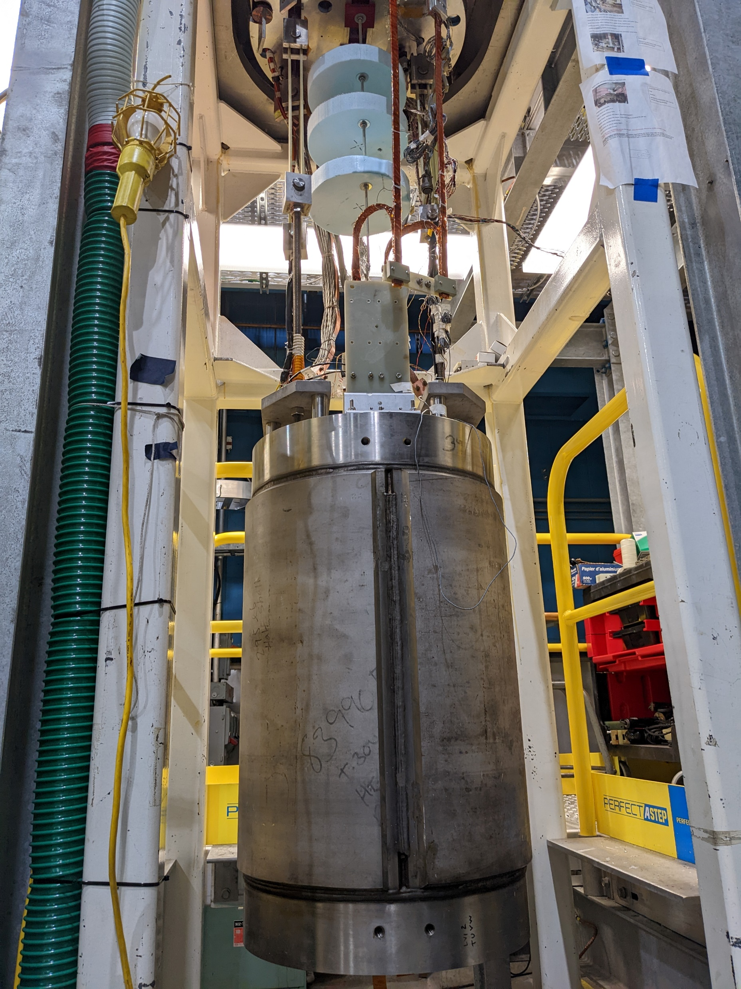
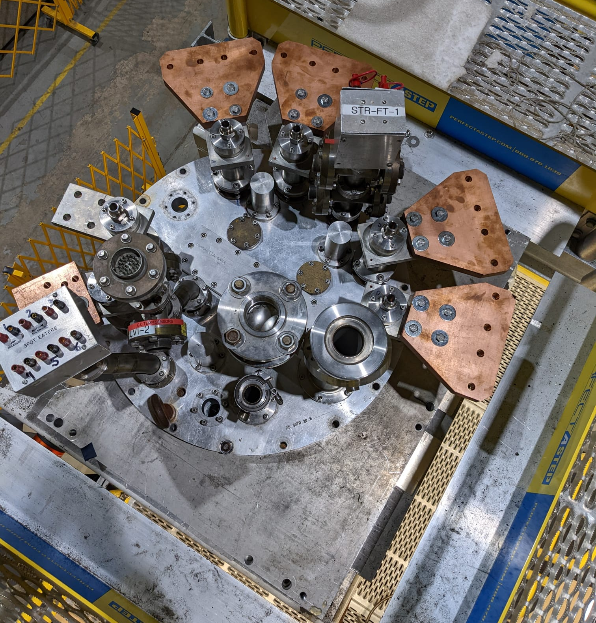
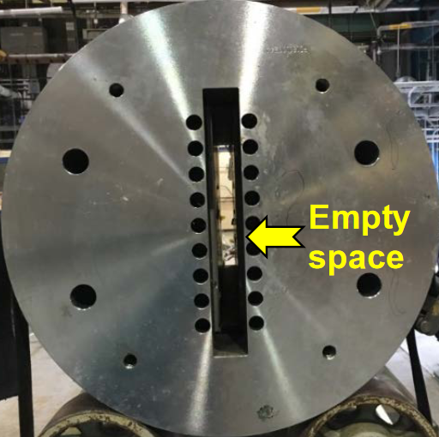
DCC017 magnet
Side View
Test Aperture: 29 mm X 335 mm.
Dipole field 9.4T (10 kA in CC).
Max Sample DC current 20kA.
Top View
Bottom View
83.825
226.6
142.75

Slide 4
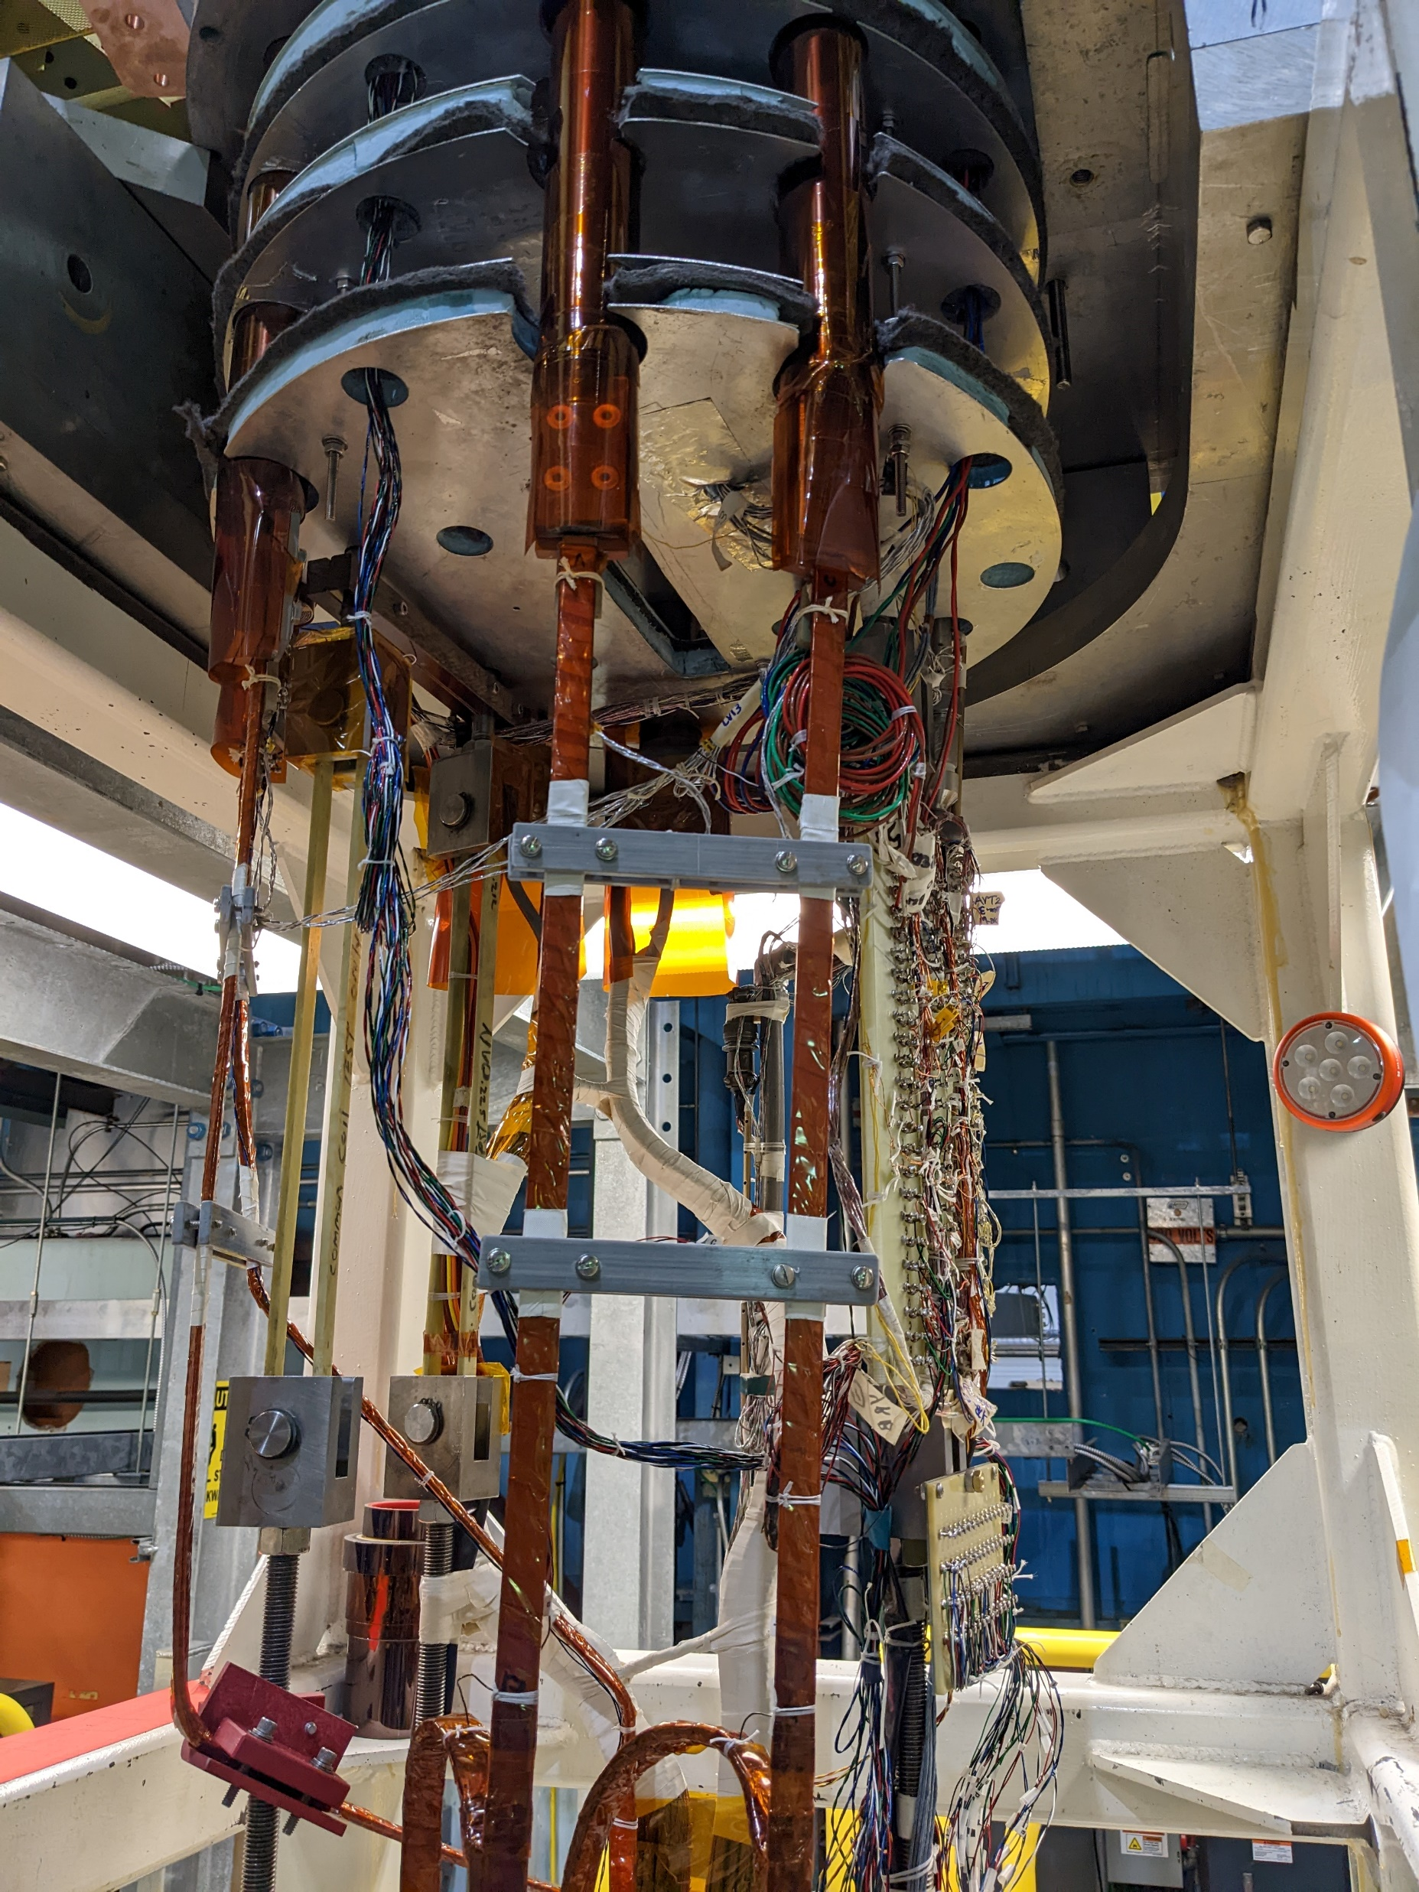
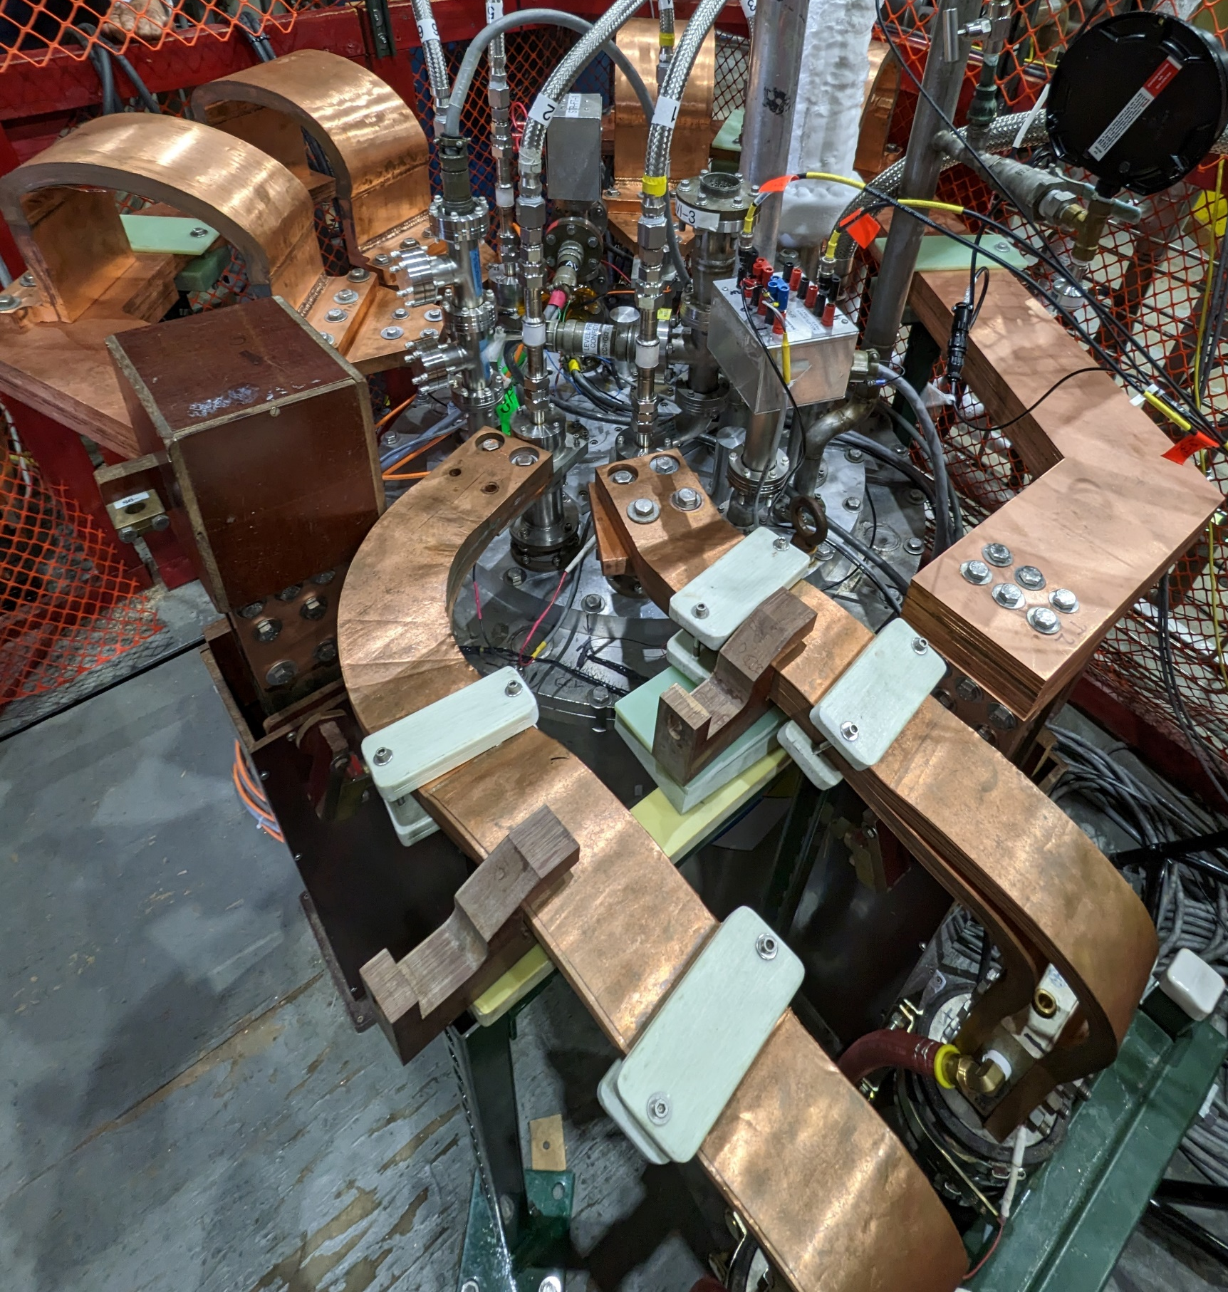
Power Leads
Gas cooled leads
Common coil leads

Slide 5
Simplified Power circuit conceptual block diagram
+
-
Sampling rate:
Slow logger=1 Hz
Fast logger=100 kHz
5 kA
DCCT
+
-
5 kA
PS Shut off
+
-
Fast and slow
data acquisition
Isolation &
Pre-Amplification
MDP coil
15 kA
DCCT
Isolation &
Pre-Amplification
Fast and slow
data acquisition
Common
coil
+
-
37.5 mΩ
37.5 mΩ
15 kA
DCCT
Quench detector
HP meter 1
HP meter 2
Quench Detector Interaction Logic
Trigger signal
Quench detector
Quench detector

Slide 6
Summary of the upgrades
Common coil operation up to 10 kA ≈ 9.44 T background field=> up to 9 kA (8.5 T) validated.
Sample #1 operation up to 20 kA=> up to 15 kA validated.
Sample #2 operation up to 4 kA.
Three FPGA based standalone quench detectors=> timing validated.
Automated cryo-controls validated.
128 channels for logging signals at 100 kHz.
64 channels for logging signals at 1 Hz.
Future upgrades
50 kA superconducting current transformer.
In dual 10 kA PS system, IGBT switch for energy extraction.
Up to 40 K test chamber.
Development of advanced instrumentation: Fiber optics, acoustics, cryo electronics etc.

Slide 7
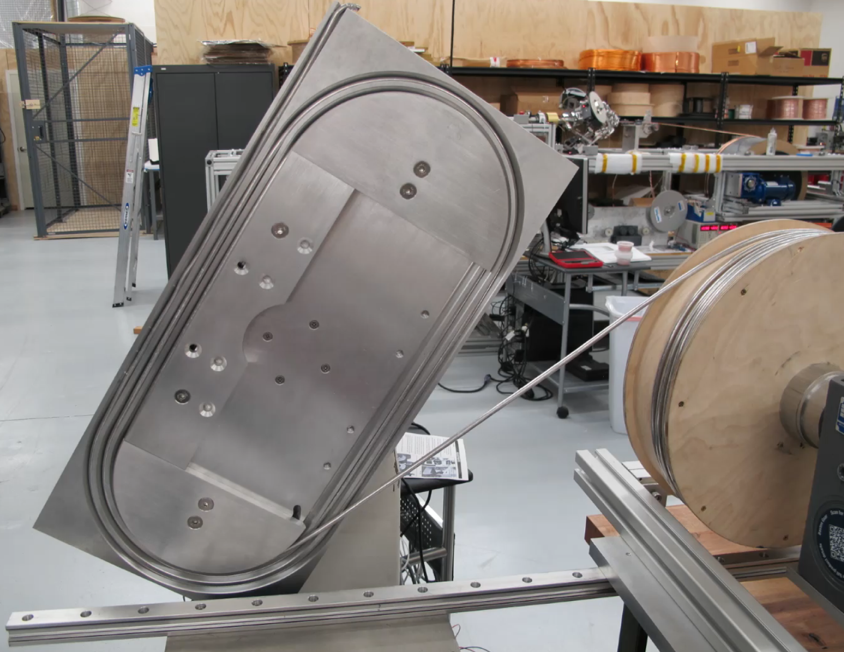
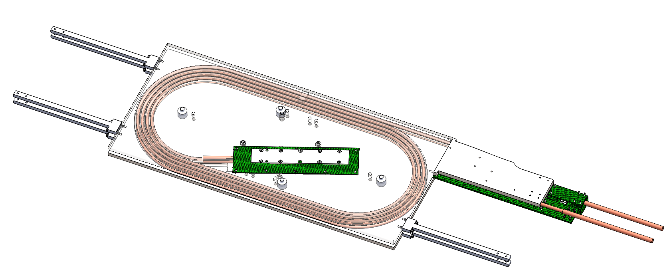
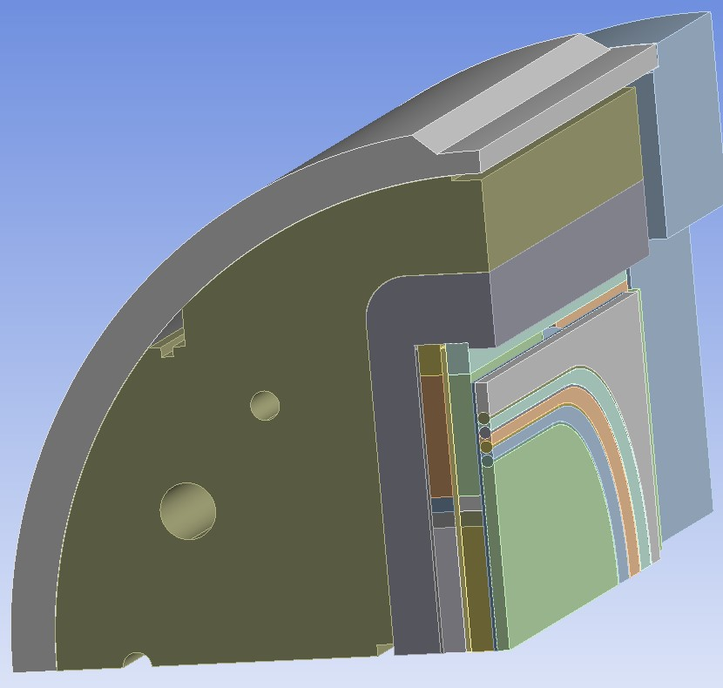
MDP CORC® insert coil
D Laan, J Weiss, Z Johnson,
R Tyber, L Luo, M, Martchevsky, X Wang
BNL, ACT, LBNL
The MDP insert coil consists of two pancake coils in racetrack geometry and is wound with a total of eight turns (four turns per pancake coil) of CORC cables.
The short sample critical current of the conductor is 11.04 kA at 10T field and 4.2 K temperature.
The self-inductance of the magnet is 7.7 μH.

Slide 8
The CORC® conductor
Short sample critical current of the conductor is 11.04 kA at 10T field and 4.2 K temperature.
Expected 10-20 % reduction after winding.
Layer | # tapes | type | thickness [mm] | Width [mm] | ID [mm] | gap [mm] | pitch [mm/rev] | alpha [°] | Layer Ic (77K) | Tape/ spool
1 | 2 | SC | 0.051 | 4.00 | 4.24 | 0.50 | 12.21 | 42.51 | 268 | 23.18
2 | 2 | SC | 0.051 | 4.00 | 4.35 | 0.50 | 11.97 | 41.22 | 268 | 23.81
3 | 2 | SC | 0.051 | 4.00 | 4.45 | 0.50 | 11.75 | 40.03 | 268 | 24.45
4 | 2 | SC | 0.051 | 4.00 | 4.56 | 0.50 | 11.57 | 38.91 | 290 | 25.09
5 | 2 | SC | 0.051 | 4.00 | 4.67 | 0.50 | 11.40 | 37.85 | 290 | 25.73
6 | 2 | SC | 0.051 | 4.00 | 4.78 | 0.50 | 11.25 | 36.86 | 288 | 26.37
7 | 2 | SC | 0.051 | 4.00 | 4.88 | 0.50 | 11.11 | 35.93 | 288 | 27.01
8 | 2 | SC | 0.051 | 4.00 | 4.99 | 0.50 | 10.99 | 35.04 | 288 | 27.66
9 | 2 | SC | 0.051 | 4.00 | 5.10 | 0.50 | 10.88 | 34.20 | 288 | 28.30
10 | 2 | SC | 0.051 | 4.00 | 5.20 | 0.50 | 10.78 | 33.40 | 288 | 28.95
11 | 2 | SC | 0.051 | 4.00 | 5.31 | 0.50 | 10.69 | 32.64 | 288 | 29.60
12 | 2 | SC | 0.051 | 4.00 | 5.42 | 0.50 | 10.60 | 31.92 | 288 | 30.26
13 | 2 | Kapton | 0.104 | 6.30 | 5.45 | -2.10 | 9.64 | 29.38 |  | 32.80
14 | 2 | Cu | 0.05 | 4.00 | 5.67 | 0.50 | 10.43 | 30.36 |  | 31.65

Slide 9
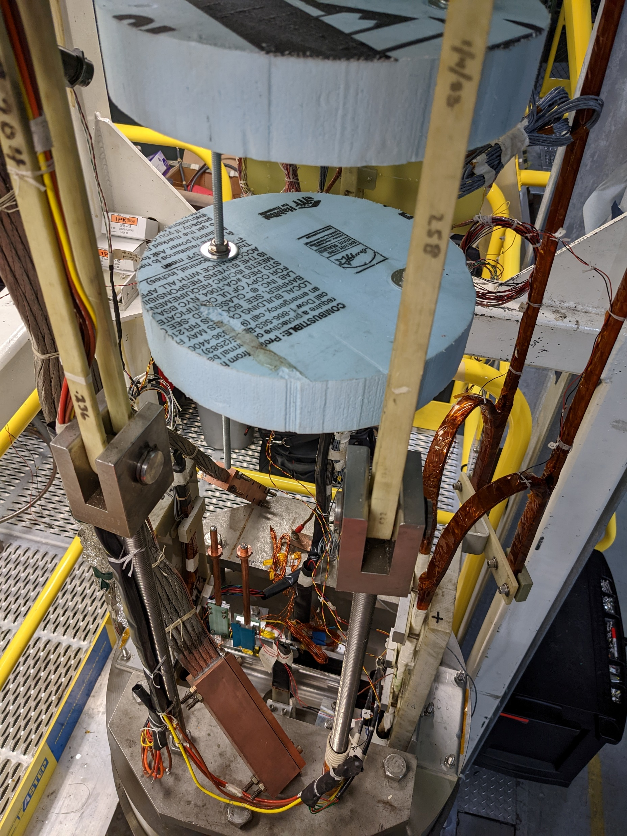
Sample installation

Slide 10
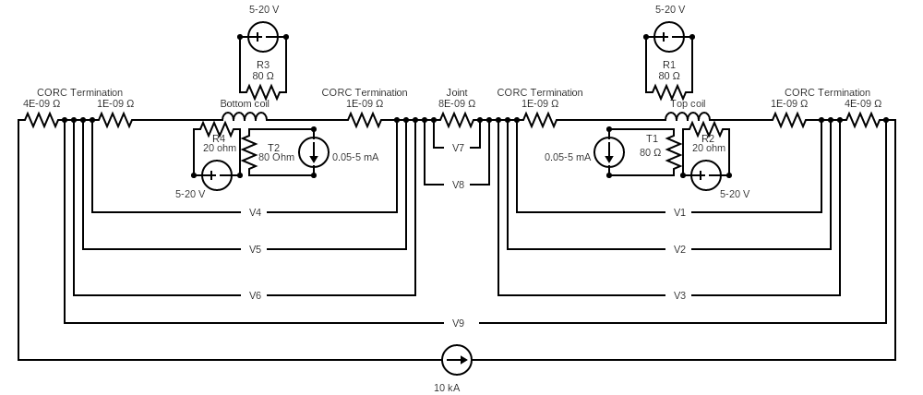
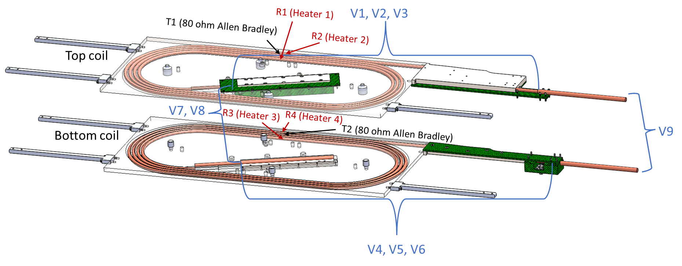
Instrumentation
Voltage taps: center taps, taps at the terminals and across the splice.
Hall probe installed in one of the coil apertures (2 hall probes at same location).
Hall probe array (14 hall element probes: 7 on each coil termination). The hall probes are connected in parallel. Powered by two voltage sources (2-4 V).
Co-wound acoustic waveguide. The voltage pins must be shorted during cool-down.
Cernox® temperature sensors (4-wire method, 2 sensors at same location) and Allan Bradley (AB) resistors (one each on the top coil and the bottom coil at the middle of the straight section in aperture #1).
Spot heaters (35-gauge nichrome wires, approximately 10 Ω) for the quench initiation: RX1, RX2, RX3, RX4. One these four spot heaters would be used for the quench initiation.

Slide 11
Experiments
Maximum I_{CC}= 10 kA,
Maximum I_{MDP}= 15 kA
Note:
The transfer function for the magnetic field in the aperture of DCC017 is 0.944 T/kA.
Selective list of experiments conducted on December 19th and 20th.
I_{CC}= 5 kA (B_{background}= 4.7 T), I_{MDP}= 12 kA (no quench), 14.4 kA.
I_{CC}= 6 kA (B_{background}= 5.7 T), I_{MDP}= 11.1 kA, 12.87 kA.
In each of these, bottom coil quenched.

Slide 12
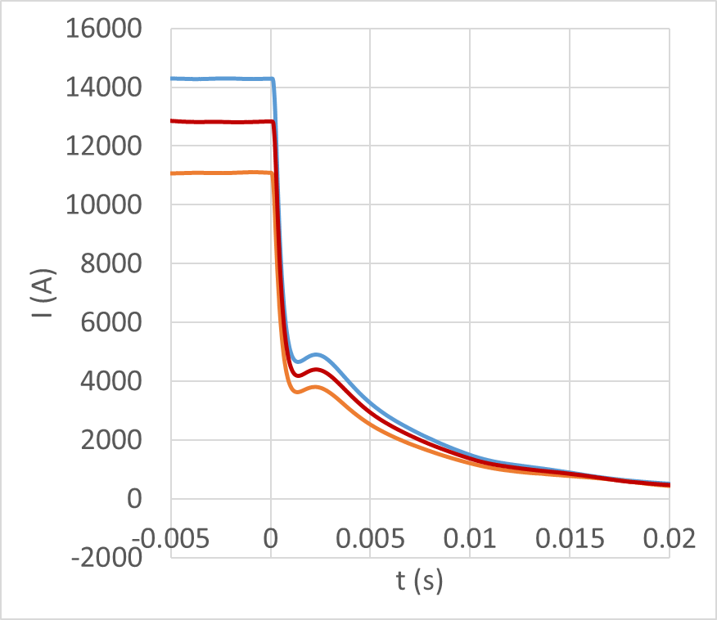
I=I(t)
Fast Logger
Signals
5 A/s
Slow Logger
Signals
20 A/s
I_{CC}= 5 kA
I_{CC}= 6 kA
I_{CC}= 6 kA
The MDP insert coil quenched at 14.36 kA with common coil outsert at 5kA. This amounts to total field of 6.28T. (4.72T from Common Coil and 1.56T from the self-field).
The MDP insert coil quenched at 12.87 kA with common coil outsert at 6kA. This amounts to total field of 7.06T. (5.66T from Common Coil and 1.4T from the self-field).

Slide 13
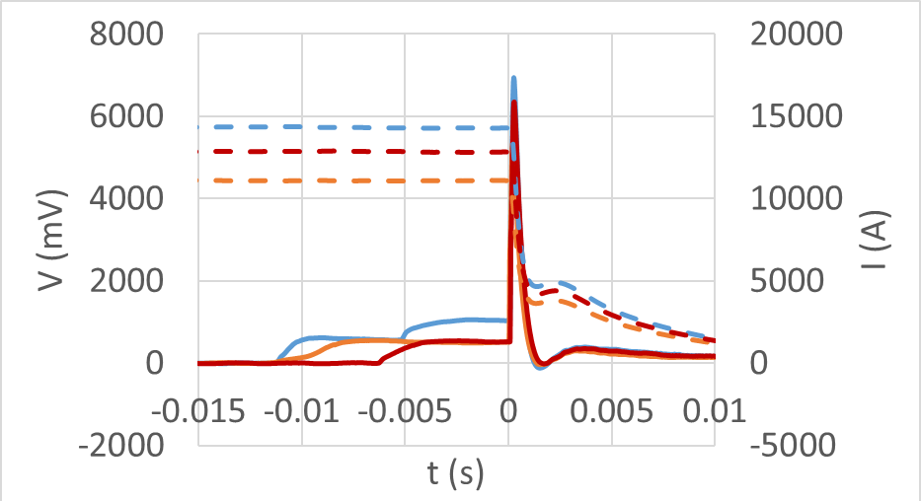
Difference Voltage
Fast Logger Signals
Current
$$V=V\left({\frac{1}{2}}^{+}\right)−V\left({\frac{1}{2}}^{−}\right)$$
Different detection thresholds and validation times
Difference
Voltage
I_{CC}= 5 kA
I_{CC}= 6 kA
I_{CC}= 6 kA

Slide 14
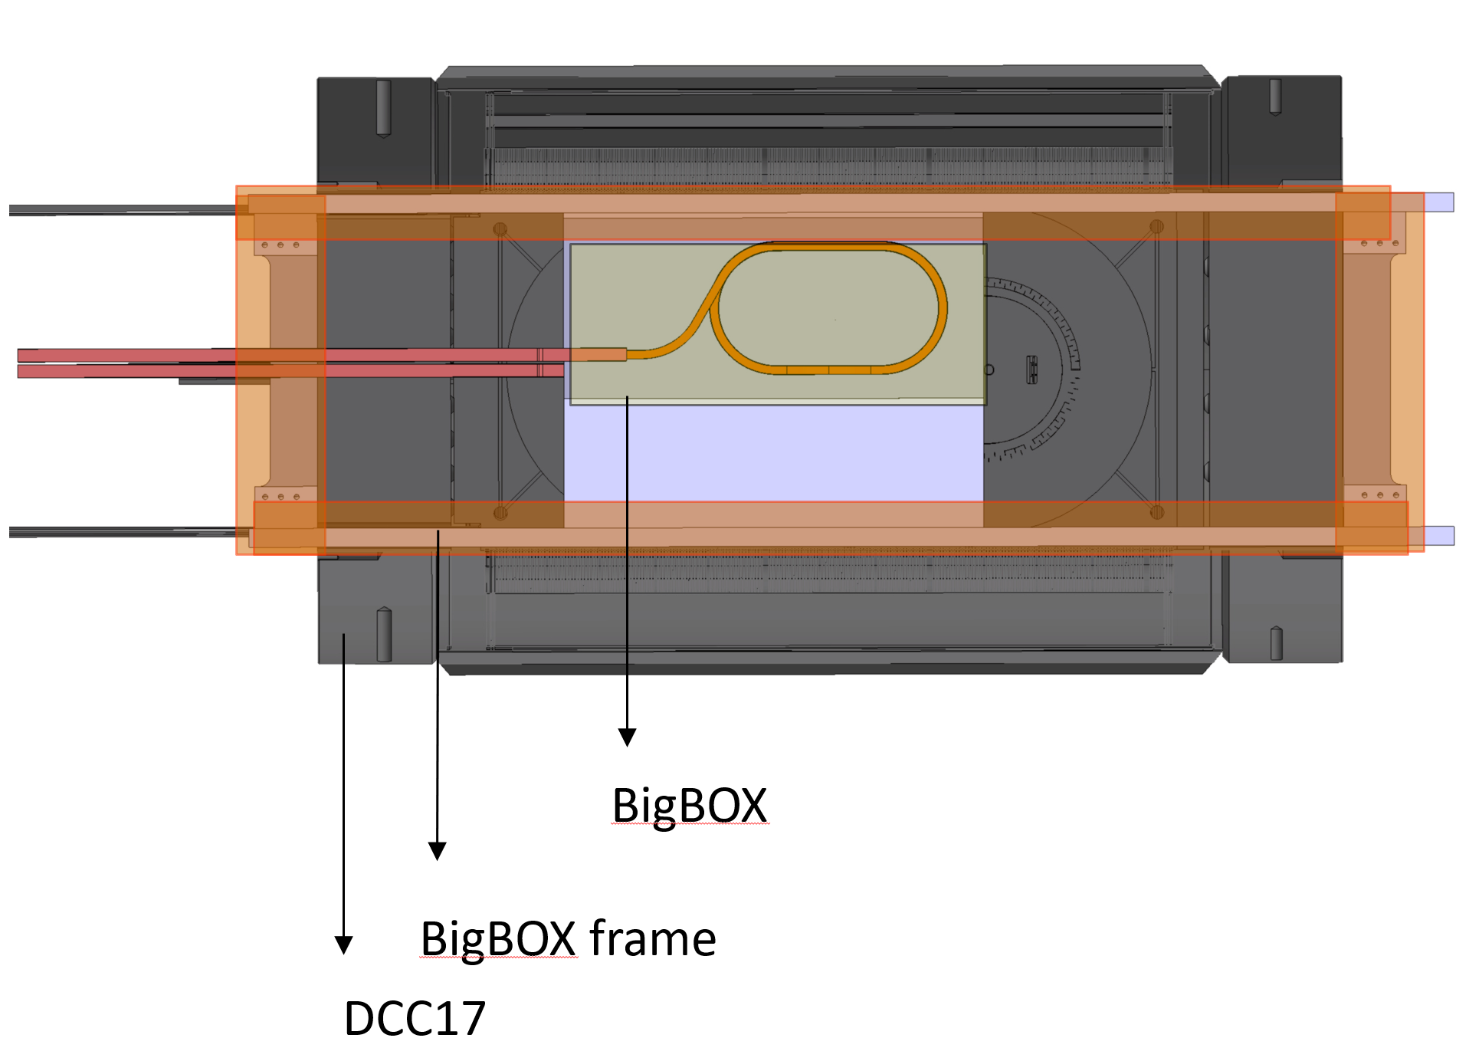
BIGBOX test (BNL+PSI)
Slide Courtesy

Slide 15
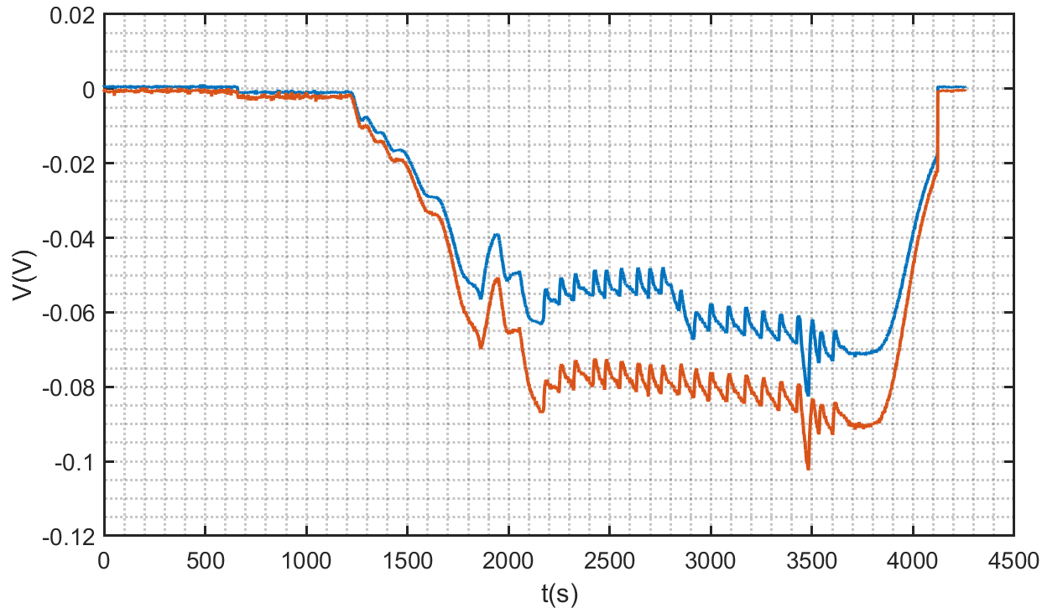
BIGBOX test (BNL+PSI)
9 kA X 0.944 T/kA = 8.5 T
Current in Common Coil held at 9 kA constant for 30 minutes
Validated GCL joints=> Common coil stable operation.

Slide 16
Conclusions and Perspectives
At DCC017, we can test coils/conductors with background dipole field of up to approximately 8.5 T.
Maximum sample current with a DC Power supply is 20 kA (limited by gas cooled leads). Ideal for quench propagation studies (I,V,T vs x,t).
A 50 kA SC transformer is under construction. Ideal for coil/ conductor characterization (I_{C} vs B vs T).
Performance of three independent standalone FPGA based quench detectors with fast acting IGBT switches was validated.
Data Loggers: approximately 128 channels for fast loggers (100 kHz sampling rate), approximately 64 channels for slow loggers (1 Hz sampling rate), HP high precision multimeters.
Finish BIGBOX test, Retest MDP coil, Test STTR coil.

Slide 17
Extra slides

Slide 18
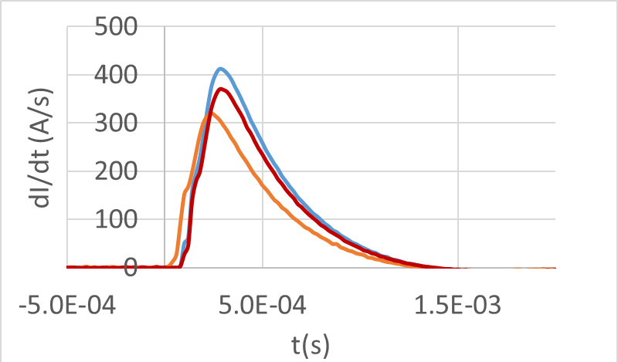
Total Voltage
Total
Voltage
0
Accelerated
decay
De-accelerated
decay
Total
Current
When switch opens, the normal zone grows and the current decay accelerates.
At 250 μs, a decrease in conductor current (and thus joule heating) and the Helium bath cooling causes de-acceleration in rate of normal zone growth.
At 1.5 ms, the rate of cooling is equal to the rate of joule heating. NZPV = 0 m/s.
Thereafter, the normal zone shrinks.
At 1.65 ms, the whole coil is superconducting.

Slide 19
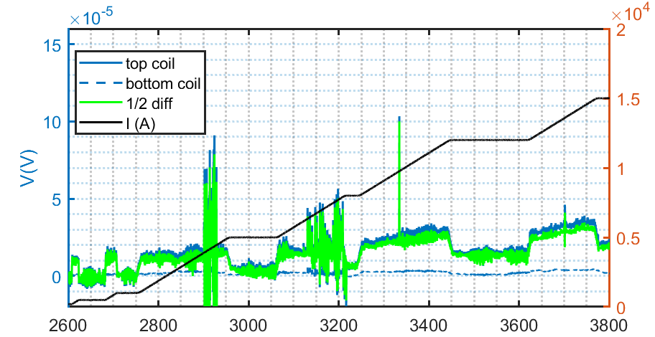
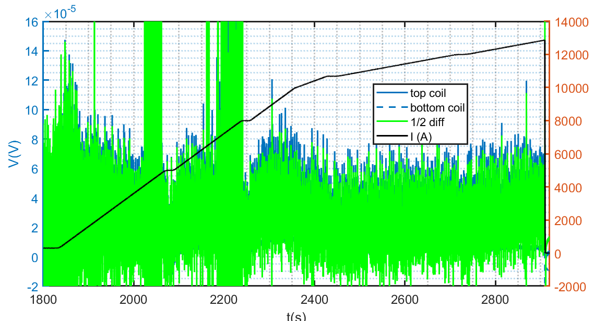
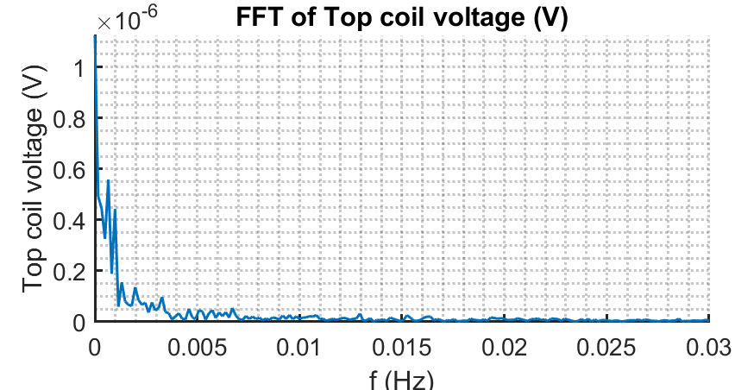
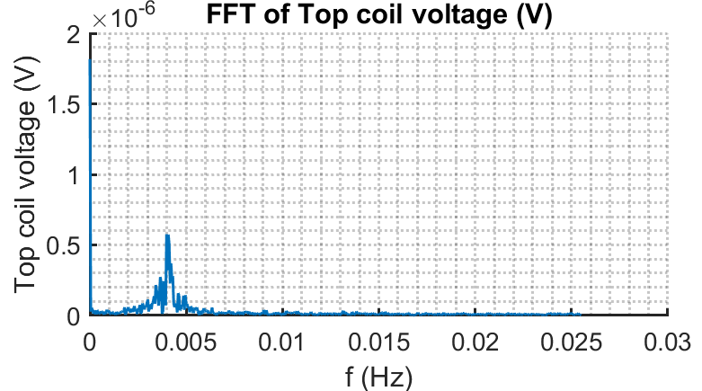
Quench recorded with HP high precision meters
HP 3458A
I_{MDP}=12.87 kA, I_{CC}= 6 kA
I_{MDP}=15 kA, I_{CC}= 0 kA

Slide 20
