Slide 1
HTS Magnets – REBCO
FNAL Report and Conductor Needs
Vadim Kashikhin
2023 MDP Collaboration Meeting
March 22, 2023

Slide 2
COMB magnet development with CORC cables
Extensive studies have been conducted on short CORC® samples:
  It was found that winding the cables into the COMB structure resulted in a considerable loss of critical current (I_{c}), often reaching 50%,
  It has not been previously observed on uniaxial (hairpin) bent samples.
Further analysis performed by Advanced Conductor Technologies (ACT) revealed the issues with drying lubricant used in CORC® production and high surface roughness on latest REBCO tapes, which hampered the bending performance.
The next generation of CORC® cables have been optimized by ACT to accept tapes with high surface roughness using new lubricant formula, winding method, and production parameters that allowed to reach ~80% I_{c} retention. Additional improvement was reported at ASC22.

Slide 3
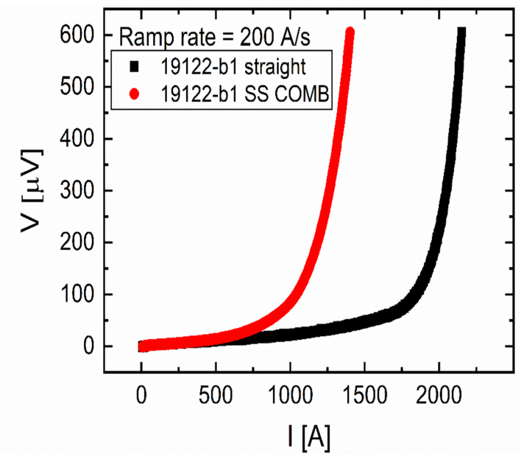
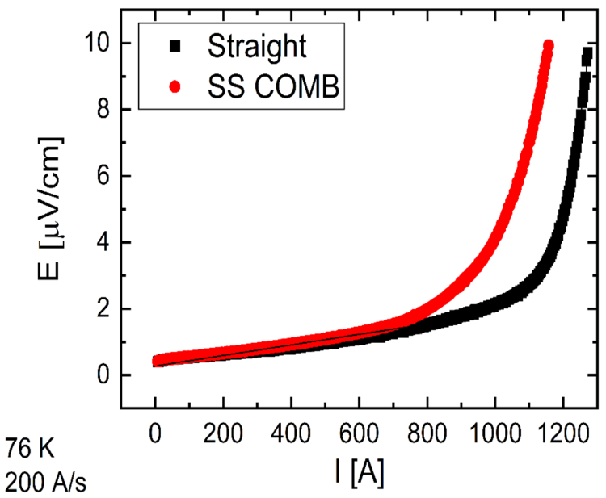
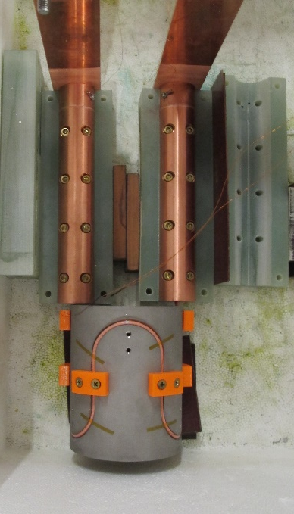
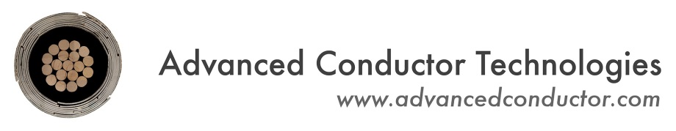
COMB magnet development with CORC cables
Early CORC cables
Later CORC cables
56 mm
Critical current of CORC cables before and after winding into the COMB structure with 100 mm ID:
  ~56% I_{c} retention in the early CORC designs
  Improved to ~80% I_{c} retention in the next generation cables
CORC-related activities are currently on hold pending procurement of the conductor with improved flexibility:
  Plans to build a 100-mm bore insert and test it as a part of a hybrid HTS/LTS magnet system in 2024-25
316L sample holder with serpentine channel and 3 bends
Data courtesy of

Slide 4
STAR in COMB SBIR with AMPeers
Phase-I (ongoing) results by mid-April 2023:
  STAR wire fabrication by AMPeers LLC – 2x5-m long pieces with 12 tapes and expected self-field I_{c} of ~1 kA at 77 K
  COMB demonstration magnet with 60 mm clear bore - design and fabrication at Fermilab
  Testing in LN₂ at Fermilab
  Target is >90% I_{c} retention after winding, but >70% is considered acceptable (with the expectation of future improvements)
Phase-II (if approved) 2024-2025:
  Manufacturing of ~100 m of STAR wire
  Fabrication of a multi-layer COMB dipole magnet
  Testing the magnet in liquid helium to demonstrate >5 T field in 60-mm bore generated by the HTS coil (performance demonstration)
  Possible hybrid test, if supported my MDP

Slide 5
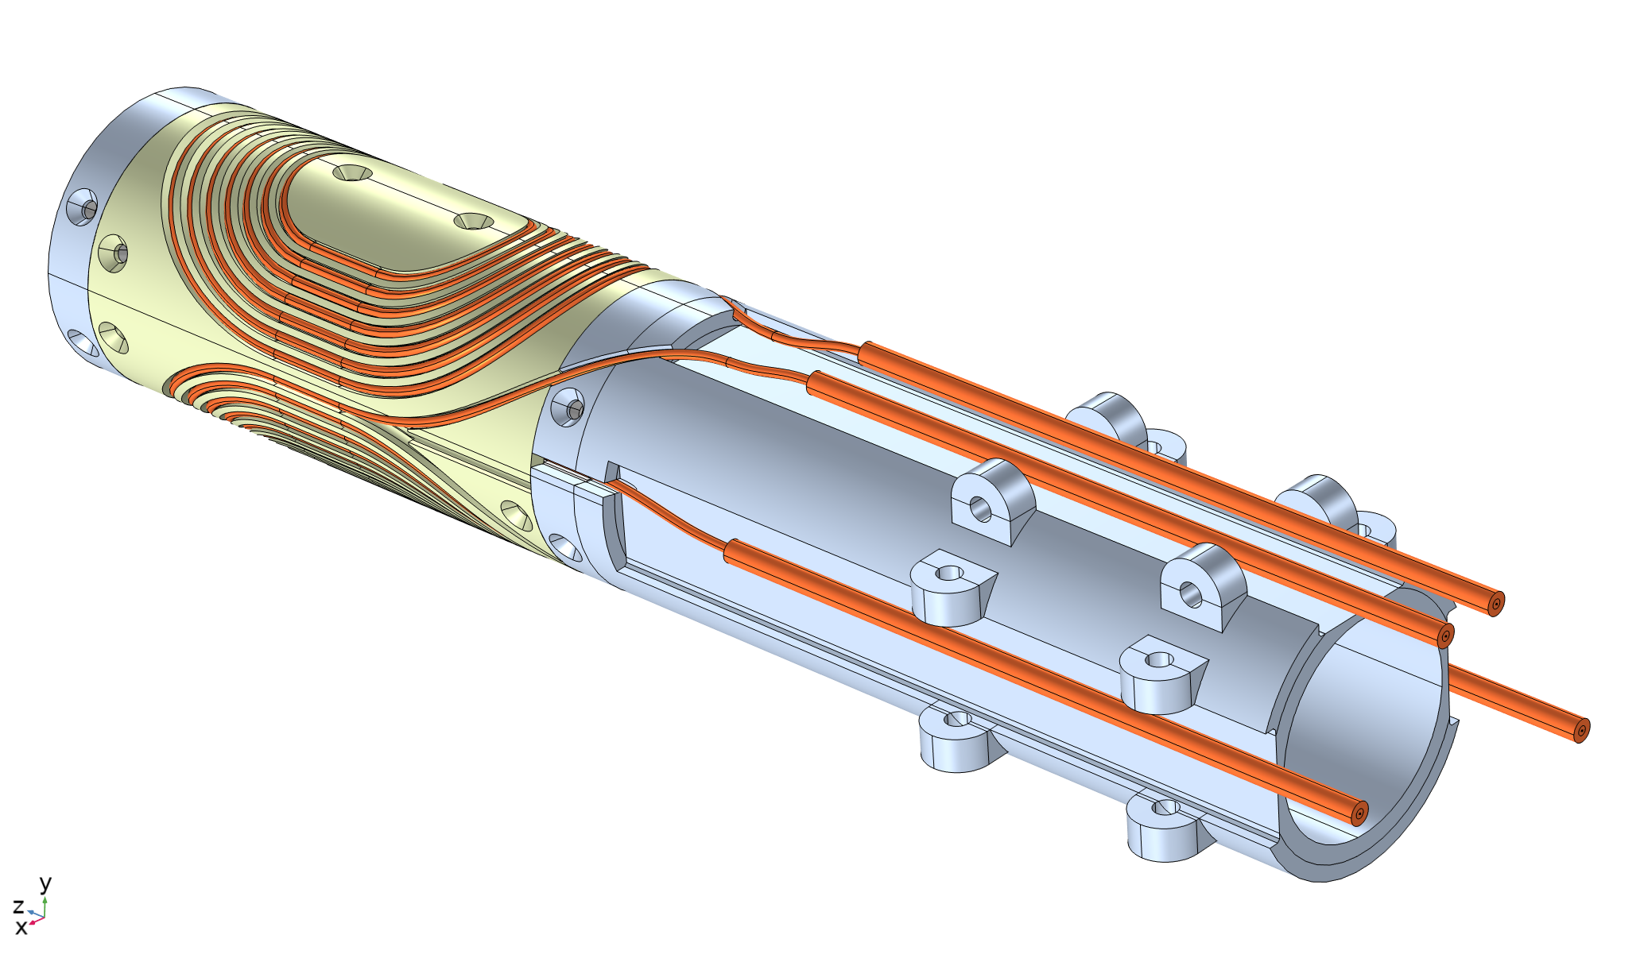
Coil/structure design
60 mm clear bore
Two half-coils, with two layers of cable each
5 m of STAR wire per half-coil, including the leads
The STAR wire is not insulated – COMB structures should not be electrically conductive
The channel is oversized to account for the thermal contraction of high-strength thermo-plastics (ULTEM)

Slide 6
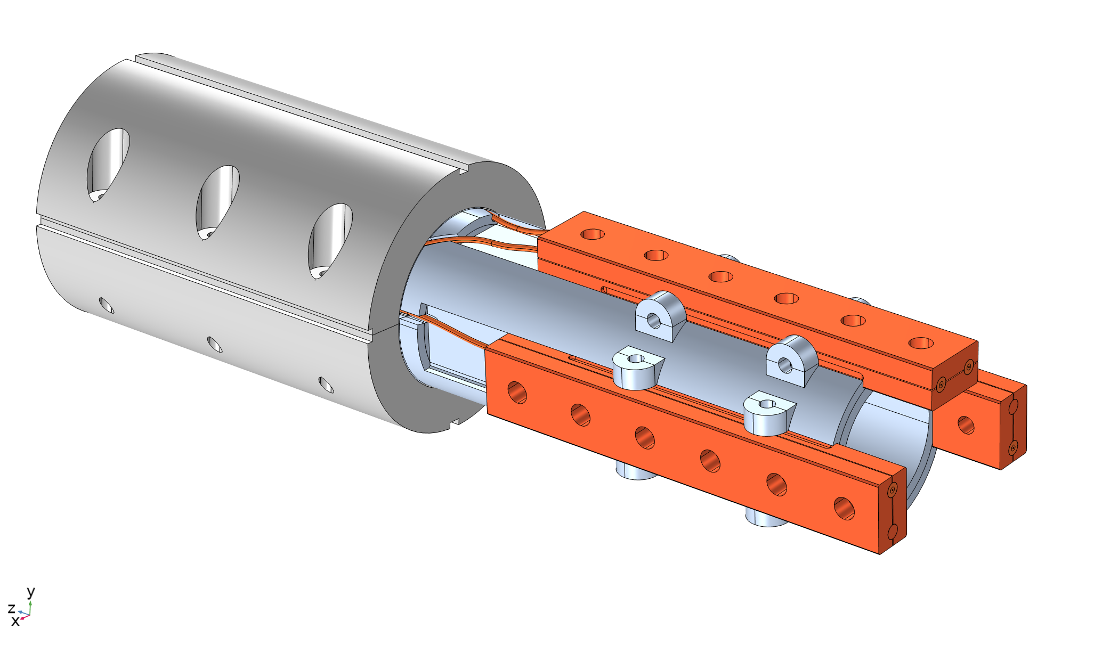
Iron yoke and terminals
Iron yoke is sized for LN₂ test with the expected bore field of 0.2-0.3 T
Designed to fit into ~400 mm OD yokes from Nb₃Sn magnet projects, which will be needed if LHe test is performed (in Phase-II) due to 4-5 T bore field
There are 3 copper adapters with the middle point between the top and bottom coils
It allows to test each half-coil separately and together

Slide 7
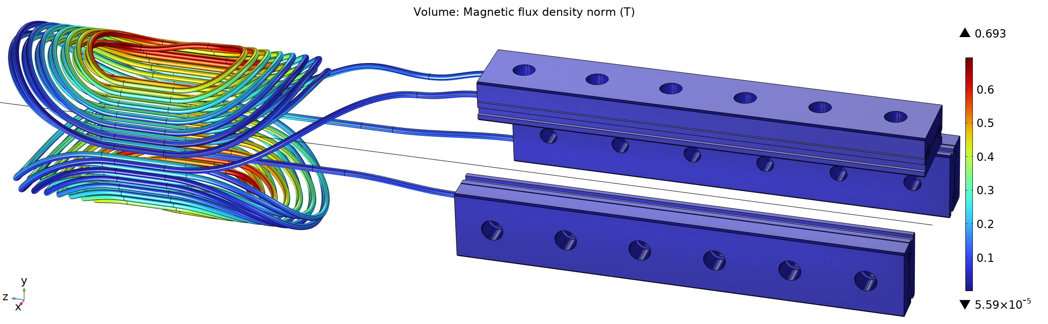
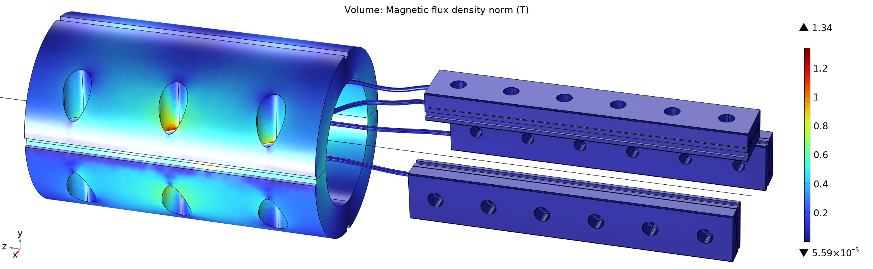
Coil and iron field
Peak field TF: 0.694 T/kA. Linear with current as the yoke is not saturated

Slide 8
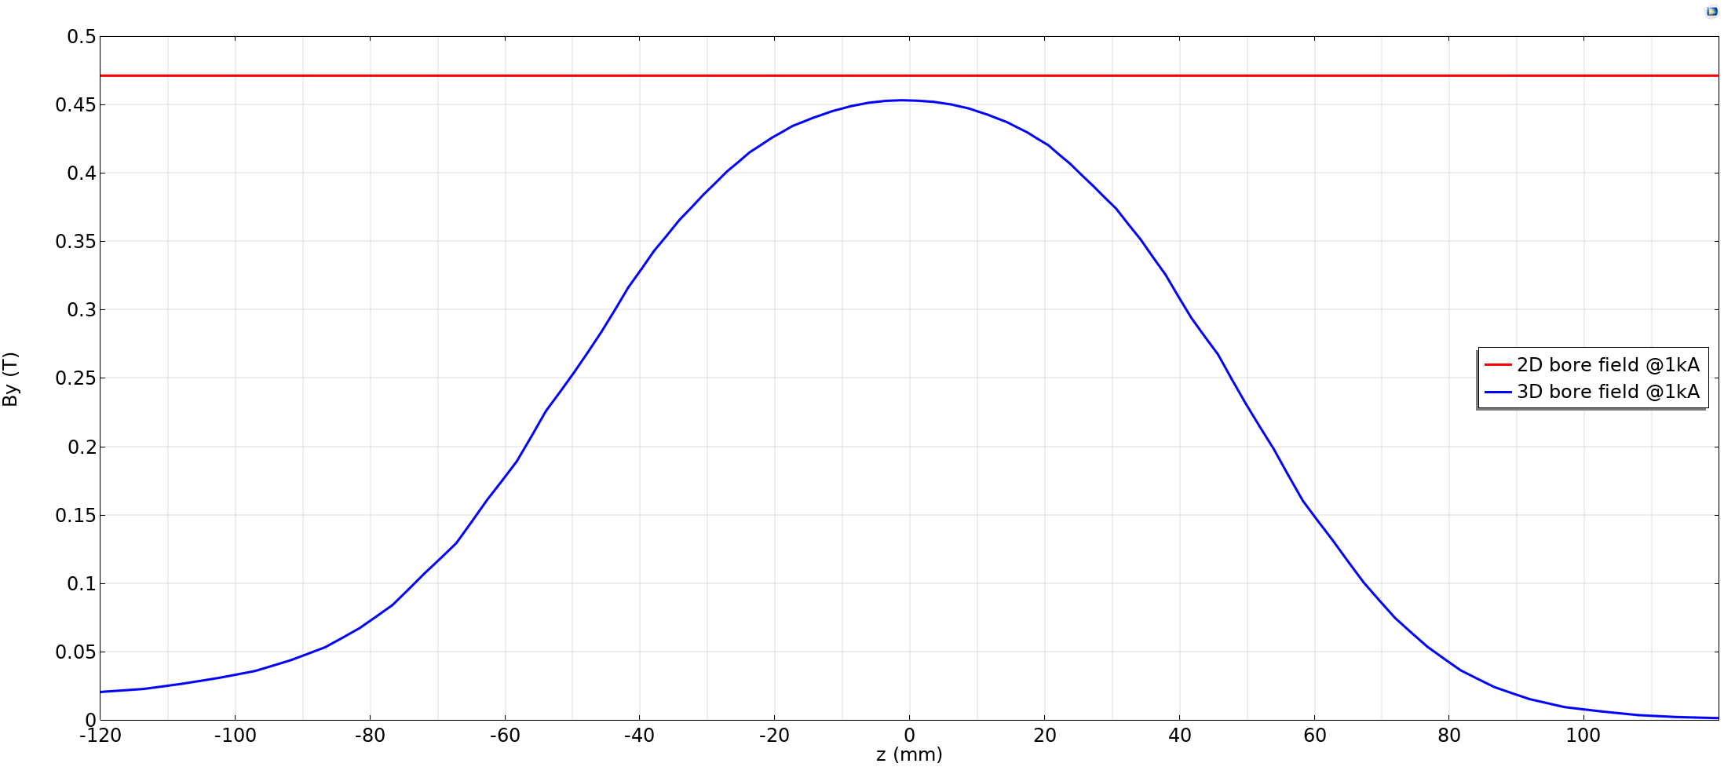
Bore field
Absence of the flat region in the magnetic field distribution means there is no magnetic straight section. Not important for the purposes of the Phase-I project.
The magnet length will be increased in Phase-II to have a proper magnetic straight section and a measurable field quality.

Slide 9
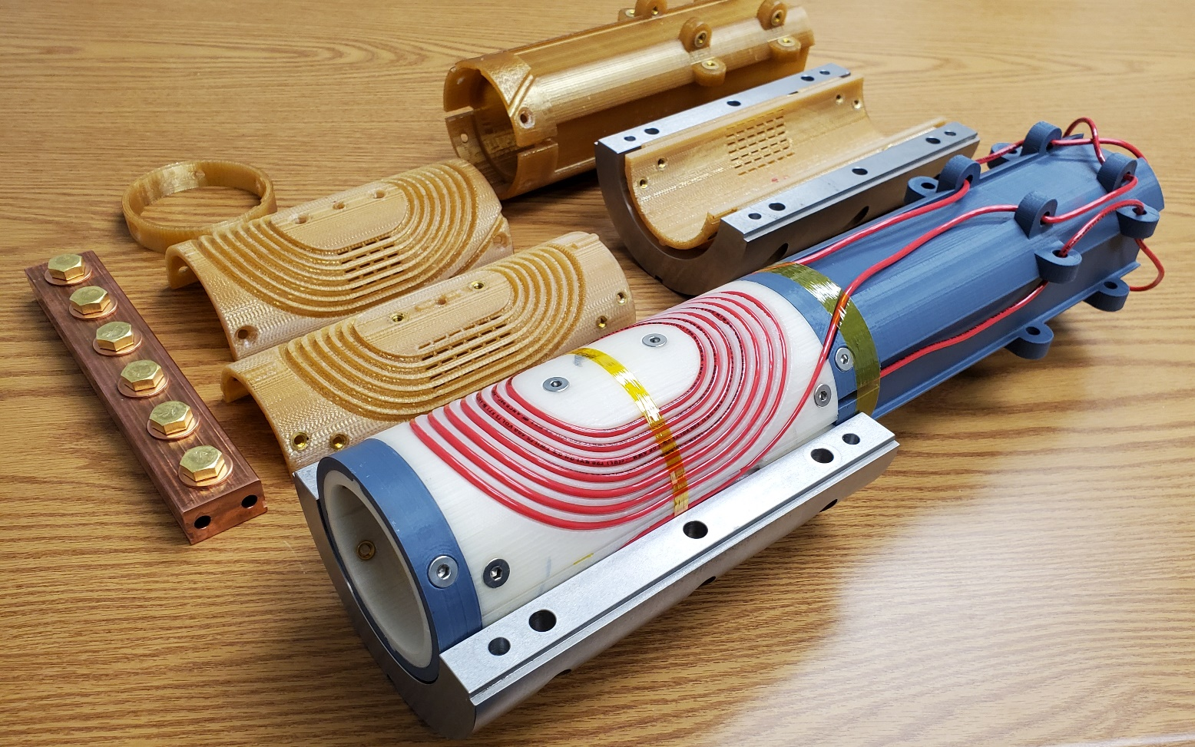
Pre-fabrication activities
Practice to go through all the steps prior to working with the real STAR wires
  Wound four mockup half-coils into the dummy and real (ULTEM) structures
  Installed ground insulation and assembled the iron yoke
The COMB-STAR magnet will be fabricated and tested in March-April 2023

Slide 10
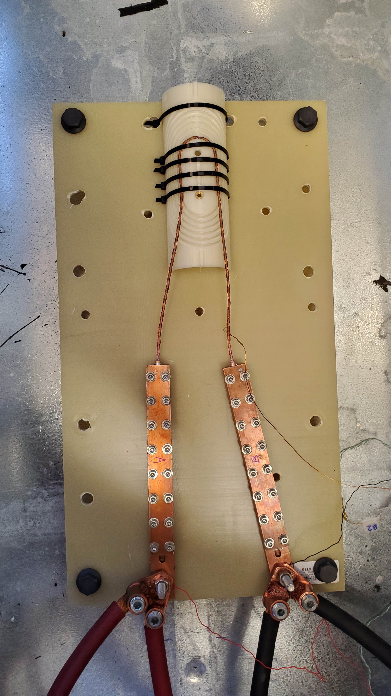
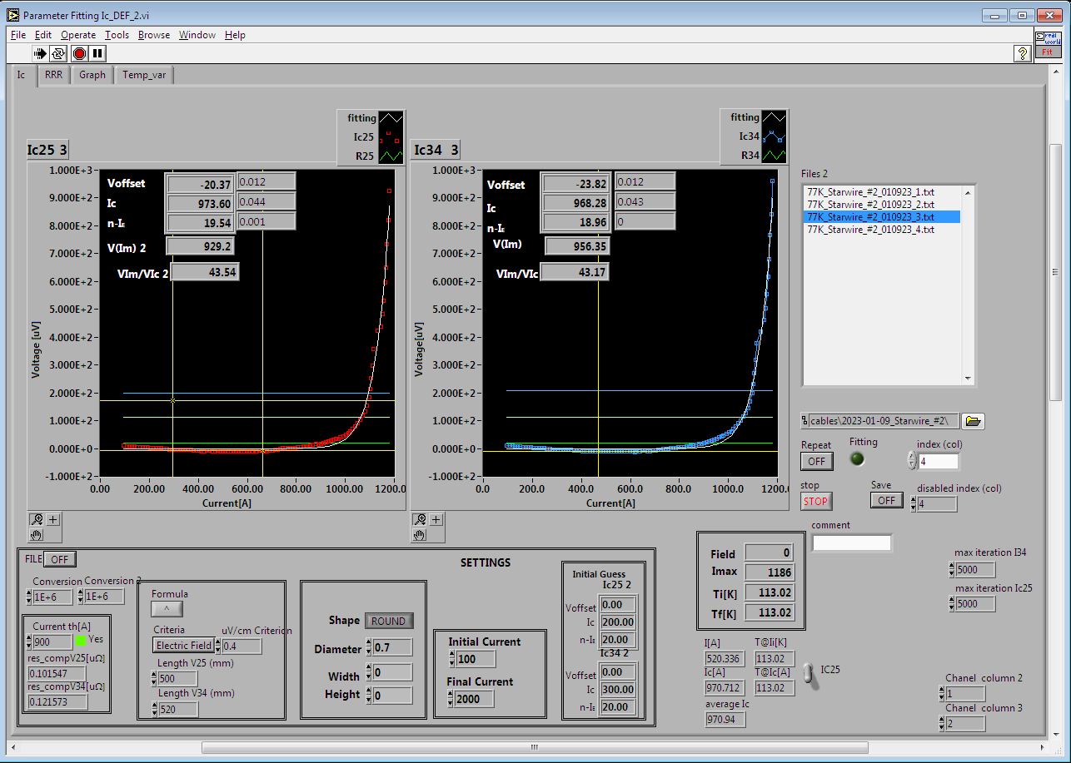
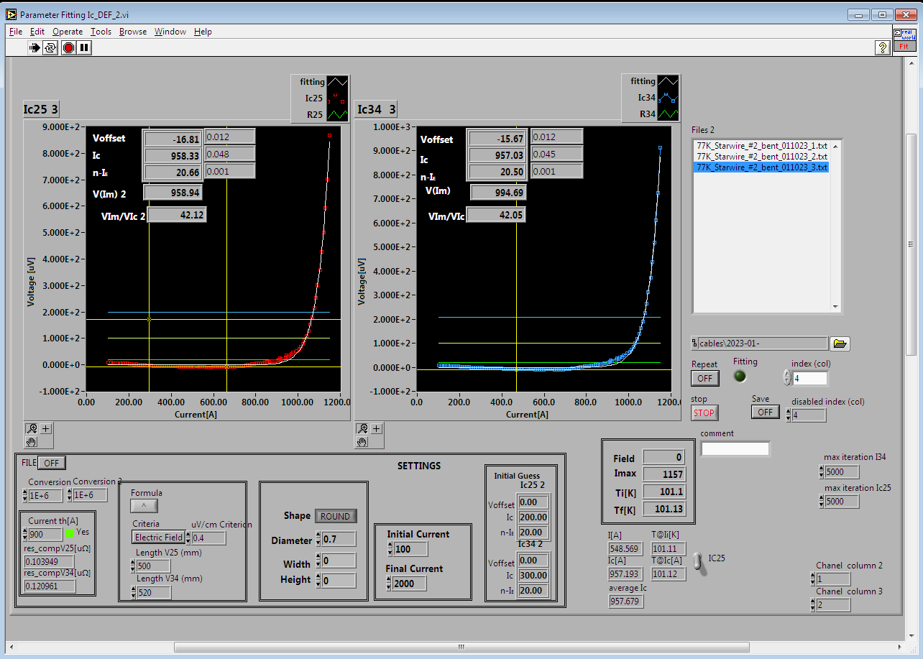
Short STAR wire testing
33 mm
A short piece or STAR wire was tested in LN₂ before and after bending around the 33-mm wide pole in the COMB structure (the tightest bend in the coil)
~98% critical current retention was observed (not corrected for the self field), which essentially means no degradation due to bending

Slide 11
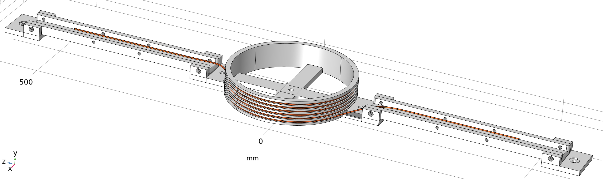
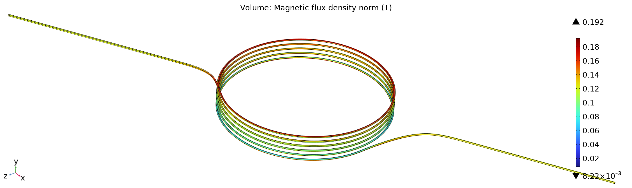
Long STAR wire testing (I)
2x5 m of STAR wire were delivered last week
Each piece will be coiled onto a large diameter spool and tested in LN₂ prior to winding into the COMB structure
Peak field TF: 0.192 T/kA

Slide 12
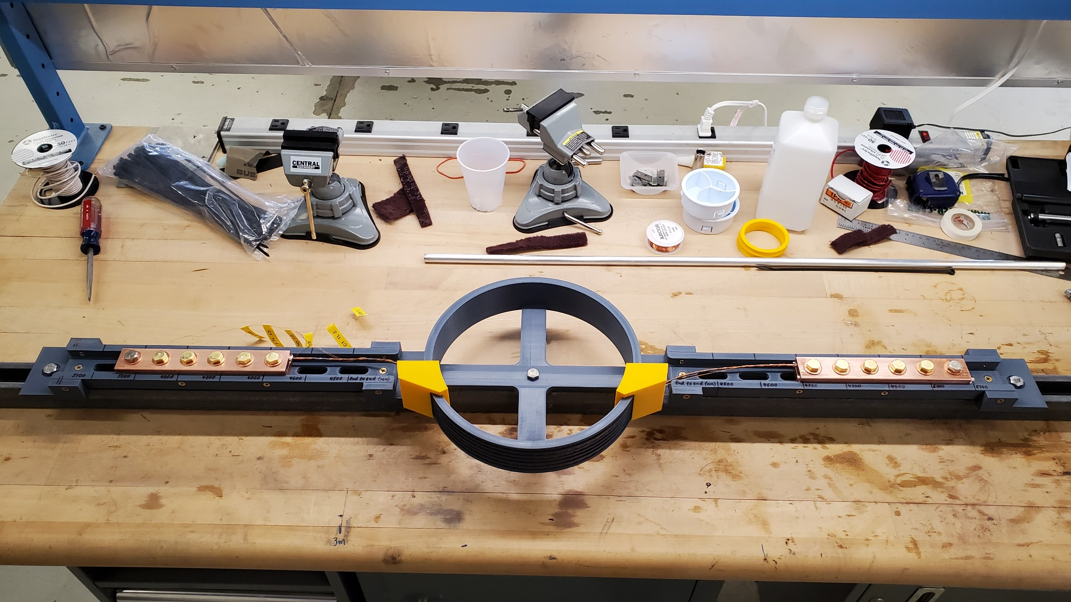
Long STAR wire testing (II)

Slide 13
Load lines and expected currents
Expected critical currents are from the tape measurements by AMPeers – to be confirmed by the long STAR wire tests at Fermilab
The most conservative assumptions are used:
  Total peak field on the surface rather than the normal and tangential components
  No current sharing due to incomplete tape transposition
Expected COMB magnet performance (with no bending degradation):
  500 A at 77 K
  9 kA and 4 T bore field at 4.2 K

Slide 14
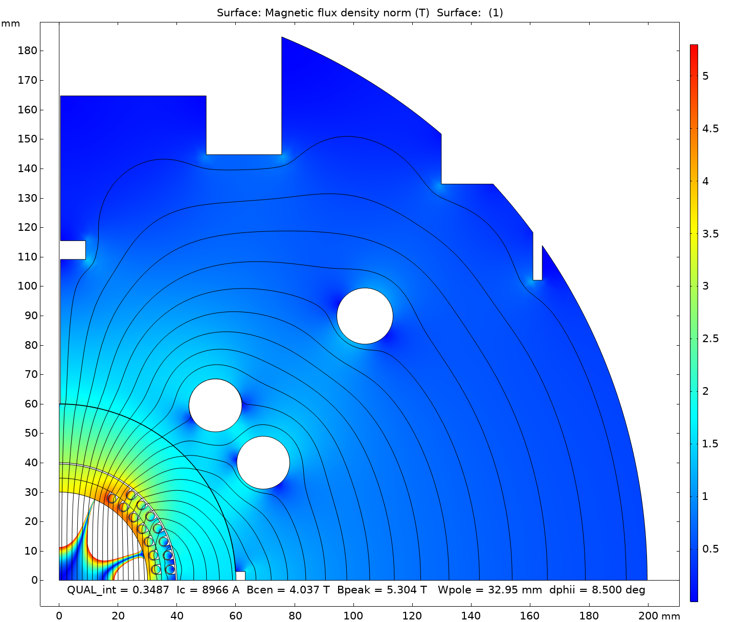
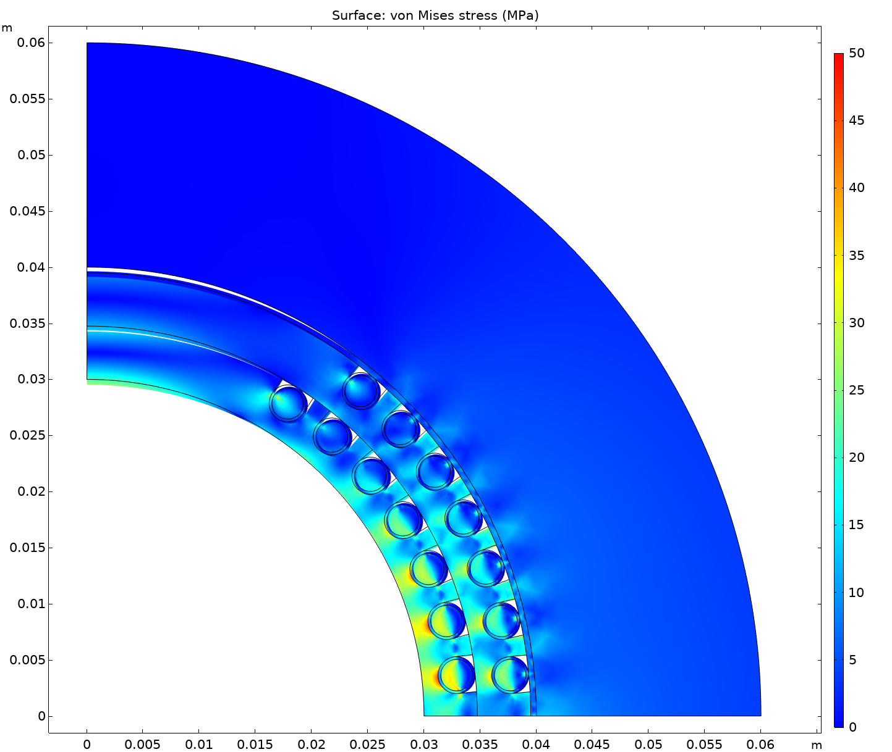
Performance at 4.2 K with a large iron yoke
46 MPa in structure
(245 MPa comp Y.S.)
34 MPa in conductor
The ULTEM thermoplastic is relatively soft with only ~3 GPa of elasticity modulus
  The structure get compressed towards the midplane, which results in large stress difference between pole and midplane turns
  Can be improved by using a metallic structure
However, the peak stresses are small. The magnet can be tested at 4.2 K “as is”

Slide 15
Conductor needs
25 m of CORC cable with improved bendability based on HM tapes. Will be used to fabricate the first COMB demonstration magnet with the CORC cables.
  CPRD meeting in April to discuss this procurement
  The coil will have 100 mm clear bore and 120 mm OD
  Fabrication and stand-alone LN₂ and LHe tests in 2023-2024
  Hybrid test as an insert in a NB₃Sn magnet (TBD) in 2025
100 m of STAR wire to fabricate a multi-layer (~4 layers) performance demonstration magnet to reach 5-7 T field in 60 mm bore.
  Application for the Phase-II SBIR with AMPeers
  Fabrication and stand-alone LN₂ and LHe tests in 2024
  A possible hybrid test as an insert in a NB₃Sn magnet in 2025

