Slide 1
What happened outside since last CM?
February 2022, Russia invaded Ukraine
October 2022, CERN reduced experiment time next year by 20% as energy costs bite
Will these lead to a higher magnet operating temperature?

Slide 2
Count on fusion or not?
Fusion development is an experiment. In two years we shall see if it can lead to a sustainable market
Fusion conductors are not necessarily suitable for HEP
Consider HEP investment to continue driving the conductor development. It may help fusion too

Slide 3
A dedicated wire development program with two vendors to double the current in three years
Fortunately, we have two best characters for REBCO: ACT and AMPeers
Let’s show them $$ and put them to work for HEP
$5 M year for 3 years with measurable goals
Double/triple wire I_{c} at 15 – 20 mm bend radius at 4.2 K, 12 T?
Order wires to make 10 T dipole magnets at Year 3

Slide 4
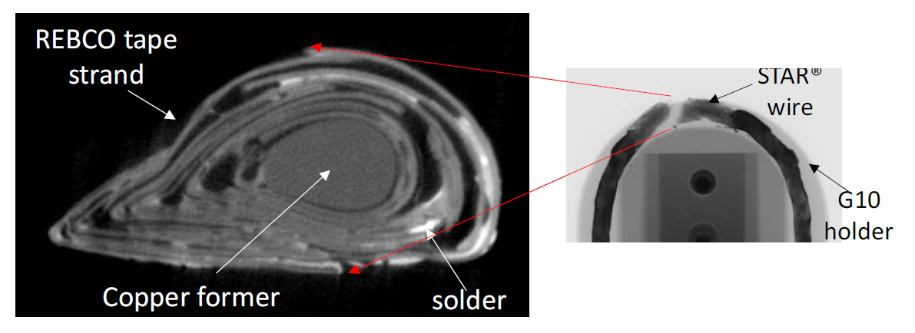
Use high background field to develop high-field magnet conductors
Wire deformed under IxB force, transverse to the wire axis,
2.5 kA, 30 T, 75 kN/m
Recent paper from AMPeers
Need to support the entire wire and the individual tapes inside the wire → impregnation?
Should be a sanity check before testing as insert?

Slide 5
To make progress is not enough
To make progress is not enough, for if the progress is not fast enough, something is going to overtake us. -- Leo Szilard

