Slide 1
Introduction and Milestones
S. Krave, T. Shen, J. L. Rudeiros, C. Reis
US Magnet Development Program

Slide 2
Goals of the working group
Work to develop processes and materials to enable high performance magnet designs
  Evaluate resin systems for standard processing parameters
    Viscosity, mixing processes, curing etc…
Applicable Driving Technical Questions:
  How do magnet materials directly affect magnet training and performance?
  How can magnet materials be designed to facilitate improved magnet performance?
  Can improved processes lead to more cost effective and robust magnet designs?

Slide 3
Materials…
Epoxy is the glue that holds everything together
  It also appears to be key in magnet training
FNAL, LBNL, and CTD are working to develop new insulation systems to allow for higher performance magnets
There are several knobs available:
  Cp, CTE, Fracture toughness, bond strength, modulus, elongation, surface treatments, radiation stability, etc
  These knobs change response to the disturbance spectrum as well as the disturbance spectrum itself, perhaps in difficult to correlate ways

Slide 4
Driving technical questions:
How do magnet materials directly affect magnet training and performance?
How can magnet materials be designed to facilitate improved magnet performance?
Can improved processes lead to more cost effective and robust magnet designs?

Slide 5
Milestones:
AIIIc-M1 | Demonstration of High Viscosity (Thermoplastic) Resin Systems for Superconducting Magnets | Jun-21 | Deferred | Jun-24 | S. Krave
AIIIc -M2 | Down-selection and Fabrication of CCT based on the above | Nov-21 | Obsolete |  | S. Krave
AIIIc -M3 | Evaluation of surface treatments and interface modification | Dec-21 | In Progress | Jun-23 | S. Krave
AIIIc -M3b | Measurement of interlaminar Fracture toughness of Nb3Sn cable stacks and sensistivity to surface treatments
AIIIc -M4 | Characterization of epoxy resin under gamma irradiation |  |  |  | T. Shen/ C. Reis
AIIIc -M5 | Evaluation of High Temperature compatible Mold Releases |  |  |  | S. Krave
Thermoplastics are a bit difficult and we don’t readily have resources to investigate
  Attempting to outsource
Generic washing of cable has not been very promising, but we have some nice, more complicated options

Slide 6
Tasks and goals
Tasks | Rationales | FY20 Q1/Q2 | FY20 Q3/Q4 | FY21 | FY22
1. Thermoplastics | Pros: High toughness and high radiation toughness Cons: (1) High viscosity and high processing temperature | Materials properties assessment: (1) CTE; (2) Shrinkage during cure. | Materials properties assessment: (3) Compression modulus and strength. (4) Shear strength. | Decision point: Testing Thermoplastics on CCT Nb₃Sn subscale magnet (SM)?
2. High toughness resins with CTD | Investigate high toughness epoxy system besides NHMFL mix-61. Support small business to develop and verify new products. Supplement funding from SBIR. | Engage CTD materials testing |  |  | Decision point: Down selections and testing the best formulation on large size magnets. Radiation tests.
 |  | Cable and CCT mandrel fabrications | Testing CTD701x (not an epoxy) on CCT Nb₃Sn SM
 |  |  |  | Testing second formulation on CCT Nb₃Sn SM
 |  |  |  | Testing third formulation on CCT Nb₃Sn SM
Still exciting but no hands or time to complete work
701X magnet was tested with Promising results

Slide 7
Tasks and goals
Tasks | Rationales | FY20 Q1/Q2 | FY20 Q3/Q4 | FY21 | FY22
3. High specific heat, low CTE Gd₂O₃ nanoparticles filled epoxy | Stress management for epoxy, especially those neat resin areas between strands within Rutherford cables. | Ten turn 3D-printed CCT mandrel potting tests. | Decision point: Testing this approach on CCT Nb₃Sn subscale magnet (SM)?
4. Understand epoxy failure with advanced diagnostics | Understanding characteristic events, feeding into modeling and machine learning models | Four cable stack short beam shear. S-2/fiber epoxy short beam shear. | S-2/fiber epoxy compression/shear
5. Improve epoxy resin and Nb₃Sn QA/QC and processing controls | Understand impacts such as temperature gradient, shelf life, and moisture control etc. on properties of epoxy. | Effects of curing temperature on compression properties and T_{g} etc. | Effects of moisture control | Effects of shelf lives of epoxy components.
6. Nb₃Sn Rutherford cable Insulation materials | What are alternative insulation systems and how will they affect quench training?
Some progress at LBNL, not enough resources to complete work
Data from AUP project, exciting info

Slide 8
Work at FNAL
S. Krave

Slide 9
Thermoplastics
Interest to effort ratio is low, but concept is promising
A rather different/difficult process to get into (high capital costs) but should have (comparatively) low production costs (Scalable to large productions)
“Fast” WRT traditional epoxies once established
  Tooling and process are major investment for coil size objects
Working to set up a partnership with Northern Illinois University to fabricate short Nb₃Sn composite samples on an injection molding machine, possibly masters student thesis
  NIU has a PEEK sample to test if their machine can process (~400° C), I’m willing to accept a “lesser” plastic such as PEI, PP, pr PS

Slide 10
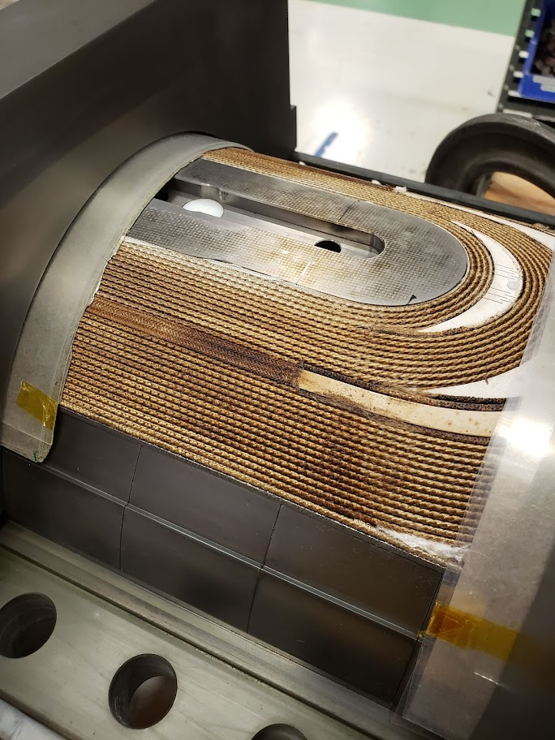
Interface Investigation
Traditionally not much attention is paid to the inputs into a system, cable is insulated and wound without much management of surfaces.
Contaminants are assumed to go away during reaction
  This is not the case.
Reaction residues remain on the cable these likely include
  Decomposed silane coupling agent
  Decomposed cable lubrication
  Other decomposed sizings and dirt
  Ceramic binder
    More silica/silicone ceramic compounds
      Contain carbon in raw state, goal is pyrolysis

Slide 11
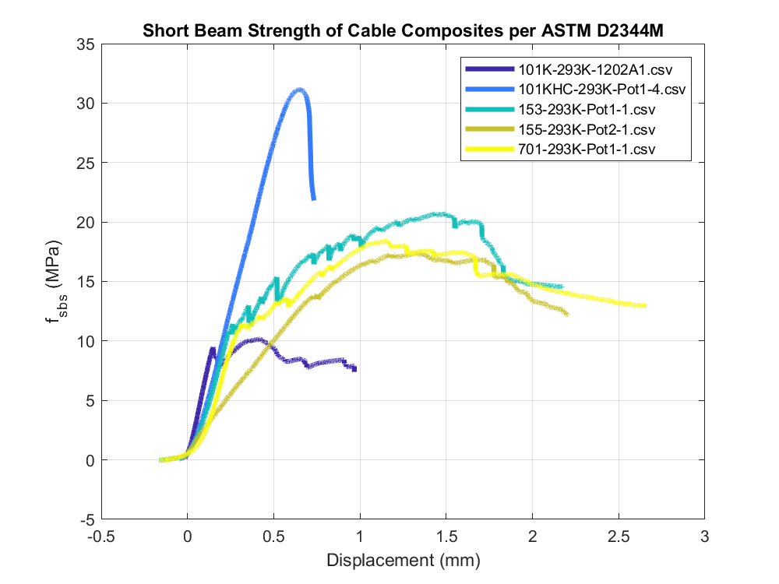
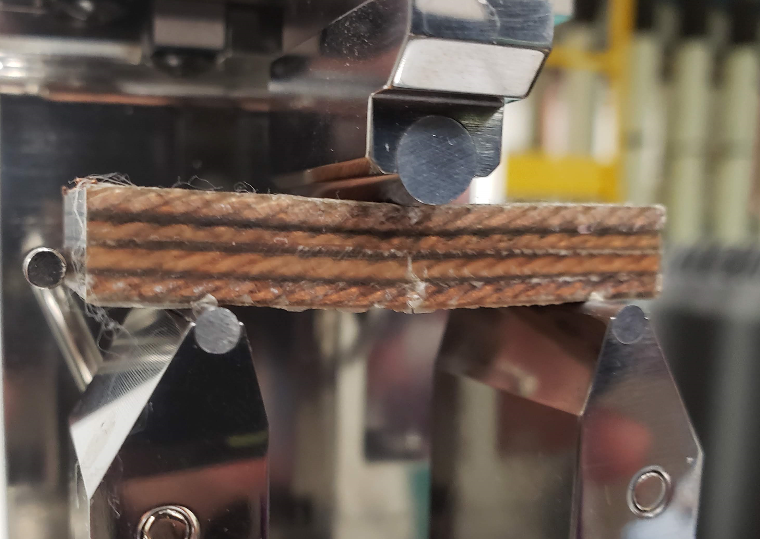
1st Pass at washing cable before reaction
Cleaning process:
Cable and insulation ultrasonic cleaned in 2% Citranox solution at 50°C for 15 minutes.
Isopropyl Alcohol rinse
  Displaces water and fast to evaporate, reduce further oxidation
Air dry
Followed by react in argon, impregnate as usual.
Results from 1st set of testing
Stacks were very well adhered, a set of shims was missing mold release and was extremely difficult to remove
Short Beam Testing revealed no shear failure, though load was ~3x the standard 101k sample
No audible cracking until failure, unlike all other tests besides 701
Note crack on bottom of stack. Failure is tensile from bending. Conductor fractured.

Slide 12
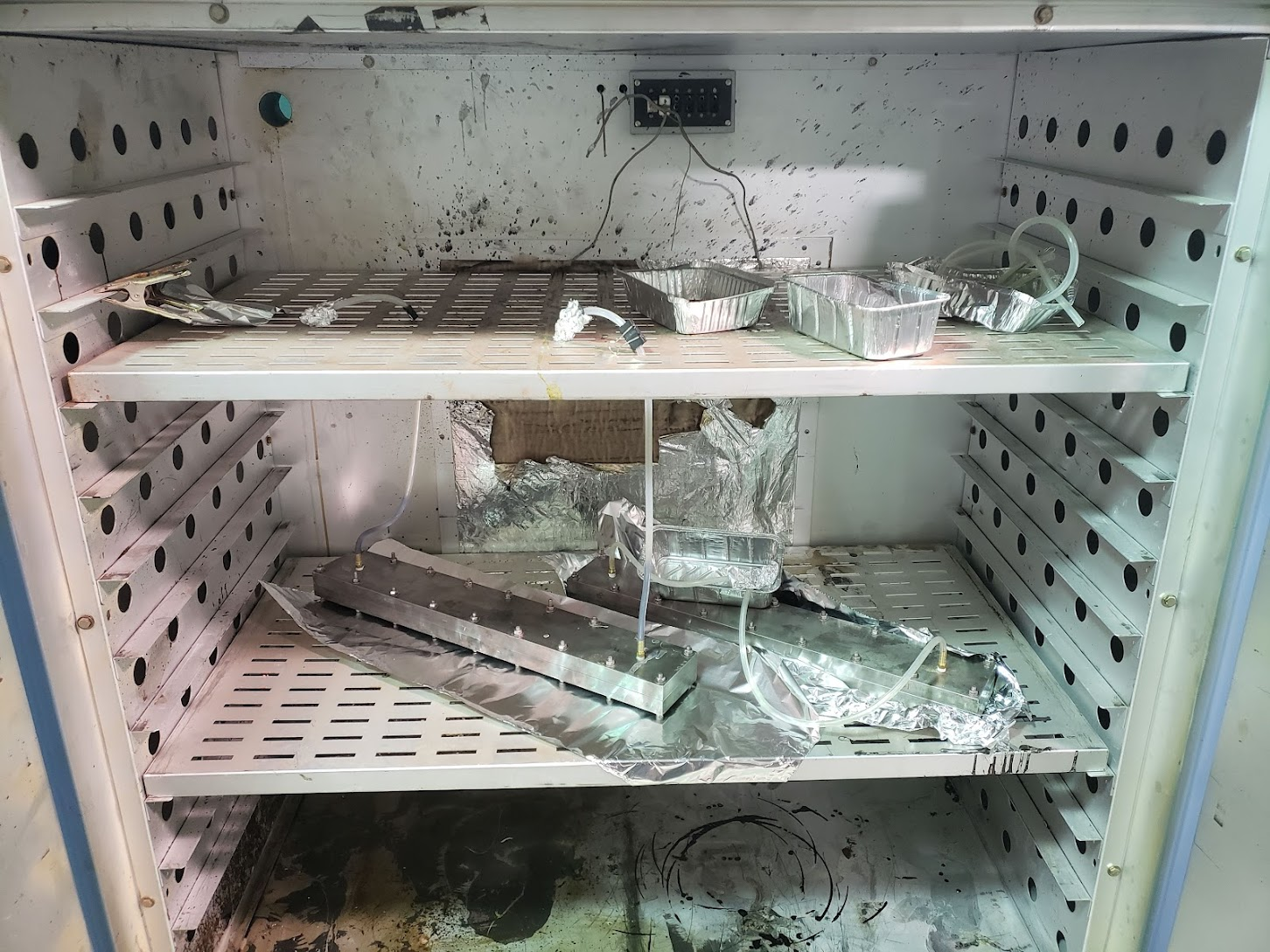
More Samples, CTD SBIR
Adhesion modified and standard 701 resin on samples of washed and unwashed cable
  Unwashed cable samples are standard AUP cable reacted in argon following standard cycle
  Washed Cable Samples have been ultrasonic cleaned in a 2% Citranox solution for 15 minutes at 60°C. Wet samples are then rinsed with isopropyl alcohol and oven dried.
    Citric acid removes oxides from copper and detergents/alcohol remove other contaminants from insulation before reaction.
All 4 samples have been tested, as well as some other samples for other projects

Slide 13
Shear Strength and Energy Release
***
*** This samples failed in bending and isn’t technically valid
Energy calculated as shift in initial position with spring constant fixed (~plastic deformation)

Slide 14
***
*** This sample failed in bending and isn’t technically valid

Slide 15
Stack Conclusions and Discussion
Proper Preparation of cable insulation greatly increases bonding performance
  Current process of untreated cable could be considered “uncontrolled”
  It should be “easy” to degrade a controlled system if desires
  Adhesion modifiers (in the 701 system) help a little, but again, preparation is key
In the regime of elastic deformation, in a well bonded sample, no cracking occurs (No AE/ No load deviation)
Suggest a subscale magnet with heat cleaned insulation as a way to determine where we sit WRT enthalpy margin and event energy

Slide 16
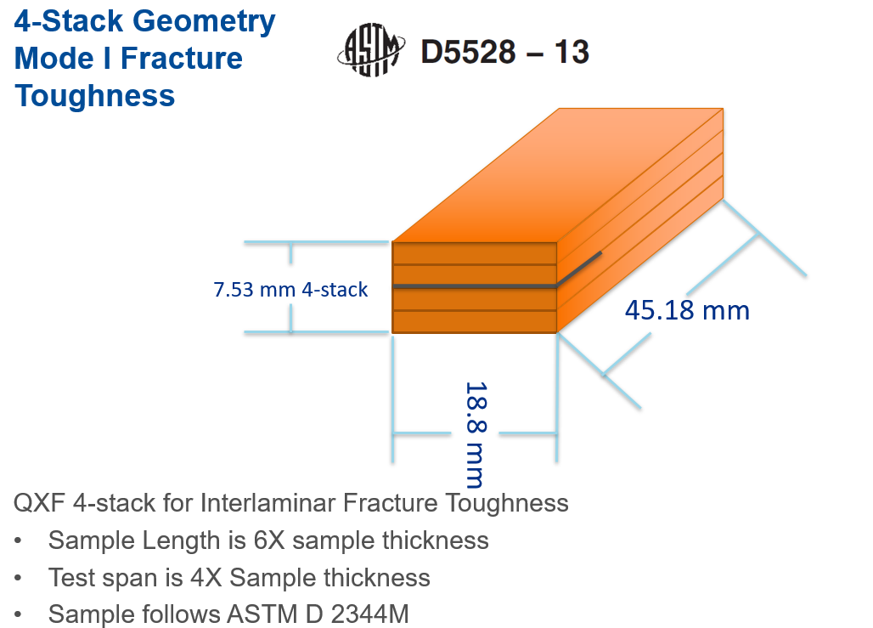
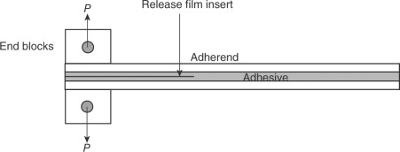
Samples in the queue
Double Cantilever Beam Interfacial Fracture Toughness Measurement (Mode 1 fracture toughness)
  Use a laminate with a pre-initiated crack to determine interfacial debonding behavior
  Test on 101K washed and unwashed, RT and 77K
  Needs some way to track crack propagation vs load/displacement
    Resorting to a student tracking the crack frame by frame in a video

Slide 17
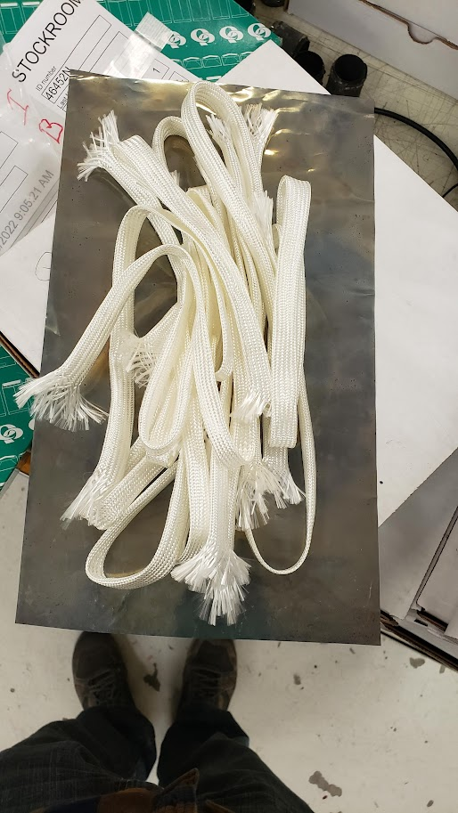
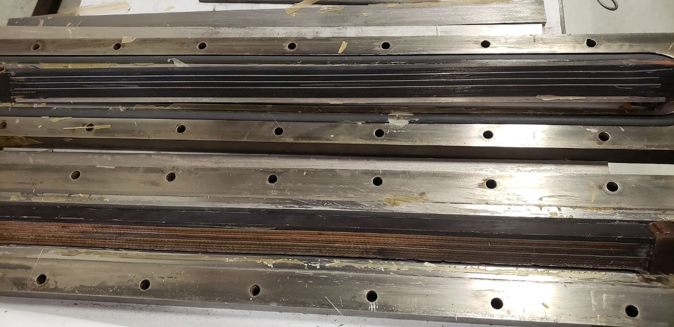
Heat Cleaning of AGY 933 Glass Insulation

Slide 18
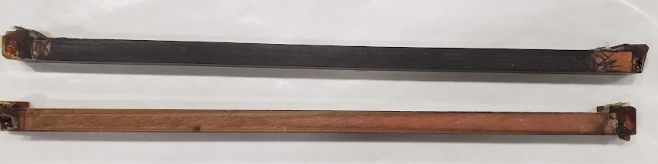
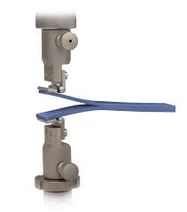
Interlaminar Fracture Toughness Testing
Samples in progress, Student is working to validate the method this week

Slide 19
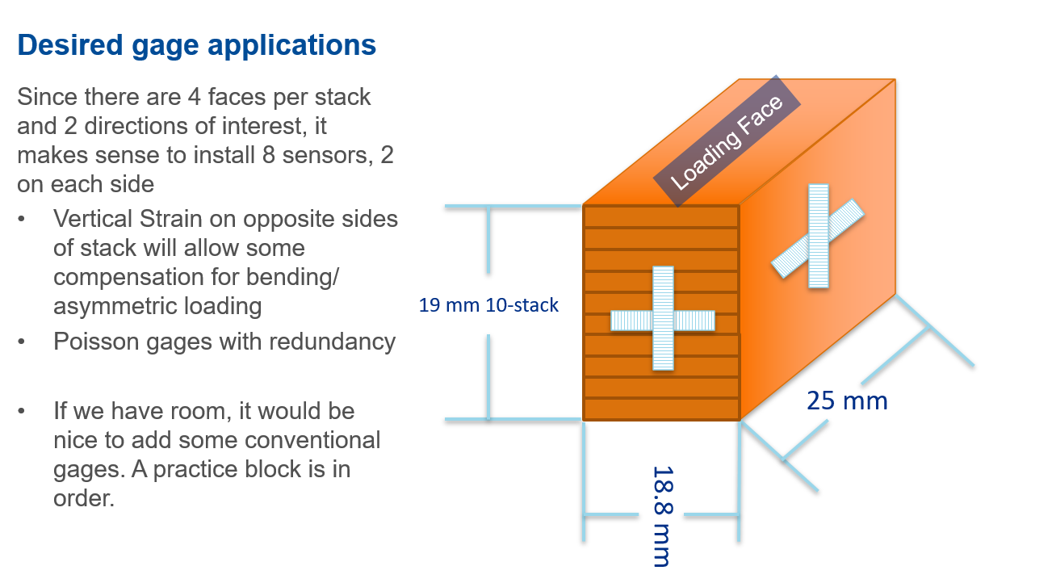
Measurements of Stacks with Fibers
We have a set of stacks ready for fiber application
Both FBG and Rayleigh, Testing on CTD-101K and 701x at RT and 77 K
It turns out that it’s rather difficult to route long fibers on such small objects
  We are getting practice on larger samples first
    Also allows development of algorithms and analysis techniques
  Rayleigh fibers look really promising as if we can fit them, we can get an FEA type picture of the strain states of all accessible faces
We had this a year ago, but then had more exciting opportunities for fiber-optics become available.

Slide 20
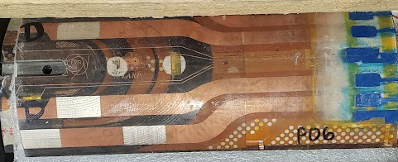
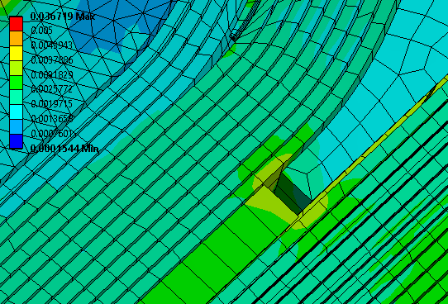
Fibers to investigate wedge transition and as realized material properties
Abbreviate Splice block?
Longitudinal Fibers
3 fibers per wedge transition (IL+OL)
2 fibers per pole transition
1 fiber for pole reference
1 fiber for coil reference
Azimuthal Fibers
3 fibers per wedge transition
1 reference for non-discontinunity area

Slide 21
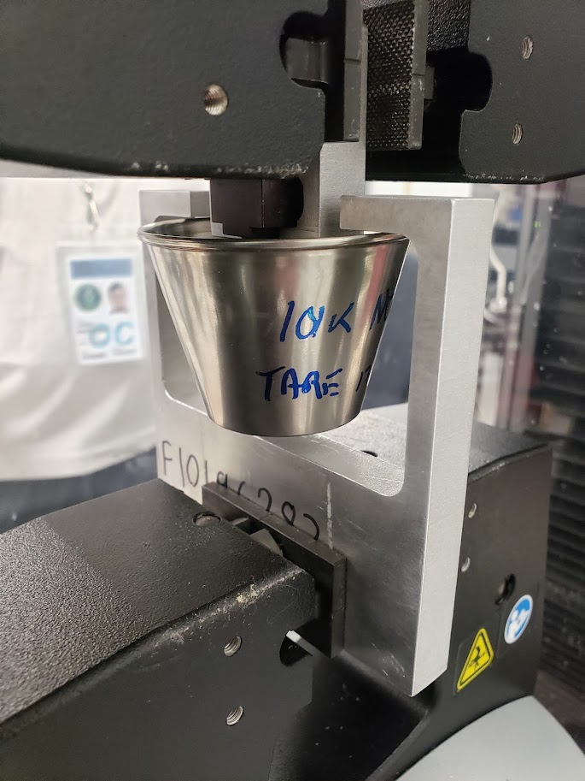
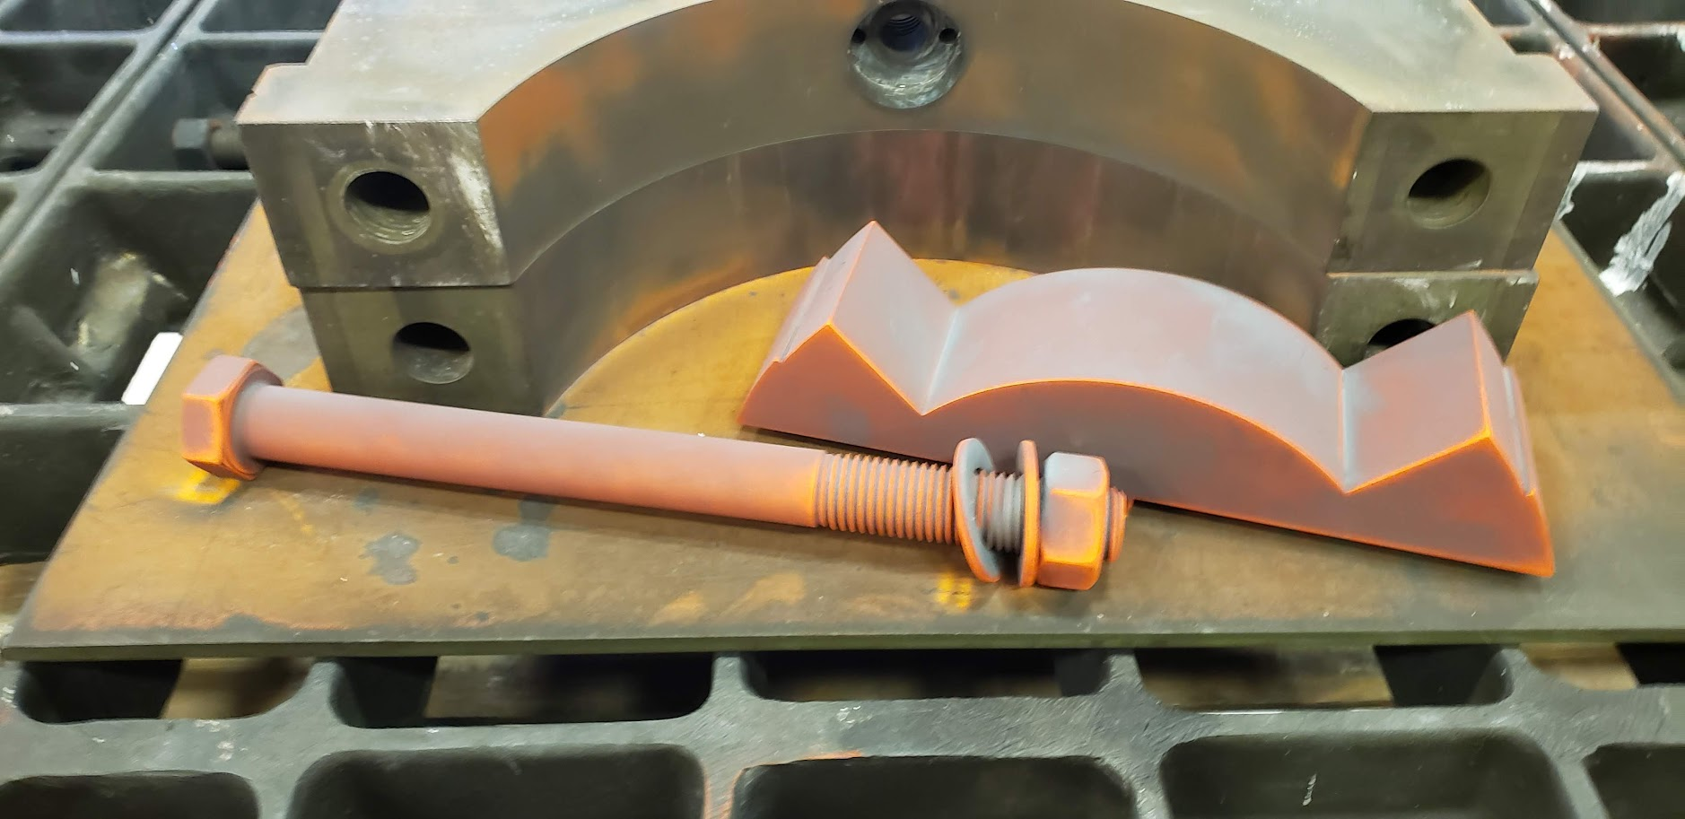
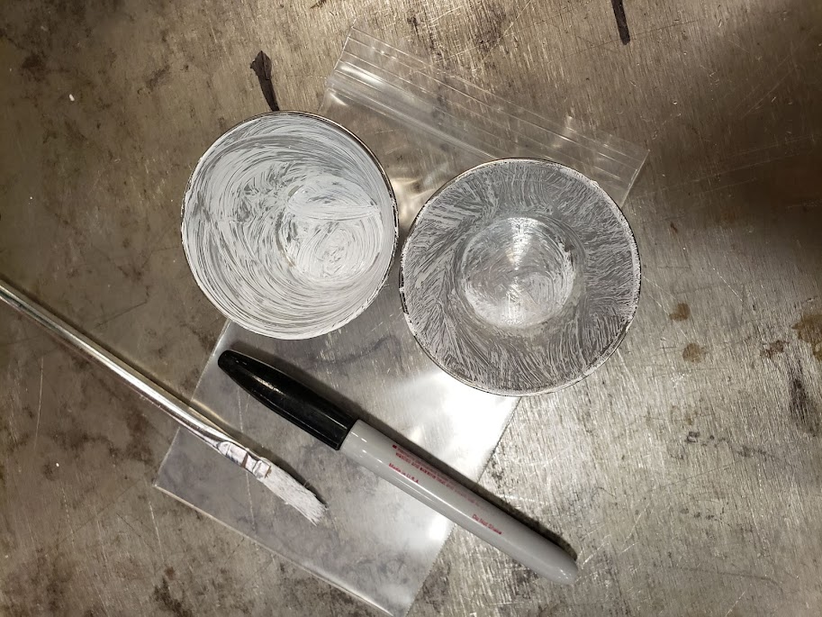
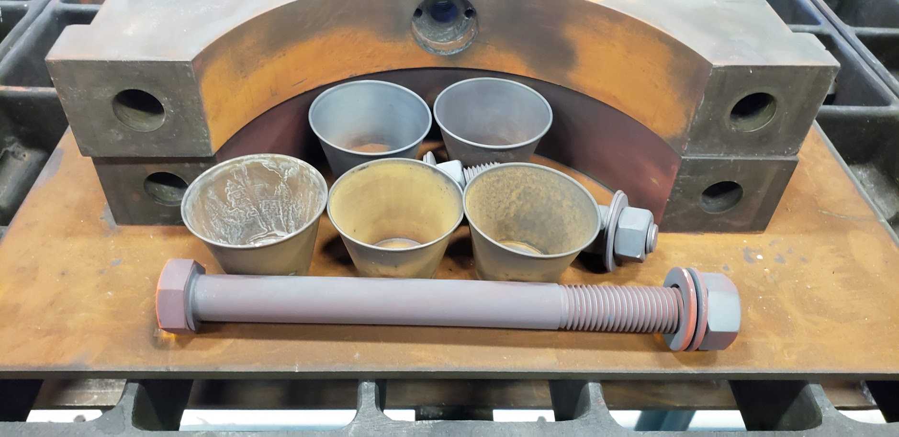
High Temperature mold releases
We have investigated a handful of “mold releases” to see if something would work through reaction
  Hint: All are boron based
They kind of worked…
  No that great
  BN works OK without reaction. After reaction, it seems to be absorbed into epoxy and doesn’t work that well
  Nickel Boron is similar
    Will check surface under microscope. Possibly destruction of good surface properties.
    Still Rusts.
We plan on running tests once we are through the 1st set of fracture toughness

Slide 22
Ongoing work On Epoxies and Interfaces
We have tested a handful of materials over the last few years to develop methods of producing robust, reproducible behavior at the interfaces within a cable stack
  Partially in an SBIR in Collaboration with CTD, studying the 701 resin system
  General results: Some adhesion promotors help on clean cable, in a specific resin system, and even a little on dirty cable. The “best” performance is achieved by de-sizing the insulation through heat cleaning before reaction
    Hypothesis is incomplete pyrolysis of silane coupling agent acting as lubricant on cable. Visual evidence of this, as well as poor wetting of glass after reaction
      Contact angle test

Slide 23
Resources @ FNAL
At this point, our available technical resources are mostly non-existent
  We have a student 2 days a week that is working on ten stacks and testing
  We are working to set up a partnership with Northern Illinois University
  The primary small sample tech, is the main strain gauge and fiber optic tech, primary laser cutter operator left the lab in September
Some of our testing infrastructure is rather outdated.
  Our large Instron (50 kN) has been out of commission since I have been at the lab (I’m looking into refurbishment, but cryogenic use may be unavailable)
  Our Low temperature loader has been in storage for a while (cryogenic instron), but the accuracy was questionable (large hysteresis and no lock on load cell balance)

Slide 24
Potential topics for future investigation
How much more should we poke at epoxies? Clearly there are issues, but we don’t want to research solutions in search of a problem…
Furnace Atmosphere
  Current “inert” atmosphere isn’t
  Mix of uncontrolled inputs leads to uncontrolled outputs
Solid state splicing during reaction
  1st sample looks promising.

