Slide 1
Impregnation of CCT with alternative Resins
J. L. Rudeiros Fernandez* D. Arbelaez, C. Bird, J. F. Croteau, P. Ferracin, S. Prestemon, T. Shen, G. Vallone
US Magnet Development Program
Lawrence Berkeley National Laboratory
US-MDP Collaboration Meeting 2023

Slide 2
Table of contents
01
Characterization of adhesion
02
Development of the Stycast VPI for CCT
03
Conclusions and next steps
J. L. Rudeiros Fernandez et al.

Slide 3
1. Characterization of adhesion
Resins used for the subscale program
Epoxy resin Mix61
CTD-701X*
Training might be related to interfacial mechanisms (heat dissipation due to frictional motion, debonding, crack propagation…) and therefore the change of resin might play a big role.
CCT sub2
CCT sub3
CCT sub4
*Haight, A., Haynes, M. M., Krave, S. T., Rudeiros-Fernandez, J. L., & Shen, T. (2021). Characterization of Candidate Insulation Resins for Training Reduction in High Energy Physics Magnets. Submitted for Publication at the CEC-ICMC.
*Krave, S., Shen, T., & Haight, A. (2021). Exploring New Resin Systems for Nb3Sn Accelerator Magnets. IEEE Transactions on Applied Superconductivity, 31(5), 1-4.
CCT sub2
J. L. Rudeiros Fernandez et al.

Slide 4
1. Characterization of adhesion
Materials
Wire:
Resins:
110 Copper wire (mirror-like surface), 1 mm diameter.
Paraffin wax Polarit G 54/56
Stycast 2850 MT BL + CAT23LV
Stycast 2850 FT BL + CAT24LV
Mix 61
CTD-101K
CCT sub2
J. L. Rudeiros Fernandez et al.

Slide 5
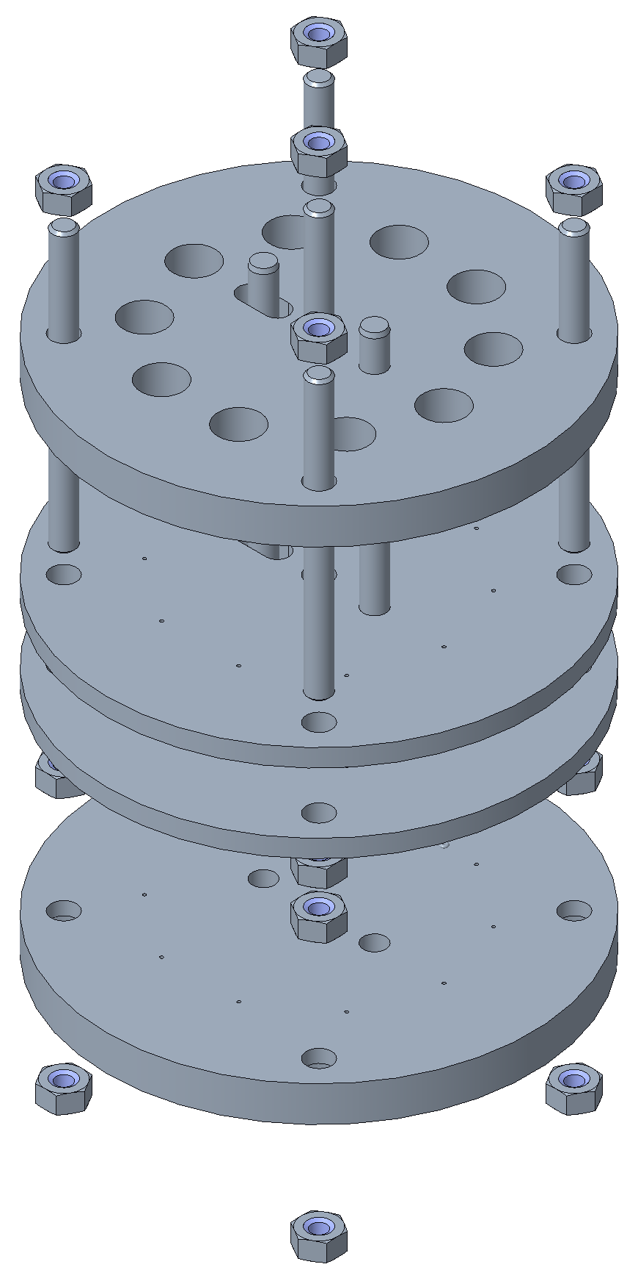
1. Characterization of adhesion
Sample preparation
Copper wire
Resin transfer
a
Resin
Copper wire
Assembly
PVC tube
Precision machined aluminum plates
a
b
Teflon disc
b
c
c
Silicone O-Ring
The specific resin is transferred to the mold formed by the assembly.
d
d
J. L. Rudeiros Fernandez et al.

Slide 6
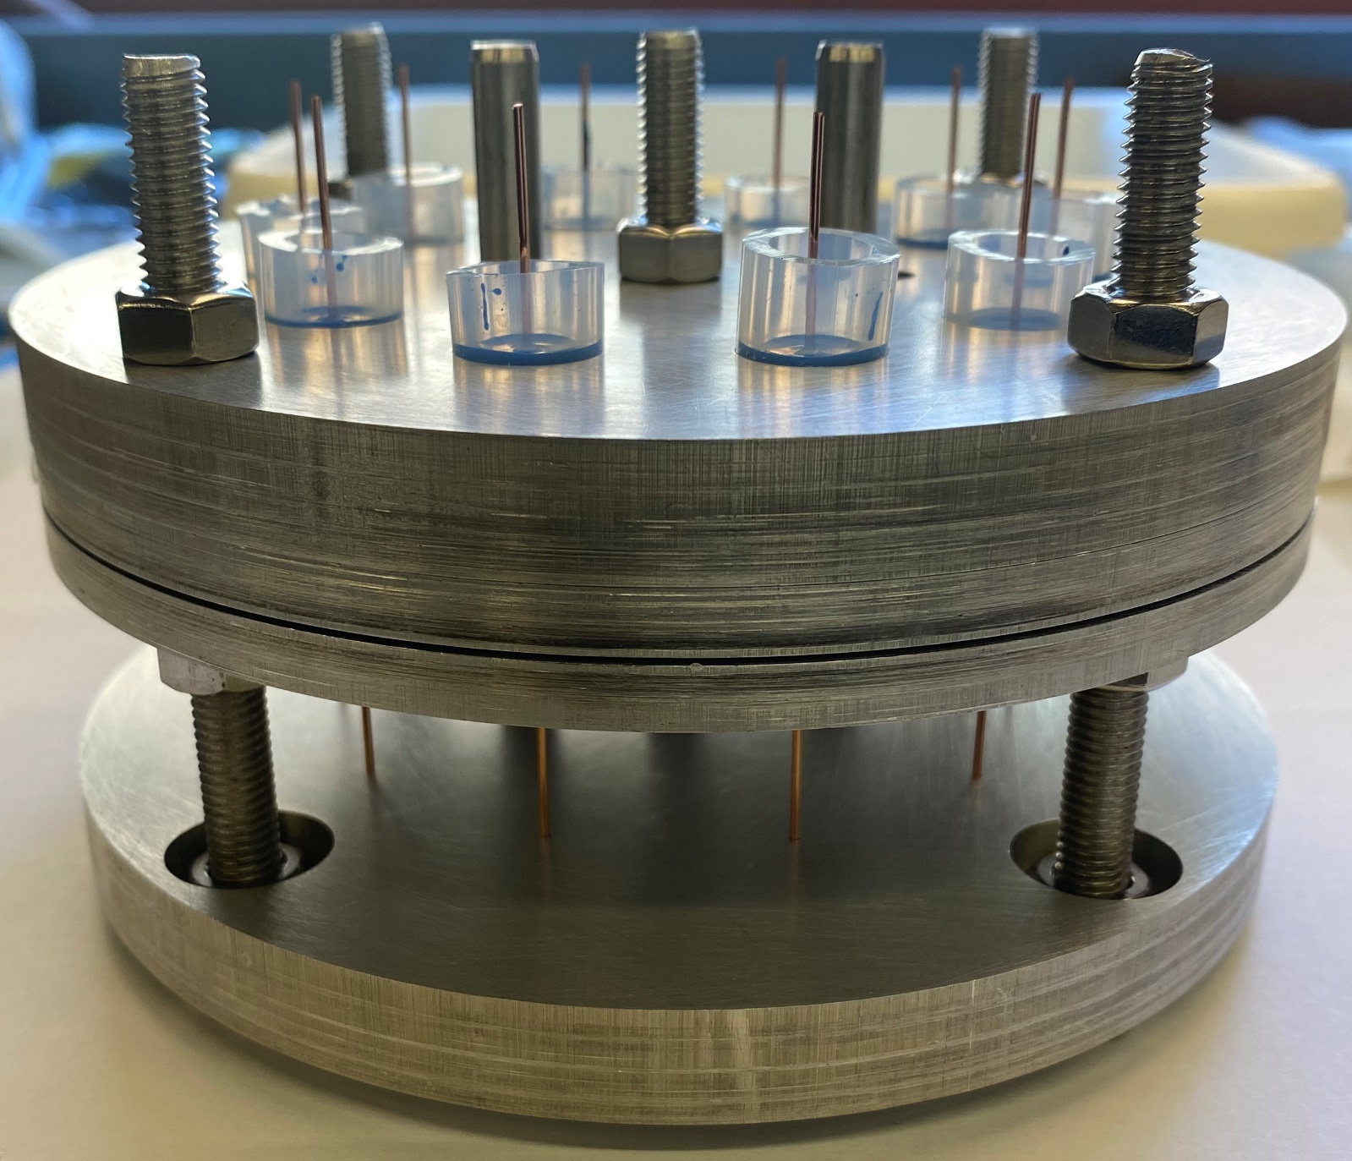
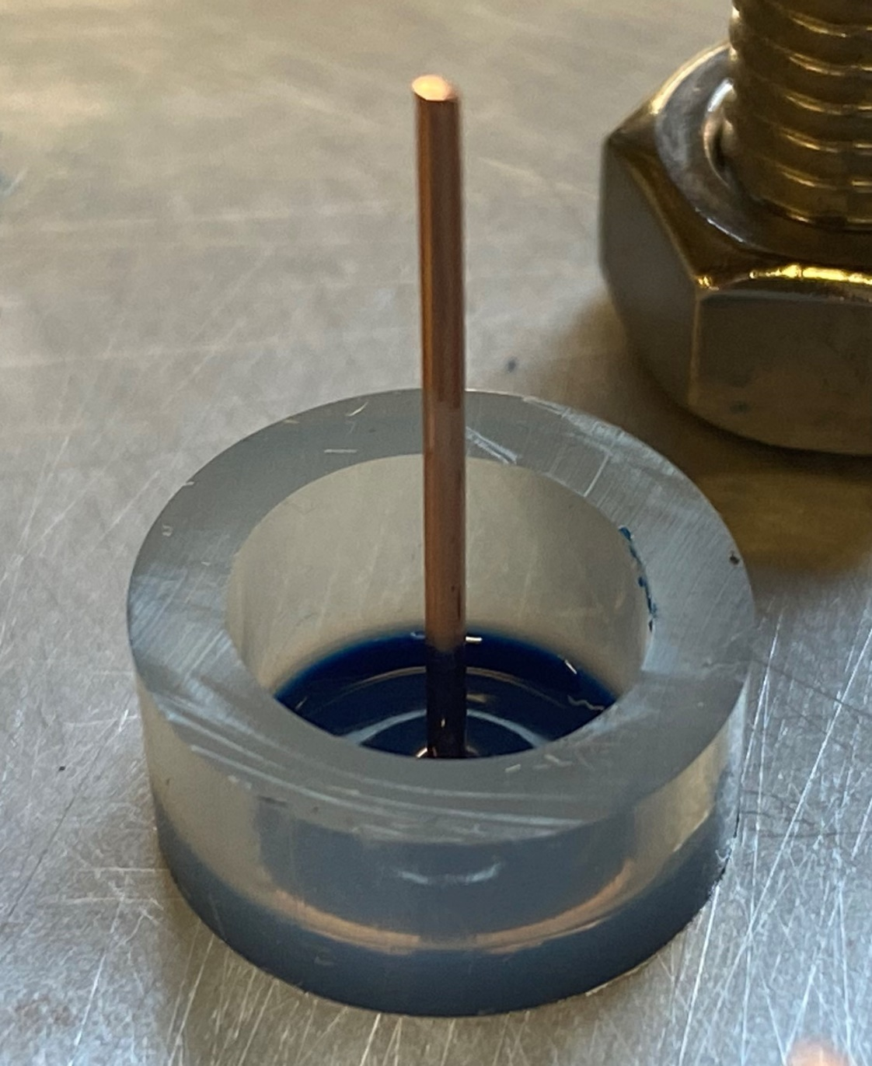
1. Characterization of adhesion
Sample preparation
Resin
a
b
c
d
J. L. Rudeiros Fernandez et al.

Slide 7
1. Characterization of adhesion
Pull-out test
$$F$$
Paraffin wax
Stycast 2850 MT
CTD-101K
Mix 61
Pull-out frame
Resin
J. L. Rudeiros Fernandez et al.

Slide 8
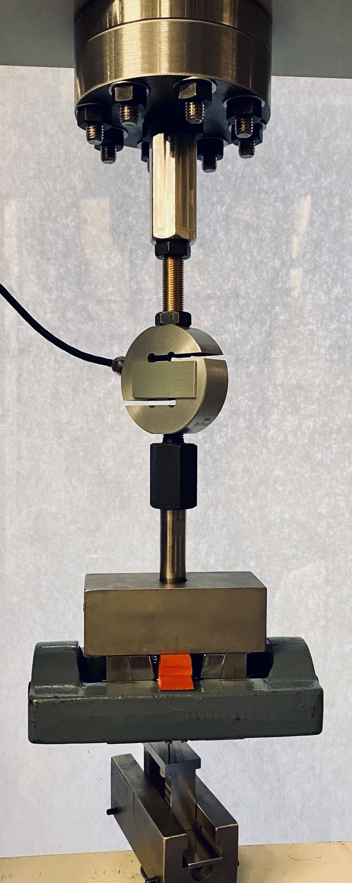
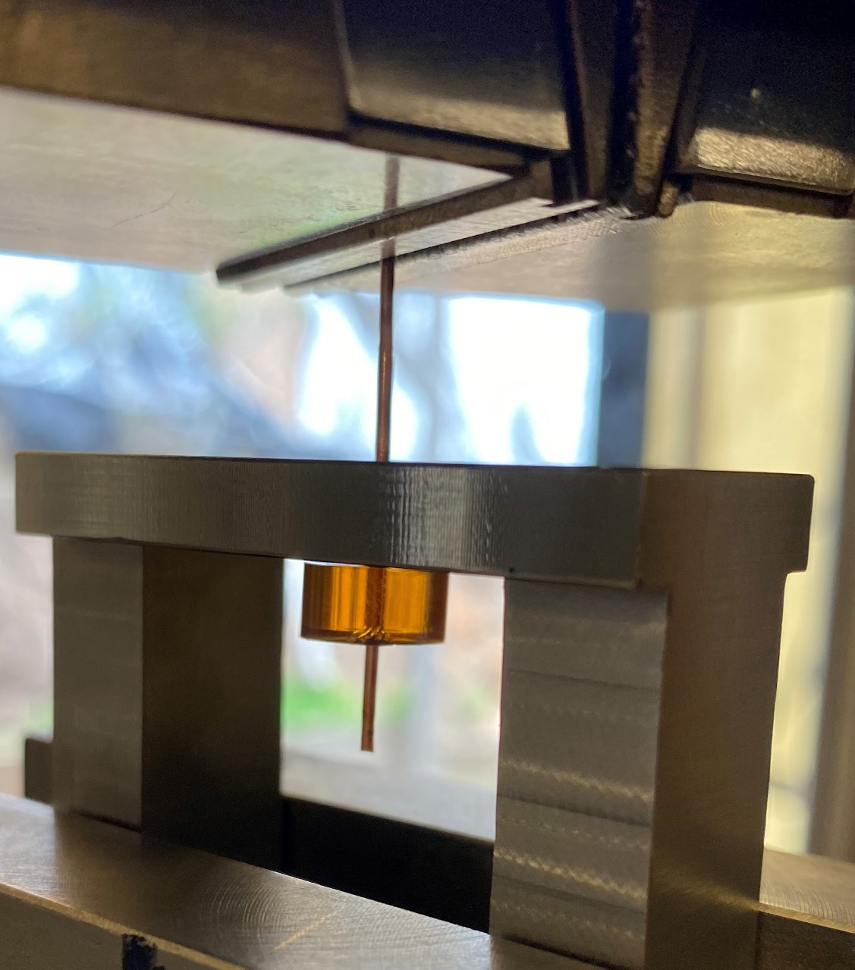
1. Characterization of adhesion
Tensile tester adapter
Tensile grips
Pull-out frame configuration
Copper wire
Load cell
Tensile tester configuration
Pull-out frame
Resin block
Tensile grips
Pull-out frame
J. L. Rudeiros Fernandez et al.

Slide 9
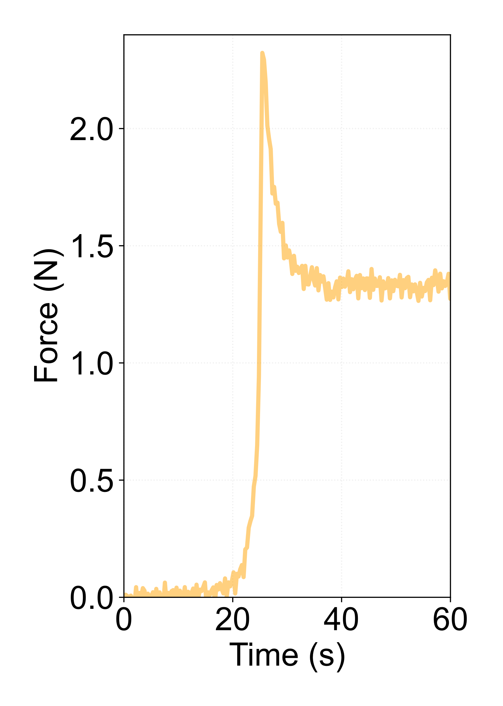
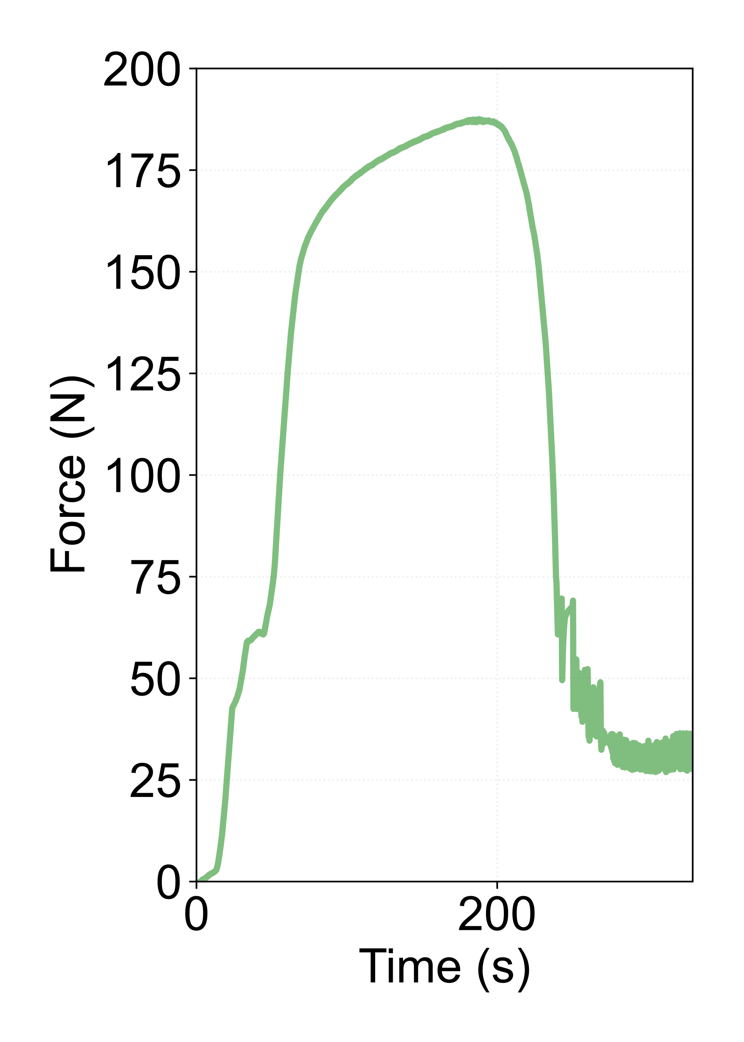
1. Characterization of adhesion
Characterization of the apparent interfacial shear strength
Crack propagation
Interface failure
Interface failure
$$F$$
Friction driven
Friction driven
Paraffin wax
Mix 61
J. L. Rudeiros Fernandez et al.

Slide 10
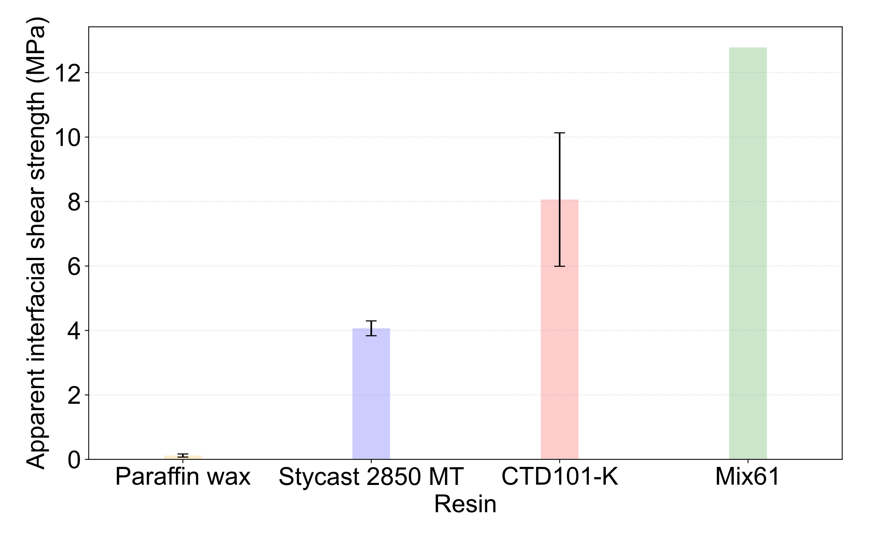
1. Characterization of adhesion
Characterization of the apparent interfacial shear strength
For each individual test, and based on a few simplification assumptions, one could compute the apparent interfacial shear strength based on: where $F_{max}$ is the peak load, $P_{f}$ is the perimeter of the wire, and $L_{e}$ is the embedded length.
$$τ_{app}= \frac{F_{max}}{P_{f}L_{e}}$$
J. L. Rudeiros Fernandez et al.

Slide 11
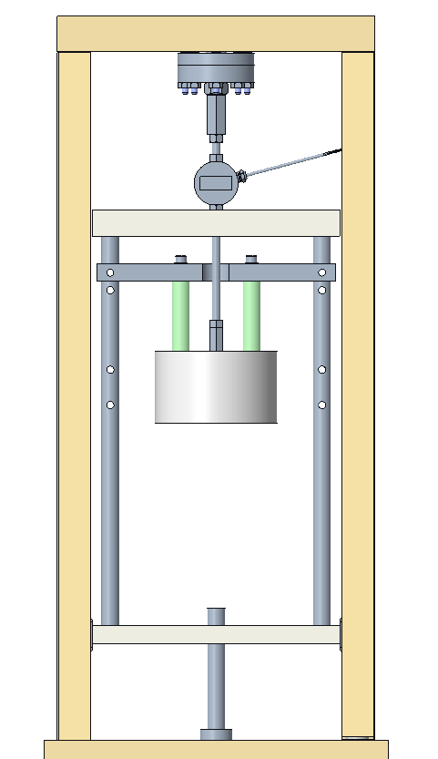
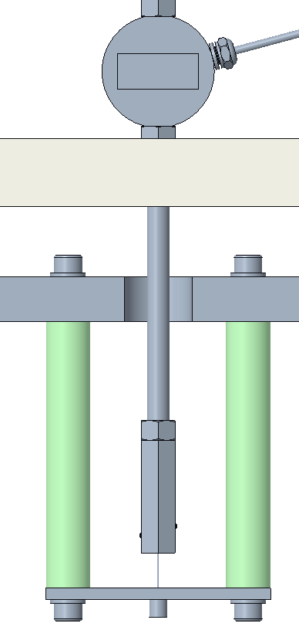
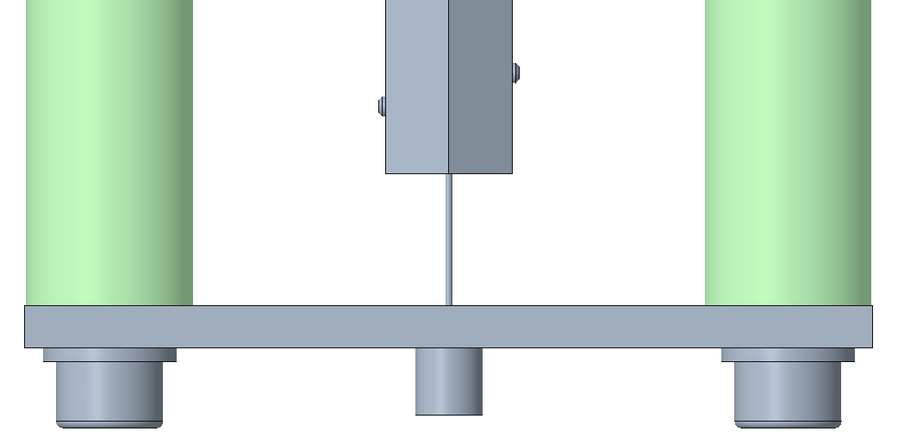
1. Characterization of adhesion
Characterization of the apparent interfacial shear strength @ 77 K
Wire grips
Tensile tester adapter
Load cell
Copper wire
Liquid Nitrogen
Dewar
Pull-out frame
G10 bars
Resin block
J. L. Rudeiros Fernandez et al.

Slide 12
Table of contents
01
Characterization of adhesion
02
Development of the Stycast VPI for CCT
03
Conclusions and next steps
J. L. Rudeiros Fernandez et al.

Slide 13
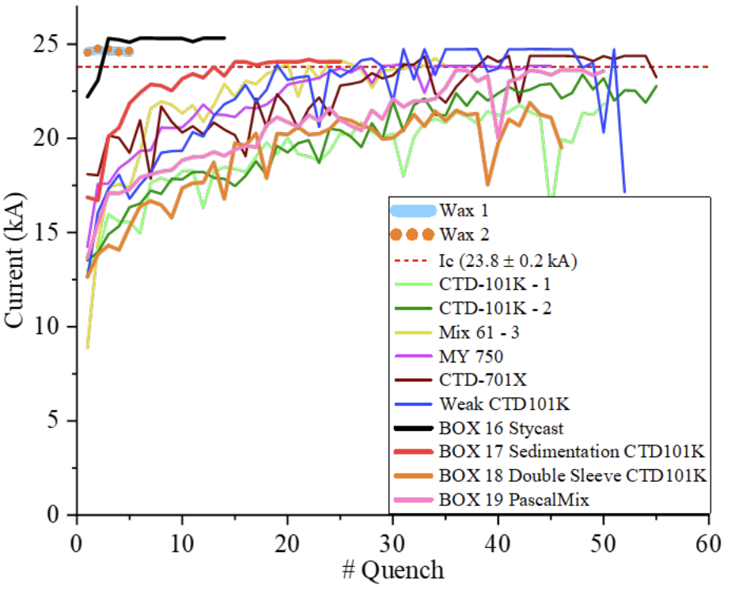
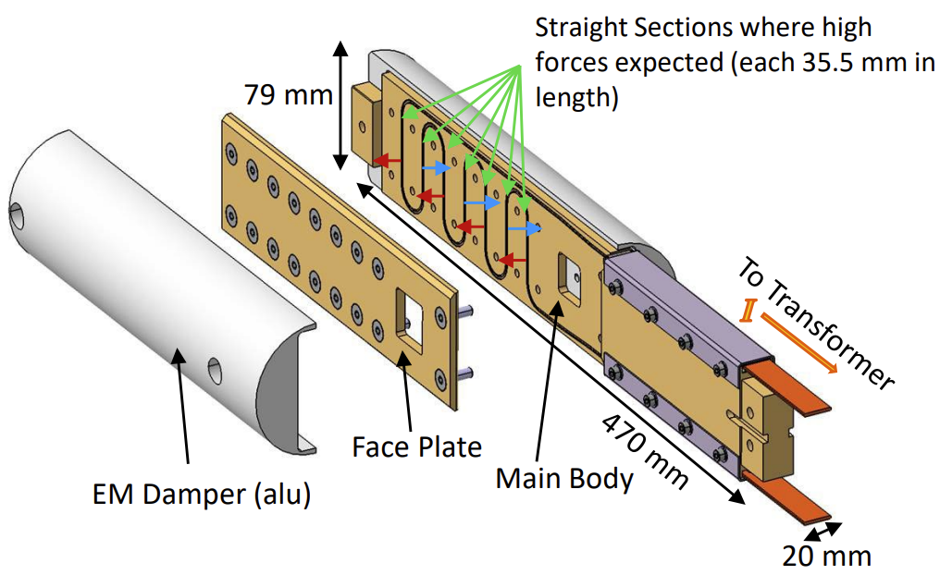
2. Development of the Stycast VPI for CCT
Main motivation
BOX sample, M. Daly, PSI
J. L. Rudeiros Fernandez et al.

Slide 14
2. Development of the Stycast VPI for CCT
General sequence of CCT for vacuum pressure impregnation (VPI) using epoxy resins (e.g. Mix61, CTD-101K) or polyolefin-based resin (e.g. CTD-701X*)
Top reservoir
Outgassing of the coil under vacuum.
Resin mixing and degassing.
Resin transfer to the coil until the reservoir is filled.
Vacuum open to atmospheric pressure.
Curing of the coils within a furnace.
Compressed air
Coil
Vacuum chamber
Resin mixer
Vacuum pump
J. L. Rudeiros Fernandez et al.

Slide 15
2. Development of the Stycast VPI for CCT
The Stycast 2850 FT process implies additional challenges with respect to traditional resins in terms of high viscosity:
Water: ∼1 cP
Paraffin used in CCT Sub5: ∼4 cP @ 100 °C
CTD-101K: <100 cP @ 60 °C
Stycast 2850FT: 250000 cP
The main strategies to enable the impregnation are:
Slightly increase of temperature (i.e. 40 °C) during resin mixing, outgassing and resin transfer.
Promote fast longitudinal flow and radial penetration with new flow media scheme.
Reduce viscosity by using Catalyst 24 LV / 23 LV.
Top reservoir
Compressed air
Coil
Vacuum chamber
Resin mixer
Vacuum pump
J. L. Rudeiros Fernandez et al.

Slide 16
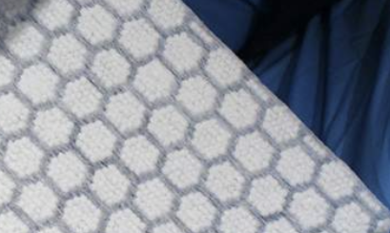
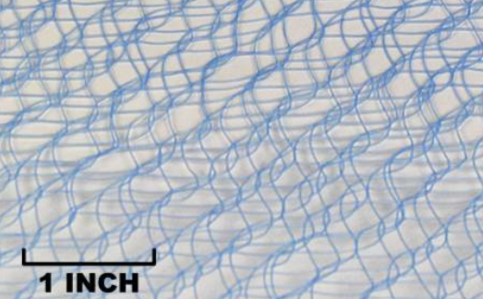
2. Development of the Stycast VPI for CCT
Diagram of the impregnation bag system for Stycast
Mandrel
Cable
Mandrel OD
Mandrel ID
Glass fiber tape
Peel ply
New expanded Flow media
Vacuum bag
External heating elements
J. L. Rudeiros Fernandez et al.

Slide 17
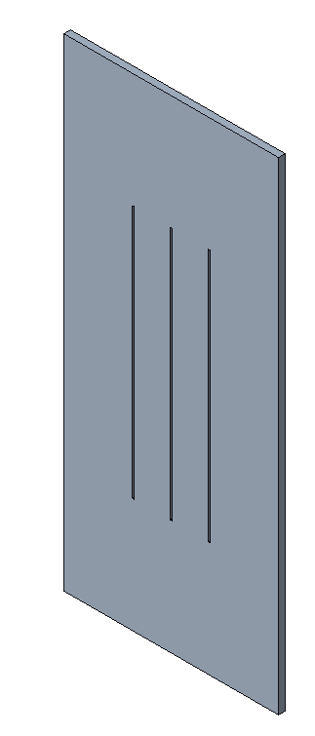
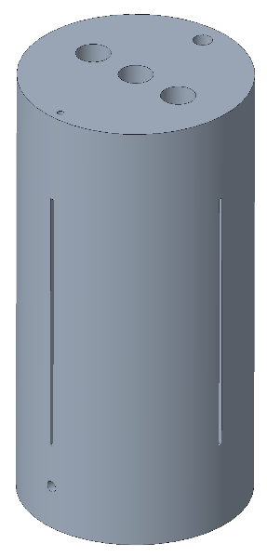
2. Development of the Stycast VPI for CCT
Vacuum Assisted Resin Transfer Molding (VARTM)
Vacuum Pressure Impregnation
Aluminum-bronze
Aluminum
Phase 1
Phase 2
Phase 3
Phase 4 (Final coil)
Development
J. L. Rudeiros Fernandez et al.

Slide 18
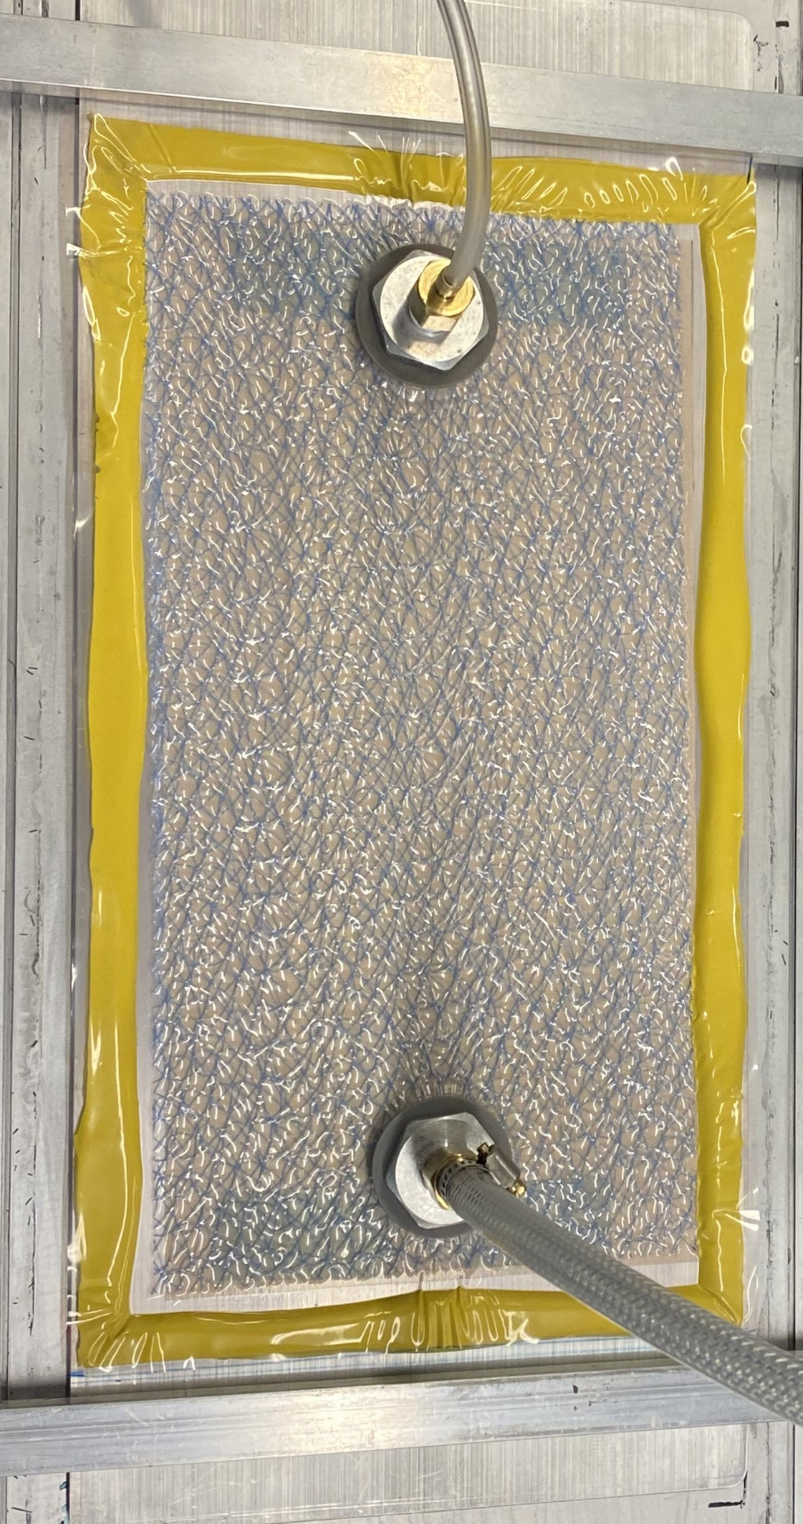
2. Development of the Stycast VPI for CCT
Vacuum Assisted Resin Transfer Molding (VARTM)
Diagram of the impregnation bag system for Stycast
Aluminum plate
Nb₃Sn cable
Cable
Peel ply
New expanded Flow media
Vacuum bag
Phase 1
External heating elements
J. L. Rudeiros Fernandez et al.

Slide 19
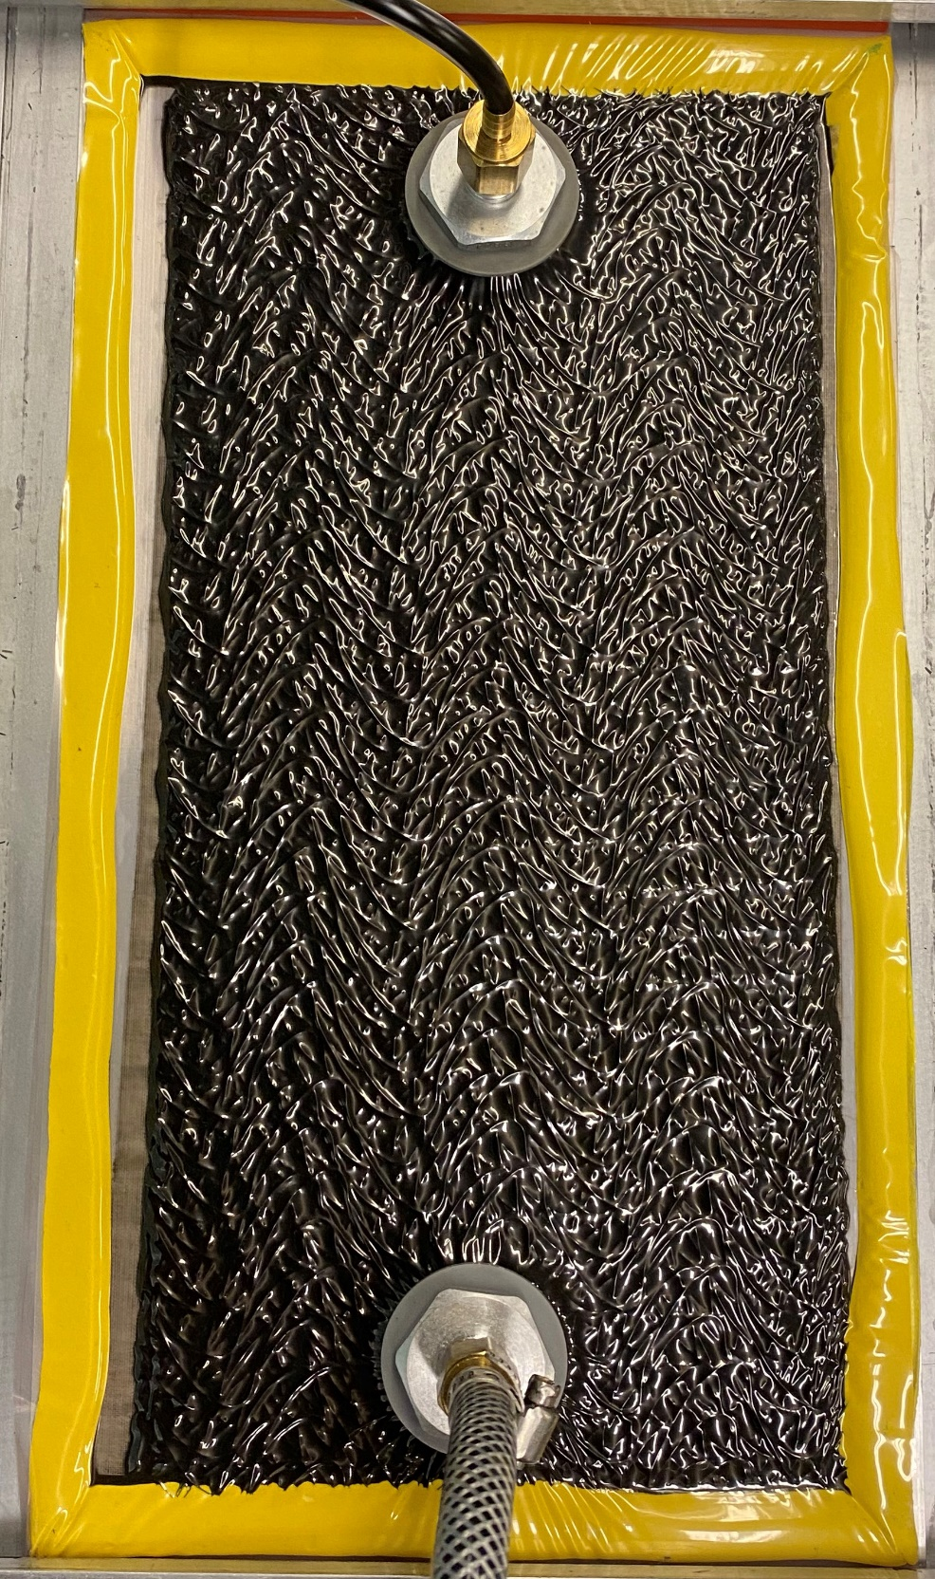
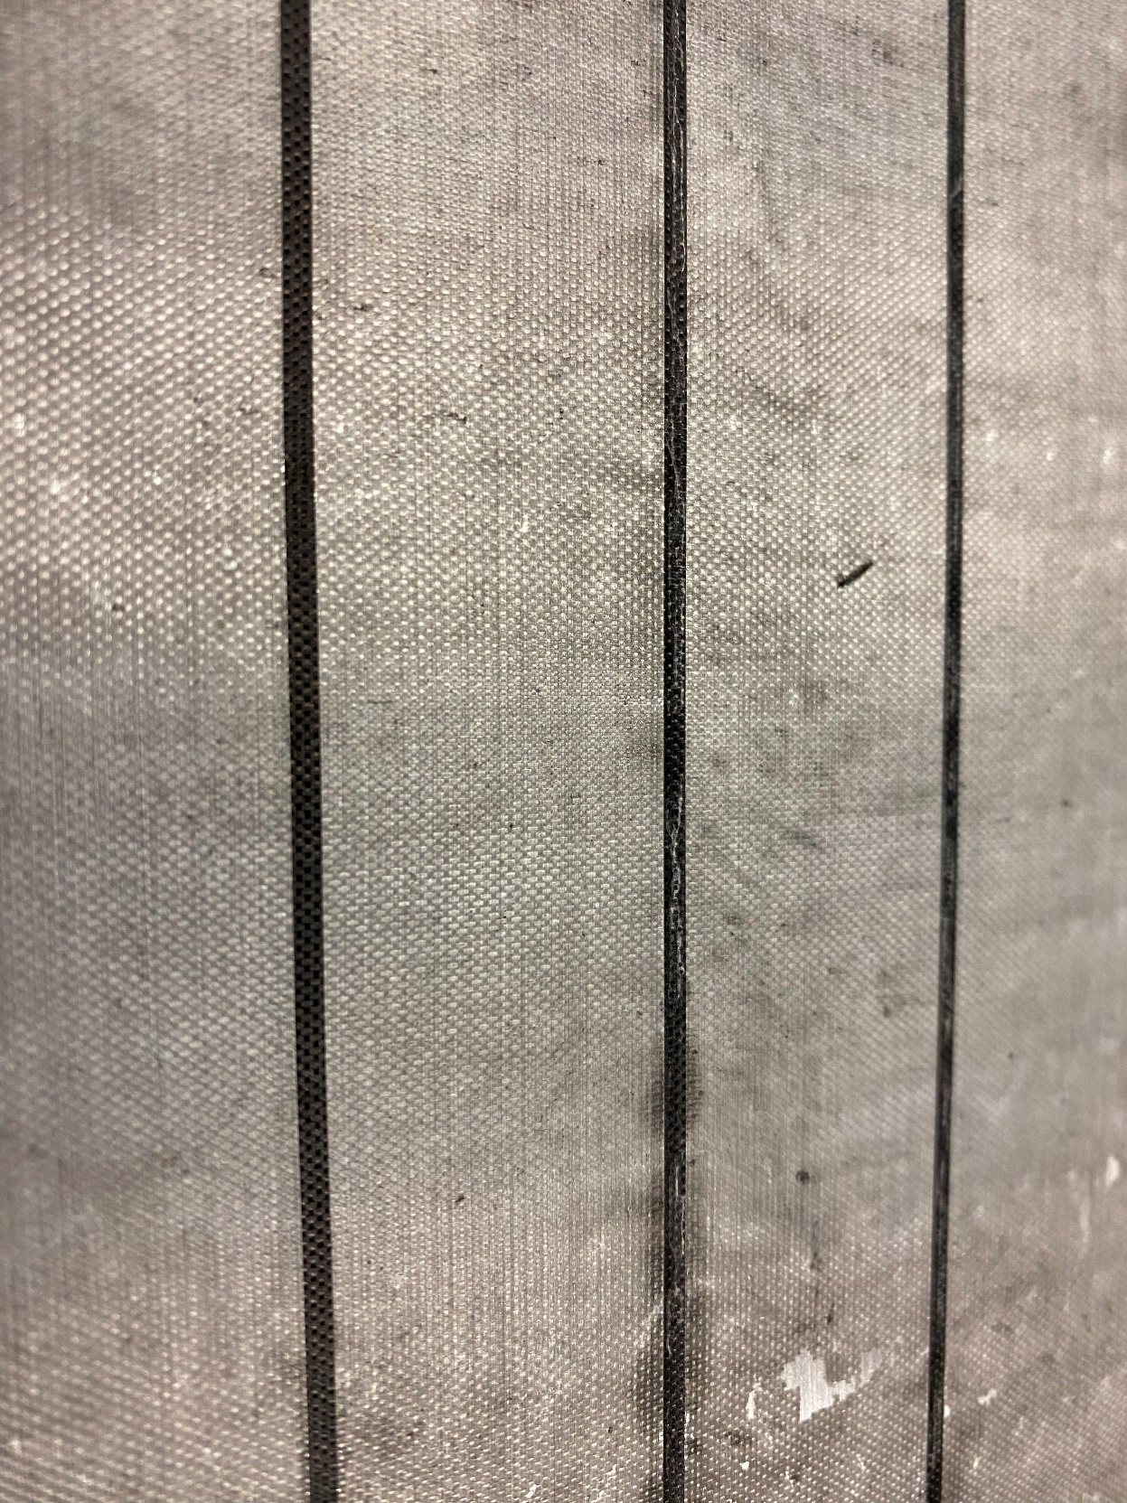
2. Development of the Stycast VPI for CCT
Vacuum Assisted Resin Transfer Molding (VARTM)
Nb₃Sn cable
Phase 1
J. L. Rudeiros Fernandez et al.

Slide 20
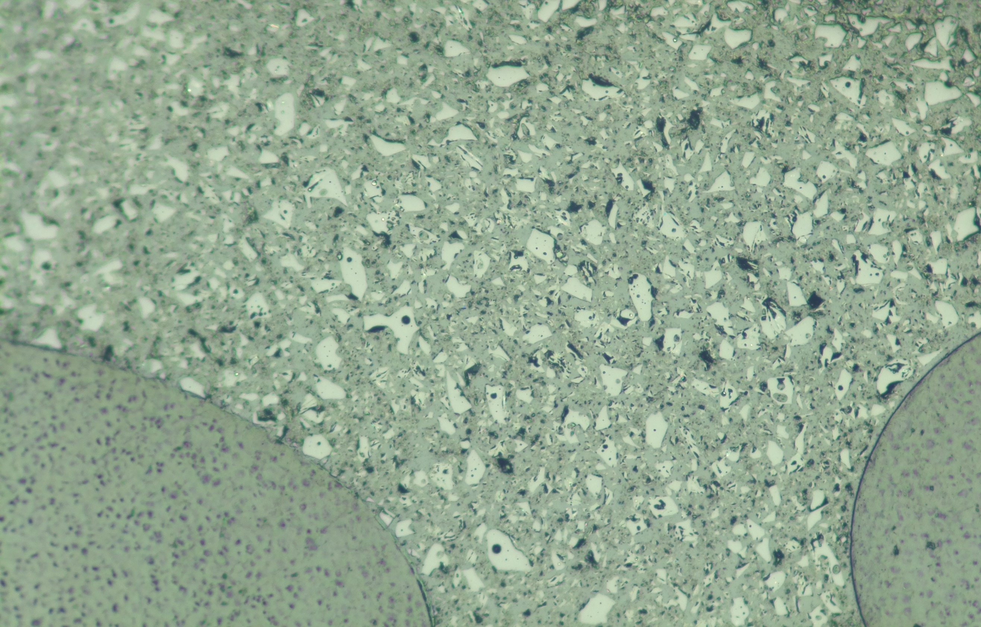
2. Development of the Stycast VPI for CCT
Vacuum Assisted Resin Transfer Molding (VARTM)
Diagram of the impregnation bag system for Stycast
Aluminum plate
Stycast
Cable
Nylon fiber
Peel ply
New expanded Flow media
Vacuum bag
External heating elements
J. L. Rudeiros Fernandez et al.

Slide 21
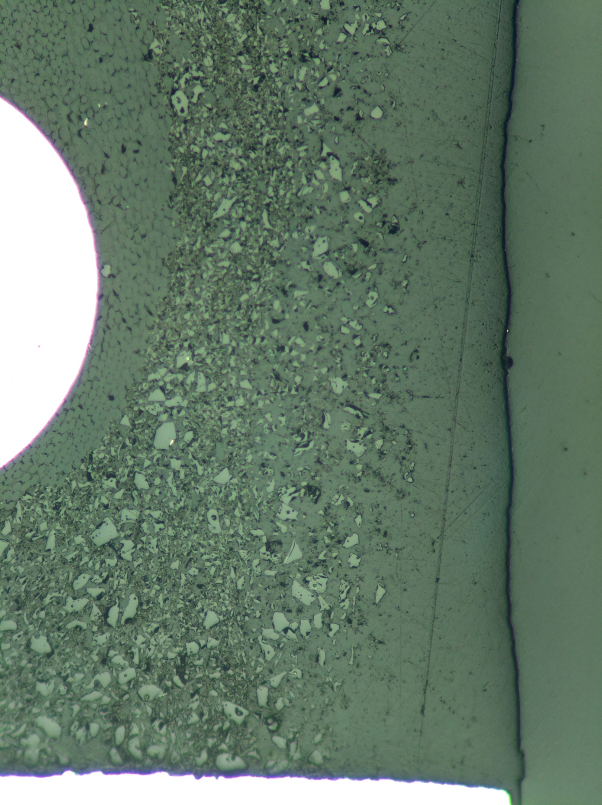
2. Development of the Stycast VPI for CCT
Vacuum Assisted Resin Transfer Molding (VARTM)
Diagram of the impregnation bag system for Stycast
Glass insulation
Aluminum plate
Nb₃Sn Strand
Cable
Stycast
Peel ply
New expanded Flow media
Vacuum bag
External heating elements
Aluminum
J. L. Rudeiros Fernandez et al.

Slide 22
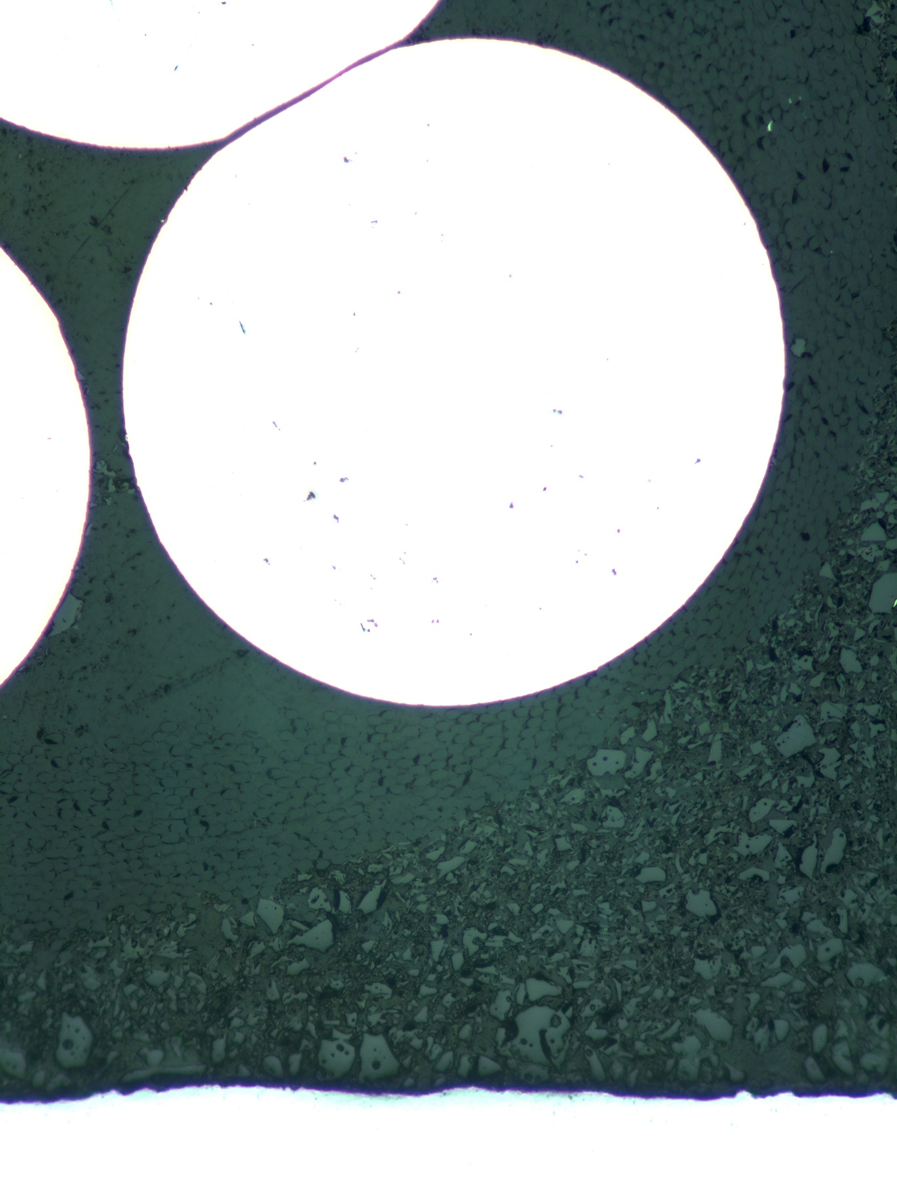
2. Development of the Stycast VPI for CCT
Vacuum Assisted Resin Transfer Molding (VARTM)
Diagram of the impregnation bag system for Stycast
Aluminum plate
Nb₃Sn Strand
Cable
Glass insulation
Stycast
Peel ply
100 µm
New expanded Flow media
Vacuum bag
Aluminum
External heating elements
J. L. Rudeiros Fernandez et al.

Slide 23
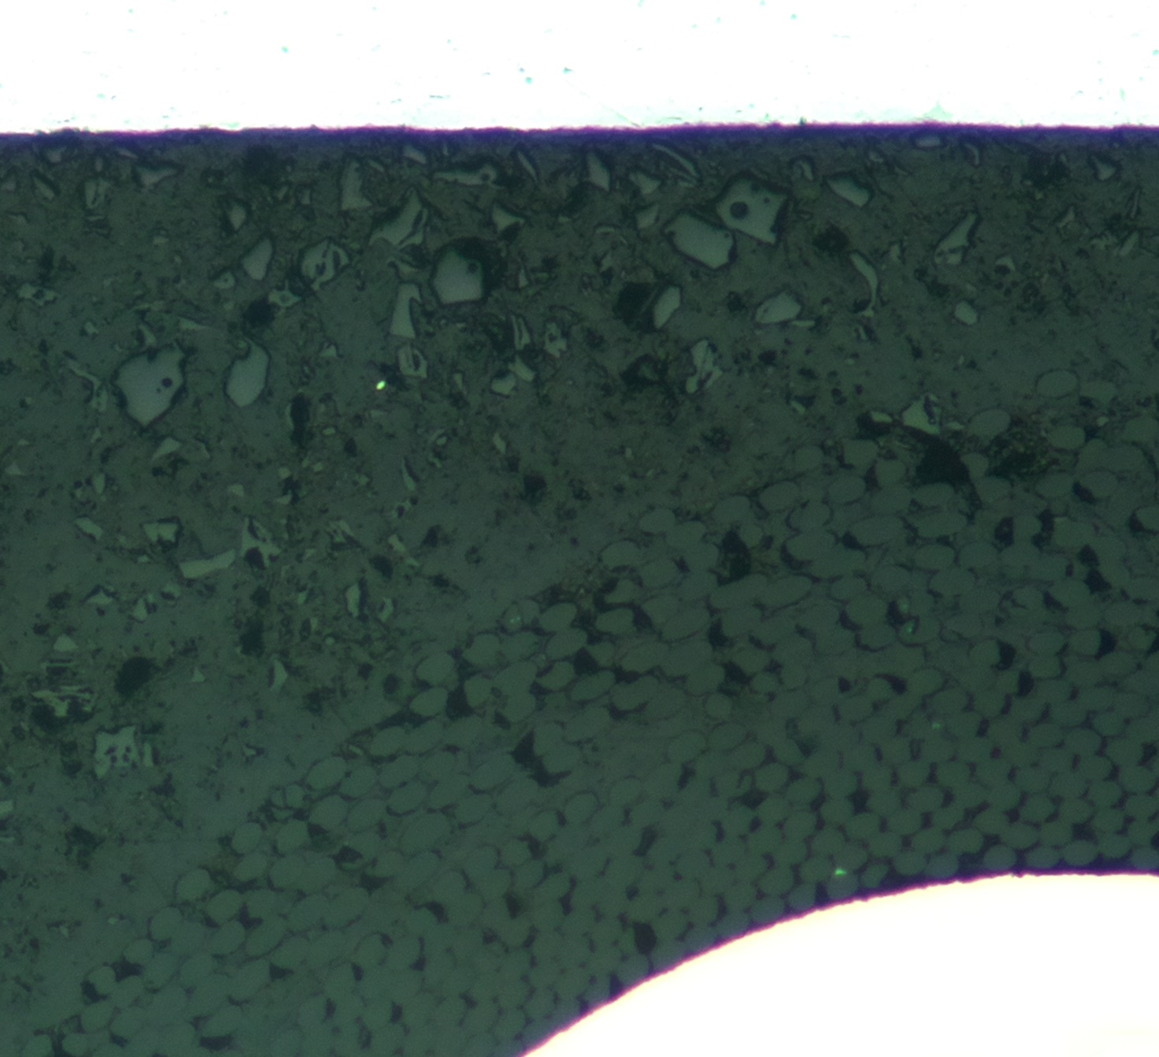
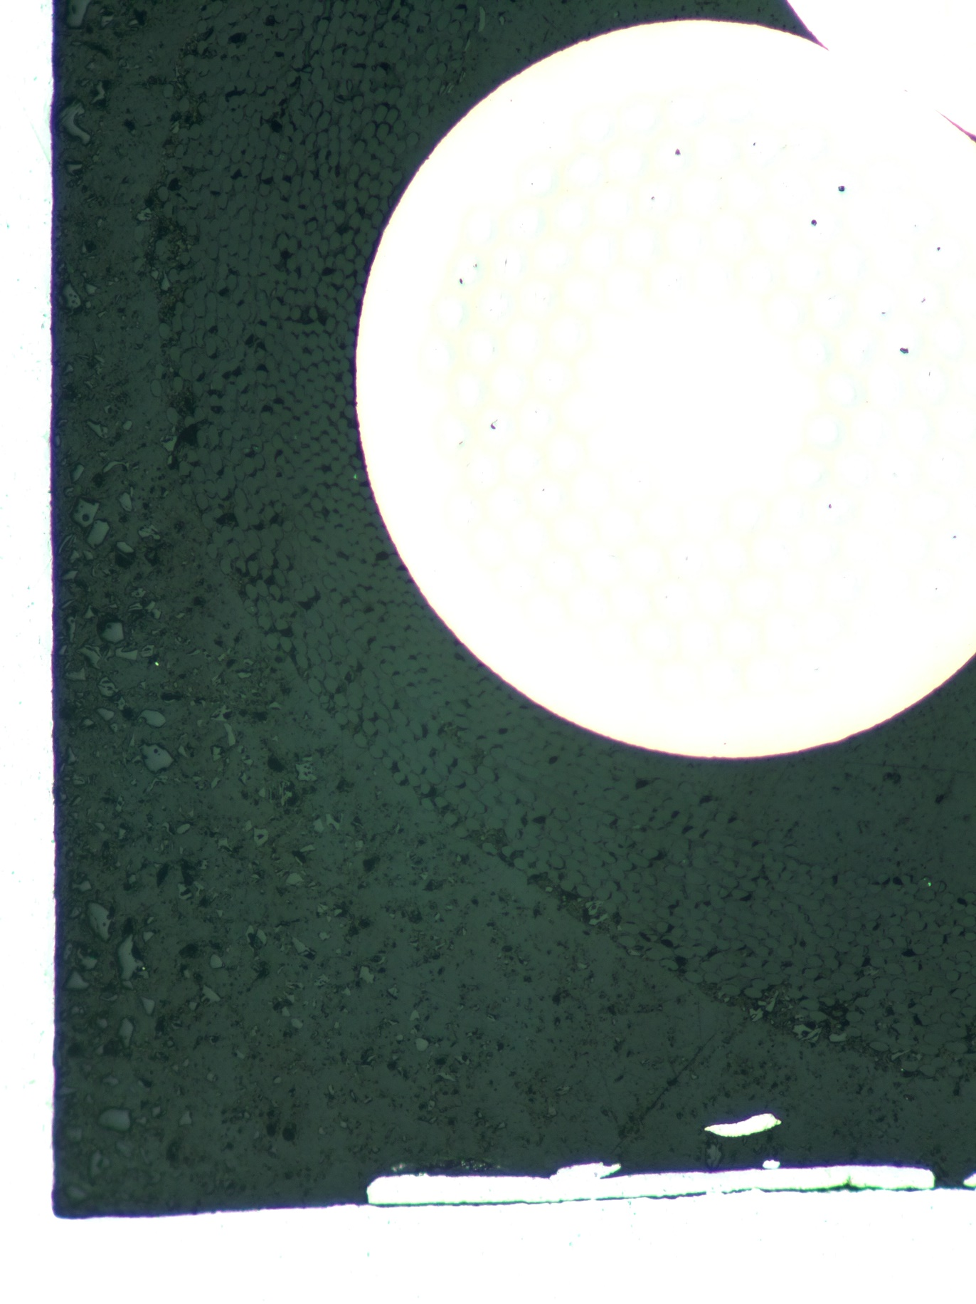
2. Development of the Stycast VPI for CCT
Vacuum Assisted Resin Transfer Molding (VARTM)
Diagram of the impregnation bag system for Stycast
Aluminum plate
Nb₃Sn Strand
Nb₃Sn Strand
Glass insulation
Cable
Aluminum
Glass insulation
Peel ply
New expanded Flow media
Stycast
Stycast
Vacuum bag
External heating elements
Aluminum
J. L. Rudeiros Fernandez et al.

Slide 24
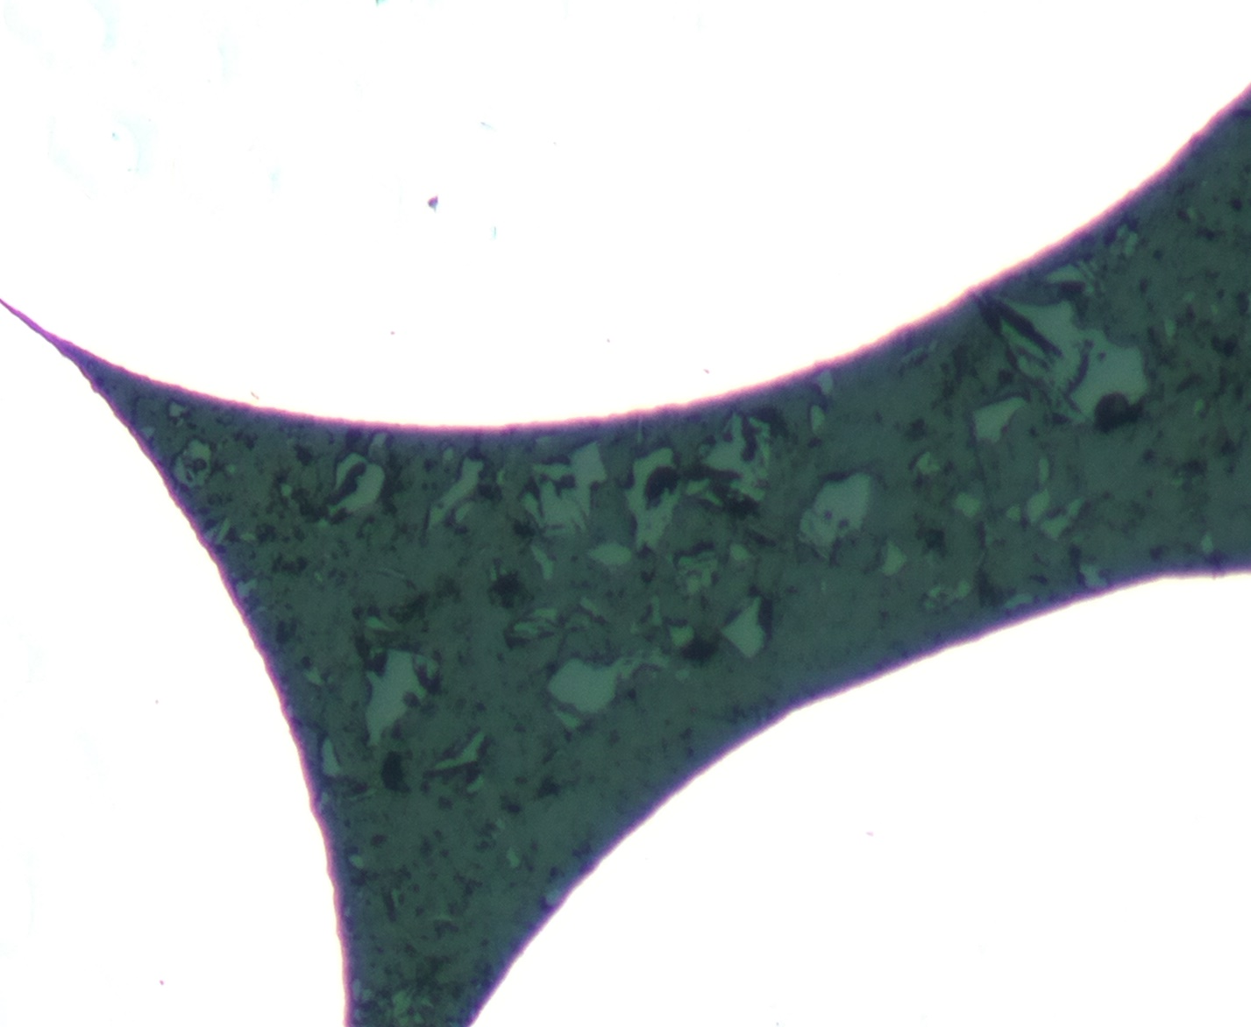
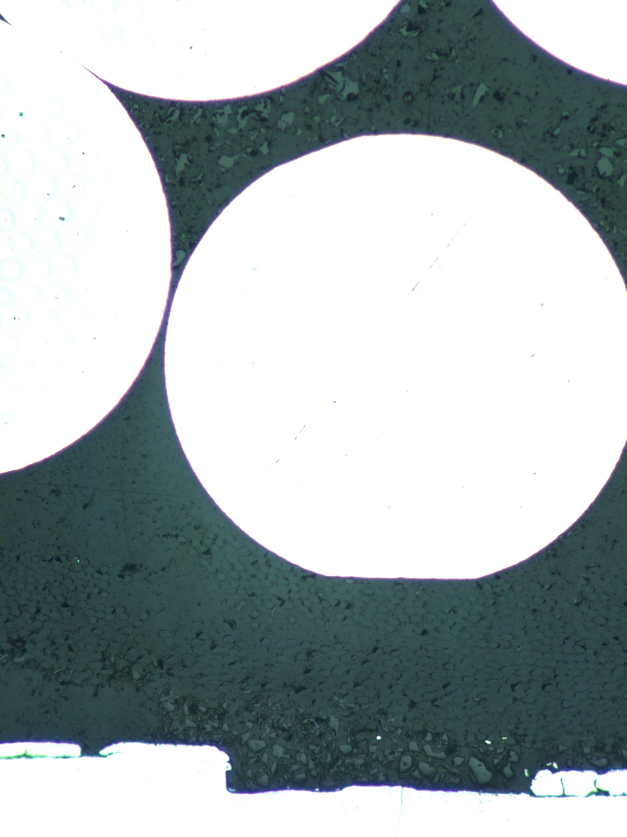
2. Development of the Stycast VPI for CCT
Vacuum Assisted Resin Transfer Molding (VARTM)
Diagram of the impregnation bag system for Stycast
Nb₃Sn Strand
Aluminum plate
Nb₃Sn Strand
Cable
Stycast
Nb₃Sn Strand
Nb₃Sn Strand
Peel ply
Glass insulation
New expanded Flow media
Vacuum bag
External heating elements
Aluminum
J. L. Rudeiros Fernandez et al.

Slide 25
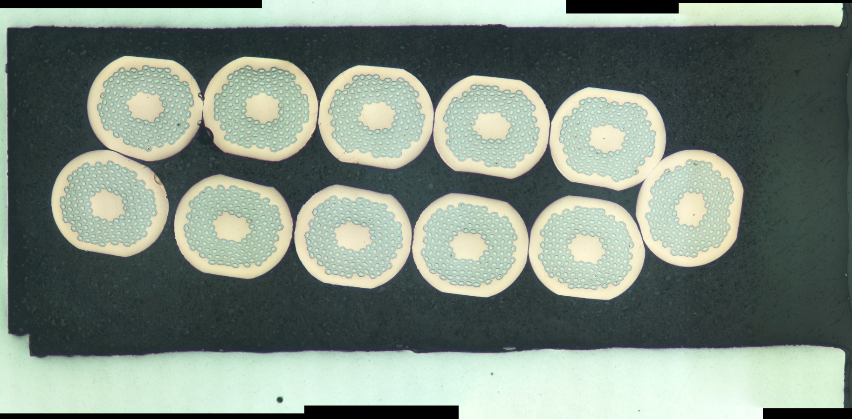
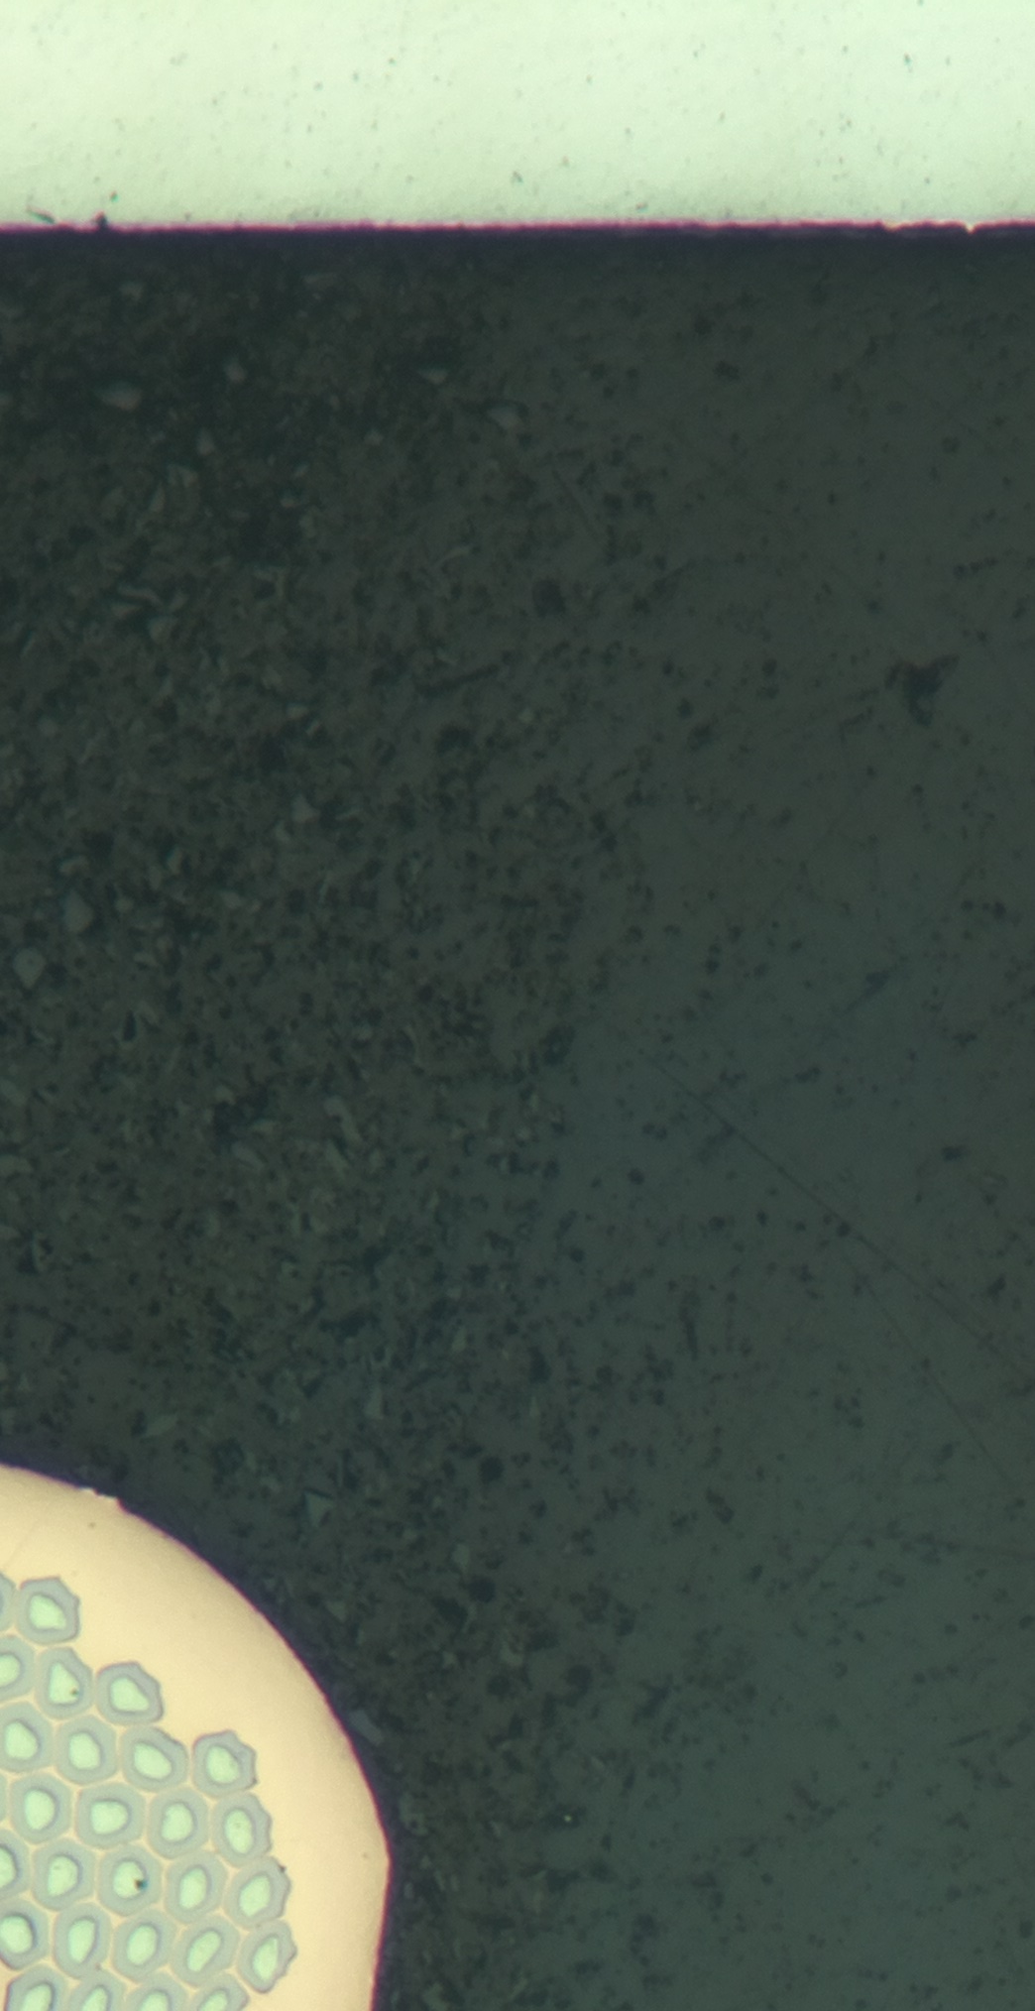
2. Development of the Stycast VPI for CCT
Vacuum Assisted Resin Transfer Molding (VARTM)
Diagram of the impregnation bag system for Stycast
Aluminum plate
Cable
Peel ply
Glass insulation
New expanded Flow media
Vacuum bag
External heating elements
J. L. Rudeiros Fernandez et al.

Slide 26
Table of contents
01
Characterization of adhesion
02
Development of the Stycast VPI for CCT
03
Conclusions and next steps
J. L. Rudeiros Fernandez et al.

Slide 27
3. Conclusions and next steps
A method to measure the adhesion between a copper wire and various resin systems at room temperature and 77 K has been developed.
The paraffin wax interfacial strength with copper wire has been characterized, showing two orders of magnitude lower adhesion in relation to the epoxy resin used for previous CCT magnets (i.e. Mix61).
Next steps include measuring adhesion properties at 77 K.
A method to successfully impregnate single layer magnets with Stycast 2850 ft based on the VPI method is being developed.
Initial results indicate that there is potential for impregnation of single layer coils in which radial impregnation is feasible but substantial challenged remain ahead.
J. L. Rudeiros Fernandez et al.

Slide 28
Thanks!
J. L. Rudeiros Fernandez et al.

