Slide 1
ML QA Data Analysis/Clustering
2023 USMDP Collaboration Meeting
Presenting work of intern Alberto Plebani
Co-supervised by Reed Teyber (LBNL), Emanuela Barzi (FNAL)
With inputs from Maxim Marchevsky, Diego Arbelaez

Slide 2
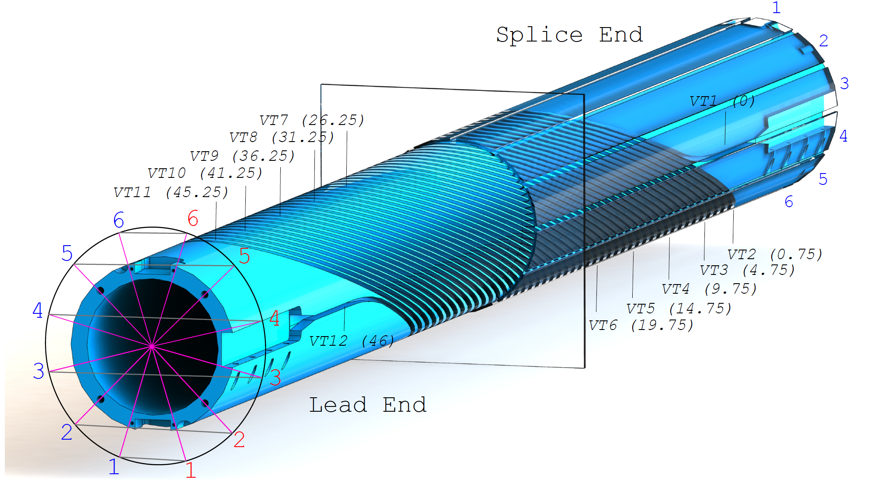
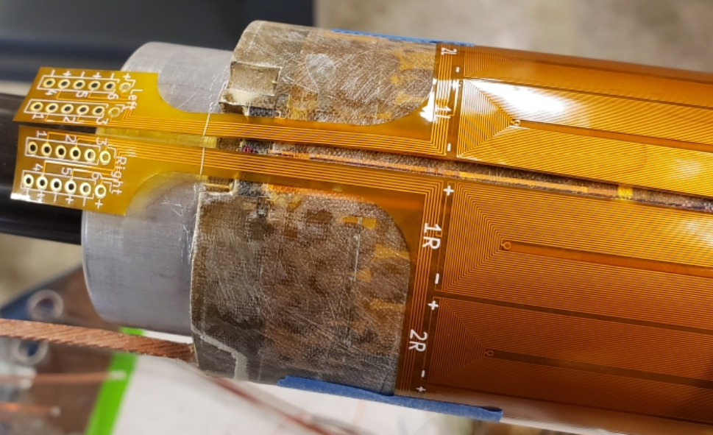
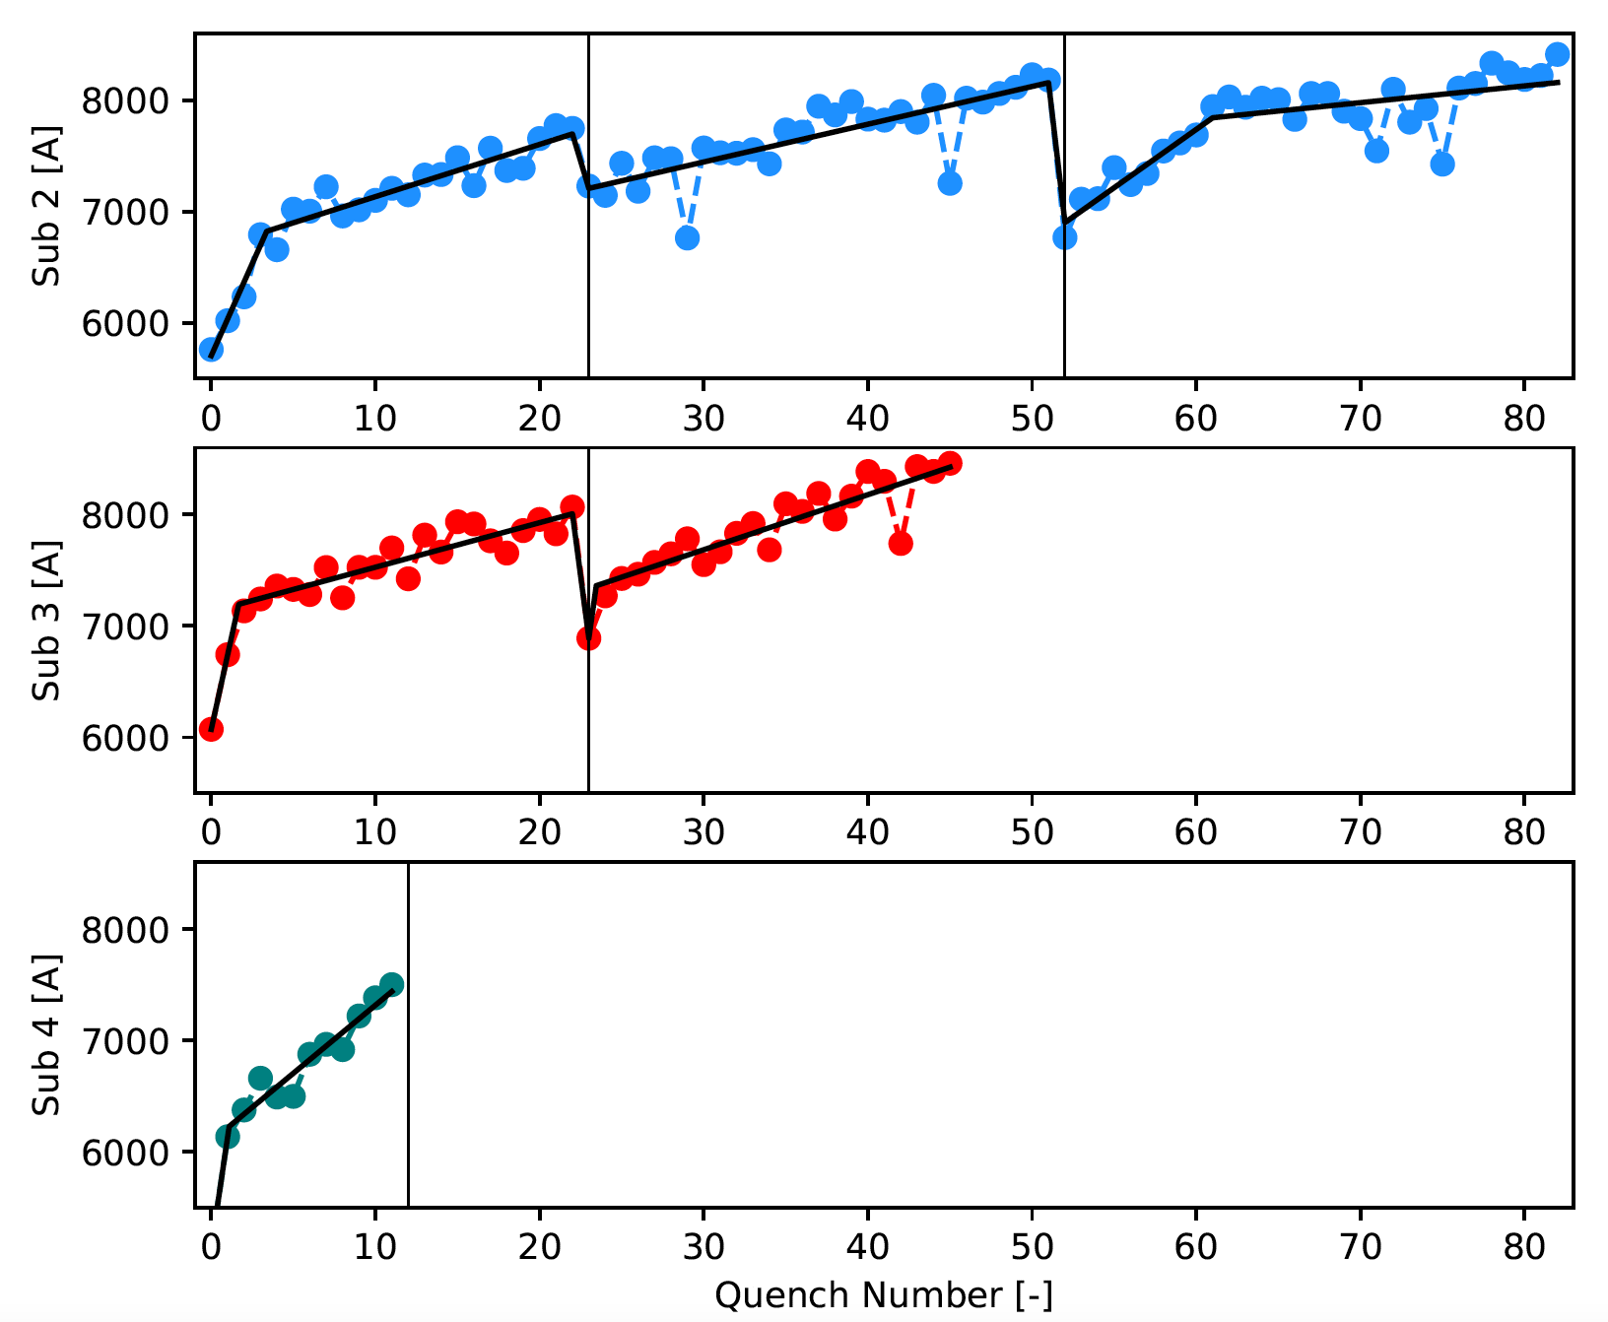
Background - Inter-Layer Quench Antennas
A suite of diagnostics have been implemented in subscale magnets (lead by Maxim Marchevsky)
One diagnostic is the inter-layer Quench antennas
Integrated into magnet yielding sensitive measurements
Dipole bucked (left-right)
Elements every 30 degrees
Dataset contains 4 magnets, 8 thermal cycles
Recorded at 25 kHz along ramp through quench

Slide 3
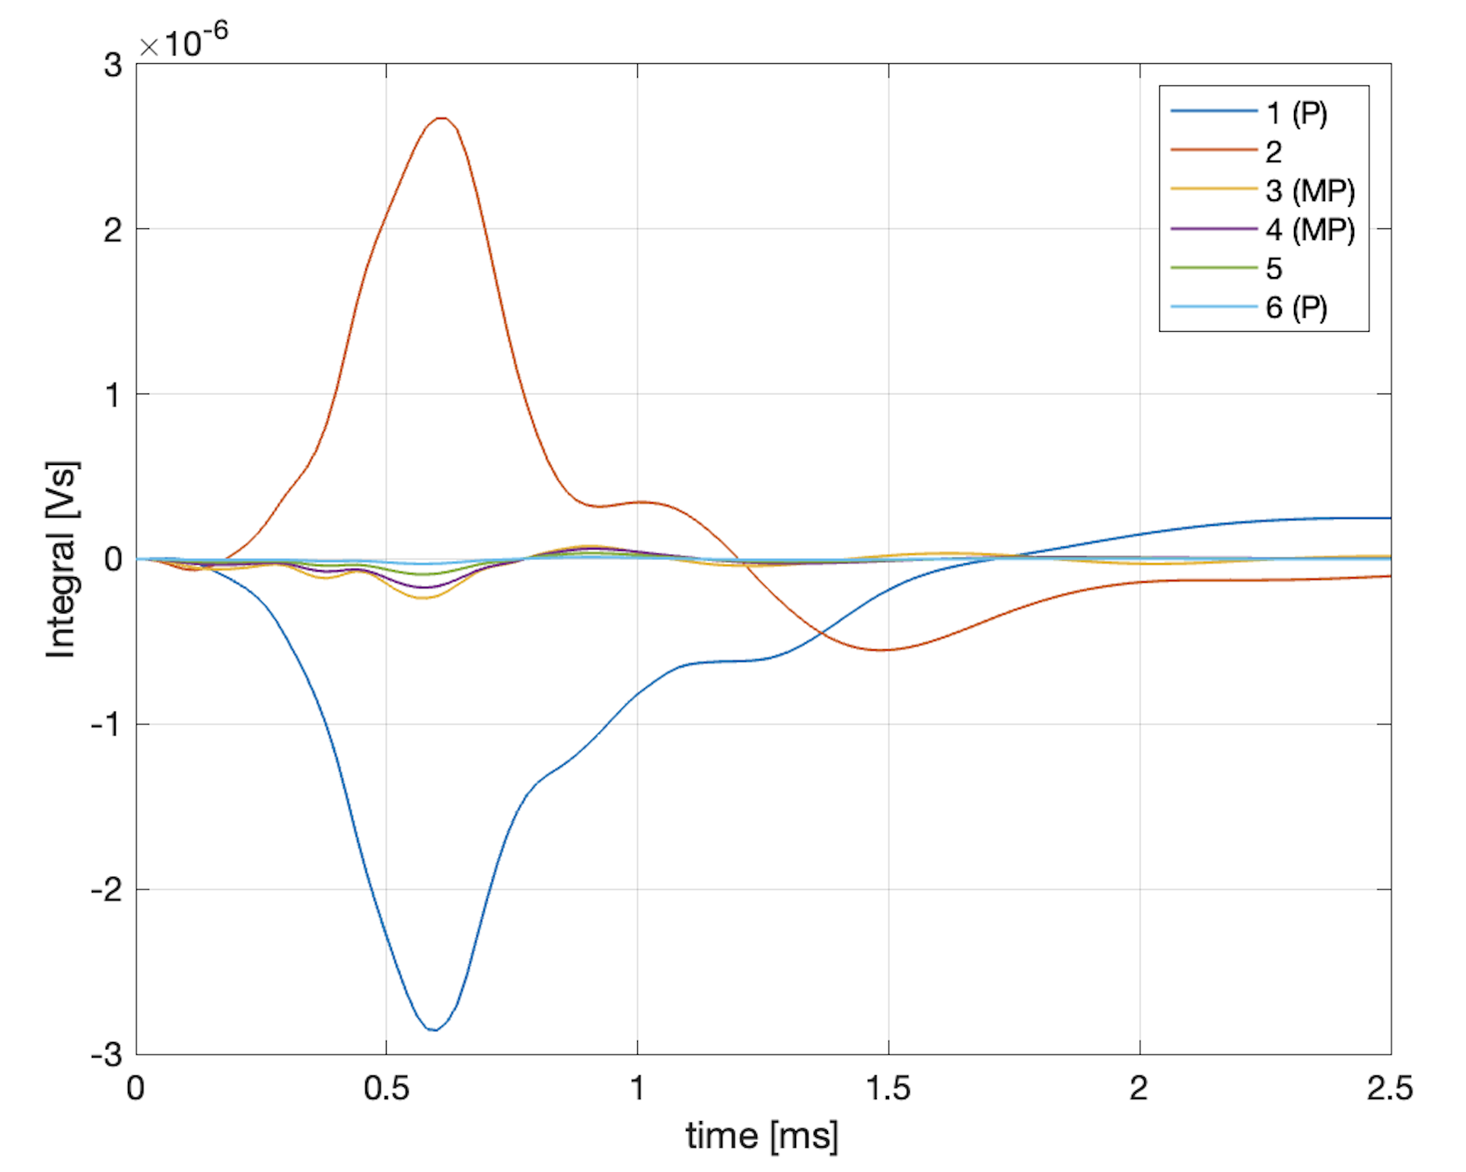
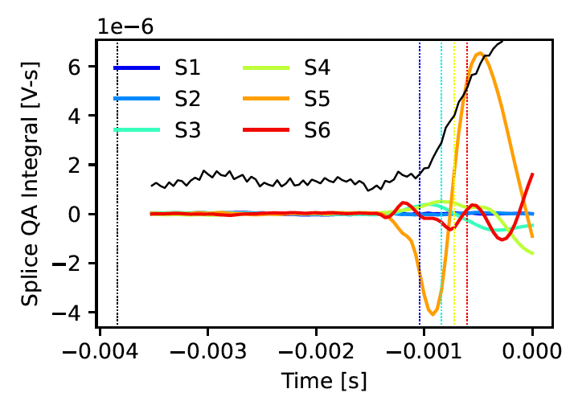
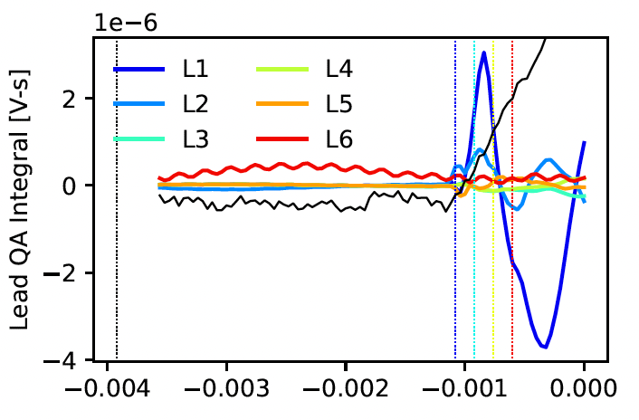
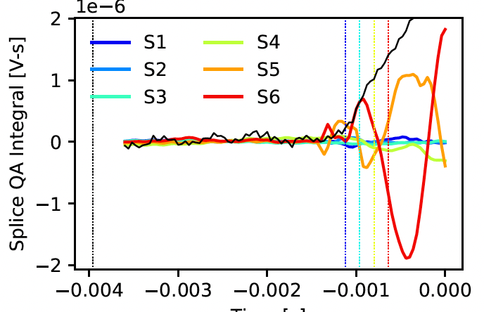
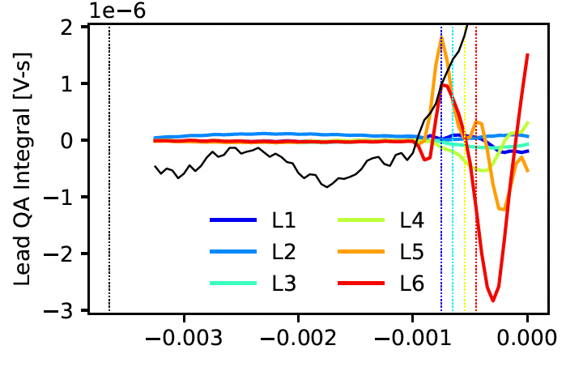
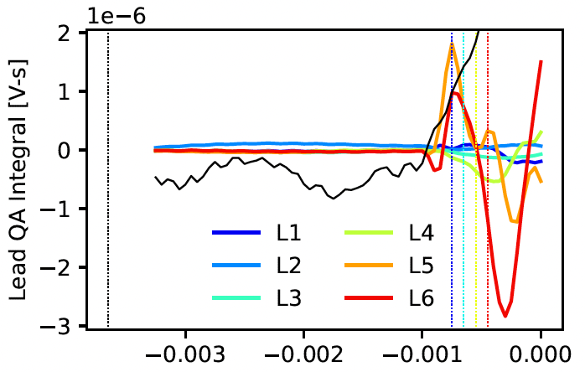
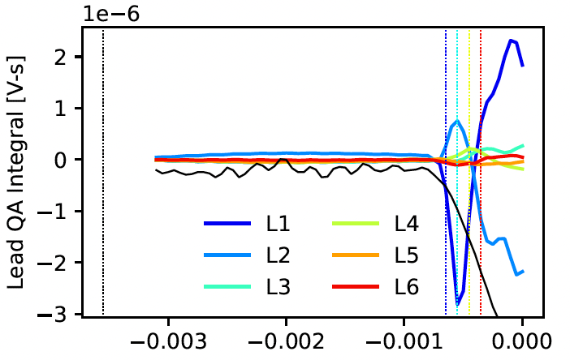
Background – The Common quench
Many quenches across subscale magnets look remarkably similar
A characteristic frequency ~ 1kHz that we associate with current redistribution phenomena
Corroborated by high-resolution cable quench simulations by Ruben Keizer (Twente/CERN)
We impose this experience on our approach
In other words, for quench antennas:
Mechanical activity has many “shapes and sizes”
Current redistribution (i.e. quench) can have clear signatures
Where along ramp do we see redistribution?
What does this mean?

Slide 4
Outline
Summer internship work of Alberto Plebani
Co-supervised by myself and Emanuela Barzi
Presenting today on his behalf
“Birds eye view” - charge to student
Take continuous ramp data, extract all ramp events + quench
Single antenna element only
Find features that characterize the events
K-means to cluster data
What are the cluster centroids?
What ramp events get clustered / show similarities with the quench?

Slide 5
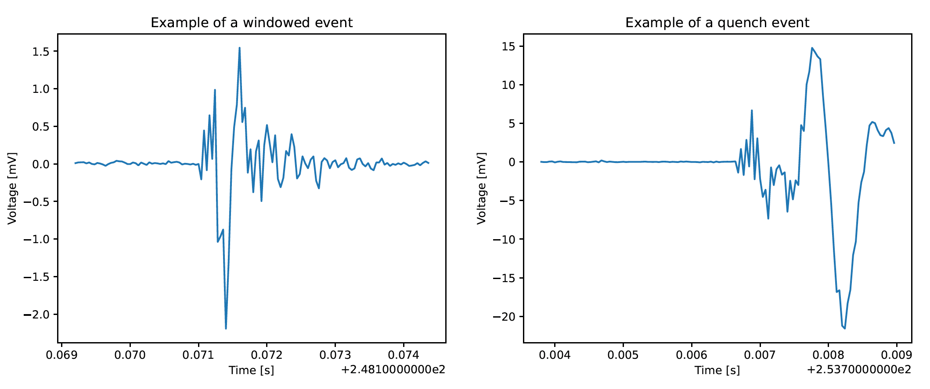
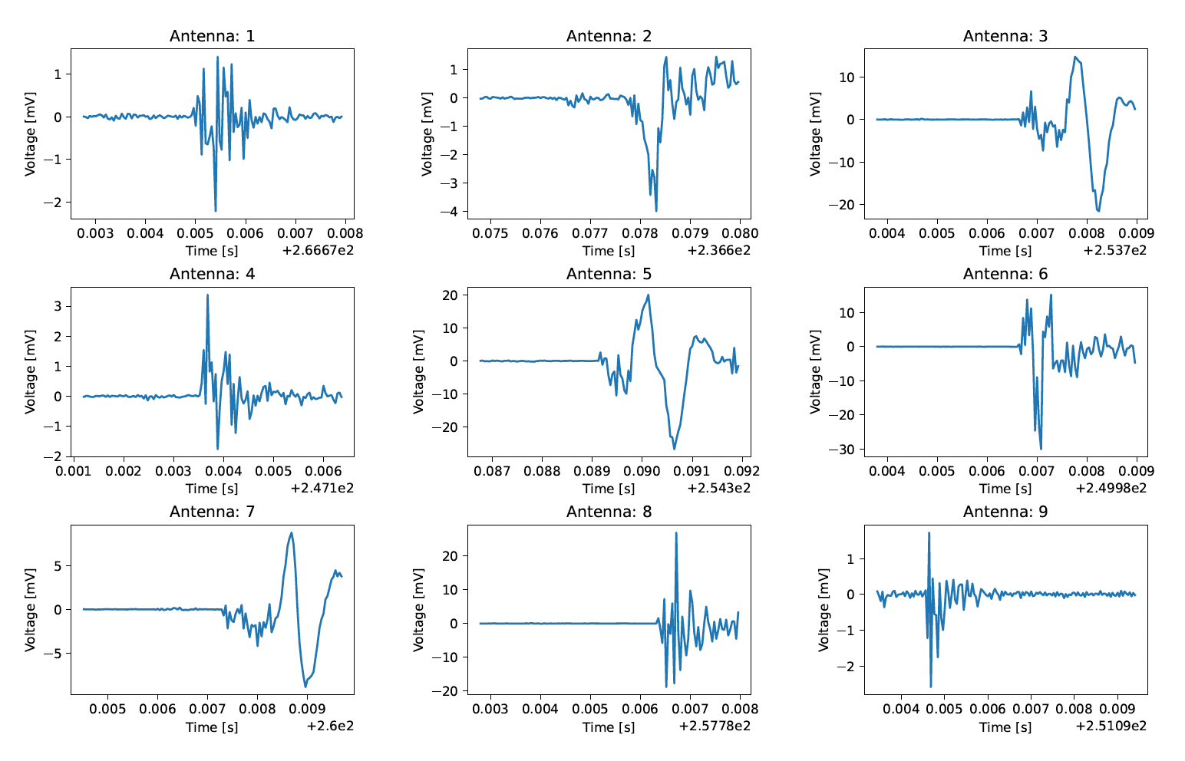
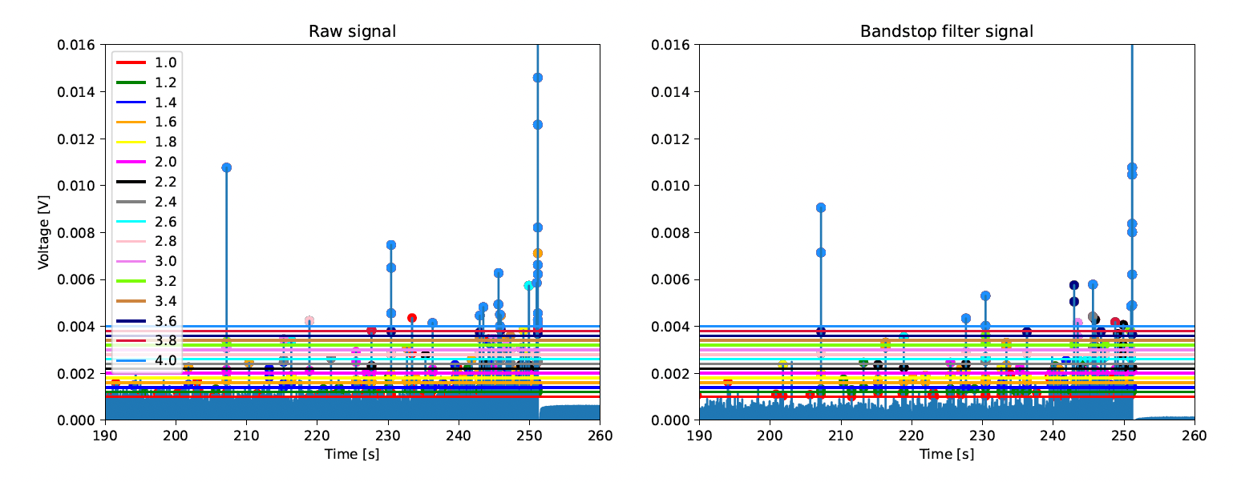
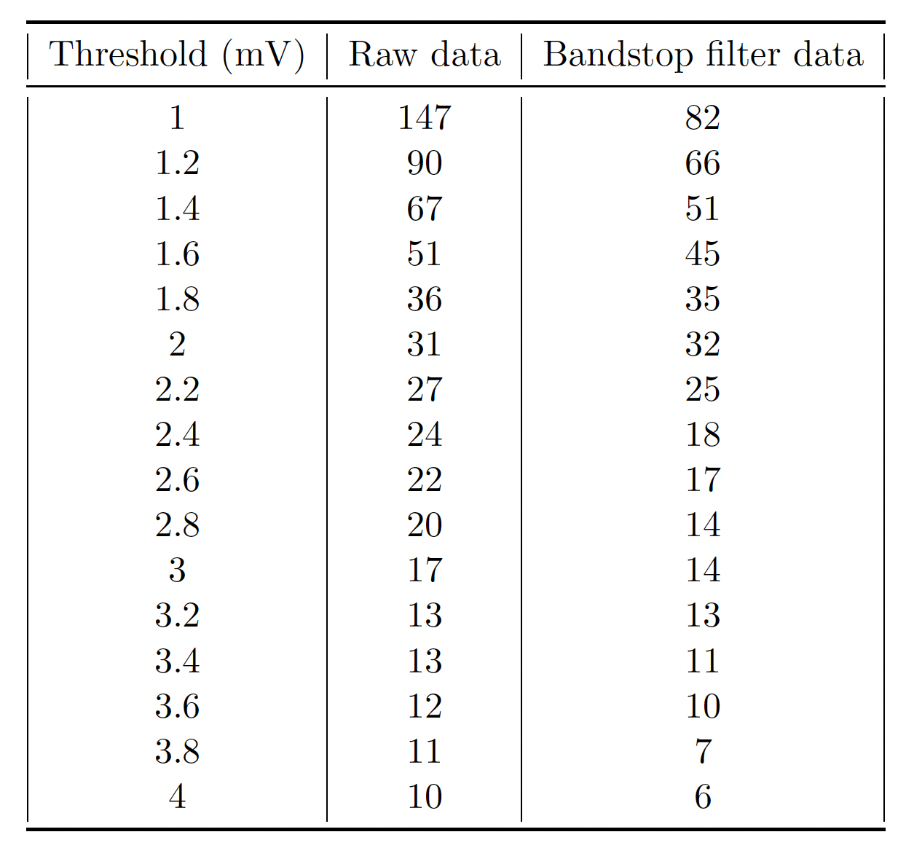
Extract ramp events
Threshold to identify events
Explored filtering, various selection, et cetera
9 ramps, quench events shown
Some quenches from other magnet locations
Alberto Plebani, Co-supervised by Reed Teyber (LBNL) and Emanuela Barzi (FNAL)

Slide 6
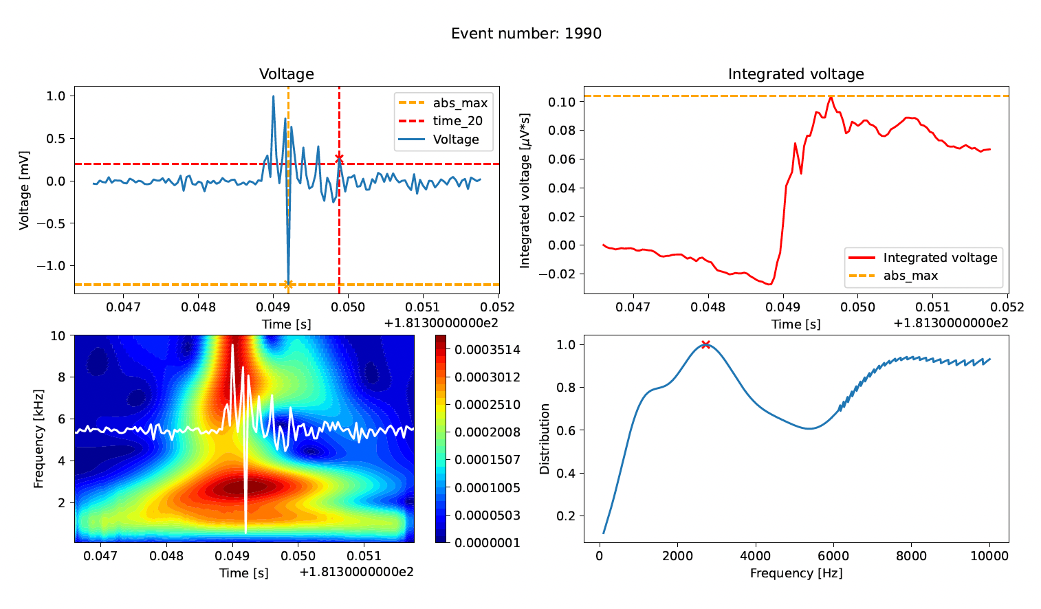
Define Features
Many, many features explored
Maximum antenna voltage
Maximum voltage integral
Signal Widths / shape
Proxies for frequency content
Dominant frequency
Measure of 1 kHz content
Many more explored
Alberto Plebani, Co-supervised by Reed Teyber (LBNL) and Emanuela Barzi (FNAL)

Slide 7
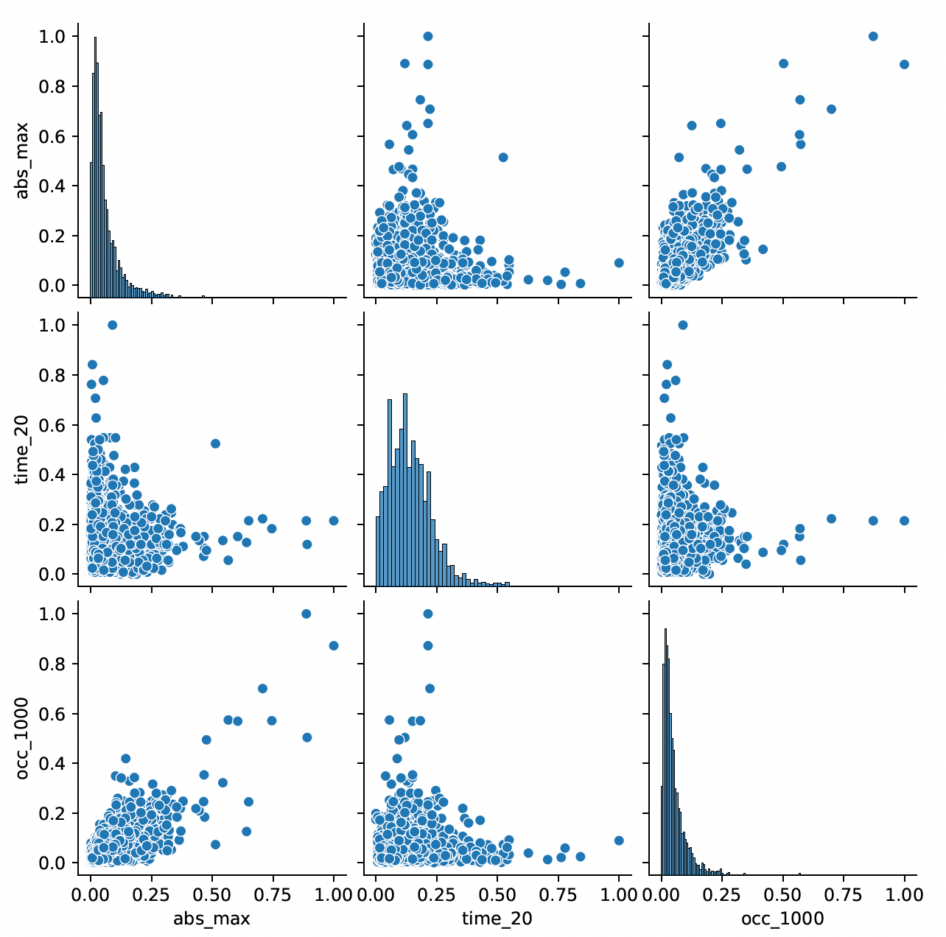
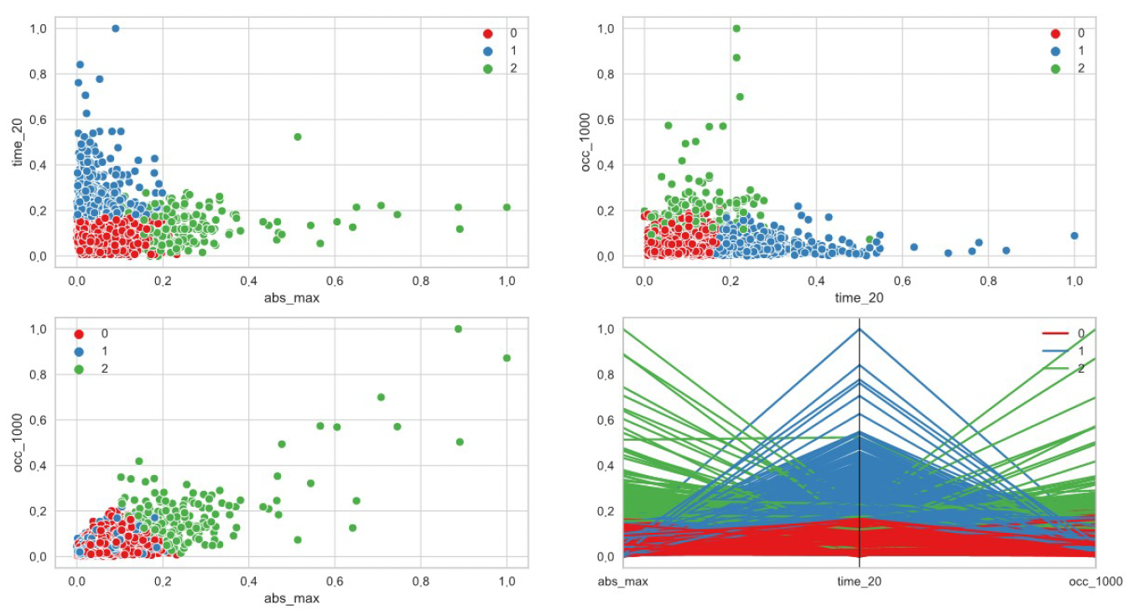
Preliminary Results
K-means clustering – 3 centroids
Iteratively find centroids to minimize distance from centroids to each event
3 features, no dimensionality reduction (presented today)
High Amp. -> “1kHz”
Quench
events
Alberto Plebani, Co-supervised by Reed Teyber (LBNL) and Emanuela Barzi (FNAL)

Slide 8
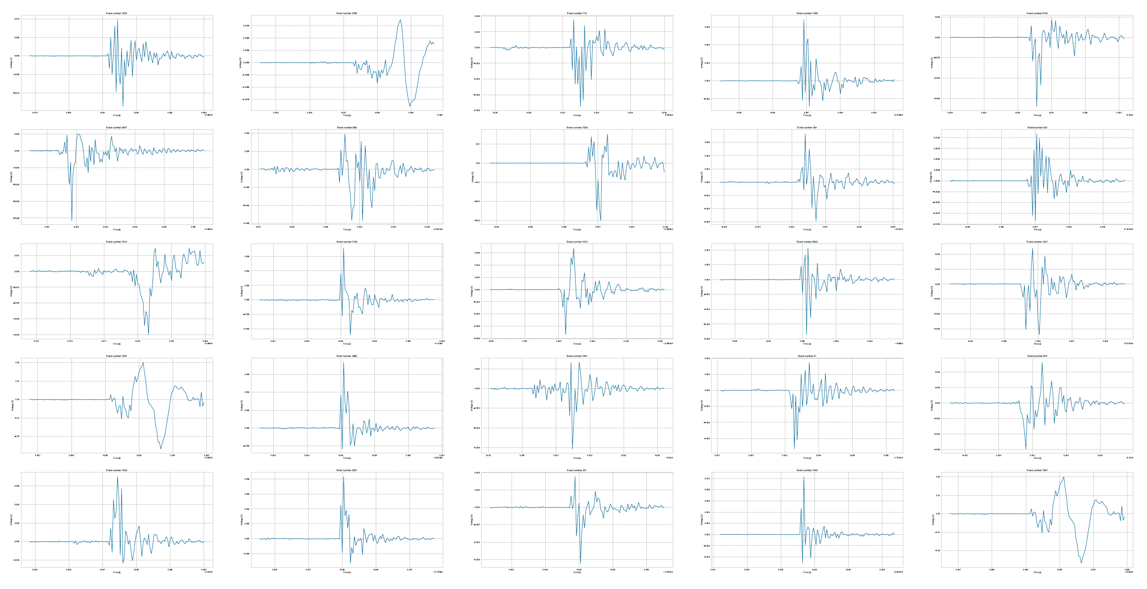
Cluster 2
25 randomly selected “cluster 2” events
Large amplitude, correlated with ~ 1kHz – includes many quenches
Alberto Plebani, Co-supervised by Reed Teyber (LBNL) and Emanuela Barzi (FNAL)

Slide 9
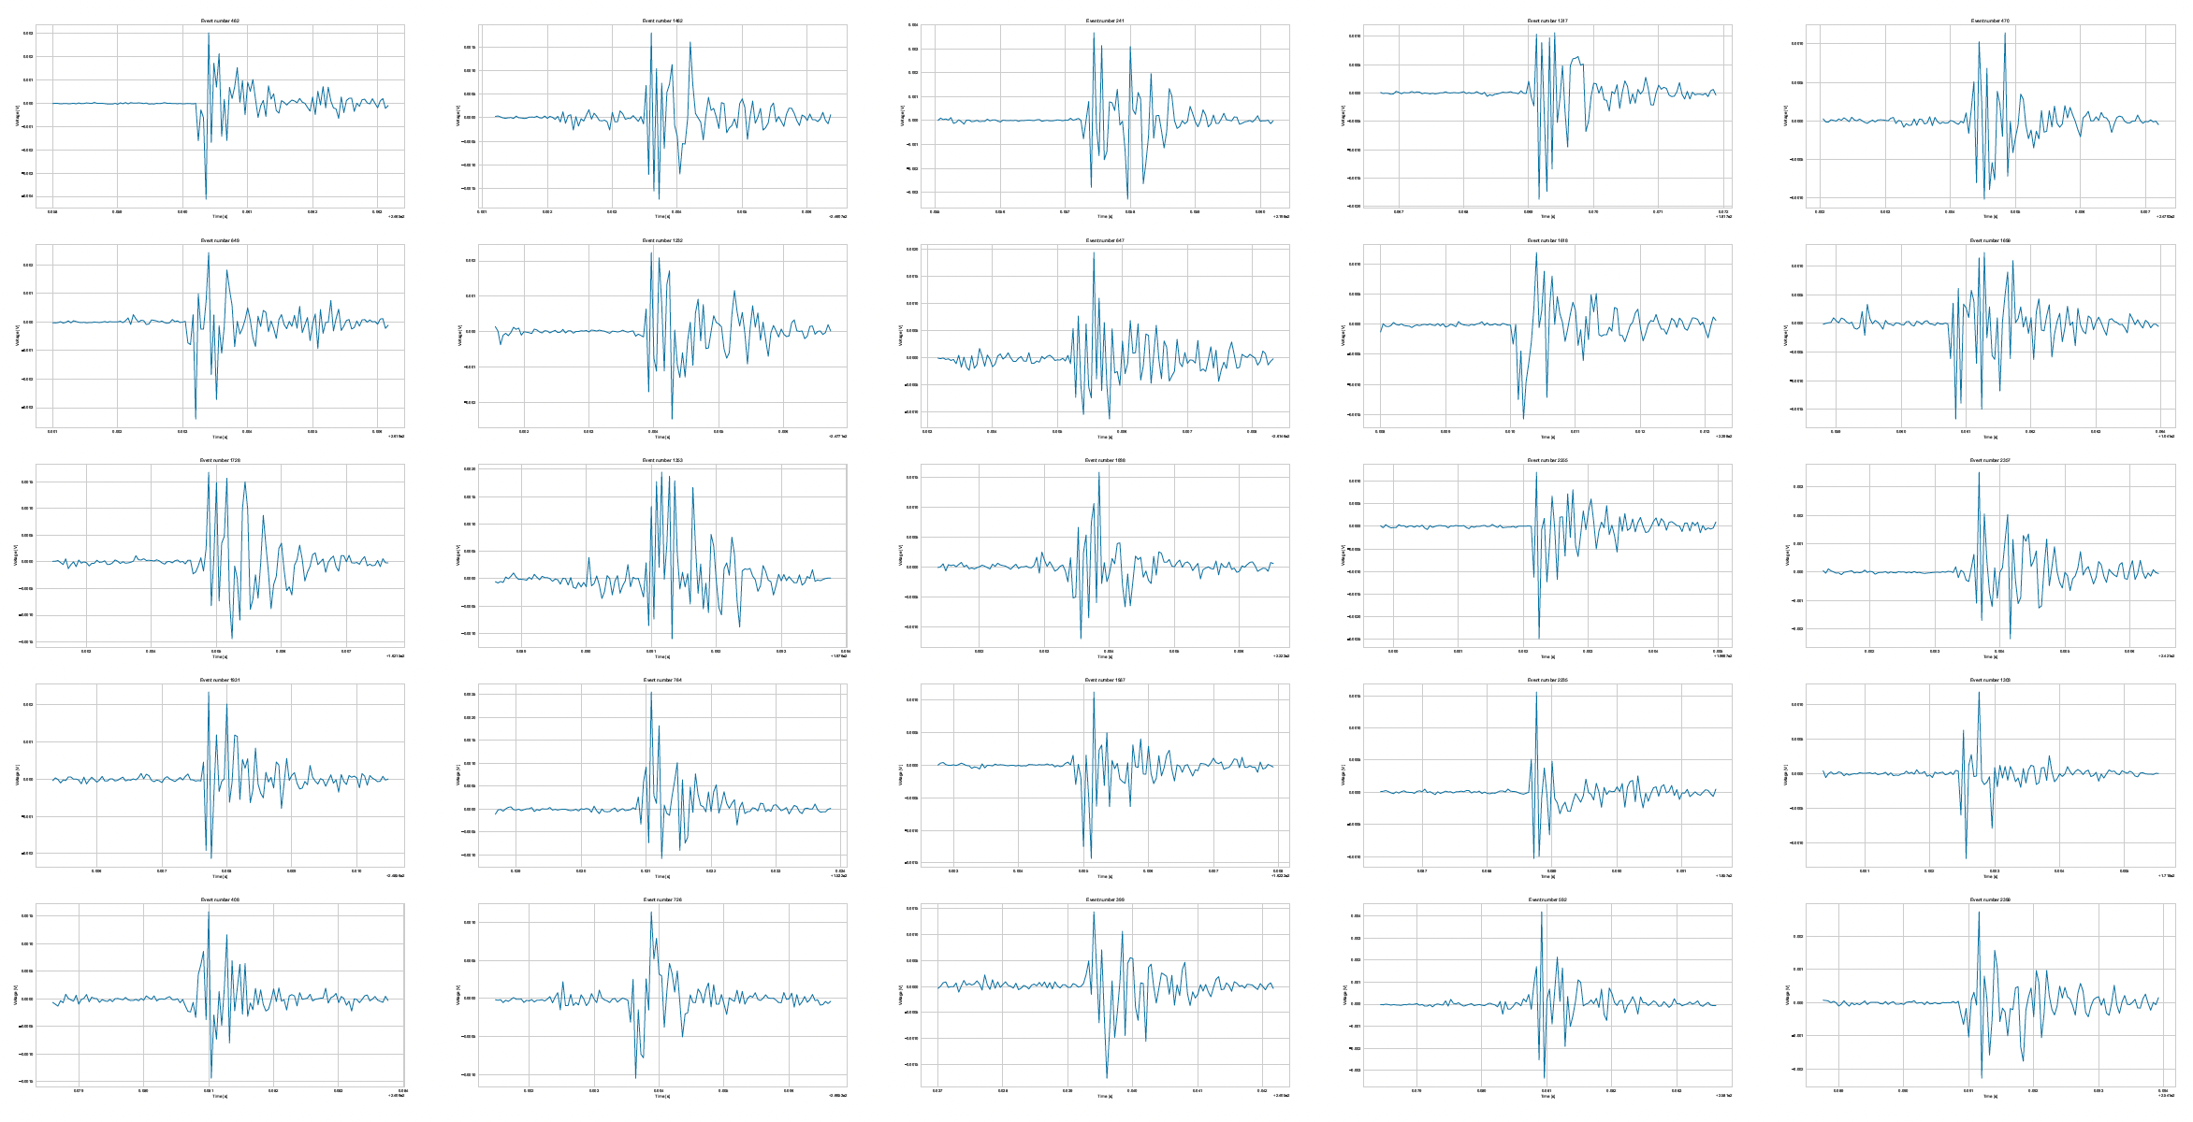
Cluster 1
25 randomly selected “cluster 1” events
Long, low-amplitude events
Alberto Plebani, Co-supervised by Reed Teyber (LBNL) and Emanuela Barzi (FNAL)

Slide 10
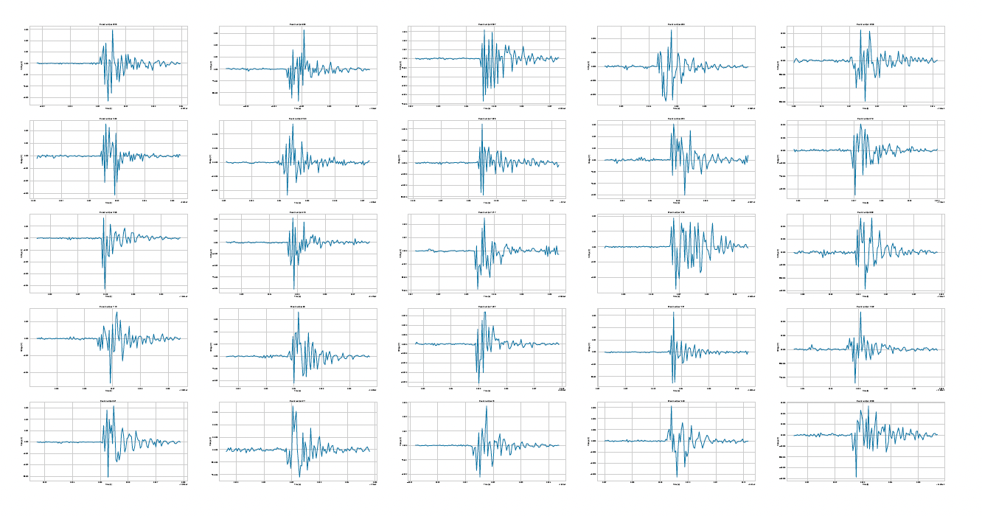
Cluster 0
25 randomly selected “cluster 0” events
Small, fast-decay events
Alberto Plebani, Co-supervised by Reed Teyber (LBNL) and Emanuela Barzi (FNAL)

Slide 11
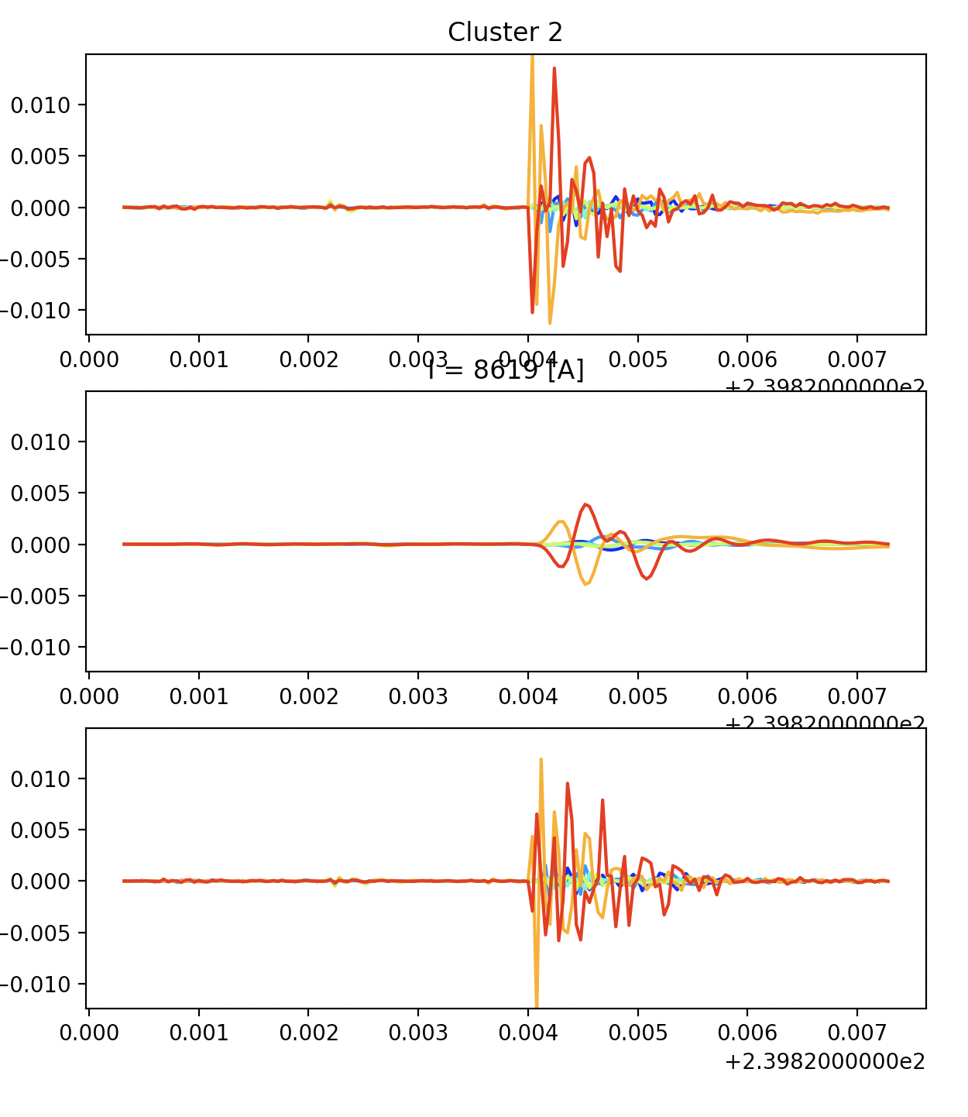
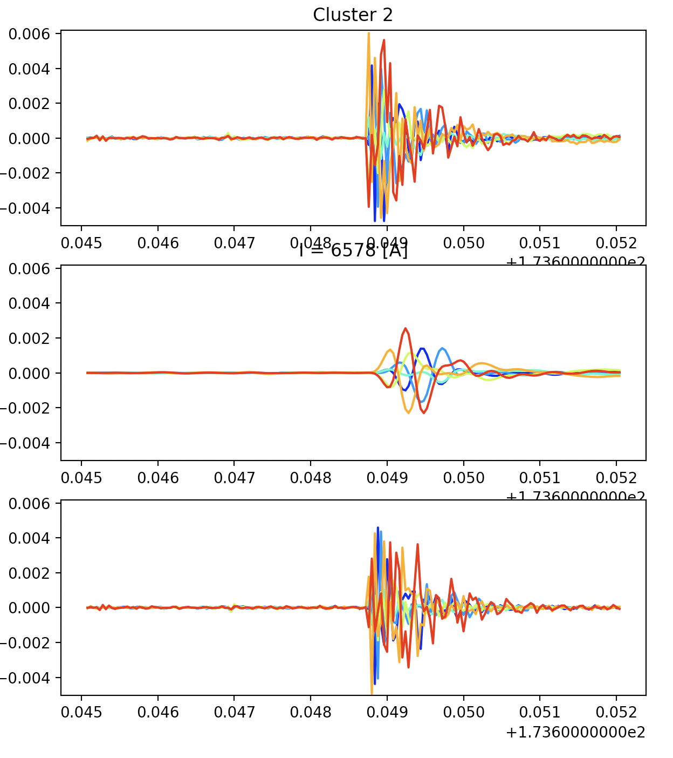
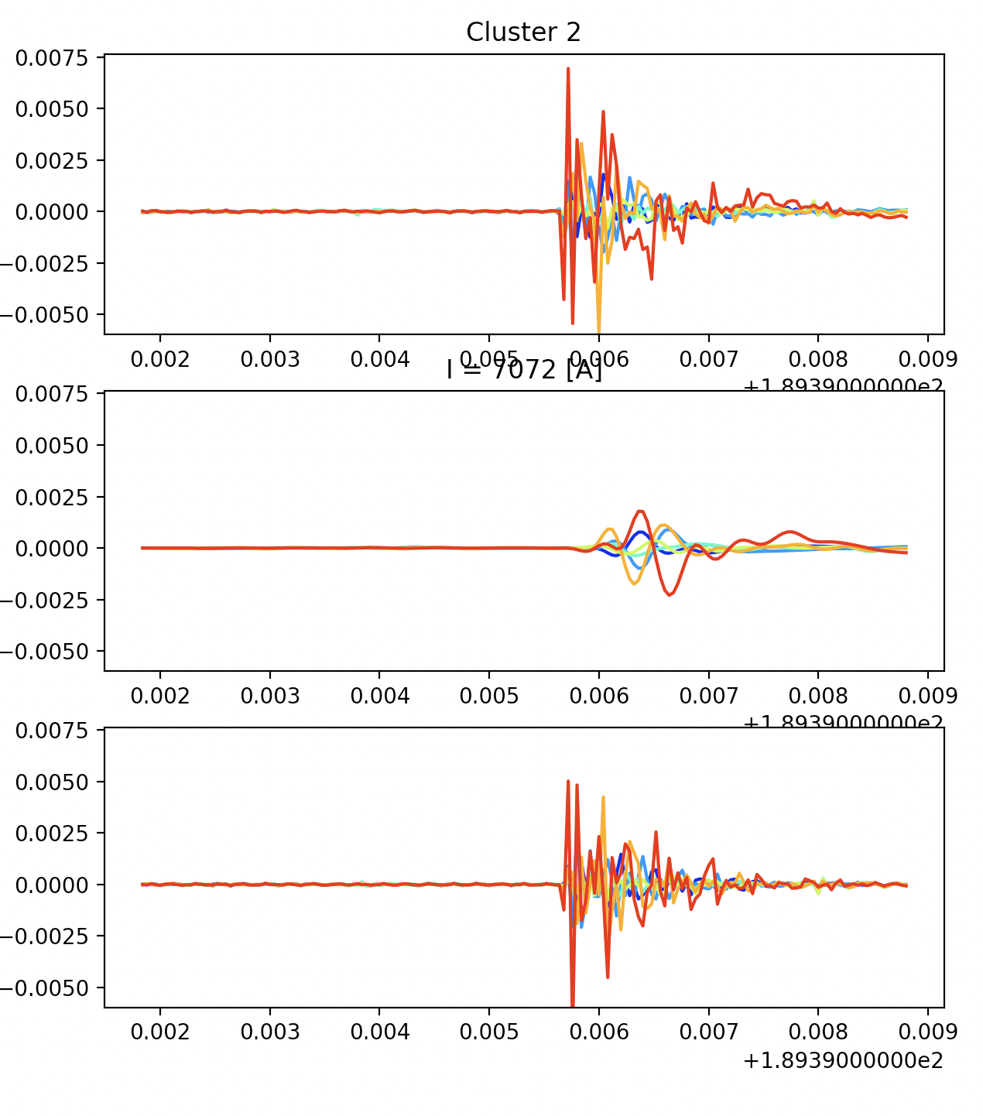
Ramp Activity
Presented on Monday
Several “cluster 2” events along ramp show similarities with quench events
Suggests disturbances that cause redistribution during ramps – ”small quenches that recover”
Not yet done – analyze trends where this occurs
Cluster “associated” with redistribution
Ramp event
– not a quench
Low pass filter
- Looks like a quench!
Typical Quench
High pass filter
Alberto Plebani, Co-supervised by Reed Teyber (LBNL) and Emanuela Barzi (FNAL)

Slide 12
Concluding Remarks (1/2)
Methods employed today are great starting point - but moving forward…
Should use more antennas, more ramps, more features, implement dimensionality reduction,…
More sophisticated clustering techniques e.g. NN-based
Could consider manually labeled events and use supervised techniques
Excellent work over very short amount of time by Alberto Plebani
Collaboration with Emanuela Barzi (FNAL) and myself (LBNL)
Wish internship was longer – student left as interesting results started being generated
Needs a focused effort – from either myself or a new student
Yet, a very nice outcome from experience!
Student presented this work during applications and was just offered a Ph.D. position at Cambridge (ATLAS)!
Alberto Plebani, Co-supervised by Reed Teyber (LBNL) and Emanuela Barzi (FNAL)

Slide 13
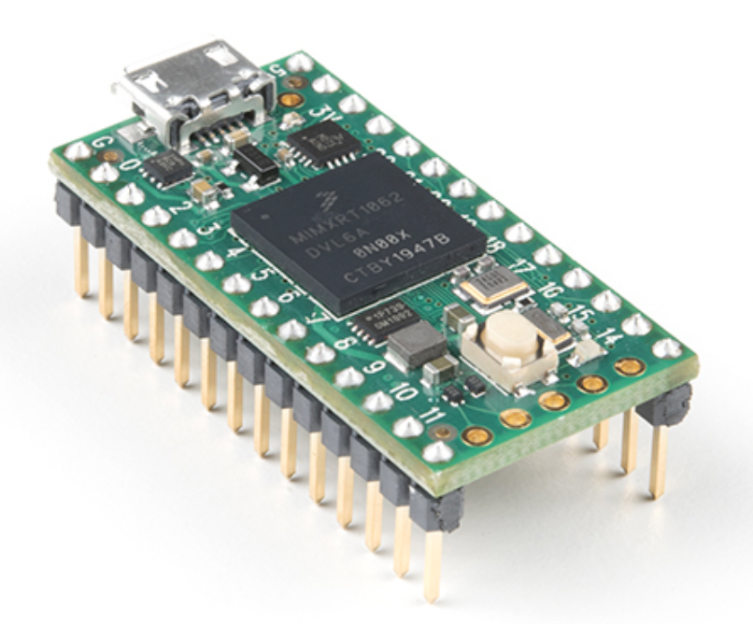
Concluding Remarks (2/2)
Quench antennas are historically a diagnostic – ”to be analyzed later”
But, if we know what frequency range to look for, and the antenna amplitudes of a quench are “unique”….
Could be interesting to build a real-time quench detection system!
Microcontrollers these days can do spectral analysis, linear algebra, basic machine learning (TensorFlow Lite),…

Slide 14
Backup Slides

Slide 15
Signal Processing
Rate of change of magnetic flux induces antenna voltage
$V_{antenna}=\sum_{i=1}^{n_{loops}}{\frac{d}{dt}\left(\int{BdA_{i}}\right)}$
Integral of induced antenna voltage gives net change in flux
Displacement of a wire from position a to b through dipole field gives constant, path-independent integrated voltage [V-S]
Quench antennas are sensitive to mechanics and current redistribution– how to isolate quench location?
Integral removes periodic content (mechanics / vibration)
Quench location - antenna with largest norm of [V-s] up to constant magnet voltage (red vertical line)
The signal shown here (location and frequency) is remarkably prevalent in all subscale magnet tests
Low frequency (~ 1 kHz) “stationary” signal
~ 1 kHz

Slide 16
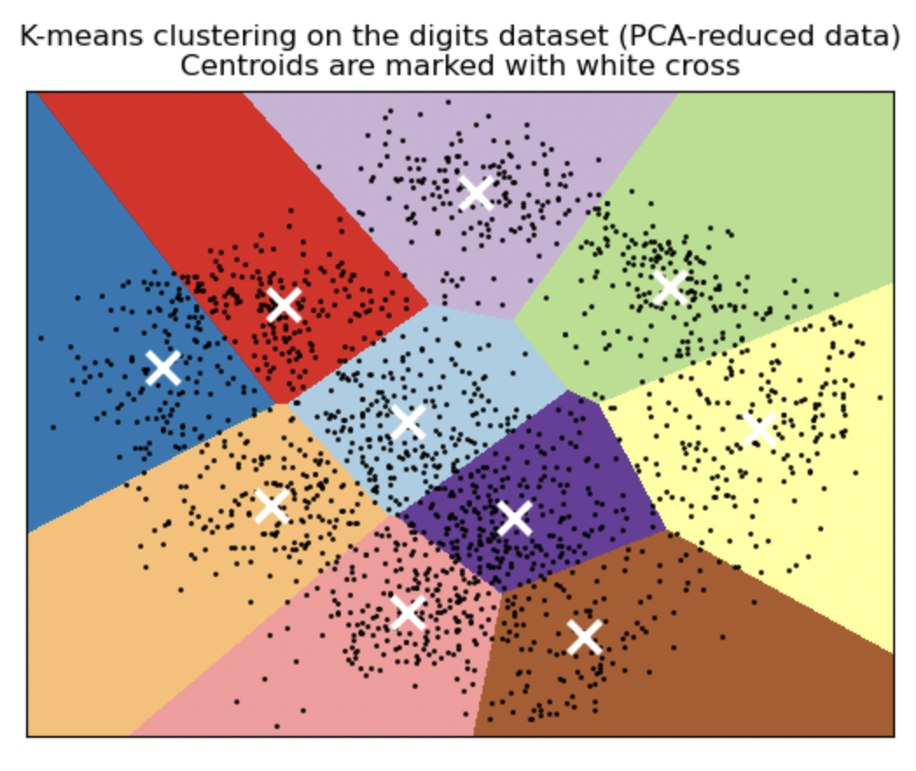
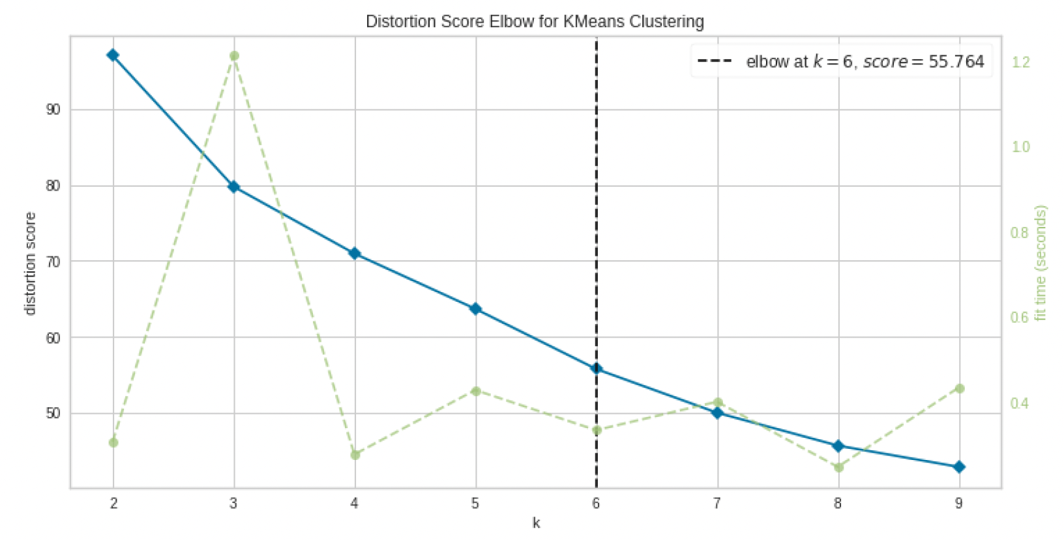
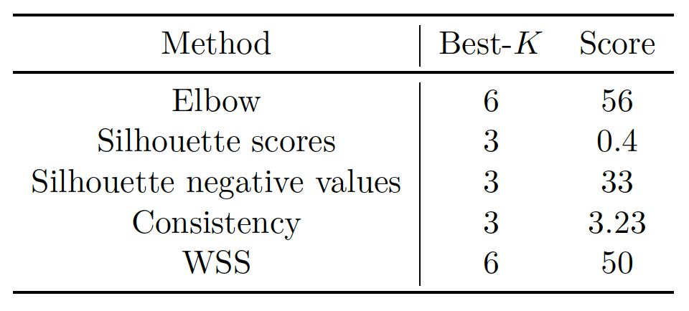
K-means clustering
We have to tell K-means how many clusters to look for
Example on right – clustering hand-written digits, would expect 10 clusters
Need to repeat clustering analysis for many # of clusters
Look for “performance” vs. number of clusters
3 chosen here
Example from scikit-learn
From Alberto
# Clusters

Slide 17
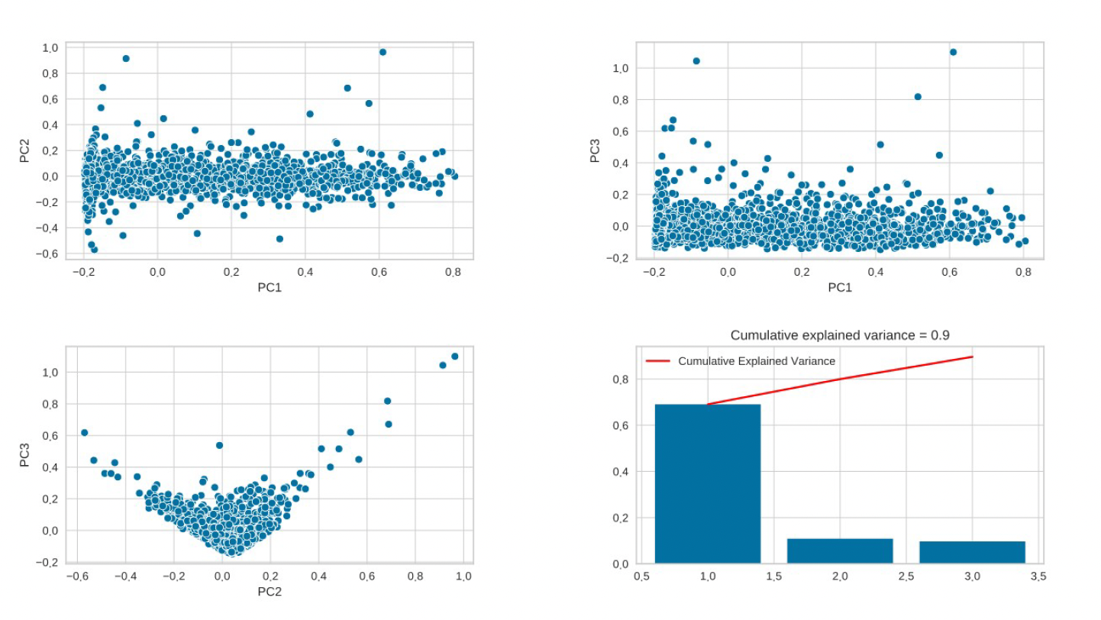
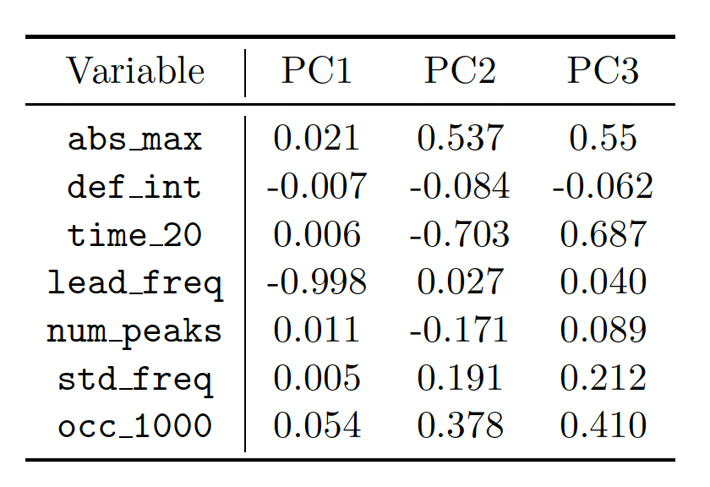
Dimensionality Reduction
K-means clustering
A simple but powerful technique to create labels for unlabeled data
Iteratively find new centroids to minimize Euclidean distance from centroids to each ramp event
Too many features -> run into issues with dimensionality
Principal Component Analysis
Singular Value Decomposition-like
Find new orthogonal axis, reduced in number, that minimizes “data loss”
Center and Scale
For each feature, center (subtract mean over all ramp events) and divide by standard deviation
Failure to do this - clustering will be dominated by the single feature with largest magnitudes
“New” features (3)
Original Features (7)

