Slide 1




Bi-2212: a Routine Long-Length Predictable Conductor and Path to Improve its Properties
Eric Hellstrom, I. Hossain, S. Barua, J. Jiang, P. Lee, A. Oloye, F. Kametani, and D. Larbalestier,
Applied Superconductivity Center, National High Magnetic Field Laboratory
Florida State University
NSF-DMR 2128556, DOE-OHEP DE-SC0010421, DOE-MDP, and the State of Florida
MDP - Brookhaven National Laboratory – Mar. 21-24, 2023

Slide 2
Overview
Presentation will be in two parts:
  Effect of filament geometry and architecture on filament bonding
  Characterize I_{C} distribution in long length wires
Driving questions
    What influences how filaments bond during the overpressure heat treatment?
    How does this affect J_{C}?
    Is the uniformity of long-length wires good enough to build large coils?

Slide 3
Champion Bi-2212 powder and wire – LXB-52
Powder is a mixture of phases
Grain size is small, so it does not degrade wire drawing
Alkaline earth cuprate
Powder: Engi-Mat LXB-52
Wire: PMM170123 (0.8 mm, 55x18)
Jiang et al., IEEE Trans. Appl. Supercond. 29, 6400405 (2019)

Slide 4
Outline 1
Observed three bundle shapes in 85x18 wires
Investigated and analyzed filament geometry and filament bonding for the three bundle shapes
  In as-received 85x18 wire
  In wires quenched from the melt state

Slide 5

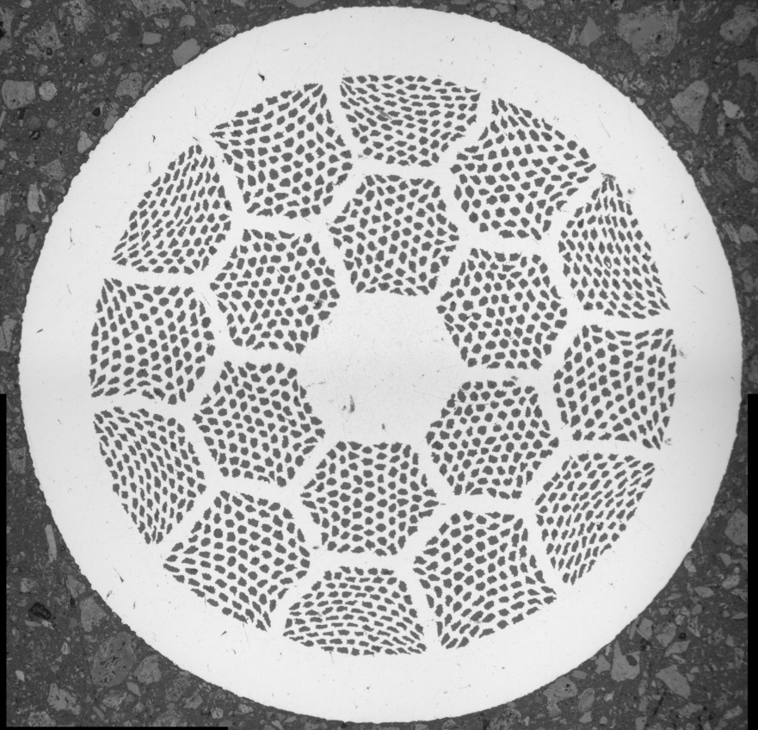
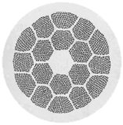
The filament geometry in the three bundle shapes in the 85x18 wires is different
Imam Hossain
Samples
85x18 architecture
1.3, 1.2, 1.0, & 0.8 mm diameter wires
Densified wires at 820 ˚C and 50 bar for 12 h to remove void space
Analyzed the three bundle shapes individually
ImageJ used to do the analysis
Tetragonal
Hexagonal
Pentagonal
50 bar overpressure
100 µm

Slide 6
Different bundle shapes have different average filament area and filament separation
Measured filament area & calculated equivalent diameter
Tetragonal bundles have the smallest average filament area
Tetragonal bundles have the smallest filament separation
pent
pent
hex
hex
tet
tet
1.3 mm
1.2 mm
Average filament diameter (µm)
1.0 mm
1.3 mm
1.2 mm
1.0 mm
0.8 mm
0.8 mm
Bundle shape

Slide 7
What happens to the filaments during the overpressure heat treatment?
Designed and built an overpressure (OP) quench furnace
OP quench furnace freezes-in filament microstructure from the melt state

Slide 8
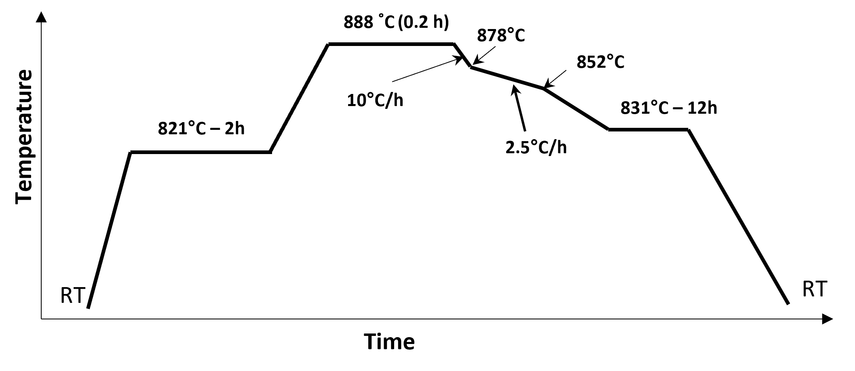
Study how the filament microstructure changes in the melt state – filament bonding occurs
Standard overpressure heat treatment
Quench at 875 °C – before solidification starts
Solidification starts at 872°C
Bi-2212 melts at ≈ 884°C
Bi-2212 is in the melt state

Slide 9
Quench samples from the melt state to study how the filament microstructure evolves in the melt state
Quenched samples after 0.2, 2, 3 and 4 h in the melt state
Increasing time in the melt for the filaments to bond together
887 °C - 0.2 h
882 °C
Bi-2212 melts at ≈ 884°C
880 °C
Quench from 875 °C
(Just before
solidification starts)
878 °C
10 °C/h
2.5 °C/h
820 °C – 2h
t_{quench} 0.2 h
RT
Quenching

Slide 10
Maximum filament bonding occurs in tetragonal bundles, which have minimum filament separation
Percent of bonded filaments
Tetragonal
Percent of bonded filaments
t_{quench} (h)
t_{quench} (h)
60%
Percent of bonded filaments
Percent of bonded filaments
t_{quench} (h)
t_{quench} (h)

Slide 11
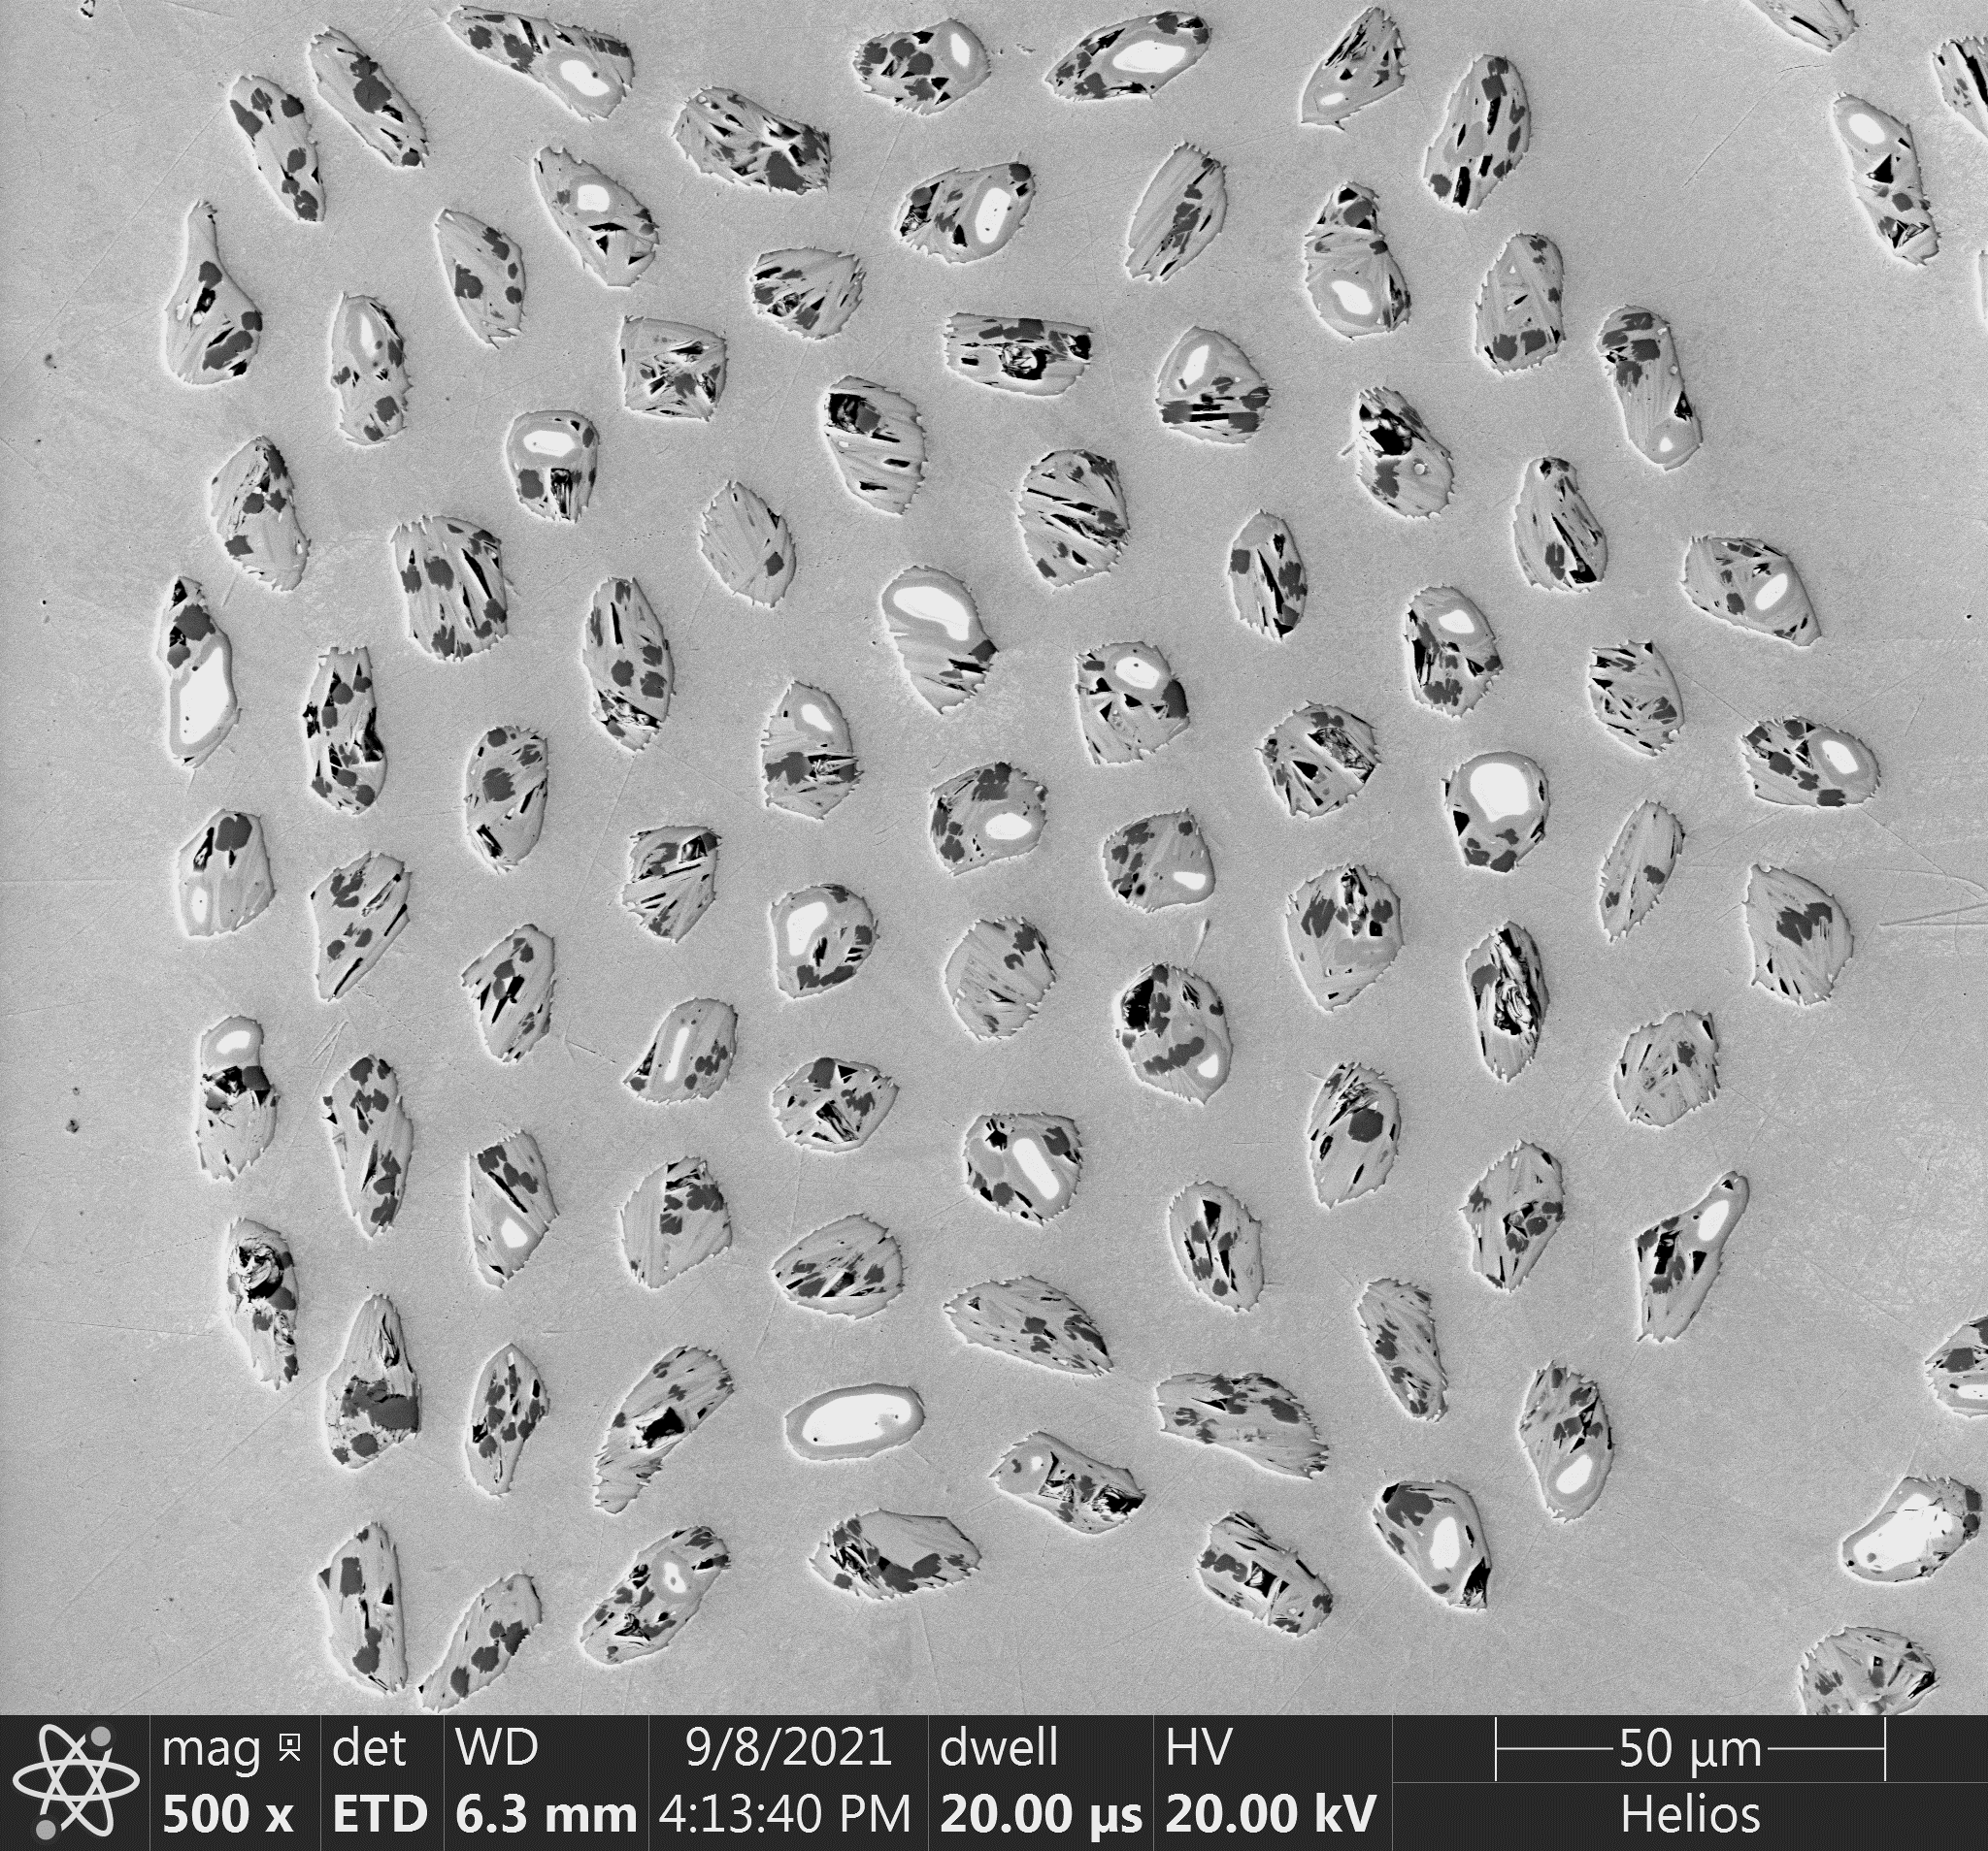
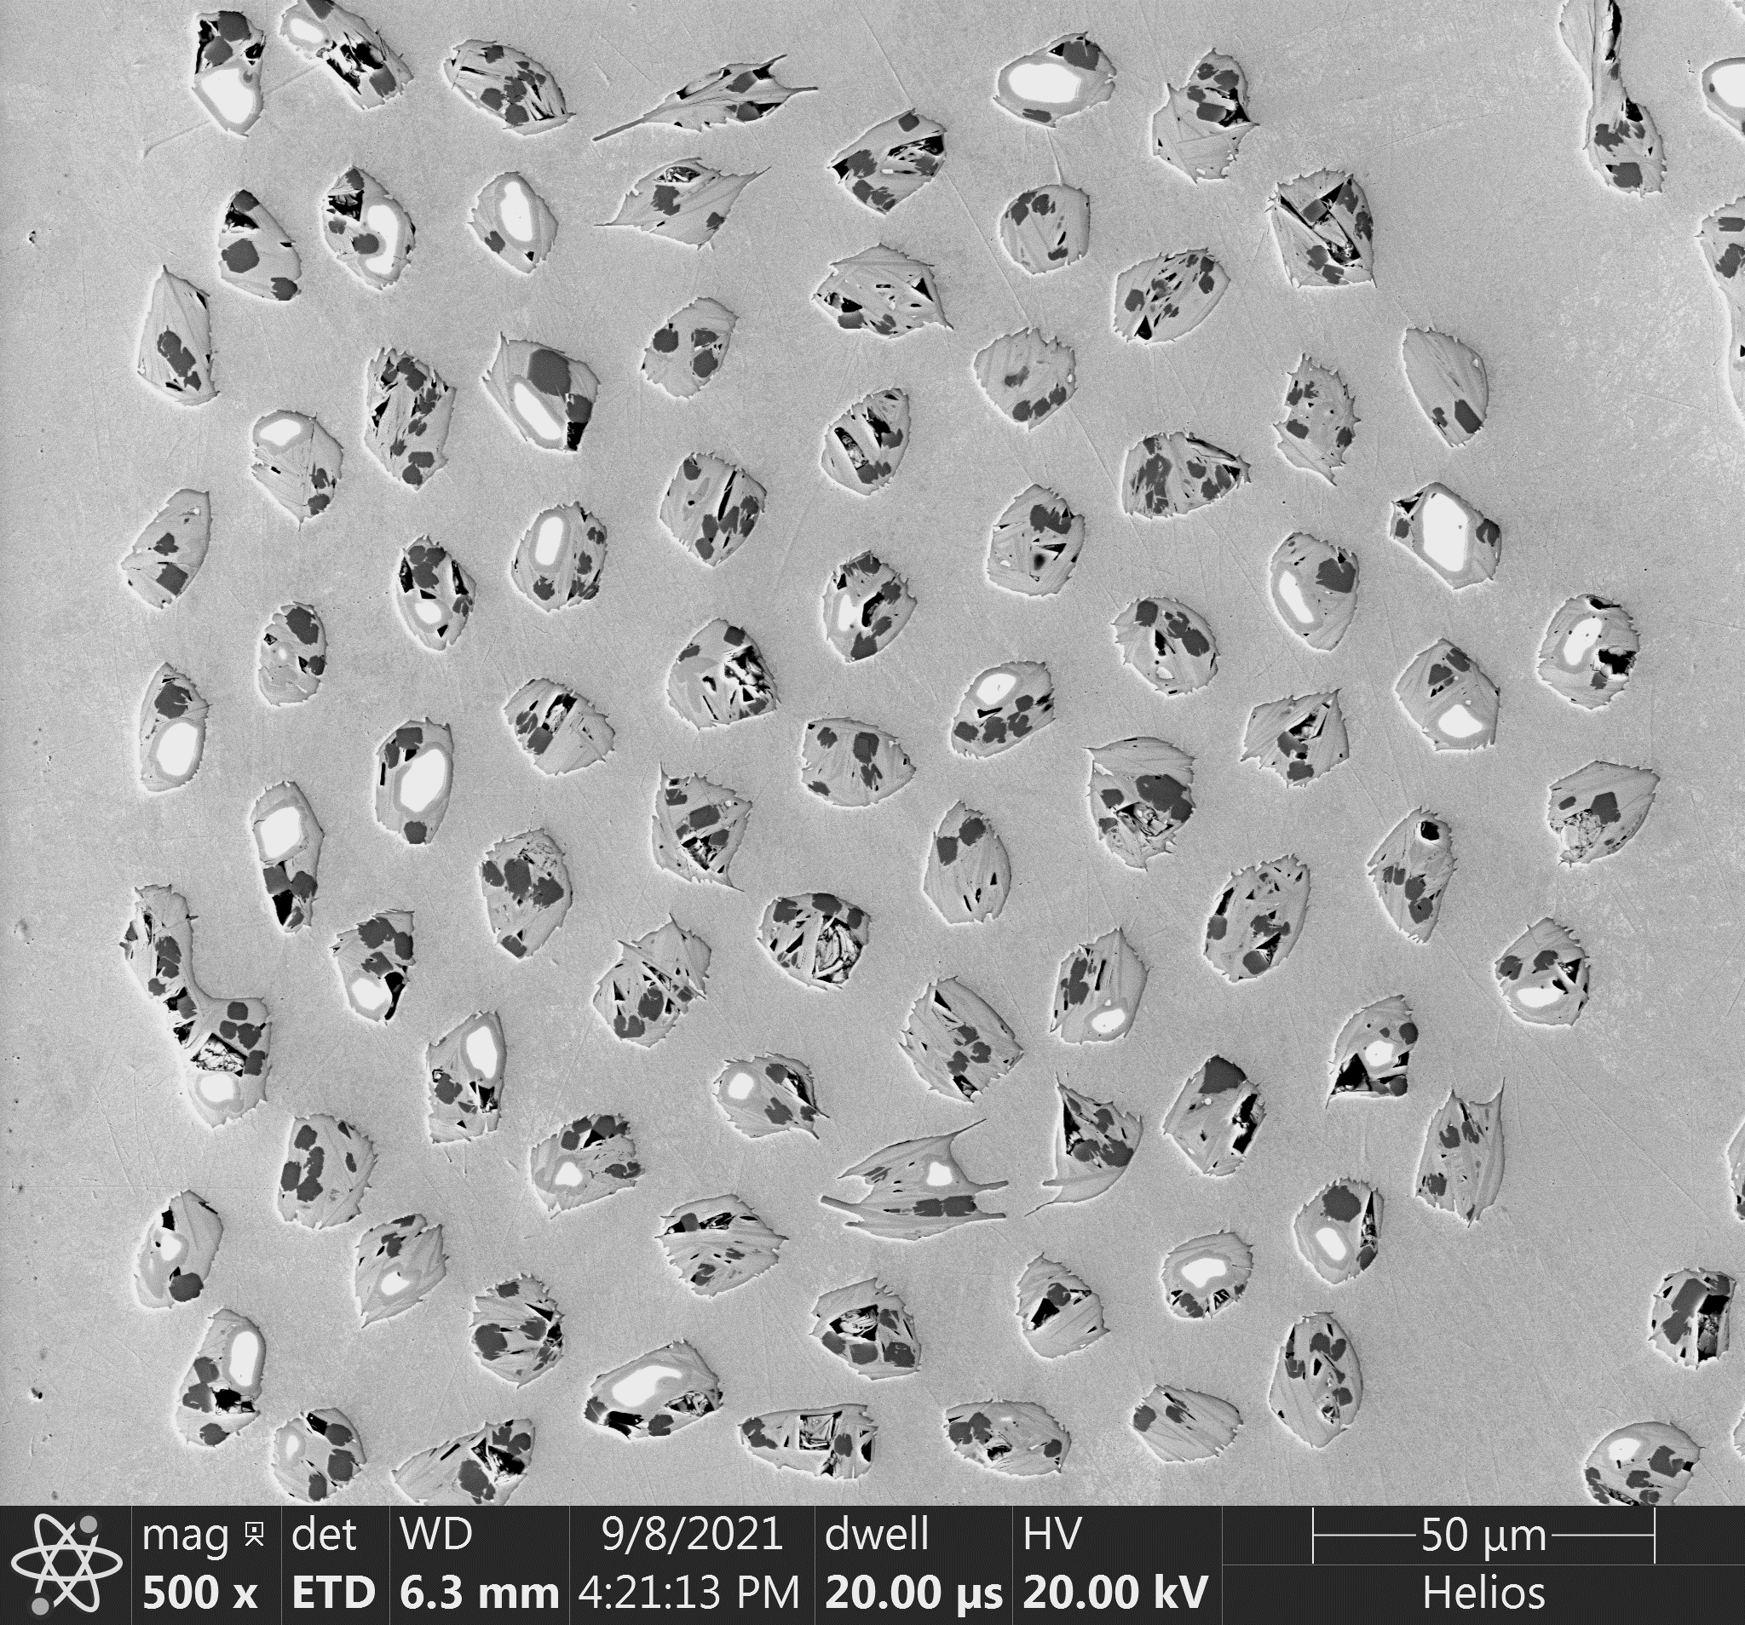
Filament bonding causes thermally-induced area fluctuation and even pinch-off
t_{quench} = 0.2 h
t_{quench} = 4 h
1.3 mm - Avg. Separation 4.34 µm
Area fluctuation occurs because liquid moves to the larger bonded region to reduce interfacial energy.
Bonded filaments
0.8 mm - Avg. Separation 2.3 µm
Some filaments are getting smaller

Slide 12
With increasing time in the melt (t_{melt})
Bonded regions increase in area
Individual filaments decrease in area
With increasing time in the melt (t_{melt})
Bonded regions increase in area
Individual filaments decrease in area
t_{quench} = 0.2 h
t_{quench} = 4 h
Investigated how the area of the smallest 5% of filaments changed with increasing t_{quench}
Bi-2212 less aligned in large regions
Small regions can pinch off

Slide 13
J_{c} decreases with increasing t_{melt}
J_{C} decreases fastest in 0.8 and 1.0 mm wires that have the smallest filament separation
Reduced J_{c} and n value with increasing t_{melt} point to possible degradation of filament continuity along the length of the wire.
J_{c} vs t_{melt}
n value vs t_{melt}
1.3 mm
J_{c} (4.2 K, 5 T) (A/mm²)
n value (4.2 K, 5 T)
1.2 mm
1.0 mm
0.8 mm
t_{melt} (h)
t_{melt} (h)

Slide 14
Summary – filament geometry/bonding
Filaments in tetragonal bundles have the smallest area and separation, and they develop the most bonding
J_{C} may degrade more in tetragonal bundles than in the other two shape bundles
Wires with uniform filament size, shape, and controlled separation should increase J_{C}

Slide 15

Driving questions – J_{C} distribution
Shaon Barua
Bi-2212 is delivered in single lengths > 1 km
  Some early coils made with Nexans powder wire exhibited some unforeseen damage that is not seen in recent coils made with Engi-Mat powder wire
  Are there serious defects in the present-day wire that would make a coil unusable?
  Are we ready to scale up to coils with 1000 m of wire?
Is there a test to evaluate the J_{c} distribution in Bi-2212 wires that could help answer these questions?
[1] Brown, M. D. et al. Prediction of the J_{c}(B) behavior of Bi-2212 wires at high field. IEEE Trans. Appl. Supercond. 29, 1–4 (2019).

Slide 16
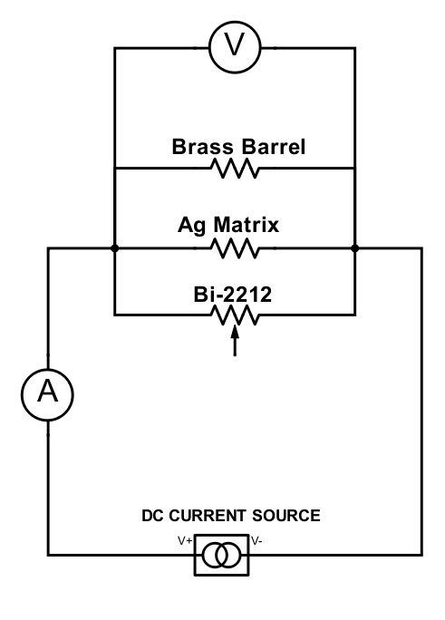
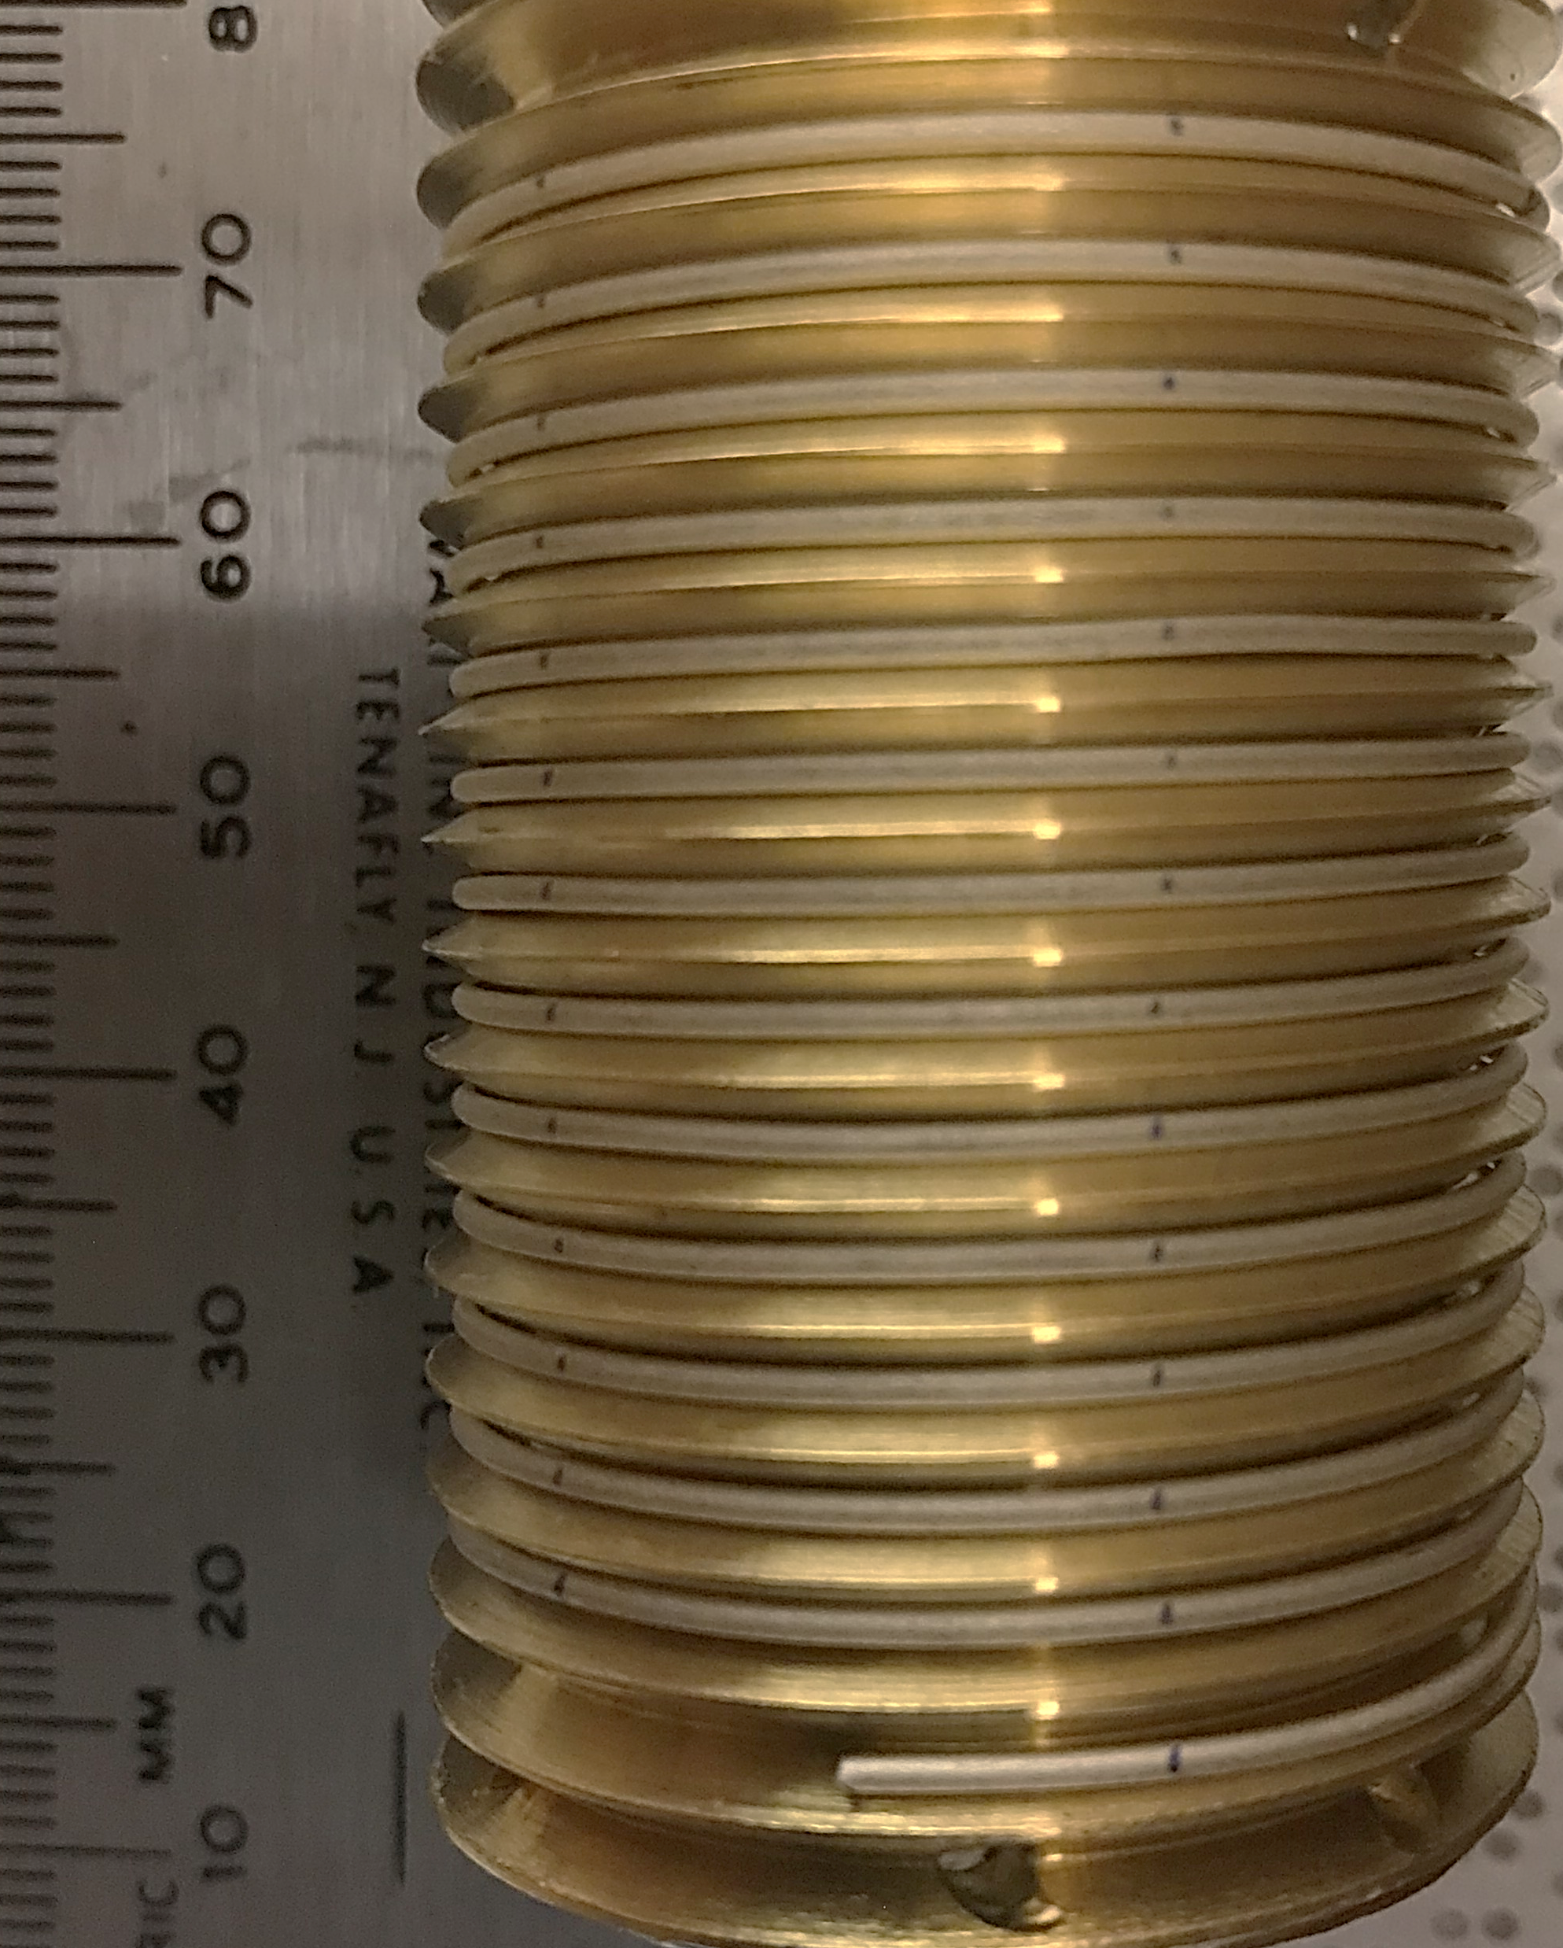
Double differentiation of the V-I signal to extract the I_{c} distribution
Proposed by Baixeras and Fournet [1] and used by Warnes ­et al. [2] to study filament-sausaging degradation of critical current density (J_{c}) in Nb-Ti.
Edelman for 2223 [3] showed that the model had an operational validity even if the strict assumptions of Baixeras and Fournet were not fulfilled – Edelman suggested it use for 2212 too.
[1] Baixeras, J. & Fournet, G. Vortex displacement losses in a non-ideal type II superconductor. Journal of Physics and Chemistry of Solids 28, 1541–1547 (1967).
[2] Warnes, W. H. & Larbalestier, D. C. Critical current distributions in superconducting composites. Cryogenics 26, 643–653 (1986).
[3] Edelman, H. S. & Larbalestier, D. C. Resistive transitions and the origin of the n value in superconductors with a Gaussian critical‐current distribution. Journal of Applied Physics 74, 3312–3315 (1993).

Slide 17
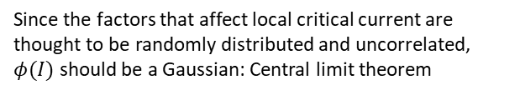

Double differentiation of the V-I signal to extract the I_{c} distribution
Number of sections with ${(i}_{c}−di_{c})<i_{c}<(i_{c}+di_{c})$
$$V\left(I\right) =\int_{0}^{I}{R_{eff}\left(I−i_{c}\right)φ(i_{c})dic}$$
$$\frac{d^{2}V(I)}{dI^{2}}=R_{eff} φ\left(I\right)$$
Voltage contribution of infinitesimally short length of wire
Since the factors that affect local critical current are thought to be randomly distributed and uncorrelated, $φ(I)$ should be a Gaussian: Central limit theorem
For a more detailed treatment:
[1] Warnes, W. H. & Larbalestier, D. C. Critical current distributions in superconducting composites. Cryogenics 26, 643–653 (1986).
[2] Plummer, C. & Evetts, J. Dependence of the shape of the resistive transition on composite inhomogeneity in multifilamentary wires. IEEE Trans. Magn. 23, 1179–1182 (1987).

Slide 18
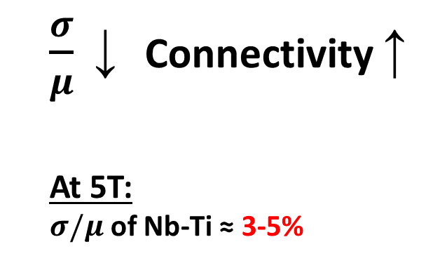
Double differentiation of the V-I signal to extract the I_{c} distribution
  $\frac{σ}{μ}$ ↓ Connectivity ↑
  At 5T:
  $σ/μ$ of Nb-Ti ≈ 3-5%

Slide 19
Is wire uniformity in 1 km long wires a concern?
Transverse
Longitudinal
d²V/dI²
NbTi current distribution curves are narrow

Slide 20
Is wire uniformity in 1 km long wires a concern?
Transverse
Longitudinal
d²V/dI²
NbTi current distribution curves are narrow
I_{c} of Bi-2212 RWs could be increased further if the filament quality is improved.

Slide 21

What is the quality of filaments in as-delivered wires?
Billet No.: PMM180410, 85$×$18, Ø 1 mm
Filament Area[μm²] Map
Pentagonal
Hexagonal
Tetragonal

Slide 22
Filament sausaging in as-delivered wires is significant
Billet No.: PMM180410, 85$×$18, Ø 1 mm
Filament Area[μm²] Map
Area [μm²]

Slide 23
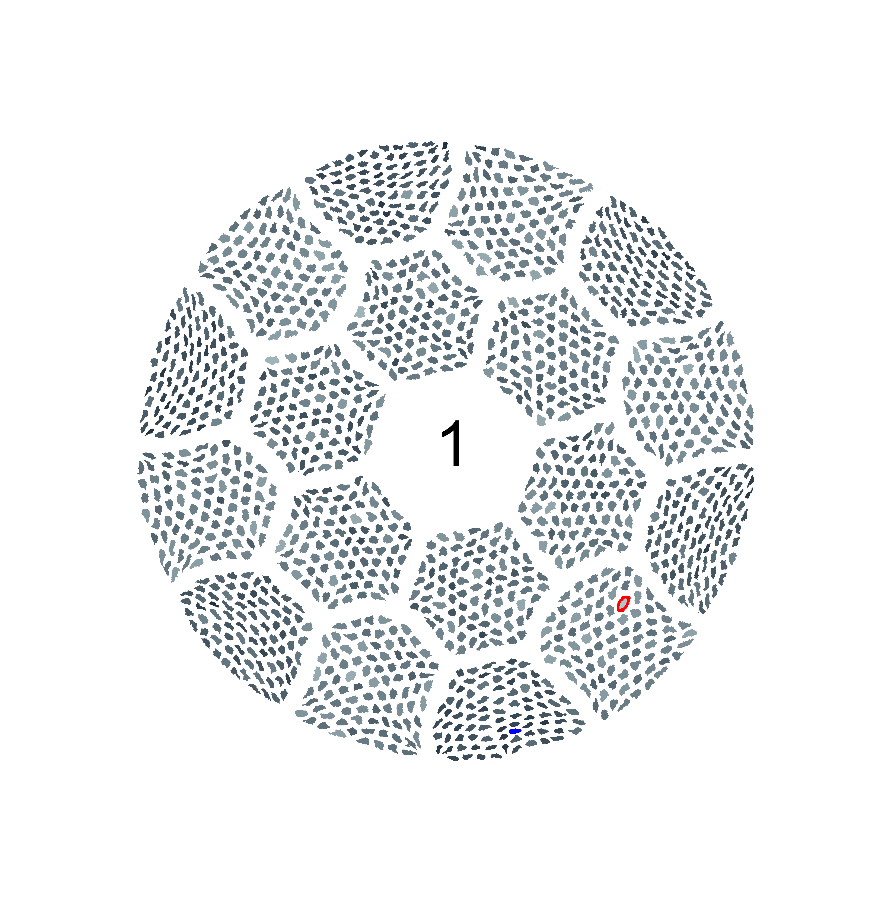
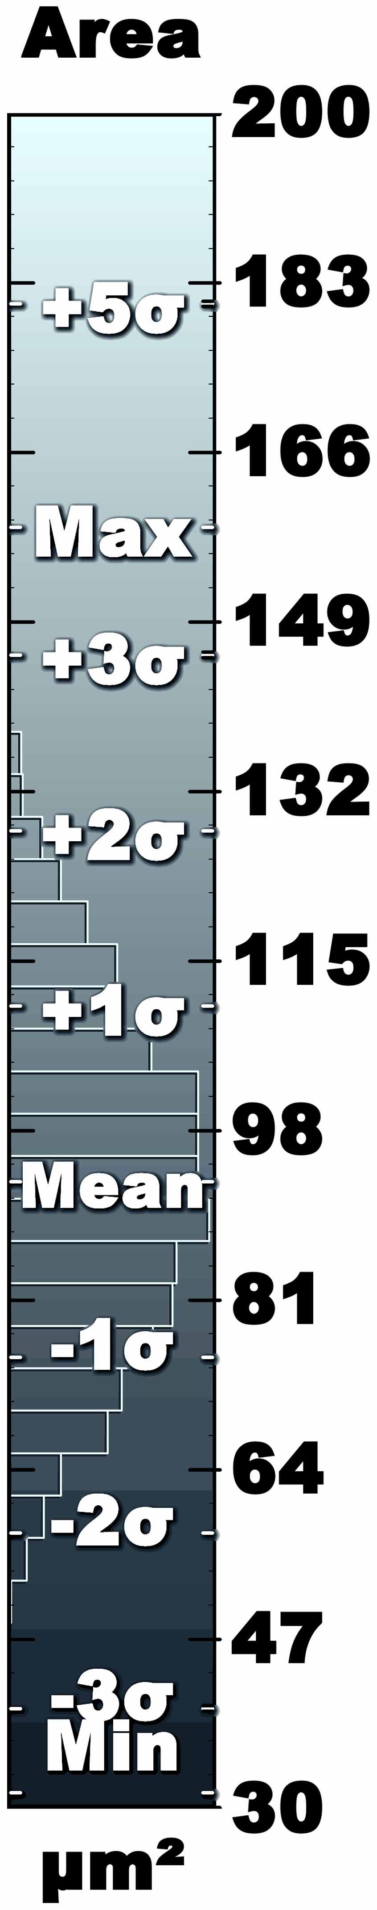
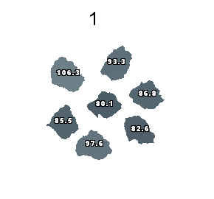
Filament sausaging in as-delivered wires is significant
Billet No.: PMM180410, 85$×$18, Ø 1 mm
Sausaging in as-delivered wire is considerably greater than for Nb-Ti and Nb₃Sn wires

Slide 24
Filament sausaging in as-delivered wires is significant
Billet No.: PMM180410, 85$×$18, Ø 1 mm
Merged Filaments
Sausaging in as-delivered wire is considerably greater than for Nb-Ti and Nb₃Sn wires

Slide 25
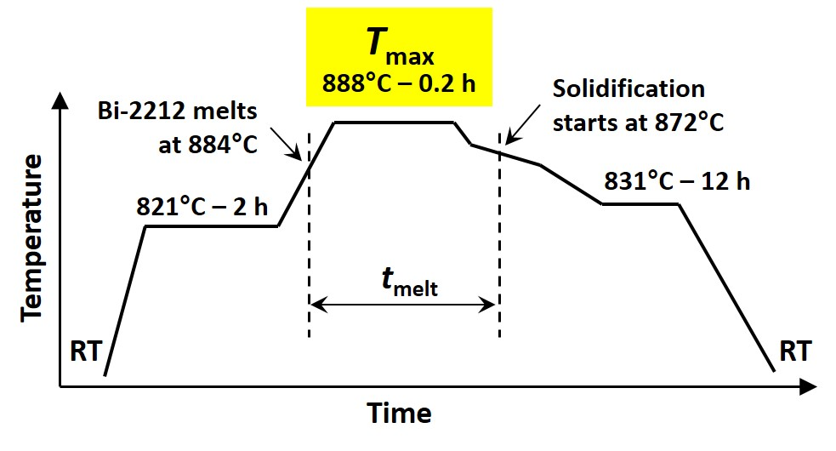
There are clear trends that J_{c} rises as σ/μ declines
Lower J_{c} for T_{max} = 896 °C - correlates to higher non-uniformity
T_{max} = Maximum temperature during over pressure heat treatment

Slide 26
There are clear trends that J_{c} rises as σ/μ declines
Lower J_{c} for T_{max} = 896 °C - correlates to higher non-uniformity
Reacted filaments
Ag-0.2wt.%Mg sheath
Bi-2212 filaments
Wire Axis
Image Analysis
Filament Area Distribution (σ/μ):
Engi-Mat: 0.19
Nexans: 0.21
Nb47wt.%Ti: 0.05
Both the area and the critical current distributions are closely correlated

Slide 27
How uniform is a ~1 km long Bi-2212 wire?
A complete strand map of the whole 10 kg billet might be able to answer our queries on long length uniformity

Slide 28
1200 m lengths of wire do not exhibit significant difference in performance

Slide 29
Takeaway messages
Conductors as presently made have highly irregular filaments, which means that sausaging is built in, not something that develops as in Nb-Ti by over-drawing
  Although these irregularities become much worse during OPHT wires have high J_{E} that is usable for coils
Wires that have filaments with uniform size, shape, and controlled separation in transverse and longitudinal sections provide a great opportunity for higher J_{c}
Long length uniformity of Bi-2212 wire is sufficiently good to wind km-lengths into magnets

Slide 30
Thoughts on developing a Bi-2212 powder specification
Specify
Overall composition
Maximum fraction of each of the non-superconducting phases in powder
Maximum particle size of non-superconducting phases in powder
Particle size of Bi-2212
Maximum C and H (H₂O) contents

