Slide 1


Photo-Acoustic Detection of Interfacial Failures in High Field Magnets
Daniel S. Davis, Aixia Xu
U.P. Trociewitz, A. Juliao, E. Martin, G. Bradford,
Y. Kim, G. Miller, C.T. Brady, A. Hernandez Chapa
This work is funded by a DOE-OHEP award no. STTR DE-SC0022901, PIs Aixia Xu (Advanced Superconducting Materials LLC) & Daniel Davis (ASC-NHMFL). Work at ASC-NHMFL is also supported by US DOE-OHEP (DE-SC0010421, DE-SC0018666, DE-SC0018683), the NHMFL Core Grant support of NSF (award no. 1157490), the Florida State University special allocation (DCL PI) for Bi-2212 commercialization, the state of Florida, and the US Magnet Development Program Collaboration for much context and many collaborations​

Slide 2
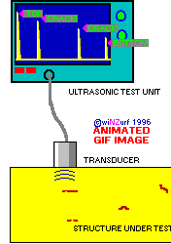
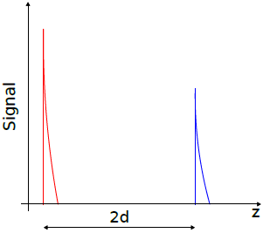
Principles of Operation: Ultrasound Scanning , Laser-Induced Ultrasound,
Laser Doppler Vibrometer
Transducers
S. Wang, J. Echeverry, L. Trevisi, K. Prather, L. Xiang, and Y. Liu, Applied Sciences, 10, 2106 (2020)
d
Material 1
Material 2
Interface
X. Zhang, J. R. Fincke, C. M. Wynn, M. R. Johnson, R. W. Haupt3 and B. W. Anthony, Light: Science & Applications (2019) 8:119
Notes:
DOI: 10.13140/RG.2.2.34827.13602
Journal of Power Sources Advances 6 (2020) 100035
Nondestructive Evaluation Techniques : Ultrasound (nde-ed.org)

Slide 3
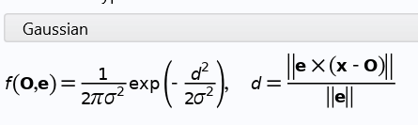
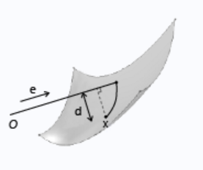

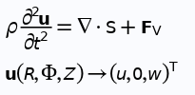
COMSOL Multi-Physics
COMSOL allows for the coupling of laser generated elastic waves and piezoelectric transducer.
  Laser simulated as gaussian pulse from deposited beam power in Heat transfer module
  Laser induces thermal expansion of small area rapidly and elastic waves are generated.
  Elastic waves propagate through sample and scatter off cracks.
  Piezoelectric receiver picks up voltage relating to intensity of elastic wave.

Slide 4
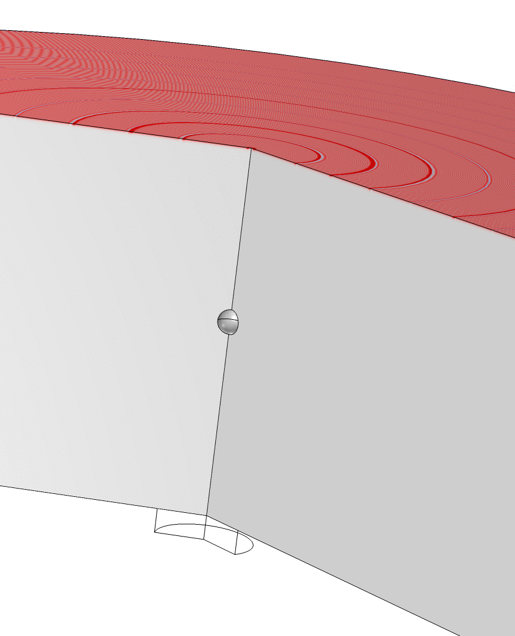
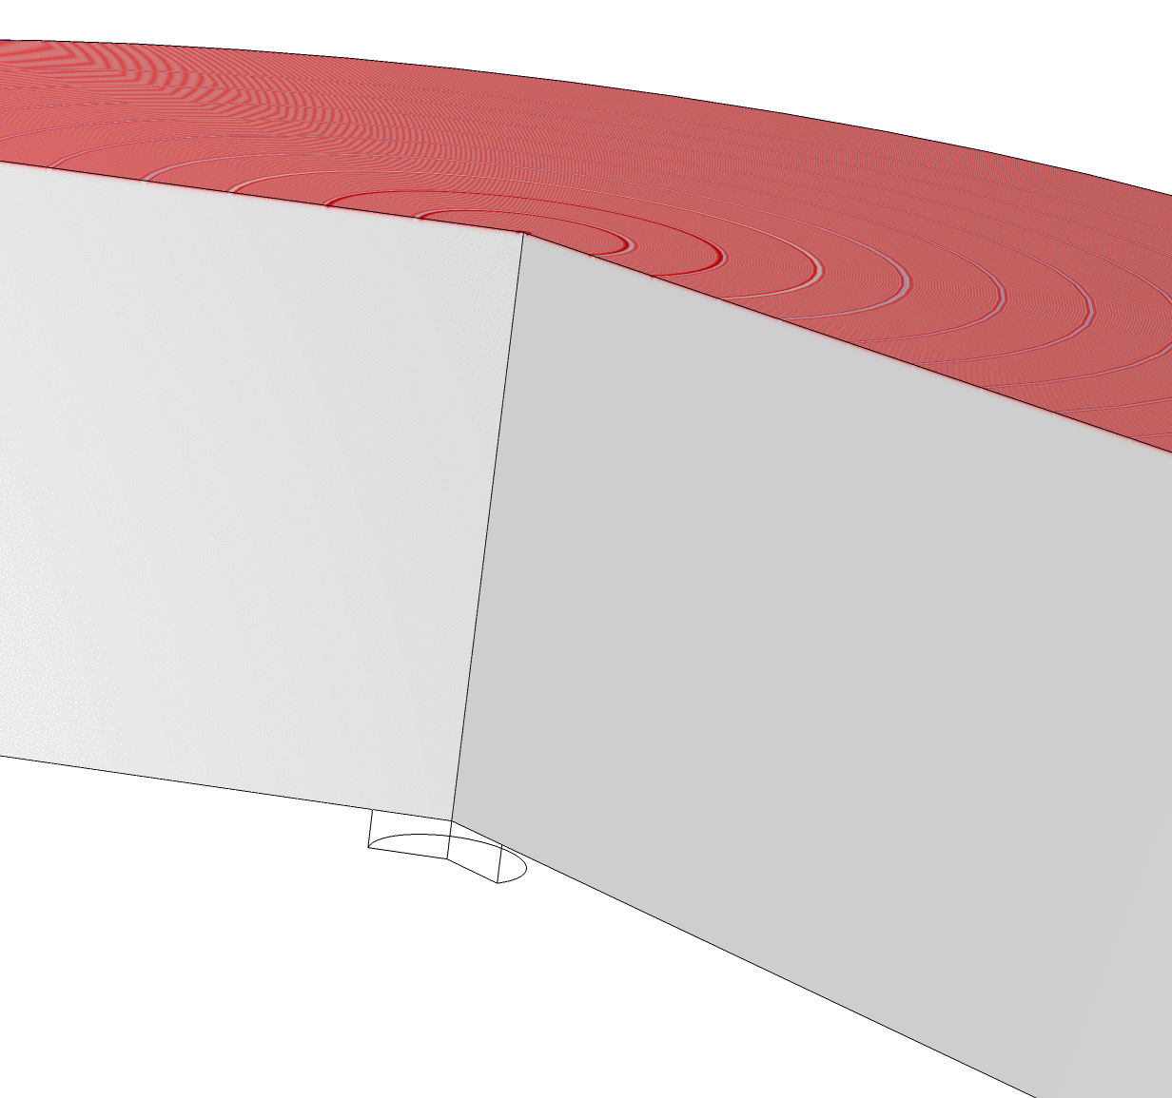
Total Acoustic Pressure
No Hole
Hole
Laser Source
Laser Source
Transducer
Transducer

Slide 5
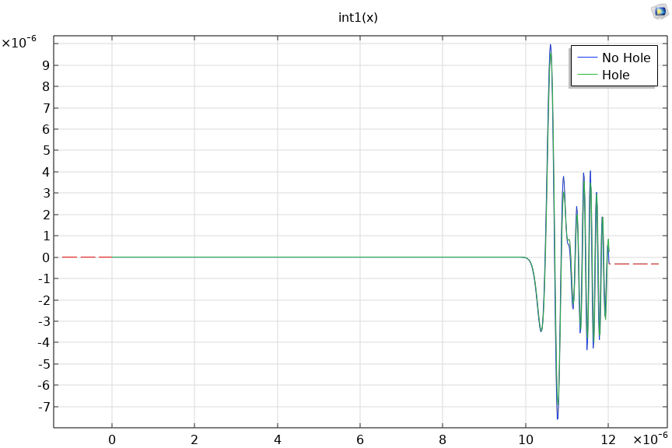
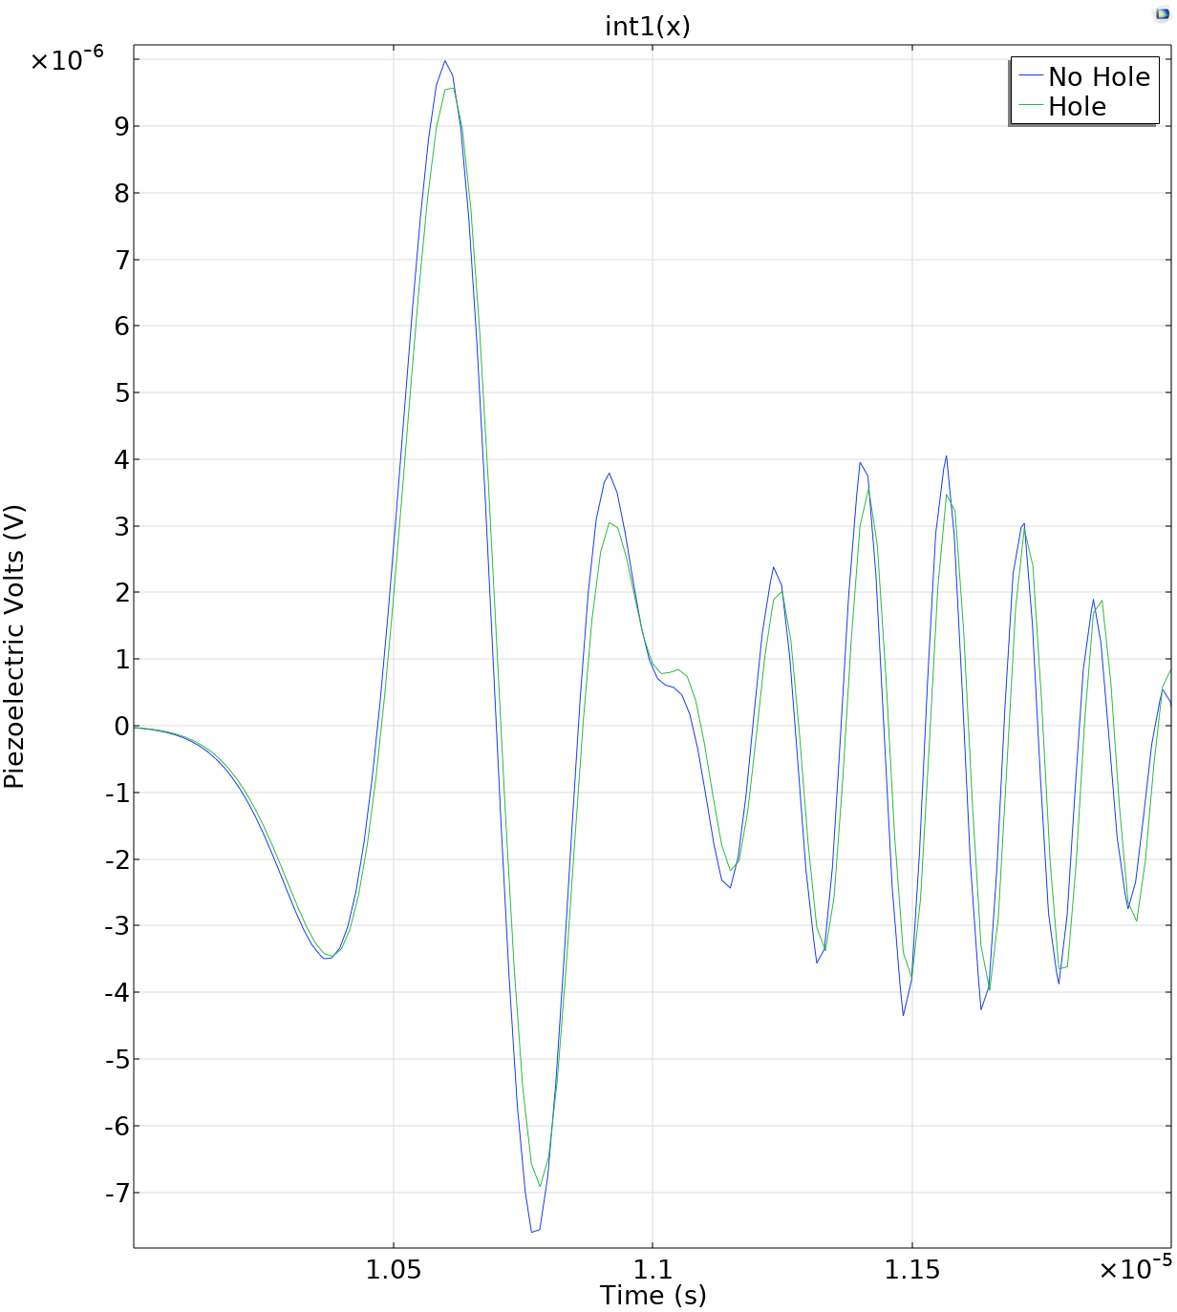
Voltage reading from piezoelectric
Amplitude of transmitted signal reduced by scattering off defect

Slide 6
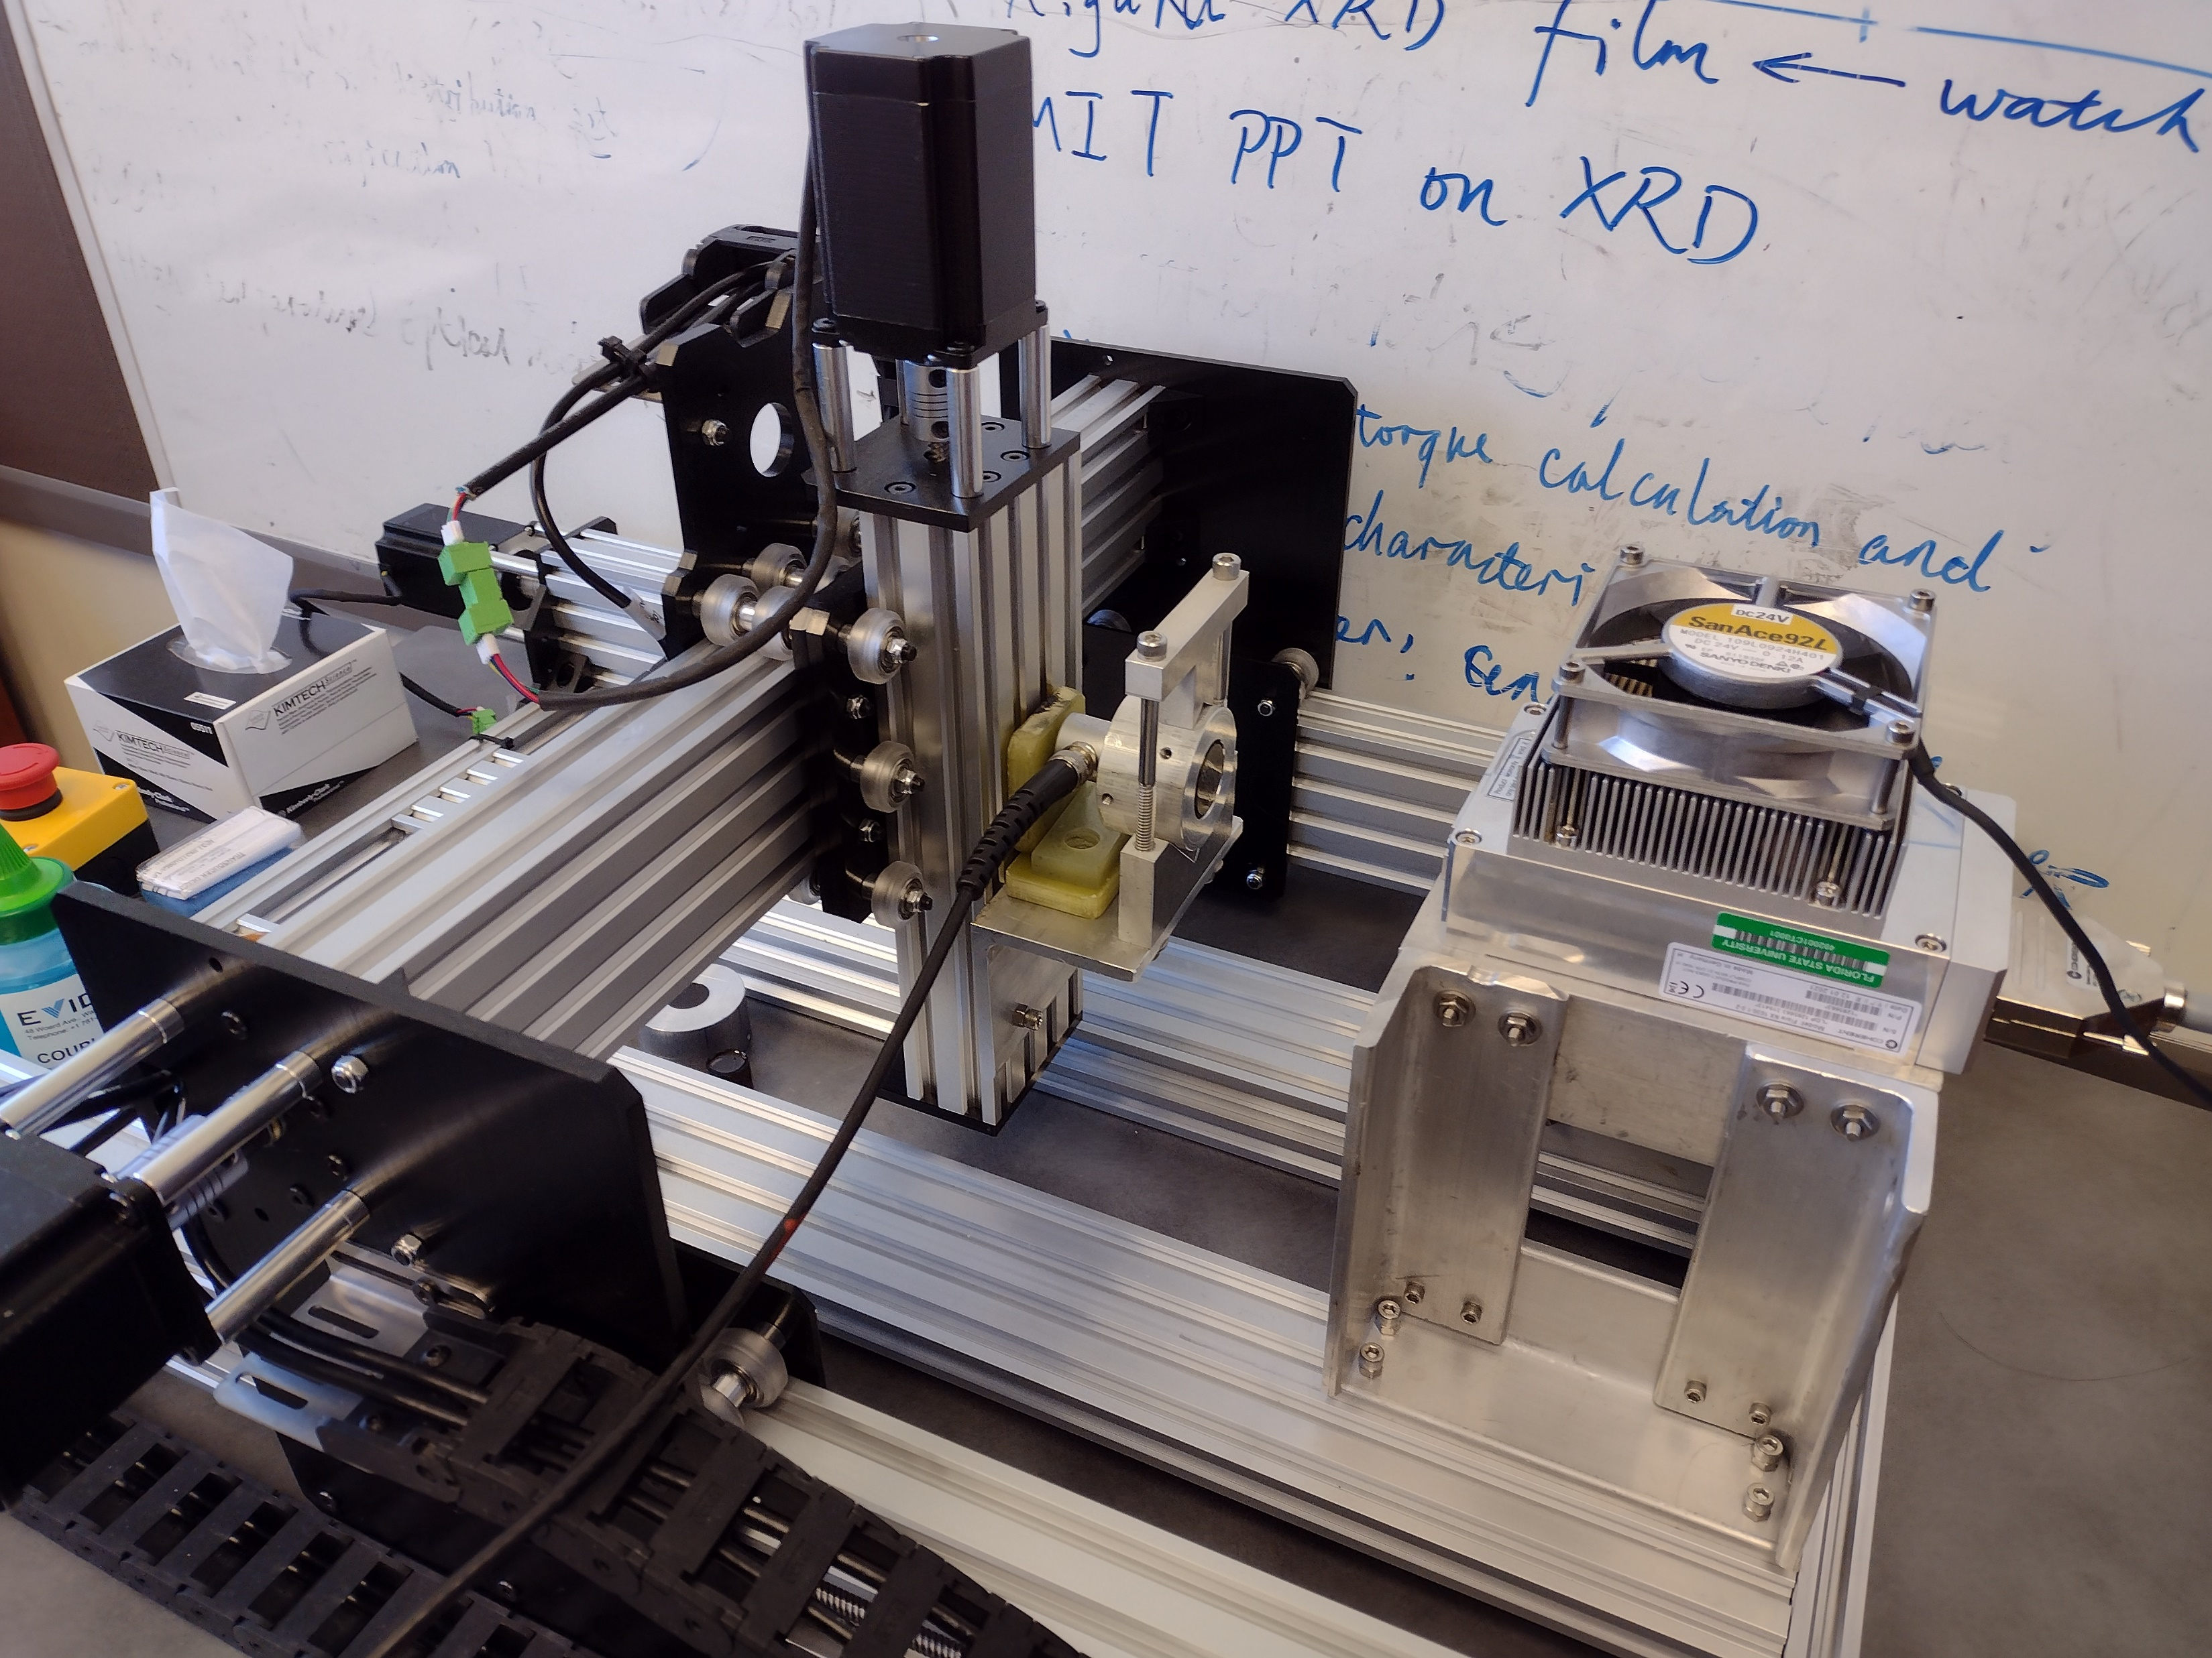
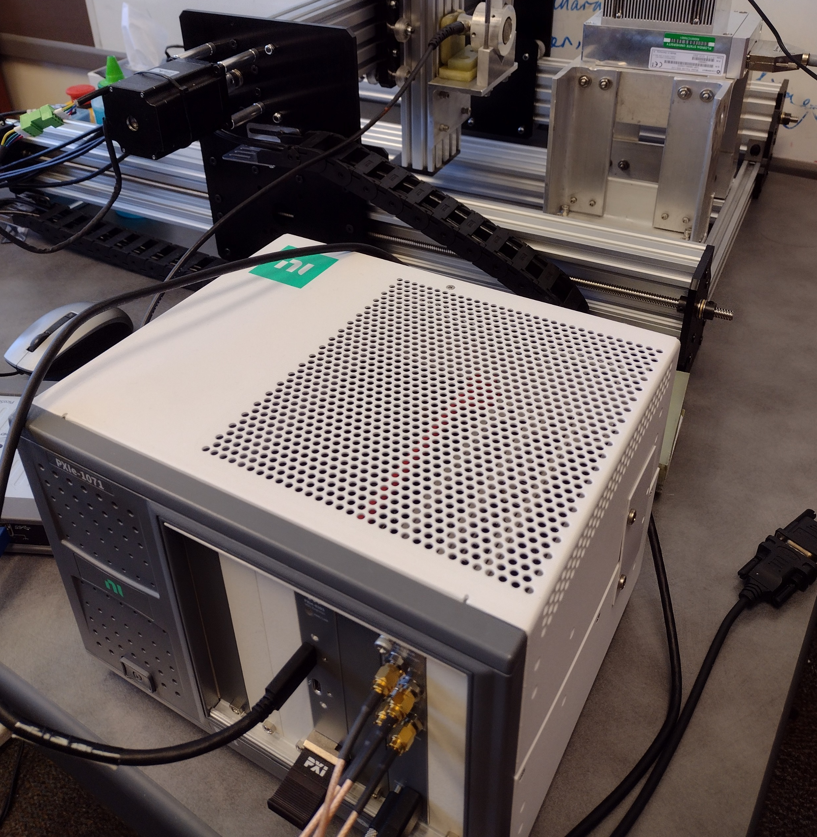
Photo-Acoustic Scanning
Laser, pulsed
Wavelength: 1030 nm
Pulse rate: 20 Hz
Pulse width: 1.58 ns
E_{pls}: 538.5 nJ
Transducer
5 MHz
Scanner
Resolution: 1 um
Step size used: 0.2 – 1.0 mm
Oscilloscope
100 MHz, 4 channel
3 axis CNC Scanning Table
Sample
Digital Oscilloscope
IR Laser
Ultra-sound Transducer

Slide 7
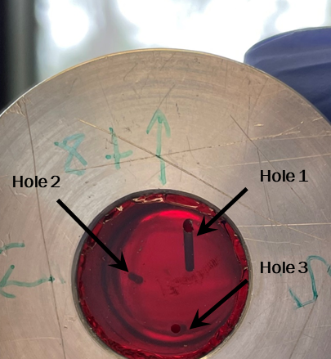
Ultrasound signal map: epoxy
Experimental
Laser repetition rate: 20 Hz
Scanning step: 1 mm

Slide 8
Signal difference before and after holes drilled

Slide 9
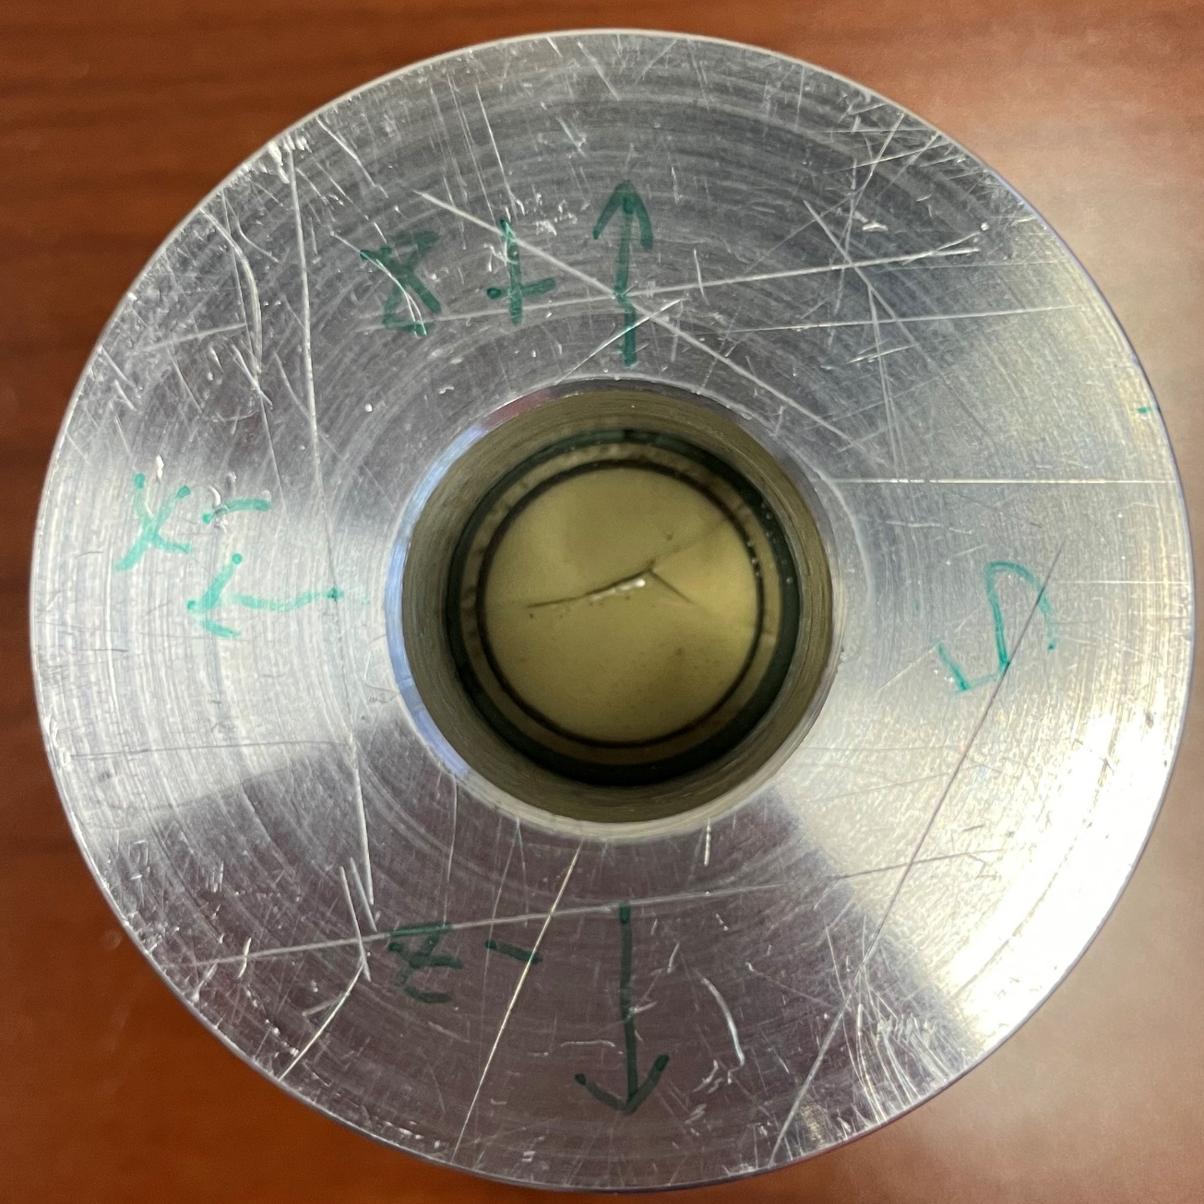
A 0.2 mm scanning step can resolve the crack structure
Peak-Peak Voltage

Slide 10
Take-Away: Another Possible Tool for the Diagnostic Toolbox
Photo-Acoustic scanning system successful at imaging epoxy defects
Modeling elastic wave propagation induced by thermal expansion from laser successfully.
  Adding cracks or materials is very easy.
  Complicated geometries can be imported into COMSOL and boundaries between materials can be treated correctly.
  Can add viscoelastic material parameters for epoxy.
Phase II goals
  Procure Laser-Doppler Vibrometer to move to non-contact scanning
  Scan intact coils before/after testing
  Further explore resolution, damping, and material interactions
  Look into low-T operation for applications including interface debonding, training, and maybe even quench detection

Slide 11
Backup Slides

Slide 12
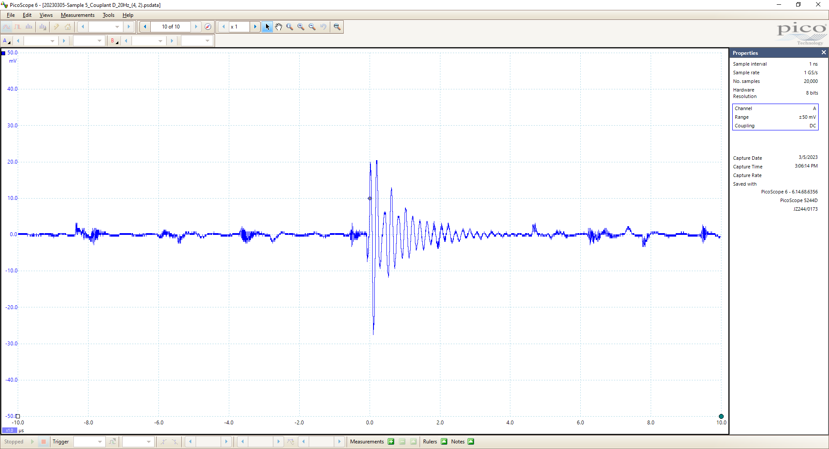
Point (4, 2) before hole 1 drilled

Slide 13
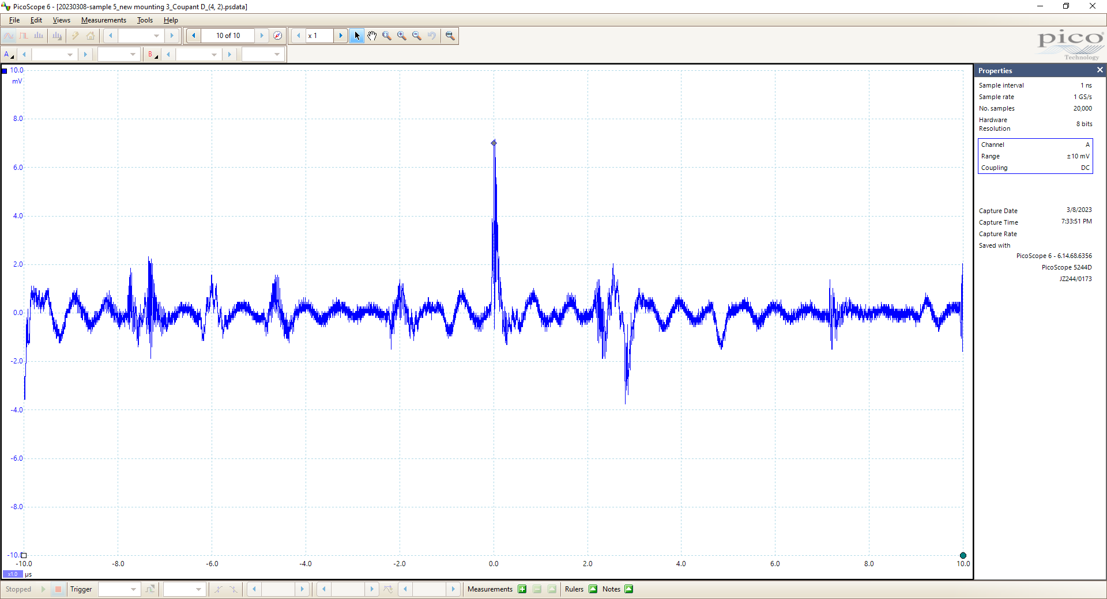
Point (4, 2) of hole 1

Slide 14
System: Laser system
Flare NX laser system (Coherent): Flare NX 1030-1.0-2 Laser Head
  Need a computer to operate the system
ALC Q-switched microlaser (Amoco Laser Company): 1053-EHQ with programable laser controller 120894)
  The original controller, which can adjust laser power, is dead.
  Current generator does not have power adjusting function, and could not enable single shot mode.
System | Wavelength (nm) | Power (mW) | Pulse length (ns) | Pulse power (μJ) | Single shot? | Pulse repetition frequency (kHz)
Flare NX | 1030 | 1077 | 1.58 | 538.5 | Yes | 0 to ≥25
ALC Q-switched microlaser | 1060 | 10-200 | 12.8 | 20-50 | No | ≥25

Slide 15
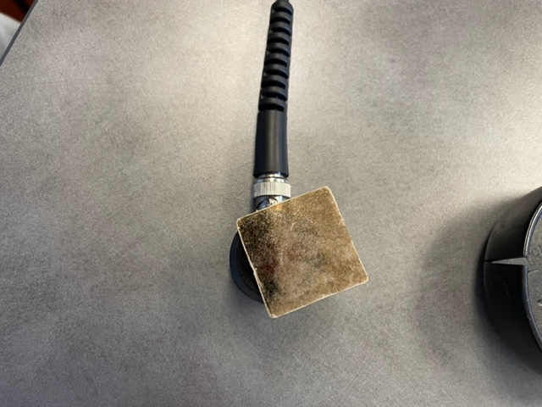
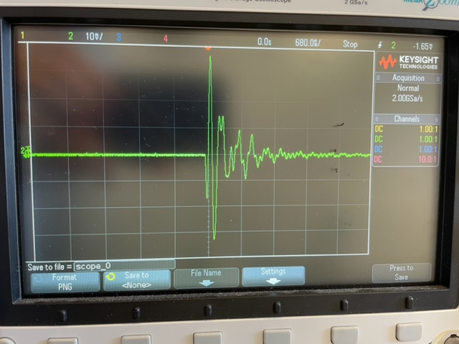
Mica, transmission, 50Hz
0.3mm thick

Slide 16
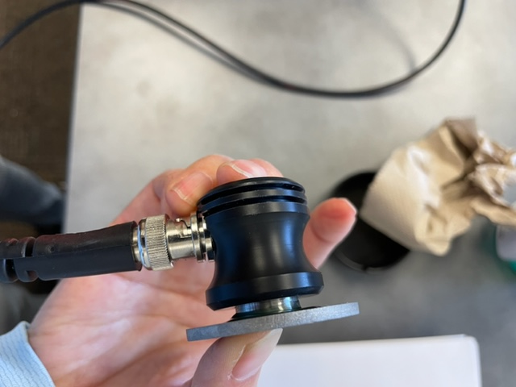
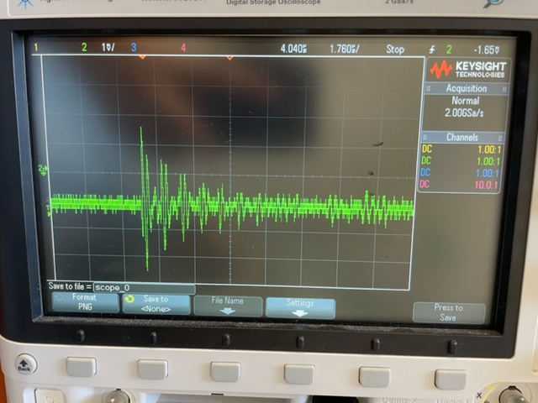
Inconel, transmission, 50 Hz

Slide 17
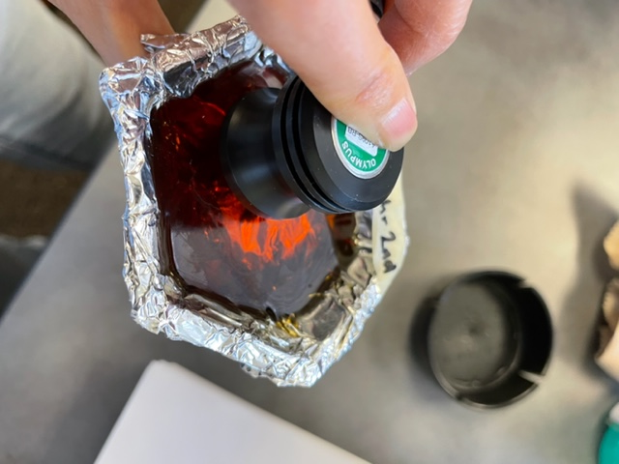
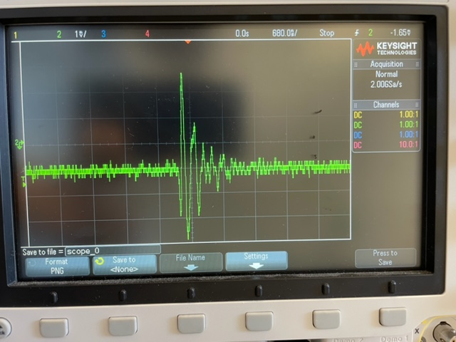
Epoxy, reflection, 50Hz

Slide 18
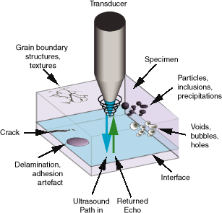
Ultrasound nonintrusive detection
Microvessels (open circles) and hair follicles (arrows) below scalp
Coin cell
PCB
Journal of Power Sources Advances 6 (2020) 1000352;
Applied Microscopy (2020) 50:25
Notes:
MECA courses - Home (bme.hu)

Slide 19
Ultrasound in superconductivity applications
Swiss ETH: debonding between SC and Al stabilizer Fermi Al-stabilized Rutherford NbTi cable
J. Neuenschwander, Th. Luthi, L. L. Horvath, and V. Pasquer, 7th European Conference on Non-Destructive Testing (ECNDT) May 26-29, 1998, Copenhagen, Denmark

Slide 20
Ultrasound in superconductivity applications
CERN: Joint soldering quality
R. Principe , L. Mora Vallejo, J. Bailey , R. Berthet, L. Favier, L. Grand-Clement , and F. Savary, IEEE Appl. Supercond. 28, 9000708 (2018);

Slide 21
Ultrasound in superconductivity applications
LBNL: Quench detection
M. Marchevsky and S. A. Gourlay, Appl. Phys. Lett. 110, 012601 (2017)

Slide 22
Ultrasound in superconductivity applications
NASA: porosity in YBCO bulk
D.J. Roth, E.R. Generazio, D. B. Stang, and A. F. Hepp, NASA Technical Memorandum !02130

