Slide 1
Conductor AI-ML
Ian Pong for Al Baskys
on behalf of the Superconductor ML Working Group
MDP 7th Collaboration Meeting
Brookhaven National Laboratory
2023 03 23
ipong@lbl.gov

Slide 2
Outline
01
Who we are
02
What we do:
Overview
HTS
LTS
03
What’s next
The work performed at LBNL was supported by the Office of High Energy and Nuclear Physics, U. S. Department of Energy, under contract No. DE-AC02-05CH11231.
The work performed at NHMFL was supported in part by the Office of High Energy and Nuclear Physics, U. S. Department of Energy, under contract No. DE-SC0010421, DE-SC0012083, DE-AC02-98CH10886, and by the National Science Foundation under DMR-1157490 and DMR-1644779 by the state of Florida.
The work performed at FNAL was supported by the Office of High Energy and Nuclear Physics, U. S. Department of Energy, under contract No. DE-AC02-07CH11259.
The work at UW-Eau Claire was financially supported by the U.S. Dept. of Energy Office of High Energy Physics, award DE-SC0020984.
This research used resources of the National Energy Research Scientific Computing Center (NERSC), a U.S. Department of Energy Office of Science User Facility located at LBNL, operated under Contract No. DE-AC02-05CH11231 using NERSC award “Nb3Sn wire and cable ML” HEP-ERCAP0022029 and HEP-ERCAP0024852.

Slide 3
Who we are
Primarily conductor researchers who joined force in the AI-ML proposal (DE-FOA-0002705) led by Al Baskys, also other researchers, observers and guest speakers
LBNL: Al Baskys*, Jean-Francois Croteau, Kevin Gillespie, Ian Pong
ASC/FSU/NHMFL: Peter Lee, Dima Abraimov, Jonathan Lee, Keyou Mao, Yavuz Oz
CERN: Simon Hopkins, Alice Moros
FNAL: Xingchen Xu
UWEC: Matt Jewell, Reed Oberg
Membership loosely formed and evolving, no mandate and no dedicated funding (yet)
Aim: To learn together, bring awareness, explore further opportunities, accelerate the pace of research and development in this specific area
We share preliminary, unpublished results, but not publishing as a group

Slide 4
What we do – overview
Use AI-ML techniques to achieve results in conductor research that cannot otherwise be done
As a start, we chose to develop image analysis tools
that are related to our expertise (conductor microstructure)
that have the potential to grow into a platform for wider applications
We are conscious of other players’ efforts, e.g.:
UniGe and collaborators on XMT of Nb₃Sn at micron voxel resolution scale void analysis
REBCO suppliers’ Big Data approach for production QC and process optimization
Non-conductor related MDP areas such as quench detection and protection
Some selected examples on
HTS (2212)
LTS (Nb₃Sn)

Slide 5
What we do – HTS (2212)
Work of Prof. Matt Jewell et al. at University of Wisconsin – Eau Claire

Slide 6
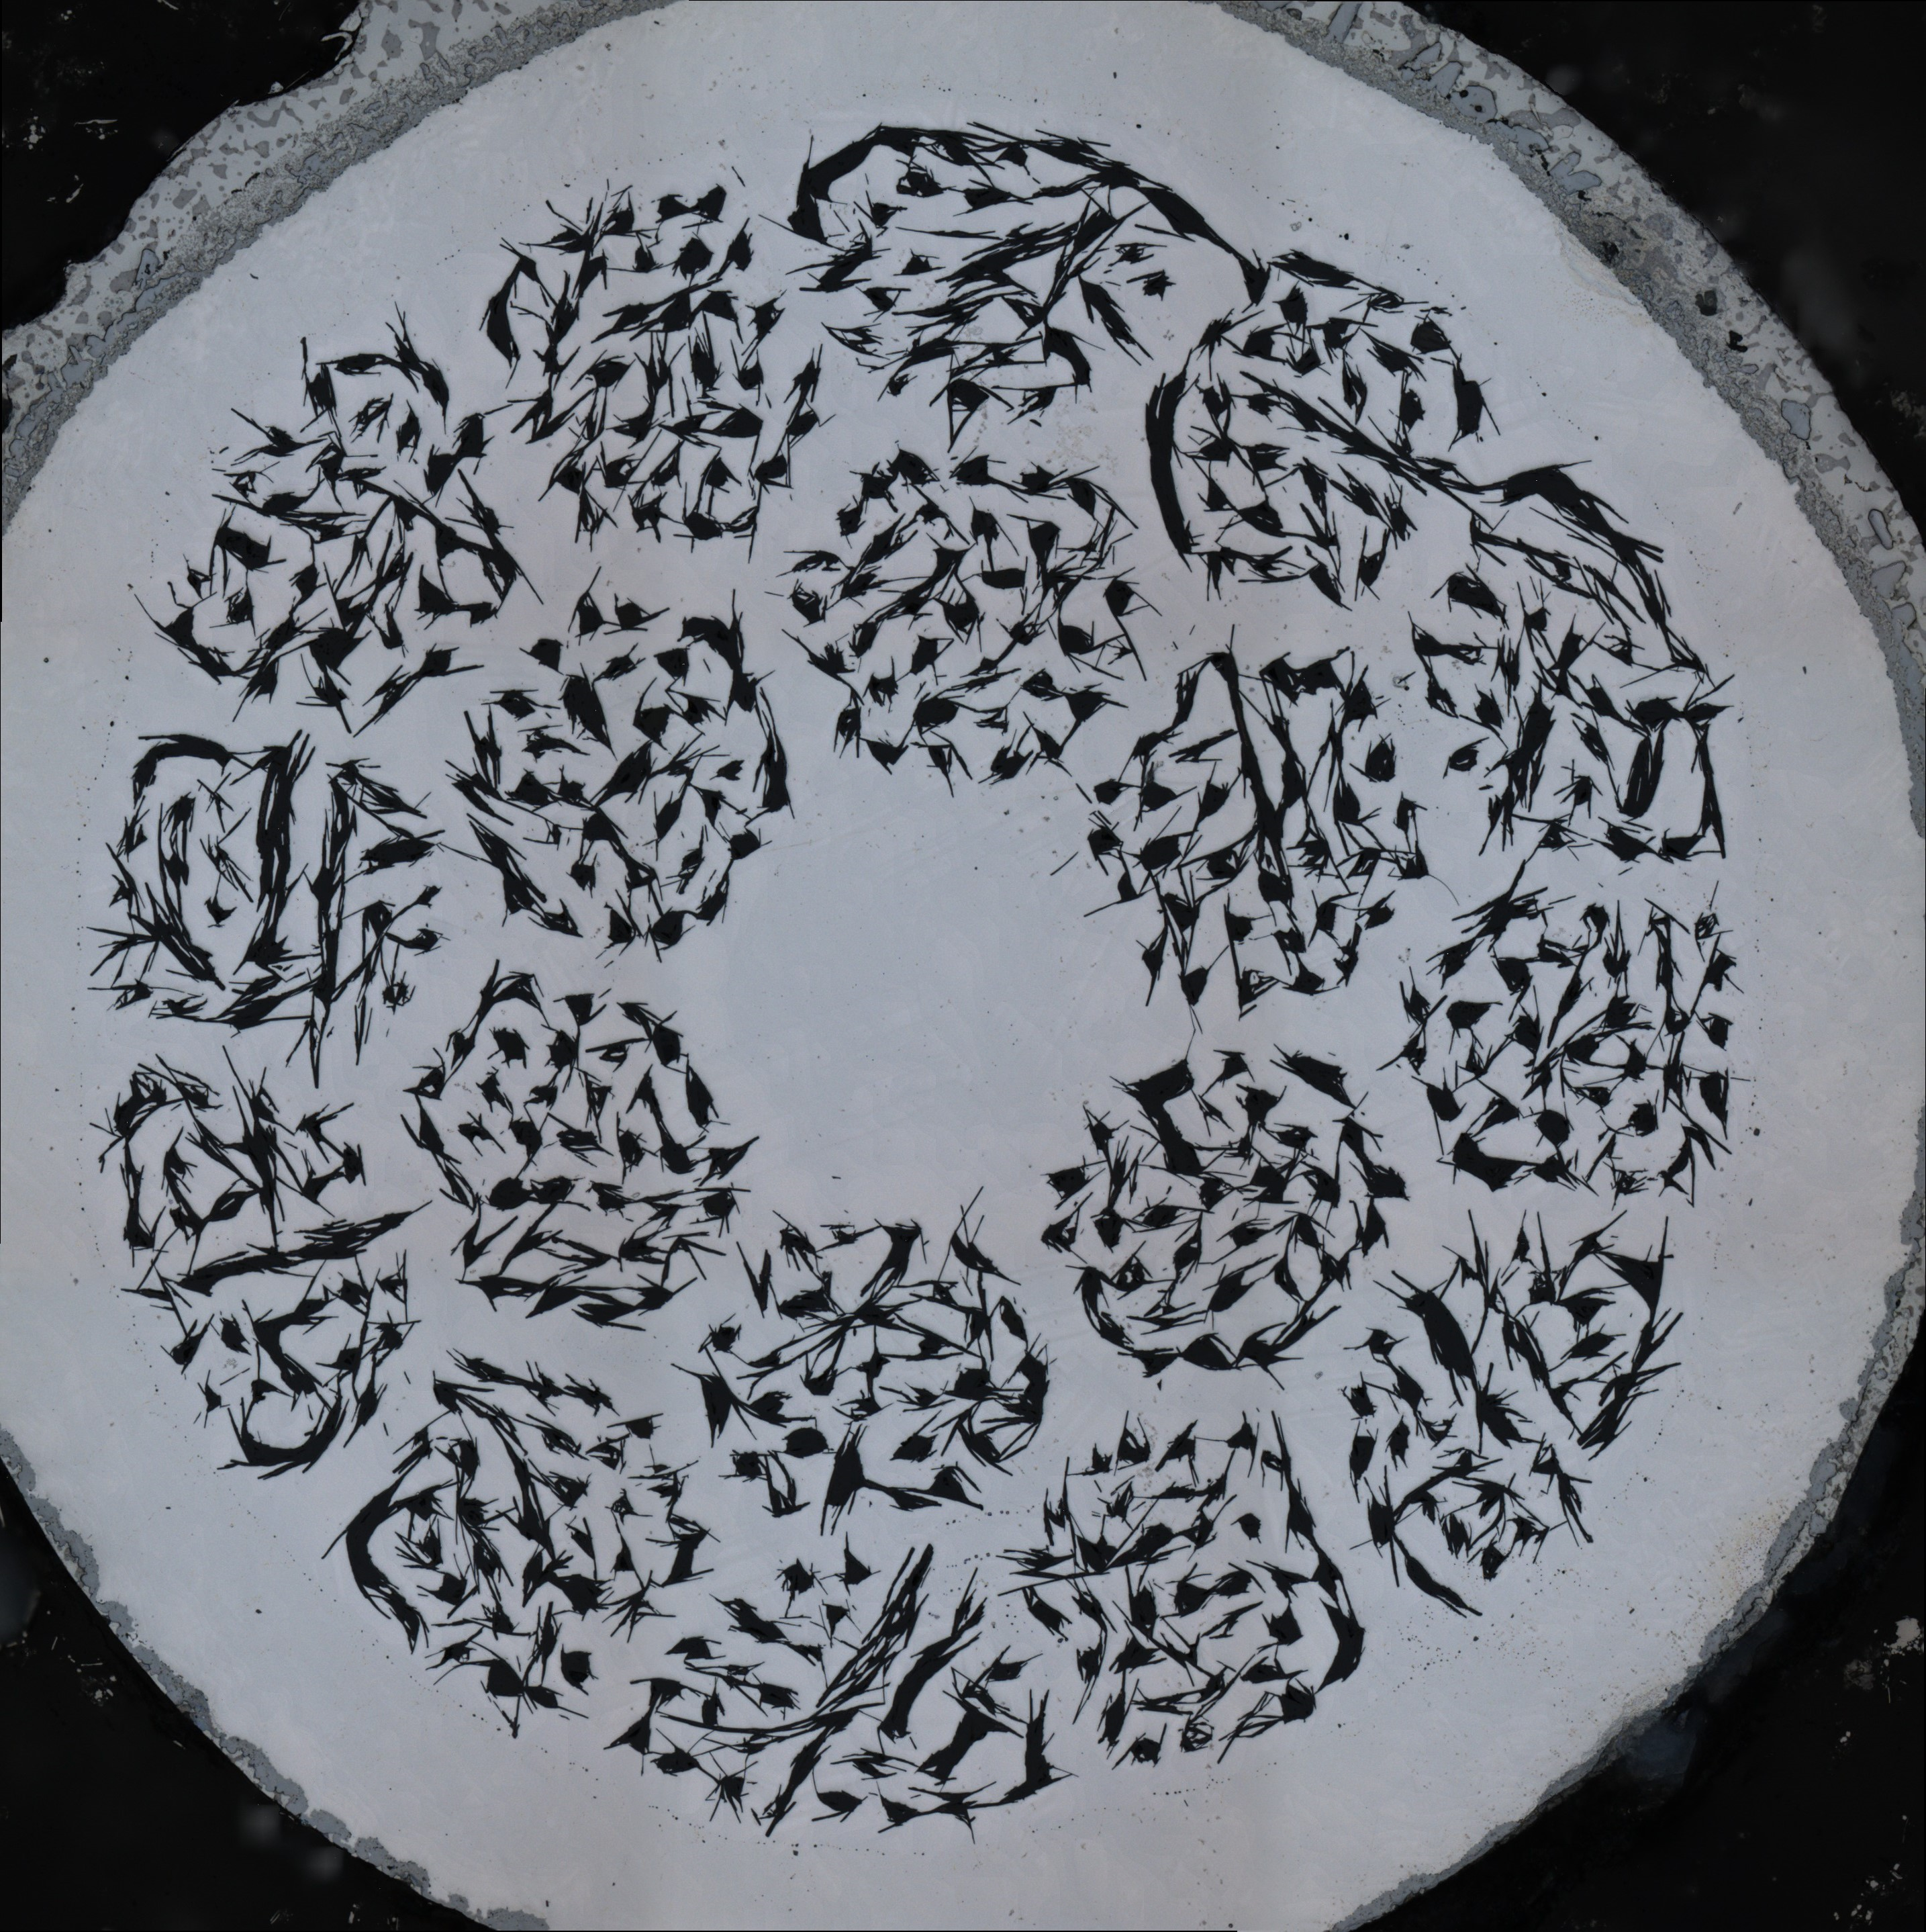
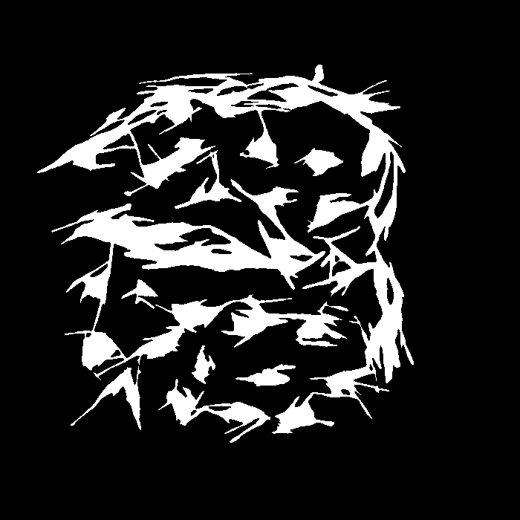
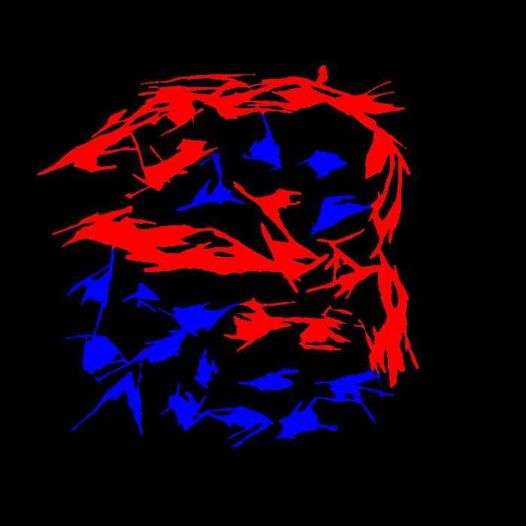
Study of filament bridging in Bi-2212 via ML
Matt Jewell and Reed Oberg, University of Wisconsin – Eau Claire
We built a semantic segmentation model to classify filaments as individual or conjoined.
Manually colorized 4,662 filaments for training, based on SEM images that were sectioned into bundles and thresholded.
This will help us quantify filament bridging for studying J_{c}, losses, current uniformity, and the impact of mechanical deformation such as rolling.
Imaging + stitching
Section + Threshold
Separate into classes
Blue = individual filaments
Red = conjoined filaments
6

Slide 7
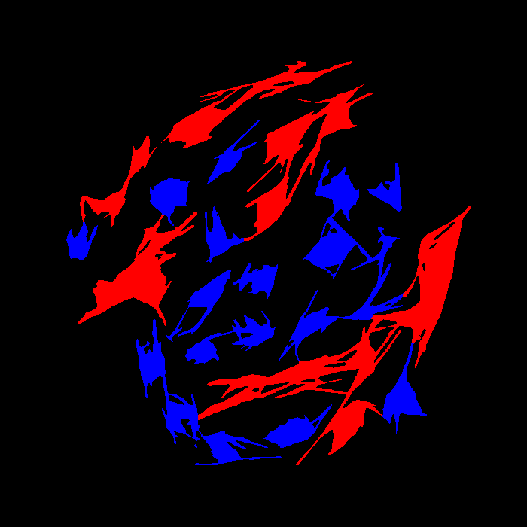
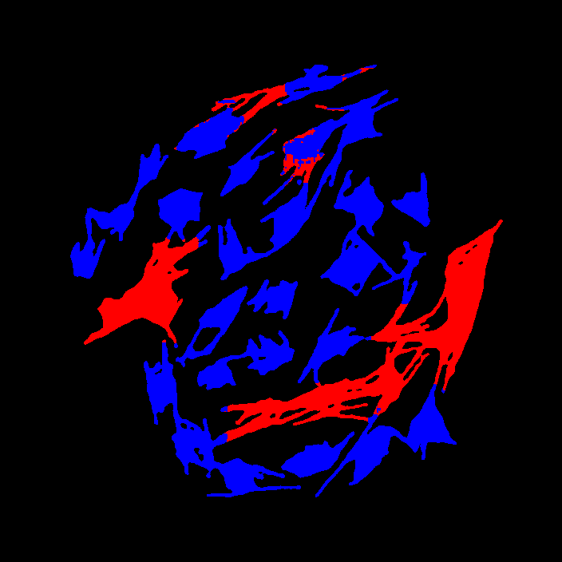
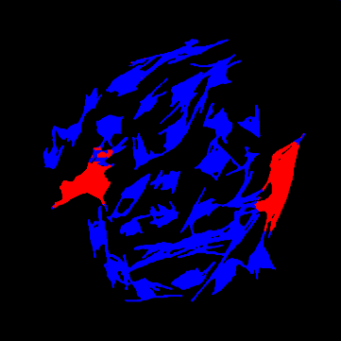
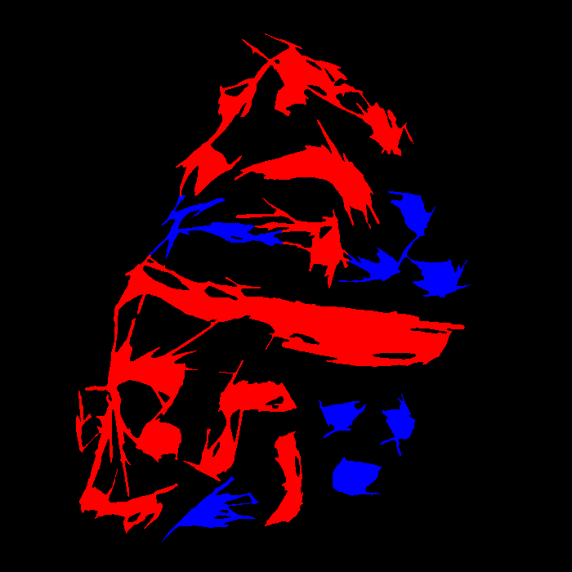
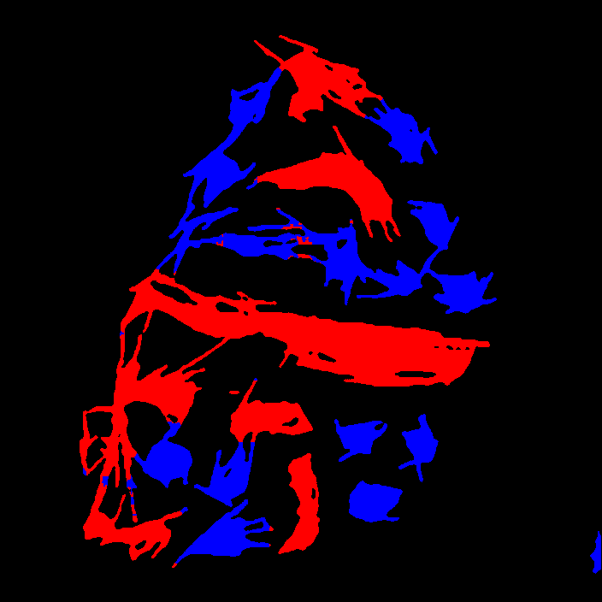
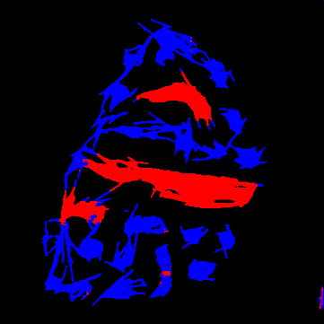
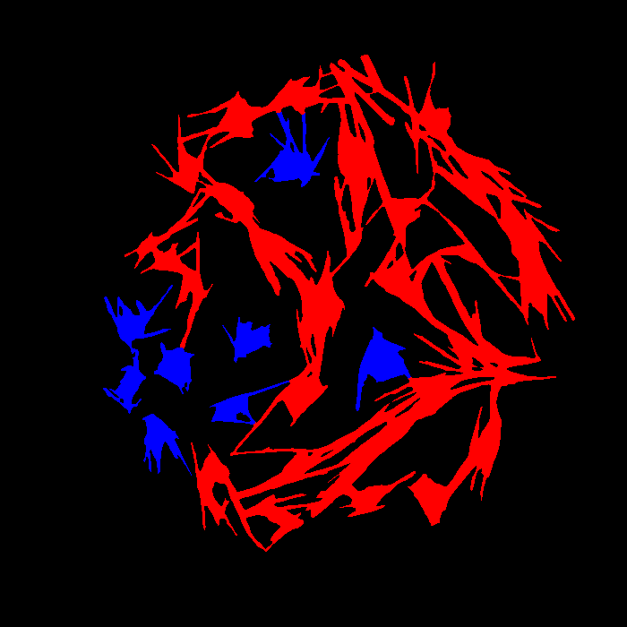
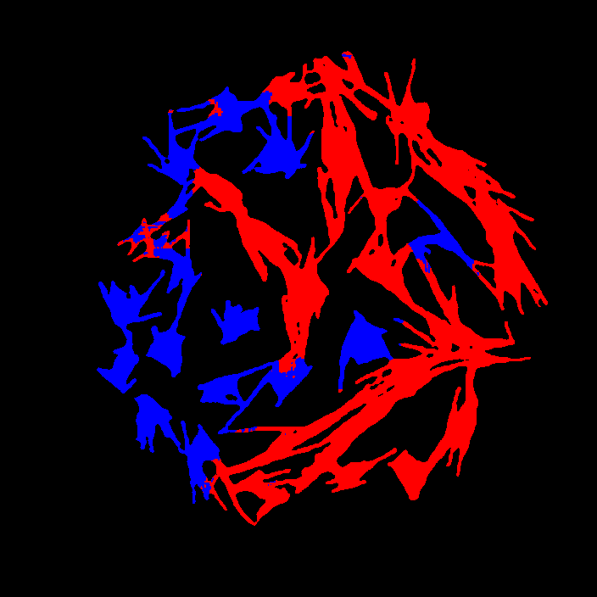
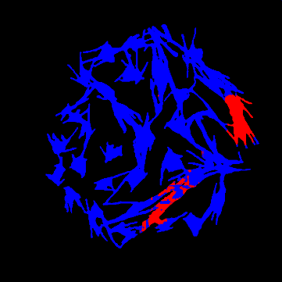
Model results
The model is able to intuitively classify filaments as conjoined or individual under two levels of sensitivity on test image.
Overall pixel accuracy of 94-95%
Filament accuracy of 73-75%
Liberal definition of conjoined
Conservative definition of conjoined
Ground truth
Model prediction
Ground truth
7
Model prediction

Slide 8
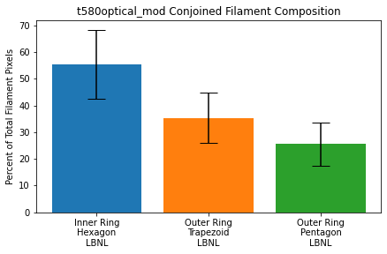
Implications and next steps
The model is suitably classifying filaments, however there is some consistent bias towards individual filaments, so we expect some continued improvement by increasing the dataset size.
We have begun to apply this model to a data set of round and rolled strand from LBNL
This is good evidence that the model is useful outside its training context
2212 strand rolling appears to increase filament bridging after heat treatment in the inner ring of sub-bundles
We are looking for collaborators to use this tool to address other questions related to conductor or magnet characterization/QA
Project support:
DOE-HEP DE-SC0020984
CPRD for wire supply
UW-Eau Claire MSEC facility support and Blugold Supercomputing Cluster
8

Slide 9
What we do – LTS (Nb₃Sn)
Work of Dr. Algirdas Baskys et al. at Lawrence Berkeley National Laboratory and of Dr. Alice Moros, formerly at Lawrence Berkeley National Laboratory, now at CERN

Slide 10
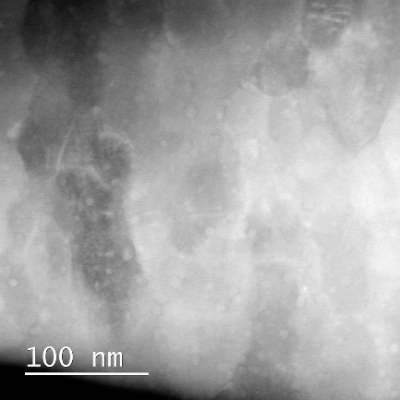
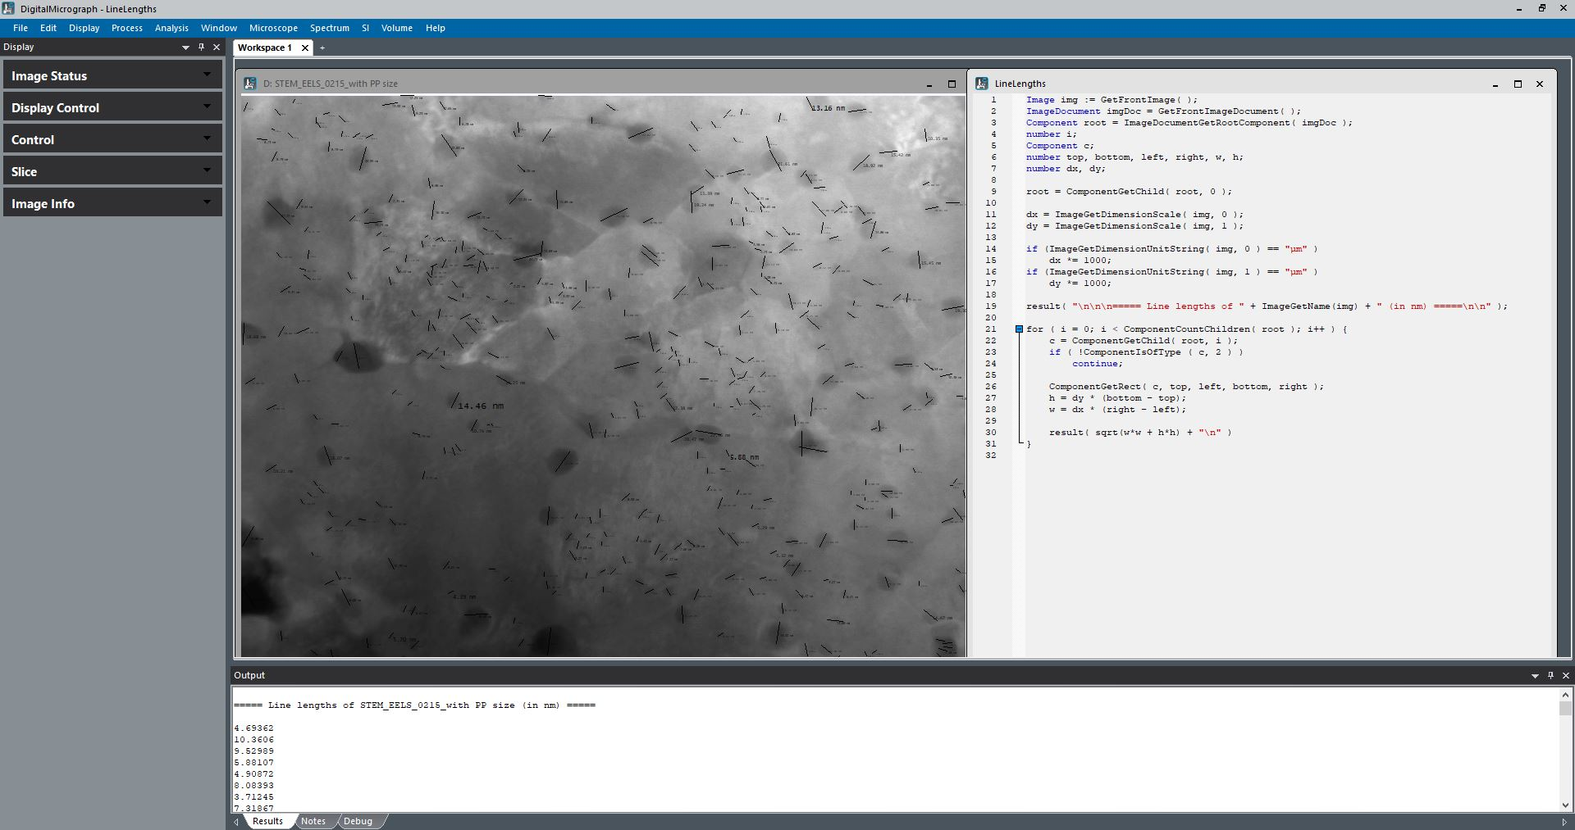
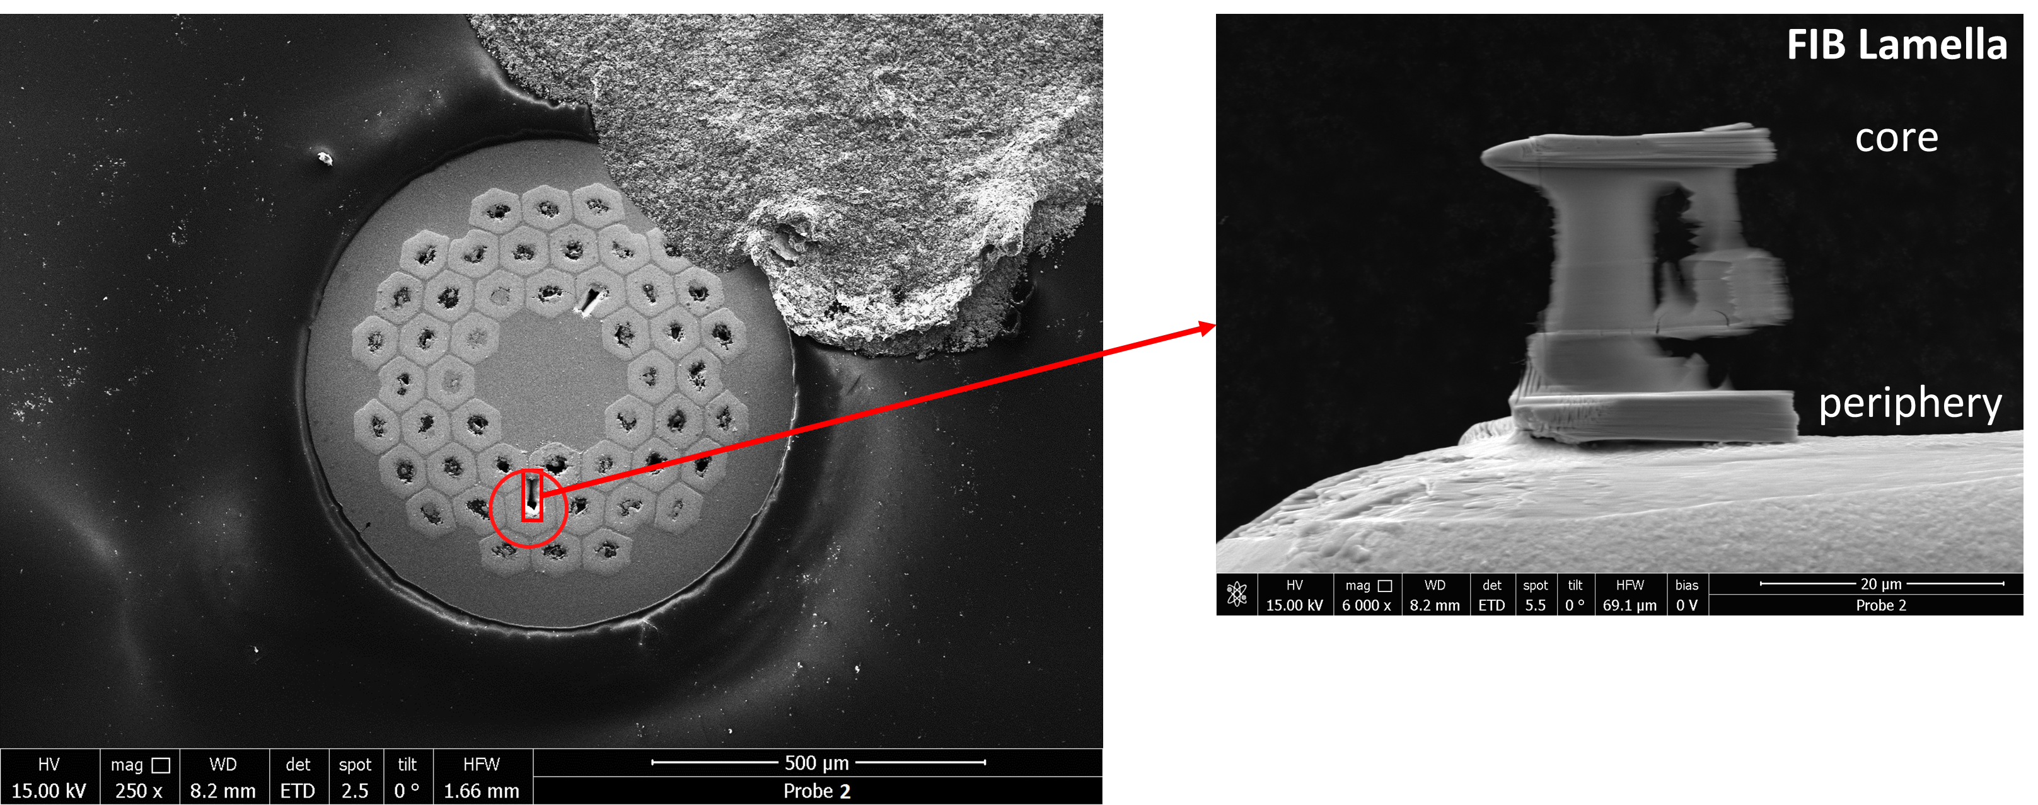
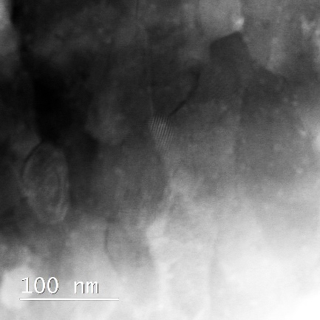
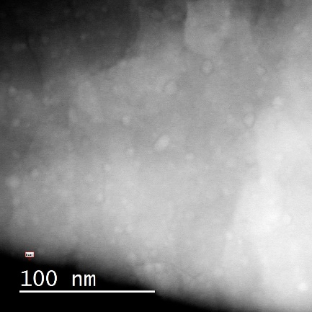
TEM study of nanoprecipiate size distribution
APC Nb₃Sn wires reacted with different HTs.
Microstructural characterization combining FIB and TEM to understand the correlations between the size and density of ZrO₂ and HfO₂ nanoprecipitates (PP) and HT.
PP sizes evaluated manually
Wire cross-section post polishing
FIB Lamella for TEM imaging
200-900 PP within an area of approx. 0.40 µm²
Digital Micrograph 3 (DM3) by Gatan to analyze PP size manually (VERY TIME CONSUMING)
+
Origin software to plot relative frequency vs size and determine the average PP size per sample
3 areas per lamella selected
through TEM/STEM imaging

Slide 11
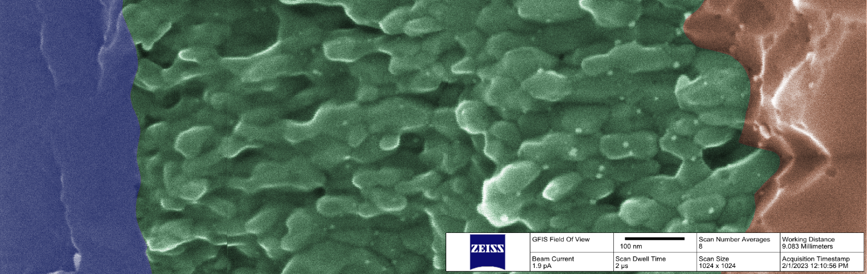
SEM/HIM study of artificial pinning centers
APC Nb₃Sn wire
HT (2h @ 700C)
Sample provided by X. Xu (FNAL)
Distribution of nanoprecipitates across the subelement is far from uniform within the Nb₃Sn layer, even when it is still thin
New nanoprecipitates nucleate at/near the Nb₃Sn/Nb-alloy interface, ppts near the core are coarsening
Sampling location very important (especially when using TEM or APT)

Slide 12
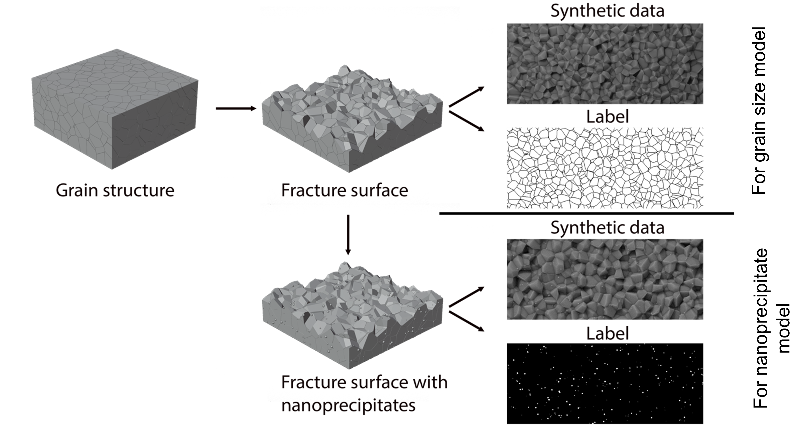
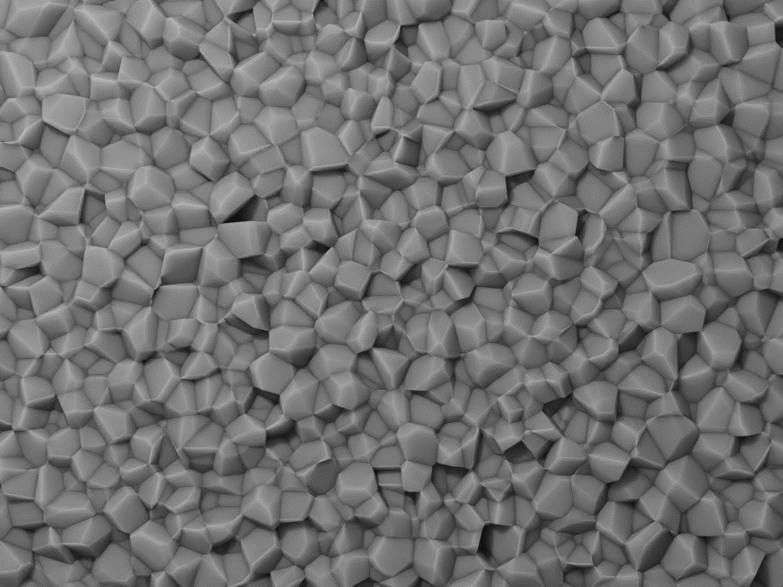
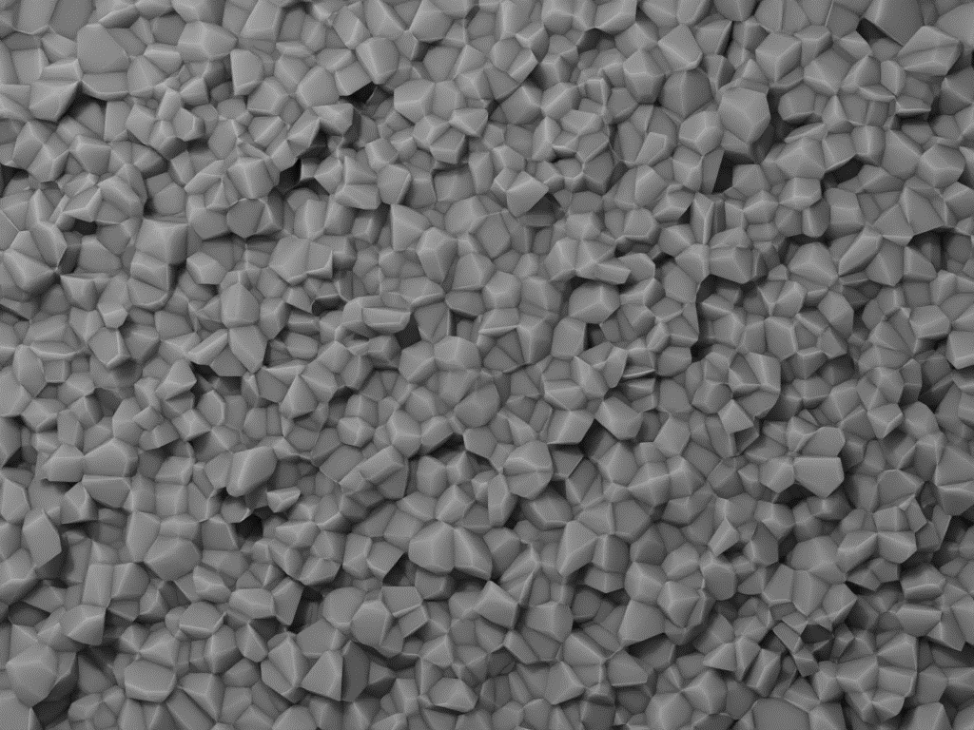
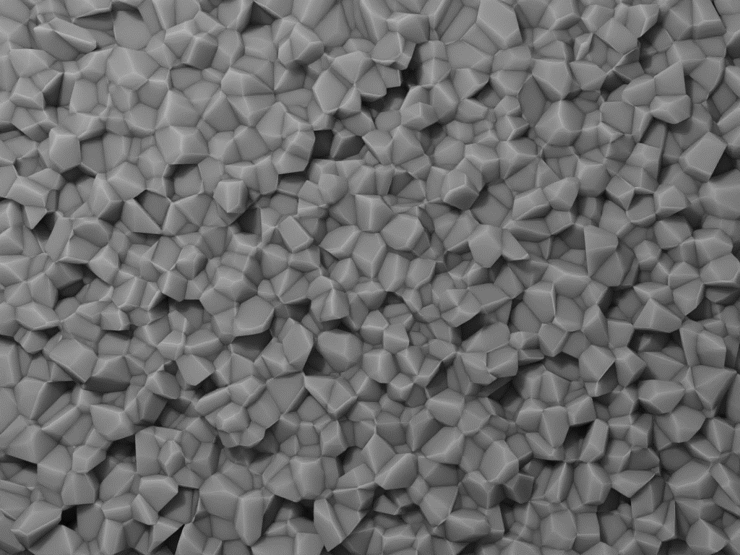
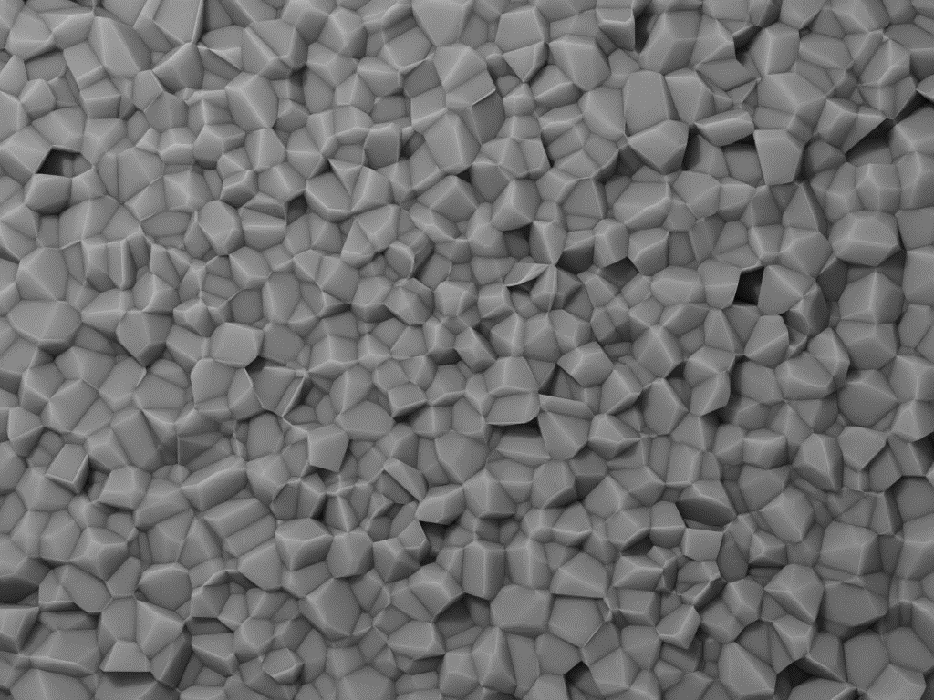
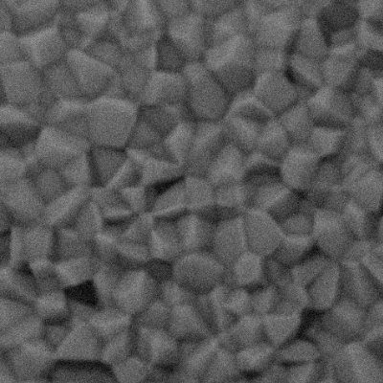
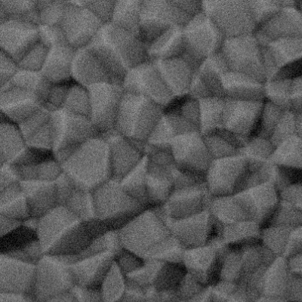
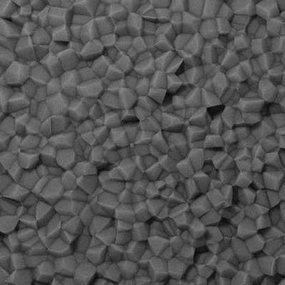
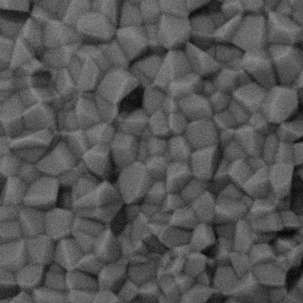
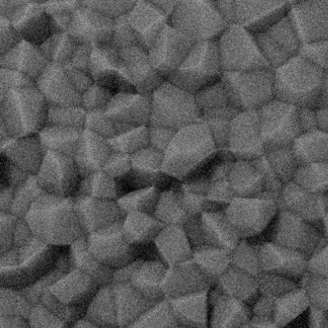
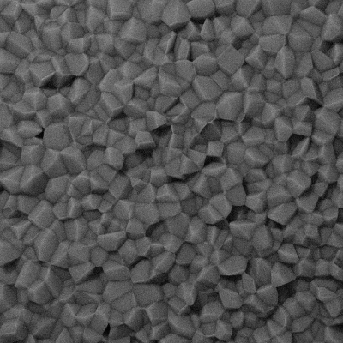
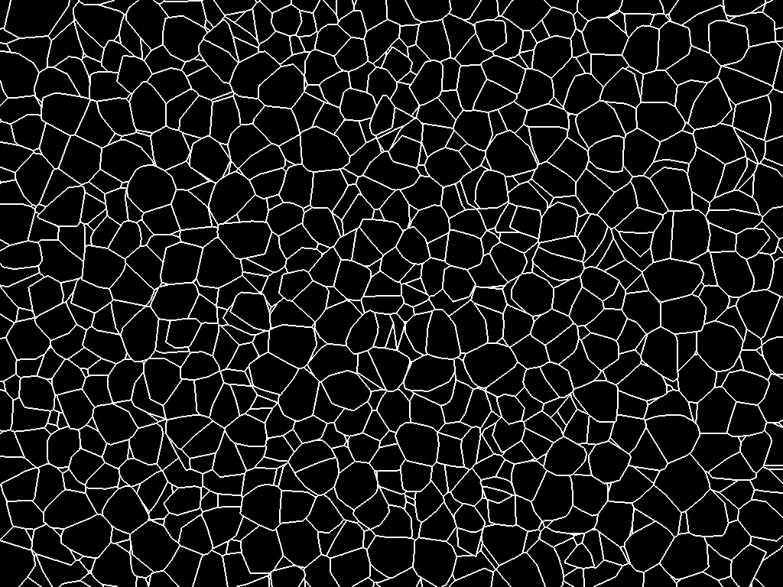
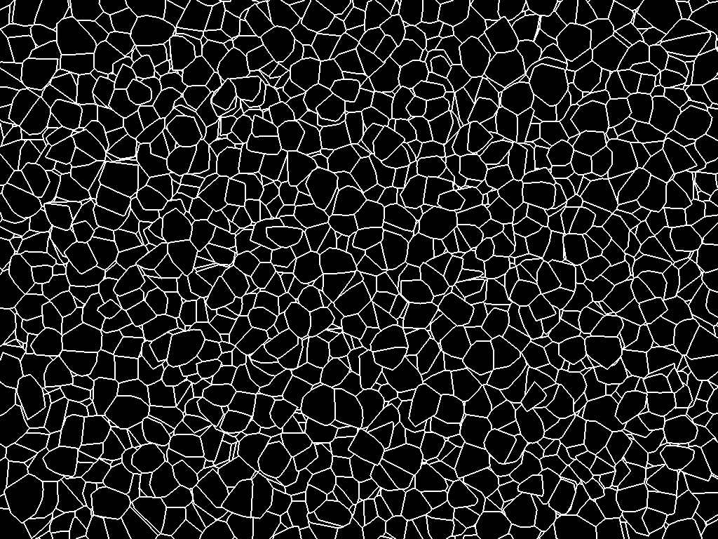
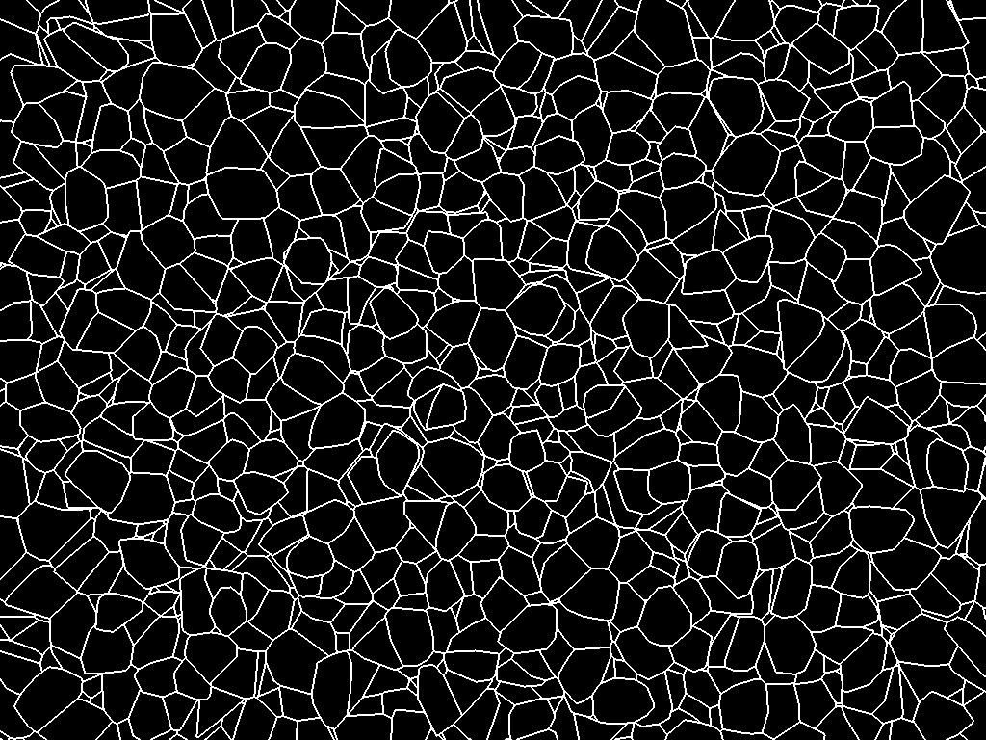
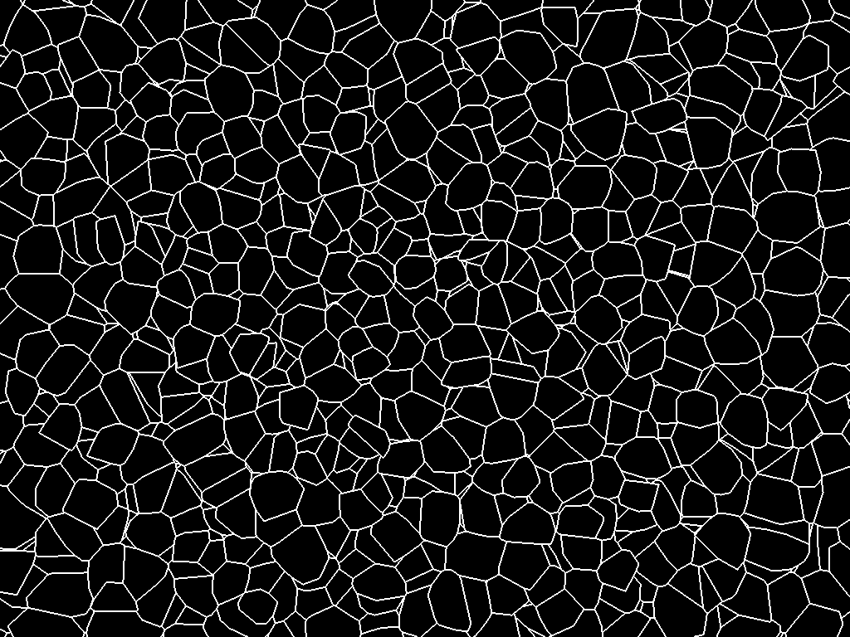
Augment hand-labeled data with synthetic data
Shaded to resemble images taken with electron microscope (secondary electron detector)
Roughness added to the fracture surface
Variable blurring (soft images due to microscope limitations or imperfect alignment)
Variable levels of noise (various acquisition speeds (scan speed))
Variable levels of scale (take care using variable scaling, as mask line thickness changes)
Data
“Data” and label created together: real ground truth
One-to-one grain properties comparison
Straight forward to automate and to create large dataset for training
Variants possible to study sensitivity to real life sample and image features
Label

Slide 13
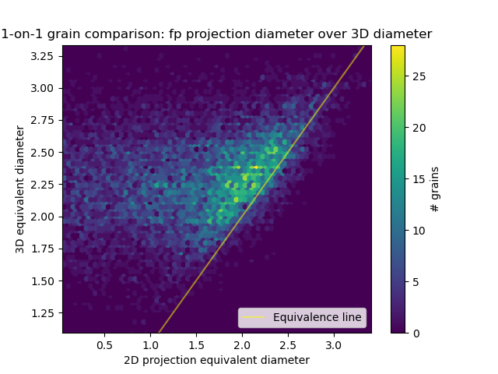
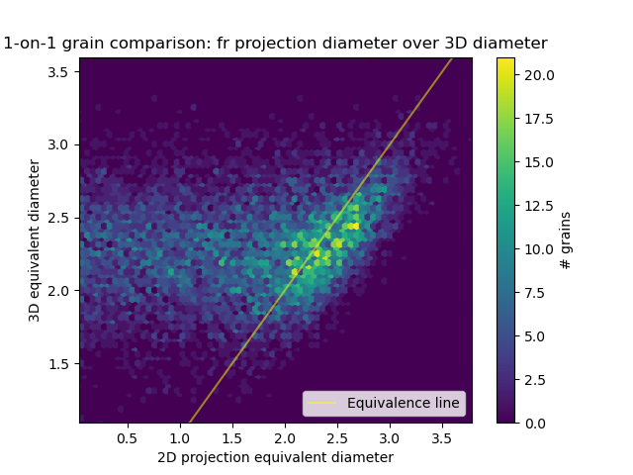
Synthetic data results
Synthetic data used for developing statistical relations of what we see (2D projections) and grain size based on volume:
Validating ASTM E112 methods (which are based on analytical formulae with many assumptions) with an otherwise impractically large population of data and improving decades old materials understanding
Sample preparation differences (fractographs and polished samples)
Grain size distributions (equiaxed or columnar grains)
Limitations on the microscopy (limited resolution/magnification)
a)
Flat polish
b)
Fractography
Flat polish observation
Hidden grain shape
Grain diameter based on volume vs. grain size based on a) 2D projection are of a fractography; b) 2D projection of a polished specimen. Figures based on a grain structure generated using Voronoi construction. (Kevin Gillespie).
[1] “Standard Test Methods for Determining Average Grain Size“, ASTM E112-13(2021), DOI: 10.1520/E0112-13R21
Notes:
Put labels on

Slide 14
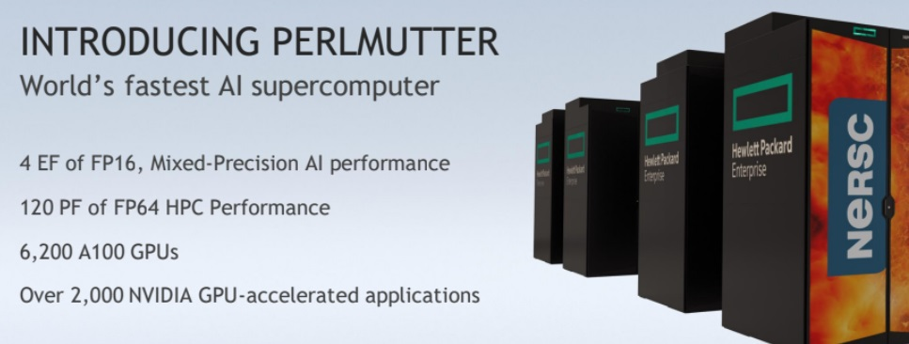
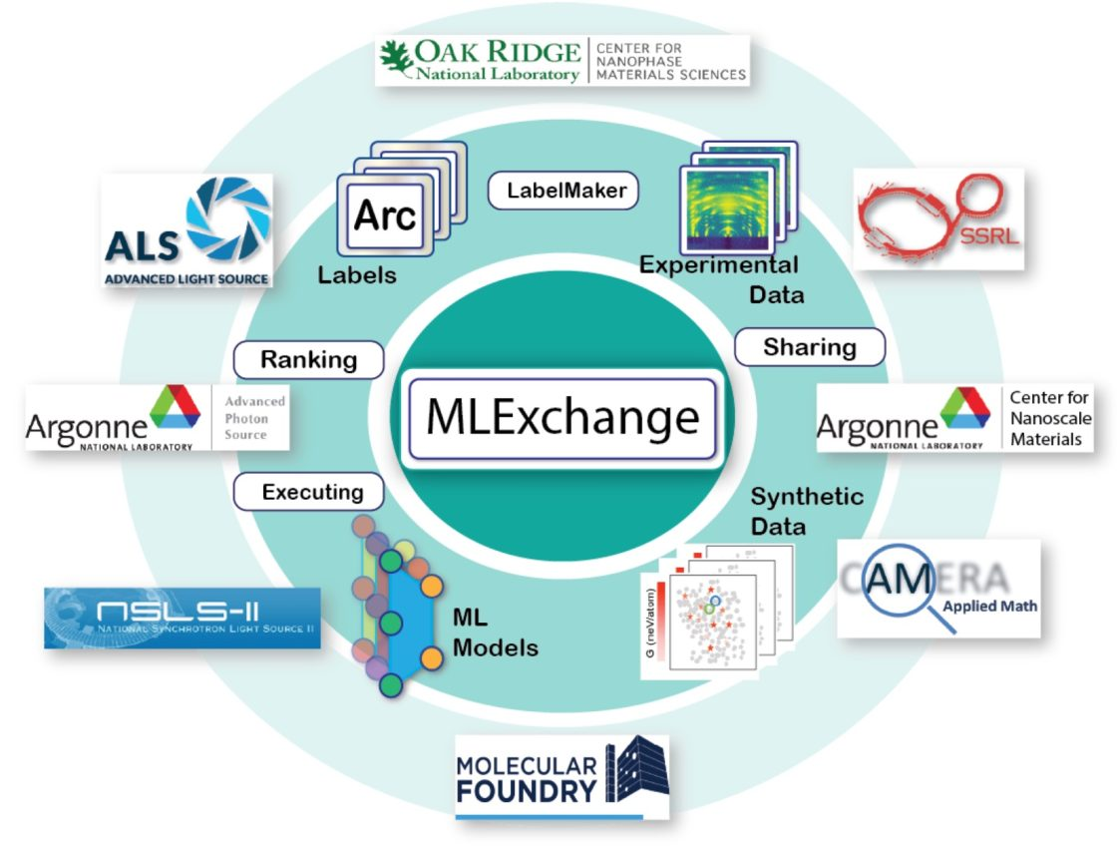
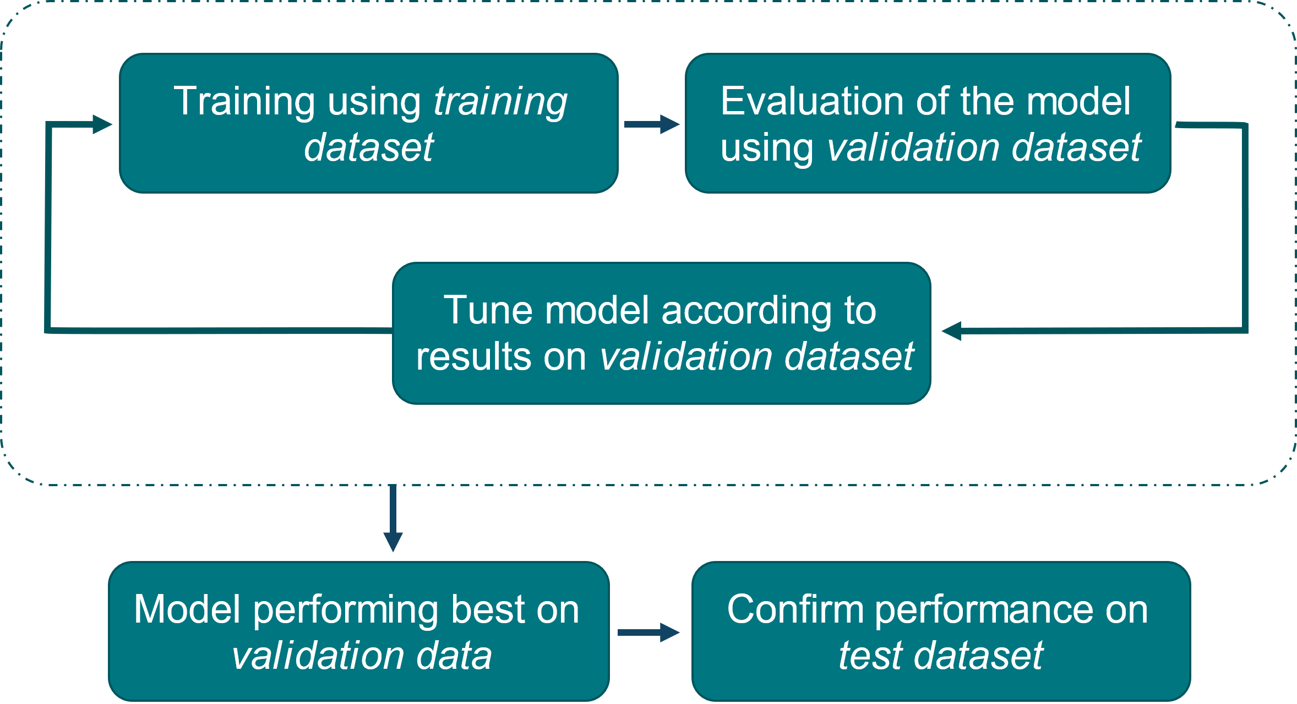
Infrastructure for analyzing and disseminating results
Models are trained using Perlmutter supercomputer at NERSC through ERCAP award
Model refinement (hyperparameter tuning) is an iterative process that can yield substantial improvements to performance
Dissemination via MLExchange and other platforms
Model training schematic
[1] http://arxiv.org/abs/1505.04597
[2] https://pytorch.org/hub/mateuszbuda_brain-segmentation-pytorch_unet/
Notes:
Not one and done approach, but required iterative tweaks to the model architecture and training regiment parameters
Methods for getting relevant data:
Atom probe tomography
TEM
Small angle X-Ray Scattering

Slide 15
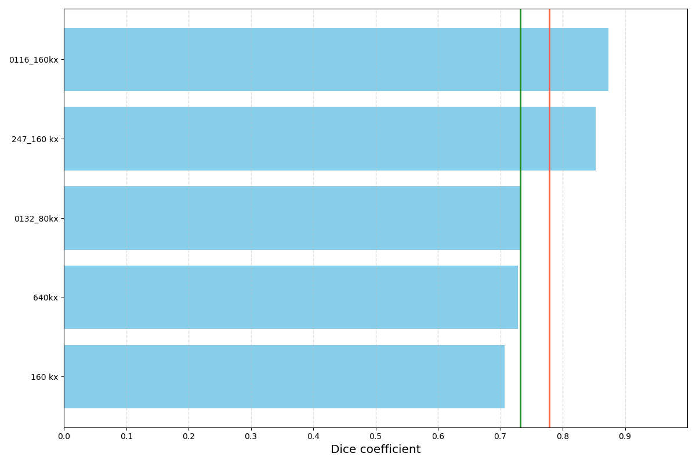
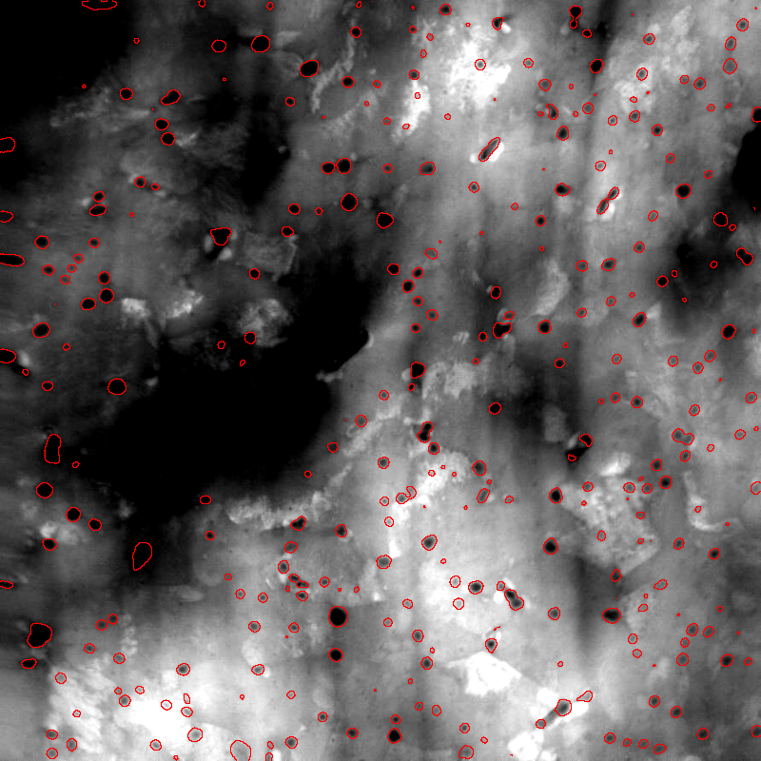
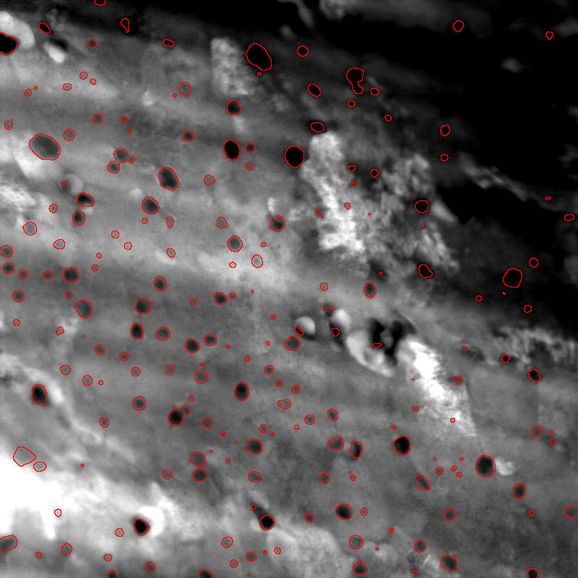
Nb₃Sn with artificial pinning centers (APC)
Initial results after hyperparameter tuning.
Model seems to capture most features of interest
DSC of 0.72 is a great start
There is some ambiguity in the data labels with makes the evaluation difficult.
160kx – 01
160kx – 02
Samples
Mean
80kx – 01
Median
640kx – 01
160kx – 03
0.0
0.1
0.2
0.3
0.4
0.5
0.6
0.7
0.8
0.9
Dice coefficient
Other parameters to check:
Identification of PPs regardless of their size
Size comparison of correctly identified PPs

Slide 16
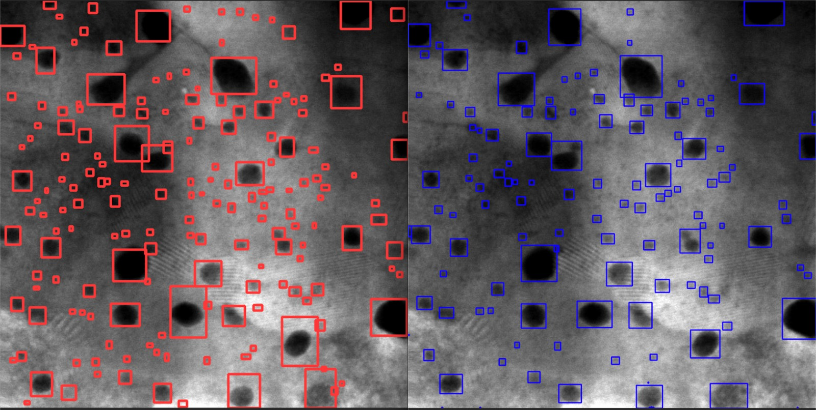
Nb₃Sn with artificial pinning centers (APC)
Alice Moros at CERN (Materials, Metrology and Non-Destructive Testing (MM) Section):
YOLO (You Only Look Once) model on same dataset
Object detection (vs. semantic segmentation)
Robust, but lose some information
Model outcome
Labeled image

Slide 17
What is next
Continue building synthetic data, and train model with labeled data: we are only scratching the surface of ML capabilities; then acquire images and apply ML
Our goals:
Analysis at the point of image acquisition
A platform of automation – work smarter and focus on science
Characterization of nano-features over macroscale (filament, subelement, wire, cable, coil)
AUP treasure trove: >5 M cable images + >10k metallography: Need resources to harvest
What we have learnt:
Preliminary work produced very promising results; but each individual problem requires slightly different approach and there are many problems to tackle
Comprehensive understanding needed for new designs and new processes
Data of many kind – requires expert knowledge in both AI-ML and material science
Impacts on superconductor and beyond

Slide 18
Conductor AI-ML
Ian Pong for Al Baskys
on behalf of the Superconductor ML Working Group
MDP 7th Collaboration Meeting
Brookhaven National Laboratory
2023 03 23
ipong@lbl.gov

