Slide 1
MDP collaboration meeting - goals, charge and agenda
Soren Prestemon
US Magnet Development Program
Lawrence Berkeley National Laboratory

Slide 2
Outline
Welcome to the 7th Annual US MDP Collaboration Meeting!
Our Magnet Development Program vision and goals, & priorities of the current Roadmaps
Our context in the broader US High Energy Physics community
Our involvement in the international community
Leveraging synergistic activities
Goals for the collaboration meeting and charge to the TAC
Some guidance for this meeting

Slide 3
Recap of our MDP vision and goals
Maintain and strengthen US Leadership in high-field accelerator magnet technology for future colliders
Focus on the four primary goals identified in the the original MDP Plan
  Explore the performance limits of Nb₃Sn accelerator magnets, with a focus on minimizing the required operating margin and significantly reducing or eliminating training
  Develop and demonstrate an HTS accelerator magnet with a self-field of 5T or greater, compatible with operation in a hybrid HTS/LTS magnet for fields beyond 16T
  Investigate fundamental aspects of magnet design and technology that can lead to substantial performance improvements and magnet cost reduction
  Pursue Nb₃Sn and HTS conductor R&D with clear targets to increase performance and reduce the cost of accelerator magnets
Further develop and integrate the teams across the partner laboratories and Universities for maximum value and effectiveness to the program
Identify and nurture cross-cutting / synergistic activities with other programs to more rapidly advance progress towards our goals

Slide 4
Program roadmap – 2020 Detailed Plan
Strategic priorities for the current plan:
  Probing stress management structures
  Hybrid HTS/LTS designs
  Understanding and impacting the disturbance-spectrum
  Advancing both LTS and HTS conductors, optimized for HEP applications
  The new element 20T Hybrid Magnet Design & Comparative Analysis, is making good progress, preparing for future program goals
  Expect to fold into magnet arena at next CM
There is growing schedule disconnect
  Driven primarily by funding + our interest in maintaining a broad program
=> Need to focus towards key hybrid magnets

Slide 5
The good news – DOE-OHEP is strengthening our program
Funding increased nearly 20% in FY23 – Thank you Ken and DOE-OHEP!!
Strong support for conductor procurement and R&D – increased from $500K to $1200K / year
Questions for discussion at this CM:
  How do we best use CPRD funds? See presentation from Ian, and follow on discussions
  The next push is to get hybrid magnets built and tested – how do we best prioritize to achieve this?
    Fabricating coil parts, winding coils, tooling, utility structure, etc
Keep an eye on our original questions: Ultimate Performance of Magnets
  What is the nature of accelerator magnet training? Can we reduce or eliminate it?
  How do we best define operating margin for Nb₃Sn and HTS accelerator magnets, and to what degree can and should it be minimized?
  Can we control the disturbance spectrum and engineer a magnet response to reduce operating margin and enhance reliable performance?
  What are the mechanical limits and possible stress-management approaches for Nb₃Sn, HTS, and 20 T hybrid LTS/HTS magnets, and do they have defined mechanical limits?
  Do hybrid designs benefit from the best features of LTS and HTS, or inherit the difficulties of both material technologies?

Slide 6
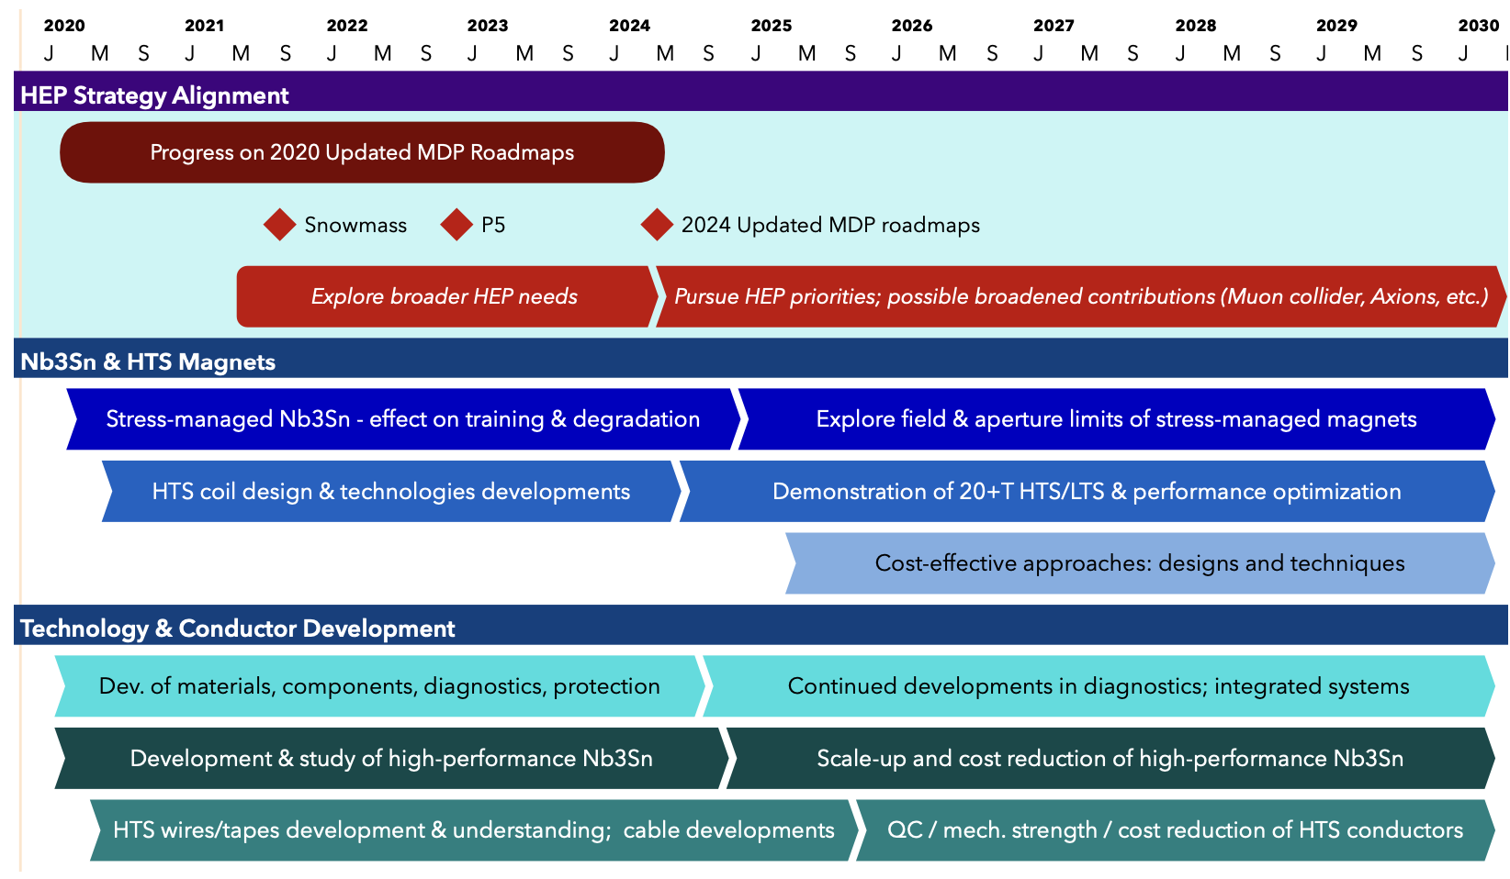
US MDP 2020 roadmaps – long range
Continue alignment with physics community needs
Focus on “stress-management” as well as hybrid HTS/LTS magnet technology
Continue to invest in the “science of magnets” and in improved conductors

Slide 7
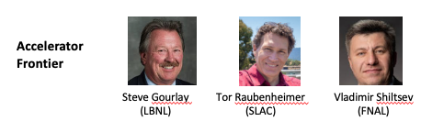
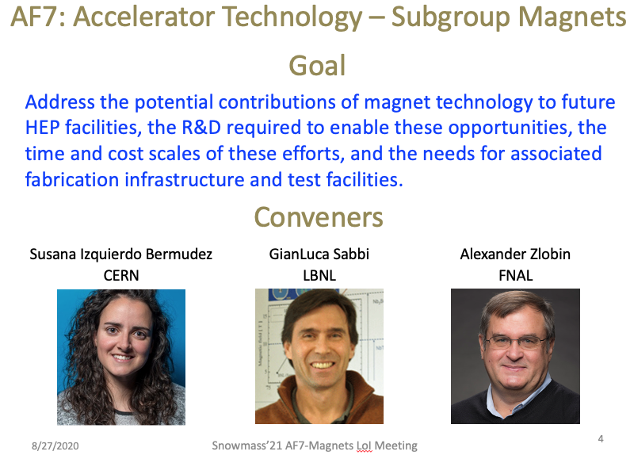
Our context in the US HEP Community
The US MDP resides under DOE-OHEP General Accelerator R&D
  Viewed as Long-term R&D – strength of DOE-OHEP, that has led to longstanding international leadership in the field
The ”Snowmass” HEP community planning exercise is completed
  Strong presence of MDP staff – excellent!
  Whitepapers submitted and discussed in Seattle
  The Snowmass process, and the follow-on P5 report, provide critical input for an update to our roadmaps circa 2024

Slide 8
We have ongoing efforts to contribute to P5 deliberations
Snowmass has concluded, and the P5 is underway
  Two MDP TAC members are on P5
    Amalia Ballarino & Mark Palmer
  One DOE Steering Council rep for MDP is on P5
    Tor Raubenheimer
P5 is holding townhalls – opportunity for input
  Presentations expected on…
    FCC-ee/FCC-hh
      Planning panel led by Tor, Vladimir, Andy
      Magnet contributions from Kathleen, Steve, Soren
    Muon Collider
      Planning panel led by Sergo Jindariani, Diktys Stratakis (Fermilab)
      Magnet contributions from Steve, Giorgio, Soren
Our research and progress can directly impact the future of high energy physics; we need to…
  Keep an open mind to opportunities
  Ask the right technical questions
  Be honest and fair about what is achievable – near, mid, and long-term, and the amount of R&D needed
  Communicate with others – e.g. accelerator physics – so we know how we can have the strongest impact on HEP

Slide 9

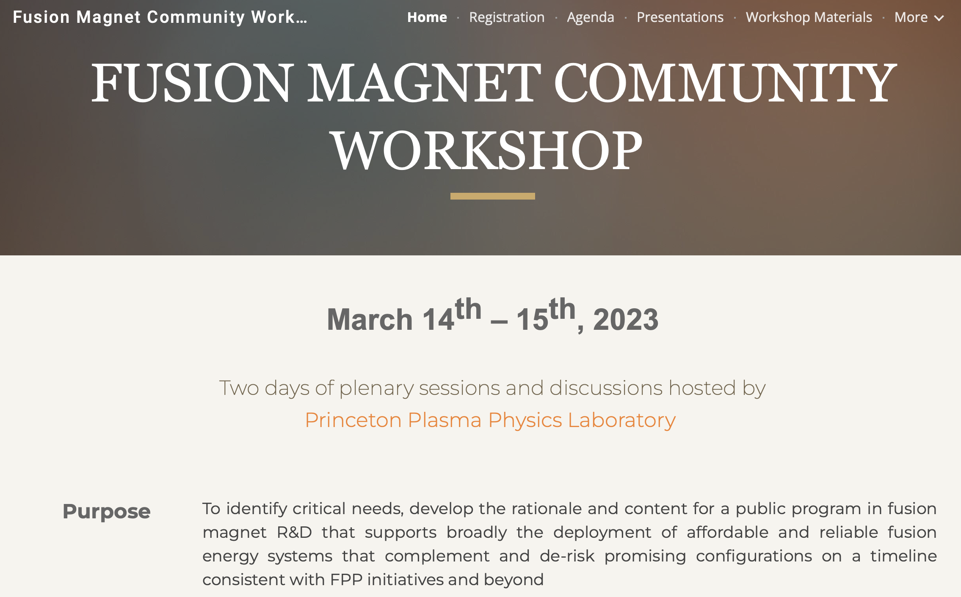
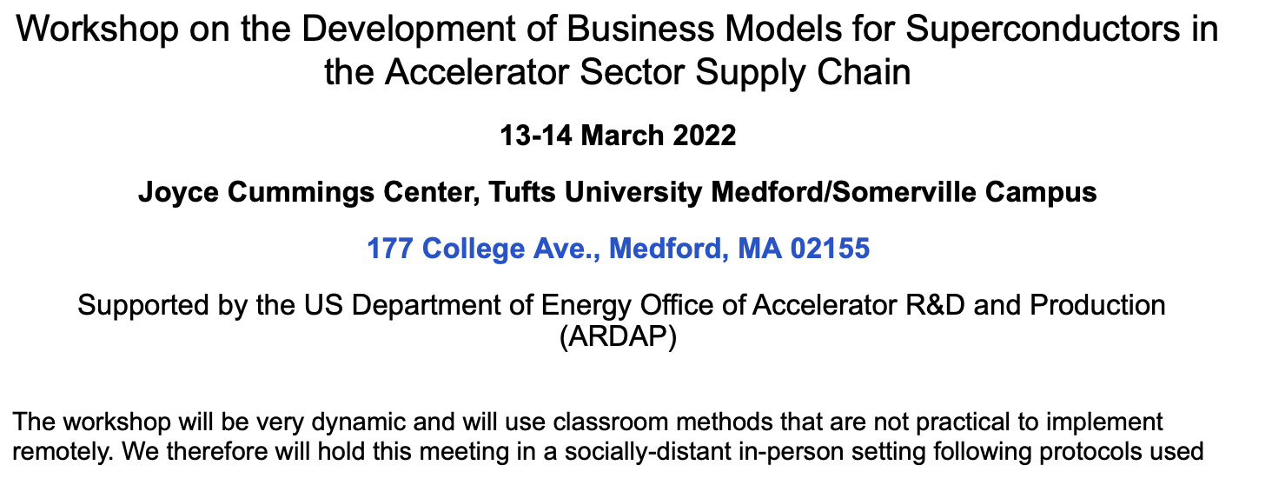
Our visibility in the International Community is strong… and important!
Strong Conference and workshop contributions, e.g.
  ASC 2022
    ~35 presentations/posters from MDP staff
More than 200 publications by MDP staff on MDP-related research since 2016 (>50 in the last year!)

Slide 10
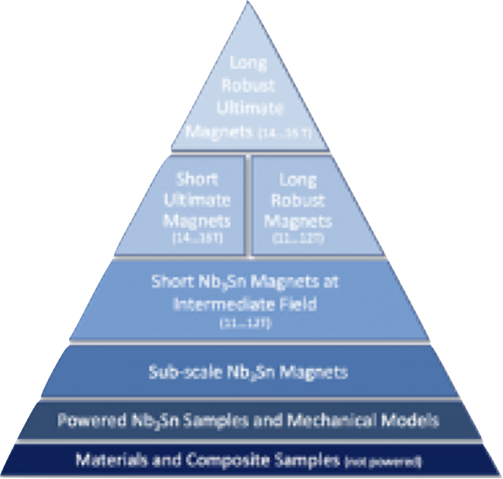
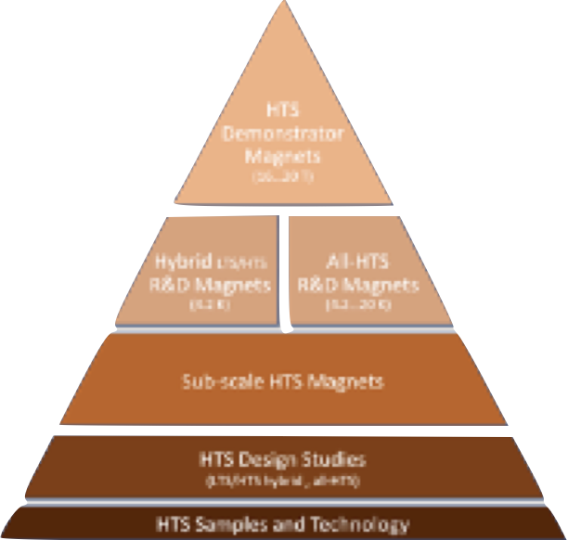
MDP plays an important role in the international context
European HFM–major elements similar to US MDP
  http://arxiv.org/abs/2201.07895
  Use of multi-lab teams, similar structure
  Key role of rapid-turnaround development platforms e.g. subscale magnets
  Funding target (5y): 112.9 MCHF + 478.5 FTEy
Intent is to have MOU with CERN that enables/encompasses work with HFM partner labs
  CERN contact Andrzej Siemko
Continue to build collaborations that are mutually beneficial
  We want to be seen as partners-of-choice
  Always keep DOE-OHEP / MDP goals in mind

Slide 11
Leveraging synergistic activities
We have various SBIRs, ARPA-E, Fusion & INFUSE, etc. projects underway
  From an MDP perspective:
    These are encouraged, but as much as possible through the lens of MDP
      Be strategic, e.g. look for synergies between MDP needs and industry interests
      Use these public-private partnerships to forge relationships, identify strong partners
      Build relation of trust, insist on sufficient access to data for honest assessment
    It is sometimes difficult, but… be ready to say “no” if the “fit” is not right
  Let's continue to partner with DOE in identifying effective SBIR topics
There are many “relevant” DOE FOA’s this year
  ECRPs
    A few submitted from MDP staff this year
ARDAP, HEP, Fusion
  Proposals developing/submitted to support…
    AI/ML applied to magnets and materials
    Conductor development
    Radiation damage
    …
  Balance “alignment” and “complementarity” with MDP
  Such proposals are strongest when teams across labs and universities come together with common interest and unique expertise and/or facilities

Slide 12
Goals for the collaboration meeting
Related to program roadmap:
  How have we progressed towards program milestones?
  Are the milestones still appropriate?
  What is a realistic timeline for the next key milestones? What issues jeopardize success?
  What issues were encountered over the last year? What lessons were learned?
  What are the near and mid-term conductor needs (to provide guidance to CPRD group)?
Related to collaboration functioning:
  Where do we see opportunities to improve, e.g.
    communication, coordination, leveraging of infrastructure, investment in infrastructure, etc.
  What appears to be working well?
  Are there lessons-learned that can/should influence how we collaborate more broadly, e.g. with HFM?
Related to long-term planning
  How well does our current program address questions/issues that impact P5 directions?
  How might our program evolve to better meet the needs of the community?

Slide 13
The MDP Technical Advisory Committee (TAC) is central to our program
Our Technical Advisory Committee provides critical guidance to / oversight of our program
  Andy Lankford (Chair), Giorgio Apollinari, Amalia Ballarino, Joe Minervini, Toru Ogitsu, Mark Palmer
TAC Charge
Some questions for the TAC to consider as they seek to provide advice on Program progress
Are the MDP priorities being followed? Have current bottlenecks to progress been identified?
Are the Areas making progress towards achieving their milestones?
Is each Area properly leveraging the capabilities within the collaboration to achieve their goals?
Is the MDP appropriately leveraging and developing synergistic activities, such as SBIR, DOE-FES, etc.?
Is MDP community involvement appropriate, i.e. in the US HEP planning process and in the context of international collaboration? Are there further avenues that should be pursued?

Slide 14
Guidance for this week's meeting
See meeting site https://indico.bnl.gov/event/18824/ for presentations & meeting timeline
  This is primarily an in-person meeting. Nevertheless we will try to maintain a zoom connection
Zoom etiquette:
  Mute your microphone when not presenting or asking a question
  Generally turn off your video, but turn it on when presenting or asking a question
  Use the raise-hand feature – in “Reactions” at bottom of zoom screen - if you want to ask a question
    Convener(s) will call on you for your question after the presentation (if time allows)
Speakers:
  Please stick to the time allotted – focus on the messages you are trying to convey
  More in-depth questions/discussions in the allotted discussion periods

Slide 15
Guidance for the meeting
Please see the US Magnet Development Program Code of Conduct on the Indico site
Keep discussions professional
  Do not seek to blame others,
  focus on technical and strategic aspects; be constructive
  Think through questions, keep them focused, and raise your hand; Keep your questions concise and to-the-point
  We value input from ALL members – students and junior/early career scientists and engineers are highly encouraged to contribute
  Thanks to all of you for attending - lets start the meeting!

