Slide 1
Introduction
General announcements and news
Timing Group Efforts Update
AOB (?)
Note to myself: Don’t forget to start recording

Slide 2
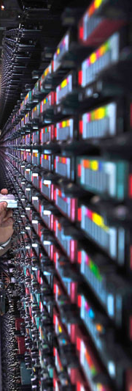
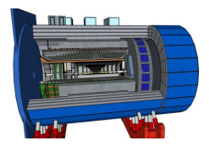
ePIC Streaming DAQ
Timing System
Detector Control
FEB = Front End Electronics Board
RDO = Front End Aggregation & E/O I/F
DAM = Data Aggregation Module
EBDC = Event Buffer / Data Compressor
FEB
DCM
DAM
EBDC
DCM
Network
Switch
DCM
FEB
DCM
DAM
EBDC
DCM
DCM
Online
Data Filter
Buffer Box
FEB
DCM
DAM
EBDC
DCM
DCM
Buffer Box
FEB
DCM
DAM
EBDC
DCM
To permanent storage and nearline processing
DCM
Buffer Box
FEB
Online
Data Filter
DCM
DAM
EBDC
DCM
DCM
Buffer Box
FEB
DCM
DAM
EBDC
DCM
DCM
Buffer Box
FEB
Online
Data Filter
DCM
DAM
EBDC
DCM
DCM
Buffer Box
FEB
DCM
DAM
EBDC
DCM
DCM
FEB
RDO
DCM
DAM
EBDC
DCM
DCM
Monitoring
O(2 Pbps)
O(10 Tbps)
O(0.5 Tbps)
O(0.1 Tbps)

Slide 3
Timing System Components
EIC Accelerator
  10ns (100MHz) bunch crossing rate
  Interaction rates up to 500kHz
EIC Clock System
  Provided by the accelerator team
  Interface to GTU board via fiber (?) in the same room
Global Timing Unit
  Tree of boards (?) splitting timing from EIC to O(100) DAM boards
  Interface to DAM boards via fiber (?) in the same room
  Reads info from EIC clock system
  Reads info from DAQ controls
  User inputs from external systems
  Transmits info to DAM boards
  Possible feedback from DAM boards for flow control
  Support for triggering (via input bits)
DAM Boards
  Accept and transmit timing info from GTU board set
  Use timing input clock as clock for fiber transceivers
  Use downlink also for detector control
  ~10 – 25 Gbit/sec transfer speed
RDOs
  Accept timing protocol
  Clock to FEE boards (ASIC) reconstructed from information stream from DAM boards
  Format Data packets in appropriate time frames

Slide 4
From the (HPTD) TCLink Reference Note:

Slide 5
TCLink Transmitter Only:
GTH Ultrascale+
GTY Ultrascale+

Slide 6
TCLink with GBTx

Slide 7
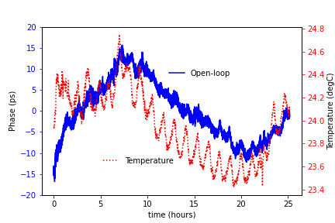
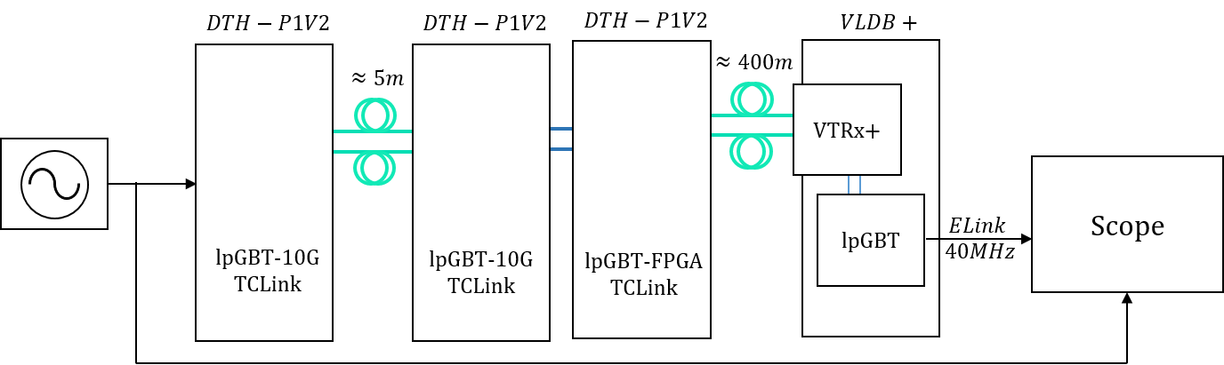
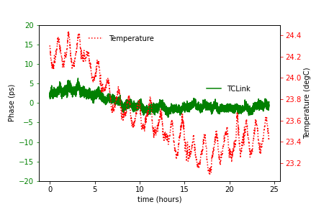
TCLink Performance for cascaded links

Slide 8
Pure Timing Distribution Example

Slide 9
Components used

Slide 10
Results

Slide 11
https://www.skyworksinc.com/en/Products/Timing/Evaluation-Kits/clock/si5338-evaluation-kit
Use some of the 80bits as “DCS” commands; e.g.,, 40bits EIC bx counter; some bits for “trigger commands”
10 Gbps link, e.g., 10b8b encoding
Would provide 10 bytes in 10ns
160kHz to 700MHz in LVPECL/LVDS, <1 ps RMS Typ Jitter, Zero ppm Freq Error
Other, more efficient encodings?
Other, more efficient encodings? FEC?
Precision Clock
Generator; e.g., SiLabs SI5338-EVB eval board
GTU
e.g. Zync Ultrascale+ eval board
FELIX
(Versal Prime class board)
RDO
(Artix-Ultrascale+ class board)
RefClk: ~100MHz?
“busy” feedback?
Do we need better clock generator here?
10 Gbps or 25 Gbps for data and interleaved slow controls response
Recovered 100 MHz clock
500 MHz = 5 times EIC clock to transmit five 16bit nibbles in one EIC clock
Fast Scope (and spectrum analyzer?)

Slide 13
Timing Group Efforts
Evaluation boards have been ordered by D. Abbott at JLAB for distribution in the timing group aiding the evaluation of these concepts. In detail:
Tonko:
  ordered 2x ZCU106 boards, plus SiLabs clock eval board
  One ZCU board as RDO prototype (for TOF), other as FELIX prototype
  Develop and vet the clock distribution scheme with emphasis towards supper low jitter for TOF
  Evaluate TOF EICROC ASIC family as it becomes available
  Develop streaming protocols using the EICROC
  Availability: little time until summer; TOF meeting with project team to request electronics engineering support to work on this

Slide 14
Timing Group Efforts
Marius:
  One ZCU102 eval board plus one SiLabs clock evaluation board
  Already has a FELIX BNL712 board
  Use FELIX together with ZCU102 serving as RDO replacement
  Timing board serves as reference for FELIX
  Compare recovered clock
  Availability: quite busy currently with ATLAS work, probably 20% over the summer

Slide 15
Timing Group Efforts
Pietro:
  Ordered one ZCU102 board, already has one at Bologna; also has FELIX board from associated ATLAS group
  Setup with one ZCU board as FELIX replacement, other as RDO
  Implement GBT-FPGA core as easy test clock transmission, expecting O(10ps) jitter
  Move to EIC-timing distribution system over TC-link implementation to compare performance
  Test data transmission over TC-link implementation
  Implement ALCOR readout on one side via FMC connector on ZCU board
  Availability: gradual ramp-up operations over next year; plans to secure time of a senior engineer to design “pre” RDO; limited time available early this year, should increase time availability later this year.

Slide 16
Timing Group Efforts
William:
  Ordered 2 different SiLabs clock evaluation boards; already has ARTIX eval board, Kintex KCU-105 board, ZCU-106 board, and custom PCIe board
  Setup will be: Clock generator board <-> KCU105/ZCU106/TIpcieUS <-> ARTIX (XEM8320) <-> Clock Generator
  Study clock recovery from RDO
  Slow/Fast controls of the RDO
  Data from/to RDO
  Availability: about 50% over the next 3 – 4 months

Slide 17
Timing Group Effort
Jo:
  Ordered Enclustra Zynq board assembly set, Opal Kelly ARTIX eval board, SiLabs clock evaluation board; already have FELIX BNL-712 board
  Setup chain SiLabs Clock board -> FELIX/Zynq – ARTIX board to test cascaded clock distribution
  Test TC-Link IP for jitter performance
  Hoping to get FELIX FLX-182 prototype to investigate porting TC-Link IP to Versal FPGA family
  Develop data transmission protocols
  Test FELIX FLX-182 prototype board
  Availability: very little time at the moment due to sPHENIX commissioning; hope to have 25% time available over the summer and later this year

