Slide 1
Collaboration Organization Overview (from DAQ perspective)
Welcome to Convener Roles: Fernando Barbosa, TBD (specific person, as yet unannounced)
Thank you for past and future efforts: Chris Cuevas, Jo Schambach, Alexandre Camsonne
Jo Schambach is playing a central role in organizing the Timing Subgroup and will continue to do so!

Slide 2
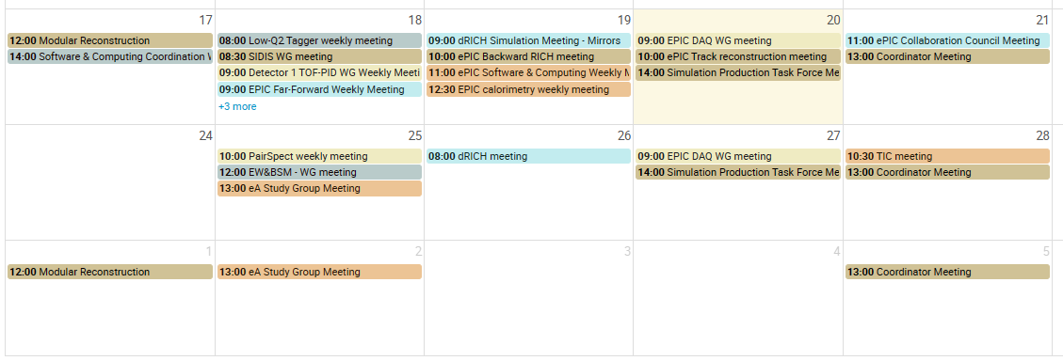
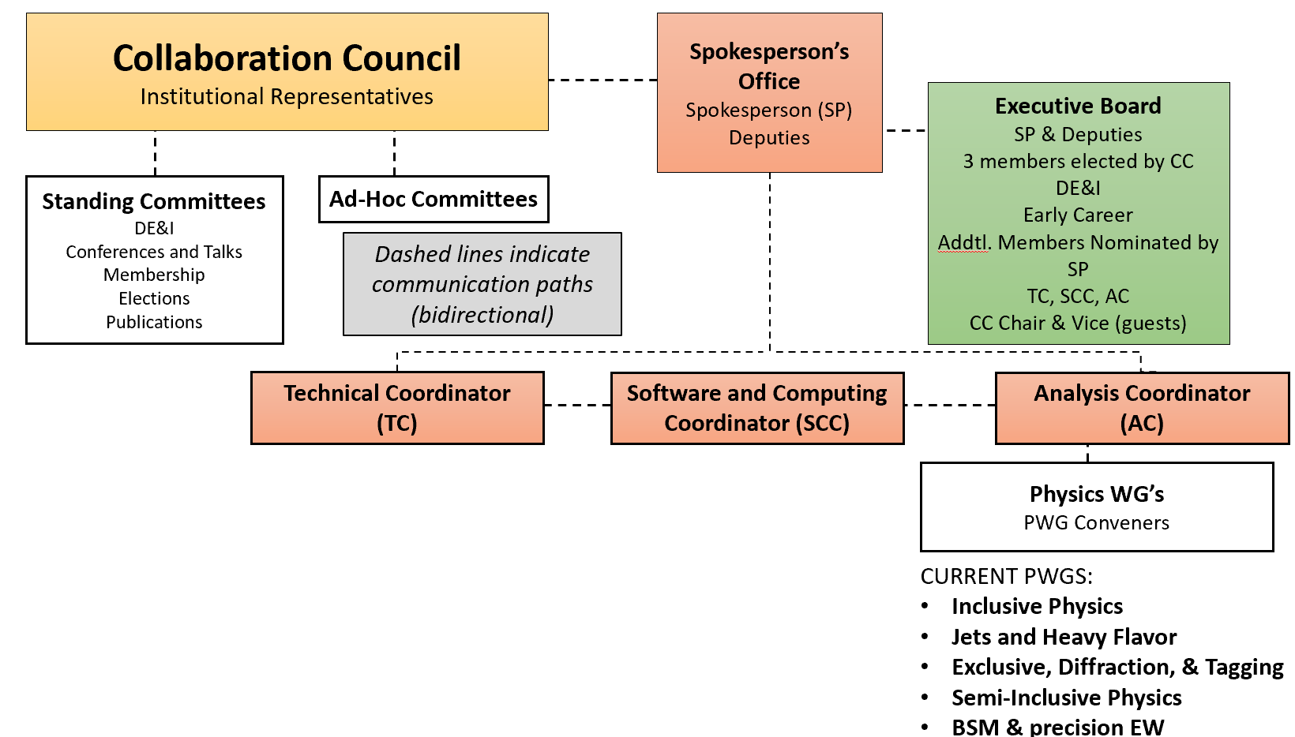
Higher Level Collaboration Management
Rosie Reed (Lehigh Univ)
Salvatore Fazio (Univ Calibra)
Klaus Dehmelt (SBU)
Marcus
Diefenthaler
(JLAB)

Slide 3
Our direct connections to the collaboration:
TIC Meeting (replaces GDI)
Normally Mondays @ 9am

Slide 4
Our direct connections to the project:
10.6.8 (Electronics)
CAM: Fernando Barbosa
10.6.9 (DAQ)
CAMs: Dave Abbot
Jeff Landgraf
Electronics, Readout and DAQ
(Fernando Barbosa, Jeff Landgraf, TBD)

Slide 5
Our WGs / Conveners

Slide 6
Detector Subsystem Collaborations (DSC’s)

Slide 7
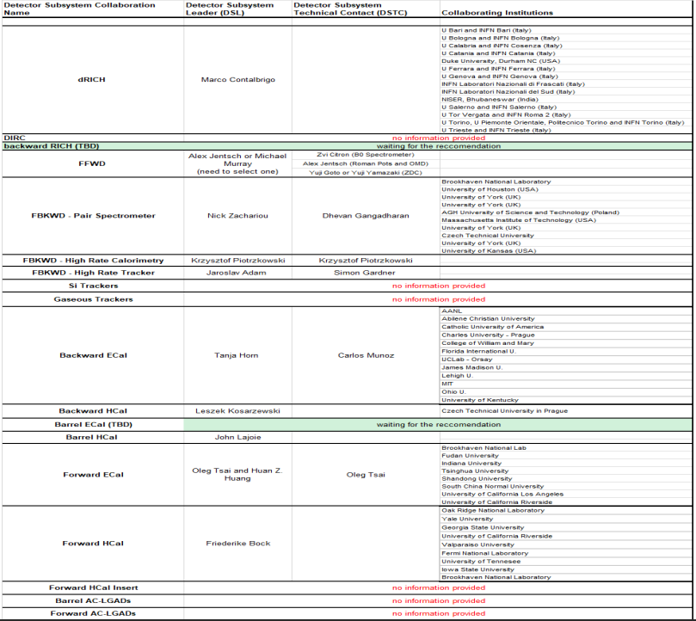
Detector Subsystem Collaborations (DSC’s)

