Slide 1
Updates to the RaDIATE Collaboration from PNNL
Andy Casella & Dave Senor
PNNL-SA-186843

Slide 2
Graphite and SiC-Coated Graphite
These samples were irradiated in BLIP
Samples were examined by thermal desorption spectroscopy
Samples were examined by SEM.
This year, we have accumulated the results into a draft paper that we have sent to Makimura-San for collaborative completion and submission.
(a)
(b)

Slide 3
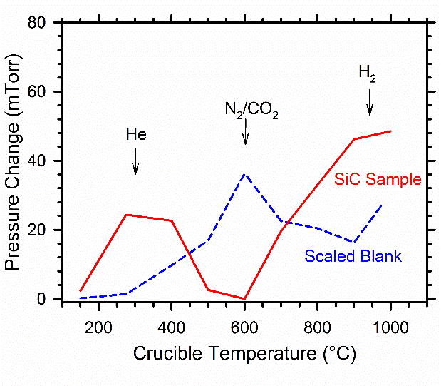
Thermal Desorption Results – Total Pressure
The experimental set includes 2 irradiated SiC coated graphite disks,an irradiated graphite spacer sample, and four blanks
The results show total pressure readings in the system

Slide 4
Thermal Desorption Results – Composition
Gas | Blank (Final P = 77.6 mTorr) | SiC Sample (Final P = 345.7 mTorr)
Hydrogen | 38.2 ± 0. 8 % | 39.7 ± 0. 8 %
3-Helium | ND^{b} | 0.65 ± 0.01 %
Helium | ND^{b} | 4.8 ± 0.1 %
Methane | 1.09 ± 0.02 % | 0.113 ± 0.002 %
Nitrogen | 45.6 ± 0.8 % | 42.3 ± 0.8 %
Ethane | 1.28 ± 0.03 % | 0.039 ± 0.001 %
Oxygen | 0.98 ± 0.02 % | 0.65 ± 0.01 %
Argon | 0.064 ±0.001 % | 0.019 ±0.001 %
Carbon Dioxide | 12.8 ± 0.3 % | 11.7 ± 0.2 %
1st Sample Blank and 1st SiC Sample
Gas | % mol Composition | Molecules (x10¹⁶)^{b}
Hydrogen | 40.6 ± 0. 8 % | 43 ± 12
3-Helium | 1.45 ± 0.03 % | 1.6 ± 0.4
Helium | 10.7 ± 0.2 % | 11 ± 3
Nitrogen | 37.0 ± 0.7 % | 40 ± 10
Oxygen | 0.235 ± 0.005 % | 0.25 ± 0.07
Carbon Dioxide | 10.1 ± 0.2 % | 11 ± 3
1st SiC Sample Blank Corrected

Slide 5
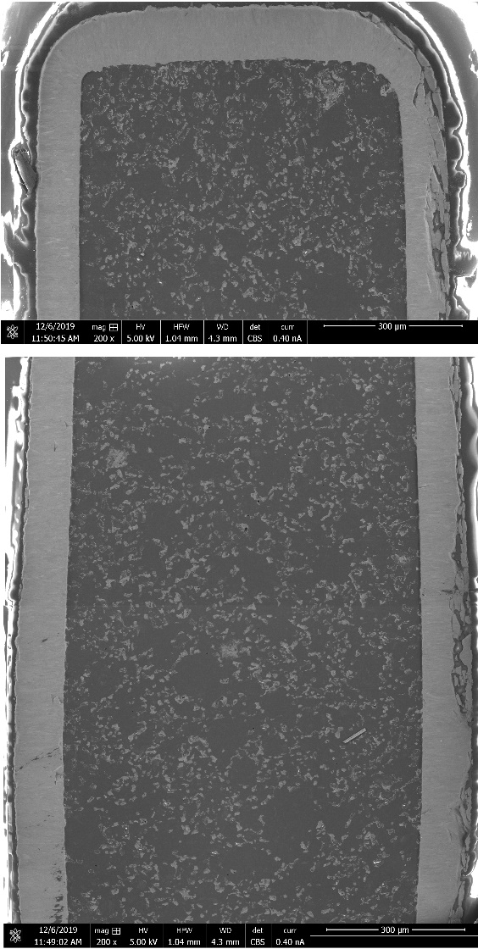
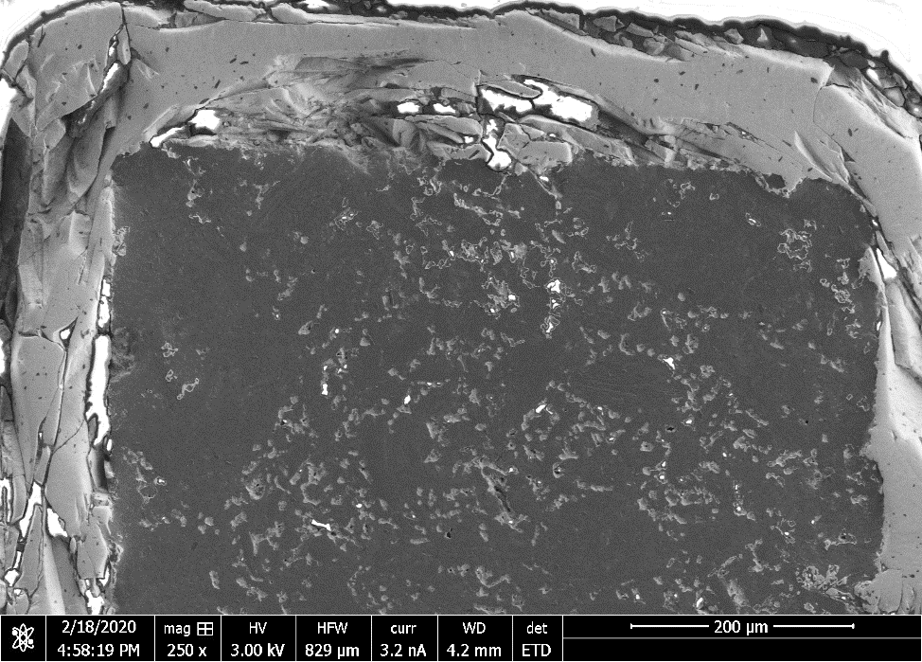
SiC-Coated Graphite
An SEM montage and SEM images of the polished cross section of the second irradiated SiC coated sample does not show much evidence of swelling as the previous sample, but fractures are apparent over a substantial portion of the SiC coating around the region highlighted by the red box. This may explain the discrepancy between the two SiC-coated samples with respect to the differing concentration of isotopes measured during testing.
A partial montage of one of the irradiated SiC-coated graphite samples reveals significant swelling has occurred in the graphite at the center of the disc. The SiC is relatively uniform on both sides of graphite and does not appear to have changed significantly in thickness. The yellow arrows and vertical lines help visualize the swelling of the graphite which was observed in the center of the disc.

Slide 6
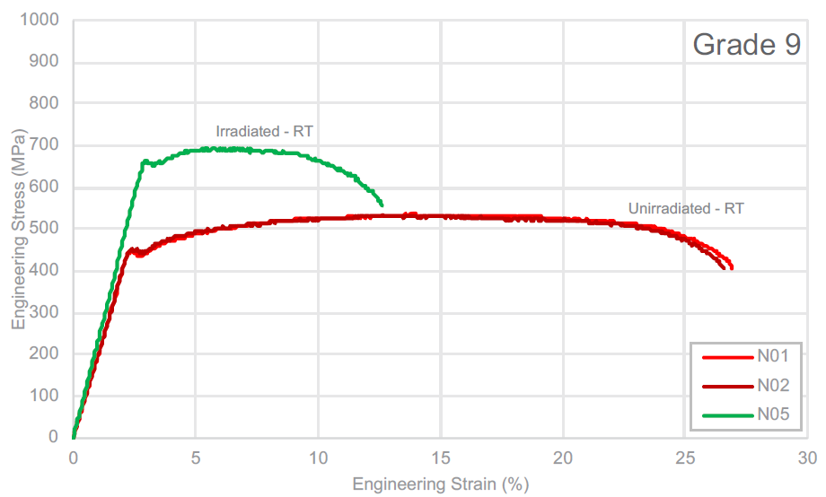
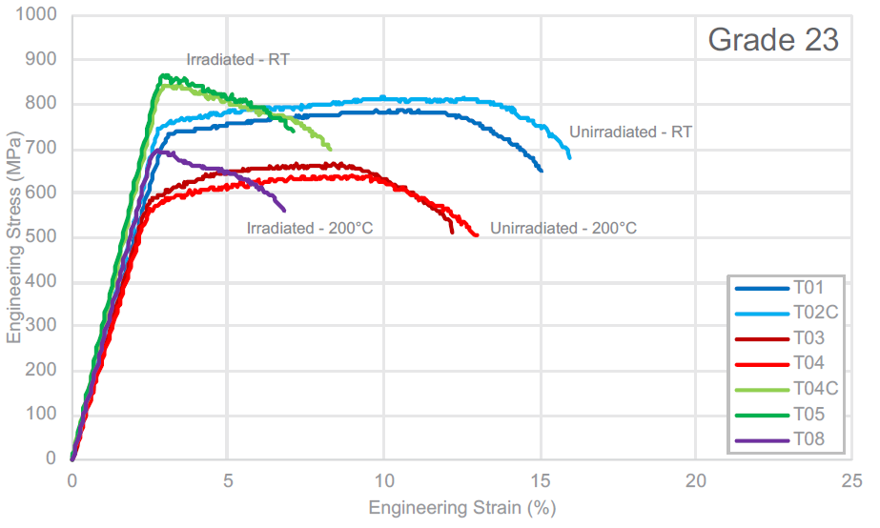
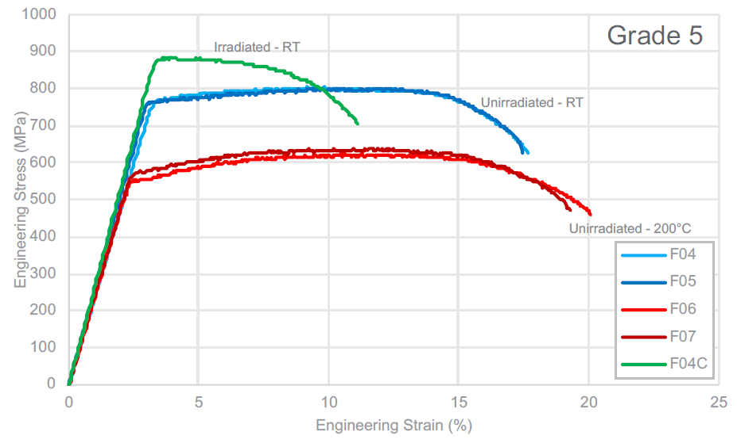
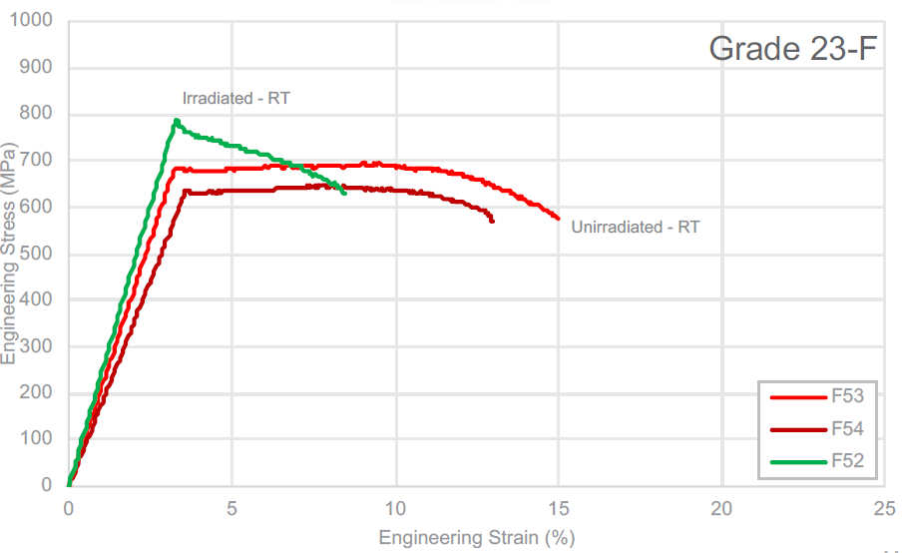
DS Ti-1 Capsule Results (Previously Reported)
(Ti-3Al-2.5V)
(Ti-6Al-4V ELI)
Near alpha
(Ti-6Al-4V)
(Ti-6Al-4V forged)

Slide 7
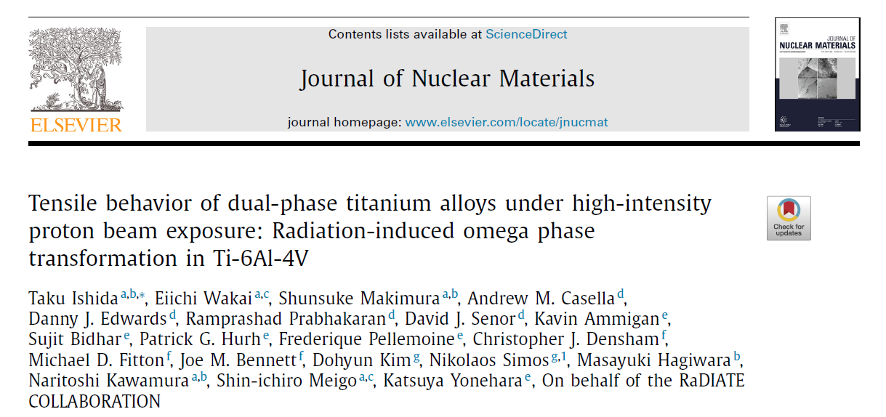
DS Ti-1 Capsule Results (Previously Reported)
Ti-6Al-4V grades are stronger than Ti-3Al-2.5V but are also less ductile
Distinct radiation hardening is observed for each of the four grades
Ti-3Al-2.5V retains some uniform elongation after irradiation while Ti-6Al-4V grades have essentially none
TEM shows likely defect clusters less than 2 nm in size.
Grade 23F tensile data shows more scatter than other grades in the unirradiated condition and also shows more scatter in the modulus.

Slide 8
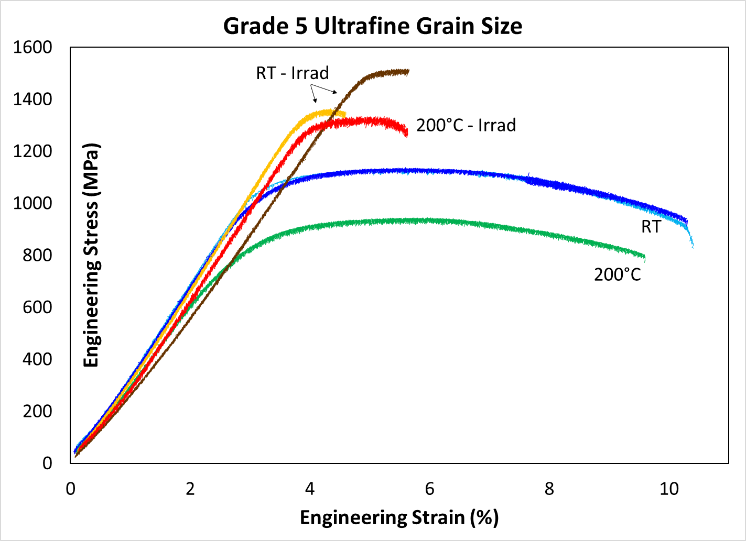
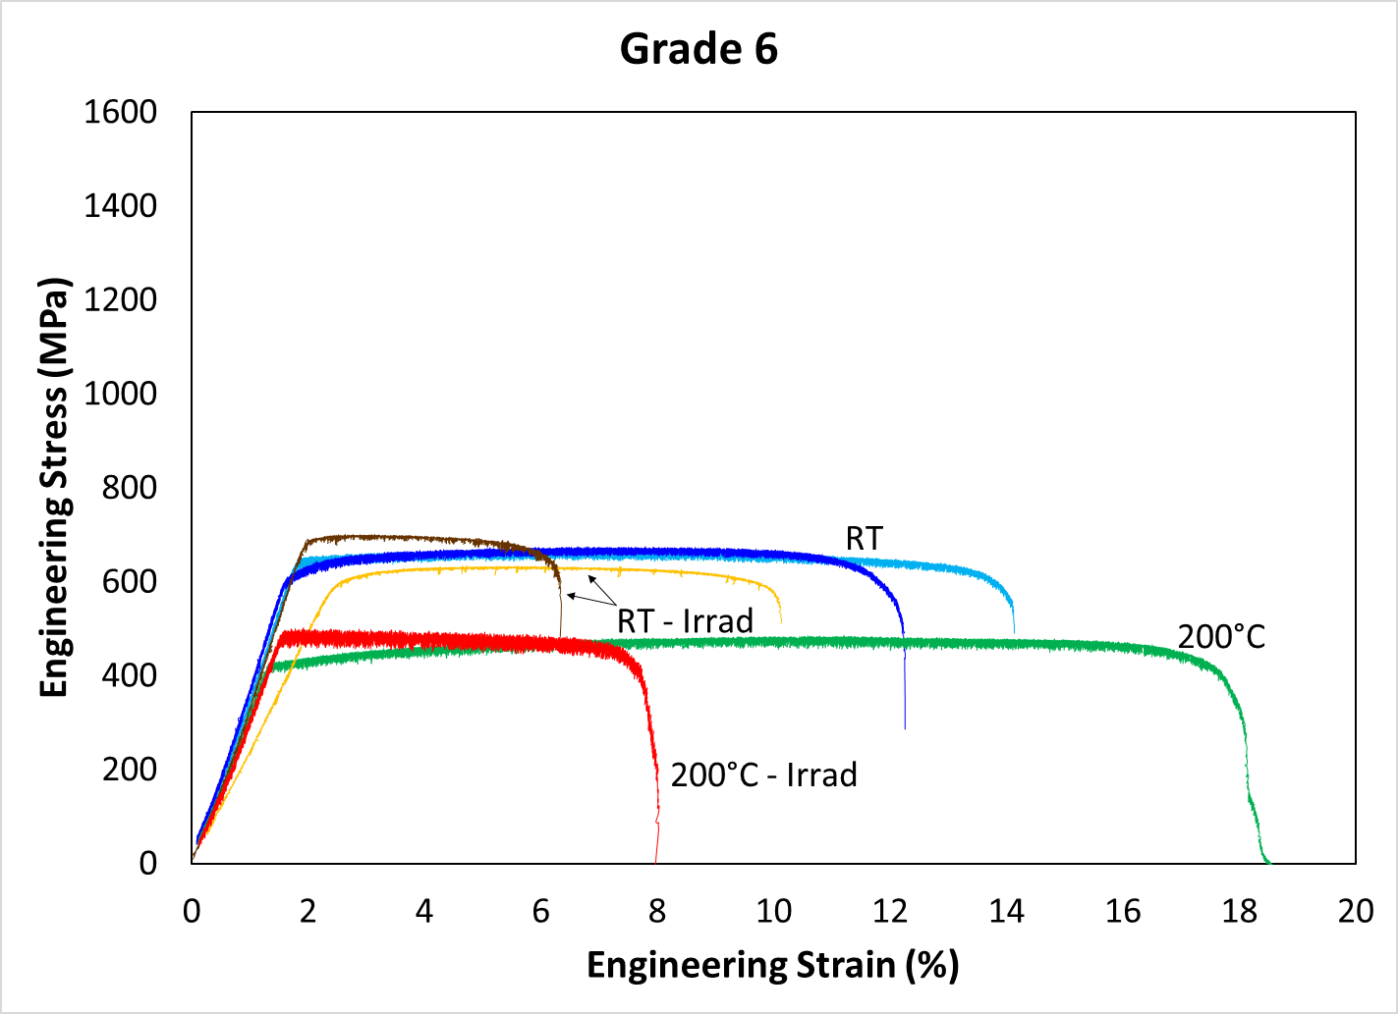
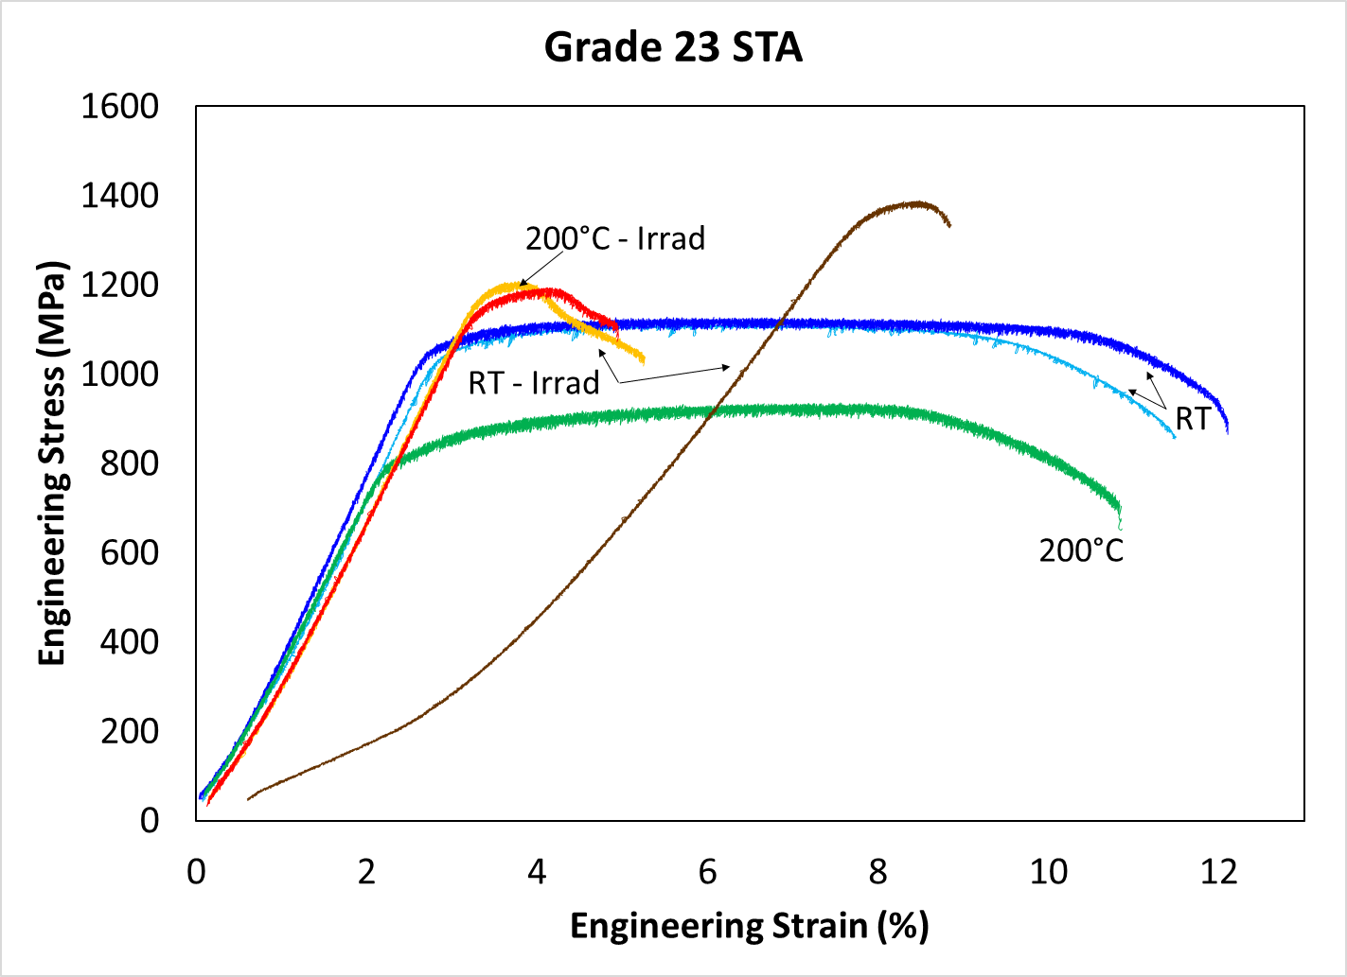
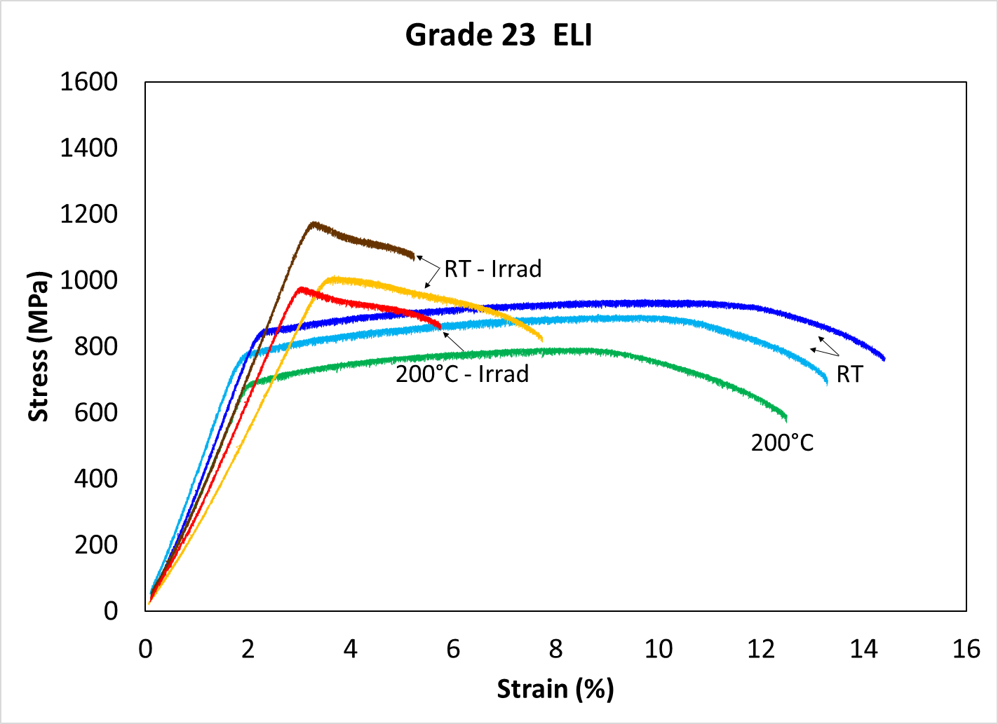
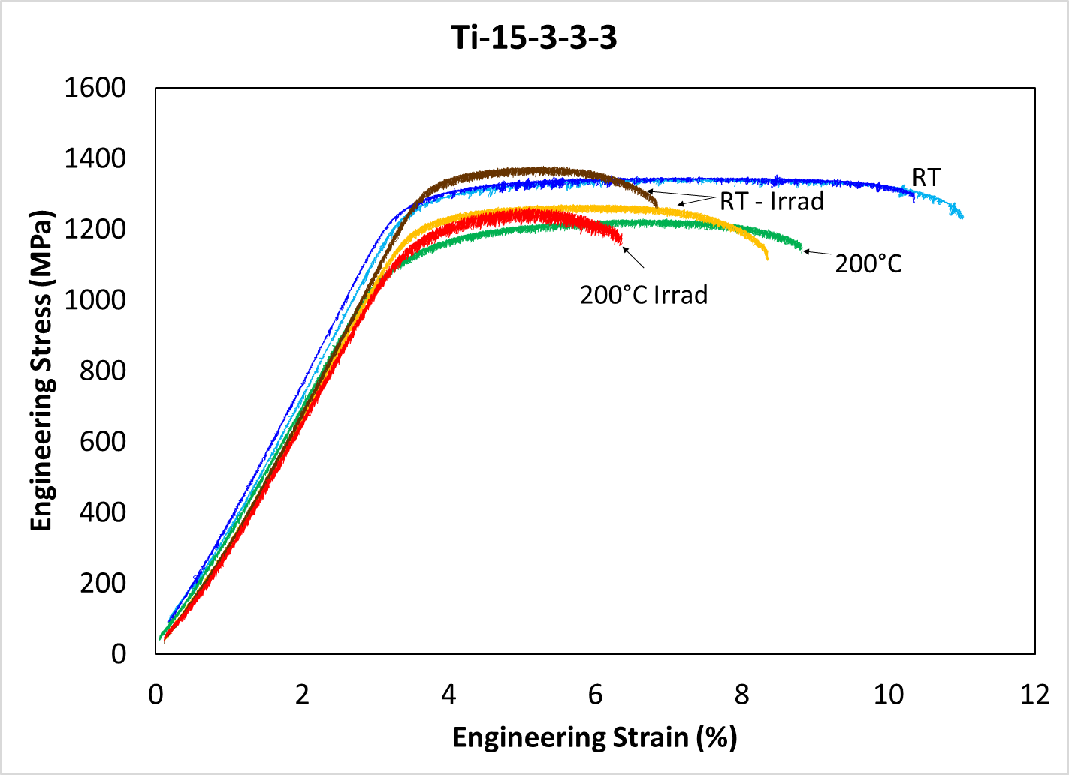
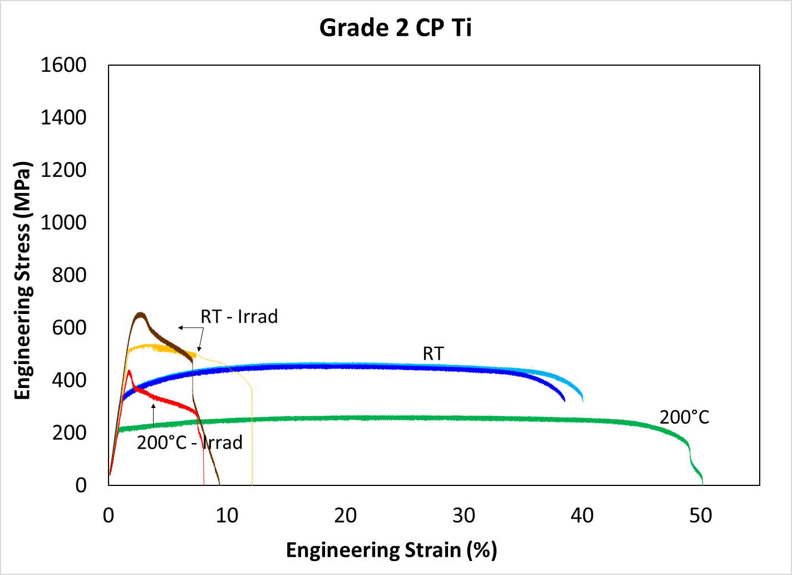
DS-Ti2 Results
(Ti-5Al-2.5Sn)
Near alpha
Alpha Ti
Ti-15V-3Cr-3Sn-3Al (β-Ti)

Slide 9
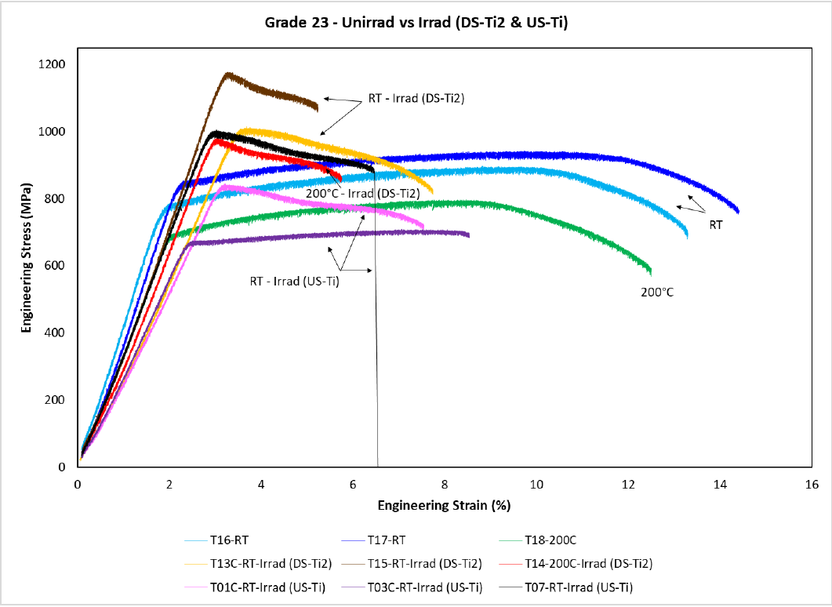
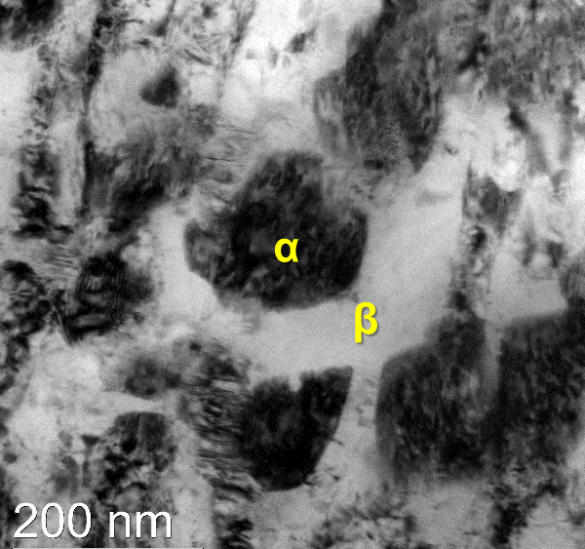
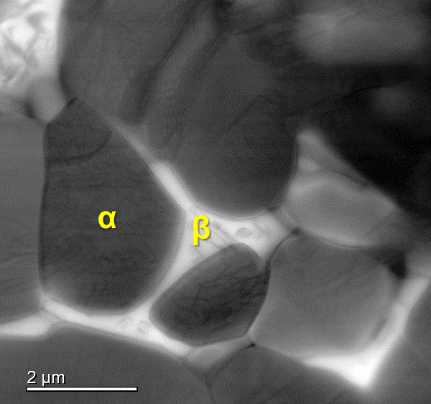
Tensile Response Dual Phase Ti Alloys After Irradiation Dictated by What Phase is Dominant
Primary β with highly strained secondary α
Primary α phase, intragranular β
Ti-15-3 shows a relatively fine grained, highly strained dual β/α microstructure that appears resistant to radiation damage to 1 dpa
Remarkably good tensile behavior, still work hardens with minimal increase in strength
No real evidence of black spot damage in either β or the highly strained α phases
No omega phase evolution in the β phase under irradiation
Gr23 is not as strong, loses its ability to work harden because the single phase, primary alpha forms a high density of black spot damage that leads to localized deformation

Slide 10
Ti Experimental Conclusions
All Ti grades irradiated in the 2018 BLIP experiment have now been investigated
For the doses and temperatures explored thus far, dual β/α phase Ti-15-3-3-3 may be the best candidate
Results indicate a potential pathway toward developing an alloy with further optimized properties to improve strength and ductility that is preserved after irradiation.
BCC Ti evolves dislocation loops/black spot damage more slowly than HCP Ti
Molecular Dynamics modeling indicates that the desirable properties of the Ti-15-3-3-3 may be due to the higher Ti displacement threshold energy and smaller defect cluster formation in the beta phase of the Ti-15-3-3-3.
The Young’s modulus decreased after irradiation for all alloys in this study
The modulus decreased by roughly the same percentage for all alloys
This result is unexpected and still under investigation
The choices of alloys for the BLIP experiment were largely affected by material availability
It is currently difficult to differentiate the phase effects versus the composition effects
A second BLIP irradiation effort utilizing lessons learned from the first could provide details that prove to be very valuable in selecting optimal Ti-base alloys for use as beam windows in future high-power applications.

Slide 11
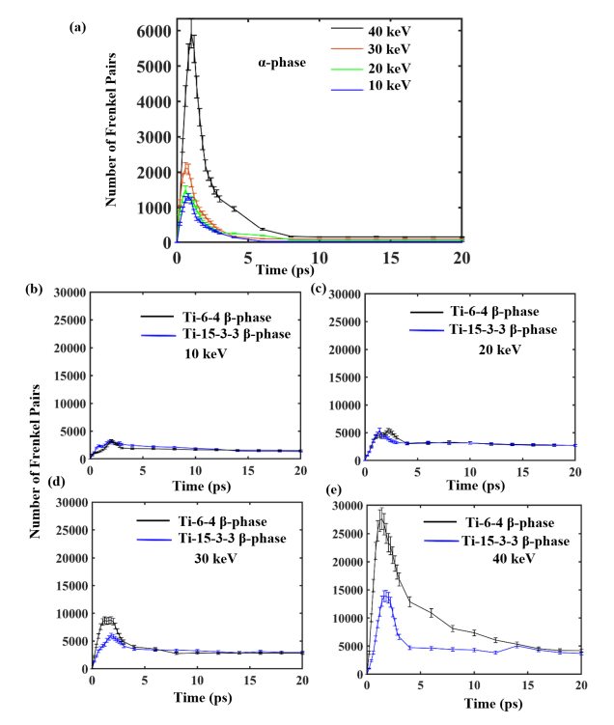
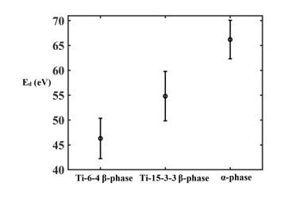
Ti Modeling
The manuscript “Insights into radiation resistance of titanium alloys from displacement cascade simulations” has been submitted to JNM and revisions have been requested.

Slide 12
Beryllium Tensile Tests
Tensile tests were completed in FY19
Tensile data (including ultrasonic modulus measurements) were reported in letter report PNNL-SA-147992, Rev. 1, dated 26 November 2019
Material | Condition | Temperature (°C) | Samples Tested
PF-60 | Unirradiated, Parallel to Rolling Direction | RT | P11, P13, P15
 |  | 300°C | P16, P17, P23
PF-60 | Unirradiated, Transverse to Rolling Direction | RT | P26, P30
PF-60 | Irradiated, Parallel to Rolling Direction | RT | P01, P08, P10
 |  | 300°C | P05, P09, P22
PF-60 | Irradiated, Transverse to Rolling Direction | RT | P27, P29
Material | Condition | Temperature (°C) | Samples Tested
S65-F | Unirradiated | RT | S01, S13, S14
 |  | 300°C | S25, S28, S29
S65-F | Irradiated | RT | S03, S04, S06, S09
 |  | 300°C | S16, S19

Slide 13
Beryllium Bend Tests
Bend tests were completed in April 2023
Bend test data analysis and post-test fractography will be completed in late FY23/early FY24
Material | Condition | Temperature (°C) | Samples Tested
PF-60 | Unirradiated | RT | P16, P19, P29, P30
 |  | 200°C | P21, P23
 |  | 300°C | P01, P02
 |  | 400°C | P24, P25
PF-60 | Irradiated | RT | P03, P04, P05, P20, P22
 |  | 200°C | P08, P28
 |  | 300°C | P12, P26
 |  | 400°C | P26, P27, P30
Material | Cond | Temperature (°C) | Samples Tested
S65-F | Unirradiated | RT | S02, S08
 |  | 200°C | S10, S11
 |  | 300°C | S20, S22
 |  | 400°C | S13, S16
S-65F | Irradiated | RT | S04, S09, S25, S30
 |  | 200°C | S12, S18
 |  | 300°C | S01, S29
 |  | 400°C | S03, S05, S17, S19

Slide 14
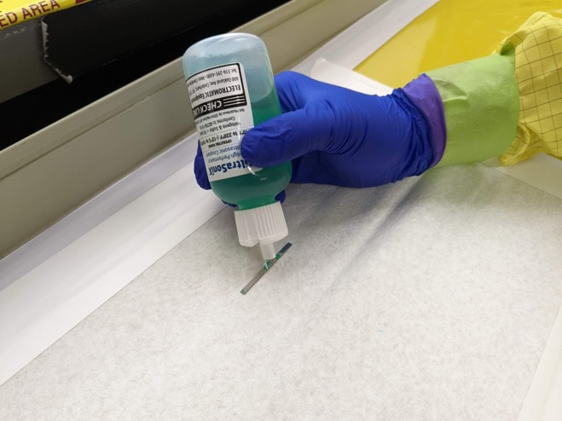
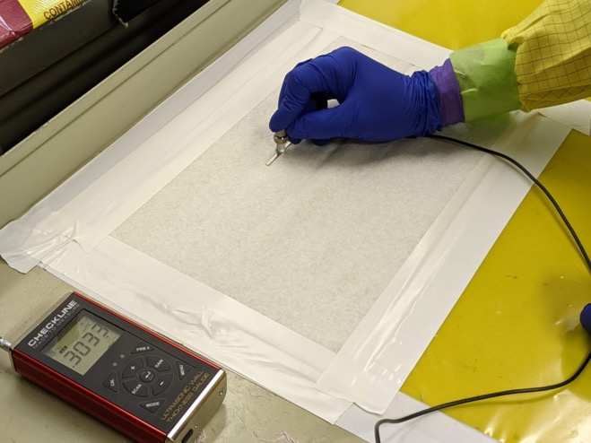
Beryllium Modulus Measurements
Modulus measurements were made on unirradiated and irradiated beryllium bend bars in the hot cell air lock
The results show an 8 – 8.5% increase in modulus after irradiation
Be Grade | Condition | Specimen ID | Sound Velocity (m/s) | Young’s Modulus (GPa) | Average Modulus (GPa) | % Change in Modulus after irradiation
PF60 | Unirradiated | P16 | 13105 | 314 | 310 | 8.06
 |  | P19 | 13101 | 314
 |  | P21 | 13027 | 310
 |  | P23 | 13198 | 318
 |  | P24 | 13081 | 313
 |  | P25 | 12837 | 301
 |  | P29⁺ | 12871 | 303
 |  | P30⁺ | 12924 | 305
 | Irradiated | P3 | 13572 | 337 | 335
 |  | P4 | 13597 | 338
 |  | P10 | 13450 | 331
 |  | P20 | 13535 | 335
 |  | P22 | 13541 | 335
 |  | P26 | 13610 | 339
 |  | P27 | 13547 | 335
 |  | P28 | 13465 | 331
Be Grade | Condition | Specimen ID | Sound Velocity (m/s) | Young’s Modulus (GPa) | Average Modulus (GPa) | % Change in Modulus after irradiation
S-65F | Unirradiated | S2 | 12577 | 289 | 292 | 8.56
 |  | S8 | 12750 | 297
 |  | S10 | 12705 | 295
 |  | S11 | 12593 | 290
 |  | S13 | 12623 | 291
 |  | S16 | 12584 | 289
 | Irradiated | S3 | 13001 | 309 | 317
 |  | S4 | 13209 | 319
 |  | S5 | 13236 | 320
 |  | S9 | 13143 | 316
 |  | S12 | 13208 | 319
 |  | S17 | 13168 | 317
 |  | S19 | 13153 | 316
 |  | S25 | 13168 | 317

Slide 15
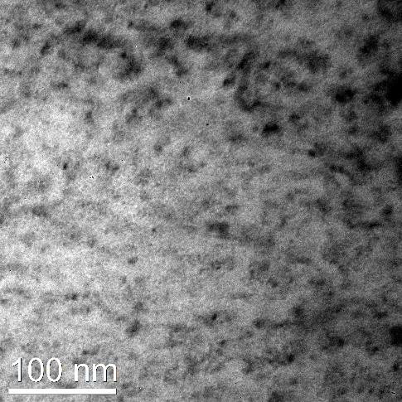
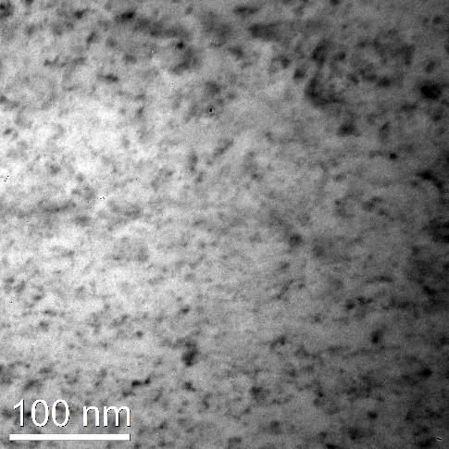
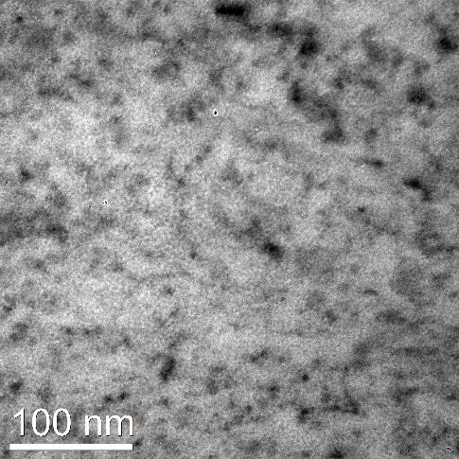
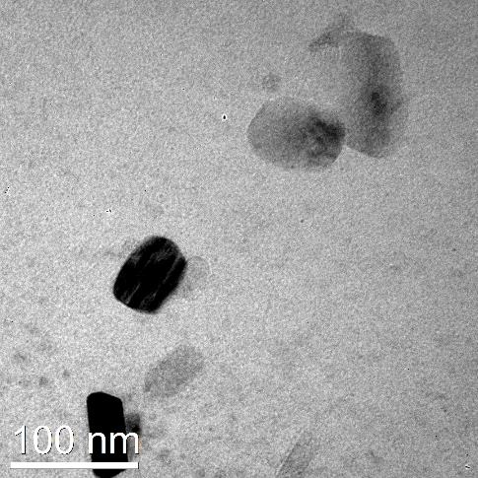
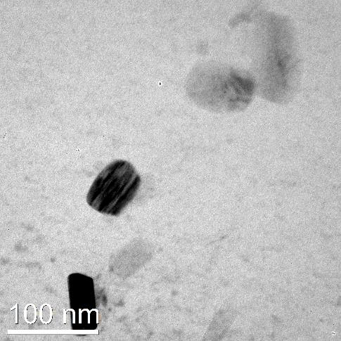
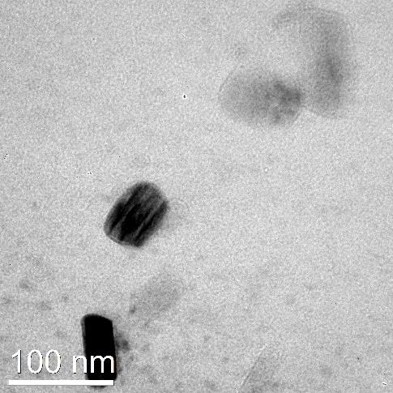
Beryllium Microscopy
U1 (unirradiated UHP Be) used to develop flash electropolishing approach
P01-2mm (PF-60 irradiated at 300C)
Next steps when funds are available
P01-1.5mm (PF-60 irradiated to 490C)
S1 (SF-65 irradiated to 490C)
-2.5 um
At focus
+2.5 um

Slide 16
Future Activities
We are ready to receive HiRadMat 60 samples when we have the additional funding to do so.
We have transferred a draft of the SiC-C/C paper to Makimura-San and hope to complete this for submission soon
Make requested revisions and resubmit the modeling Ti paper in July
Complete the characterization Ti paper and submit it
Perform Be microscopy and work up the Be mechanical properties results and generate a collaboration paper for submission
Continue additional PIE of HRMT and BLIP specimens
Our work will be limited by the funds we will have available to support these efforts
We are planning to receive $48K from Japan
We are planning to receive $75K this year from US

