Slide 1

Measurement of displacement cross section for high-energy protons and future plan for material damage using 400-MeV protons at J-PARC
8th RaDIATE Collaboration Meeting
June 26 – 30, 2023
(J-PARC/JAEA) Shin-ichiro Meigo

Slide 2
Outlook
Introduction of displacement cross section
Measurement of displacement cross section
  J-PARC for 0.4 – 30 GeV
  FNAL for 120 GeV
  CERN for 430 GeV
New facility for irradiation facility at J-PARC
  Aim for irradiation facility
  Multipurpose use for new facility
Summary

Slide 3
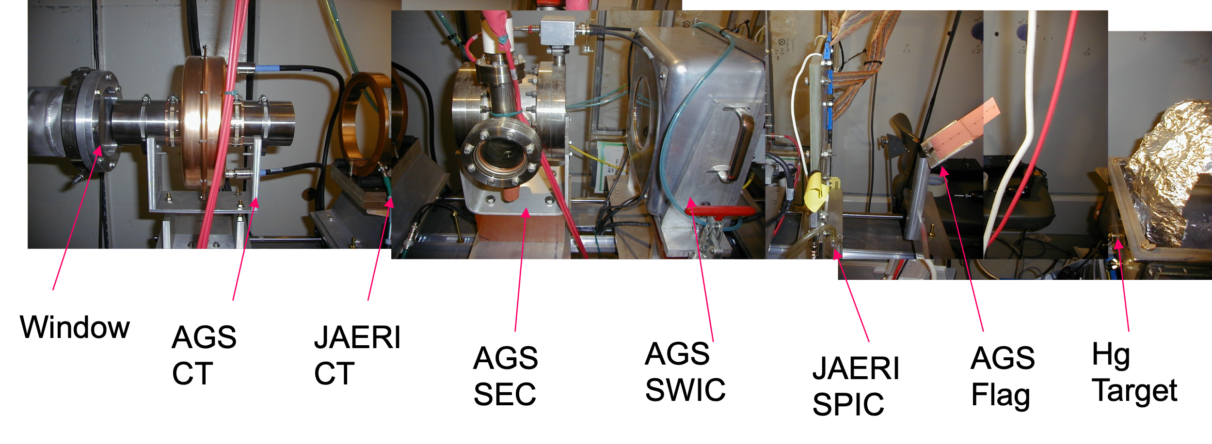
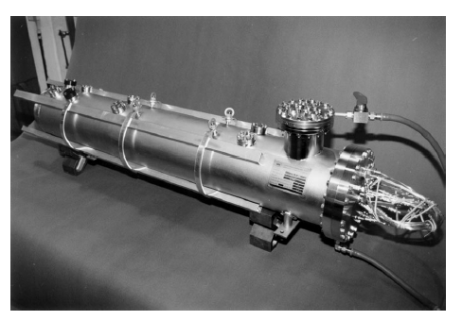
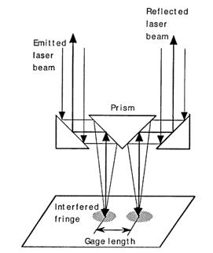
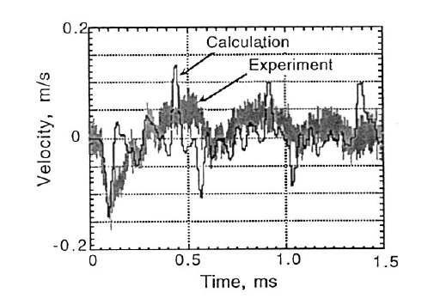
Thank you BNL (ASTE collaboration)
Before start building of SNS, J-PARC, we did experiment using mercury target and proton beam at AGS/BNL as AGS spallation target experiment (ASTE) collaboration.
AGS to RHIC
Beam instruments
Laser Doppler Vibrometer
(LDV)
D 20 cm x L 1.3 m
Mercury target vessel
M. Futakawa, et al., NIM A439 1 (2000)

Slide 4
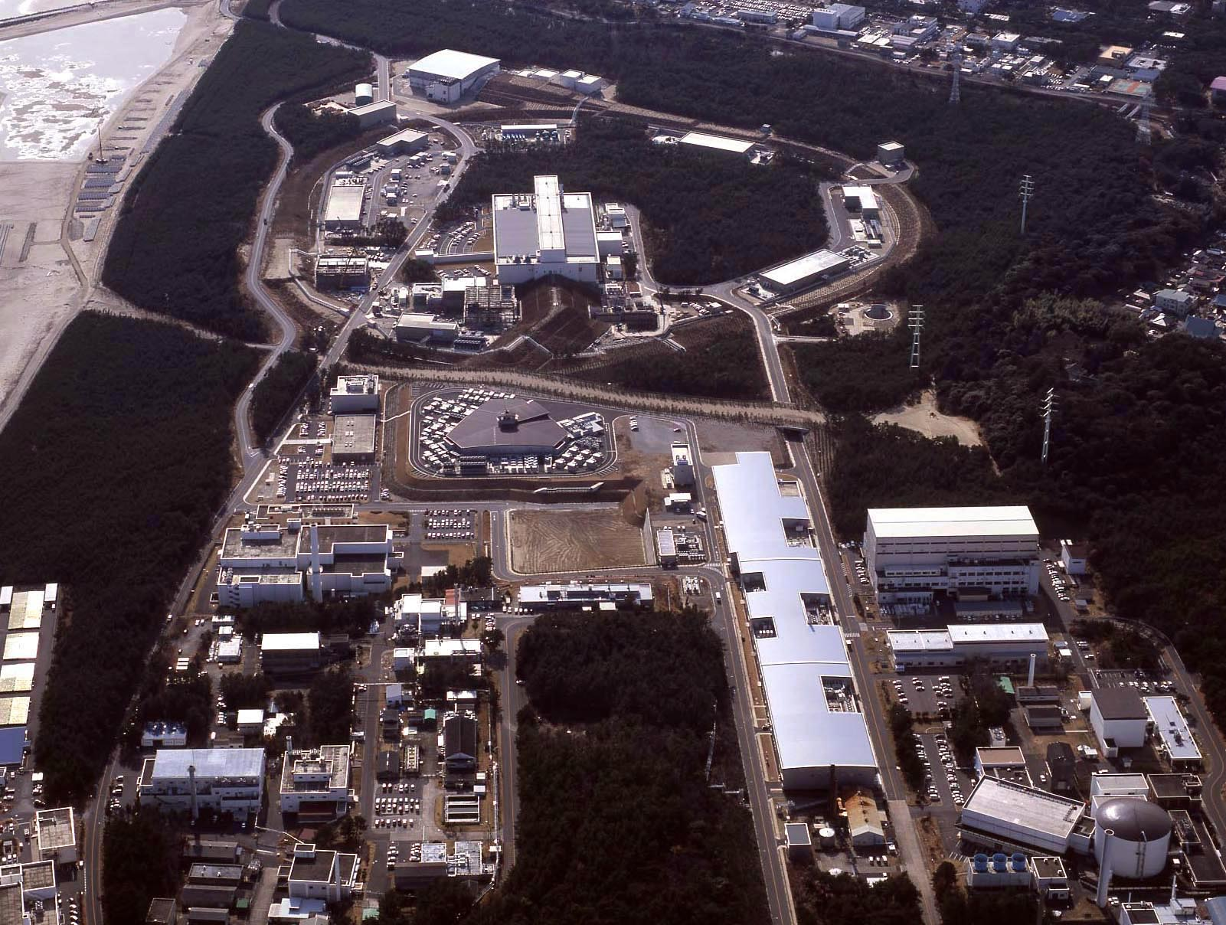

Contents
Hadron Experiment Facility
30GeV Synchrotron
MR (0.75MW)
Introduction of displacement cross section
Measurement of displacement cross section
  J-PARC 0.4 – 30 GeV
  FNAL 120 GeV
  CERN 430 GeV
New facility for irradiation facility at J-PARC
  Aim for irradiation facility
  Multipurpose use for new facility
Summary
Materials & Life Science Facility (MLF)
Bird’s eye photo
3GeV Synchrotron
RCS (25Hz,1MW)
Neutrino Exp. Facility
(294km to Super KAMIOKANDE)
Transmutation
Facility (TEF)
(Phase II）
Linac
400MeV(50mA)
JFY2007 Beam
JFY2008 Beam
JFY2009 Beam
JRR-3M
800m to MLF
Neutron beam lines (23)
J-PARC = Japan Proton Accelerator Research Complex

Slide 5
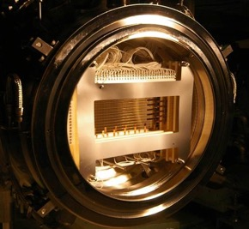
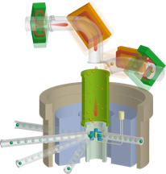
Introduction
Damage estimation is crucial to structural materials such as beam windows and targets used in high-intensity proton acceleration facilities (ADS, spallation neutron source).
ADS proposed by JAEA
Beam power 30 MW
1.5 GeV, 20 mA
Pb-Bi target
Proton beam window： Al alloy
(J-PARC neutron source at MLF)
Beam window： Ti alloy
(J-PARC Neutrino facility)
Proton
1.5 GeV
Proton
3 GeV
Proton
30 GeV
W target: J-PARC TS2 for neutron and muon (Planned)
Displacement of atom
Window
Proton injection

Slide 6
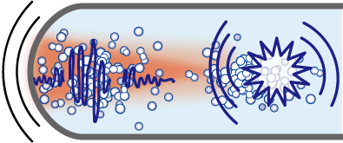
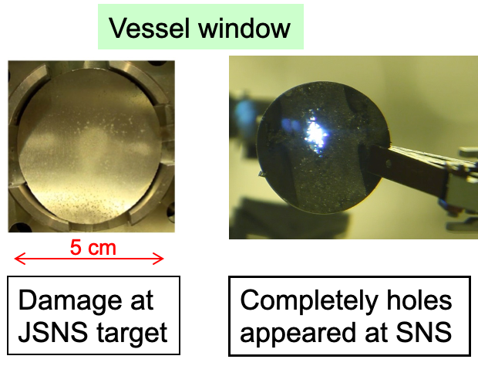
Neutron prod. target vessel
Mercury (Hg) target vessel has a pitting erosion due to the high-pressure wave.
Tentative radioactive storage getting narrower
  The vessel is going to be used for 2 years instead of 1 year.
Mercury vessel
Beam window (2.5 mm-t)
Most vulnerable to cavitation damage
Cavitation bubble
Mercury
Bubble inflates by the mercury negative pressure.
Abrupt heating of mercury
Wall
Thermal expansion
Cavitation bubble shrinks rapidly.
Pressure wave
Wall
Micro-jet
Shrink energy concentrates to one point

Slide 7
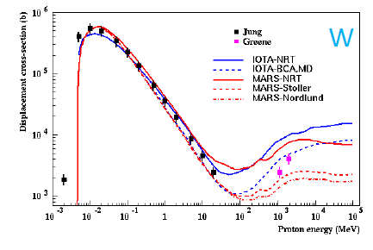

Displacement cross section (X-sec)
dpa (displacement per atom)：
Widely used as damage index for fission
and fusion reactors, and accelerator fac.
dpa = Fluence x displacement X-sec
Lack of data above 20 MeV: Difficult validation of calculation models
⇒ Experiments started at J-PARC
Displacement cross section：
Following Matthiessen's low obtained by observation of electrical resistivity [Ω/m].
To sustain the damage in sample, cryocooling is required for T < 20 K.
N. Mokhov, HPTW2016
σ(E): Displacement cross section [b]
Δρ： Change of resistivity [Ω/m]
Φ: Fluence of incident protons [/cm²]
ρ_{f}: Resistivity change by Frenkel pair [Ω/m]

Slide 8
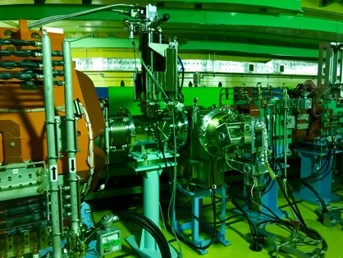
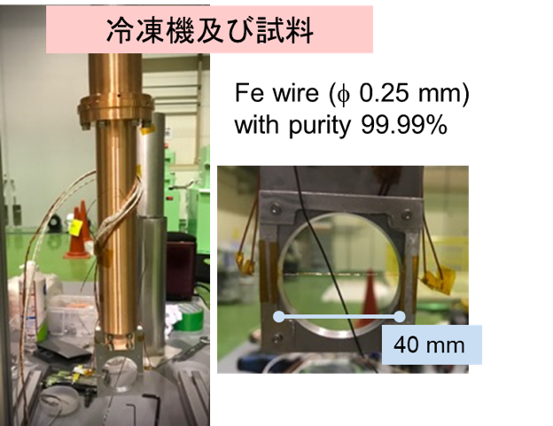
Displacement cross section at J-PARC
Instruments equipped upstream of beam dump for 3GeV synchrotron (RCS Rapid Cycling Synchrotron) : available various kinetic energy of proton 0.4~3 GeV
  Precious beam turning and monitor (beam scanning made for alignment)
  Achieved ~4 K (but used ~8 K to maintain normal conducting at sample)
From 3GeV RCS
To MLF
Beam dump
Equipped vacuum chamber with GM cooler
Cryocooler and sample
To obtain precious resistance
4 electrodes applied
Nb wire (Φ 0.25 mm) 99.9%
Beam
V+
V-
I+
I-
1 m
Sample wire

Slide 9
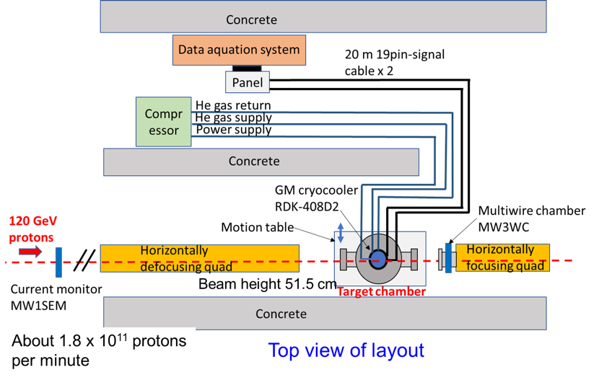
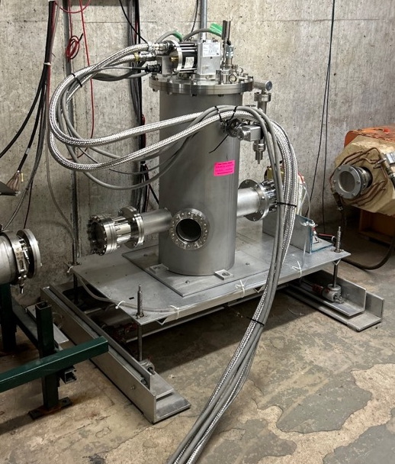
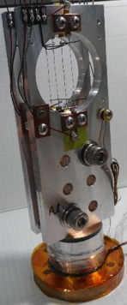
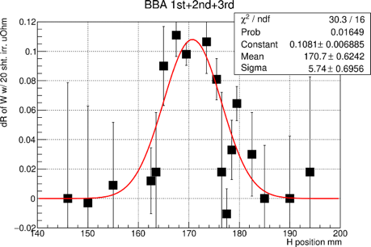
Experiment at FNAL
Similar manner of J-PARC experiment was applied at Fermilab Beam Test Facility (FTBF) M03.
GM cooler RDK-408D2
Horizontal beam position and width were scanned by using motion table.
I+
V+
V-
I-
Thermometer
1 m
Al plate

Slide 10
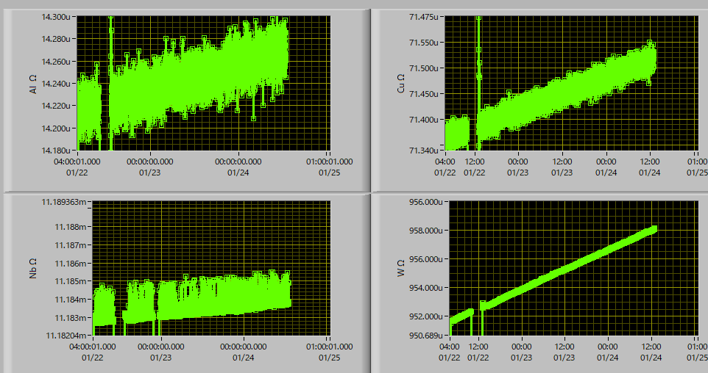
Electrical resistance change
Al
Cu
165 nΩ for 6.4×10¹⁴ protons
68 nΩ for 6.4×10¹⁴ protons
Nb
W
1.2 μΩ for 6.4×10¹⁴ protons
Thermal jump?
7.3 μΩ for 6.4×10¹⁴ protons
Electrical resistance changes of metals at 8 K under 120 GeV proton irradiation

Slide 11

Disp. X-sec calculation in PHITS
Displace number
i : particle species
Cross section given by PHITS
  Widely utilized Norgett-Robinson-Torrens (NRT) model
  arc-dpa model
    Nordlund and Konobeyev’s parameter applied
arc: Athermal Recombination Correction
Displace number by NRT model (N_{d})
Displace number by arc-dpa model (N_{d arcdpa})
T_{d}: Displacement energy
For ramp region T_{d}> 2E_{d}/0.8,
the difference between the two models is a factor of 1.5.
ramp
Displacement number
N_{d} [Number]
Nb
E_{d} 78 eV
x 1.5
arc-dpa: instantaneous recombination at cryogenic
Displacement energy T_{d} [eV]

Slide 12
Comparison with calculation
Similar tendency of NRT and arc-dpa calculation for Ep<120 GeV
Nb ??
Hopefully try to measure by another chance
H. Matsuda, JNST 57 1141 (2020)
S. Meigo, EPJ Web of conf 239 06006 (2020)

Slide 13
Ep 430 GeV at HiRadMat in CERN (plan)
Borrowing vac. chamber and cryocooler used at HiRadMat
Experiment in 2024

Slide 14
  New facility for beam irradiation at J-PARC

Slide 15
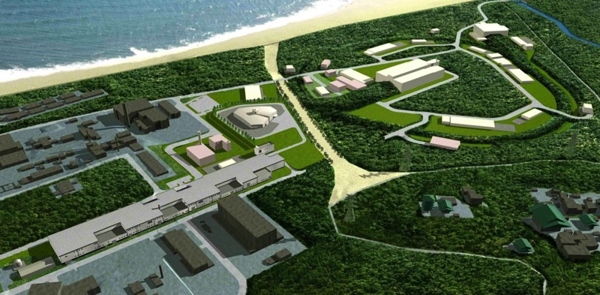
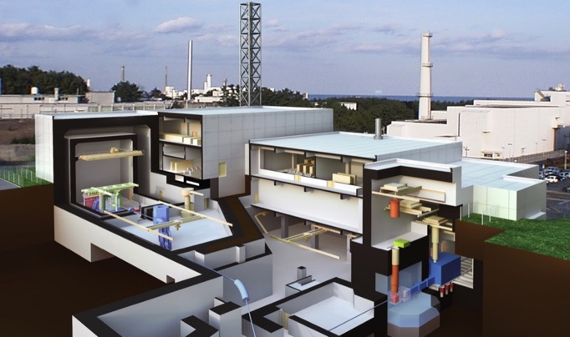
J-PARC TEF/ADS Project
Transmutation Experimental Facility
HD
ADS Target Test Facility (TEF-T)
Investigate engineering characteristics of LBE spallation target
400MeV-250kW Proton Beam
LBE Temperature 500℃_{max}
Oxygen Potential Controlled
Hot Cell for PIE samples preparation
RCS
NU
MLF
MR
LINAC
LINAC: Linear accelerator
RCS： Rapid Cycling Synchrotron 3 GeV synchrotron
MR: Main Ring
MLF： Material Life Science Experimental Facility
HD: Hadron experimental facility
NU: Neutrino experimental facility
TEF-P
TEF-T
Notes:
In the J-PARC, we are trying to build up the TEF, transmutation experimental facility to develop the ADS.
As you know already, the TEF is divided into two fields:
One is a target facility and another is Physics facility.
This facility is do the engineering experiments relating to target technologies and physics on subcritical core.

Slide 16
Overview of TEF-T
ADS Target Test Facility : TEF-T
Isotope separation on-Line (ISOL) and belonging 2nd target were planned. Those are eliminated in the new plan.
TEF-P beam transport is no needed.

Slide 17
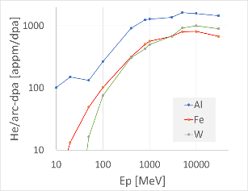
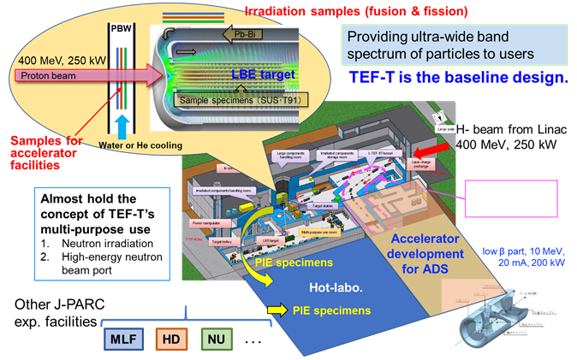
J-PARC proton beam irradiation facility
Proton beam irradiation facility planned at J-PARC
  H⁻ beam 0.4 GeV, Power >250 kW with 25 Hz
  Dose >20 dpa/year at the Pb-Bi (LBE) target
User communities established for multi-purpose
  Head of mat. irradiation: Makimura-san
With 0.4 GeV proton, sample receives equivalent He/dpa for high energy region.
²³²Th(p,X)²²⁵Ac
Building Hot-lab is also planned for PIE
Multi-purpose use
1. Irradiation fac.
2. Neutron for soft error
3. RI medicine ²²⁵Ac
4. Space env. use
Low int. H⁺ extracted by LASER
Proton for space env. use
ADS: accelerator driven system
TEF-T: ADS Target Test facility
(JAEA Tech 2017-3)

Slide 18
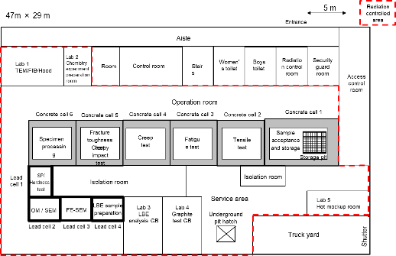
Hot lab for PIE
For the PIE of the samples irradiated at new facility, a new hot lab is planned to be constructed adjacent to the new facility.
Due to difference of the law regarding to irradiation sample environment, PIE has not been performed at J-PARC.
  JAEA: Radio Isotope
  J-PARC: Activated materials
J-PARC needs hot lab for PIE not only for MLF, but also other facilities of T2K and hadron.
Allowing to dismount MLF’s target vessel for mercury
Cells for PIE
- With manipulators
Specimens placed at LBE target will be transferred to cells by the channel located at underground.
We will minimize the space of the hot lab to reduce the cost.

Slide 20
Variate of irradiation circumstance
LBE target
High-energy accelerator and fusion users were excavated by attending their conference

Slide 21
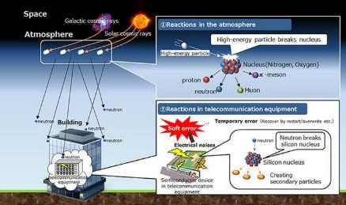
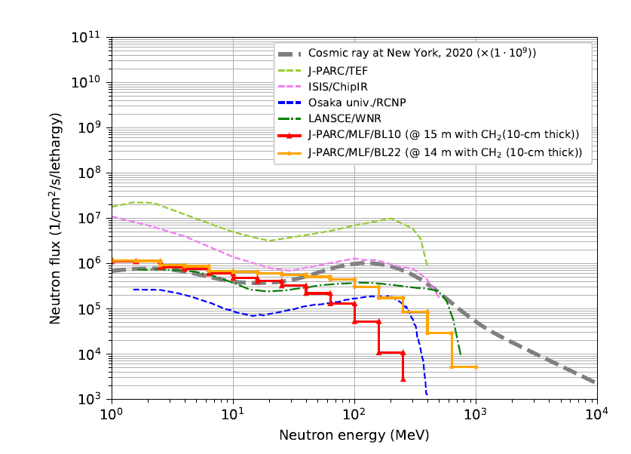
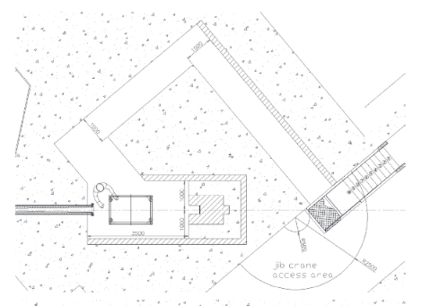
Soft errors and semiconductor
Hitachi web page
Neutron beam profile
Φ0.2 m
Neutron beam line
w/o moderation
Highest cosmic neutron can provide.

Slide 22
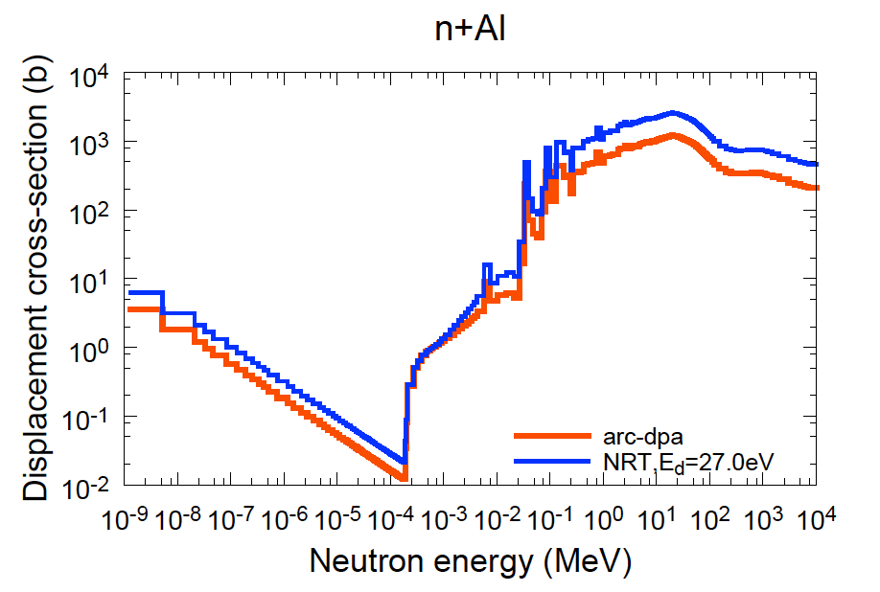
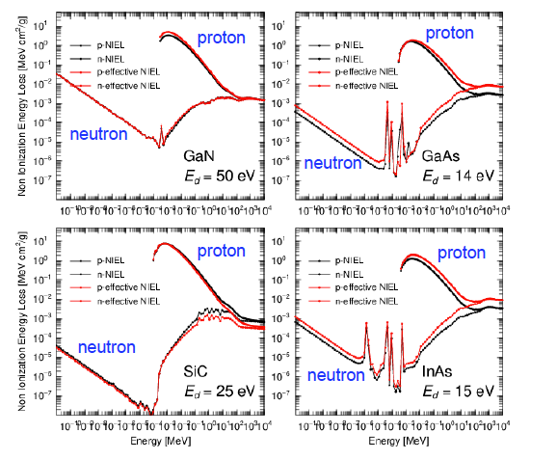
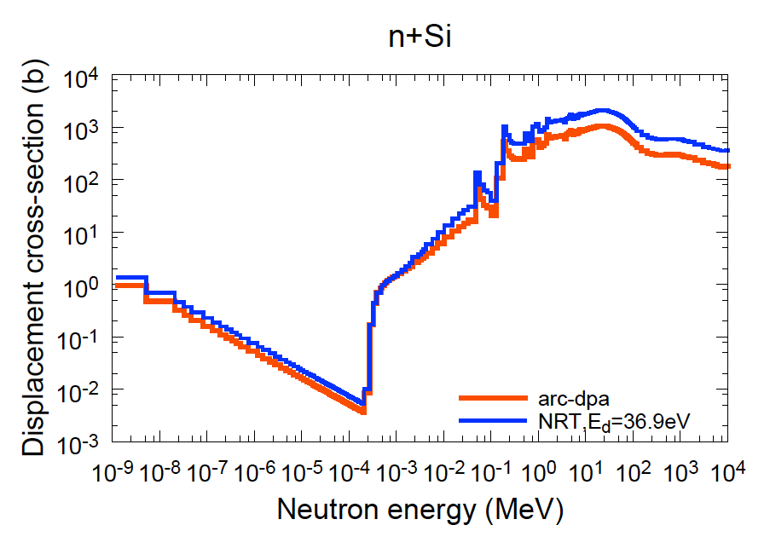
dpa and Single Event Upset (SEU) at semiconductor
Displacement X-sec
NIEL: Non Ionization Energy Loss
= SEU cross section
Recoil of capture gamma (1/v behavior)
Very simulator behaviors for projectile energy

Slide 23
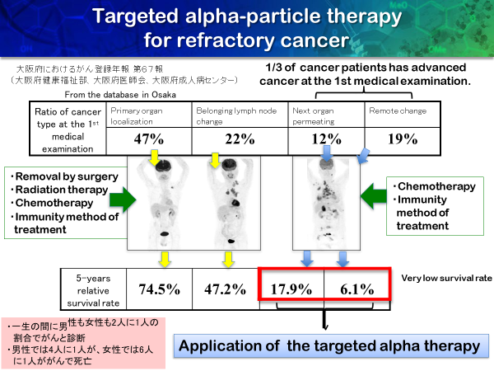
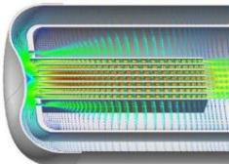
RI medicine production
Production of RI for medicine for TAT
α-emitting nuclides such as ²²⁵Ac (T_{1/2} 10 d) play important roles.
²¹¹As production was promoted at RCNP and RIKEN using ²⁰⁹Bi(α,2n)²¹¹At reaction.
²³²Th target
(Φ110 – 60 mm x L 5mm)
LBE
²²⁵Ac production from ²²⁶Ra
~ 0.1TBq/year

Slide 24
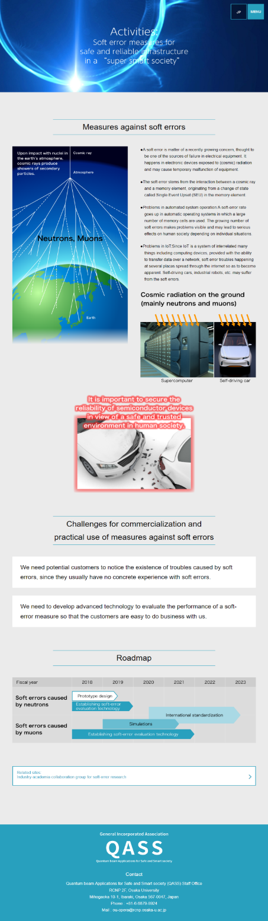
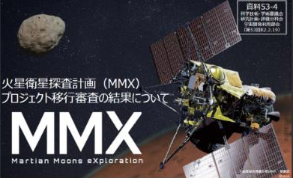
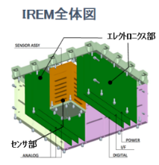
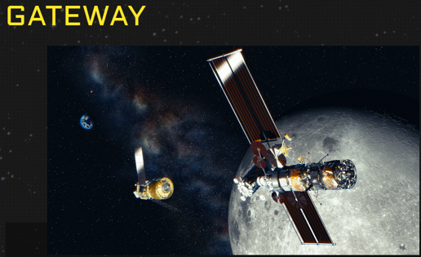
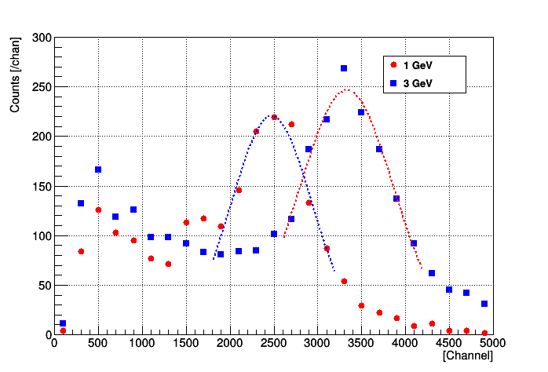
Proton for space use
To enhance the construction of the new facility, we explore the multi-purpose use for use of proton with low intensity, as well.
Japan Aerospace Exploration Agency (JAXA): MMX (MMX: Martian Moons Exploration) Launch 2024 and return to earth 2029
CHARMS (Charging and Radiation Monitors for Space weather) by NICT
Interplanetary Radiation Environment Monitor (IREM)
NICT: National Institute of Information and Communications Technology
Experiments made at RCS beam dump
J-PARC with JAXA and NICT conducted the experiment at 3NBT.
Laser charge exchanger in new facility make it possible more frequently

Slide 25
Summary
120-GeV proton displacement cross-section:
  Successfully obtained the experimental data
  arc-dpa : good agreement with experiment except for Nb (Hopefully, retry in the future)
  NRT: Overestimate similar to the results for Ep < 30 GeV.
New facility:
  User community was established not only for material irradiation but also soft error and RI medicine.
  Since their demand is important to build the new facility, we are going to stimulate the activate among the communities.
  User community established (member ~250 persons)
  Technical Advisory Committee requires international user community. Please join this community!

Slide 26
Supplement

Slide 27
Comparison of Nb X-sec for neutron incident
With similar manner, data for 14-MeV neutron was deduced from the LLNL experiment.
M.W. Guinan et al., JNM 108&109 95 (1982)
PHITS code
KIT evaluation
NRT and arc-dpa showing agreement with experiment within error
NRT： Overestimation 50%
arc-dpa： good agreement
Neutron results similar to proton E>100 MeV：
proton incident （nuclear force + Coulomb force)
⇒ Showing applicability for high energy region neutrons

Slide 29
Workshop for Facility Planning
Workshop on “J-PARC Proton Beam Irradiation Facility Plan and Launch of User Community”
Host: J-PARC Center
Date: July 28, 2022, 13:00−16:00
Style: in-person @J-PARC + on-line (hybrid)
Purpose
  To discuss status of the facility planning and the possibility for versatile needs
  To launch a user community for supporting the facility planning and clarifying versatile needs
Agenda
Opening H. Oigawa (JAEA director)
Nuclear transmutation K. Tsujimoto (JAEA)
Facility design update F. Maekawa (J-PARC)
Needs from materials irradiation S. Makimura (KEK)
Needs from proton beam applications K. Otsuji (NICT)
Needs from Medical RI production K. Nagatsu (QST)
Needs from soft error testing K. Kobayashi (Kyoto I. T.)
Discussion, Launch of user community all
Closing T. Kobayashi (J-PARC)
Participants:
In-person 14
On-line 119
Total 133
J-PARC 35
JAEA (non J-PARC) 19
KEK (non J-PARC) 7
University 14
Research institute 19
Industry 36
Others 3
Findings
In addition to the nuclear transmutation research, it turned out that there were high expectations for the facility that could use the J-PARC’s high-intensity proton beam at J-PARC.
The user community for the experimental facility was launched.

Slide 30
TEF-T specification
Already Technical Design Report has been published to JAEA report.

Slide 31
Hot lab for PIE
For the PIE of the samples irradiated at new facility, a new hot lab is planned to be constructed adjacent to the new facility.
Due to difference of the law regarding to irradiation sample environment, PIE has not been performed at J-PARC.
  JAEA: Radio Isotope
  J-PARC: Activated materials
J-PARC needs hot lab for PIE not only for MLF, but also other facilities of neutrino and hadron.
Furthermore, MLF probably requires to dismount the large target vessel for mercury using laser, which will be one of option of dismount stratage.
Cells for PIE
- With manipulators
Specimens placed at LBE target will be transferred to cells by the channel located at underground.
We will minimize the space of the hot lab to reduce the cost.

Slide 32
Soft errors and semiconductor
Hitachi web page
For soft error and semiconductor
For application of space environment

Slide 33
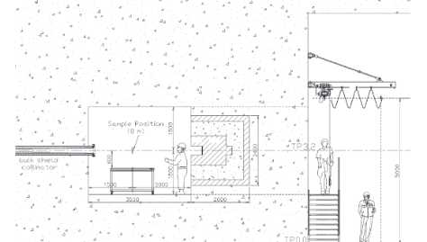
Neutron beam line at new facility
Horizontal view
Vertical view
JAEA Tech. 2017-003
Low
dose
Neutron beam profile (calculation)
Φ200 mm (Plan to expand the beam
User wants low dose area by the irradiation samples to prevent from soft-error of their instruments for data acutorsion.

Slide 34
Proton use
To enhance the construction of the new facility, we proceed to explore the multi-purpose use for use of proton with low intensity, as well.
Japan Aerospace Exploration Agency (JAXA): MMX (MMX: Martian Moons Exploration) Launch 2024 and return to earth 2029
CHARMS (Charging and Radiation Monitors for Space weather) by NICT
Interplanetary Radiation Environment Monitor (IREM)
NICT: National Institute of Information and Communications Technology
JAXA and NICT asked to use the GeV protons with low intensity.
Primary beam usage is difficult to simultaneously provide the beam to other facilities. Method using secondary protons produced by scattering at the beam dump window was developed.

Slide 35
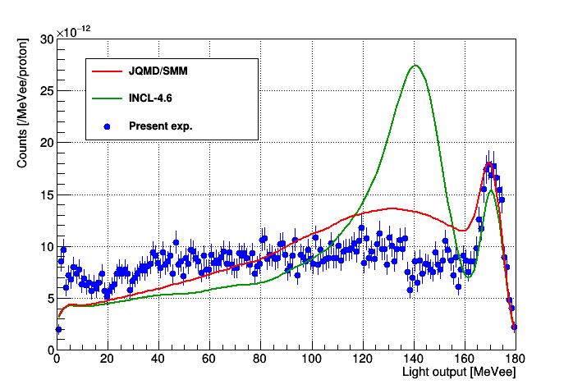
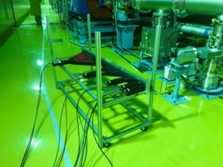
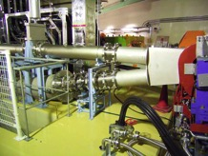
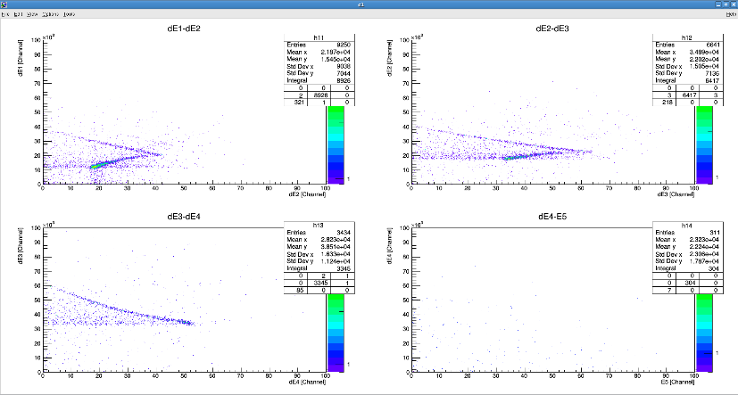
Examination use of protons at atmosphere
To boost up multipurpose activities, we continued the work at 3NBT dump.
Energy spectrum of protons emitted from the beam dump window (Al) was successfully obtained as function of response function of scintillator.
Obtained energy spectrum of secondary proton spectrum emitted to air at J-PARC 3NBT for the case of 0.4-GeV protons irradiation.
Spectrum of detector #4 for Ep 0.4 GeV
Plastic scintillators □50 mm
3NBT Dump at RCS
Total leng.
1.45 m
14 m at 13-deg for beam direction
Al-window (0.3 mm-t)
Cherenkov counter response
Obtained proton spectrum
NICT already made experiments. JAXA will do experiment in March.
They want to vary the energy less than 0.4 GeV. At the new facility, the degrader may permit us.
As for validation of nuclear data, the new facility will play the role.
dE3 [channel]
Proton band
E4 [channel]

Slide 36
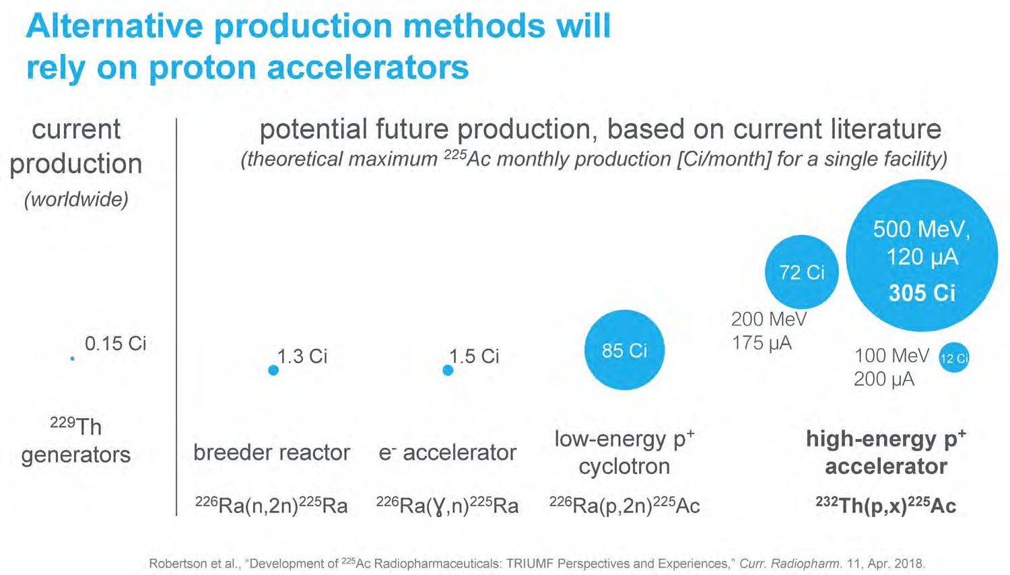
・Target: Th-232 ～8g
・Beam: ～70 μA, 480 MeV proton
・Irradiation： 25 mAh/target
・Product： Ac-225, Ra-225
2,664GBq
11,285GBq
5.5GBq
48.1GBq
55.5GBq
3,145GBq
444
GBq
²²⁵Ra (15 d) → β→ ²²⁵Ac (9.9d)
This slide is reproduced and slightly modified by the courtesy of Dr. P Schaffer and Prof. H Fukuda, and Prof. T Nakano
In Japan, no explicit plan of Ac-225 production so far
New facility has the capability to produce Ac-225 at a level of several hundred GBq by using the proton beam halo in front of the LBE target.

Slide 37
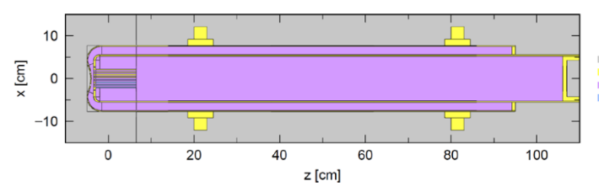
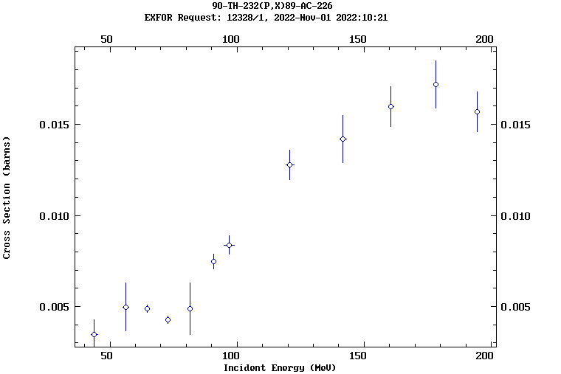
Estimation of Ac-225 production at new facility
²²⁵Ac : TRIUMF produced already
²³²Th target（1 mmt, Φ110 - 60 mm, 78 g)
Irradiation 25 kW beam(10% of overall)
²³²Th (p,x)²²⁵Ra cross section [mb] for Ep 438 MeV
※ Law of small amount of nuclear fuel Th < 0.9 kg
※ Detail target design under consideration
Exp. | PHITS calc.
4.2 | 5.1
Production estimation with ²³²Th 1-mmt target
400 h (～2 weeks) enough
²²⁵Ra
²²⁵Ac* ~2 GBq
from ²²⁵Ra
Available ²²⁶Ra production?
²³²Th(p,x)²²⁶Ra exp
PHITS calc for 0.4 GeV
0.025 barn
⇒ ~10 μg
※J-PARC operation：5000 h/year
5 mmt Th ~10 GBq/mon. ⇒ ~100 GBq/year
Note： Reactor (JOYO) ²²⁶Ra 2 g ⇔ 24 GBq/60d
Insufficient production of ²²⁶Ra
Availability Tb production like CERN?

Slide 38
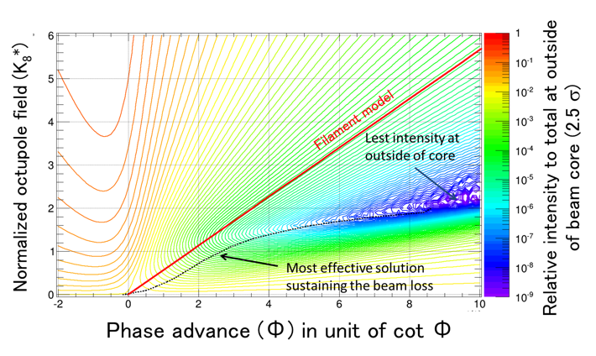
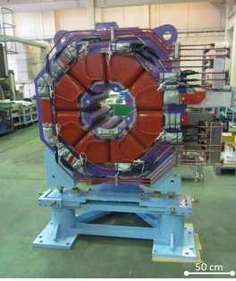
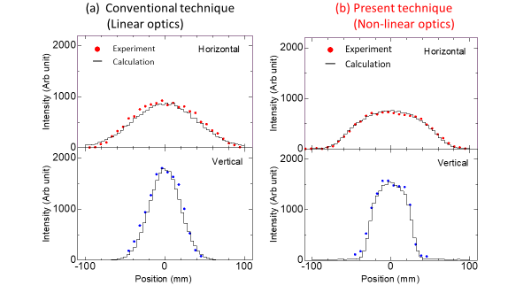
Beam optics using nonlinear optics at MLF
Optimization of the parameter for peak reduction and beam loss
Development of High Intensity Proton Beam Control Technology at J-PARC
Beam shaping using nonlinear optics reduces target damage and contributes to safe operation
Octupole magnet
Press release on July 21 2020
S. Meigo et al., “Two-parameter model for optimizing target beam distribution with an octupole magnet”, PRAB (2020)

Slide 39
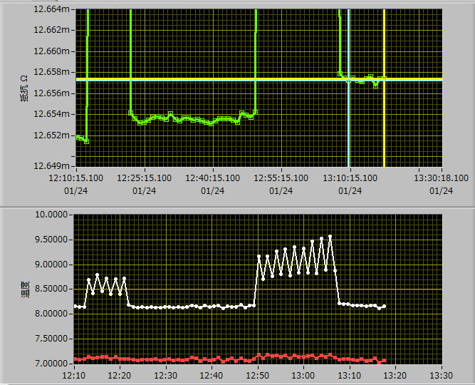
Experimental results of displacement X-sec
Cross section for 0.4, 0.8, 1.3, 2.2 and 3.0 GeV protons were observed.
- Proton beam repetition rate ~ 1 Hz
Resistivity and temperature during irradiation
Δρ (resistivity): ΔR x L/A
L, A: sample geometry
Φ (proton fluence)：
observed by beam monitor
ρ_{f} : resistivity change by a Frankel pair
Resistance [Ω]
ΔR
4 μΩ
Tk [GeV] | Experimental result [b]
0.4 | 1920±455
0.8 | 2140±508
1.3 | 2390±568
2.2 | 2250±534
3.0 | 2550±606
Temp. [K]
Error is dominated by resistivity change for a Frankel pair creation.
ρ_{f} = 14 ± 3 Ωm

Slide 40
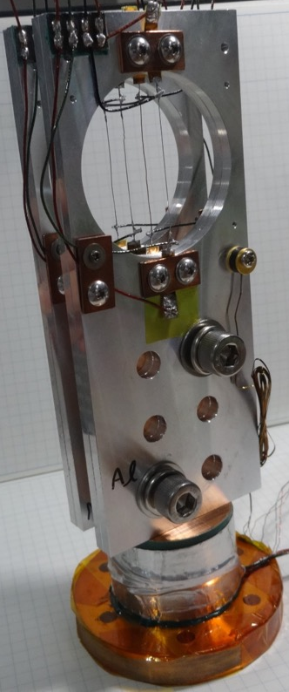
Sample assembly
I+
Al, Cu, Nb, and W wires with 0.25 mm diameter and 40 mm length were fixed to aluminum plate.
Electrical resistance measurement using delta-mode 4-terminal method with suppressed thermoelectromotive force.
V+
V-
I-
Thermometer
V+
Nano-voltmeter
V-
2182A Keithley Inc.
Four point technique
Al plate
I+
Source:6221
PC
Labview
I-
±10-100 mA
Sample assembly
Data taking system

Slide 41
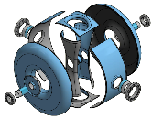
Role of niobium (Nb) material in accelerator
Superconducting accelerator: Mainly used Nb
JAEA-ADS accelerator (1.5 GeV, 20 mA)
SC magnets:
Neutrino facility at J-PARC
Normal conducting
Super conducting (SC)
B. Yee-Rendon et al., Phys. Rev. Accel. Beams 24, 12010 (2021)
Prototype for ADS: Nb
（Spoke: SSR)
J-PARC COMET
SC solenoid
- Data of Nb for proton projectile are required.

Slide 42
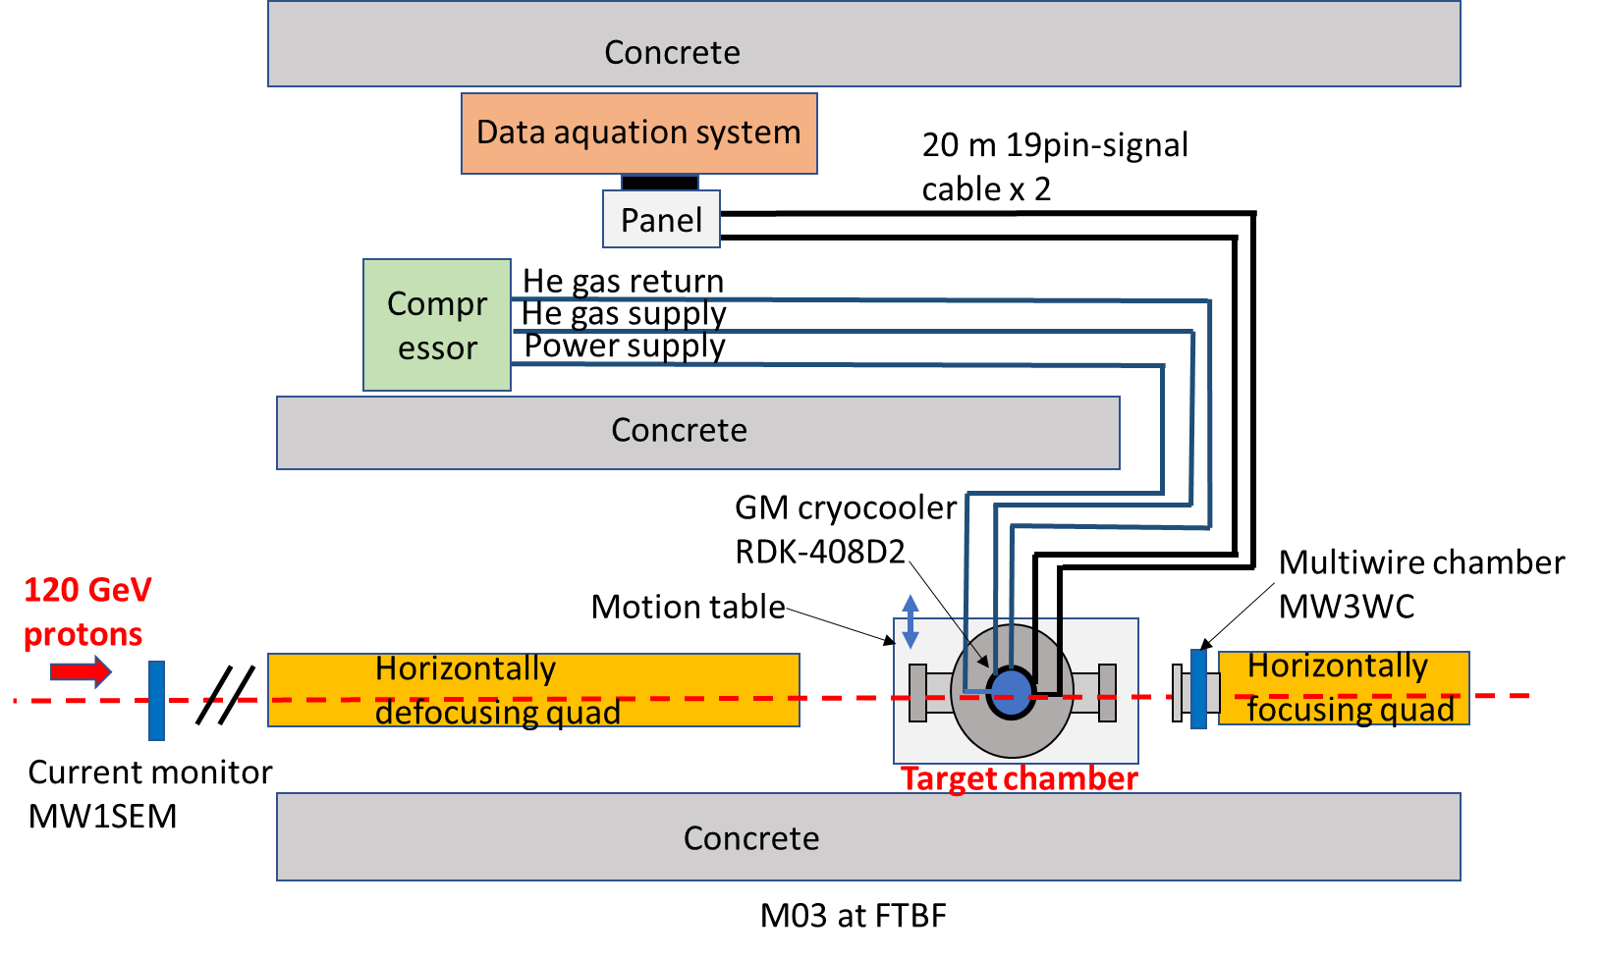
Equipment layout in FTBF M03
Beam height 51.5 cm
About 1.8 x 10¹¹ protons per minute
Top view of layout
42

Slide 43

Layout (cont’d)
Same as T-TAC6
J-PARC
Linac
Electricity yard
(prohibiting to use underground)
To avoid conflict at here, as the first step design, we skip to be shorten beam transport about 35 m.
Hot Lab.61 mx43 m
Acc.
pRAD
35 m

Slide 44


Neutron for semiconductor and soft error
N.B. Lethargy: divided by relative energy bin-width
Terrestrial neutron spectrum has a peak ~150 MeV.
Required to be at least 150 MeV in power device semiconductor test procedure (JEP151).
Solar neutron (E_{n}< 1GeV)
Spallation neutrons gives users similar ones with a terrestrial spectrum.
New facility gives the flux with ~10 and ~100 times of ISIS/ChipIR and RCNP, respectively.
New facility will provide the best circumstance for SC and soft research.

Slide 45



RCNP (Osaka univ.)
RCNP: Research Center Nuclear Physics
Neutron flux at RCNP WN

Slide 46



Community for soft error
To enhance the construction of the new facility, we proceed to explore the multi-purpose use such as study for soft error.
We joined QiSS (Quantum Innovation for Safety and Smart Society) organized by RCNP at Osaka Univ. The representative of the J-PARC center N. Saito was taken over by Meigo.
We will join general incorporated association QASS (Quantum beam Applications for Safe and Smart society)

Slide 47

Preparation use of protons at atmosphere
To boost up multipurpose activities, we successfully obtained an additional budget from the JAEA president's discretionary expenses for R&D space and soft-error.
For proton use at RCS, the energy spectrum of protons emitted from the beam dump window (Al) was successfully obtained as function of response function of scintillator.
Same technique can be applied at new facility to use protons for satellite.
Counter telescope of (dE1 – E5) plastic scintillators to apply calorimetric counting
Obtained energy spectrum of secondary proton spectrum emitted to air at J-PARC 3NBT for the case of 0.4-GeV protons irradiation.
Plastic scintillators □50 mm
3NBT Dump at RCS
Total leng.
1.45 m
14 m at 13-deg for beam direction
Spectrum of detector #4 for Ep 0.4 GeV
Al-window (0.3 mm-t)
Obtained proton spectrum
Preliminary
dE3 [channel]
Proton band
E4 [channel]

Slide 48

High energy part accel. R&D
For ADS accelerator studies at high-energy region, SC cavities (Spoke, Elliptical) can be installed at beam transport
H⁻ Beam
400 MeV 25Hz 250kW
Pulse width 0.5ms
Peak current 50mA
10W
Dump
TEF-T
Wall
10W
Dump
H⁺
8kW
Dump
H⁰Foil
New
building
H⁰
Already built
H⁻
TEF-T BT: 130m
H⁻
YAG ( 2J/pulse)

Slide 50
LBE target

Slide 51
Requirement of power semiconductors
Requirement of JEDEC (Joint Electron Device Engineering Council)
Subject | Report | Year
Test Method for Real-Time Soft Error Rate | JESD89-1A | 2007
Test Method for Alpha Source Accelerated Soft Error Rate | JESD89-2A | 2007
Test Procedure for the Measurement of Terrestrial Cosmic Ray Induced Destructive Effects in Power Semiconductor Devices | JEP151 | 2015
Only RCNP and J-PARC/MLF can be applied to JEP151 in Japan.
So far, only two experiments made by Kyusyu-Univ. and a SC bender carried out at MLF/BL10 in J-PARC for SC and soft research.

Slide 52
TRIUMF implementation plan
De-risking technologies: (matching to JAEA 2050+)

Slide 53


Neutron facility for SC and soft error
Osaka Univ. (RCNP: Research Center for Nuclear Physics)
ChipIr at ISIS TS-2 (RAL UK)
Contributing self-driving cars and ADAS (Advanced Driver-Assistance Systems)
Users at WNS gradually increased since 2004
Worldwide use

Slide 54







Window
AGS
CT
JAERI
CT
AGS
SEC
AGS
SWIC
JAERI
SPIC
AGS
Flag
Hg
Target

