Slide 1
Exploring High Entropy Alloys for Next-Generation Beam Windows: A Computational Approach
Gaurav Arora
RaDIATE Collaboration Meeting (BNL) 2023
29th June 2023

Slide 2
Self introduction
Completed Ph.D. in Aug 2022 from the University of Wyoming
  Dissertation title: Defect Properties in High Entropy Alloys from Atomistic Calculations and Machine Learning
Joined Fermilab as a postdoc research associate in Oct 2022
  Project: Designing new material for beam windows

Slide 3
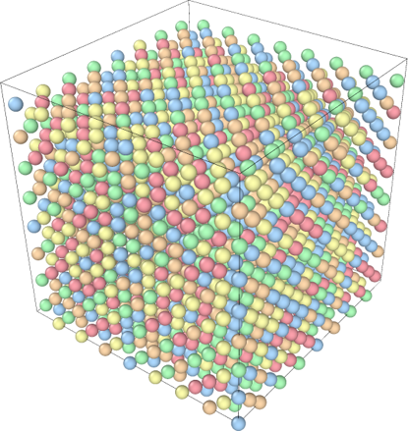
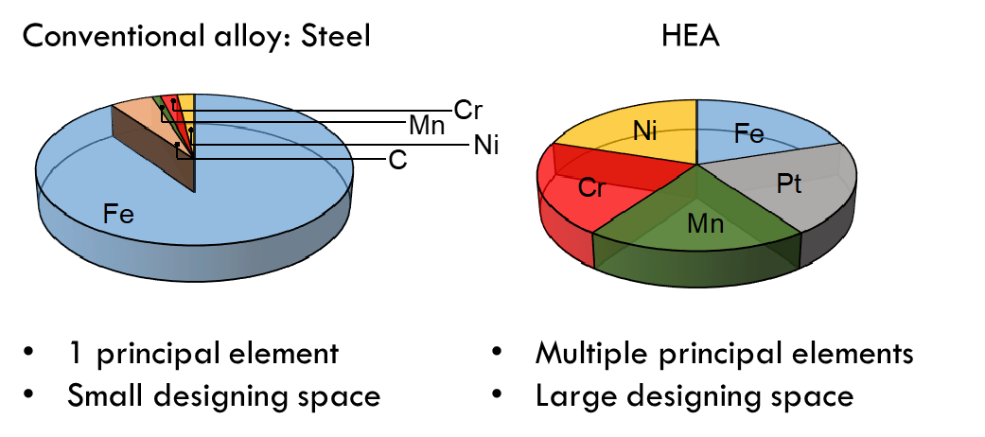
Overview of high entropy alloys (HEAs)
Multi-principal elemental alloys
Random solid solution
Equi-atomic or near equi-atomic composition
FCC, BCC or HCP crystal structures
Distorted lattice
Large number of HEAs can be designed by changing the chemistry and composition of principal elements
Yang, Tengfei, et al.Journal of Materials Research 33.19 (2018): 3077-3091.

Slide 4
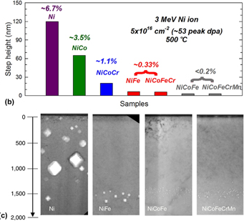
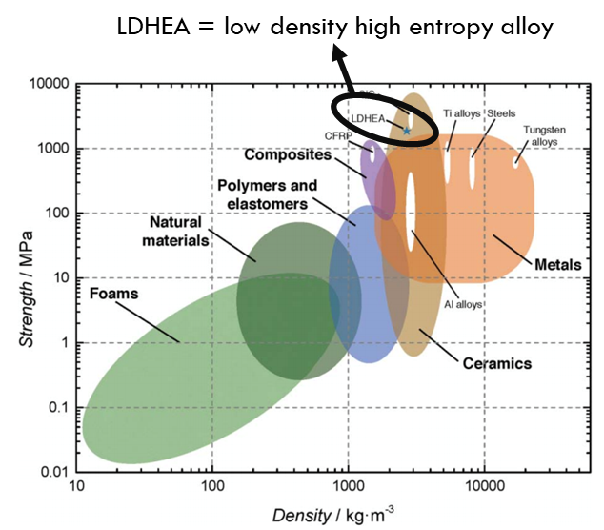
Exceptional properties of HEAs
Radiation tolerant property of HEAs
High strength along with high ductility
High strength while maintaining low density
HEAs offer a new route for exploring and designing next generation material for beam windows

Slide 5
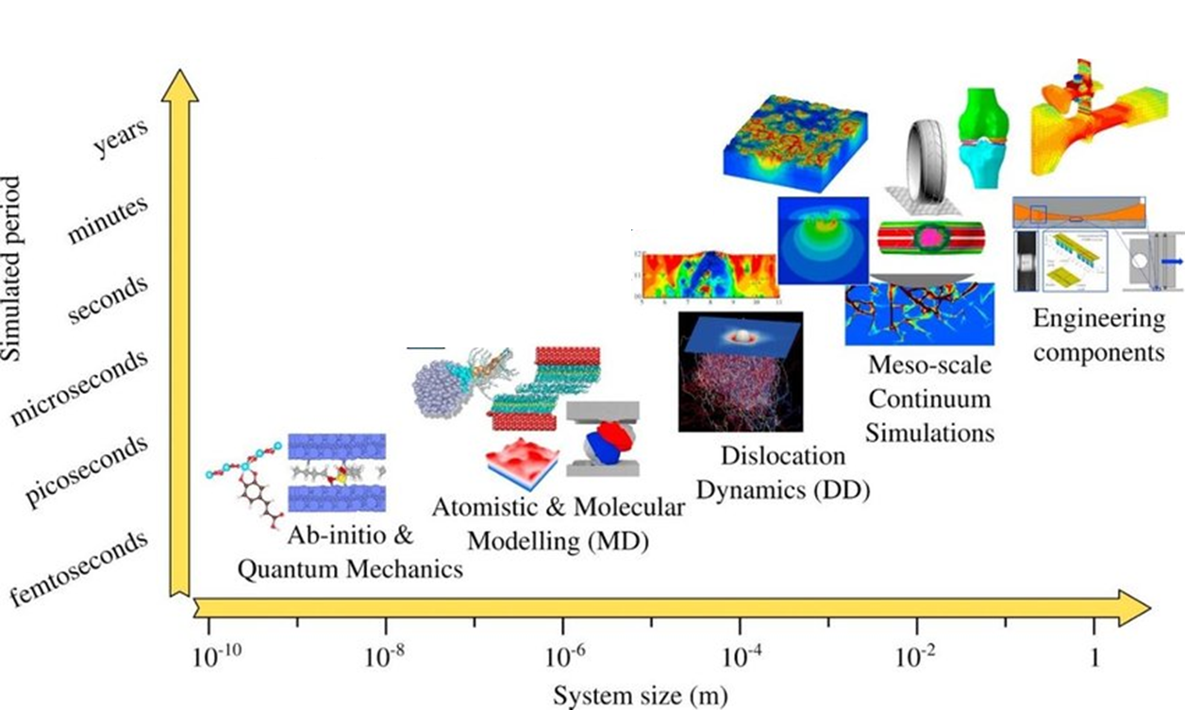
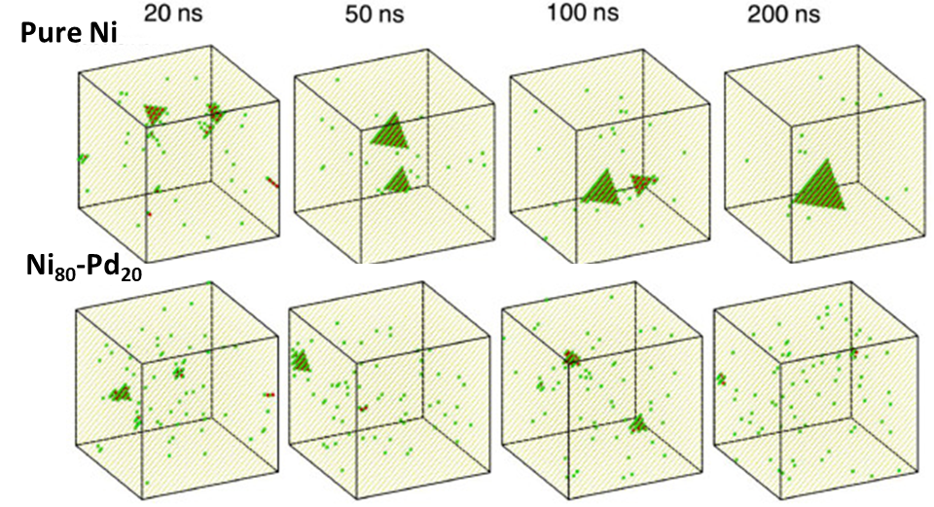
Types of simulations: Time vs. system size
MD simulations are used to study the radiation defects such as vacancy formation, void formation and formation of short-range order in HEAs.
Goel, Saurav, et al. Materials Today Chemistry 18 (2020): 100356
Arora, Gaurav, et al." Materialia 15 (2021): 100974

Slide 6
Overview of density functional theory (DFT)
Basic definition
DFT is a quantum mechanical modeling method used to study the electronic structure and properties of materials.
It provides insights into the behavior of atoms and molecules at the atomic scale.
Methodology
Focuses on solving for electron density instead of individual electrons
  Helps in reformulating many-body problem as an equivalent single-particle problem
Advantage of DFT
Wide applicability: DFT can be applied to range of materials to study electronic structures, charge density, magnetic and more.
Does not require any input from the experiment as it uses fundamental equations to solve the problem
Insight into chemical and physical processes: Offers deep understanding of the chemical reactions, electronic transitions and physical phenomena at atomic level.
Complement experimental results.
  Allows the extraction of additional information such as atomic structures, reaction pathways.
DFT serves as powerful tool for screening and analyzing electronic properties of the materials before they are even synthesized

Slide 7
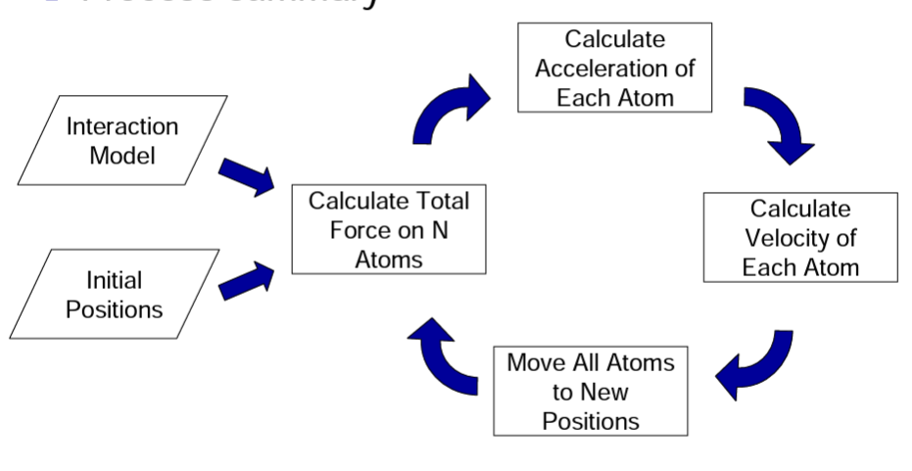
Overview of molecular dynamic (MD)
Basic definition
Based on classical physics and is used to describe positions, velocities, and orientations of molecules over time.
Energy/forces are calculated using Newton’s law of motion.
Advantages
System can be simulated using different conditions, for example at very high temperature and pressure.
Visualize the evolution of system with time.
Millions of atoms can be modeled.
MD serves as powerful tool for studying microscopic properties of materials
https://www.compchems.com/molecular-dynamics-md/#advantages-and-disadvantages
https://nanohub.org/resources/7573/download/Martini_L1_Introduction.pdf

Slide 8
Summary of DFT and MD
DFT
Work on the principle of quantum physics
Highly accurate
Computationally expensive
Limited to ~300 atoms
Software: VASP, Q-espresso, etc.
MD
Work on the principle of Newton laws
As accurate as interatomic potentials
Computationally cheap
Million of atoms can be modeled
Software: LAMMPS
Interatomic potentials
Mathematical function for calculating potential energy of the system with given positions of atoms.
Equations are fitted using data derived from DFT and/or experiments.
Not all the properties can be derived from just one form of inter-atomic potentials.
Accuracy of the simulations depends upon the accuracy of the interatomic potentials.
Development of accurate interatomic potentials is the key challenge in designing or studying defect properties in HEAs

Slide 9
Development of interatomic potentials
DFT or experimental data is required for developing interatomic potentials.
Conventionally, developed using hit and trial method.
Challenge: Tedious and time-consuming task
Solution: Use of machine learning
Broad idea
Conventional method
Input data from DFT/experiments
Energies
Human input
Interatomic potential
New method
Forces/energy
Positions
Input data from DFT/experiments
Machine learning model
Interatomic potential

Slide 10
Design approach
Find suitable compositions from the large design space using CALPHAD
Single phase over large range of temperature
Perform density functional theory calculations
Strain calculations
Point defect calculations
Migration barriers calculations
Making of new inter-atomic potentials
Running MD simulations
Notes:
Talk about that its an iterative process

Slide 11
Exploring large design space using CALPHAD
Find suitable compositions from the large design space using CALPHAD
Single phase over large range of temperature
Cr-Mn-V base ternary alloy to avoid high activation elements
  - Single phase BCC crystals
Additional elements for improved strength
  Ti as impurity getter
  Al for lower density
  Co to from semi-coherent B2 phase for strengthening
Range of elements explored (~120,000 combinations were explored)
 | Al | Co | Ti | Cr | Mn | V
Min | 0 | 0 | 0 | 0 | 0 | 0
Max | 20 | 5 | 20 | 50 | 50 | 50
Step | 2 | 1 | 2 | 3 | 3 | Bal
Alloy compositions sorted by single-phase BCC/B2 temperature range
Resulted in ~120,000 unique compositions
Notes:
Talk about that its an iterative process

Slide 12
Final down-selected compositions
Study the effect of Ti concentration
Al10-Co4-Cr25-Mn26-Ti1-V34
Al10-Co4-Cr27-Mn21-Ti4-V34
2. Study the effect of Co concentration
Al16-Co2-Cr25-Mn30-Ti1-V26
Al16-Co4-Cr25-Mn30-Ti1-V24
3. Study the effect of Al and removing Cr
Al20-Co1-Mn27-Ti2-V50
Al12-Co3-Cr6-Mn27-Ti2-V50
4. Study the effect of removing Co
Al18-Mn30-Ti2-V50
Al20-Co2-Mn26-Ti2-V50
In collaboration with Nicholas (Uni. Of Wisconsin, Madison)
Notes:
Talk about that its an iterative process

Slide 13
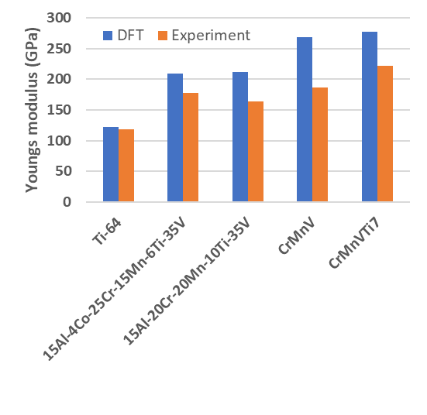
In progress: DFT simulations
Perform density functional theory calculations
Strain calculations
Point defect calculations
Migration barriers calculations
Beginning stage of collecting data
Performing convergence test for finding optimum input parameters.
Youngs modulus comparison
Trends between DFT and experimental values for young’s modulus match except for 6 element system

Slide 14
Conclusions
HEAs are next-generation materials needed to be explored for next-generation particle accelerators.
Simulation tools such as DFT and MD serve as important tools for designing materials.
Machine learning can be used to develop accurate potentials.
Simulations can provide valuable insight about reaction paths and processes.
Thank you!

