Slide 1
FRIB Linac Beam-Intercepting Device Material Challenges
Takuji Kanemura, Alexander Plastun, Felix Marti, Michael LaVere, Nathan Bultman, Tom Ginter, Yoichi Momozaki¹, and Jie Wei
Facility for Rare Isotope Beams (FRIB), Michigan State University
¹Also at Argonne National Laboratory

Slide 2
Outline
What is FRIB?
What are Charge stripper and charge selector?
Technical challenges of charge stripper and charge selector
Charge stripper: carbon stripper foil radiation damage
Charge selector: slits radiation damage
Summary

Slide 3
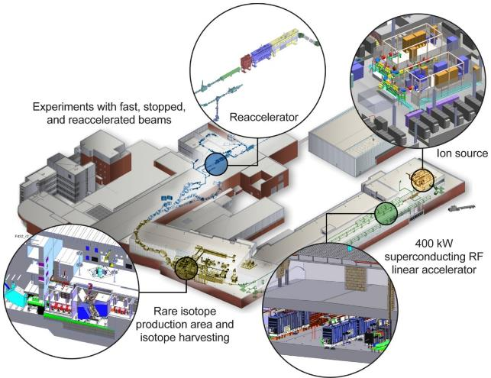
What is FRIB?
The Facility for Rare Isotope Beams (FRIB) is a U.S. Department of Energy Office of Science (DOE-SC) scientific user facility for rare isotope research supporting the mission of the Office of Nuclear Physics in DOE-SC
Key features are 400 kW beam power for all ions (8 p𝜇A or 5x10¹³ ²³⁸U/s) and E/A>200 MeV/u
Separation of isotopes
in-flight provides
  Fast development time for any isotope
  Beams of all elements and short half-lives
  Fast, stopped, and
  reaccelerated beams
User operation started with 1 kW in 5/2022, currently 5 kW, foreseeing 10 kW this winter
400 kW full power operation in six years

Slide 4
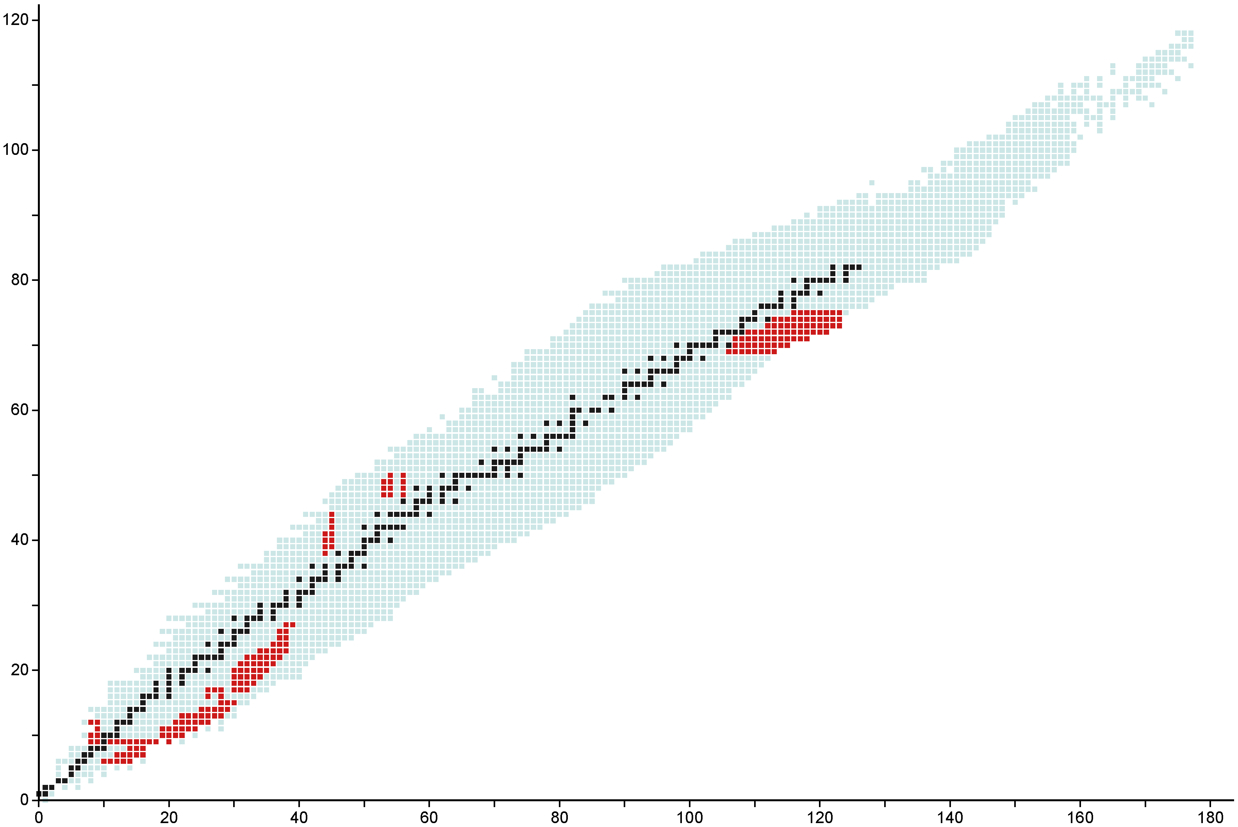
More than 200 Rare Isotope Beams Have Been Delivered to FRIB Experiments
Most Recent Experiments:
E21034: ⁸²Sr, ^{83,84}Y, ^{84,85}Zr, ^{85,86}Nb, ⁸⁷Mo, ⁸⁸Tc, ⁸⁹Ru
E21009: ^{42,44}S, ⁴³⁻⁴⁵Cl
E22501: ¹⁷⁵⁻¹⁸²Tm, ¹⁷⁶⁻¹⁸⁵Yb, ¹⁷⁸⁻¹⁸⁹Lu, ¹⁸¹⁻¹⁹³Hf, ¹⁸⁵⁻¹⁹⁶Ta, ¹⁸⁶⁻¹⁹⁷W, ¹⁹¹⁻¹⁹⁸Re
E21003: ^{104,106}Sn, ^{102,103,105}In, ^{101,102,104}Cd, ^{100,101,103}Ag
E21062: ¹⁶⁻²⁰C, ¹⁹⁻²³N, ²²⁻²⁴O, ^{19-27,29}F, ²⁹⁻³²Ne, ³⁰⁻³⁵Na,
³³⁻³⁸Mg, ³⁵⁻⁴¹Al, ³⁹⁻⁴³Si, ⁴³⁻⁴⁵P
Protons
Primary Beams | Max Power Achieved
³⁶Ar | 5 kW
⁴⁸Ca | 5 kW
⁷⁰Zn | 5 kW
⁸²Se | 5 kW
¹²⁴Xe | 5 kW
¹⁹⁸Pt | 2 kW
Stable isotopes
Observed isotopes
Experiments at FRIB
Data Date: 2023-04-11
Neutrons
Stolz

Slide 5
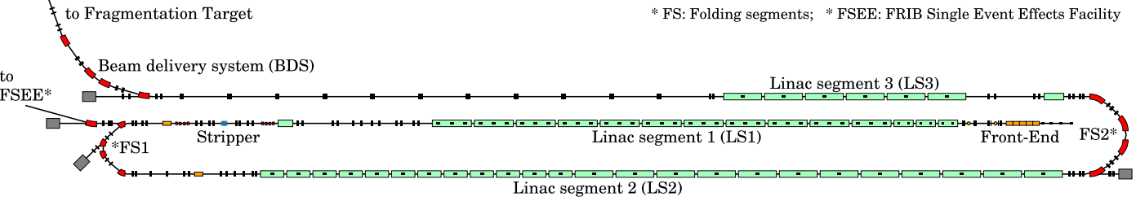
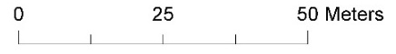
FRIB Driver Linac: 400 kW CW SRF Linac
FRIB linac includes 46 superconducting RF cryomodules
  324 SRF cavities in total with velocity β from 0.041 to 0.53
Three linac segments (LS1, LS2 and LS3) with two folding segments (FS1 and FS2) for a compact design
The charge stripper and charge selector are located in FS1

Slide 6
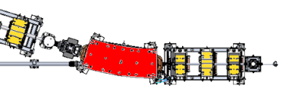
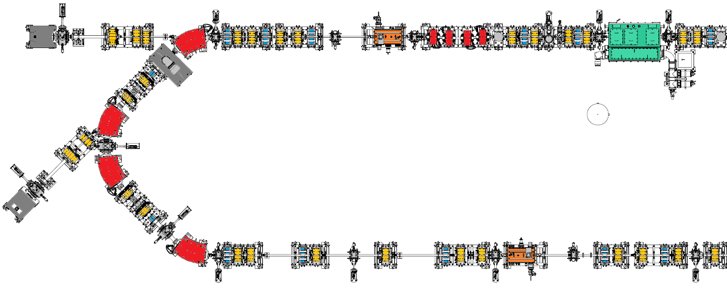
Folding Segment 1 (FS1)
Charge Stripper and Selector
Charge Strippers (Carbon foil and liquid lithium film)
Charge Selector
Beam energy at FS1 entrance: 17-20 MeV/u (20 for ions lighter than Xe, 17 for Xe and heavier)
Beam power at FS1 entrance: 40 kW (full power case. About 1/10 of final power)
Water-cooled vacuum chamber
LS1
MGB 01
Chicane
FS1a dump / FSEE
Collimator-4
Collimator-1
Lq Lithium
Stripper
Charge
Selector
Collimator-5
Collimator-3
Collimator-2
Carbon
Stripper
Collimator-6
Collimator-7
Collimator-8
Collimator-9
Collimator-11
Collimator-10
LS2
FS1b dump
MGB 02

Slide 7
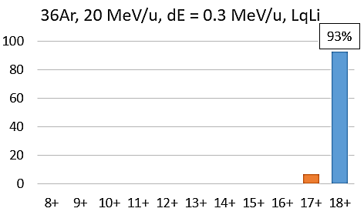
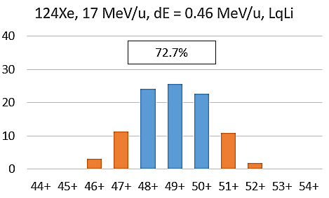
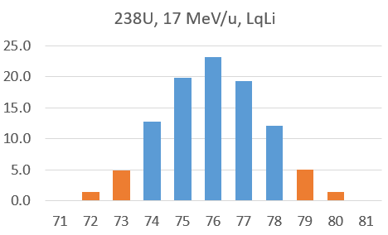
What is Charge Stripper?
Removes electrons from the beam being accelerated to increase energy gain by a factor of 2 (e.g. ²³⁸U³⁶⁺ >> ²³⁸U⁷⁶⁺). This process, however, produces multiple charge states after the stripper
Charge state distribution after stripper depends on beam parameters (ions and beam energies) and stripper material and thickness
  Low-Z ions: almost fully stripped
    Argon, Z=18
  Med to High-Z ions: partially stripped
    Xenon, Z=54
    Uranium, Z=92

Slide 8
What is Charge Selector?
Intercepts the charge states that cannot be accepted by the post-stripper linac segments
  FRIB linac is capable of multi-charge simultaneous acceleration (up to 5 for U beam).
Receives 20 % of beam power (~10 kW for full power operations)
Blue: Acceptable
Orange: Intercepted

Slide 9
Technical Challenges in
Charge Stripper and Charge Selector
Technical challenges (common in both charge stripper and selector)
  Extreme thermal load, and
  Radiation damage (when a solid material is used) by heavy ions (²³⁸U)
Damage produced by a ²⁰⁸Pb²⁷⁺ beam, 8.1MeV/u, on DLC foils in the NSCL K1200 Cyclotron. The leftmost photo shows an unused foil, and the middle and rightmost photos show two different foils exposed to the beam.
dE/dx of uranium is 3 orders of magnitude higher than H (> ~2 MeV/u)!!!
J. A. Nolen and F. Marti, Reviews of Accelerator Science and Technology, Vol. 6 (2013) 221–236

Slide 10
Technical Challenges in
Charge Stripper and Charge Selector
Charge stripper suffers the severest condition (beam focused and single footprint). Liquid lithium charge stripper for high power operations.
Charge selector suffers milder condition (beam splits into multiple beamlets) but beams stop in slits. We consider graphite disk as the next generation charge selector.
Device | Medium | Beam power | Beam size | Thermal load (uranium) |  | DPA rate
Charge stripper | 1.5 mg/cm² Solid C | 1 kW (10 kW at target) | σ 1 mm | 47 W | 2 MW/cm³ (average) | ~10⁻⁴ dpa/s assuming static foil
 | 1.5 mg/cm² Liquid Li | 40 kW (400 kW at target) | σ 0.5 mm | 1360 W | 58 MW/cm³ (average) | N/A
Charge selector | Glidcop (Cu alloy) | 1 kW (10 kW at target) | σ_{x} 0.7 mm σ_{y} 1.25 mm | 200 W (shared by 4 charge states) | 0.3 MW/cm³ (average) | ~10⁻³ dpa/s at Bragg peak assuming static slits
 | Graphite (planned) | 40 kW (400 kW at target) | σ_{x} 0.7 mm σ_{y} 1.25 mm | 10 kW (shared by 4 charge states) | 6.5 MW/cm³ (average) | ~10⁻² dpa/s at Bragg peak assuming static slits

Slide 11
Charge Stripper

Slide 12
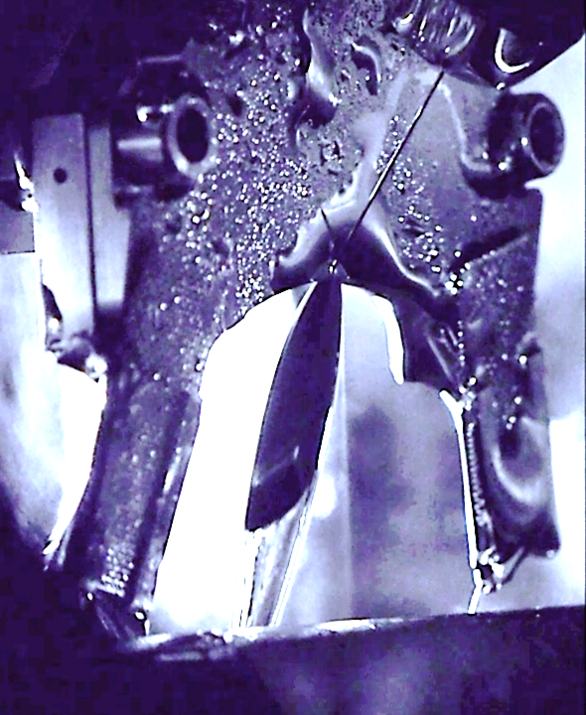
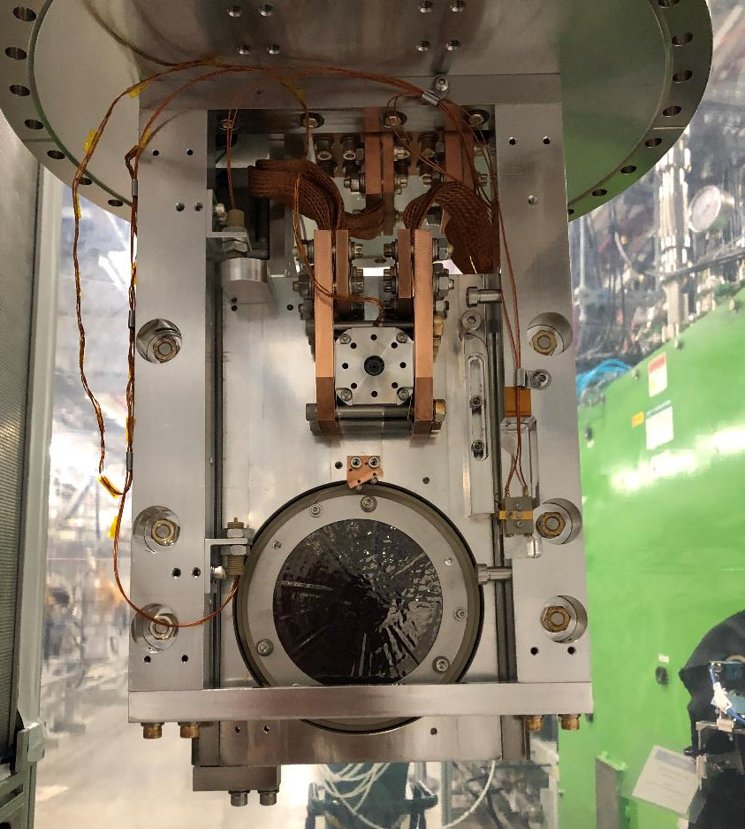
FRIB Charge Stripper:
Liquid Lithium Film for Full Power Operation with Back up Carbon Foil
FRIB has established a liquid lithium charge stripper (LLCS) for full power U beam operations.
Commissioning with heavy ion beams was successful. LLCS has served user operations.
Rotating carbon charge stripper installed next to LLCS being used for user operations as well.
T. Kanemura, et al., Phys. Rev. Lett. 128, 212301 (2022)
C foil
D=100 mm
20 mm
  Lithium speed: 60 m/s
  Vacuum pressure: 1e-6 Pa

Slide 13
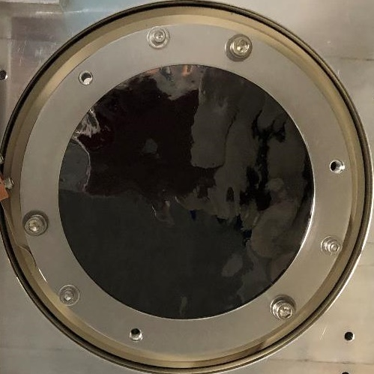
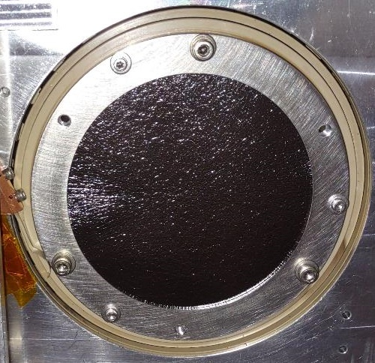
Carbon Charge Stripper
We have two brands of foil available
Thickness: 1.0-1.5 mg/cm² (approx. 5-7.5 um)
Kaneka foils are used at RIKEN to strip high-power heavy ion beams
Applied Nanotech, Inc. (USA)
https://doi.org/10.1116/1.3693594
Kaneka (Japan)
https://doi.org/10.1063/1.5035522

Slide 14
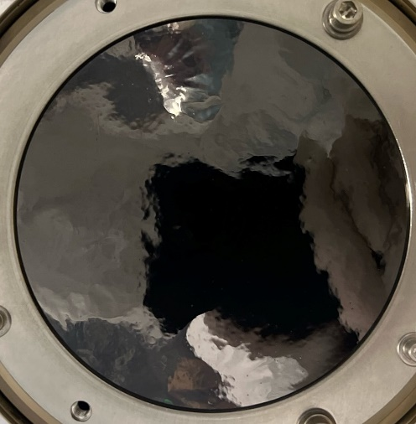
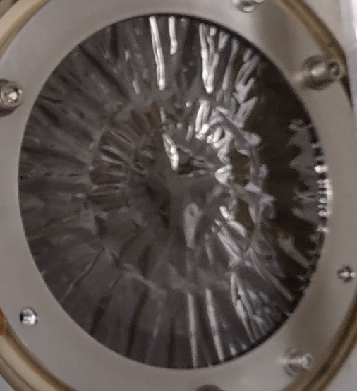
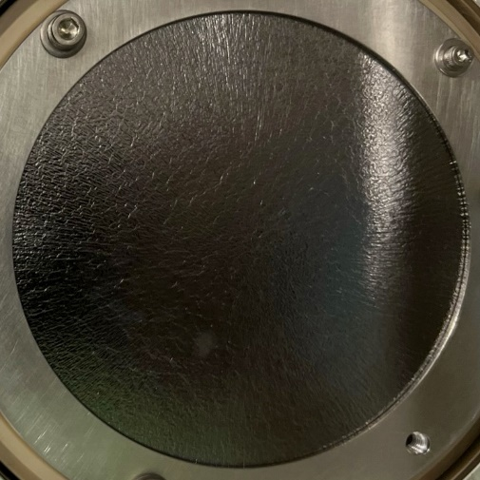
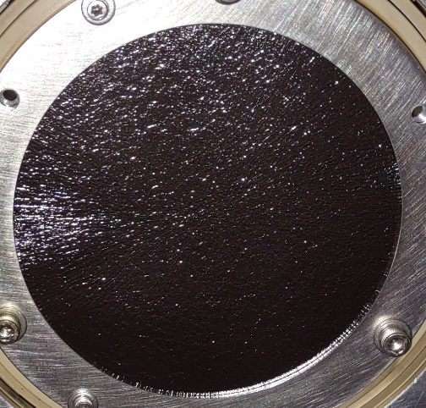
Foil Performance Comparison: after 5-kW-at-target Xe beam irradiation
Applied Nanotech: Buckled due to heat deposited from the 5-kW-at-target Xe beam. Can support continuous 5 kW Xe beam operations
Kaneka: even after 5-kW-at-target Xe beam irradiation, still looks new, consistent with Riken’s experiences
  But probably because of heating of the nearby bearing, it thermally expanded and friction increased, leading to step losses at rotation motor. Couldn’t support continue operations. Design update on the way.
New
After
New
After
Applied Nanotech
Kaneka

Slide 15
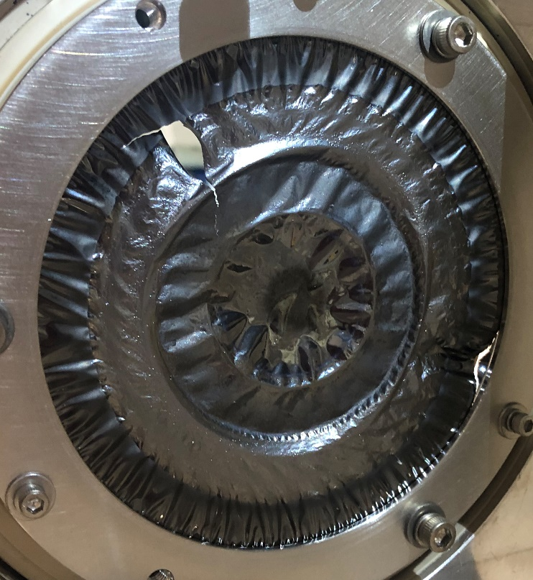
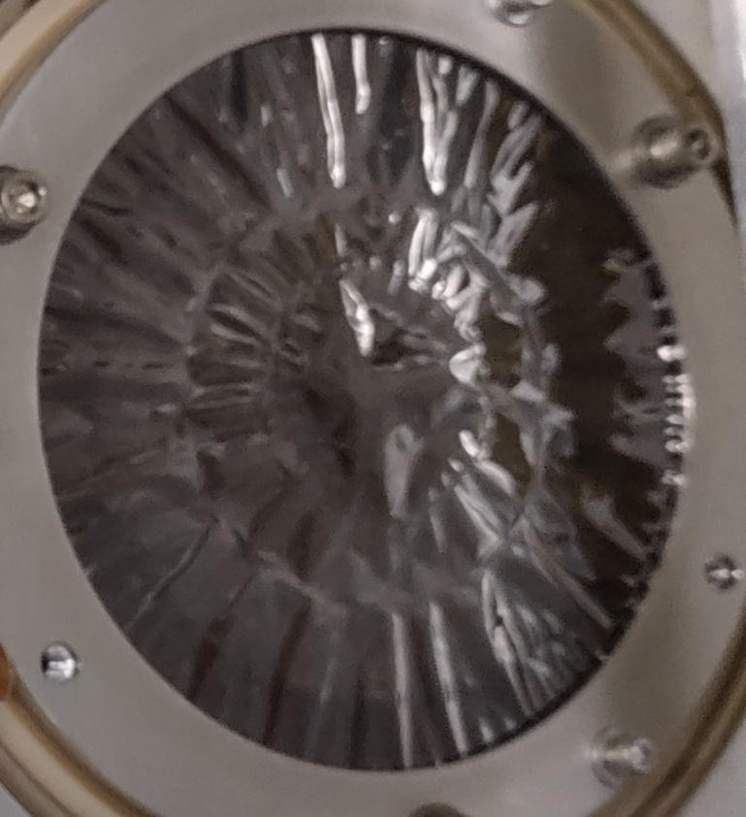
Radiation Damage to Foil with Pt beam
¹⁹⁸Pt (Z=78) left severe damages in API carbon foil
  Beam power at stripper: 200 W (2 kW at target), 90 pnA
  Power deposition to foil: 7 W
¹²⁴Xe (Z=54) left only buckling
  Beam power at stripper 500 W (5 kW at target), 250 pnA
  Power deposition to foil: 16 W

Slide 16
DPA Rate in Carbon Foil
Difference in DPA rates between Ca (Z=20) and U (Z=92): a factor of 4
DPA rates of Xe and Pt should be closer (no calc for Xe nor Pt)
Which doesn’t seem to be consistent with what we have observed
  Pt damaged after less than 1-day 2 kW irradiation
  Xe intact after 1-week 5 kW irradiation
Damage that is not characterized well by dpa happened with heavy ions (ion hammering)?
No PIE tests yet. Looking for opportunities
  I have PhD student who will work on linac BID radiation damage study
PHITS used

Slide 17
Charge Selector

Slide 18
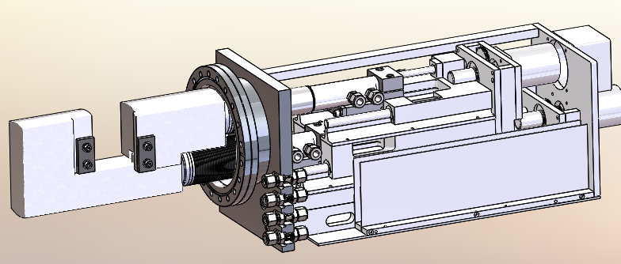
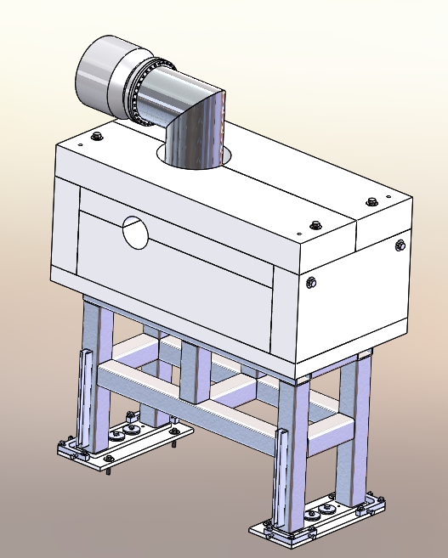
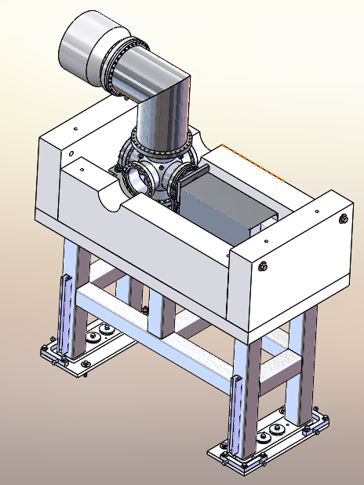
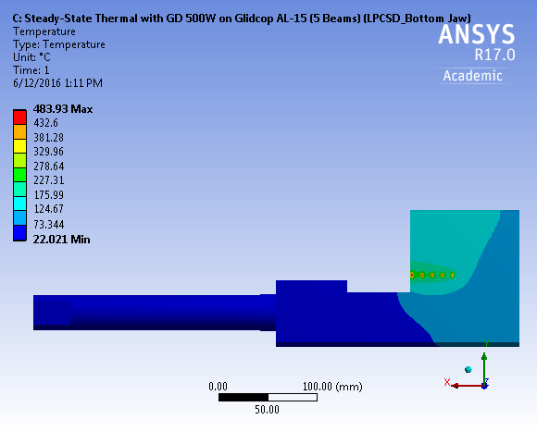
Low-power Charge Selector: Glidcop
Limited to 500 W per beam spot of rms=(0.7x1.25) mm due to thermal stress in Glidcop. Limit does not depend on ion species
TMP
Shielding
9000 lb

Slide 19
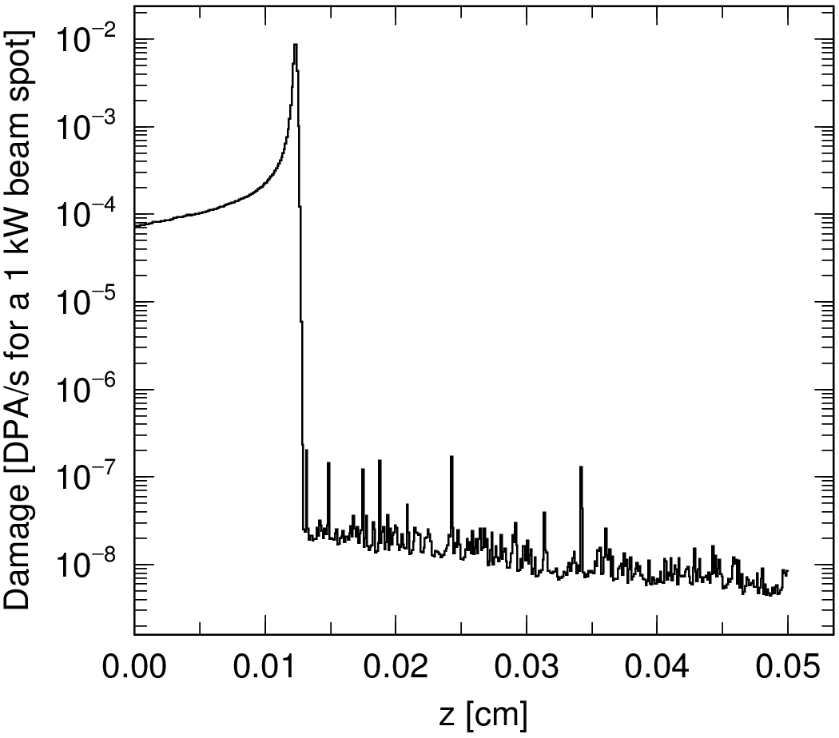
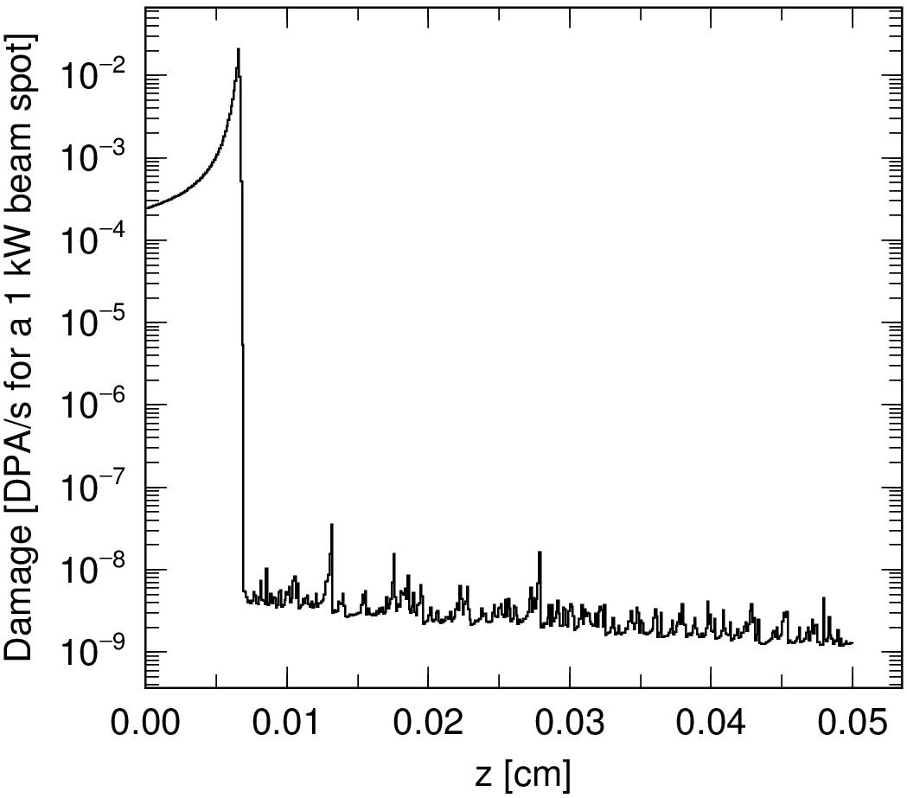
DPA Results for Glidcop Slits
Ca-48 vs. U-238
Beam spot size used is typical of 1 U-238 charge state
  0.7 mm (horizontal rms) x 1.25 mm (vertical rms)
DPA rate shall be scaled by expected beam power (e.g. 1 kW to 500 W)
  1 week = 6e5 seconds
Ca-48
1 kW, 20 MeV/u
U-238
1 kW, 17 MeV/u

Slide 20
Ion Implantation Rate:
Back-of-the-envelope calculation
This summer, visual inspection of slits surface will be conducted
When damage observed, slits will be replaced

Slide 21
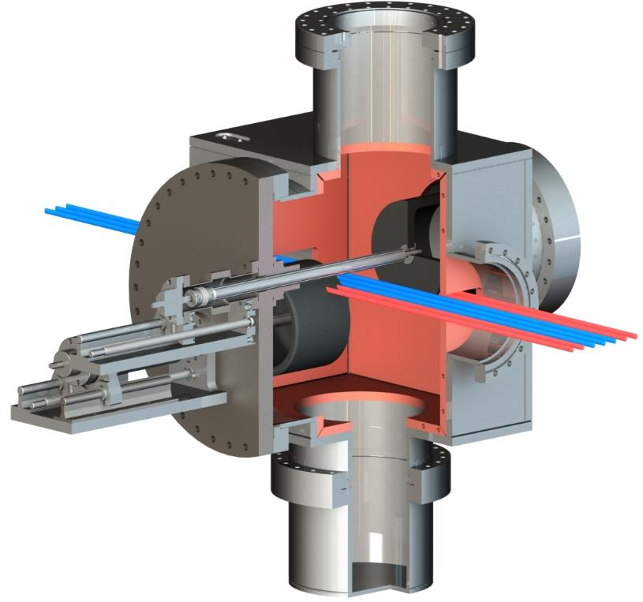
Intermediate-Power Charge Selector: Stage 1
Thermo-mechanical limit
5 kW / spot
Pumping / Diagnostics port
Linear/Rotary Bearing
Water
6” Graphite wheel
Water-cooled bimetal chamber
Bellow
Ferrofluid feedthrough
Multiple charge
state beam
Linear actuators
At Stage 2

Slide 22
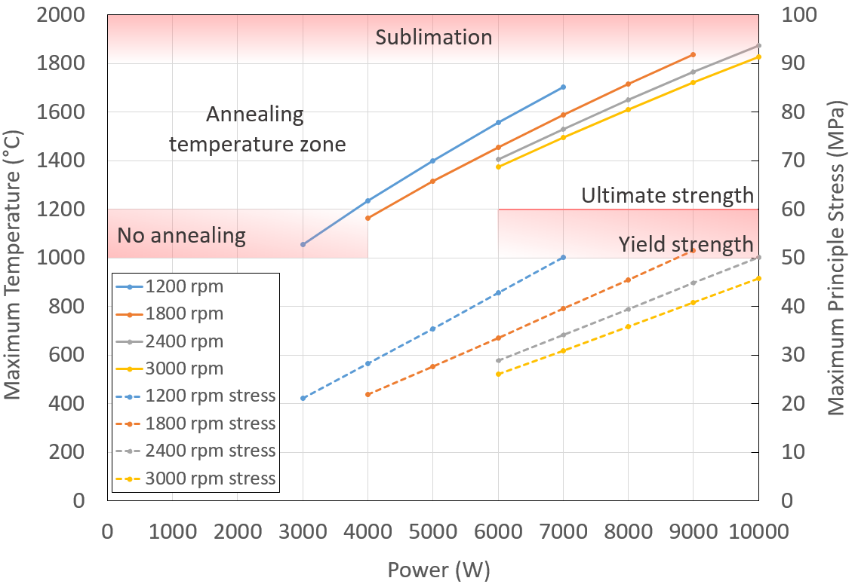
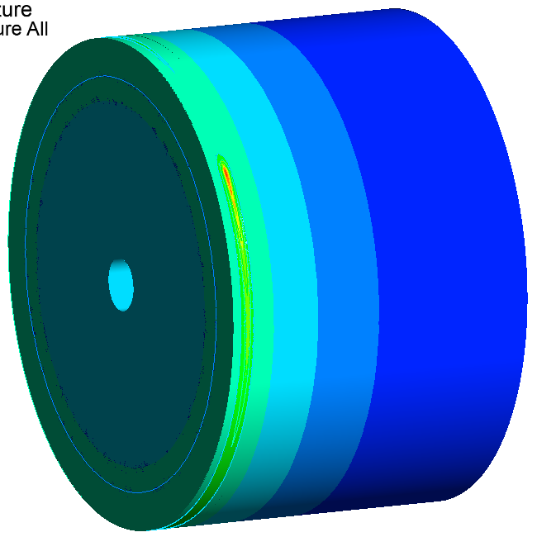

Graphite Wheel Thermal Analysis
Beam
  ⁴⁸Ca on graphite
  Beam size $σ_{x}=0.7 mm$, $σ_{y}=1.25 mm$, $depth=0.372 mm$
Temperature and stress
?

Slide 23
DPA Results for Graphite
Ca-48 vs. U-238
Beam spot size used is typical of 1 U-238 charge state
  0.7 mm (horizontal rms) x 1.25 mm (vertical rms)
  Static condition assumed
DPA rate shall be scaled by expected beam power and graphite wheel size
  6” wheel: factor of ~2.6e-3, 1 week = 6e5 seconds
  Thus 20 dpa / week for a 1 kW beam spot
U-238
1 kW, 17 MeV/u
Ca-48
1 kW, 20 MeV/u

Slide 24
Low-Energy Irradiation Study dE/dx in carbon
0.5 MeV/u, the exit energy at RFQ, gives a similar dE/dx at 17-20 MeV/u
  For 238U, 25.5 keV/nm at 17 MeV/u, 18.7 keV/nm at 0.5 MeV/u
0.5
17
Calculated with SRIM

Slide 25
DPA Rate Comparison
0.5 vs 17-20 MeV/u, ⁴⁸Ca vs ²³⁸U
PHITS used for calculations
Beam spot size used is typical of one ²³⁸U charge state
  0.7 mm (horizontal rms) x 1.25 mm (vertical rms)
Same beam intensity used for the two energies
Peak DPA rates are almost the same for the two energies although there is a large difference in dE/dx between ⁴⁸Ca and ²³⁸U (does dE/dx have to do with radiation damage?)

Slide 26
Considerations
Confirming which model used in PHITS: NRT vs arc model
Ion implantation
  Same beam intensity = same implantation rate
  Volumetric concentration at 0.5 MeV/u will be higher than the one at 17 MeV/u, due to the difference in range
    Uranium stops 9 um in carbon at 0.5 MeV/u, 70 um at 17 MeV/u
  Diffusion flux will be different due to the difference in concentrations
Temperature
  In terms of volumetric heating, energy difference (factor of 34) will be compensated by range difference (factor of 8) to some extent, but still a factor-of-4 difference remains.
  Temperature control necessary?
Secondary ions
  Not very critical compared to implanted primary ions?
Surface roughness is important
  Polishing will be necessary because of the very short range

Slide 27
Considerations
How to apply thermal cycle due to rotation?
Graphite grade, quality controls (manufacturers certificate vs independent inspection (e.g. SEM observations) by us)
Crystal structure change due to heating to high temperatures ~1600 C?
  Grain size could become larger at higher temperatures?
  Isotropic graphite could become anisotropic due to heating?
Other material? E.g. W+Cu bimetal: with W faced against the beam and Cu cooled by water

Slide 28
Summary
FRIB Linac has two major beam-intercepting devices
  Charge stripper
  Charge selector
We use two types of charge stripper
  Liquid lithium charge stripper for high power operation, free from radiation damage
  Rotating carbon charge stripper for low power operation
Damage to AN foils to be investigated, as well as design upgrade for continuous use of Kaneka foils
Charge selector currently uses Glidcop slits for low power operations (up to 20 kW at target), which needs to be improved to receive higher power beams and to meet our power ramp up plan.
Radiation damage in Graphite by 17-20 MeV/u heavy ions not well understood. 0.5 MeV/u beam irradiation test is under consideration. Comments / helps from the community are very much appreciated

Slide 29
Appendices

Slide 30
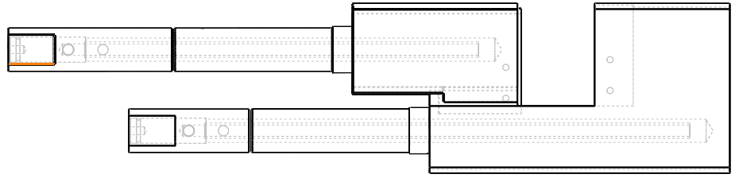
Low Power Charge Selector FEM Analysis
Parameters
Assumed five beamlets are intercepted by charge separation device
Beamlets are separated by 10.3 mm gap and each beamlet of size (Gaussian with σ=0.7 mm and 1.25 mm (H and V), up to 4 σ in both H and V considered)
Total power in each beamlet = 500 W
Total beam power intercepted = 2.5 kW
Assumed heat transfer coefficient of 0.5 W/cm²/K for a flow rate of 1.9 LPM in Ø6.35 mm cooling channel
Inner Jaw
Outer Jaw

Slide 31
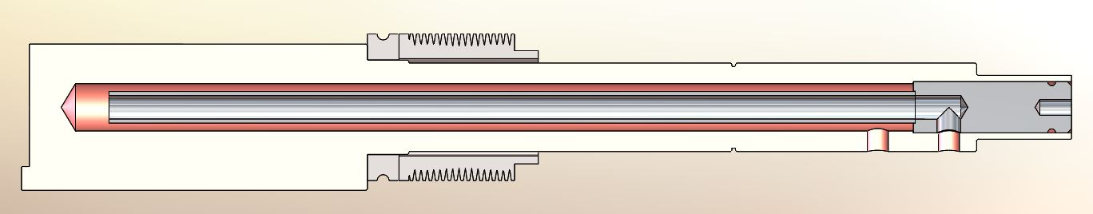
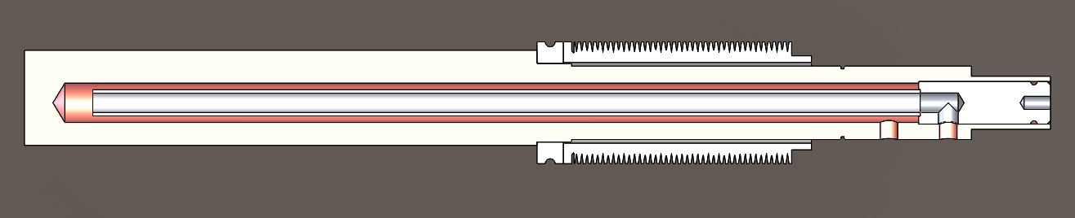
Jaw Cooling
WATER
OUTLET
WATER
INLET
0.75” Gundrill Hole
0.50” Cooling Tube OD
0.37” Cooling Tube ID
INNER JAW
WATER
OUTLET
WATER
INLET
OUTER JAW

Slide 32
Summary of FEM Analysis
 | Peak Temp. (°C) | Peak Cooling Wall Temp. (°C) | Peak Thermal Stress (Von-Misses) (MPa)
OFE Copper C10100 | 456 | 99 | 287
CuCrZr C18150 | 537 | 104 | 341
Glidcop AL-15 | 483 | 101 | 325
Glidcop AL-15 would be a material choice for intercepting beam power of 500W in each beamlet (5x beamlets)
CuCrZr can be used for beam power of 400W or less in each beamlet (5x beamlets)
OFE Copper can be used for beam power of 300W or less in each beamlet (5x beamlets)

Slide 33
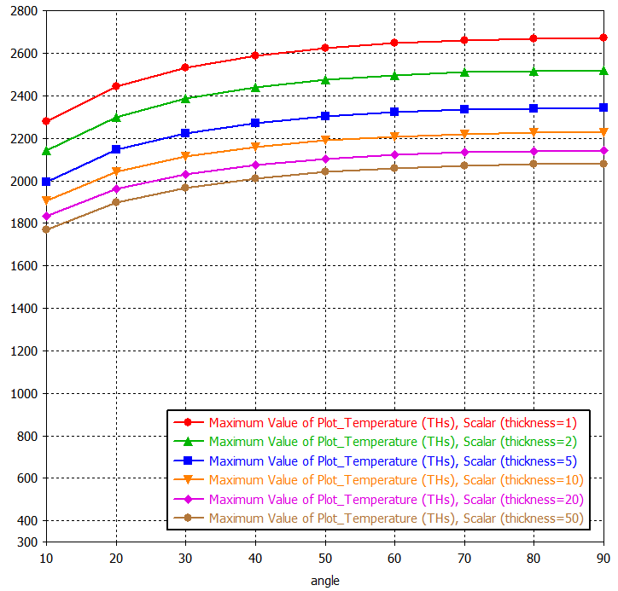
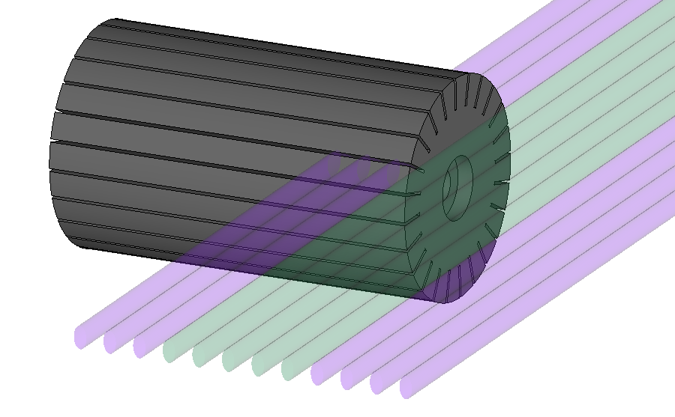
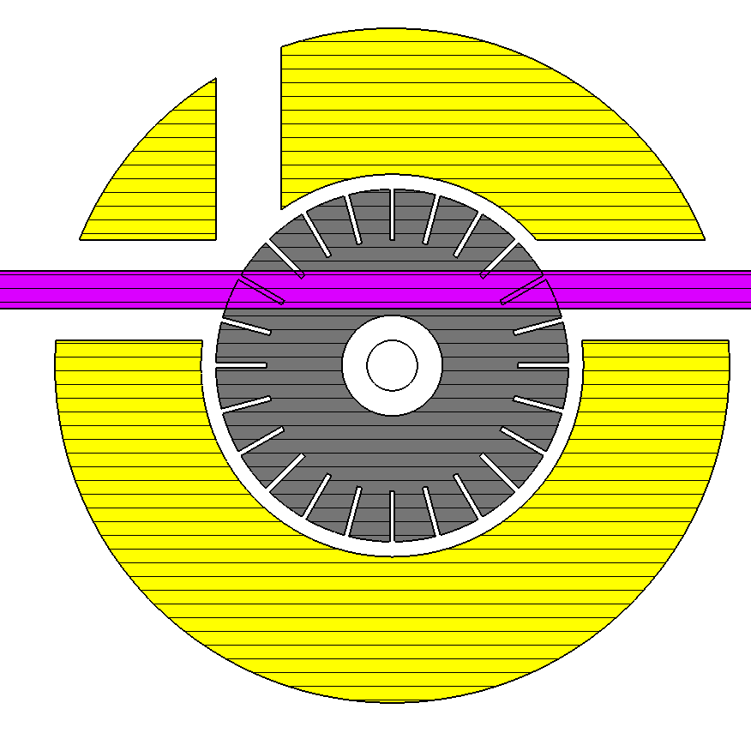
Concept: Rotating Graphite Cylinder
One can get some advantage from the thickness of the slit material
Longitudinal cuts may be necessary to suppress thermal stresses
T [K]
Beam charge states
Heat Exchanger

Slide 34
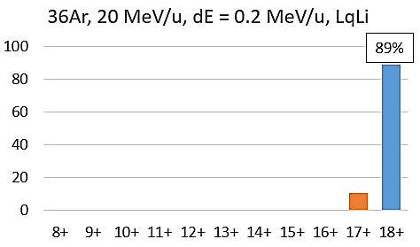
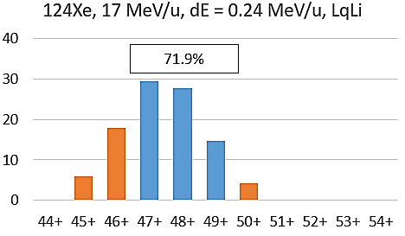
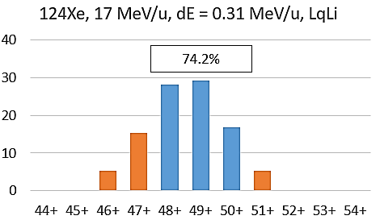
Charge Selector: Measured Distributions
Intercepts the charge states that cannot be accepted by the post-stripper linac segments
The intercepted beam power tightly coupled to the charge state distribution produced by the charge stripper
  For low-Z ions, stripping efficiency needs to be maximized
  For high-Z ions, right thickness of the stripper media needs to be selected

Slide 35
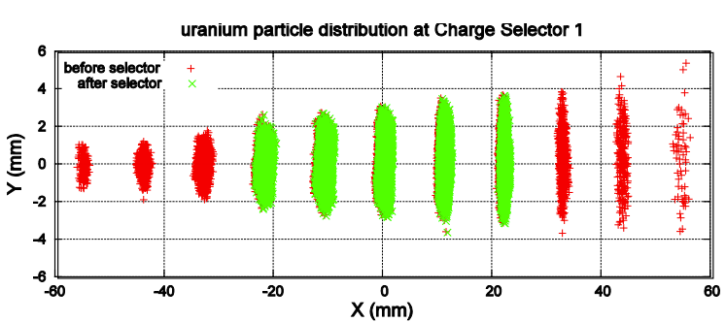
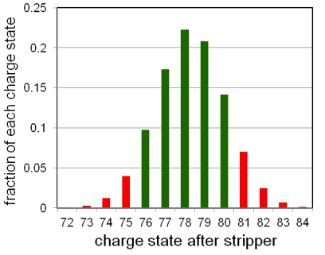
Charge Selector: Uranium Case
²³⁸U example:
  Stripped into multiple charge states
  Only five charge states can be accepted downstream
  Other charge states are intercepted by the charge selector slits
Measured distribution
Expected distribution
Low-power charge selector:

Slide 36
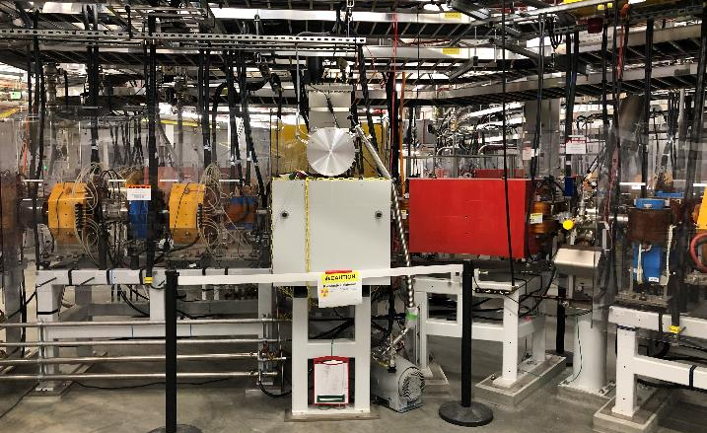
High-power Charge Selector: Location
Restrictions
  Width is restricted by the straight FS1a/FSEE beamline (1.7 m)
  Length is restricted by neighboring magnets (0.85 m)
  Height is restricted by cable trays
  Weight is restricted by the crane unavailability in that area
LS1
FS1a/FSEE
MGB01
Charge
Stripper
Charge
Selector
LS2
FS1b

Slide 37
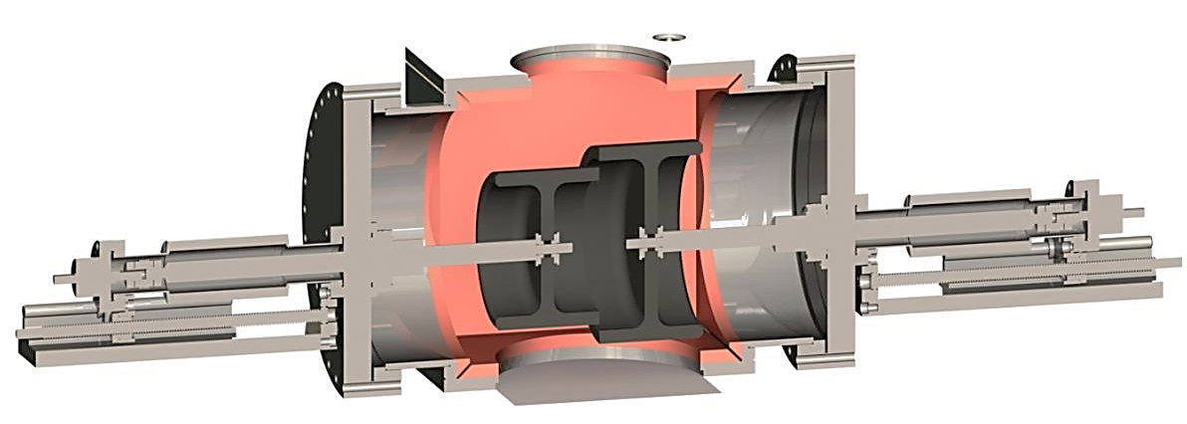
High-power Charge Selector: Stage 2
After the FSEE line is removed from FS1, Stage 1 can be upgraded to Stage 2 by installing larger wheels from the opposite sides of the same vacuum chamber
  Minimum impact on the interfaces (vacuum and beamline ports, water, etc.)
  Assuming linear scaling with the wheel diameter, Stage 2 will allow for a factor of 1.33 on the left and a factor 1.66 higher power on the right slit
10” Graphite wheel
8” Graphite wheel
Thermo-mechanical limit: 8 kW / spot
Deliver by 2027

Slide 38
dE/dx in carbon: SRIM
At 0.5 MeV/u, the electrical loss is already 98% of the total loss.

Slide 39
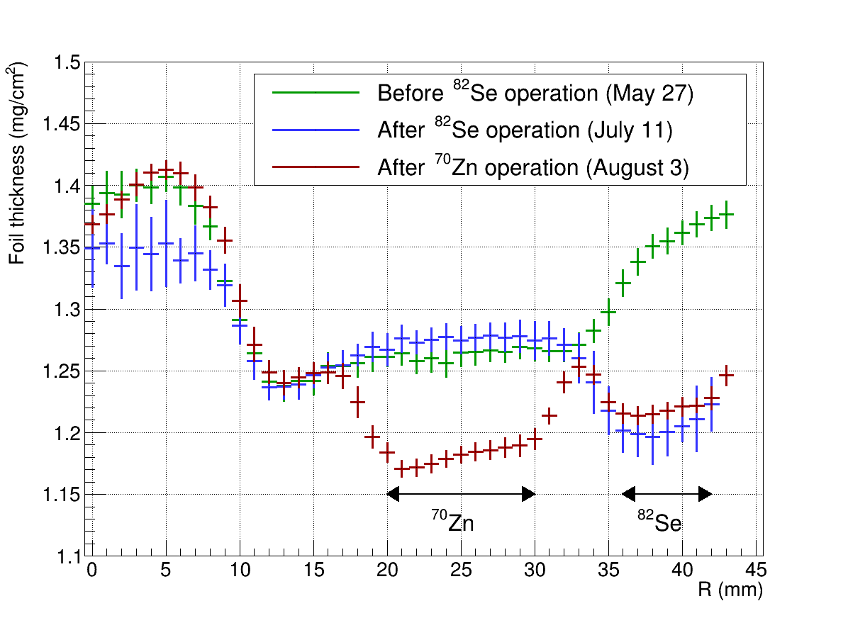
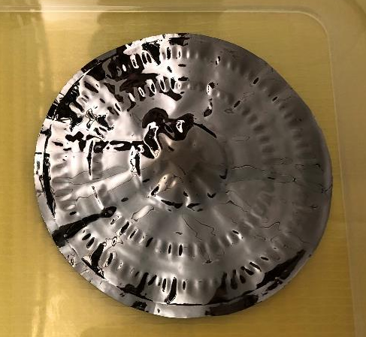
Rotating Carbon Charge Stripper:
Operational Experiences
Foil: Graphene sheets from Applied Nanotech, Inc. (API)
Foil movement: rotational (100 rpm) and vertical (3 mm/s)
Irradiation history
Beams | Energy [MeV/u] | Intensity [puA] | Total ions irradiated
⁴⁸Ca | 20 | 0.13 | 2E17
⁸²Se | 20 | 0.18 | 5E17
⁷⁰Zn | 20 | 0.17 | 6E17
100 mm
After ⁴⁸Ca operation
⁴⁸Ca
Original thickness was not measured…

