Slide 1
Irradiation campaign and PIE needs for STS target systems R&D
Yong Joong Lee
On behalf of
Tom Muth, Justin Mach, Aaron Jacques, Tom McManamy, Joseph Tipton, Don Erdman, Ben Garrison, TS Byun, Neelam Pradhan

Slide 2
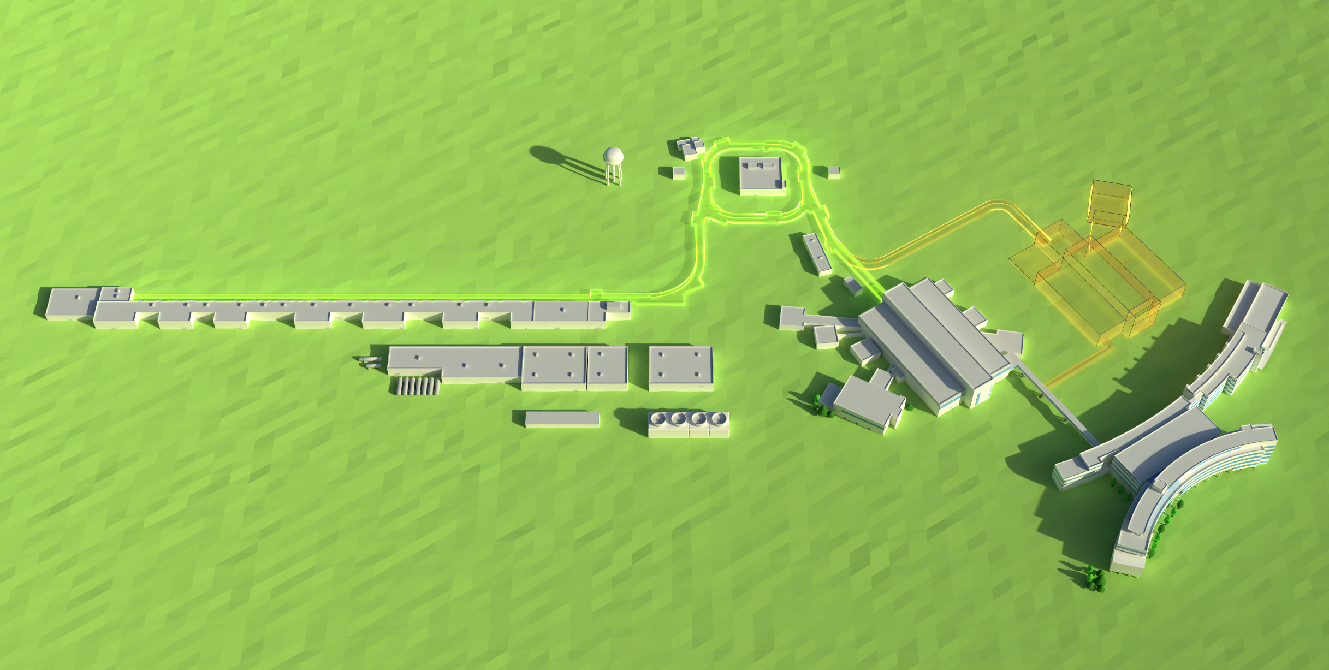
Second Target Station (STS) – Accelerator Layout
The accumulator ring compresses the pulse to ~700 nsec
Future
Second Target Station
H-Source
Warm LINAC
Superconducting LINAC
186 MeV
~1000 MeV
RFQ
The LINAC accelerates a 26 mA, ~1 msec long H⁻ beam
First Target Station
Liquid Hg Target
@ 60 Hz, this represents a 1.4 MW proton beam power
PPU will double the beam power capability to 2.8 MW and deliver 2.0 MW to the first target station
21-G02146/gim

Slide 3
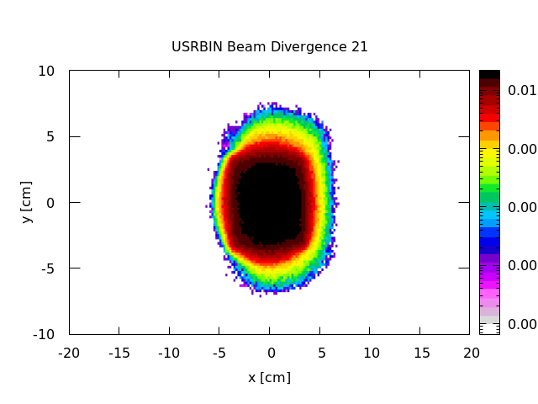
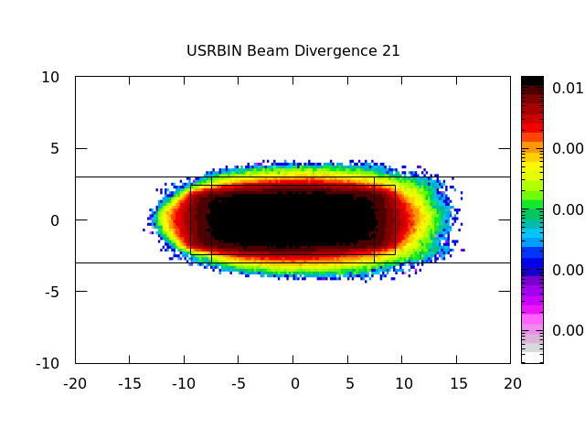
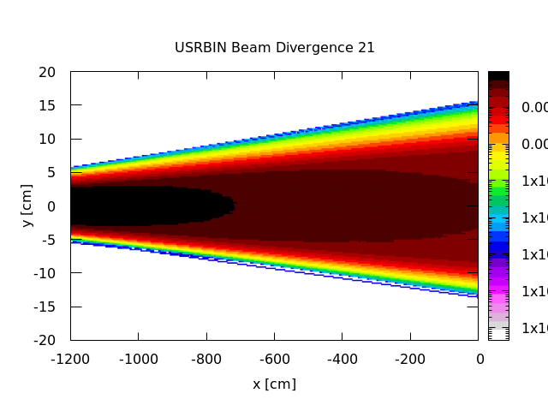
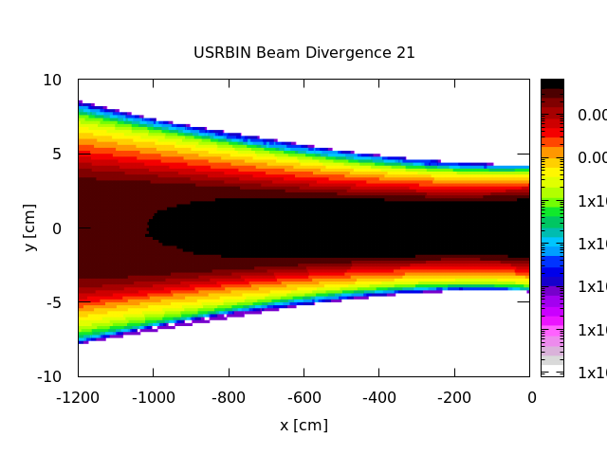
STS Beam on Target Parameters
Beam energy: 1.3 GeV
Beam power: 700 kW
Pulse length: 700 ns
Pulse repetition rate: 15 Hz

Slide 4
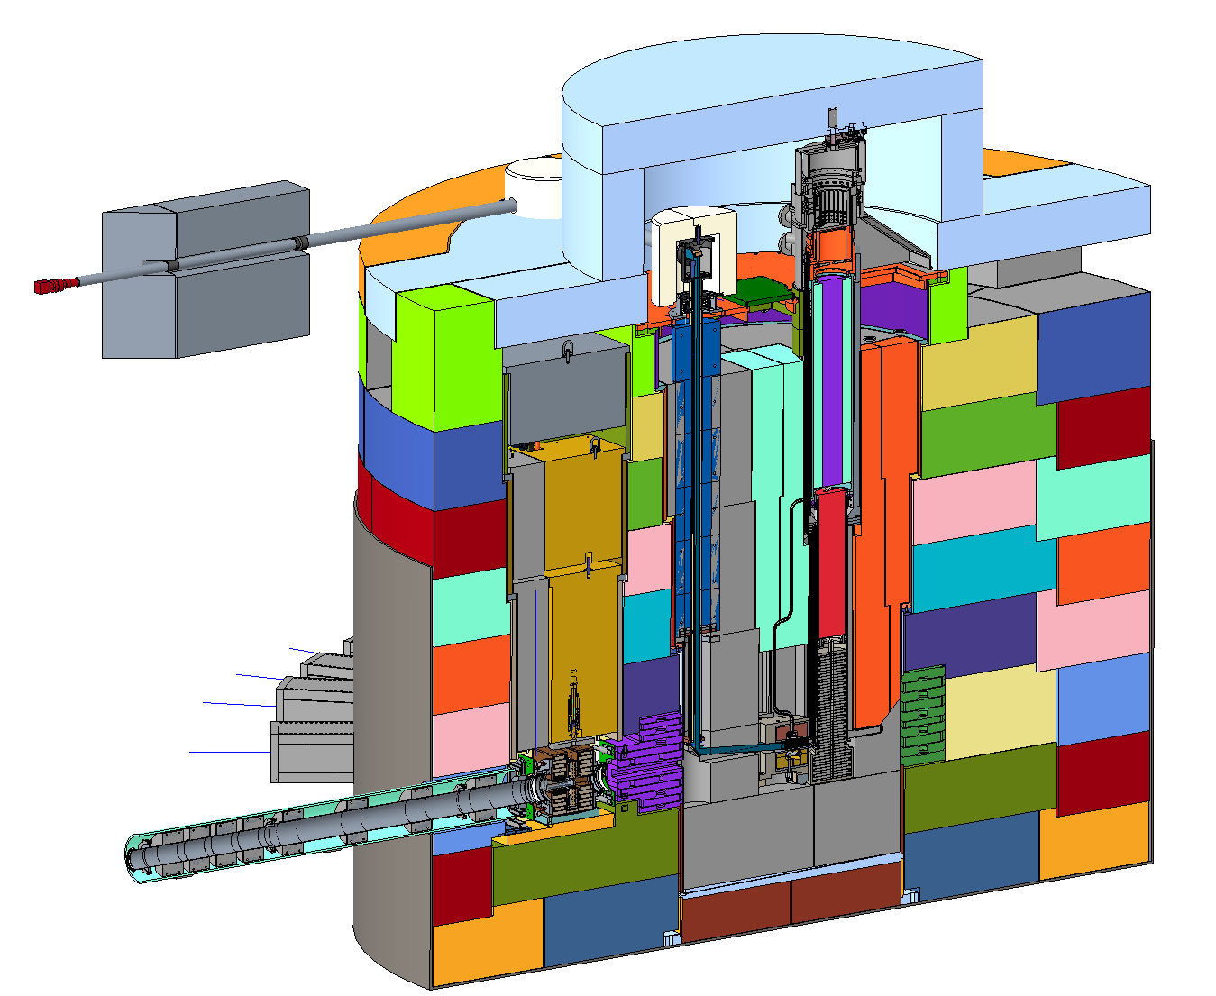
STS Target Systems
Target Assembly
Target Viewing
Periscope (TVP)
Moderator Reflector
Assembly (MRA)
Proton Beam Window (PBW)
Target Wheel
Proton
Beam

Slide 5
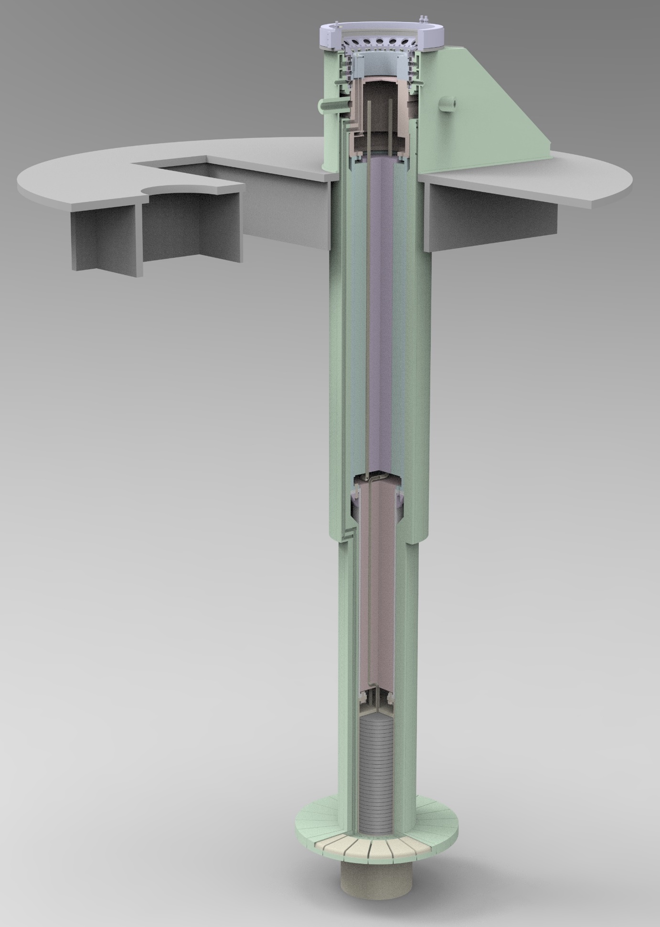
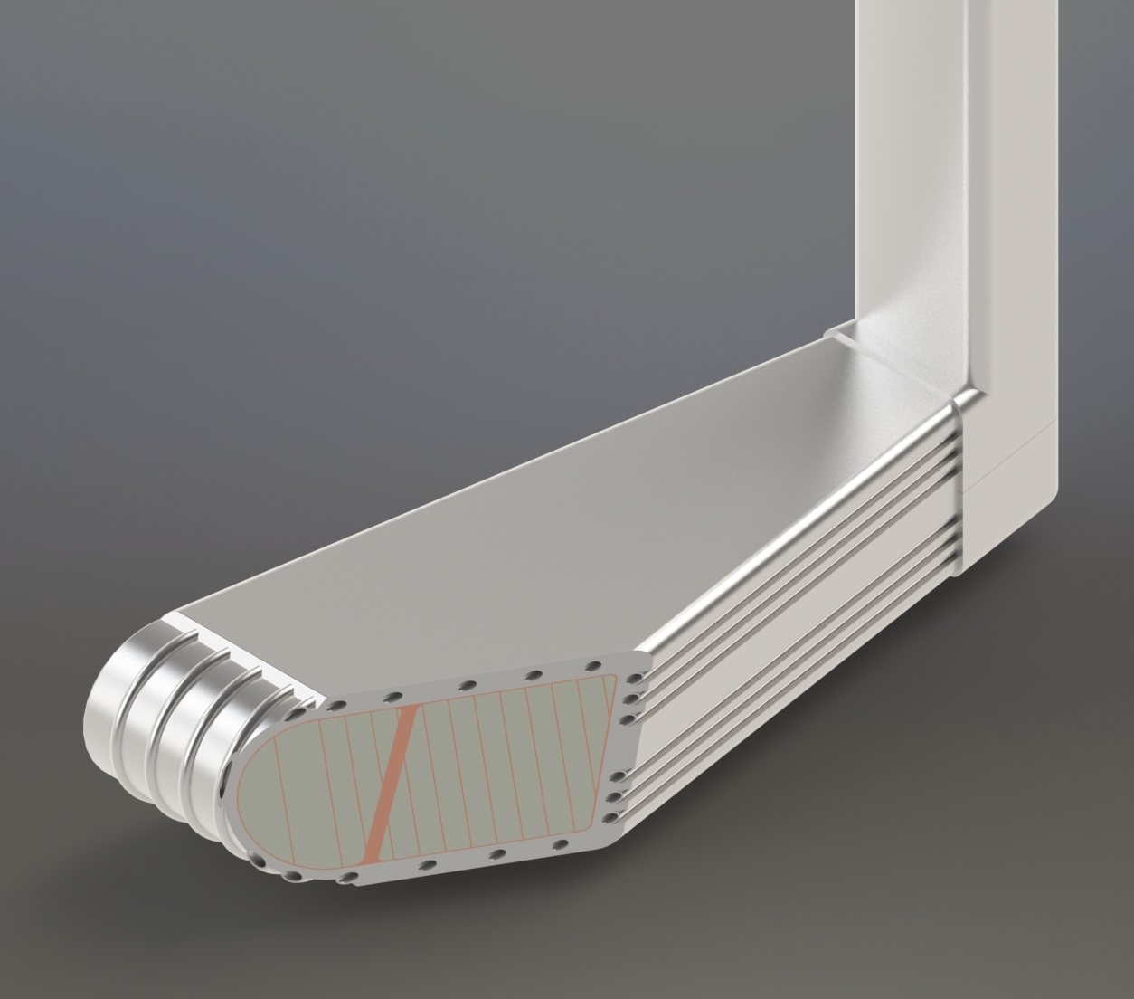
STS Target
Rotating solid tungsten target with 21 segments
Integrated monolithic segment structure
  Tungsten core bonded to Inconel 718 with thin copper thermal interface layer
  Target segment is edge cooled with water channels integrated in the Inconel 718 structure
Important to know the radiation damage behaviors of the target materials in spallation environment:
  Tungsten
  Copper
  Inconel 718

Slide 6
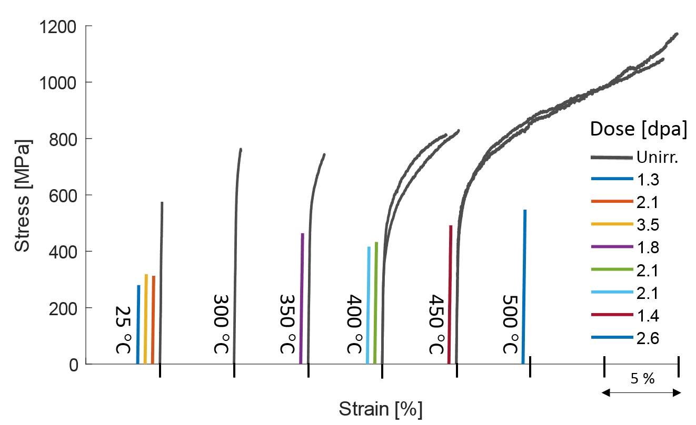
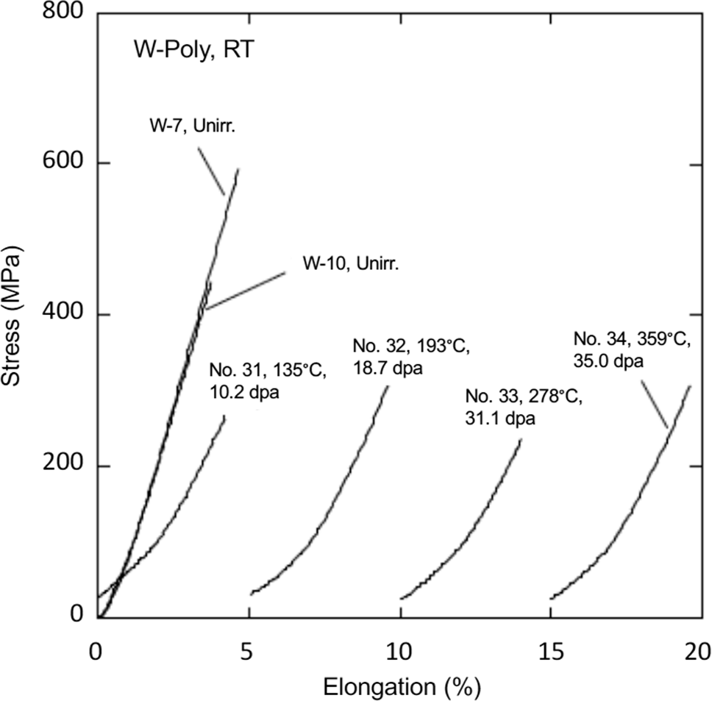
Tungsten - Radiation induced hardening and embrittlement
We know some.
  3-point bend tests (STIP-V):
    For > 1.3 dpa, DBTT is higher than 500 C
    Flexural strength reduces by ~1/2 for > 1.3 dpa
  Tensile tests (STIP-II):
    For > 10.2 dpa, UTS is reduced by ~1/2
J. Habainy et al.,
J of Nuclear Materials 514 (2019) 189
S. Saito et al.,
Nuclear Materials and Energy 34 (2023) 101338

Slide 7
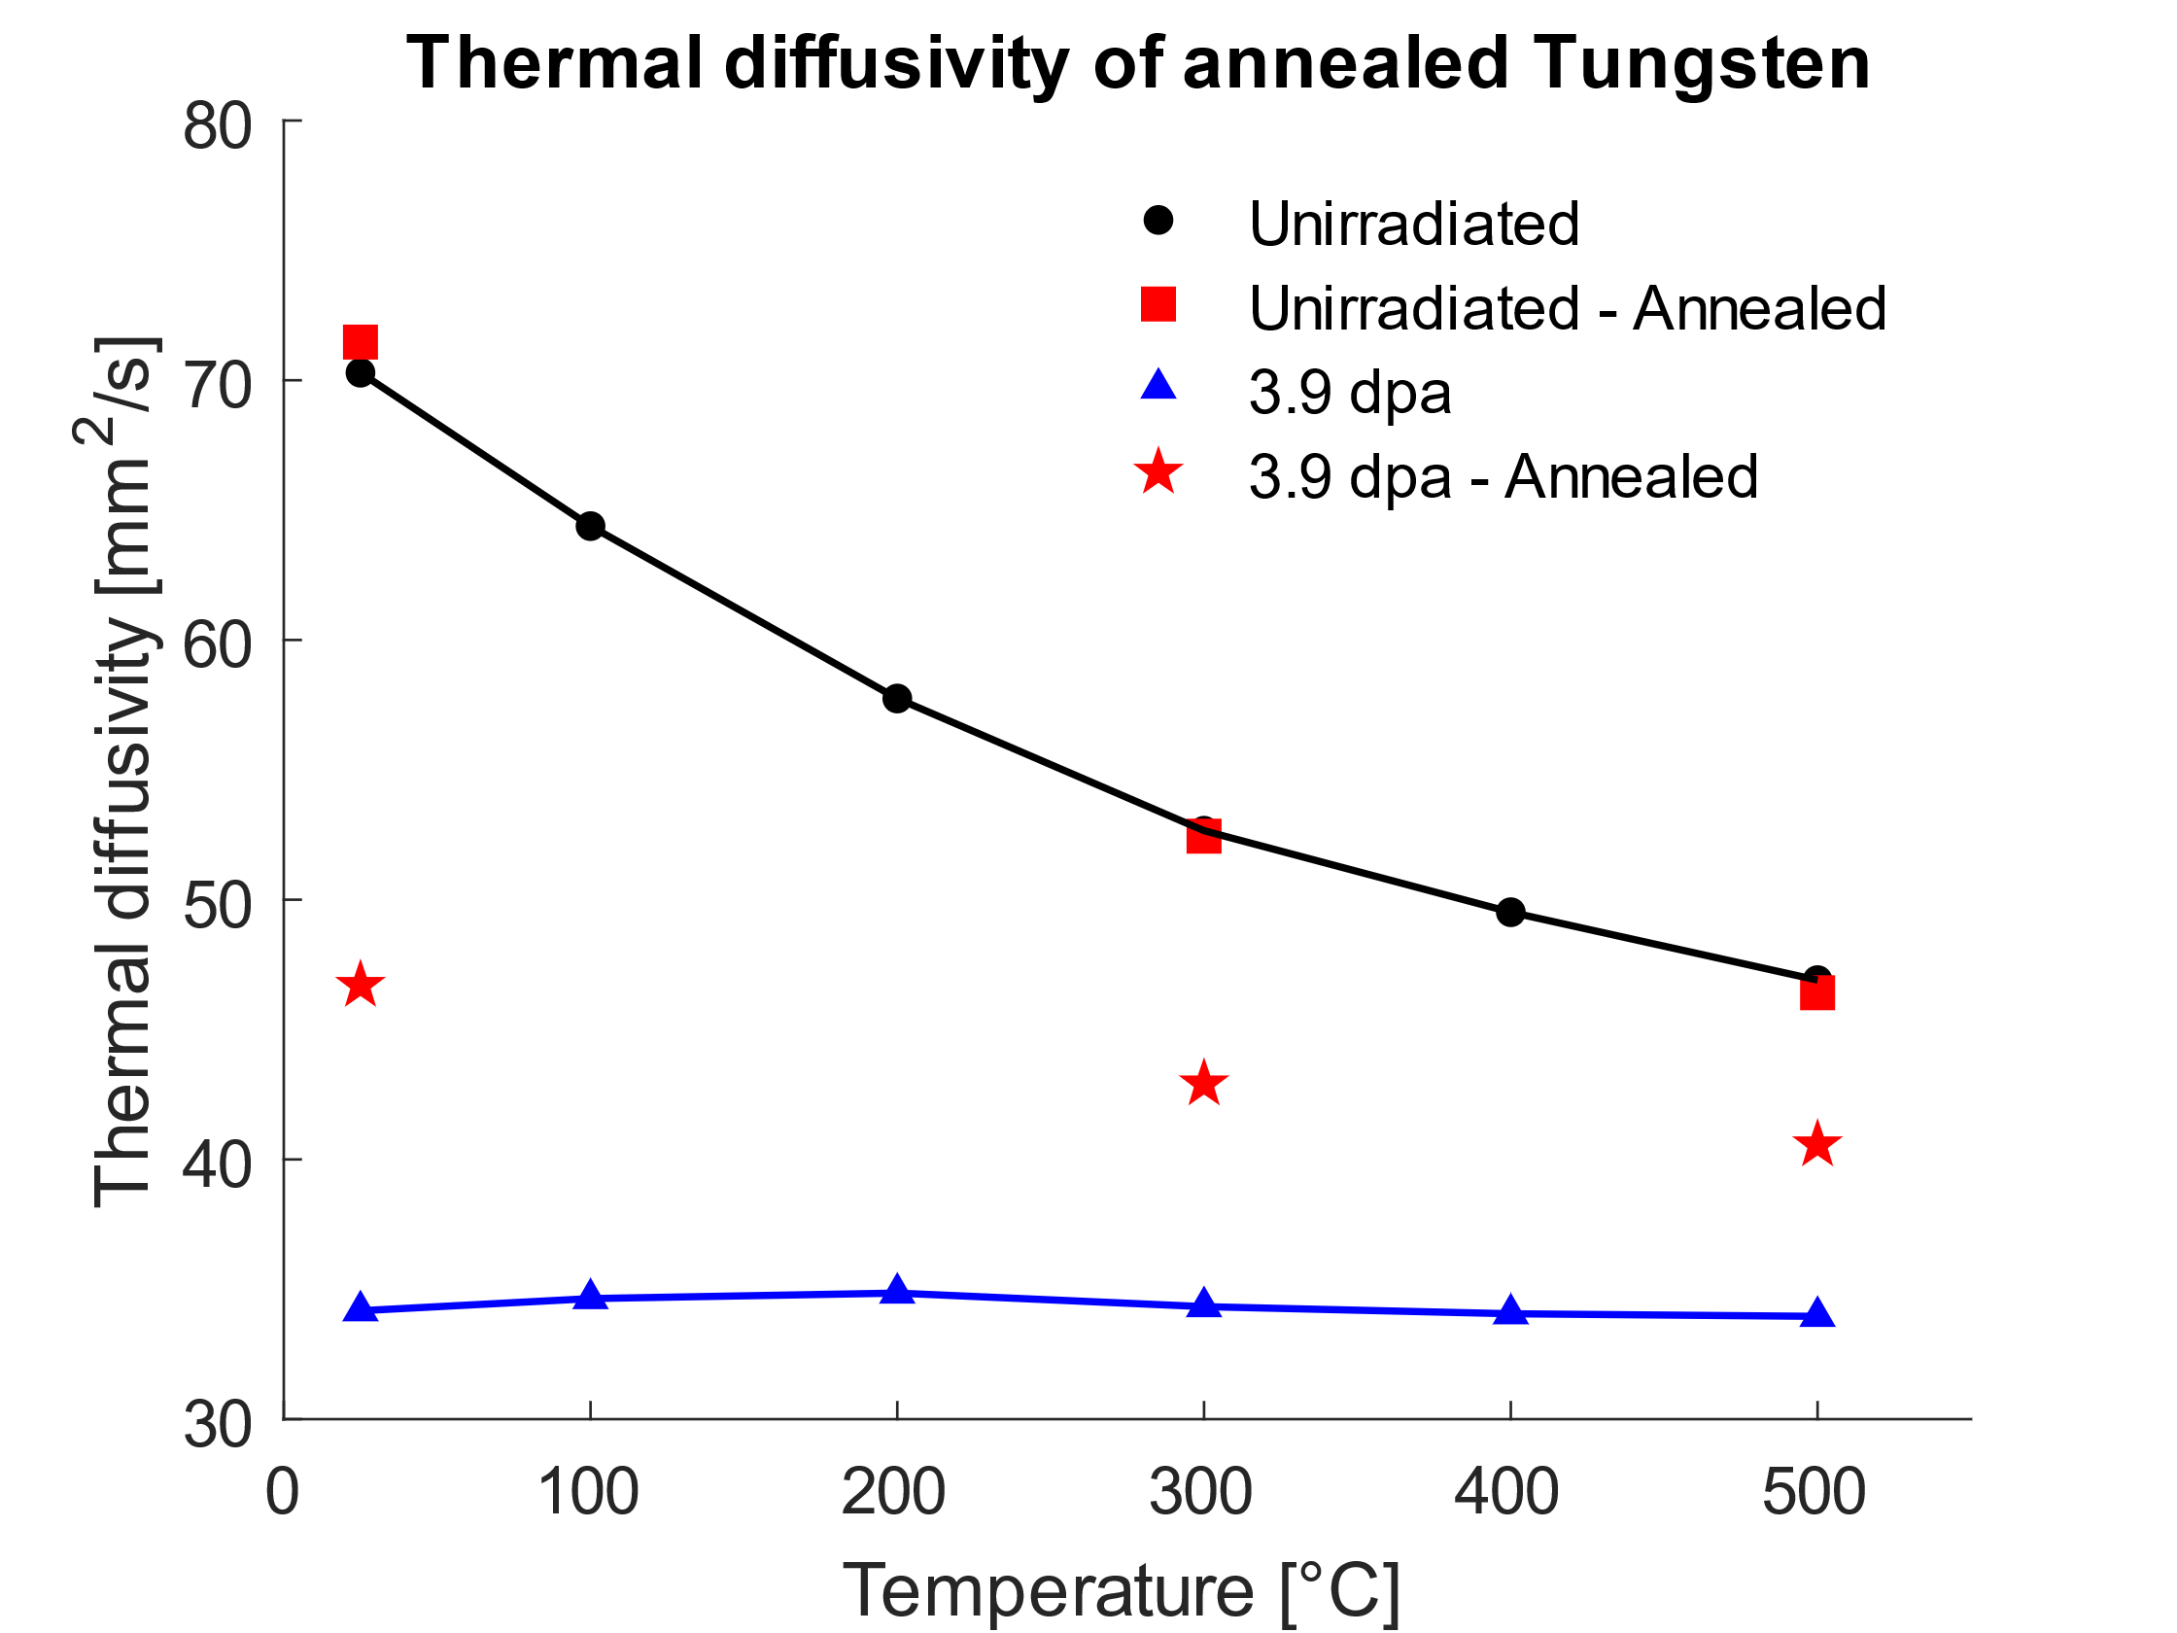
Tungsten - Radiation induced thermal diffusivity decrease
We know some
  Decrease of thermal diffusivity due to:
    Displacement damage
      Saturates at > 1 dpa
    Solid transmutation
      Rhenium production via thermal neutron capture and beat decay
  Loss of thermal conductivity increases energy deposition driven steady thermomechanical stress
J. Habainy et al.
JNM 509 (2018) 140

Slide 8
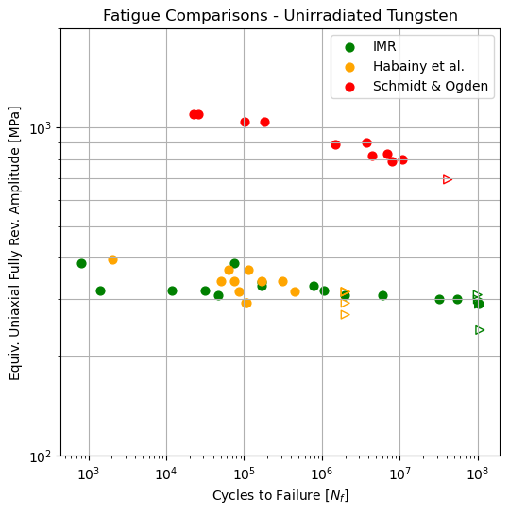
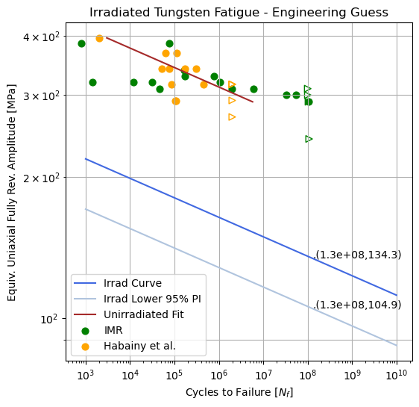
Tungsten – Fatigue (Missing Puzzle)
Unirradiated
Irradiated
The fatigue S-N curve data point are highly stochastic, posing challenges with lifetime estimates
We make educated guess … so far.
Fatigue data of unirradiated tungsten specimens were scaled with STIP-V bend test data

Slide 9
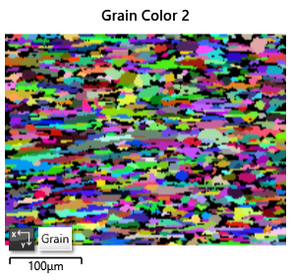
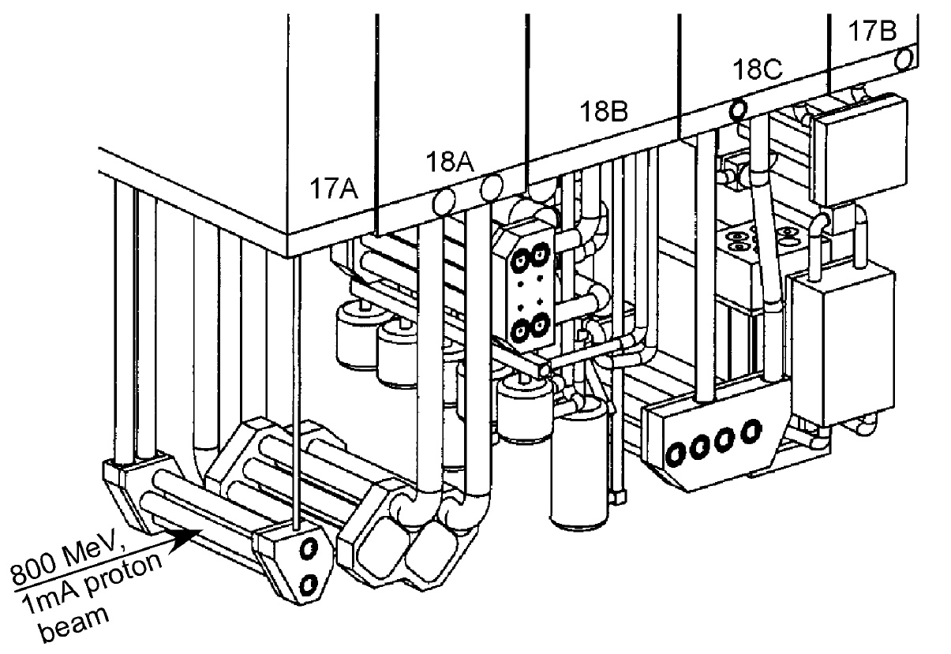
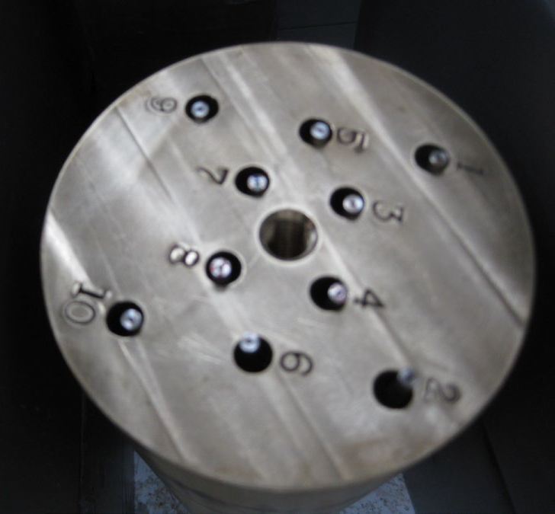
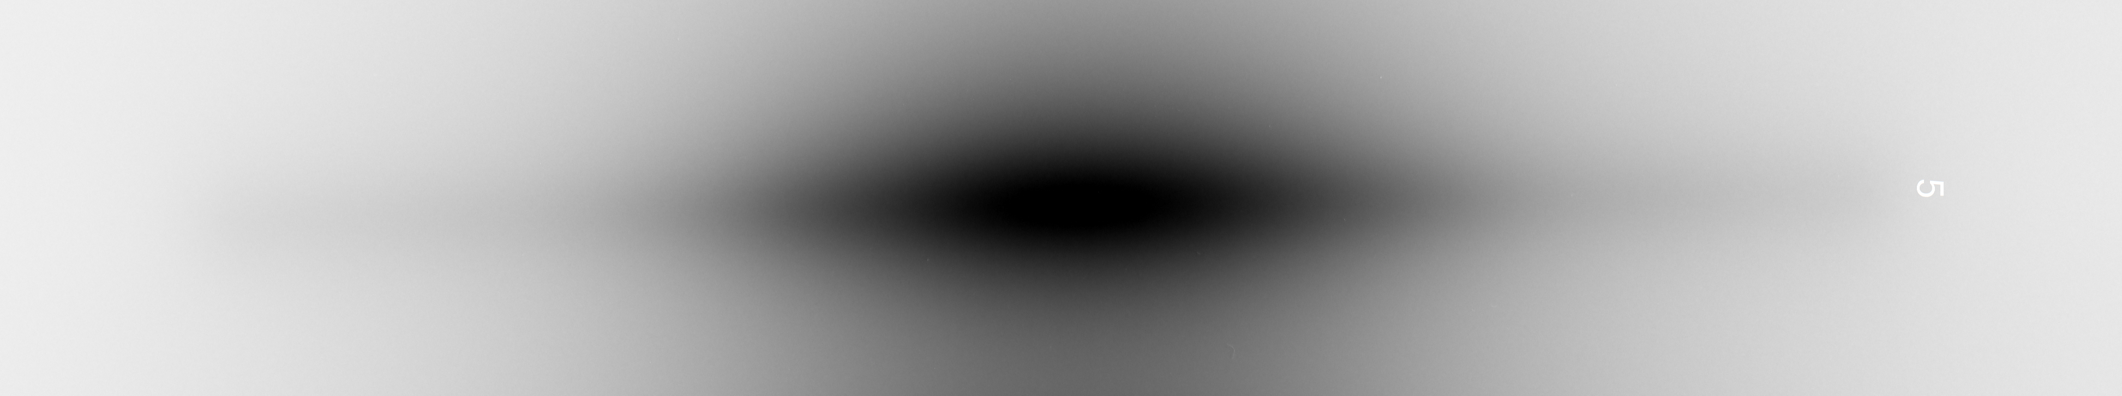
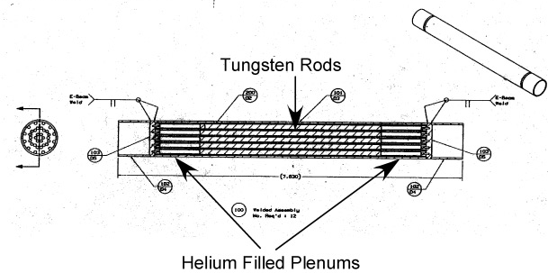
Proton irradiated tungsten rods from LANSCE
Samples
Tests to be performed
Inventory:
  10+ H⁺-irradiated rods (𝛷2.6 mm; ℓ106 mm)
  2+ control rods
Irradiation profile:
  Max DPA: 25
  Max irradiation temperature: 271 C
  H-appm/dpa = 447; He-appm/dpa = 83
Radiography
Bend tests/Bend fatigue tests:
  Cantilever loading on notched W rods
  Biaxial ball loading on miniature discs
Elastic modulus
Microstructural characterization

Slide 10
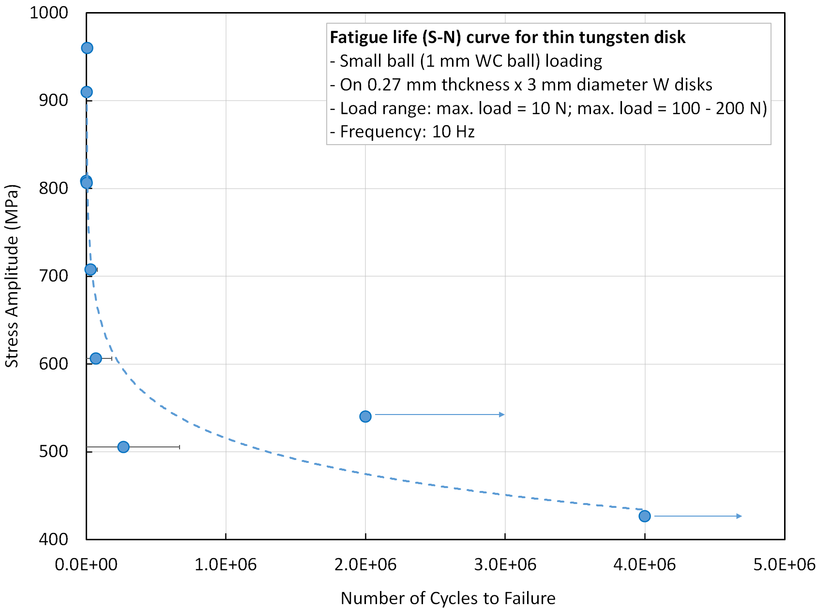
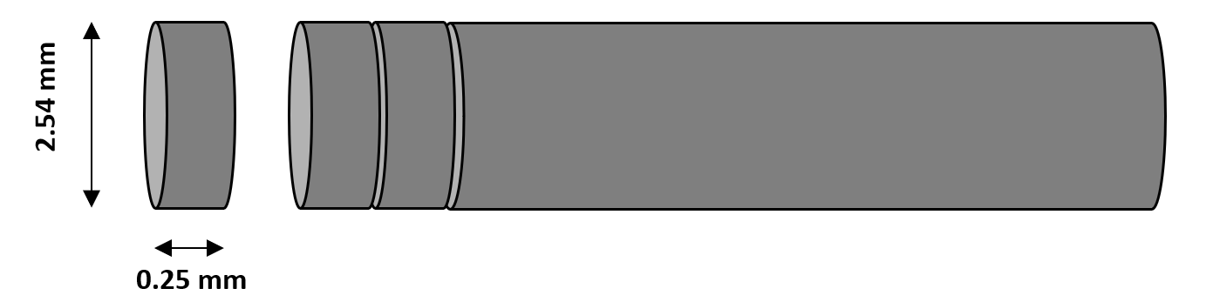
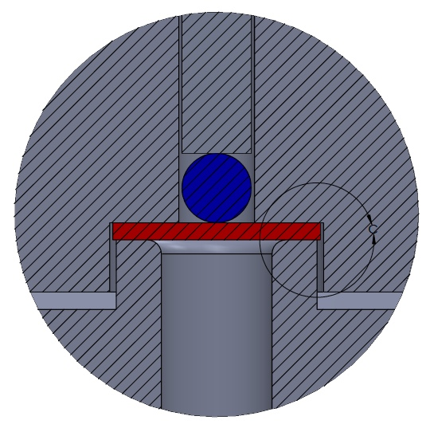
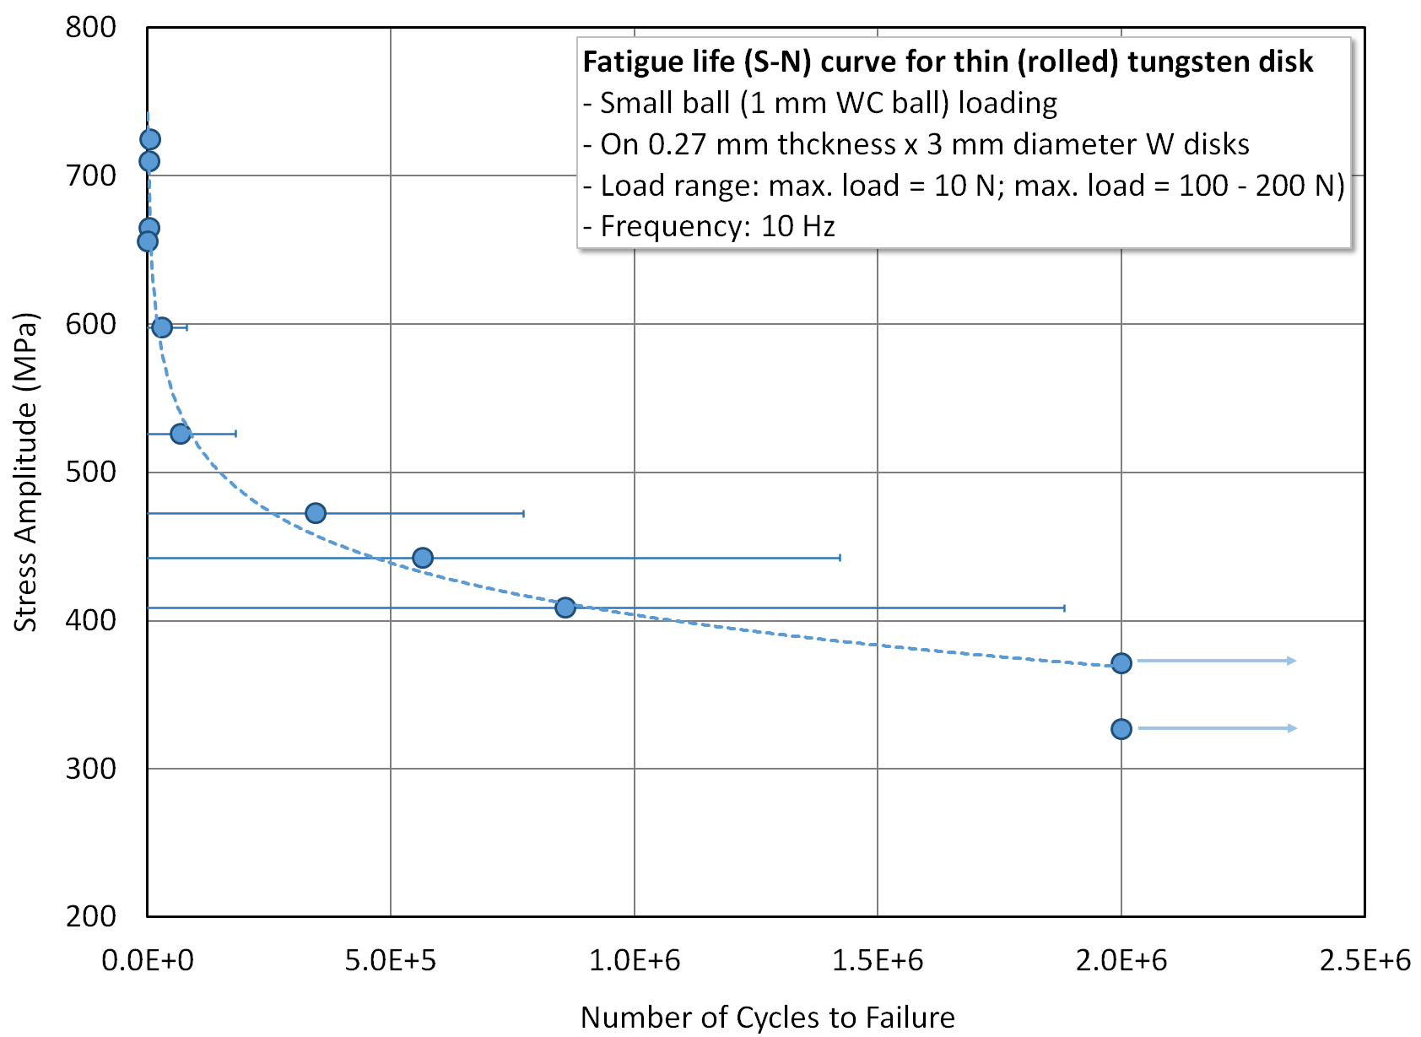
WC-ball loaded bend fatigue tests on miniature discs
Biaxial ball loading
Miniature disc samples can be cut from small diameter tungsten rods
  Each cut location correlates to different dpa => Large S-N data points
Feasibility study with TEM/SP samples has performed

Slide 11
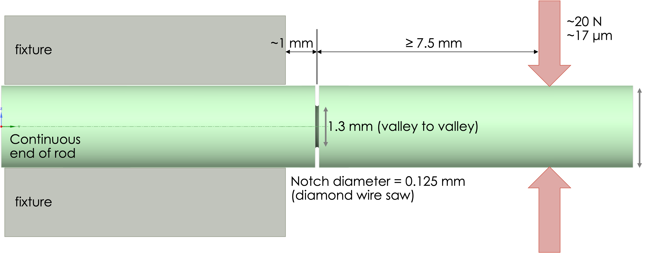
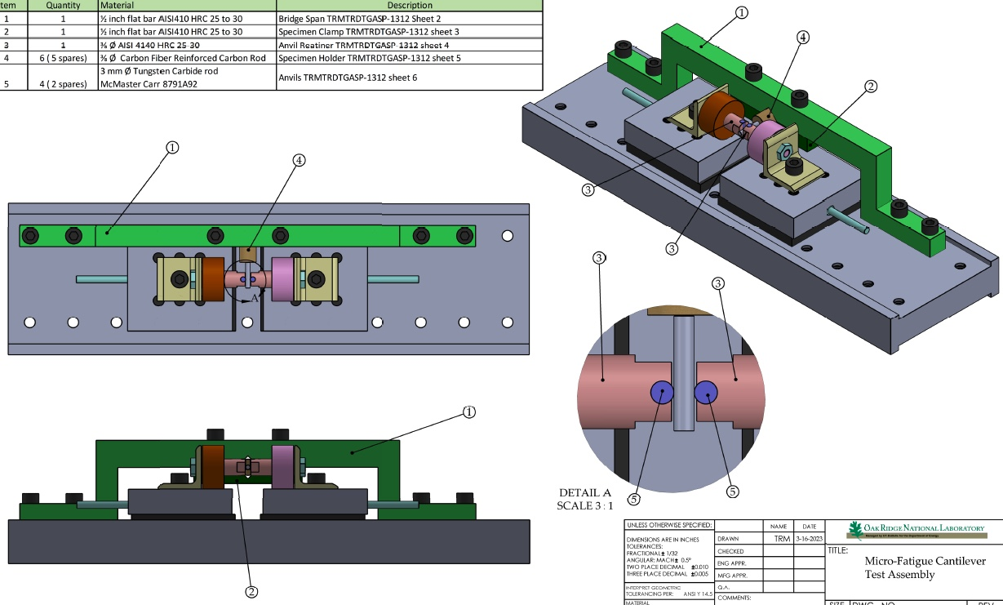
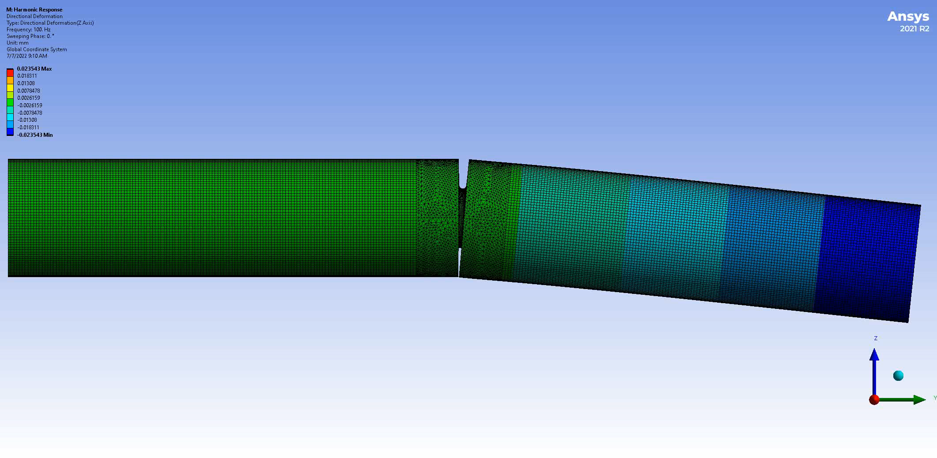
Bend fatigue tests with notched W-cantilever
Concept
Test setup
Notches made with diamond wire saw
  About 10 data points per each chosen dpa
  Wire diameter: 0.125 mm
  Notch depth: 0.65 mm
Piezo controller has max 75 Vdc excitation to provide 0–30-micron displacements
  20 um lateral displacement will yield >1000 MPa tensile load on the notch

Slide 12
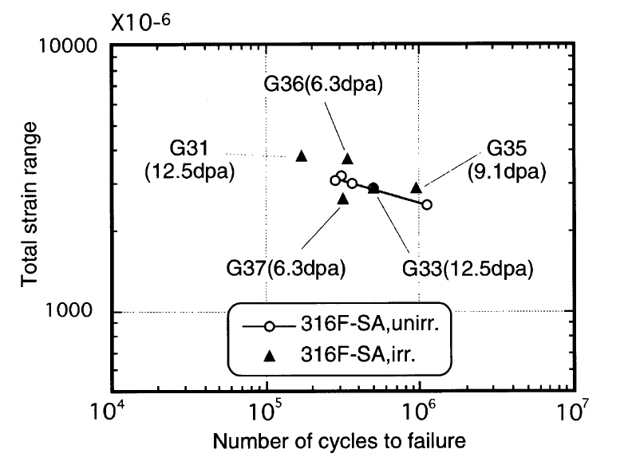
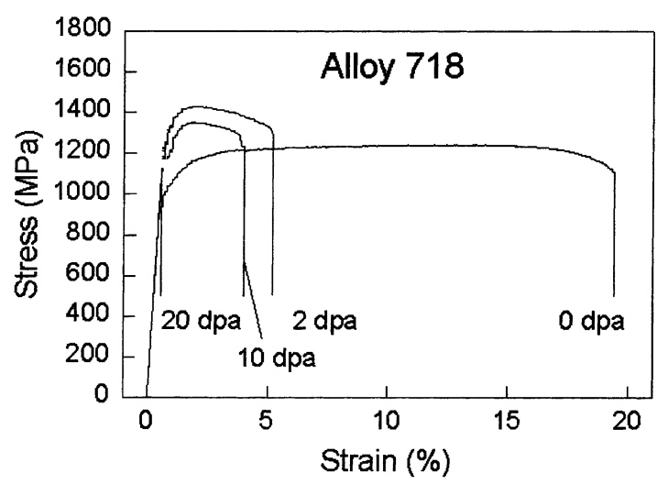
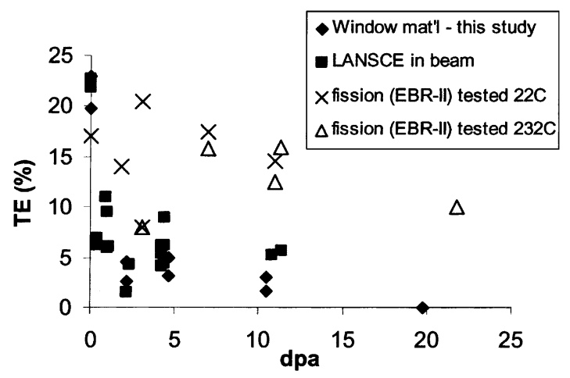
Irradiated Inconel 718
Operational record with H⁺ beam
Irradiated properties
PBW of SNS:
  9.7 DPA, 1833 He-appm, 7211 H-appm [D. A. McClintock et al., Acta Materialia 231 (2022) 117889
PBW of LANSCE
  20 DPA at 400ºC [M. R. James et al., JNM 296 (2001) 139-144]
Radiation induced embrittlement behavior:
  Not fully understood but it seems that Inconel 718 retains a certain level of ductility at 10 dpa.
Unknowns:
  Fatigue behavior under radiation damage
  Disposal path of Nb-94

Slide 13
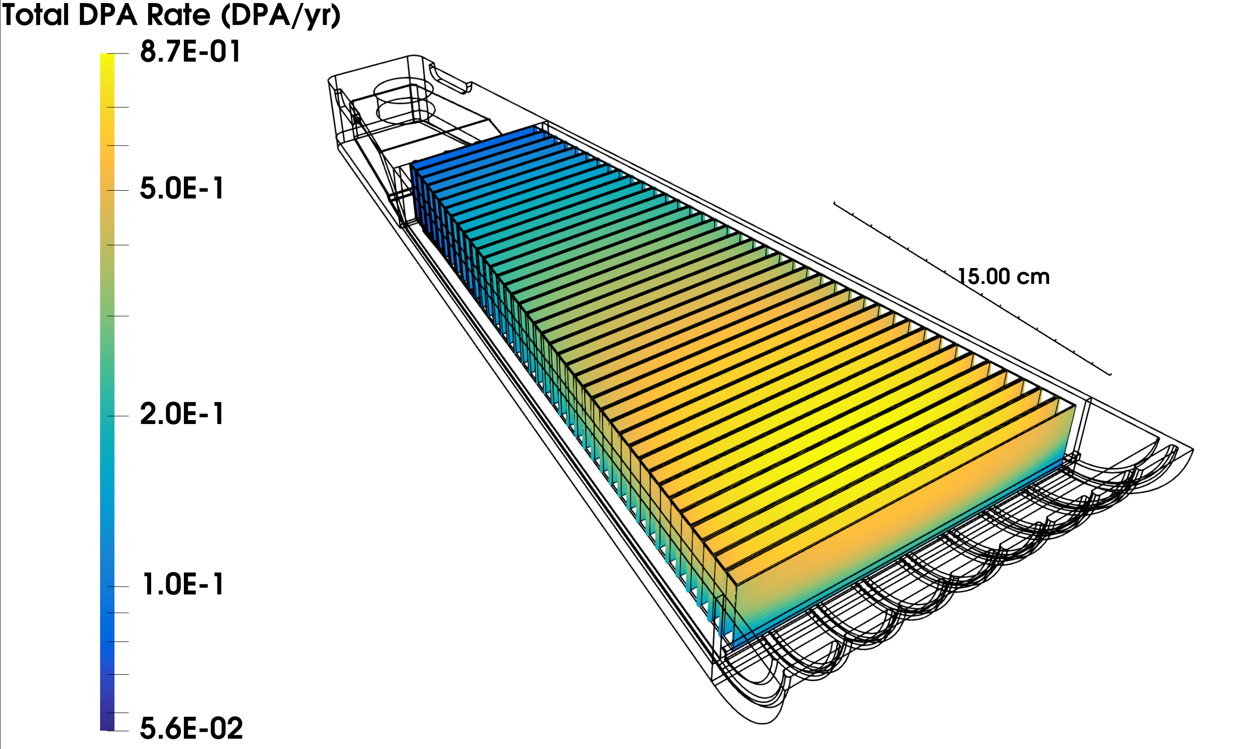
DPA and He-Production Rates in Copper
Reference Beam Profile:
  90 cm2 beam footprint on the target
  5000 hours annual beam on target operation
Reference DPA and He-Production Rates
  Peak DPA rate (8th Cu layer): 0.9 DPA/yr
  Volume-averaged He-production in 1st Cu layer: 22 He-appm/yr
  Volume-averaged DPA rate in 1st Cu layer: 0.5 DPA/yr => 44 He-appm/DPA
Target representative numbers after 10 years of operation
  He-content: 500 He-appm
  DPA: 10 DPA
MCNP calculations by
T. McClanahan and L. Zavorka

Slide 14
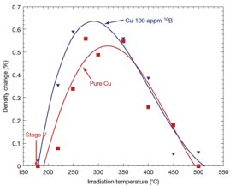
Copper - Swelling
Zinkle: Temperature range where swelling becomes an issue
  Fission neutrons (1.1-1.3 DPA): > 190 C
  100 appm-He doping: > 180 C
    Lowering of the setoff temperature by -10 C
    Lowering of max-swelling temp. by -20 C
  Swelling and DPA
    A steady-state swelling rate of 0.5%/dpa is observed in Cu at high doses, and the swelling level can be as high as 60%.
  Swelling and DPA rate:
    An order of magnitude decrease in neutron flux can lower the peak swelling temperature by 20 C
      Zinkle: 2e-7 dpa/s
      STS: < 6e-8 dpa/s < 2e-7 dpa/s
Xu: Both He and H enhanced void swelling
  The effect of H is more important at low temp. (646 K)
    STS: H production rate is by an order of magnitude higher than that of He.
  He effect dominates at high temp. (683 K)
Questions:
  Swelling rate in spallation environment
  Swelling setoff temperature for high He-appm
S J Zinkle (2016)
Phys. Scr. 2016 014004

Slide 15
Copper - Stress-Strain Curves
Fission neutron radiation data:
  He-production rate: Orders of magnitudes lower He-appm/DPA compared to STS
  Radiation hardening effect saturates at 0.1 DPA
  Yield stress at low temperatures (< 250 C) increase more than factor 5
  Loss of UE below 200 C with recovery of strain hardening above 200 C
Initial Postulation on Inelastic Analysis Procedure (IAP) for DEMO:
  T < 200 C: Stress-strain curve with radiation hardening
  T > 200 C: Stress-strain curve of unirradiated Cu with modified yield strength
S J Zinkle (2016)
Phys. Scr. 2016 014004

Slide 16
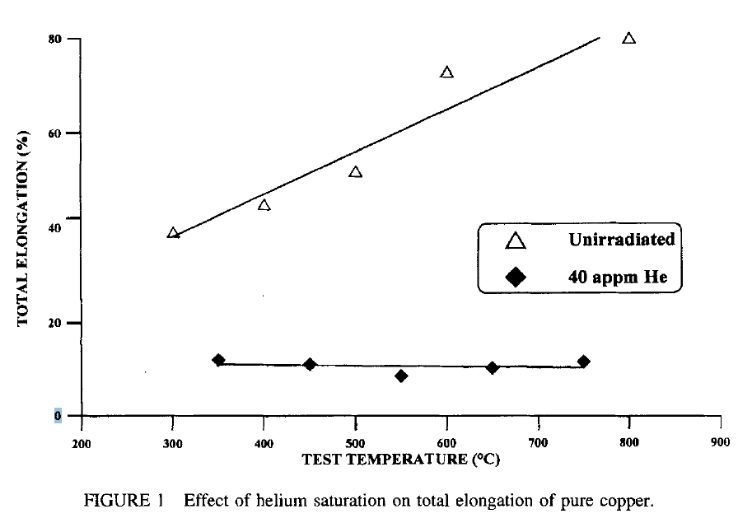
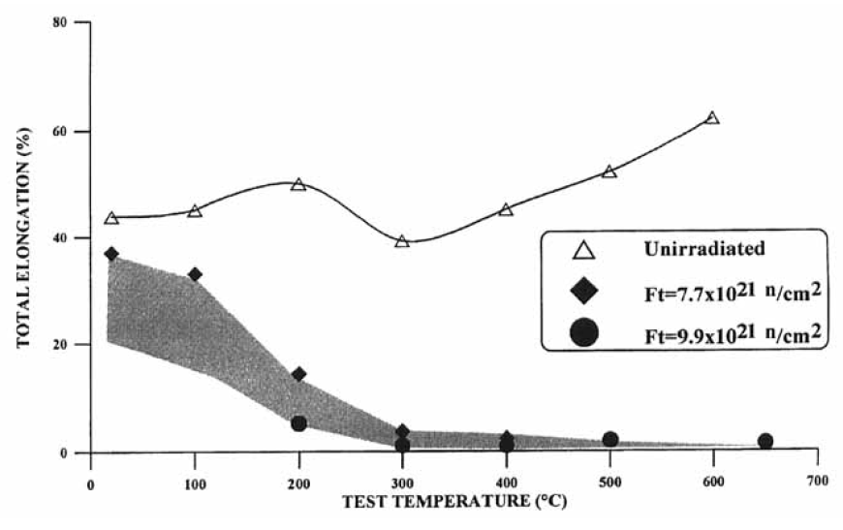
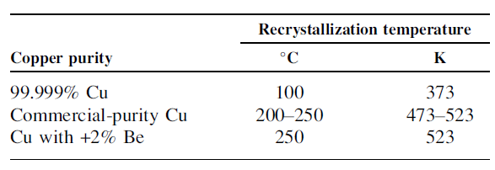
Copper - Stress-Strain Curves: Helium Effect
Cyclotron at E = 40 MeV
  Helium saturated at 40 He-appm
  Low irradiation temp.: 100 C
BOR-60 reactor: Sodium cooled fast reactor
  Fast neutron fluence (~ 2 DPA):
    7.7e21 n/cm2 (Trad = 335 C)
    9.9e21 n/cm2 (Trad = 345 C)
  2 He-appm
Cu has a very low resistance to He-embrittlement
  Almost complete loss of TE for T > 300 C
  Attributed to an effective He-accumulation at the grain boundaries during an accumulating recrystallization under irradiation
Question:
  Whether He-embrittlement is progressively worsening with increasing He-appm.
S. A. FABRITSIEV et al. (1997)
Plasma Devices and Operations, Vol. 5

Slide 17
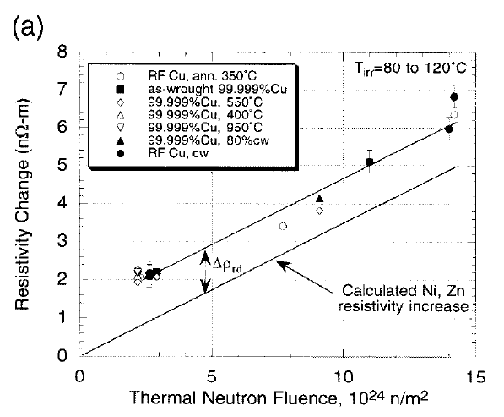
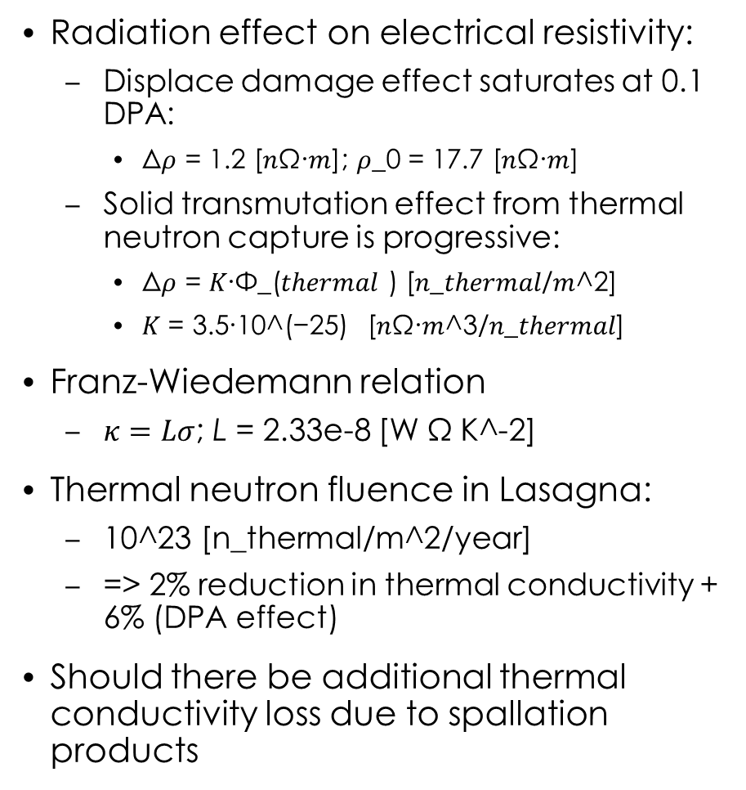
Copper - Thermal Conductivity
Radiation effect on electrical resistivity:
  Displace damage effect saturates at 0.1 DPA:
    Δ𝜌 = 1.2 [𝑛Ω∙𝑚]; 𝜌_0 = 17.7 [𝑛Ω∙𝑚]
  Solid transmutation effect from thermal neutron capture is progressive:
    Δ𝜌 = 𝐾∙Φ_(𝑡ℎ𝑒𝑟𝑚𝑎𝑙 ) [𝑛_𝑡ℎ𝑒𝑟𝑚𝑎𝑙/𝑚^2]
    𝐾 = 3.5∙10^(−25) [𝑛Ω∙𝑚^3/𝑛_𝑡ℎ𝑒𝑟𝑚𝑎𝑙]
Franz-Wiedemann relation
  $κ=Lσ$; L = 2.33e-8 [W Ω K^-2]
Thermal neutron fluence in Lasagna:
  10^23 [n_thermal/m^2/year]
  => 2% reduction in thermal conductivity + 6% (DPA effect)
Should there be additional thermal conductivity loss due to spallation products
IAP for ITER:
  Lifetime neutron fluence: 5 DPA
  Contributions from DPA, solid-transmutation and swelling = 15 %
Questions:
  Quantitative evaluation of spallation product and swelling effects.
Has someone done proton irradiation and PIE on pure copper?
S. A. FABRITSIEV et al.
JNM 233-237 (1996)

Slide 18
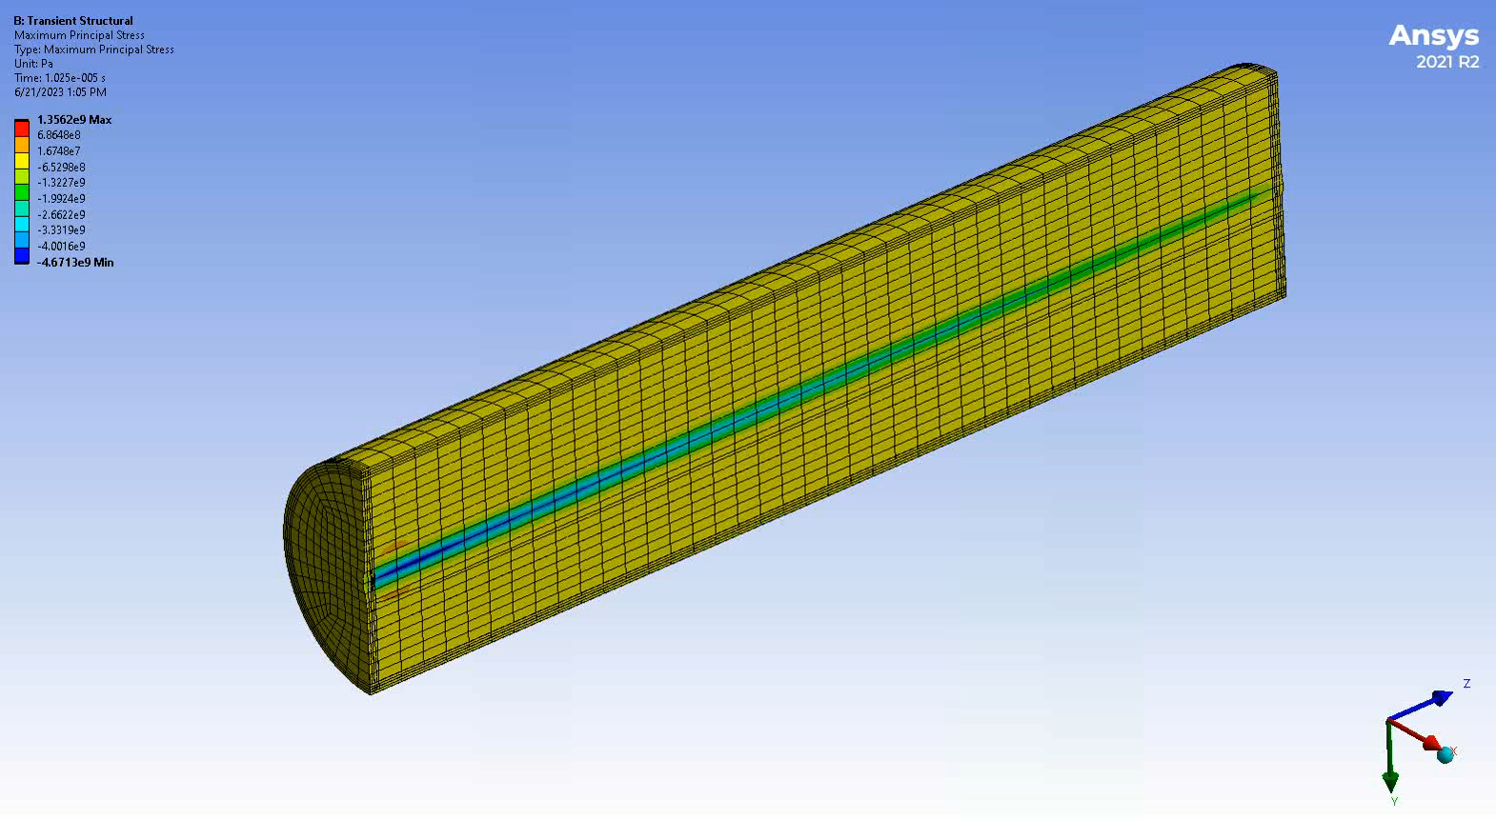
Dynamic Response of Solid Target to Beam Pulse - HiRadMat
To understand the structural integration of the W, Cu and Inconel parts under massive beam pulse
HiRadMat beam will push the target prototype to its structural limit and beyond
  Internal structural damage
    Dynamic strain response
    LDV
    Acoustic fingerprint
  Thermal contact damage
    IR: Temperature change on the surface
Simulation based on
Proton momentum: 440 GeV/c
Bunch intensity: 5e9 protons
Number of bunches: 41
Pulse length: 1.025 us
=> > 1.3 GPa Max. Principal Stress in W

Slide 19
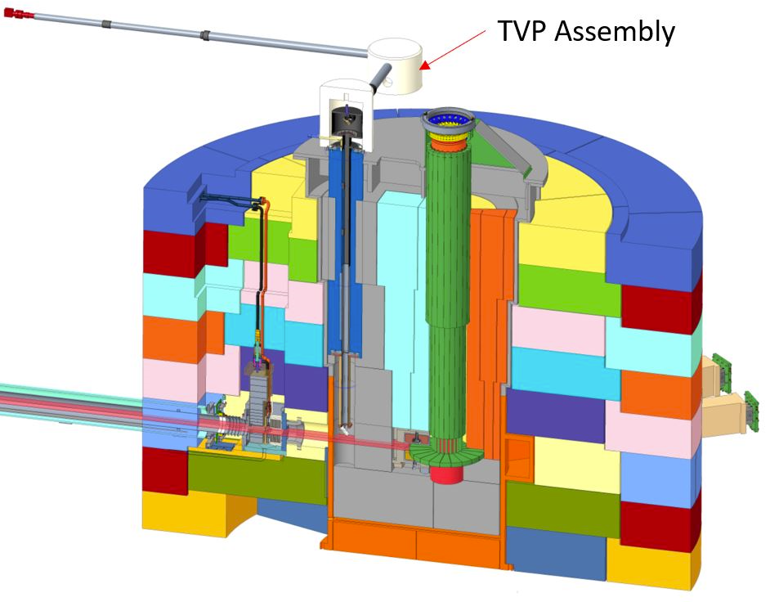
Target Viewing Periscope (TVP) Assembly - Beam imaging from luminescent coating
Luminescent coating materials with high luminosity and radiation resistance
Vacuum windows with high transmission coefficients for visible and infrared lights
Mirror with high reflectivity and resistance to nitric acid corrosion
M3
M2
M1

Slide 20
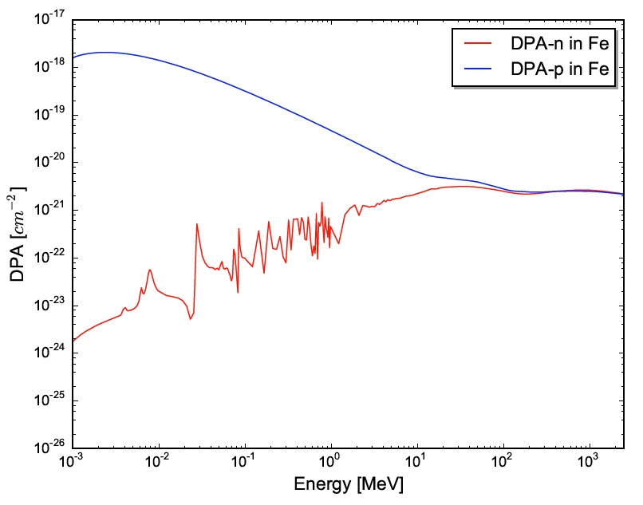
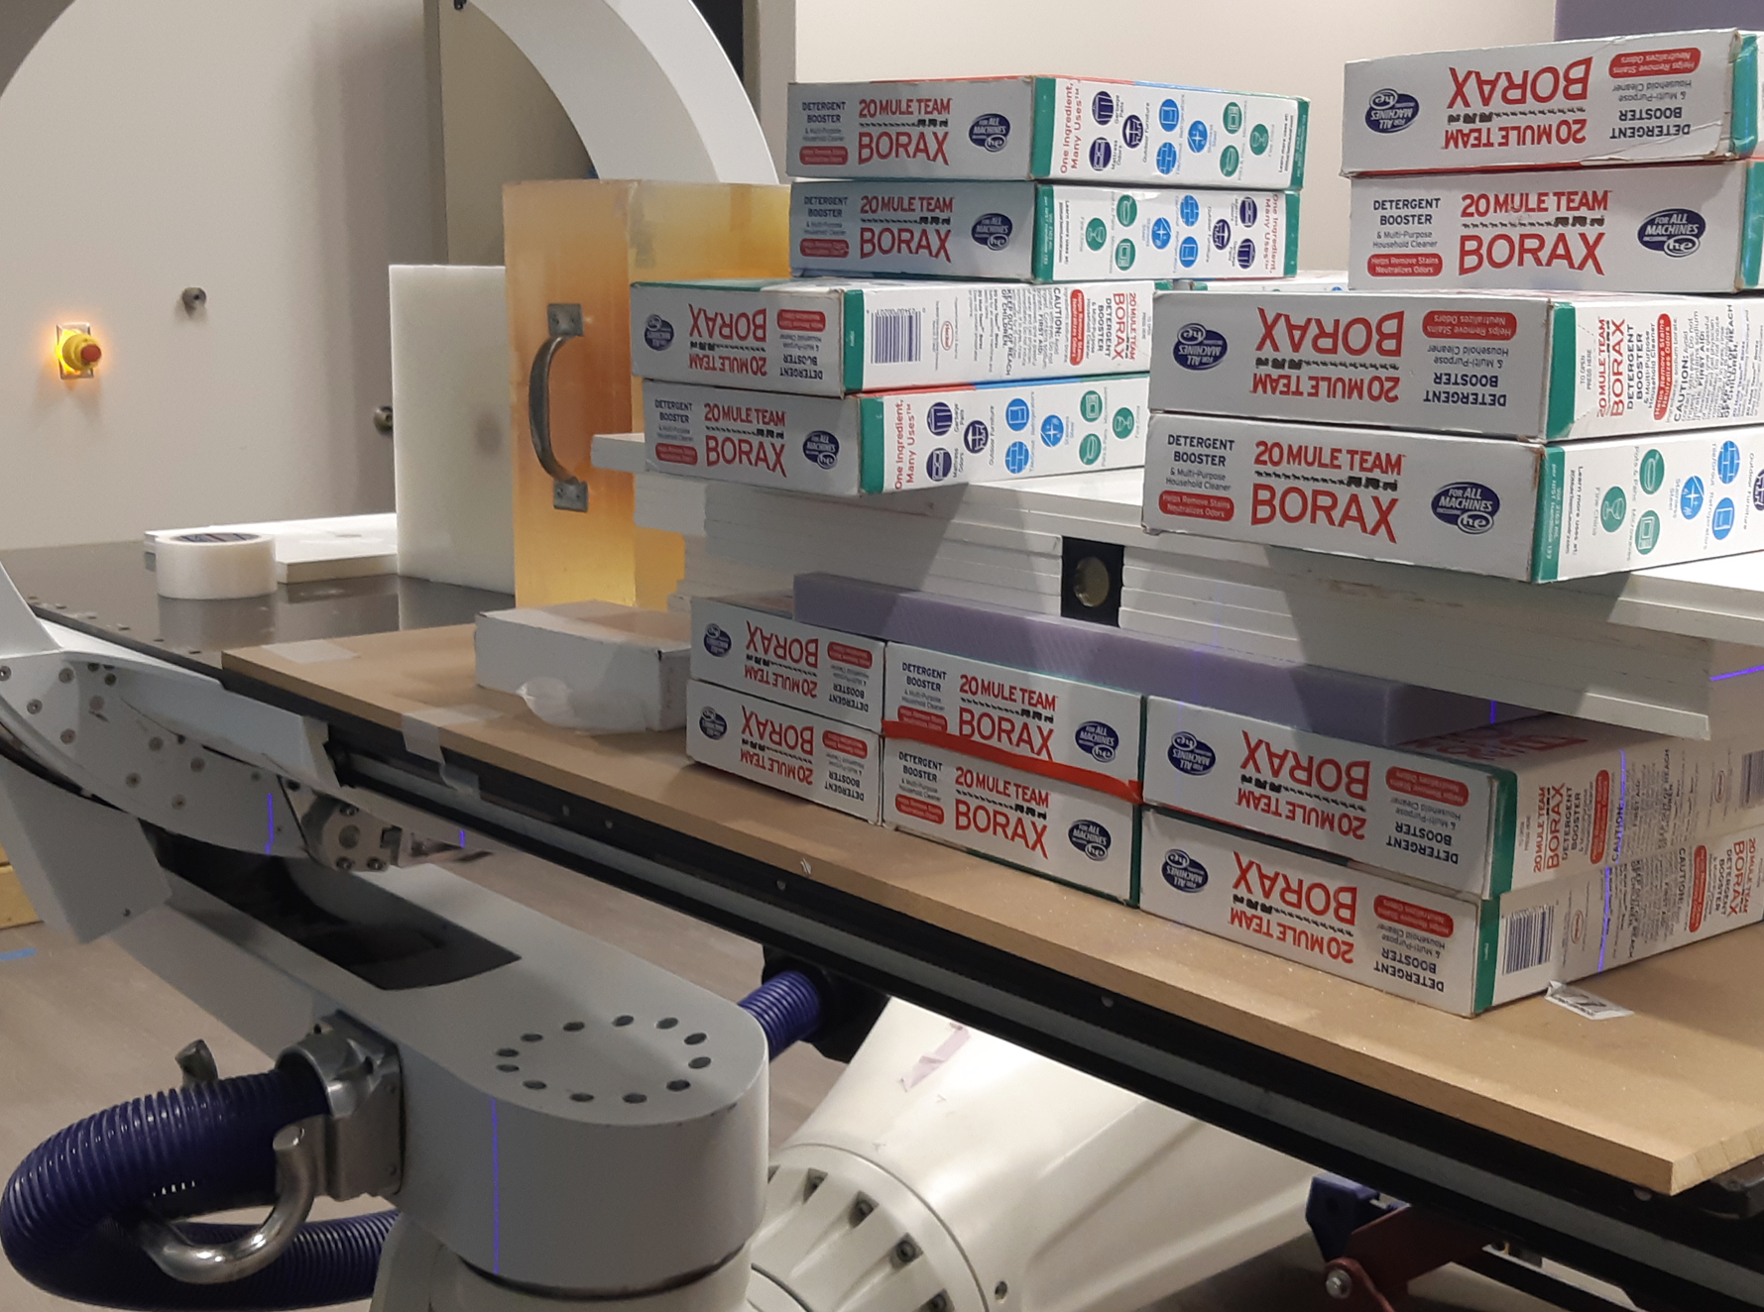
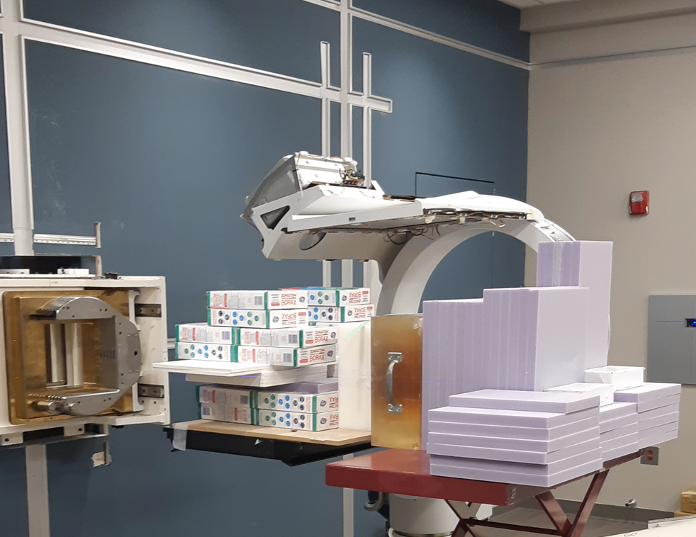
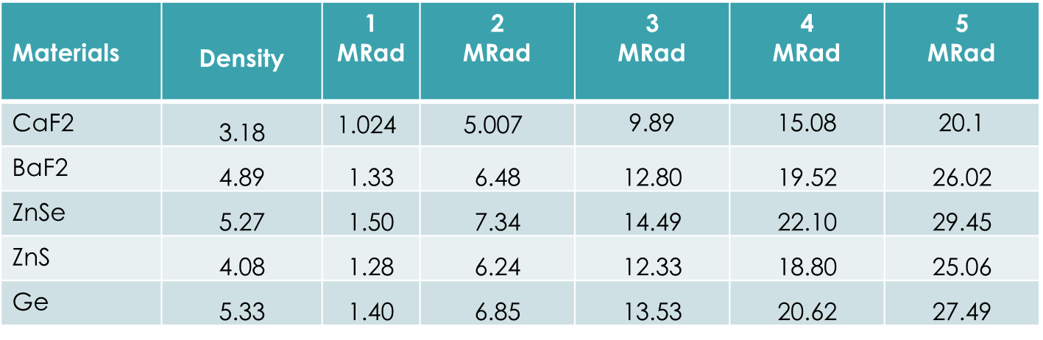
R&D TVP windows
Radiation environment of TVP window
Proton irradiation campaign - Pronova
Radiation environment of TVP window
  Mostly neutron dose: 4.28e7 n/cm²/s
  50 kGy (5 Mrad) neutron dose/year
Proton energy: 226 MeV
  At high energies > 10 MeV, the n-dpa-xs is similar to p-dpa-xs
Sample materials: BaF₂, ZnSe, ZnS , CaF₂, Ge
  𝛷25 mm; ℓ4 mm)

Slide 21
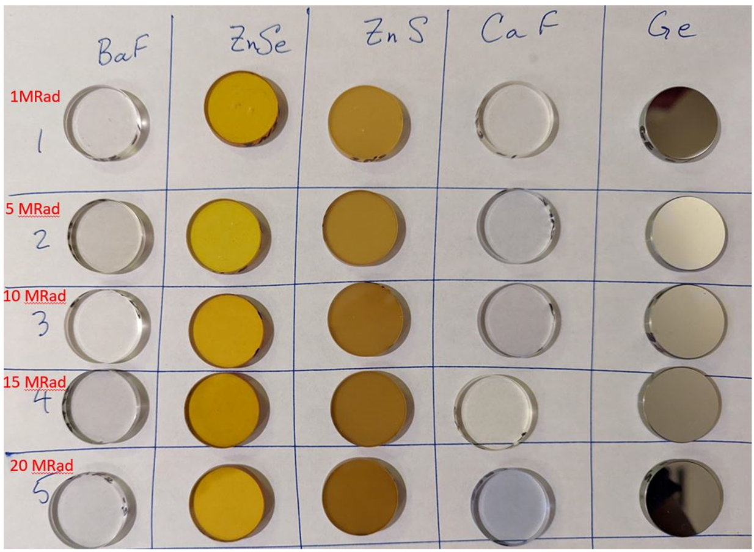
TVP R&D – Proton Irradiation for Windows
FTIR (Fourier-transform Infrared) and visible spectrometer measurements of proton irradiated samples done at ORNL
Shortlisted Vacuum Window materials based on Proton Irradiation : ZnSe, BaF₂
  ZnSe and BaF₂ showed little to no radiation damage until 20MRad
  ZnSe has wider wavelength range from visible -15µm but lower transmission (~70%)
  BaF₂ has higher transmission(~90%), but range is visible - 10µm
ZnSe Transmission at 0-20 MRad Dose

Slide 22
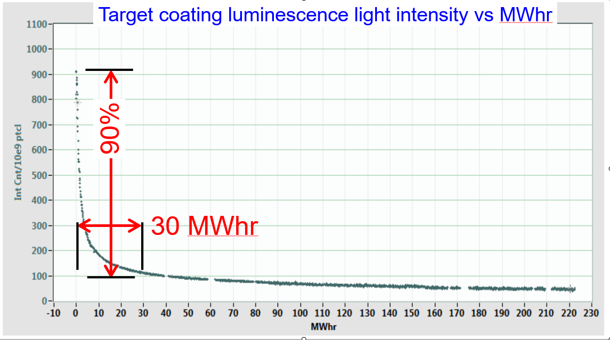
Luminescent Coating Materials
Candidate materials:
  Ce-doped YAG
  Cr-doped Al2O3
  mixed Ce-doped YAG/Al2O3 (1:1)
  Etc.
Challenges:
  Development of coating parameters
  Radiation induced luminescence attenuation
Damage rate to MWh
< 0.003 DPA/MWh
Coating material represented by Al2O3 (Alumina)

Slide 23
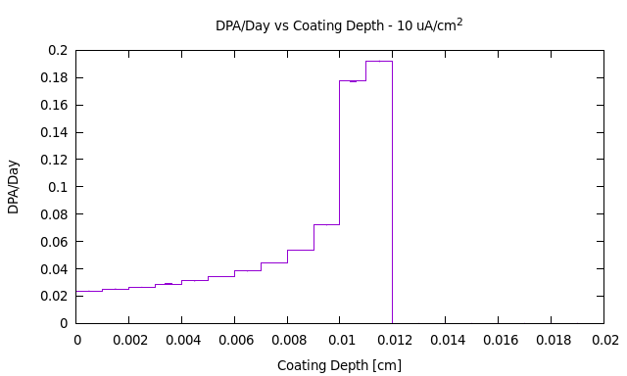
Coating - Radiation Campaign Feasibility
Radiation requirement
  Order of 0.1 DPA damage in the coating material
    Corresponds to several 100 MWh beam on target at SNS
Michigan Ion Beam Laboratory (Option)
  Beam parameters (Jiao)
    Maximum proton energy: 4.8 MeV – below Coulomb barrier
    Maximum proton current: 25-40 uA
    Beam intensity: Variable – Beam raster with FWHM 2-3 mm
Simulation based on
Proton energy: 4.8 MeV
Beam current density: 10 uA/cm2
Coating material represented by Al2O3 (Alumina)

Slide 24
Summary
Design by analysis of the STS target needs data on radiation damage characteristics of the following materials in spallation environments:
  Tungsten: Fatigue data is lacking. Tests are planned with tungsten rods irradiated at LANSCE
  Copper: Critical are radiation induced swelling and helium embrittlement.
  Inconel 718: Fatigue data is lacking
Dynamic response of the integrated target segment monolithic structure and structural internal damage mechanism damage can be understood with HiRadMat beams.
Luminescent coating materials R&D needs dedicated irradiation campaign
  Preferred is proton beam with energy below Coulomb barrier
    Only marginal activation
    High DPA rates

