Slide 1
Development of High Entropy Alloys for Next-Generation Beam Windows
and the effects of nanocrystallinity on radiation tolerance of beryllium
Nick Crnkovich¹, Michael Moorehead³, Gaurav Arora¹, Kavin Ammigan², Frederique Pellemoine², Izabela Szlufarska¹, Sujit Bidhar², Adrien Couet¹
University of Wisconsin-Madison, Madison, Wisconsin, U.S.A
Fermi National Accelerator Laboratory, Batavia, Illinois, U.S.A
Idaho National Laboratory, Idaho Falls, ID, U.S.A
Notes:
What is an HEA
Radiation damage in metals
Radiation Tolerance
Design process for HEA

Slide 2
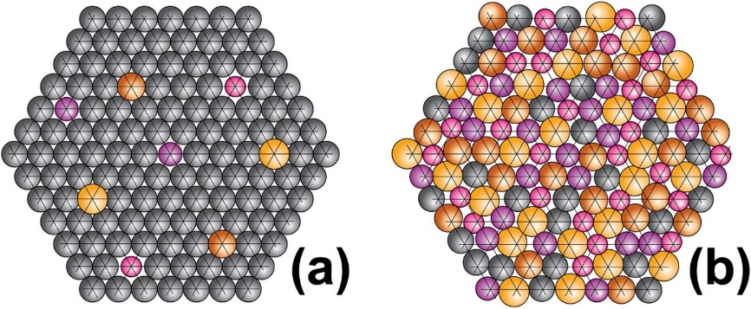
What are High Entropy Alloys
AKA ‘multi-principle element’ or ‘compositionally complex’ alloys (MPEAs, CCAs)
Typically no element exceeds 35 at. %
Studied in solid solution – simple crystals
Promising properties observed…
Exceptional mechanical properties
High temperature stability/strength
Increased fracture toughness
Enhanced radiation tolerance
(a) Conventional alloy, (b) High-entropy alloy (Miracle, Senkov | 2017)
[1] D.B. Miracle, O.N. Senkov, “A critical review of high entropy alloys and related concepts”, Acta Materialia, Volume 122, 2017.

Slide 3
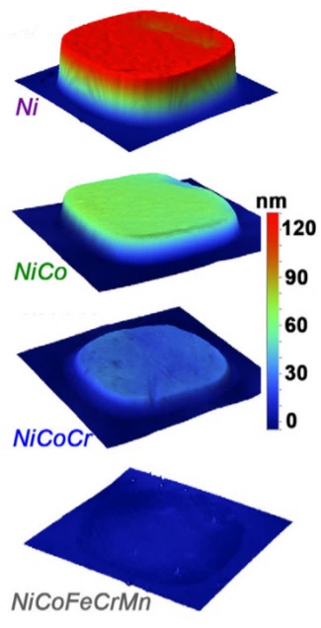
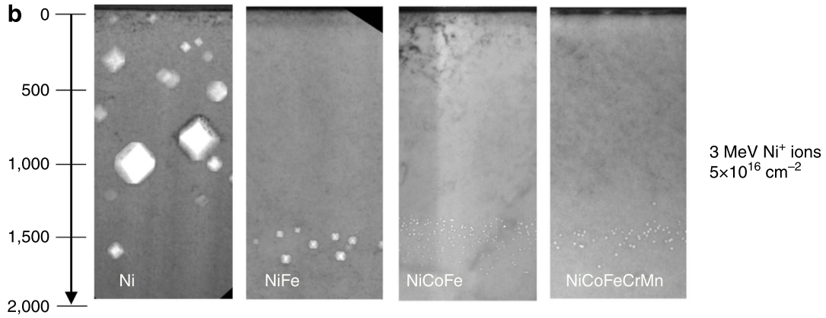
Radiation Tolerance in HEAs
Enhanced radiation tolerance has been shown in modeling and experimentation
Numerous proposed mechanisms:
Enhanced recombination due to
Concentration of damage cascade/ thermal spike
Preferential diffusion pathways
Sluggish diffusion of defects
T = 500 °C
(Lu | 2016)
[2] K. Jin, C. Lu, et al., “Effects of compositional complexity on the ion-irradiation induced swelling and hardening in Ni-containing equiatomic alloys”, Scripta Materialia, Volume 119, 2016.
Notes:
FULL CITATIONS

Slide 4
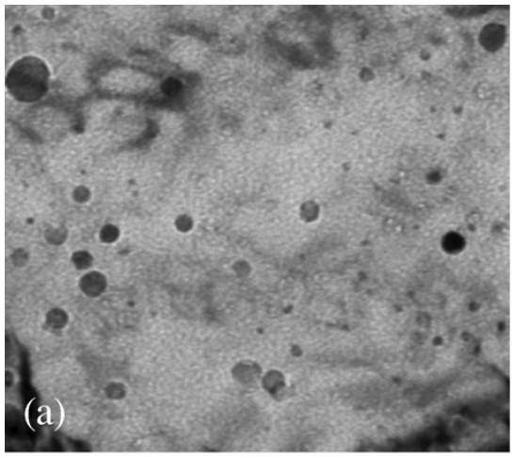
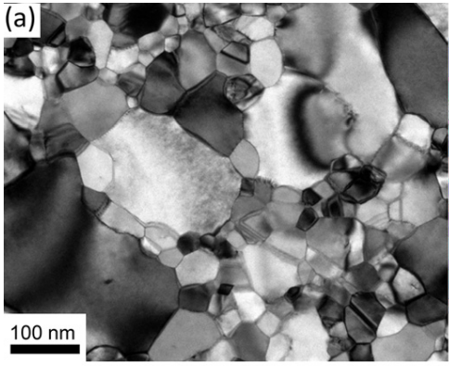
Radiation Tolerant Microstructures
Typical approach to improving radiation tolerance: increase sink density
Can be unstable for different temperature/damage regimes
Oxide-dispersion strengthened (ODS) alloys
Nanocrystalline alloys
Cold-worked alloys
100 nm
(Allen | 2008)
(Barr | 2018)
(Alshater | 2018)

Slide 5
Design Goals for HEA
Property
Response
Specific Heat
CTE
Density
Yield stress
Heat Deposition
Temperature Rise
Thermal Expansion
Plasticity
Desired Properties
Low density
High specific heat
Low coeff. of thermal expansion.
Good radiation tolerance
High yield strength
Notes:
BORING

Slide 6
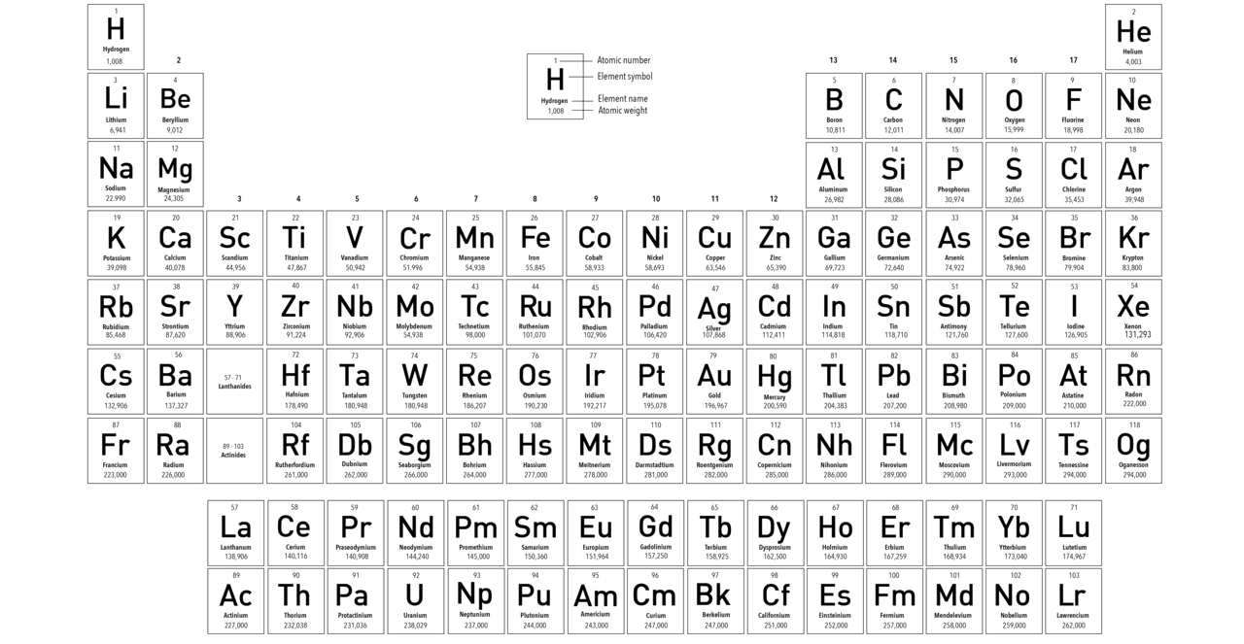
High Entropy Alloy Element Selection
Low density/Z
Light transition metals
Forms single phase alloy
Desirable for easier analysis
Cr-Mn-V ternary forms single phase
Fe forms intermetallic compounds
Minimal activation under protons
Co/Cu/Ni have activation concerns

Slide 7
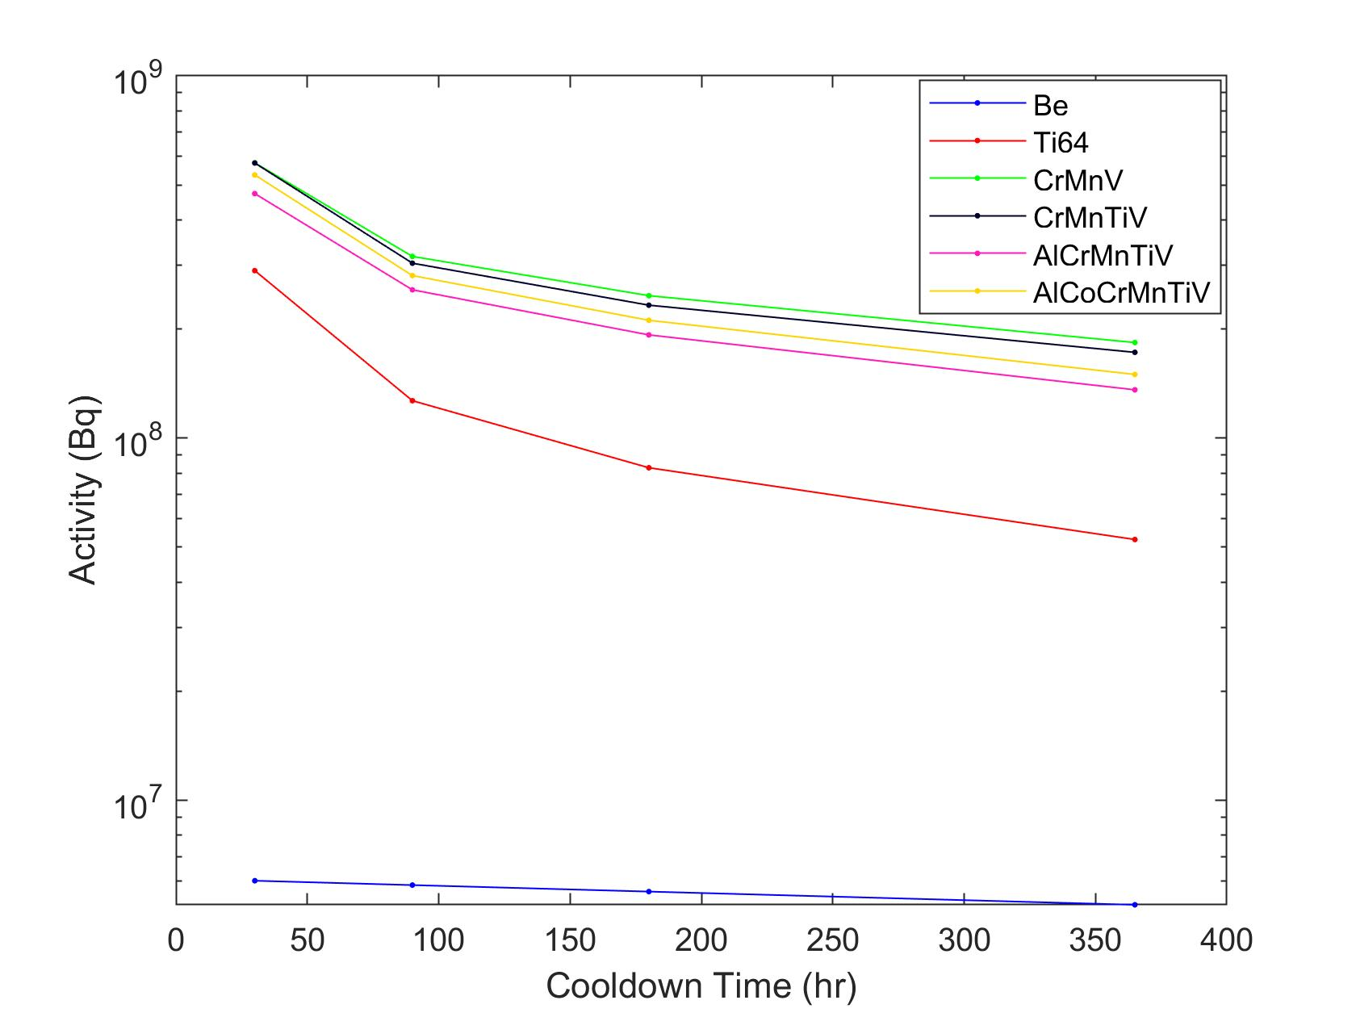
High Entropy Alloy Design
Activity (Bq) after 5 hr of irradiation (120 GeV protons, 5.2e13 p/s)

Slide 8
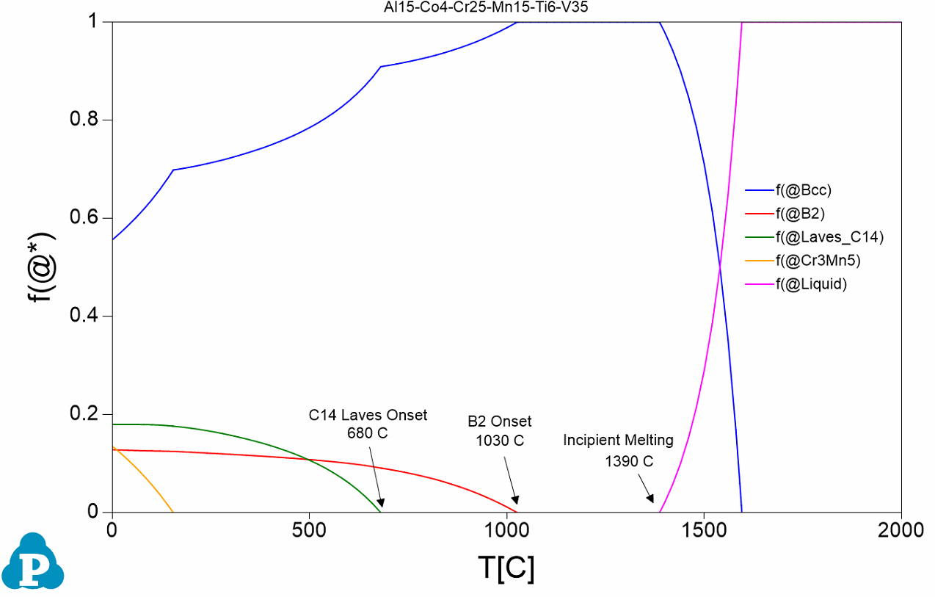
High Entropy Alloy Design
CrMnV (1)
AlCrMnTiV (3)
Lower density/higher specific heat
AlCoCrMnTiV (4)
CrMnTiV (2)
Equimolar BCC single phase
Impurity getter
Semi-coherent B2 phase
Region to Maximize
Initial (low throughput) attempt resulted in Al₁₅Co₄Cr₂₅Mn₁₅Ti₆V₃₅
Alloys 1-4 manufactured and studied
Phase fraction diagram of Al₁₅Co₄Cr₂₅Mn₁₅Ti₆V₃₅

Slide 9
HEA Design Refinement
Systematic search using high-throughput CALPHAD simulations
>8500 compositions for optimization of
B2 phase region
Onset of embrittling secondary phases
Density, specific heat, CTE
> 120,000 compositions searched by Gaurav Aurora (presenting next)
New stable single-phase BCC alloys found
Compositional search space (at%)
 | Al | Co | Ti | Cr | Mn | V
Min | 10 | 0 | 1 | 10 | 1 | 10
Max | 30 | 5 | 15 | 35 | 30 | 35
Step | 4 | 1 | 2 | 3 | Bal | 2

Slide 10
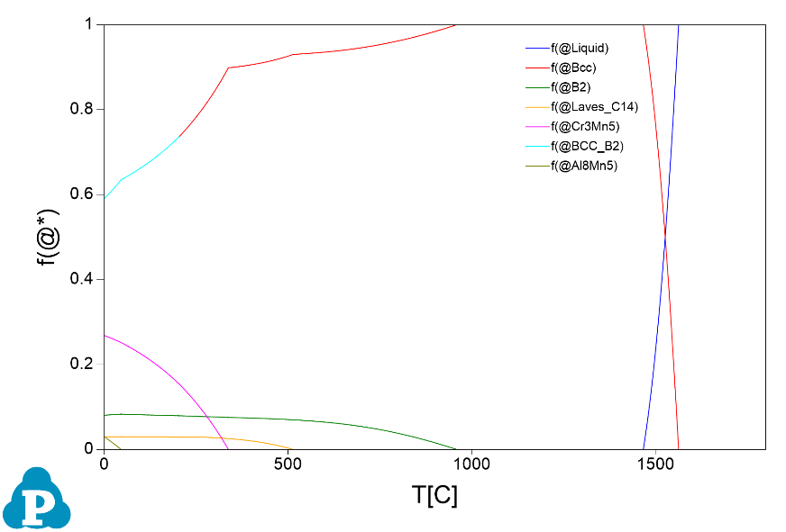
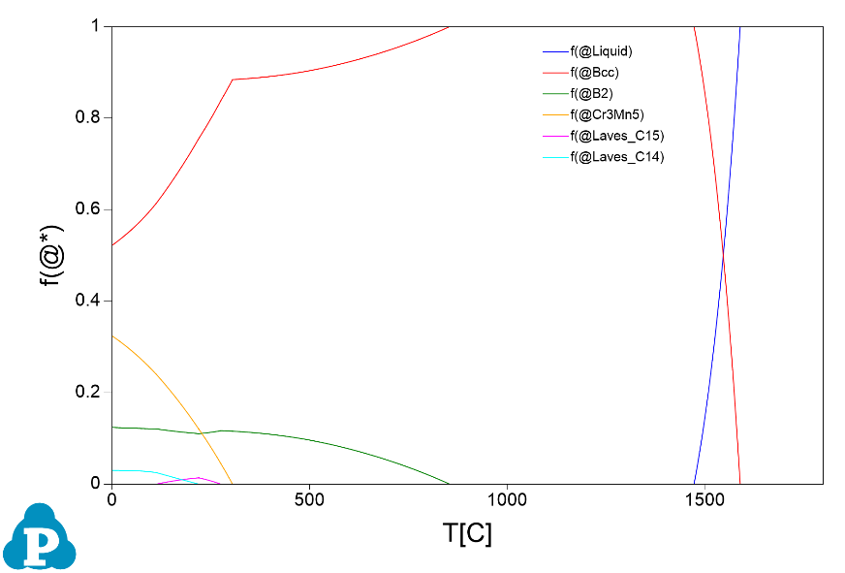
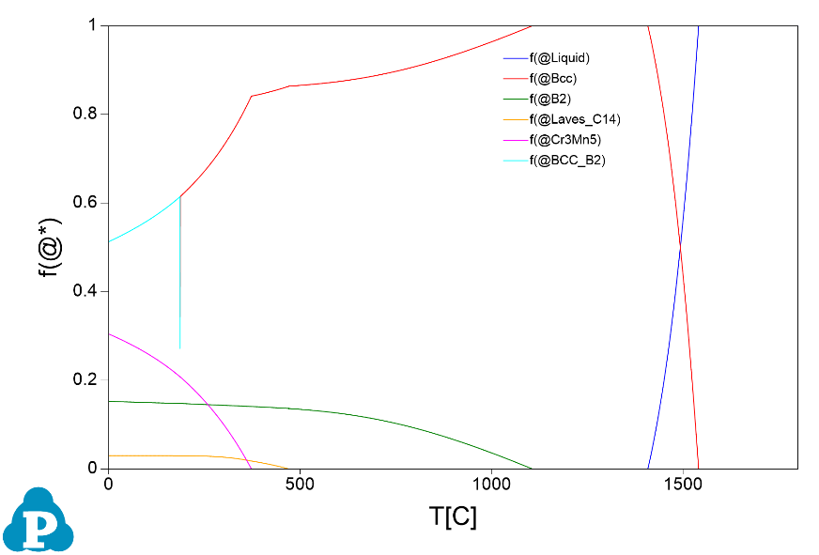
HEA Design Refinement
Al₁₆Cr₂₅Mn₃₀Ti₁V₂₄Co₄
Al₁₀Cr₂₅Mn₂₆Ti₃V₃₄Co₂
Increased solidus
Al₁₆Cr₂₅Mn₃₀Ti₁V₂₆Co₂
Al₁₀Cr₂₅Mn₂₈Ti₁V₃₄Co₂
Lower sec. phase onset

Slide 11
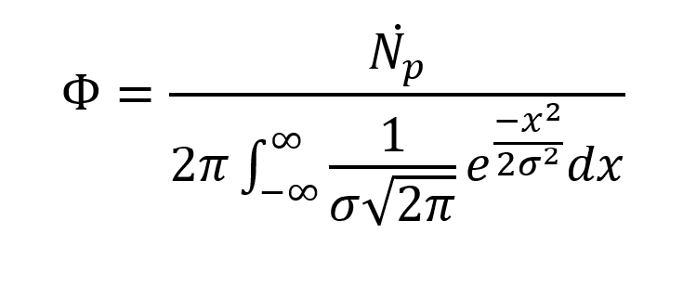
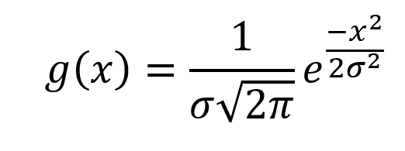
HEA Beam Heating
Target case: FNAL’s NuMI beam line
120 GeV protons—1 MW
10 µs pulse @ 0.75 Hz repetition
3 cm diameter window, edge held at 300 K
Energy deposition
Beam Gaussian distribution
Proton flux
Bethe-Bohr electronic stopping power

Slide 12
HEA Beam Heating
T_{avg} = 670 °C
T_{avg} = 171 °C
T_{avg} = 48 °C
Temperature profile from single pulse of NuMI beam (120 GeV p, 6.25e13 ppp, σ = 1.3 mm)
Centerline temperature from pulsed of NuMI beam (10 us pulse, 0.752 Hz)

Slide 13
HEA Beam Heating
Average operating temperature of Al₁₅Co₄Cr₂₅Mn₁₅Ti₆V₃₅ between 150-200 °C
Desired microstructure isn’t thermodynamically stable
How quickly will C14 Laves or intermetallics form?
Test kinetics via heat treatment at 450-500 °C
Potentially enhanced by irradiation, but pulsed beam might mitigate
Desired microstructure window
Stable operating microstructure
Centerline temperature from pulsed of NuMI beam (10 us pulse, 0.752 Hz)

Slide 14
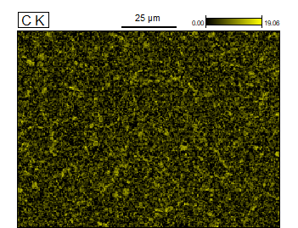
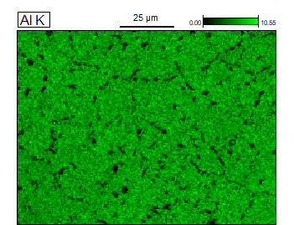
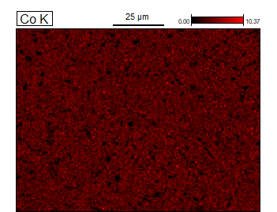
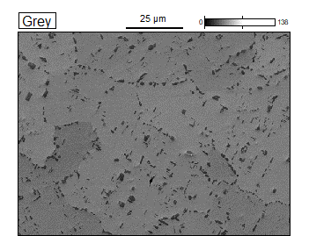
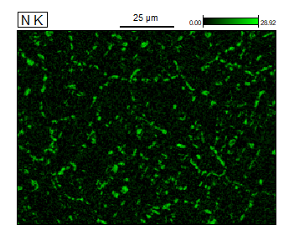
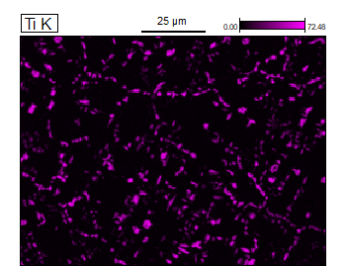
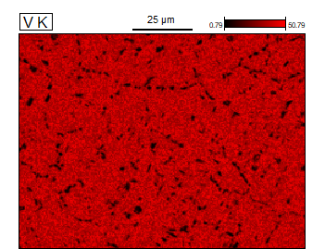
HEA Initial Characterization
SEM/EDX of
Al₁₅Co₄Cr₂₅Mn₁₅Ti₆V₃₅
Ti(C-N)

Slide 15
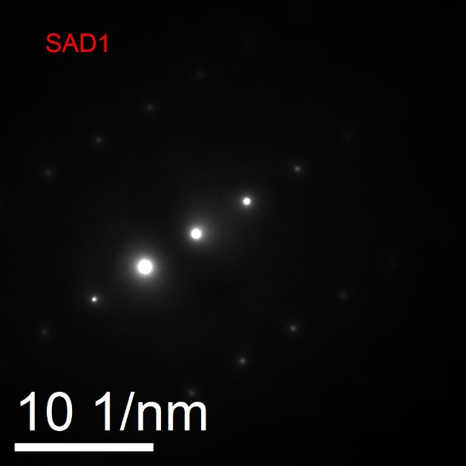
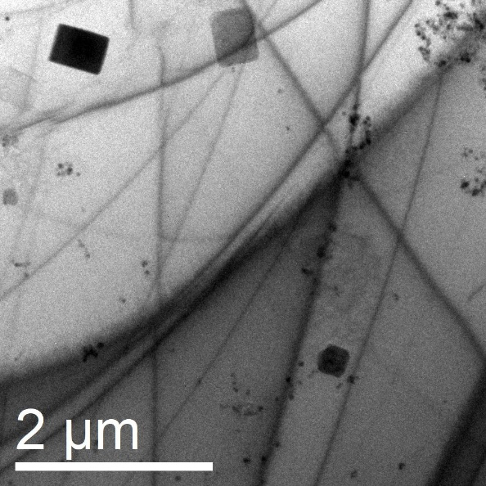
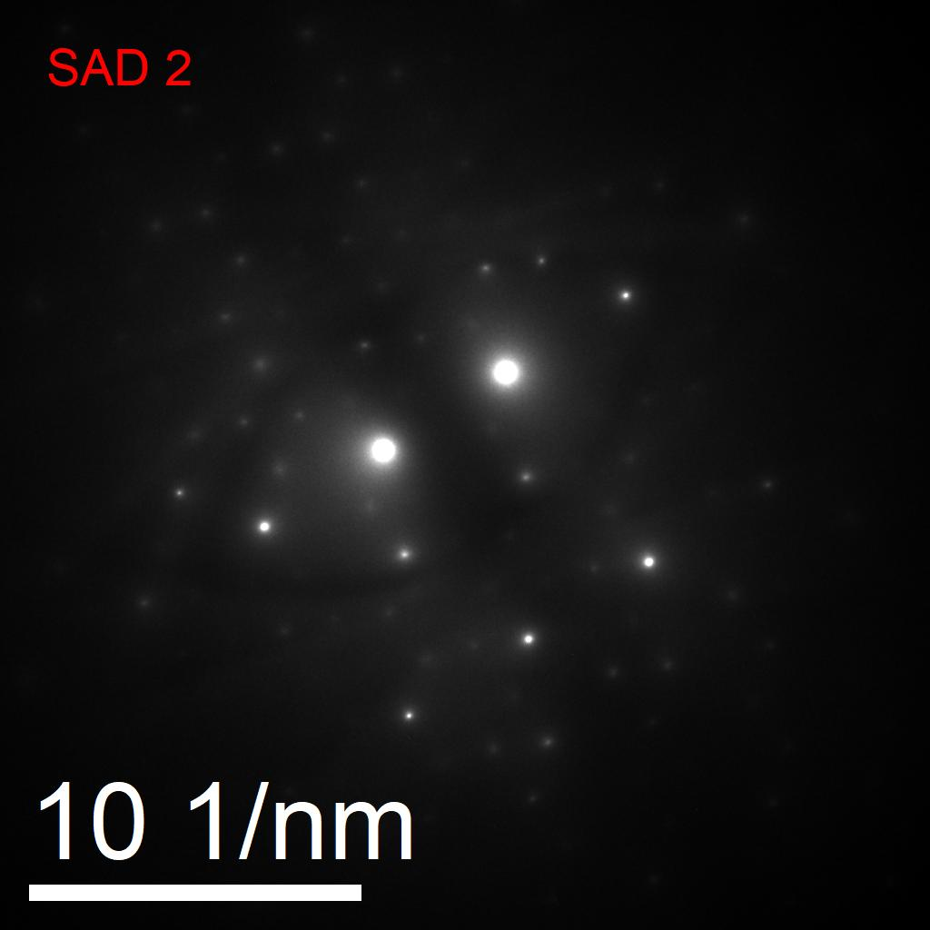
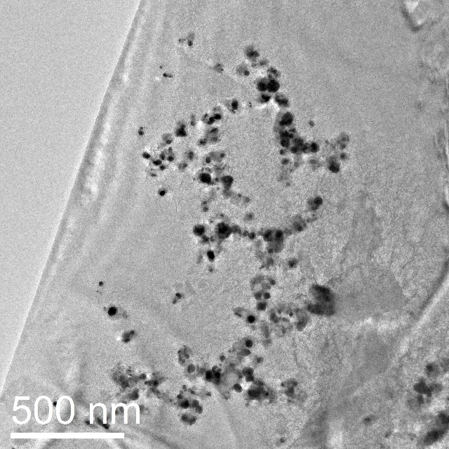
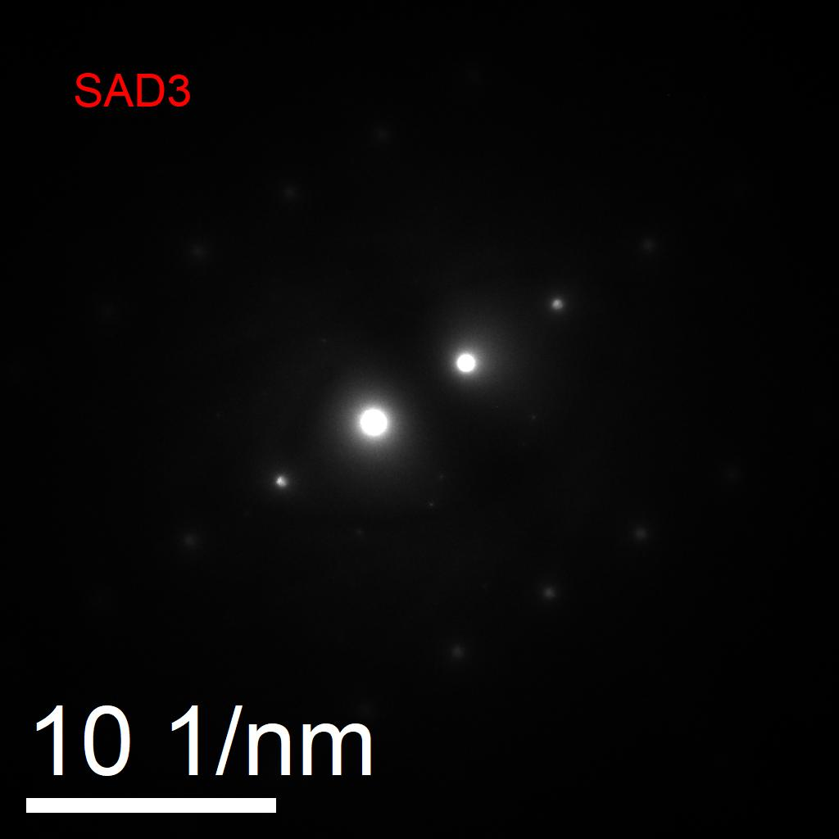
HEA Initial Characterization
Images taken this month
High volume of precipitates
Two entirely different morphologies
Still need confirmation via EDX
Morphology resembles Laves C14
Heat treatment employed poor at promoting B2 phase
Homogenized and held at 1200 °C only
Notes:
Which axis

Slide 16
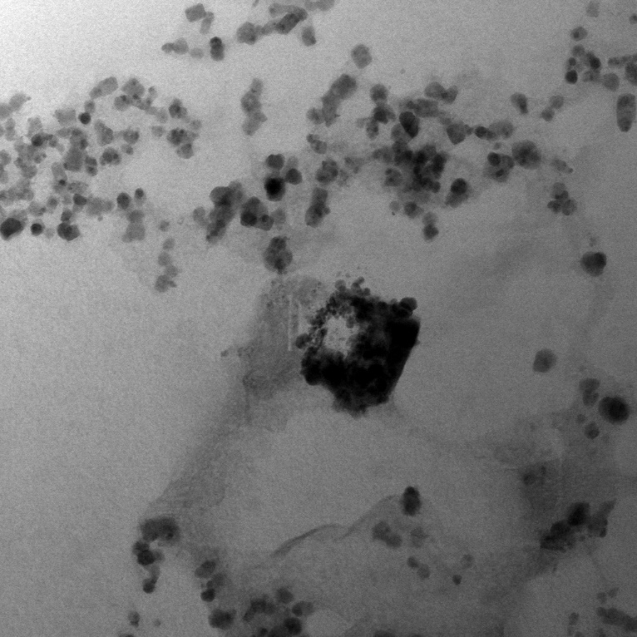
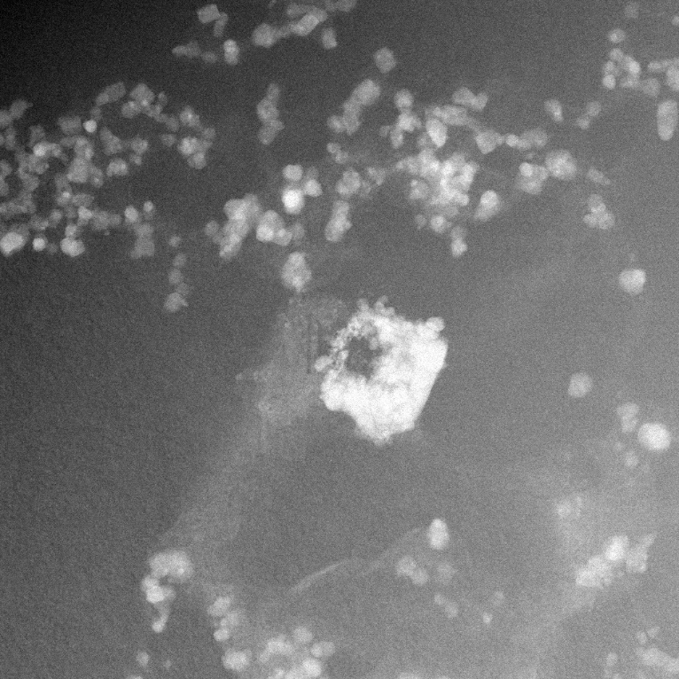
HEA Initial Characterization
Images taken this month
High volume of precipitates
Two entirely different morphologies
Still need confirmation via EDX
Morphology resembles Laves C14
Heat treatment employed poor at promoting B2 phase
Homogenized and held at 1200 °C only
STEM BF
HAADF
Notes:
High angle annular dark field
Is central precipitate an agglomeration of the small ones?? Are the small ones nucleations of the big ones

Slide 17
HEA Indentation
Lower density of Ti-(CN)

Slide 18
HEA Indentation
No crack initiation
Dislocation pileup
5 component alloy
6 component alloy

Slide 19
HEA Indentation
Significant hardness increase but with promising signs of ductility
Stiffness greater than but comparable to Ti64
Sample | Vicker’s Hardness (Hv) | Modulus of Elasticity (GPa)
CrMnV | 390.58 | 186.93
CrMnTiV | 499.80 | 222.06
AlCrMnTiV | 453.06 | 163.36
AlCoCrMnTiV | 608.19 | 177.29
Ti64 | 339 | 110
5 component (top), 6 component (bottom)

Slide 20
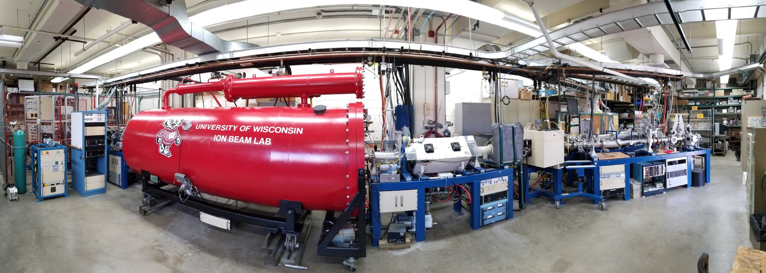
HEA Current/Future Work
Irradiation with protons and V²⁺ ions at UW
At 50-100 dpa what are dominant irradiation effects?
At low dpa are effects visible?
Differential Scanning Calorimetry at FNAL
Next round of alloys being manufactured
8 alloys encompassing my work and Gaurav’s
Efficiency of Ti gettering
Effect of B2 phase fraction
High V content alloy
Heat treatment to determine microstructure evolution at estimated operating temperature
Hold at 500 °C for 45 days
UW Ion Beam Lab is NSUF facility!
Protons up to 3 MeV and heavy ions
LN2 cooling recently developed

Slide 21
Effects of Nanocrystallinity on Irradiation of Beryllium

Slide 22
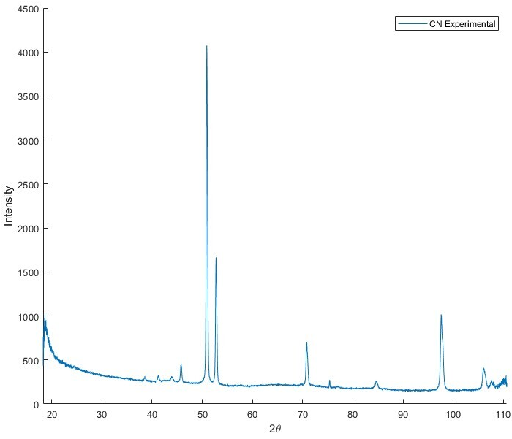
Beryllium XRD
[0001]
[0001]
$$[10\overline{1}1]$$
$$[10\overline{1}1]$$
[0001]
$$[10\overline{1}3]$$
[1010]
$$[10\overline{1}2]$$
$$[11\overline{2}0]$$
$$[10\overline{1}3]$$
$$[10\overline{1}2]$$
[1010]
[1010]
$$[10\overline{1}1]$$
$$[10\overline{1}3]$$
$$[11\overline{2}0]$$
Materion – highly textured to basal plane
FNAL- untextured
LiJing Be- less textured

Slide 23
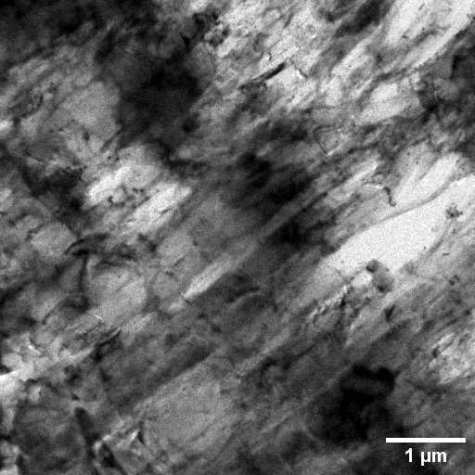
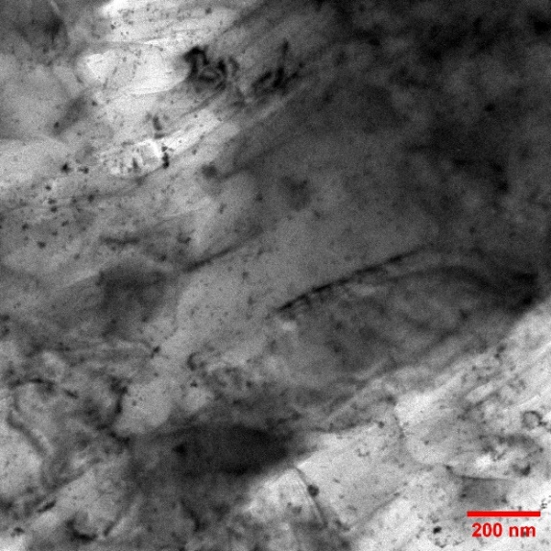
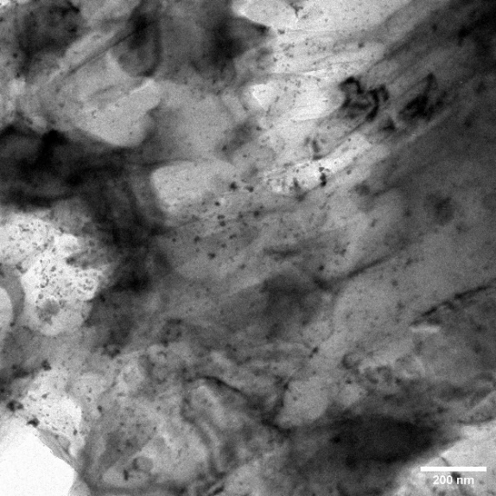
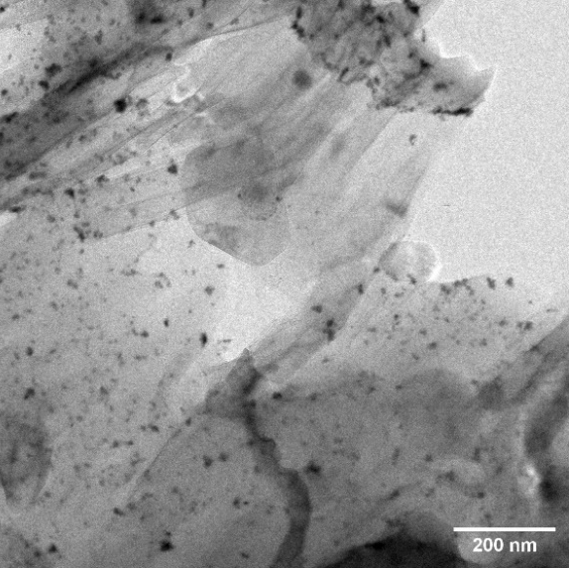
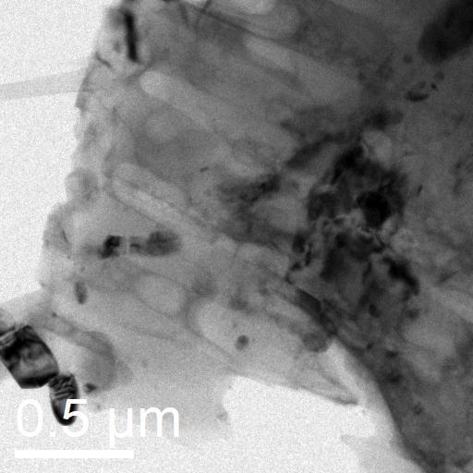
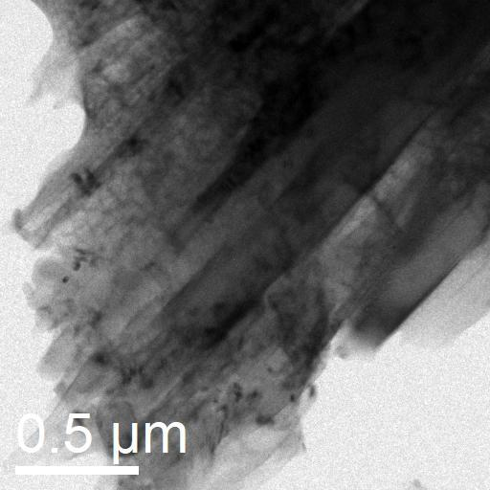
Preliminary TEM of Be
Materion Be
LiJing Be
BeO precipitates?
Columnar grains

Slide 24
Beryllium Irradiation Campaign
2.0 MeV protons to 0.25 dpa
Nanocrystalline/textured Be from Materion
Untextured Be from FNAL
Nanograins typically improve radiation tolerance via increased sink density
Effects of texturing?
In process of preparing for TEM
Twin-jet electropolishing for thin sample proving challenging

Slide 25
Questions?

Slide 26
Radiation Damage in Metals
Damage Cascade
Primary Collision
Thermal Spike
Quench
t→∞
Primary Knock-on Atom (PKA)
Long-Term Defect Evolution:
As time progresses and more damage cascades are produced, the population of point defects increases.
As diffusion occurs (minutes, hours, days), point defects can diffuse towards free surfaces or interfaces (sinks) to be annihilated. Dissimilar point defects can annihilate with one another. Alternatively, similar point defects can cluster together, giving rise to voids and dislocations.
Quench
Following the thermal spike, displaced atoms are mobile enough to quickly find new lattice sites. However, as heat from the thermal spike dissipates, the mobility of atoms plummets leaving several surviving point defects: self-interstitial atoms and vacancies.
Vacancies
Thermal Spike:
The PKA recoils and collides with nearby atoms which are knocked from their lattice sites and collide with other atoms forming a damage cascade. Over picoseconds, many atoms are displaced from their lattice sites and the temperature locally rises far above the melting point of the material forming a thermal spike.
Primary Collision: Incident particle scatters off nucleus of atom in crystal lattice with sufficient energy to remove the atom from its lattice site. This atom is called the Primary Knock-on Atom (PKA).
Self-Interstitials
Thermal Spike
Incoming Particle (n, p⁺, etc.)

