Slide 1
Multiphysics Modeling and Simulation for the Development of a Nanofiber Target Concept
Will Asztalos, Yağmur Torun (Illinois Institute of Technology)
Frederique Pellemoine, Sujit Bidhar (Fermi National Accelerator Laboratory)
Prasenjit Rath (Indian Institute of Technology, Bhubaneswar)
6/29/2023
8th RaDIATE Collaboration Meeting

Slide 2
Background
As others have explained in better detail:
Need to advance target technology to match increasing primary beam power. Opens the door to lots of new facilities and experiments!
Many creative approaches by the HPT R&D community to meet these challenges
In this presentation, we will review work we conducted that supports ongoing research by the High Power Targetry R&D Group at Fermilab on one such novel target concept: nanofiber targets!

Slide 3
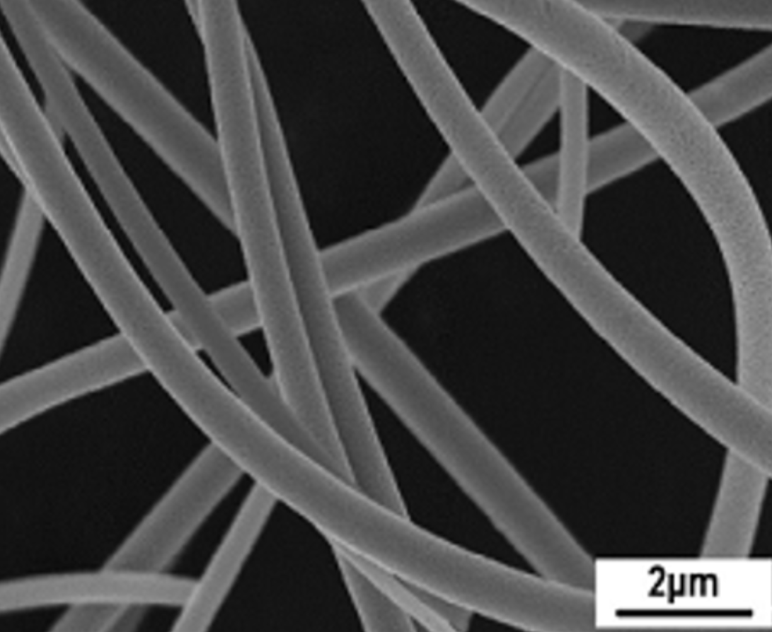
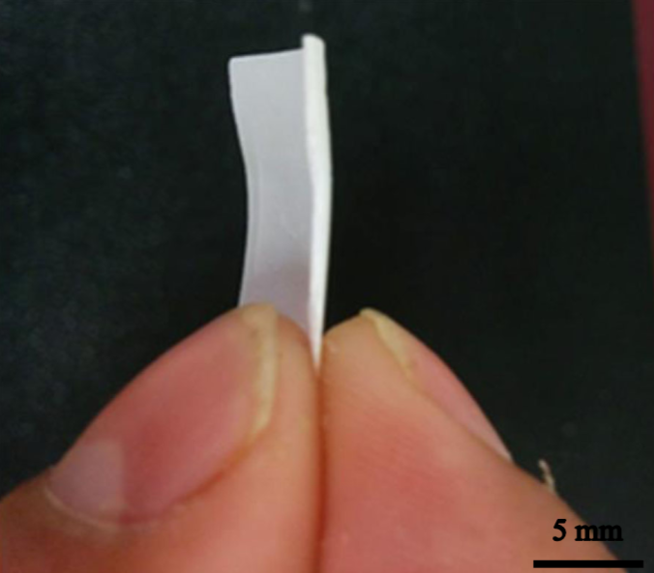
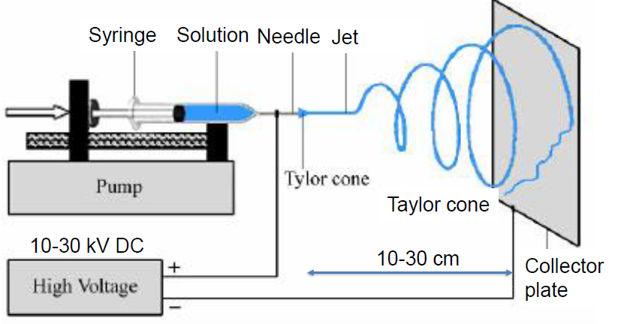
Nanofiber Targets
A nonwoven network of layered nanofibers produced by electrospinning
Demonstrate resistance to radiation damage without additional treatment due to small grain size [1]
Biggest difference in behavior is due to porosity of the target: space between fibers allows expansion and motion of individual fibers AND for cooling gas to be forced through
Use Yttria Stabilized Zirconia as solid to compensate for reduced yield
Images courtesy of Sujit Bidhar
Notes:
Mention that work on nanofibers began significantly before my time.

Slide 4
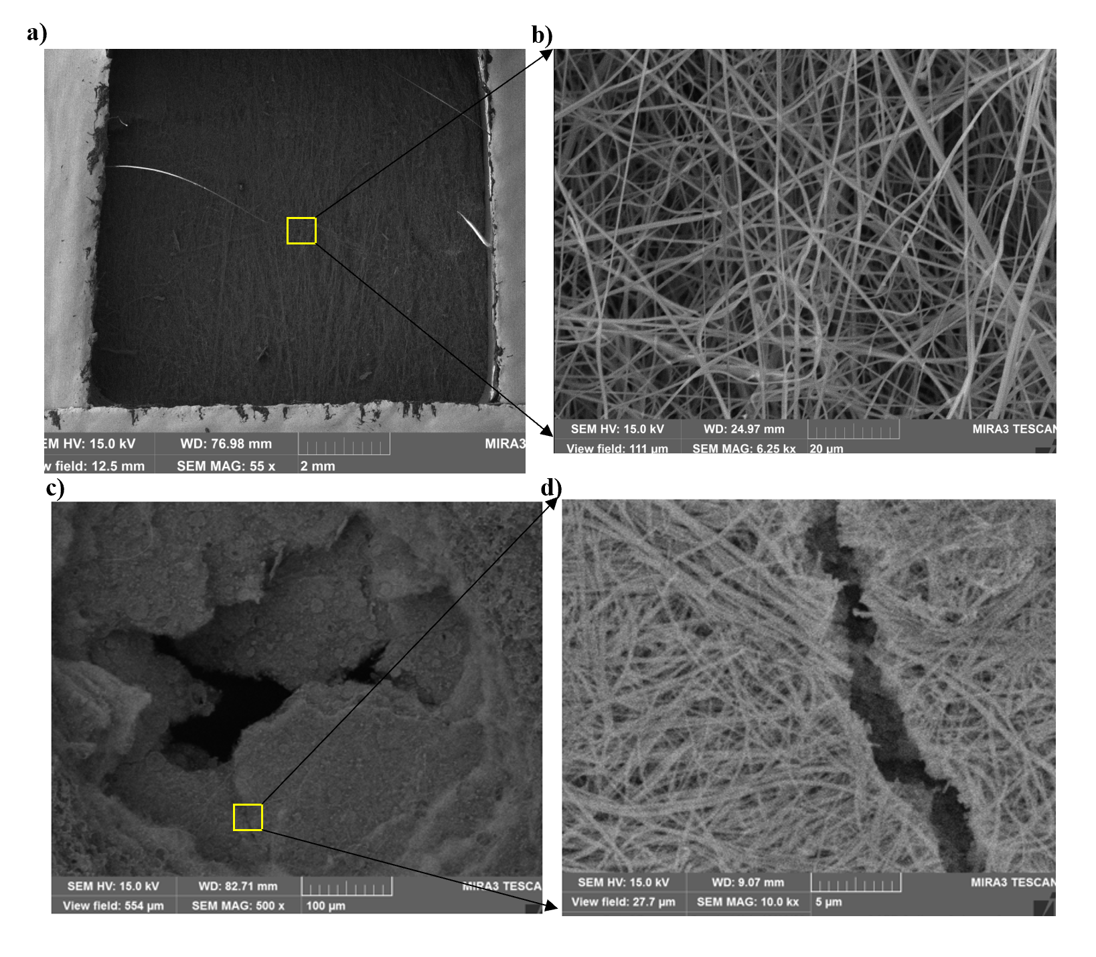
HiRadMat Experiments
To test nanofiber mats’ performance, some samples were sent to HiRadMat 3 years ago for a thermal shock experiment [1]
Each mat had dimensions ~10 x 10 x 0.1 mm, but they differed in how densely layered the fibers are.
Solid Volume Fraction (SVF):
$$f=\frac{\text{Volume} \text{of} \text{Solid} \text{Nanofibers}}{\text{Volume} \text{of} \text{Whole} \text{Mat}}$$
One batch of samples were prepared with an SVF of f=0.05, and the others with f=0.20
HRM images courtesy of Sujit Bidhar

Slide 5
Results of HRM Test…
Figures on the left are SEM images of samples after irradiation by an intense proton beam at HiRadMat
The top row (a and b) are of a low-density sample (f=0.05), which shows no damage
The bottom row (c and d) are of a high-density sample (f=0.20); a hole formed at the beam center, and the mat became brittle.
…Why did this happen?
HRM images courtesy of Sujit Bidhar

Slide 6
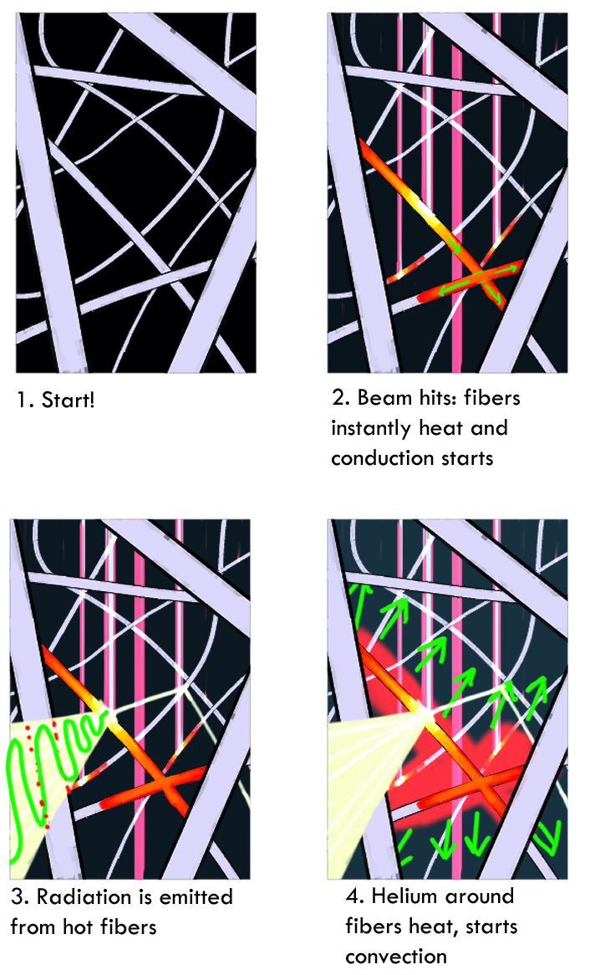
Motivation for Our Work
Exact cause of the failure is unclear! Individual fibers intact, perhaps rapid expansion of trapped gas?
Would like to understand what is happening in a nanofiber target, but the involvement of fluid dynamics and the nanostructure complicate things significantly
That is, the unique strengths of nanofiber targets also raise unique challenges
All 3 Modes of heat transfer become significant, convection expected to dominate conduction, radiation requires nanoscale model since λ~r (100 nm)

Slide 7
A Problem of Two Scales
The trouble is, there are significant nanoscale effects and features, BUT we cannot exclusively work at the nanoscale—macroscopic structure is significant
Behavior at beam center is very different from the boundary, and so a study of qualitative performance can’t neglect this
But, in a 10 x 10 x 1 mm mat there are ~1 Billion nanofibers. Can’t model them all explicitly

Slide 8
Porous Media Modeling
Our approach: Porous media models (PMMs)
Allows modeling of macroscale structure while still accounting for nanoscale effects in some capacity
Two main approaches: (1) modify physical laws, (2) replace material properties with “effective” ones, or both
Mathematically, these typically involve some kind of averaging process.
The Motto Is:

Slide 9
Modeling Fluid Flow with Darcy’s Law
Example of a PMM: volume average fluid flow governing equations (Navier-Stokes) over representative volume, Ω [2]
Write new governing eq’ns in terms of volume-averaged equivalents. Similar to derivation of macroscopic Maxwell’s equations
This amounts to just adding a momentum source term to N-S:
Where μ is the dynamic viscosity and α is the permeability to fluid flow
$$\overset{⃑}{u}→\overline{u}=\frac{1}{V}\iiint_{Ω}{\overset{⃑}{u} dV}$$
Study avg flow velocity instead:
$\overset{⃑}{∇}$p = $−\frac{\text{μ}}{\text{α}} \overset{⃑}{u}$
(Darcy’s Law)

Slide 10
Permeability to Fluid Flow
Permeability completely characterizes Darcy’s Law since inertial effects are negligible and viscous effects dominate [2]
Estimating α is a difficult task on its own. Used a group of results known as Λ-methods [3] to predict it for an electrospun bed of nanofibers
$\overset{⃑}{∇}$p = $−\frac{\text{μ}}{\text{α}} \overset{⃑}{u}$
$$α=\frac{ε R^{2}}{8 {(\ln{ε})}^{2}}\frac{{\left(ε−ε_{p}\right)}^{x+2}}{{\left(1−ε_{p}\right)}^{x}{\left[\left(x+1\right)ε−ε_{p}\right]}^{2}}$$
$$ε \text{= 1 –} \text{f}\text{, }ε_{p}\text{ =} \text{0.11, }\text{x}\text{=0.521}$$
R is the average nanofiber radius, $ε$ is the porosity (% of empty space in mat), and x and $ε_{p}$ are parameters from the Λ-methods model

Slide 11
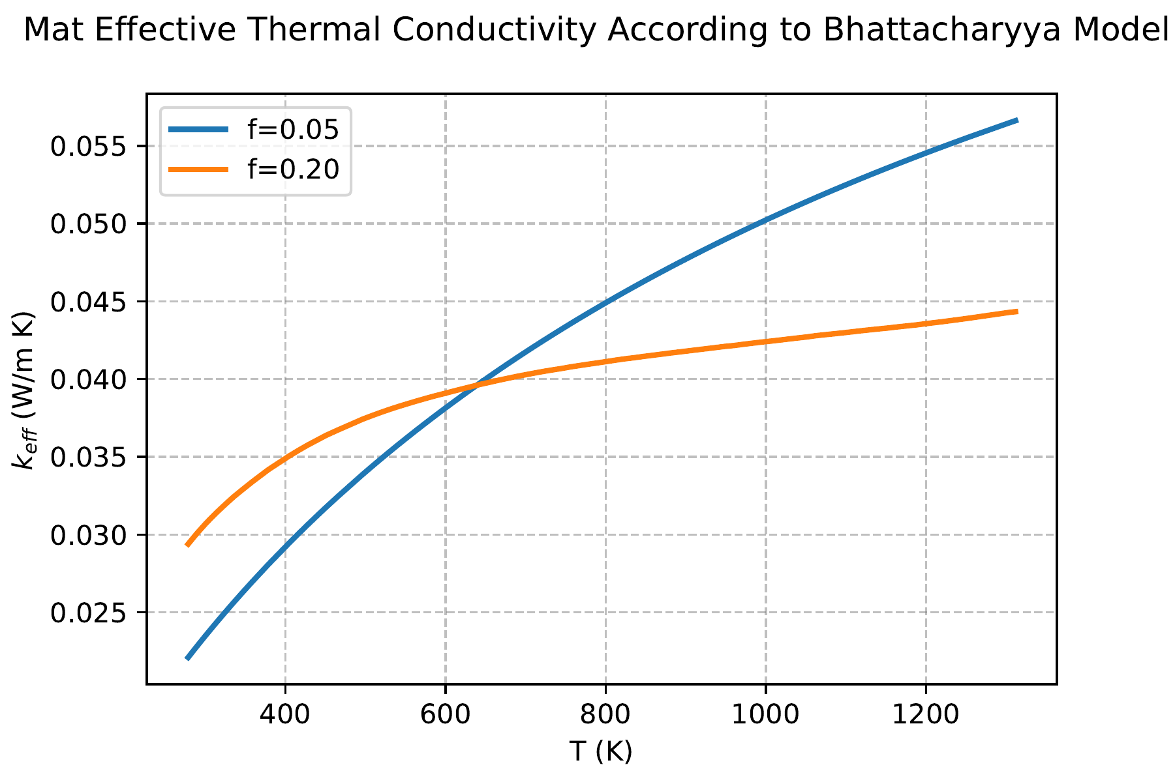
Conduction Model
Use models of Daryabeigi and Bhattacharyya: assign nanofiber mat an effective thermal conductivity, $k_{\text{eff}}$, computed from conductivity of solid, gas phases, $k_{s}, k_{g}$ [4,5]
Then solve conduction problem as if it were a completely homogeneous medium!
Right: computed effective conductivities for samples used in HRM study, similar to air’s
$$k_{\text{eff}}(T)=k_{s}+\frac{k_{g}−k_{s}}{1+\frac{f}{1−f}\left[1+\frac{5}{6} \frac{k_{g}−k_{s}}{k_{g}+k_{s}}\right]}$$

Slide 12
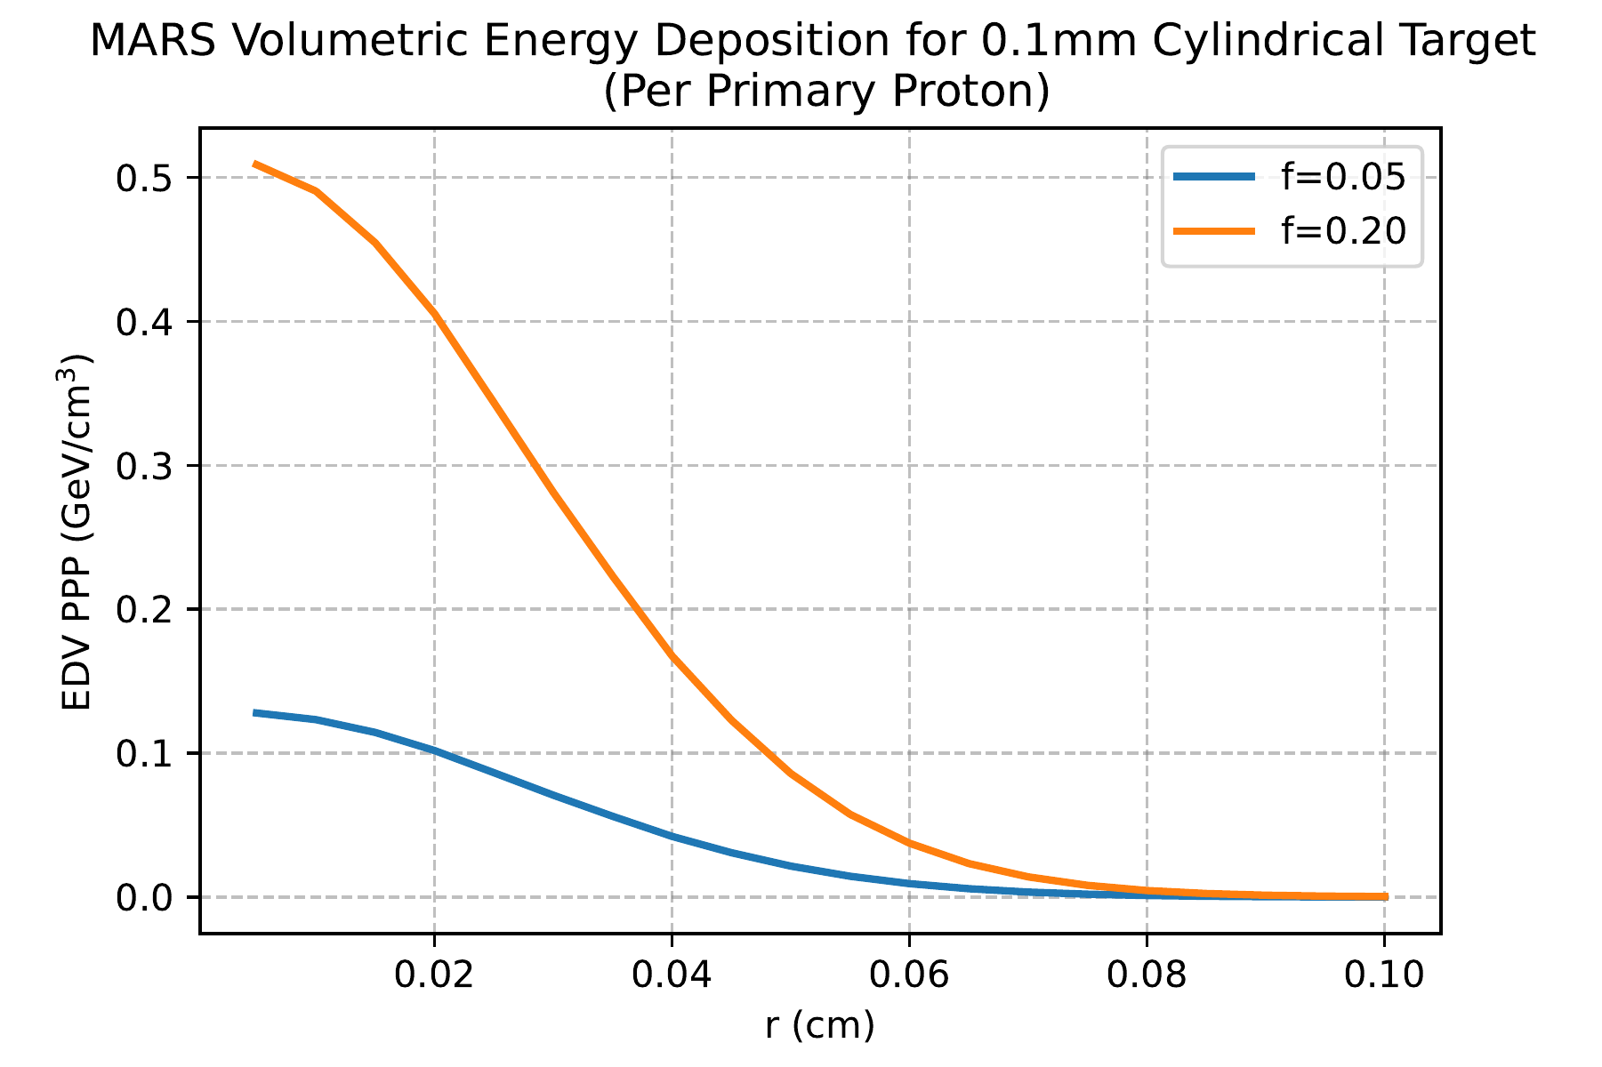
Modeling the Beam
Use MARS [6-9] to estimate the energy deposition due to the HiRadMat beam
HRM beam: 440 GeV p’s, 4 μs pulse, σ=0.25 mm, N~1.21E+13
Use volumetric energy deposition to calculate a power density, supply as a source term to the energy equation
MARS does not have PMMs built in, but by supplying density and calculating mass fractions of constituent elements, effect of changing SVF can be seen
(Energy Dep fits well to a Gaussian)

Slide 13
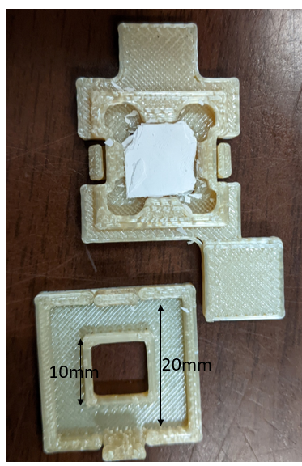
Putting the Model to Work: Multiphysics Simulations
With the PMMs ready, we can use them to simulate the response of a nanofiber target to getting whacked with a beam!
We focus on the motivating HRM problem and simulate two mats: one with f=0.05 and one with f=0.20
Used ANSYS Fluent as solver, with SIMPLE algorithm.
Solve for t=10 μs, with Δt=0.1 μs during beam pulse (t≤4 μs) and Δt=0.5 μs after
y
Outflow
BC
z
beam
10 x 10 x 0.1 mm mat
5 mm (air)
HRM target holders are open at top, and no room for outflow on the sides, so apply Dirichlet BC’s for velocity
Target holder images courtesy of Sujit Bidhar

Slide 14
Temperature Contours (Beam’s Eye View)
5000 K
5000 K
300 K
300 K
f=0.05 (low density mat)
f=0.20 (high density mat)
Scale: min 300 K (blue) max 5000 K (red)

Slide 15
Pressure Contours (Beam’s Eye View)
2.5 MPa
2.5 MPa
-5 kPa
-5 kPa
f=0.05 (low density mat)
f=0.20 (high density mat)
Scale: min -5 kPa (blue) max 2.5 MPa (red)

Slide 16
Velocity Contours (Side View)
240 m/s
240 m/s
beam
beam
0 m/s
0 m/s
f=0.05 (low density mat)
f=0.20 (high density mat)
Scale: min 0 m/s (blue) max 240 m/s (red)

Slide 17
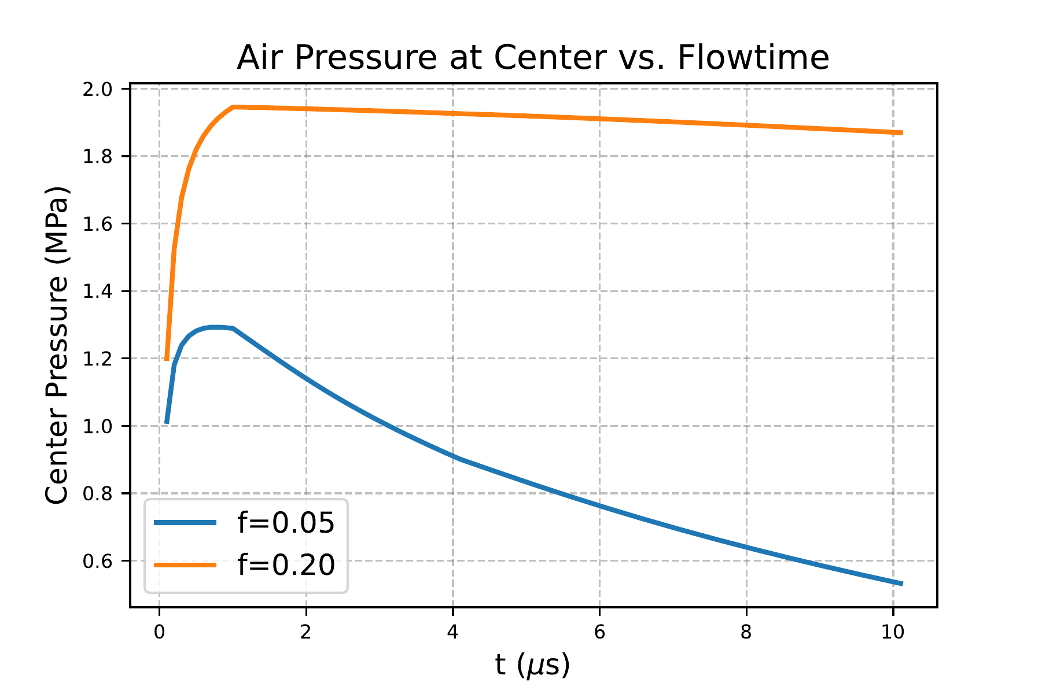
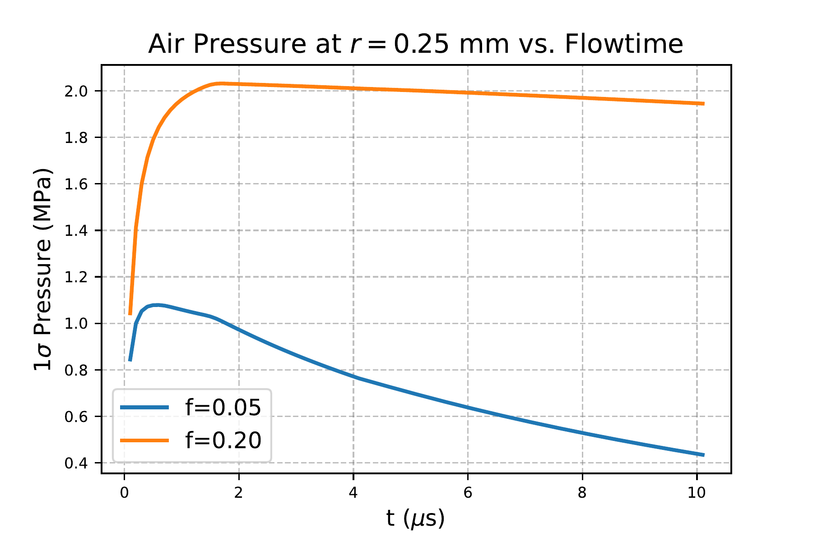
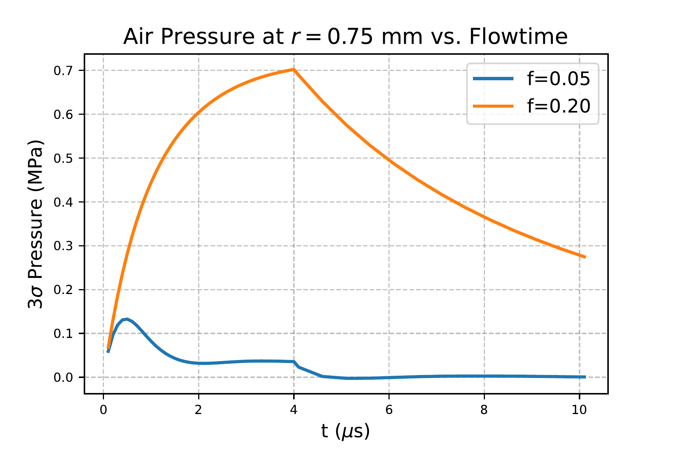
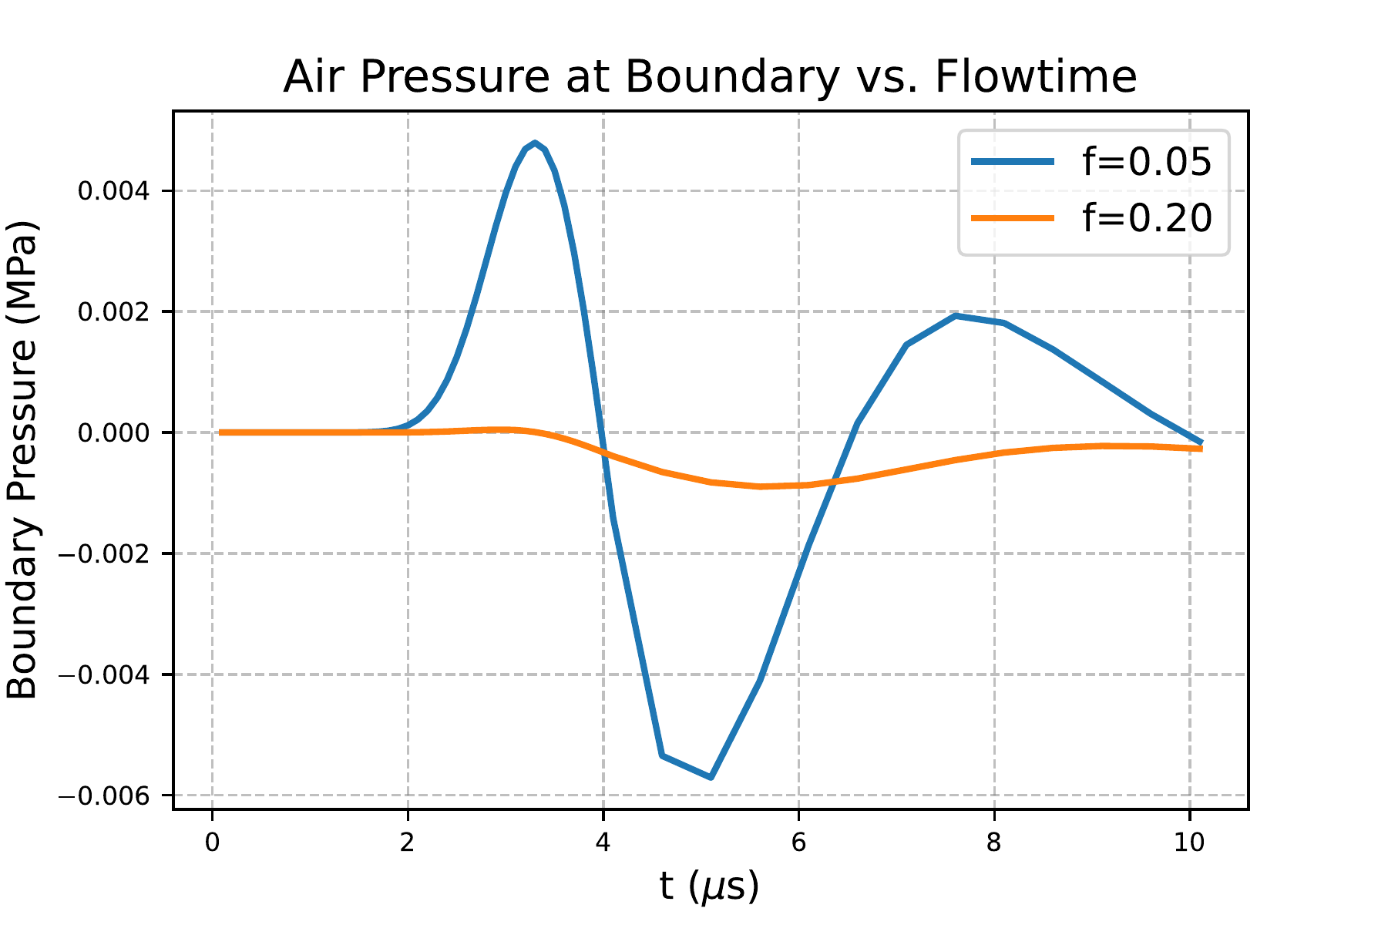
Pressure Plots for Various Points
Comparison of fluid phase pressure between low and high density cases shows:
Near center and at 1 sigma (r=0.25 mm) pressure is approx. double for f=0.20
Pressure wave propagates faster in f=0.05 case

Slide 18
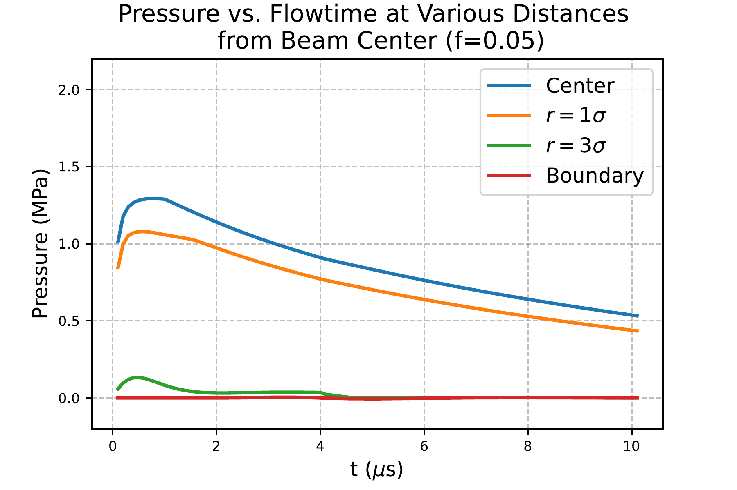
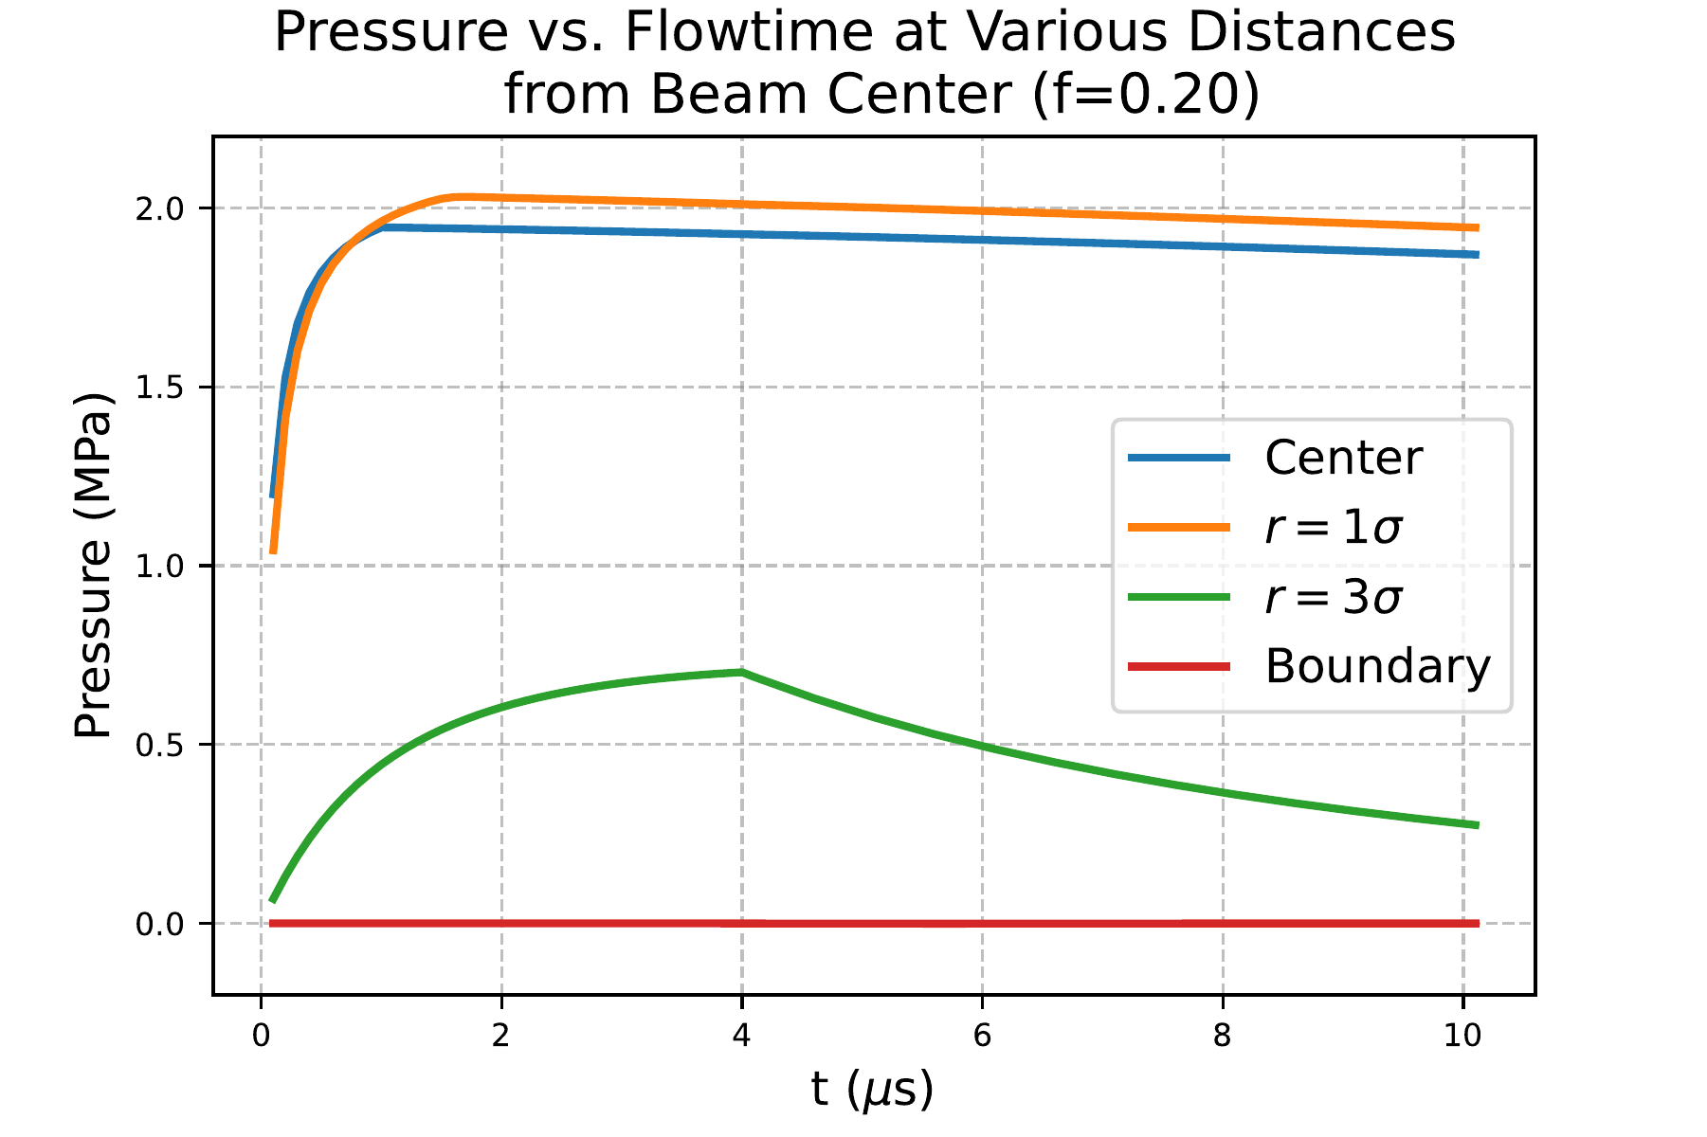
Pressure Plots Case by Case
f=0.05 (low density mat)
f=0.20 (high density mat)
Scale is identical between plots; beam sigma is 0.25 mm, boundary is at 5 mm

Slide 19
Interpretation: What Happened at HRM?
We see a nearly identical temperature rise, and SEM did not show breaking or melting of individual fibers
The air pressure rise in the denser mat is significantly larger
Velocity contours show a “shockwave” in both cases during firing that propagates more freely in the low density mat
Suggests that a trapped pressure wave in the higher density mat caused the damage!
HRM images courtesy of Sujit Bidhar

Slide 20
Conclusions
Using Porous Media Models, we carried out multiphysics simulations of nanofiber targets, the first to incorporate the fluid flow, with the results qualitatively consistent with experiments at HRM
There is room for improvement and refinements—the subject of my thesis research and continuing collaboration with the HPT R&D Group. An exciting problem bringing together lots of physics
Such simulations can also be used for optimization studies to predict optimal design parameters—a good application for Bayesian Optimization (emailing questions about this is encouraged)
wasztalos@hawk.iit.edu

Slide 21
Thanks for Your Time and Attention!
Image courtesy of FNAL Symmetry Magazie, How To Make A Neutrino Beam

Slide 22
References
[1] S. Bidhar et al., “Production and qualification of an electrospun ceramic nanofiber material as a candidate future high power target,” Phys. Rev. Accel. Beams, vol. 24, p. 123001, Dec 2021.
[2] S. Whitaker, “Flow in porous media I: A theoretical derivation of Darcy’s law,” Transp Porous Med, p. 3- 25, 1986.
[3] D. L. Johnson, J. Koplik, and R. Dashen, “Theory of dynamic permeability and tortuosity in fluid-saturated porous media,” Journal of Fluid Mechanics, vol. 176, p. 379-402, 1987.
[4] K. Daryabeigi, “Heat transfer in high-temperature fibrous insulation,” Journal of Thermophysics and Heat Transfer, vol. 17, no. 1, pp. 10-20, 2003.
[5] R. Bhattacharyya, “Heat-transfer model for fibrous insulations,” ASTM special technical publications, pp. 272-286, 1980.
[6] N. Mokhov et al., “MARS15 code developments driven by the intensity frontier needs,” Prog. Nucl. Sci. Technol., pp. 496-501, 2014.
[7] N. Mokhov, “Status of MARS code,” Fermilab-Conf-03/053, (Batavia, Illinois), 2003.
[8] N.V. Mokhov and C.C. James, The MARS Code System User’s Guide, Version 15 (2016).
[9] “MARS website.” https://mars.fnal.gov

Slide 23
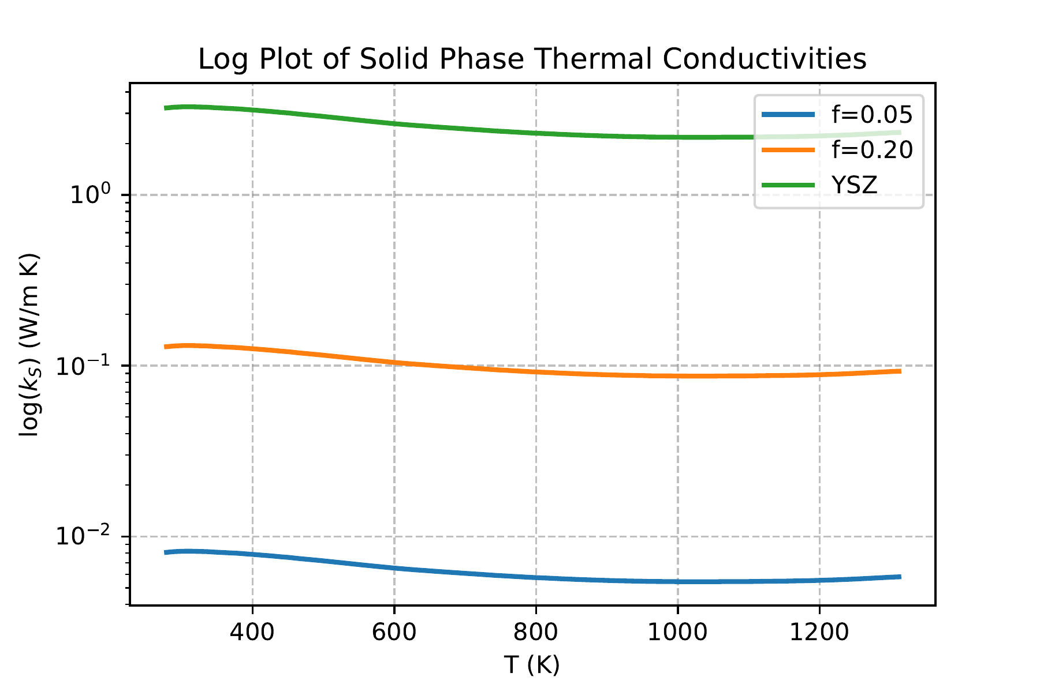
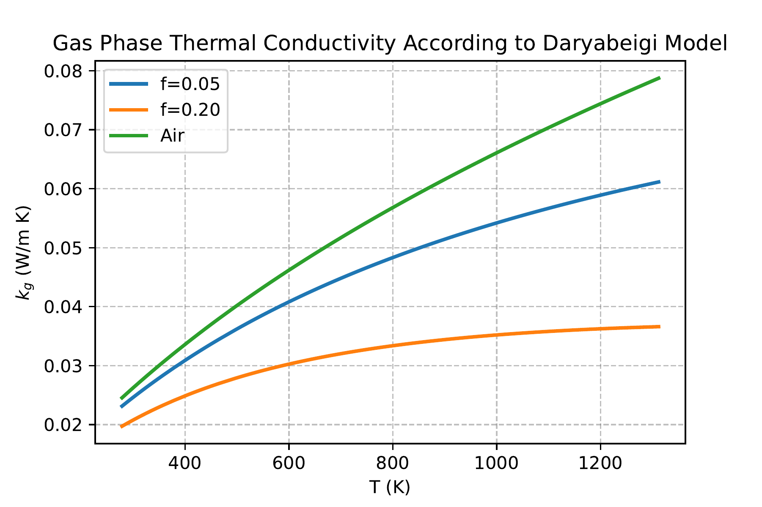
Appendix: Thermal Conductivity

Slide 24
Appendix: kg and ks
Thermal conductivity of individual phases actually differs from bulk quantities in the following ways:
Thermal Accomodation coefficient handles nonequilibrium btwn fibers and gas
Interested in better calculating (or measuring) individual nanofiber thermal conductivity.
Empirical model for solid phase:
$$k_{s}=f^{2}{ k}_{\text{YSZ}\text{ (}\text{bulk}\text{)}}$$
(Verschoor and Greebler, 1952.)
Theoretical Model for Gas Phase (Gas-Collision Dynamics, Daryabeigi [4]):
Values of $Φ and Ψ$
$$depend on Flow Regime$$
$$k_{g}=\frac{k_{\text{gas}\text{ (}\text{bulk}\text{)}}}{Φ+2Ψ\left(\frac{2−ζ_{g}}{ζ_{g}}\right)\left(\frac{γ}{γ+1}\right)\left(\frac{Kn}{Pr}\right)}$$
$$\left\{\begin{aligned}Φ=1, Ψ=0 \text{(}\text{Continuum}\text{)} \\ Φ=1, Ψ=1 \text{(}\text{Transitional}\text{)} \\ Φ=0, Ψ=1 \text{(}\text{Statistical}\text{)}\end{aligned}\right.$$
$γ$=ratio of heat caps, Pr=ratio of thermal diffusivity to momentum diffusivity, Kn=ratio of molecular mean free path to characteristic length (gap between fibers)

Slide 25
Appendix: Bayesian Optimization
Identify parameters of interest: max temp reached, max pressure exerted on target, DPA, etc, and build an objective function that combines them in some way
Deviation in secondary particleyield from graphite
Temperature at Beam Center after cooling cycle
Maximum pressure in gas phase
Apply Bayesian Optimization to find maximum of objective function: can approach global maximum with exponential speed (!) in a way that minimizes evaluation of objective function (!!!)

