Slide 1
LBNF Neutrino Beamline Radiation Damage R&D Needs
Patrick Hurh, on behalf of the LBNF Beamline Project
RaDIATE Collaboration Meeting
26-30 June 2023
v1 – posted DD Month

Slide 2
Outline
Overview of irradiation environment for LBNF Beam Intercepting Devices (BID)
LBNF Absorber
Irradiation and Loading Environment
Identified R&D needs
LBNF Target
Irradiation and Loading Environment
Identified R&D needs
Thoughts on engineering motivations for radiation damage R&D
What is important for avoiding early failure? for predicting lifetime? for satisfying safety requirements?
Detectable flaws, fracture toughness, and ASME BPVC Section III (Rules for Constructions of Nuclear Facility Components)

Slide 3
LBNF Drives DUNE Long Baseline Neutrino Facility – Deep Underground Neutrino Experiment
The effort involves a world-leading new particle accelerator (part of the PIP-II project), an upgraded neutrino beam (provided by the LBNF project) and a world-class experiment (built by the DUNE collaboration). DUNE includes a sophisticated particle detection system at Fermilab and the massive particle detector modules to be installed a mile beneath the surface at Sanford Underground Research Facility in South Dakota. Once PIP-II, LBNF and DUNE are complete, scientists will send trillions of neutrinos 1,300 kilometers (800 miles) through the earth, with no tunnel required, and study them when they interact in detectors on both ends of that journey.

Slide 4
LBNF at Fermilab

Slide 5
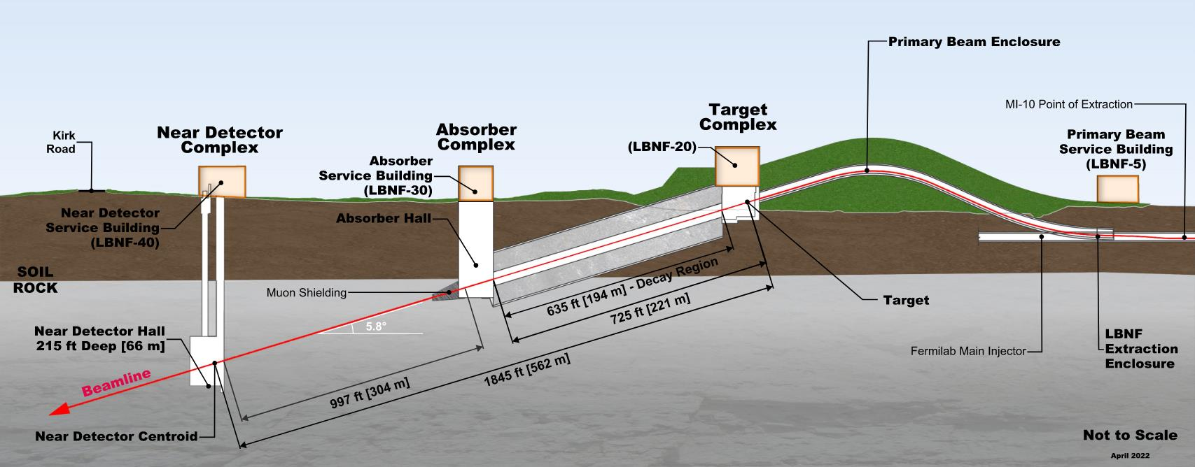
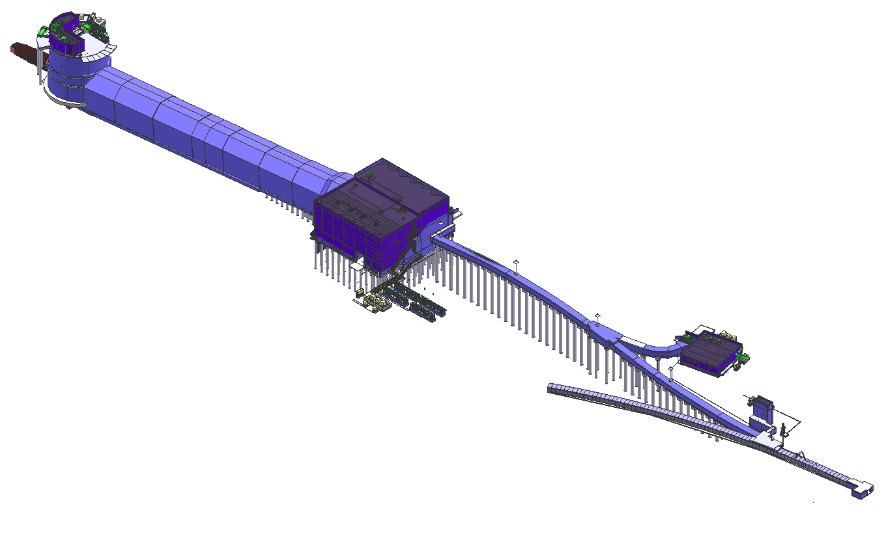
LBNF Beamline Construction
Absorber Complex
(LBNF-30)
Neutrino Beam
to SURF, SD
Absorber Complex Services:
Hadron Absorber
DS Decay Pipe Window
Hadron Monitor
Muon Monitors
Decay Region
Target
Complex
(LBNF-20)
Primary
Beamline
Enclosure
Primary Beam Service Building
(LBNF-5)
Target Complex Services:
Baffle
Target
Horns A, B, & C
US Decay Pipe Window
Beam on Target Instrumentation
Fermilab
Main Injector
Tunnel
Extraction
Enclosure
Primary Beam Services:
Beamline (magnets, vacuum, etc)
Primary Beam Instrumentation
Primary Beam Window
Proton Beam
From MI-10

Slide 6
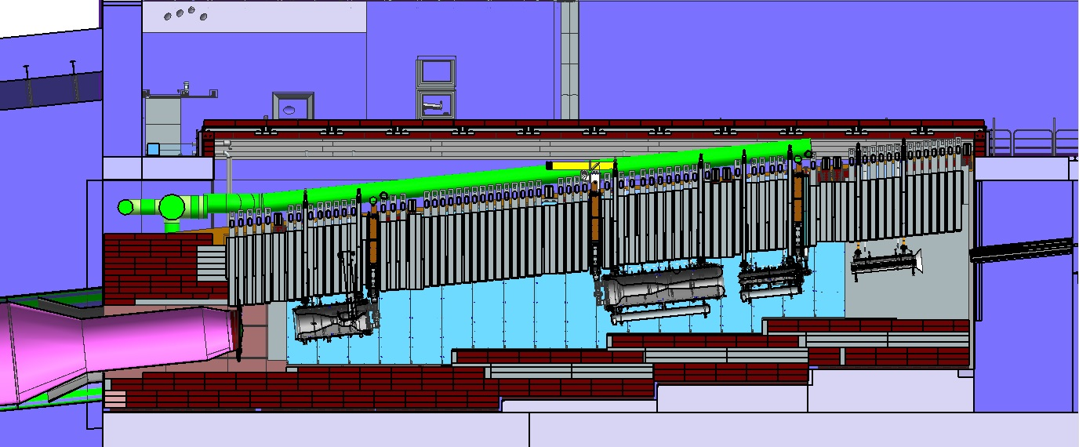
LBNF-20 (Target Complex)
Removable
Steel Shielding
Work
Cell
Sealed Hatch Covers
Beam
Decay Region Upstream Window
Horn A with Target
Primary Beam Window
Assembly
Steel
Shielding
Cooling
Panels
Baffle
Horn C
Horn B

Slide 7
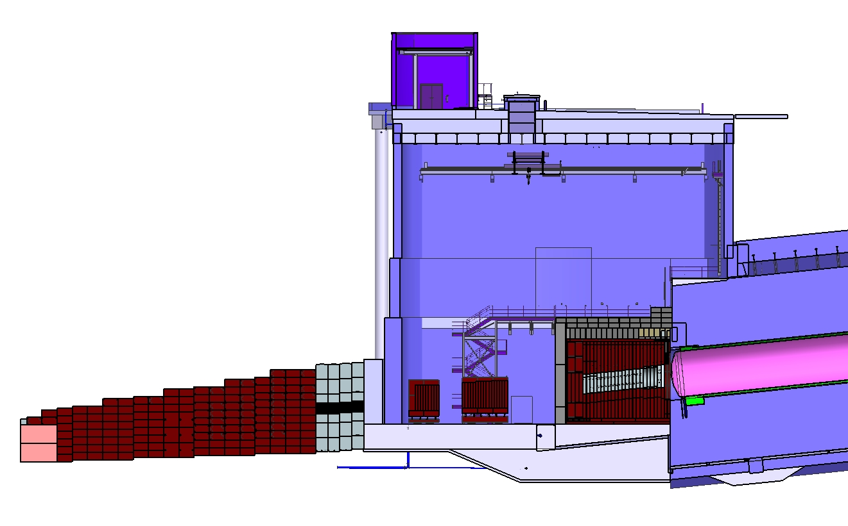
LBNF Absorber Facility and Downstream Decay Pipe
Surface
Hatch
Absorber
Service
Building
Absorber
Hall
Muon
Monitors
with
Shielding
Muon
Steel
Shielding
Neutrino Beam
to SURF, SD
Hadron
Absorber
DS Decay Pipe Window
Decay Region
Nitrogen Cooling
Decay Region
Helium Vessel

Slide 8
LBNF Beamline BID Irradiation Environment Parameter Table
Compnent Name | Material | Material Grade | LBNF Primary Beam Power Case (MW) | Required Lifetime (op year) | Peak dpa/year | dpa/life | Peak Fluence/year (p/cm^2) | Fluence/life (p/cm^2) | Mean peak temp (C)
Primary Beam Window | Beryllium | S200FH | 1.2 | 5 | 9.35E-02 | 4.67E-01 | 2.46E+21 | 1.23E+22 | 90
Target windows | Titanium | 6Al-4V Mill Anneal | 1.2 | 1 | 2.50E+00 | 2.50E+00 | 2.46E+21 | 2.46E+21 | 144
Target core | Graphite | IG-430 | 1.2 | 1 | 5.00E-01 | 5.00E-01 | 2.46E+21 | 2.46E+21 | 487
US Decay Pipe Window | Aluminum | 6061-T6 | 1.2 | 5 | 4.55E-01 | 2.27E+00 | - | - | 94
DS Decay Pipe Window | Stainless Steel | S304L | 2.4 | 30 | 1.19E-03 | 3.58E-02 | 2.24E+17 | 6.72E+18 | 107
Hadron Absorber | Aluminum | 6061-T6 | 2.4 | 30 | 3.10E-04 | 9.30E-03 | 2.24E+17 | 6.72E+18 | 70

Slide 9
LBNF Absorber

Slide 10
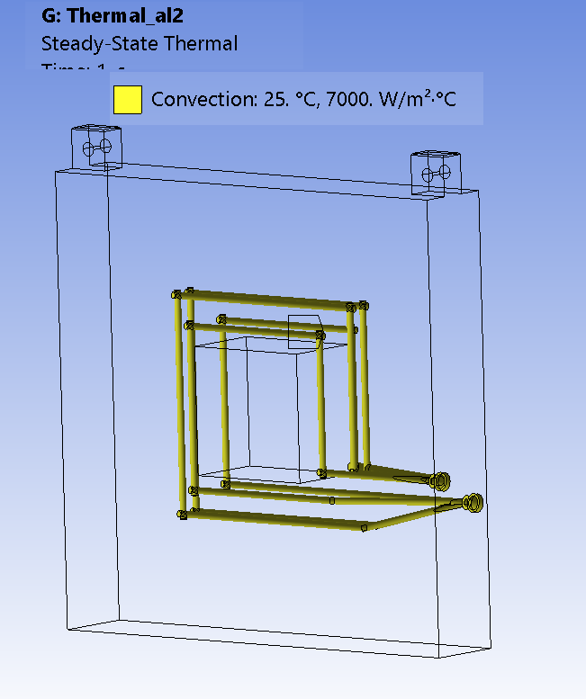
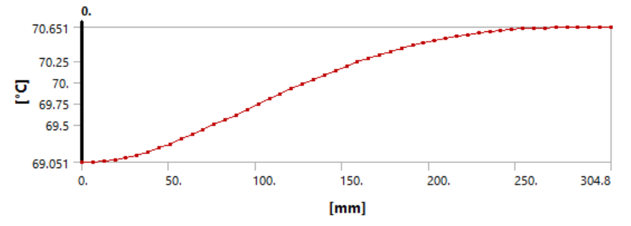
2nd Aluminum block (highest temperature) thermal analysis
Aluminum 2nd block temperature _C
Beam direction +Z
Beam direction

Slide 11
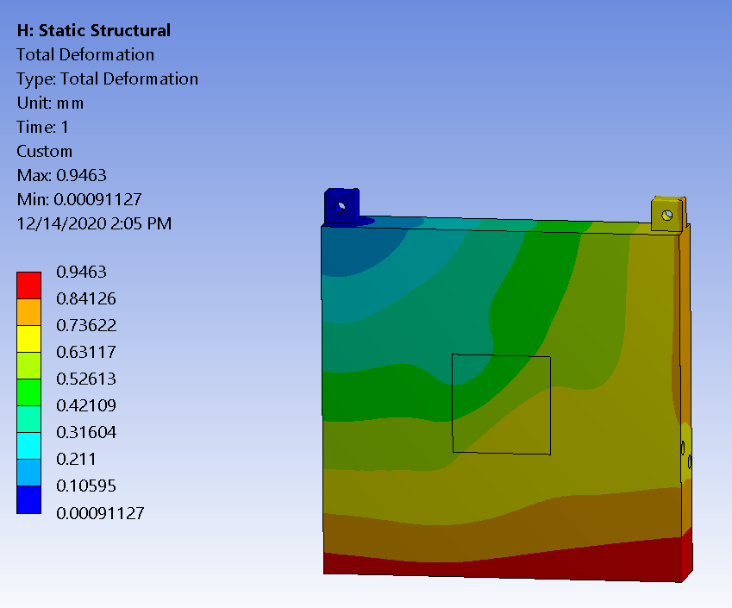
2nd aluminum block_ stress and deflection
Vertical deflection ~0.89 mm
Stress ~12 ksi <<40 ksi
Total deflection ~0.94 mm

Slide 12
Summary of Result Absorber Rectangular Cooling Circuit (for the 1.5-m RAL Target _ 2.4 MW)
 | Rectangular Cooling Circuit _ The Latest Design Dec 2020
 | Maximum temperature (C ) | FEA heat reaction (KW) | MARS data (kW) | FEA/MARSRatio | Stress (ksi) | Total deflection (mm)
Spoiler | 57.58 | 27.05 | 27.32 | 99.01% | 11.3 | 1.3
Aluminum_1 | 59.21 | 28.547 | 29.27 | 97.53% | 13.6 | 0.969
Aluminum_2 | 70.651 | 31.688 | 32.18 | 98.47% | 12.01 | 0.946
Aluminum_3 | 69.121 | 28.092 | 28.67 | 97.98% | 9.97 | 0.953
Material is Al 6061-T6. with the yield stress of 40 ksi.
The 13.6 ksi (mostly from the thermal loading) << 40 ksi.

Slide 13
dpa Calculations last performed in 2015 (being updated)
ε₉₅ = 20π mm-mrad, N_{p} = 1.5×10¹⁴ ppp
Beam starts at z = -7.3 m from MC0, tilt = 0.101074
Study assumed NuMI-like rectangular “fin” target (10 mm x 27 mm x 96 cm long)
Scenario | E_{p} (GeV) | P (MW) Q (MJ) | σ₀ (mm) at MC0 | β₀ (m) at MC0 | Cycle (s) | × 10¹⁴
Normal | 120 | 2.40 MW | 1.7 | 110.8837 | 1.2 | 1.25 p/s
No-target accident* | 120 | 2.88 MJ | 2.4 | 221.03 | 1.2 | 1.5 ppp
Off-axis accident** | 120 | 2.88 MJ | 2.4 | 221.03 | 1.2 | 1.5 ppp
Normal | 60 | 2.06 MW | 1.7 | 55.44 | 0.7 | 2.14 p/s
*On-axis
**Off-normal beam points to absorber cooling water pipes

Slide 14
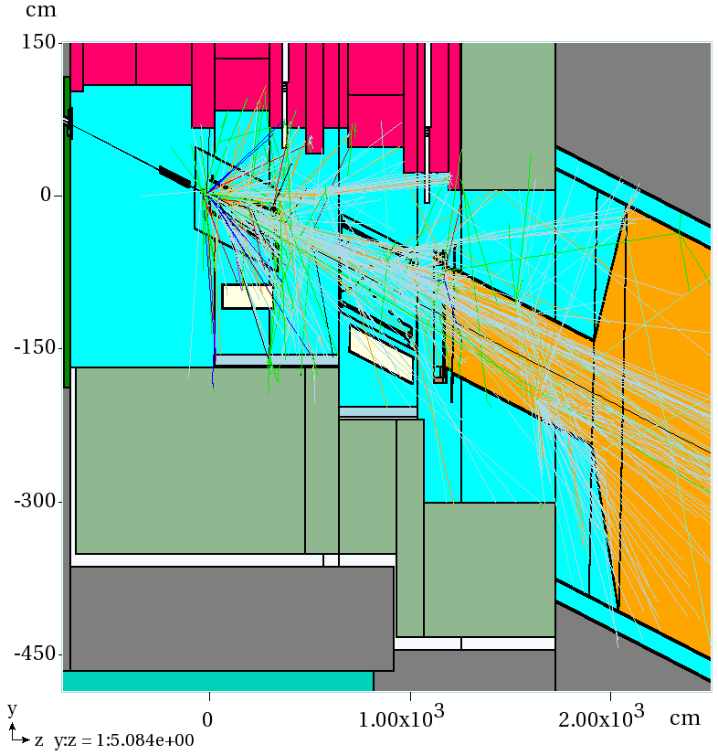
2015 MARS15 Source Term Simulations
C-Baffle: OD=5.7cm, L=150cm
ID=1.3 cm (normal)
ID=3.0 cm (accident)
C-target, 48 segments:
1cm(W)×2.67cm(H)×2cm(L)
Starting with a proton beam at z = -7.3m from MC0, high-statistics runs for all the four scenarios to get source terms at z = 219.25 m, i.e., 1.5m upstream the absorber spoiler

Slide 15
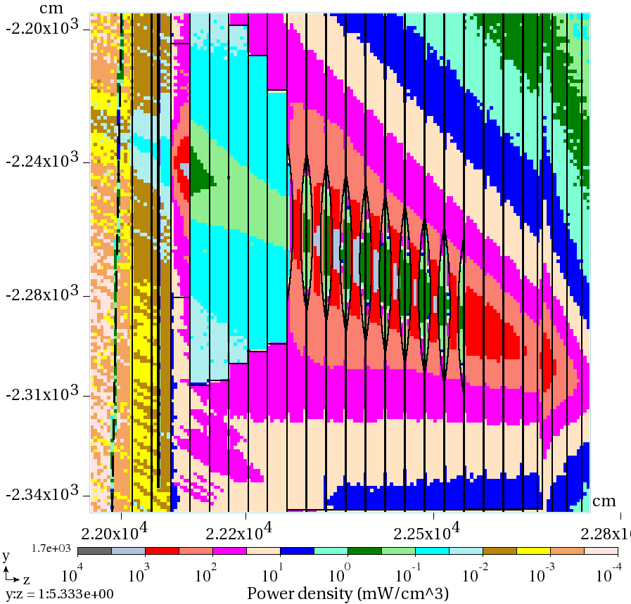
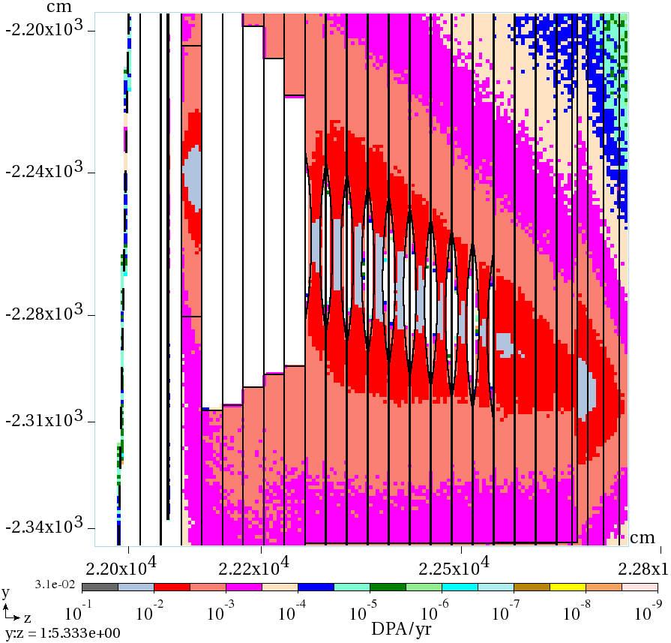
2015 Power Density (mW/cm³) & DPA/yr in the Core
mW/cm³
DPA/yr
Normal, 120 GeV
Peak_{Al} = 1.8 W/cm³
y:z = 1:5.333
Peak_{Al} = 0.031 DPA/yr
Peak_{Air} = 0.8 mW/cm³ (Ozone production)

Slide 16
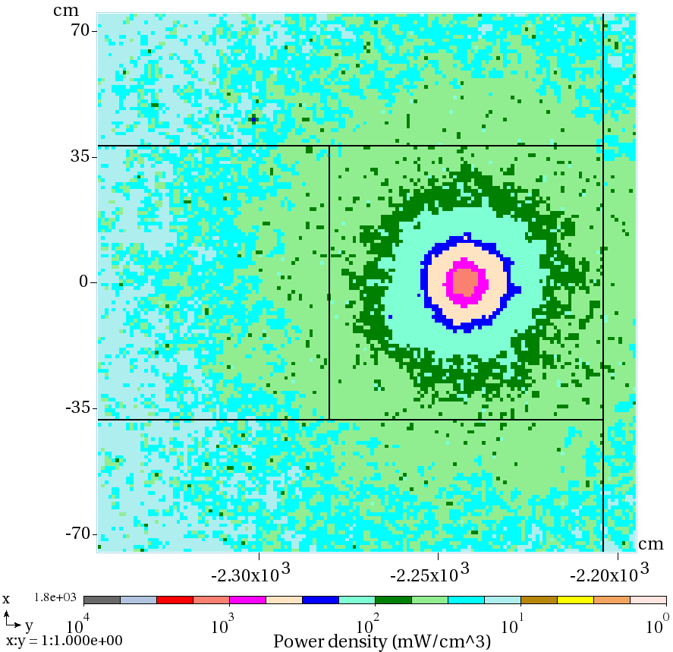
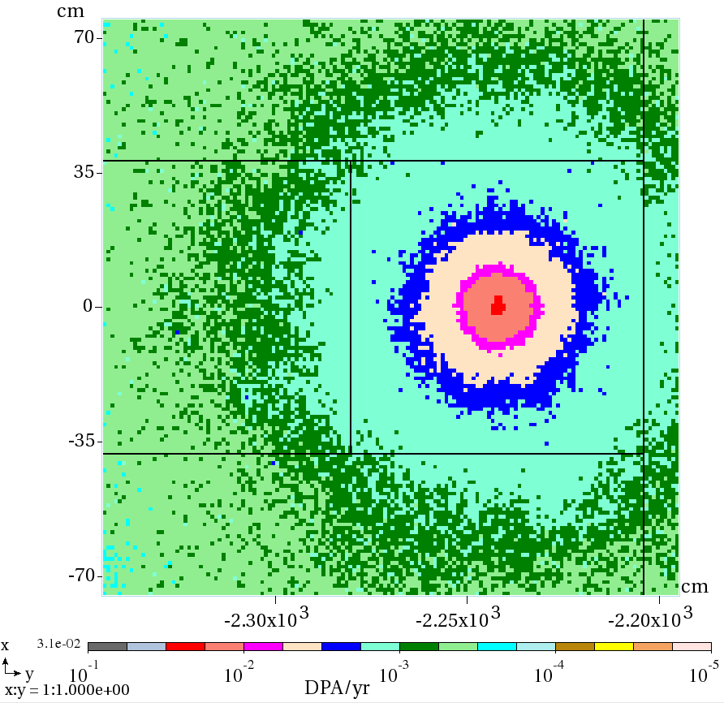
2015 Power Density (mW/cm³) & DPA/yr in Al Spoiler
mW/cm³
DPA/yr
Normal, 120 GeV
Peak 1.8 W/cm³
Peak 0.031 DPA/yr
At longitudinal maximum in the block

Slide 17
2015 Peak Values in the Core & Radiation Damage
Normal, 120 GeV
 | Al spoiler | Al_{sculpted} #3 | Al_{solid} #1 | Steel #1
PD (W/cm³) | 1.8 | 1.8 | 0.77 | 0.78
DPA/yr | 0.031 | 0.024 | 0.01 | 0.017
F (cm⁻² s⁻¹), × 10¹¹ | 11.20 | 11.03 | 4.23 | 4.71
DPA per 20 years | 0.62 | 0.48 | 0.20 | 0.34
*DPA_{limit} | 5-10 | 5-10 | 5-10 | 10
F (cm⁻² per 20 yr), ×10²⁰ | 4.48 | 4.41 | 1.69 | 1.88
*F_{limit} (cm⁻²), × 10²⁰ | 50 | 50 | 50 | 700
F is hadron flux/fluence for E > 0.1 MeV.
*) Limit values: No significant effect on specific heat, swelling, elongation, elastic and tensile properties up to the values shown.

Slide 18
Scaling for larger, cylindrical, shorter target results in 100x’s smaller dpa rates in absorber! (0.031 dpa/yr to 0.00031 dpa/yr)
“wings” are fins that are actually cylinders
Extended for the length of the target is essentially a cylindrical target
Almost twice the spot size also reduces the HE proton flux at the absorber
Just accounting for “wings” and target length (1.5 m > 1 m), result in reduction of factor of 100.
Full MARS runs for entire beamline are being run, including dpa results.

Slide 19
LBNF Beamline BID Irradiation Environment Parameter Table
Compnent Name | Material | Material Grade | LBNF Primary Beam Power Case (MW) | Required Lifetime (op year) | Peak dpa/year | dpa/life | Peak Fluence/year (p/cm^2) | Fluence/life (p/cm^2) | Mean peak temp (C)
Primary Beam Window | Beryllium | S200FH | 1.2 | 5 | 9.35E-02 | 4.67E-01 | 2.46E+21 | 1.23E+22 | 90
Target windows | Titanium | 6Al-4V Mill Anneal | 1.2 | 1 | 2.50E+00 | 2.50E+00 | 2.46E+21 | 2.46E+21 | 144
Target core | Graphite | IG-430 | 1.2 | 1 | 5.00E-01 | 5.00E-01 | 2.46E+21 | 2.46E+21 | 487
US Decay Pipe Window | Aluminum | 6061-T6 | 1.2 | 5 | 4.55E-01 | 2.27E+00 | - | - | 94
DS Decay Pipe Window | Stainless Steel | S304L | 2.4 | 30 | 1.19E-03 | 3.58E-02 | 2.24E+17 | 6.72E+18 | 107
Hadron Absorber | Aluminum | 6061-T6 | 2.4 | 30 | 3.10E-04 | 9.30E-03 | 2.24E+17 | 6.72E+18 | 70
For Absorber, radiation damage effects in Al is not critical due to low dpa, except for physical properties (thermal conductivity). Possibility of collaboration on Al PBW at ORNL and Al windows at TRIUMF

Slide 20
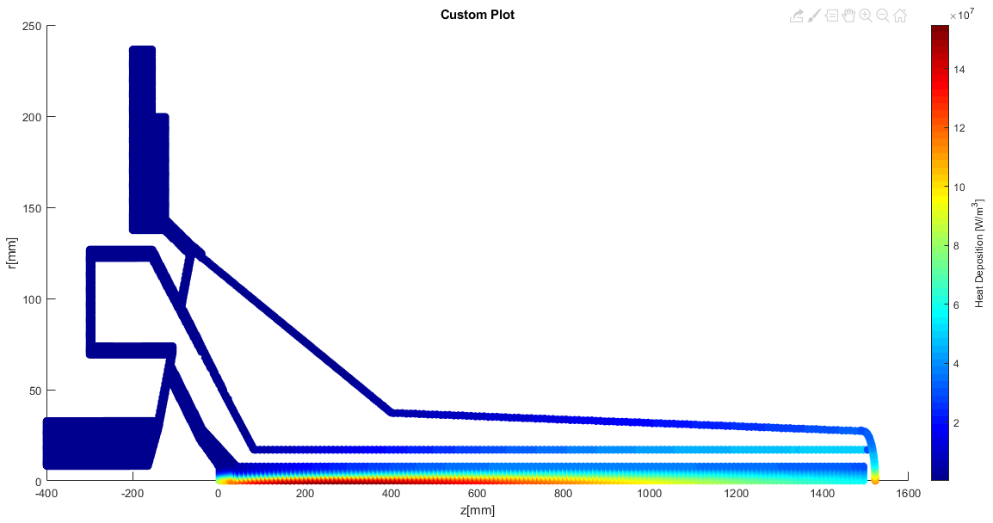
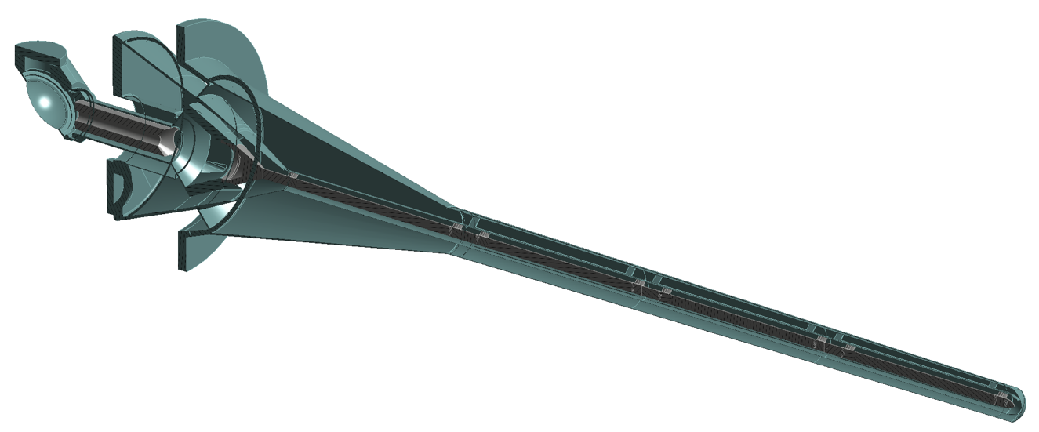
LBNF Target Irradiation Environment - Thermal
FLUKA simulation by John Back of Warwick University
1.2MW on a 1.5m long target
24.3kW total heat deposition

Slide 21
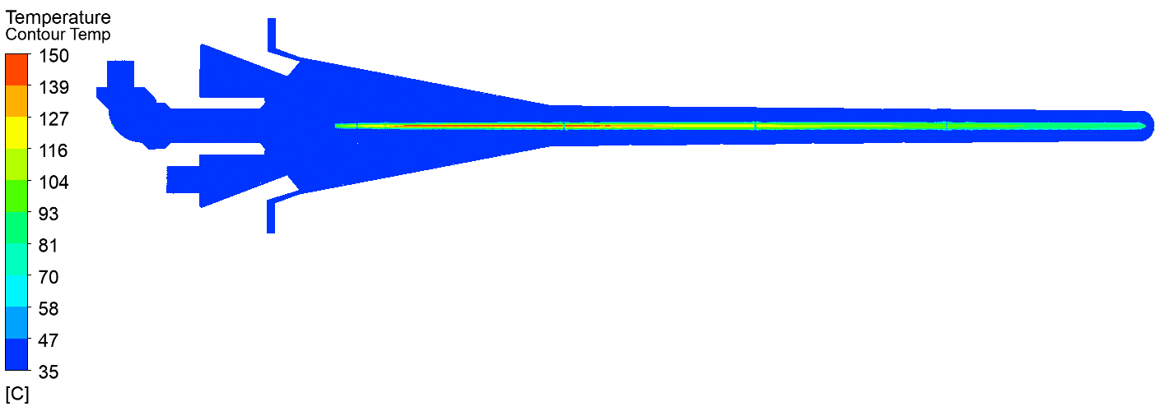
1 Pulse Thermal
Cross check that heat load has been correctly applied in CFX by simulating a single pulse on an initially cold target
Peak ΔT per pulse:
115°C in graphite
70 °C in titanium

Slide 22
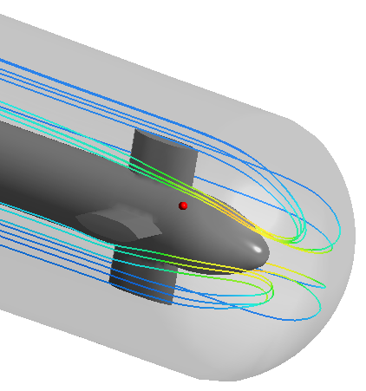
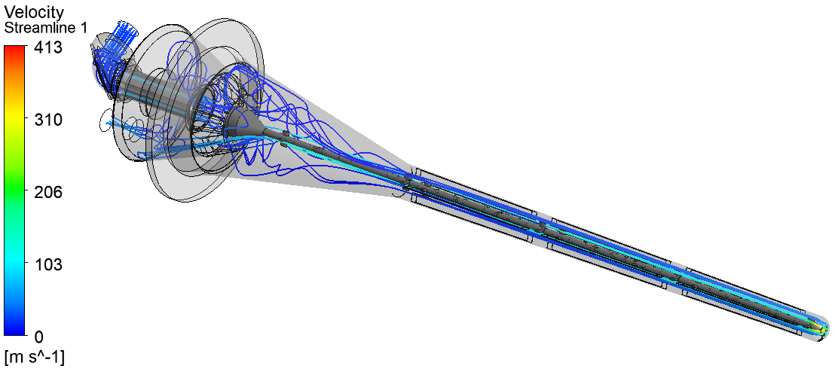
Steady State Fluid
Peak Velocity = 413m/s
Peak Mach Number = 0.38
Pressure drop = 0.42bar
Target length = 1.5m
Beam power = 1.2MW
Inlet temperature = 35°C
Helium mass flowrate = 40g/s
Back-pressure at outlet = 4.5barA

Slide 23
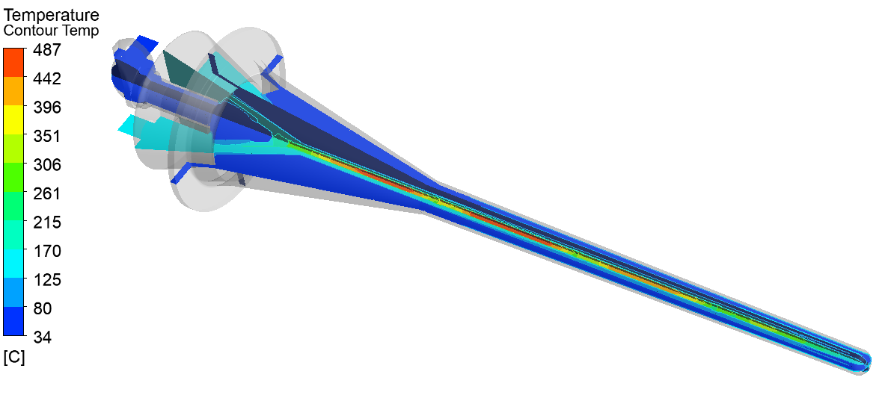
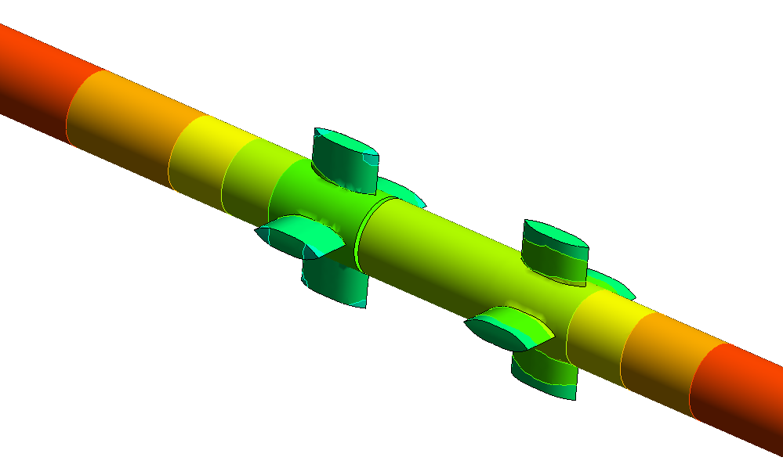
Steady State Temperature
Target length = 1.5m
Beam power = 1.2MW
Inlet temperature = 35°C
Helium mass flowrate = 40g/s
Back-pressure at outlet = 4.5barA
Peak Velocity = 413m/s
Peak Mach Number = 0.38
Pressure drop = 0.42bar

Slide 24
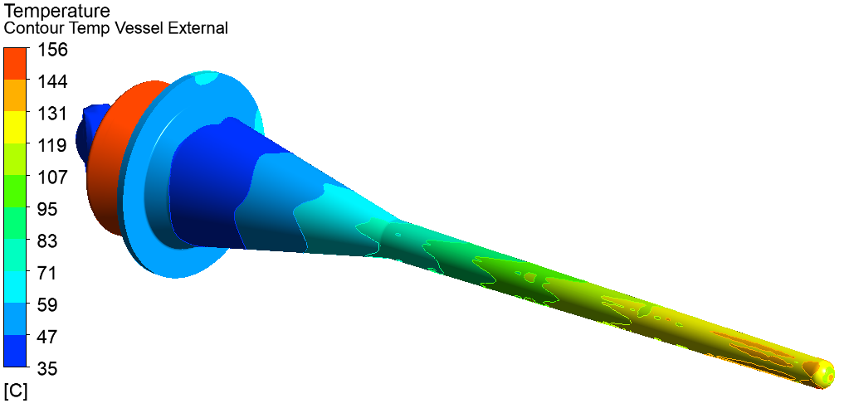
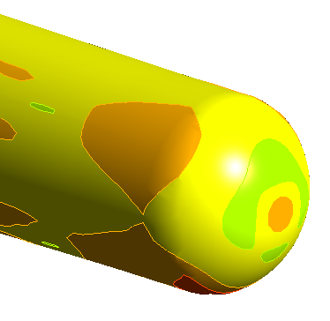
Graphite core runs hot (200-490°C in most places), while pressure vessel is well cooled (<156°C everywhere), as intended
Target length = 1.5m
Beam power = 1.2MW
Inlet temperature = 35°C
Helium mass flowrate = 40g/s
Back-pressure at outlet = 4.5barA

Slide 25
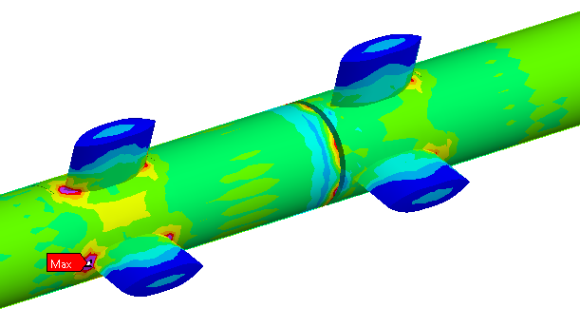
Steady State Structural
Detailed pressure vessel structural analysis covered in next talk
Stress in graphite is low except at support feet, risk is mainly from fatigue and radiation-induced swelling
UTS of IG-43 Graphite = 37MPa
Peak Von Mises stress = 1.4MPa
Steady state stress due to temperature profile in simply supported graphite segments

Slide 26
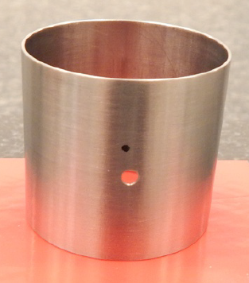
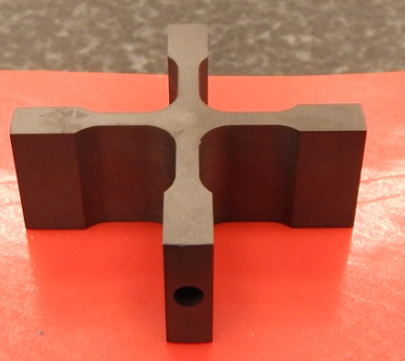
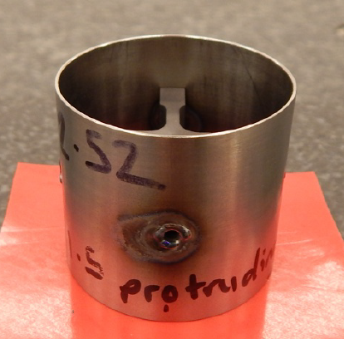
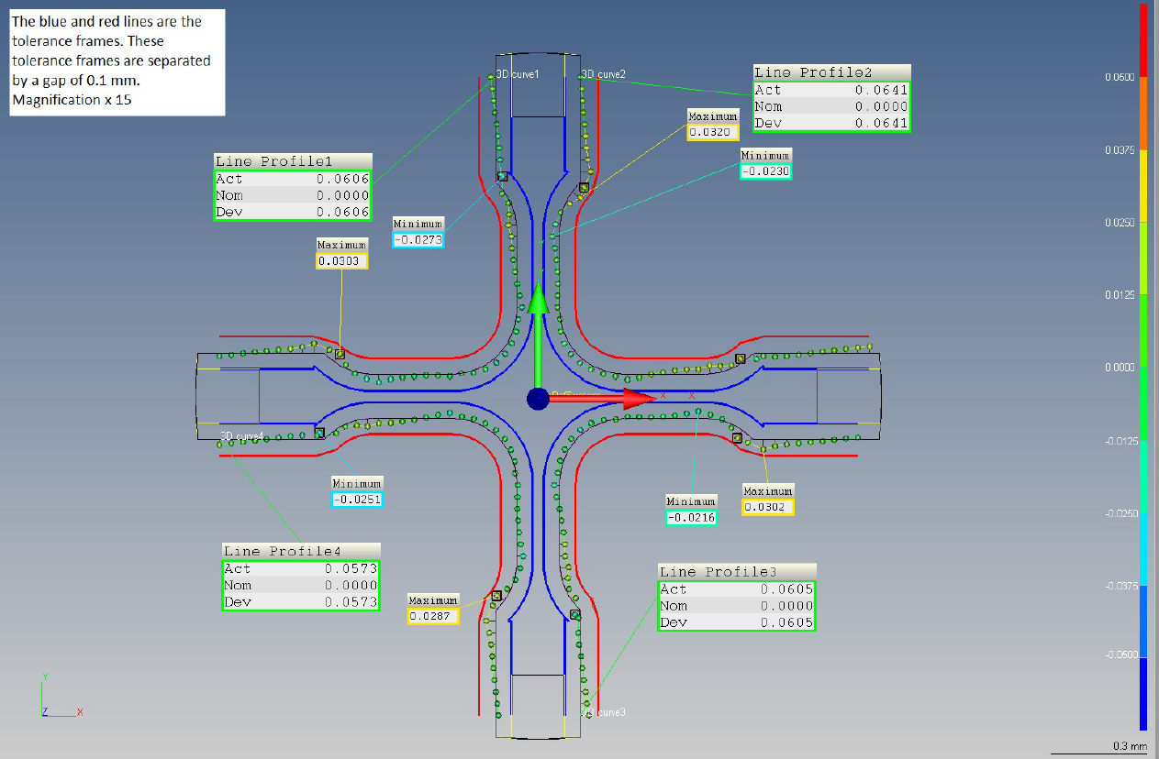
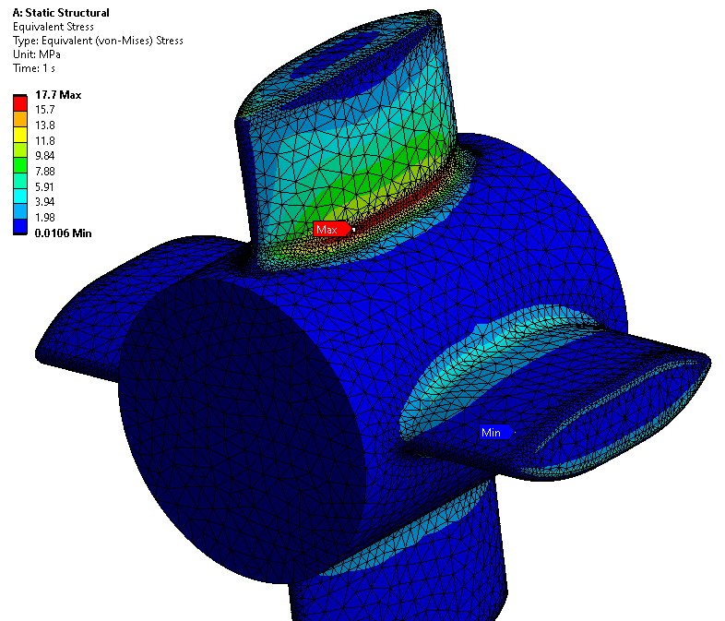
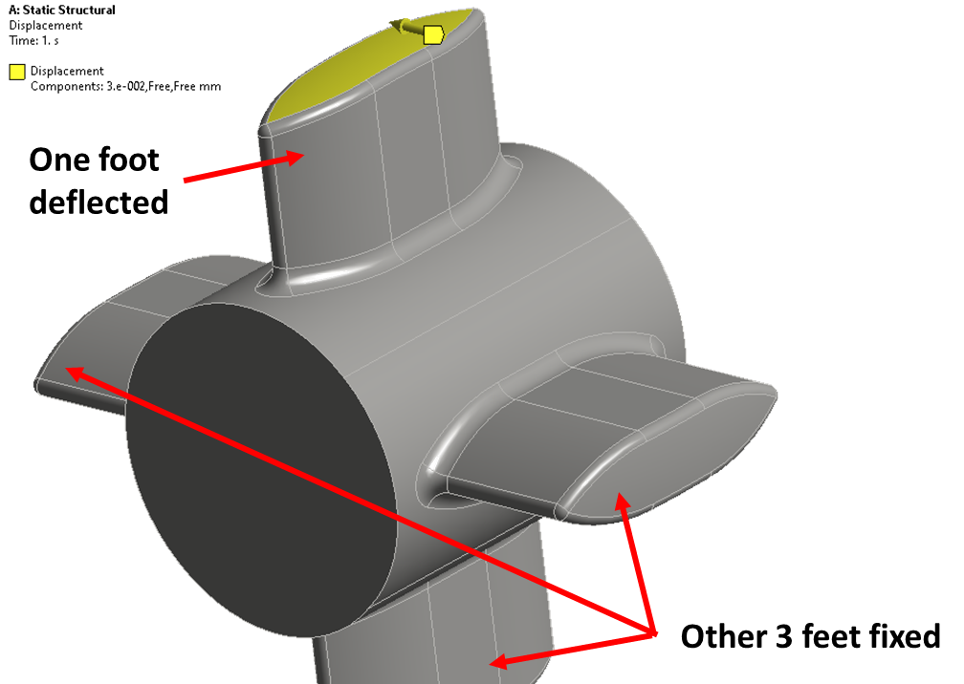
Steady State Structural – Graphite Supports
Test piece mounted in titanium tube
Measured distortion applied to ANSYS model
UTS of IG-43 Graphite = 37MPa
Peak Von Mises stress = 17.7MPa
Simplify complex deflections to worst case:
0.03mm lateral displacement of one fin

Slide 27
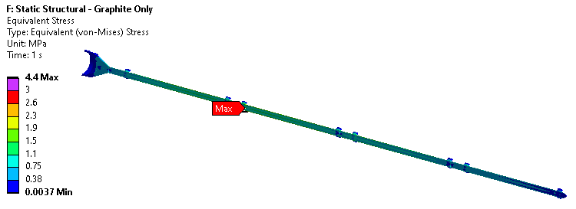
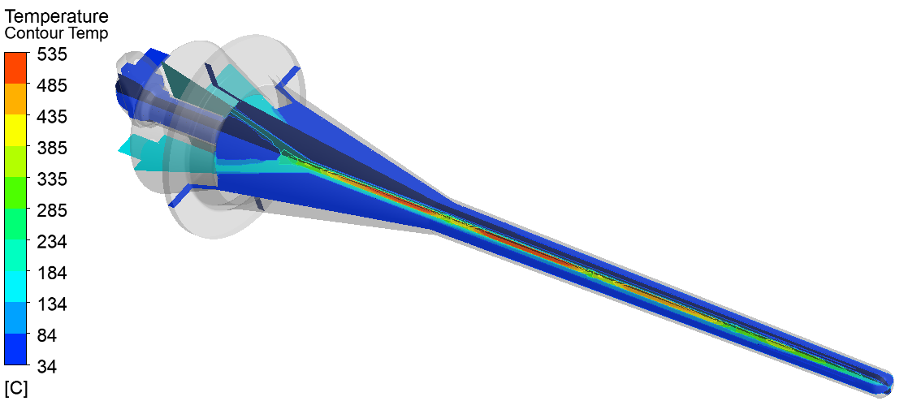
Radiation Damage of Graphite
Thermal conductivity change for IG-110 graphite†
Graphite thermal conductivity reduced from 165 to 41.25 W/(m.K) at room temperature
Assume same reduction factor at higher temperatures
No change to temperature of pressure-containing titanium parts
†Mohanty, S. and Majumdar, S. (2011). HTGR Graphite Core Component Stress, Analysis Research Program, Argonne, Argonne National Lab, p.58
UTS of IG-43 Graphite = 37MPa
Irradiated Peak σ_{VM} = 4.4MPa
Unirradiated = 1.4MPa
Irradiated, Tmax = 535°C
Unirradiated = 487°C

Slide 28
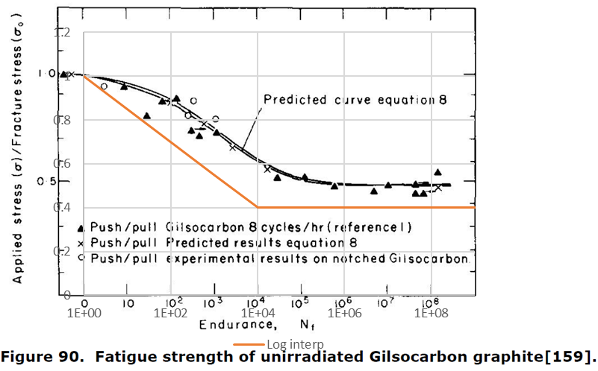
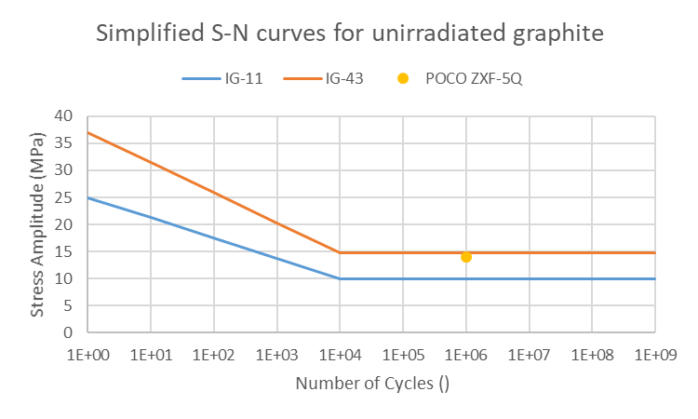
Available Fatigue Data – Graphite
Data for nuclear grade graphite (tested on Gilsocarbon) from [1] applied to IG-11 and IG-43
Endurance limit is approximately 50% of UTS, we assumed 40% to account for scatter
Tensile strength of POCO ZXF-5Q is 79MPa, so fatigue strength would be expected to be higher than for IG-43, but the one value given by Bidhar et al. suggests that it is similar [2]
Pulse cycles per year | 1.5E+07
Trip cycles per year | 5.0E+03
[1] “Literature Review On The Irradiation Response Of Be, W And Graphite for Proton Accelerator Applications”, NNL (13) 12703, Issue 1, 2013
[2] “Failure investigation of nuclear grade POCO graphite target in high energy neutrino physics through numerical simulation”, S. Bidhar et al., Nuclear Materials and Energy, 2020

Slide 29
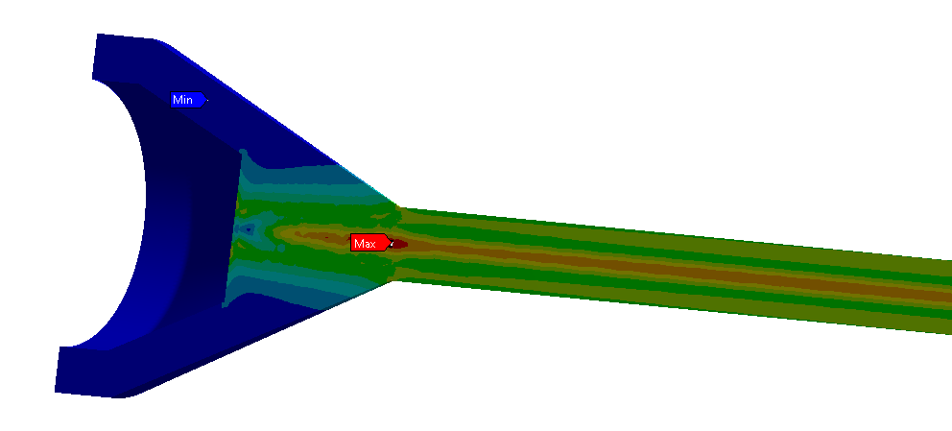
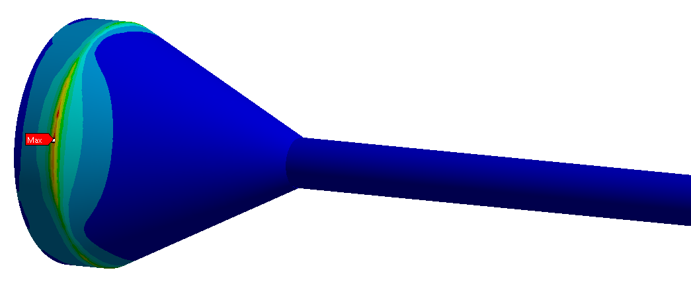
Results – Graphite Fatigue
Limits based on unirradiated data
Equivalent SE (MPa) | Design Limit | ANSYS Result
Target Pulses | 15 | 0.9
Target Trips | ~15 | 10.8
Target Trips, No Stress Conc. | ~15 | 1.0

Slide 30
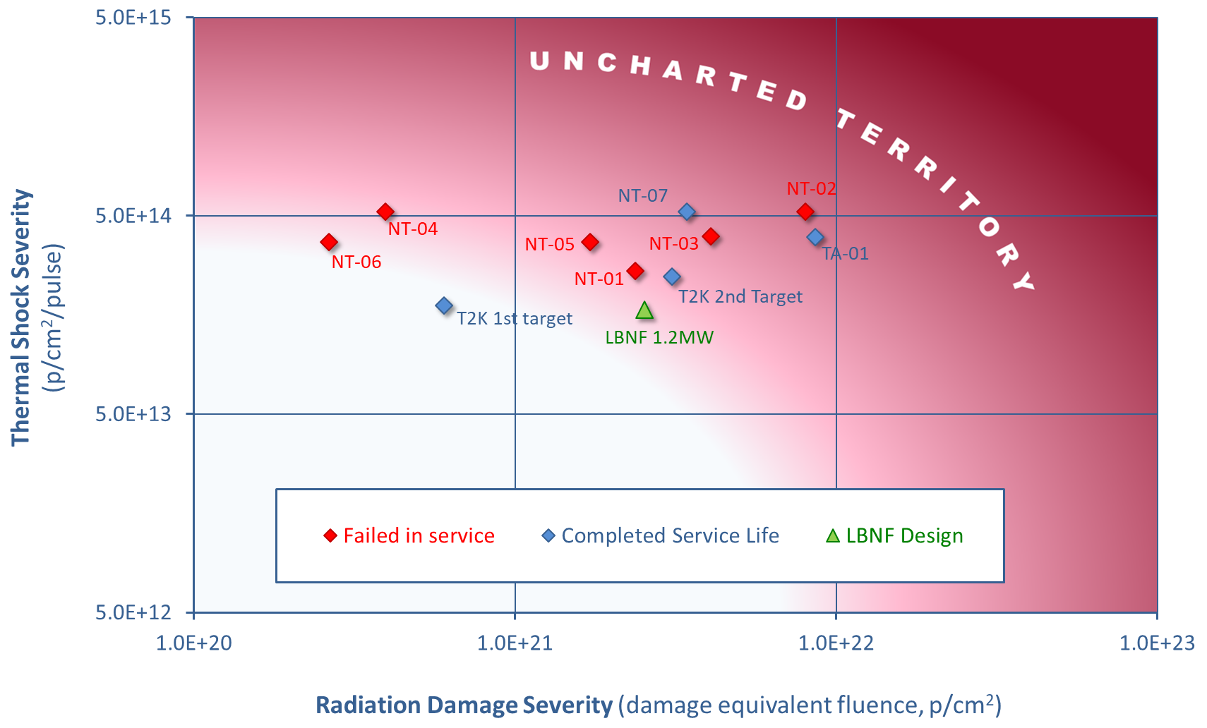
Radiation Damage
Limited relevant irradiated fatigue data for graphite
Operating experience at T2K gives confidence
The graphite core does not serve a safety function, but if it is damaged the neutrino output will be compromised
The likely graphite failure modes are:
Cracking due to thermal fatigue
Swelling due to irradiation
Large Beam spot means that beam intensity will be less severe than T2K or NuMI/NOvA
Peak graphite dose = 0.5 DPA per run year, from FLUKA simulations by John Back

Slide 31
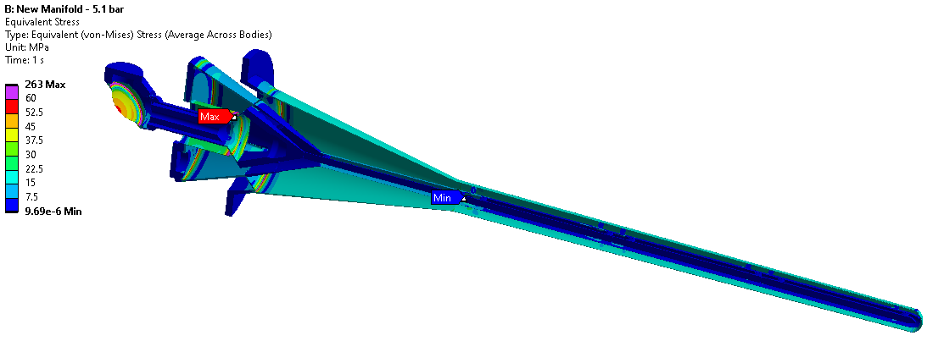
Plastic Collapse: Primary Loads
Design Pressure (5.1barG) + Self Weight

Slide 32
Linearised Stress Results
Limit for Grade 5 at 200°C applied everywhere
Actual peak temperature = 156°C
Location Details |  |  |  |  |  | Fraction of Allowable Stress (/)
Ref. | Name | Location Type | Weld? | Category | Wall Thickness (mm) | Membrane | Bending | Membrane +Bending | Total | Total inc. Thermal | Triaxial | Triaxial inc. Thermal
A | Path US Win Surround | Discontinuity | N |  | 2.94 | 3.2% | 10.1% | 10.6% | 16.4% | 15.7% | 25.7% | 25.1%
B | Path US Win Weld | Near Bulk? | Y | C? | 3.00 | 6.0% | 23.5% | 25.1% | 12.5% | 11.8% | 11.6% | 11.7%
C | Path US Win Edge | Discontinuity | N |  | 0.70 | 9.8% | 4.5% | 8.8% | 8.9% | 9.1% | 13.5% | 14.0%
D | Path US Win CL | Bulk | N |  | 0.30 | 22.6% | 0.0% | 15.1% | 7.6% | 7.7% | 11.3% | 11.3%
E | Path Baffle Tube US Weld | Near Bulk? | Y | B | 3.00 | 3.2% | 1.4% | 3.2% | 1.6% | 1.6% | 2.3% | 2.5%
F | Path Baffle Tube US Corner | Discontinuity | N |  | 3.00 | 0.8% | 0.2% | 0.6% | 0.6% | 0.5% | 0.9% | 0.2%
G | Path Baffle Tube DS Weld | Near Discontinuity? | Y | B | 3.00 | 6.9% | 1.1% | 5.5% | 2.8% | 4.5% | 3.0% | 6.5%
H | Path Manifold to Baffle Tube Corner | Discontinuity | N |  | 3.31 | 3.8% | 0.5% | 2.3% | 2.4% | 3.6% | 1.8% | 3.4%
I | Path Cross Flow to Manifold Corner | Discontinuity | N |  | 3.00 | 7.8% | 2.8% | 4.9% | 12.9% | 8.7% | 2.4% | 3.0%
J | Path Manifold Corner | Discontinuity | N |  | 1.66 | 7.8% | 17.8% | 21.1% | 36.7% | 34.2% | 49.3% | 44.7%
K | Path Manifold Thin Weld | Near Discontinuity? | Y | ?? | 1.50 | 17.8% | 48.8% | 51.4% | 24.5% | 21.1% | 30.9% | 23.5%
L | Path Manifold S Bend | Discontinuity | N |  | 1.50 | 6.7% | 14.1% | 15.6% | 18.0% | 22.3% | 19.4% | 19.3%
M | Path Manifold Thin to Thick | Discontinuity | N |  | 1.50 | 6.1% | 0.9% | 3.6% | 3.7% | 3.5% | 0.7% | 1.6%
N | Path Manifold Thick Corner | Discontinuity | N |  | 4.93 | 2.8% | 4.7% | 5.3% | 8.6% | 7.1% | 8.8% | 7.5%
O | Path Manifold Thick Weld | Discontinuity | Y | B | 4.82 | 8.3% | 0.7% | 6.1% | 3.0% | 3.5% | 2.8% | 3.4%
P | Path Cross Flow Outer 1 | Discontinuity | N |  | 4.76 | 2.3% | 0.4% | 1.2% | 1.3% | 2.0% | 2.3% | 0.0%
Q | Path Cross Flow Outer 2 | Discontinuity | N |  | 3.11 | 2.4% | 0.4% | 1.3% | 1.3% | 6.2% | 1.7% | 5.4%
R | Path Cross Flow Outer 3 | Discontinuity | N |  | 3.00 | 4.6% | 4.0% | 5.9% | 5.5% | 10.2% | 4.0% | 9.3%
S | Path Cross Flow Outer 4 | Discontinuity | N |  | 3.29 | 4.3% | 5.6% | 6.8% | 9.7% | 6.1% | 10.6% | 6.4%
T | Path Cross Flow to Cone Weld | Near Bulk? | Y | B | 3.30 | 10.7% | 15.0% | 20.5% | 9.7% | 5.8% | 7.7% | 4.7%
U | Path Cone Corner | Discontinuity | N |  | 1.06 | 6.2% | 0.9% | 3.4% | 3.4% | 4.0% | 4.2% | 5.2%
V | Path Cone to Seg 1 Weld | Near Bulk? | Y | B | 1.00 | 14.2% | 0.7% | 10.1% | 5.0% | 6.0% | 5.4% | 7.4%
W | Path Seg 1 to Seg 2 Weld | Bulk | Y | B | 0.90 | 11.8% | 0.3% | 8.1% | 4.1% | 4.7% | 5.1% | 5.3%
X | Path Seg 2 to Seg 3 Weld | Bulk | Y | B | 0.80 | 11.9% | 0.4% | 8.3% | 4.2% | 4.8% | 5.3% | 4.9%
Y | Path Seg 3 to DSWin Weld | Bulk | Y | B | 0.70 | 12.4% | 0.8% | 9.0% | 4.5% | 5.2% | 6.1% | 7.5%
Z | Path DS Win Edge | Discontinuity | N |  | 0.64 | 3.2% | 1.9% | 3.5% | 3.5% | 3.6% | 3.4% | 3.5%
AA | Path DS Win CL | Bulk | N |  | 0.40 | 7.9% | 0.1% | 5.4% | 2.7% | 3.1% | 3.9% | 4.3%
All welds assumed to be bulk material (overly conservative in most cases?)
Weld derating factor: 0.6 (from Div.1, also conservative as we are in Div.2)

Slide 33
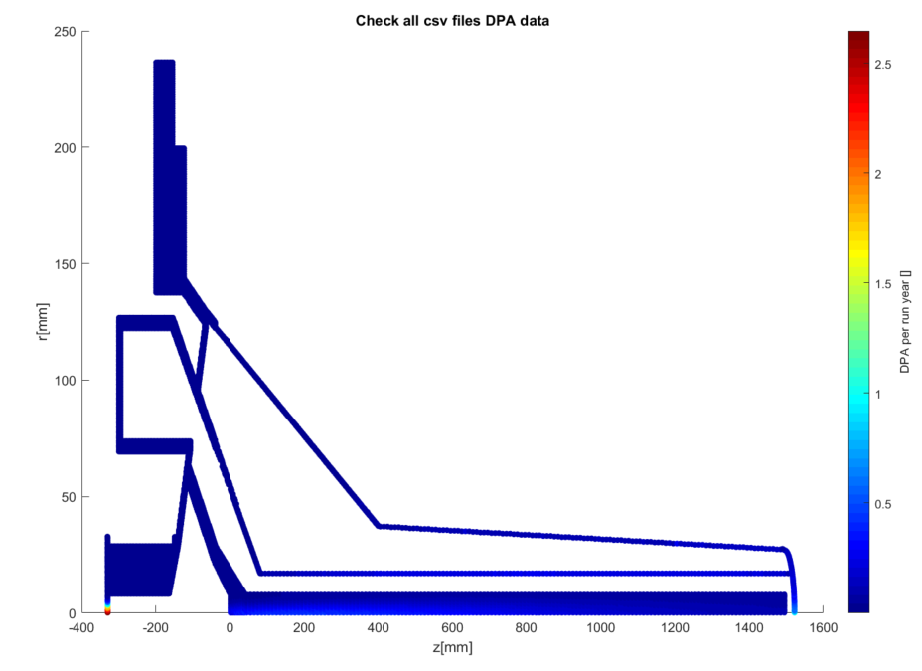
Radiation Damage – Nominal Beam, 1.2MW
DPA is highest in the windows (2.5/yr upstream, 0.7.yr downstream), as expected
Peak DPA in any other component is 0.5/yr in the target, then 0.26/yr in the flow divider tube, but these parts are not pressure-containing
Peak DPA at a weld is 0.14/yr, between the outer containment and the DS window. This is also the peak DPA in any other pressure-containing part
Peak DPA in all other parts is less than 0.03/yr

Slide 34
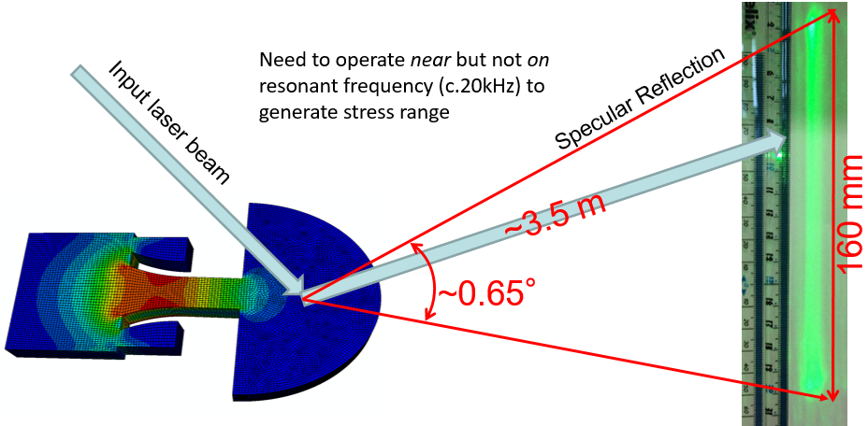
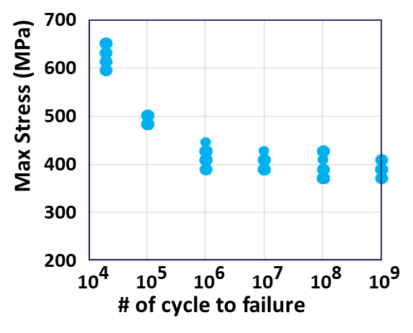
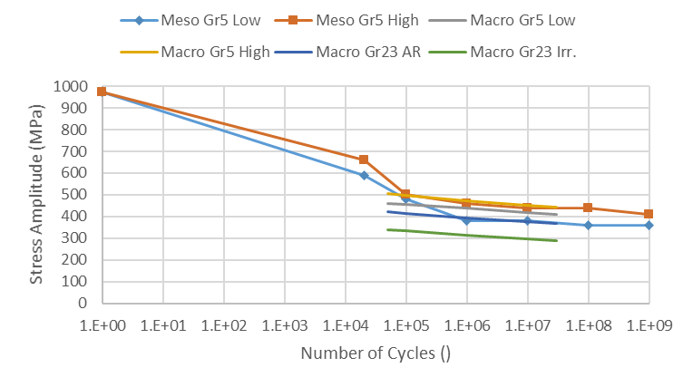
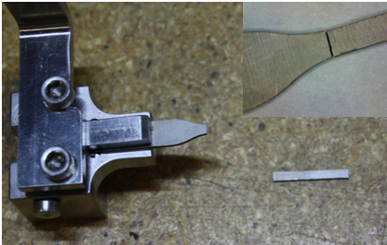
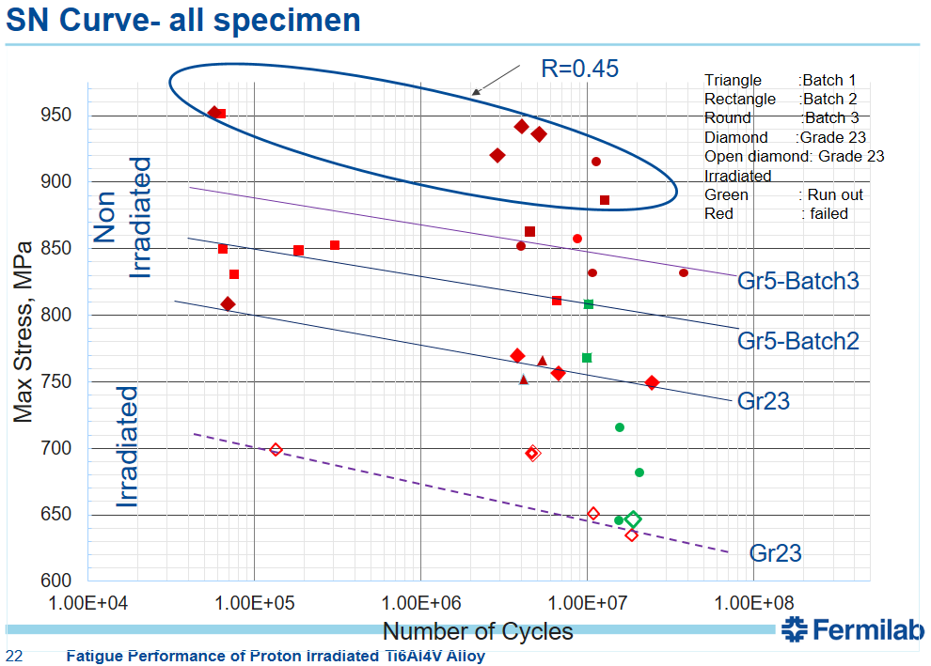
Available Fatigue Data – Titanium
Meso-scale Fatigue Testing
Gr23 A&STA, Gr2, 15-3Ti, Unirradiated data only
Gerber equivalent fully-reversed stress amplitudes:
V. Kuksenko, RaDIATE2017
Macro-scale Fatigue Testing
Irradiated to 0.06~0.24 DPA
Grades 5, 23
Dose at neck region: 0.06~0.24 DPA
Irradiation temp: 50C~125C
“Fatigue Performance of Proton Irradiated Ti6Al4V Alloy”, Sujit Bidhar, 6th RaDIATE Collaboration Meeting, Dec 10, 2019
Conservative to assume irradiated grade 5 will have the same fatigue strength as irradiated grade 23?
Pulse cycles per year | 1.5E+07
Trip cycles per year | 5.0E+03

Slide 35
Results – Titanium
Ignoring stress concentrations, the highest fatigue in titanium occurs at the upstream window
Equivalent SE (MPa) | ASME Limit | ANSYS Result
Titanium Pulses | 290 | 82.7
Titanium Trips | 350 | 111.3

Slide 36
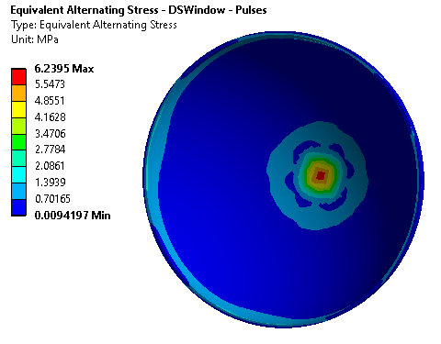
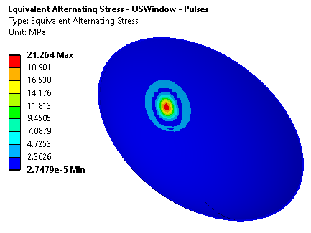
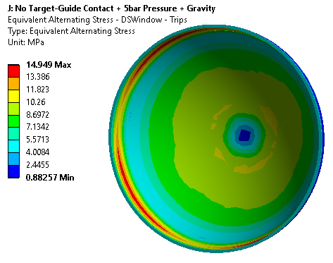
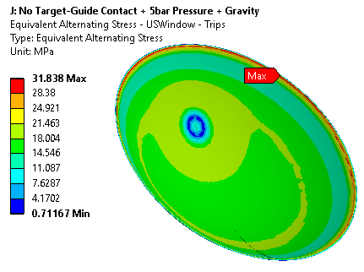
Results – Beam Windows
Limits based on irradiated data for 0.06~0.24 DPA
Equivalent SE (MPa) | ASME Limit | ANSYS Result
USWin Pulses | 290 | 21.3
USWin Trips | 350 | 31.8
USWin Trips, No Stress Conc. | 350 | 28.0
Equivalent SE (MPa) | ASME Limit | ANSYS Result
DSWin Pulses | 290 | 6.2
DSWin Trips | 350 | 14.9
DSWin Trips, No Stress Conc. | 350 | 10.8
DS Window: 0.7 DPA/yr
US Window: 2.5 DPA/yr
t_{min} = 0.4mm
T_{max} = 150°C steady state, 175°C peak
ΔT = 55°C/pulse
t_{min} = 0.3mm
T_{max} = 115°C steady state, 150°C peak
ΔT = 70°C/pulse

Slide 37
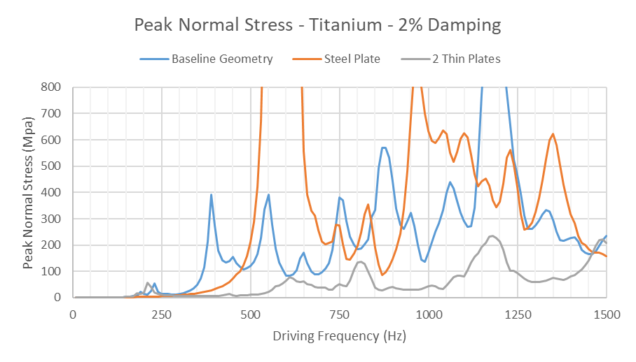
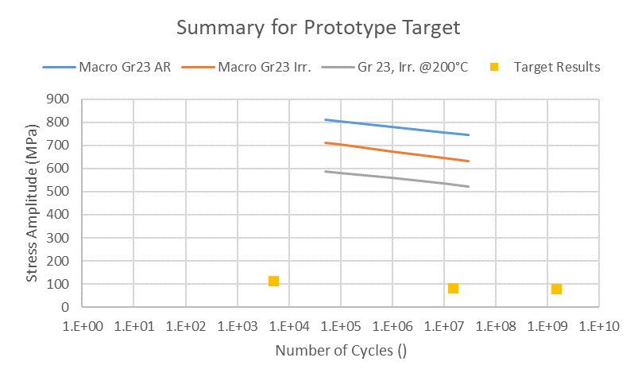
Fatigue Summary
Target fatigue results well below S-N curve for irradiated grade 23
S-N curve derated for temperature based on UTS change in grade 5
Peak vibration stress in driving frequency range = 78MPa, 1.5E9 cycles/yr max
Note that this peak is adjacent to the core segments, not in a pressure containing part
Stress Criterion
Irradiated to 0.06~0.24 DPA
Titanium peak results occur at stress concentrations and should be overly conservative

Slide 38
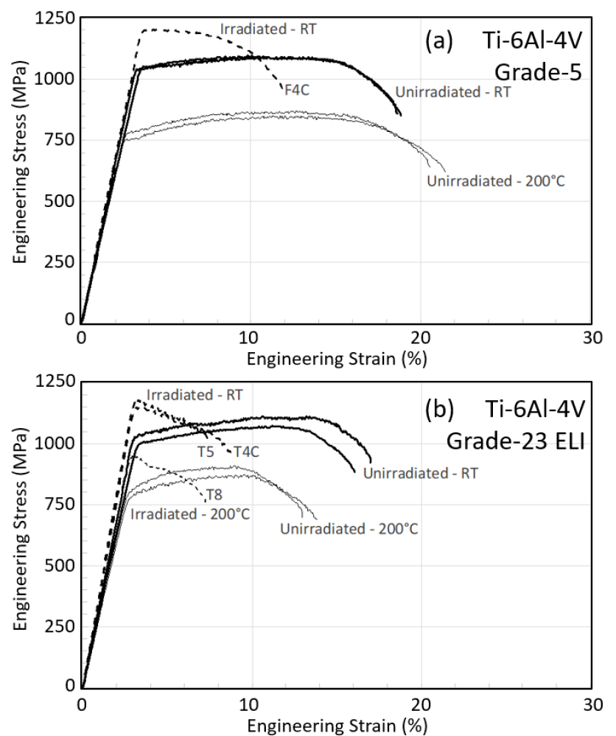
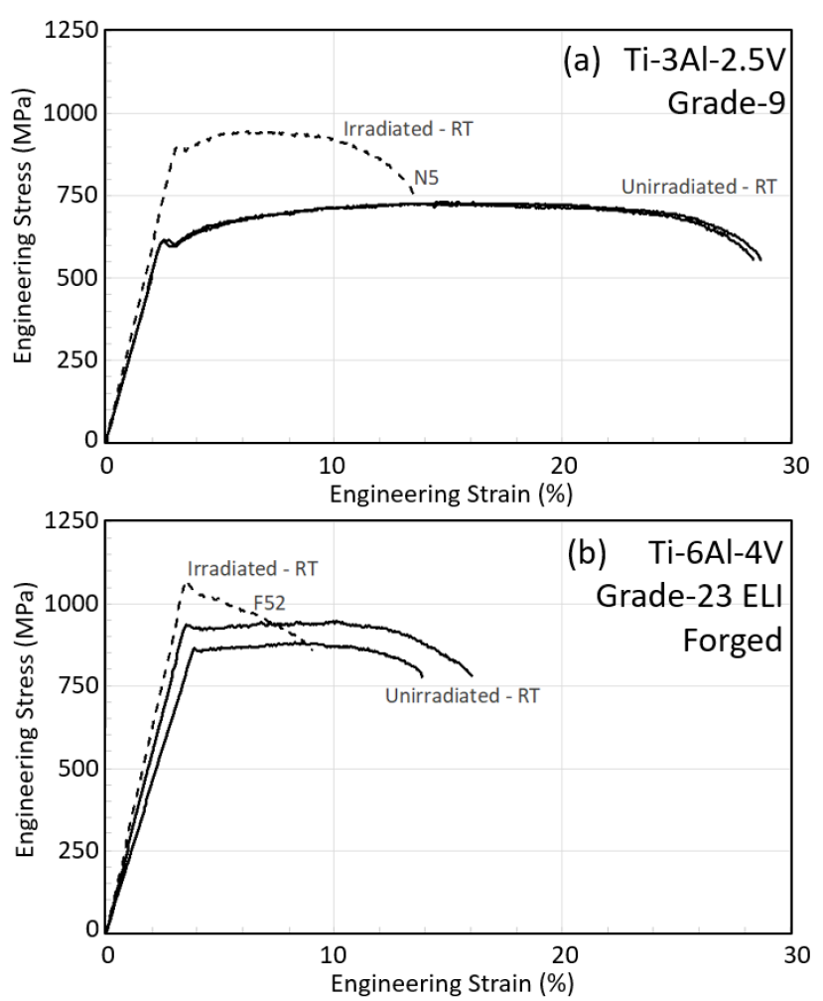
Irradiated Titanium Data
Increase in UTS, but rapid loss of ductility. Results based on stress linearisation may no longer be conservative.
Tensile-tensile irradiated fatigue tests will also capture some effect of tensile strength.
No guidelines in ASME BPVC for how to account for radiation damage.
F4C=0.06 dpa at Tirr=47°C
N5=0.22 dpa @112°C
T4C=0.06 dpa @ 47°C,
T5/T8=0.23 dpa @ 125°C
F52=0.22 dpa @112°C
“Tensile behavior of dual-phase titanium alloys under high-intensity proton beam exposure: radiation-induced omega phase transformation in Ti-6Al-4V”, T. Ishida et al., Journal of Nuclear Materials, 2020

Slide 39
LBNF Beamline BID Irradiation Environment Parameter Table
Compnent Name | Material | Material Grade | LBNF Primary Beam Power Case (MW) | Required Lifetime (op year) | Peak dpa/year | dpa/life | Peak Fluence/year (p/cm^2) | Fluence/life (p/cm^2) | Mean peak temp (C)
Primary Beam Window | Beryllium | S200FH | 1.2 | 5 | 9.35E-02 | 4.67E-01 | 2.46E+21 | 1.23E+22 | 90
Target windows | Titanium | 6Al-4V Mill Anneal | 1.2 | 1 | 2.50E+00 | 2.50E+00 | 2.46E+21 | 2.46E+21 | 144
Target core | Graphite | IG-430 | 1.2 | 1 | 5.00E-01 | 5.00E-01 | 2.46E+21 | 2.46E+21 | 487
US Decay Pipe Window | Aluminum | 6061-T6 | 1.2 | 5 | 4.55E-01 | 2.27E+00 | - | - | 94
DS Decay Pipe Window | Stainless Steel | S304L | 2.4 | 30 | 1.19E-03 | 3.58E-02 | 2.24E+17 | 6.72E+18 | 107
Hadron Absorber | Aluminum | 6061-T6 | 2.4 | 30 | 3.10E-04 | 9.30E-03 | 2.24E+17 | 6.72E+18 | 70
Ongoing studies at Birmingham/RAL/CCFE and FNAL/J-PARC on Ti alloys (fatigue), but need higher dpa and maybe fracture toughness(?)

Slide 40
Some observations on engineering design and standard compliance needs
Many of the recent RaDIATE studies have focused upon fundamental mechanisms of radiation damage effect, for good reasons:
Need to understand fundamental process and interactions to better predict and explain observed material behavior in our facilities
Lack of resources to do full engineering characterization and qualification of irradiated materials for every application and radiation environment
Lack of bulk volume irradiation and PIE facilities
This is not likely to change in the near to mid-future.
Engineers need to design and qualify targetry materials now to meet the near-future accelerator target facility project timelines
There is increasing pressure for design and operations engineers to show that designs and fabrication comply with national consensus standards, such as ASME BPVC

Slide 41
How to incorporate radiation damage into standards compliance
At Fermilab, we have safety policies that allow design and fabrication of vessels that provide the same “level” of safety and quality assurance of the applicable national consensus standard
Unlisted material
Physics limited geometries that do not fully satisfy the applicable standard
Necessary fabrication processes which cannot meet exact quality assurance (inspection) criteria
However, incorporating radiation damage effects has, to date, either not occurred or has been limited
Lack of irradiated data
Modeling gradients of radiation damage across the beam interaction continuum
Almost impossible goal of showing complete compliance to ASME BPVC Section VIII (never fail)

Slide 42
How does ASME BPVC Section III (Rules for Constructions of Nuclear Facility Components) Consider Radiation Effects?
From very recent, very quick review it appears that Section III primarily utilizes a method of
Damage/flaw tolerance
Monitoring and Licensing periods
E.g. Minimum detectable flaw size and fracture toughness
Section III suggests a ¼ wall thickness flaw should be tolerable by ensuring fracture toughness of the pressure bearing vessel wall is greater than the K_{Ic} of the material at the end of the licensing period
IE If there is an existing crack in the vessel, or one develops, up to ¼ of the wall thickness, the crack will not propagate
Uses operational experience and fracture toughness data to arrive at a conservative licensing period
Include fracture toughness samples in reactor neutron field to monitor
If fracture toughness samples display enough toughness left as licensing period end approaches (as well as many other criteria), the reactor can be re-licensed for an extended period
Section III allows for increasing operating temperature to take advantage of increased ductility (fracture toughness) at higher temperatures (and this has been done at operating reactors!)

Slide 43
How does this inform our design/QA compliance efforts?
Within RaDIATE studies for targets, absorbers, and beam windows, we have been researching radiation effects on design properties (tensile, thermal, dimensional, fatigue)
Our devices are designed to avoid stress concentrations and notches
Our irradiated volumes are relatively small (just beam spot interaction regions)
Our devices are, for the most part, replaceable and can run to failure without significant consequences
Our devices are not usually part of the life-safety boundary (envelope)
However, adopting a reasonable flaw or damage tolerant approach may be very beneficial for compliance efforts and help focus QA programs
What is our minimum detectable flaw in, say, a beam window?
If we assume that flaw in the beam center region, what is the stress intensity?
Should we be including fracture toughness samples in our irradiation studies?
Can we say anything about fracture toughness from the data we already have (tensile or bending behavior)?

Slide 44
Stress Intensity is Calculable
Assuming a max flaw size possible, stress intensity can be easily calculated
Non-irradiated Ti critical stress intensities are available
https://www.digitalengineering247.com/article/get-cracking-with-ansys-workbench-19.2/
Stress Intensity factor directly proportional to energy release rate, G
Fuwen Chen, Yulei Gu, Guanglong Xu, Yuwen Cui, Hui Chang, Lian Zhou, Improved fracture toughness by microalloying of Fe in Ti-6Al-4V, Materials & Design, Volume 185, 2020,

Slide 45
Can we get relative decrease in fracture toughness from tensile data for irradiated materials?
F4C=0.06 dpa at Tirr=47°C
N5=0.22 dpa @112°C
T4C=0.06 dpa @ 47°C,
T5/T8=0.23 dpa @ 125°C
F52=0.22 dpa @112°C

Slide 46
Conclusion
LBNF BID irradiation and loading environments presented
Can we use an ASME Section III approach to show “same level of safety as provided by national consensus standards” for irradiation effects integration?
Suggest to refresh fracture mechanics and do some exploratory studies for a real-world application

Slide 47
Back-up slides follow

Slide 48
Primary Beam Window dpa scaling

