Slide 1
Non-destructive Characterization of Nuclear Materials Through X-ray Absorption And Diffraction Contrast Tomography: Case Study on Surrogate TRISO particle
Mehmet Topsakal
Brookhaven National Laboratory
Nuclear Science and Technology Department

Slide 2
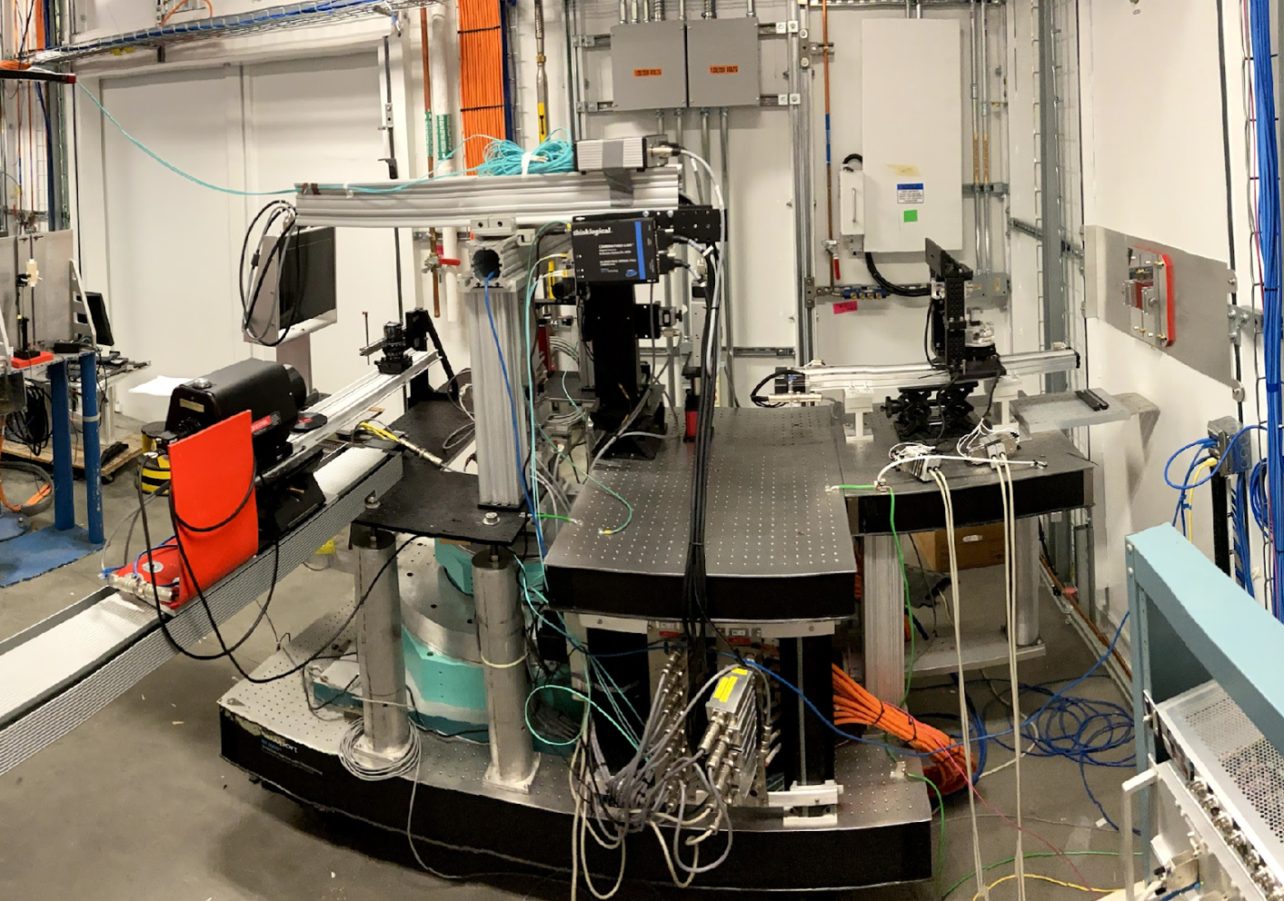
Outline of this talk
XRD-CT endstation at NSLS-II
What can you do with it?
What is this facility?
How can you use it?

Slide 3
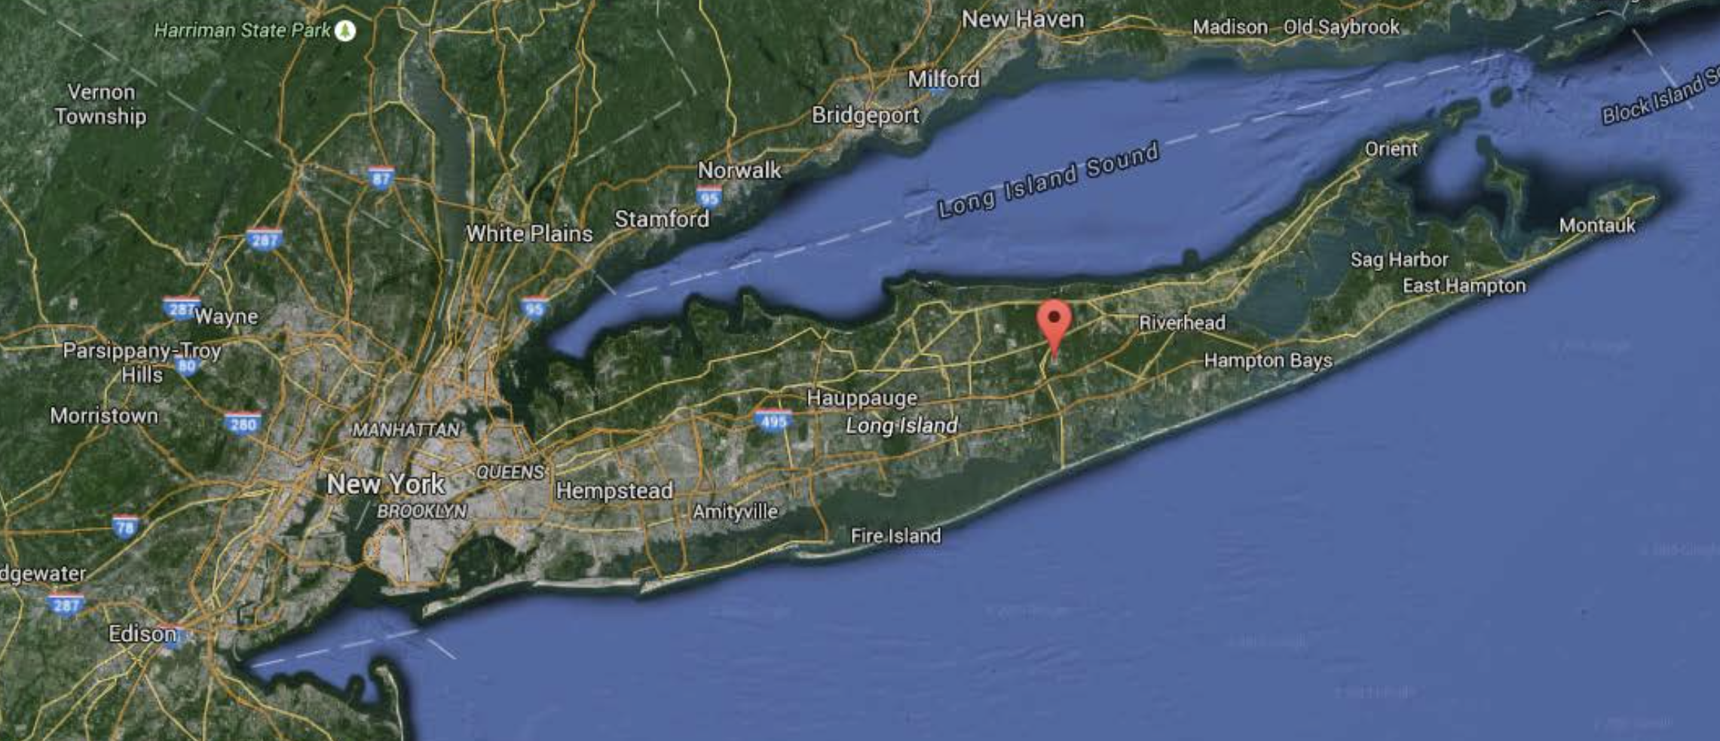
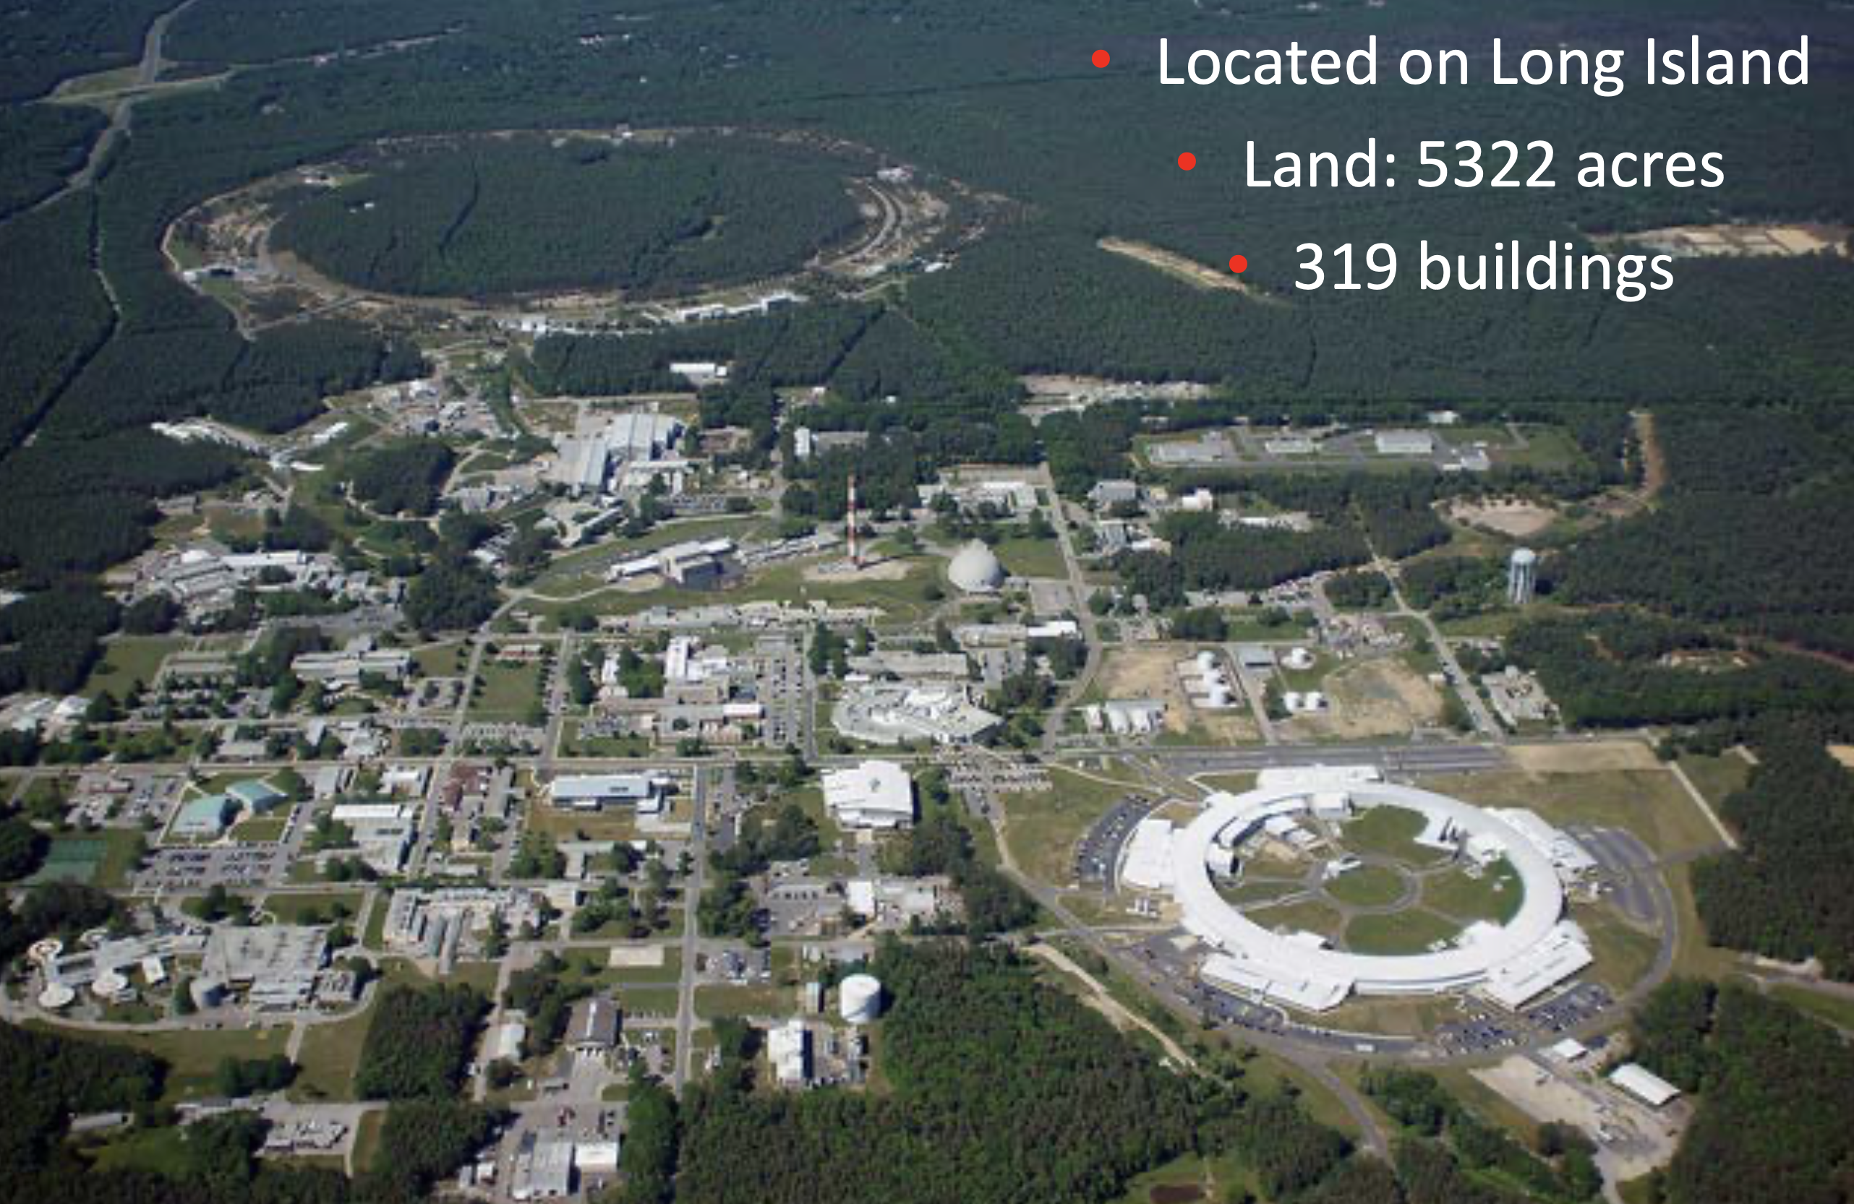
Brookhaven National Laboratory (BNL) is a United States Department of Energy national laboratory located in Upton, New York, on Long Island, and was formally established in 1947.
BNL hosts National Synchrotron Light Source-II (NSLS-II)

Slide 6
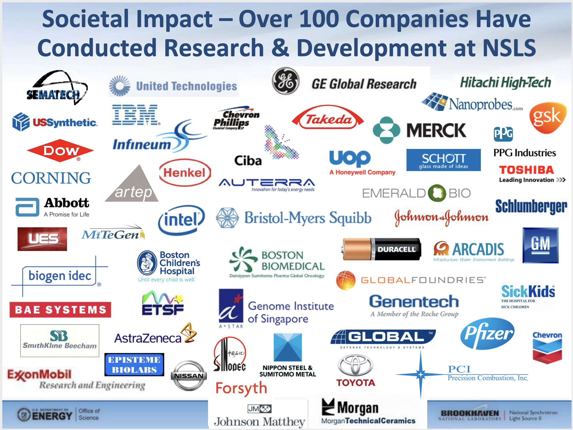
…plus many universities
all around the world

Slide 7
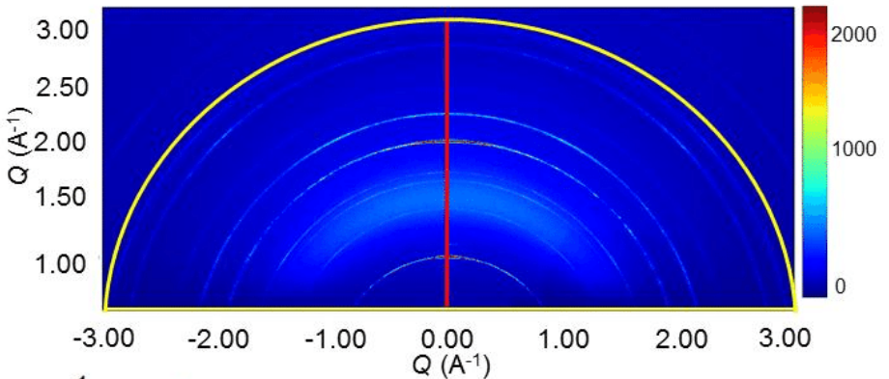
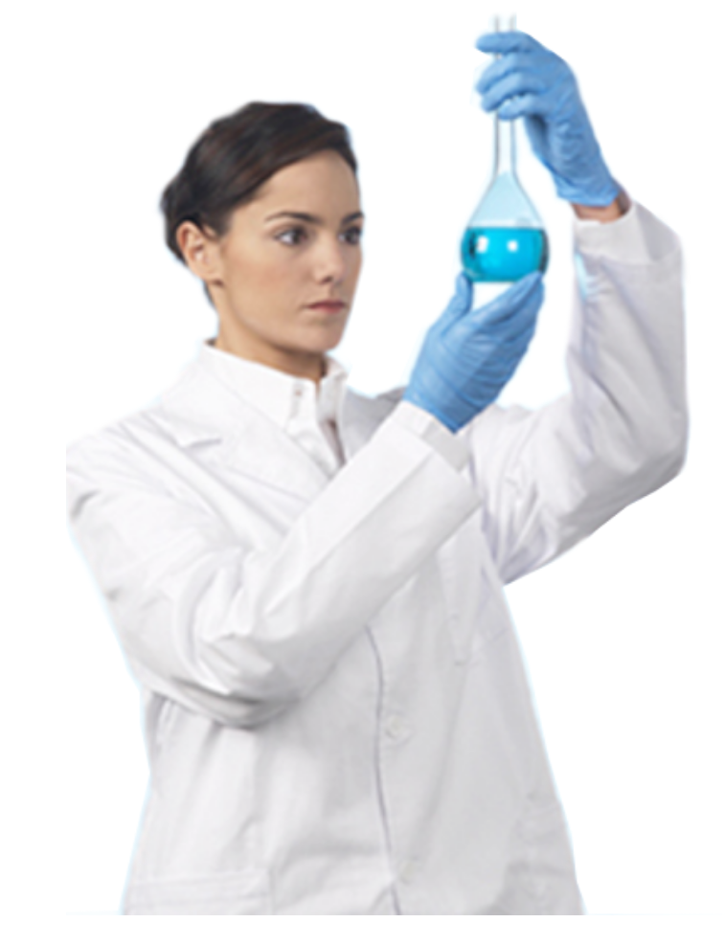
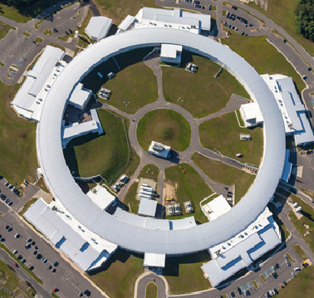
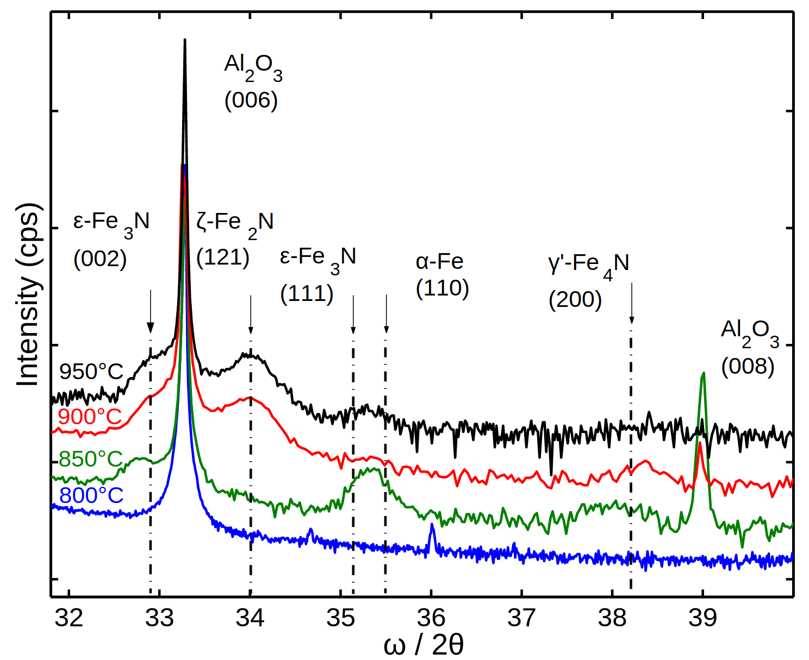
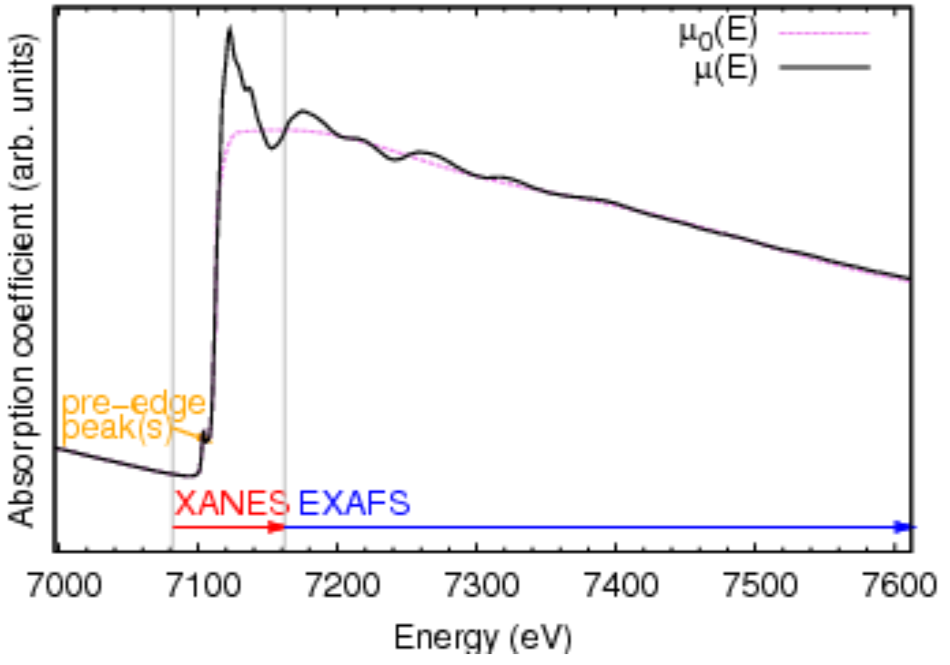
Why do scientists go to light sources ?
???
XRD
XAS

Slide 8
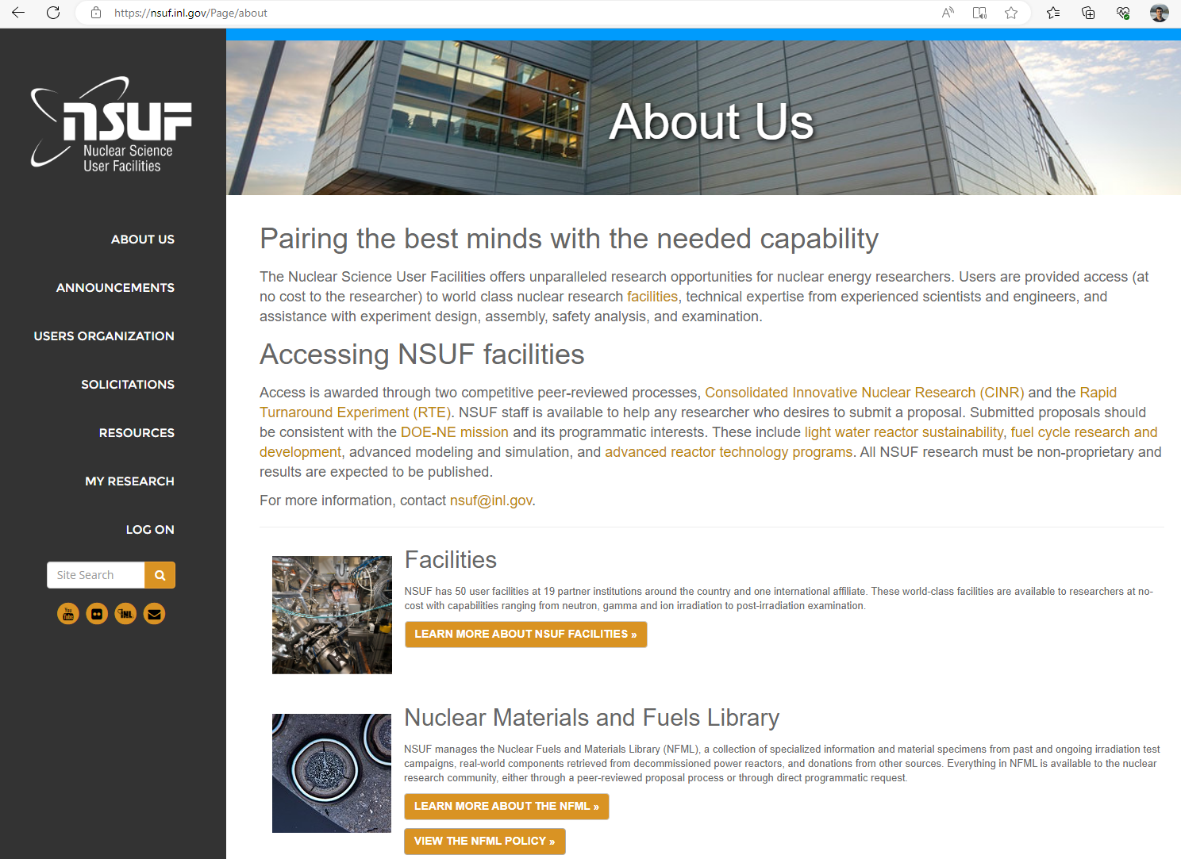

Slide 9
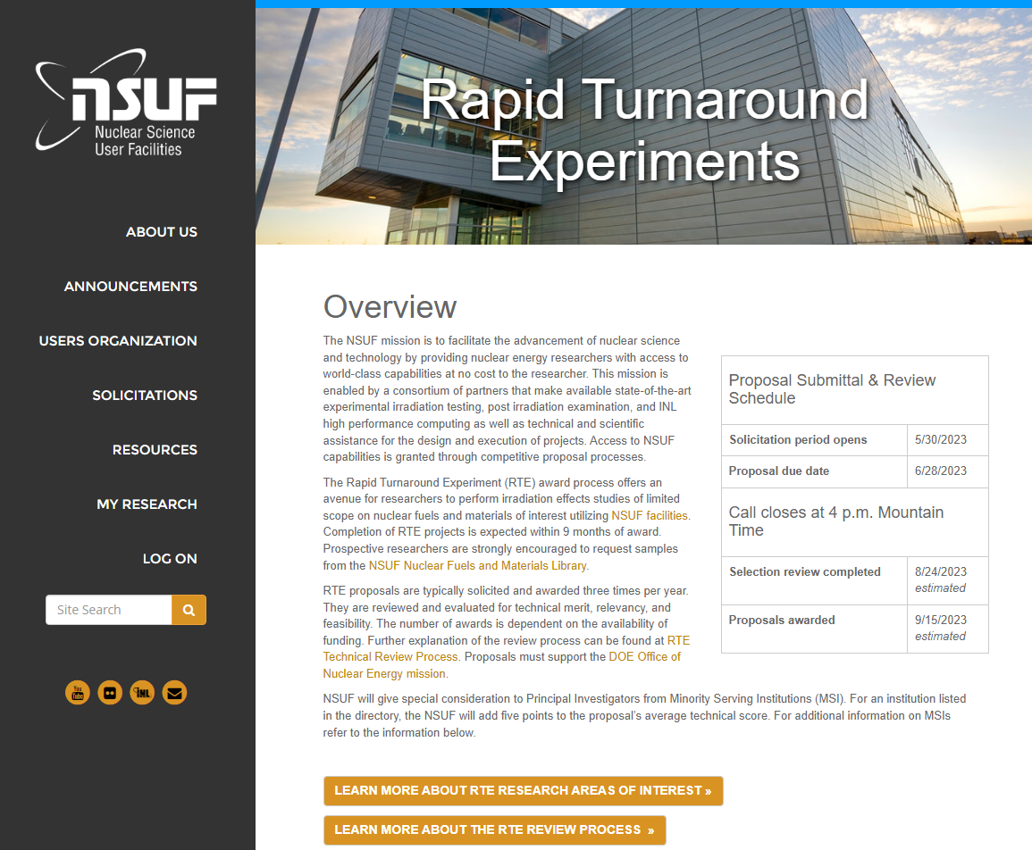
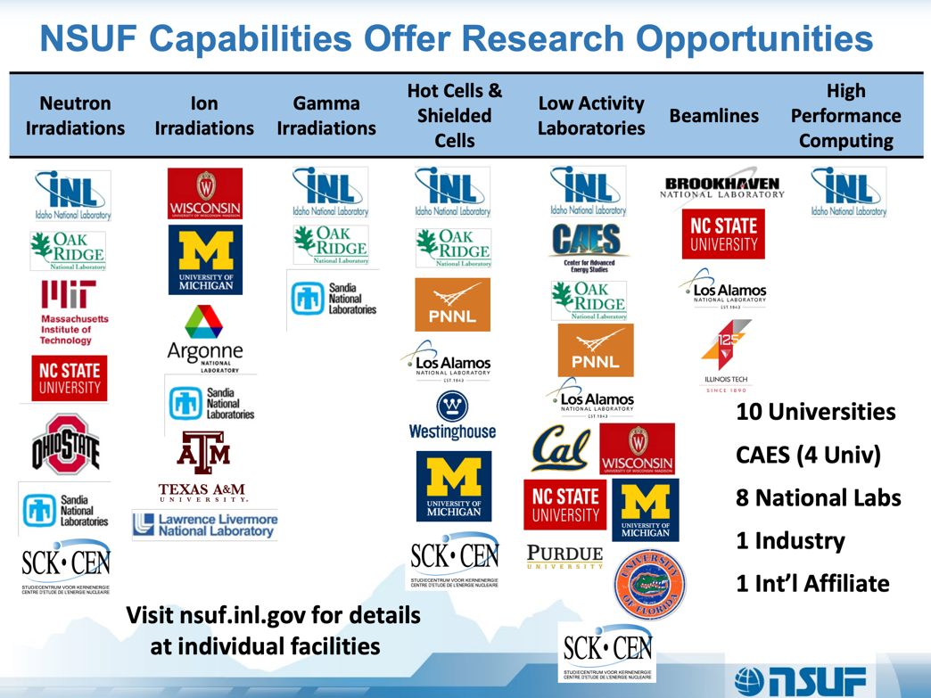
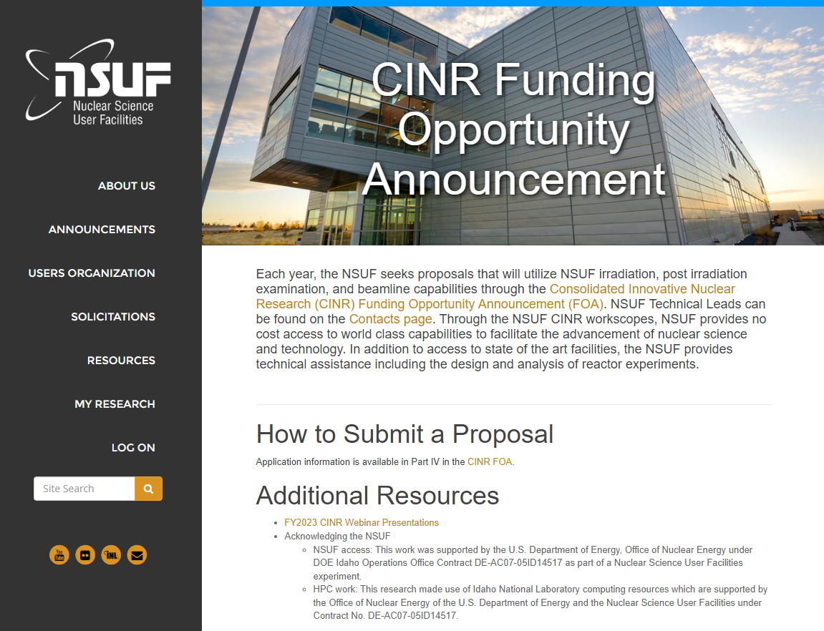
We are operating under the umbrella of NSUF @ INL

Slide 10
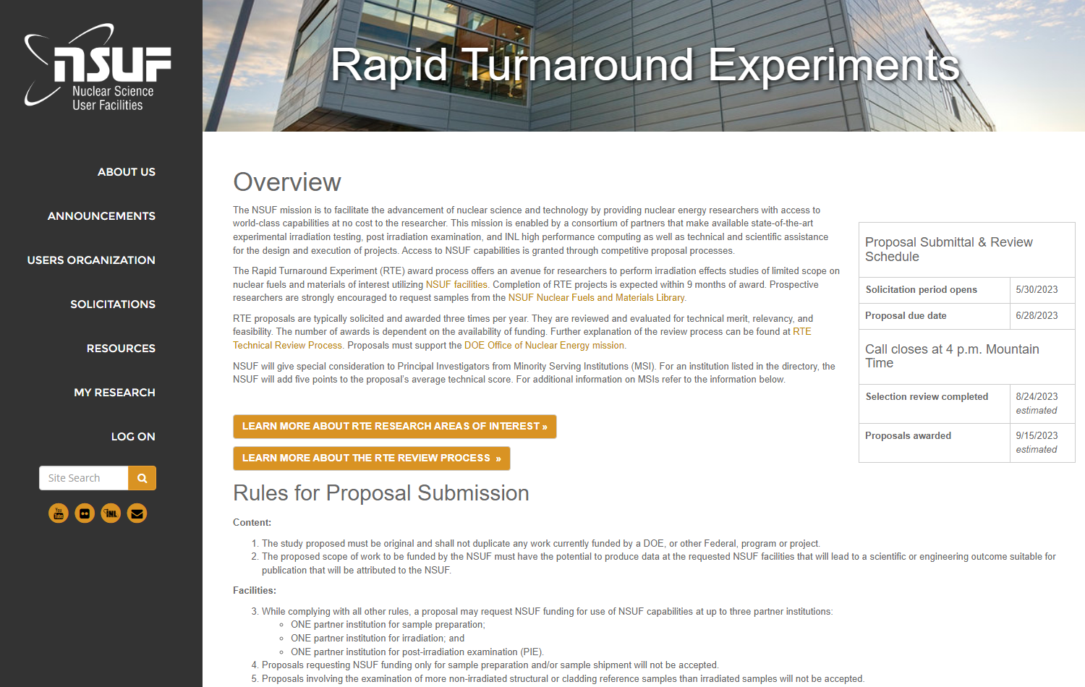
Call is open now !

Slide 11
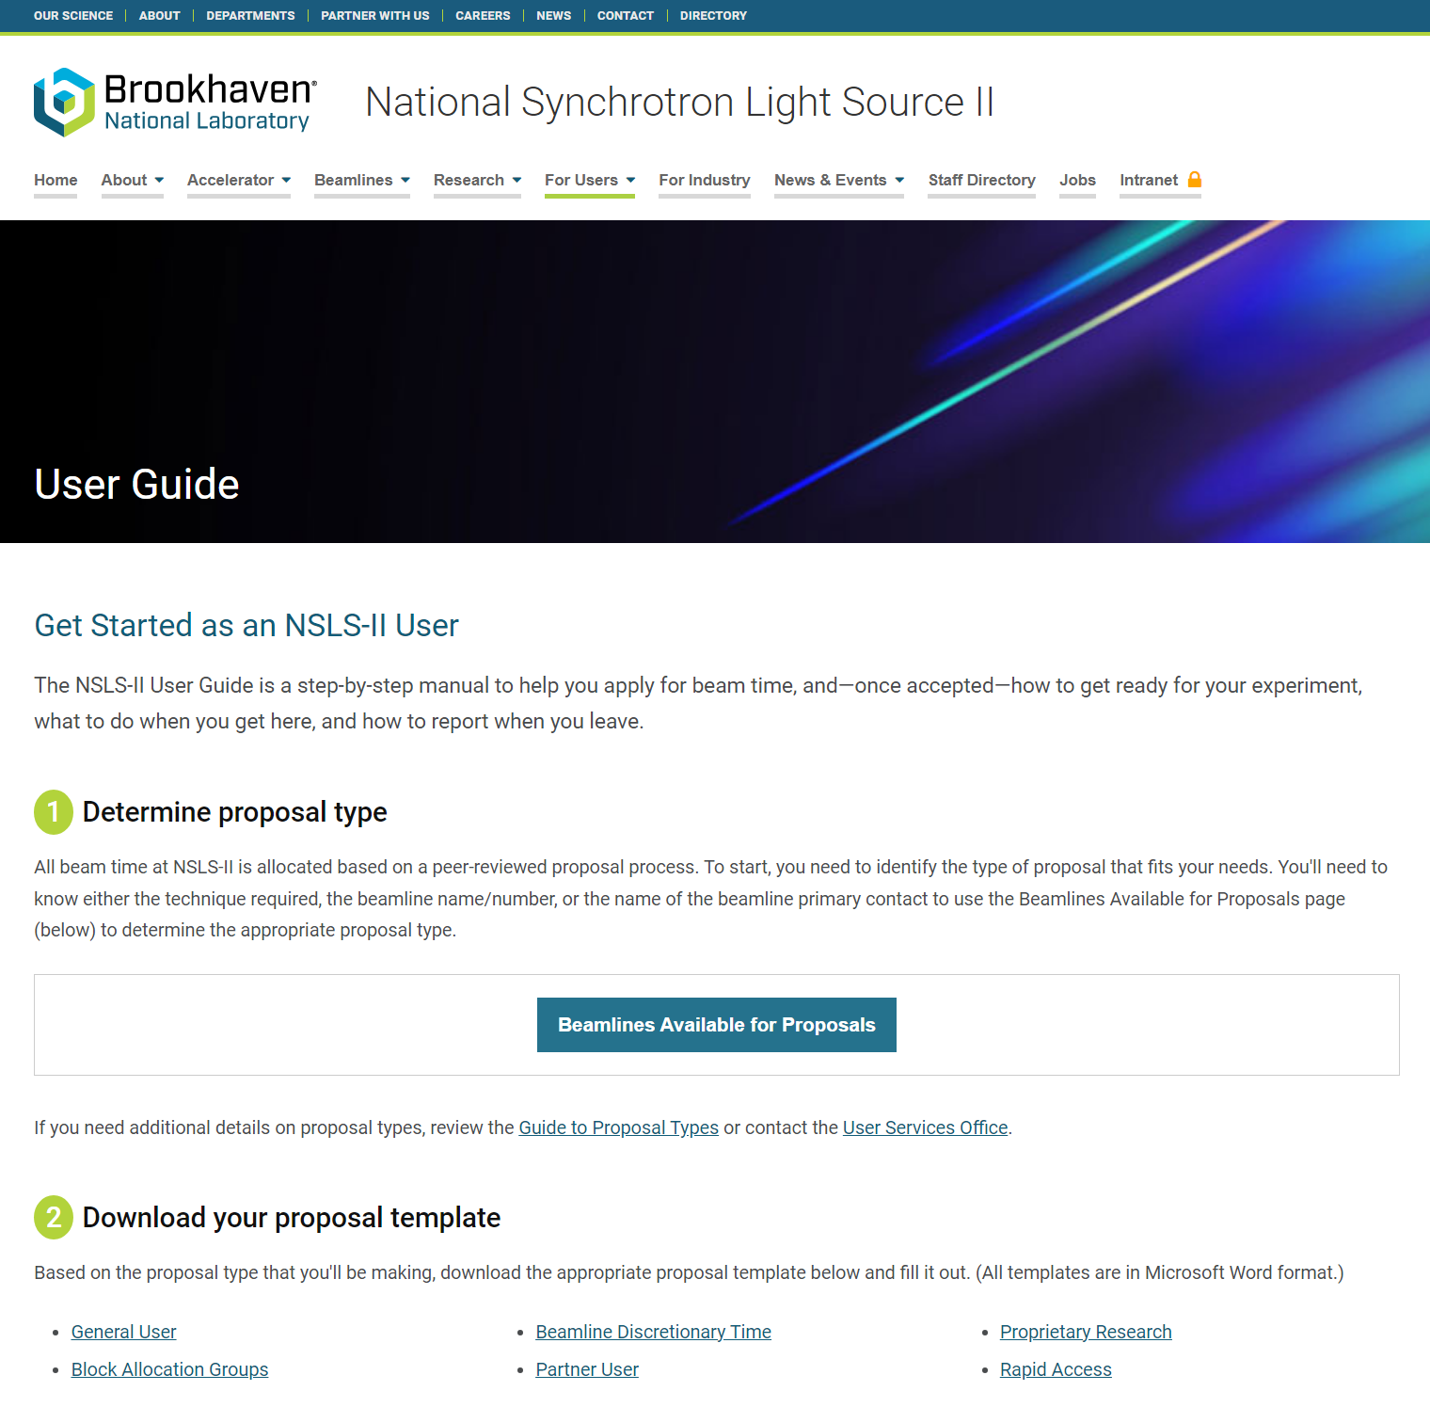
https://www.bnl.gov/nsls2/userguide/

Slide 12
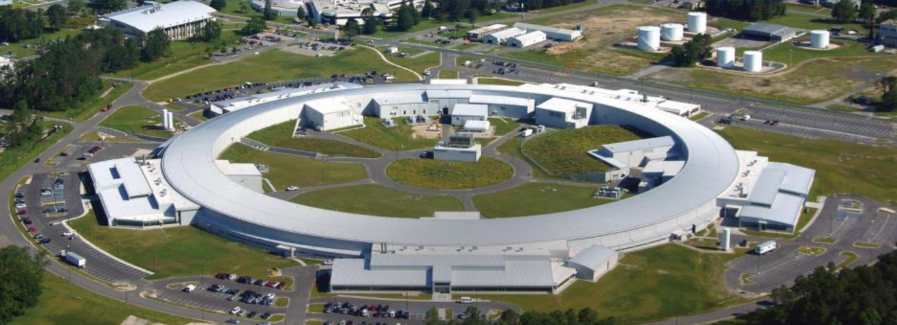
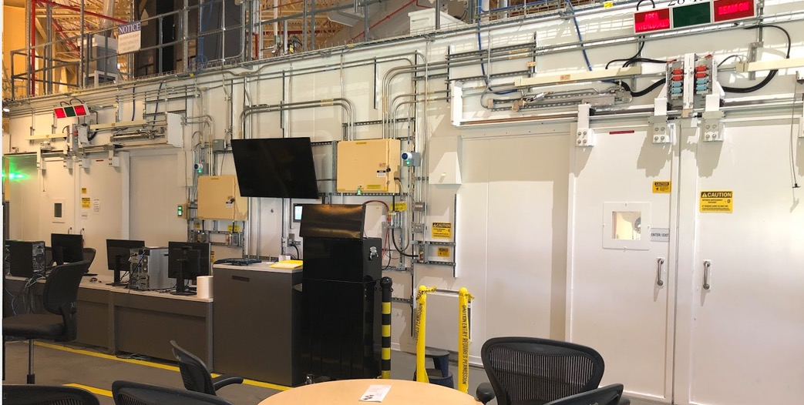
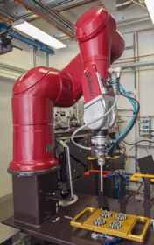
D-hutch
C-hutch
XPD beamline (28-ID) at NSLS-II

Slide 13
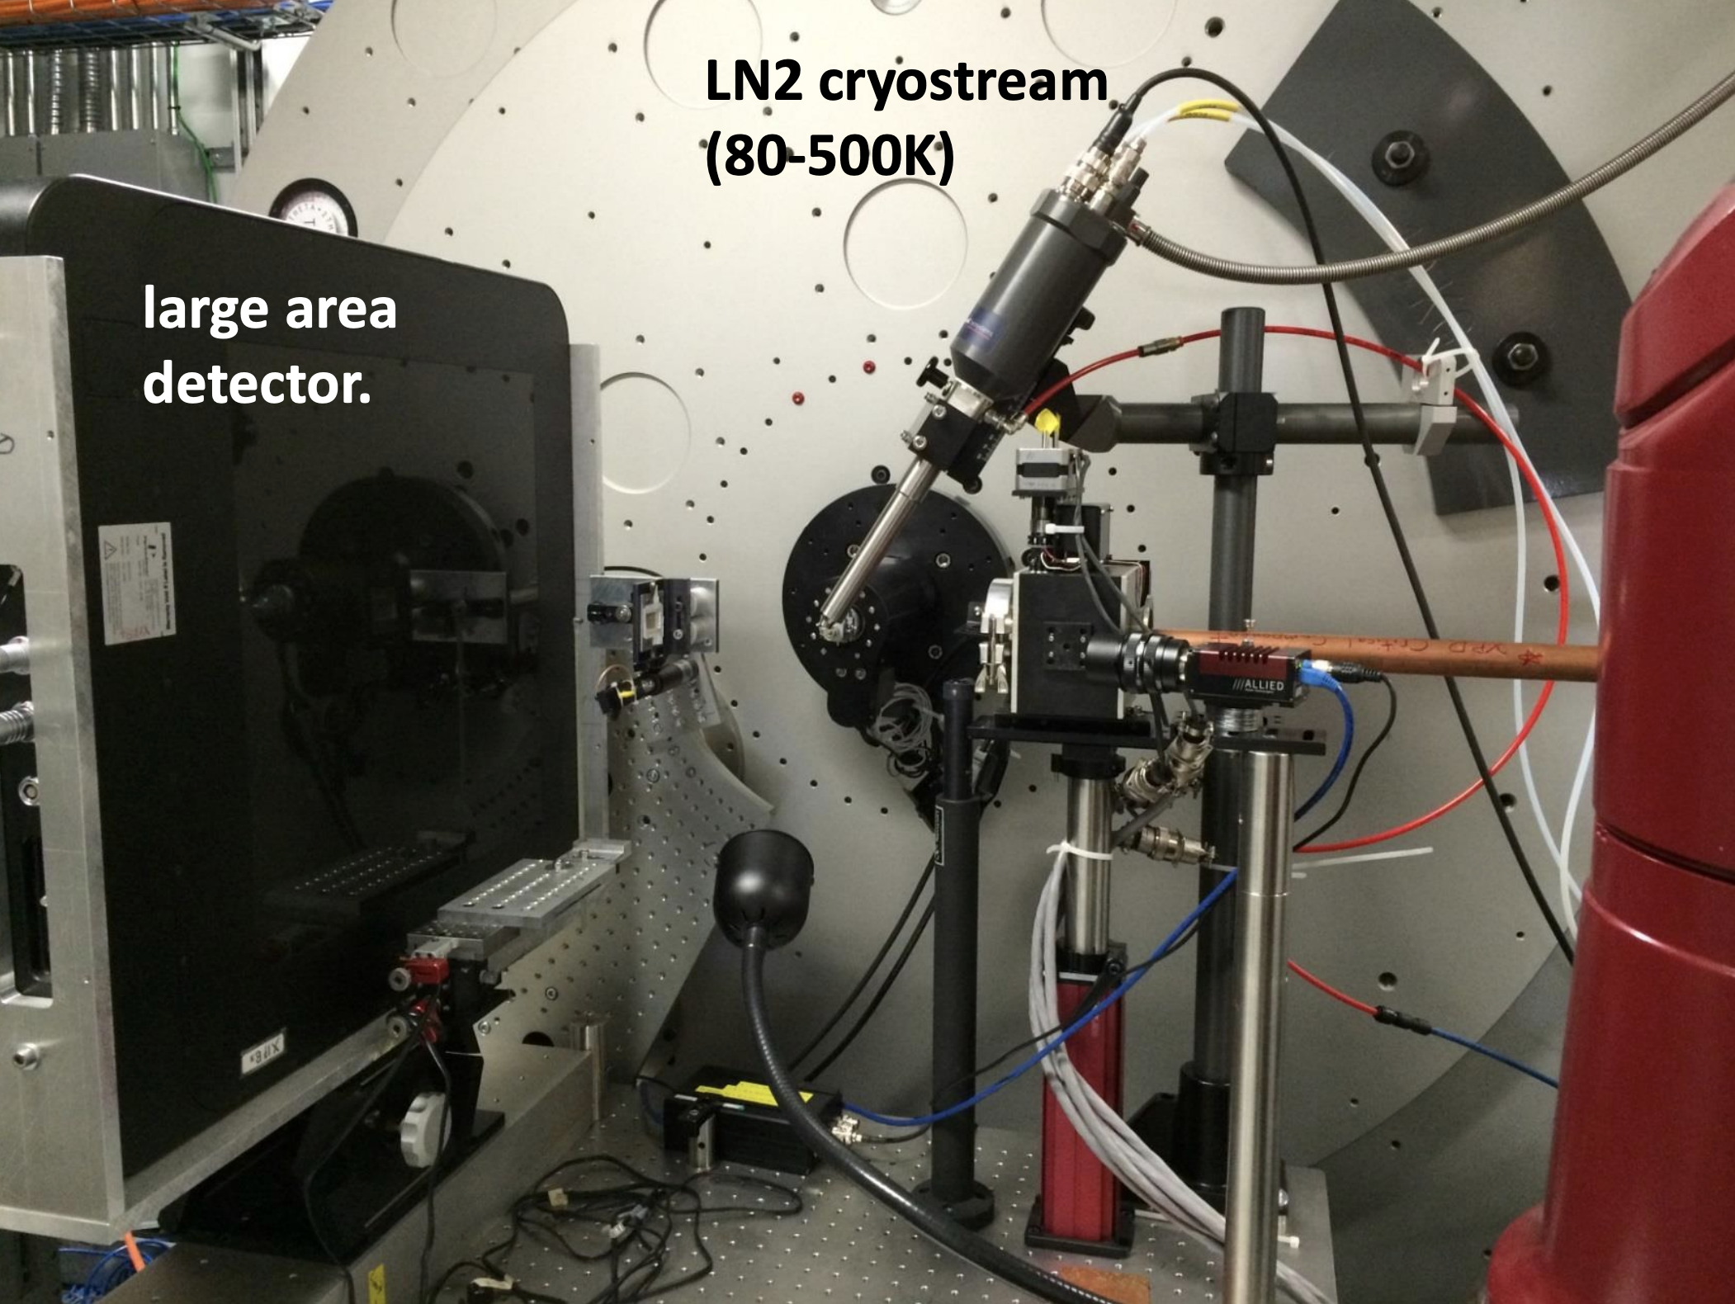
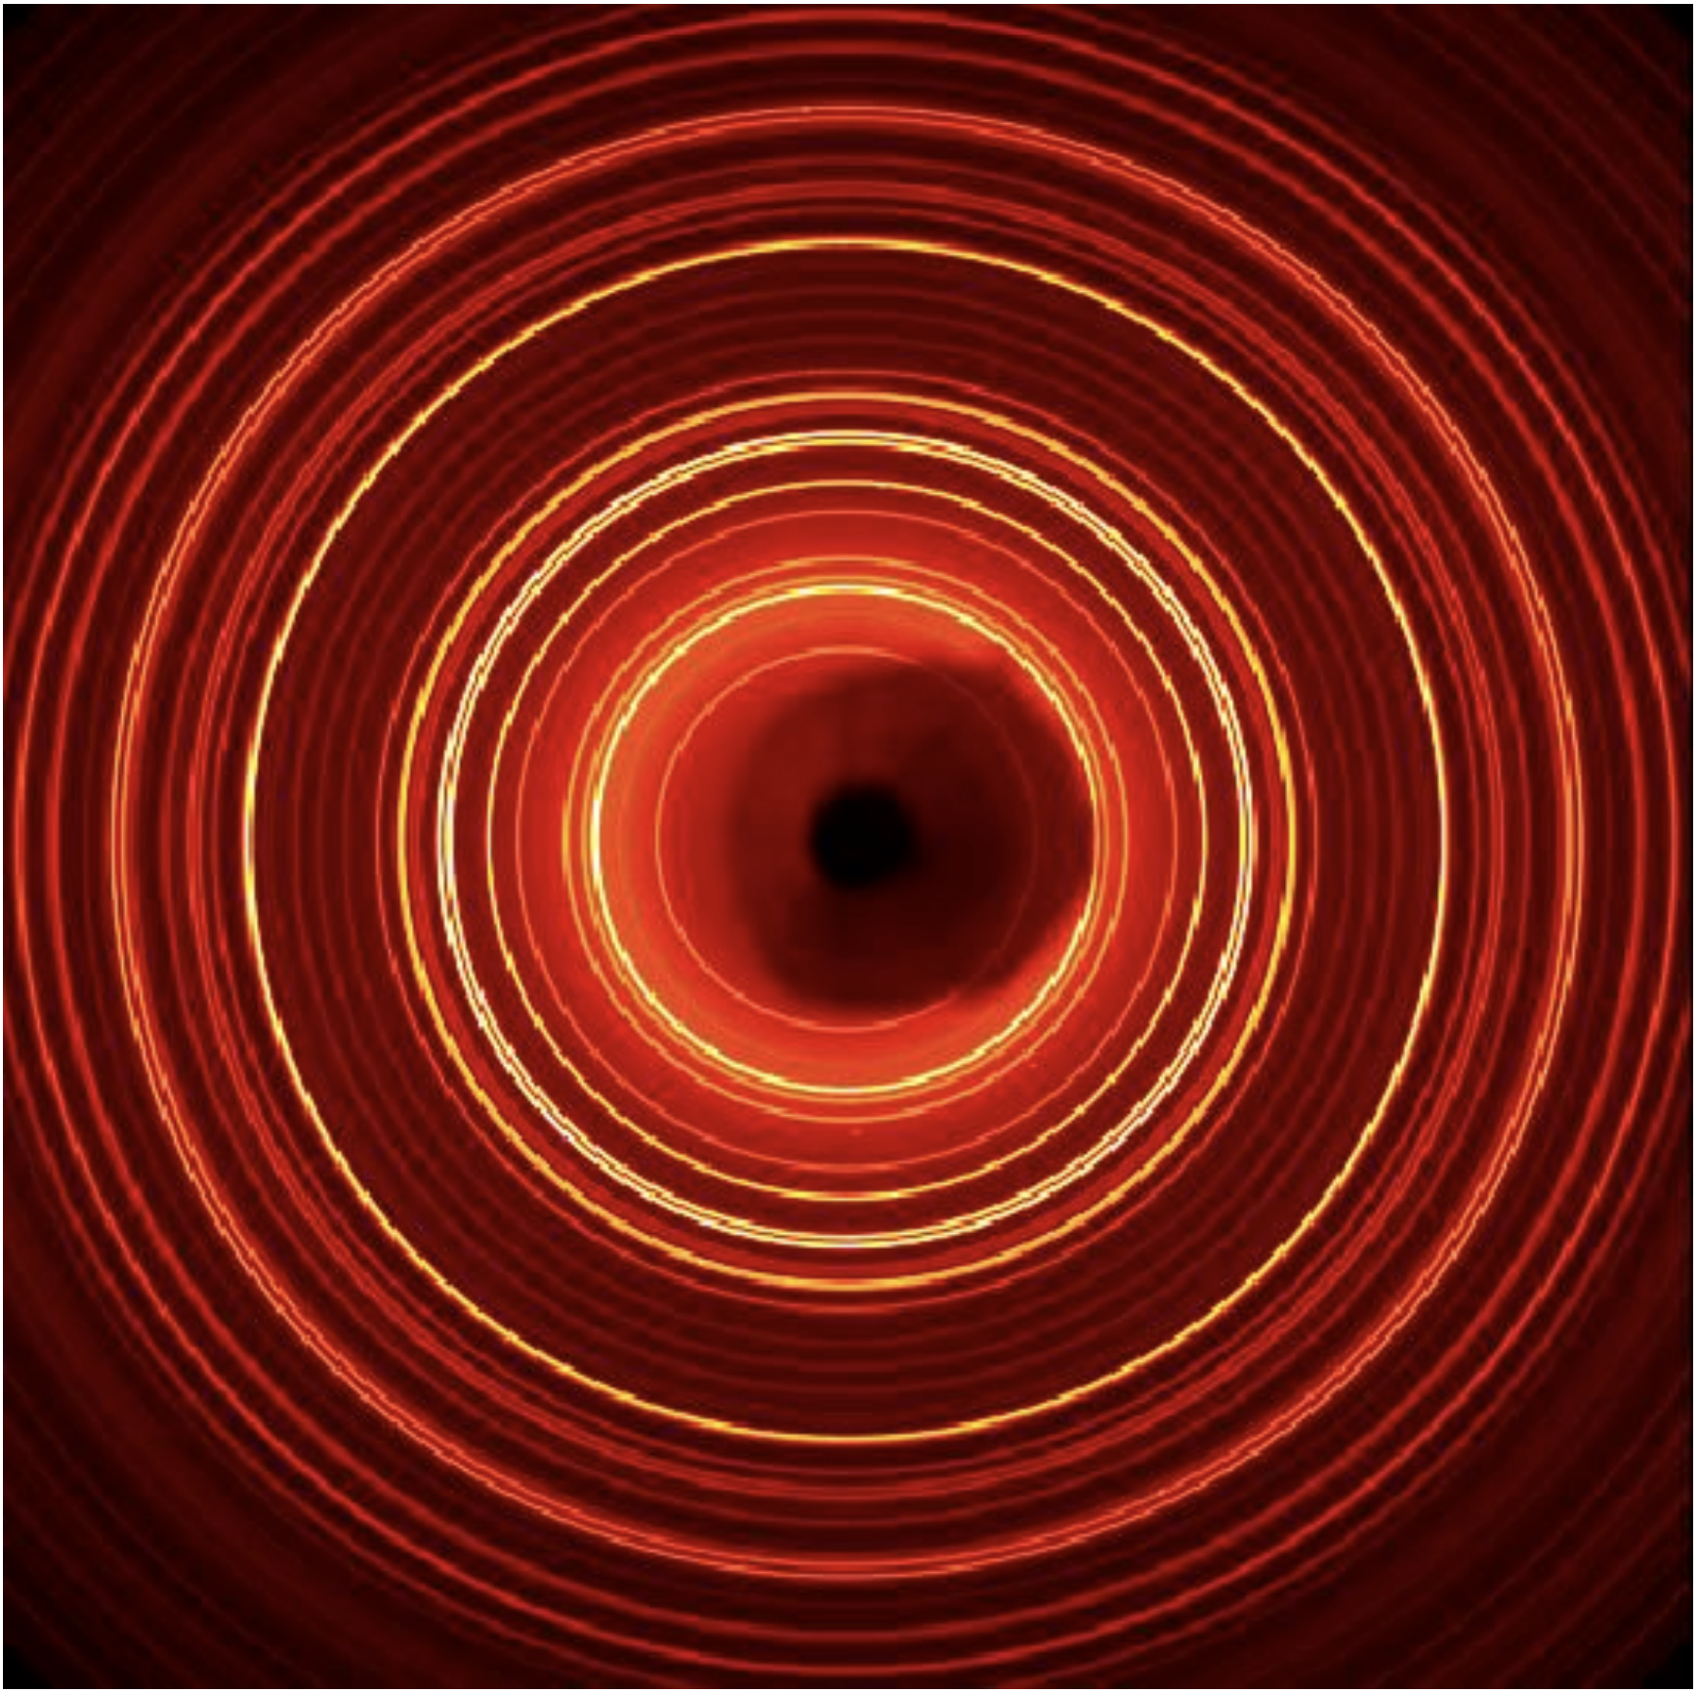
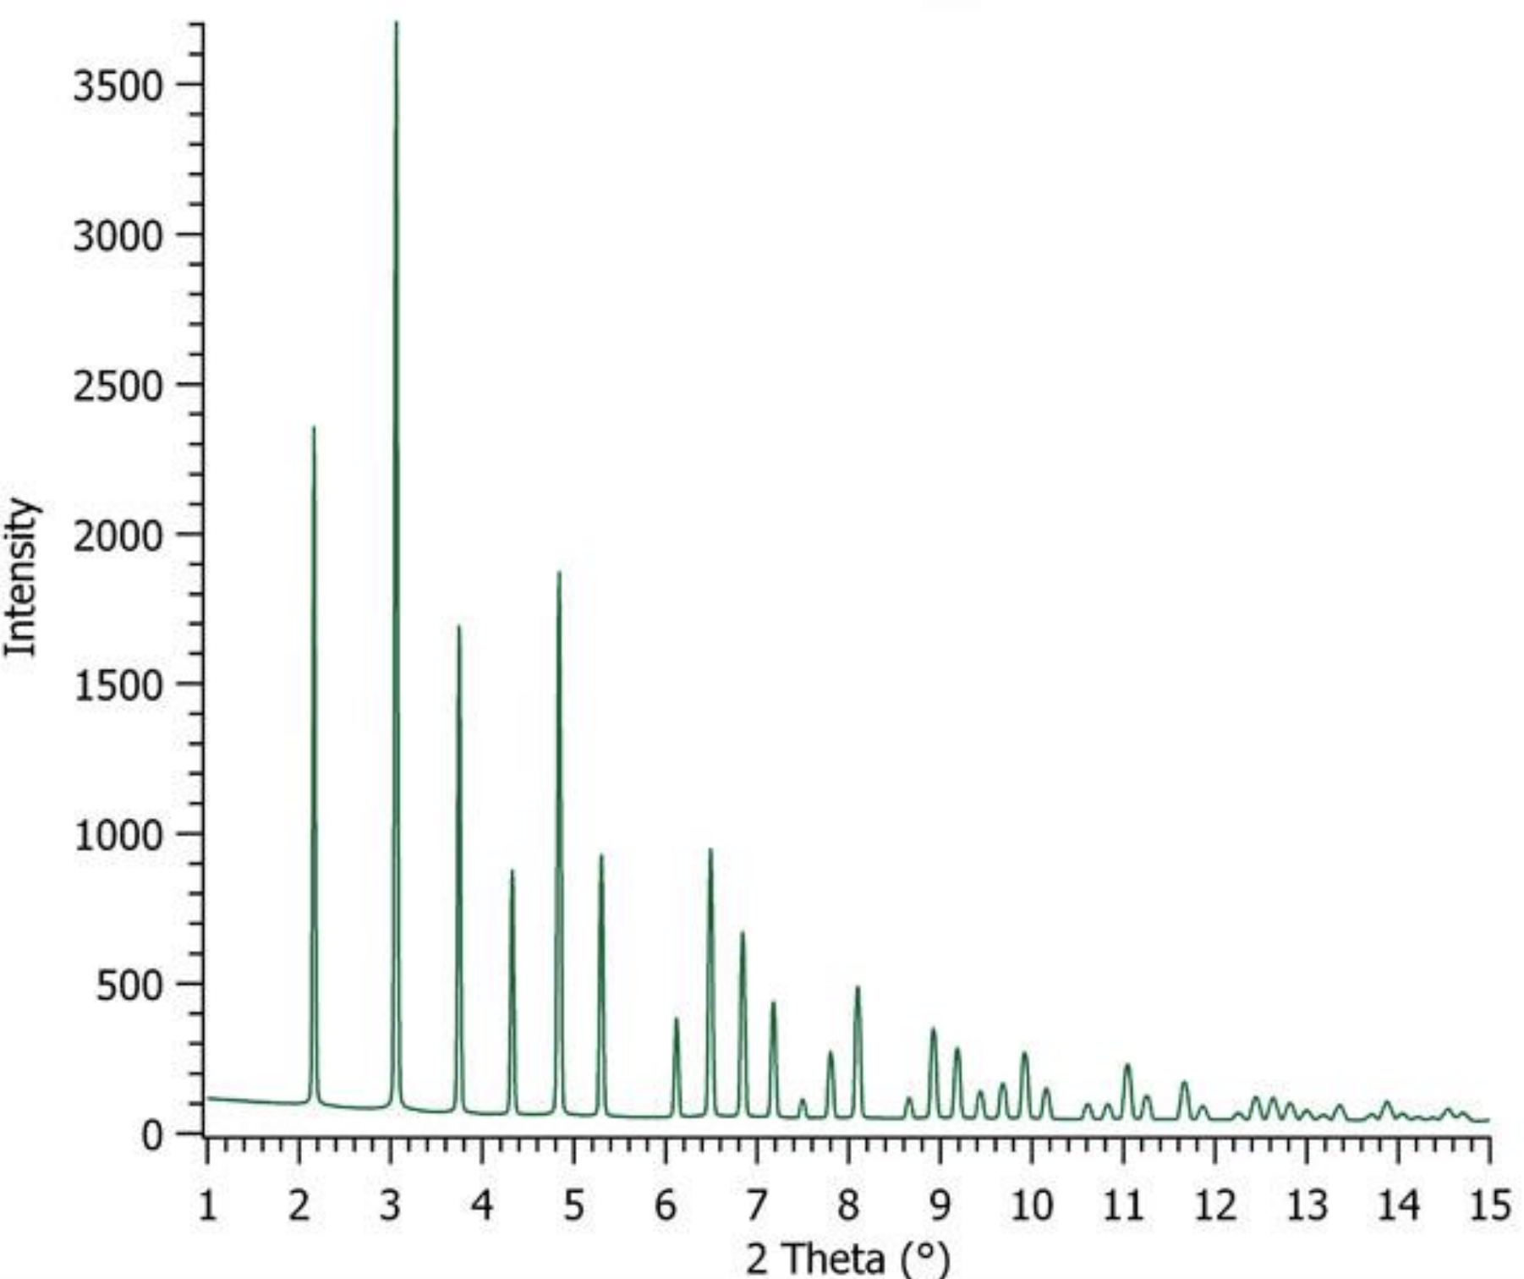
One-slide on X-ray diffraction method
A typical X-ray diffraction setup with area detector
2D image
1D pattern
Azimuthal
integration
x-ray beam
Phase information
Micro strain
Lattice parameters
Crystalline size
Phase mass fraction
Stacking faults

Slide 14
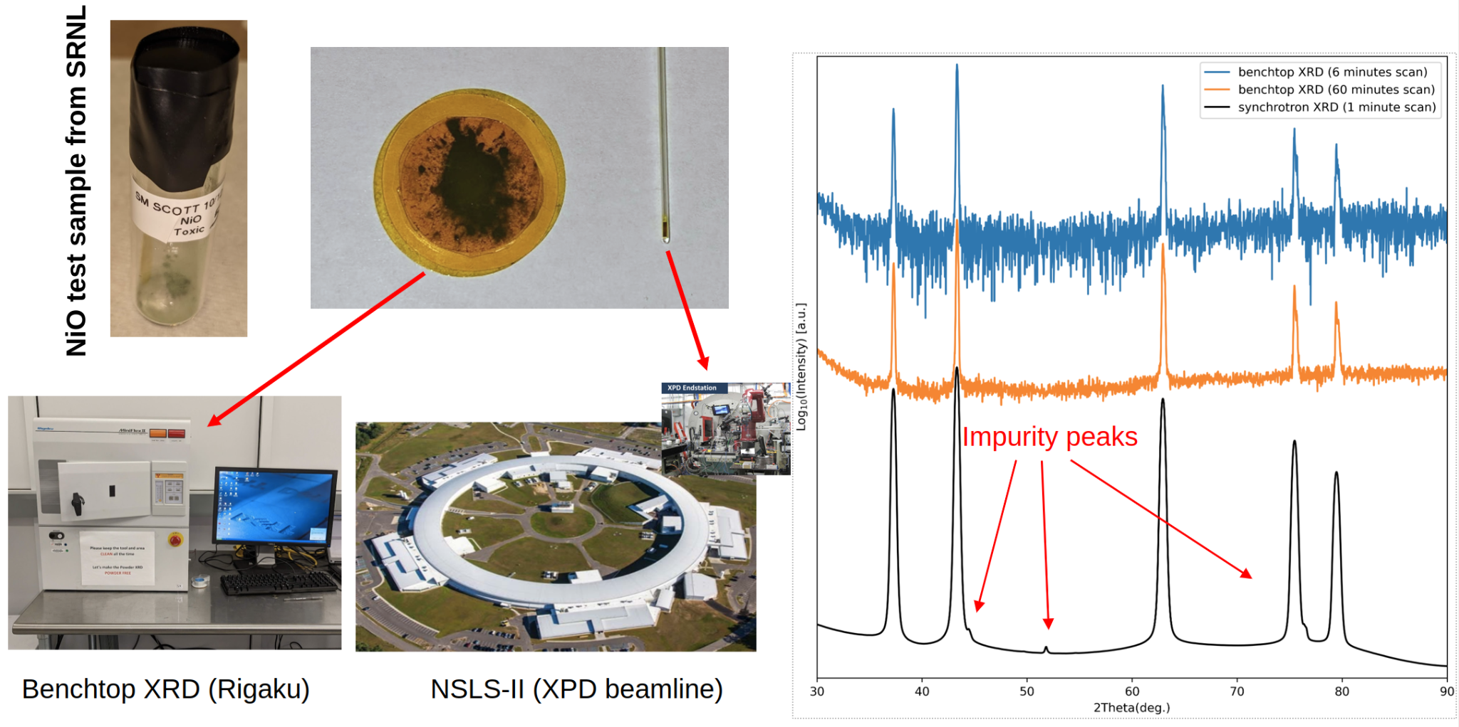
Why do we need synchrotron resources ?

Slide 15
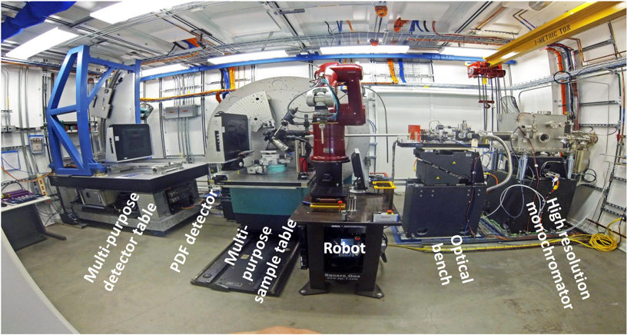
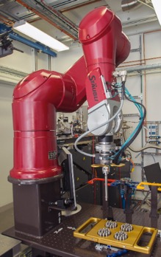
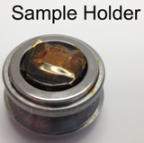
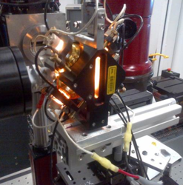
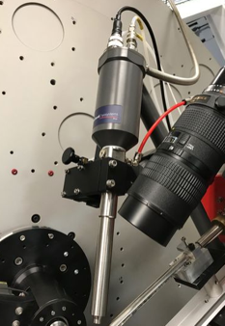
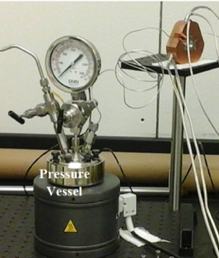
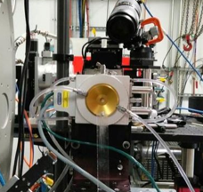
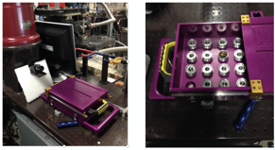
C-hutch
Robot for high-throughput
sample changing
Heating up to 2000ºC
Cryostream (80K-500K)
Corrosion cell

Slide 16
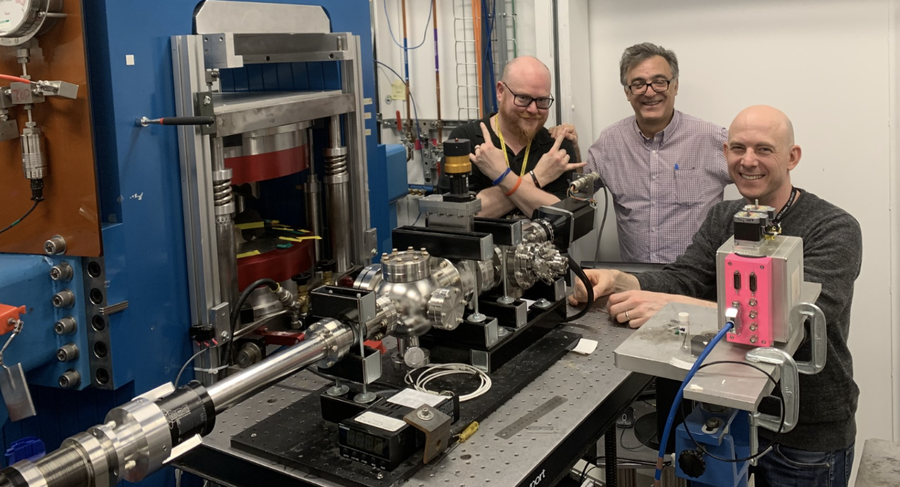
We do support custom equipment
Please contact us (mtopsakal@bnl.gov) and Sanjit Ghose (sghose@bnl.gov) about your needs.

Slide 17
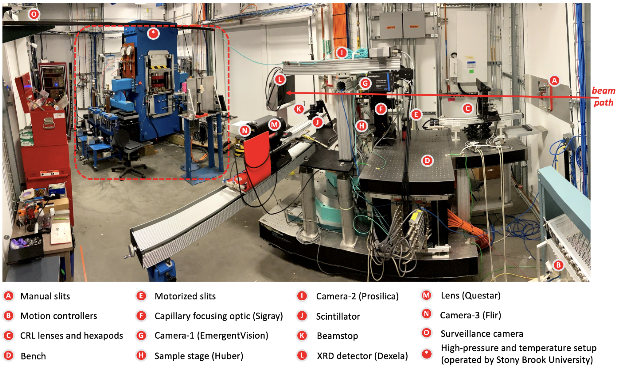
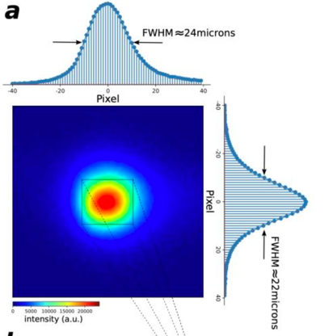
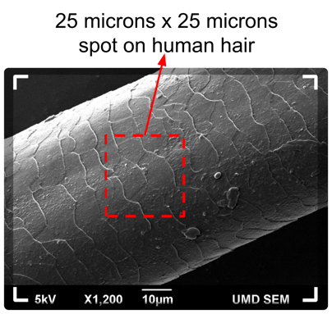
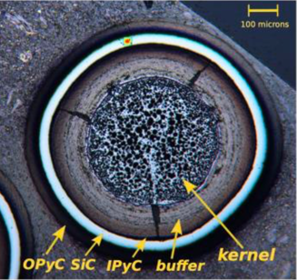
proudly
supported by
D-hutch
Focused beam
(~25x25 µm)
25 microns x 25 microns
spot on TRISO fuel
Techniques enabled with small beam:
1D & 2D mapping (phase, lattice, strain…)
3D X-ray diffraction computed tomography
(XRD-CT)
X-ray fluoresce spectroscopy with high-energy beam.
Multi-modal 1D, 2D, and 3D non-destructive characterization of nuclear materials.

Slide 18
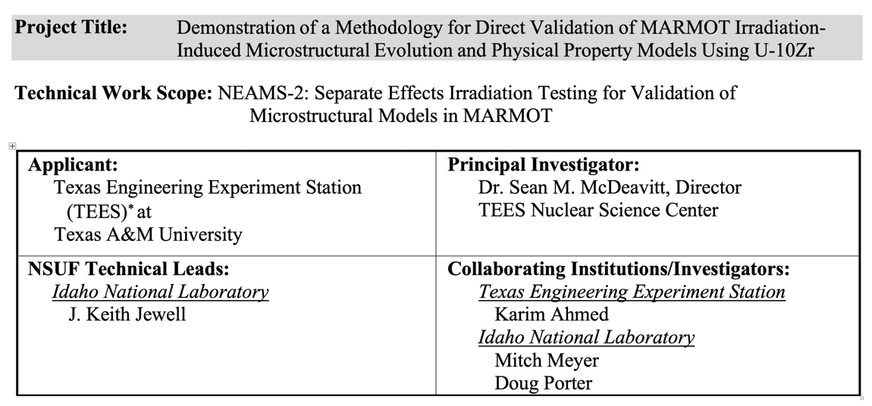
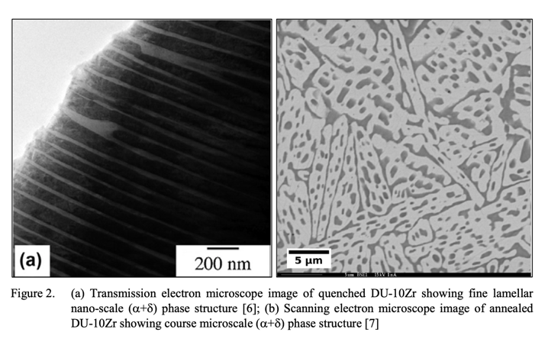
An example from INL

Slide 19
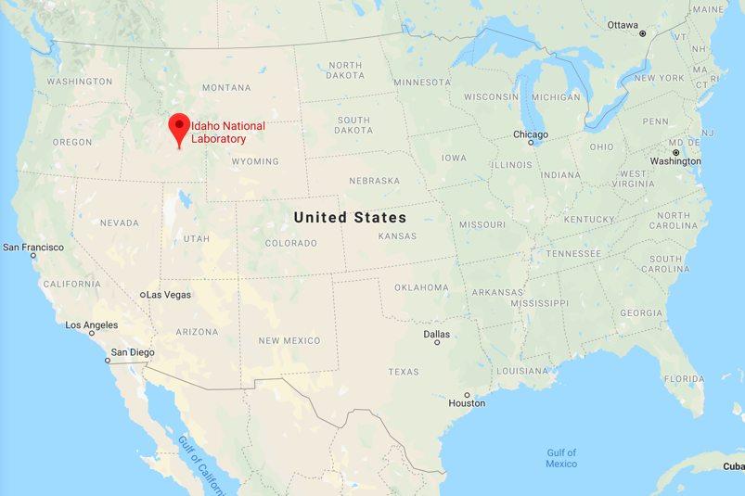
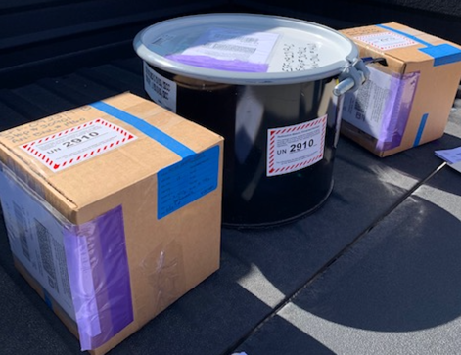
Depleted (DU) and highly-enriched (HEU) samples were shipped to NSLS-II for characterization before irradiation at ATR
DU and HEU samples
sent to NSLS-II for characterization
16 annealed U:10Zr
16 quenched U:10Zr
16 extruded U:10Zr
16 enriched U:10Zr
(Highly enriched 31%)

Slide 20
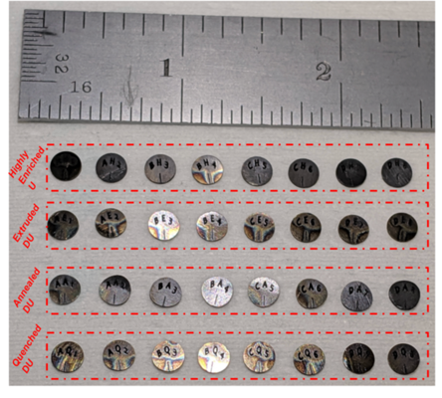
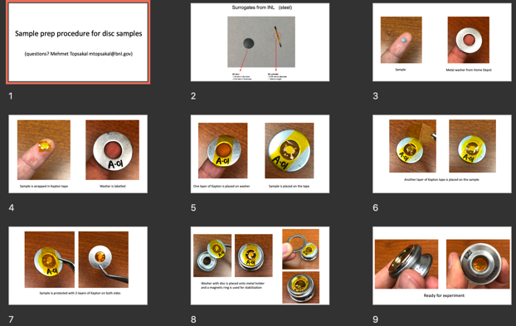
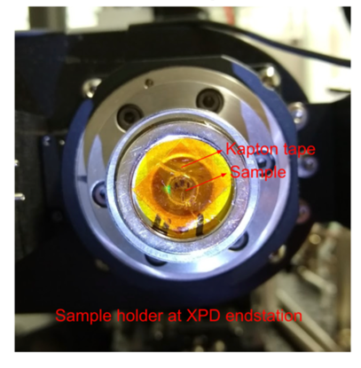
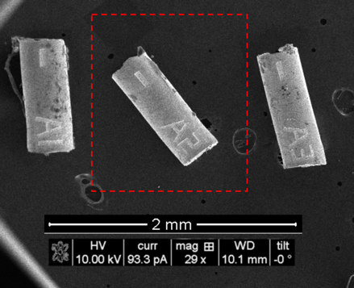
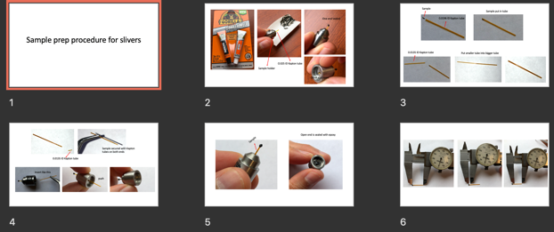
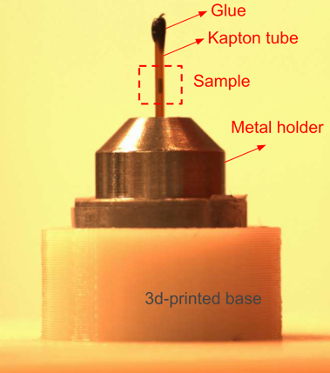
Samples @ INL Sample prep procedure Samples at BNL
shared with users
(ready for experiment)

Slide 21
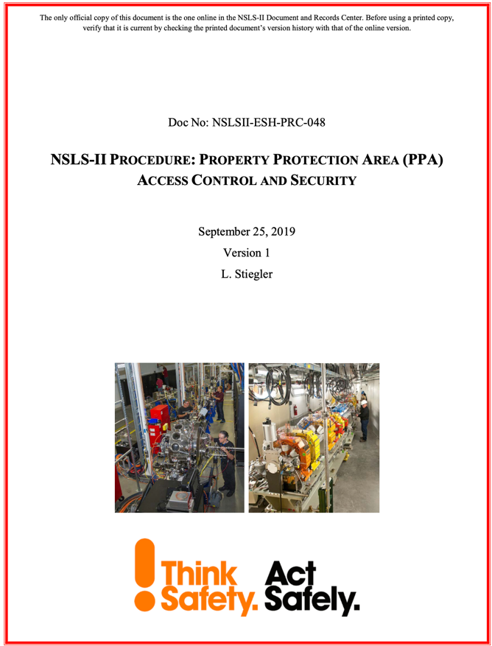
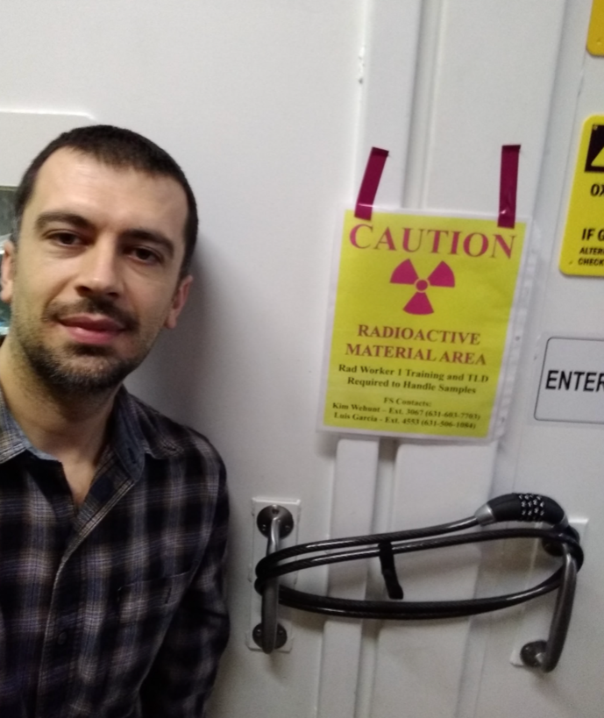
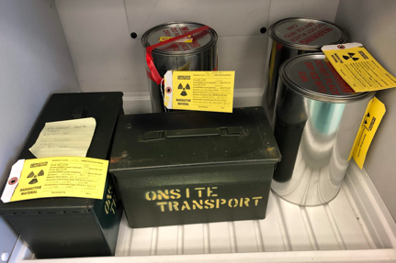
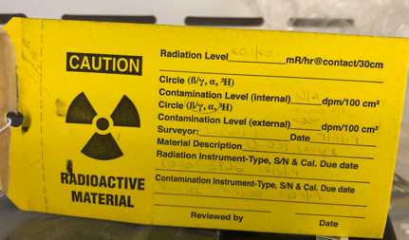
We are experienced with radioactive materials at NSLS-II

Slide 22
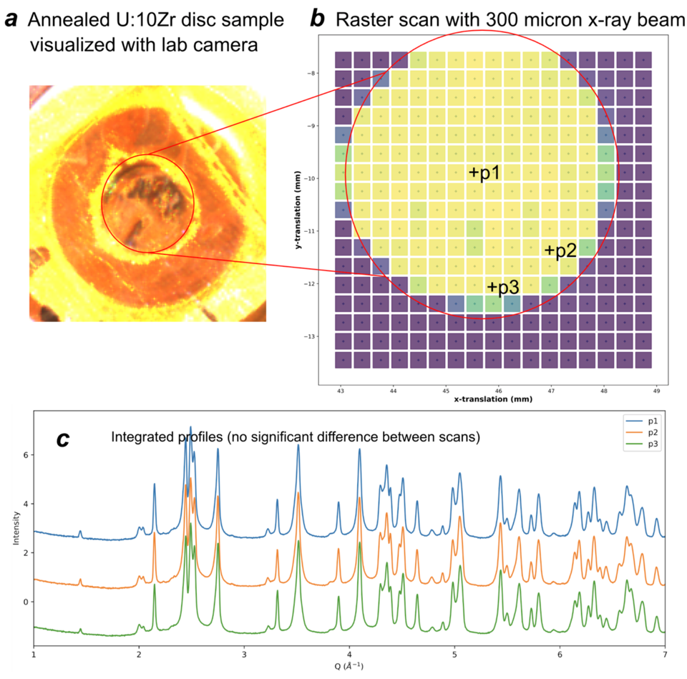

Slide 23
Another example from ORNL

Slide 24
…..Credit: Nedim Cinbiz - TMS 2023

Slide 25
Another example from ORNL

Slide 26
….manuscript under review

Slide 27
TRISO example
Surrogate particle
measured at the
endstation
Real triso particle
(visualized destructively)

Slide 28
TRISO example
OPyC layer
SiC layer
IPyC layer
Buffer layer
Kernel (HfO₂)
Possible defect
needle tip
Under X-ray light
Limitation: Absorption count is the only information we can get
Under visible light

Slide 29
TRISO example
z
X-ray diffraction Computed tomography (XRD-CT) scan along equatorial plane
y
XRD pattern from SiC layer
XRD pattern from buffer layer
XRD pattern from kernel
x
Advantage of XRD-CT: We can get real structural information from internals of the sample in a non-destructive way (without slicing the sample).

Slide 30
Please feel free to contact us (mtopsakal@bnl.gov & gills@bnl.gov)
if you want to use facility resources through NSUF.
We will be happy to help you.

Slide 31
Acknowledgements
Eric Dooryhee
Michael Drakopoulos
David Sprouster
Sanjit Ghose
Jiaming Bai
John Trunk

Slide 32
Call is open now !

Slide 33
https://www.bnl.gov/nsls2/userguide/

Slide 34
Thanks

