Slide 1
The Nick Simos Effect
Nikolaos Simos Memorial Session
at the RaDIATE Collaboration 2023 Annual Meeting
P. Hurh (FNAL)

Slide 2
Session Outline
The Nick Simos Effect – this talk
2 HPT/RaDIATE related case studies
Effect Irradiation on Ferro Fluid Rotary Feedthrough and Permanent Magnet Performance – F. Pellemoine (FNAL)
Simulation of the NuMI Target Graphite Failure Incorporating Measured Irradiated Graphite Data – S. Bidhar/K. Ammigan (FNAL)
Highlights of NSLS and NSLS-II work with Nick Simos – D. Sprouster (SBU)
Open for attendee remarks
Closing with Nick’s Journey in words and Photos – K. Simos

Slide 3
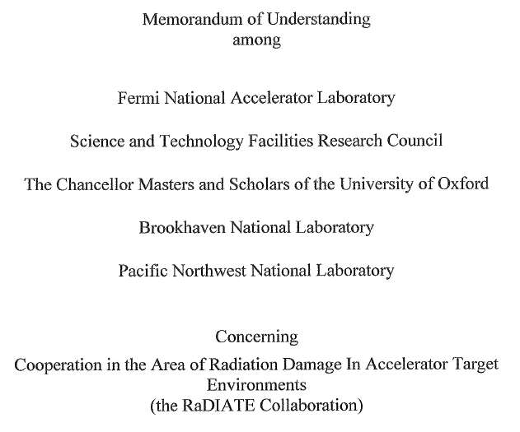
Nick the Initiator
BLIP irradiations and RaDIATE

Slide 4
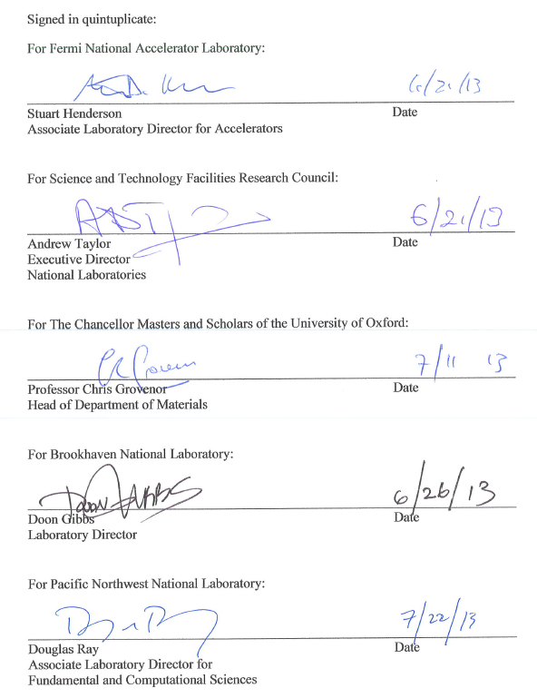
Nick the Initiator
BLIP irradiations and RaDIATE

Slide 5
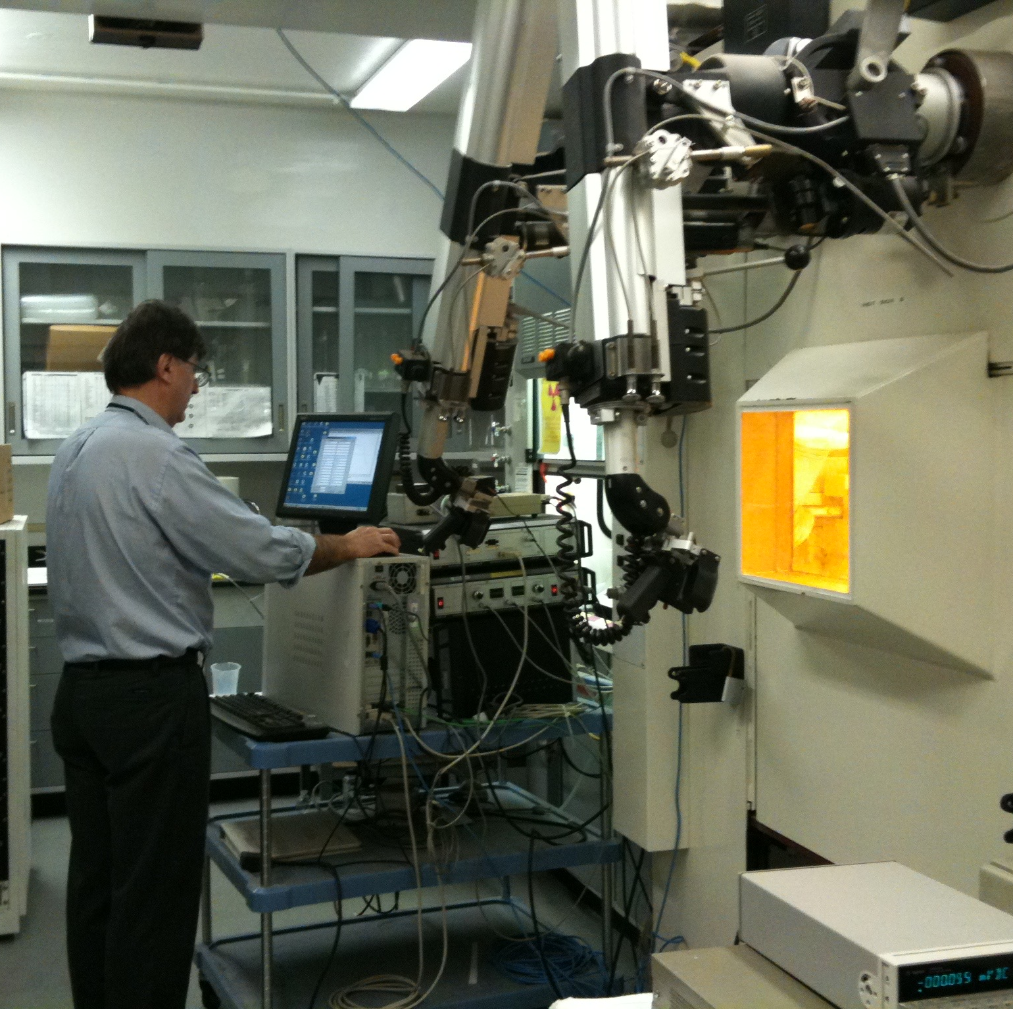
Nick the Initiator
BLIP irradiations and RaDIATE

Slide 6
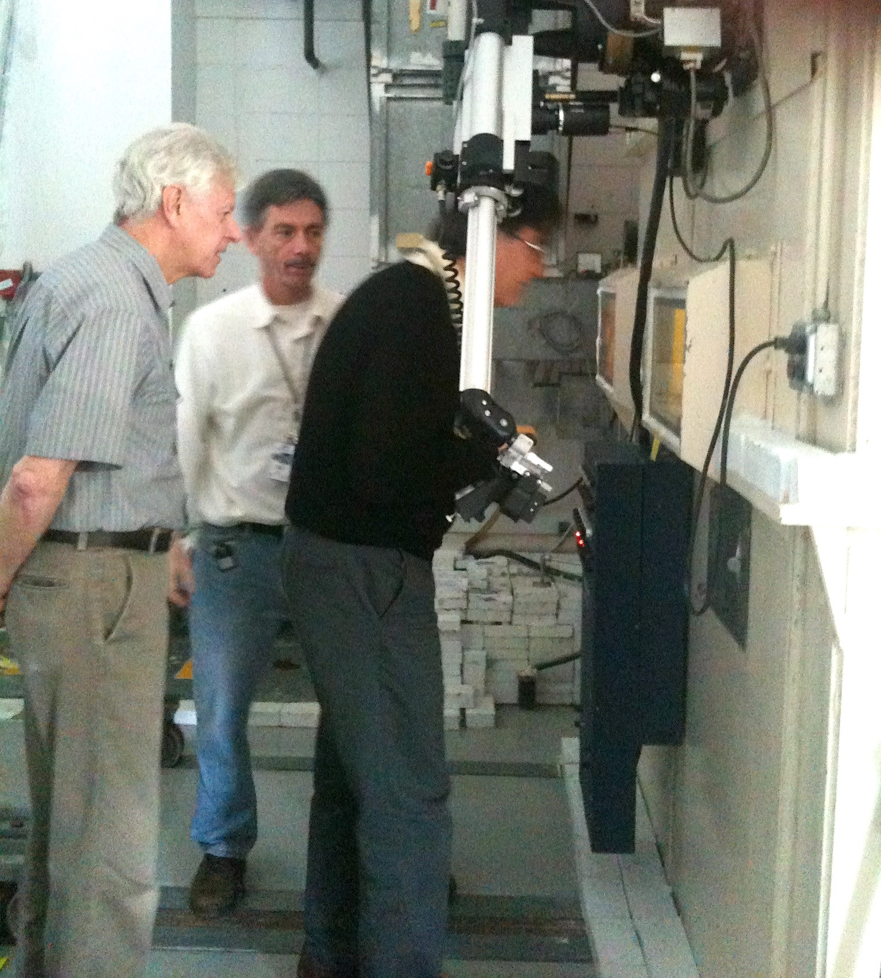
Nick the Initiator
BLIP irradiations and RaDIATE
I first started working with Nick about 20 years ago when he approached me to discuss the possibility of studying radiation damage of materials from irradiation at BLIP. I eventually learned a lot about the mechanisms of radiation damage and Nick became a proficient hot cell operator. The collaboration has been highly successful, and obviously continues in the present.
-Leonard Mausner (BNL, ret)

Slide 7
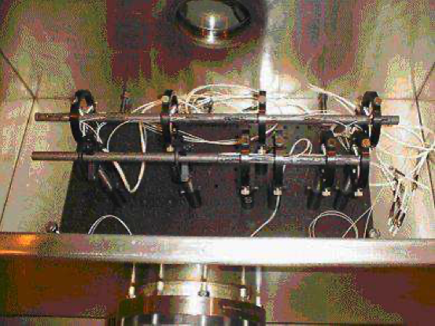
Nick the Initiator
Carbon-Carbon composite and ATJ graphite target arrangement for the E951 experiment
BLIP irradiations and RaDIATE
High Power Targetry Community

Slide 8
Nick the Initiator
Carbon-Carbon composite and ATJ graphite target arrangement for the E951 experiment
BLIP irradiations and RaDIATE
High Power Targetry Community
I’d met Nick much before HRM. I first recall during target experiments at the AGS where Nick took interest in our dynamic strain measuring systems. We’d been working on those for mercury targets but had also done in-beam tests with solid targets including graphite rods back in the day. Another early interaction was at IWSMT in Hayama Japan. Nick presented on potential for graphite targets for neutrino factory concepts. I recall he stimulated considerable discussion.
We shared a keen appreciation on the critical value for conducting in-beam experiments, and all the challenges that come with that. I really enjoyed working with Nick on the HRM Sci Board. He he greatly missed.
- Bernie Riemer (ORNL, ret)

Slide 9
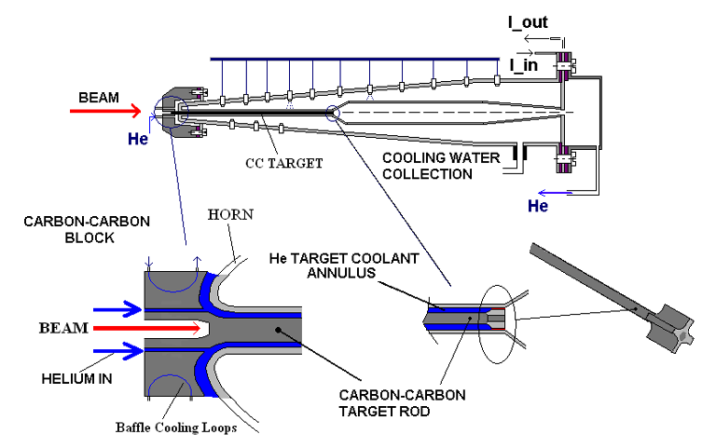
Nick the Initiator
BLIP irradiations and RaDIATE
High Power Targetry Community
Neutrino Super-beams for Long-Baseline Nu Oscillation Experiments
June 26, 2006

Slide 10
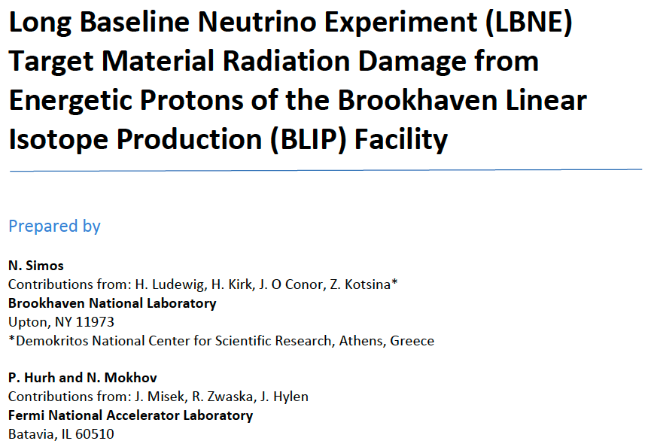
Nick the Initiator
BLIP irradiations and RaDIATE
High Power Targetry Community
Neutrino Super-beams for Long-Baseline Nu Oscillation Experiments

Slide 11
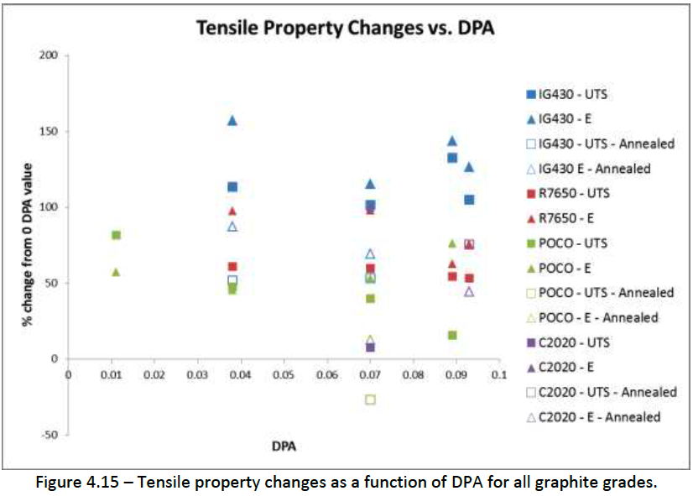
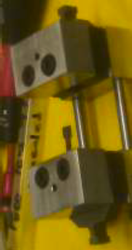
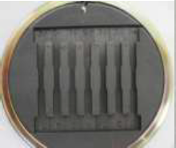
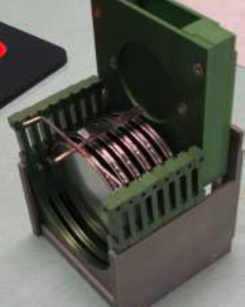
Nick the Initiator
BLIP irradiations and RaDIATE
High Power Targetry Community
Neutrino Super-beams for Long-Baseline Nu Oscillation Experiments

Slide 12
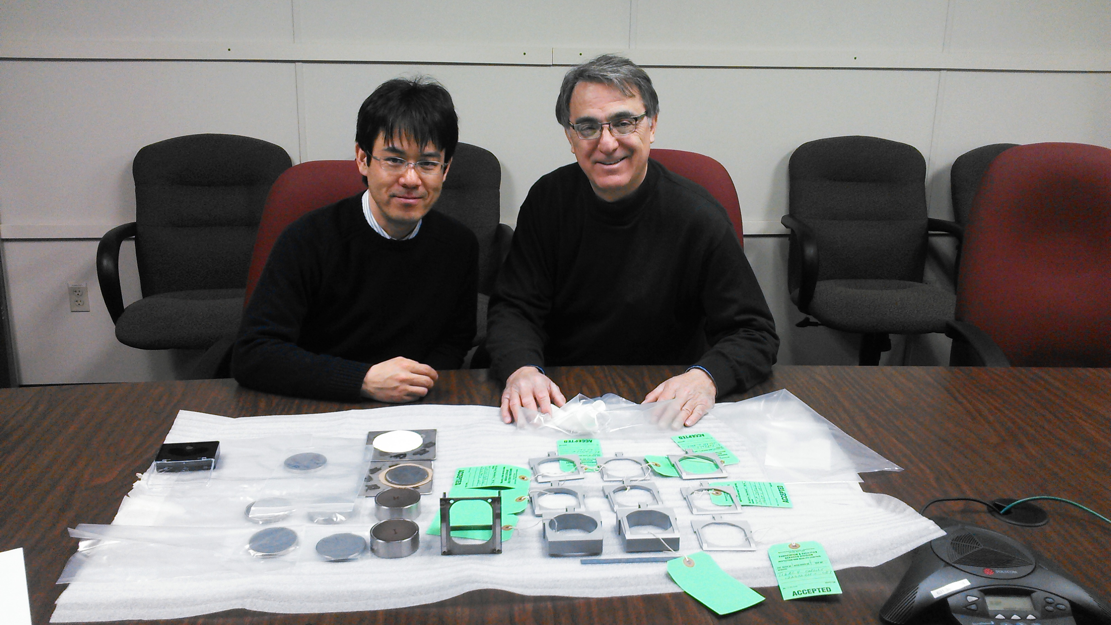
Nick the Initiator
BLIP irradiations and RaDIATE
High Power Targetry Community
Neutrino Super-beams for Long-Baseline Nu Oscillation Experiments
Dear Nick-san,
I never forget our visit to you at BNL on Feb. 2017, just before the irradiation campaign starts, we were so excited and happy in front of the capsules waiting for the coming irradiation, and we talked about many things for the future of our collaboration. It is my deep sorrow that I will never be able to meet and work with you again. I’d like to quote our condolence in our first paper in 2020: “Dr. Simos initiated and made possible the pioneering contributions to radiation damage studies of high power targetry materials, which became the foundational basis of activities conducted by the RaDIATE collaboration for over a decade."
R.I.P.
– Taku Ishida

Slide 13
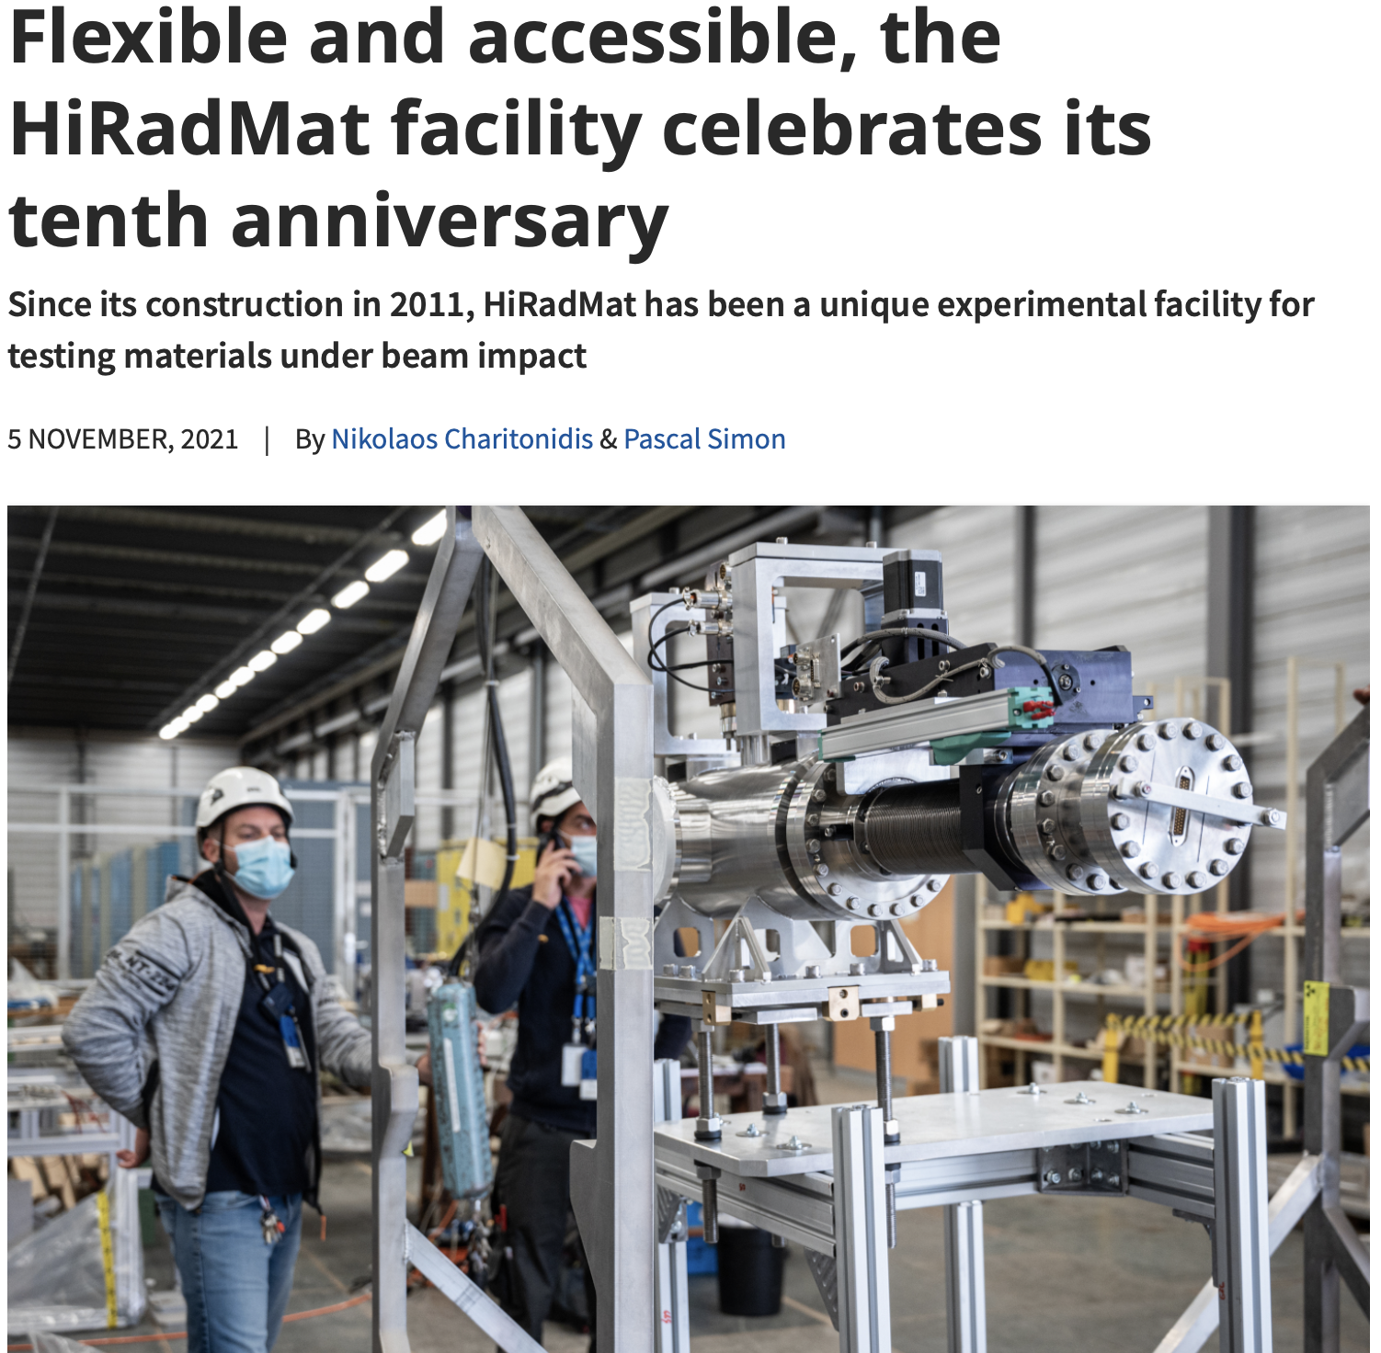
Nick the Initiator
BLIP irradiations and RaDIATE
High Power Targetry Community
Neutrino Super-beams for Long-Baseline Nu Oscillation Experiments
HiRadMat Beamline at CERN

Slide 14
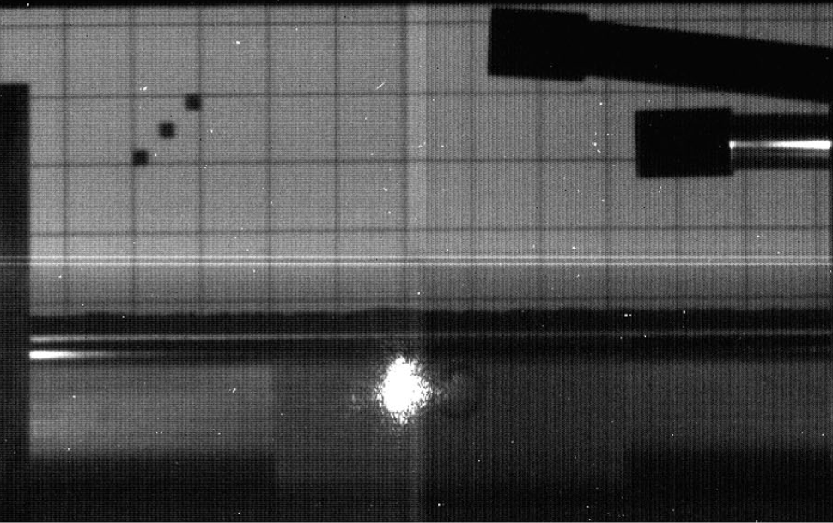
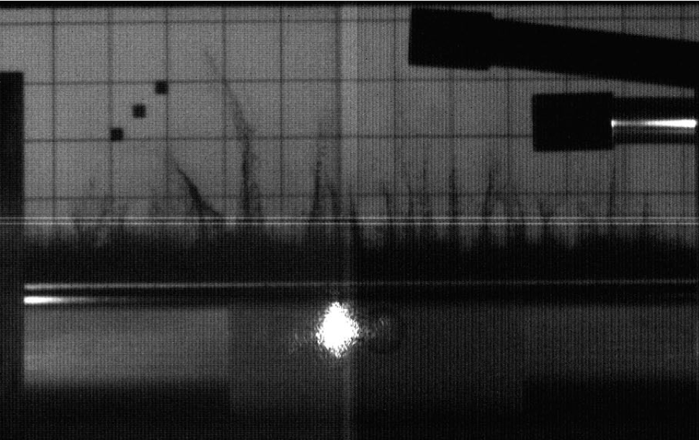
Nick the Initiator
BLIP irradiations and RaDIATE
High Power Targetry Community
Neutrino Super-beams for Long-Baseline Nu Oscillation Experiments
HiRadMat Beamline at CERN
On the professional side I admired his “can do” attitude very much, and benefitted from his support and encouragement towards a more practical/experimentalist approach on numerous occasions.
For example his encouragement to take forward a number of HiRadMat experiments, which turned into some of the most interesting and rewarding work I have done.
-P. Loveridge (RAL)

Slide 15
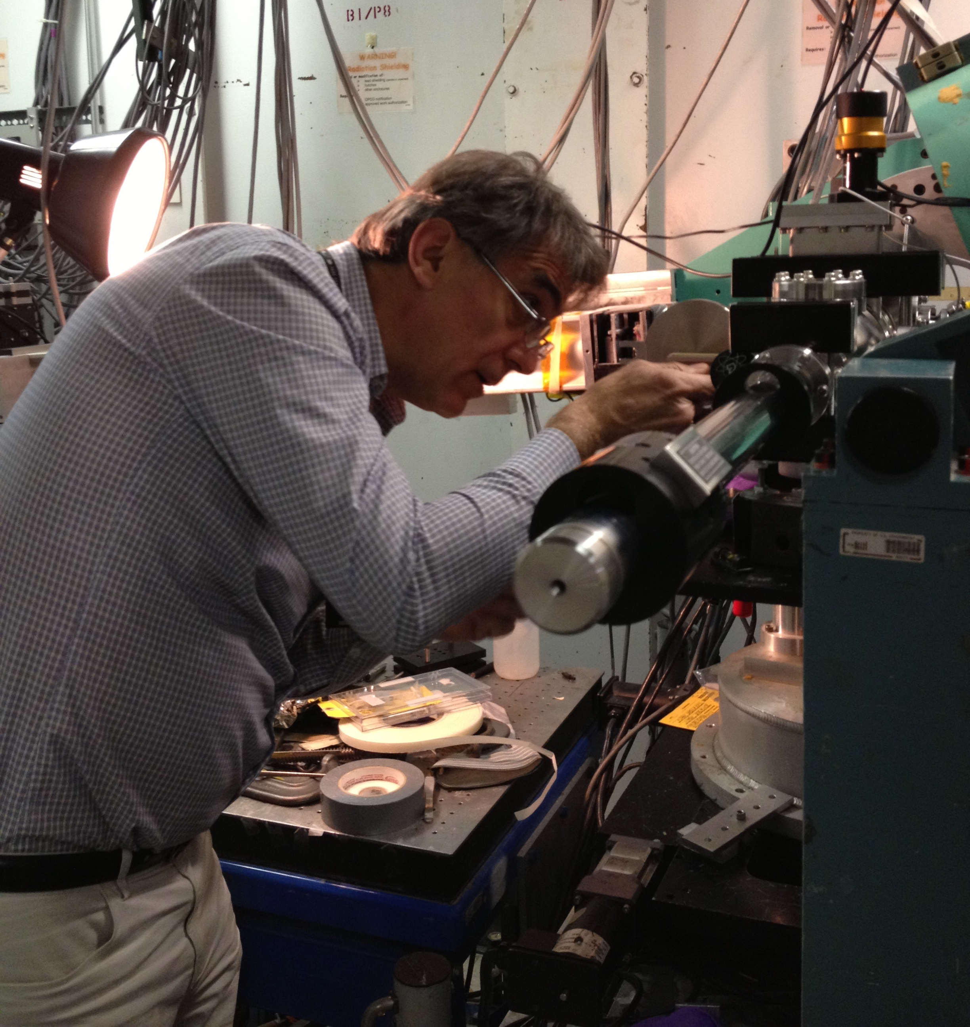
Nick the Initiator
BLIP irradiations and RaDIATE
High Power Targetry Community
Neutrino Super-beams for Long-Baseline Nu Oscillation Experiments
HiRadMat Beamline at CERN
First irradiated material studies at NSLS (and later NSLS-II)

Slide 16
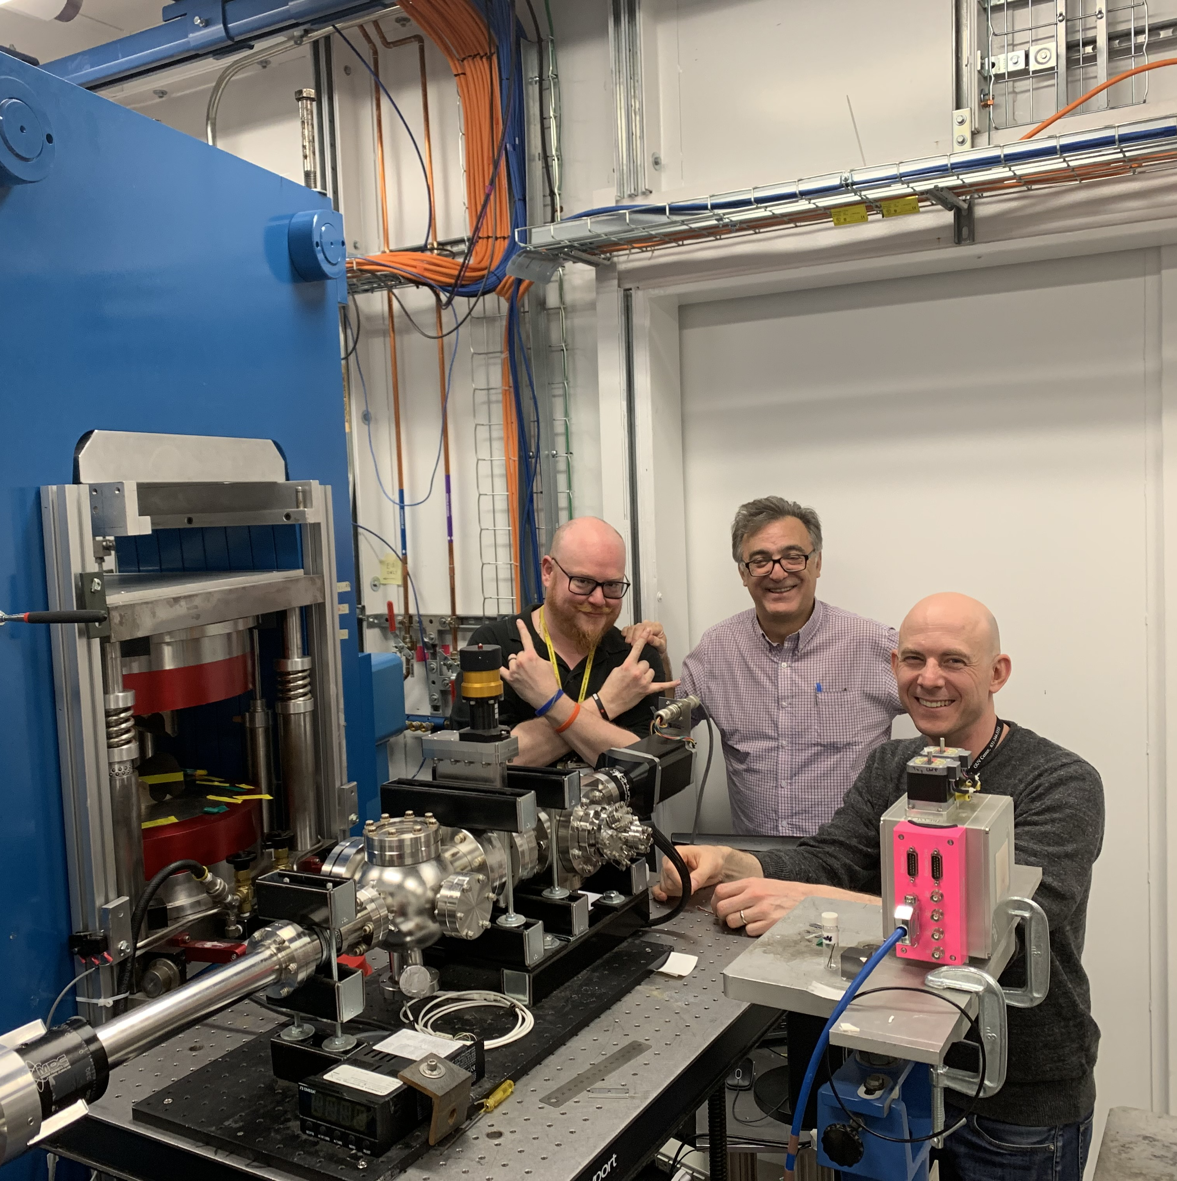
Nick the Initiator
BLIP irradiations and RaDIATE
High Power Targetry Community
Neutrino Super-beams for Long-Baseline Nu Oscillation Experiments
HiRadMat Beamline at CERN
First irradiated material studies at NSLS (and later NSLS-II)

Slide 17
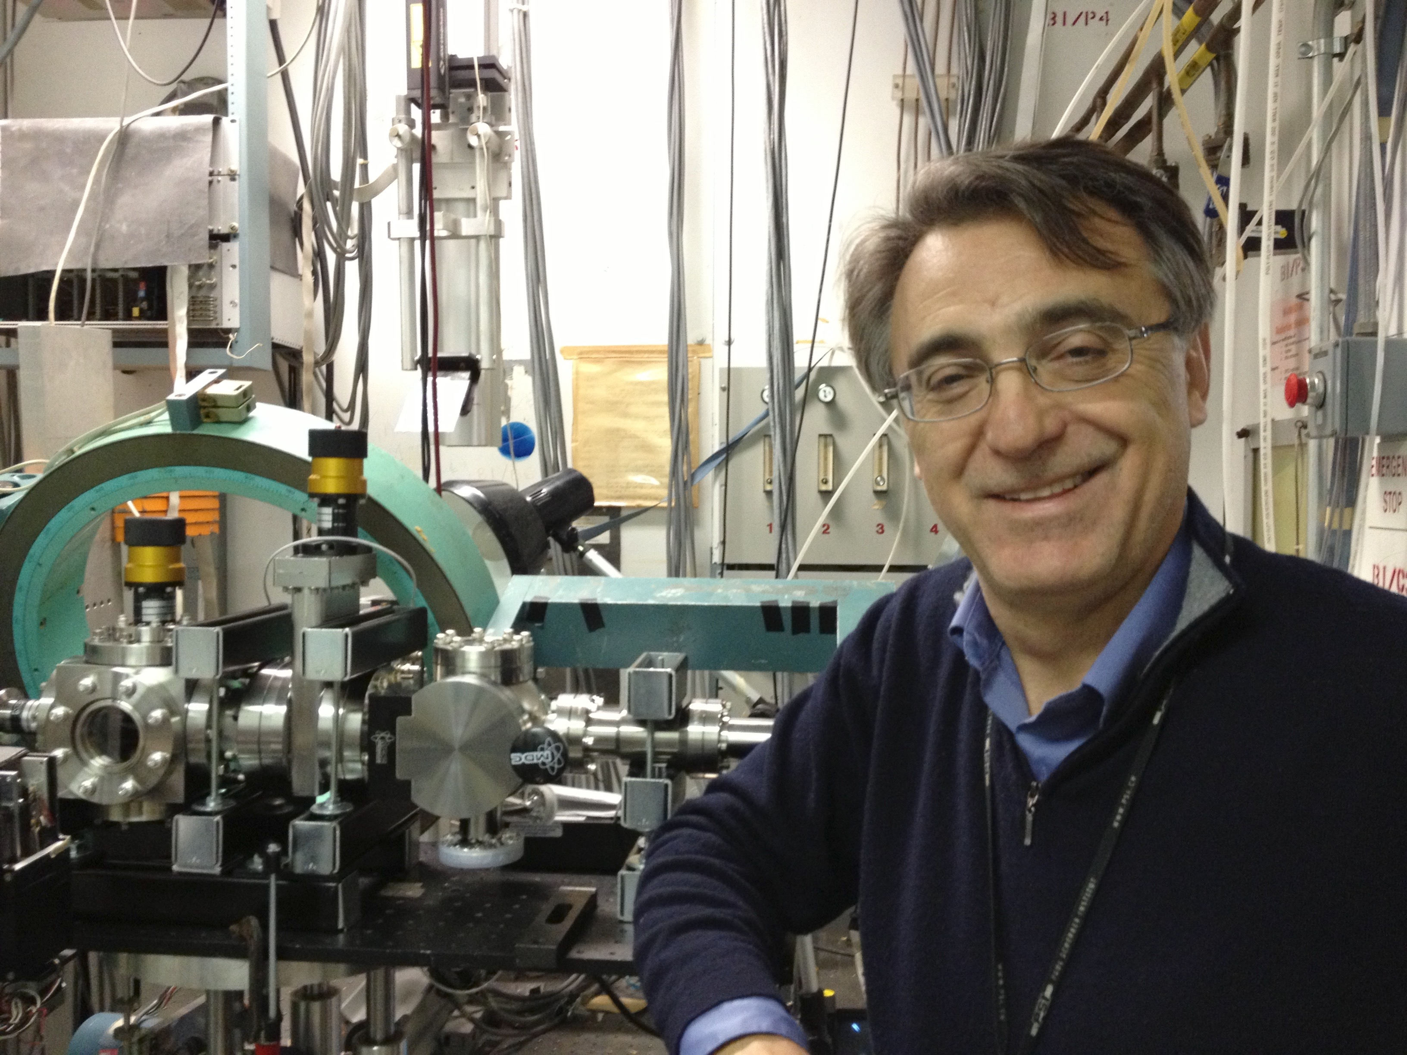
Nick the Initiator
BLIP irradiations and RaDIATE
High Power Targetry Community
Neutrino Super-beams for Long-Baseline Nu Oscillation Experiments
HiRadMat Beamline at CERN
First irradiated material studies at NSLS (and later NSLS-II)
Much more on NSLS I & II in Dave Sprouster’s talk

Slide 18
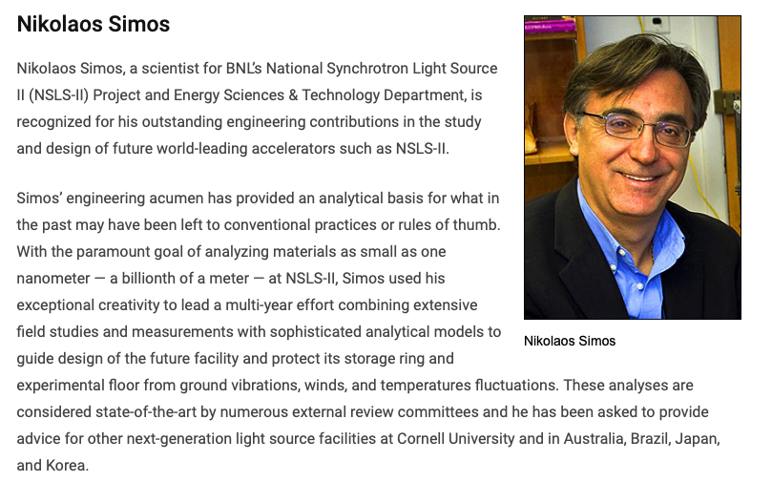
Nick the Initiator
BLIP irradiations and RaDIATE
High Power Targetry Community
Neutrino Super-beams for Long-Baseline Nu Oscillation Experiments
HiRadMat Beamline at CERN
First irradiated material studies at NSLS (and later NSLS-II)
Seismic – Vibration studies for light sources and reactors

Slide 19
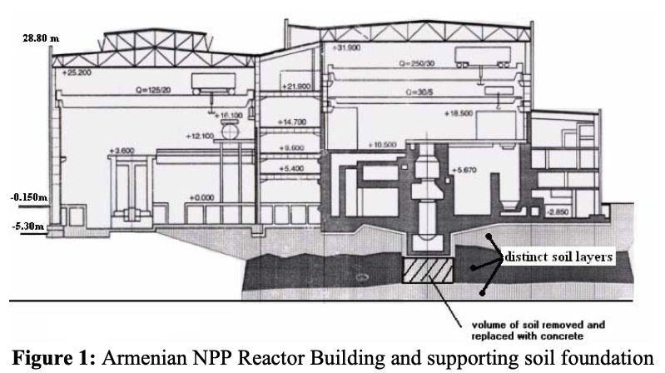
Nick the Initiator
BLIP irradiations and RaDIATE
High Power Targetry Community
Neutrino Super-beams for Long-Baseline Nu Oscillation Experiments
HiRadMat Beamline at CERN
First irradiated material studies at NSLS (and later NSLS-II)
Seismic – Vibration studies for light sources and reactors

Slide 20
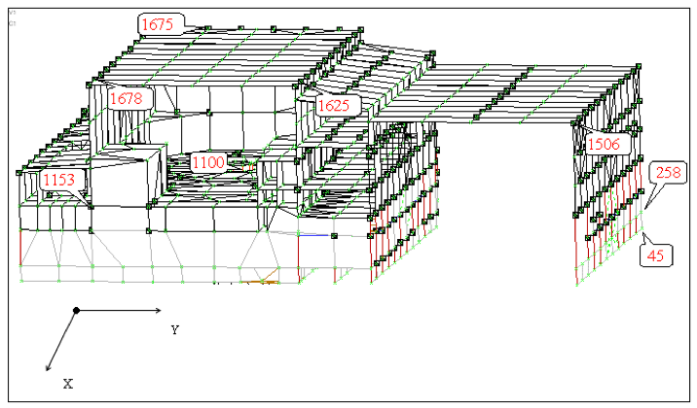
Nick the Initiator
BLIP irradiations and RaDIATE
High Power Targetry Community
Neutrino Super-beams for Long-Baseline Nu Oscillation Experiments
HiRadMat Beamline at CERN
First irradiated material studies at NSLS (and later NSLS-II)
Seismic – Vibration studies for light sources and reactors

Slide 21
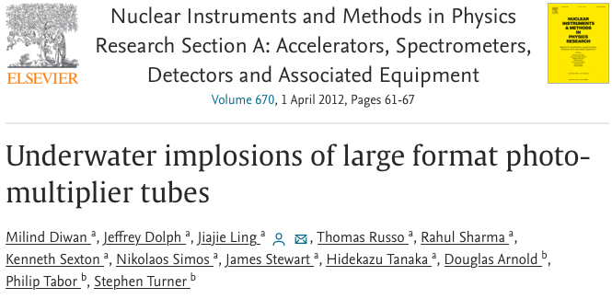
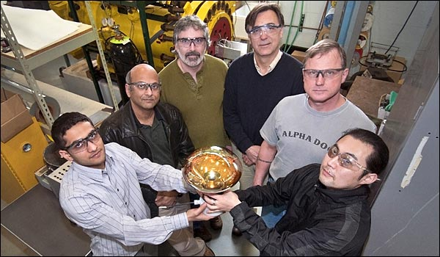
Nick the Engineer
Many, many examples (like everything just mentioned)
Water Cherenkov Photomultiplier Tube Implosion Simulation and Testing

Slide 22
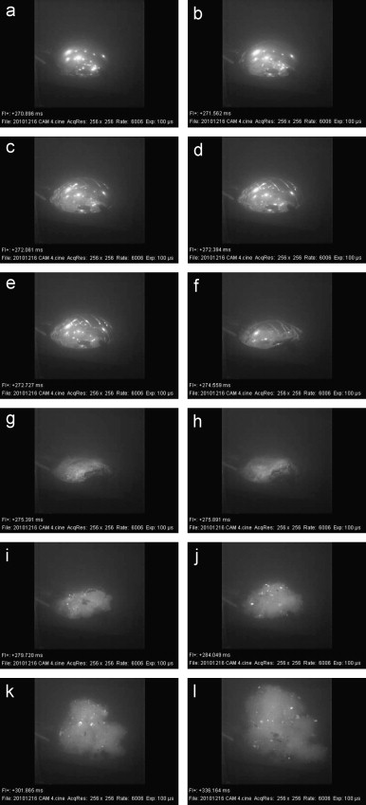
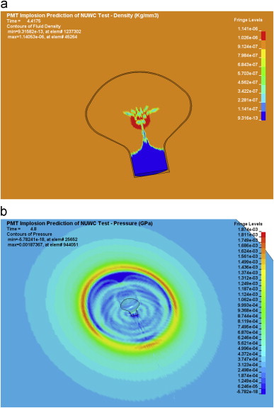
Nick the Engineer
Many, many examples (like everything just mentioned)
Water Cherenkov Photomultiplier Tube Implosion Simulation and Testing

Slide 23
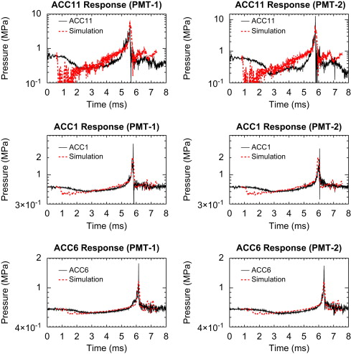
Nick the Engineer
Many, many examples (like everything just mentioned)
Water Cherenkov Photomultiplier Tube Implosion Simulation and Testing

Slide 24
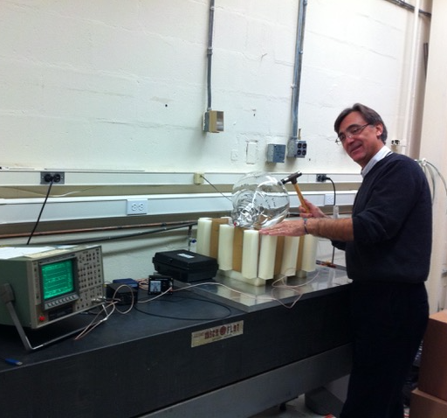
This is an amazing article when I look at it now. It is a mechanical engineering dream. We collected beautiful and excellent data and compared with Nick’s model.
-Milind Diwan (BNL)
Nick the Engineer
Many, many examples (like everything just mentioned)
Water Cherenkov Photomultiplier Tube Implosion Simulation and Testing

Slide 25
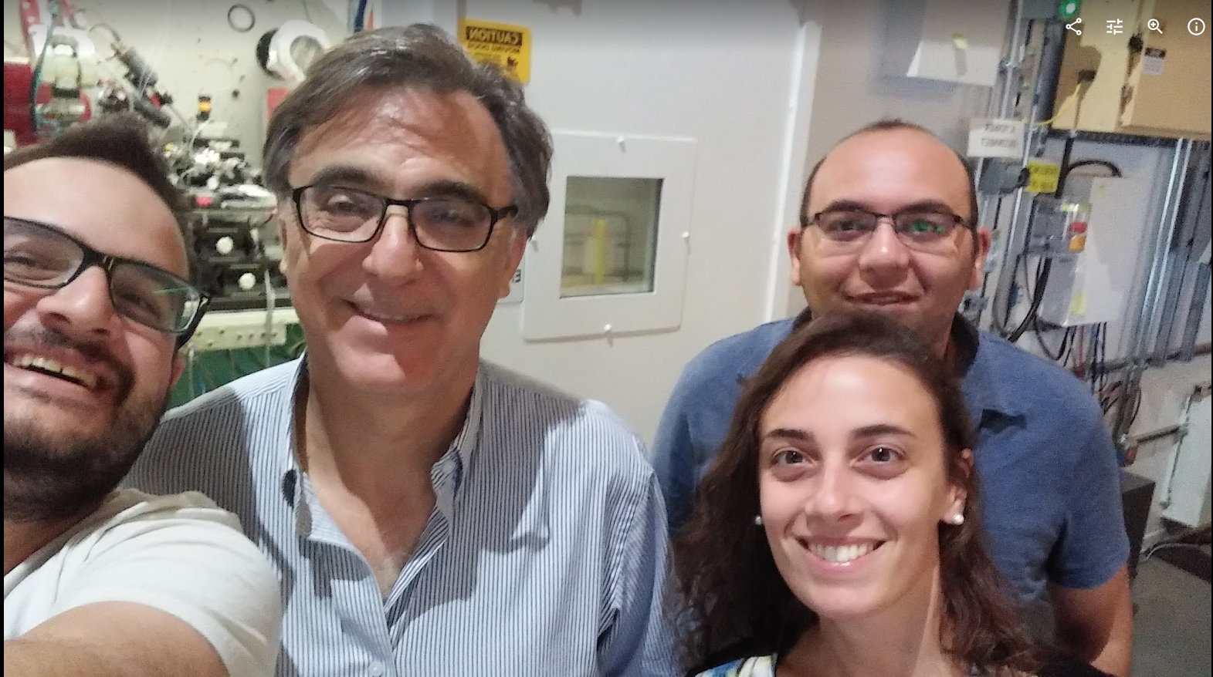
Nick the Motivator, Mentor
& Friend
Nick was instrumental in motivating me to continue pursuing the RaDIATE Collaboration in spite of seemingly insurmountable bureaucracy and “no-men”.
It seems to be a common theme with all his students, post-doc’s, and colleagues
“You must see the vision of what can be, before you see the obstacles of what cannot” - paraphrased from a conversation with Nick
With Nick and Mohamed, we performed several experiments at NSLS II and previously at NSLS , where we had the change to see its “last light”. I remember that it was a so touching moment for Nick, who was telling us stories and anecdotes from past years working in that facility, what incredible people he met and the results obtained. … he always supported and believed in me as well as in the scientific contribution of my studies. What he has transmitted to me is his passion for science, dedication to work and commitment with people.
-Elena Quaranta (PhD student from CERN)

Slide 26
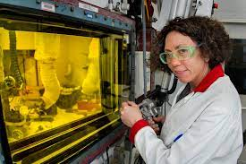
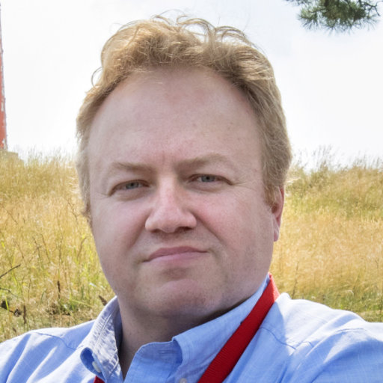
Nick the Motivator, Mentor
& Friend
When I think of Nick, I picture him walking on-site in his grey sweater: if he was nearby, he’d always stop to talk, if he was at a distance, he would always extent his hand with a palm towards you as a greeting. It is almost like he always made you feel important and noticeable. He treated everyone the same, from technical staff to PhDs, with the same level of respect. He loved Greece and always showed beautiful parts of it intermingling those with invitations to come and visit “next time I go there”.
Nick always spoke about science with an incredible enthusiasm. Even during difficult times for him he would be passionate about science.
-Dmitri Medvedev & Lisa Muench (BNL-BLIP Colleagues)
Nick was instrumental in motivating me to continue pursuing the RaDIATE Collaboration in spite of seemingly insurmountable bureaucracy and “no-men”.
It seems to be a common theme with all his students, post-doc’s, and colleagues
“You must see the vision of what can be, before you see the obstacles of what cannot” - paraphrased from a conversation with Nick

Slide 27
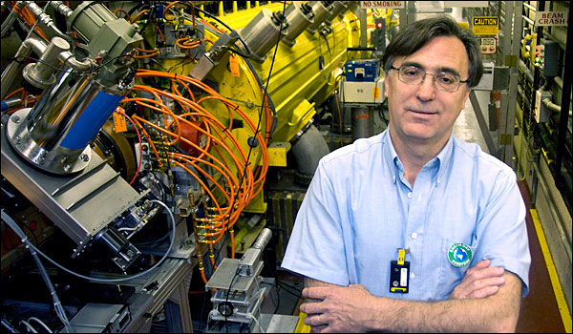
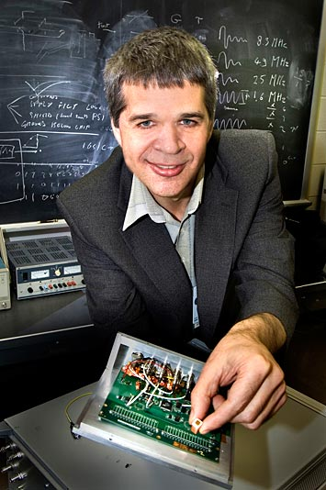
Nick the Motivator, Mentor
& Friend
Nick was instrumental in motivating me to continue pursuing the RaDIATE Collaboration in spite of seemingly insurmountable bureaucracy and “no-men”.
It seems to be a common theme with all his students, post-doc’s, and colleagues
“You must see the vision of what can be, before you see the obstacles of what cannot” - paraphrased from a conversation with Nick
Nick appeared in my life like an enchanter, instantly taking me into his magical world full of new science, ideas, and interesting stories. Every time he stopped by my office it was like a volcano and a tornado entered together with him ….
I remember Nick as a very kind person and a great scientist who deeply affected my life.
-Aleksey Bolotnik (BNL)

Slide 28
> From: owner-radiate@listserv.fnal.gov <owner-radiate@listserv.fnal.gov> > On Behalf Of Simos, Nikolaos > Sent: 27 April 2017 00:22 > To: radiate <radiate@listserv.fnal.gov>; Cutler, Cathy <ccutler@bnl.gov> > Subject: RADIATE BLIP Experiment Update - WE ARE ON!!! > Importance: High Dear Colleagues I am pleased to inform you that as 6:55 PM the BIG RaDIATE Experiment at BLIP is on with 180 MeV and 140 uA beam on target. It has been a nail biting day because of the changes in beam energy and the uncooperative beam. But the diligence of Deepak made happen.
While the excitement of the science out of this experiment is down the road, this milestone (two years almost in the making) has been reached and we are ON! Us at the RaDiATE collaboration should extend our thanks and gratitude to Cathy's BLIP staff (Slawko, Anna, Jason and of course to our collaboration members Dmitri and Leonard) for the help they offered in crucial times (especially today).
Also thanks to Dana and his safety committee for the right attitude and the constructive suggestions in the safety review process (their guiding principle "we are going to make this work" rather than looking for small things to delay it). We are running it with a slightly lower beam current for tonight until things get stable before the current is pushed up tomorrow. I will be keeping you posted. Now I can start to "untie the knots in my stomach" and hopefully relax. Cheers Nick

Slide 29
