Slide 1

Interaction with Nick
Met in 2018 and 2019
Extensive knowledge in material science, radiation damage, mechanical engineering
Eagerness to share his insights and knowledge with his peers and mentees
Full of energy and enthusiasm

Slide 2
Irradiation Induced Failure Analysis of NuMI Target
Sujit Bidhar
June 27, 2023

Slide 3
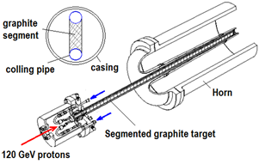
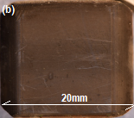
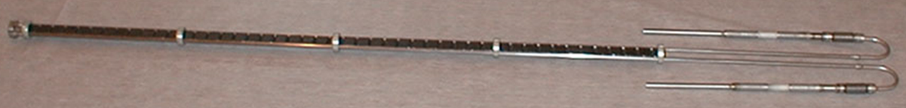
Background- NT02 Target Fin
95 cm
Individual target fin
20mm x 15 mm x 6.6 mm
Segmented Fins- 47 pieces
Material : POCO ZXF 5Q graphite
Isotropic

Slide 4
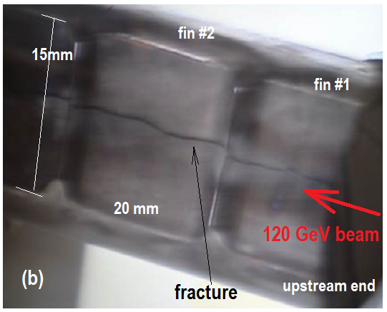
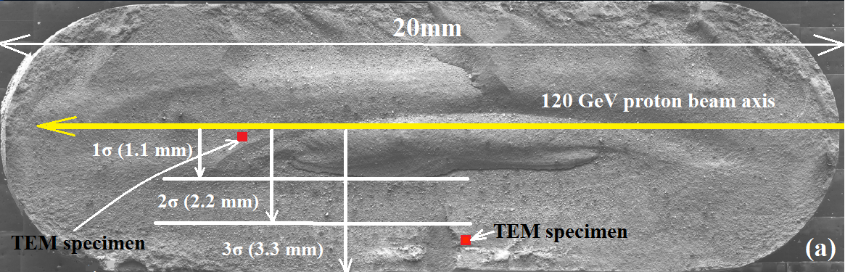
Background- Fracture fin
x
y
z
z
Beam Parameters:
Energy :120 GeV
Beam sigma : 1.1mm
Spill duration : 10µsec, 4x10¹³ protons/pulse
Duty cycle :1.87sec
Peak fluence : 8.6x10²¹ protons/cm²
Bulk swelling of ~2%

Slide 5
Graphite Swelling→ Fluence factor
XRD – Pyrolytic carbon
C-axis expansion is more than a-axis contraction
Swelling →f(fluence, temperature)
  More swelling at lower temperature
Kelly, J. Vac. Sci. Technol. A 4 (3), 1986

Slide 6
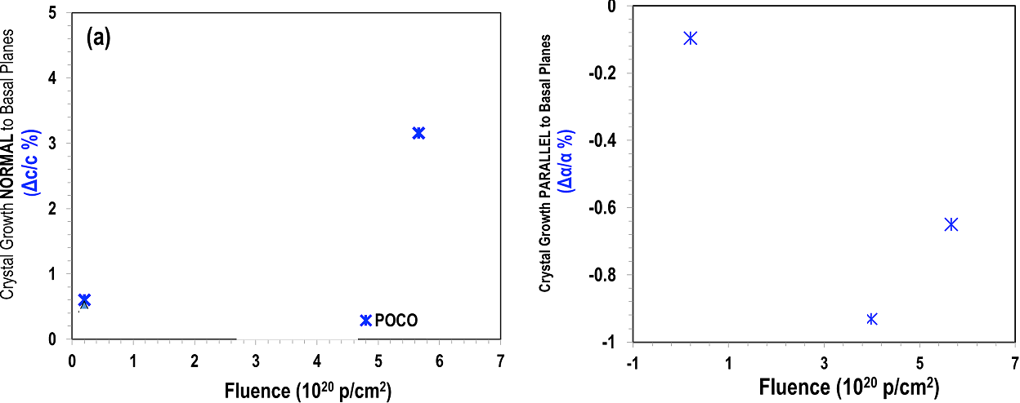
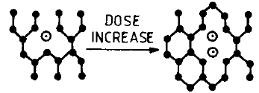
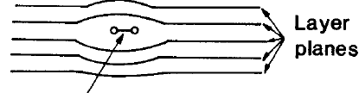
Graphite Swelling→ XRD- POCO ZXF5Q
150 C
150 C
C-axis expansion is more than a-axis contraction → net expansion
c
a
a
Interstitial → expansion
Vacancy →contraction
N. Simos, PRAB 20, 071002 (2017)

Slide 7
Swelling factor function
Local Swelling factor =f(fluence)*g(temperature)
sw(Ø,T)= f(Ø).g(T)
u=u(x,y,z)
Fluence is Gaussian distribution with location
f(Ø)=exp{-b(u/σ)²}
∂(sw)= g(T). ∂f(Ø) + f(Ø).{∂ g(T)/ ∂T}. {∂T/ ∂u }
At constant fluence swelling factor follows a polynomial function with temperature (next slide)
Steady state thermal analysis

Slide 8
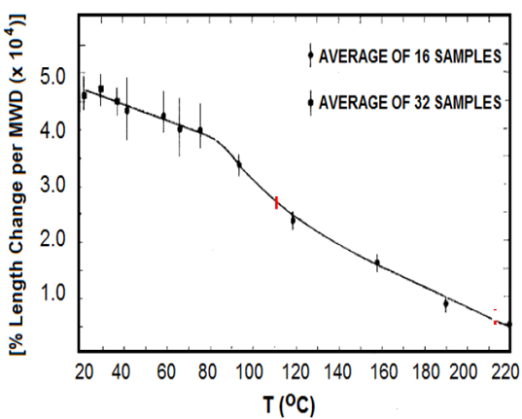

Swelling →Temperature Factor
NTO2 steady state operating temperature range
1 MWD = 7e16 nvt
∂g(T)=$2x10$⁻⁷ T³ - $7x10$⁻⁵ T² + $1.5x10$⁻³ T+1.0083
Pronounced swelling at lower temperatures
D. Schweitzer, Physical Review, Vol 128 (2), 1962, pp .556-559

Slide 9
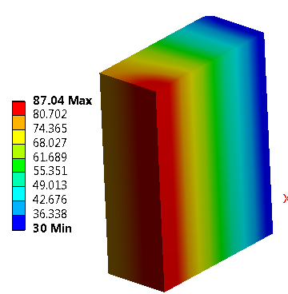
Steady State Thermal Analysis
1/8th symmetry model
Transient Temp. at beam center
(a)
Beam direction
Steady state thermal
Path-y
Path-x
Average irradiation temperature 30C~87C

Slide 10
Swelling factor →combined function of fluence and temperature
sw(u,T)=${C.exp⁡\{−b\left(\frac{u}{σ}\right)}^{2}\}.{\{5x10\text{−}\text{8} \text{T}\text{4}\text{ −} 2x10\text{−5} \text{T}\text{3}\text{ +} 5x10\text{−}\text{4} \text{T}\text{2}\text{+1.0083}T+1}^{}$}
g(T) is plotted as function of location , from steady state temperature distribution

Slide 11
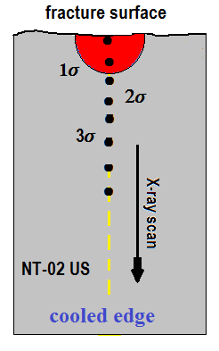
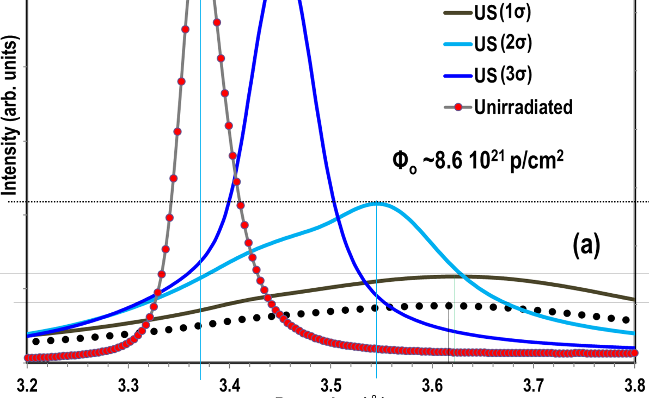
XRD data NTO2 From Nick
Assumption
Experimental swelling = ∂(d/d0)
3.542
3.37
d-spacing, A⁰
3.621
3.618
XRD scan spot size is 50µm x 50µm x 10mm
In FEA, element size is made ~ 50µm so that it would match to XRD scan volume

Slide 12
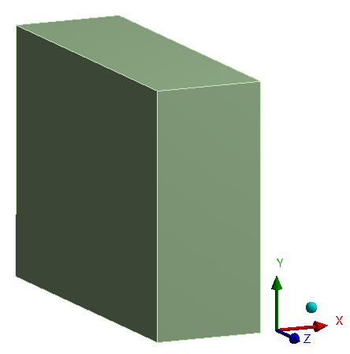
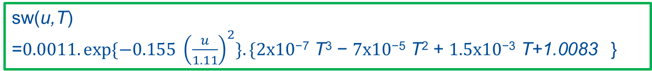
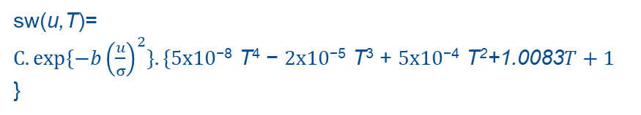
Determining Swelling Coefficient
U (mm) | Temperature | sw | d-spacing | ∂(d/d0) | C
0 | 88 | 0.779 | 3.621 | 0.074481 | 0.000894
1.1 | 84 | 0.686 | 3.618 | 0.073591 | 0.001073
2.2 | 81 | 0.442 | 3.542 | 0.051039 | 0.001211
3.3 | 78 | 0.210 | 3.45 | 0.023739 | 0.001245
u
XRD
sw(u,T)=${C.exp⁡\{−b\left(\frac{u}{σ}\right)}^{2}\}.{\{5x10\text{−}\text{8} \text{T}\text{4}\text{ −} 2x10\text{−5} \text{T}\text{3}\text{ +} 5x10\text{−}\text{4} \text{T}\text{2}\text{+1.0083}T+1}^{}$}
Equating sw(u,T) to ∂(d/d0) ➔ C
Multi-variate regression analysis:
Varying “b” and “σ”to get C curve as flat as possible
→ b= 0.155, C = 0.00107, σ =1.11
sw(u,T)
=${0.0011.exp⁡\{−0.155 \left(\frac{u}{1.11}\right)}^{2}\}.{\{2x10\text{−7} \text{T}\text{3}\text{ −} 7x10\text{−5} \text{T}\text{2}\text{ +} 1.5x10\text{−3} \text{T}\text{+1.0083}}^{}$}

Slide 13
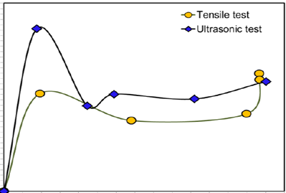



Young’s Modulus variation with Fluence Ø
Peak fluence 8 x10²⁰ p/cm²
Analytical function fit f₁$\left(φ\right)$
$$f_{1}\left(φ\right)=1.5{\left(\frac{Ø}{13}\right)}^{1.3−1}exp{{\left(−\frac{Ø}{13}\right)}^{1.3}}$$
“E” varies with Ø
Ø varies with location.
This two relationship is used to map “E” as a function of location
Ø = Ø₀ exp{-0.5(u/1.1)²}
E=E0[1+f₁(Ø) ]

Slide 14

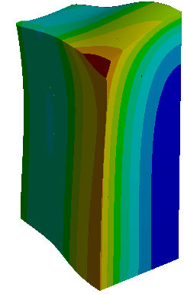
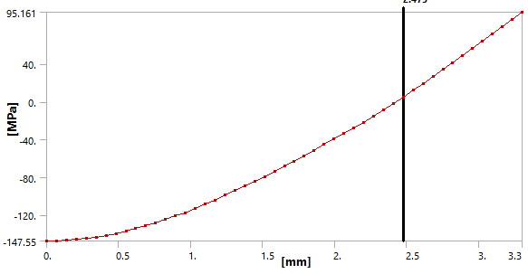
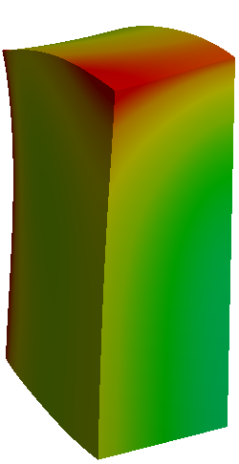

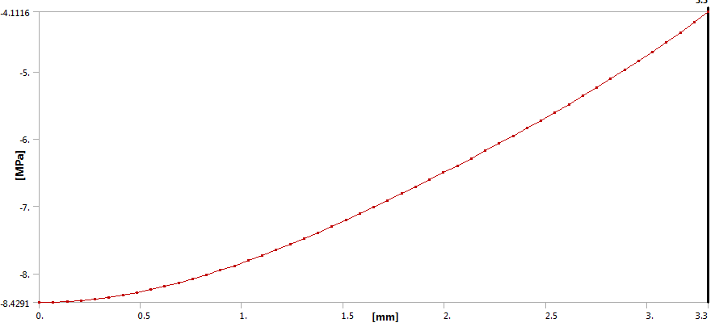
Static Structural analysis – σ_{yy} Distribution
With Swelling
Path-x
Tensile
Compressive
Beam direction
2.45 mm
Path-x
Without Swelling
Path-x
Beam direction
Path-x
State just before beam pulse after number of years of exposure to neutrons

Slide 15
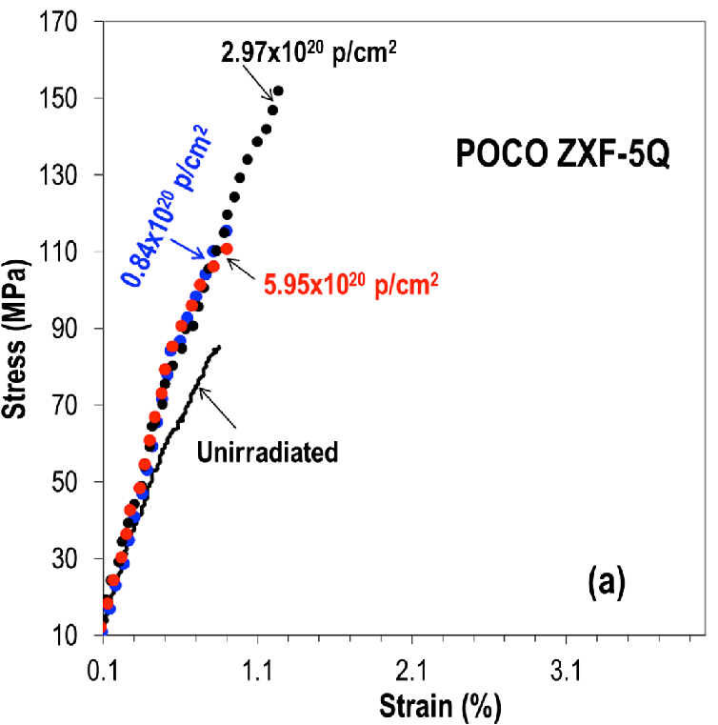
Simulation validation- failure strength
N. Simos, PRAB 20, 071002 (2017)
Swelling formulation raised the stress level up to 150 Mpa
Nick’s experimental data provided validation of swelling formulation

Slide 16
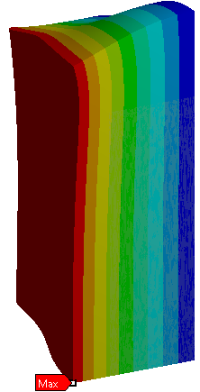

Simulation Validation- amount of swelling
Deformed location
From Simulation
(3.323-3.3)*100/3.3= 0.7 %
Observed bulk swelling at that location ~ 2%
Difference of factor of 2 is not too bad…?
Measurement technique
Assumptions in empirical formulation
3.3 mm

Slide 17
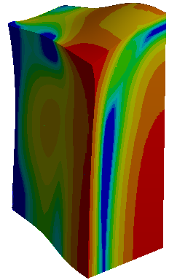
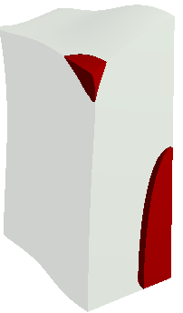

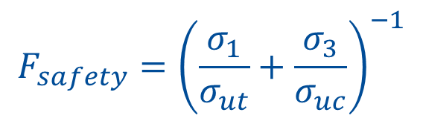
Simulation Validation- Mohr-Coulumb’s factor of safety
FS distribution
FS <1
$$F_{safety}={\left(\frac{σ_{1}}{σ_{ut}}+\frac{σ_{3}}{σ_{uc}}\right)}^{−1}$$
79 MPa
175 MPa
Fracture plane
Beam
Probable crack initiation sites
Fractography suggest crack starting from inside and propagating outward

Slide 18
Result
Nick’s experimental data helped in development of an empirical formula for local swelling
Better understanding of material failure mode
Publication of scientific journal paper Nuclear Material and Energy 24(2000)

Slide 19
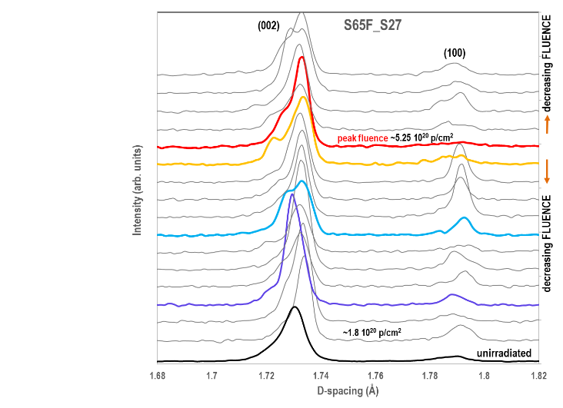
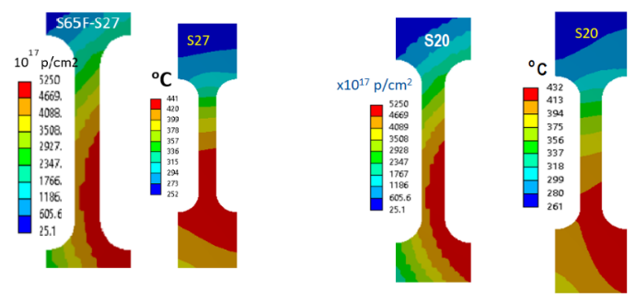
XRD at NSLS-II (BNL)
^{65keV}
Xray Spot : 2mm x 0.05mm elliptical
Nick initiated this work and tried to get XRD tomography
We are carrying forward this effort

Slide 20
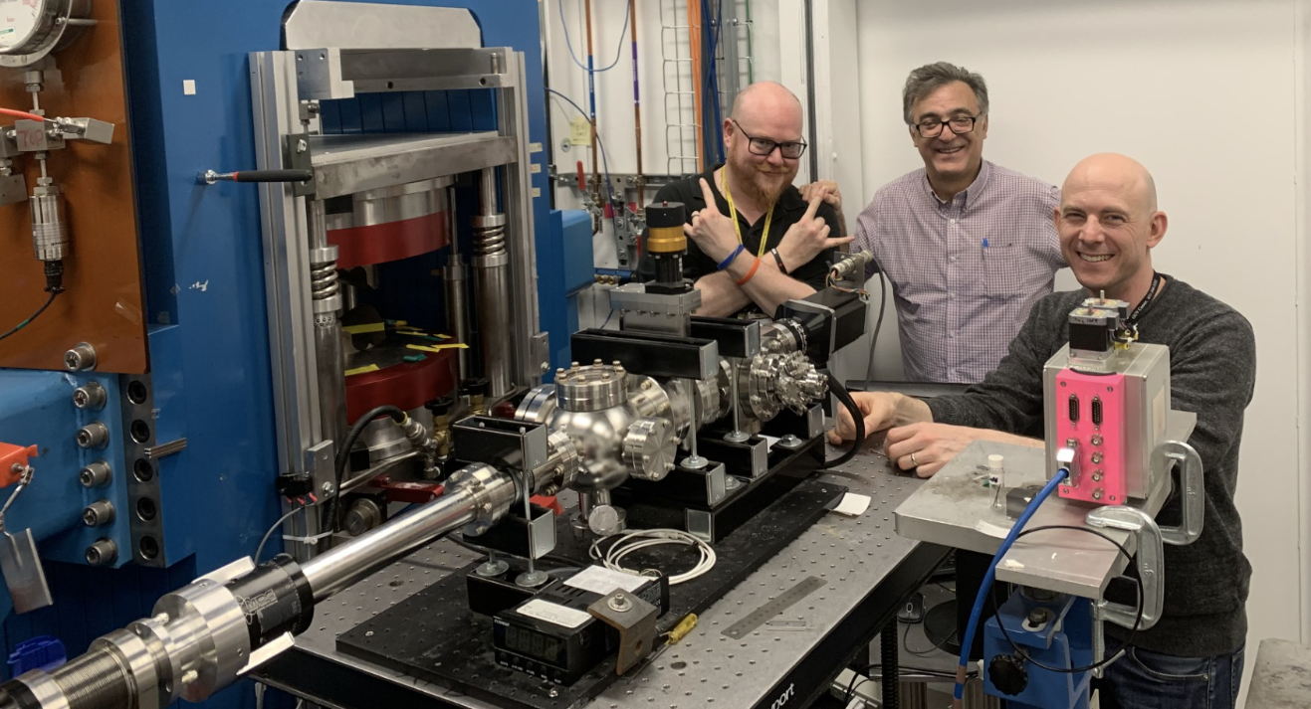
In-situ XRD tomography with loading

Slide 21
Rest in Eternal Peace
Supportive and collaborative environment
Nurturing the next generation of scientists and engineers
Inspirational legacy of excellence and pushing boundaries

