Slide 1
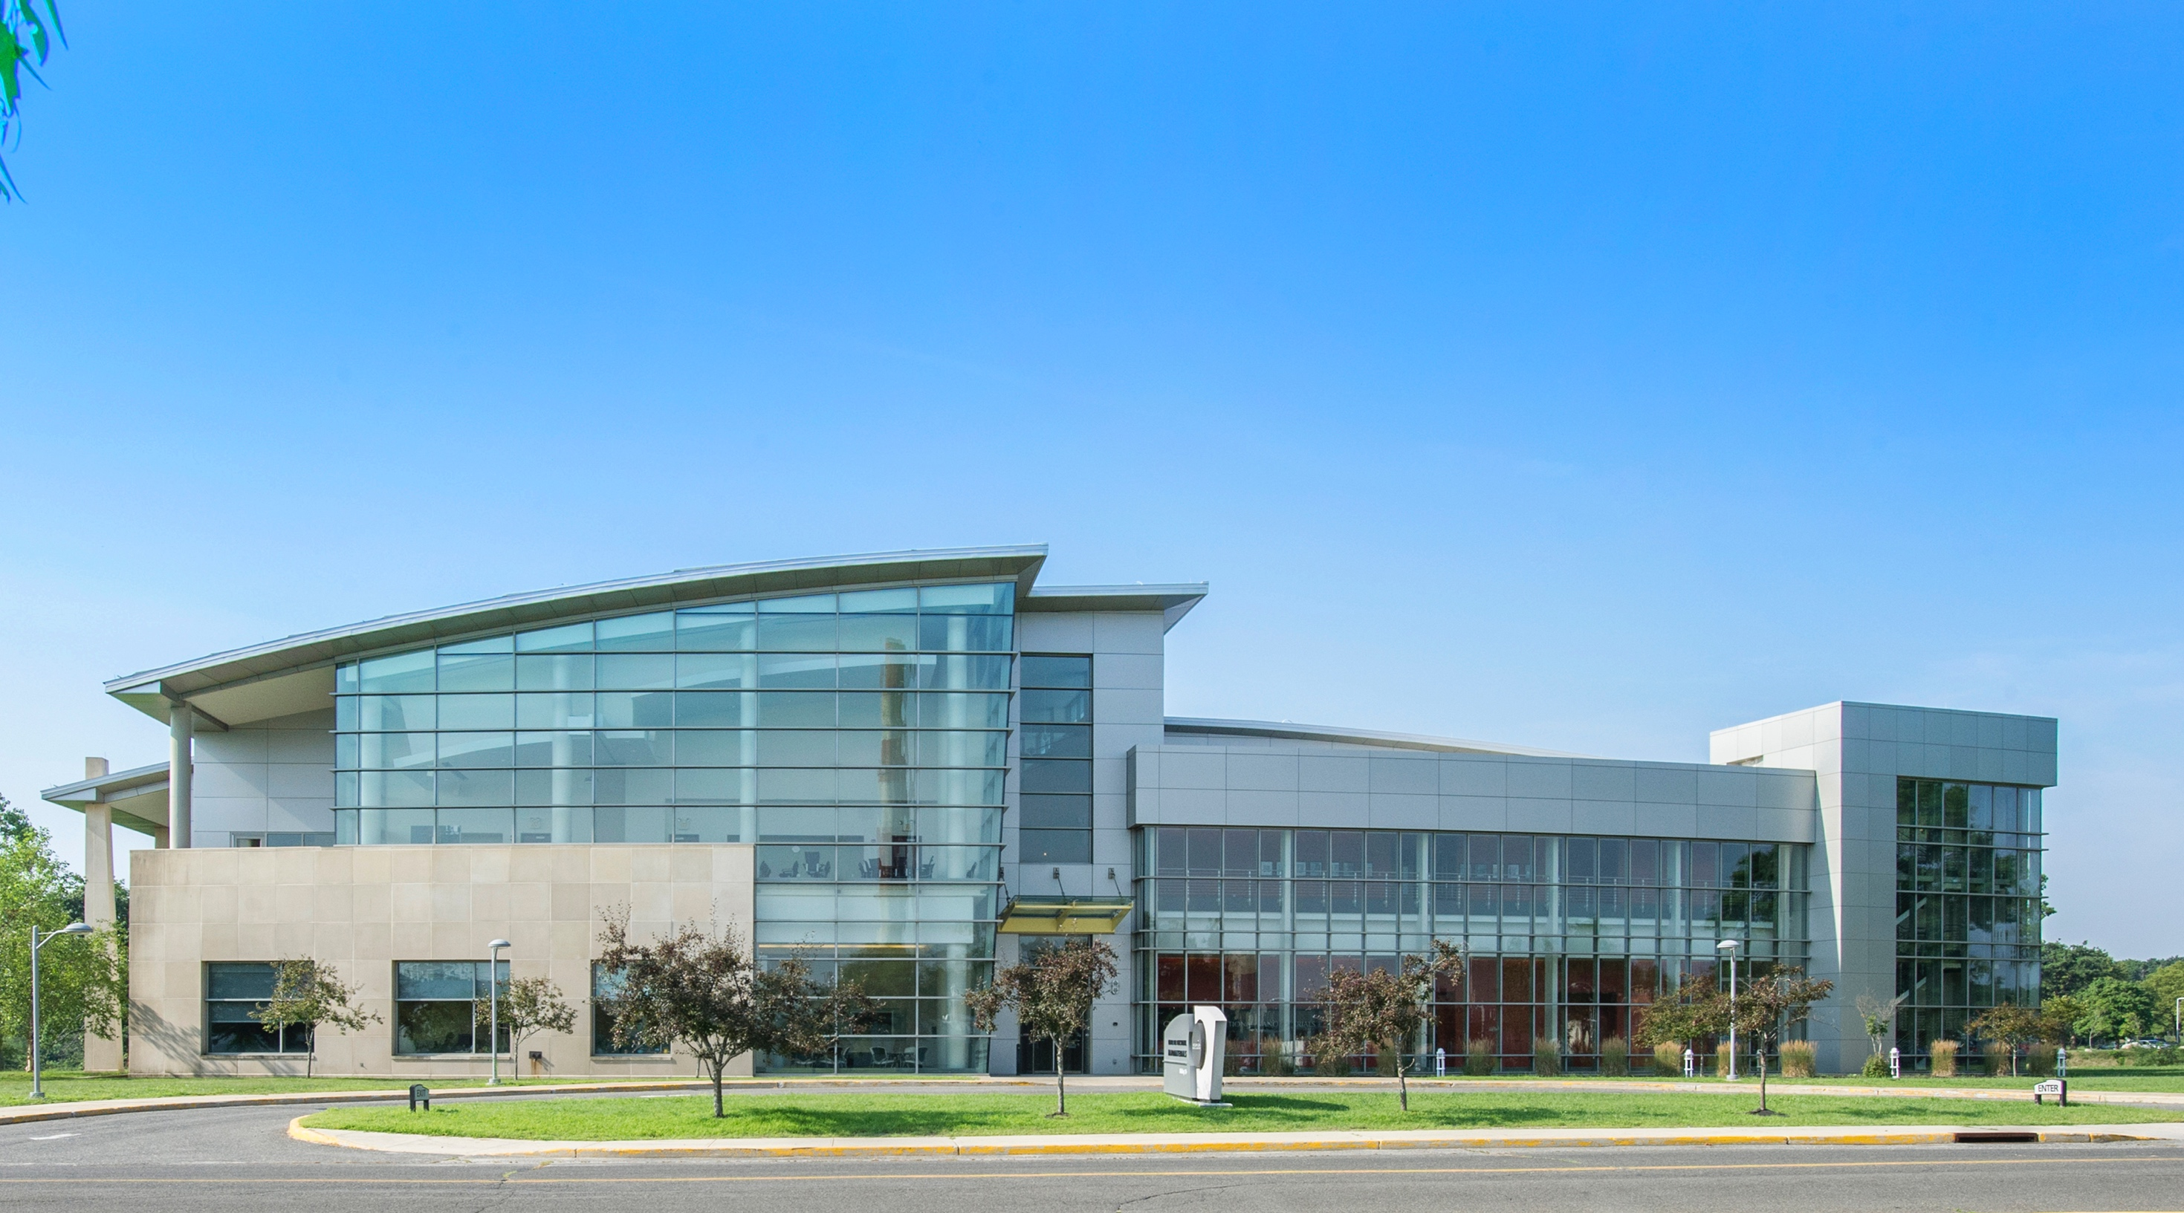
Center for Functional Nanomaterials a DOE Scientific User Facility
Dmytro Nykypanchuk
June 28, 2023
RaDIATE, June 26-30, 2023

Slide 2
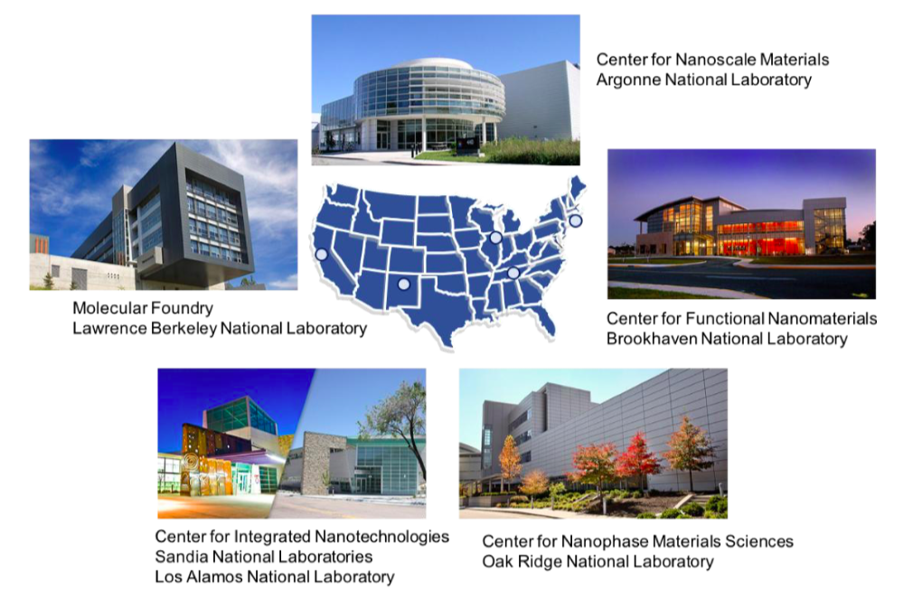
The DOE Nanoscale Science Research Centers are a network of five facilities for creating, characterizing & understanding nanomaterials
The NSRC model combines an expert staff, a portfolio of distinctive instruments, and a core commitment to collaborative science

Slide 3
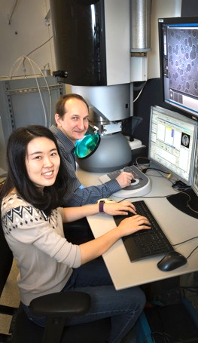
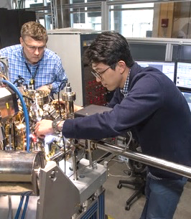
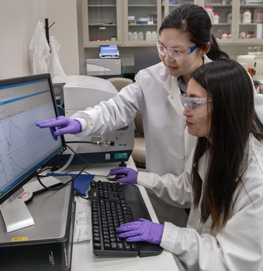
The CFN mission is to advance nanoscience
A national scientific user facility operated for the U.S. Dept. of Energy
Permanent staff: 40+ (30 scientists)
600+ users/yr; 330+ pubs/yr
We accomplish our mission by:
Enabling the research of a productive user community
Delivering breakthrough nanoscience discoveries through internal research
Providing essential nanoscience capabilities for the scientific community
Training staff and users to work safely

Slide 4
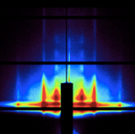
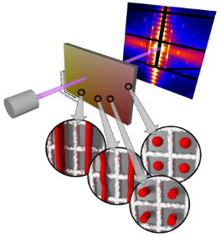
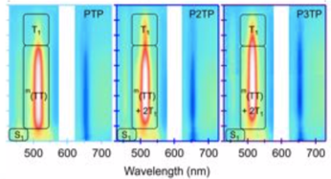
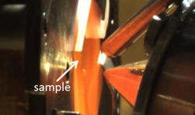
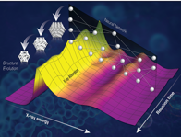
Three strategic nanoscience themes guide new facility development and research directions
We create new strategies for Nanomaterial Synthesis by Assembly, designing architectures with target functionality by organizing components
Small- and wide-angle X-ray scattering
Low-dose electron microscopy and tomography
We devise and apply new platforms that Accelerate Nanomaterial Discovery, to achieve improved performance
Advanced optical spectroscopy
Combinatorial nanomaterial synthesis
We advance characterization of Nanomaterials in Operando Conditions, in real-world environments
In-situ surface science and electron microscopy
Theory linking spectra to structure

Slide 5
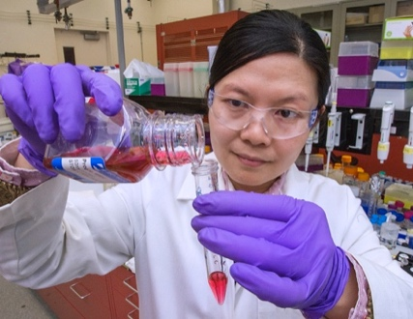
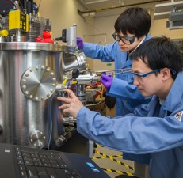
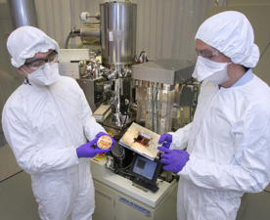
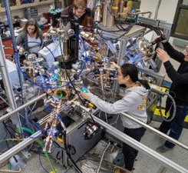
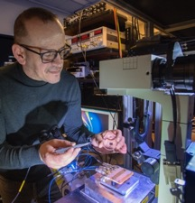
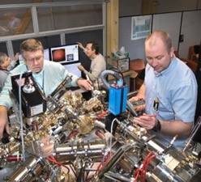
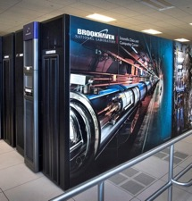
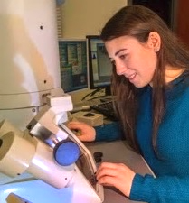
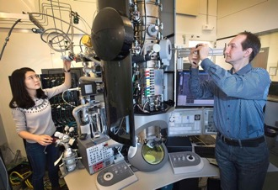
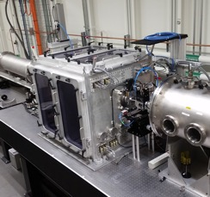
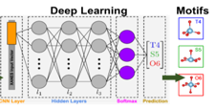
A portfolio of seven facilities integrates the full-cycle of materials research
CFN invests $2-3M each year in new nanoscience instrumentation
Materials Synthesis & Characterization
Nanofabrication
Adv. Optical Spectroscopy & Microscopy
Proximal Probes
Electron Microscopy
Advanced UV and X-ray Probes
Theory, Computation, and Data Analytics

Slide 6
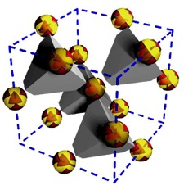
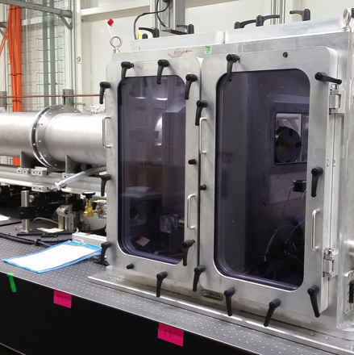
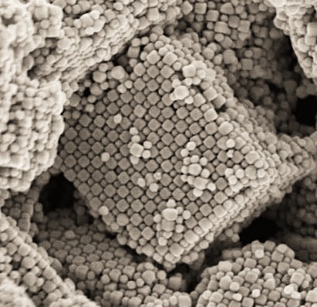
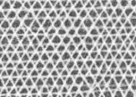
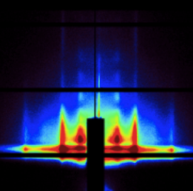
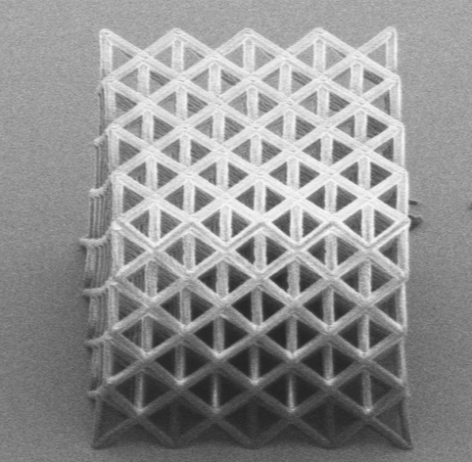
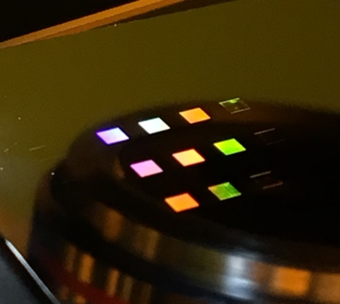
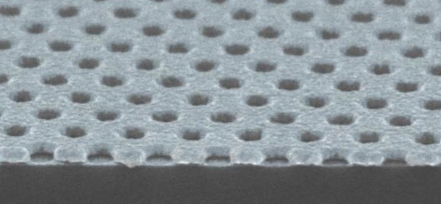
Leading research and state-of-the-art facilities for Nanomaterial Synthesis by Assembly
DNA mediated assembly
Small- and wide-angle X-ray scattering (w/ NSLS-II)
Theory of self-assembled structures
Block copolymer self assembly
High-res patterning in 2- and 3D
Plasmonic colors by wide-area e-beam lithography

Slide 7
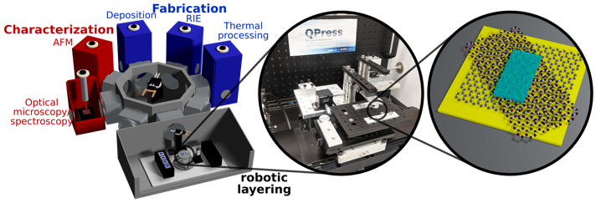
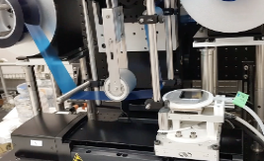
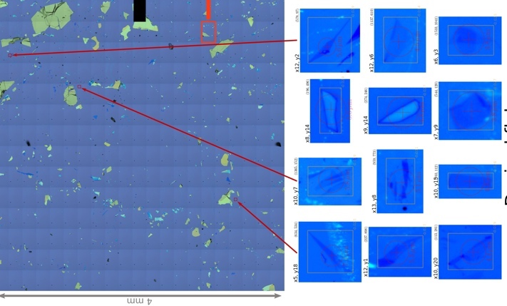
Automated Synthesis of Layered 2D Material Heterostructures by Assembly
Expand experimental possibilities with instrument to reliably fabricate complex stacks of atomically-thin materials
Modules
Robotic exfoliation from parent crystals
Automatic cataloging of exfoliated flakes. Machine-vision finds & classifies flakes
Long-term library storage of 2D flakes for later selection/use
Robotic stacker for precise heterostructure construction
Integrated characterization and processing
Robotic laminator exfoliates crystals
Cataloger scans sample & IDs candidate 2D flakes

Slide 8
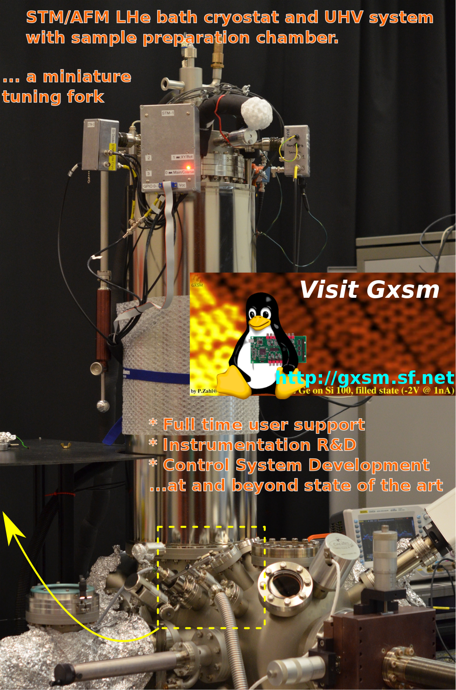
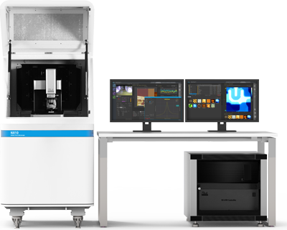
Surface and Bulk Characterization
(atomic force microscopy)
Cypher AFM:
Fast imaging and force measurements; measurements in liquids
Park NX10:
General purpose AFM
True molecular resolution in-house built AFM

Slide 9
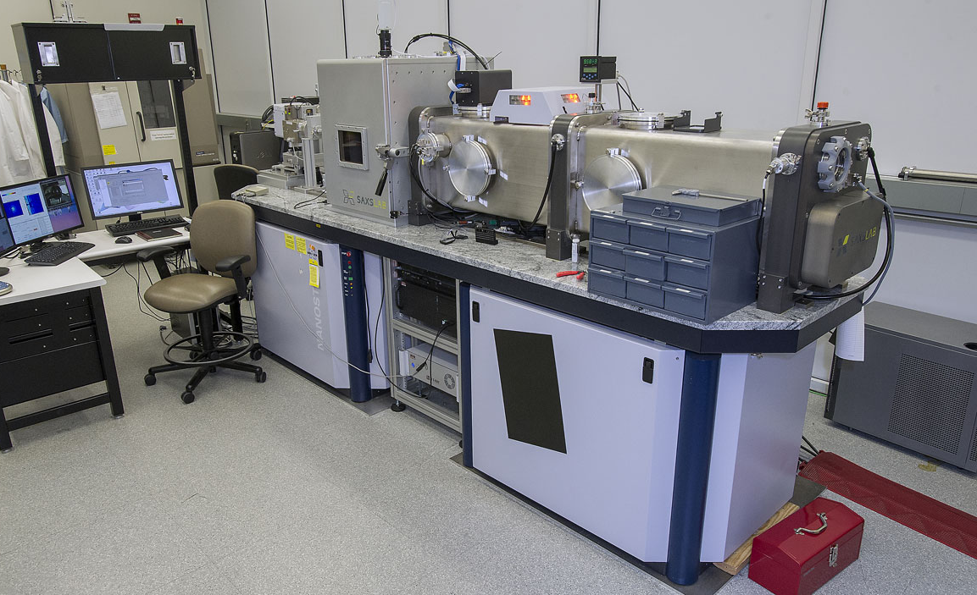
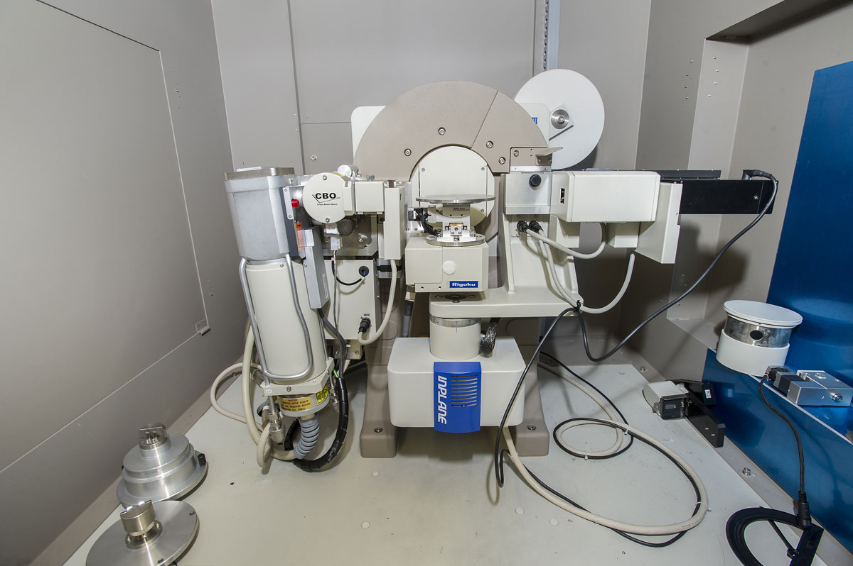
Surface and Bulk Characterization
SAXS/GISAXS/WAXS capabilities to investigate material structure from angstroms to ~200 nm.
Universal diffractometer for thin films, bulk powders, and surfaces. Capable of in-situ high temperature studies at up to 1100 °C.

Slide 10
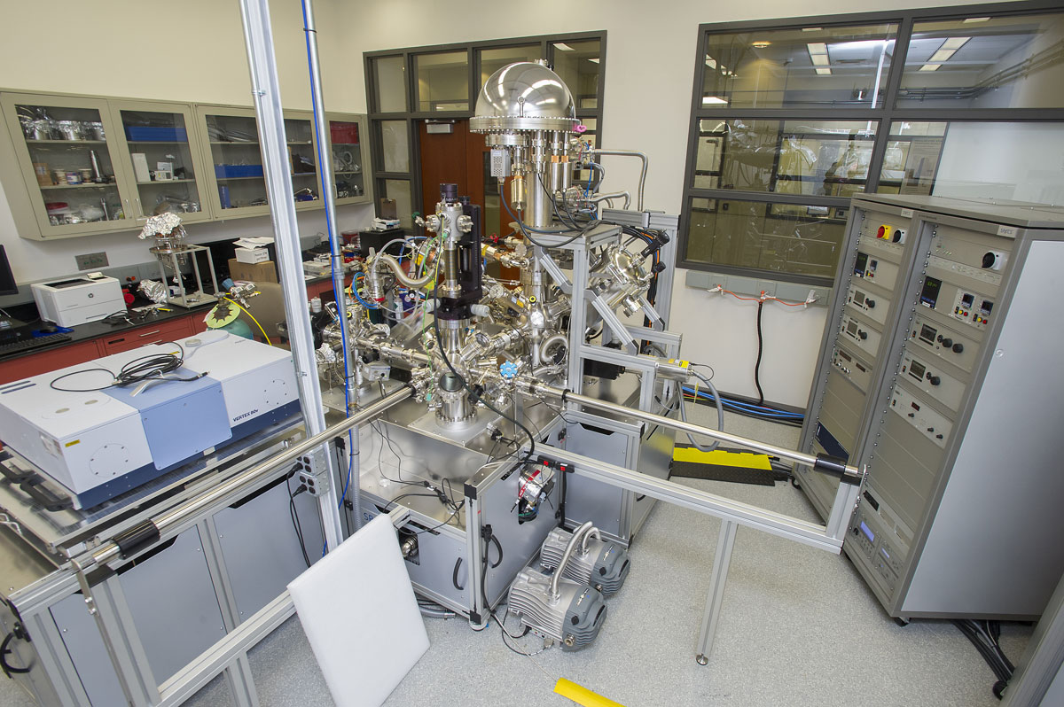
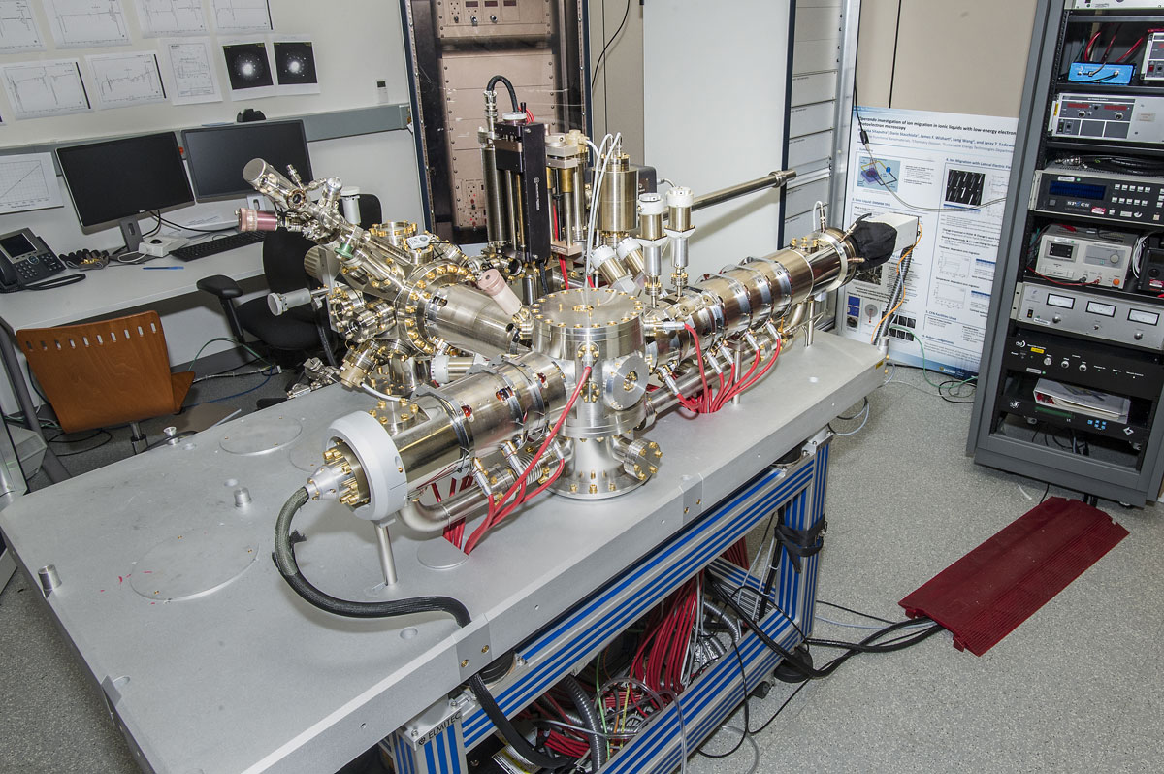
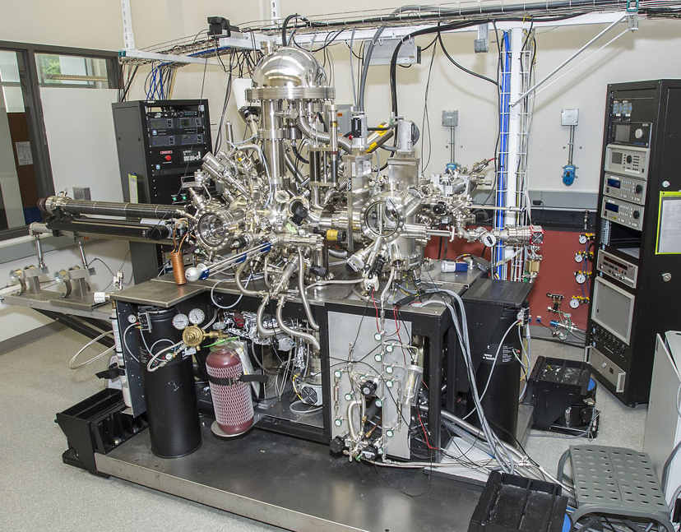
Surface and Bulk Characterization
Ambient Pressure XPS & UPS
Low Energy Electron Microscope V (LEEM)
Multiprobe Surface Analysis System - UHV/STM/XPS/UPS/ISS/LEED/TPD

Slide 11
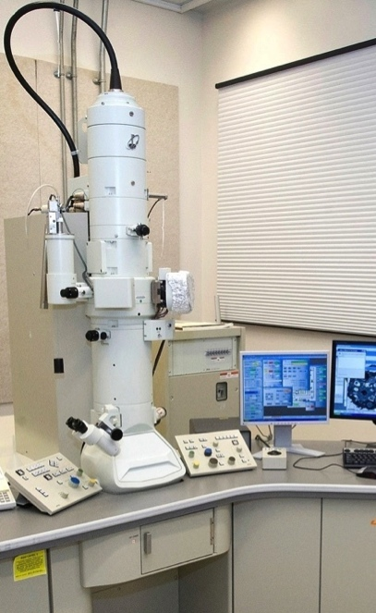
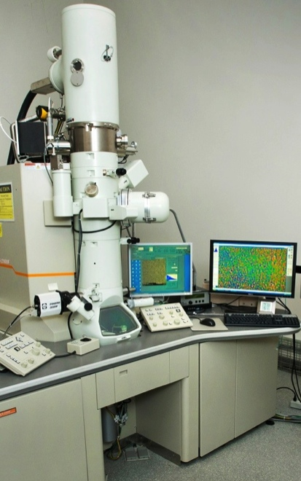
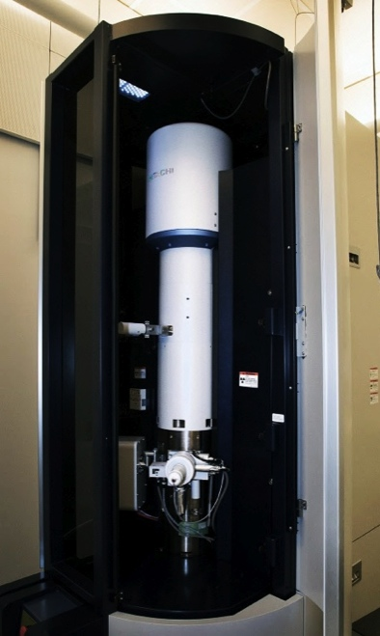
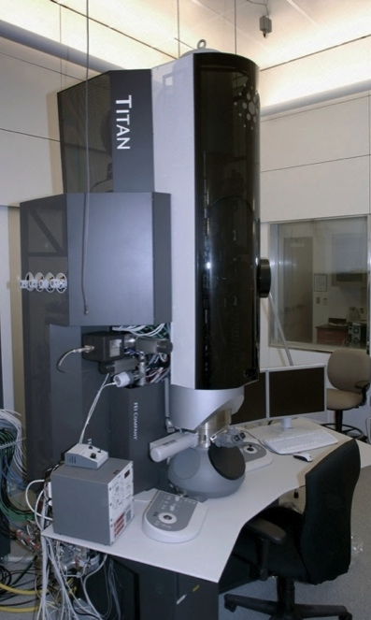
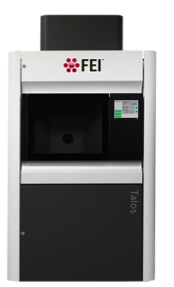
Electron microscopy
JEOL 1400
Low voltage TEM
JEOL 2100F Analytical electron microscope
Hitachi HD2700C STEM Probe corrector
Titan 80-300 ETEM Image corrector
FEI Talos 200X Operando STEM/TEM
Soft & biological materials through cryo-microscopy
Versatile
analytical & in-situ experimentation
Forefront analytical instrument
Environmental & in-situ studies
Atmospheric pressure experiments in liquids & gases

Slide 12
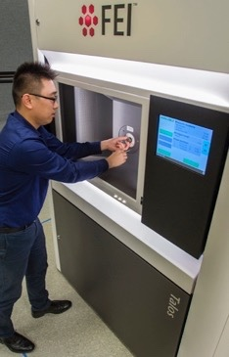
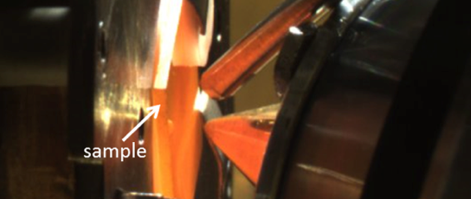
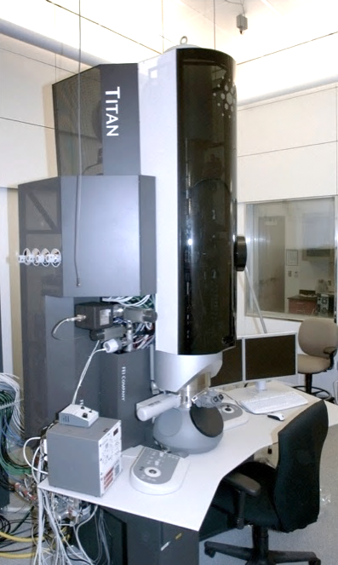
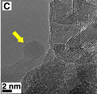
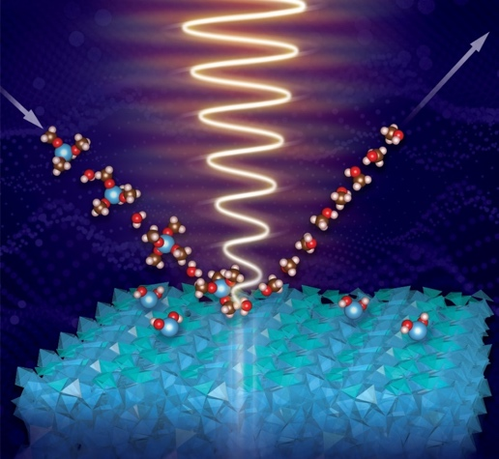
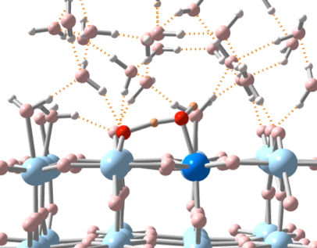
World-class capabilities for studies of Nanomaterials in Operando Conditions
Operando TEM/STEM in gas and liquids
Ambient pressure XPS
Aberration-corrected Environmental TEM
In-situ electron tomography
O_{br}
(H₂O)_{ads}
Ultrafast spectroscopy of working photocatalysts
Electrolyte
Ti_{5c}
Data analytics for understanding real-time, in-situ measurements

Slide 13
Advanced UV and X-Ray probes
Partner beamlines at NSLS-II
X-ray scattering: SMI and CMS (SAXS/WAXS/GISAXS/GIWAXS)
Surface Spectro-Microscopy: ESM (LEEM/PEEM)

Slide 14
Advanced Optical Spectroscopy and Microscopy
Femtosecond and Nanosecond Transient Absorption Spectrometers
Time and Spectrally Resolved Confocal Photoluminescence and Electroluminescence Microscope

Slide 15
Theory and computation
Computer Cluster
70 high performance nodes consisting of dual 18-core CPUs, two Nvidia K80 or P100 GPUs and 256 GB memory
InfinitiBand EDR connectivity and 200 TB GPFS distributed storage
112 dual hex- and 60 dual quad-core nodes
Over 12 million core-hours available for each cycle
Various software for exploring properties of nanomaterial

Slide 16
Accelerate Nanomaterial Discovery by combining synthesis/fabrication, characterization, and AI/data analytics
Robotic nanomaterial synthesis by assembly
Combinatorial organic and inorganic thin-film synthesis
Autonomous nanomaterial explorations
Nanoscale spectromicroscopy with LEEM/PEEM
Low-dose TEM imaging
Ultrafast spectroscopy of conjugated polymers

Slide 17
The CFN mission is advancing nanoscience to impact society
The CFN offers users a research experience supported by top-caliber scientists and using state-of-the-art capabilities for nanoscience
CFN staff members are skilled at providing expert support for leading research carried out by external users
CFN staff engage with users and collaborators in a variety of ways, depending on intersections of mutual interest
Synthesis by assembly of nanoarchitectures to improve the quality of life
Forefront electron, X-ray, and laser-based facilities for studying nanomaterials in their operating environments

Slide 18
Modes of access to CFN facilities
General user access to CFN facilities (2 years term)
Submissions of research proposal through web proposal system
Feasibility review and external review (~2-3 month)
Approval, Safety and Training
Important deadlines January 31st, May 31st, September 30th
Rapid Access to CFN facilities (1-3 month term)
Submissions of rapid access research proposal through web proposal system
Internal and external review (typically 2-3 weeks)
Ongoing process
Information to start:
Website: https://www.bnl.gov/cfn/user/
https://www.bnl.gov/cfn/equipment/
Center for Functional Nanomaterials (CFN) User Office, x3227, CFNuser@bnl.gov

