Slide 1
Opportunities for Materials Science at Brookhaven’s Light Source (NSLS-II)
Eric Dooryhee
June 28, 2023
Notes:
Abstract: The National Synchrotron Light Source II (NSLS-II) at Brookhaven National Laboratory thrives at delivering world-class x-ray capabilities for studying complex and heterogeneous materials. NSLS-II’s beamlines and experimental stations offer unique, cutting-edge research tools, enabling in-situ, operando & extreme environments studies, as well as high throughput and real-time observations. Beamlines are organized into six scientific programs, offering specialized spectroscopy, diffraction and imaging research techniques, supported by computational resources and modeling.

Slide 2
Structural Effects induced by High Energy Ion Irradiation. GANIL Nuclear Physics Facility
Formation of Si 2-3nm clusters in thin films of SiO (2 SiO → Si + SiO₂)
Nucl. Inst. and Methods B 107 (1996)
First evidence of the cubic to monoclinic transformation of Y₂O₃
Nucl. Inst. and Methods B122 (1997)
Currently: “Hard X-ray Scattering and Spectroscopy’ program at the NSLS-II

Slide 3
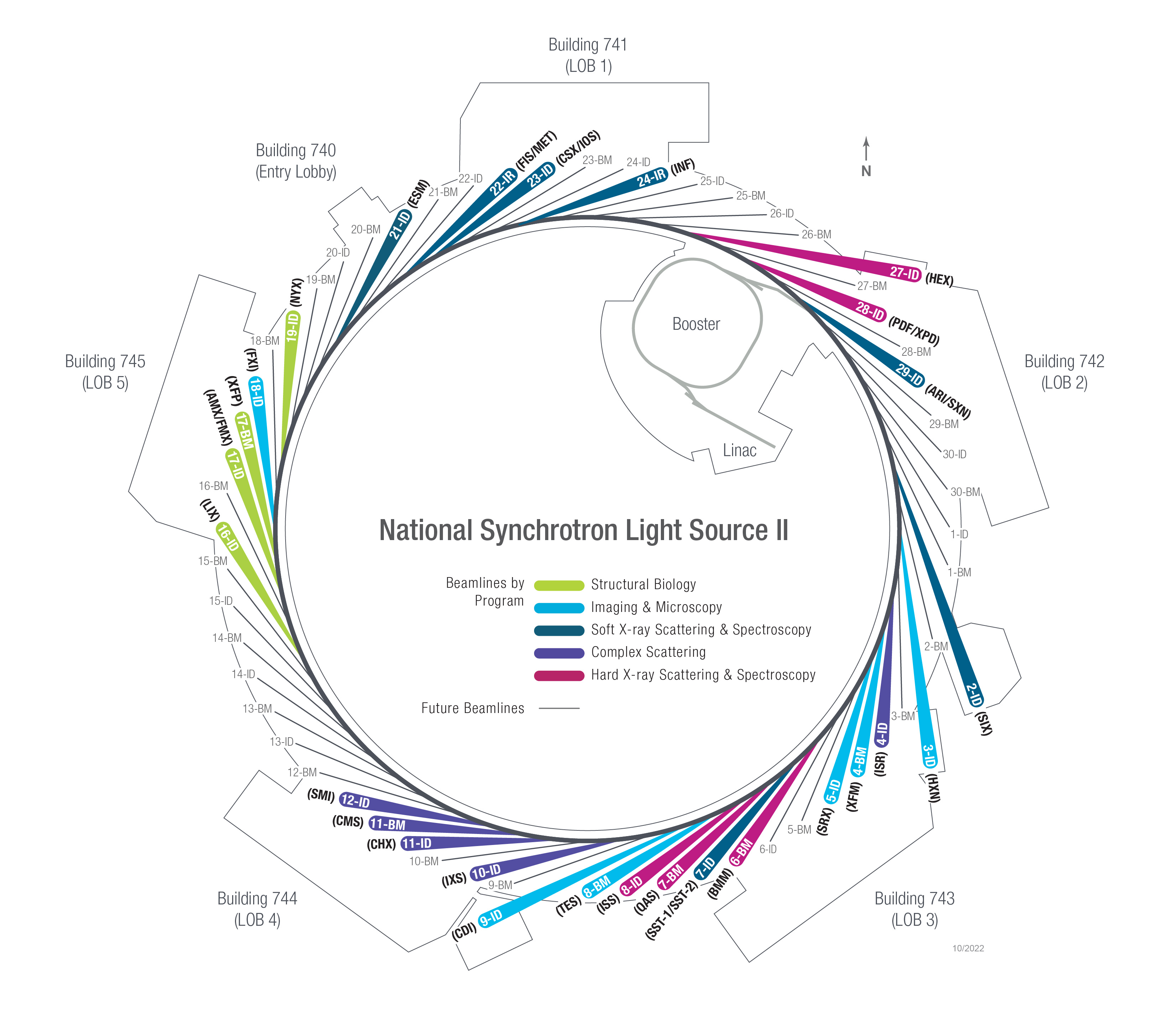
NSLS-II Beamline Portfolio
Soft X-Ray Scattering & Spectroscopy
2-ID: Soft Inelastic X-ray Scattering (2017)
7-ID-1: Spectroscopy Soft and Tender (2017)
7-ID-2: Spectroscopy Soft and Tender (2017)
21-ID: Electron Spectro-Microscopy (2017)
22-BM: Magneto, Ellipso, High Pressure IR (2018)
23-ID-1: Coherent Soft X-ray Scattering (2015)
23-ID-2:In situ and Operando Soft X-ray Spectroscopy (2015)
29-ID-1: Soft X-ray Nanoprobe (2025)
29-ID-2: ARPES and RIXS Imaging (2025)
Complex Scattering
4-ID: In-Situ & Resonant X-Ray Studies (2017)
10-ID: Inelastic X-ray Scattering (2015)
11-ID: Coherent Hard X-ray Scattering (2015)
11-BM: Complex Materials Scattering (2016)
12-ID: Soft Matter Interfaces (2017)
Hard X-Ray Scattering & Spectroscopy
6-BM: Beamline for Mater. Measurements (2017)
7-BM: Quick X-ray Absorption and Scattering (2016)
8-ID: Inner Shell Spectroscopy (2017)
27-ID: High energy Engineering X-ray scattering (2022)
28-ID-1: Pair Distribution Function (2017)
28-ID-2: X-ray Powder Diffraction (2015)
Imaging & Microscopy
3-ID: Hard X-ray Nanoprobe (2015)
4-BM: X-ray Fluorescence Microscopy (2017)
5-ID: Sub-micron Res X-ray Spec (2015)
8-BM: Tender X-ray Absorption Spectroscopy (2017)
9-ID: Coherent Diffractive Imaging (2025)
18-ID: Full-field X-ray Imaging (2018)
Structural Biology
16-ID: X-ray Scattering for Biology (2016)
17-ID-1: Frontier Macromolecular Cryst (2016)
17-ID-2: Flexible Access Macromolecular Cryst (2016)
17-BM: X-ray Footprinting (2016)
19-ID: Microdiffraction Beamline (2017)
24

Slide 4
Materials Microstructure with high-energy X-rays at NSLS-II

Slide 5
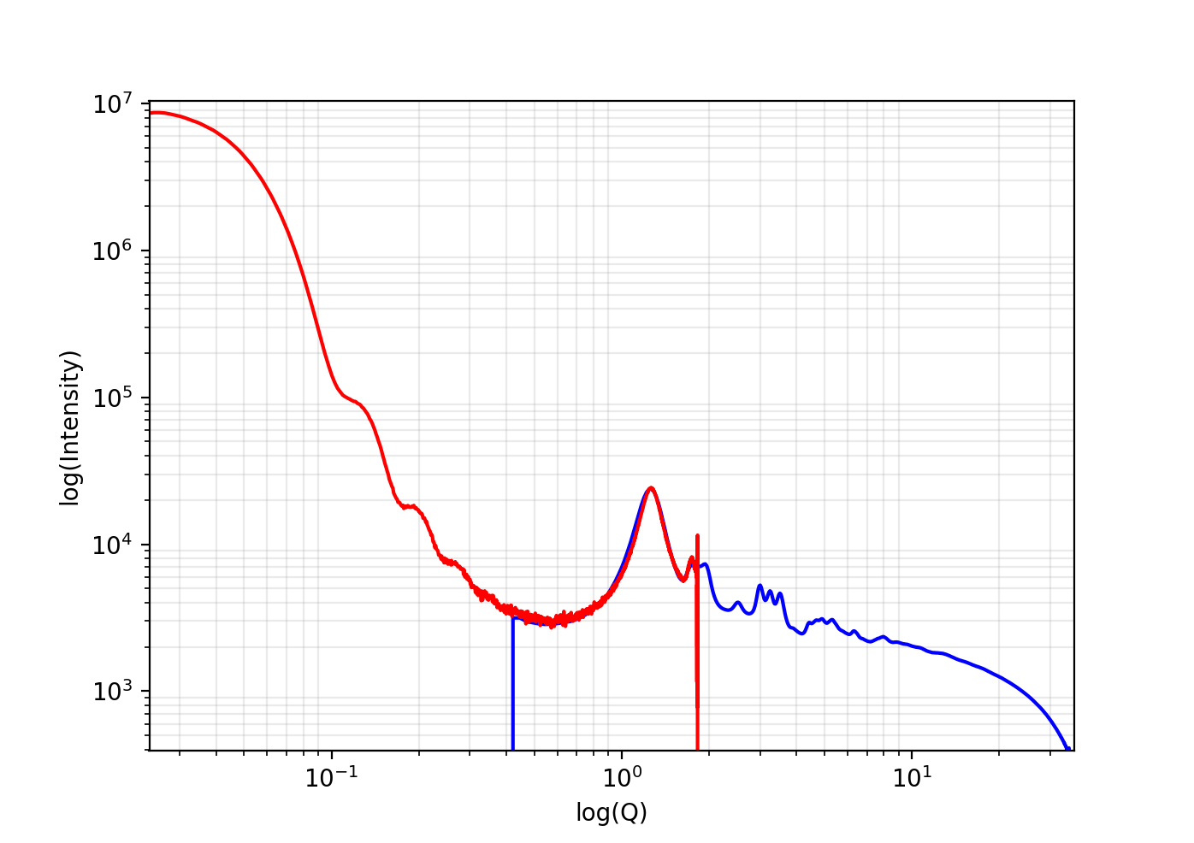
High Energy Diffraction Beamlines (XPD, PDF, HEX)
Monochromatic beam > 40 keV
mm³ sample, high Z
≤ 400μm @70keV for Pu as an example
≥ 0.3mm spatial resolution (beam size)
min to 0.1 sec
Combined XRD (μm), PDF (nm) and SAXS (100nm)
Diffraction mapping or 3D-CT with a 25µm focus
White beam (EDXD) up to 200 keV
Radiography (100 mm x 20 mm field of view with 1µm resolution)
SAXS + PDF Q range (0.023 - 28) Å⁻¹

Slide 6
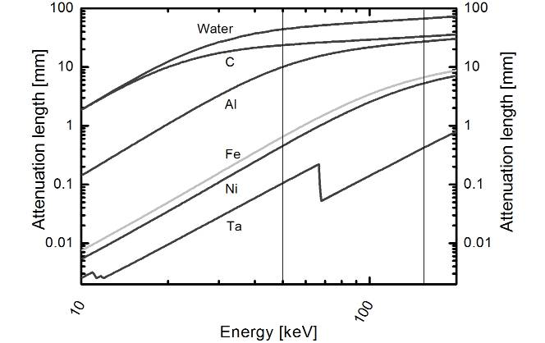
Transmission through dense material
40–150 keV
Metals and alloys: 0.1 mm – 20 mm
Ceramics: 1 mm – 50 mm

Slide 7
Use cases
phase ID (transformation, precipitation, diluted or impurity, …)
lattice parameters, unit cell volume
elastic lattice strain > 0.1%
planar faults, grain size, micro-stress, texture
disordered, amorphous, or nanocrystalline
high-throughput (a large number of measurements or samples)

Slide 8
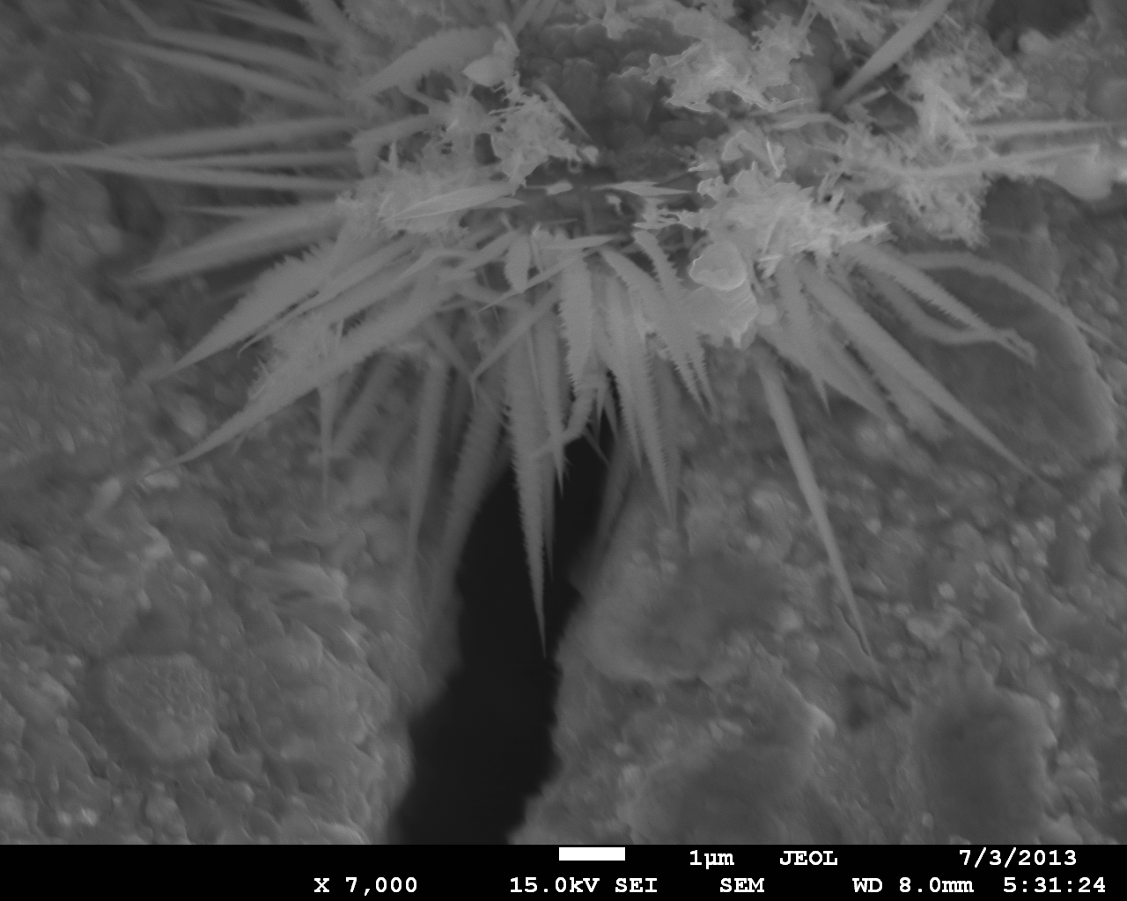
Nuclear Material Characterization Using High Energy X-rays at BNL Synchrotrons: From Reactor Steels and Molten Salts to Large Hadron Collider Novel Materials
Goal: flexibility in X-ray energies and techniques provides a reliable path in understanding phase evolution, precipitation, swelling, defect formation, and ordering within the irradiated material.
Applications: Studies on reactor-vessel steels and coatings, oxide-dispersion-strengthened copper alloys, super alloys, neutrino physics graphite targets, nuclear graphite and SiC, etc. following proton and fast neutron irradiation.
Here: Irradiated amorphous Fe-based nanostructured coating on steel using 120 MeV protons at BNL BLIP. Evidence of remarkable resistance to corrosion and to loss of ductility with increased fluence and temperature.
N. Simos et al. Synchrotron Rad. News, 32:6, 50 (2019)
Work performed at NSLS-II 28-ID (XPD)
Notes:
Nuclear Materials 489, 101016 (2017). doi:10.1016/j.jnucmat. 2017.03.030
A Nanostructured Iron-Alloy Coating Beefs Up Nuclear Steel | BNL Newsroom
Summary:
To extend the life of nuclear steels in the extreme environment of the next generation nuclear reactors, and in particular High-Temperature/Fast Neutron reactors, promising protective properties of nano-structured coatings such as resistance to ductility loss and corrosion/oxidation have been explored through fast neutron irradiation and aggressively corrosive environments. To achieve a comprehensive understanding of the evolution of the Fe-based nano-structure the macroscopically observed post-irradiation behavior required the understanding of phase evolution. X-ray diffraction studies coupled with electron microscopy and macroscopic studies revealed (a) the remarkable resistance to corrosion of the Fe-based nano-structure owed to the formation of the Fe₂B phase and the present alloying elements, (b) resistance to ductility loss due to radiation-induced excess free volume and (c) the amorphous character of the nano-structured coating following neutron irradiation.
Full Reference:
N. Simos, Z. Zhong, E. Dooryhee, G. Ghose, S. Gill, F. Camino, İ. Şavklıyıldız and E. K. Akdoğan, High-temperature annealing of proton irradiated beryllium - A dilatometry-based study J. Nucl. Mat. 489, 164-179 (2017). DOI: 10.1016/j.jnucmat.2016.04.001
Acknowledgement:
This research was supported by the DOE-NE (NEET) under contract No. CT-13BN040505. Research was carried out at the Brookhaven Linear Isotope Producer (BLIP) beamline, the Isotope Extraction Facility and in part at the Center for Functional Nanomaterials and National Synchrotron Light Source II, Brookhaven National Laboratory, which are supported by the U.S. Department of Energy, Office of Basic Energy Sciences, under Contract No. DE-SC0012704.

Slide 9
In Situ Testing of Materials with high-energy X-rays at NSLS-II

Slide 10
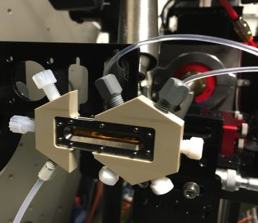
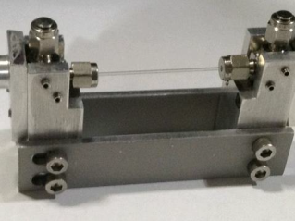
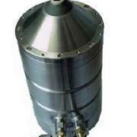
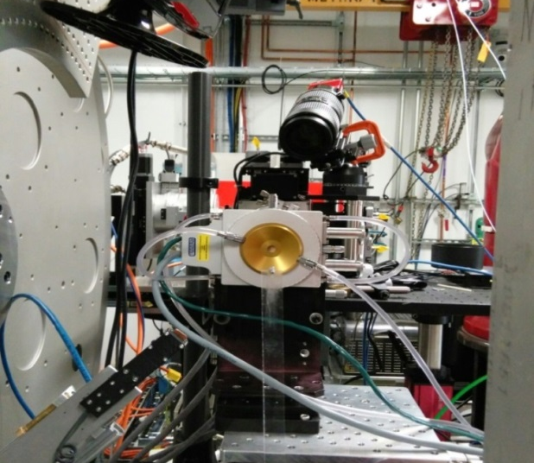
In Situ & Operando
Lamp furnace (RT- 1800°C)
Linkam flat plate furnace (RT- 1500°C)
Hot air blower (RT - 1000°C)
Coil heater ( RT-1200°C)
Gas flow capillary reactors with heaters
High pressure reaction cell (up to 400°C & 150 bar) (gas, liquid)
Cryostream (80K - 500K)
He cryostat (10K – 500K)
Multi-purpose cell (oxidative or corrosive gases, 3D stress, vertical and axial loads up to 20 lbs)
Microwave furnace
Electric Flash Sintering
Solution synthesis (e.g., colloidal)
Notes:
in situ and operando e.g., aging, load, fatigue, manufacturing
user-custom equipment e.g., milling, laser fusion, CVD, electrodeposition
gases: inert; H₂; CO; C₂H₆; CH₄; C₂H₄; O₂; CO₂

Slide 11
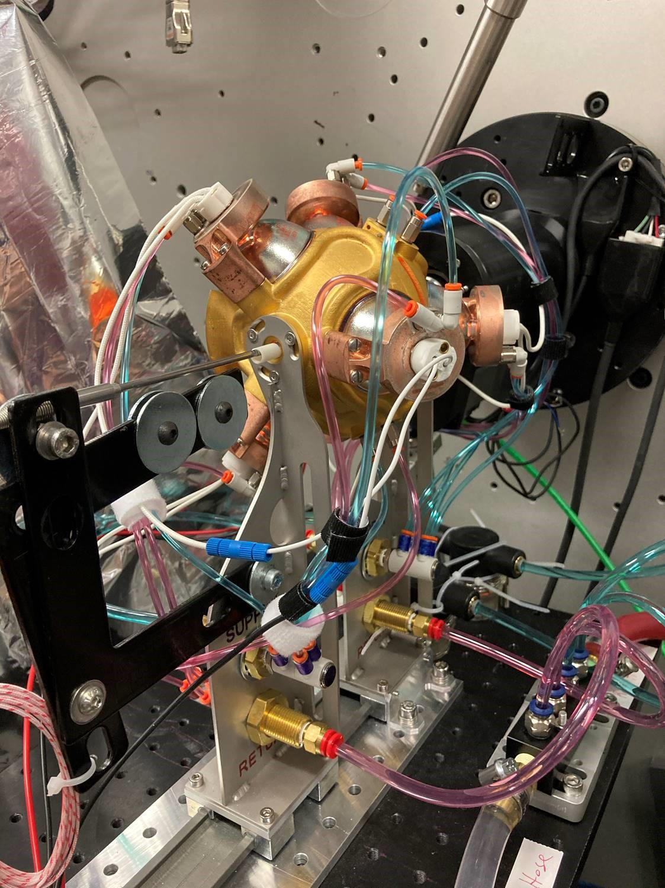
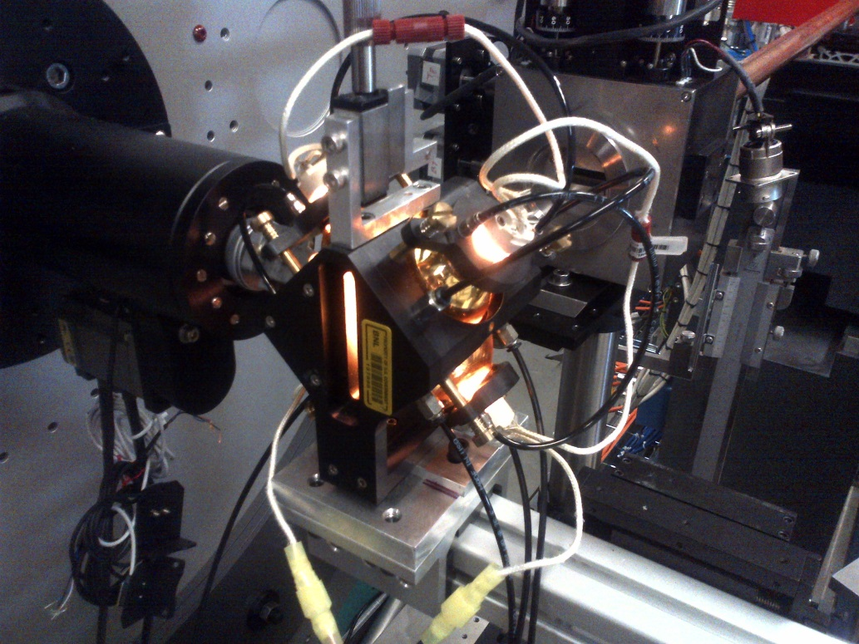
In Situ Testing of Materials
In-situ, high temperature oxidation studies of HfB₂ composites using a quadrupole lamp furnace.
P. Sarin, Univ. of Oklahoma
In-house development of an hexapole furnace (S. Ghose and team)

Slide 12
Material Processing (sintering) under Electric Field
Stage 1
Stage 2
Stage 3
Goal: fast and energy-efficient solid-state synthesis of dense, single phase ceramic materials (i.e., ∼1 min/900 °C, instead of 2 hours/1,550 °C).
Method: spinel formation (S) is being tracked during reactive flash sintering of (A + M):
Al₂O₃ + MgO → MgAl₂O₄ (catalyzed by YSZ)
Here: the reaction proceeds through an incubation stage, before the onset of a rapid, nonlinear increase of the current flowing through the specimen under constant applied voltage. Whole process takes ≤ 50s (200 ms/image).
B. Yoon, S. Ghose S, R. Raj. J. Am. Ceram. Soc. 2019 and Scripta Mater. 2021. Work done at XPD.

Slide 13
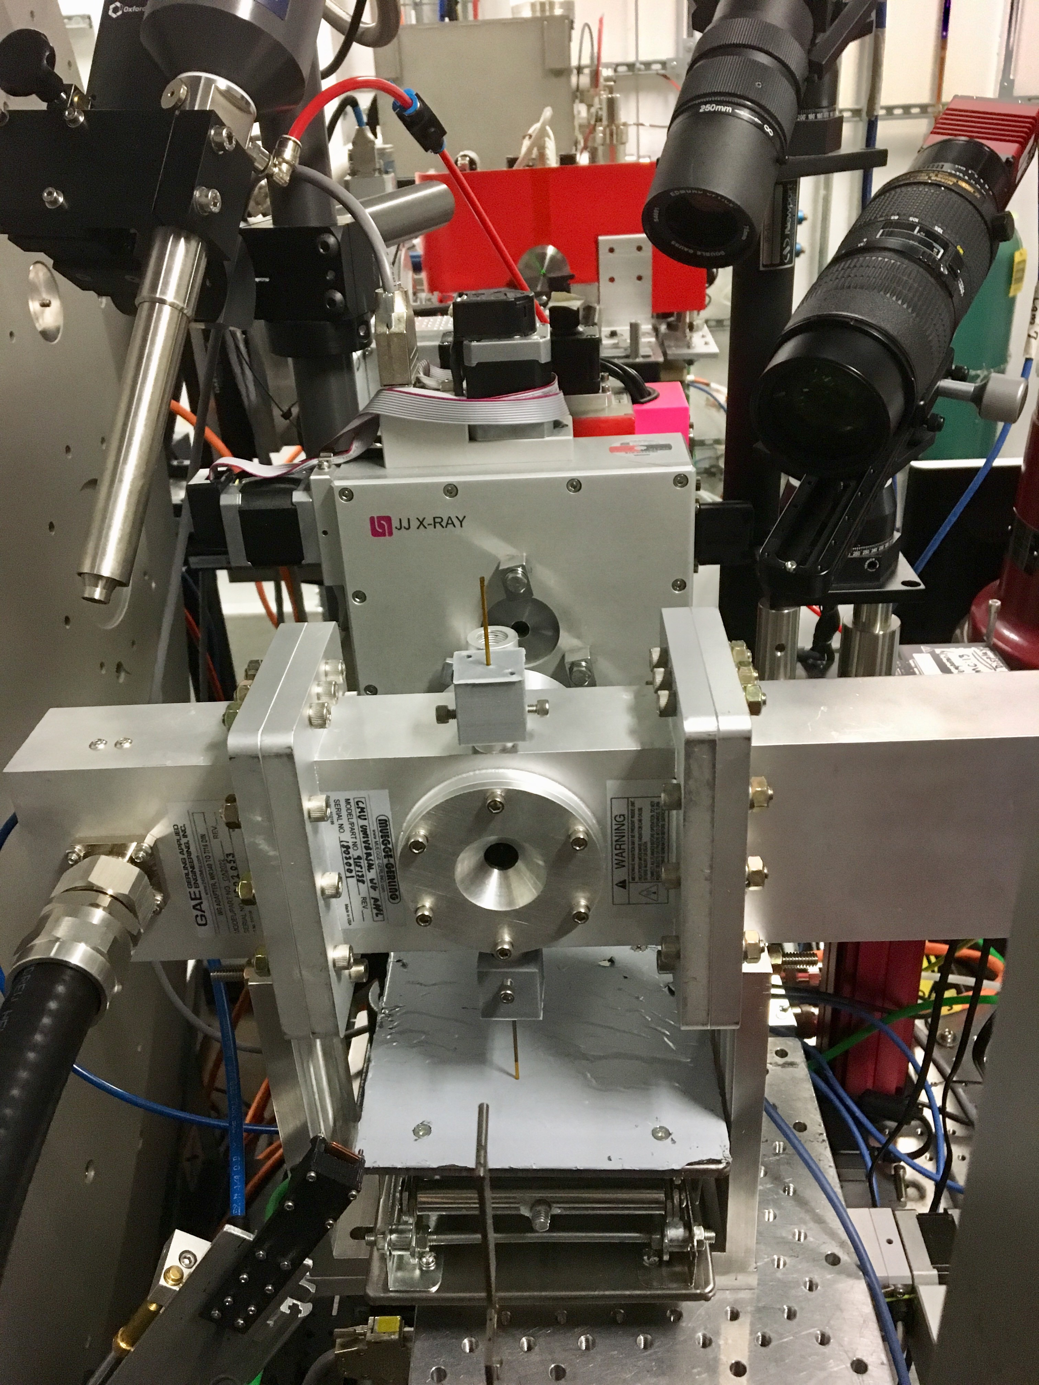
Material Processing under an ElectroMagnetic Field
Goal: establish a novel method for rapid, single-step, low temperature (< 200 °C) synthesis compared to other syntheses (solid state > 750 °C >10 hours, in solution, hydro-solvo-thermal):
Ni1/3Mn1/3Co1/3(OH)2 + LiOH → LiNi1/3Mn1/3Co1/3O2
Method: monitoring the structural and morphological evolution during the out-of-equilibrium Micro-Wave Radiation assisted reaction.
Here: the synthesis of the layered end-product is complete in 4 min around 160 °C (as opposed to calcination at 1,000 °C for hours).
M.J. Zhang, F. Wang, J. Bai et al., Sci. Adv. 6 (2020) Work done at 28ID (XPD)
Commercial MW reactor (2.45 GHz, 160 ºC, 40 W)

Slide 14
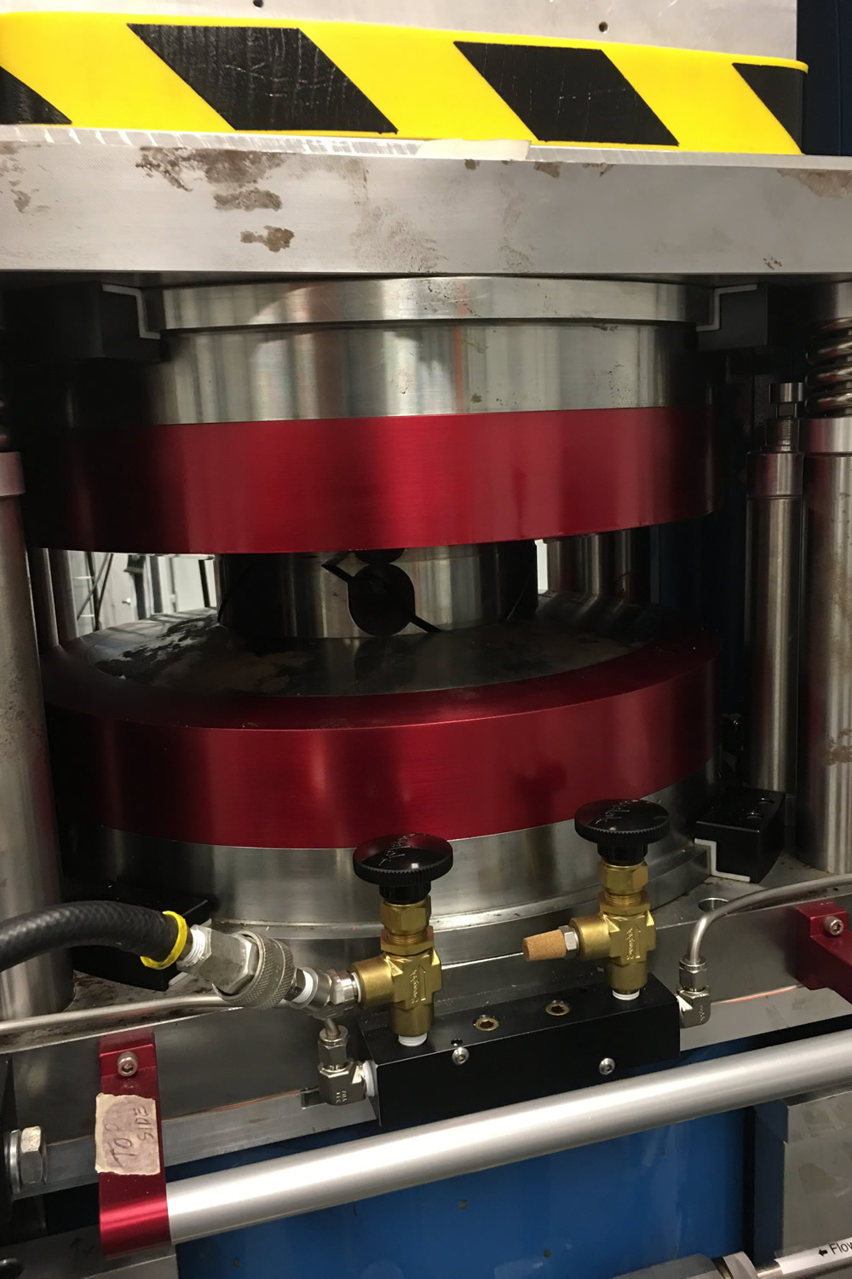
Material Processing under Extreme Pressures/Temperatures
Goal: search for new topologically non-trivial materials, i.e., with a band structure that forces transport into specific or directional paths.
Method: employ a high-pressure flux synthesis method.
Here: discovery of Ni₃Pb₂, the first structurally characterized binary phase in the Ni–Pb system.
A. Tamerius et al. J. Am. Chem. Soc. 144, 11943 (2022)
Initial mix of Ni & Pb taken to high P and T (~9 GPa, 1200 K). Pb melts out, Ni₃Pb₂ forms; remaining liquid Pb crystallizes when quenched. Sample is recoverable at room conditions and studied postmortem.
M. Whitaker. Multi-anvil setup at the NSLS-II (MAXPD)
COMPRES

Slide 15
In-situ Imaging with high-energy X-rays at NSLS-II

Slide 16
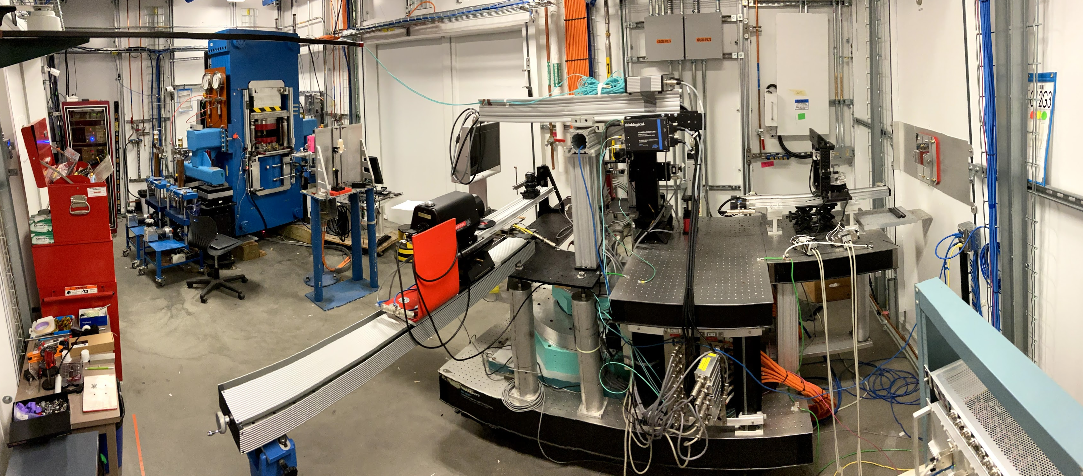
X-ray Synchrotron Diffraction CT
Lynne Ecker
Simerjeet Gill
David Sprouster
Mehmet Topsakal
SEM image of U-10Zr sliver samples
Sliver sample on its custom sample holder
Diffraction 2D mapping or in CT mode:
Beam size down to 25 µm
Flat panel detector 26 fps - Qmax = 12 A⁻¹
Imaging radiography or in CT mode:
Field Of View = (2mm)²
80 fps. Resolution = 6 μm
Chemical mapping
Fluorescence mode is being tested

Slide 17
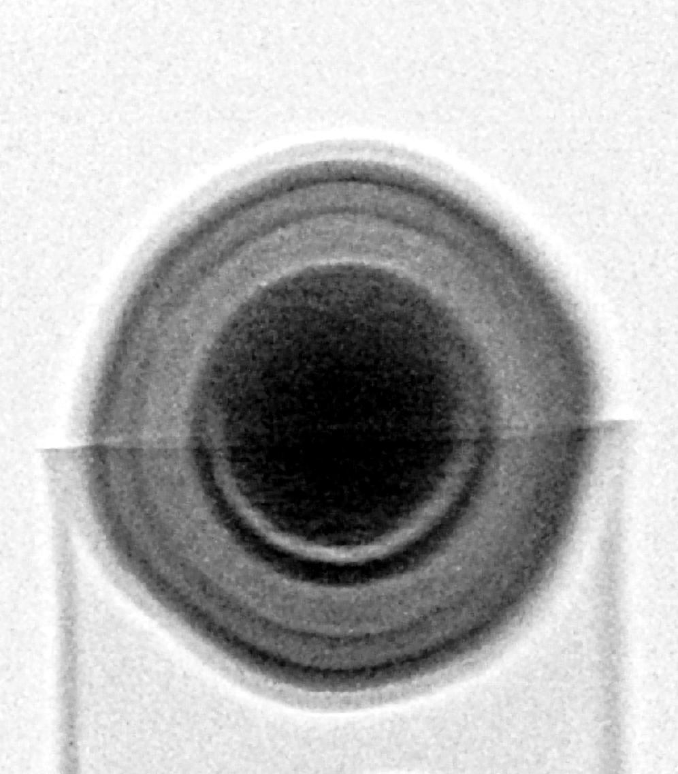
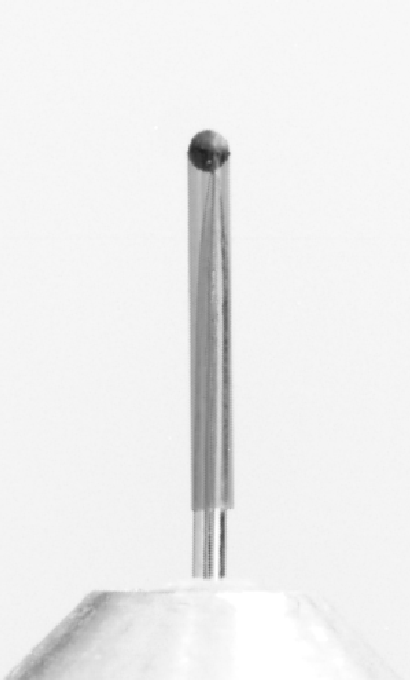
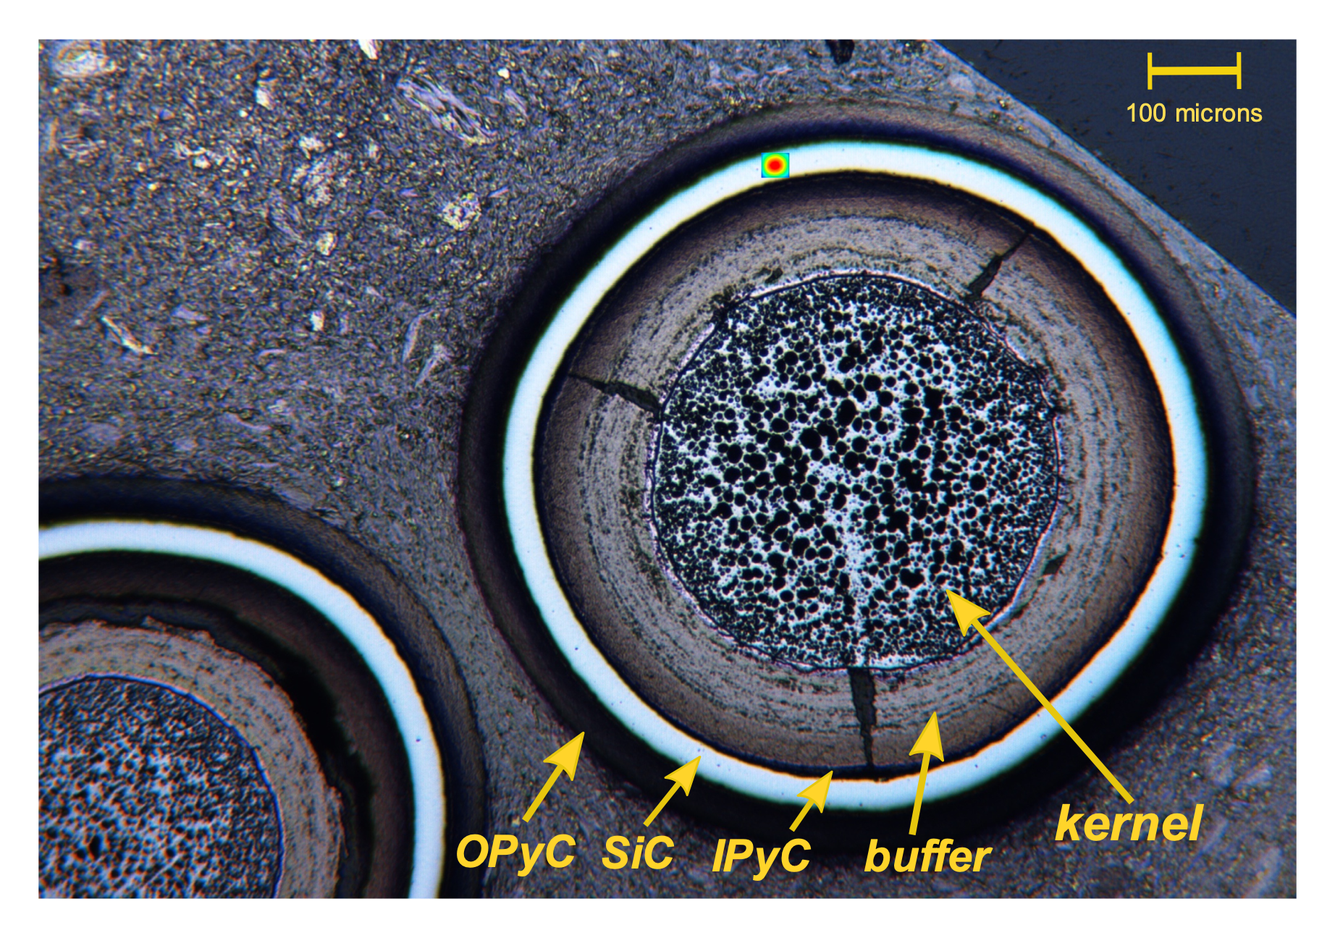
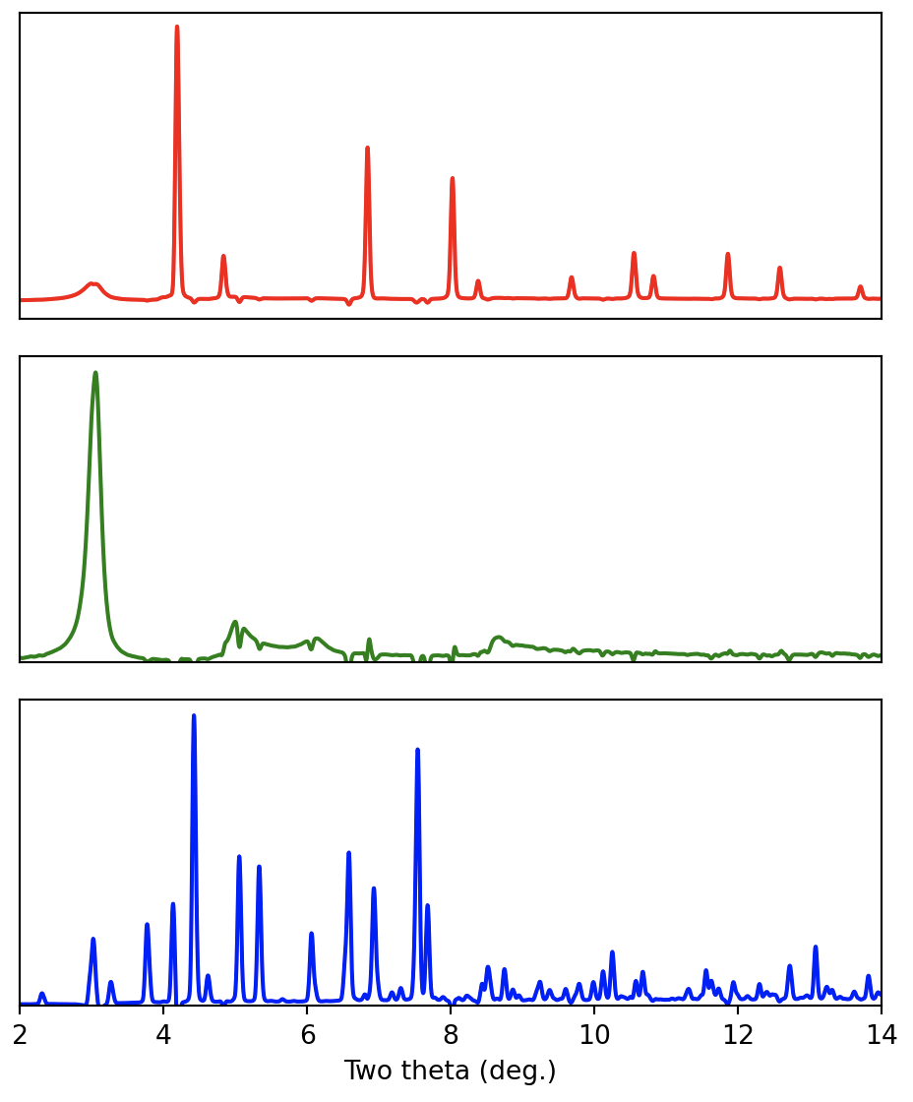
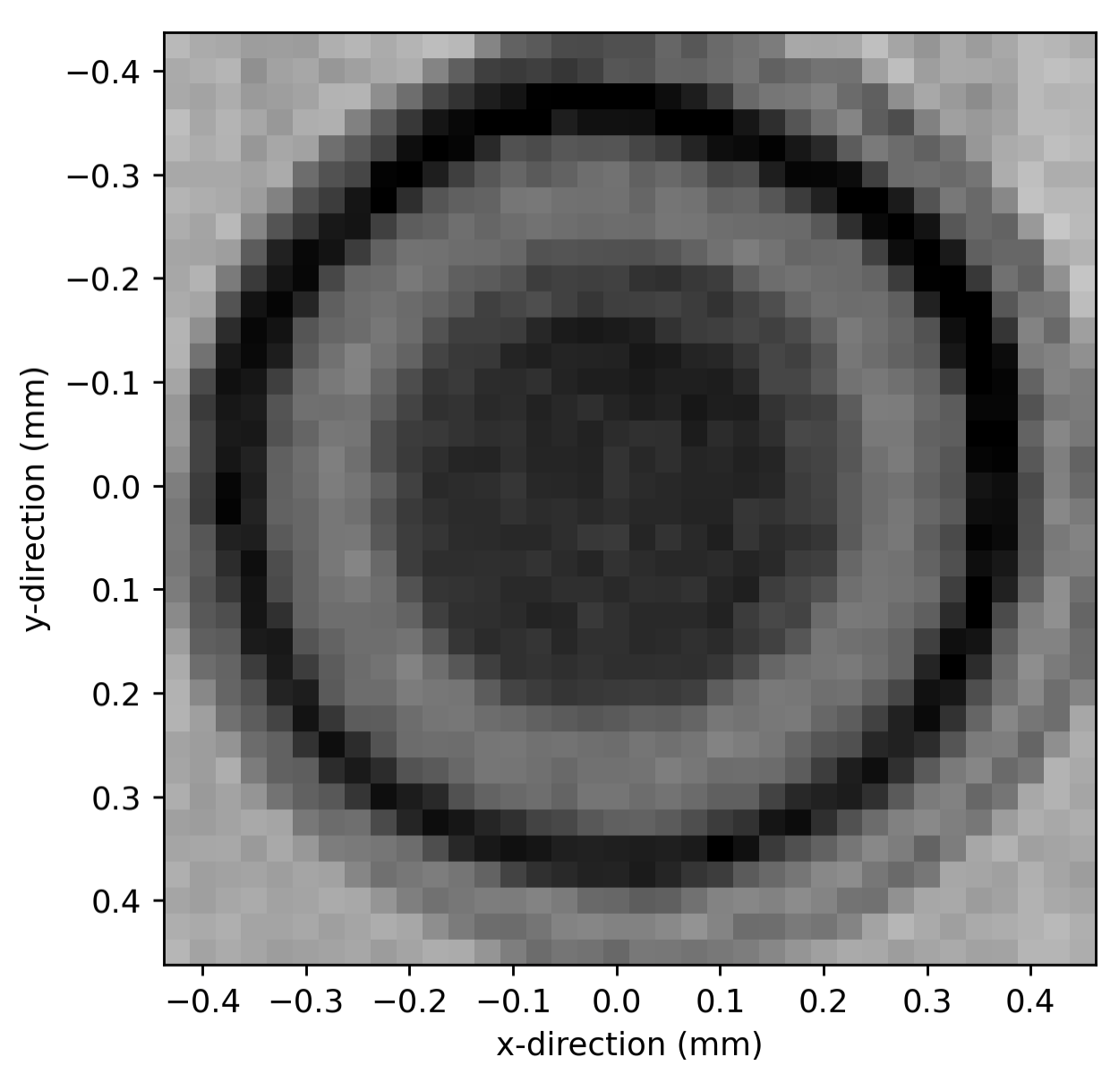
OPyC layer
B)
A)
SiC layer
IPyC layer
Goal: non-destructive examination of an encapsulated nuclear fuel particle (TRISO, spherical).
Method: absorption contrast (full-field radiography) and phase imaging (XRD-CT, 25 μm beam).
Here: A) surrogate particle; B) full-field image (6 μm resolution); C) diffraction CT in the equatorial plane reveals the 0.5 mm-OD kernel (HfO₂), the buffer and the ceramic encapsulation.
Courtesy of M. Topsakal (BNL) and M. Nedim Cimbiz (INL)
Buffer layer
Kernel (HfO₂)
Possible defect
XRD pattern from SiC layer
XRD pattern from buffer layer
XRD pattern from kernel
X-Y plane
X-Z plane
C)
D)

Slide 18
HEX: mono/white beam Imaging and Diffraction
Goal: track the evolution of an engineering material under real conditions both at the micrometer and nanometer scale.
Method: sees density contrasts > a few % such as precipitates, bubbles or cracks
perfectly suited for operando studies on integrated components (batteries, tension rigs, reactors, corrosion, explosion chambers,…)
Here: In situ X-ray imaging of defect and molten pool dynamics in laser additive manufacturing
C. L. A. Leung et al., Nat. Comm. 9, 1355 (2018) Work done at the Diamond Light Source
Notes:
https://www.nature.com/articles/s41467-018-03734-7#Sec13
video

Slide 19
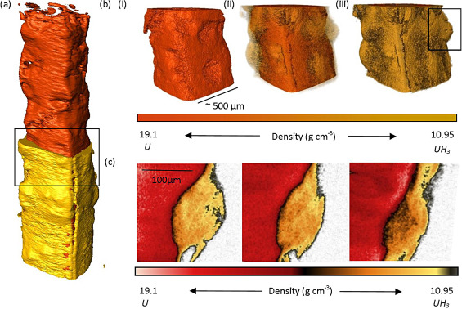
Combined Tomography and Powder Diffraction of Uranium encapsulated in Grout
Goal: safe long-term management of uranium-bearing intermediate level waste. U + 2H₂O → UO₂ + 2H₂ and U + 3H₂ → 2UH₃
Method: XRT and XRPD can distinguish uranium metal from its associated corrosion products, without breaking the grout containment.
Here: 3D reconstructions of the grout-encapsulated uranium sample before, and after, deliberately constrained H₂ corrosion. Uranium in orange, and a mixture of UO₂ and UH₃ in yellow.
C.A. Stitt et al. Journal of Hazardous Materials,
285, 221 (2015).
Work performed at the Diamond Light Source

Slide 20
Multimoal Approach

Slide 21
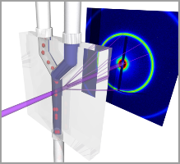
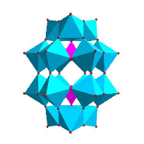
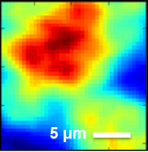
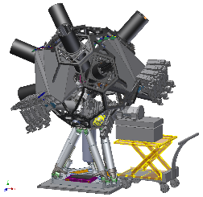
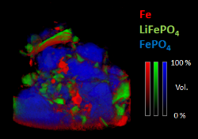
Synchrotron Analysis for Materials Science
Scattering
Diffraction
Spectroscopy
Imaging
Structure
Chemistry
ISS
Morphology
XPD
CMS
FXI
ISR
SRX
PDF
HXN
(ISS): Inner Shell Spectroscopy
(XPD): X-ray Powder Diffraction
(SRX): Sub-micron Resolution X-ray Spectroscopy
(PDF): Pair Distribution Function
(XPEEM): X-Ray Photoemission Electron Microscopy
(CMS): Complex Materials Scattering
(HXN): Hard X-ray Nanoprobe
(ISR): In-Situ & Resonant X-Ray Studies
(FXI): Full-Field X-ray Imaging
Courtesy: G. Halada, Stony Brook

Slide 22
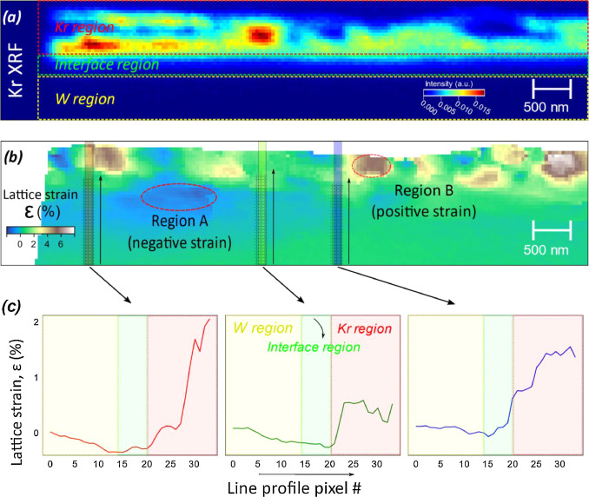
Sub-20nm X-ray Mapping of a Single Crystal W irradiated by MeV Kr particles
Goal: microstructural and strain evolutions induced by noble gas ions in a nuclear fuel matrix or in plasma-facing materials
Method: spatially resolved (~12 nm) 2D X-ray fluorescence and diffraction maps.
Here: (a) Kr XRF map of a Kr-irradiated single crystal showing Kr-irradiated, interface and pristine regions. (b) Strain maps from nano-diffraction imaging. (c) variation of strain across the W, interface and Kr irradiated region.
S. Gill et al. Scripta Materialia,188, 296 (2020)
Work performed at NSLS-II 3-ID (HXN)
Notes:
Irradiation, especially at very high doses, can cause bubble formation and growth leading to voids, and eventually blistering, which can alter the residual stress and strain field in the material significantly, thereby impacting performance
peak concentration of Kr is between 300 and 400 nm
spatially resolved (~12 nm) 2D X-ray patterns as function of depth
a series of 2D imaging as a function of the rocking angle of the sample
- The structure becomes porous-like due to the formation of large voids and Kr containing cavities which are commonly formed in materials under high temperature irradiation environments. Such voids are formed from the agglomeration of mobile vacancies and evolve with the absorption and emission of vacancies or self-interstitials atoms (SIA) at the irradiated surface region
- formation of grain boundaries in the region of maximum damage interface region is observed (Fig. 2a) and is indicative of the recrystallization expected during high temperature irradiation.
- Severe degradation of crystallinity is pronounced in the Kr irradiated region which can be observed in the diffuse X-ray peaks

Slide 23
Self-assembly of solid Nanoclusters in Mo under Kr gas Ion Implantation
Goal: microstructure of a nuclear reactor material exposed to fission gases, toward the development of radiation-tolerant materials.
Method: XANES shows the formation of a solid nanocluster superlattice in molybdenum.
Here: The “white line” and oscillations (solid blue) clearly indicate that the Kr atoms in the NCs in Mo are solid. The internal pressure of Kr clusters is derived from a comparison with literature data (dashed curves). A comparison of experimental and DFT simulated Kr K-edge XANES spectra at 2 GPa in Mo.
Cheng Sun et al. Scripta Materialia 194, 113651 (2021)
Work performed at NSLS-II 8-ID (ISS)
Notes:
formation of a solid nanocluster superlattice in molybdenum, an important constituent in metallic fuels, under krypton gas ion implantation.
self-assembly of fission gas bubbles in metallic fuels under neutron irradiation could cause the formation of krypton (Kr) and xenon (Xe) superlattice, which is a highly efficient mechanism for gas storage under irradiation.

Slide 24
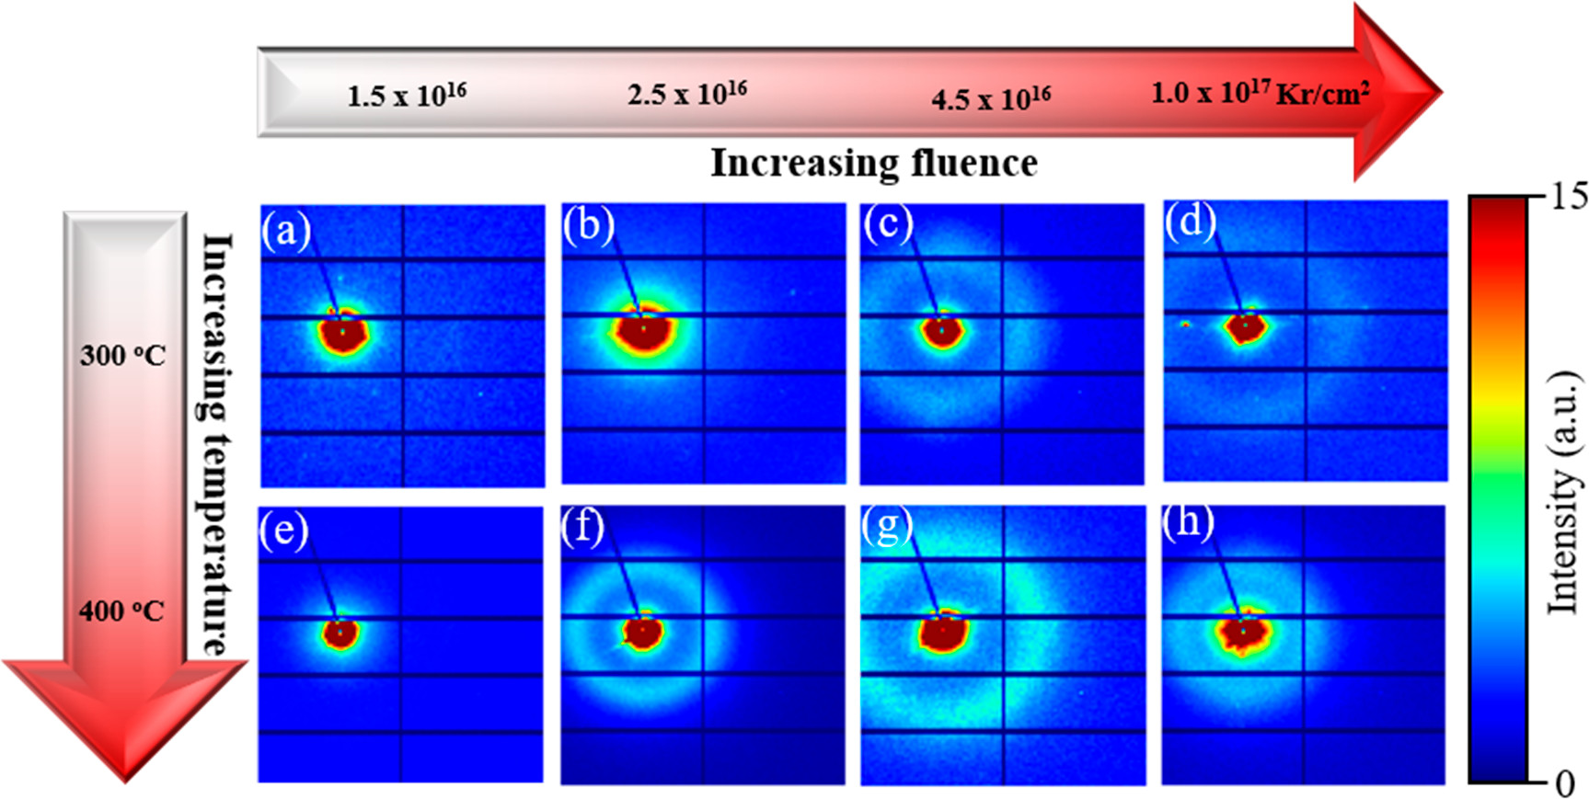
Early-Stage Ordering of Krypton Solid Bubbles in Molybdenum
Goal: describe the self-assembly of fission gas bubbles in metallic fuels under neutron irradiation.
Method: 2D SAXS patterns of implanted Mo after exposure Kr irradiation at 300°C and 400°C.
Here: the diffuse diffraction peaks in the SAXS patterns and TEM observations are suggestive of an early stage of Kr self-organization and ordering in the bubbles.
E. Jossou et al. J. Phys. Chem. C 125, 23338 (2021)
Work performed at NSLS-II 16-ID (LIX)
Notes:
Self-organization of defects such as fission gas bubbles in materials

Slide 25
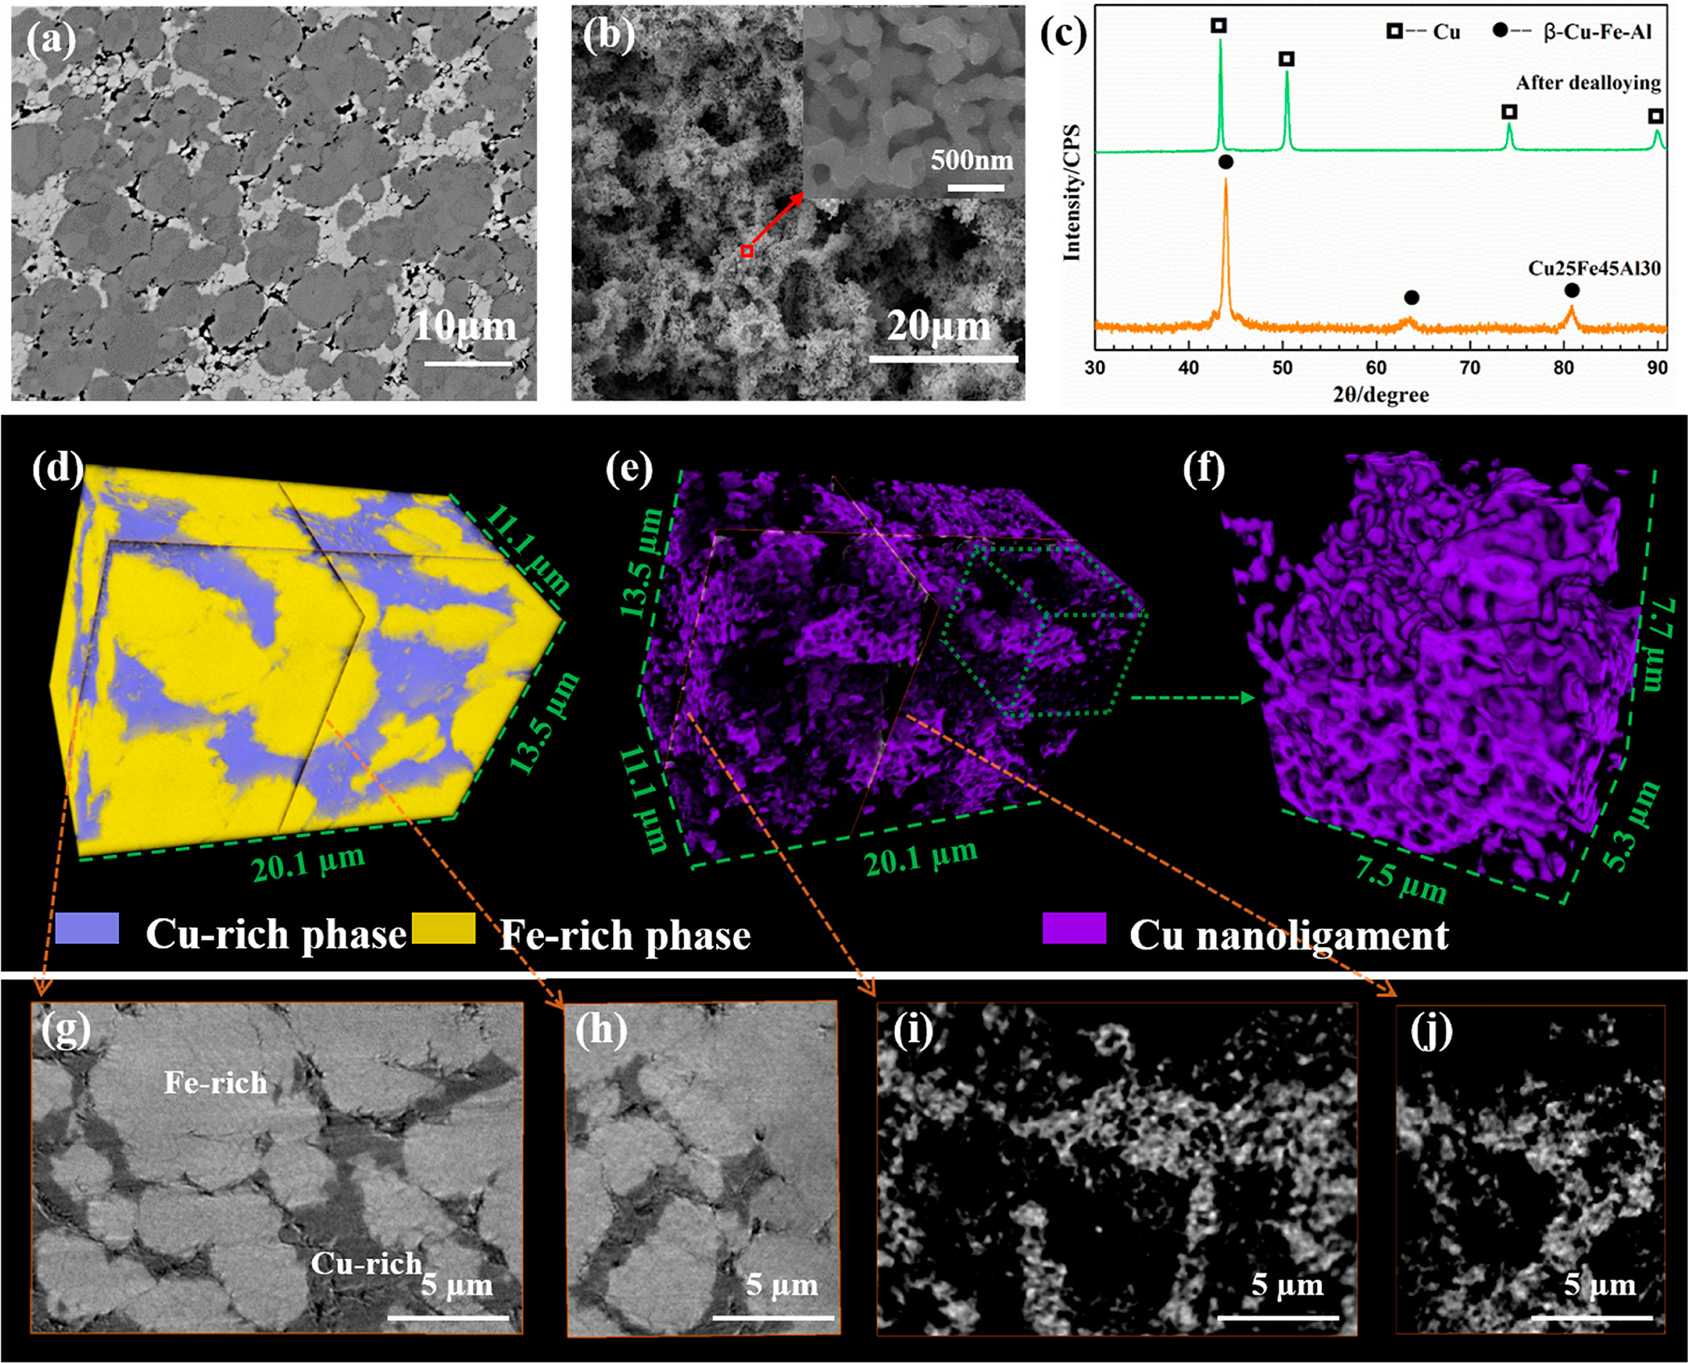
3D Morphological Evolution Mechanism Revealed via X-ray tomography with sub-50 nm spatial resolution
Goal: fabrication of multiscale, bimodal porous copper from simple dealloying of Cu–Fe–Al ternary alloy for enhanced chemical properties and long-range diffusion through the pores.
Method: multiscale pore formation and tortuosity during dealloying visualized with in situ X-ray nano-tomography. Incident X-ray energy was tuned above and below Cu and Fe absorption K-edges (FOV 43 μm × 36 μm, pixel size of 34 nm)
Here: Microstructure, phase composition (XRD) and 3D morphology (tomo) of Al₃₀Fe₄₅Cu₂₅ alloy before and after dealloying. Results show the formation of porous Cu with both micron-sized pores and nano-sized pores.
L. Zou et al. ACS Appl. Mat. Interfaces 12, 2793 (2020)
Work performed at NSLS-II 18-ID (FXI)
Notes:
Microstructure, phase composition and 3D morphology of Al30Fe45Cu25 precursor alloy and its corresponding fully dealloyed, bimodal porous Cu from dealloying the precursor alloy in 5 wt % H2SO4 aqueous solution at 90 °C. SEM images showing surface microstructure of (a) Al30Fe45Cu25 alloy precursor and (b) corresponding bimodal porous. (c) XRD diffraction pattern. X-ray nano-tomography reconstruction showing the 3D morphology: (d) Al30Fe45Cu25 alloy, (e) bimodal porous Cu with micron- and nano-sized porous; a zoom-in view of the nanoporous structure is shown in (f). Pseudo cross-section images from X-ray nano-tomography for both (g-h) the pristine and (i-j) bimodal porous Cu, imagined at above Cu K-edge, where the X-ray attenuation of the Cu-rich phase is significantly increased, so that the contrast between the Fe-rich and Cu-rich phases can be enhanced.

Slide 26
Hazardous Materials

Slide 27
Handling Radioactive Materials
Property Protection Area (PPA)
Robotic Sample Manipulator
Double- or triple-containment (nested holders)
Authorized total dose 0.1 rem/h at 30 cm
Special Nuclear Materials (SNM), such as Highly Enriched Uranium (HEU) samples
…
Notes:
D.J. Sprouster, R. Weidner, S.K. Ghose, E. Dooryhee, T.J. Novakowski, T. Stan, P. Wells, N. Almirall, G.R. Odette, L.E. Ecker, “Infrastructure Development for Radioactive Materials at the NSLS-II,” Nuclear Inst. and Methods in Physics Research, A 880 (2018) 40–45. https://www.sciencedirect.com/science/article/pii/S016890021731135X

Slide 28
Partnership with NSUF and BNL Nuclear Science and Technology
Notes:
More information on NSUF and their supported research activities can be found at: Nuclear Science User Facilities (NSUF) 2017 Annual Report: https://nsuf.inl.gov/documents/flipbook/index.html?page=1

Slide 29
Use cases
Materials for Advanced Nuclear Reactors
e.g. n-irradiated SiC under stress (accident tolerant fuel cladding)
Metallic Fuels
e.g. U-Zr and U-Mo at low burnups/fluences
Ni-Cr-Fe Structural Alloys (service lifetime)
Encapsulation of nuclear waste (glasses and ceramics)
…
BNL Nuclear Science & Technology Department

Slide 30
AI/ML tools

Slide 31
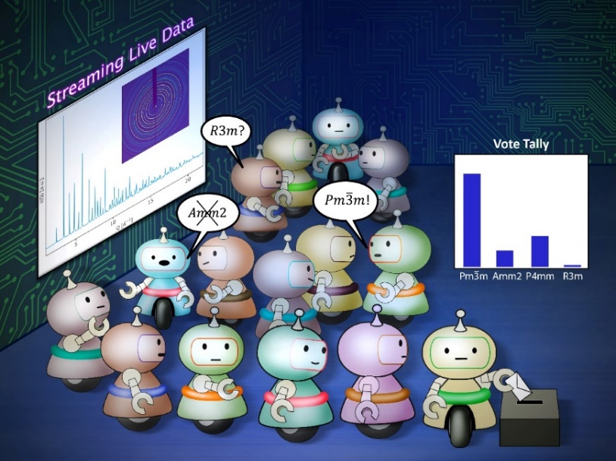
AI and Automation as Beamline Assistants
Automation of data collection
Sanity-checks on data
Adaptive/smart scans to focus on features-of-interest during scans.
Fast on-line classification/prediction tool to assist decision making
An artificial intelligence (AI) ensemble is pre-trained on a materials structure database and enables the autonomous recognition of XRD/PDF data
Accelerate analysis to match speeds of data collection at modern beamlines.
An ensemble of AI agents observes streaming XRD data, argues amongst itself, ultimately votes to classify potential material structure solutions and establishes uncertainty on the predicted crystal models.
Maffettone, P.M., et al. "Crystallography companion agent for high-throughput materials discovery." Nat. Comput. Sci. 1, 290-297 (2021)
Maffettone, P.M., et al. "Gaming the Beamlines - Employing Reinforcement Learning to Maximize Scientific Outcomes at Large-Scale User Facilities“ MLST 2, 025025 (2021).

Slide 32
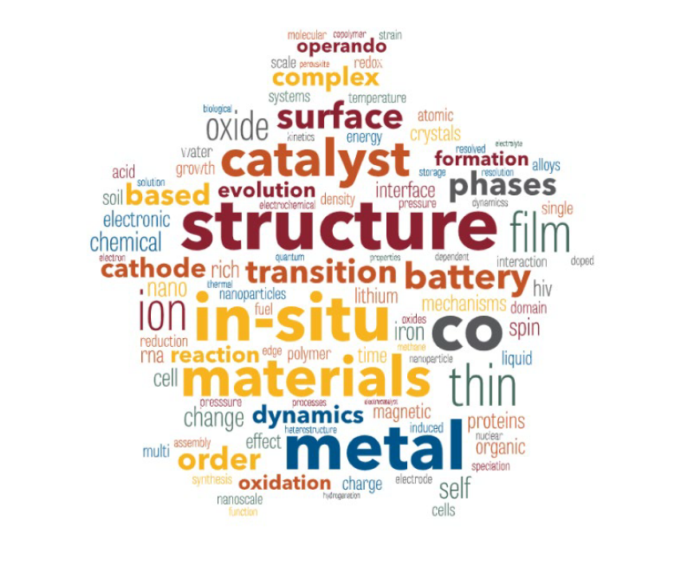
Conclusion
NSLS-II offers a comprehensive suite of complementary techniques - enabling time-resolved, operando, multi-modal and multi-dimensional studies
Beams at photon energies (up to 150 keV) and spatial resolutions (nm-µm-mm) can be tailored to irradiation depths and from the atomic to mesoscopic scales.
Expertise and provision for developing specialized in-situ experimental systems and sample environments for the RaDIATE Community.

Slide 33
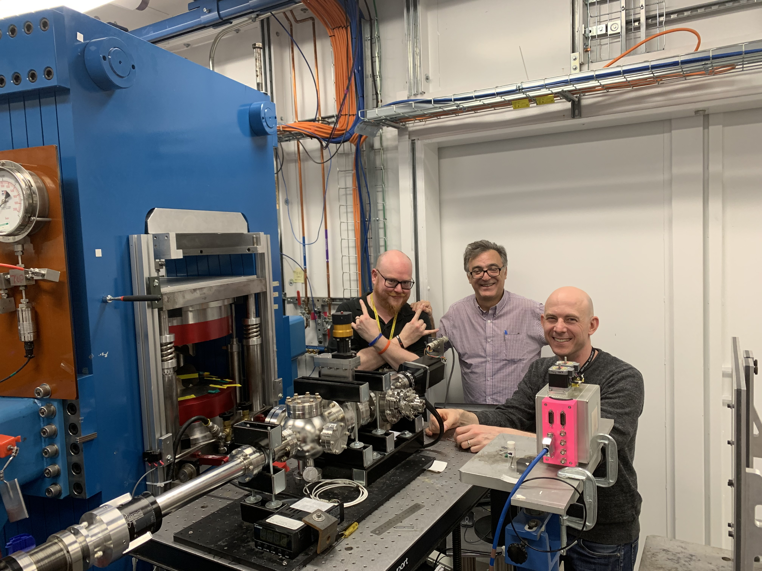
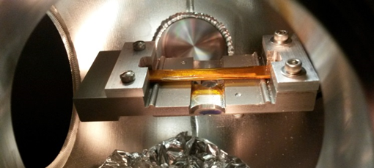
N. Simos at the XPD beamline of NSLS-II
in-situ, multidirectional state of stress with real time thermal annealing
1 atm for oxidation or corrosion
up to 1100°C
4-point bending and/or axial + twist (max vertical and axial loads are 20 lbs)

