Slide 1
The Proposed High Energy Effects Test Facility at Brookhaven National Laboratory
Kevin A. Brown, brownk@bnl.gov
Brookhaven National Laboratory, Upton, NY 11973, USA
ECE Dept., Stony Brook University, Stony Brook, NY 11794, USA
30 June 2023 RaDIATE Collaboration Meeting

Slide 2
Short history
~2011 – demand for electronics testing at NSRL, outside of normal NASA program
May 2020 – request for cost estimate for an AGS facility
2021 – working on Program Development funds, worked with MDA/DoD to develop KPPs for HEET (came up with HEET name at that time)
MDA/DoD is strongly interested. In 2022 DoD set aside funds for building a high energy facility (a few options + AGS).
MDA/DoD allocated funds to perform design study (not yet released)
6/2023 – MDA/DoD is conducting a requirements study prior to seeking proposals

Slide 4
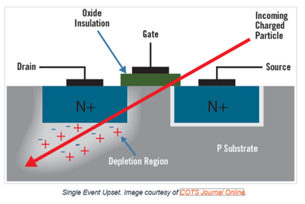
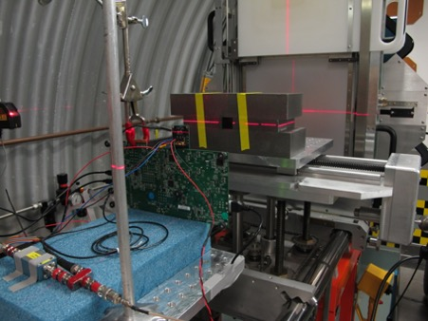
HEET
SEE = Single Event Effects
Notes:
This picture does not delineate between low and high energy test demands. Current capacity is mostly (90%) low energy. Future demands (40%) require high energy (>100 MeV/n).

Slide 5
The AGS is capable of going as high as > 10 GeV/n.
No users envision going this high, so current stakeholders specify that 2500 MeV/n is sufficient. However, future upgrades would only require modifying part of the external beamline and adding a second one.
Note:
FRIB/MSU < 100 MeV/n
HEET: 40 - 2500 MeV/n
https://nscl.msu.edu/users/beams.html

Slide 6
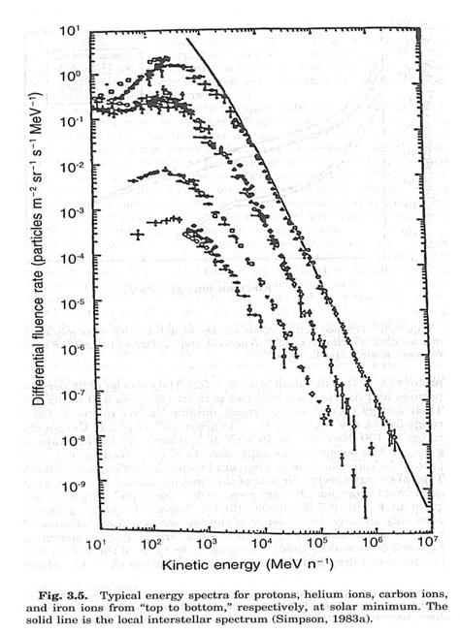
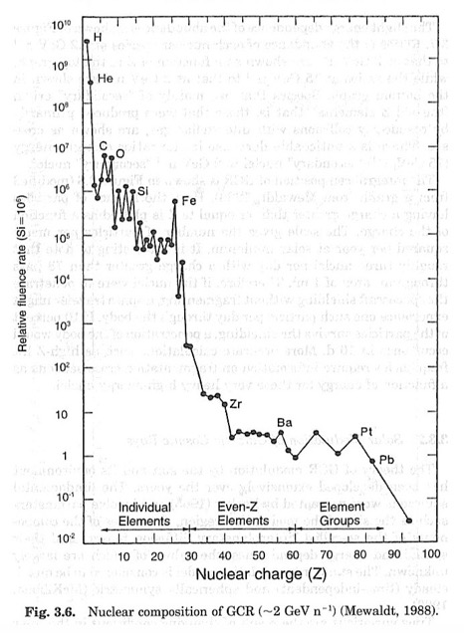
Space Weather
AGS Max.
H
On a Pleasant “day” in space.
Charged Ionizing Radiation
Outer-Space is full of them
Solar Particle Events
Trapped protons in Van Allen Belts
Galactic Cosmic Radiation
He
C
Fe
HEET
Figures reproduced from:
Mewaldt, R.A., "Elemental Composition and Energy Spectra of Galactic Cosmic Rays”, Interplanetary Particle Environment, JPL Publications 88-28, edited by J.~Feynman and S.~Gabriel, NASA Jet Propulsion Laboratory, Pasadena, CA, 1988
Simpson, J.A., "Elemental and Isotopic Composition of the Galactic Cosmic Rays”, Annual Reviews of Nuclear and Particle Sciences, Vol. 33, 1983, p.706
NSRL

Slide 7
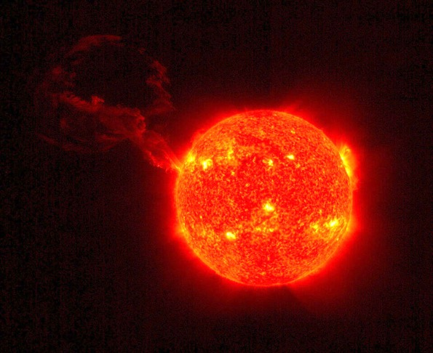
Solar Proton Events = Coronal Mass Ejections
Trapped protons in Van Allen Belts cover same energy range

Slide 8
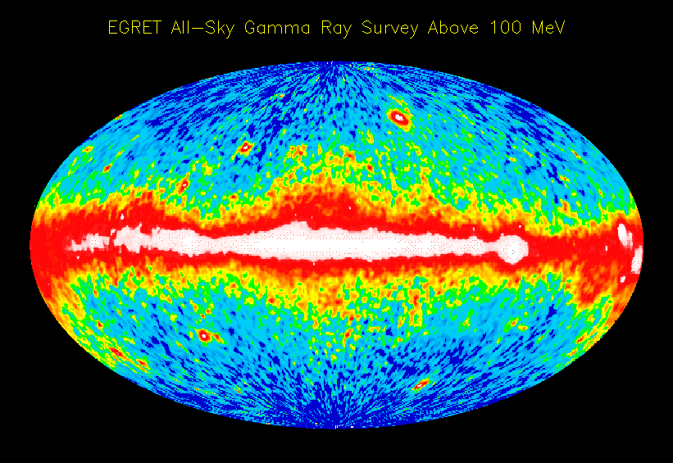
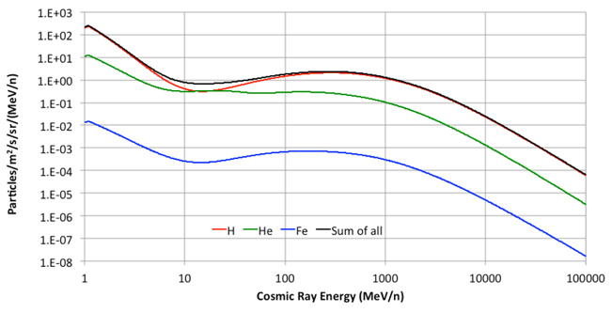
Galactic Cosmic Rays = HZE Particles
Spectra* for H, He, Fe and sum of all ions in vacuum of space
EGRET Team
*from Creme96 simulation at Geosynchronous Earth Orbit

Slide 9
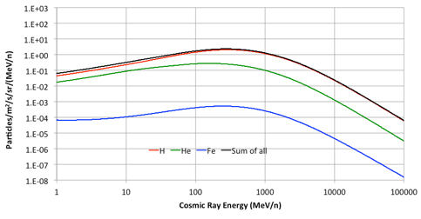
Galactic Cosmic Rays = HZE Particles
Spectra inside spacecraft:
(8mm thick Aluminum “shielding”)
Peak Energy is around 300 MeV/n for all ion species
EGRET Team
*from Creme96 simulation at Geosynchronous Earth Orbit

Slide 10
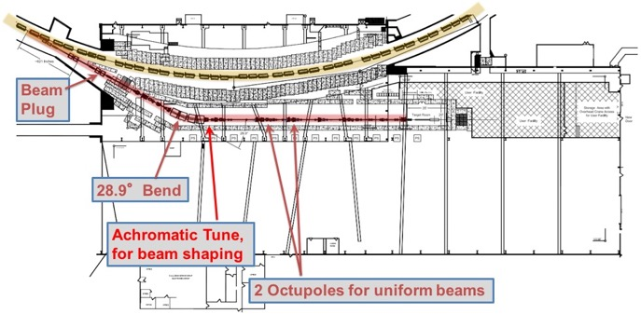
BNL Collider-Accelerator Complex and Locations of existing and future SEE testing facilities.

Slide 11
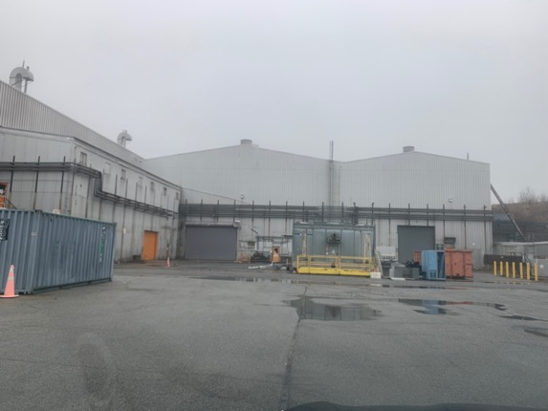
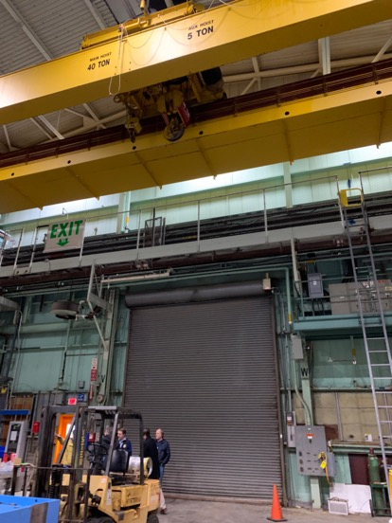
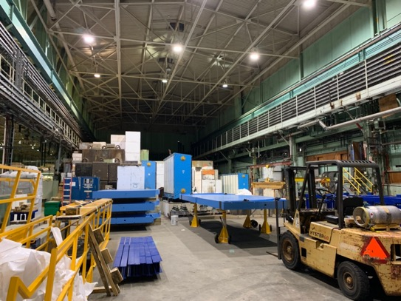
Safety walkthroughs and initial safety and environmental evaluation have been done.

Slide 12
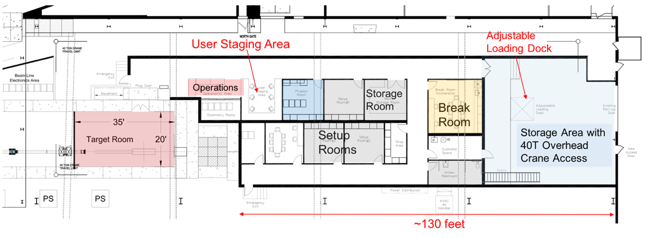
Proposed User Building and Target Room layout
Beam
13.5’
Side View

Slide 13
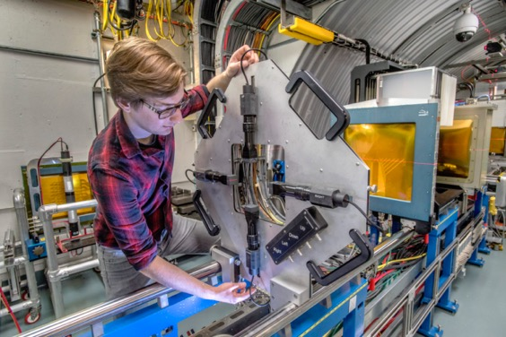

Slide 14
HEET Energy Range and Beams
Note:
GCR = Galactic Cosmic Ray
SPE = Solar Particle Event
Note 1) The GCR Spectrum does not include the solar cosmic rays which are predominantly low energy protons.
Note 2) The GCR Spectrum used here is from a cosmic ray simulation routine that is commonly used in the industry. It is called CRÈME, and these data came specifically from CRÈME96. See footnote: https://creme.isde.vanderbilt.edu/
Note 3) The GCR Spectrum has been transported through 300 mils (7.62 mm) of “Aluminum shielding” which filters out soft stuff.

Slide 16
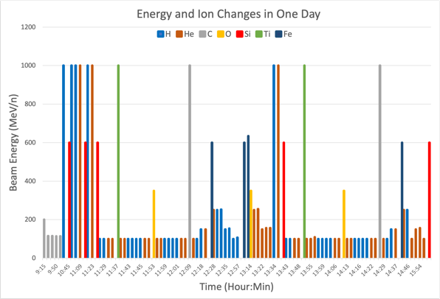
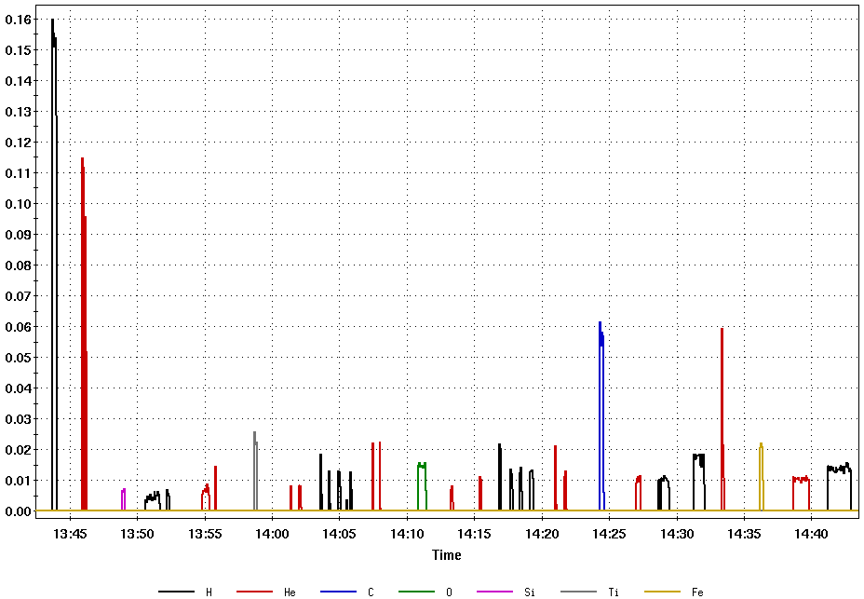
Delivered GCR and SPE Spectra at NSRL
7 different ions and
33 different beams in 1 hour!

Slide 17
Operations
44 weeks available per year
we shut down for 8 weeks every summer for maintenance
Every two weeks, 8-hour maintenance period when beam is not available
Assume 24/7 operations during the 44 weeks of the yearly operation period
Assume 80% facility availability during operations. 20% accounts for down time due to failures and use of the accelerator for injecting beam into RHIC and EIC in the future
Assume the present situation of concurrent operation with RHIC, NSRL, and MIRP (Medical Isotope Production) and, in the future, concurrent operation with EIC, NSRL, and MIRP. During EIC construction operations only concurrent with NSRL and MIRP. EIC Commissioning begins ~2028.
NSRL & HEET would run concurrently, taking different ions at different energies
Some time (~10%) is used for developing beams (energy/ions) and to develop better quality
>4000 - 5000 hours of availability per year

Slide 18
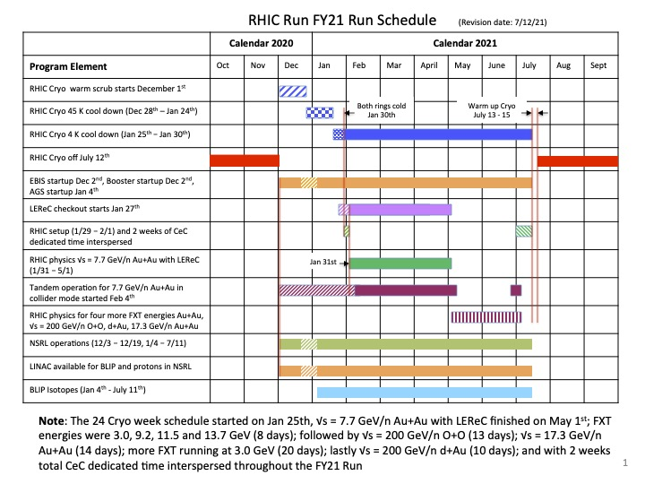
Example Schedule from FY2021 Running (as run)
HEET will share
AGS with EIC
Booster with EIC & NSRL
EBIS with EIC & NSRL
LINAC with EIC, NSRL, & BLIP
HEET is independent from NSRL & everyone else
NSRL & BLIP run independently, although BLIP shares the LINAC (which provides polarized protons to RHIC) and NSRL shares EBIS (ion sources) and the Booster with RHIC.

Slide 19
Modes of operations
The combination of having two synchrotrons (the Booster and the AGS) AND a Laser Ion Source at EBIS, allows us to do things nobody else can do!
Normal operation is to do first stage of acceleration in the Booster, transfer the beam(s) to the AGS, accelerate to desired energy, and extract to the HEET beamline
To increase the intensity, multiple beams can be transferred to the AGS before acceleration – allowing for x2 and up to x5 more intensity and perhaps more to be extracted to HEET
For lower energies (approx. 200 MeV/n and below), the Booster can handle all the acceleration and the AGS will act as a ’stretcher’ ring = No acceleration. Beam is injected, debunched, and immediately extracted, enabling extremely long beam spills. This goes beyond what cyclotrons can deliver, since the beams will have no rf structure
With the ability to do multiple beam transfers from the Booster to the AGS with different ions from EBIS, we can also match the beam ‘rigidity’ (Bρ=p k/Q) for ions and deliver ‘mixed fields’ of ions in a single spill

Slide 20
Technology segments
The facility will be built with motivation from Single Event Effects electronics testing but will be useful for many other purposes.
Quantum devices for space
Small nuclear reactors
Materials for space (space suits, water filtration, soil/fertilizer, etc.)
General device failures beyond SEE
The facility has opportunities for expansion
Development of neutron dosimetry
High energy electron beams
Synergies with ATF and NSLS II

Slide 21
Status & Summary
HEET is designed to be a dedicated SEE testing facility capable of supplying
  Wide range of beam energies with high energy reach
  (40 MeV/n to 2500 MeV/n, <100 MeV/n with degrader)
  Beams of 6D uniform distribution protons and ions (very long spills possible)
  Ability to simulate GCR spectra (cocktails)
  Ability to simulate SPE spectra
  Able to operate a large number of hours/year (>4000 hours/yr)
The facility will support classified and proprietary experiments

