Slide 1
RaDIATE Collaboration Update
Frederique Pellemoine on behalf of the RaDIATE Collaboration
RaDIATE Collaboration Meeting
26 June 2023

Slide 2
Outline
RaDIATE Collaboration Update
  MoU
  Point of Contact
Current Activities
Near and mid term Activities
  Needs for material R&D
  Needs for material test

Slide 3

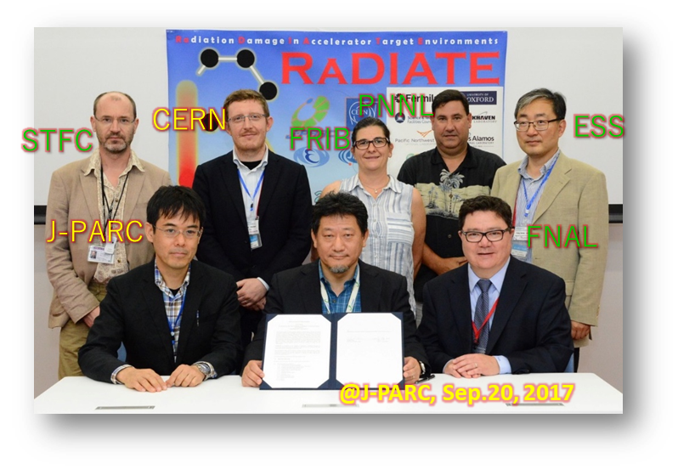
R a D I A T E Collaboration
Radiation Damage In Accelerator Target Environments
RaDIATE collaboration created in 2012, with Fermilab as the leading institution
Objective:
Harness existing expertise in nuclear materials and accelerator
targets
Generate new and useful materials data for application within
the accelerator and fission/fusion communities
Activities include:
Analysis of materials taken from existing beamline as well as
new irradiations of candidate target materials at low and high
energy beam facilities
Coordinate larger experiments (such BLIP or HRMT) between several institutions with similar interest/research in material tests
Program manager: Dr. Frederique Pellemoine (FNAL) – radiate.fnal.gov
Notes:
To address these material challenges, the HPT community formed the RaDIATE collaboration in 2012, with Fermilab as the leading institution. The goal was to bring experts from the accelerator and fission/fusion communities together to generate new data for accelerator materials. The collaboration has grown up to 14 institutions over the years.

Slide 4
R a D I A T E Collaboration
Radiation Damage In Accelerator Target Environments
The current MOU has been carefully crafted to not commit anything to anyone at any time for any reason.
It covers (not limited to):
Short and long term visits to each other’s facilities, subject to appropriate written arrangements
Exchange of publicly available information
Conduct of workshops, seminar and other meetings
Irradiation material study:
C (polycrystalline, C-C), Be, Ti-allos, W-alloys, Mo-alloys, Ti-alloys, Austenitic SS, Ta, Al-alloys, Ni-based super alloys, Ferritic-martensitic steels, Si, Ir, others
Thermal and mechanical properties, microstructures, annealing, corrosion
It doesn’t cover:
This MoU does not create any legally binding obligations between or among the participants
Each participant is to be responsible for the costs it incurs in participating in cooperative activities under this MoU
Notes:
To address these material challenges, the HPT community formed the RaDIATE collaboration in 2012, with Fermilab as the leading institution. The goal was to bring experts from the accelerator and fission/fusion communities together to generate new data for accelerator materials. The collaboration has grown up to 14 institutions over the years.

Slide 5



















R a D I A T E Collaboration
Radiation Damage In Accelerator Target Environments
RaDIATE collaboration MoU renewed on December 11, 2022
Only one signatumre is missing from Los Alamos:
Different approval and signature process
Needed the MoU signed by all other institutions first before they can sign
Initial Collaborators in 2013
Additional Collaborators in 2015
New Collaborators since 2022
Additional Collaborators in 2017
Notes:
To address these material challenges, the HPT community formed the RaDIATE collaboration in 2012, with Fermilab as the leading institution. The goal was to bring experts from the accelerator and fission/fusion communities together to generate new data for accelerator materials. The collaboration has grown up to 14 institutions over the years.

Slide 6
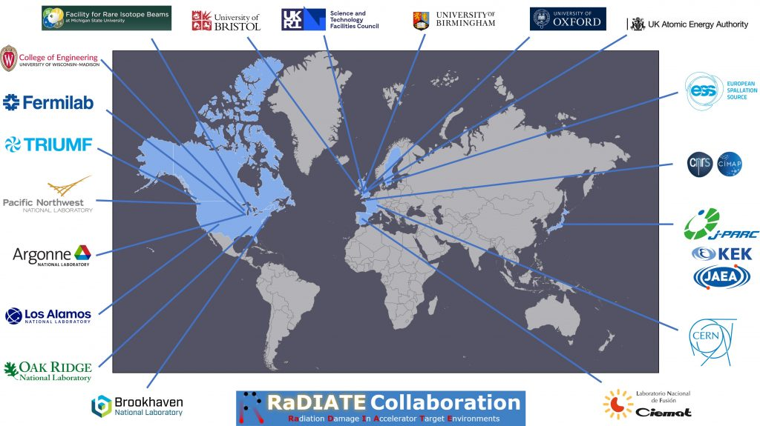
R a D I A T E Collaboration
Radiation Damage In Accelerator Target Environments
RaDIATE collaboration today
Notes:
To address these material challenges, the HPT community formed the RaDIATE collaboration in 2012, with Fermilab as the leading institution. The goal was to bring experts from the accelerator and fission/fusion communities together to generate new data for accelerator materials. The collaboration has grown up to 14 institutions over the years.

Slide 7
R a D I A T E Collaboration
Radiation Damage In Accelerator Target Environments
RaDIATE collaboration today
86 subscribers to the RADIATE@LISTSERV.FNAL.GOV
Point of contact
  FNAL: F. Pellemoine Proton Accelerator
  BNL: D. Kim Proton-Heavy ion Accelerator – Irradiation Facility (BLIP)
  PNNL: D. Senor PIE
  STFC: C. Densham Proton Accelerator
  University of Oxford: J. Marrow Material Science
  ANL: W-Y. Chen heavy ion Accelerator – Irradiation Facility (IVEM)
  CIEMAT: A. Ibarra Fusion Material
  LANL: T. Saleh Proton Accelerator – Irradiation Facility (LANSCE)
  MSU-FRIB: A. Stolz Heavy ion Accelerator
  ORNL: D. Mcclintock (FTS) / Y-J. Lee (STS) Proton Accelerator
  ESS: M. Wohlmuther Proton Accelerator
  CERN: M. Calviani Proton-Heavy ion – Irradiation/Testing Facility
  J-PARC: S. Makimura (KEK) / S. Meigo (JAEA) Proton Accelerator
  TRIUMF Inc.: A. Gottberg Proton-electron Accelerator – Irradiation Facility
  UKAEA: S. Kuksenko PIE
  University of Bristol: D. Liu Material Science
  University of Birmingham: Y-L. Chiu Proton Accelerator – Irradiation Facility
  University of Wisconsin-Madison: A. Couet Material Science- Modelisation-Irradiation Facility
  CNRS-GANIL: C. Grygiel Heavy ion Accelerator – Irradiation Facility
Notes:
To address these material challenges, the HPT community formed the RaDIATE collaboration in 2012, with Fermilab as the leading institution. The goal was to bring experts from the accelerator and fission/fusion communities together to generate new data for accelerator materials. The collaboration has grown up to 14 institutions over the years.

Slide 8






This week updates

Slide 9
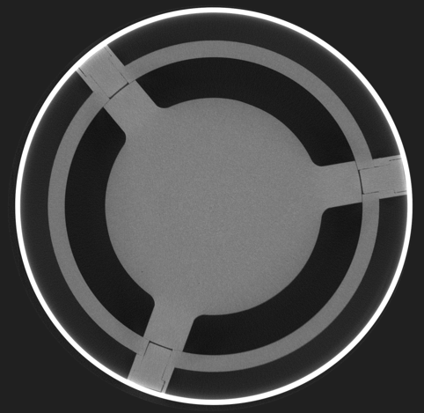
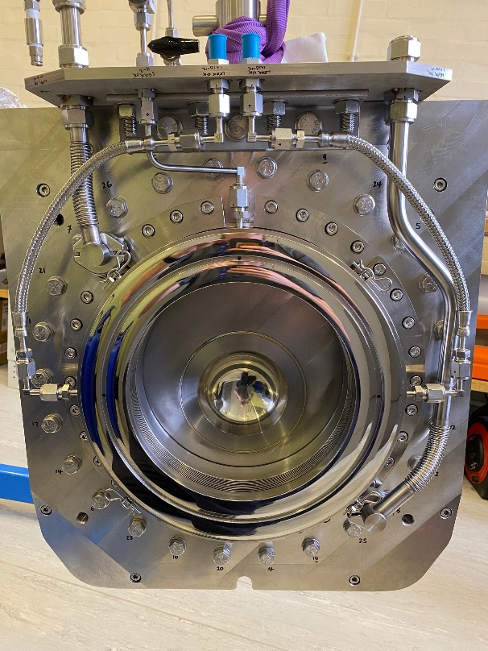
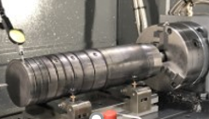
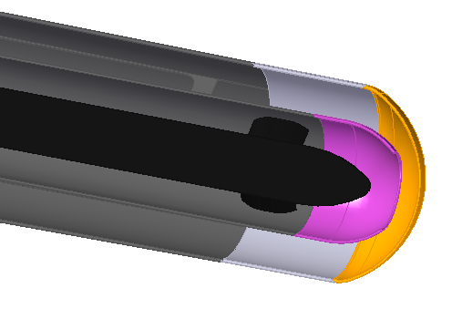


T2K
ISIS
LBNF
Overlapping Interests in RaDIATE for UK/STFC RAL
Titanium, Graphite
Tungsten,
Beryllium
Materials
Facilities, Techniques

Slide 10
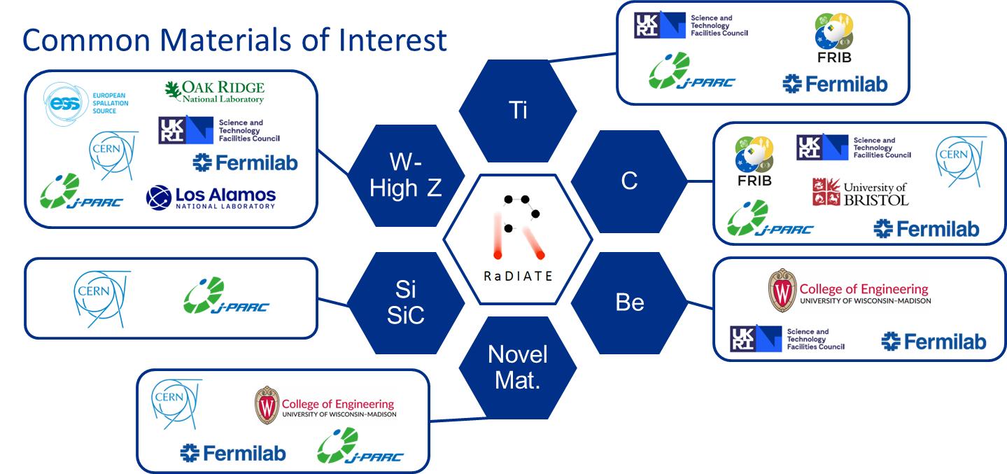
Current Materials of interest

Slide 11
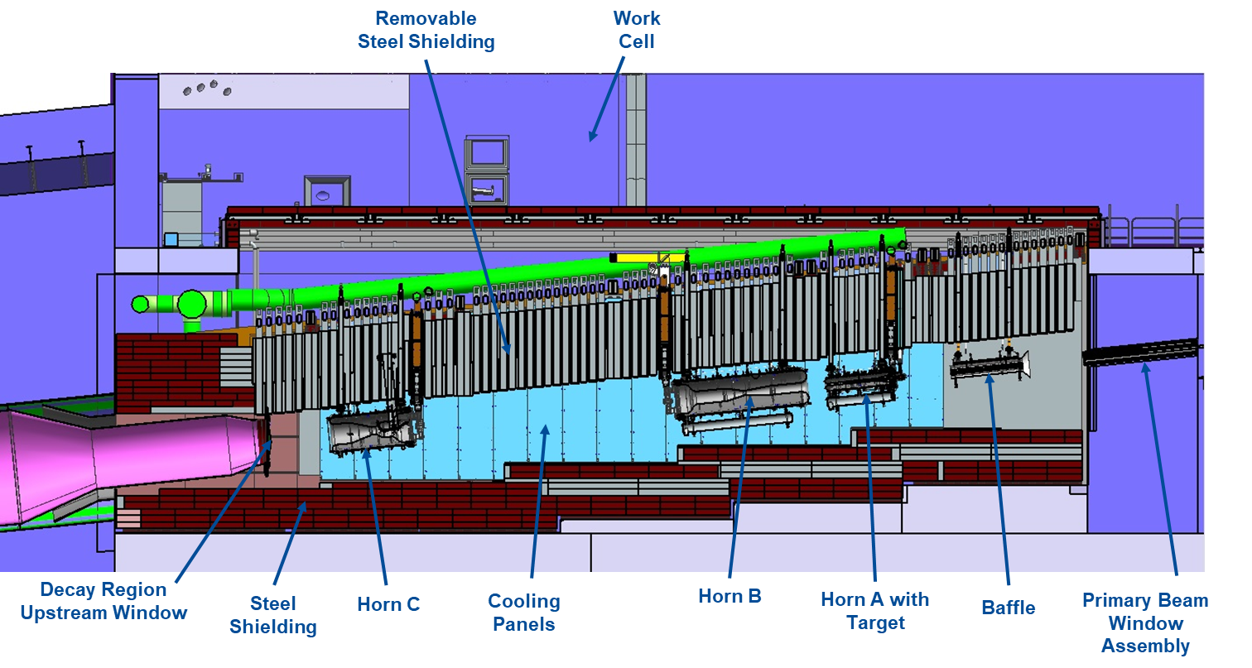
LBNF target systems - Beam-Intercepting Device Inventory
2.4 MW
2.4 MW
1.2 MW
DS Decay Pipe Window
>1.2 MW?
>1.2 MW?
>1.2 MW?
>1.2 MW?
2.4 MW
2.4 MW
2.4 MW
2.4 MW
1.2 MW

Slide 12
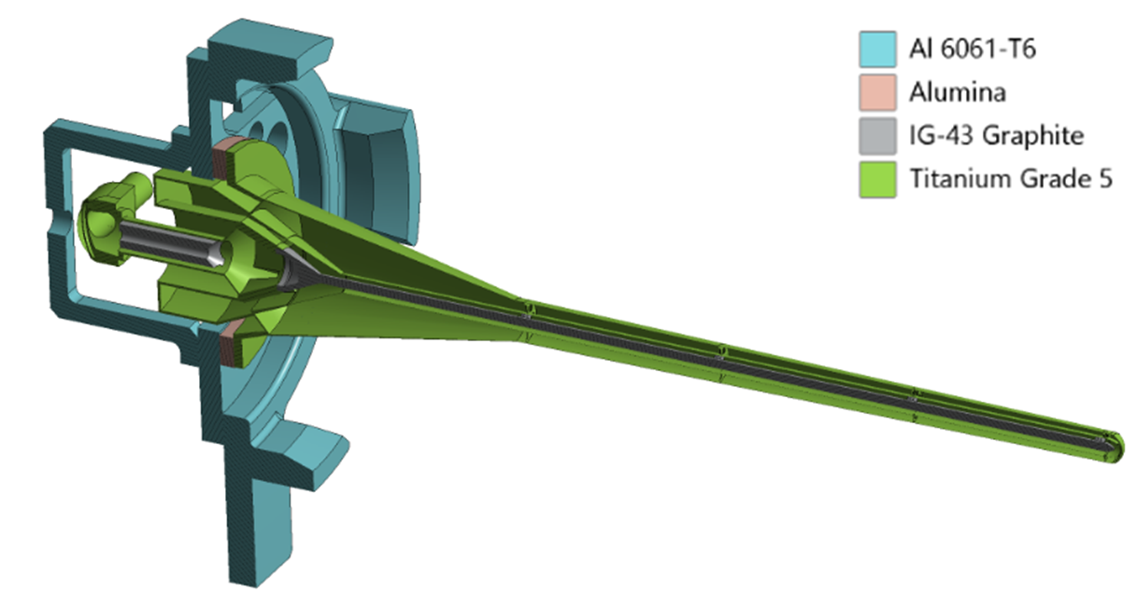
Production target concept – Neutrino Program
?
?
?
X 2
? 4 MW+ ??
LBNF 2 MW+
? m
50 kW in target at 120 GeV
higher power density/pulse
Option 0 - LBNF 2 MW+
? m
50 kW in target at 120 GeV
same power density/pulse
LBNF 1.2 MW Target core Graphite
1.5-1.8 m x 16 mm
25 kW in target at 120 GeV
More power density = More challenges
P. Hurh’s and Q. Peterson’s talk on Thursday
Notes:
Generation after generation, the beam power increase and the energy decrease, leading to more and more power density deposited in material.
The different targets are presented with the same scale so you can compare the size from one to another design.

Slide 13
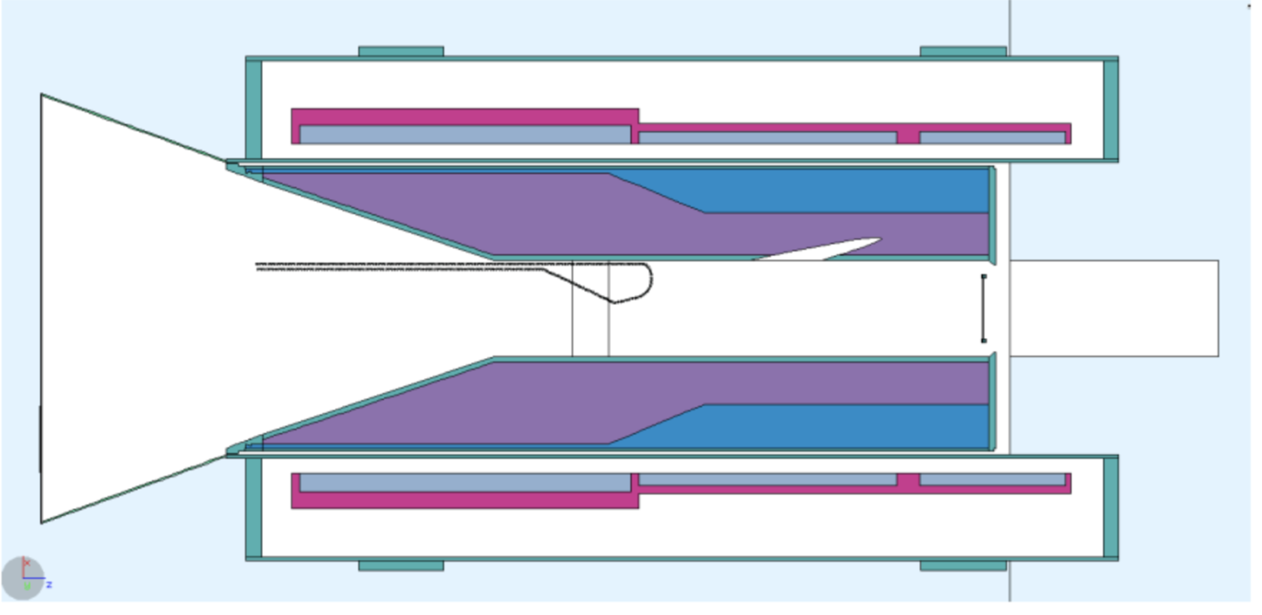
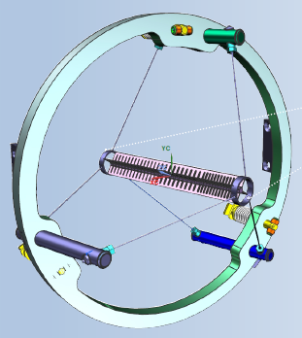
RPF Experiment Targetry - Production target concept – Muon Program
X ?
?
X 2.5
?
X 140
p
Muon Collider 1 to 4 MW
??
300 kW in C target at 8 GeV
Conveyor target
AMF Target core ?
??
250 kW in target at 800 MeV
Mu2e-II Target core C, W, WC, SiC,…?
~ 10 mm x 200 mm
100 kW in target at 800 MeV
Mu2e Target core Tungsten
6.3 mm x 220 m
700 W in target at 8 GeV
More power density = More challenges
Notes:
Generation after generation, the beam power increase and the energy decrease, leading to more and more power density deposited in material.
The different targets are presented with the same scale so you can compare the size from one to another design.

Slide 14
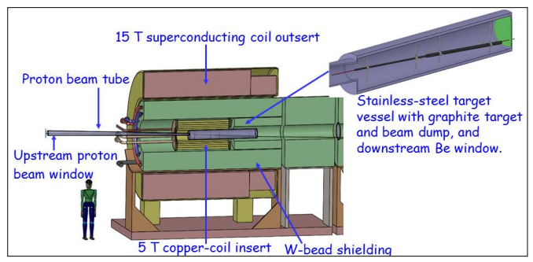
Muon Collider target: Concept & technology needs
Technology requirements for MuC targets:
  Target materials that produce high
  muon yield; This requires their
  placement in a high-field solenoid
  (15-20T)
  Tolerant materials to thermal shock
  and fatigue from MW-scale beams
  Shielding system that protects the
  capture magnet and surrounds
  Large solenoidal aperture to allow
  for shielding

Slide 15
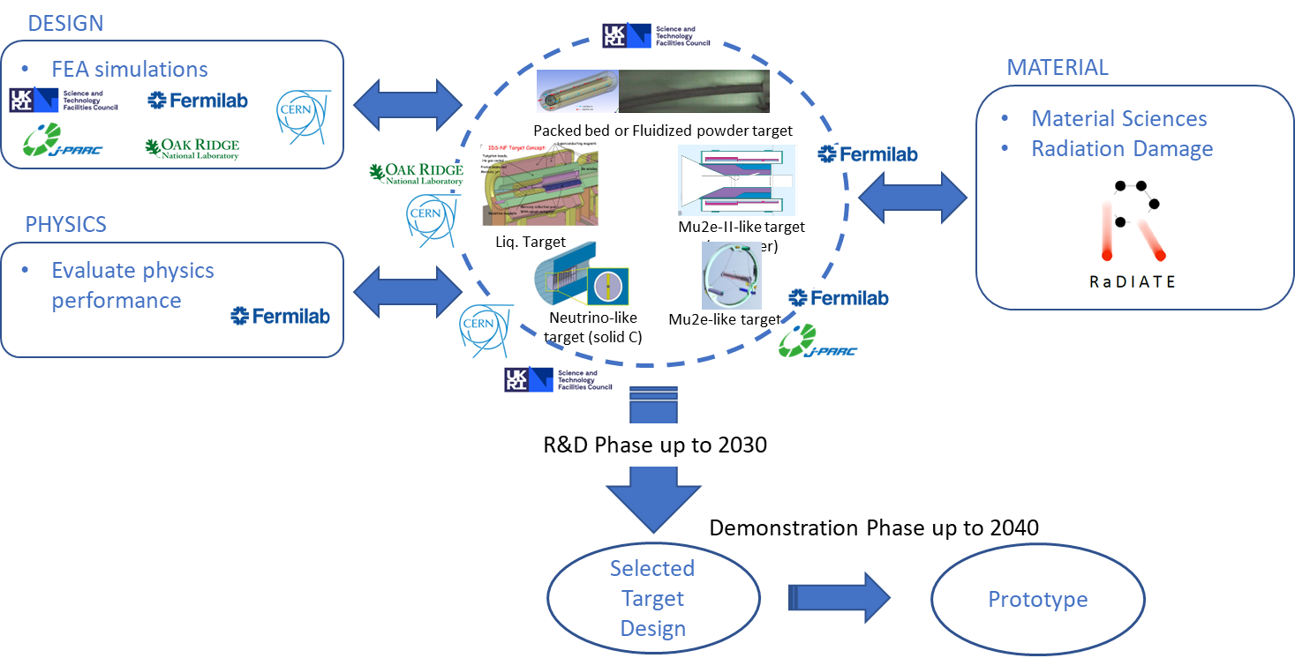
RPF Experiment Targetry – R&D Approach for Muon Collider

Slide 16
How can Muon Targetry Fit into HPT R&D?
Potential successors to Mu2e: Mu2e-II and AMF
Focus has been on neutrino beams and accelerator components
  Can certainly be extended to other HEP applications
  Fermilab HPT R&D so far focused on fixed target made of graphite, beryllium, Ti-alloys, High entropy alloys and ceramic nanofiber
    High-Z material with very short muon bunches
      Not part yet of HPT R&D program
      R&D already ongoing through RaDIATE collaboration
    High efficiency cooling and/or novel concept need to be developed
      Not part yet of HPT R&D program
      More R&D needed through RaDIATE collaboration
  Design development:
    Unproven concept exist for 100 kW (Mu2e-II) but will require R&D effort
    For AMF, no idea how to build a MW scale target

Slide 17



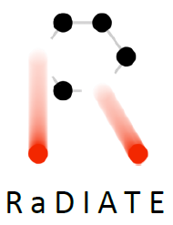

Potential Materials for Muon Production Targets and related R&D
?
C
Liq. Metal
?
Si
SiC
W-High Z

Slide 18
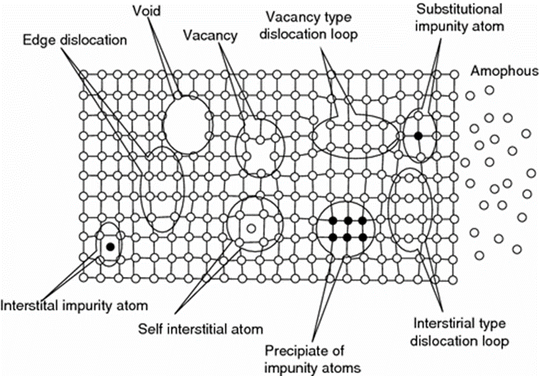
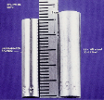


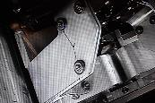
Radiation Damage & Thermal Shock
Radiation Damage: Displacements in crystal lattice expressed as Displacements Per Atom (DPA)
Hardening and embrittlement
Creep and swelling
Fracture toughness reduction
Thermal/electrical conductivity reduction
Coefficient of thermal expansion
Modulus of elasticity
Transmutation products (H, He gas production can cause void formation and embrittlement)
Thermal Shock: Sudden energy deposition from pulsed beam
Fast expansion of the material surrounded by cooler material generates localized area of compressive stress
  1 MW target: ~250 K in 10 µs pulse (2.5 x 10⁷ K/s)
Stress waves move through the material at sonic velocities
Plastic deformation, cracking and fatigue failure can occur
Thermal Fatigue: Cycling loading environment
  Cycling loading progressively damage material’s microstructure such that it can ultimately fail at stress levels that are actually lower than its failure strength
    Fatigue Stress Cycle Amplitude x2 at 2.4 MW
D.L. Porter and F. A. Garner, J. Nuclear Materials, 159, p. 114 (1988)
Iridium (left) and Sigraflex (right) targets tested at CERN’s HiRadMat facility
Horn stripline fatigue failure (FNAL)

Slide 19

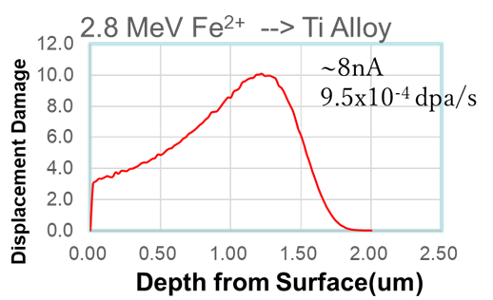
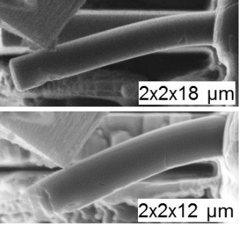
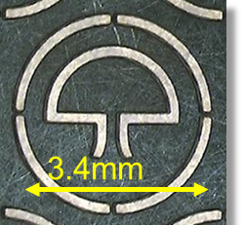

Tools to Support R&D Program
High energy beam irradiation
  Highly activated material
  High energy ⇨ Low dpa rate ⇨ long irradiation time (order of months) ⇨ Expensive
Alternative radiation damage method
  Low-energy proton/ion irradiation
    Lower cost, high dose rate with lower to no activation of the specimen
    Very shallow penetration ⇨ needs advanced microscale and mesoscale testing
  Few heavy ion and proton irradiation facilities around the world
S. Makimura’s talk today
Notes:
Ligne type IRRSUD

Slide 20
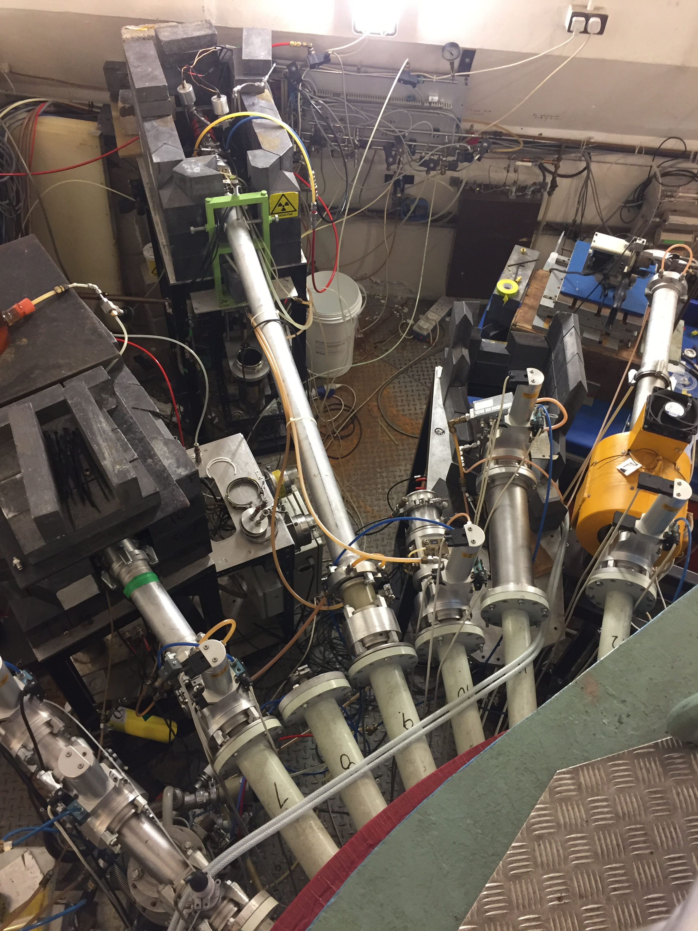
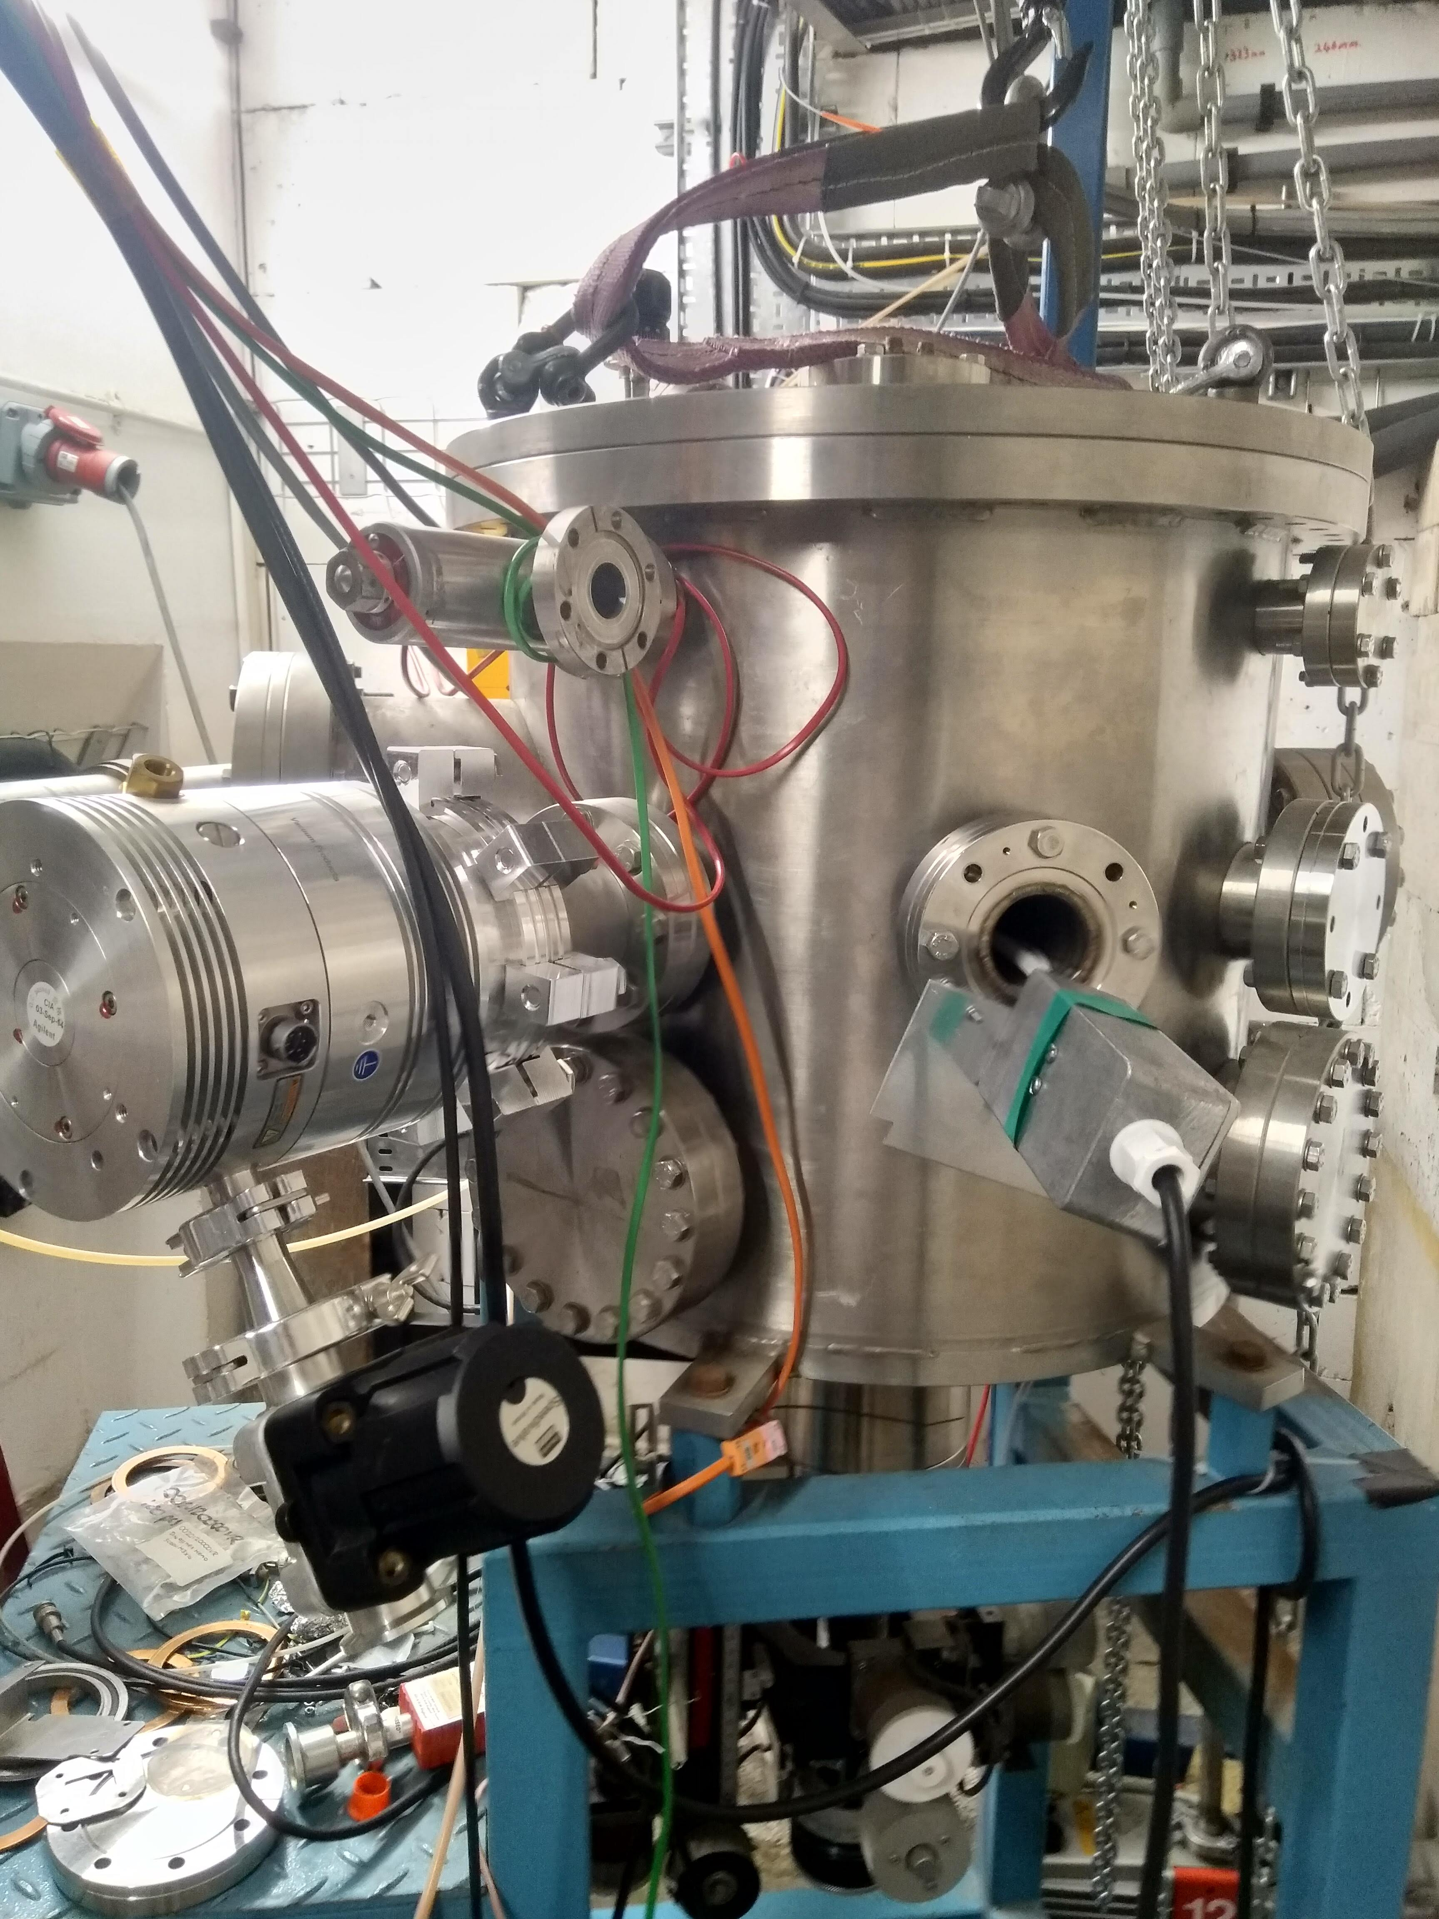
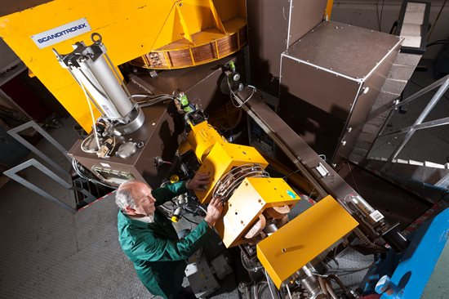
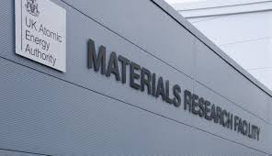
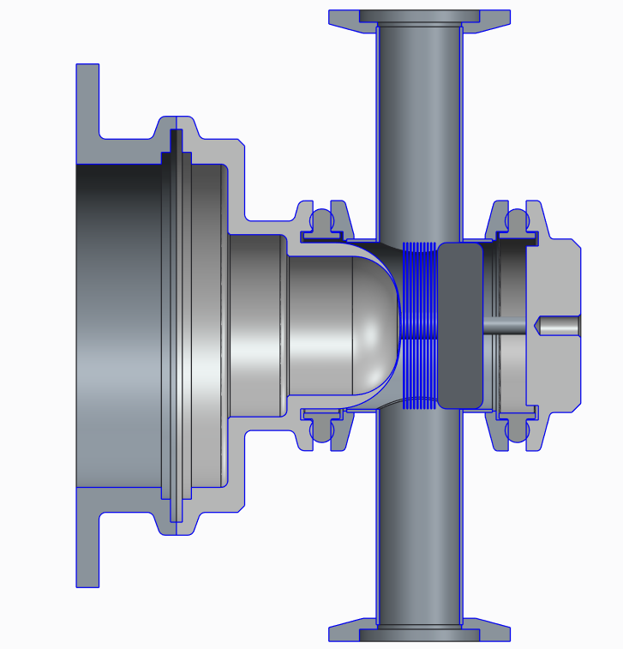
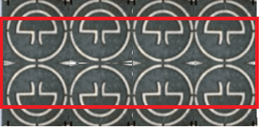
Plans for materials irradiation studies with Birmingham MC40 Cyclotron
Gas cooled material samples could be put into one of several beamlines
This study focuses on titanium foils for meso-scale fatigue testing as PIE
Sample & environment
(Birmingham)
PIE
Micro/nano indentation
High cycle fatigue testing
TEM/XRD
MC40 irradiation
Sample design (Oxford)
Sample environment
(RAL)
Proton and He irradiation at high energy
(Oxford, Birmingham @Culham)
(Birmingham)
Remotely handleable sample environment
Meso-scale fatigue samples c/o Oxford (Gong)
Beam footprint
P. Earp’s talk today

Slide 21



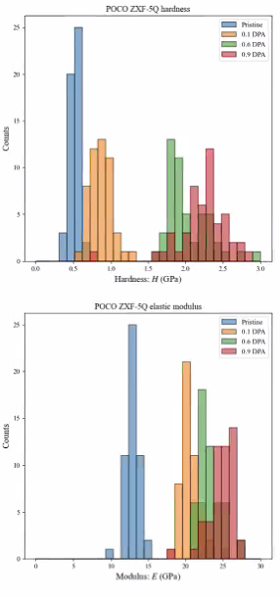
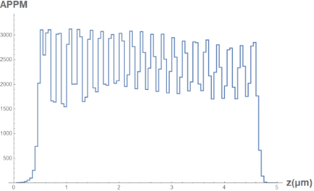
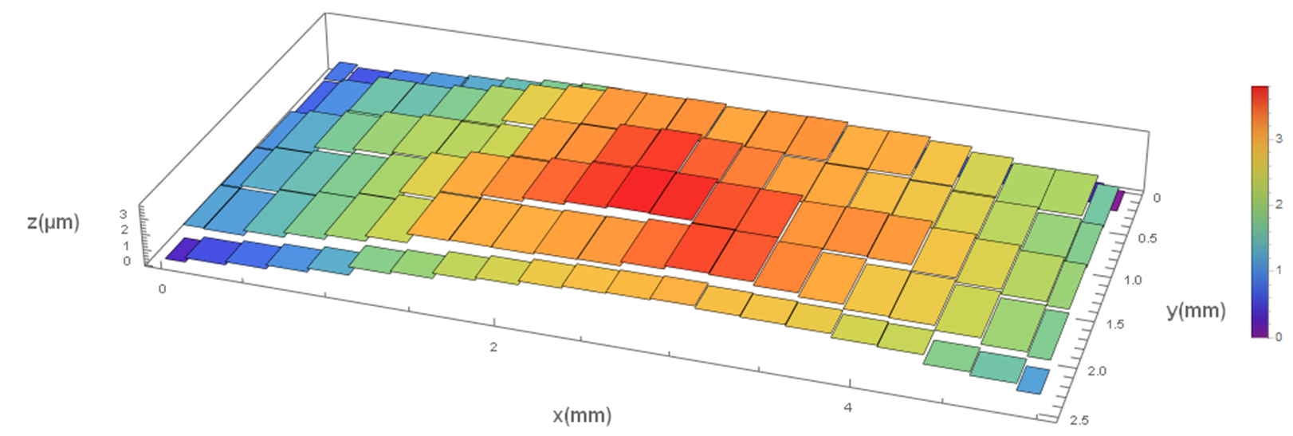
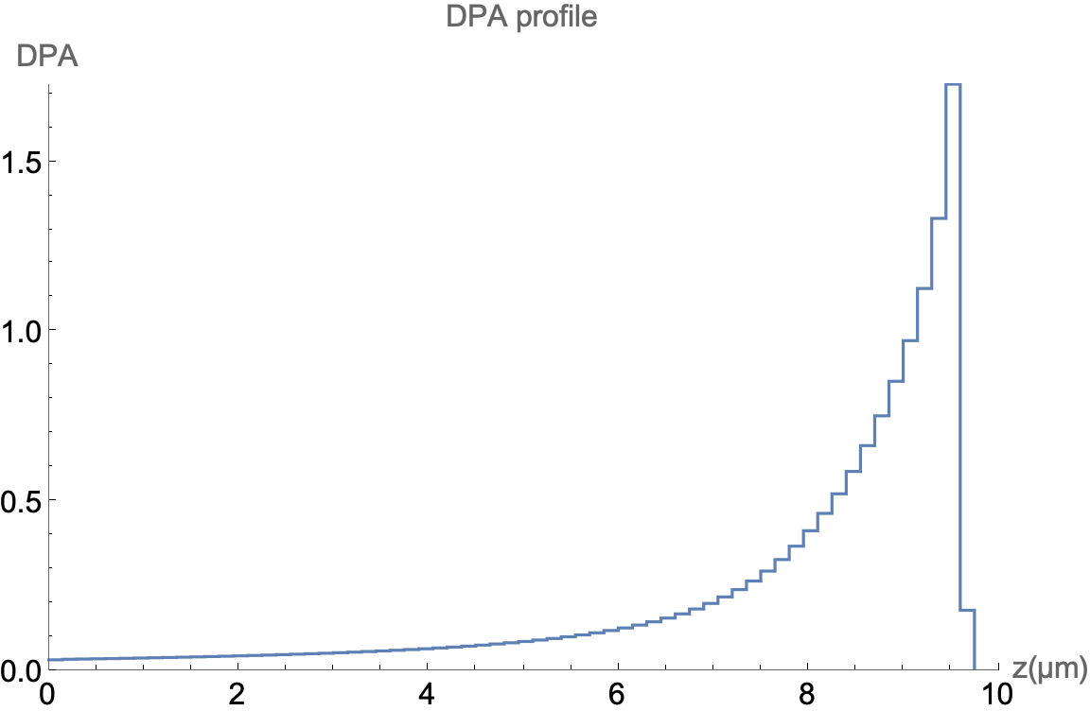

Graphite Irradiation Studies with Heavy Ions
A. Burleigh and Prof. J. Terry (IIT)
Compare radiation damage in graphite irradiated by high energy proton beams (FNAL NT-02) failed target with low energy
heavy ion irradiated graphite
  120 GeV proton beam
  He implantation up to 1500 appm (MIBL) only
  Damage only (CIMAP/IRRSUD - Notre Dame U5 facility)
  He implantation ⇨ damage (CIMAP/IRRSUD, Notre Dame U5 facility)
  Dual beam He implantation + damage (MIBL)
  Dose at 0.03, 0.07, 0.1, 0.27, 0.6 and 0.87/0.9 dpa
  100 ° C and 300 °C
2330 APPM He
4.5 MeV He++ ions at MIBL
region of interest from 0 - 4.5 $μ$m.
AFM measurements show bulk swelling of ~3.8 µm in the irradiated region

Slide 22
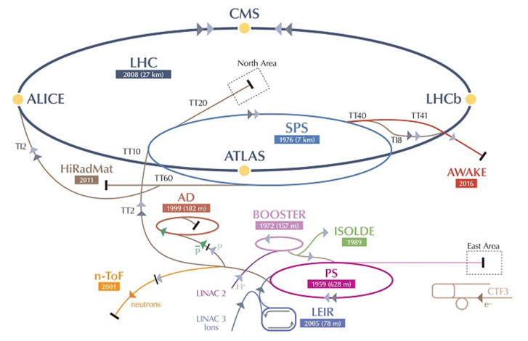
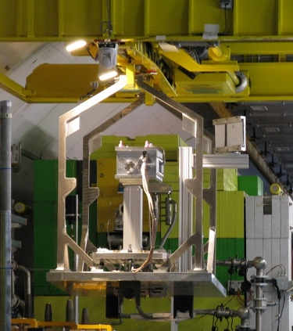
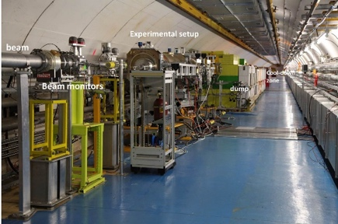
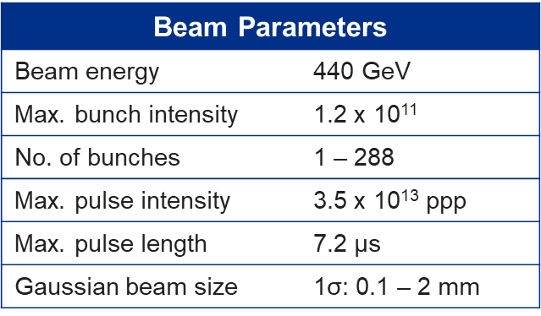
Response of Irradiated Materials to Thermal Shock by High Intensity Proton Beam at CERN’s HiRadMat Facility
Primary Objective: Compare thermal shock response between non-irradiated and previously irradiated material specimens from BNL BLIP
  Irradiated specimens included Beryllium, Graphite, Silicon, Titanium, SiC-coated Graphite, Glassy Carbon specimens from BLIP
  First unique test with radiation damaged materials with actual high-intensity proton beam-loading condition

Slide 23
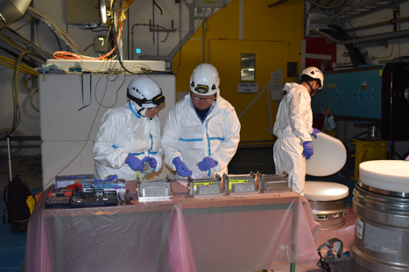
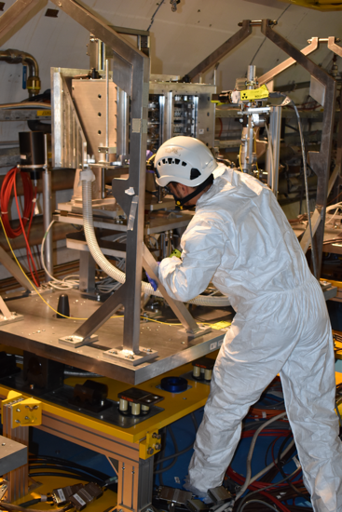
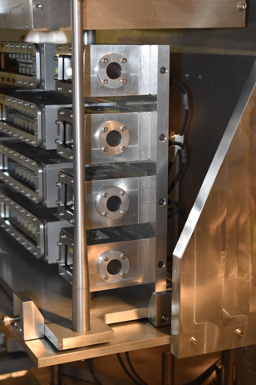
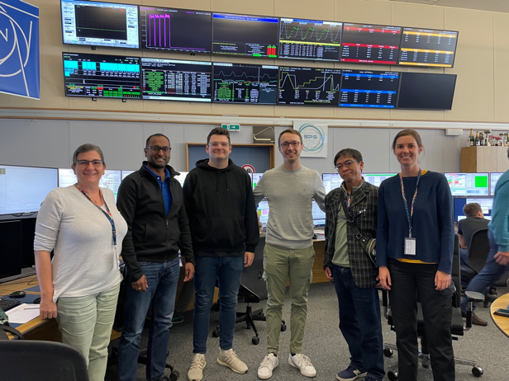
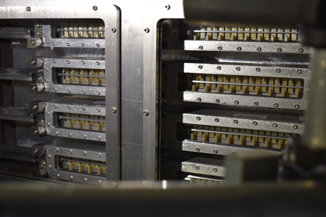
HRMT60 – RaDIATE experiment
Completed in 2022
~120 material specimens tested:
  Graphite, Ti alloys, Beryllium, Nanofiber mats, High-Entropy alloys, Sigraflex, TFGR tungsten, SiC/SiC composite
Now planning post-irradiation examination at several institutions
N. Solieri’s and S. Makimura’s talks today

Slide 24
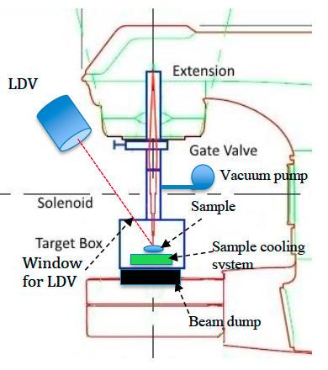
More Tools to Support R&D Program
Alternative thermal shock method
  Use of electron beams, lasers, or other techniques to induce thermal shock (reduce R&D cycle length)
Ab initio and molecular dynamics (MD) modeling
  still not yet mature enough to model atomistic changes to micro-structural evolution to macro-properties of real-world materials. Prediction of fundamental response of various material classes to irradiation helps steer material choices and experiment design for future irradiation studies
Notes:
Ligne type IRRSUD

Slide 25
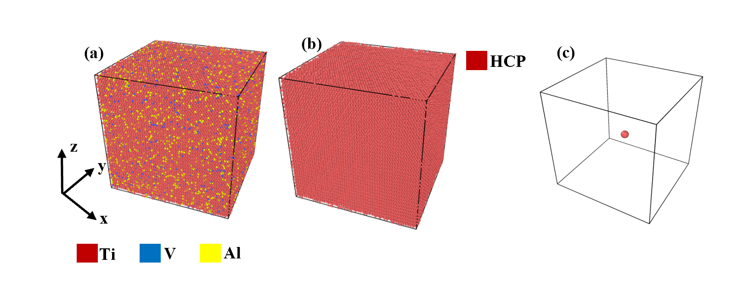

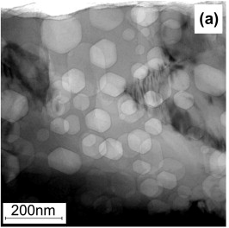
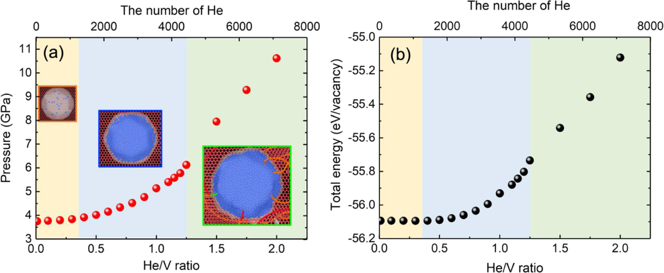
Ab Initio and Molecular Dynamics Material Modeling
G. Arora’s and A. Casella’s talks on Thursday
Ti alloy Radiation Damage Modeling at PNNL ongoing
Collaboration with Computation Materials Group at University of Wisconsin – Madison
  Modeling of He gas bubbles in Beryllium – ongoing
    the shape of He bubble in Be is ellipsoid-like, which is consistent with earlier experimental observations
  Modeling of radiation damage in High Entropy Alloys – starting
Need more experimental data from irradiation station
(proton, Heavy ion, …) with controlled parameters
to validate our models
  Irradiation with low energy heavy ion under
  preparation with Prof. Couet
J. Xi et al., J. Nuclear Materials 576 (2023) 154249
M. Klimenkov et al., J. Nuclear Materials 443 issues 1-3 (2013) 409-416

Slide 26
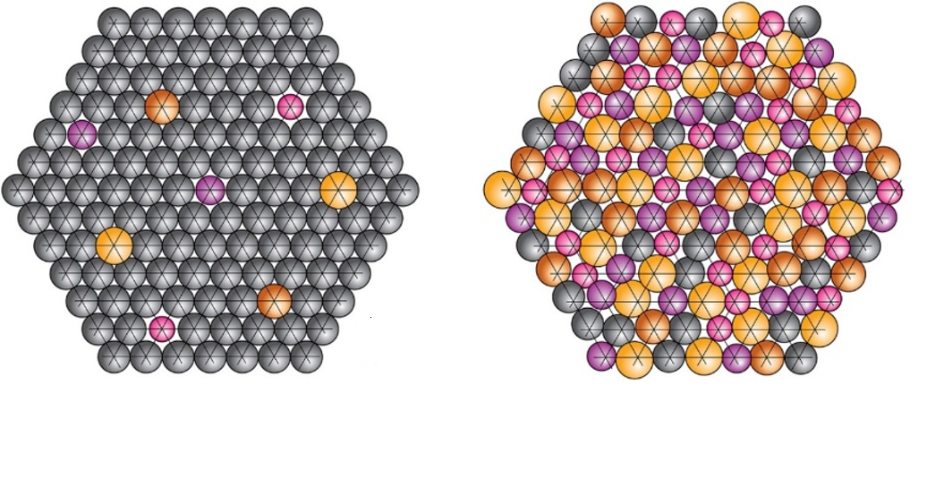
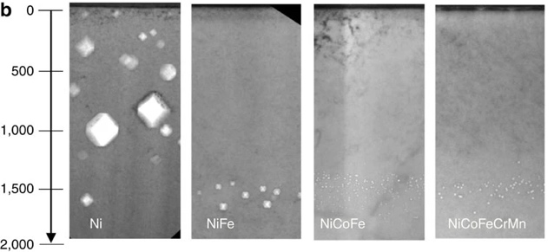
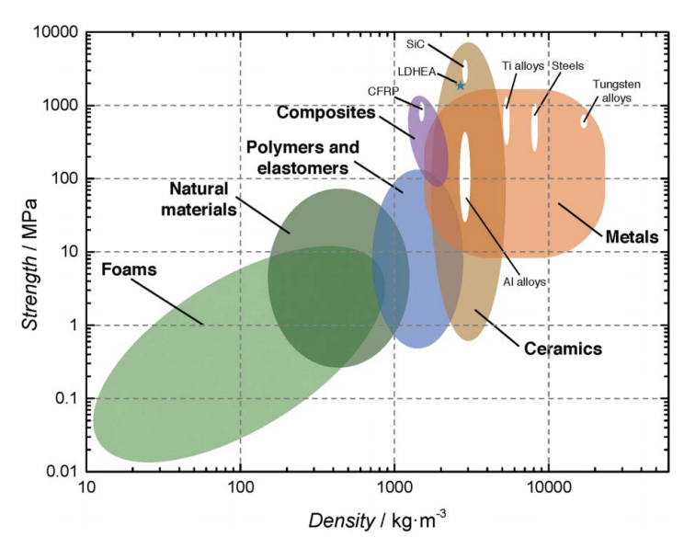
Novel Targetry Materials: HEAs
    High-Entropy Alloy (HEA) development at UW-M
    Alloys consisting of 3 or more principal elements with Equi-atomic or near equi-atomic composition
    Excellent inherent properties including enhanced radiation damage resistance
    ECRP awarded in July 2022 to support novel material development over 5 years
(a)
(b)
(a) Conventional alloy, (b) High-entropy alloy (Miracle & Senkov, 2016)
Irradiation tolerant properties
low density high entropy alloy
Reduction in irradiation-induced void distribution in nickel and multi-component HEAs after 3-MeV Ni+ ion irradiation at 773 K
Lu, Chenyang, et al. Nature communications 7.1 (2016): 1-8
Youssef et al., Materials Research Letters, 95-99 (2015)
K. Ammigan’s talk on Thursday
Notes:
Highlight need for further R&D as we look to novel materials beyond the current state-of-the-art. Novel materials that are more radiation damage resistant to enable next-generation multi-MW target facilities.

Slide 27
High Entropy Alloy Design
Cr-Mn-V base ternary to avoid high activation elements
  Single phase BCC crystals
Additional elements for improved strength…
  Ti as impurity getter (forming Ti-(CON))
  Al as BCC phase stabilizer
  Co to form semi-coherent B2 phase for strengthening
High throughput search of compositional space using CALPHAD
  Filter by range of BCC/BC phases, density, specific heat, CTE
Most promising compositions to be manufactured, irradiated, physical properties tested
Proton irradiations of selected compositions at the University of Wisconsin Ion Beam Laboratory
CrMnV₃
AlCrMnTiV
BCC phase stabilizer
AlCoCrMnTiV
CrMnVTi
Equimolar BCC single phase
Impurity getter
Semi-coherent secondary phase
Density ~
(Q_{deposit})
Spec. Heat ~
(ΔT)
CTE ~
(σ)
Yield stress ~ (plasticity)
N. CRNKOVICH’s talk on Thursday

Slide 28
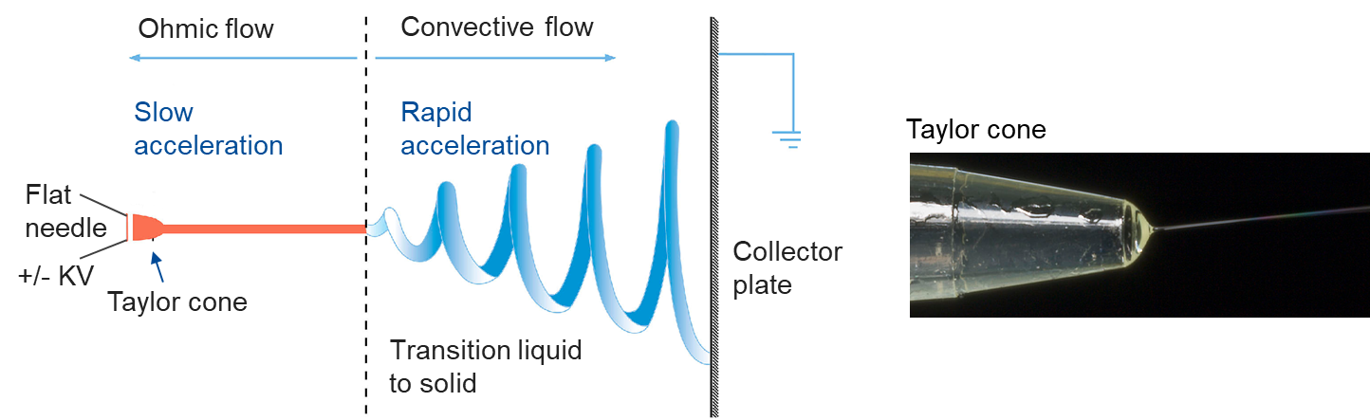
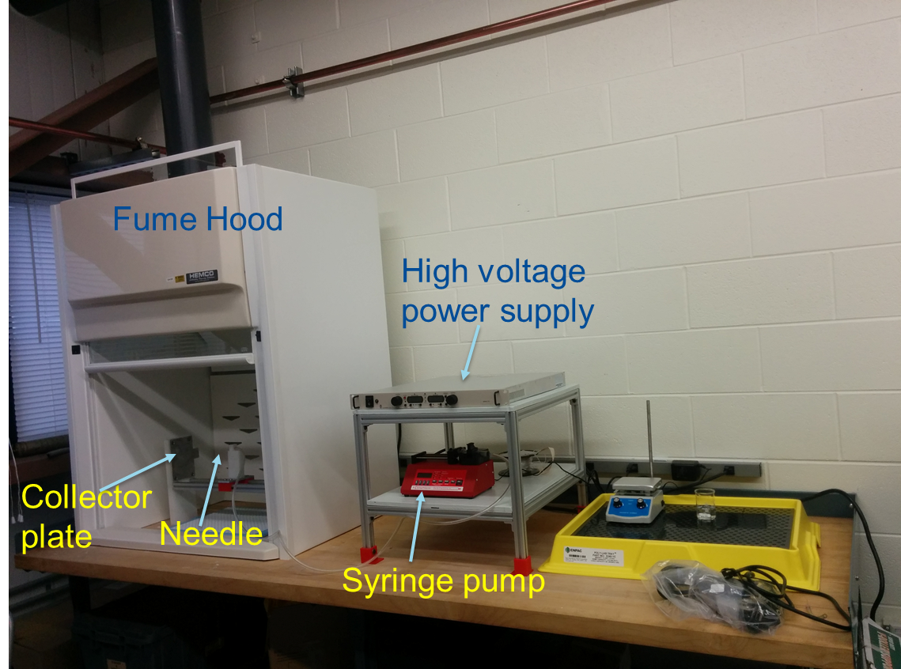
Novel Targetry Materials: Electrospun Nanofibers
    Nanofiber electro-spinning at Fermilab
    Nanofiber continuum is discretized at the microscale to allow fibers to absorb and dampen thermal shock, and discontinuity prevents stress wave propagation
    Evidence of radiation damage resistance due to nanopolycrystalline structure of the material
    ECRP awarded in July 2022 to support novel material development over 5 years
TEM image of Zirconia nanofibers. Before (left) and after irradiation at 5 dpa (right)
Electrostatically driven electrospinning process
S. Bidhar et al., PRAB 24, 123001, 2021
Electro-spinning set-up at Fermilab
S. Bidhar’s talks today
K. Ammigan’s talks on Thursday
Notes:
Highlight need for further R&D as we look to novel materials beyond the current state-of-the-art. Novel materials that are more radiation damage resistant to enable next-generation multi-MW target facilities.

Slide 29
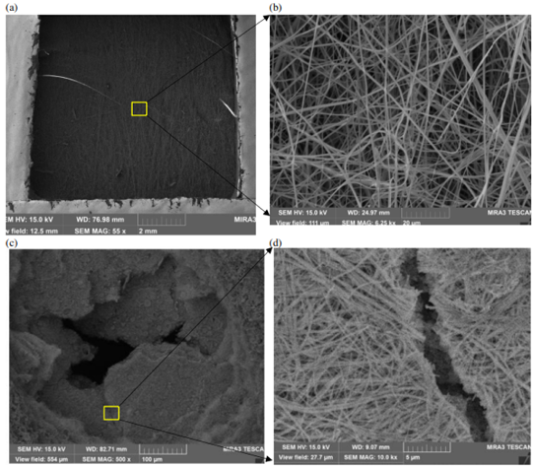
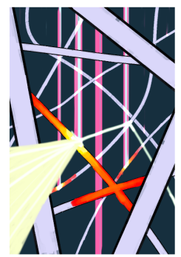
Analysis and Mitigation of Thermal Issues in a Nanofiber Target
W. Azstalos and Prof. Y. Torun (IIT)
Need better understanding of mass and heat transport mechanism in nanofiber media
Very complex heat and mass transfer
Conduction along fiber axis and crossings
Convection through He flow
Radiation reflects off nearby fibers, additional heating at certain λ’s
Need of nanoscale radiation model (λ-r)
Complex fluid flow
Low packing density
Beam
High packing density
Approach:
Use Porous Media Models to handle all three modes of heat transfer:
  Conduction: introduce effective k(T) for nanofiber mat due to Bhattacharyya and Daryabeigi
  Convection: use Darcy’s Law to simulate fluid flow, include energy equation in simulations
  Radiation: Mie Theory to solve scattering off infinite cylinder exactly, feed into model due to Lee
Low packing density samples survived
Holes, cracks in higher density samples
W. Asztalos’ talks on Thursday

Slide 30

HPT R&D Roadmap
HPT R&D is aligned
with timeline of HEP
Accelerators
HEP HPT R&D Workshop – April 11-12 2023

Slide 31
Summary
Want to hear from all of you to review and identify:
  all the materials of interest
  the needs for R&D for current and future project
    Missing data to support HPT R&D
  a list of potential material tests
Friday morning, we will have a special meeting to seek ideas to perform a new thermal shock test at HiRadMat

Slide 32














