Slide 1
RaDIATE Collaboration Meeting – Wrap-up
Frederique Pellemoine
8th Radiate Collaboration Meeting
26-30 June 2023

Slide 2
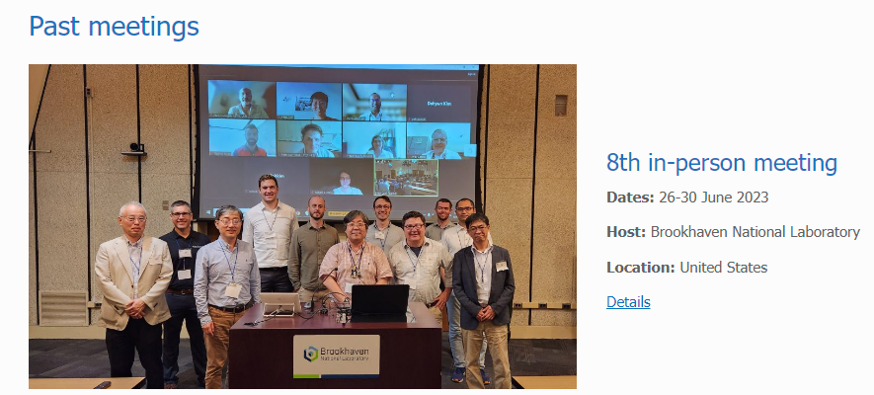
Thank you Dohyun and Courtney for your hard work
Total Participants
  32 participants :
    19-3 in person
    13+3 remotly
  RaDIATE website updated with link
  to this meeting
    Top right menu: Resources\ Annual meeting

Slide 3
Monday
Welcome from Dimitri Denisov
  Presentation of BNL and accelerator complex including the 3 largest programs:
    Nuclear Physics
    Basic Energy Sciences
    HEP
  Support for RadIATE BLIP test
    RadIATE Collaboration to prepare “1 pager” by mid of July: brief document about RaDIATE plans for irradiation at BLIP for the next three years. It should start from brief description of the collaboration/goals and then list (table is fine) planned irradiation (doses, durations, etc.).
    provide an estimate in this 1 pager how much, in the current funding arrangement, planned irradiations will cost.
    Concluding paragraph should ask for eliminating or reducing the irradiation costs. Especially if the irradiation is done as a secondary target after main isotope target.
    Please send me and Dohyun your interest to participate to a BLIP test with the list of material and the expected dose (no guaranty!)

Slide 4
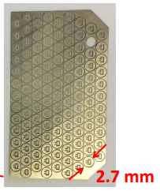
Monday
RaDIATE update by Frederique Pellemoine
  MoU signature almost completed: waiting for LANL
    6 new institutions
    7 new point of contacts (6 new institutions + Yong Joong for STS at ORNL)
  Needs to initiate coordinated R&D program for muon program as FNAL will need to start soon to support
    Inventory of current studies with J-PARC, CERN, STFC, ORNL (STS)… on high-Z material
    Strengthen the synergy within RaDIATE collaborators
  Continue to develop tools to support R&D: irradiation stations, PIE, modeling, novel materials
RaDIATE UK Update by Philip Earp
  Support from HyperK-UK, now LBNF-UK, coordination with US-JP collaboration
  Strong synergy between STFC-RAL, ISIS, Bristol, Birmingham, Oxford, UKAEA-MRF,
  all part of RaDIATE Collaborations
  Material studies
    Titanium including new irradiation, development of mesoscale testing and ultrasonic
    fatigue
    Graphite, thin ceramic coatings
  Extended capability with NNUF (National Nuclear User Facility)

Slide 5
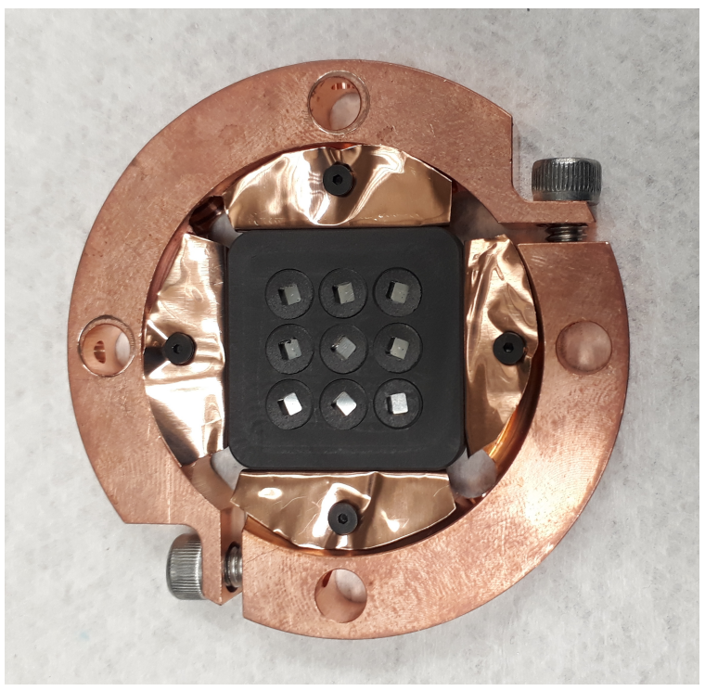
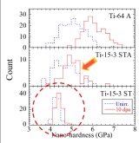
Monday
Material Irradiation Studies at ISAC-TRIUMF by Ferran Boix Pamies
  Progress, Highlights and Prospects
    Material irradiations and new capabilities with secondary irradiation
    Materials: PEEK, comparison between SS316L and HEA-Canton
    (FeCrMnNi), between Al6061-T6 and AM AlSiMg
    Prospective for material for next generation nuclear reactors, high temp irradiation, molten actinide fuel reactor (ZrC), with INFN-SPES for Tantalum material
RaDIATE activities at J-PARC by Shunsuke Makimura
  New framework at J-PARC to extend activities (arrangement with LANL,
  neutron irradiation Oarai (Tohoku University), proton irradiation at J-PARC)
  A lot of updates!
    Materials: Ti-alloys, SiC coated graphite, NITE SiC/SiC, novel material
    (TFGR Tungsten, HEAs: Ti, Fe and W based for window, structural material
    and target)
    Irradiation Studies: HRMT, HIT
    Don’t Forget to register to the HPTW at RIKEN On Nov 6-10 2023

Slide 6
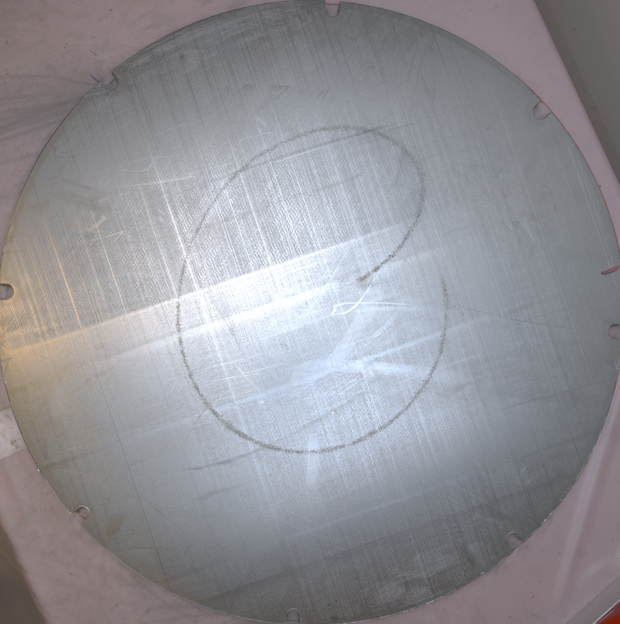
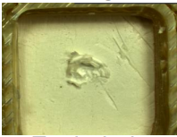
Monday
Developments on RaDIATE-related R&D for CERN's Beam Intercepting Devices by Nicola Solieri
  A lot of updates on BLIP CERN2 capsule, LHC Beam Dump activities, beam
  windows at the HRMT facility, BDF Prototype PIE
    Materials: MoGr and CFC, Sigraflex, Graphitic materials (Glassy C, Isostatic
    Graphite), Be, W, TZM
    Design: cladding Ta-alloy/TZM or W
Material R&D under US-JP and RaDIATE Collaboration by Sujit Bidhar
  Renewal of the US-JP collaboration to cover Be and Ti PIE (PNNL, BNL),
  Ti-alloy modeling (PNNL), HRMT samples PIE (PNNL), TGS development
  (FNAL), HEA development (J-PARC, FNAL)
  current US-JP activities cover fatigue test machine (FNAL), dpa
  measurement (J-PARC, FNAL)

Slide 7
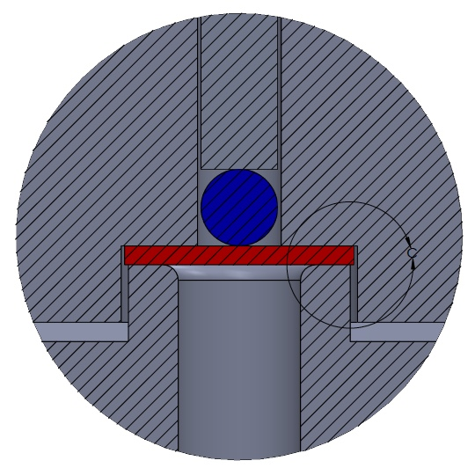
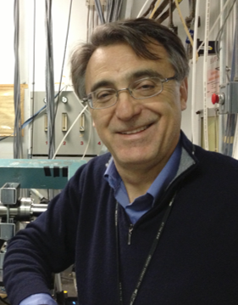
Tuesday
Two invited talks
  Non-destructive Characterization of Nuclear Materials Through X-ray Absorption And Diffraction Contrast Tomography: Case Study on Surrogate TRISO Particle by Mehmet Topsakai
  Low current irradiation experiments at BLIP to address nuclear data needs by Dmitri Medvedev
Production of Radioisotopes using Secondary Neutrons at BLIP by Michael Skulski
Irradiation campaign and PIE needs for STS target systems R&D by Yong Joong Lee
  Tunsgten irradiation effect : hardening, embrittlement, thermal diffusivity decrease.,
  Fatigue with 2 methods: WC-ball loaded bend fatigue test, bend fatigue tests
  with notched W-cantilever
  Extensive study on copper: swelling, hardening, low resistance to He-embrittlement
  Studies on Target Viewing Periscope
    Materials: BaF2, ZnSe, ZnS, CaF2, Ge, luminescence coating
Afternoon dedicated to Nick Simos Memorial
  Thank you, Pat and David, for your effort to prepare this very emotional event.

Slide 8
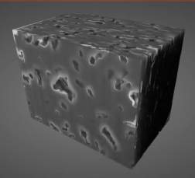
Wednesday
Two invited talks to prepare for the afternoon visits
  Center for Functional Nanomaterials by Dmytro Nykypanchuck
  Opportunities for Materials Science at Brookhaven’s Light Source (NSLS-II) by Eric Dooryhee
Crystal damage and porosity evolution in proton irradiated POCO graphite
by Ming Jiang
  Porosity evolution studied by FIB-SEM tomography
  Crystal damage studied by Raman spectroscopy
Measurement of displacement cross section for high-energy protons
and future plan for material damage using 400 MeV protons at J-PARC
by Shin-Ichiro Meigo
  Good agreement between arc-dpa and experimental data (except for Nb)
  NRT overestimate values for higher Ep value
  New facility at J-PARC TEF/ADS (Transmutation Experimental Facility)
    User community was established not only for material irradiation but also soft
    error and RI medicine

Slide 9
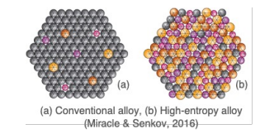
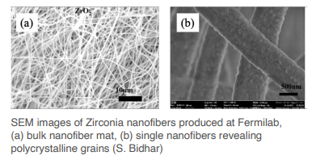
Thursday
Medical Isotope Research and Production/BLIP by Cathy Cutler
Session on Novel Material development
  Novel Materials R&D for Next-Generation Accelerator Target Facilities by Kavin Ammigan
    ECRP focus on HEAs and nanofibers
      Context, simulation approach, preliminary HEA Synthesis and irradiation, fabrication, path forward
  Design and Study of High Entropy Alloys for Next Generation Beam Windows by Nicholas Crnkovich
    Design and fabrication approach, initial characterization
  Exploring High Entropy Alloys for Next-Generation Beam Windows: A Computational Approach by Gaurav Arora
  Multiphysics Modeling and Simulation for the Development of a Nanofiber Target Concept by William Asztalos
    Multiphysics simulations to optimize nanofiber development and predict optimal design parameters

Slide 10
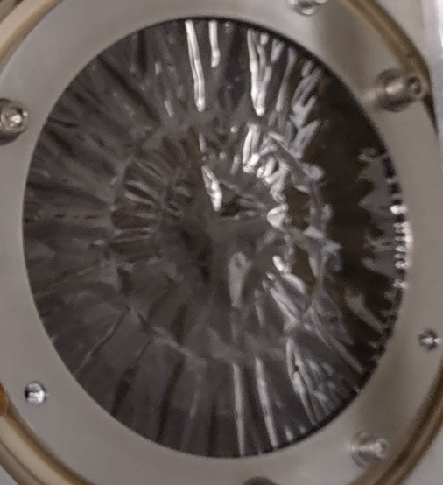
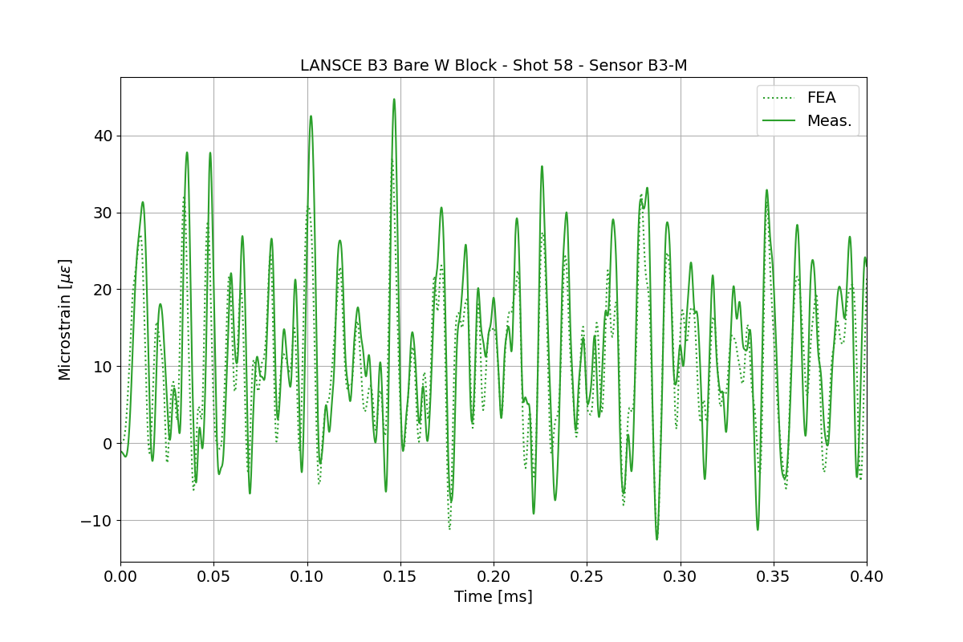
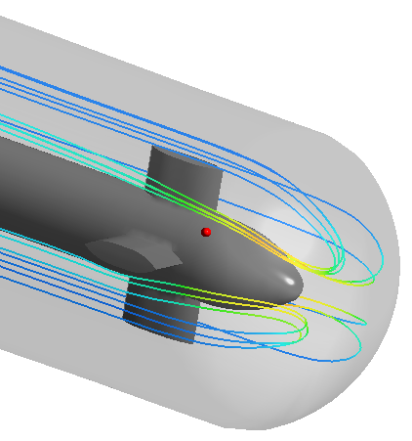
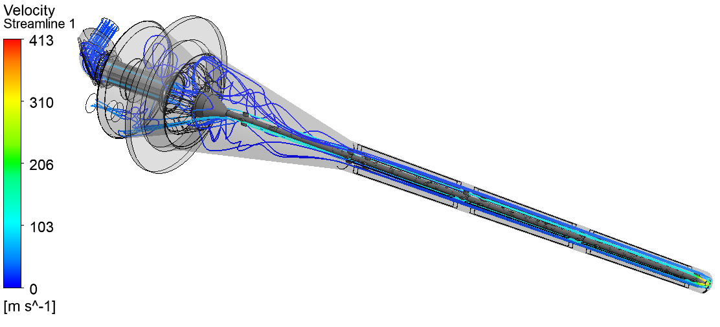
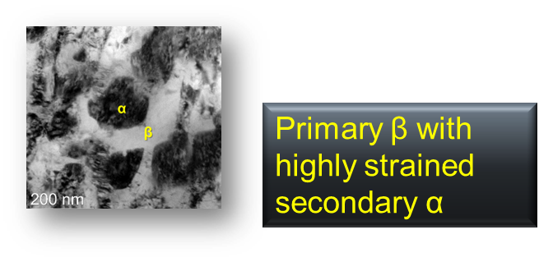
Thursday
FRIB Linac Beam-Intercepting Device Material Challenges by Takuji Kanemura
  Technical challenges of charge stripper and charge selector
Thermal shock study of clad and bare tungsten target samples by Justin Mach
  Thermal shock test at LANSCE Facility
  Validation of analysis predictions, assessment of damping and assessment of the effect of cladding
LBNF Nu Beamline Radiation Damage R&D Needs / LBNF Nu Upstream Decay Pipe Window Radiation Damage R&D Need by Pat Hurh (Quinn Peterson)
  Presentation of the irradiation and loading environment and listed the R&D needs for LBNF Absorber and Target
  Thoughts on engineering motivations for irradiation damage R&D: integration
  of radiation damage into standards compliance, avoid early failure, predict
  lifetime, satisfy safety requirements.
  3 beam windows: design, thermal and structural analysis
Updates to the RaDIATE Collaboration from PNNL by Andrew Casella
  A lot of update on graphite, SiC-coated graphite (thermal desorption), Ti-alloys (Tensile tests, modeling), Be (Tensile tests, bend tests, modulus measurements, microscopy)

Slide 11
Friday
The Proposed High Energy Effects Test facility at BNL’s AGS by Kevin Brown
Future HiRadMat test - discussion
Potential new collaborations and synergy
  Help FRIB for charge stripper and charge selector
  HEAs: FNAL/J-PARC
  Nanofibers: FNAL/ CERN/TRIUMF
  DSC: FNAL/UKAEA
  LBNF:
    FNAL/ORNL on SNS Al windows thermal diffusivity, Ti alloy BLIP samples
    TRIUMF on Al window thermal diffusivity, Ti alloy fracture toughness of ISAC isotope target
  And probably many more during breaks discussions
Thank you for your very active participation
The location for the next RaDIATE Collaboration Meeting will be announced later by email and via the RaDIATE website (radiate.fnal.gov)

Slide 12
