Slide 1
HiRadMat Test
RaDIATE Collaboration meeting
30 June 2023

Slide 2
Future HRMT
When
Long shut down will start in 2026 for 3 years
Test in 2025
discussion : now and during summer
Seek interest from RaDIATE collaborators: now and during summer
Selection of the test and preliminary list of material: early Fall
Preparation of the proposal: September-October
Send the proposal in November-January
Be prepared to present the new experiment to the HRMT Scientific Board sometime in 2024

Slide 3
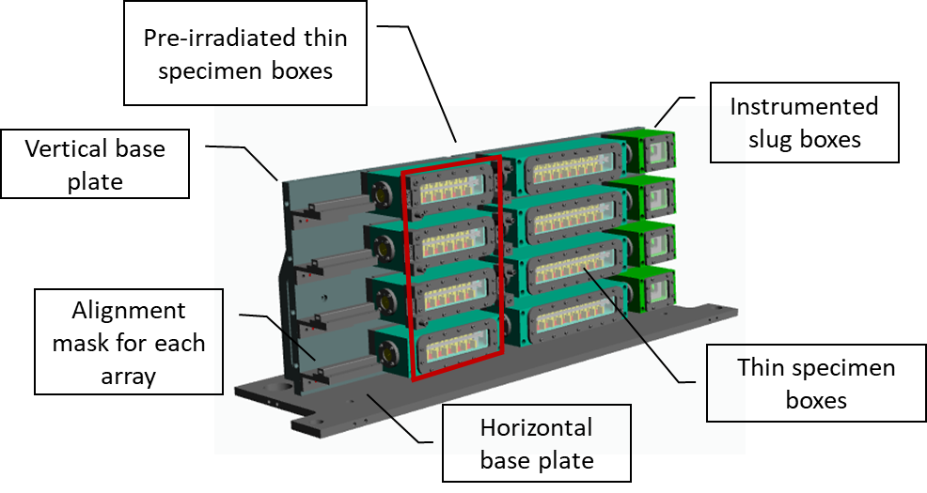
Current Set up

Slide 4
HRMT possibilities
Single pulse for new materials (TBD).
Do we have more irradiated materials to test?
Multiple pulses with previous materials (and/or new materials)
Up to 6 to 8 pulsed done in the past (HRMT-24)
Repeat similar experiment
Have more pulses (need to verify the maximum number of pulses allowable)
Higher intensity pulse (due to HRMT upgrade)
More slug for dynamic response of material
redo the test with Be, Ti-alloy and SiC/SiC
New material
Thermal shock at high temperature
Pre-stressed specimen/windows
Test concept
Target shaping
Dynamic Response of Solid Target (W, Cu and Inconel parts) to Beam Pulse - ORNL

