Slide 1
ePIC Management Plan for the Next 2-Year Term John Lajoie and Silvia Dalla Torre Revised: 3/9/2023

Slide 2
Introductory Notes (1/2)
This ePIC management plan is proposed with a focus on the next two years
It has been developed by the SP/Deputy SP candidates jointly
It includes contributions from the ePIC SC based on the experience gained together
We consider this a Work-In-Progress and look forward to feedback and suggestions!

Slide 3
Introductory Notes (2/2)
The Charter establishes the high-level managerial structure, while the scientific management structure is not depicted in the document
Our focus: present our model for the ePIC scientific management structure
We expect this structure will evolve as the Collaboration evolves, according to the needs in the different phases
Emphasis here is on the structure needed to support CD-2/3

Slide 4
Collaboration structure from the Charter
The high-level management structure, as set by the charter.

Slide 5
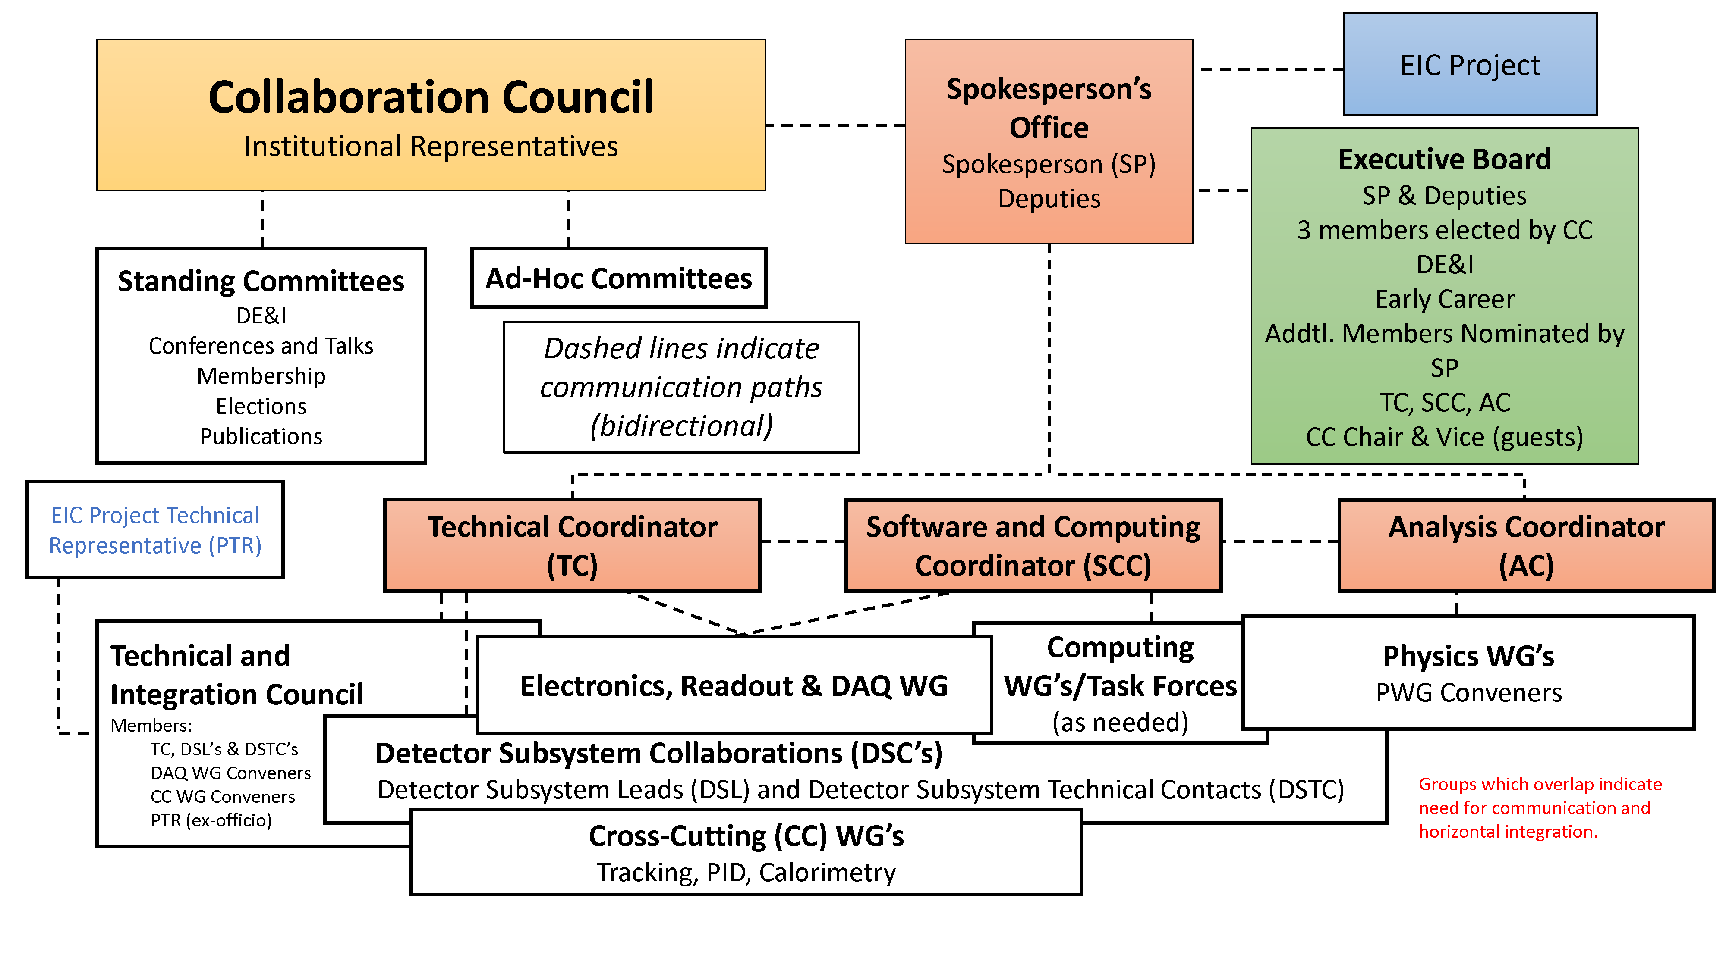
Collaboration Structure Including the Scientific Structure for the Next Two-Year Term
Black dashed lines indicate communication paths (bidirectional)
Our proposal for
the management plan

Slide 6
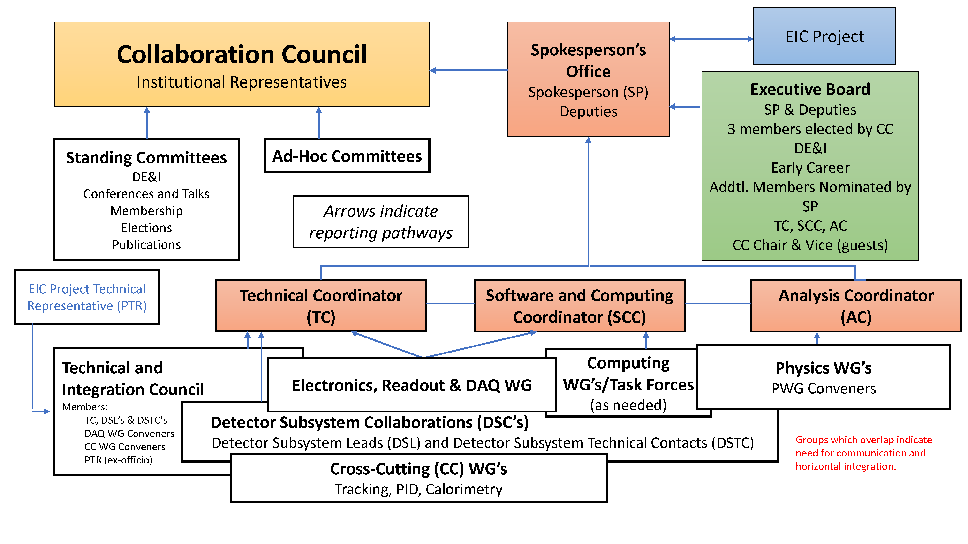
Collaboration Structure Including the Scientific Structure for the Next Two-Year Term
Arrows indicate reporting pathways
Our proposal for
the management plan

Slide 7
Collaboration Structure Including the Scientific Structure for the Next Two-Year Term
EB members advise the SP Office and provide needed input from collaboration stakeholders
CC Chair and Vice Chair standing guests
SP Office provides clear direction and accountability

Slide 8
Collaboration Structure Including the Scientific Structure for the Next Two-Year Term
TC, SCC and AC are proposed by SP and endorsed by CC as coordinators and EB members
Coordinator Deputies can be envisioned, to be discussed with the individual coordinators

Slide 9
Collaboration Structure Including the Scientific Structure for the Next Two-Year Term
Primary Goal: To use physics performance as a tool to guide the technical design
WG structure provides a clear entry point for new collaborators
Physics WGs with ~ 2 conveners
Number and domain of WGs to be discussed with the present WGs/collaboration
Enhance flexibility and communication with short-term task forces

Slide 10
Collaboration Structure Including the Scientific Structure for the Next Two-Year Term
Software and Computing Coordinator
Interface with host labs
Coordinates collaboration activity
Computing WG/Task Forces:
Software architecture
Simulations
Computing resources
Advanced algorithms & AI
Documentation and User Support
…
A dedicated WG and flexible structure of subgroups

Slide 11
Collaboration Structure Including the Scientific Structure for the Next Two-Year Term
Need to evolve DWGs to a structure more appropriate to the (pre-)TDR/construction phase:
WGs → Detector Subsytems
Each project corresponds to a subdetector built by a Detector Subsystem Collaboration (DSC) of the groups and institutions contributing to it
Each DSC will choose its Detector Subsystem Lead (DSL) and Detector Subsystem Technical Contact (DSTC)
DSL/DSTC (Collab.) <-> L4 Tech. Contacts (Project)

Slide 12
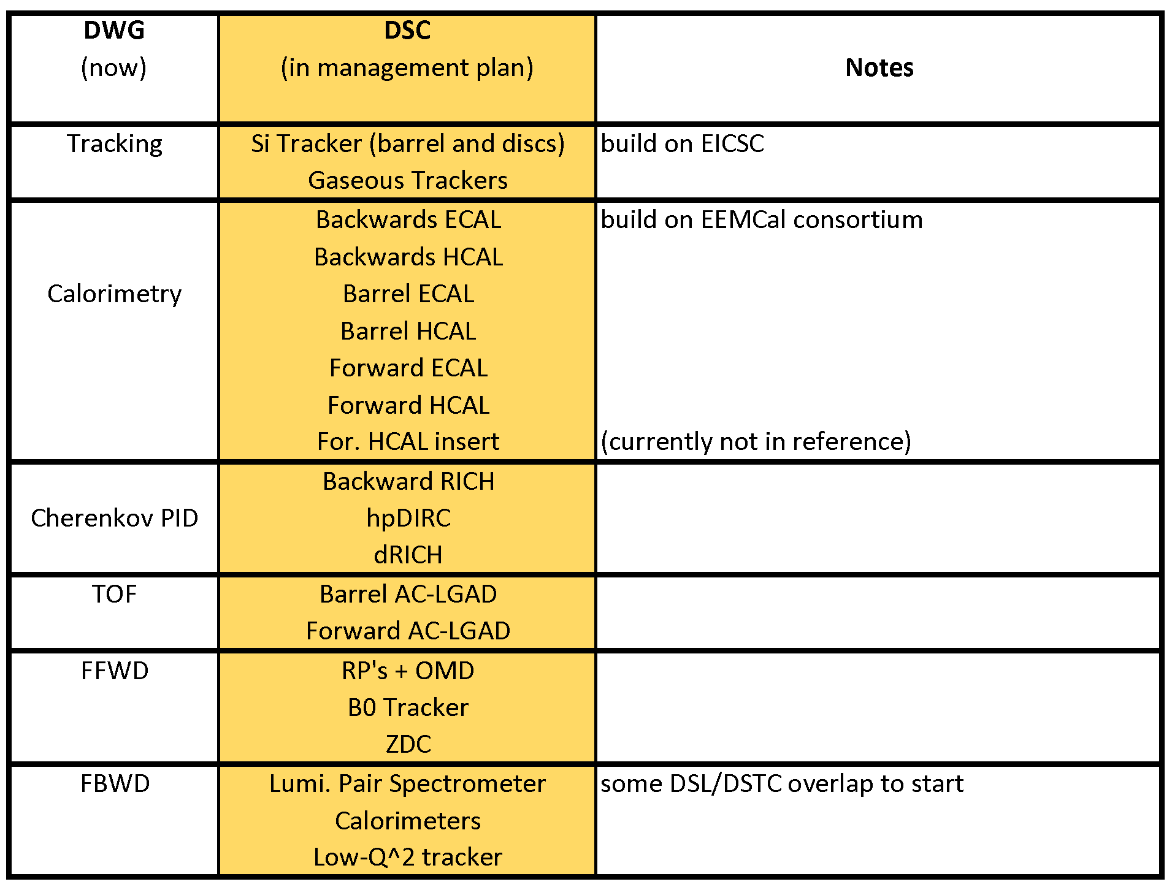
DSC scheme (draft for discussion)

Slide 13
Integration with EIC Project (I)
Slide from Elke and Rolf
For Si Tracker, seems logical that DSL/DSTC can be drawn from EICSC, and overlap with L4 Technical Contacts
MPGD tracking may be broken down further to μRWell and μMegas at the DSL/DSTC level.
Work Package Owners can also be drawn from the collaboration.
The goal is a tight integration between the project and the collaboration at a technical level.

Slide 14
Integration with EIC Project (II)
Slide from Elke and Rolf
This example looks at how things might be structured for a potential in-kind contribution.
Again, DSL/DSTC connected with project as L4 Technical Contact. Work Package Owners can also be drawn from the collaboration (examples shown).
The goal is a tight integration between the project and the collaboration at a technical level.

Slide 15
Collaboration Structure Including the Scientific Structure for the Next Two-Year Term
Need to evolve DWGs to a structure more appropriate to the (pre-)TDR/construction phase:
WGs → Detector Subsytems
Each project corresponds to a subdetector built by a Detector Subsystem Collaboration (DSC) of the groups and institutions contributing to it
Each DSC will choose its Detector Subsystem Lead (DSL) and Detector Subsystem Technical Contact (DSTC)
DSL/DSTC (Collab.) <-> L4 Tech. Contacts (Project)
RO and DAQ, which is cross-cutting to sub-detectors, remains a separate WG with ~3 conveners

Slide 16
Collaboration Structure Including the Scientific Structure for the Next Two-Year Term
Need to evolve DWGs to a structure more appropriate to the (pre-)TDR/construction phase:
WGs → Detector Subsytems
Each project corresponds to a subdetector built by a Detector Subsystem Collaboration (DSC) of the groups and institutions contributing to it
Each DSC will choose its Detector Subsystem Lead (DSL) and Detector Subsystem Technical Contact (DSTC)
DSL/DSTC (Collab.) <-> L4 Tech. Contacts (Project)
Technical and Integration Council is formed by
TC (chair)
DSL’s and DSTC’s
RO&DAQ WG conveners
CC WG conveners
EIC PTR (ex-offico)
RO and DAQ, which is cross-cutting to sub-detectors, remains a separate WG with ~3 conveners

Slide 17
Collaboration Structure Including the Scientific Structure for the Next Two-Year Term
Cross-Cutting WG’s (CCWG’s) preserve a forum to complete the design of integrated systems and evolve the analysis software and techniques.
2 Conveners per CCWG

Slide 18
Collaboration Structure Including the Scientific Structure for the Next Two-Year Term
Task Forces
Proposed by coordinators (TC,SCC,AC)
Formed as needed to address critical issues, or issues that require coordination between efforts
Examples:
Background Task Force (formed by Project)
Potential TF’s: ACTS/Tracking TF, Global Event Kinematics, etc.
Task forces and Cross-Cutting WG’s provide the bridge between disparate efforts!

Slide 19
Detector Decision Flow
Review, analysis and report by TIC
Recommendation formulated by SP Office in consultation with EB
SP Office ensures communication with EIC Project and CC, consistent with ePIC charter
ePIC Charter lines 66-70:
"Whenever unforeseen constraints identified by the EIC Project require substantial modifications to the detector design, the Collaboration will work with the EIC Project on related technical proposals, will assess the impact on physics capabilities of EPIC and will report their findings to the EIC project. In cases of particular relevance, this may even necessitate the Spokesperson to call for a Collaboration Council vote on the proposed changes."

Slide 20
ePIC Official meetings Goal: each meeting has a clear purpose, reduce redundancy in meetings
ePIC General Meetings:
Monthly (held at two times?)
Twice per year in-person (hybrid)
One per year outside US
Attendance: the whole collaboration

Slide 21
ePIC Official meetings Goal: each meeting has a clear purpose, reduce redundancy in meetings
EB Meetings:
Bi-weekly
Additional meetings as needed
Attendance: the EB members and invited guests

Slide 22
ePIC Official meetings Goal: each meeting has a clear purpose, reduce redundancy in meetings
TIC, Software and Computing, Analysis Meetings:
Bi-weekly
Attendance:
TIC, Computing WG/Task Force Leaders, PWG Conveners (respectively)
Open to collaboration (publicly announced in the collaboration calendar)

Slide 23
ePIC Official meetings Goal: each meeting has a clear purpose, reduce redundancy in meetings
WG/TF/DSC MEETINGs:
Detector Subsystems, RO and DAQ WG, computing WGs/Task Forces, PWGs will organize their agendas as they see fit
Open to collaboration (publicly announced in the collaboration calendar)

Slide 24
ePIC Official meetings Goal: each meeting has a clear purpose, reduce redundancy in meetings
CC Meetings (TBD by CC):
SP-office would suggest meetings every few (~3) months
In-person meetings should include CC meeting
Attendance: the whole collaboration

Slide 25
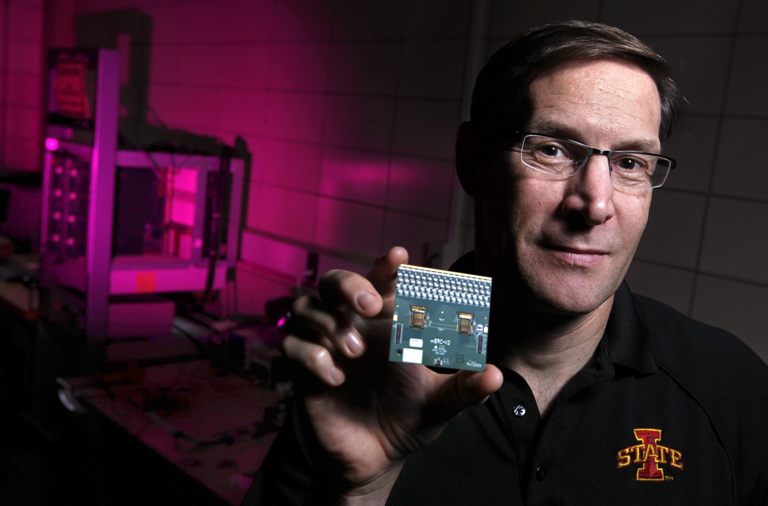
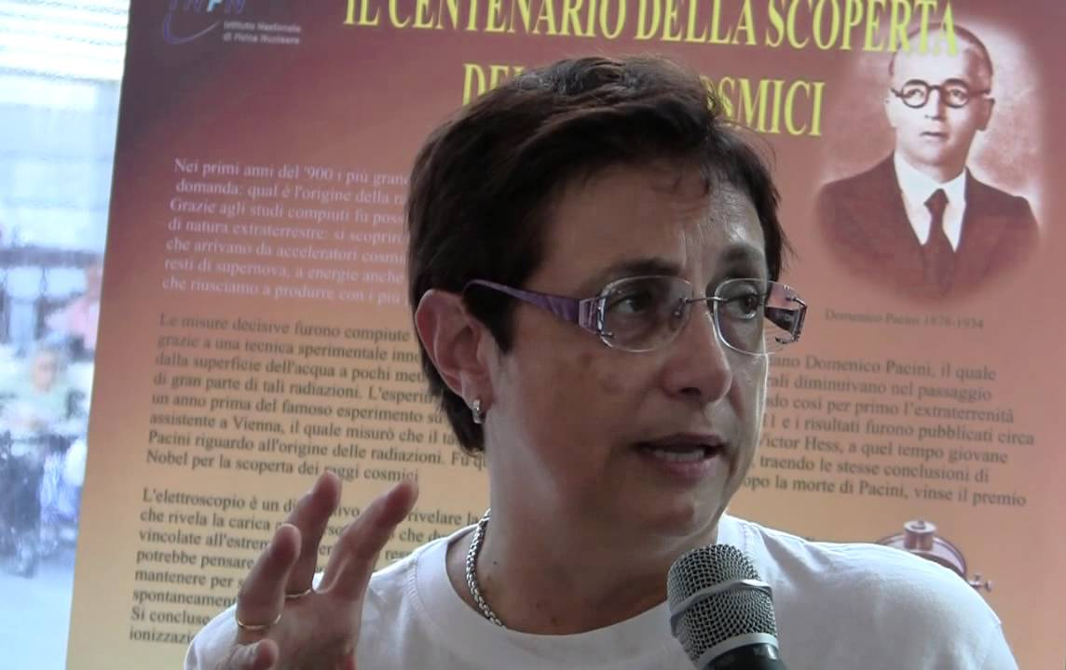
The SP Office
SP: John Lajoie
Deputy SP: Silvia Dalla Torre
Both SP and Deputy SP will dedicate to ePIC > 80% of their professional time
Well defined distribution of responsibilities

Slide 26
The SP-Office and Responsibilities
SP:
Represents the Collaboration in all circumstances
Overall responsibility for ePIC scientific management
Relationship and communication with EB, PM, CC and its Committees
Relationship with BNL, JLab and laboratory user groups, university groups
Raising the visibility of ePIC/EIC worldwide
Deputy SP:
Communication with the coordinators (TC, PC, CoC) and the corresponding board (TIC)
Managing the detector technology and integration decision process
Relationship with RRB
Relationships with Institutes/Groups concerning effective FTE and in-kind
Joint Responsibilities:
We plan to work as a collegial team. The areas above are intended as guidelines to make the work efficient.

Slide 27
Increasing International Engagement
ePIC will need strong international engagement in order to succeed!
Role of the Spokesperson’s Office:
Outreach/encourage participation in ePIC
Help nuclear physics communities raise EIC visibility in their home countries
Support international groups by helping them engage with ePIC, match their talents and capabilities to work that need to be done
Provide assistance/training to students and postdocs integrating into WG’s
Help with laboratory appointments, access to resources
Assist Project with coordinating planning for international contributions
Especially workforce in international groups
Support the efforts of the Project in the RRB

Slide 28
Community
To be successful we will not only need to grow the ePIC Collaboration but take full advantage of the skills, talents, and capabilities of all our collaborators
Silvia and I are dedicated to making ePIC a collegial, friendly, safe, and welcoming environment for everyone
It is critical to build this into ePIC culture from the very beginning!
Support the CC in developing a strong Code of Conduct
The ePIC charter includes concrete provisions to address misconduct
Code of Conduct should be developed quickly as a policy document
Support the CC in appointing a Talks Committee
Track assignment of talks, ensure an equitable distribution across all groups
Support the professional development of junior scientists
Provide opportunities for leadership and recognition
Facilitate participation in ePIC
While some can dedicate all their time to ePIC, many will have to balance ongoing commitments. Make sure that everyone can contribute to the best of their ability.

Slide 29
ePIC Relationship with PM (via SP supported by CC)
Major Guidelines:
Work with EIC PM to ensure the realization of the full EIC science program in the ePIC detector
PTR an ex-officio member of the TIC
Detector Subsystem Collaborations work in concert with EIC CAMs
Facilitate communication to ensure transparency in project decisions and the prompt exchange of information
Ensure that ePIC responds in a timely and complete manner to EIC PM requests
Provide the link between the collaboration and EIC PM to guarantee a constructive and friendly environment for ePIC
Support collaboration proposals to PM
Maintain a constructive and cooperative attitude

Slide 30
Transition of the Scientific Structure (1)
General considerations :
The transition of the high-level Collaboration management structure will follow the path indicated in the charter
The transition of the scientific structure is proposed in the next slides and follows the guiding principles:
Complete the transition in a reasonable time, but avoid disruption due to unnecessarily sharp transitions
Work as much as possible in consultation with the community
Truly dedicated WG conveners, DSL’s and DSTC’s

Slide 31
Transition of the Scientific Structure (2)
PWGs:
Presently 5 WGs with 4 conveners each
Model to be discussed with the community: 5 or 6 PWGs with 2 conveners each
Look at ways to maintain contact between PWG’s, make it possible for people to be active in multiple PWG’s
Computing:
Areas of Responsibility:
Software architecture; Simulations; Computing resources; Advanced algorithms and AI; Documentation; User Support; ….
Presently: 2 WGs with 4 conveners each (condensed to one group)
Possible model:
Flexible subgroups and task forces
To be determined in consultation with the community

Slide 32
Transition of the Scientific Structure (3)
R-O & DAQ:
Connections to all detector projects
Presently 1 WG with 4 conveners
Model proposed: 1 WG with 2-4 conveners
Subdetectors:
Presently: 6 WGs with 4 conveners each
Proposed model:
Detector Subsystem Collaborations (DSC’s) each building a well-defined subdetector
Each DSC determines its Detector Subsystem Leader (DSL) and Detector Subsystem Technical Contact (DSTC)
The breakdown in projects to be discussed/optimized with the collaboration

Slide 33
The Ongoing GD/I Review Process (BECal/backwards RICH)
Review process is already underway:
The review committee is GD/I with external reviewers
External reviewers contacted, dates set, charge discussed with proponents
GD/I remains in charge of the process as a review committee
No change to current plans
GD/I will provide a report to the EB
GD/I will be terminated after the completions of these reviews
The TIC will be set up in parallel to this process

