Slide 1
Techtra 2” HRPPD Anode Samples
M. Popecki
3/23/2023

Slide 2
Techtra Two Inch Sample Anode
Highland pulser
A
D
A fast, positive MCP-like pulse was applied to Input A, and observed on Output A1
Caen DT5742B waveform sampler
Sample waveforms collected.
Sample #1
50 ohm splitter
Caen DT5742B
Tr0
Ch 0
Ch 1
A1
A
B1
B
C1
C
D
B
B1
D1
Techtra Anode
Input A, B, C or D;
Output A1, B1, C1 or D1

Slide 3
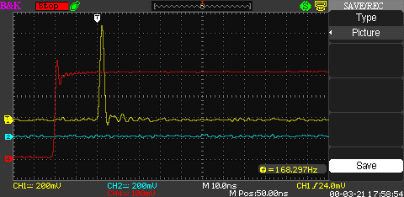
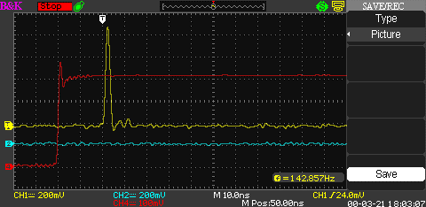
Sample waveforms
300 MHz oscilloscope
800 mV pulse in
B to B1 appears to have the least ringing
A1
A
B1
B
C1
C
D1
D

Slide 4
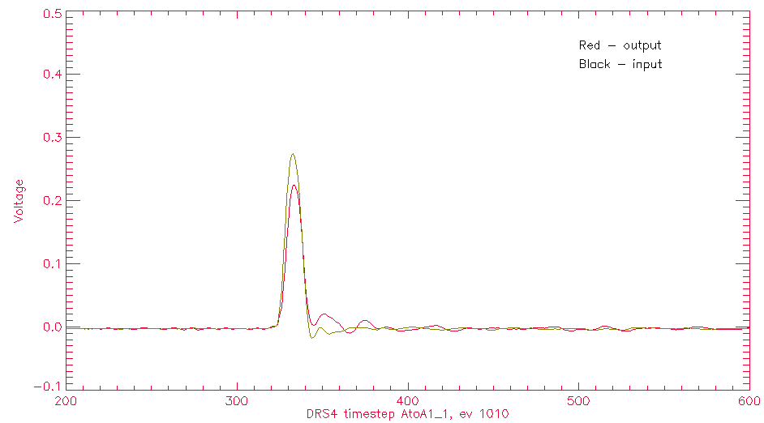
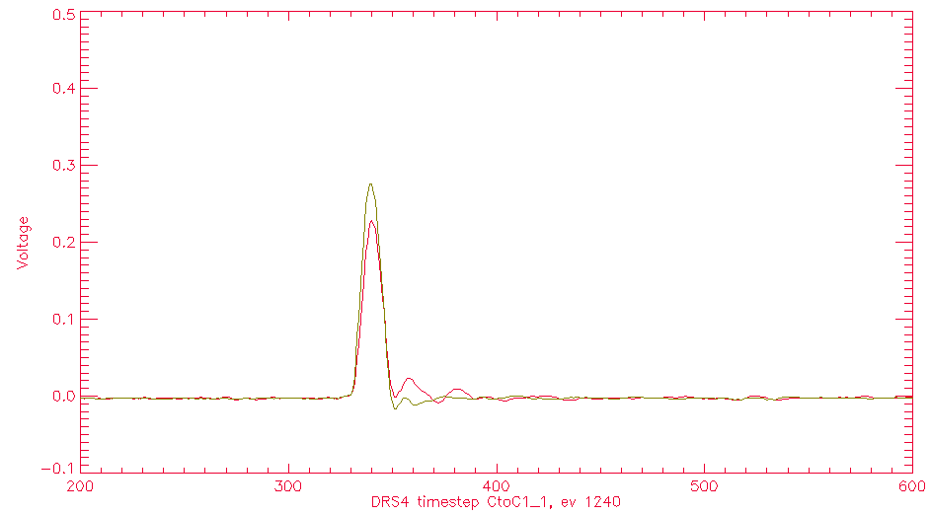
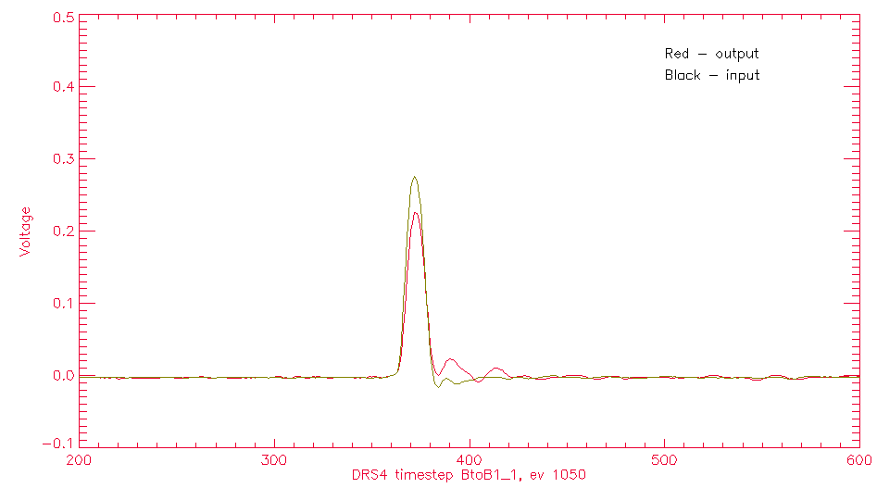
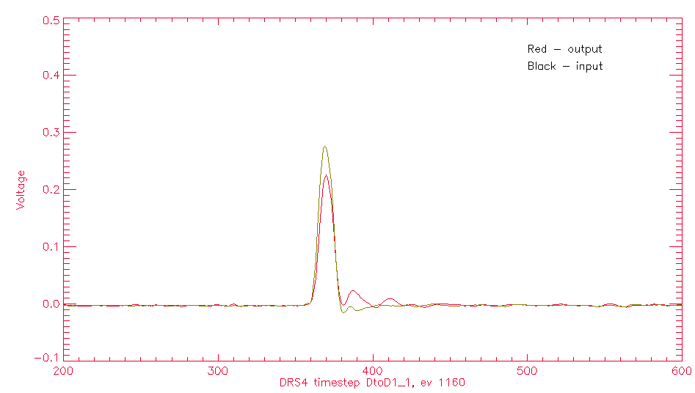
Sample Waveforms – Caen DRS4
Input/Output waveforms into A, B, C, D
A
C
B
D

Slide 5
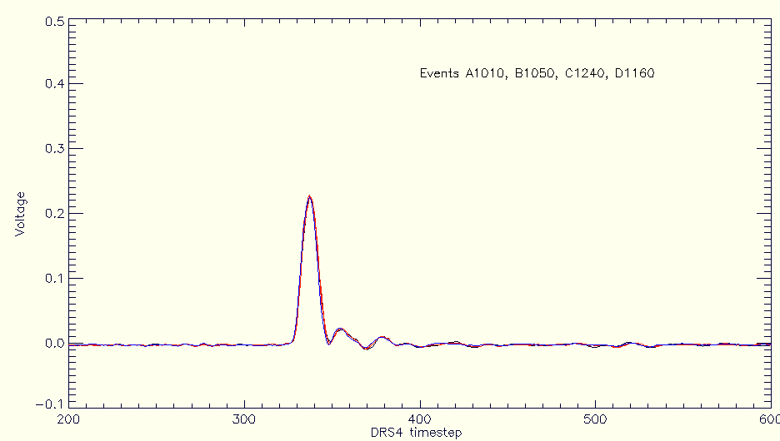
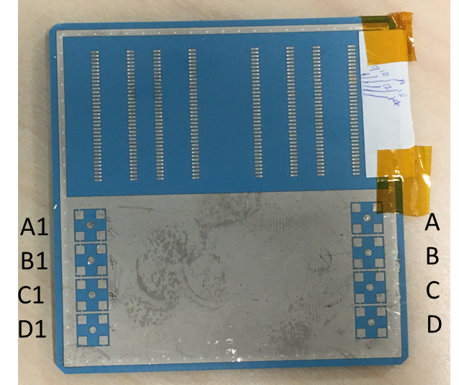
Sample Waveforms – Caen DRS4
Caen DT5742 DRS4 waveform sampler
Four output pulses superimposed:
A1010
B1050
C1240
D1160
Similar output waveforms

Slide 6
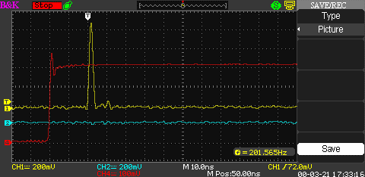
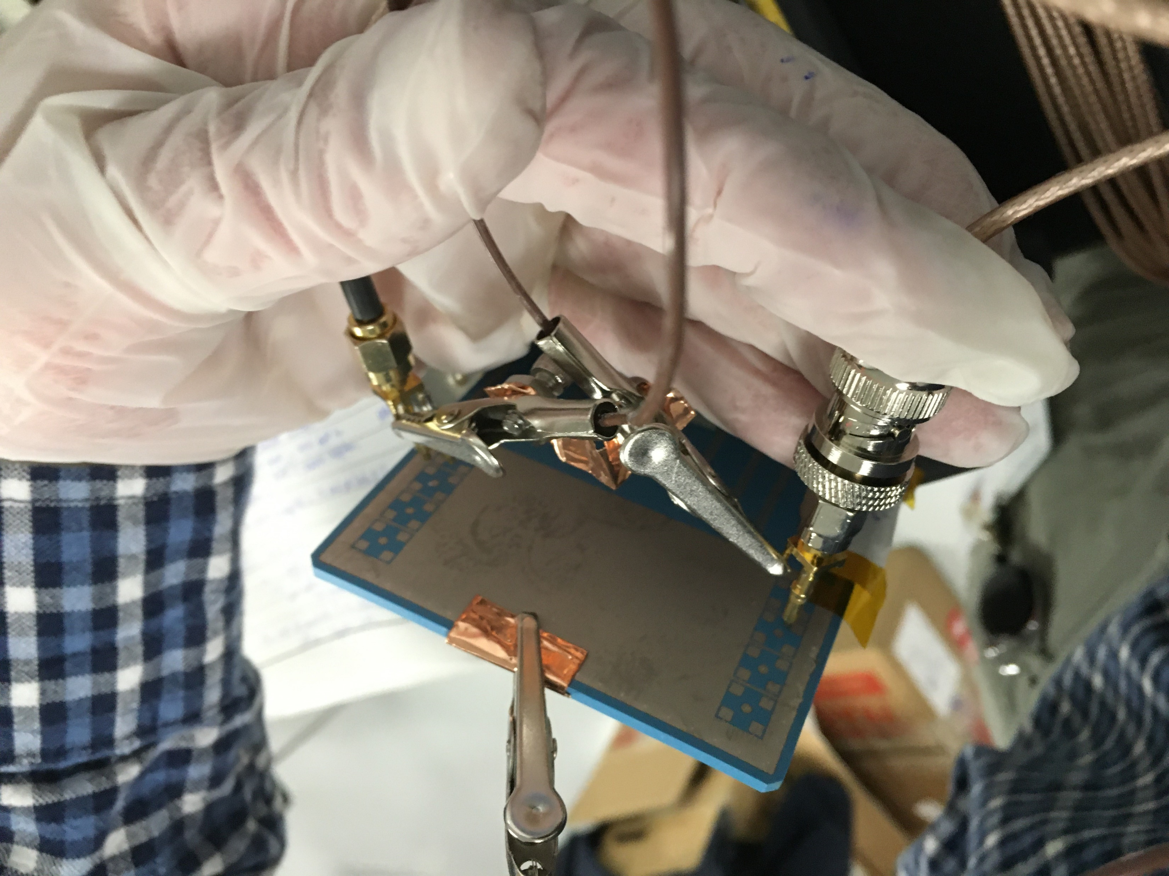
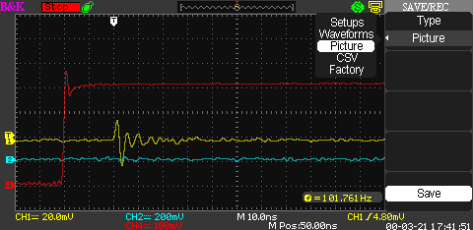
Pulse – Samtec to Pixel
Pulse applied to Samtec connector trace, observed at pixel on opposite side.
Input pulse height 800 mV.
Grounding of coaxial cables may contribute to ringing.
Pulse into Samtec trace 10, observed at corresponding Pixel 10
Pulse into Samtec trace 10, observed at neighboring Pixel 11. Ringing may result from ground arrangement.

Slide 7
IDL> fil='E:\HRPPD\Techtra 2 inch square anode 03-23-2023\AtoA1_1\_eventdat900’
IDL> asciird,fil,18,1024,dat,2,jct,txt,jtxt
IDL> plot,dat(0:jct,0)-4,dat(0:jct,2),xtitl='DRS4 timestep AtoA1_1, ev900',ytitl='Voltage',back=255,color=100,xrange=[200,600],yrange=[-0.05,0.5]
IDL> oplot,dat(0:jct,0),dat(0:jct,1),color=50
IDL> xyouts,500,0.41,'Black - input',color=0
IDL> xyouts,500,0.44,'Red - output',color=0

