Slide 1
RHIC/AGS Annual User’s Meeting ePIC Readout Electronics
Fernando Barbosa (JLab), L3 CAM
Jeff Landgraff (BNL), L3 CAM
Jin Huang (BNL)
ePIC Electronics & DAQ WG Conveners
2 August 2023
BNL, Upton, NY

Slide 2
Outline
Requirements and Design Philosophy
Streaming Readout Architecture
Readout Chain – Functions and Nomenclature
Readout Channels
eRD109 Proposals
Summary of Electronics Developments
ePIC Full Readout Chain
Summary

Slide 3
Requirements and Design Philosophy
Front-End Boards custom designed for each detector, populated with ASICs/COTS, operate in large magnetic fields.
ASICs/COTS process analog signals and digitization tailored to each type of detector technology, data reduction (e.g., zero suppression) desirable.
Maximize synergies in electronics and minimize cabling.
Electronics, including digitizers, close to the detector as much as possible and where applicable.
Prefer to limit FPGA use inside detector volume.
Serviceability as a design criteria.
Triggerless operation of the electronics as default; triggered operation for calibration, test, de-bugging.
Meet current US standards per NEC, UL, FCC, NEMA.

Slide 4
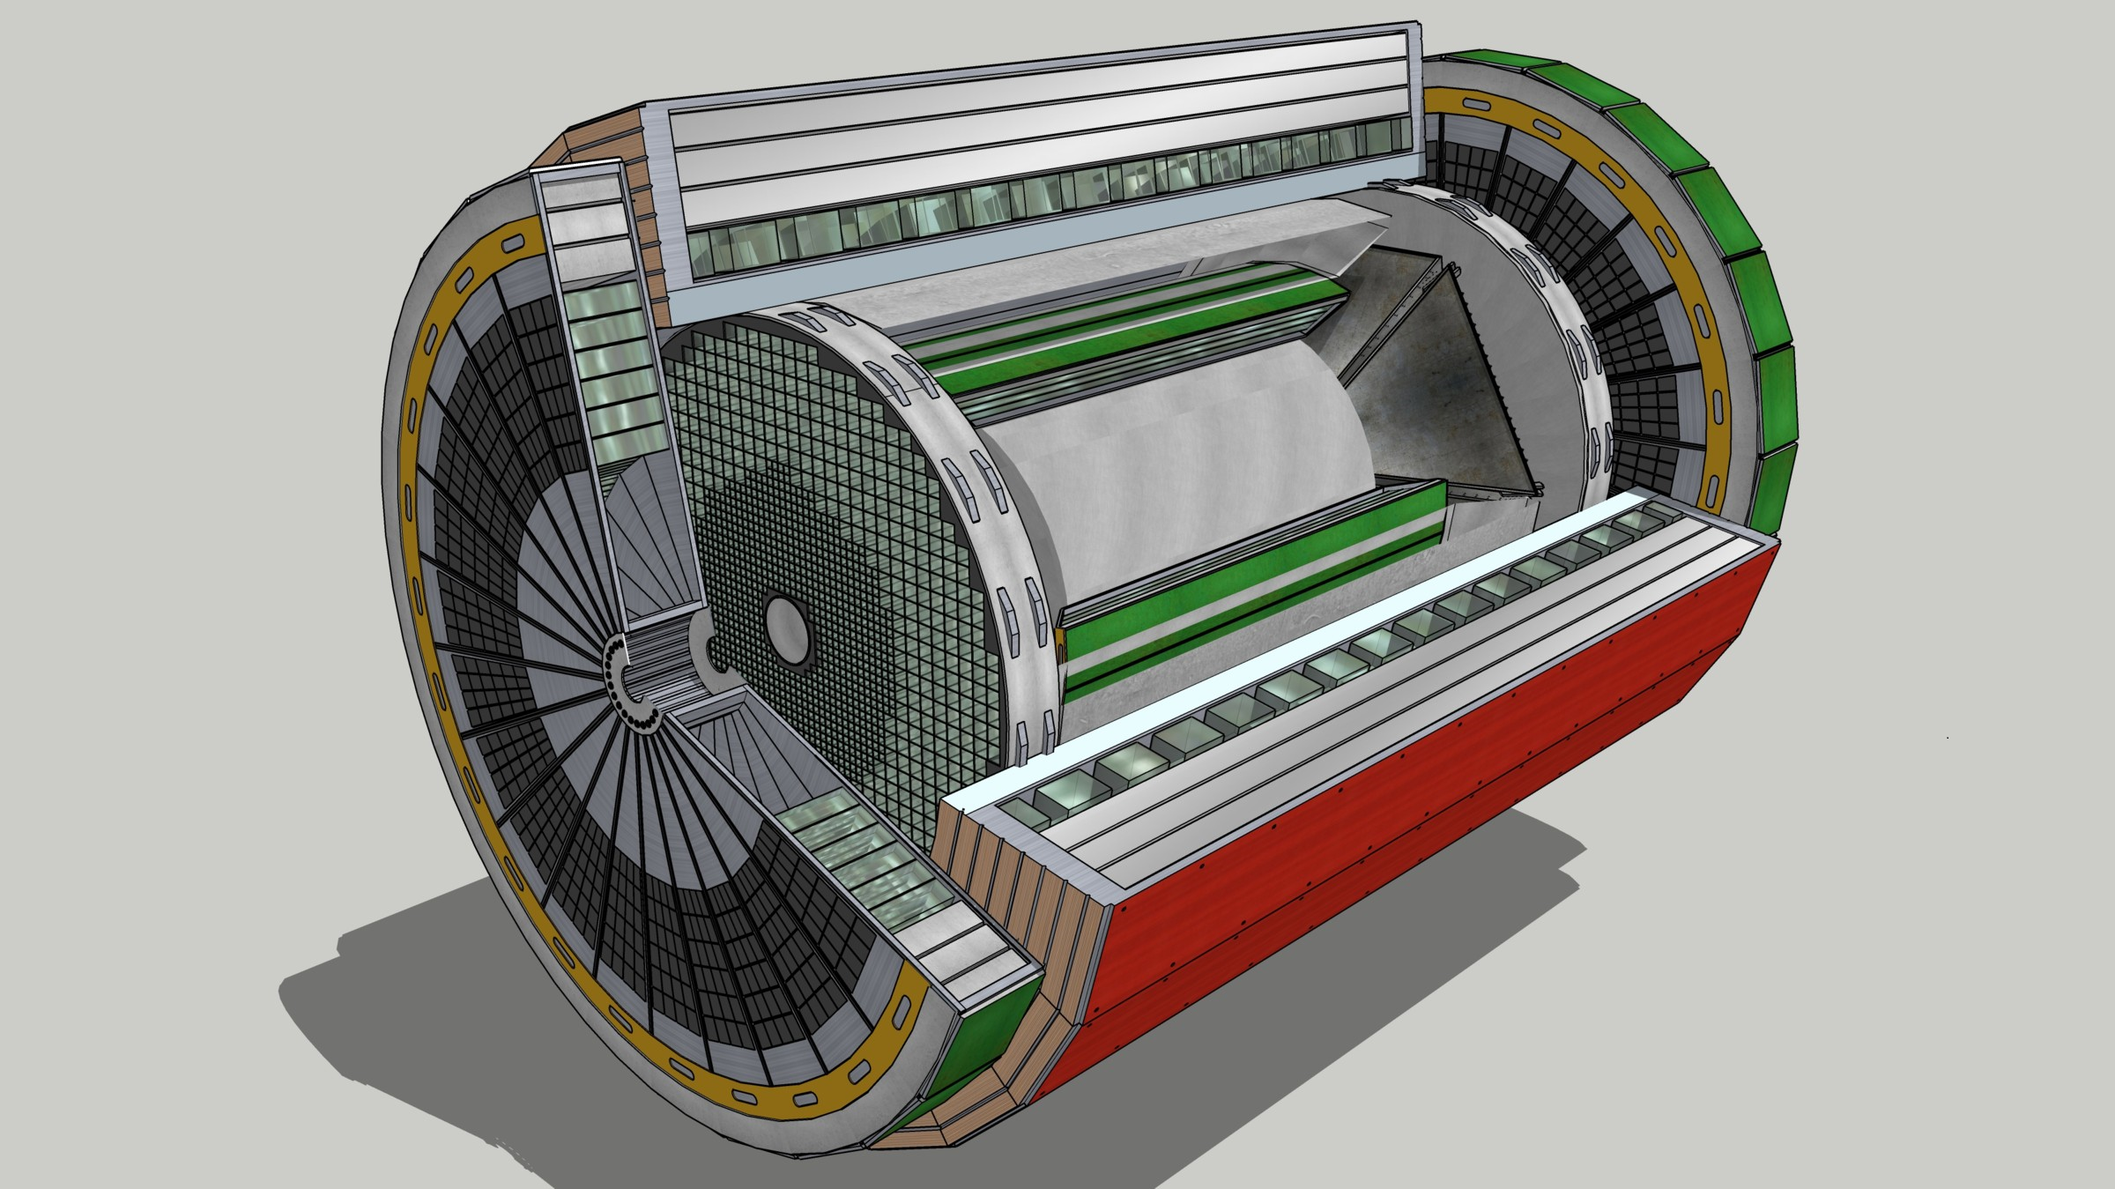
EIC Streaming Readout Architecture
Front-End Electronics
DAQ
Detector
FEB
(Front End Board)
RDO
(Readout Board)
DAM + Computing (Data Aggregation Module)
Total
BW: O(100 Tbps)
BW: O(10 Tbps)
GTU
(Global Timing Unit)
Bunch Crossing ~ 10.2 ns/98.5 MHz
Event Rate ~ 2 us/500 kHz
Low occupancy.
L ~ 100 m
fiber
Jitter ~ 5 ps
ASIC
Goal: O(100 Gbps)
Fiber
Switch / Server / Link-Exchange: Readout
Switch / Server: Processing
Switch / Server: Buffer
FEB
Storage
FPGA
Fiber
Monitoring
RDO
FEB
LVDS ~ 20-30 m*
Analog ~ 20m
Power Supply System
(HV, LV, Bias)
Cooling Systems
Data
Configuration & Control
Power
*LVDS – ANSI/TIA/EIA-644A standard. Maximum cable length dependent on data rate.
w/ Jin and Kai

Slide 5
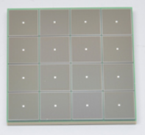
EIC Readout Chain
Global Timing Unit (GTU)
-Interfaces to Collider, Run Control & DAM
-Config & Control
-Clock & Timing
On Detector
SMT BGA
Name
Design
Function
Attributes
Sensor
Detector Specific
-Multi-Channel Sensor
-MAPS
-AC-LGAD
-MPGD
-MCP-PMT
-SiPM
-LAPPD
Adapter
Detector Specific
-HV/Bias Distribution
-HV divider
-Interconnect Routing
-Sensor Specific
-Passive
Front End Board
(FEB)
Detector Specific
-Amplification
-Shaping
-Digitization
-Zero Suppression
-Bias Control & Monitoring
-ASIC/ADC
-Discrete
-Serial Link
Readout Board
(RDO)
Few Variants
-Communication
-Aggregation
-Formatting
-Data Readout
-Config & Control
-Clock & Timing
-FPGA
-Fiber Link
Data Aggregation Module (DAM)
Common
-Computing Interface
-Aggregation
-Software Trigger
-Config & Control
-Clock & Timing
-Large FPGA
-PCIe
-Ethernet
Computing
Common
-Data Buffering and Sinking
-Calibration Support
-QA/Scalers
-Collider Feedback
-Event ID/Building
-Software Trigger
-Monitoring
-COTS
-Ethernet

Slide 6
ePIC Readout Channels (w/ Project P6 updates) – Refinements are on-going, e.g. Astropix, Timepix.
Detector System | Channels | Nominal Readout Technology | eRD109 Initiatives
Si Tracking: 3 vertex layers, 3 sagitta layers, 4 backward disks, 5 forward disks | 7 m^2 32 B pixels 5,200 MAPS sensors | MAPS – ITS-3
MPGD tracking: 3 layers | 100k | Strips | SALSA
Calorimeters: (in P6) Forward: LFHCAL pECAL Barrel: HCAL ECAL Backward: ECAL nHCAL | 31640 19000 1536 5760 3256 3240 | SiPM | Discrete/HGCROC
Far Forward: B0: 3 MAPS layers 1 or 2 AC-LGAD layer 2 Roman Pots 2 Off Momentum ZDC: Crystal Calorimeter 32 Silicon pad layer 4 silicon pixel layers 2 boxes scintillator | 3x20cmx20cm (300M pixel) 300k or 600k 1M (4 x 135k layers each) 650k (4 x 80k layers each) 400 11520 160k 72 | MAPS – ITS-3 AC-LGAG AC-LGAD AC-LGAD APD Si PMT/SiPM | EICROC EICROC EICROC Discrete/HGCROC HGCROC Discrete/HGCROC
Far Backward: Low Q Tagger 1 Low Q Tagger 2 2 Calorimeters | 1.3M 480k 700 | AC-LGAD AC-LGAD PMT/SiPM | EICROC EICROC Discrete/HGCROC
PID-TOF Barrel TOF CTTL Hadron Endcap TOF FTTL | 3M-50M | AC-LGAD | EICROC
PID-Cherenkov: dRICH pfRICH DIRC | 5376 69632 69362 | SiPM HRPPD HRPPD | ALCOR EICROC EICROC

Slide 7
eRD109 Status
FY23 - Contract awards have taken much longer than expected.
 | Detector/Technology | Discrete/ASIC | Group | Awarded
A | Calorimeter | Discrete | IUCF | April 2023
B | Calorimeter | HGCROC | ORNL | April 2023
C | dRICH | ALCOR | INFN | April 2023
D | AC-LGAD | EICROC | Omega/IN2P3 | See below
 |  | FCFD | FNAL | June 2023
 |  | Barrel L-M Serv. Hybrid | ORNL | April 2023
 |  | 3rd Party Evaluation | UCSC | Pending Legal
E | MPGD/µRWell | SALSA | CEA | May 2023
 |  |  | USP | May 2023
FY24 – Proposed and subject to DAC review 28-31 August 2023.
 | Detector/Technology | Discrete/ASIC | Group
A | Calorimeter | Discrete | IUCF
B | Calorimeter | HGCROC | ORNL
C | dRICH | ALCOR | INFN –BO, TO
D | AC-LGAD | EICROC | Omega/IN2P3/ IJCLab/CEA/IRFU
 |  | Barrel L-M Serv. Hybrid | ORNL
 |  | High Precision Clock Dist. | BNL/Rice/UIC/ORNL
E | MPGD/µRWell | SALSA | CEA/IRFU
 |  |  | USP
IN2P3 and OMEGA have committed considerable resources to the design of the ROC ASICs to meet the EIC streaming readout needs.

Slide 8
ePIC Readout Electronics – Present Assessment
EICROC and HGCROC families of ASICs have similar interfaces and follow similar developments at IN2P3/OMEGA/IRFU/IJCLab.
Commitment by IN2P3 and OMEGA narrows the ASIC field, favors convergence:
Detector Group | Channels | AC-LGAD | SiPM/PMT | MPGD
 | MAPS | AC-LGAD, HRPPD | SiPM/PMT | MPGD
Tracking | 32 B |  |  | 100k
Calorimeters | 50M |  | 67k
Far Forward | 300M | 2.3M | 500
Far Backward |  | 1.8M | 700
PID |  | 3M-50M + 140k | 300k
TOTAL | 32 B | 7.1M-54M | 370k | 100k
ASIC | ITS-3 | EICROC | Discrete/COTS HGCROC3 ALCOR-EIC | SALSA
HRPPD
eRD109

Slide 9
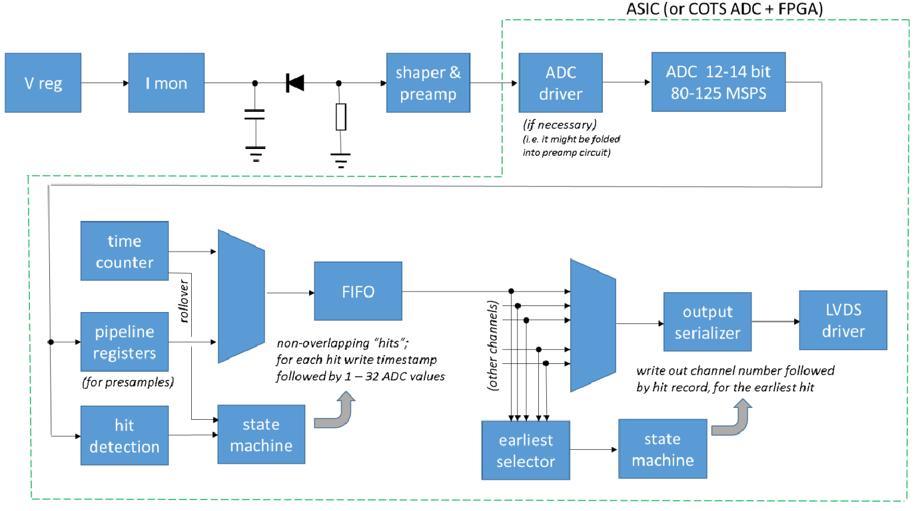
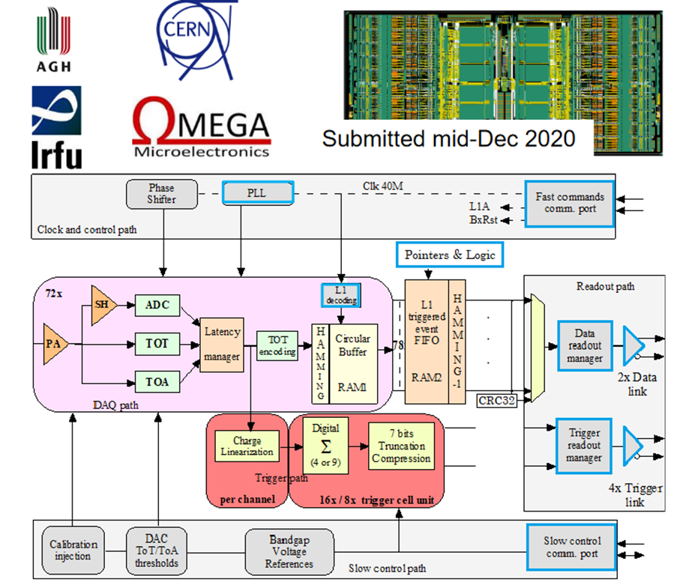
Summary of Electronics Developments
MAPS – ITS-3 (Monolithic Active Pixel Sensor)
Based on ALICE ALPIDE - 62 nm CMOS.
Tr < 2 us, 40 nW/pixel, 1.2 Gbps serial link
Radiation Tolerant.
Calorimeters – SiPMs – a) Discrete/COTS/ASIC (IU), b) HGCROCv3 (ORNL)
FEB PCBs
Adapter PCBs
32 ch, Waveform, 12/14-bit
Cabling, Power, Cooling, Packaging.
72 ch, Charge (ADC+TOT), Time (TOA,25 ps)
Large Dynamic range, 2xGbps links, 20 mW/ch
40 MHz, SRO with FPGA
Radiation Tolerant

Slide 10
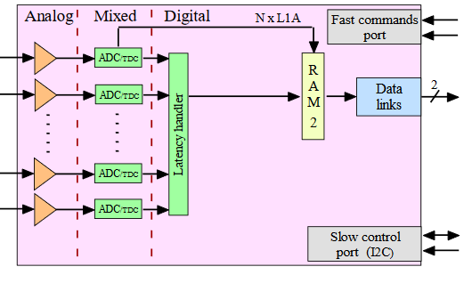
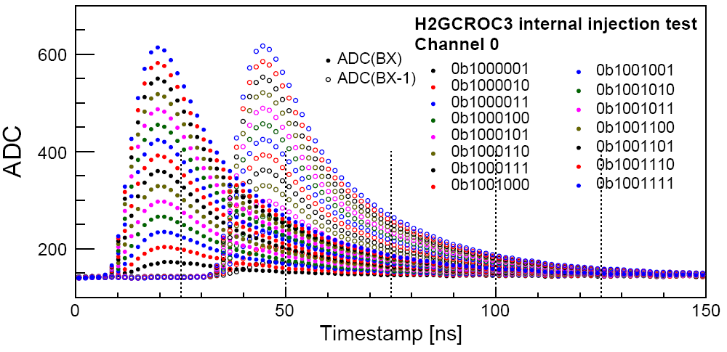
ROC ASIC Developments
Proposed HGCROC (based on H2GCROC3) – ePIROC?
Triggerless, to be checked w/existing chip.
40 MHz operation from external clock with BX 98.5 MHz.
1280 Mbps @ 40 MHz.
Triggered Tests,
N. Novitzky
No Change
Modify trig, mem, CLK dist.
Proposed EICROC
Different input structure, similar interfaces as HGCROC.
A few variants possible (direct attach BGA, interposer, IC package, # Pixels) to fit detectors.
HGCROC
1D, 72 ch.
Cdin: 5-50 pF
Dynamic Range: 1-10 pC
Timing: 100-120 ps
Power: 10-15 mW/ch
EICROC
2D, 32x32, 1024 ch
Cdin: 1-5 pF
Dynamic Range: 1-50 fC
Timing: 15-20ps
Power: < 1 mW/ch

Slide 11
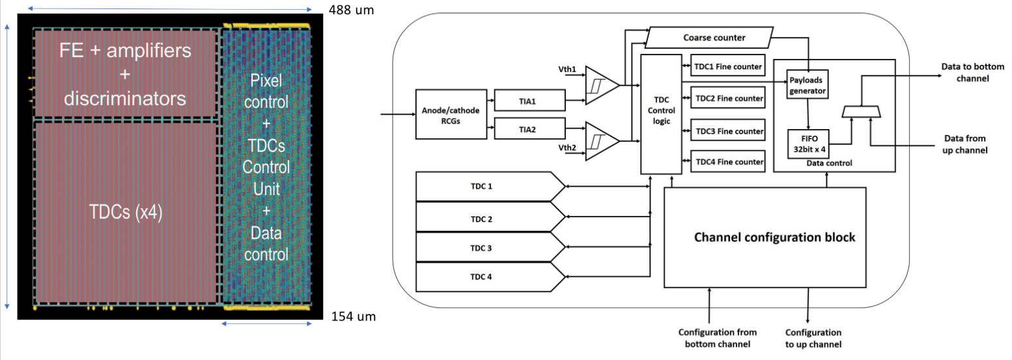
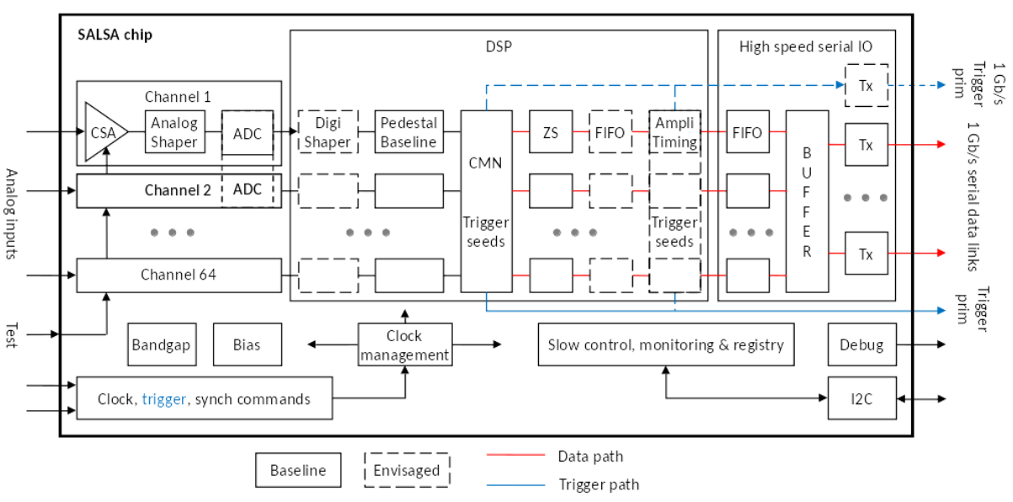
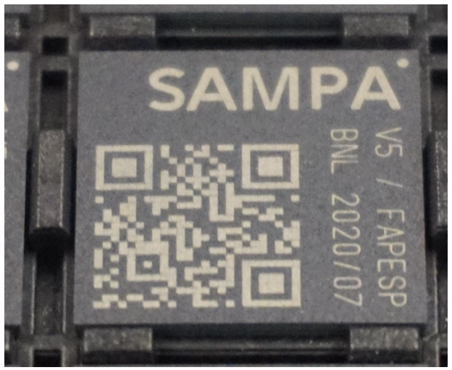
dRICH – SiPM – ALCOR (INFN)
64-Ch, 110/65 nm CMOS, SiPM readout.
Amplification, conditioning, digitization.
Triggerless and triggered operation.
25 ps TDCs, 5 MHz input.
4 or 8x 640 Mbps LVDS links.
MPGD – SALSA (CEA-Saclay, U. Sao Paulo)
64-Ch, 65 nm CMOS.
Peaking time: 50 – 500 ns
Inputs: >200 pF; Dual polarity
Rates: ~100’s kHz)
ADC: 12 bits, 5 – 50 MSPS.
Extensive data processing capabilities.
Triggerless and triggered operation.
Power: 15 mW/Ch
Several 1 Gbps links.
Updated design from SAMPA v5
Migration to 65 nm CMOS.

Slide 12
ePIC Full Readout Chain - Refinements are on-going.
Detector Group | Channels | AC-LGAD | SiPM/PMT | MPGD |  | RDOs / Fibers | DAM | Data Volume Estimate (Gb/s) | Data Volume To Tape (Gb/s)
 | MAPS | AC-LGAD | SiPM/PMT | MPGD | LAPPD
Tracking | 32 B |  |  | 100k |  | 415 | 11 | 15 | 15
Calorimeters | 88M* |  | 67k |  |  | 305 | 11 | 15 | 15
Far Forward | 300M | 2.3M | 500 |  |  | 174 | 5 | 1 | 1
Far Backward |  | 1.8M | 700 |  |  | 113 | 4 | 100 | 2
PID |  | 3M-50M | 300k |  | 150k | 1070 | 41 | 1856 | 45
TOTAL | 32 B | 7.1M-54M | 370k | 100k | 150k | 1662 | 72 | 1987 | 78
RDO – Readout Board – Interface between FEBs and DAMs with:
Aggregation, data formatting & readout, configuration & control, clock & timing.
Data transport via fibers.
A few design variants are planned.
DAM – Data Aggregation Module – Interface between DAMs and Computing:
Aggregation, computing, configuration & control, clock & timing, software trigger.
One design for ePIC.
Data volume to tape estimated to be less than 100 Gbps.

Slide 13
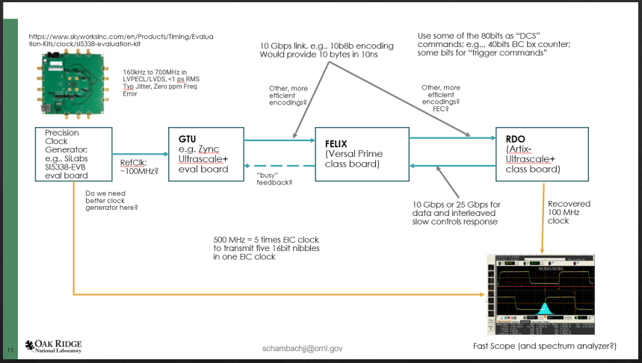
Other current activities:
Location/partitioning of electronics under consideration: space, power, radiation, cabling – overall performance:
by Irakli M.
On-detector for dRICH
RDO/Timing subgroup – GTU/DAM/RDO clock timing validation tests (~5 ps).
by Jo S., Jeff L.

Slide 14
Summary
ePIC is actively developing a streaming readout architecture, benefiting from resources within its large collaboration and to meet the physics goals of the EIC.
Developing the readout electronics by building upon previous developments, with design re-use as a guiding principle.
Engaging the community and benefiting from in-kind contributions.
Significant Progress:
Readout architecture and nomenclature completed.
Active design initiatives:
ASICs/Discrete circuitry
Full chain Interface standards (FEBs/RDOs/DAMs)
Clock timing and distribution (GTU).
DAQ Computing & Streaming Models.
Please join:
• Mailing Lists – https://lists.bnl.gov/mailman/listinfo • Indico Agenda - https://indico.bnl.gov/category/402/ • Wiki - https://wiki.bnl.gov/EPIC

