Slide 1
Inaugural tic meeting
Klaus Dehmelt
Technical Integration Council Meeting
April 28, 2023

Slide 2
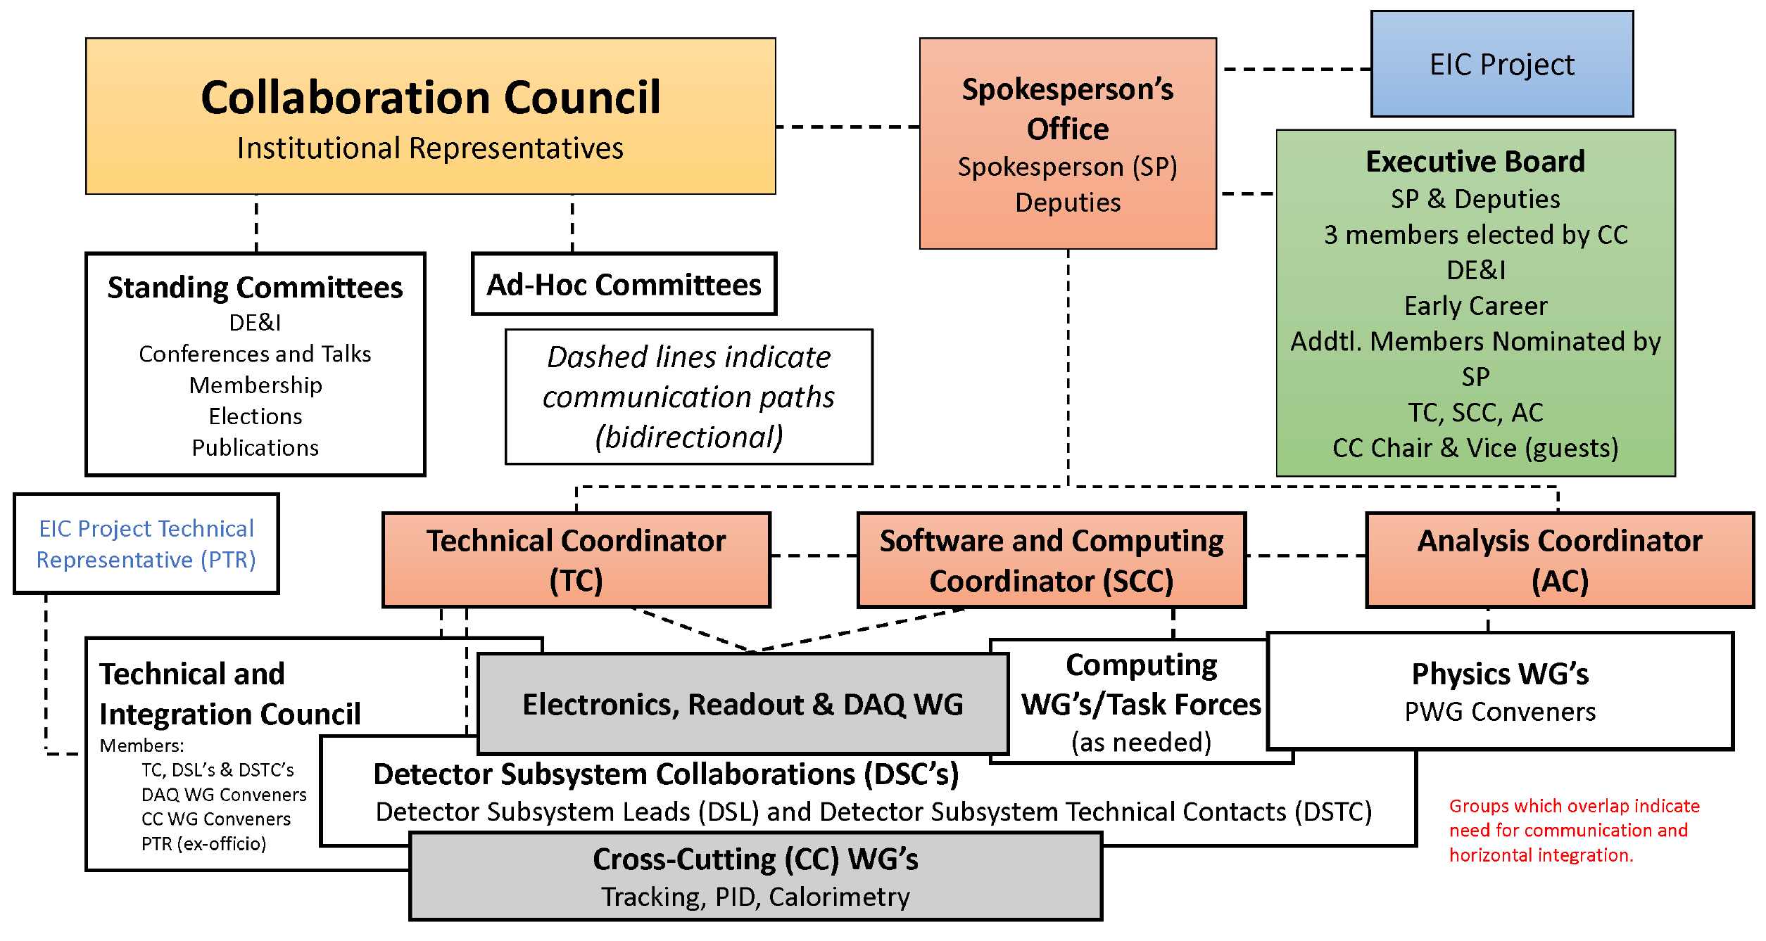
Technical and integration council

Slide 3
welcome!
Technical Integration Council TIC → succeeds GD/I entity

Slide 4
welcome!
Technical Integration Council TIC → succeeds GD/I entity
Today’s topic

Slide 5
Detector subsystem collaborations
dRICH
hpDIRC
backward RICH (pfRICH)
FFWD
FBKWD - Pair Spectrometer
FBKWD - High-Rate Calorimetry
FBKWD - High-Rate Tracker
Si Trackers
Gaseous Trackers
Backward ECal
Backward HCal
Barrel ECal (Pb/Sci)
Barrel HCal
Forward ECal
Forward HCal
Forward HCal Insert
AC-LGAD TOF (Barrel + Forward)
Identified 17 DSCs at this time
Status update in the following

Slide 6
Detector subsystem collaborations
Identified 17 DSCs at this time
Status update in the following
Handover meeting GD/I → TC and SP
Identified topics to be pursued in the future
Priority list
Topical list

Slide 7
Priority list
BECal down selection → Done
bRICH down selection → Done
Tracking performance study/optimization with reconstruction and background embedding
Service routing and clearance control
Forward dRICH geometry optimization
Low-Q² gap in our acceptance [0.01, 1] GeV²
dRICH data reduction → streaming DAQ

Slide 8
topical list
Integration
Tracking
Calorimeter
RICH
TOF → LGAD
DAQ
Far Forward/Backward

Slide 9
Future tic meetings
I suggest to start a series of TIC meetings on a weekly basis until next simulation campaign started
Taking over Monday’s GD/I spot
Work on topics of the priority list
Touch base regarding topical list
Mailing lists

