Slide 1
Detector subsystem collaborations
DSC representatives
Technical Integration Council Meeting
April 28, 2023

Slide 5
ePIC, fECal DSC
Chinese Universities Consortia (Fudan University, Shandong University, South China Normal University, Tsinghua University)
University of California EIC Consortium (UCLA, UCR)
IUCF
BNL
DSL - Huan Z. Huang (UCLA), Oleg Tsai (UCLA/BNL)
DSTC – O. Tsai
Groups has extensive expertise and capabilities in executing large scale project in high energy and nuclear physics experiments around the world. (RHIC, JLab, CERN, Super KEKB).
Including recently built forward calorimetry systems for STAR and participating in sPHENIX WScFi barrel Ecal construction (same technology for fECal).
Participating Institution has extensive capabilities to curry large scale construction projects.
All are members of ongoing ePIC R&Ds. All groups are in eRD106 (fECal), and some are members of related R&D projects eRD109 and eRD110.

Slide 6
Far-Forward Subsystem Collaborations
One Detector Subsystem lead for all subsystems: Alex Jentsch
Three technical contacts:
Yuji Goto – Zero-Degree Calorimeter (goto@bnl.gov)
Zvi Citron – B0 Tracker + EMCAL (zhcitron@bgu.ac.il)
Alex Jentsch – Roman pots and Off-momentum detectors (ajentsch@bnl.gov)
Cross-cutting FF + FB working group (for common integration issues): Nathaly Santiesteban and Simon Gardner.
Status summary
All detector’s primary technologies chosen.
Heavy focus on engineering design and integration (for B0, RP, and OMD); optimization of setup for ZDC (# of imaging layers, more uniformity in design to for compensation).
Impedance studies and iteration of engineering design (RP + OMD).
Support infrastructure and integration with accelerator magnet (B0).
Understanding of background and doses (B0 + ZDC, primarily).

Slide 7
AC-LGAD Time-of-Flight Detector
ePIC AC-LGAD TOF Detector System
Barrel: 1 cm*500 um strips, ~10 m², ~2M channels
Forward: 500*500 um² pixels, ~1.4 m², ~6M channels
TOF Detector Working Group
Convener: Constantin Loizides (ORNL), Frank Geurts (Rice), Wei Li (Rice), Zhenyu Ye (UIC)
DAQ contact: Tonko Ljubicic (BNL)
Simulation contact: Nicholas Schmidt (ORNL)
LGAD consortium, eRD109 (ASIC & Electronics), eRD112 (Sensor & Mechanics)
TOF Detector Subsystem Collaboration
Nominated for DSL and Deputy DSL: Zhenyu Ye (UIC), Satoshi Yano (Hiroshima)
In the process of defining working groups/packages, and collect institutional interests/responsibilities
Institutions:
USA: Brookhaven National Laboratory, Los Alamos National Laboratory, Oak Ridge National Laboratory, Ohio State University, Purdue University, Rice University, University of California Santa Cruz, University of Illinois at Chicago
Japan: Hiroshima University, RIKEN, University of Tokyo
India: IIT Mandi, National Institute of Science Education and Research
Taiwan: National Central University, National Cheng Kung University, National Taiwan University
China: South China Normal University, University of Science and Technology of China
4/28/2023
7

Slide 16
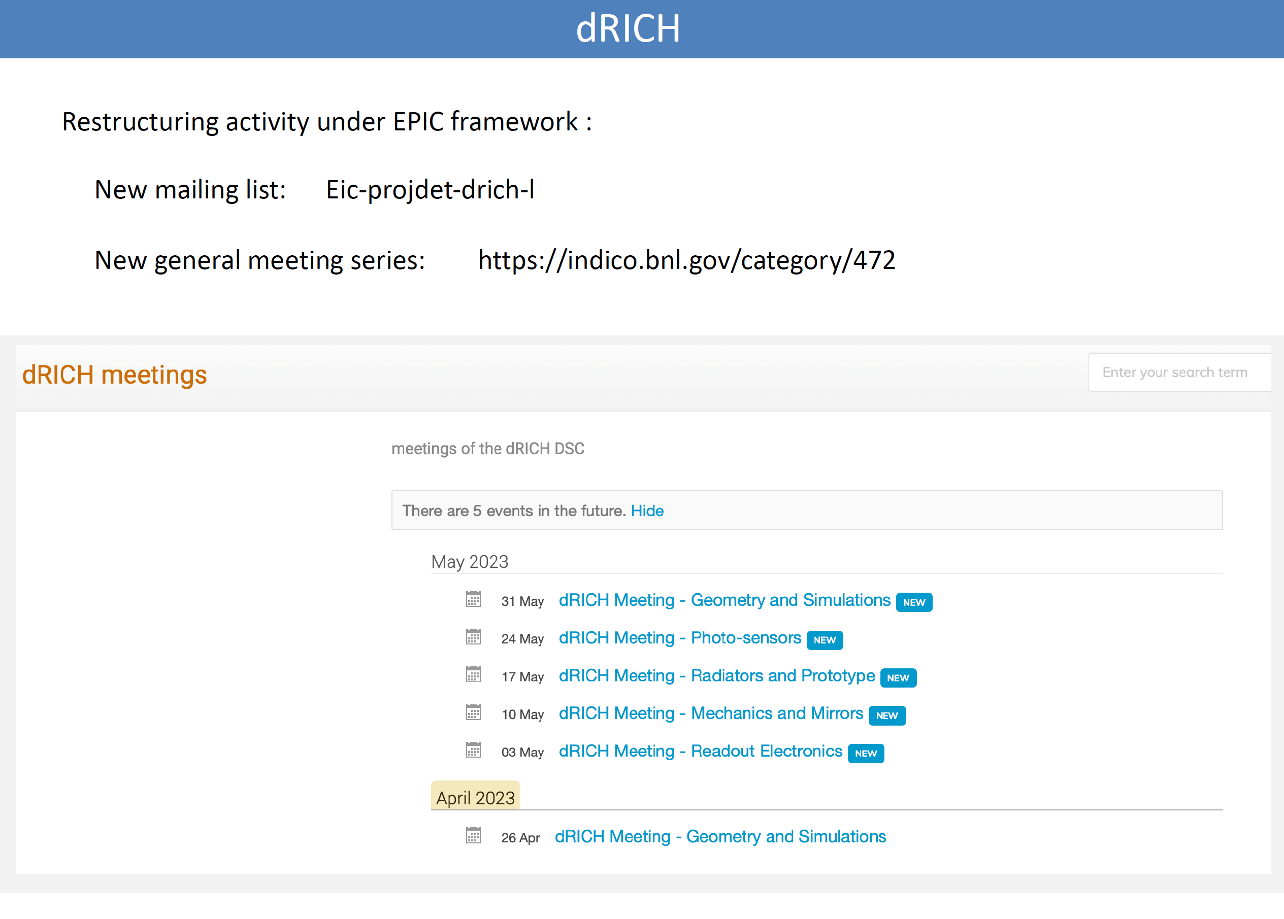

Slide 24
