Slide 1
Collider-Accelerator Department
Wolfram Fischer, C-AD Chair
Workshop on
Exploring Collaboration with MSIs in Nuclear and Particle Physics
18 July 2023
Notes:
25 min, =>20 slides max

Slide 2
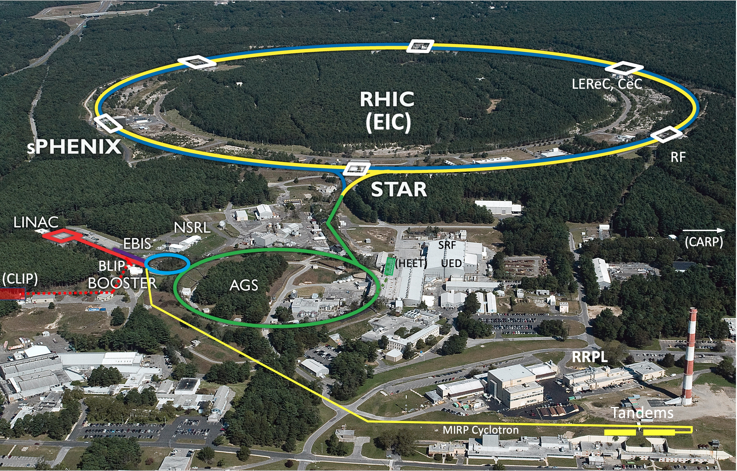
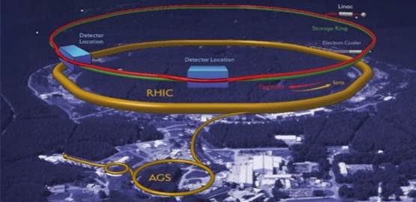
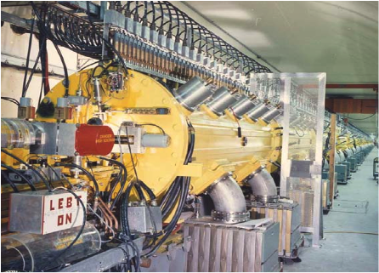
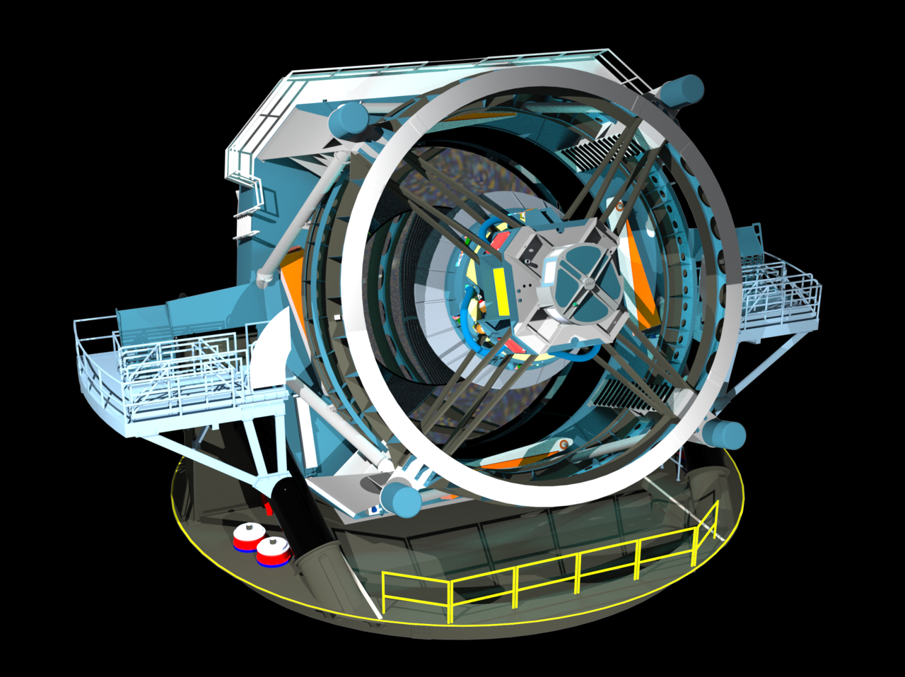
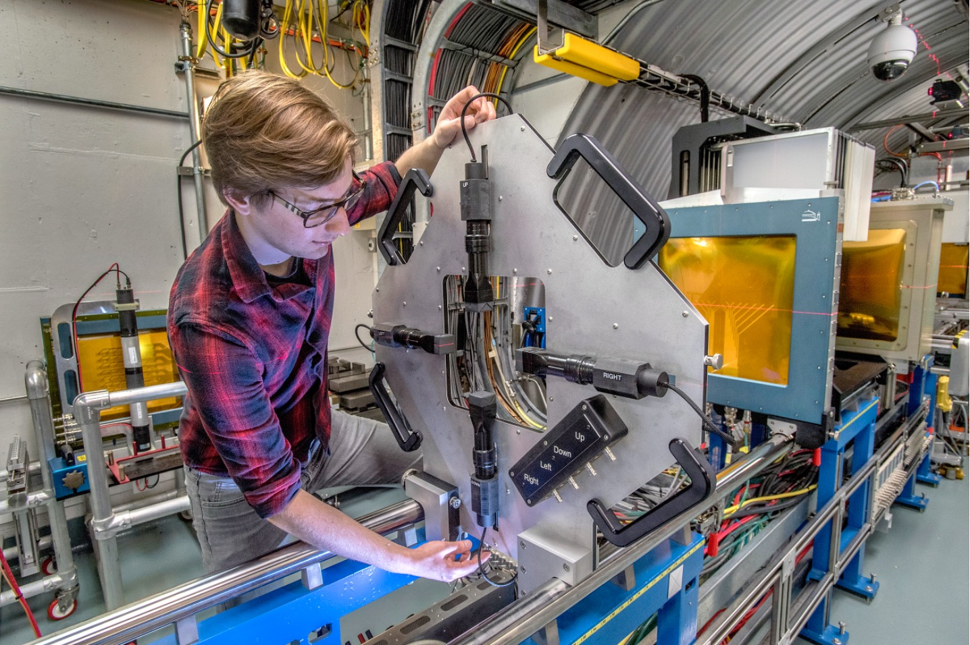
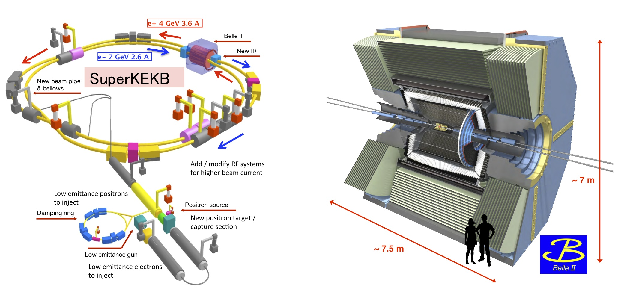
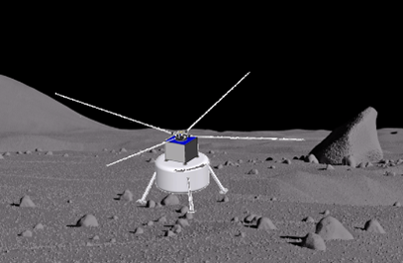
Nuclear & Particle Physics at BNL
To understand sub-atomic world deeper and deeper
Electron-Ion Collider
Develop unique technologies to answer fundamental questions in nature and for applications
BLIP: Medical Isotopes
ATLAS @ LHC
Long Baseline Neutrino Experiment
Rubin Observatory
NASA Space Radiation Lab
Belle II at SuperKEKB
LuSEE-Night mission

Slide 3
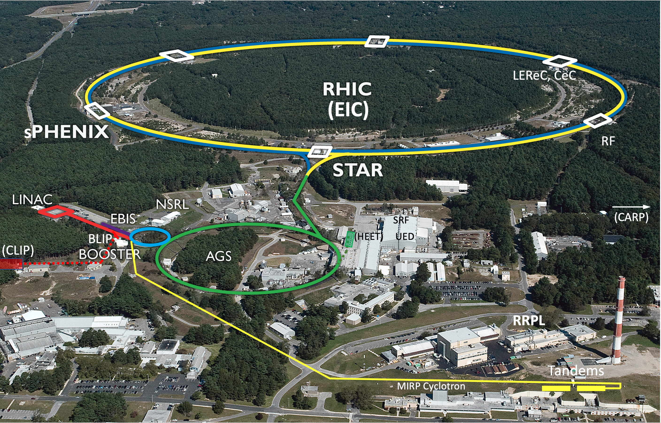
BNL Collider-Accelerator Department (C-AD)
C-AD designs, improves and
operates particle accelerators for
basic research
RHIC (=> EIC)
isotope production
LINAC/BLIP, Cyclotron
space radiation testing
Tandem, Booster/NSRL
industrial applications
Tandem
The department requires a wide
range of skills
accelerator science & technology
engineering
mechanical, vacuum, cryogenic,
electrical, radio frequency, civil,
controls, instrumentation, laser,
computer
technicians
accelerator operations, safety
and administrative staff
Relativistic Heavy Ion Collider (RHIC)
=> Electron-Ion Collider (EIC)
NASA Space Radiation Lab (NSRL)
Brookhaven LINAC
Isotope Producer (BLIP)
Tandems
Cyclotron

Slide 4
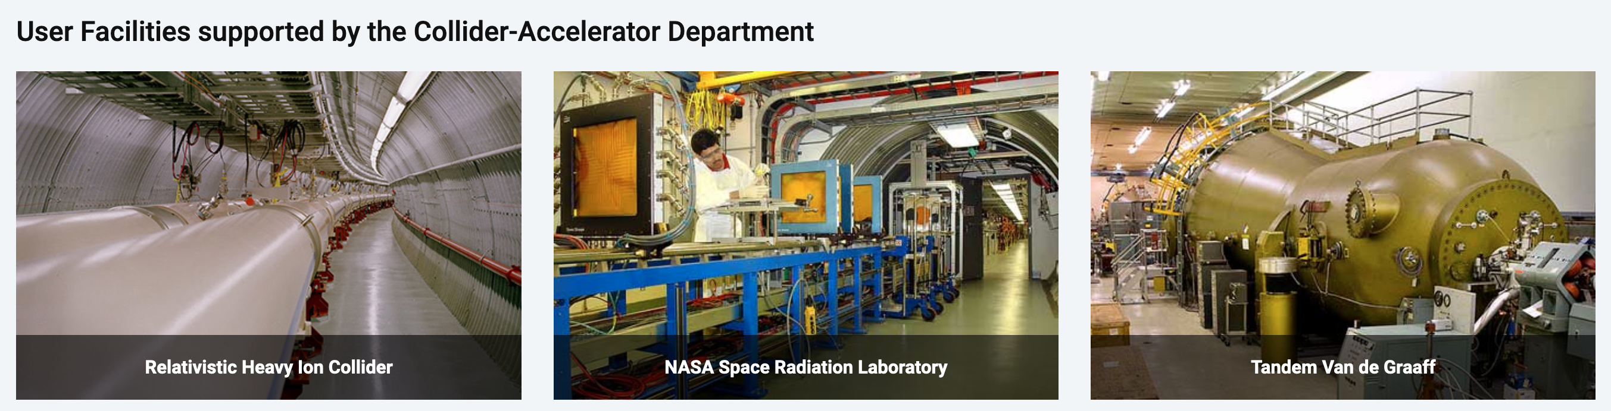
Collider-Accelerator Department
Mission: Design, develop, commission and operate state-of-the-art accelerators to carry out accelerator-based experiments in an environmentally responsible and safe manner. Perform accelerator R&D towards the next generation of accelerator facilities and accelerator applications in support of national needs.
FY2022: 402 head, 398 FTE (318 RHIC)
Significant legacy infrastructure issues (AGS started operation in 1960) are being addressed through continuous renovation and replacement of obsolete equipment.

Slide 5
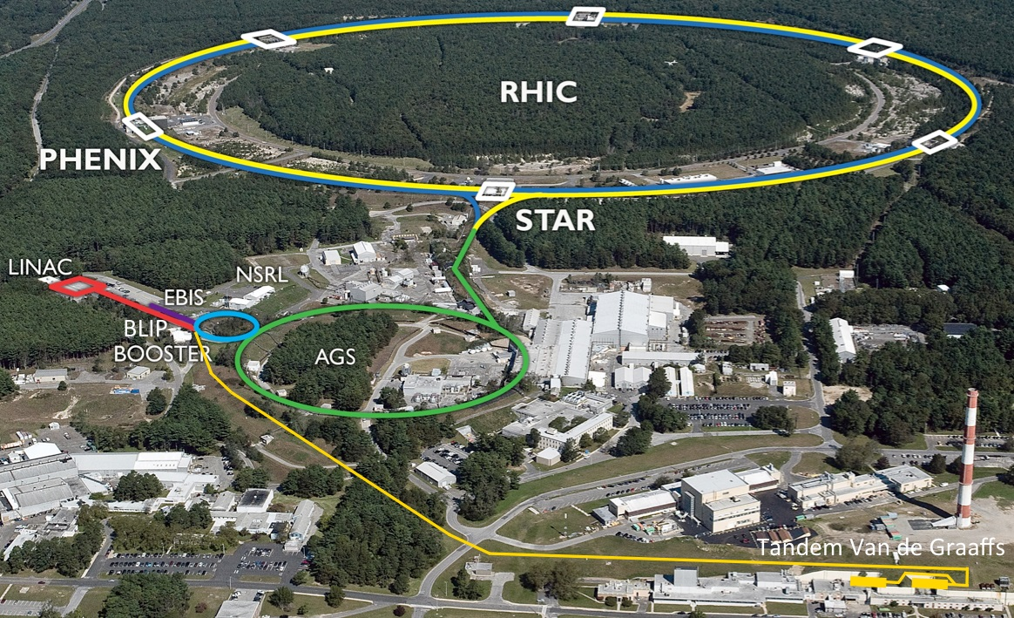
s
high intensity H–
polarized H –
He to U
Start of operation : 2000
Circumference : 3.8 km
Max dipole field : 3.5 T
Species : ph to U (incl. asymmetric)
Energy : Au 100 GeV/nucleon
: ph 255 GeV
Max ph–ph L : 2.67x10³² cm⁻²s⁻¹
Experiments : STAR, sPHENIX
p to Au (backup)

Slide 6
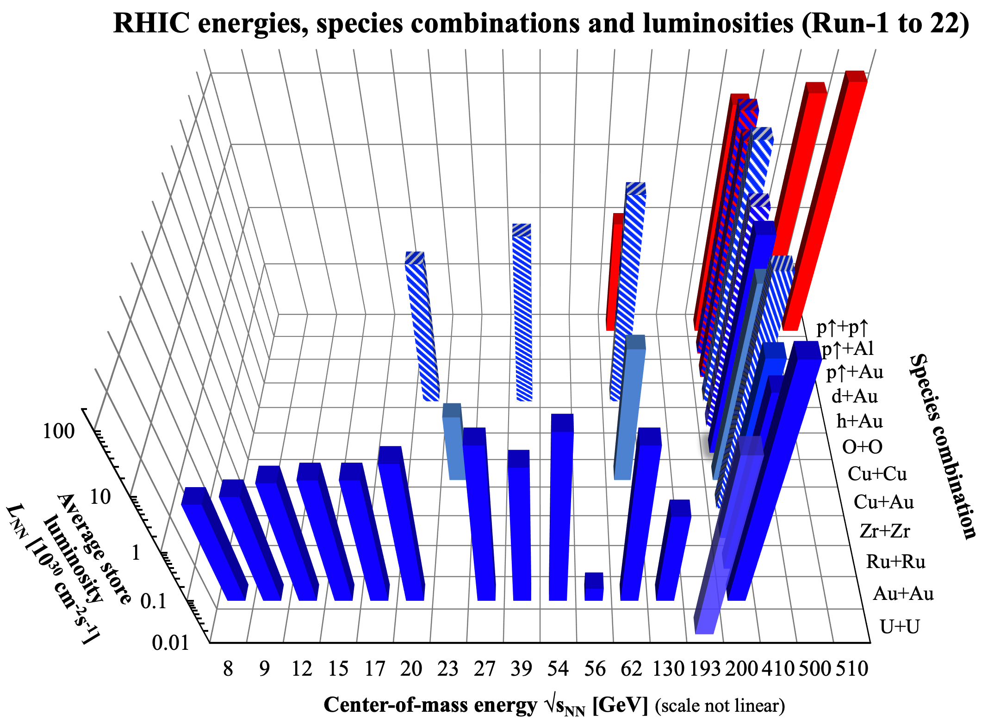

RHIC – study of QGP requires flexibility
nominal injection energy

Slide 7
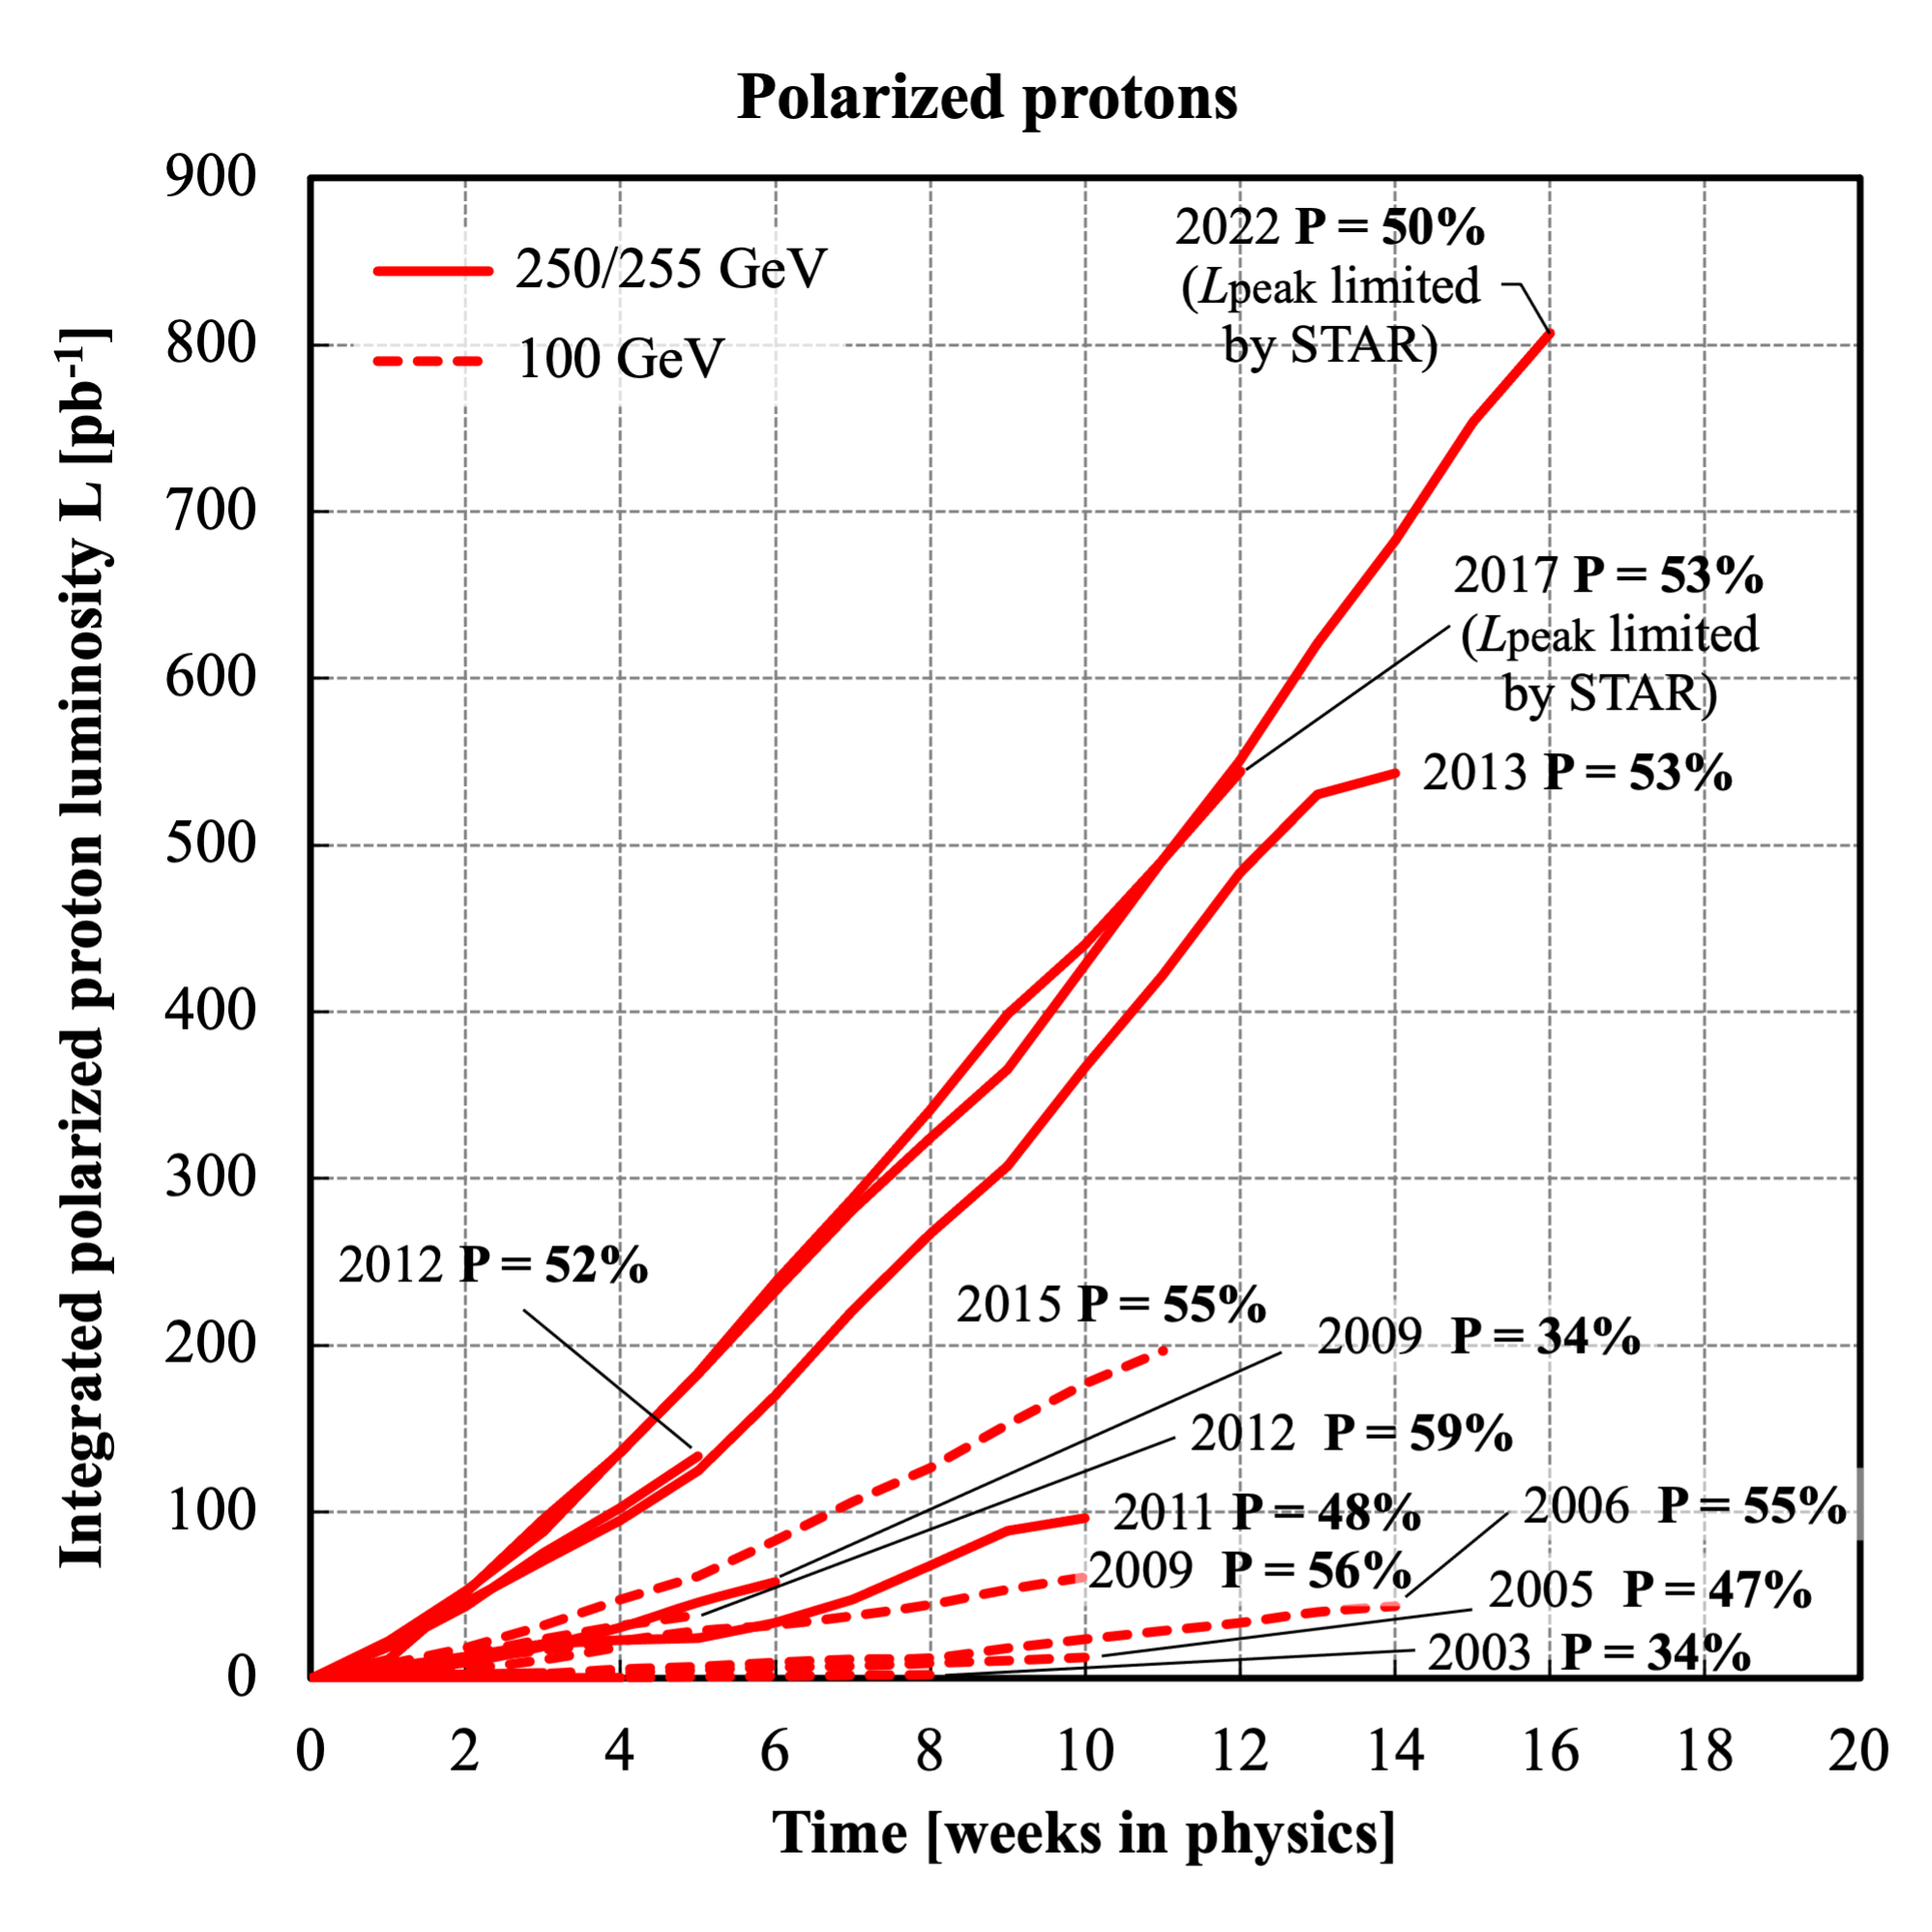
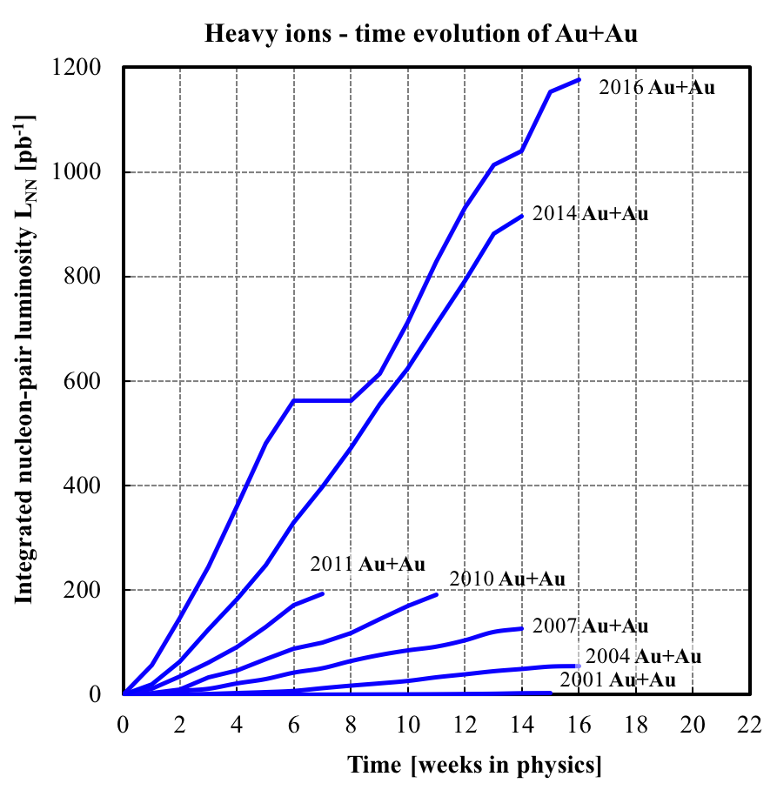
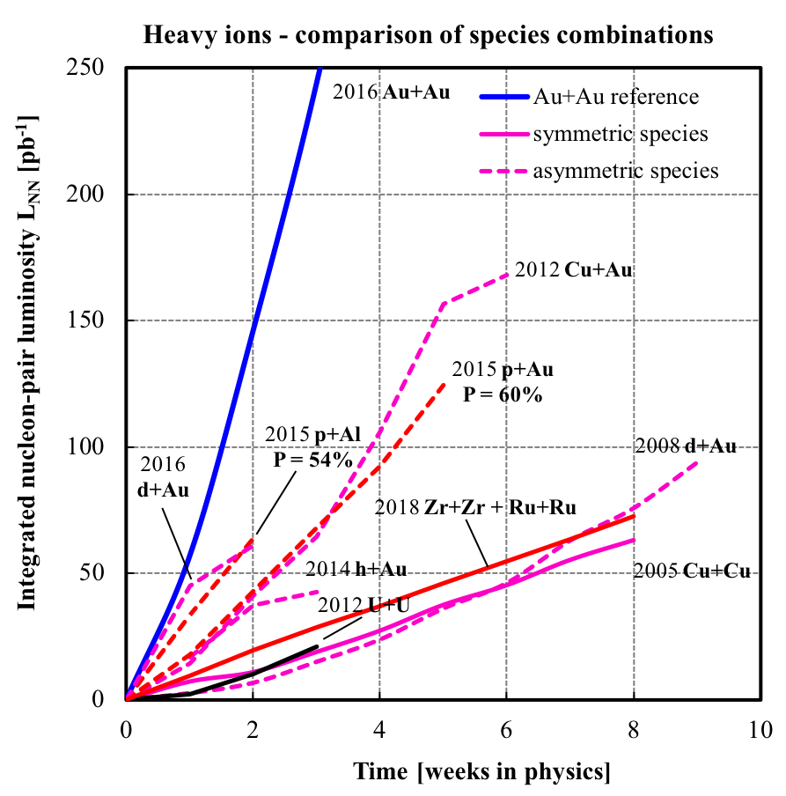
RHIC Integrated Luminosity
Dramatic increase of RHIC performance as a result of ongoing accelerator R&D, accelerator improvements, and replacement of obsolete technology
10 min for same
number of collisions
as in all of 2000

Slide 8
RHIC Beam Energy Scan – exploration of the nuclear phase diagram beam energies down to ~40% of nominal injection energy, far outside design
BES-I : 2010-14
BES-II: 2019-21
~10x more events
[2015 NSAC Long Range Plan for Nuclear Science]
Notes:
Picture from 2015 NSAC long-range plan

Slide 9
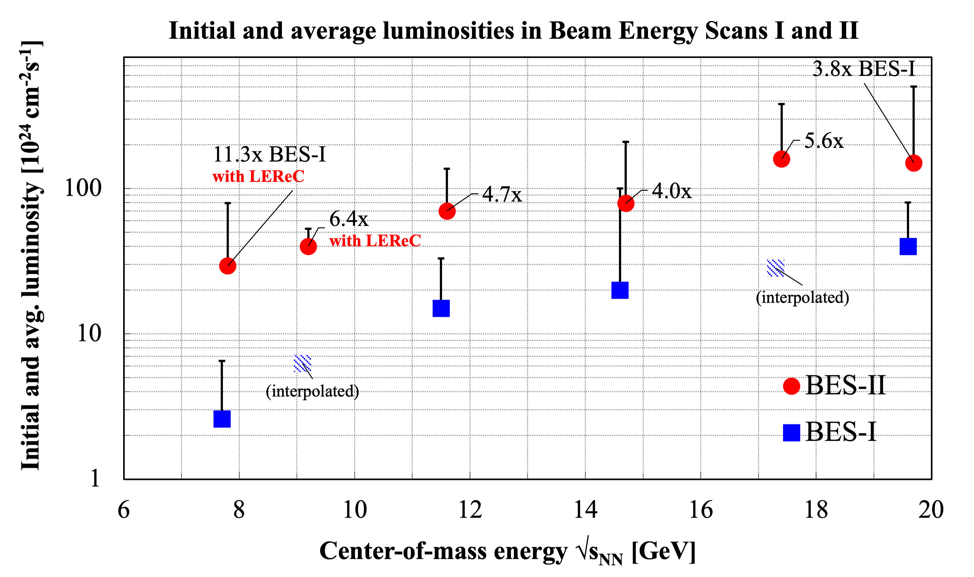
RHIC store luminosity in Beam Energy Scans I and II

Slide 10
Synergistic application programs
Industrial applications
  at Tandems
Isotope production => Presentation by Cathy Cutler
  uses 200 MeV H⁻ Linac
  BLIP (Brookhaven Linac Isotope Producer)
Space radiation testing – NASA (biology) + MDA/TRMC (DoD, electronics)
(MDA – Missile Defense Agency, TRMC – Test Resource Management Center)
  uses EBIS/Booster + NSRL (NASA Space Radiation Laboratory)
  proposal to use AGS + new facility HEET (High Energy single events Effects Test facility)
Notes:
MDA = Missile Defense Agency
TRMC = Test Resource Management Center

Slide 11
Accelerator Science and Technology: many subfields – in combination
Electrodynamics (guide and acceleration fields, diagnostics)
Classical mechanics (stability of chaotic hadron motion in storage ring)
Plasma physics (guns, cooling, discharge)
QED (heavy ion beam in collision losses dominated by bound-free pair production)
Superconductivity (magnets, RF, diagnostics)
Lasers (electron and ion sources)
Surface physics and chemistry (photo-cathodes, SRF surfaces)
Computing (accelerator controls, simulations of EM fields, particle motion, AI/ML)
Mechanical and electrical design, vacuum, cryogenics
…

Slide 12
Accelerator R&D at C-AD
Improvement of RHIC performance
  Improved polarized proton acceleration in AGS and RHIC (~10% increase)
  Maximize useful luminosity for sPHENIX in small (±10 cm) vertex region (2023 – 2025)
Transformational accelerator technologies in support of future NP facilities, including EIC
  Strong hadron cooling: CeC demonstration
  Polarized He-3 production, acceleration and polarimetry
  Development of high intensity high brightness electron source for strong hadron cooling
    High intensity, high brightness SRF e gun development (NP Accelerator R&D FOA, contributing)
    High intensity CW e gun, based on LEReC gun
  Photocathodes (ECA)
  Ion source developments
  Permanent magnet applications (LDRD)
Future possibilities:
  Polarized positron source for EIC and CEBAF
  High intensity ERL development (single pass CBETA) for strong hadron cooling
  FFA applications in CEBAF energy upgrade or medical applications

Slide 13
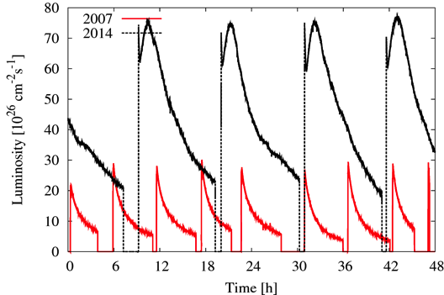
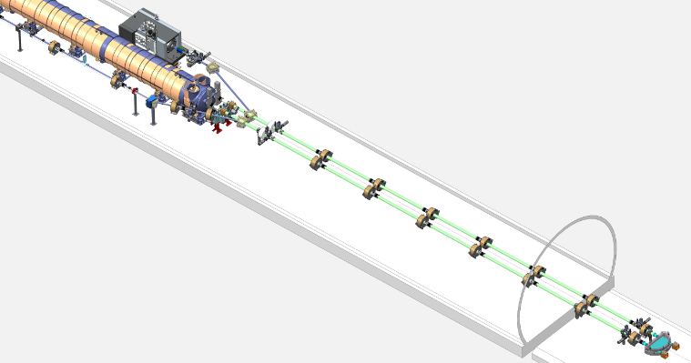
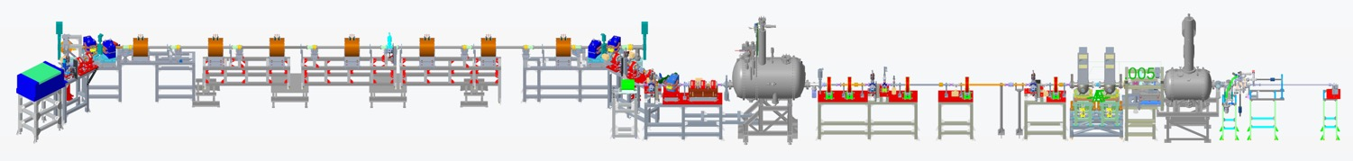
High energy hadron cooling at RHIC
First high energy, bunched beam stochastic cooling gives record heavy ion collision rates
(10 GHz microwave technology)
First bunched beam electron cooling for
luminosity upgrade of “low” energy
heavy ion collisions
Experimental investigation of
Coherent electron Cooling,
(stochastic cooling with a 30 THz
bandwidth)
  PCA demonstration in 2021/2022
Kicker
Modulator
Plasma Cascade Amplifier

Slide 14
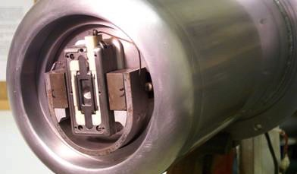
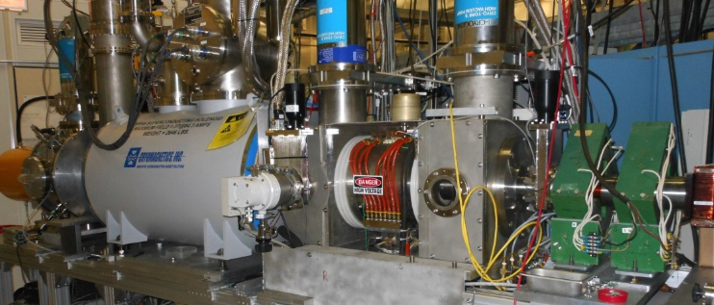
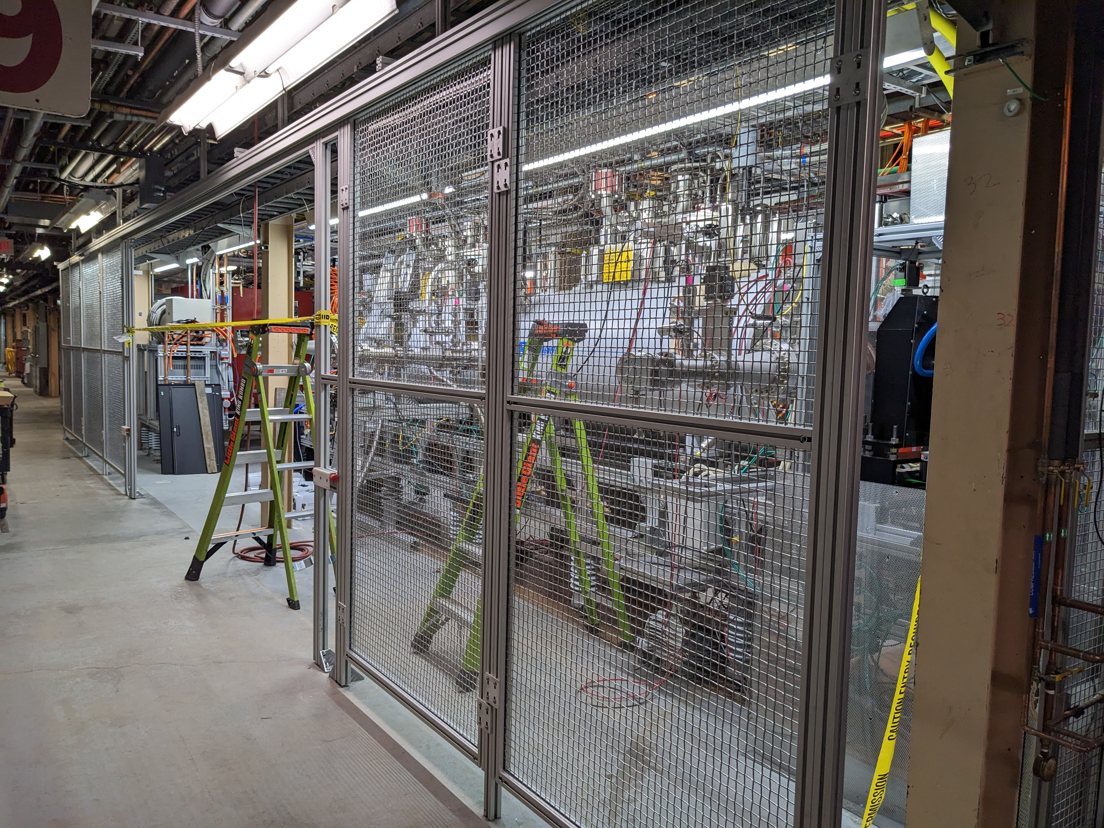
High-intensity ion sources at BNL
BNL Magnetron H⁻ source
  Hydrogen plasma interacts with Cs-Mo surface
  Highest H⁻ peak current (100 mA)
BNL Optically Pumped Polarized Ion Source (OPPIS)
  Polarized electrons from optically pumped Rubidium
  are used to generate polarized H⁻ ions
  Highest intensity (1 mA) polarized (83%) H⁻ source
BNL Electron Beam Ion Source (EBIS => Extended EBIS)
  Intense electron beam inside high-field solenoid is
  used to stepwise ionize heavy ions.
  Reaches Au³²⁺ after about 40 ms
  Highest intensity EBIS
  World’s most flexible ion source through coupling
  to Laser Ion source (LION)
  Upgraded with 2nd solenoid
  longer trap length + gas cell (also for pol. He-3)

Slide 15
High-intensity electron sources at BNL
Active photocathode development
  Bi-alkali antimonide cathodes with QE up to 9%
DC photo-electron gun for LEReC
  Built by Cornell and installed at RHIC IR2
  350-400 kV operation
  50 mA CW current demonstrated in 2022, plan for higher
SRF photo-electron gun for CeC
  High brightness: 1.56 MeV, 0.5 nC and 0.3 um
  High bunch charge: up to 10 nC
  CW operation at 80 kHz with little QE drop
  High current operation limited by FPC

Slide 16

Early Career Award 2021
Mengjia Gaowei
“Cathode R&D for high-intensity electron source
in support of EIC”
Objectives:
Improve quantum efficiency with reproducible single crystal
photocathode material
Upgrade the cathode growth chamber with offline characterization
capabilities by incorporating a reflection high energy electron
diffraction (RHEED) system
Develop the capability to transfer cathodes between the initial growth chamber, the materials diagnostic tools and the chamber for high current damage analysis and emittance measurement
Test the traditionally grown and single crystal cathodes at high emission current ~ 100 mA
Evaluate various protective mechanisms including 2-D material encapsulation and nanostructure enhancement, for high current performance

Slide 17
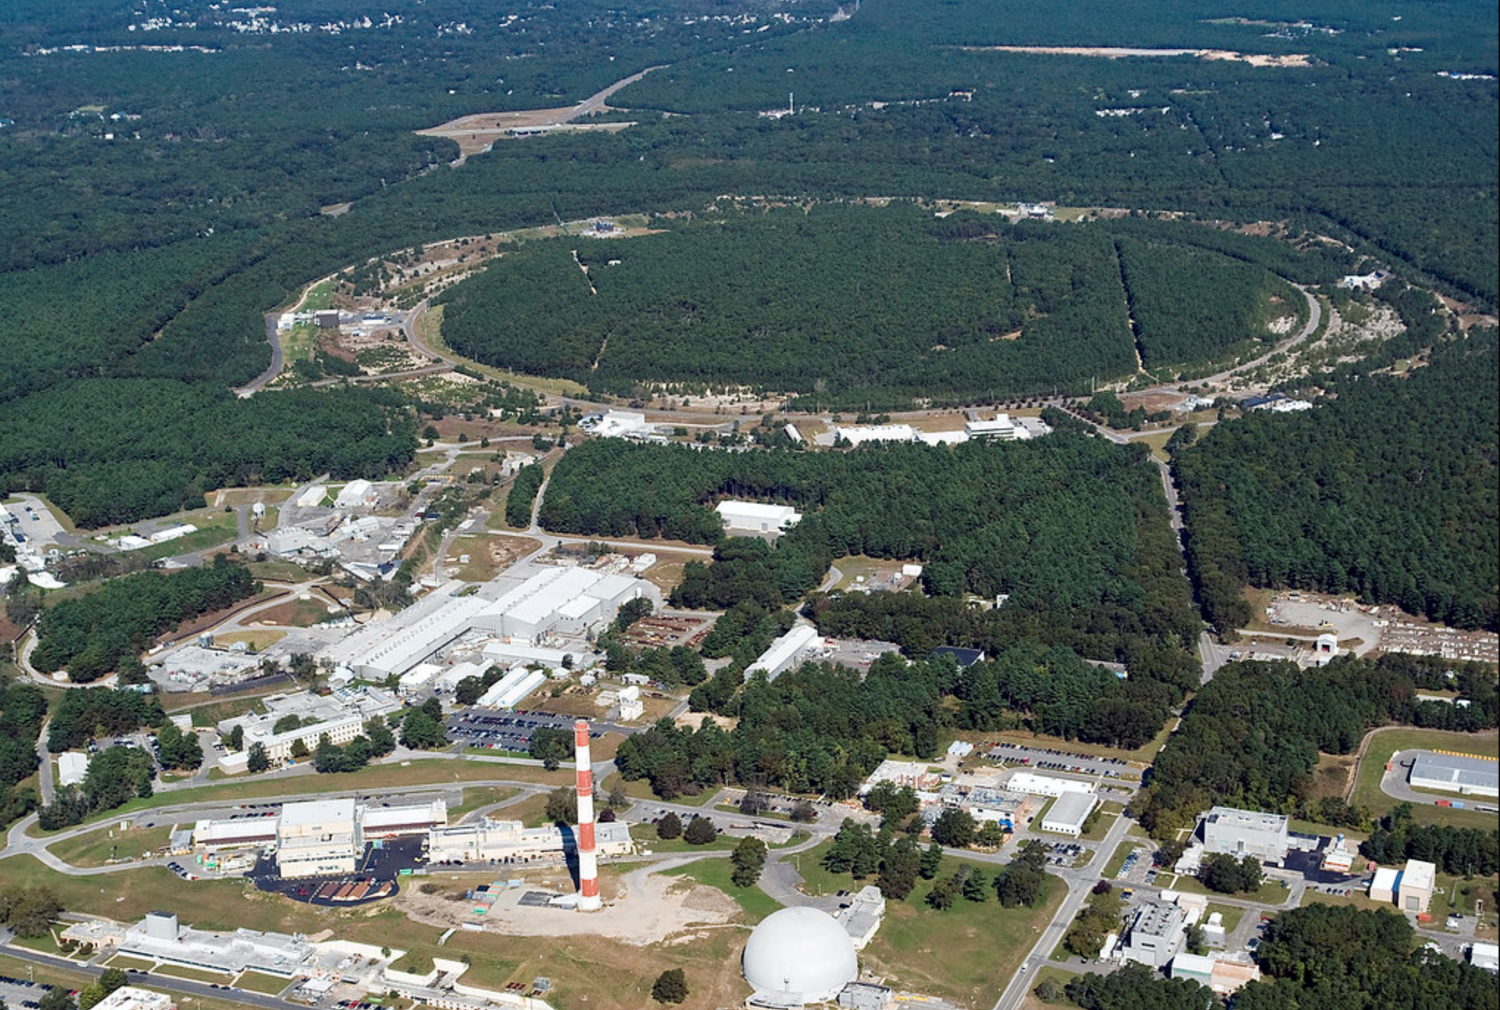

Electron-Ion Collider
Ferdinand Willeke et al.
BNL-JLab partnership with national and international contribution
sited at BNL - uses RHIC hadron complex
CD-1 June 2021 (Conceptual Design complete, cost range),
operation 2032 (planned)
Hadron storage Ring (RHIC Rings) 40-275 GeV (existing)
  1160 bunches, 1A beam current (3x RHIC)
  small vertical beam emittance 1.5 nm
  strong cooling (coherent electron cooling)
Electron storage ring 2.5–18 GeV (new)
  many bunches, large beam current, 2.5 A ➔ 9 MW S.R. power
  SC RF cavities
  Full energy injection of polarized bunches
Electron rapid cycling synchrotron 0.4–(new)
  1-2 Hz
  Spin transparent due to high periodicity
High luminosity interaction region(s) (new)
  L = 10³⁴ cm⁻²s⁻¹
  Superconducting magnets
  25 mrad full crossing angle with crab cavities
  Spin rotators (longitudinal spin)
  Forward hadron instrumentation
RHIC
EIC

Slide 18
BNL Collider-Accelerator Department (C-AD)
C-AD designs, improves and
operates particle accelerators for
basic research
RHIC (=> EIC)
isotope production
LINAC/BLIP, Cyclotron
space radiation testing
Tandem, Booster/NSRL
industrial applications
Tandem
The department requires a wide
range of skills
accelerator science & technology
engineering
mechanical, vacuum, cryogenic,
electrical, radio frequency, civil,
controls, instrumentation, laser,
computer
technicians
accelerator operations, safety
and administrative staff
Relativistic Heavy Ion Collider (RHIC)
=> Electron-Ion Collider (EIC)
NASA Space Radiation Lab (NSRL)
Brookhaven LINAC
Isotope Producer (BLIP)
Tandems
Cyclotron

