Slide 1
Opportunities at the Isotope Program
Cathy S. Cutler
July 17, 2023

Slide 2
DOE Isotope Program Mission
Produce and/or distribute radioactive and stable isotopes that are in short supply; includes by-products, surplus materials and related isotope services
Maintain and upgrade the infrastructure required to produce and supply priority isotope products and related service
Conduct R&D on new and improved isotope production and processing techniques which can make available priority isotopes for research and application. Develop workforce.
Ensure robust domestic supply chains. Reduce U.S. dependency on foreign supply to ensure National Preparedness.
Isotopes are forms of the same element that contain equal numbers of protons but different numbers of neutrons in their nuclei, and hence differ in relative atomic mass but not in chemical properties; in particular, a radioactive form of an element.

Slide 3
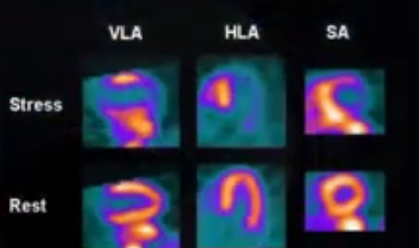
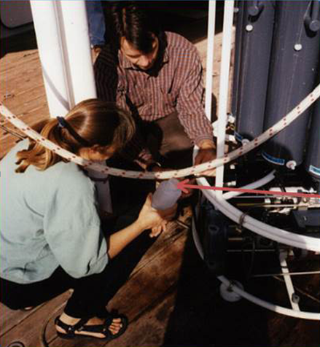
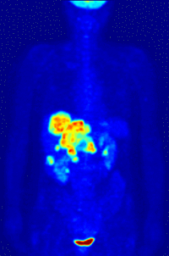
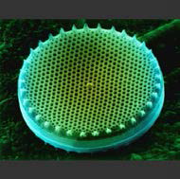
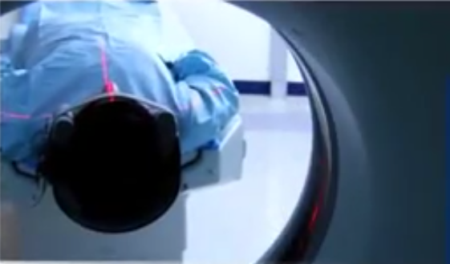
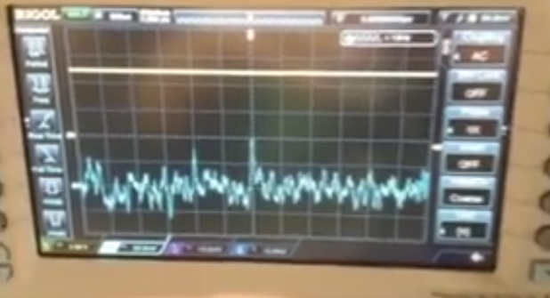
Applications – Accelerator Isotopes
Ge-68/Ga-68:
Generator-
cancer imaging
Sr-82/Rb-82:
Generator- cardiac imaging
Si-32: Environmental applications
Na-22: Source for PET imaging
Cd-109: X-ray fluorescence source
Notes:
Focusing initially on accelerator isotope products, LANL and BNL are engaged in the routine production of Ge-68 for Ga-68 generator applications (cancer imaging) and Sr-82 for cardiac imaging application. Both sites produce a variety of other products like Cd-109 (for X-ray….), Na-22 (a calibration source for PET imaging) and Si-32 (for environmental imaging) to name a few. The accelerator sites are also engaged in active R&D campaigns to make new isotopes available for applications development in the areas of fundamental R&D, medical research, and national security applications
Ge-68 (271 day)/Ga-68 (68 min)
Sr-82 (25 day)/Rb-82 (75 sec)
Si-32 (approx 170 years)
Cd-109 (461 days)
Na-22 (2.6 years)

Slide 4
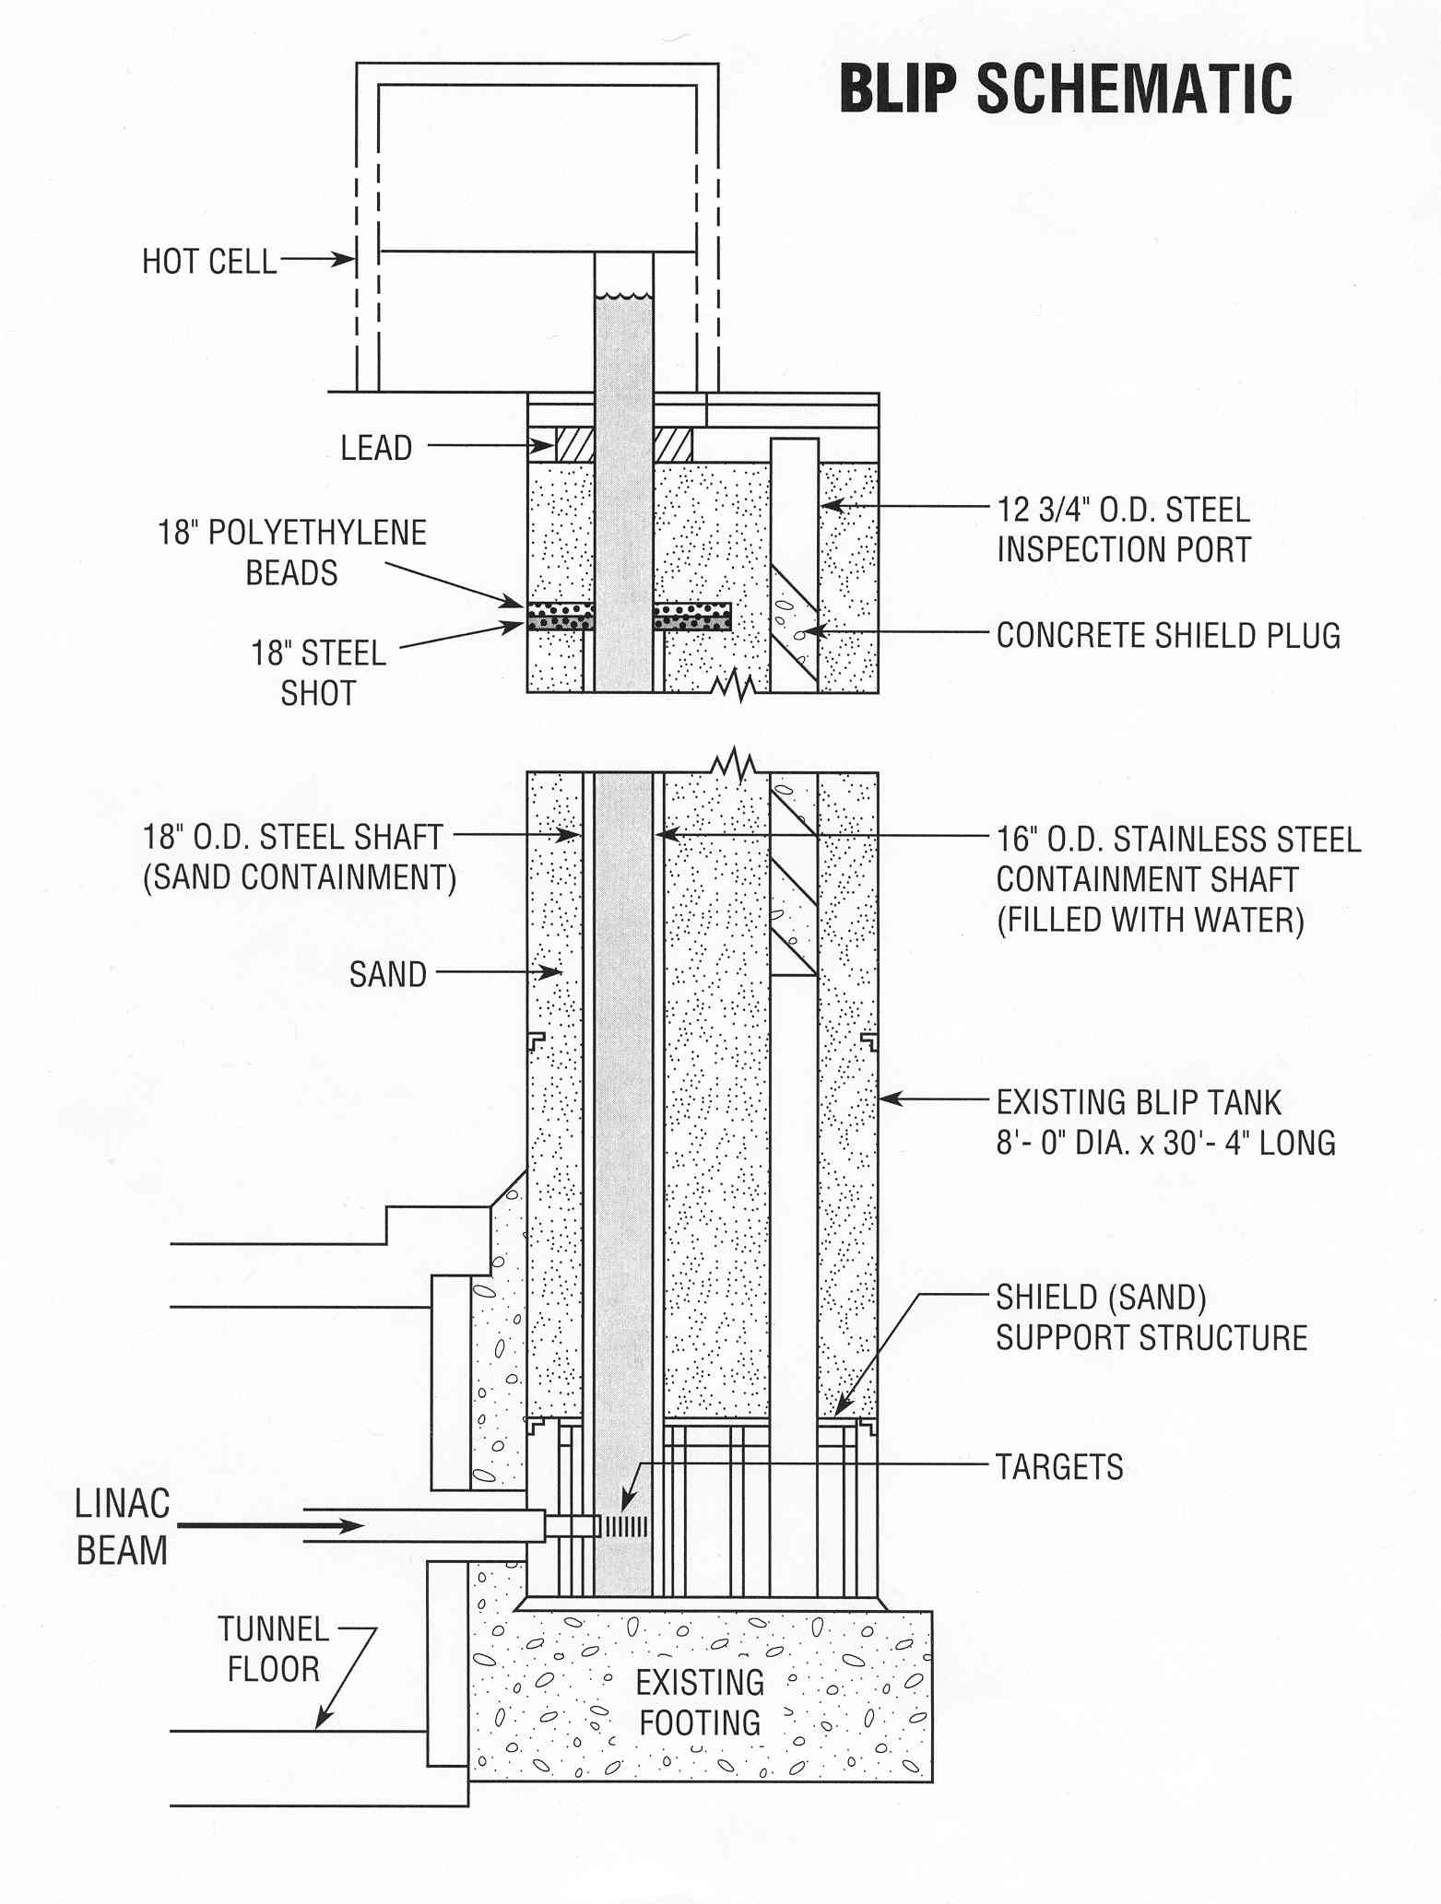
Brookhaven Linac Isotope Producer
BLIP target stack
BLIP schematics
30 MeV (C-slot)
68 MeV
97 MeV
106 MeV
RbCl 2
RbCl 1
degrader
Proton beam
Target basket
Cooling water

Slide 5
Opportunities for isotope Production and R&D
^{nat}Ga(p,xn)⁶⁸Ge
⁸⁶Sr(p,n)⁸⁶Y
¹⁸⁶W(p,n)¹⁸⁶Re
¹⁹²Os(p,2np)¹⁸⁹Re
⁴⁵Sc(p,2n)⁴⁴Ti
⁴⁸Ti(p,2p)⁴⁷Sc
^{nat}Rb(p,xn)⁸²Sr
⁸²Sr - API for Bracco’s Cardiogen-82® generator
⁷⁵As(p,4n)⁷²Se
²³²Th(p,2p6n)²²⁵Ac
⁶⁸Zn(p,2p)⁶⁷Cu
Notes:
Capable of producing high energy protons (up to 200 MeV)
High current (up to ~173 µA)
New raster magnet installed to more uniformly distribute the beam

Slide 6
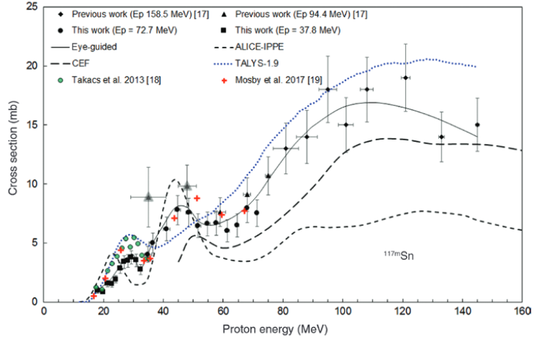

Slide 7
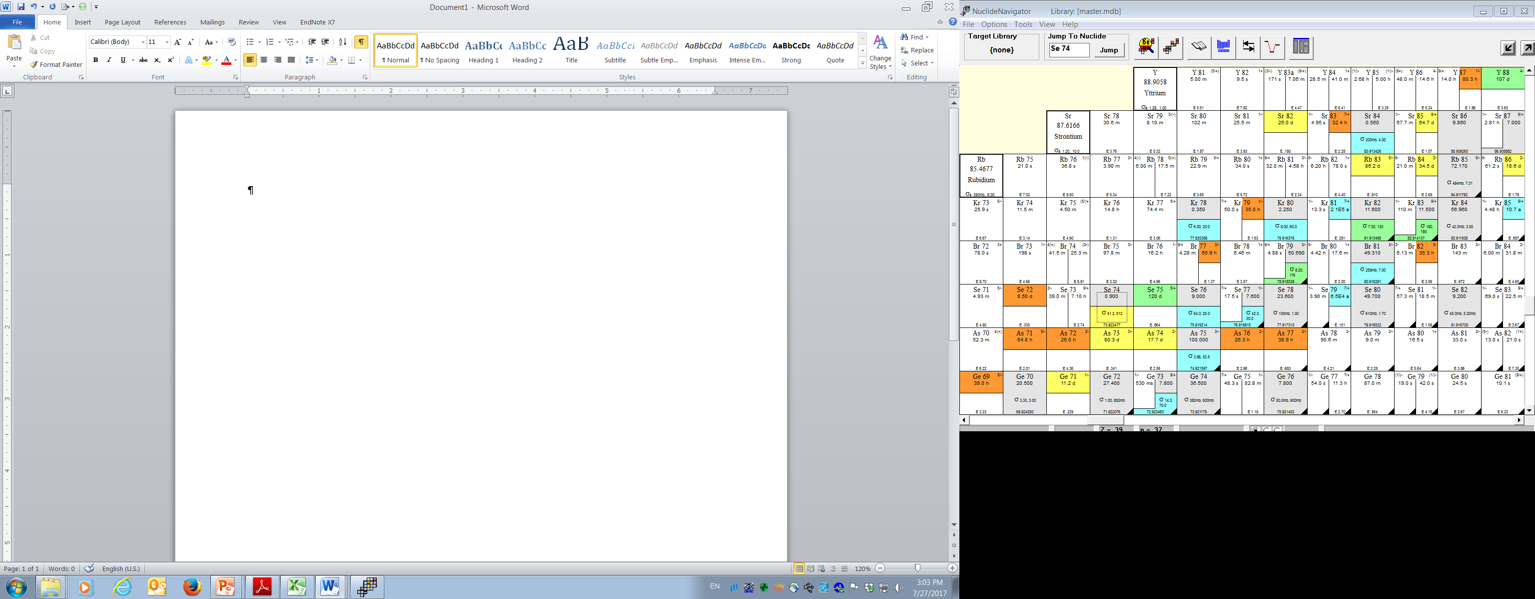
High Specific Activity ⁷²As –
Imaging Isotope ⁷²As (T_{1/2}= 26 h)
Positron energy comparison
No-carrier added As-72 can be obtained from ⁷²Se/⁷²As generator
Accelerator production of ⁷²Se from ^{nat}RbBr(p,x) at high energy and ⁷⁵As(p,4n) at intermediate energy has been reported
We are interested in ⁷⁵As(p,4n) production route for which excitation functions up to 45 MeV have been reported
Isotope | ⁸⁹Zr (3.27 d) | ⁶⁸Ga (67.7 m) | ¹²⁴I (4.18 d) | ⁷²As (26 h)
Mean E_{β}⁺, keV | 396 (22.7%) | 829.5 (88.9%) | 870 (22.7%) | 1170 (87.8%)
(p,4n)
(p,n)

Slide 8

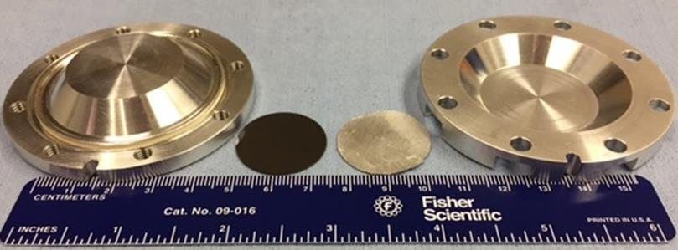
Measurements of 75As(p,x)
Work done by Dr. Anthony DeGraffenreid
Irradiation conditions:
Target material: GaAs foil, d×h=2.5×0.00254 cm
Beam current: ~30 µA, focused beam
Irradiation time: 2 h
Incident energy: 117 MeV incident, lower points achieved by degradation with Al degraders
Aluminum foil used for beam monitoring

Slide 9
Excitation functions for Se-75 and Se-72 production from As

Slide 10
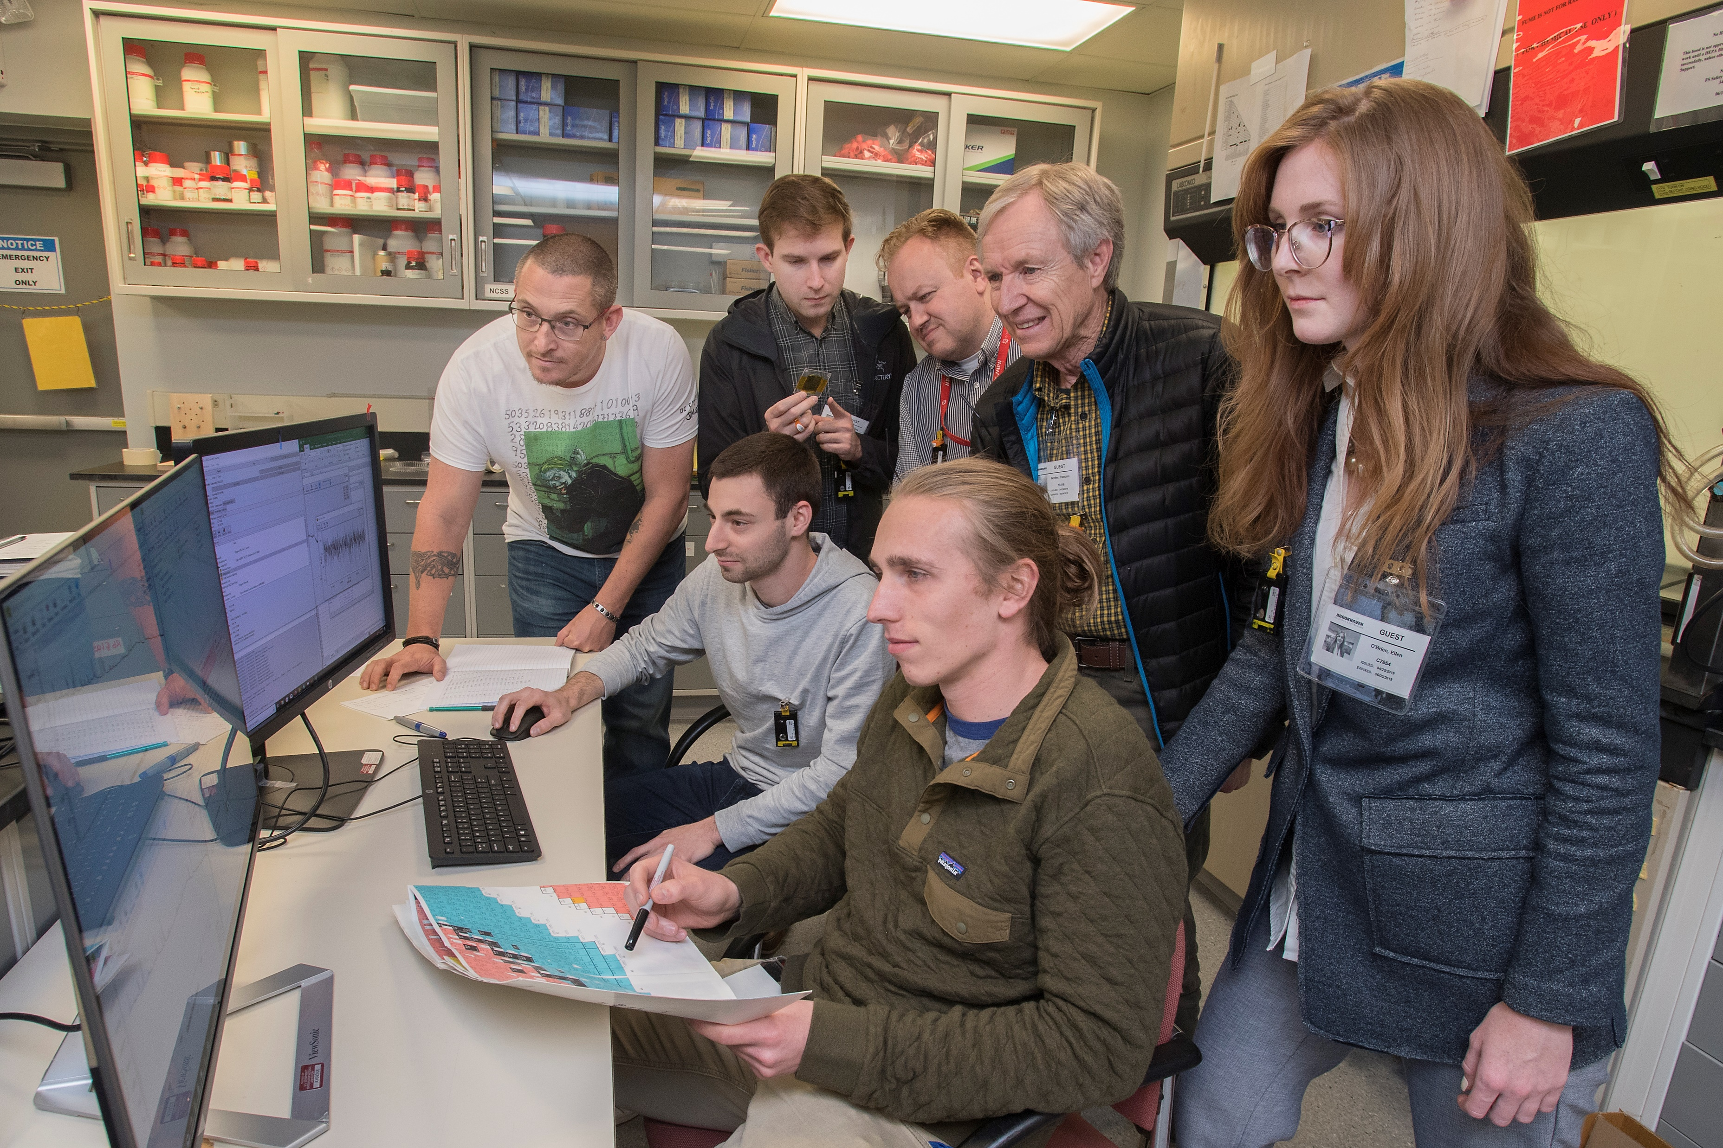
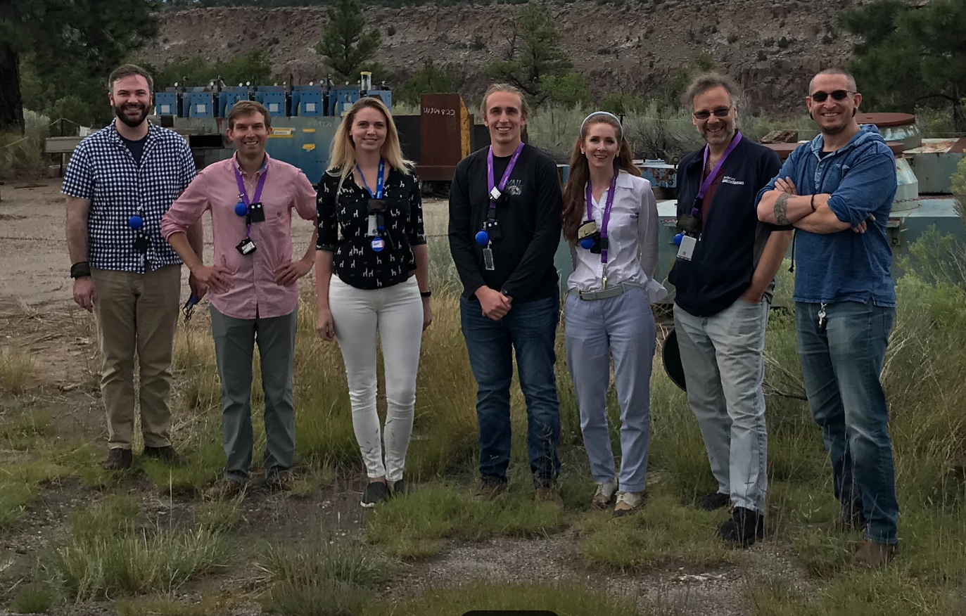
TRi-Laboratory Effort in Nuclear Data
(TREND)
Collaboration of BNL, LANL, LBNL
Formed to address a lack of nuclear data for predicting yields for desired isotopes as well as contaminants that are co-produced
Measured cross sections provide valuable data for isotope production, but also are important inputs into nuclear physics models for predicting cross sections across the chart of nuclides
Official Use Only

Slide 11
Large scale production of ⁷²Se at 105-103.5 MeV
Melting Point/ Decomposition
Aluminum arsenide (mp—1740 °C)
Gallium arsenide (mp—1240 °C)
Arsenic metal (sublimation—615 °C)
Thermal Conductivity and Density
Aluminum arsenide—84 W/mK; 3.81 g/cm³
Gallium arsenide—55 W/mK; 5.32 g/cm³
Arsenic metal—50.2 W/mK; 5.73 g/cm³

Slide 12
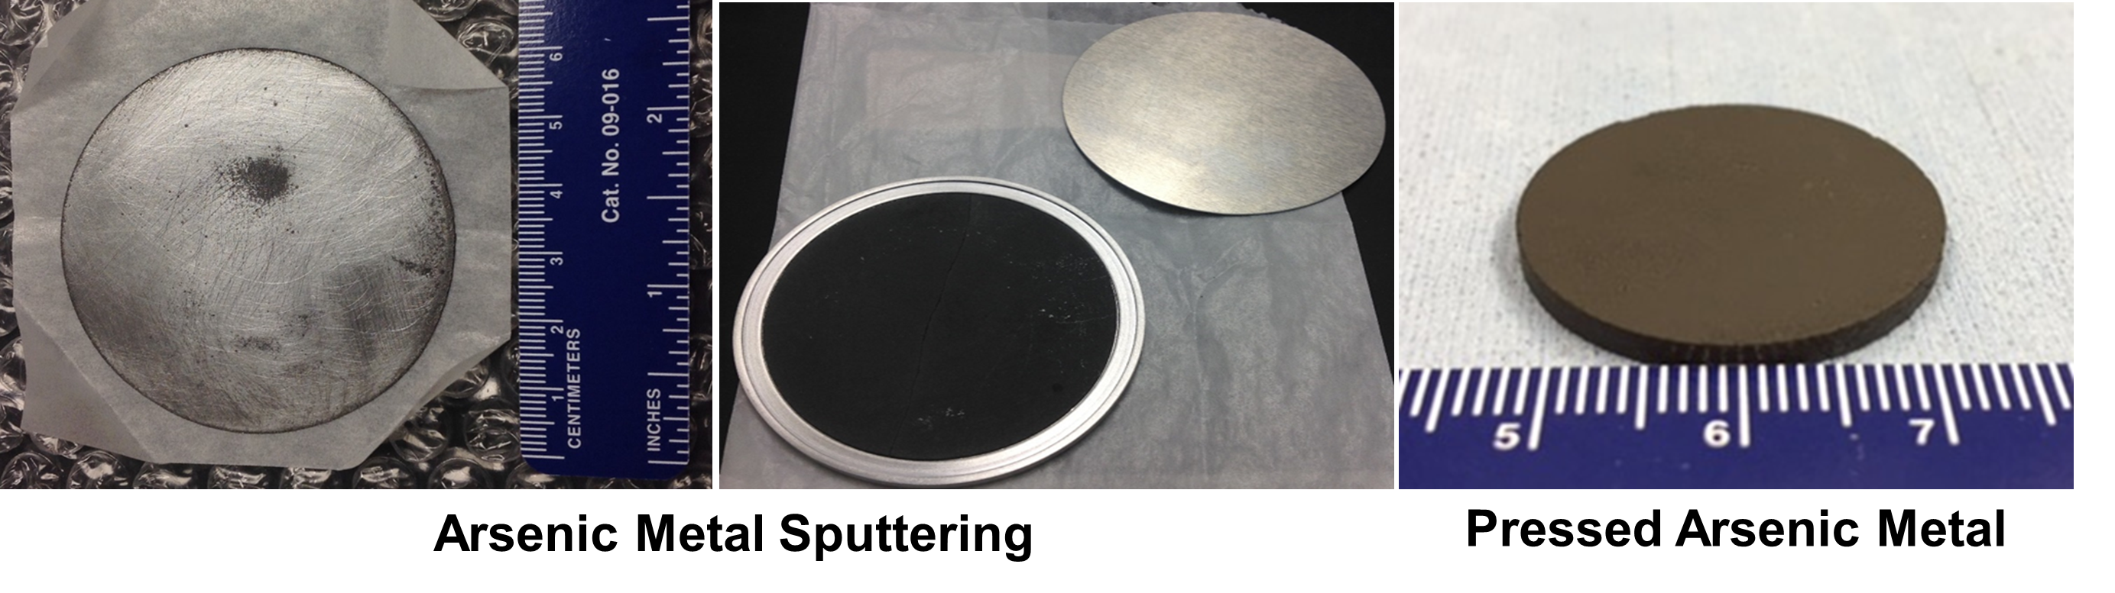
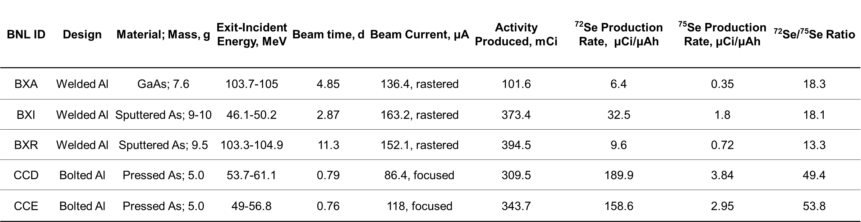

Slide 13
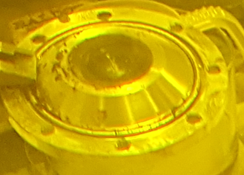
Opportunities in MIRP- Separations
Process of purifying radioisotope of interest from bulk target materials.
Chemical differences
Atomic weight of the isotope
Radioanalytical techniques
ICP
Gamma Spectroscopy

Slide 14
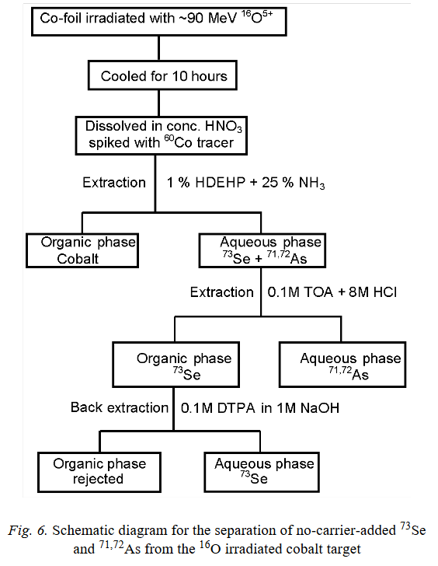
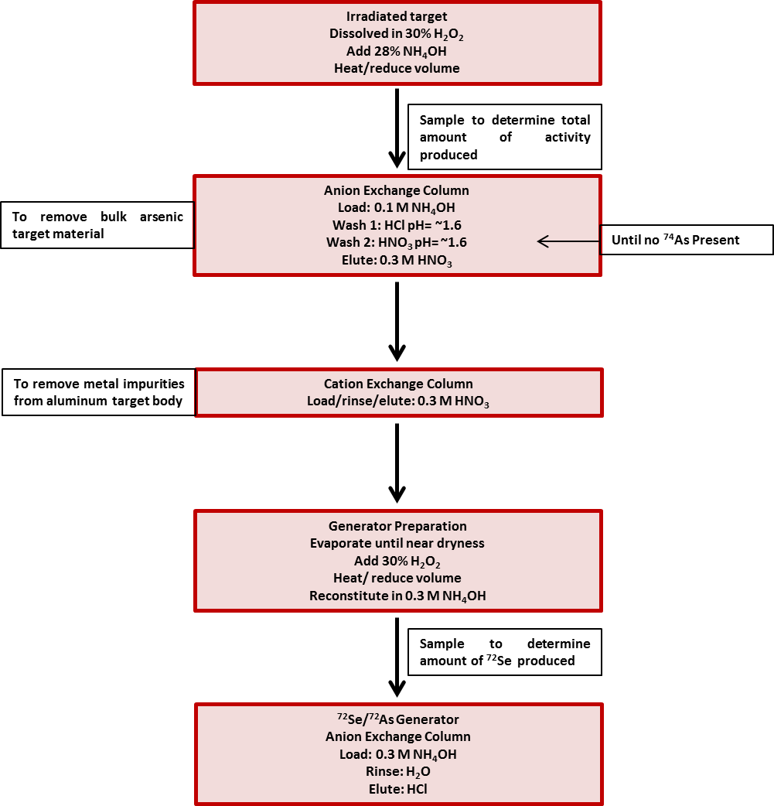
Opportunities within MIRP - Separations
Column Chromatography
⁷²Se isolation from arsenic targets
Solvent Extraction
Isolation of ⁷³Se from ¹⁶O irradiated Co targets
Radiochim. Acta 2012, 100, 865-870.
J. Radioanal. Nucl. Chem. 2002, 251, 159-162

Slide 15







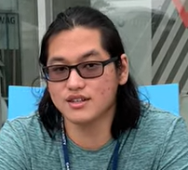
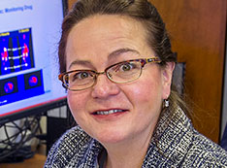
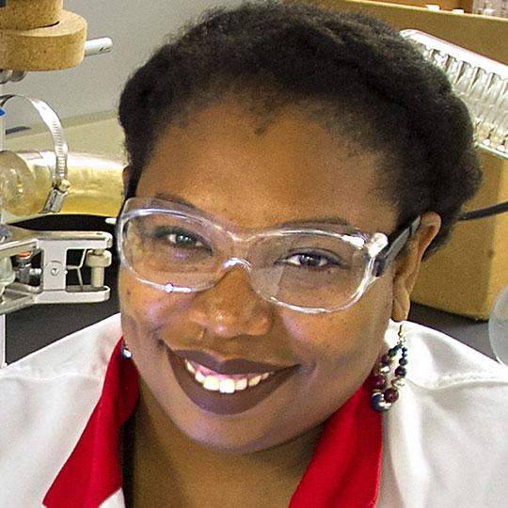



DGA membranes for Ac-225 purification
(Part of a 2020 DOE Early Career Research Award)
Christine Duval
Asst. Professor, PI
Megan Sibley
Post Doc
(now at ORNL)
Tuli Banik
Grad Student
Maura Sepesy
Grad Student
Alexa Ford
Undergrad
Tim Yen
Undergrad
Collaborators
Cathy S. Cutler, PhD
Jasmine Hatcher-Lamarre, PhD
Pavithra H.A. Kankanamalage, PhD
@Duval_Lab
1
Official Use Only
Notes:
Add a bullet point here that Ac-225 is successful but the supply is limited.

Slide 16
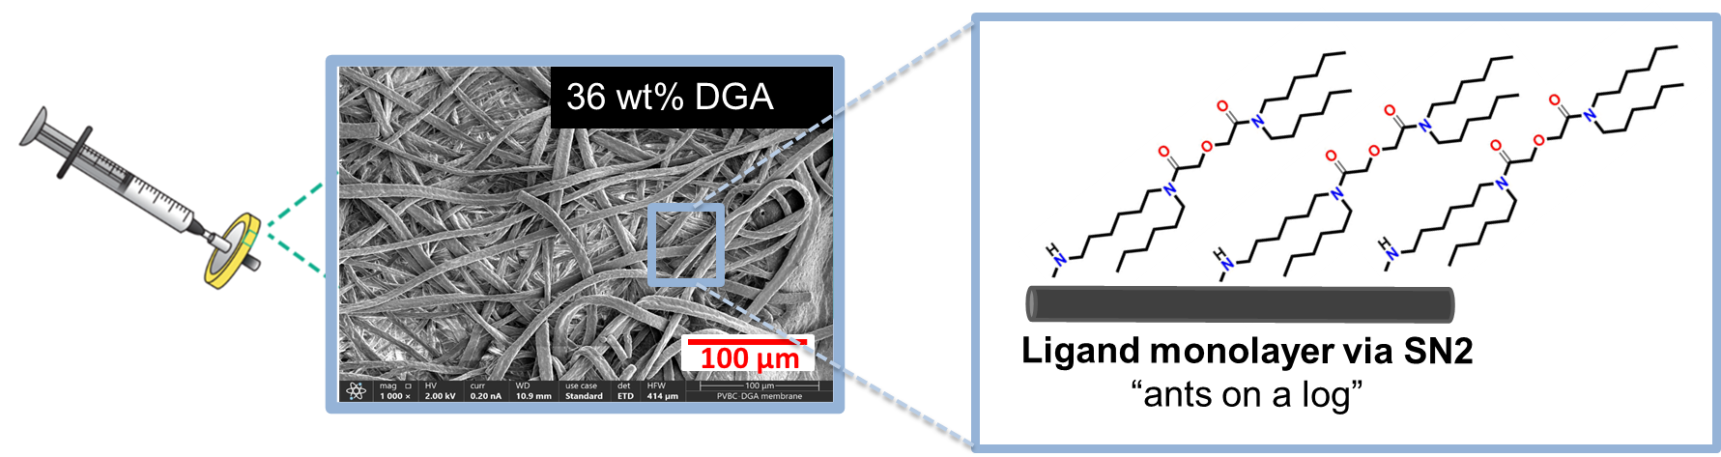
Goal: reduce separation time from hours to minutes
Our approach is to use membrane adsorbers due to their potential for:
  High product capture at high flowrates – minimize product loss to decay
  Small bed volumes (sharp elution curves) – minimizing concentrative process steps
  Unlike resins, membranes can be stacked without appreciate rise in pressure drop
6
Sibley et al. “DGA-functionalized membranes for Ac-225 purification.” In preparation.
Notes:
Tie this to improving from the drawbacks of resins

Slide 17
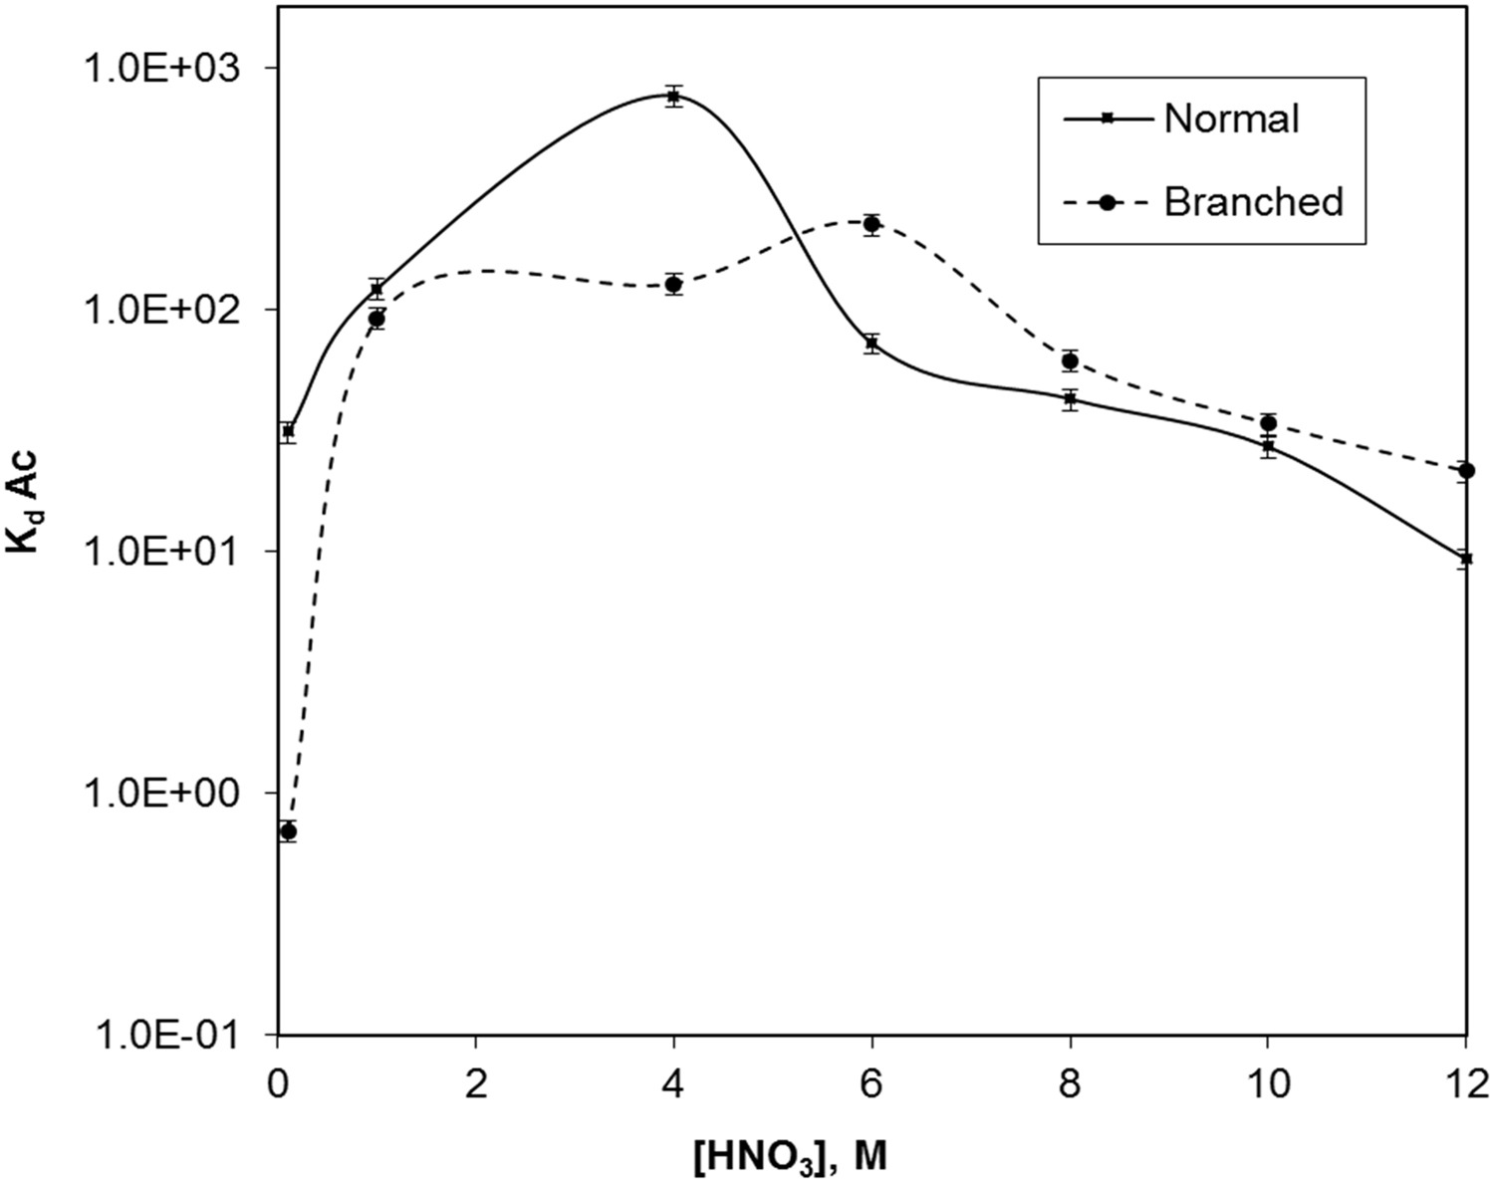

Comparing Ac-225 resin & membrane data
$$K_{d}=\frac{A_{solid,eq}}{A_{liquid,eq}}$$
DGA membrane
DGA resin
Figure 4: 50 mg resin, 1 mL solution, 5.9 kBq Ac-225
(3 pg Ac-225) [1]
Figure 3: 1.25 mg membrane, 1 mL solution, 418 kBq Ac-225 (160 pg Ac-225) [2]
Cannot directly compare the absolute value of the Kd because the measurements were made at different mass to volume ratios and with different initial concentrations of Ac-225 – but the trends are consistent with DGA resins
[1] Radchenko et al. “Radiometric evaluation of diglycolamides resins for the chromatographic separation of actinium from fission product lanthanides.” Talanta. 2017, 175 (318-324)
[2] Sibley et al. “DGA-functionalized membranes for Ac-225 purification.” In preparation.
16

Slide 18
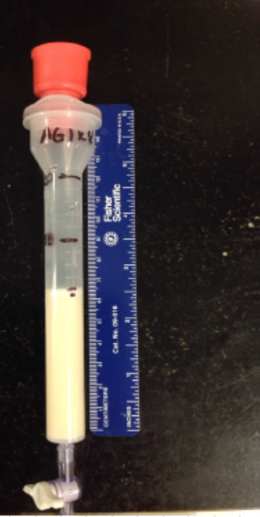
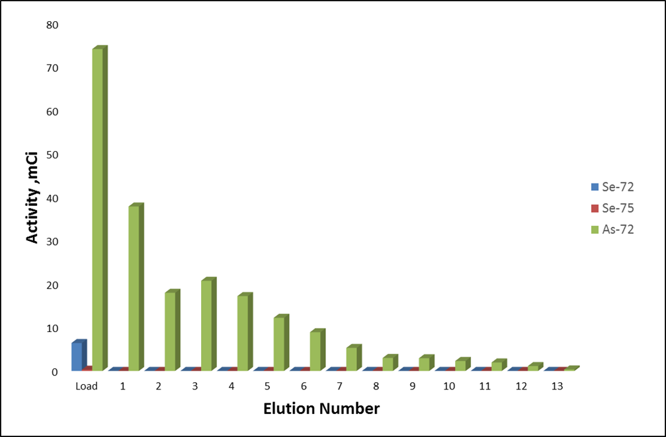
Opportunities within MIRP - Generator Development
  A device that allows for the production of a short-lived radioisotope (daughter) following the decay of a long-lived radioisotope (parent)
    Easily transportable
  It allows for the use of shorter-lived radioisotopes without the need for a production facility (i.e. cyclotron) within a close proximity.
  Uses adsorbent material which has strong affinity for the parent nuclide and allows for simple removal of daughter nuclide
    Ion exchange resin
    Alumina
    zirconia

Slide 19
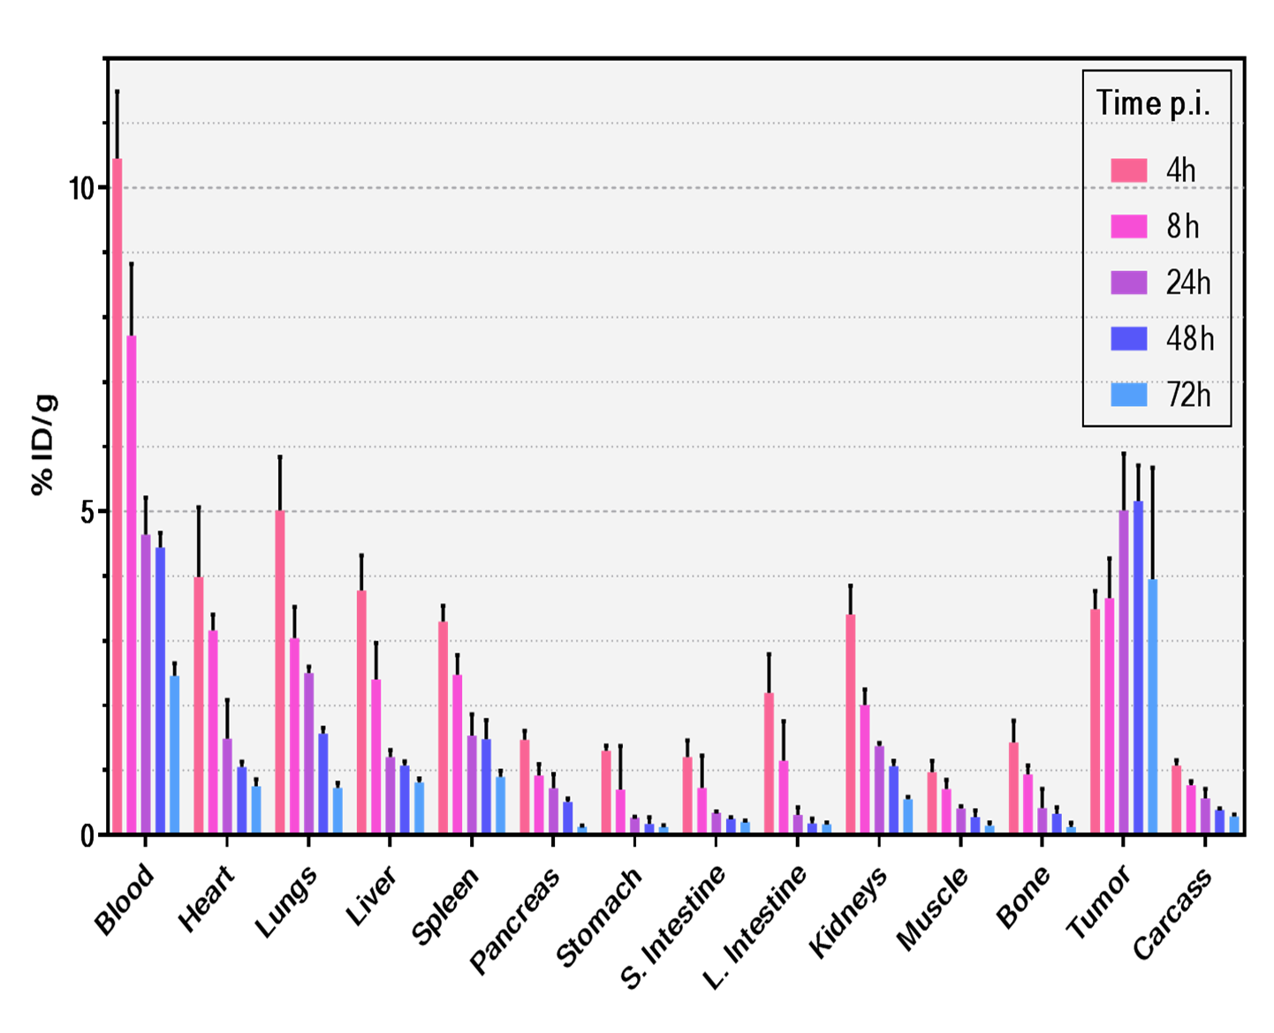
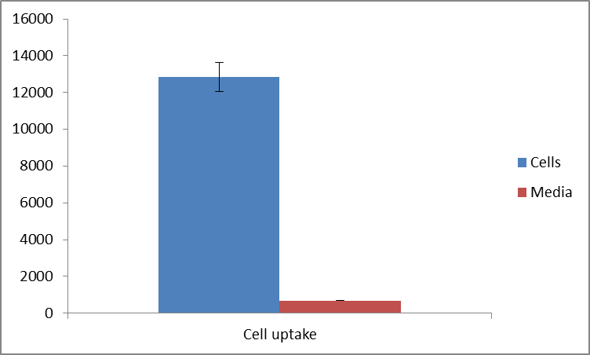
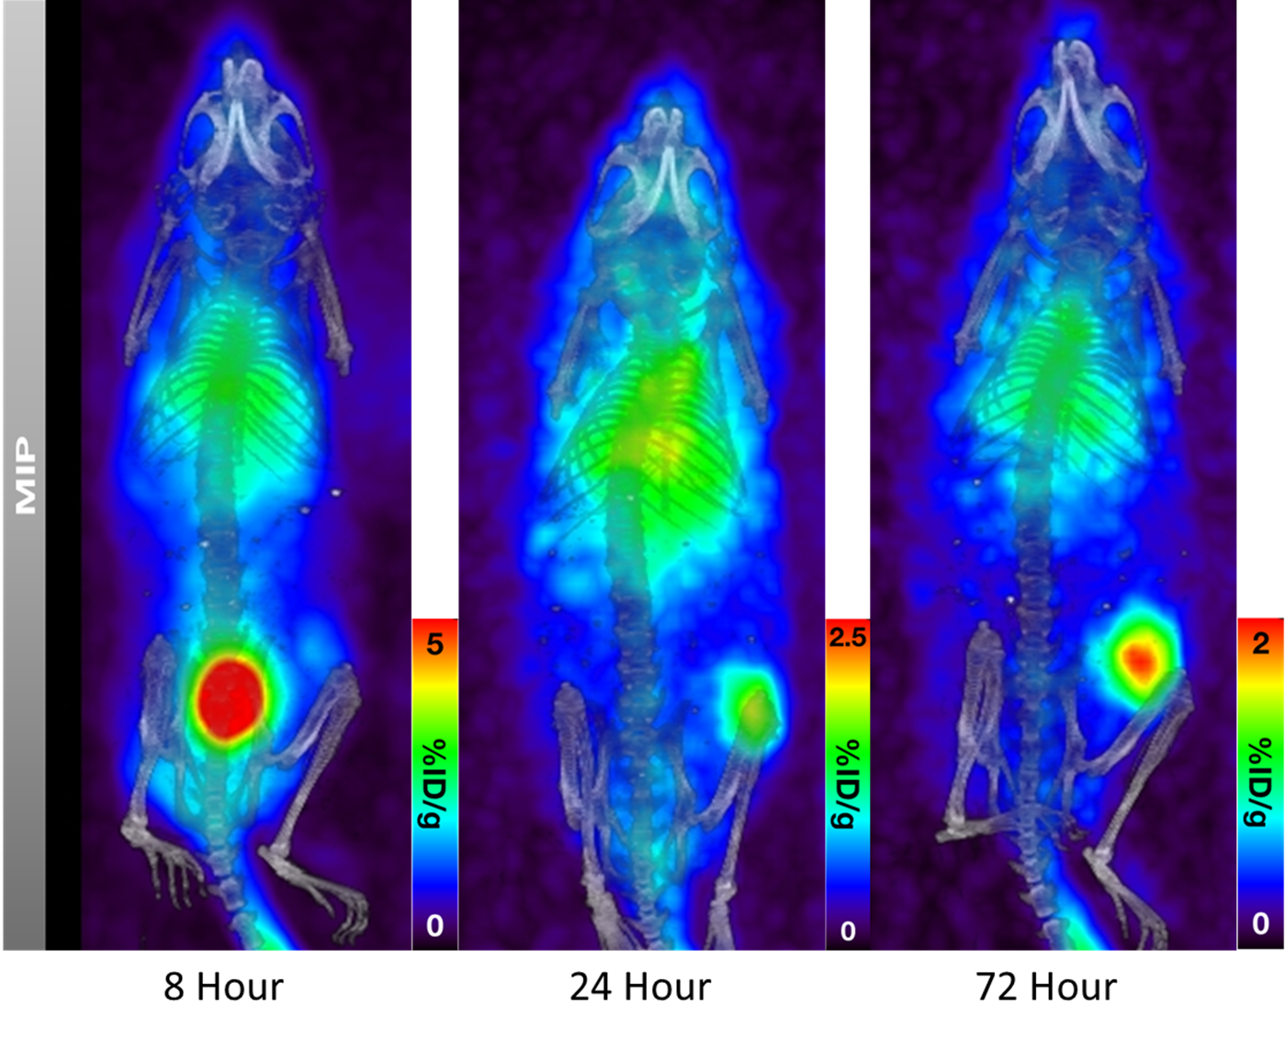
Opportunities within MIRP - Radiolabeling and Preclinical Studies
Gastric Cancer Cell Uptake
Free ⁷²As
18.5 times uptake in cells!!!
⁷²As-Trastuzumab
1st images of indirectly labeled ⁷²As-mAb!!

Slide 20
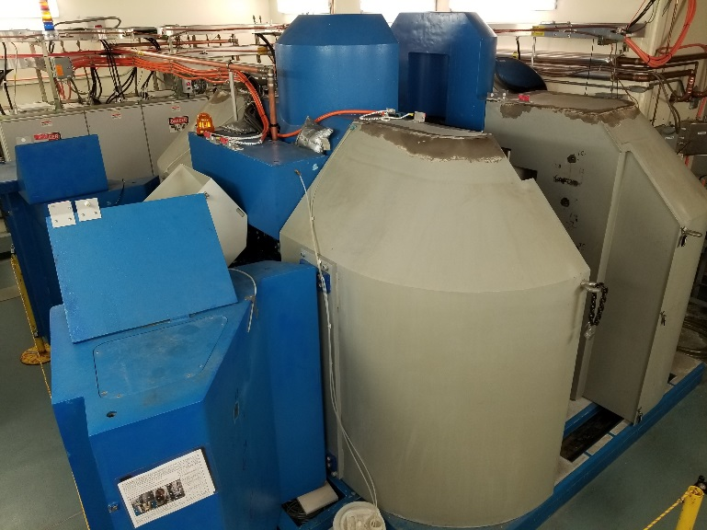
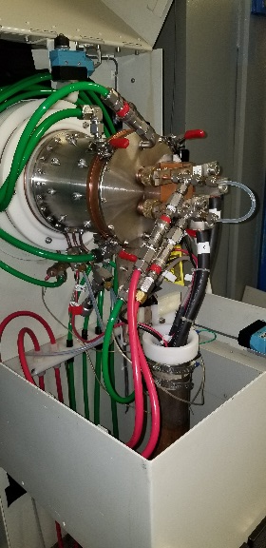
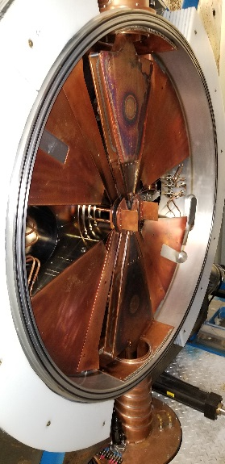
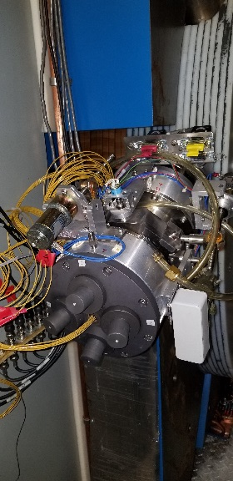
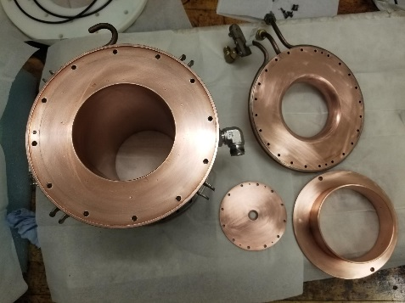
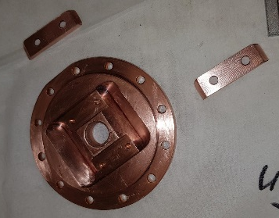
Other modes of Isotope production
TR-19 Cyclotron
Provides protons- 13 - 19 meV
Beam current 200 µA
Supports gas, liquid, and solid targets

Slide 21
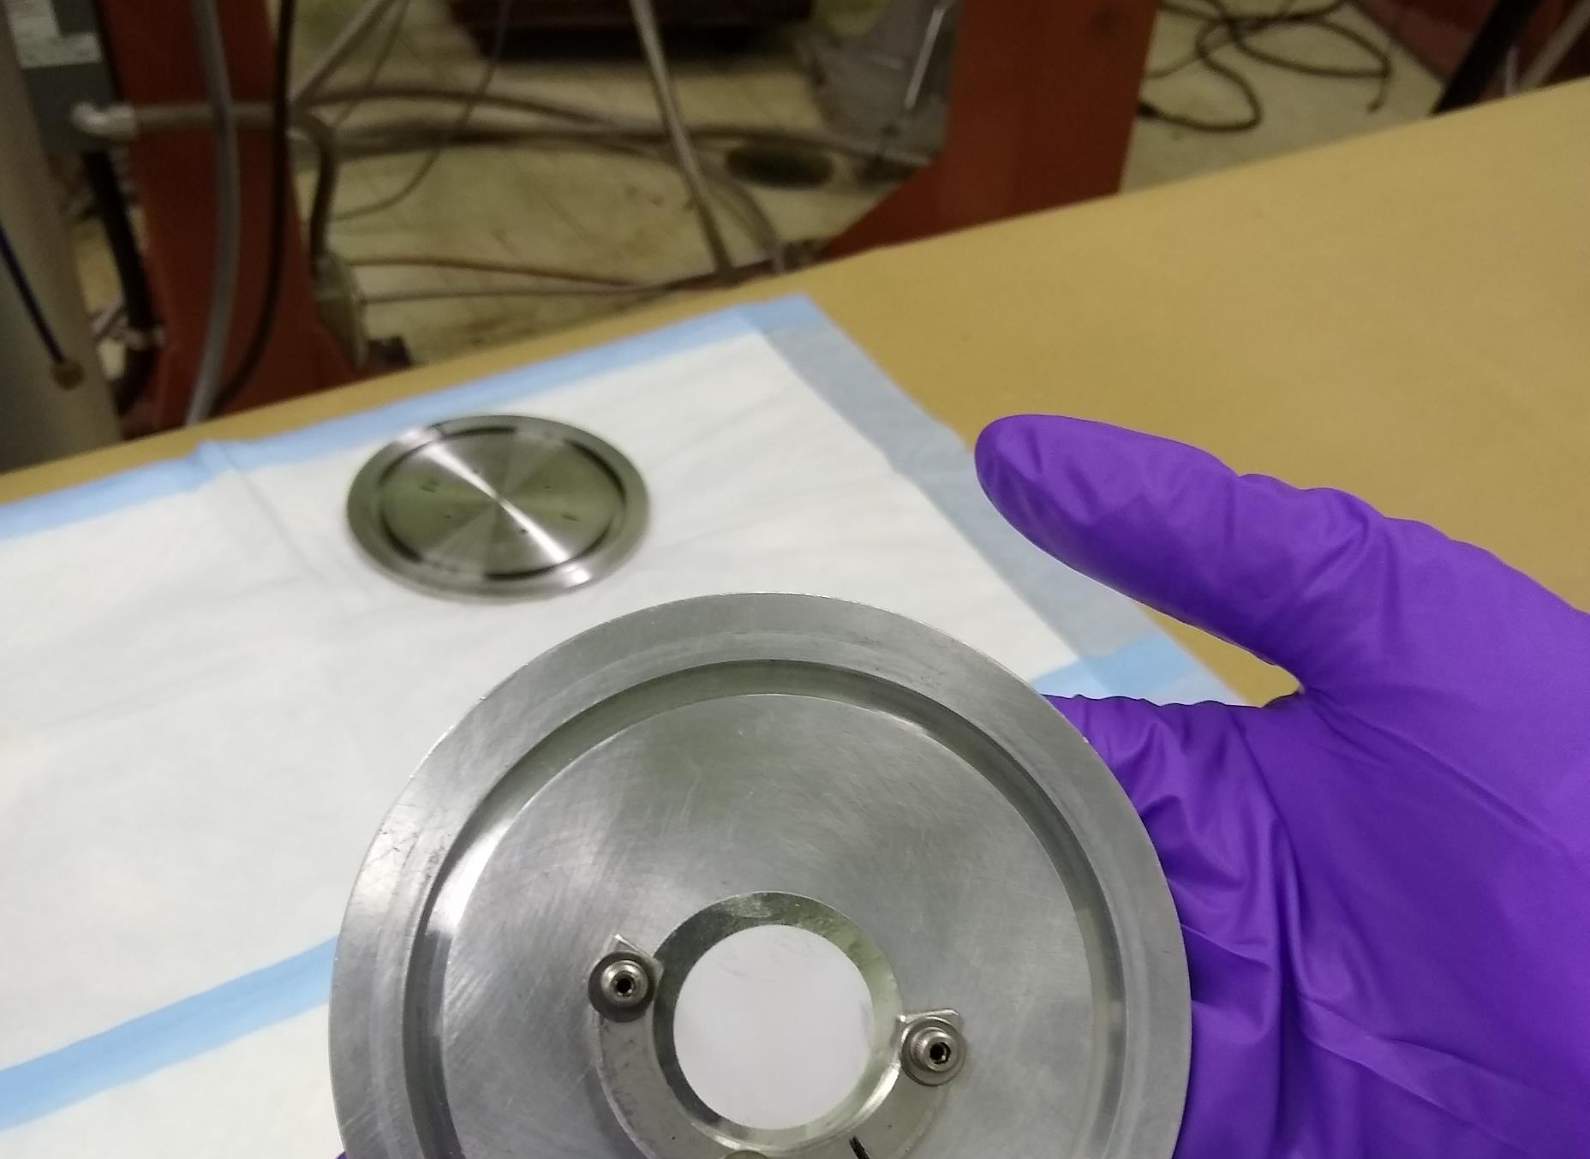


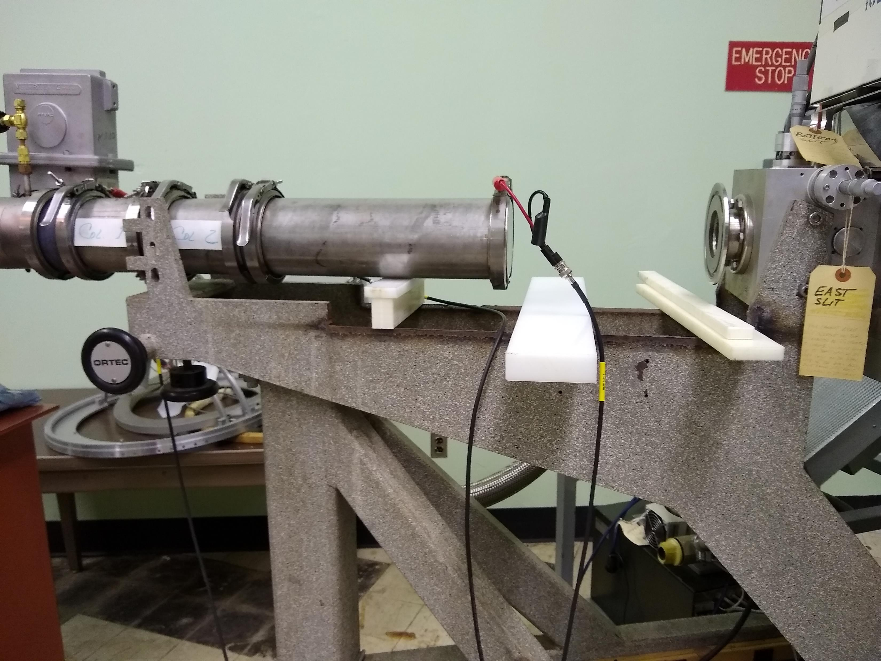
Target Development for EBCO cyclotron
Isabella Pasha
Najah Curtis

Slide 22
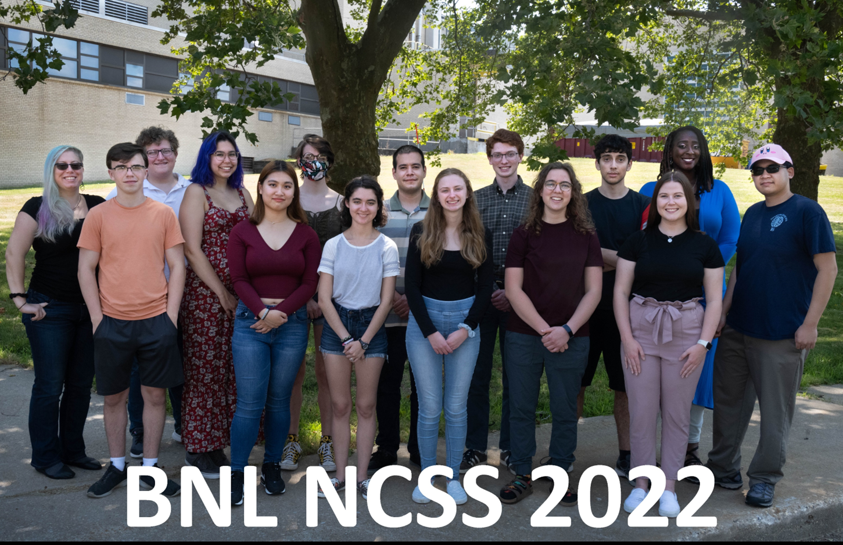
NCSS at BNL
An intensive six-week Summer School in Nuclear and Radiochemistry for undergraduates. NCSS 2023 started this Monday.
Sponsored by the Division of Nuclear Chemistry and Technology of the American Chemical Society (ACS DNC&T) and funding by the U.S. Department of Energy.
Provide fundamental training in nuclear and radiochemistry principles, particularly to physical science and engineering students from institutions that do not have such programs.
Stimulate interest in physical science and engineering undergraduates in graduate studies in fields founded in nuclear and radiochemistry.
Generate awareness and acceptance of nuclear technologies and application in society among participants.
12 students selected for each site primarily from institutions that do not offer nuclear studies
~48% of NCSS students continue to graduate studies in nuclear science.

Slide 23
Presentation Summary
Various opportunities to engage with the isotope program
Visiting Faculty program, SULI program GEM, SURP
Projects on targetry, nuclear data, engineering, separations, radiolabeling, automation, modeling
NCSS for undergraduate's deep dive into radiochemistry and nuclear chemistry
Continue efforts to reach out and collaborate to provide access to unique facilities
Official Use Only

