Slide 1
Summary and Discussion Workshop on Exploring Collaboration with MSIs in Nuclear and Particle Physics
Hong Ma
July 19, 2023

Slide 2
Thank you for participating in the workshop

Slide 3
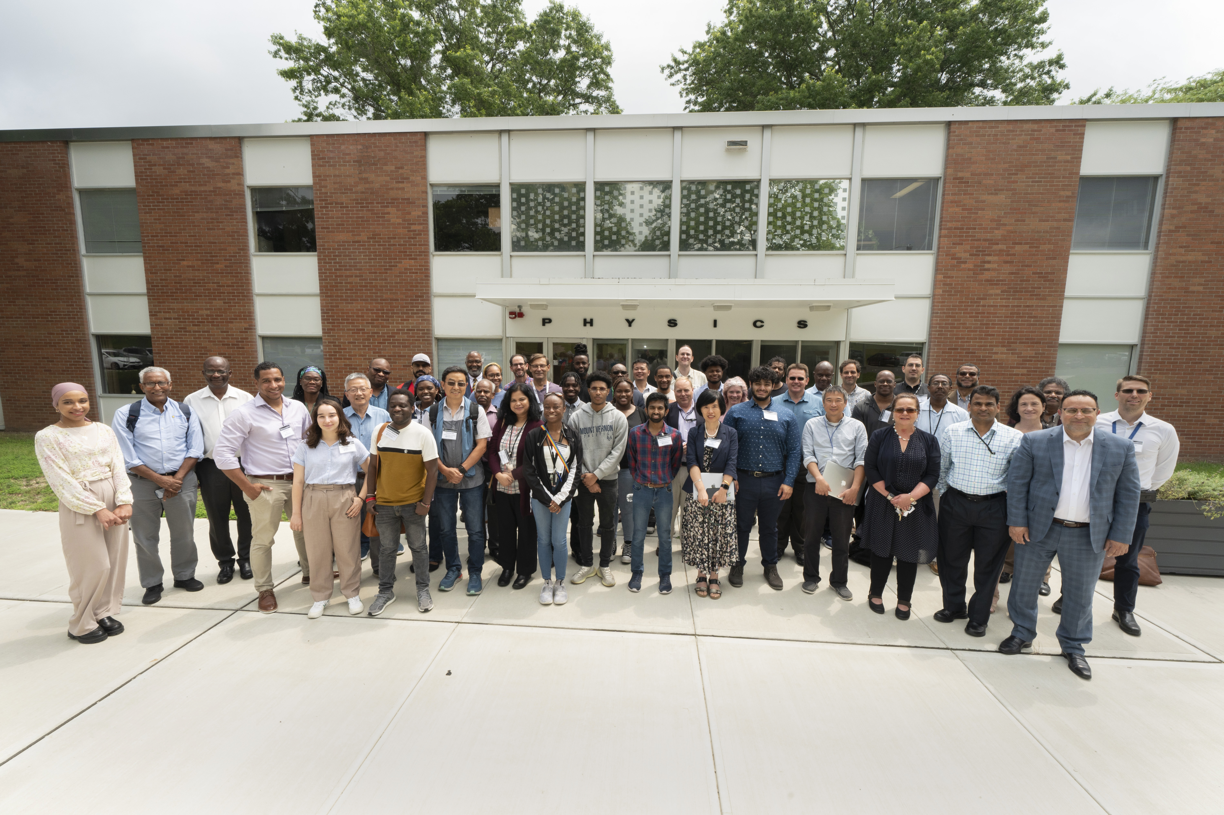

Slide 4
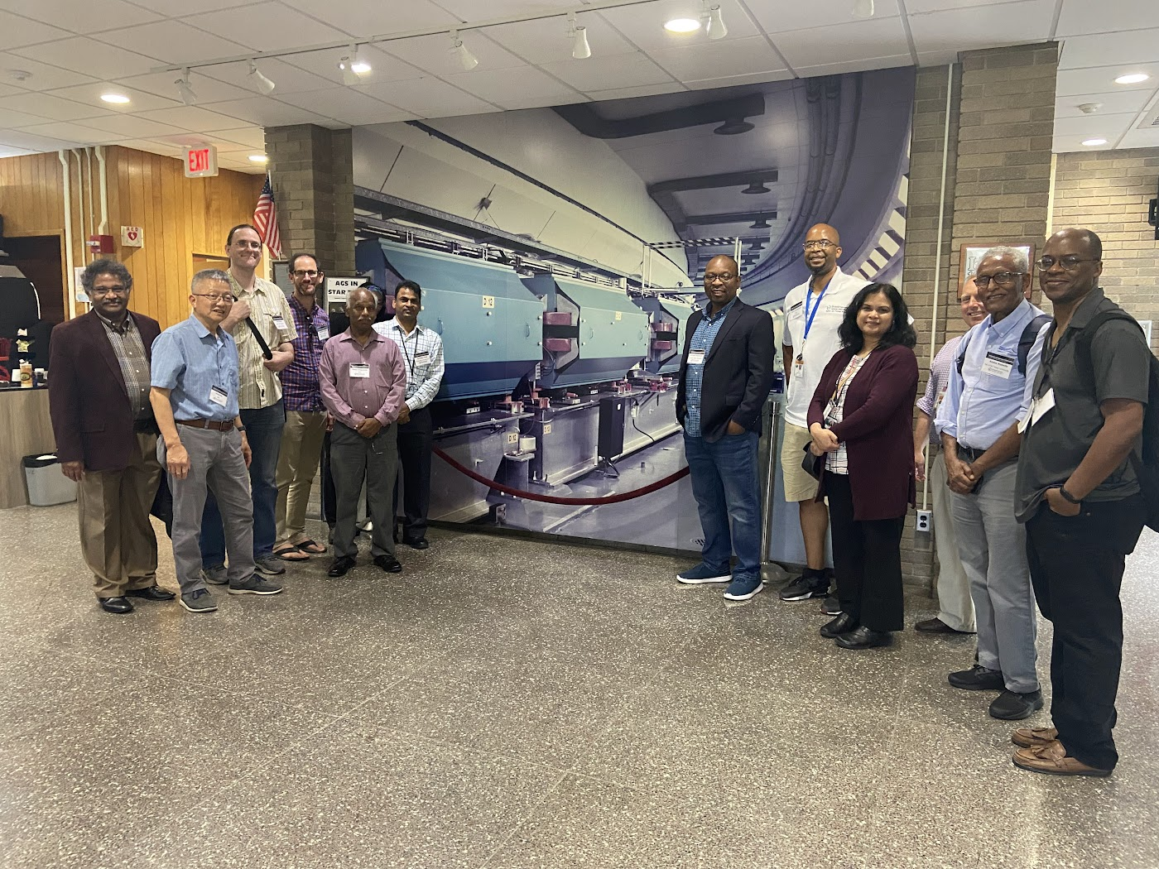
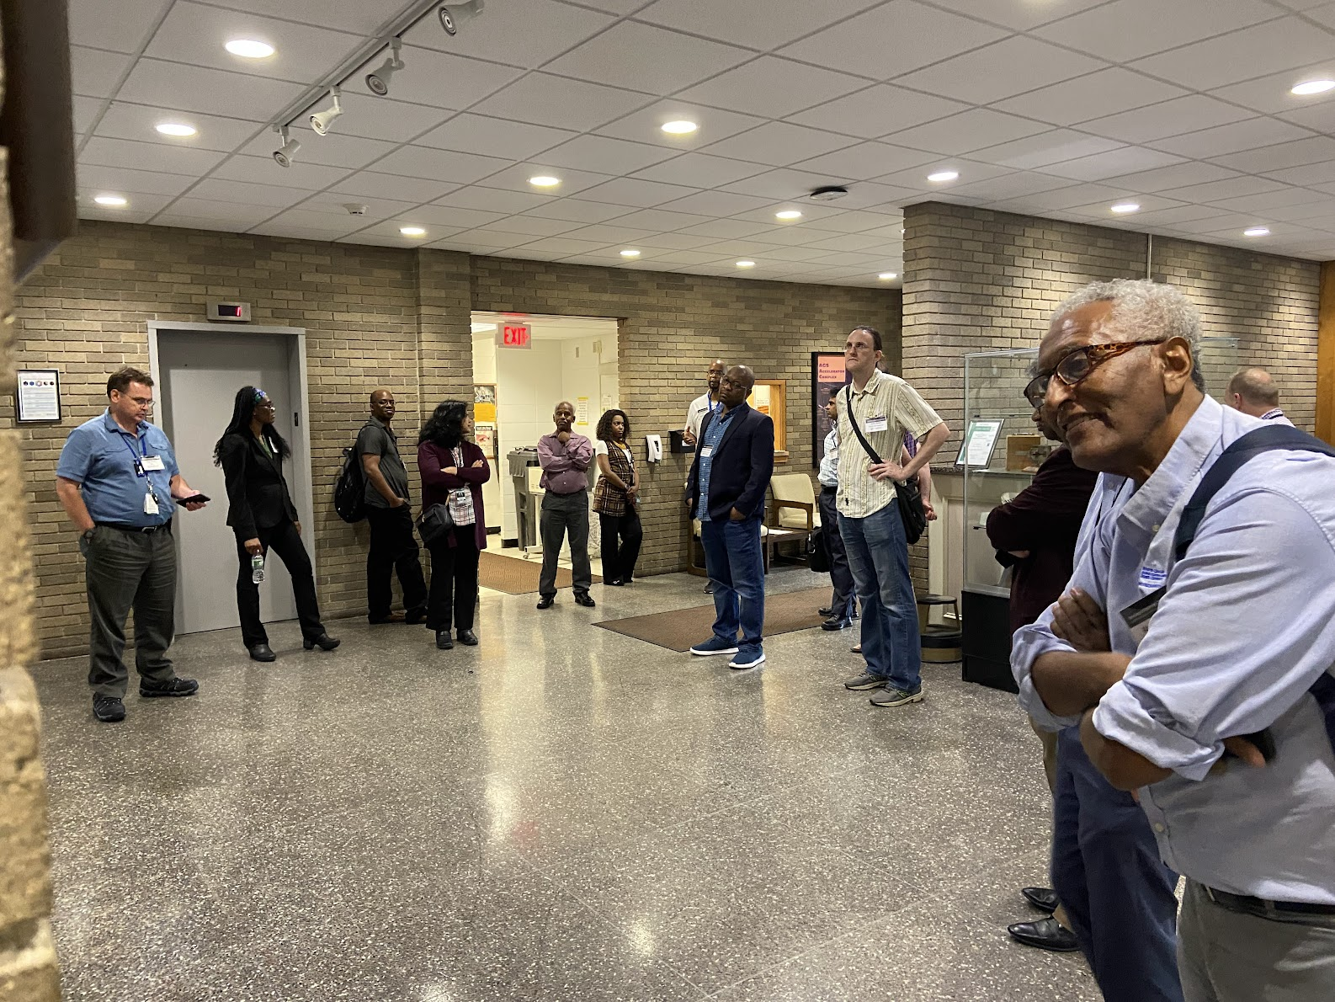
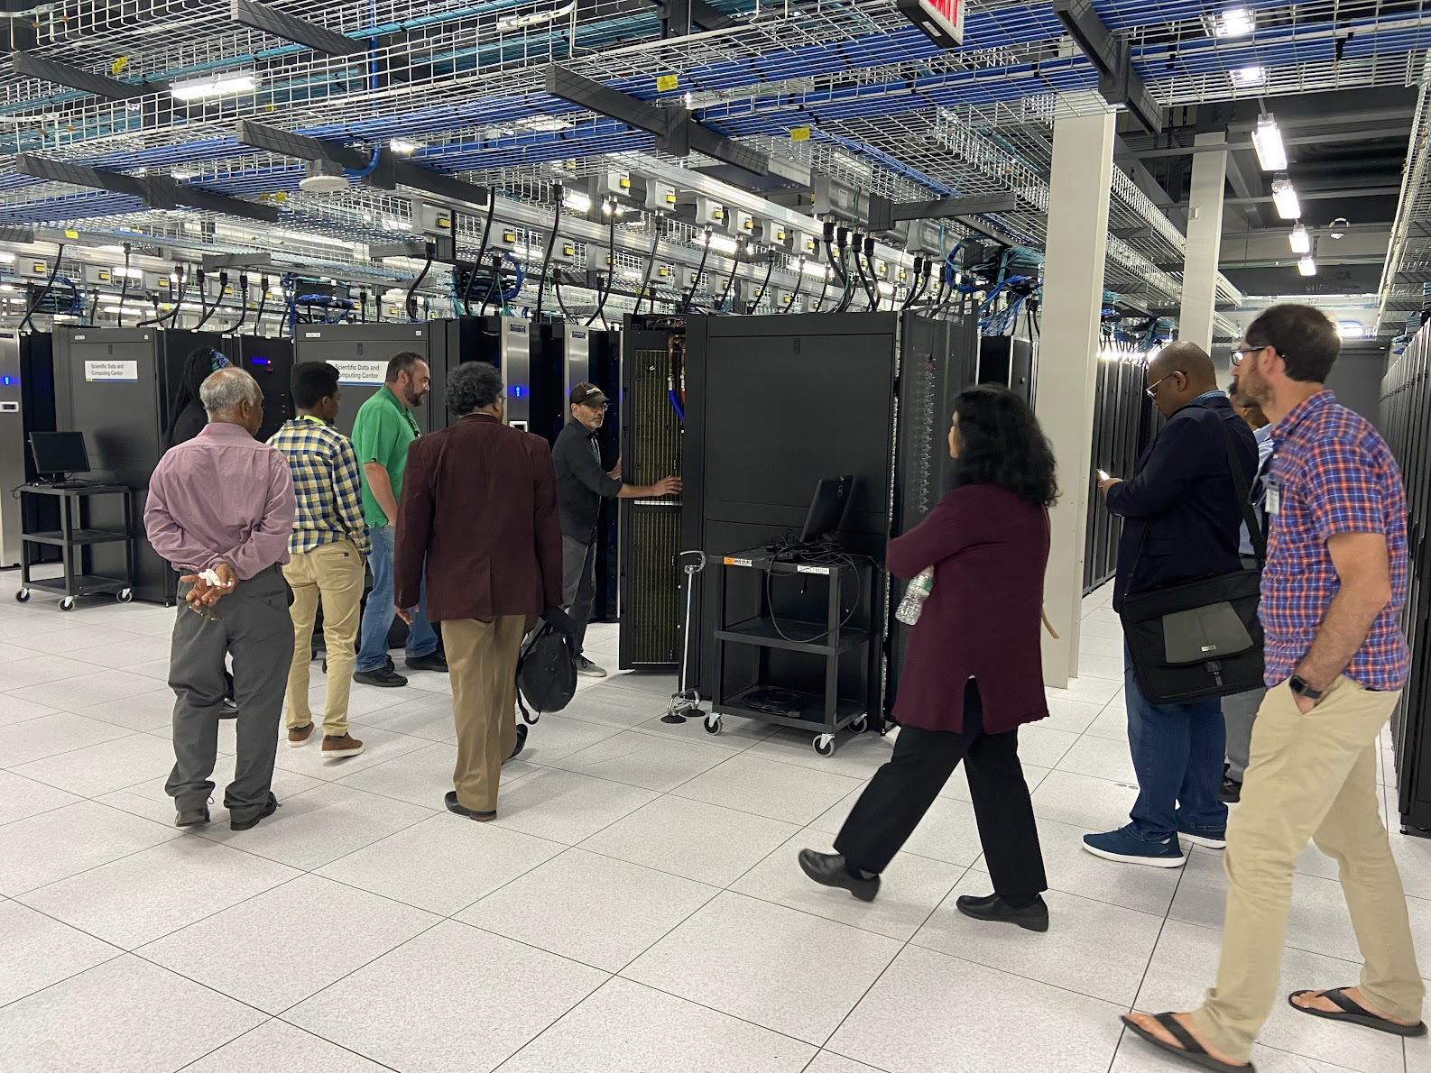

Slide 5
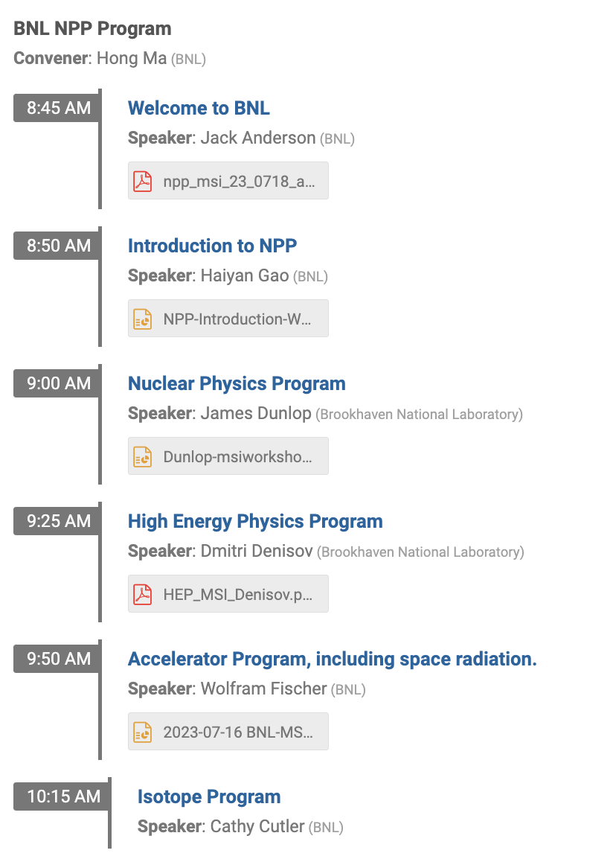
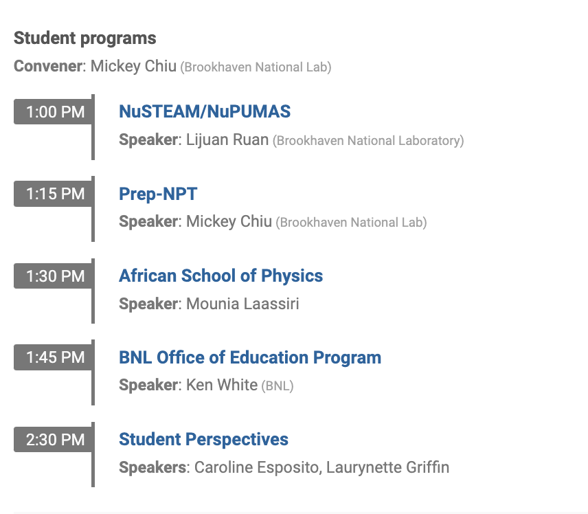

Slide 6
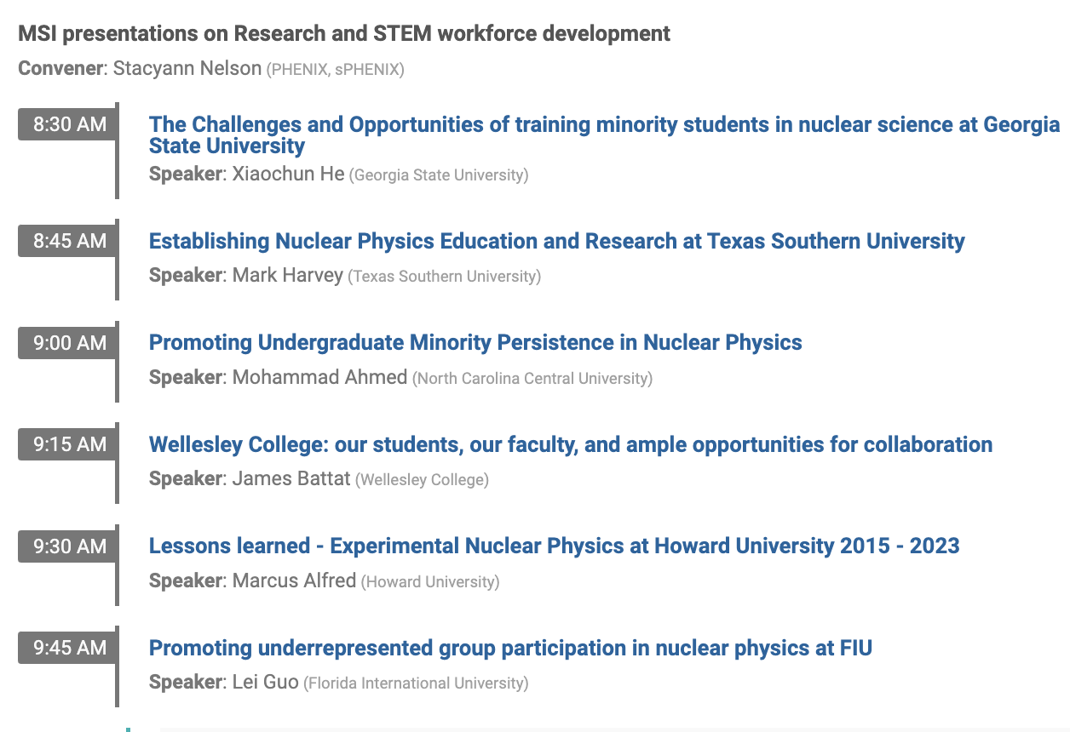
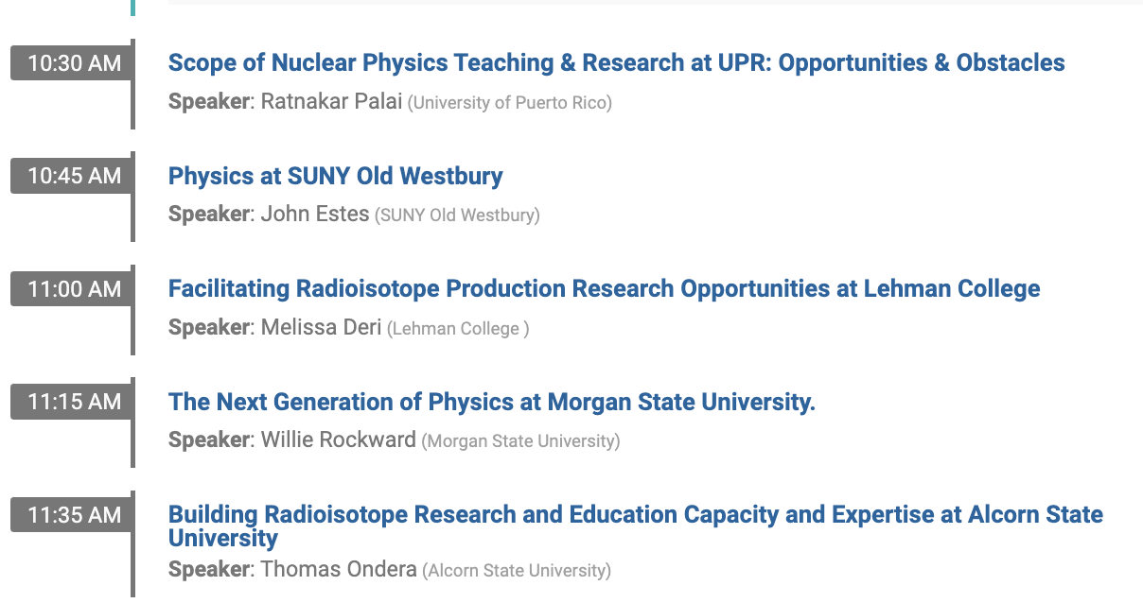

Slide 7
Open Discussions on next steps
Developing physics major
Developing nuclear and particle physics curriculum
Pipeline to graduate schools.
Pipeline from high school and community college
Support for graduate students (stipend)
Engineering and t
SULI/CCI/VFP programs
Traineeship programs
Bridge positions with national labs
Joint research and support in collaborations

Slide 8
Many Thanks to Erica Lamar and Leesa Allen for the administrative support !

