Slide 1
Results from the BNL-MSI PREP-NPT* Program (Program for Research Excellence and Preparation via Nuclear Physics Traineeships)
Mickey Chiu
28 Oct 2022
APS DNP 2022
*A DOE Nuclear Physics Traineeship Program

Slide 2
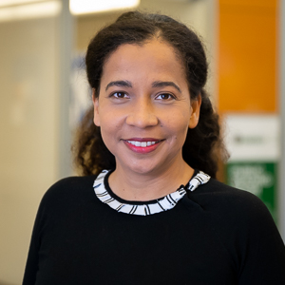
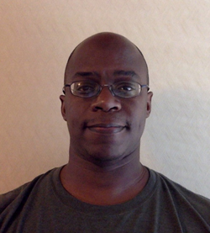
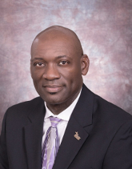
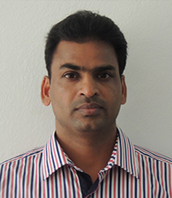
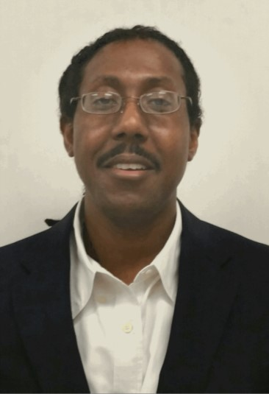
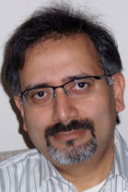
The Core University Partners and Advisors…
Florida A&M University*: Prof. Carol Scarlett
Howard University*: Prof. Marcus Alfred
Morgan State University: Prof. Willie Rockward
University of Puerto Rico: Prof. Ratnakar Palai
Texas Southern University*: Prof. Mark Harvey
Stony Brook University: Prof. Abhay Deshpande
* HBCU Collider Collaboration, funded by NSF EiR and hopefully continued by DOE RENEW

Slide 3
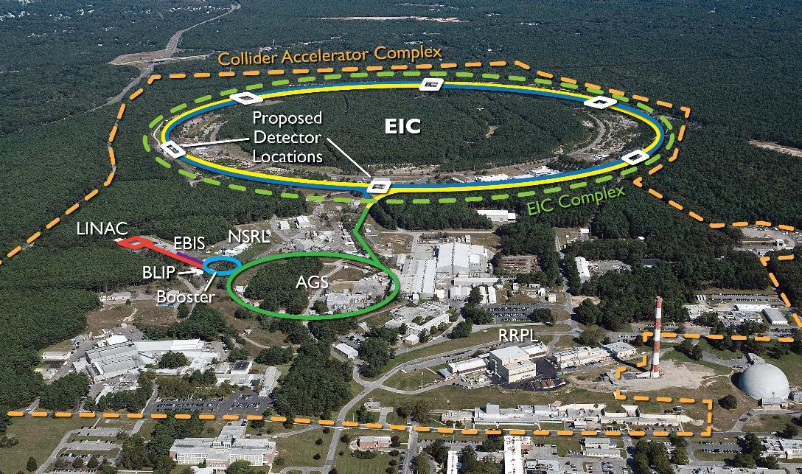
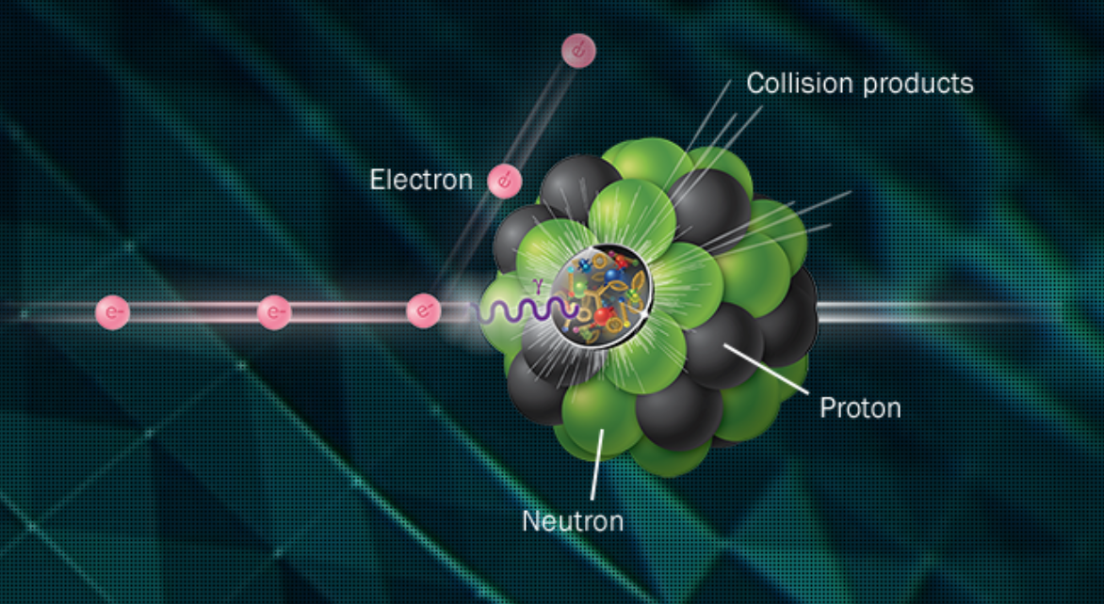
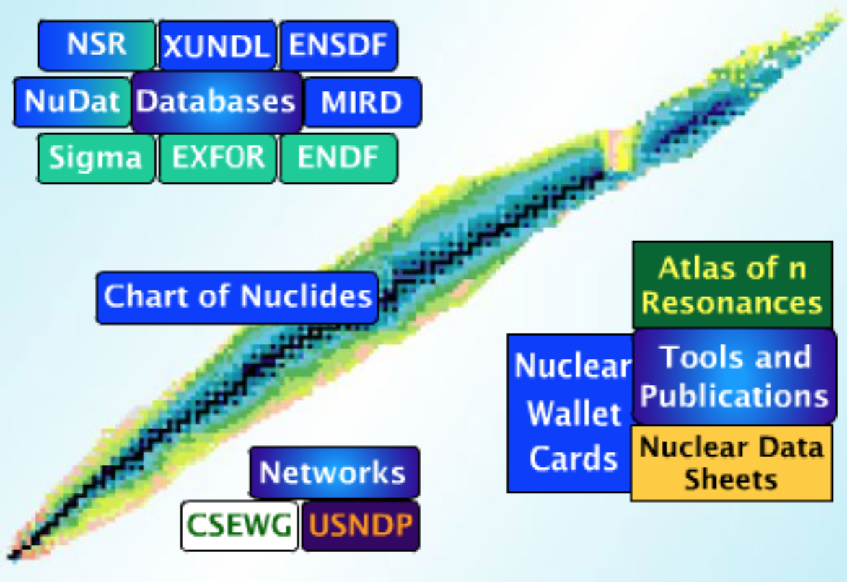
Mentor Volunteers from BNL NP Groups
RHIC and EIC (Relativistic Heavy Ion Collider, Electron-Ion Collider):
Dr. Lijuan Ruan, Prof. Abhay Deshpande, Dr. Elke Aschenauer, Dr. Oleg Eyser, Dr. Luca Cultrera, Dr. Triveni Rao, Dr. Mickey Chiu
Nuclear Physics Theory:
Dr. Bjeorn Schenke, Dr. Raju Venugopalan
NNDC (National Nuclear Data Center):
Dr. David Brown, Dr. Gustavo Nobre, Dr. Matteo Vorabbi, Dr. Alejandro Sonzogni, Dr. Elizabeth McCutchan, Dr. Simerjeet Gill, Dr. Luis Betancourt
CSI (Computation Science Initiative):
Dr. Shantenu Jha, Dr. Li Tan, Dr. Mikhael Titov
Nonproliferation and National Security
Dr. Rebecca Coles

Slide 4
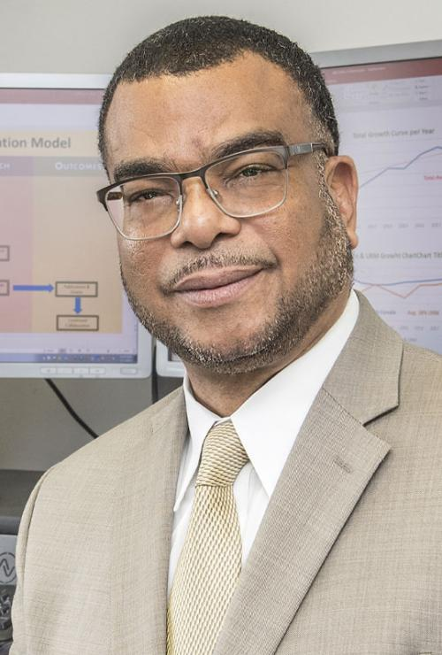
Plus the BNL Office of Educational Programs
Existing infrastructure and experience for students
Have successfully run SULI, CCI, HSRP, VFP, and other internships for decades
Provides organizational framework for bringing student fellows on-board
Provides training in giving scientific talks, writing reports and articles, professional behavior
Organizes talks, tours, and social activities
Student surveys already part of evaluation
Longstanding relationship (network) to universities for recruiting
Key to recruiting students and finding those diamonds in the rough
Noel Blackburn
Chief Diversity Officer

Slide 5
Past Experiences
Despite effort from VFP (Visiting Faculty Program) and SULI, there still weren’t students from the MSI’s going into the graduate school pipeline in NP
Intense summer session finished with an abrupt end when students returned to home institution
Many students were not thinking of a career path as a scientist
Most were pre-med or engineering, and if they were physics majors, they were interested in astronomy
Difficult for under-resourced MSI professors and students to keep concentrating on research and redirecting students to a life of research during academic semesters
High teaching loads
Extremely difficult for professors to pick up new specialty in Nuclear Physics
Notes:
What was wrong with SULI? What’s different in the new program. SULI++, or mini-graduate student experience

Slide 6
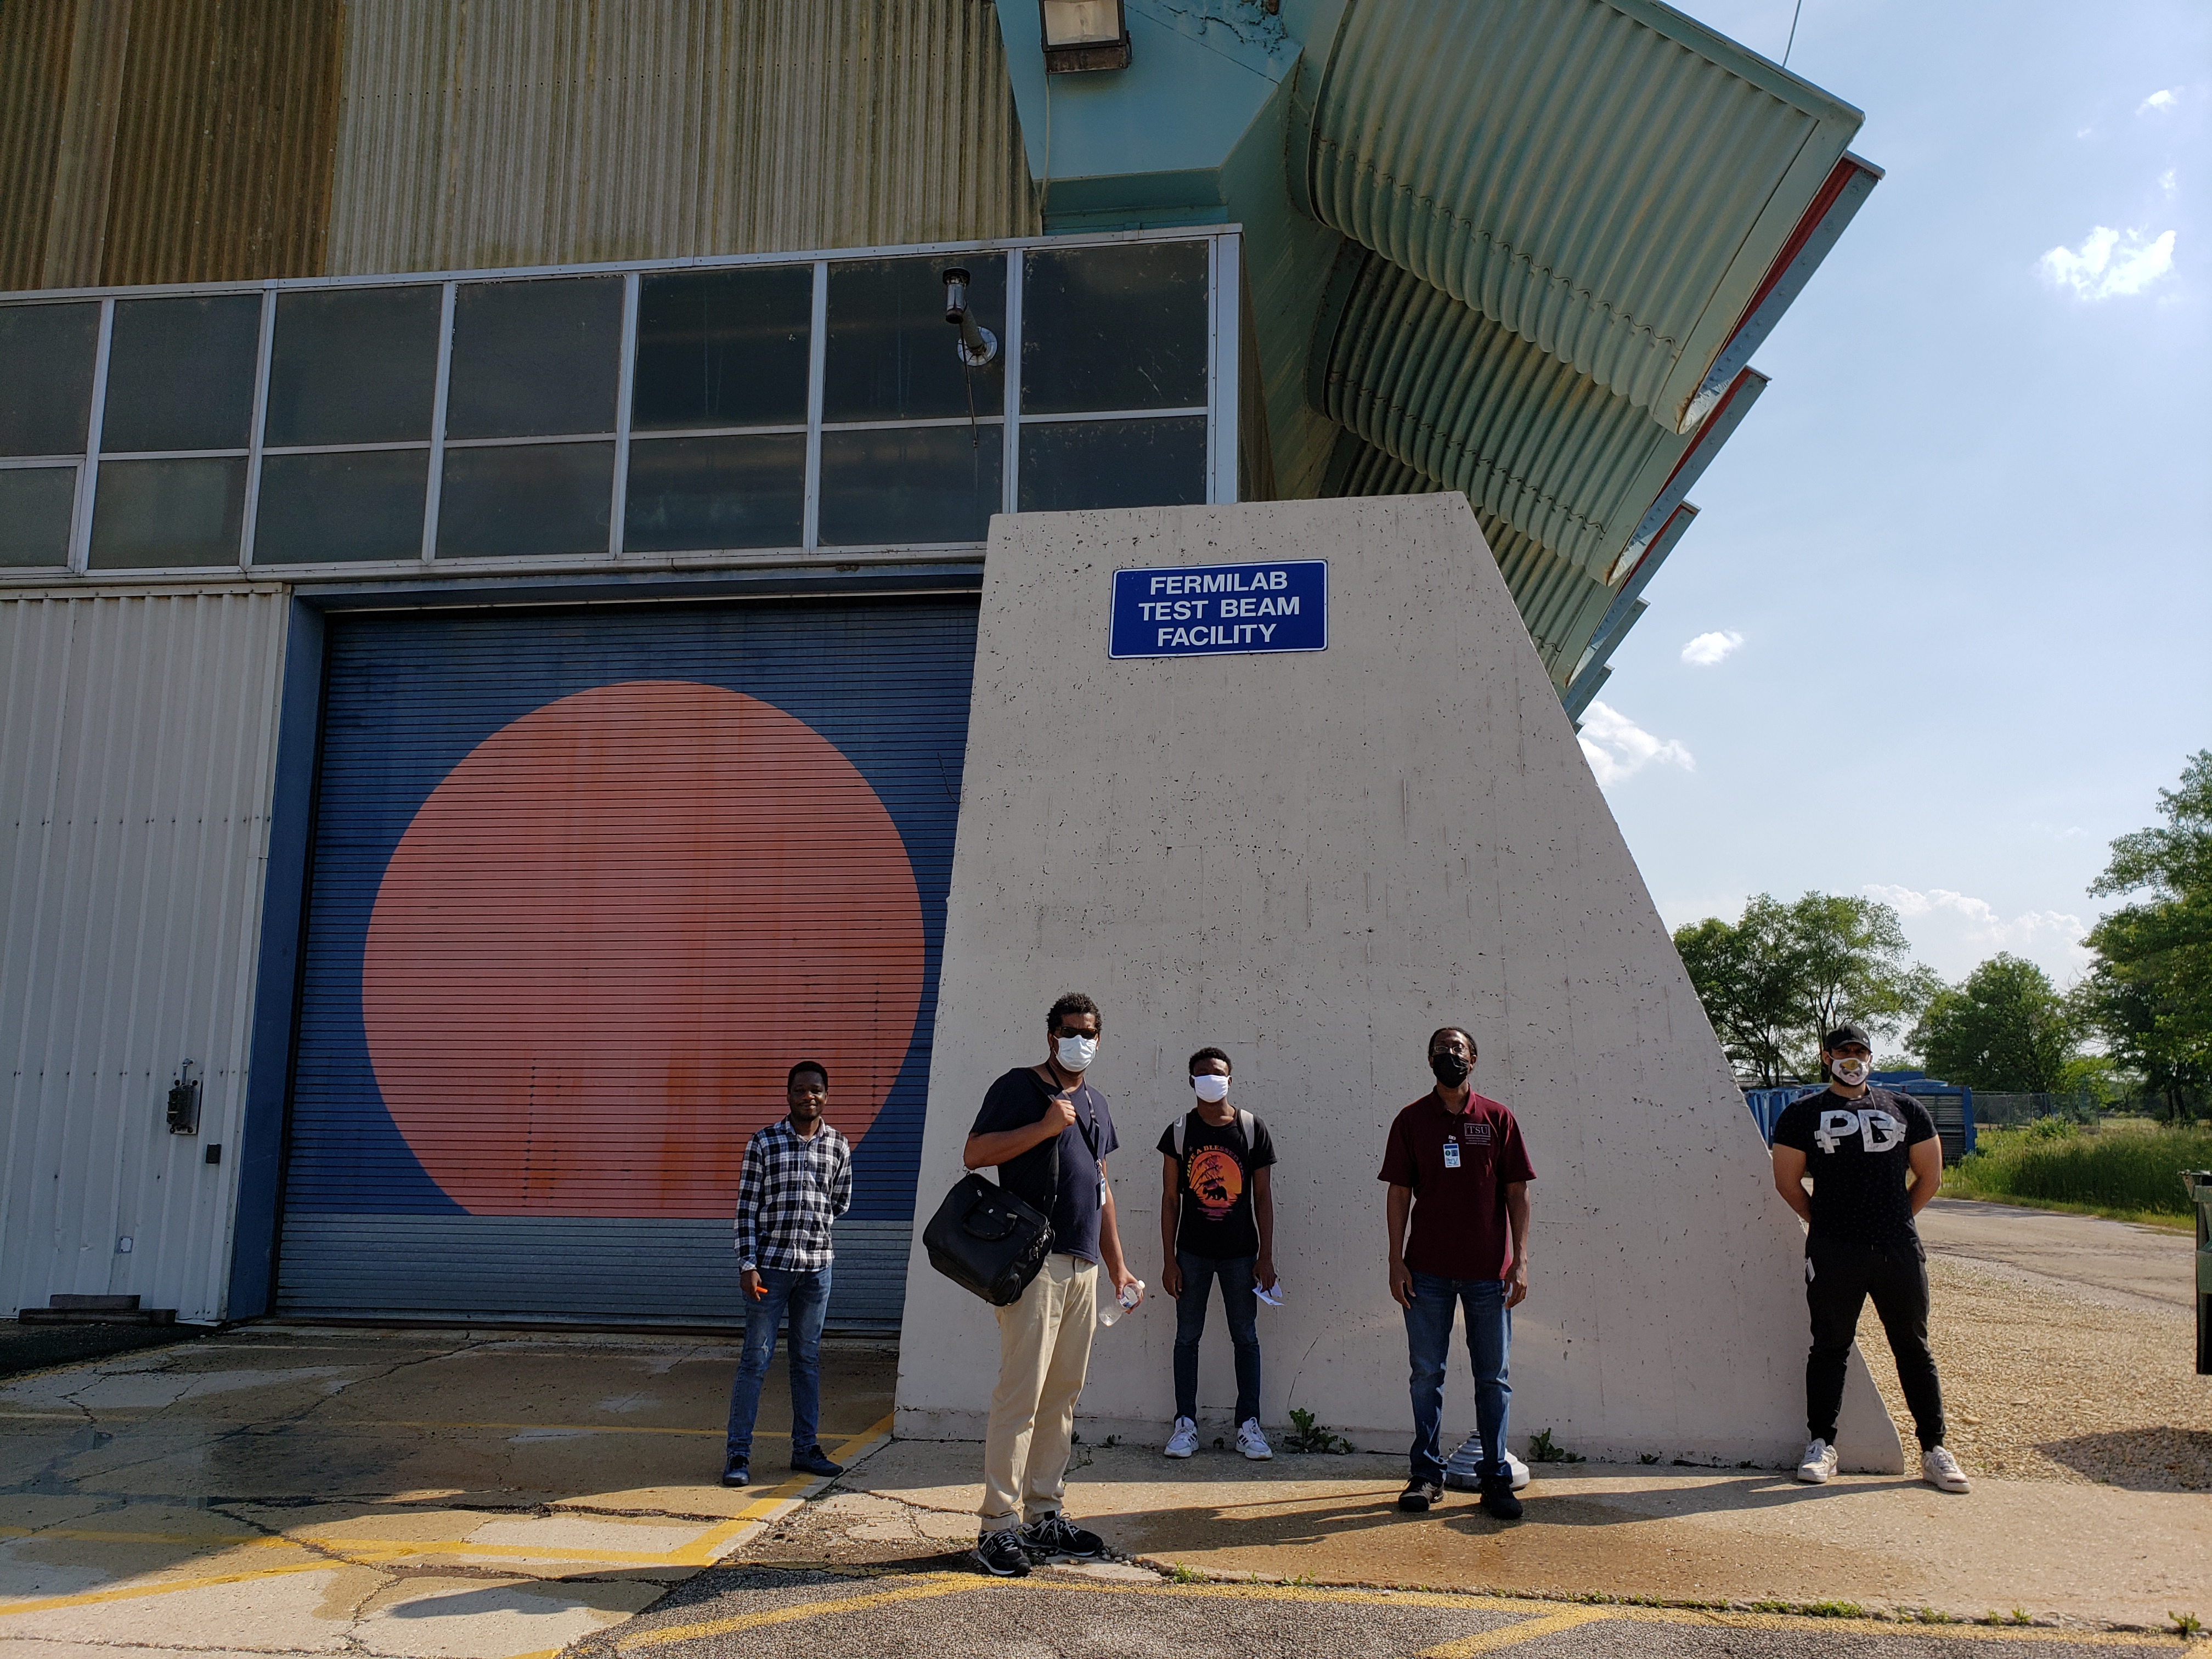
Program Goals for the Fellows
Have fun.

Slide 7
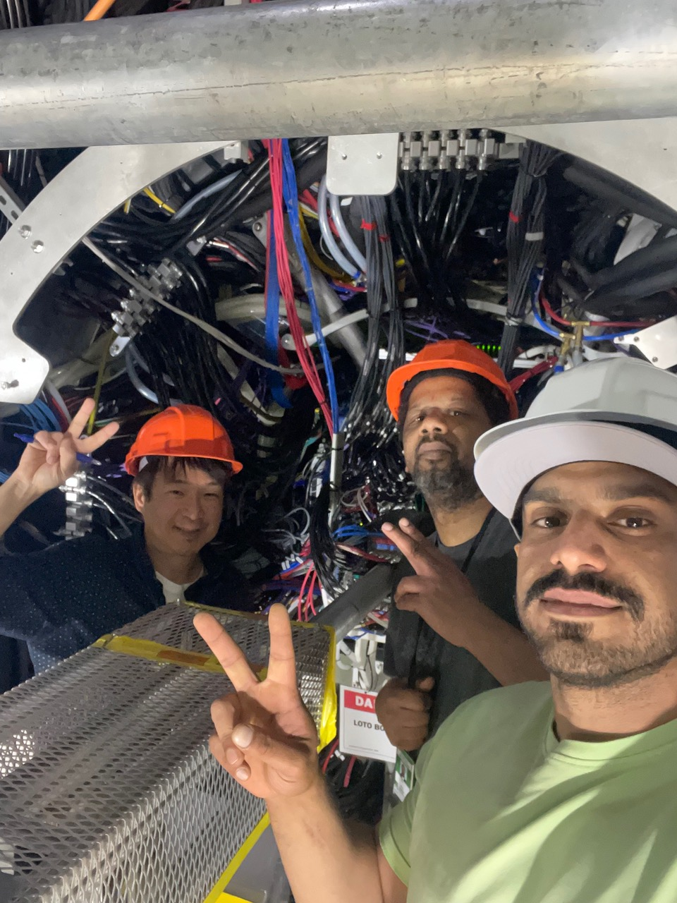
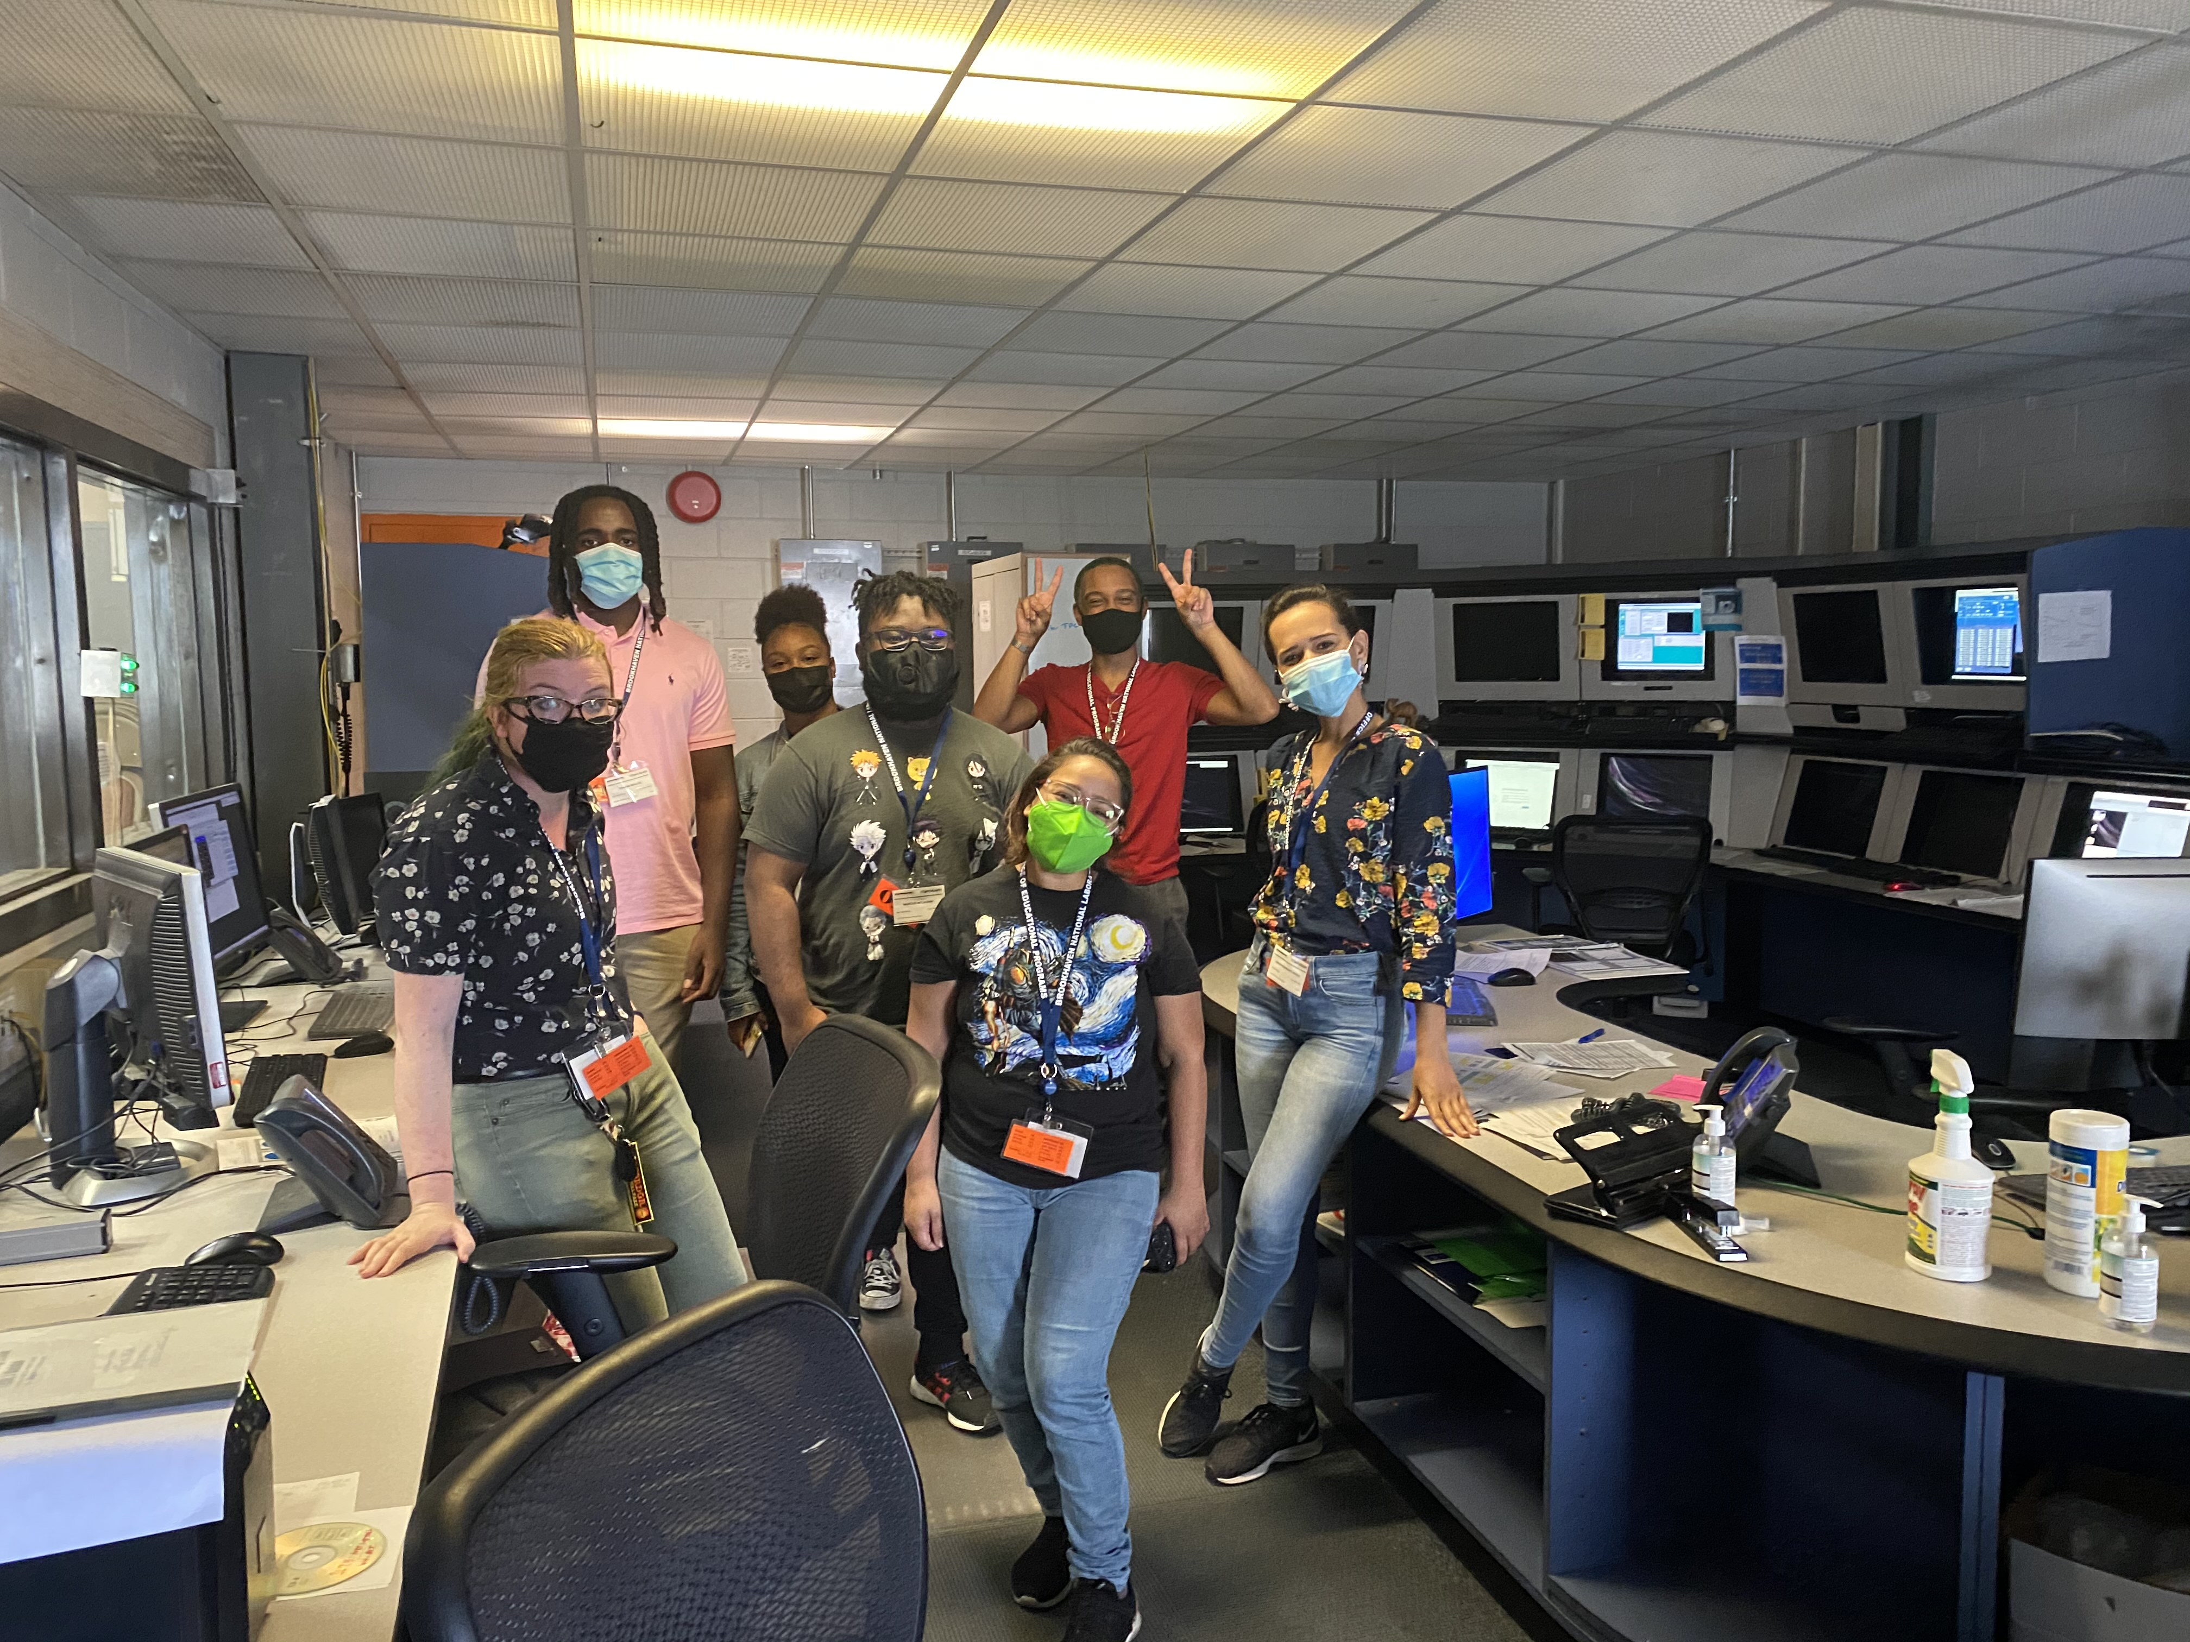
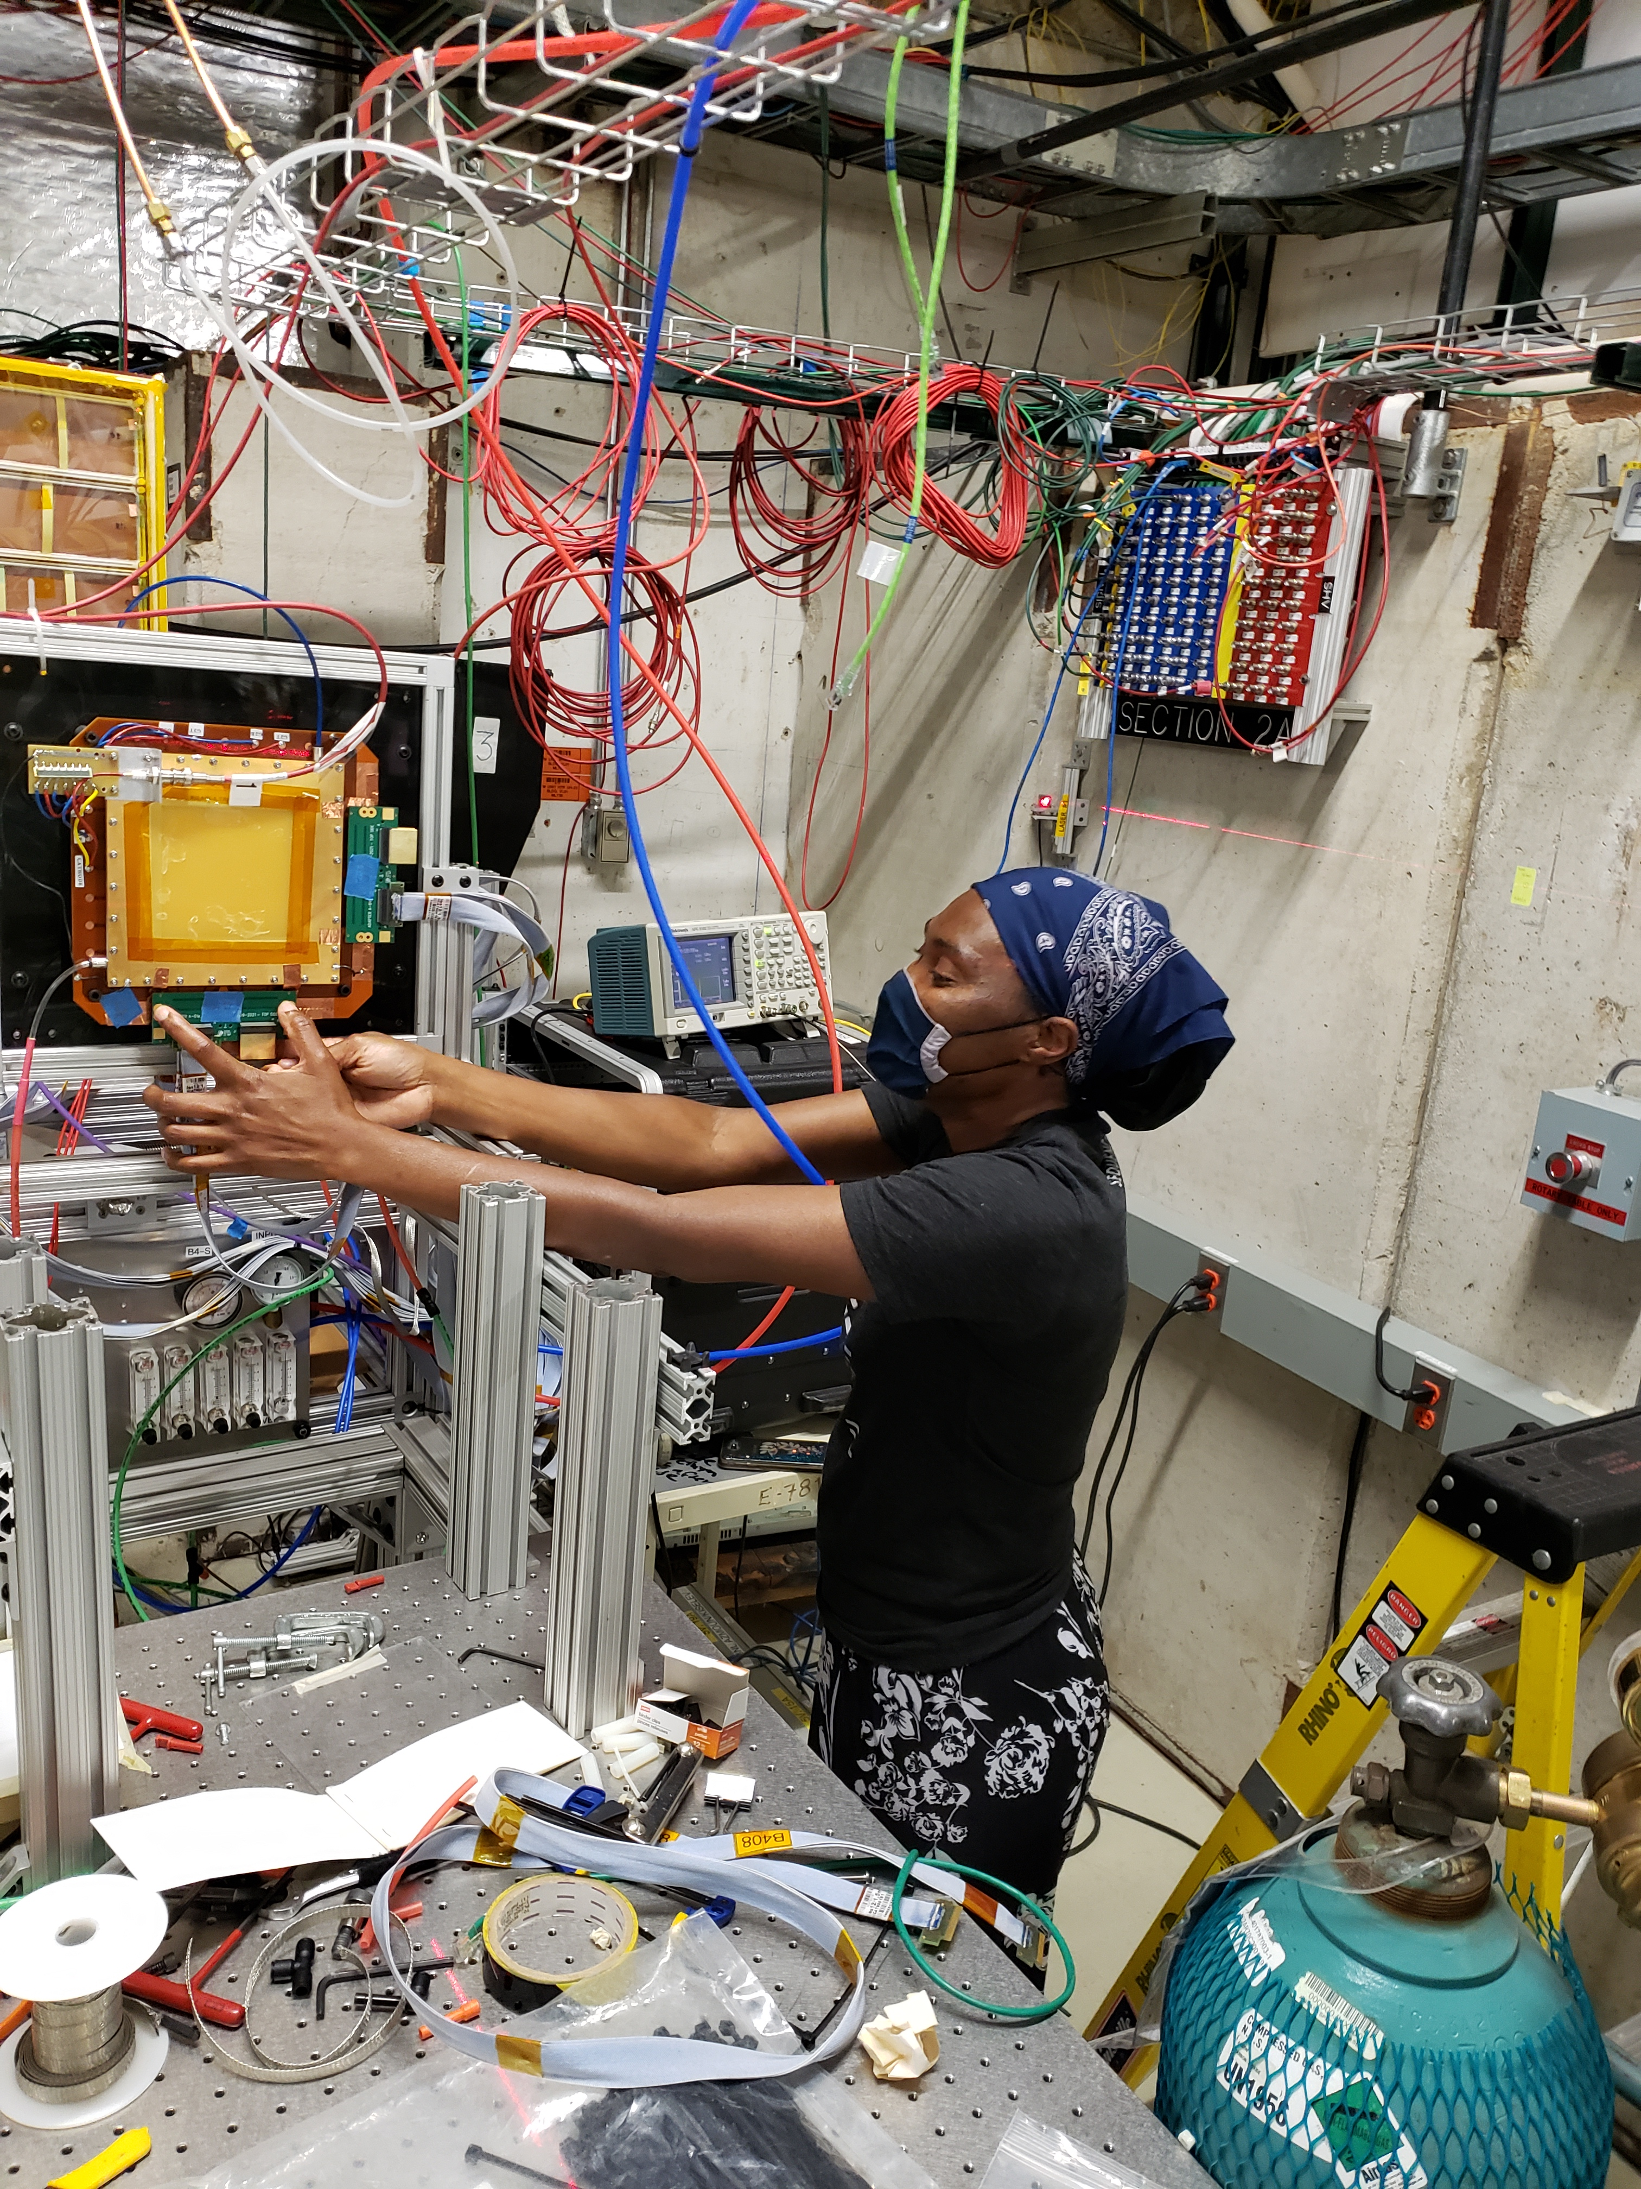
Have Fun!
Very powerful to be able to bring Fellows to BNL for two weeks at end of Covid Summer 2021

Slide 8
Goals for the NPT Fellowship Program
Provide the support they need to succeed in research
Program includes financial support for full-time (40 hrs/wk) summer student research @ BNL
$6000 stipend for the summer, full support for lodging and travel (equivalent to SULI)
Bring students to BNL in summer
Supports student research for 2 days per week during the Fall and Spring semesters (15 weeks each)
$3600/semester ($15/hr)
We want them to be able to concentrate on your research and studies
Long term commitment (1-2 years) for all Fellows, through their final undergraduate years and into graduate school or other STEM career
Intense mentorship from Scientists and Professors
Can go deeper into the knowledge needed on a research topic compared to SULI
Individualized Research and Education Plan for each Fellow provided by university professors and BNL scientists

Slide 9
Goals for the NPT Fellowship Program
Provide the structure that makes the goals possible
Supplemental lectures and seminars from BNL scientists, in addition to the individual mentoring from research advisors
Python bootcamp, Unix/C++/ROOT bootcamp, DAQ lecture, GRE Physics Workshops
Summer Lecture Series from BNL Physics, OEP Brown Bag Lunch
Form a peer support community of Fellows
A group of nerdy friends is a good thing!
It helps to be able to interact with someone with the same background
Give them opportunities to see what being a scientist is like
Do the research, and present the research
10+ talks/posters presented or to be presented at APS DNP CEU 2022, NSBP, NAPAC 2022
4 papers published or in pipeline to be published with student fellows as contributing author
And we’re very open to any ideas to improve this program
Trying to stay away from preconceived notions of what should work (clearly what we have been doing wasn’t working too well)

Slide 10
Year 1 Cohort Projects
PREP—NP Student Fellow | Mentors | Dept | Project
Grace Farrell (Morgan St) | Prof. Rockward, Dr. McCutchan, Dr. Sonzogni | NNDC | Systematics of Inverse-Beta-Decay Antineutrino Yields
Rosemary Cortes-Robles (UPR) | Prof. Palai, Dr. Betancourt, Dr. Gill | NNDC | Understanding metal speciation in molten salts using X-ray absorption spectroscopy
Khadim Mbacke (Morehouse) | Prof. Scarlett, Dr. Nobre, Dr. Brown, Dr. Vorabbi | NNDC | Resonance systematics for capture reactions using Machine Learning
Kolby Davis (Howard) | Prof. Alfred, Dr. Chiu | RHIC | Exploring the Nature of the Early Universe using the sPHENIX Experiment
Sixtus Kuudar (FAMU) | Prof. Scarlett, Dr. Schenke, Dr. Venugopalan | NP Theory | Exploring the origin of mean transverse momentum fluctuations in heavy ion collisions
Kurt Kennedy (Morgan St) | Prof. Rockward, Dr. Ruan, Dr. Eyser, Dr. Aschenauer | RHIC | Calibration and data analysis with STAR forward upgrades
Ambar Rodriguez-Alicea (UPR) | Prof. Palai, Dr. Cultrera, Dr. Rao | EIC | Numerical simulation of spin transport in advanced structures for spin polarized photoemission
Brynna Moran (Clarke Univ) | Prof. Harvey, Prof. Deshpande | EIC | A systematic study of novel rare isotope production at the Electron Ion Collider
Tiana Lynch (FAMU) | Prof. Scarlett, Dr. Jha, Dr. Tan, Dr. Titov | CSI | High-Performance and High-Throughput Computing In Nuclear Physics
Marcus McLaurin (Morgan St) | Prof. Rockward, Dr. Vorabbi | NNDC | Unresolved resonance probability distributions using Machine Learning

Slide 11
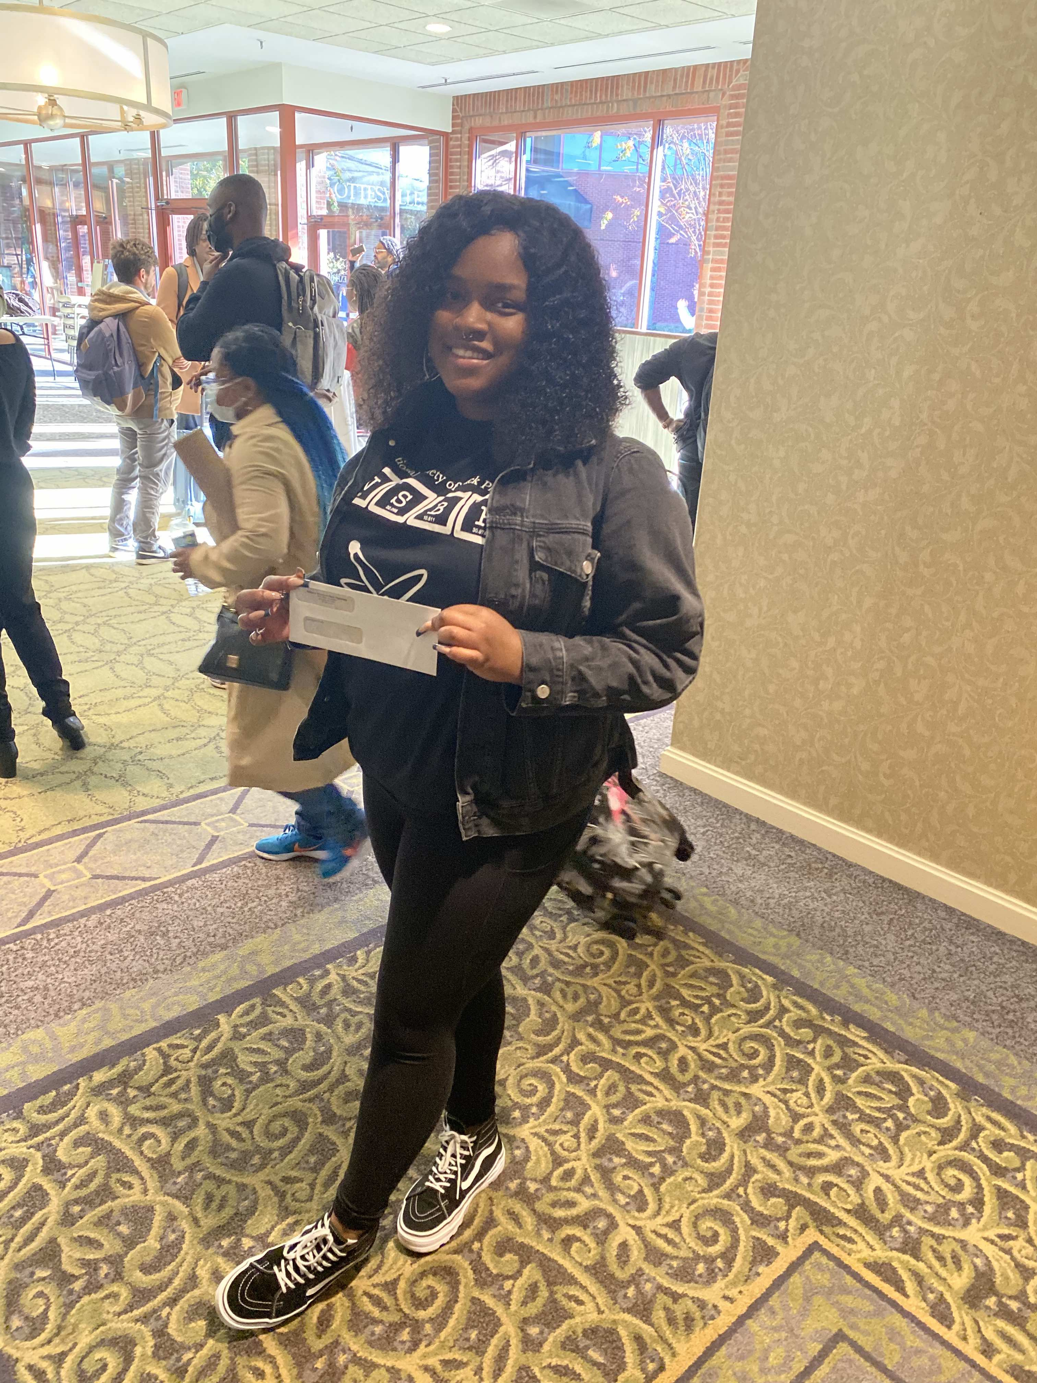
Conference and Other Scientist Experiences
OEP deliverables
Abstract and Paper
Poster
Presentation
5 talks/posters presented at conferences 2021 (NSBP and )
8 presented at APS DNP CEU and NSBP in 2022 (including one award at NSBP)

Slide 12
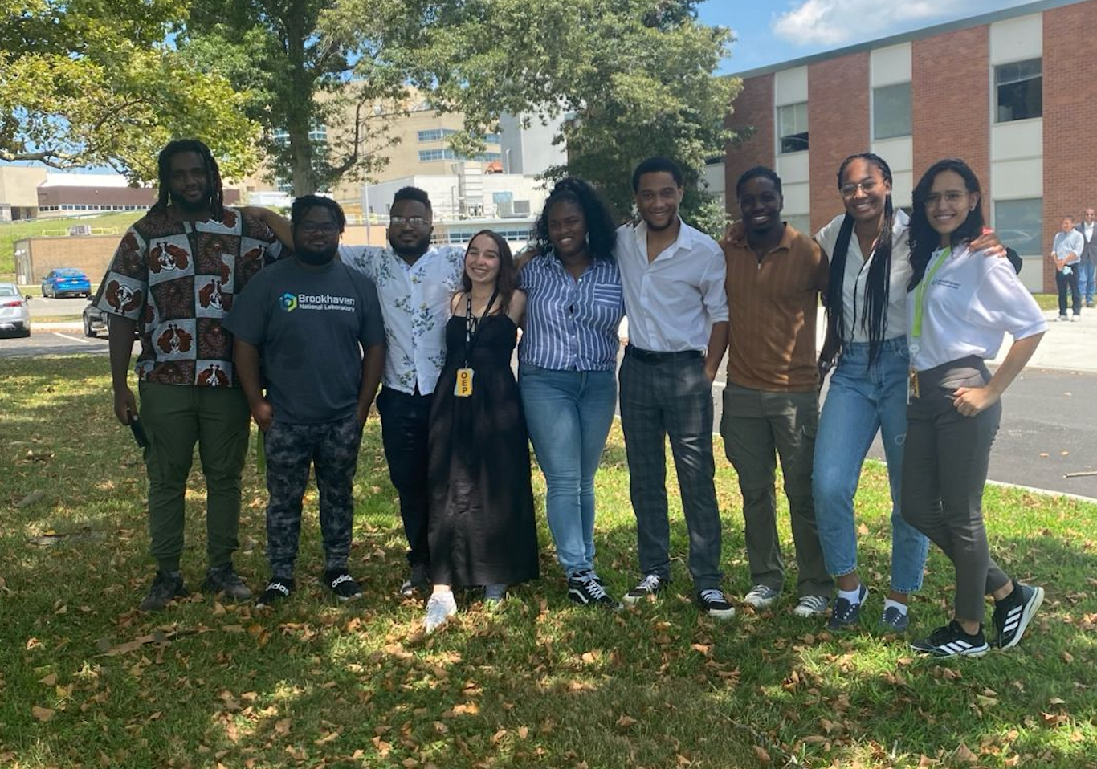
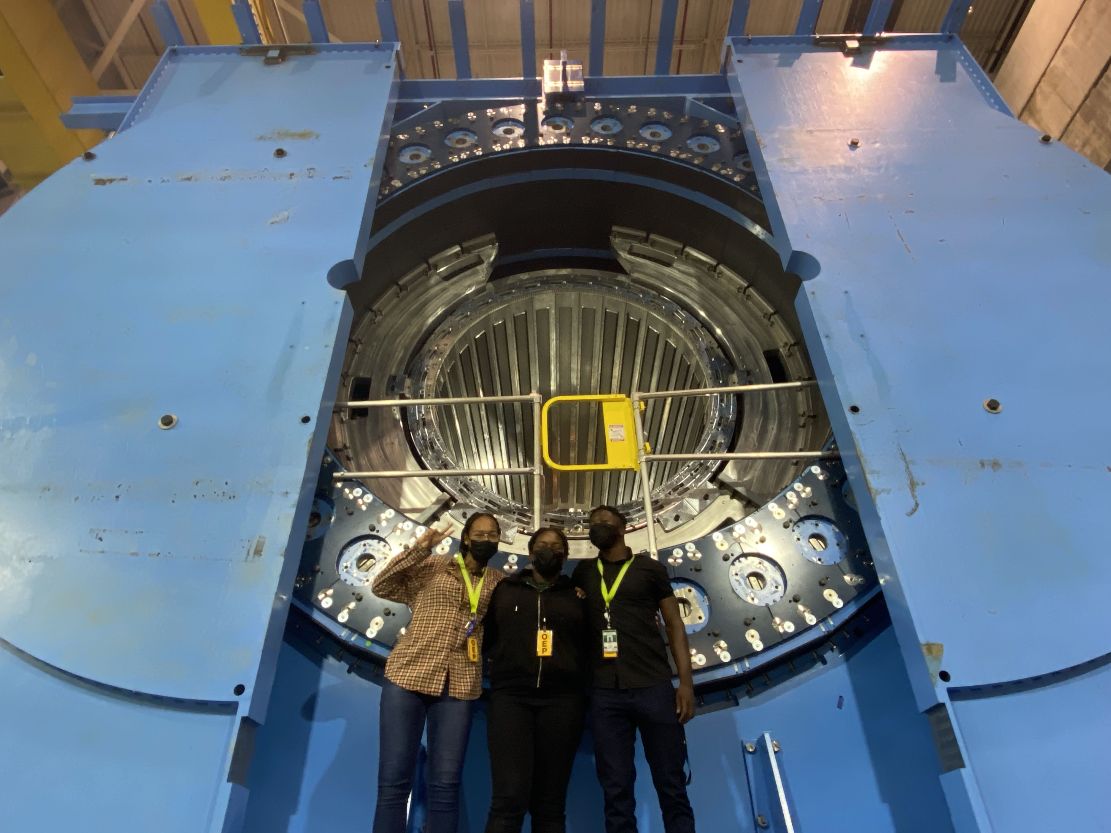
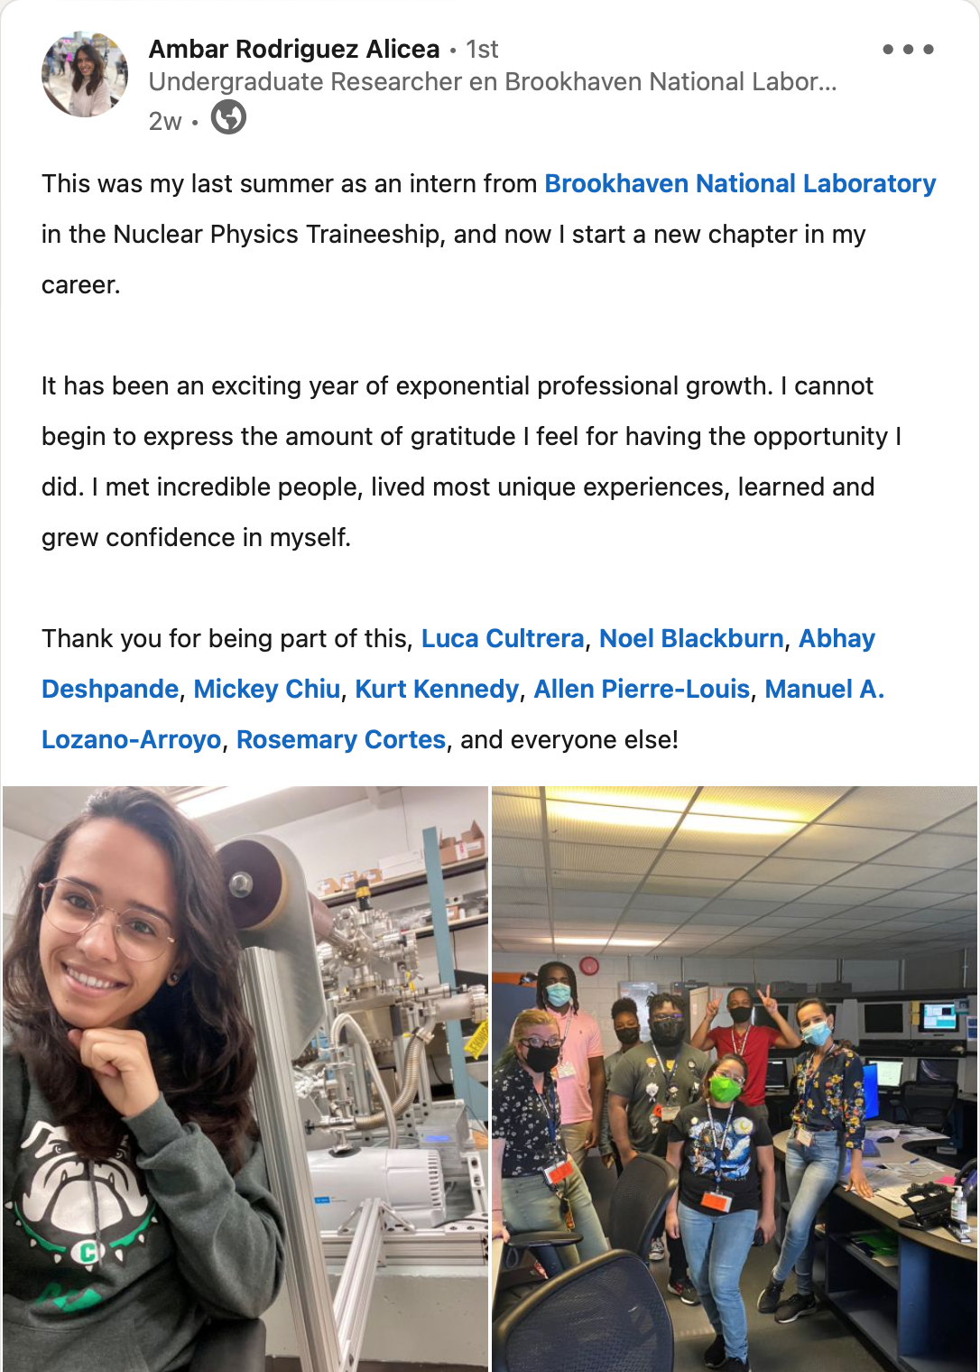
Program Results for the Fellows
Near conclusion of pilot, 8/9 fellows are in or will be going to graduate school
2 papers submitted for publication, at least 2 more expected in the coming year
Graduate Program | Mentor
Stony Brook MS Physics | Abhay Deshpande
Stony Brook MS Physics | Abday Deshpande
Michigan St PhD Physics | Luca Cultrera
Univ of Puerto Rico MS Physics | Luis Betancourt
Graduate Program | Mentor
Morgan St MS Math | Matteo Vorabbi
Michigan St PhD Biophysics | Matteo Vorabbi/David Brown
Vanderbilt Univ PhD Physics | Mickey Chiu
Vanderbilt Univ PhD Physics | Mickey Chiu

Slide 13
Summary and Conclusion
There’s a lot of excitement and support for this program from BNL and our partner universities
It fills a crucial missing link in the pipeline
We believe ability to keep students intellectually involved in the research through the semester is key to maintaining their interest
Provided opportunities for exposure to NP research to MSI’s
Where it had been almost missing previously
Our primary evaluation metric is how many of these Student Fellows go on to graduate school in physics, particularly NP, or to other STEM positions
So far this has been going well – 8 out of 9 have gone on to grad school
Another 8 students in this coming year’s cohort if funded
We will continue to evaluate how well they do and how we can improve the program
Thinking how to continue these efforts and expand to other parts of the leaky pipeline
Program started as a 2-year Pilot in the DOE ONP, thank goodness for RENEW-NP
Need more physics majors at the undergraduate level
Program to bring HS/early college students to BNL for 2-day tours/school?

