Slide 1
The challenges and opportunities of training the minority students in nuclear science at GSU
Megan Connors, Murad Sarsour, Xiaochun He, and Yang-Ting Chien
Department of Physics and Astronomy

Slide 2
Outline
Georgia State University (GSU)
Nuclear Physics Group
Research projects for students
Challenges and opportunities

Slide 3
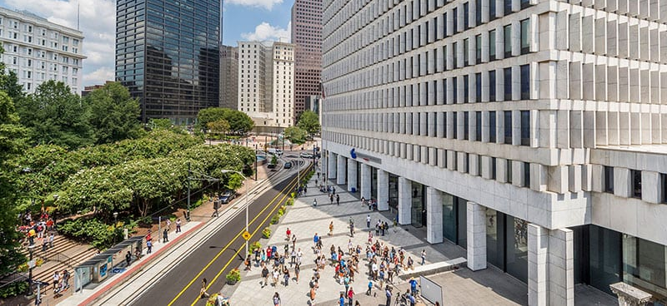
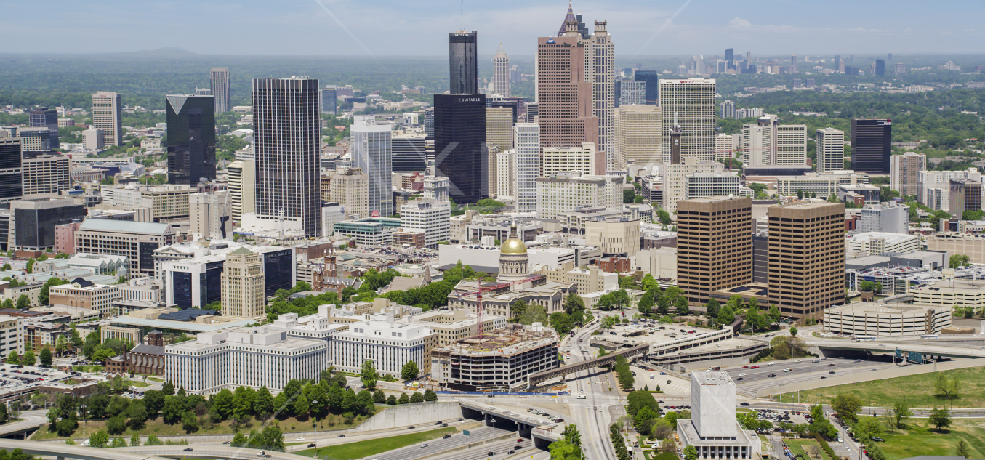
GSU is located in downtown Atlanta
College of Arts and Sciences
The university's main campus is situated in the heart of downtown Atlanta, making it an integral part of the city's vibrant and dynamic urban environment.

Slide 4
June 19, 2023
“Georgia State is incredibly proud to be one of the most diverse institutions in the country, graduating more African American undergraduates than any other university in the United States. Our diversity defines us and we are a better institution for it. We are home to more than 50,000 students from incredibly diverse backgrounds.”
Dr. Brian Blake, joined GSU in July 2021 as the university president

Slide 5
Success at the University and Department Level
GSU is one of the most diverse universities in the U.S. with a minority enrollment of 46%, and a leading institution for undergraduate degrees conferred to African Americans and has recently been classified as a Title V Hispanic-serving institution. Furthermore, GSU is the only institution in the top ten for graduating African Americans with undergraduate physics degrees that is not an HBCU.
GSU has a record of programs and initiatives that prove students from all backgrounds can succeed. In recognition of the outstanding commitment to diversity, equity, and inclusion, GSU received the Insight Into Diversity's 2021 Higher Education Excellence in Diversity (HEED) Award.
The Department of Physics and Astronomy has had major successes in growing the number of underrepresented B.S. in Physics graduates. Over the last three years, 23 students of the total of 57 physics graduates, that is about 40%, were from underrepresented minority groups. Currently, 67 of the 174 physics majors over all years are from underrepresented minority groups.

Slide 6
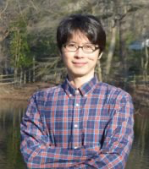
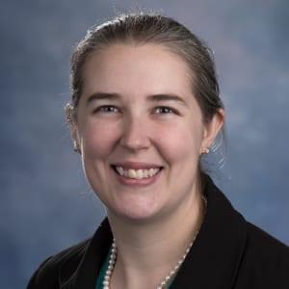
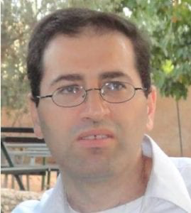
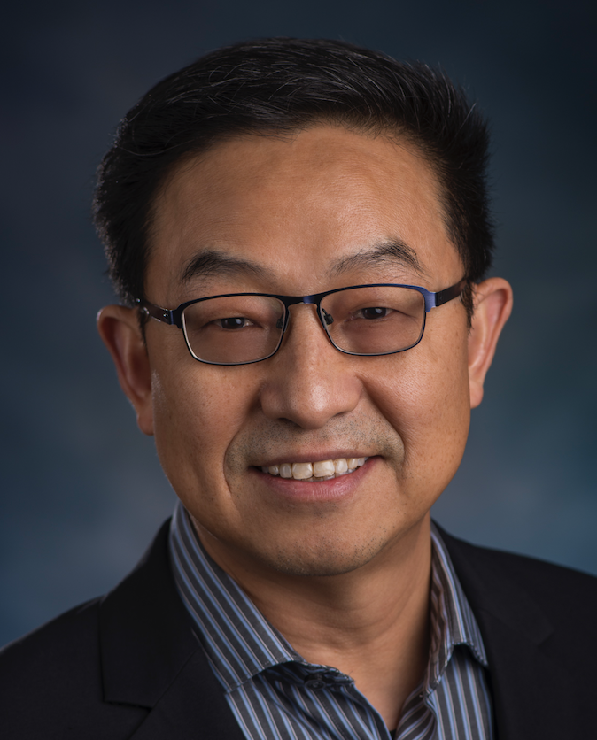
Yang-Ting Chien, Megan Connors, Murad Sarsour, and Xiaochun He
Postdocs: 2
Graduate students: 9 + 6(new)
Undergraduate students: 6
Many collaborators worldwide
http://phynp6.phy-astr.gsu.edu/

Slide 7
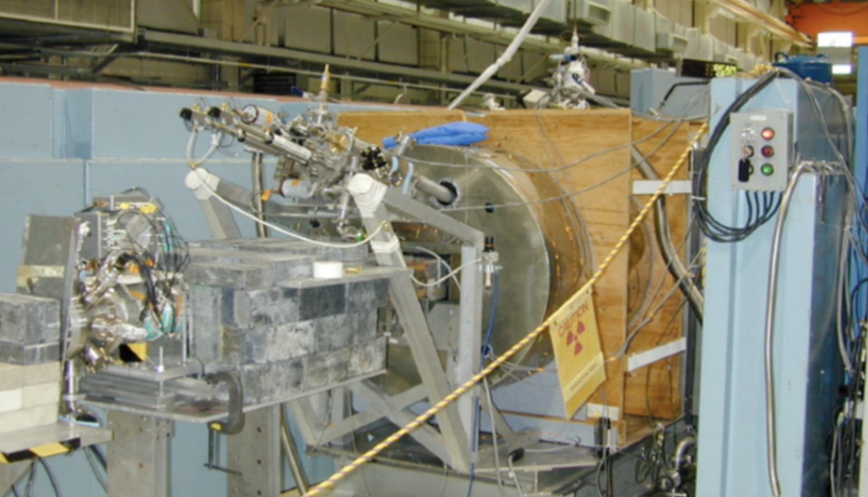
Research Opportunities for Students
Data Taking Period 2000 - 2016
Data Taking Period 2023 - 2025
Data Taking Period from 2030 -
Data Taking Period – long-term
PHENIX
sPHENIX
EIC
Cosmic Ray
Weak force study with NSR
http://phynp6.phy-astr.gsu.edu/

Slide 8
We always look for students to join the group to work on many of the exciting projects
Building cosmic ray detectors
Testing sPHENIX scintillator tiles
Testing sPHENIX scintillator tiles
Working on EIC Detector R&D

Slide 9
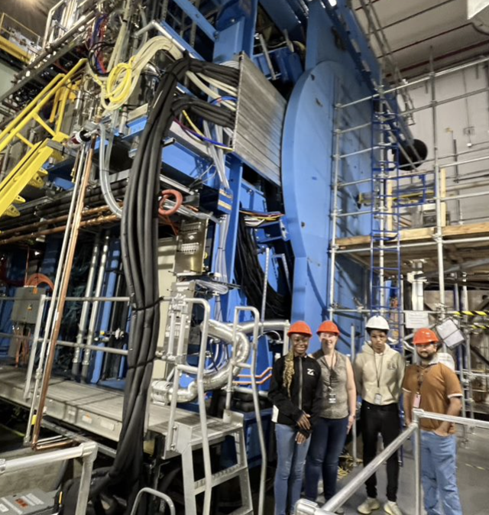
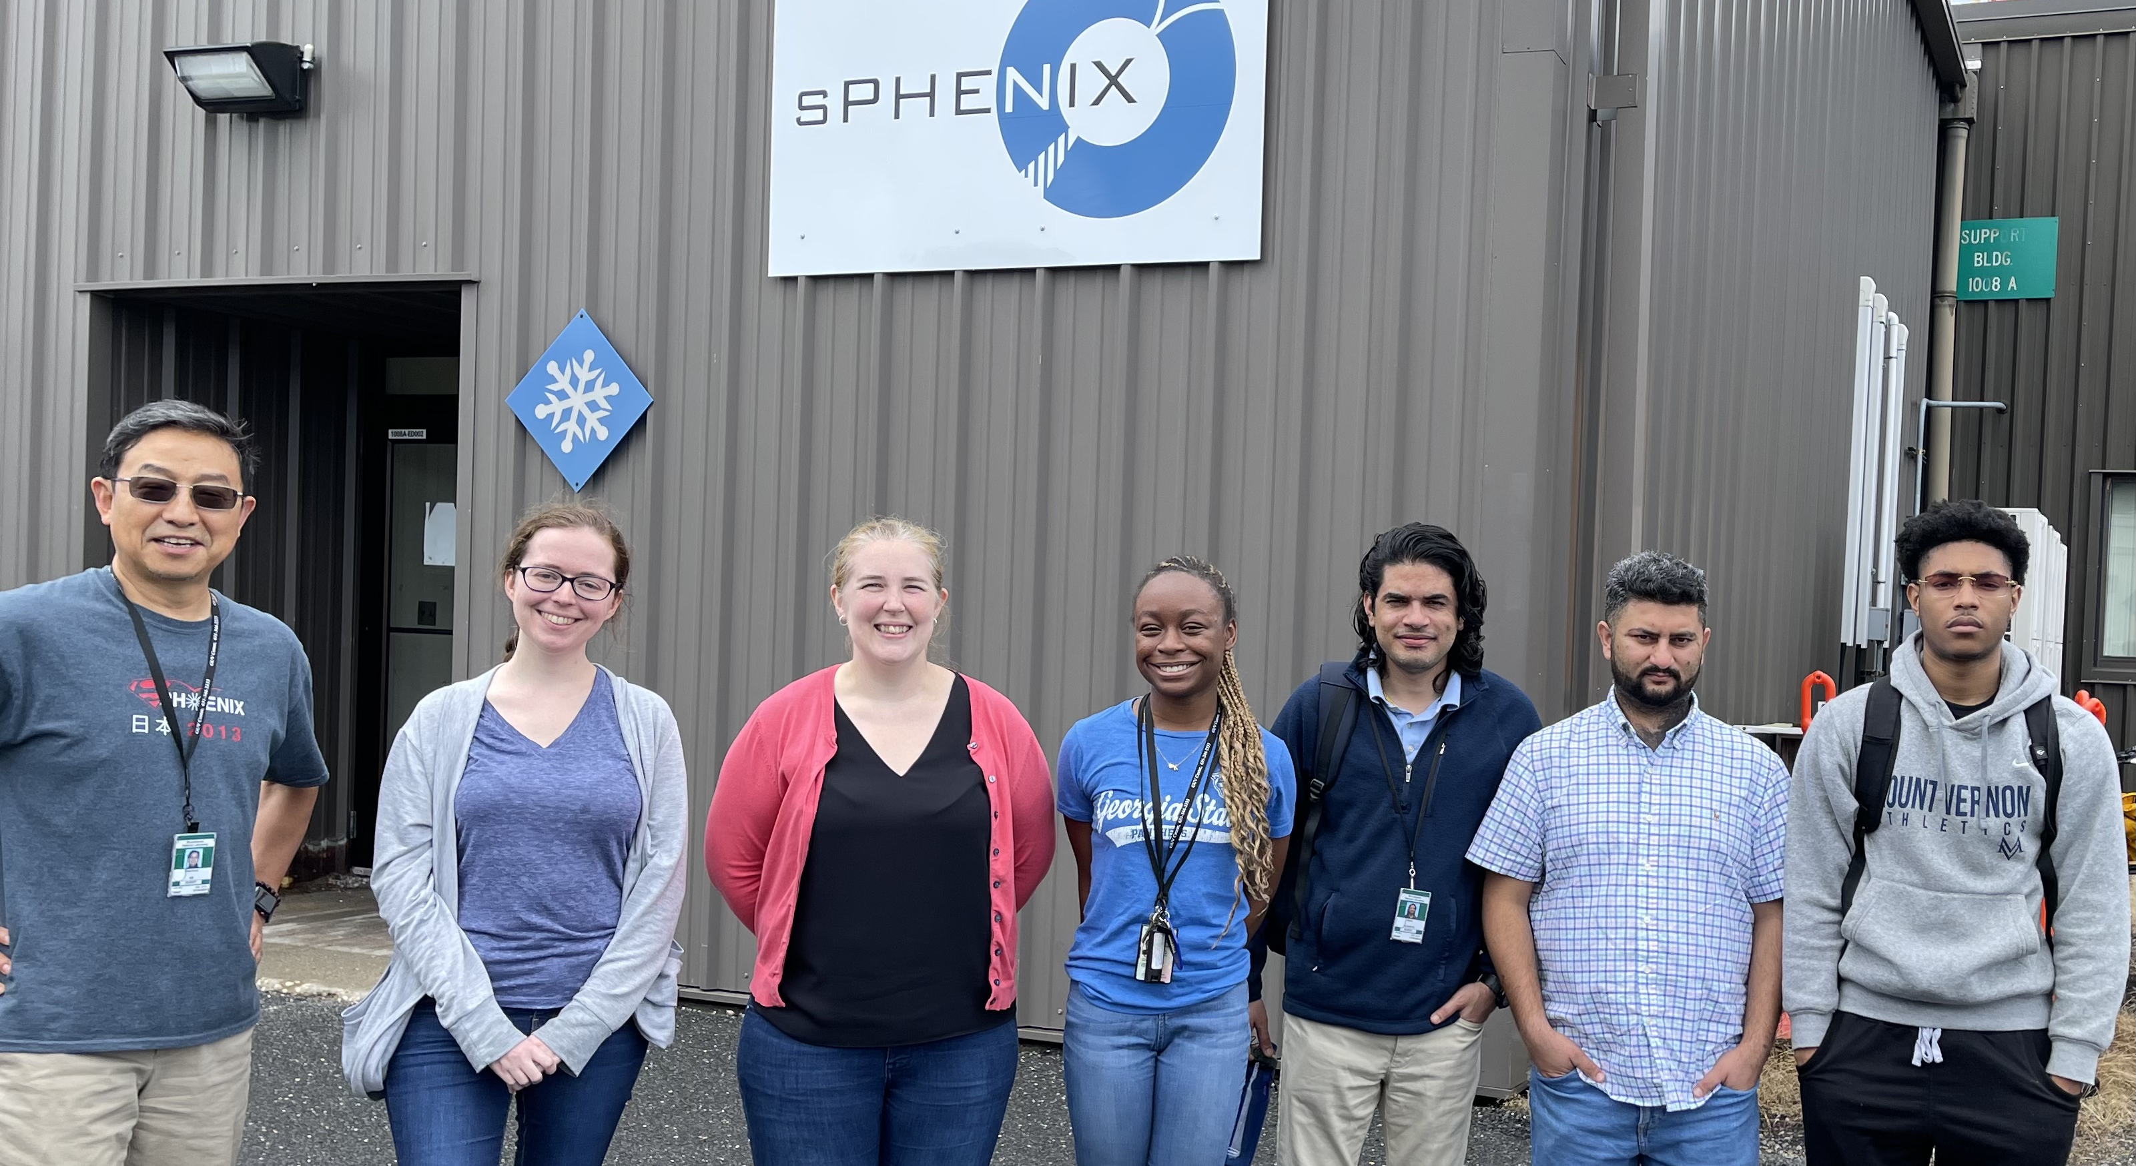
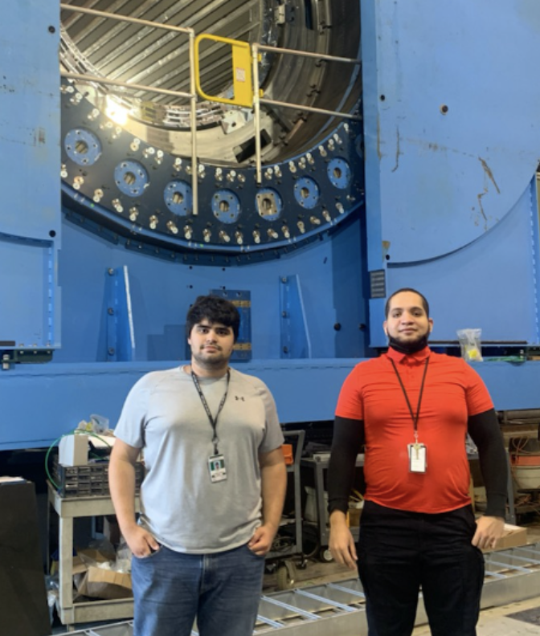
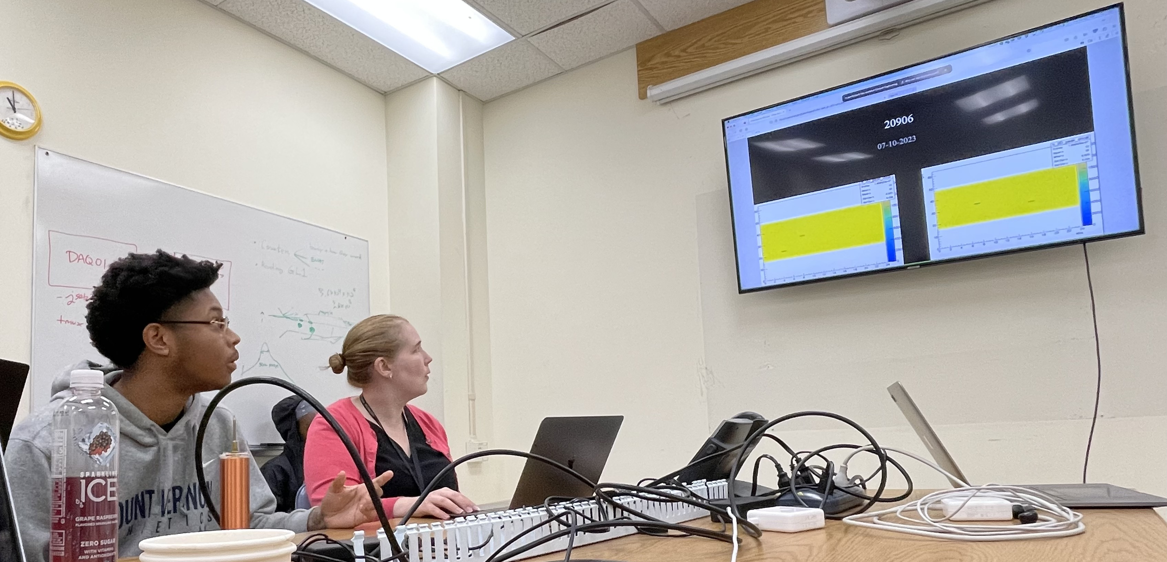
sPHENIX
2023
7/14/2023
Summer 2022
7/14/2023
Daivon was presenting his LED
Data analysis

Slide 10
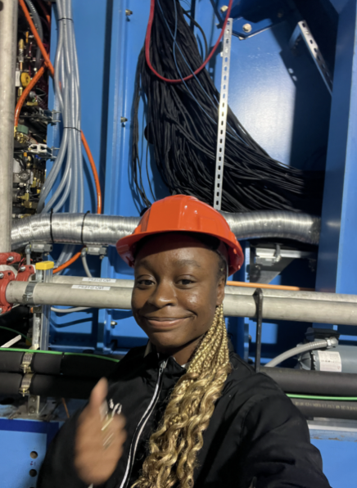
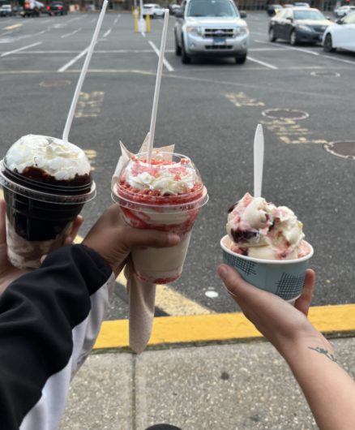
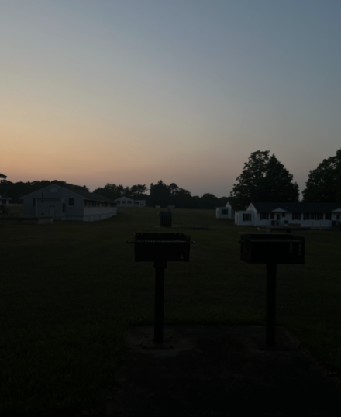
From Kristyn Spears
"It has been empowering and enjoyable to be in an environment where physics is the priority and loved by so many people. Another thing I've loved is meeting Olivia and Katie, I wish I knew them my whole life."

Slide 11
Success of the Nuclear Physics Group at GSU
Our research team (PI: Murad Sarsour, Co-PI: Xiaochun He, Megan Connors, and Yang-Ting Chien) successfully received a DOE traineeship award (sponsor award # DE-SC0022543) to enhance the participation of minority undergraduate students in nuclear science by providing financial stability throughout the whole year which allows them to concentrate on their research.
Over the past year we had two Hispanic students and recently added three more African-American students. This is a very important step towards inclusive and equitable research because we believe it starts by involving students early in their education.

Slide 12
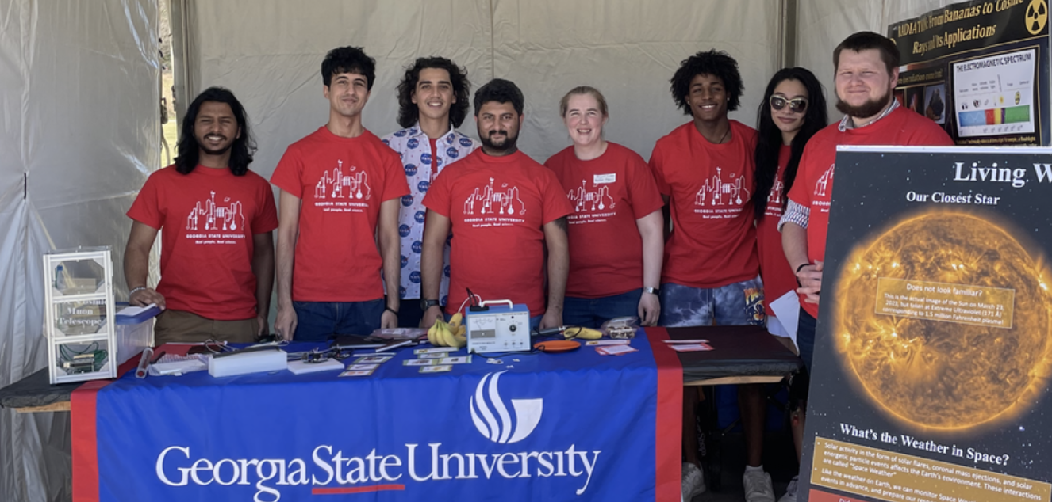
STEM Outreach & Recruitment
2023
Atlanta Science Festival: faculty and graduate students talk to public about radiation and cosmic ray measurement.
2017 Solar eclipse

Slide 13
Challenges (How?)
Student
Motivation ?
Support ?
Commitment ?
Peer inspiration ?
Advancement ?
Faculty
Mentoring culture ?
Faculty recruitment ?
Retention ?
Long term commitment ?
Support (reward) ?
Two-way interaction

Slide 14
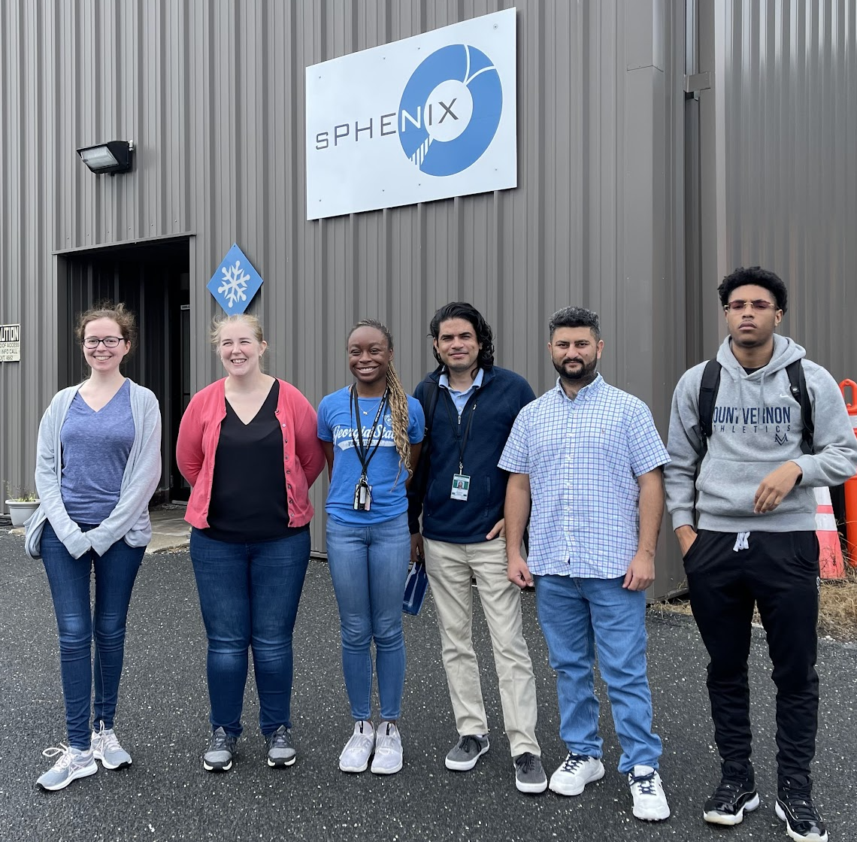
Flexible and Mixed Mentorship Approach
Our postdoc, Virginia Bailey, played a critical role for mentoring undergraduate students, especially when they are at BNL
Faculty
Postdoc
Graduates
Undergraduate
Summer 2022
Summer 2023

Slide 15
Community effort at a broad level
Advancement
Career
Success
Parents
K-12
Colleges & universities

Slide 16
Working at BNL and with BNL
We have a wide range of research activities for our students. PHENIX, sPHENIX and EIC experiments are the great projects for students to get involved. We had two undergraduate students at BNL last summer and have two this year. The DOE traineeship grant was extremely helpful.
At GSU, students could either learn to analyze sPHENIX data and/or involve in detector development for EIC.
GSU group is developing a global network of portable and low-cost cosmic ray muon detectors for monitoring the dynamic changes in space and terrestrial weather. A very interesting application of nuclear science. This has been a great project for students to get involved with different background and skill levels. We could collaborate with experts in atmospheric studies to explore new tools to monitor the changes in atmosphere in large scale, as an example. We would certainly like to get help from experts at BNL to improve our detector design.

Slide 17
Thank you

Slide 18
About GSU
Georgia State University (GSU) is a public research university located in downtown Atlanta, Georgia, United States. It was founded in 1913 as the Georgia School of Techno-Mechanical Arts, and over the years, it has grown and evolved into a comprehensive university offering a wide range of academic programs.
GSU is known for its urban campus, diverse student body, and strong emphasis on research and community engagement. The university offers more than 250 undergraduate and graduate degree programs across various disciplines, including business, arts and sciences, education, health sciences, law, and more. It is organized into 10 colleges and schools, including the J. Mack Robinson College of Business, College of Arts and Sciences, College of Education and Human Development, College of Law, and College of Health and Human Sciences.
The university is committed to providing a high-quality education to its students and has a reputation for innovation in teaching and learning. It is recognized for its programs in business, law, public health, social sciences, and computer science, among others. GSU is also known for its strong research initiatives and has received significant funding for various research projects.
In recent years, Georgia State University has made significant strides in improving its graduation rates and student success. It has implemented programs and initiatives aimed at supporting student retention and completion, particularly for students from diverse backgrounds and low-income families.
As a leading urban institution, GSU is closely connected to the city of Atlanta and offers numerous opportunities for internships, experiential learning, and community involvement. The university's location provides students with access to cultural institutions, businesses, and organizations in the heart of the city.
Overall, Georgia State University is a dynamic and vibrant institution that combines academic excellence, research, and community engagement to prepare students for success in their chosen fields.

