Slide 1

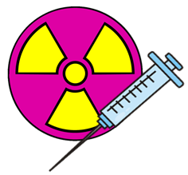
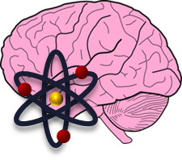
Facilitating Radioisotope Production Research Opportunities at Lehman College
Melissa A. Deri, PhD
Assistant Professor of Chemistry
Lehman College of the
City University of New York
July 19th, 2023

Slide 2
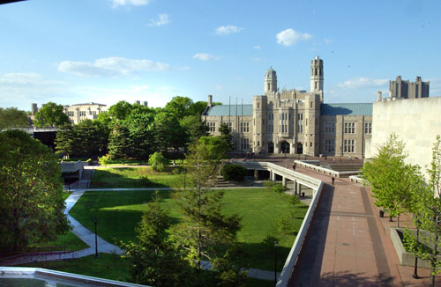
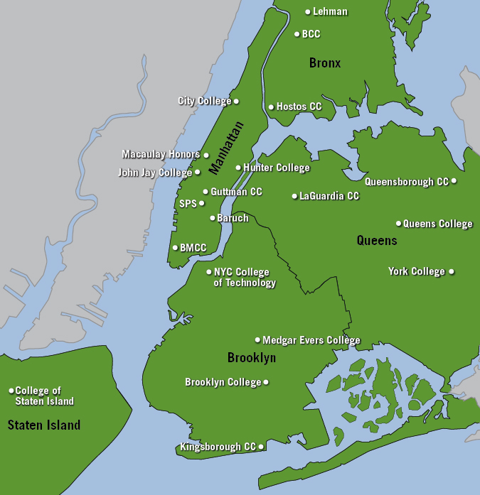
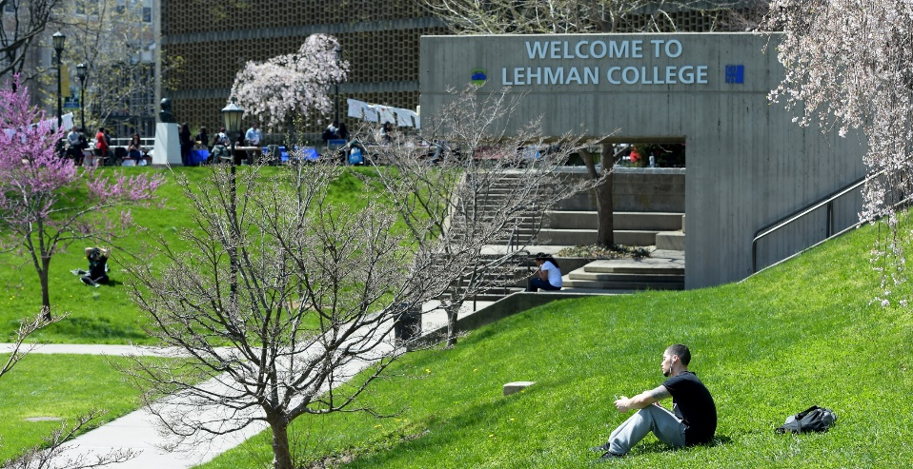
Lehman College
Notes:
Herbert H. Lehman College is the only public senior college in the Bronx. As a result, Lehman is a commuter school with a mixed population of students directly from the New York City public school system and a substantial amount of older students returning to school. A major goal of the college, and of the Chemistry Department specifically, is to elevate students from the Bronx, a largely minority and low-income population, to the middle class through a rigorous course of study with a focus on career preparation and exposure to research. In support of this mission, all faculty members balance teaching and research, however funding opportunities like this one enable periods of more dedicated time for focusing on growing research programs. In addition to the undergraduate student population, the Chemistry Department has a growing number of doctoral graduate students conducting research at Lehman through programs based at the CUNY Graduate Center.

Slide 3
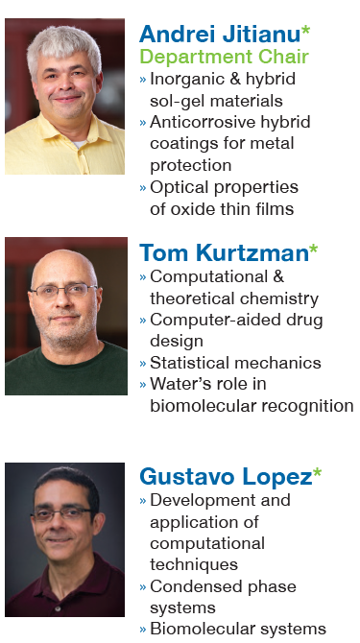
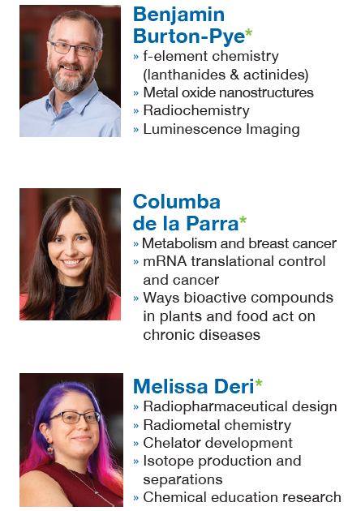
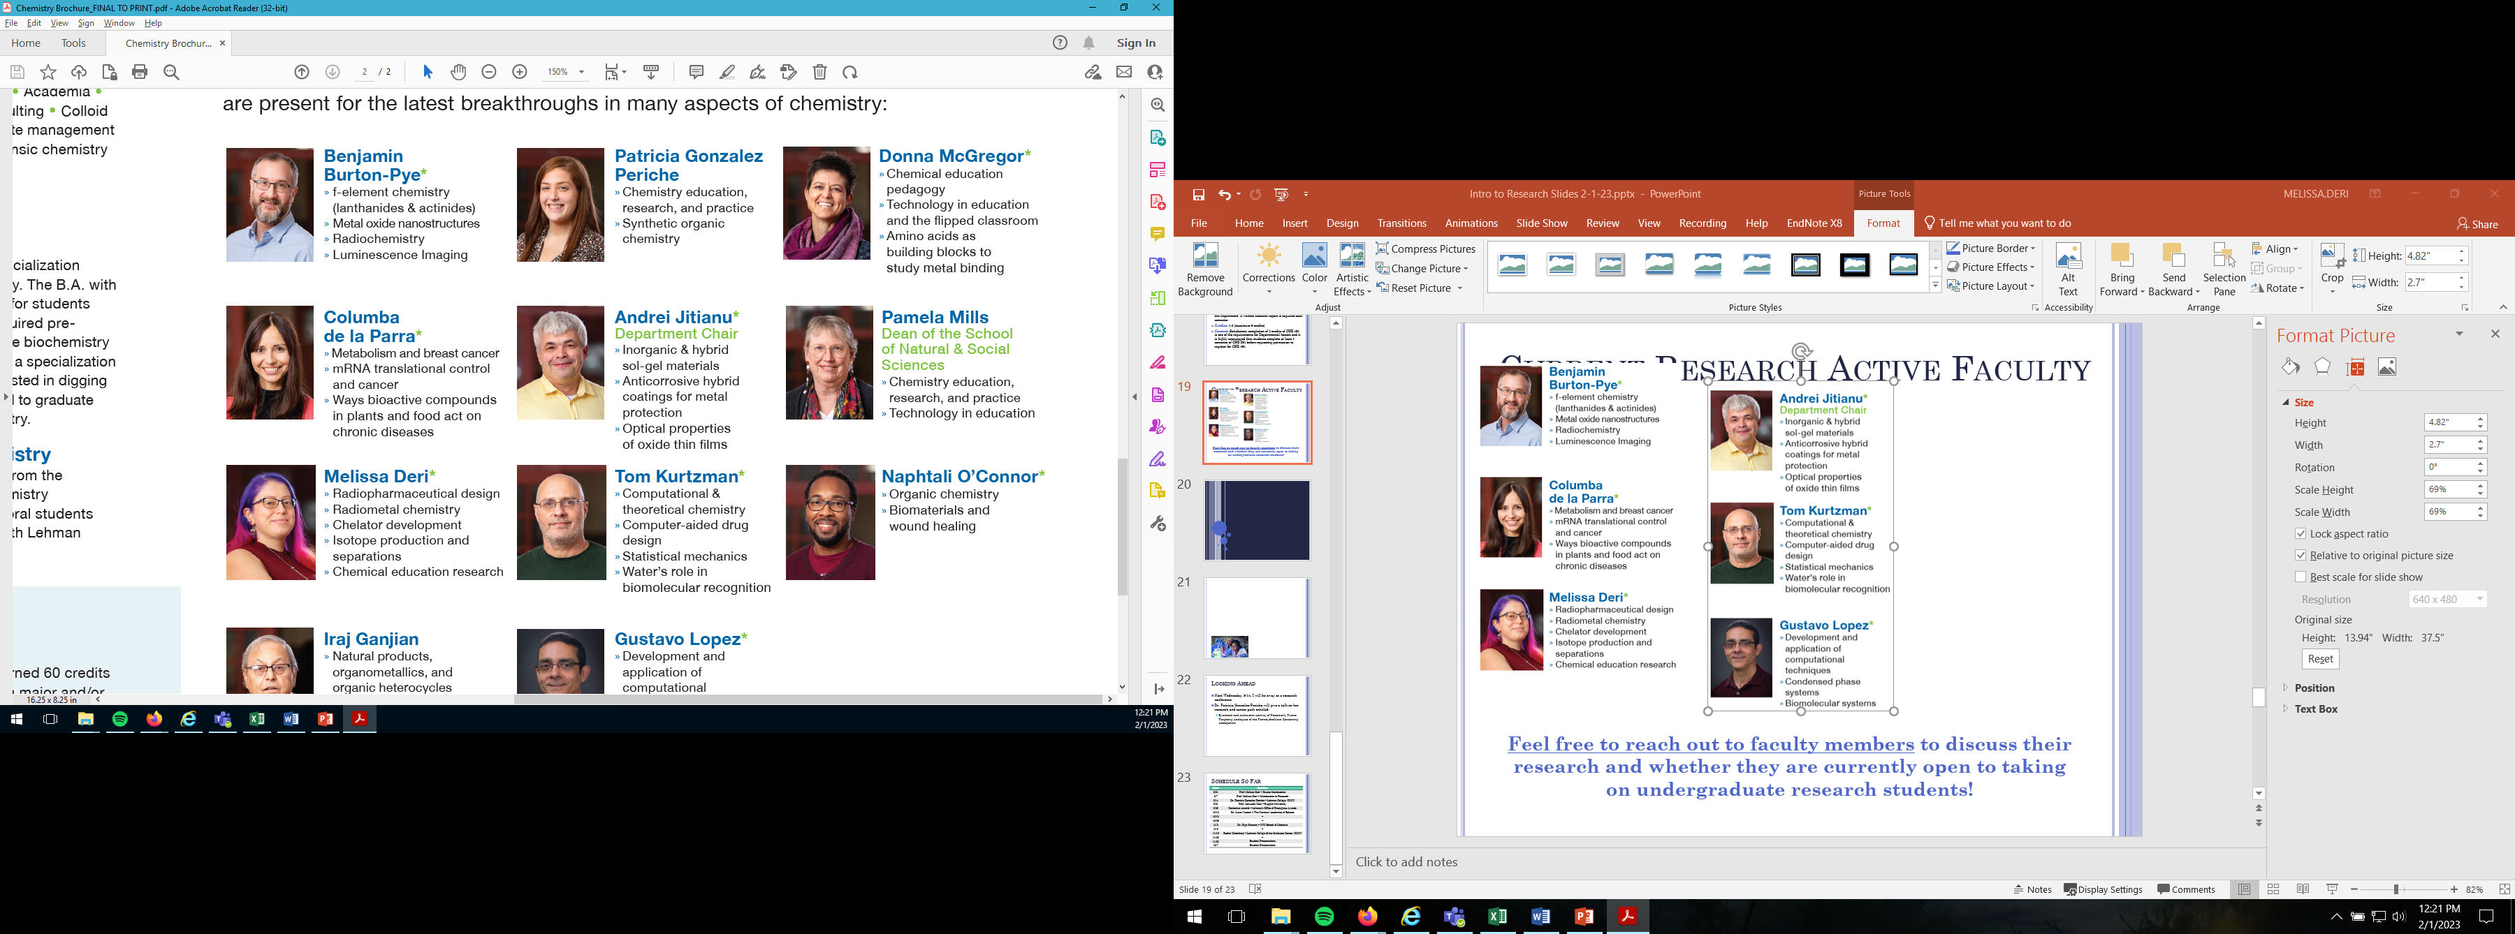
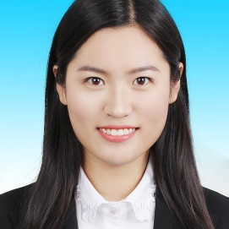

Current Research Active Faculty
Yuemei Ye
New hire starting Fall 2023
Environmental Chemistry
Chemistry Department

Slide 4
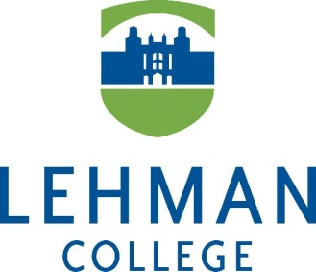

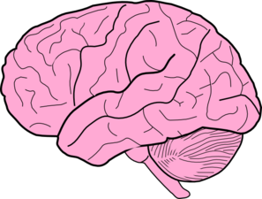
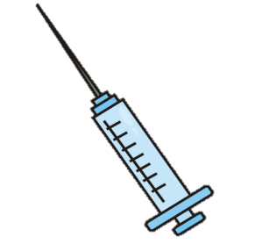

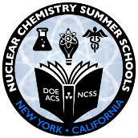

Who am I?
Radiopharmaceutical
Drug Design
Chemical Education Pedagogy
Melissa Deri, PhD
Assistant Professor of Chemistry
BNL NCSS Site Director
Nuclear Chemistry Summer School

Slide 5
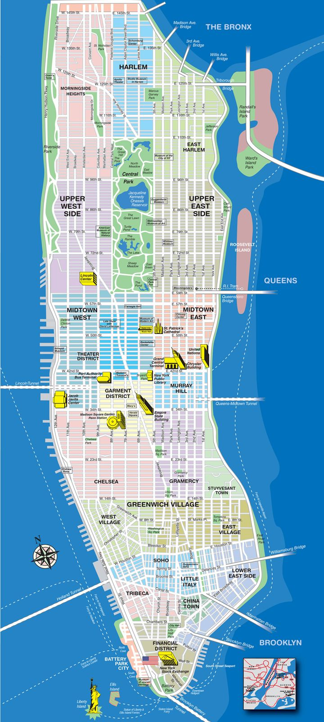
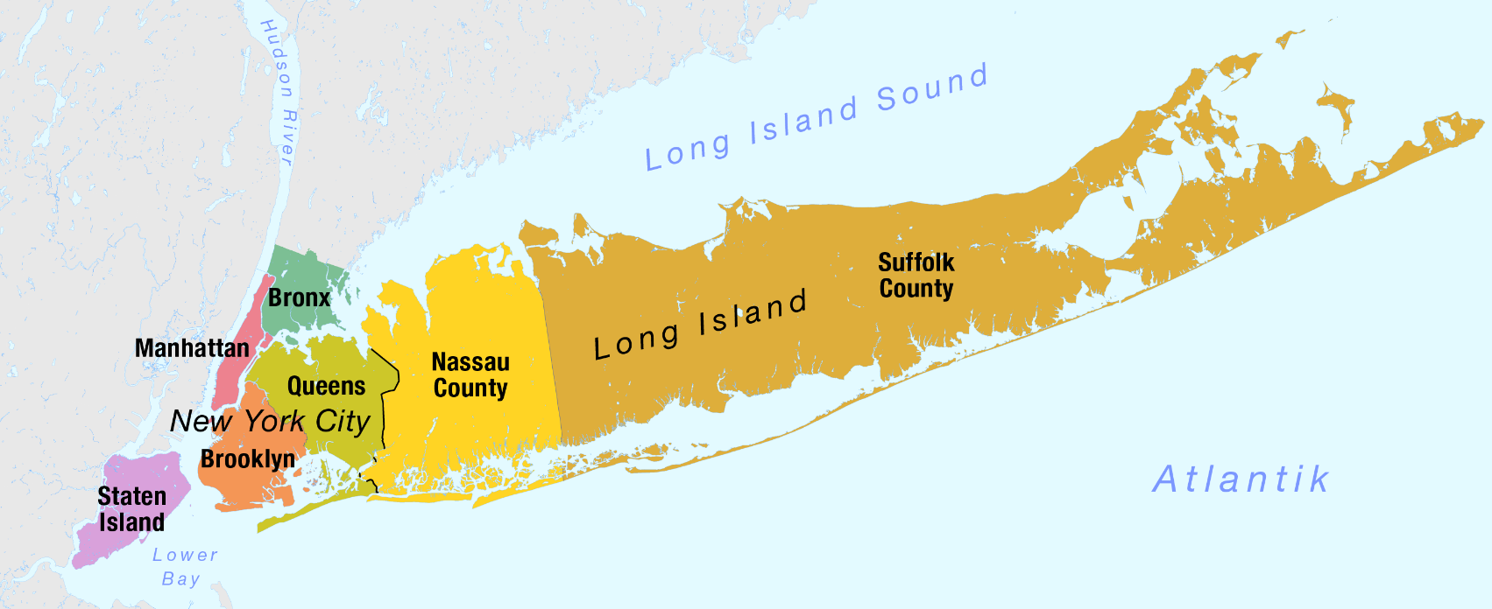




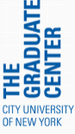
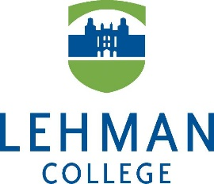
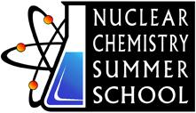
How Did I Get Here?
Atlantic

Slide 6
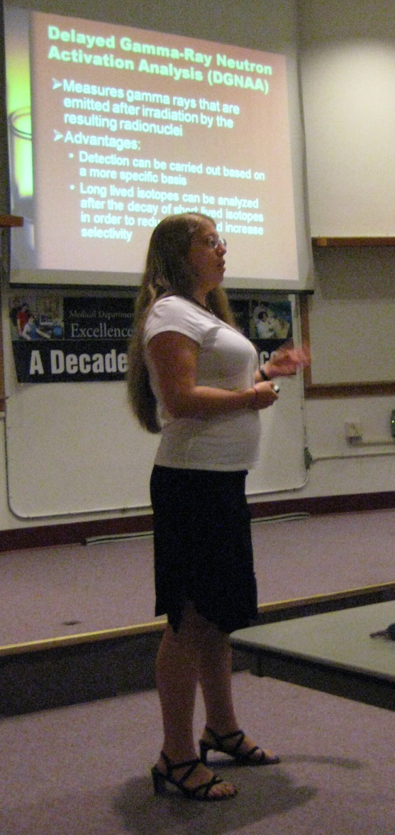
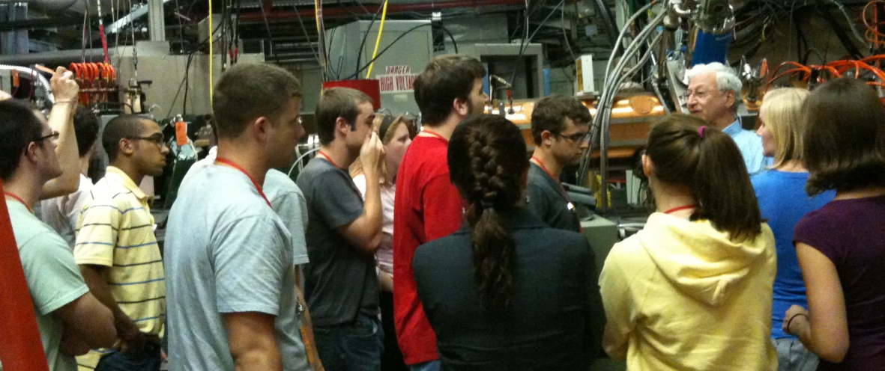
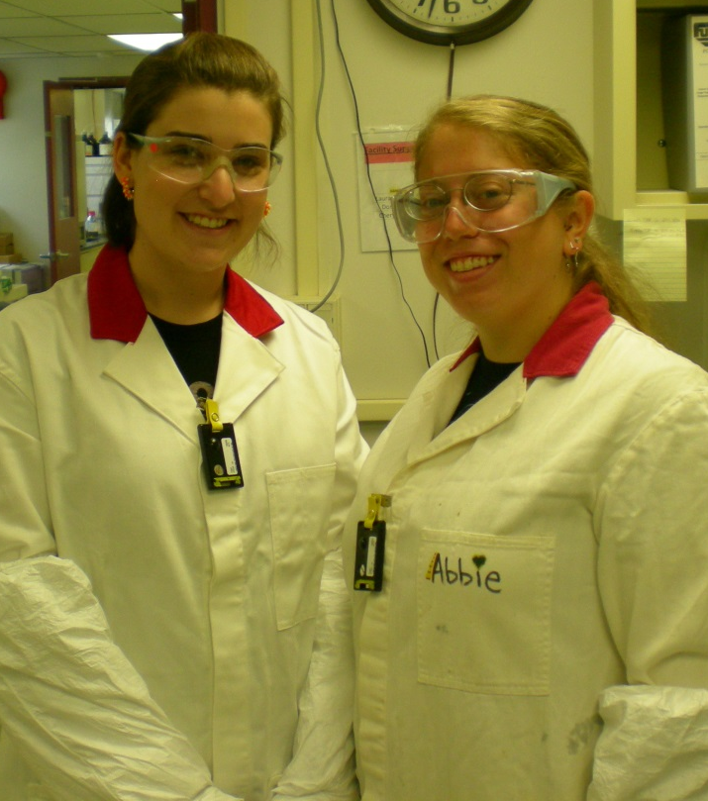
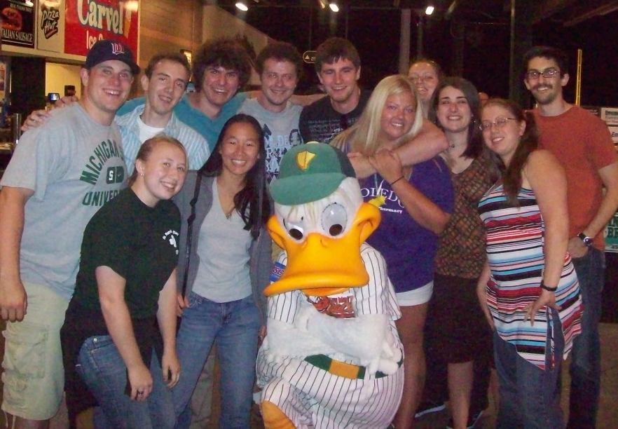
BNL NCSS 2009 & 2010
Notes:
It was the first time I felt like a chemist rather than a chemistry student. It was my first experience being engulfed in a community of scientists.

Slide 7
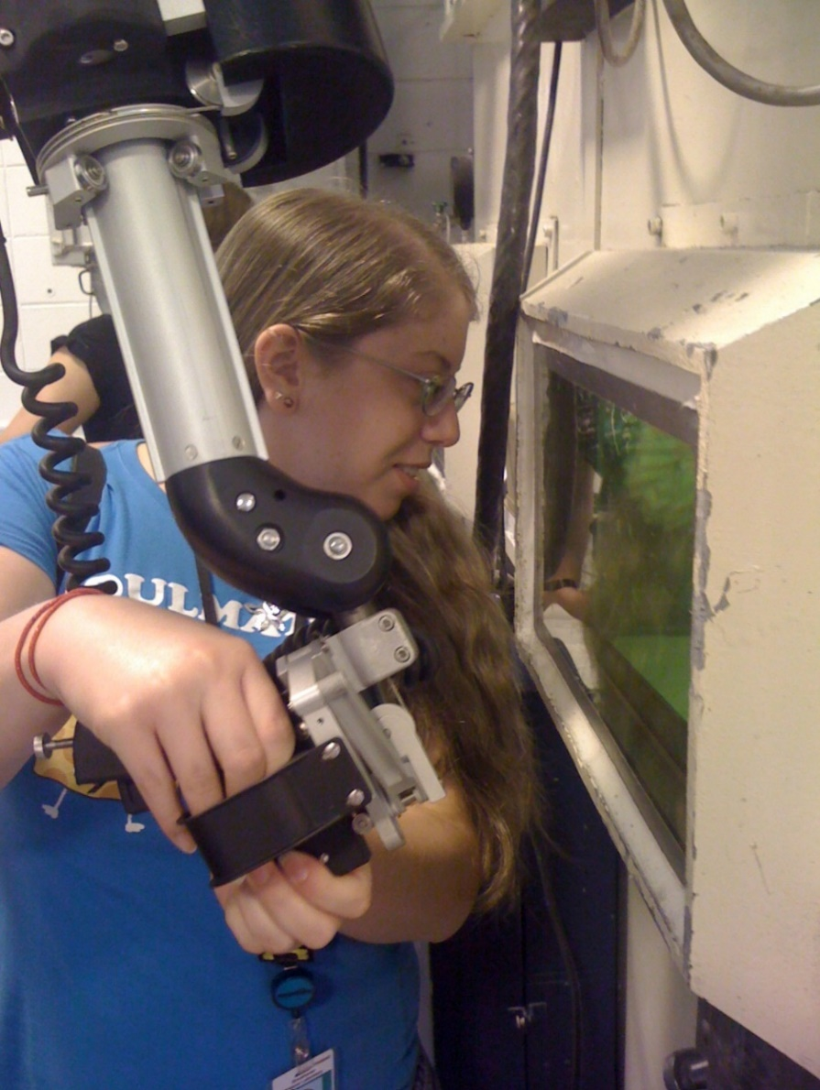
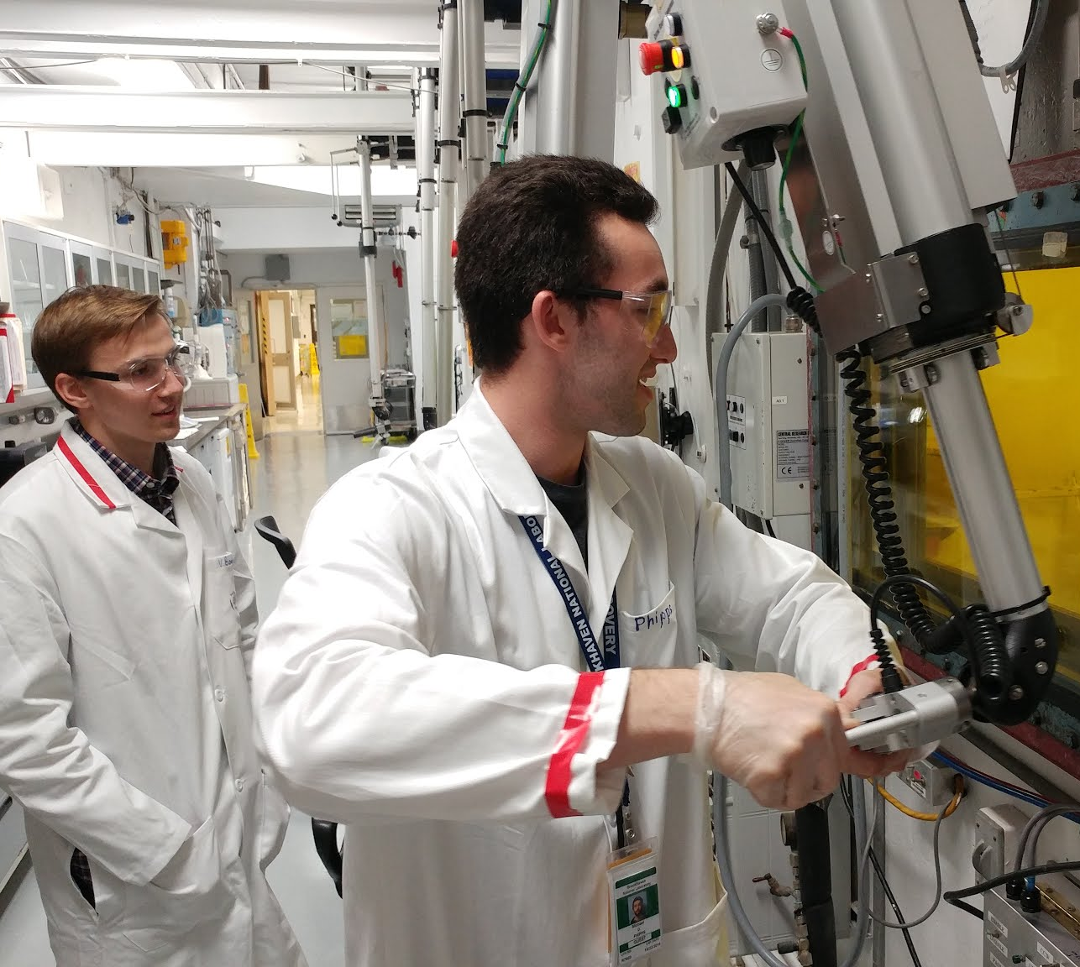
Back at Brookhaven
← 2009 Nuclear and Radiochemistry
Summer School (NCSS) Student
2010 NCSS Teaching Assistant
2018 Visiting Faculty →
Program Participant with Two Students

Slide 8
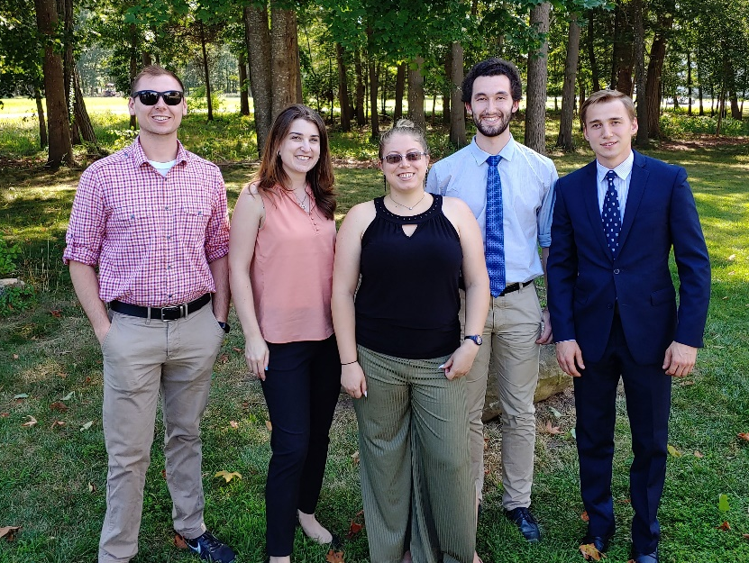
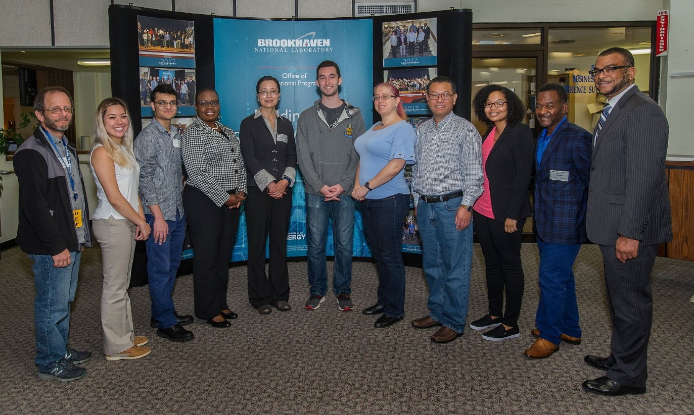
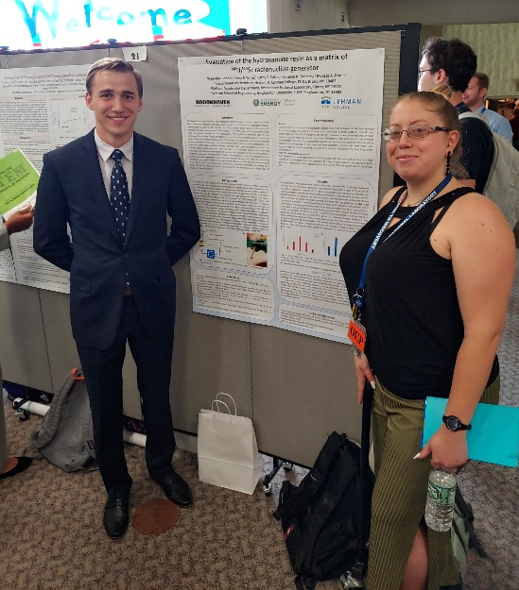
Visiting Faculty Program
Summer 2018 & 2019
  Michael Phipps (PhD student)
  Vladyslav Bodnar (undergrad)
  10 weeks

Slide 9
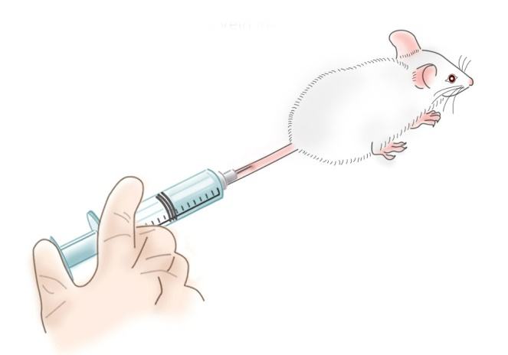
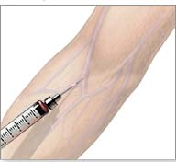
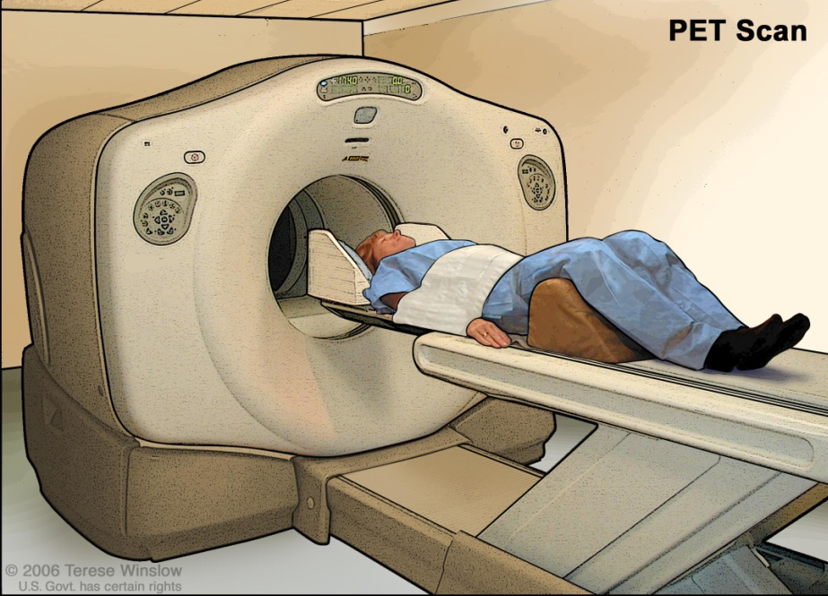
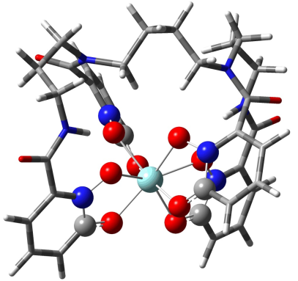
Radiopharmaceutical Research
From bench to bedside
Leveraging fundamental chemistry to improve biomedical products
Collaborative, interdisciplinary, & application-based
Notes:
Basic chemistry principles can be translated into radiochemical applications and used to predict and improve the ultimate biological properties of radiopharmaceuticals

Slide 10
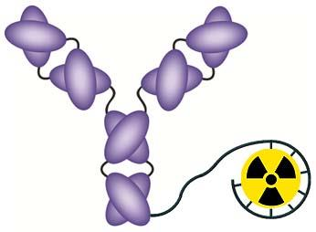
Radiometal Based Drugs
Targeting
Vector
Antibodies
Aptamers
Nanoparticles
Proteins
Bifunctional Chelate
Imaging radiometals
Therapeutic radiometals
Radiometal
Radioscandium isotopes:
  ⁴⁴Sc/⁴⁷Sc pair offers both imaging and therapy applications
  One chelator for two distinct and complementary drugs
Radionuclide | Emission | Half-Life | Application | Production
⁴⁴Sc | β⁺ | 3.97 h | Imaging | Generator
⁴⁷Sc | β⁻ | 80.2 h | Therapy | Accelerator
Notes:
Largely modular
Choice of each component is influenced by the others
Adaptable for different applications
Blood circulation time of the targeting vector needs to match the half life of the radiometal
Chemical properties of the radiometal determine the type of chelator

Slide 11
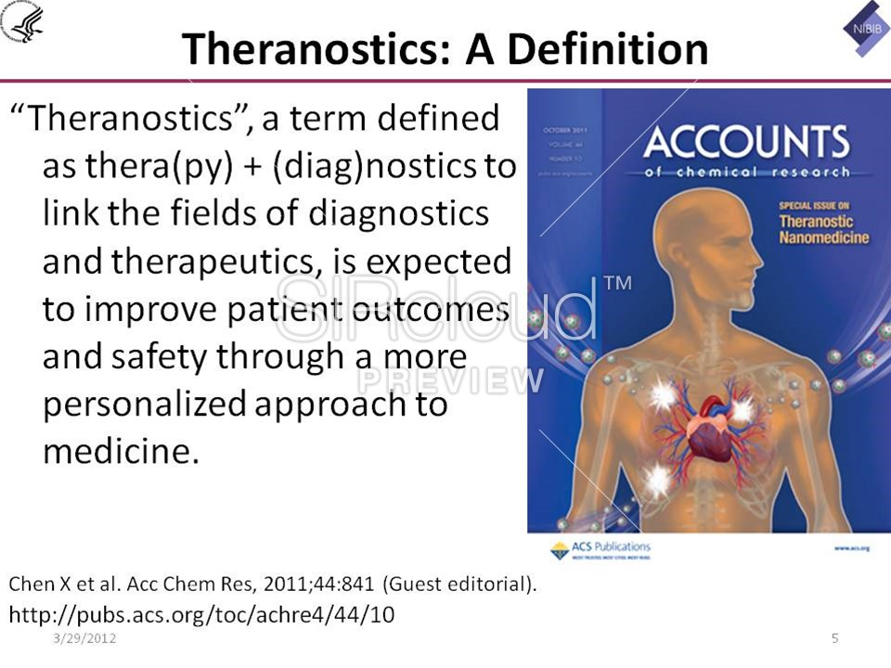
Scandium’s Theranostic Potential
Scandium-47 is a beta particle emitting nuclide suitable for targeted radiotherapy
  Therapy
Scandium-44 is a positron emitting nuclide suitable
for positron emission tomography (PET) imaging
  Diagnostic
Since the chemistry of both isotopes is the same, you can design one drug that works for both applications
  Theranostic
Notes:
One chelator for two distinct and complementary drugs

Slide 12
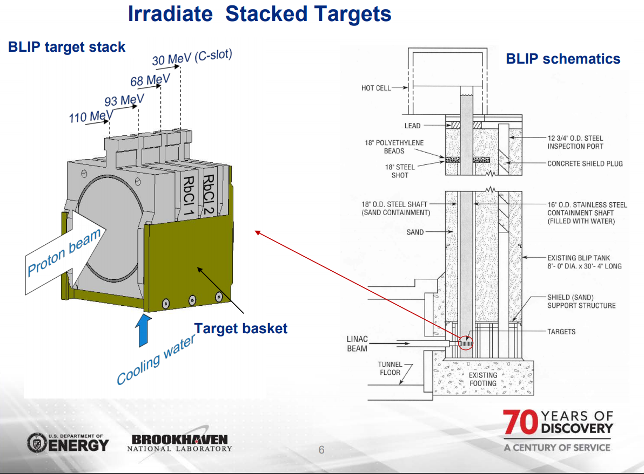
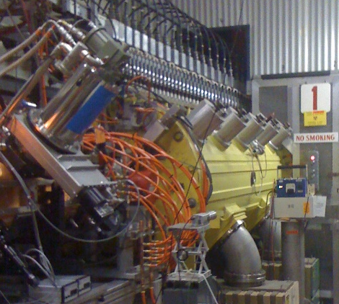
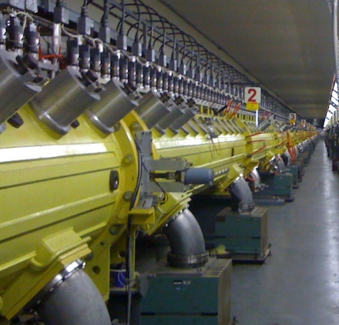
Scandium Production
⁴⁴Sc |  | ⁴⁷Sc
⁴⁴Ti→⁴⁴Sc generator produced |  | ⁴⁸Ti(p,2p)⁴⁷Sc accelerator produced
β⁺ emitter for PET imaging |  | β⁻ emitter for radiotherapy
t_{½} | 3.97 h | t_{½} | 3.35 d
β⁺_{max} | 1.47 MeV | β⁻_{max} | 600 keV
γ | 1157 keV | γ | 159.4 keV
⁴⁴Sc
  ⁴⁴Ti/⁴⁴Sc generator
⁴⁷Sc
  Linear accelerator
  at BLIP
  ⁴⁸Ti(p,2p)⁴⁷Sc

Slide 13
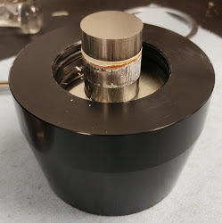
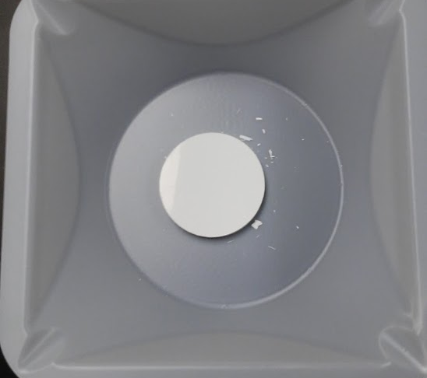
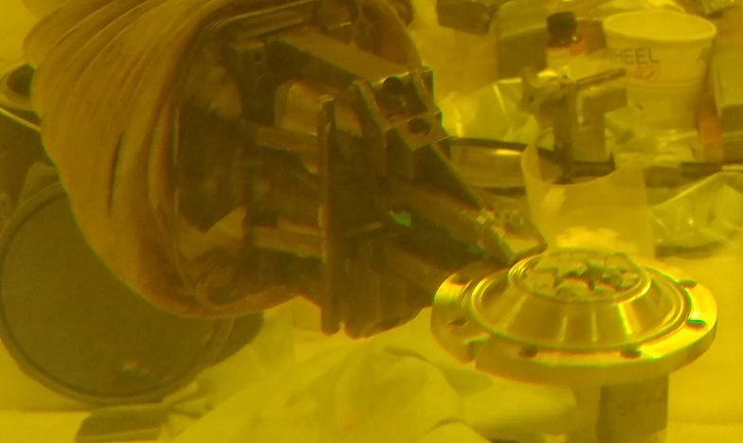
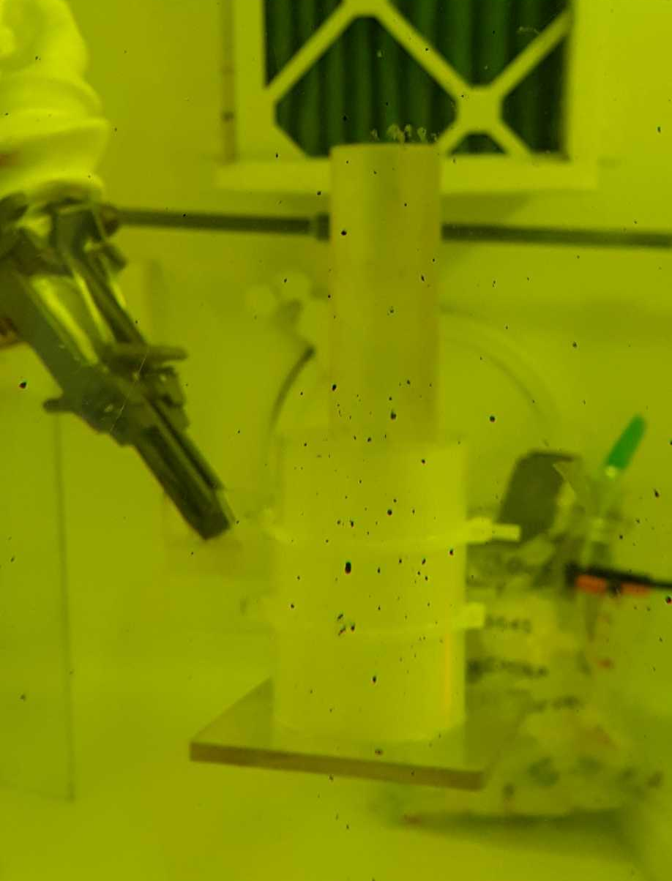
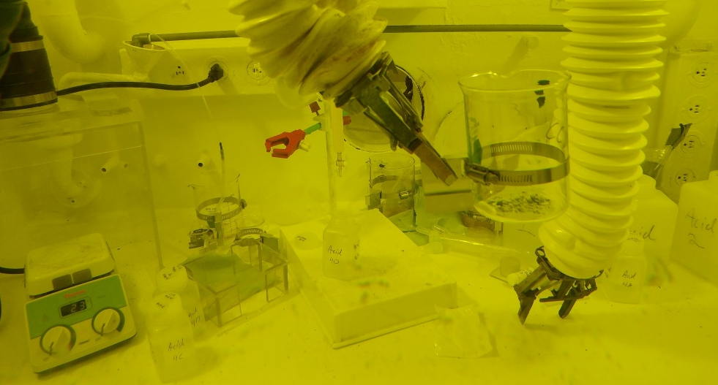
⁴⁷Sc Project
Target preparation
Irradiation of targets
Chemical processing of practice and irradiated targets
Separation of ⁴⁷Sc from bulk Ti and other produced radionuclides

Slide 14
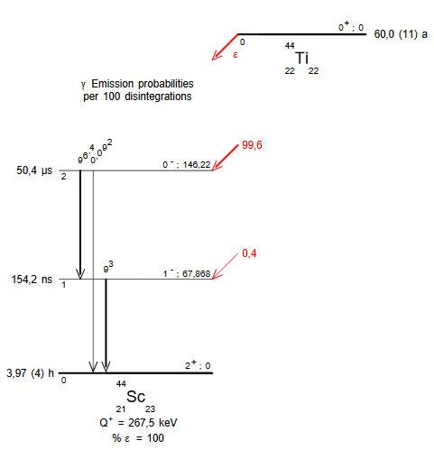
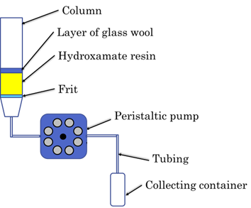
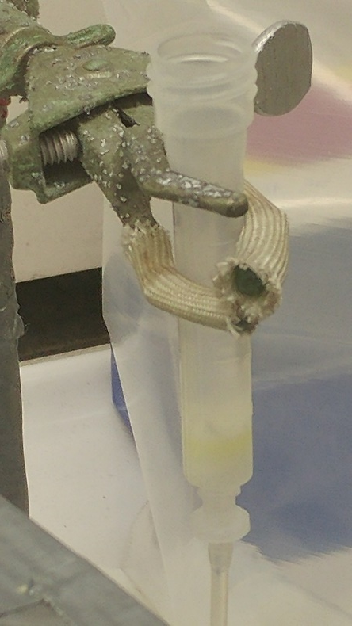
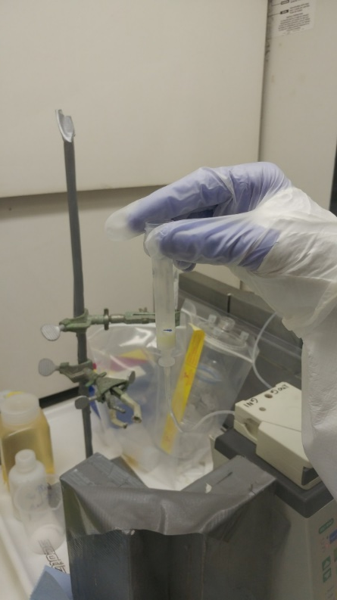
⁴⁴Sc Projects
⁴⁴Ti/⁴⁴Sc generator systems
Known breakthrough issues due to prolonged use
Investigating different column matrices
Evaluating elution profiles

Slide 15
Downstream Scandium Chemistry
Investigation of scandium coordination chemistry
Chelator evaluation
Radiolabeling experiments
Bioconjugation strategies
Development of
targeted agents

Slide 16
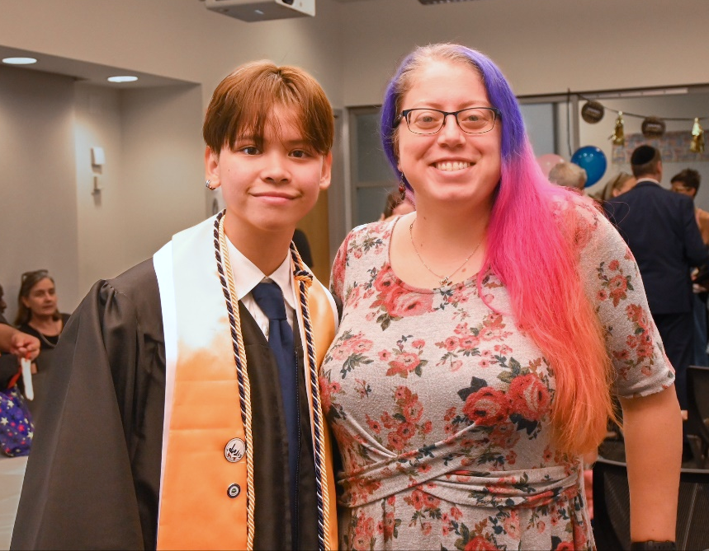
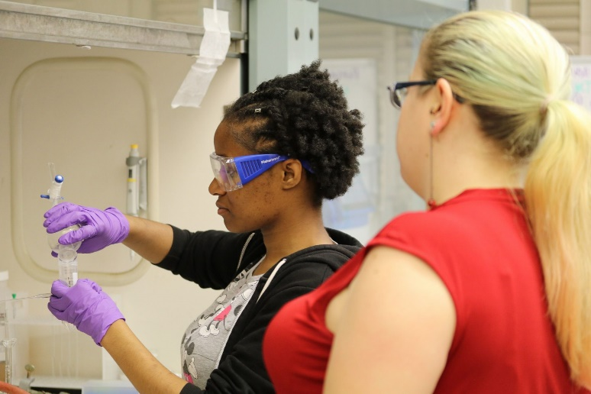
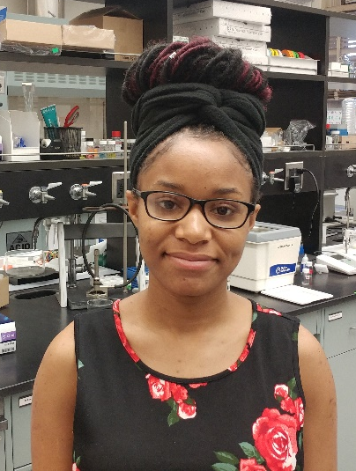
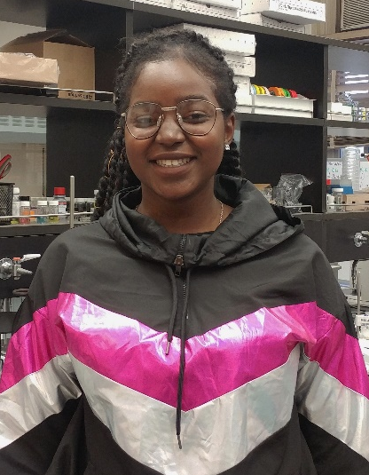
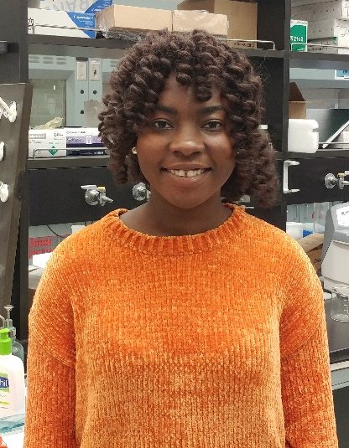
Lehman Undergraduates
Involved with Sc-peptide projects and/or generator development at Lehman
  Sheavonnie Wright
  Deborah Ofosu
  Ramata Fofana
  MJ Robis
Notes:
Non-rad experiments

Slide 17



This Summer
Christine Schmidt
(PhD student)
NCSS 2023 Class

Slide 18

BNL Benefits
World class facilities
Highly skilled experts
Advanced instrumentation
Welcoming, collaborative environment
Tangible products so far:
  2 thesis committee members
  1 patent application
  2 published papers
  5 grant applications

Slide 19

Acknowledgements
Cathy Cutler
Vanessa Sanders
Dmitri Medvedev
The MIRP group
The DOE & the Visiting Faculty Program
Thank you!
melissa.deri@lehman.cuny.edu
Notes:
That’s all I have time for today. I couldn’t have done any of this without the guidance of my two excellent advisors as well as the help and support of all of the people I work with in both my labs and beyond. I want to thank you all for your attention and I’d be happy to answer any questions.

Slide 20

Doctoral Program
$33k
i

