Slide 1

BNL MSI Workshop 2023
The Next Generation of Physics at Morgan State University
Willie Rockward, Chair & Professor
Department of Physics & Engineering Physics
Morgan State University

Slide 2

Morgan State University, a public, urban, HBCU, coeducational institution, is located in a residential section of Baltimore, Maryland.
By action of the Maryland Legislature, the University has been designated as Maryland's Preeminent Public Urban Research University, with the responsibility of addressing the needs of residents, schools, and organizations within the Baltimore Metropolitan Area.
The future for MSU → #1 goal is to be first HBCU to be an Research-1 Institution.
Please watch more about Morgan State here.

Slide 3
SCMNS Enrollment (2015 – 2020)
School of Computer, Mathematics & Natural Sciences
(SCMNS)
Goal: 1200-1500
Graduate 15 PhDs per year
30% increase since 2015 while overall university enrollment remains flat

Slide 4
Vision 2029: t. e. a. m. physics
Theme – Celebrating 75 years of Scholarship & Service in Physics at Morgan State
Focus – The High Five: Recruitment, Retention, Research, Remodel and Removal
T.E.A.M. Physics – The Scholarship
  Teacher Education, Earth Science, Astronomy & Accelerator Physics and Materials
T.E.A.M. Physics – The Service
  Teaching & Training, Ethical Leadership, Alliances & Alumni, and Monetary & Management

Slide 5
MSU Physics: We C.A.R.E. Approach
Curriculum
  Fixed & Flexible course availability based on student input
  Refresh physics major to reflect viable & known career paths
Advisement
  Career mentoring (academic, life skills, pipeline guidance, etc.)
Recruitment / Retention / Research
  Pre-collegiate summer programs / Faculty high school visits
  Saturday Academy / Summer Placements (REUs, Interns, etc.)
Extras
  Graduate School Tours / Special Speakers
  Town Hall meetings by SPS / Scientific leadership & citizenship

Slide 6
We C.A.R.E.: Curriculum Refreshed & Relevant
Physics
Grad
School
Earth Science
Astronomy
PHYSICS CORE
Math Physics I & II
Analytical Mechanics I & II
Electricity & Mag. I & II
Quantum Mech. I
Thermodynamics
Optics
Experimental course (PHYS 409 or 412)
PHYSICS
CORE
(10)
Physics
Education
Engineering Physics
Accelerator Physics
Acoustics
Corporate
Physics

Slide 7
We C.A.R.E.: Curriculum Refreshed & Relevant
Applied
Physics
Employ.
Software Engr.
Aerospace Engr.
Engineering Physics CORE
Math Physics I & II
Analytical Mechanics I
Electricity & Magnetism I
Quantum Mech. I
Thermodynamics
Optics
Experimental/Engineering courses (PHYS 412 or ENGR xxx)
Engr. Physics
CORE
(8)
Engineering Physics
Business Industry
Dual Degree Engr.
Medical Industry
Accelerator Science

Slide 8
Background: Education
B.S. – Physics – Grambling State Univ. (1988)
    Champions: Drs. T. Odom and J. Terrell
M.S. – Physics – S.U.N.Y. Albany (1991)
    Champions: Drs. Y. Nix, J. Kimball, C. MacDonald and 2 others
Ph.D. – Physics – Georgia Tech (1997)
    Champions: Drs. H. Valk, D. O’Shea, W. Callen, and B. Kennedy

Slide 9


Background: Research in Optics
Electromagnetic Spectrum
EUV Lithography
THz Imaging
Plasmonic Metamaterials
Gamma Rays
Radio Waves
X-rays
UV
Infrared
Microwaves
10⁻²
10⁰
10²
10⁴
10⁶
10⁸
10¹⁰
10¹²
Wavelength (nm)
Visible

Slide 10
Background: Research Collaborations
Micro/Nano Optics Research and Education (MORE) Laboratory
  (W. Rockward, Physics & Engineering Physics, Morgan State)
THz Photonics: Phase Change Materials for Switchable THz Devices
  (T. Searles, ECE, Univ. of Illinois-Chicago and E. Red & W. Sims, Physics, Morehouse College)
THz Imaging: Undergraduate THz Studio Laboratory
  (J. Matthews, Electro-Optics & Photonics/Physics, University of Dayton)
EUV Nanolithography: Fabrication of optical elements for EUV Interferometry
  (M. Marconi, Electrical Engineering, Colorado State University, NSF-ERC EUV)
Research funding from 1998 to current: over $8.0M
Over 50 URAs with PhDs in STEM disciplines

Slide 11
40 nm
BNL VFP 2022: Time-Resolved Kerr Rotation (TRKR) Experiment
Motivation:
  Electron Ion Collider (EIC) which is planned to be built in the next decade at Brookhaven National Laboratory is an accelerator-based facility designed to collide spin polarized electrons and ions at very high energy to shed light on the structure of nuclei
  production of the highly spin polarized electron beams, which are critical for the EIC success, is currently possible only with GaAs based photocathode materials
  photo-emit spin polarized electrons from GaAs based photocathode they must be excited with photon energies near the band gap. Under these circumstances their extraction is possible only if the photocathode surface has been activated to the Negative Electron Affinity (NEA) condition.
  As of today, there are no alternatives to GaAs-based photocathodes for producing highly spin polarized electron beams
  technological challenges posed by the growth process used to synthesize semiconductors belonging to the III-Vs family and because there are lifetime limitations related to the sensitivity if the NEA layers that cannot be easily overcome in GaAs based photocathodes
  Searching for alternative materials that could outperform GaAs photocathodes
  Measurement of the optical Time-Resolved-Kerr-Rotation (TRKR) allows to study the spin polarization dynamics of electrons excited in the conduction band.
  All-optical pump-probe technique that require the use of fast laser pulses to obtain time resolved information on the electron spin
  Using TRKR initial spin polarization and depolarization rates can be measured without the need of extracting electrons
  Using these TRKR it will be possible to characterize the spin dynamics in new candidate materials for the production of spin polarized electron beam
Notes:
So we set out to try and do just that thru the fabrication of helical plasmonic nanostructures. Our goal was to create helical block copolymer structures using confinement into porous alumina membranes. Then we would coat them with seed-grown nanoparticles to enhance the optical activity. The next step would be to study the optical properties. And finally through the use of a flexible matrix, mechanically tune them.

Slide 12
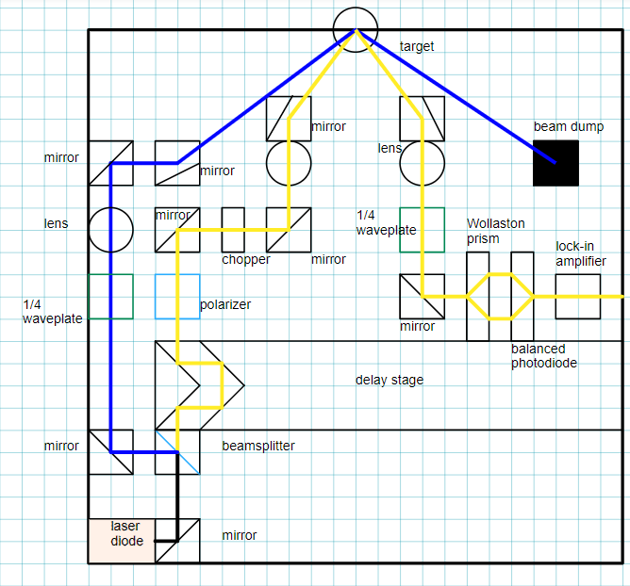
Proposed Optical Schematic of TRKR Experiment
Kurt Kennedy (Morgan State) & Luca Cultrera (BNL)

Slide 13
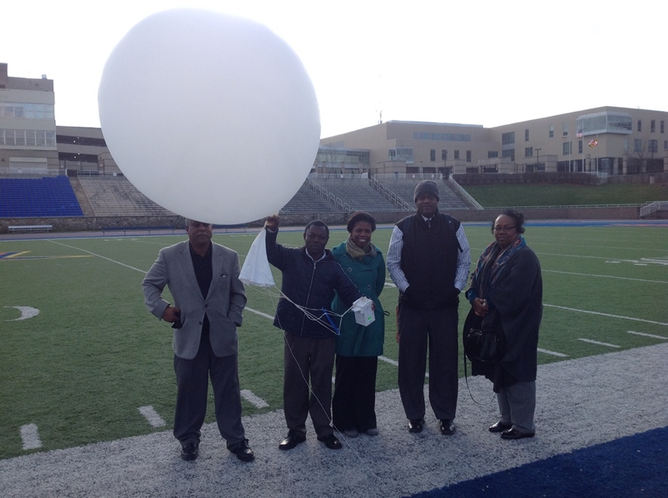
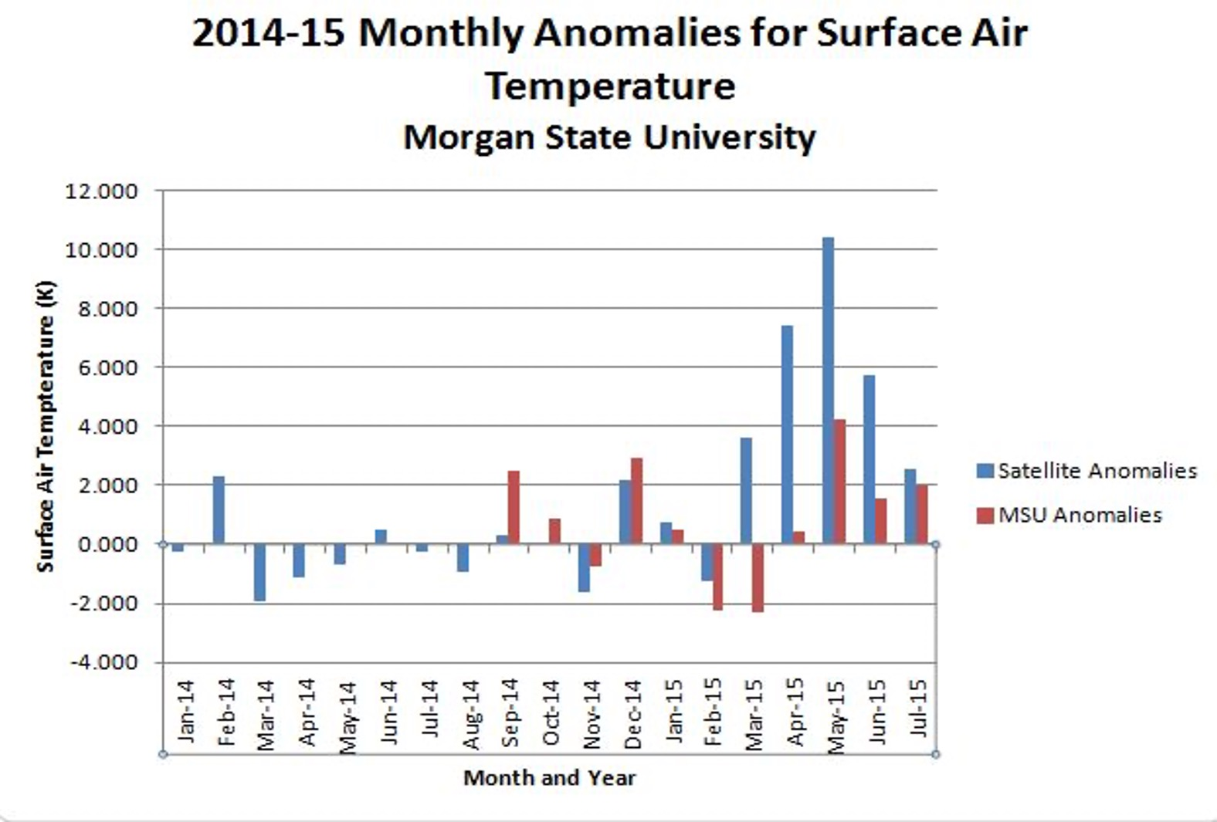
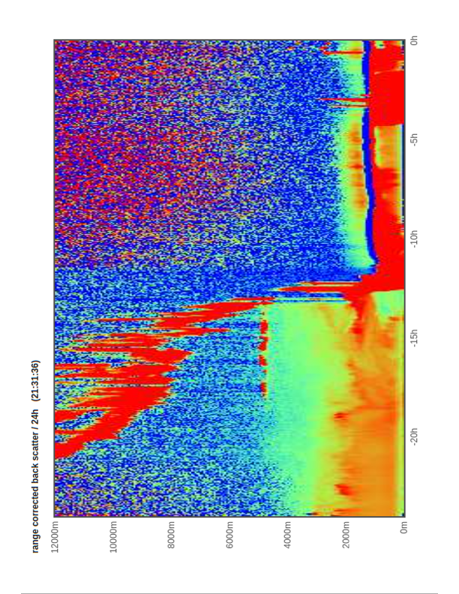
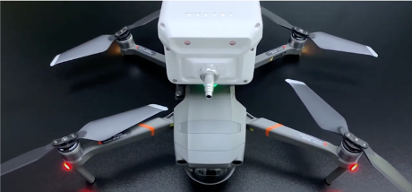
AIR QUALITY AND CLIMATE
RICHARD Damoah, MORGAN STATE UNIVERSITY
WEATHER & CLIMATE MONITOING:
Using ground station and weather balloon to
monitor Climate Changed and validate satellite
observations
CLIMATE & HUMAN HEALTH:
Investigating the impact of environmental
conditions on human health such as
malaria and asthma
AIR POLLUTION MONITORING:
Investigating the impact of pollution levels
using LIDAR and air quality drone
ATMOSPHERIC MODELING:
Using atmospheric and climate models to
determine the impact of air pollution on climate
Weather Balloon launch at MSU
Satellite validation with MSU station Data
MSU Air Quality Drone for Pollution
Measurement
Backscatter from MSU LIDAR

Slide 14
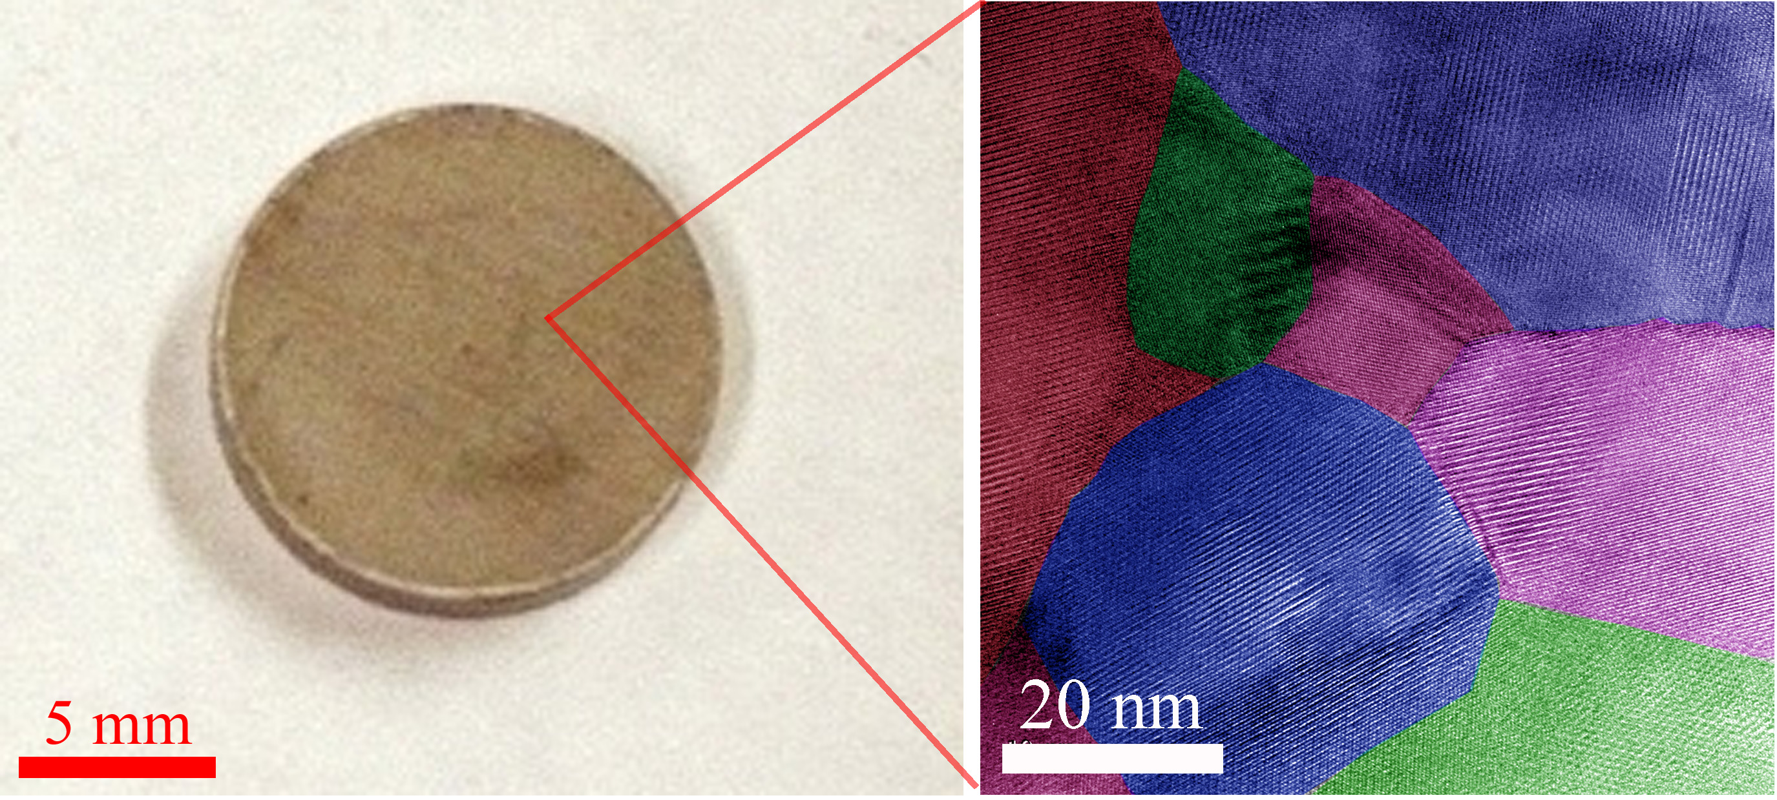
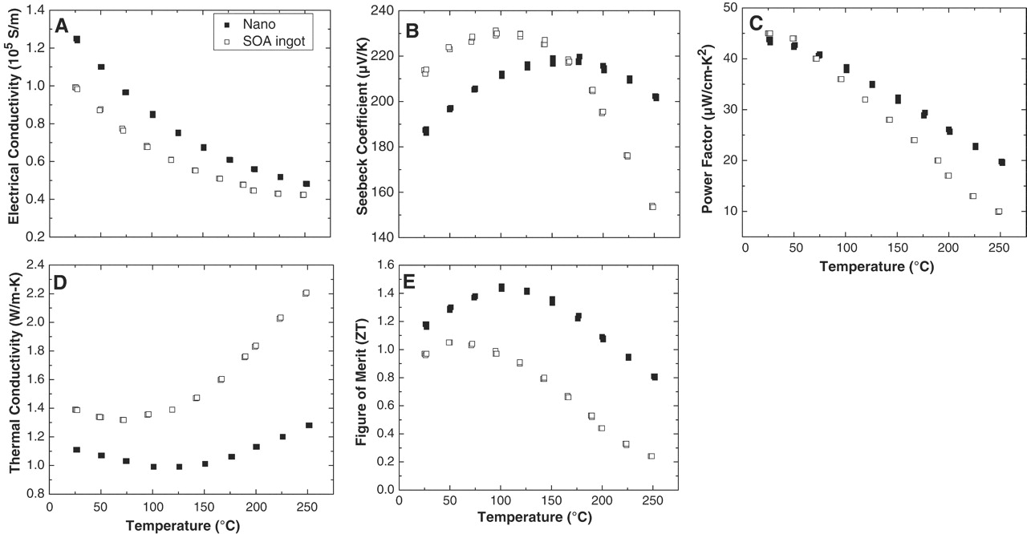
RENEWABLE ENERGY
yucheng Lan, Morgan State University, DOE DE-FE0031906 and NSF 2108298
Research interest:
Thermoelectric materials and applications.
Catalytical nanostructures: photo- and electronic.
Photovoltaic materials.
Sensing.
Electron microscopy and X-ray diffraction.
Thermoelectric disk and nanostructure. Left: optical; right: HRTEM.
Physical properties of Bi2Te3 nanocomposites with enhance figure of merit. Thermoelectric performances were improved through nanostructuring.

Slide 15
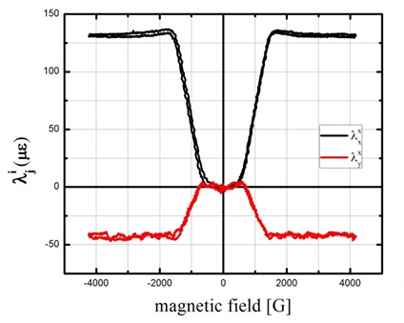
Functional Ferromagnets
Abdellah Lisfi, Morgan State University, NSF DMR 2055432 and 2117180
Research interest:
Hysteresis-free highly magnetostrictive ferromagnets.
Eiptaxial magnetic heterostructures including ceramics and metals.
Nano-chessboard structures.
Permanent magnets.
Magneto-electric materials.
Magnetic imaging.
Magnetostriction of Co₆₅Fe₃₅ disk with [001] normal to the disk plane. The quantities λ𝑥𝑥 and λ𝑦𝑥 denote the strains determined parallel and perpendicular to the x-direction of the applied magnetic field.
Hysteresis loops of (110) CoFe₂O₄ film measured along three different field angles from the easy axis (0°, 30° and 60°).
AFM and MFM of FePt grown on STO imaged in the AC demagnetized state.

Slide 16
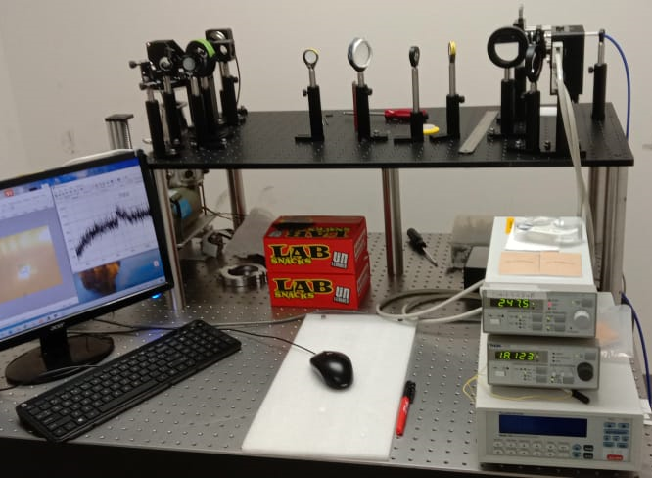
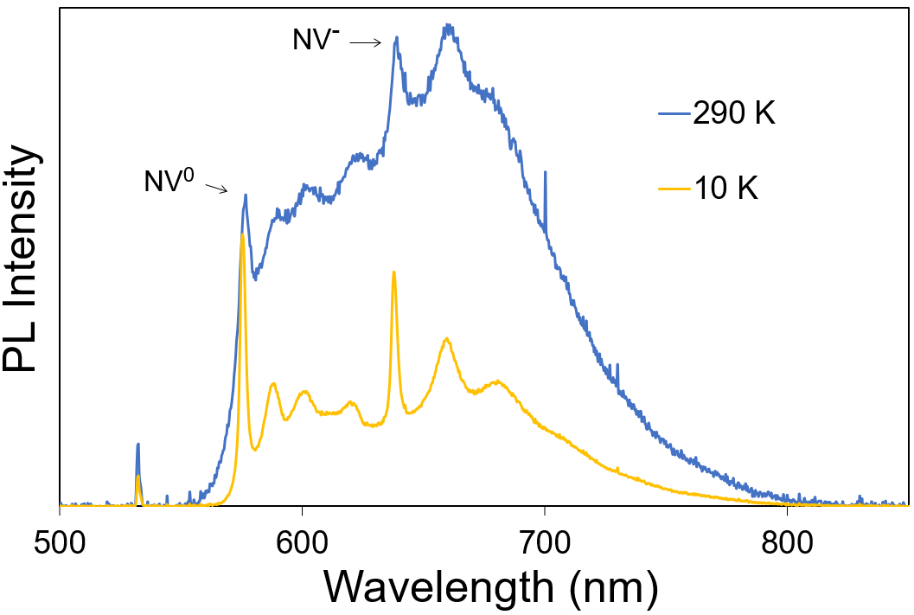
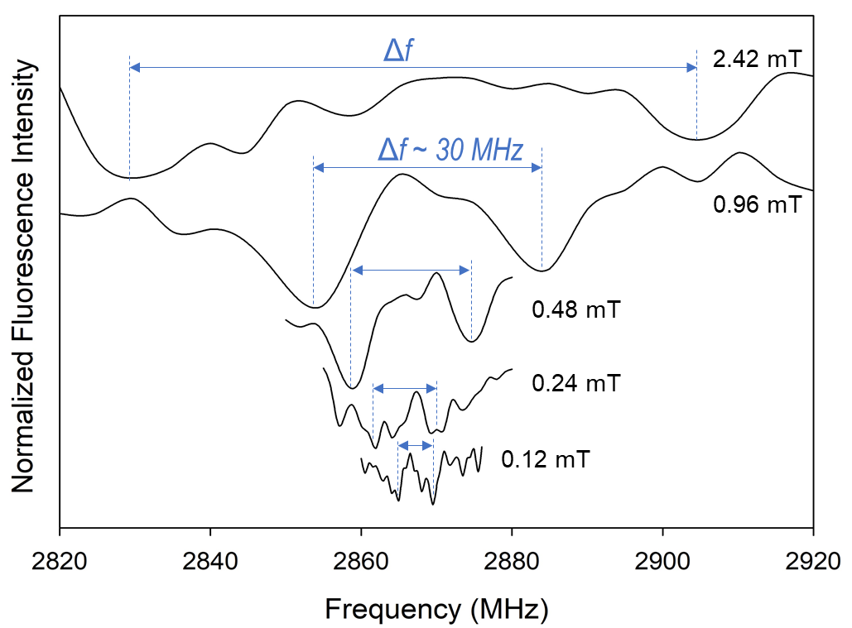
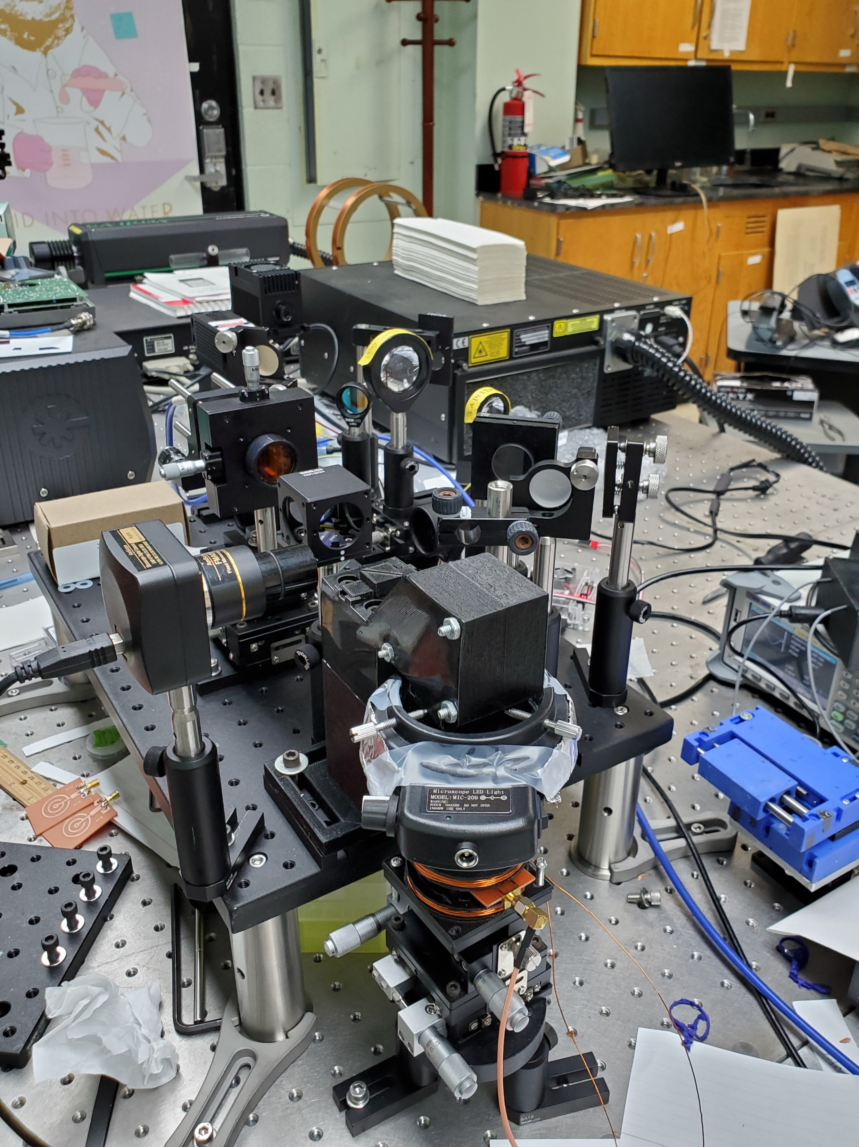
Quantum SENSING LAB birol Ozturk, morgan state university
PI: Birol Ozturk
Quantum sensing of extremely low-level temperature changes, magnetic and electric fields with defects in wide bandgap semiconductors such as diamond, SiC and two-dimensional materials.
Recent results and custom-built setup:
Custom built confocal PL setups for visible (left) and IR (top) ranges with ODMR capability.
Confocal PL signal from NV color centers in nanodiamond at room and 10K temperatures.
Magnetic field detection with ODMR using NV color center PL signals in bulk diamond.

Slide 17

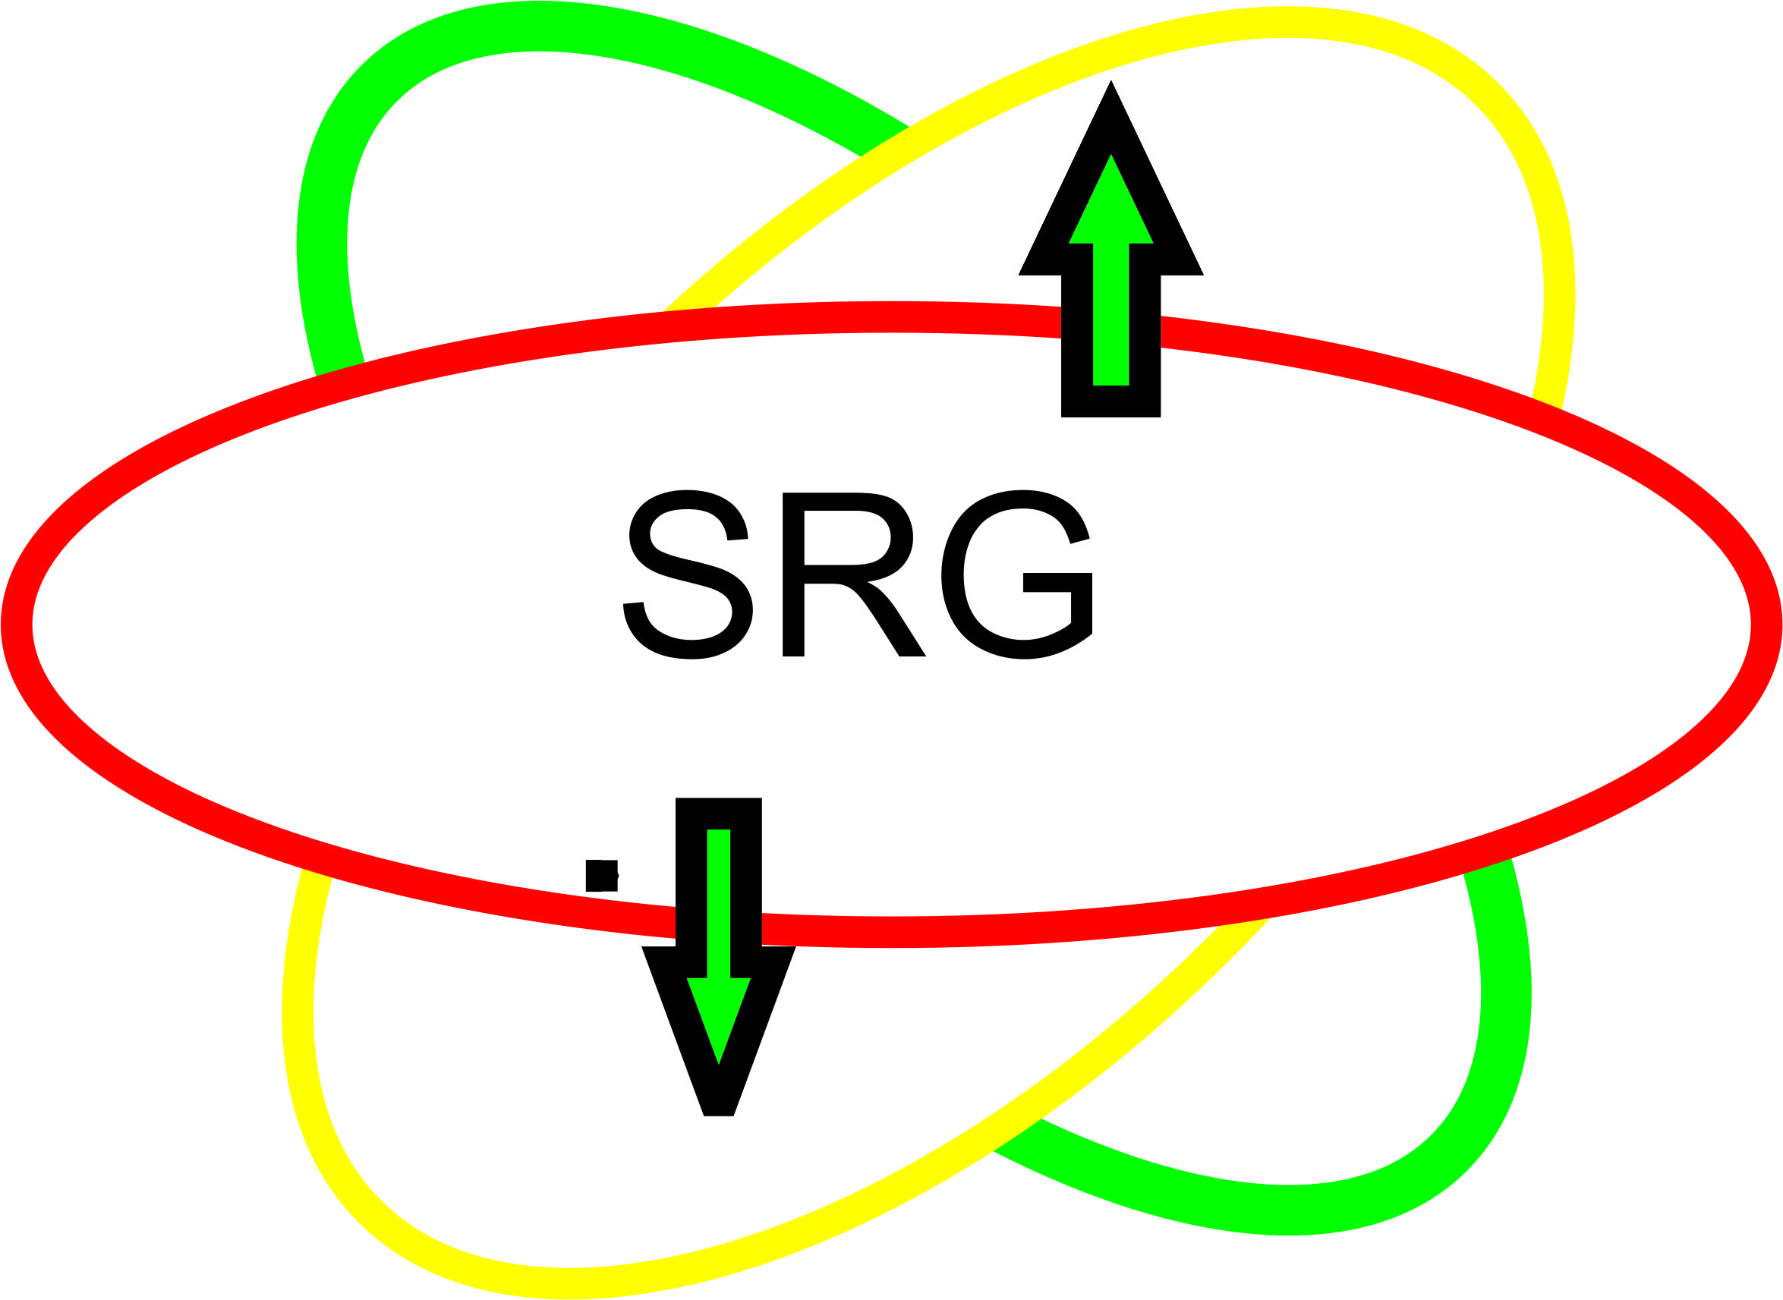
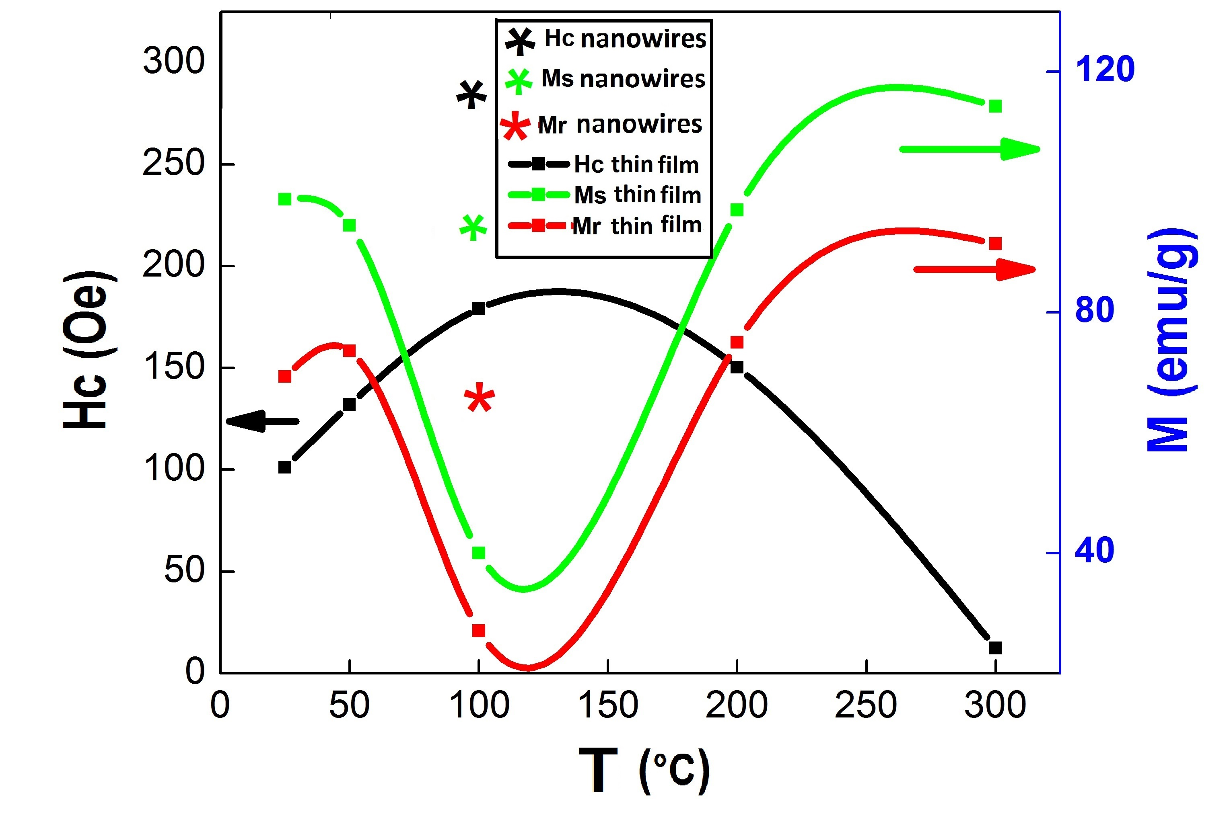
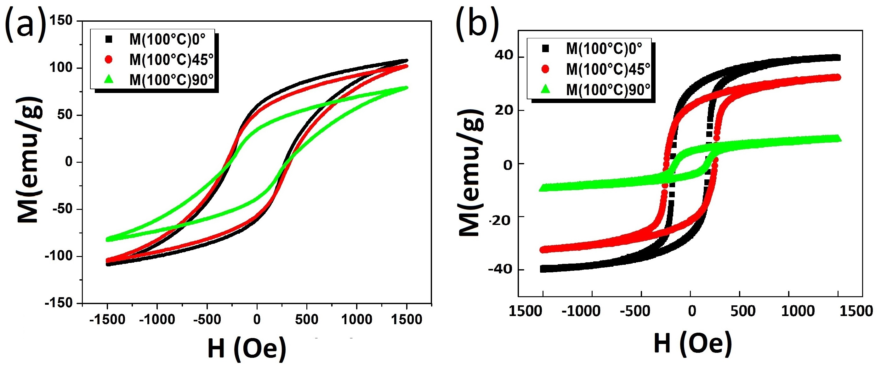
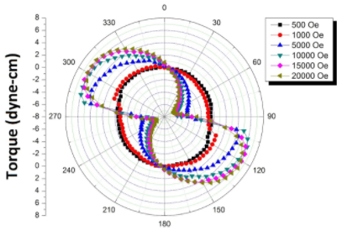
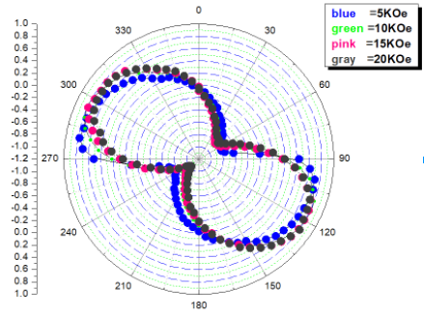
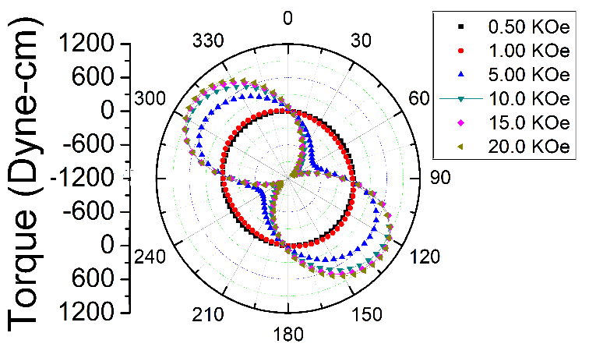
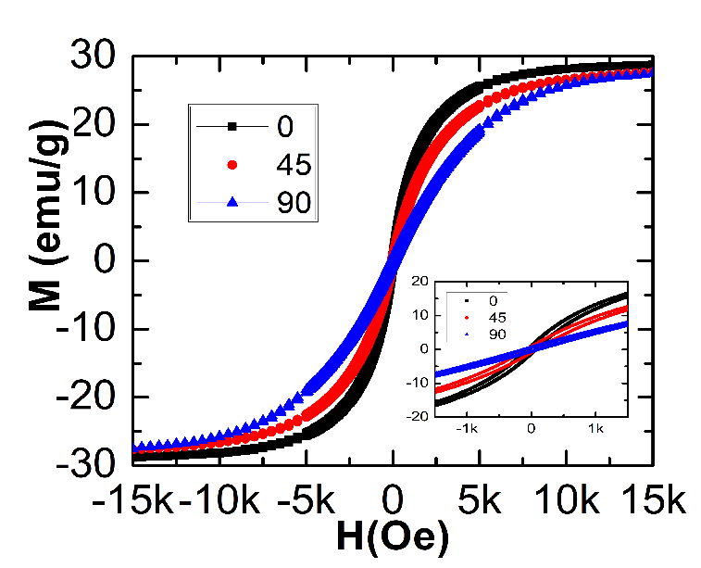
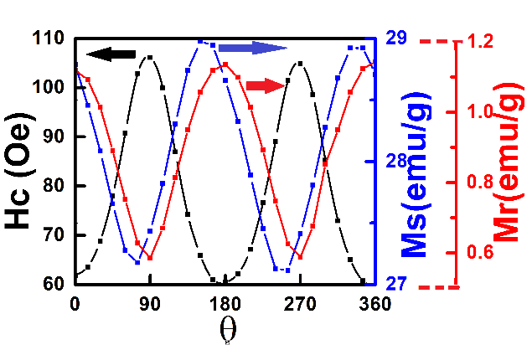
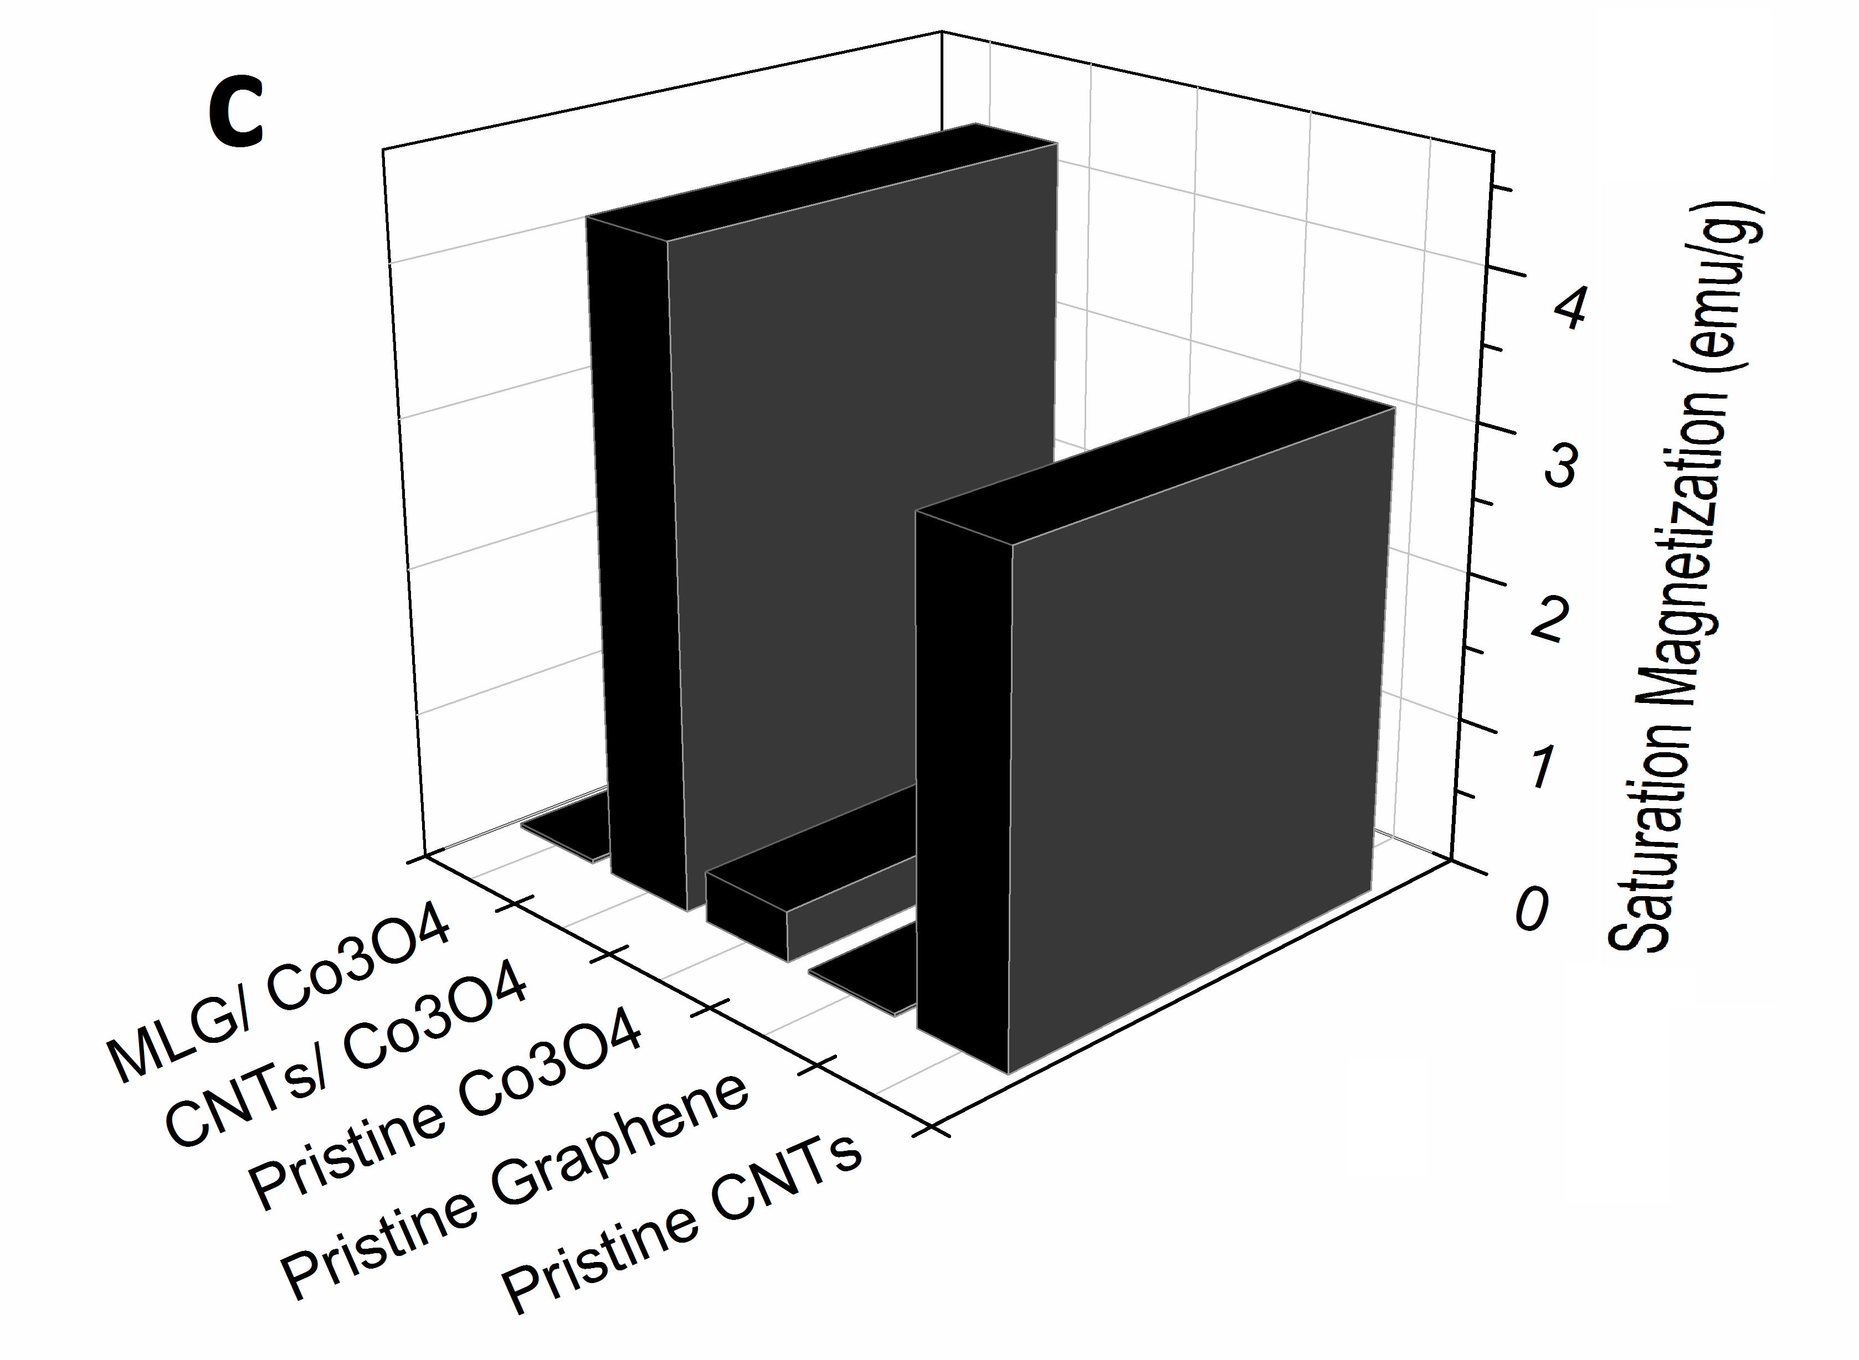
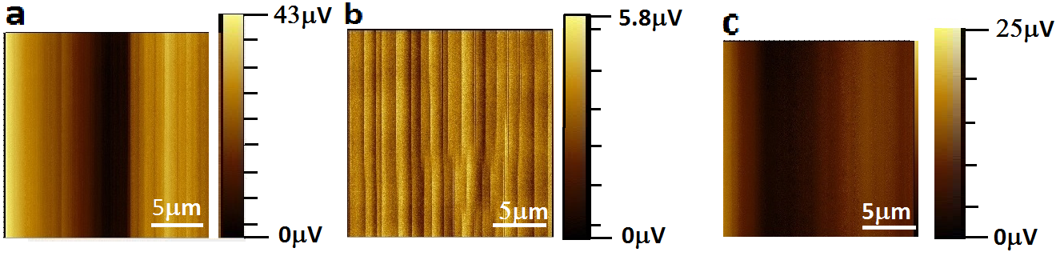
Quantum Materials
Sponsors: - NSF, ARL-VTD, ARL-WMRD, & DOD
Dereje Seifu, Morgan State University
Research Interests:
Tunneling magnetoresistance (TMR): with higher TMR ratio at room temp. can be used to for ultrasensitive sensors, logic gates, and magnetic random access memory.
Planar Films
Arrays of
Filled CNTs
Nano-columns (NC)
Thin film (TF)
FM
Insulator
FM
Figure 1 – Schematic of planar and array of TMR structure.
Both sets of samples were grown using the same magnetron
sputtering deposition tool. The planar films (TF) will establish initial growth conditions for the arrays of nano-columns (NC).
Figure 4 – Torque magnetometer of (a) TF (b) NC, both synthesized at 100 ºC.
Figure 2 – Vibrating Sample magnetometer (VSM) measurements of Hc, Ms, and Mr of TF and NC(*) Vs substrate temperatures.
Figure 3 – (a) B-H loop of NC (b) B-H loop of TF
both synthesized at 100 ºC at several angle
orientation to the applied magnetic field.
- Magnetostrictive materials:
Tb_{0.3}Fe₂Dy_{0.7} (TFD) embedded in carbon-fiber-reinforced-polymer (CFRP) possesses enhanced magnetic response, as shown below. This property is desirable to design an ultra-sensitive sensor for prognostics and diagnostics of early onset of structural damage.
Figure 1. VSM of TFD embedded in CFRP sample oriented at 0º, 45º, and 90º from the field. The inset shows the low field behavior of the hysteresis loop.
Figure 2. Coercive field Hc (black), saturation magnetization Ms (blue), and remanent magnetization Mr (red) of TFD embedded in CFRP sample as a function of the angle between the sample surface and direction of the applied magnetic field.
Figure 3. Torque magnetometry of TFD embedded in CFRP 0.5 kOe to 20 kOe from 0º to 360º (clockwise) in a polar plot.
Lower dimensional materials: Carbon nanotubes (CNTs) and multilayer graphene (MLG) functionalized with magnetic
nanoparticles reveal enhanced magnetization, which can be used for magnetic sensing.
Figure 1. (a) MFM of MLG/Co₃O₄,
(b) CNTs/Co₃O₄, (c) Co₃O_{4.}
Figure (c) Saturation magnetization (Ms) of MLG/Co₃O₄, CNTs/Co₃O₄, pristine Co₃O₄, pristine CNTs, and pristine MLG.

Slide 18
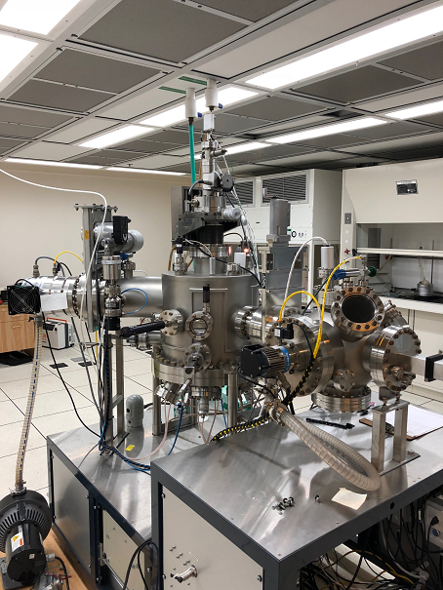
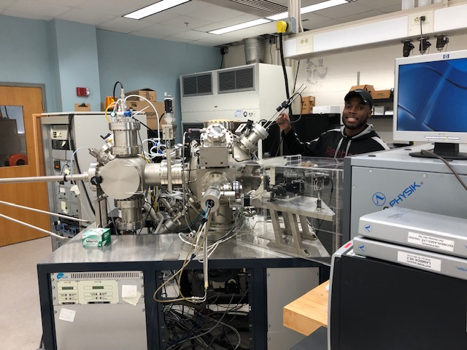
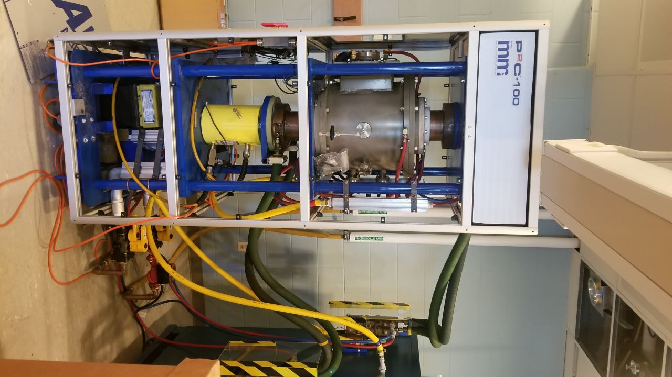
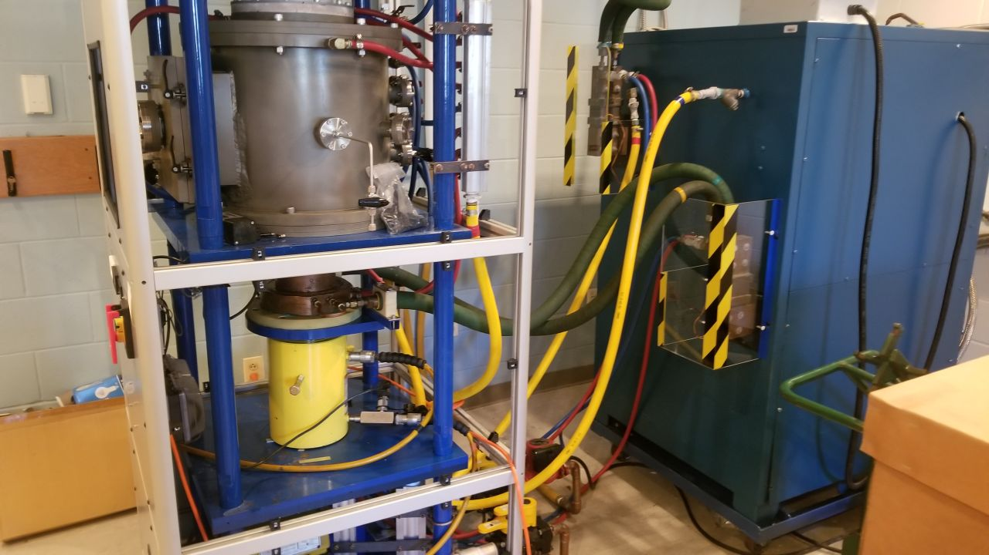
Thin Films & Bulk materials synthesis facilities - LAB
RAMESH Budhani
UHV Sputtering
PLD & Sputtering Hybrid
SPS System
SPS System

Slide 19
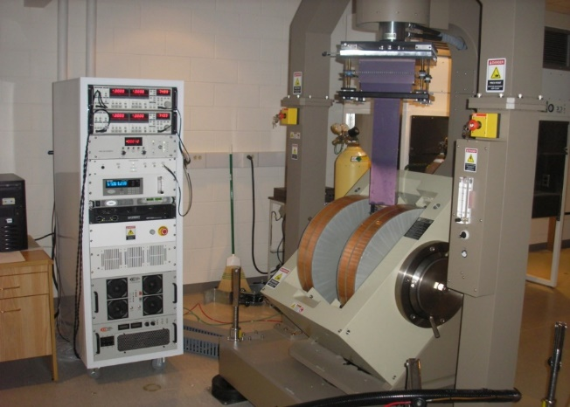
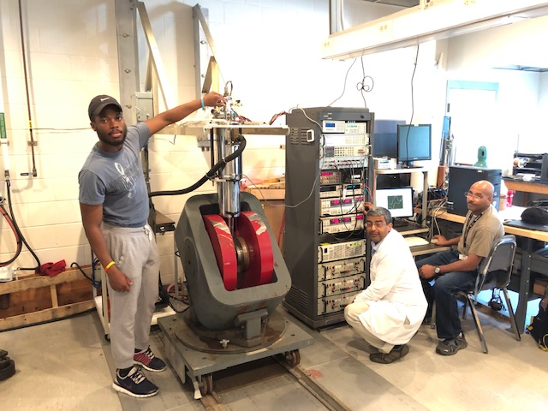
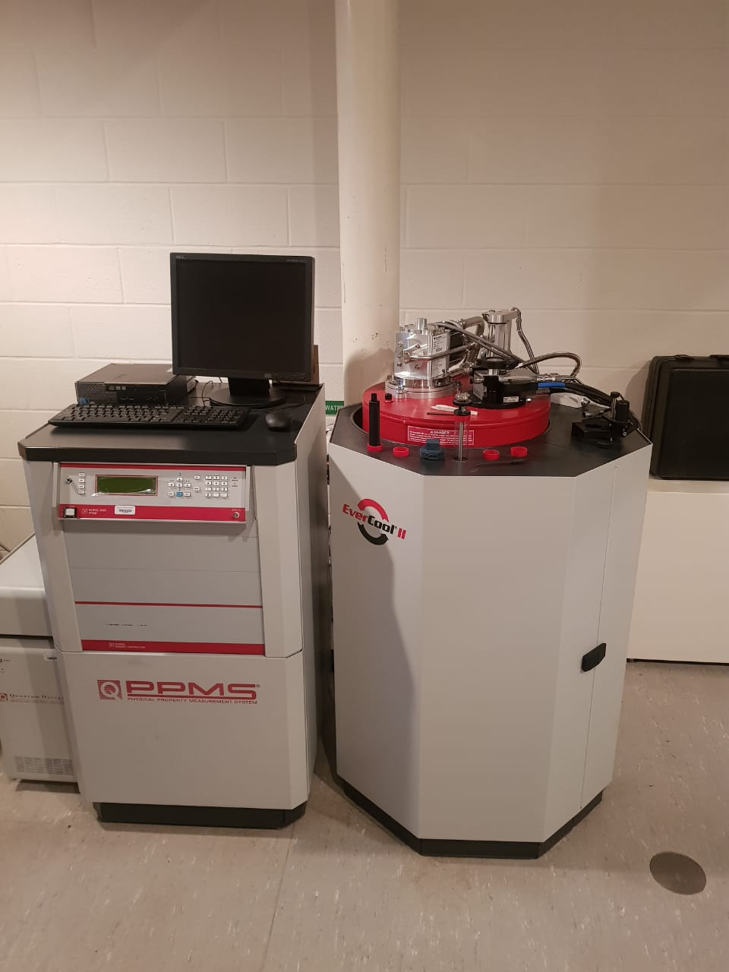
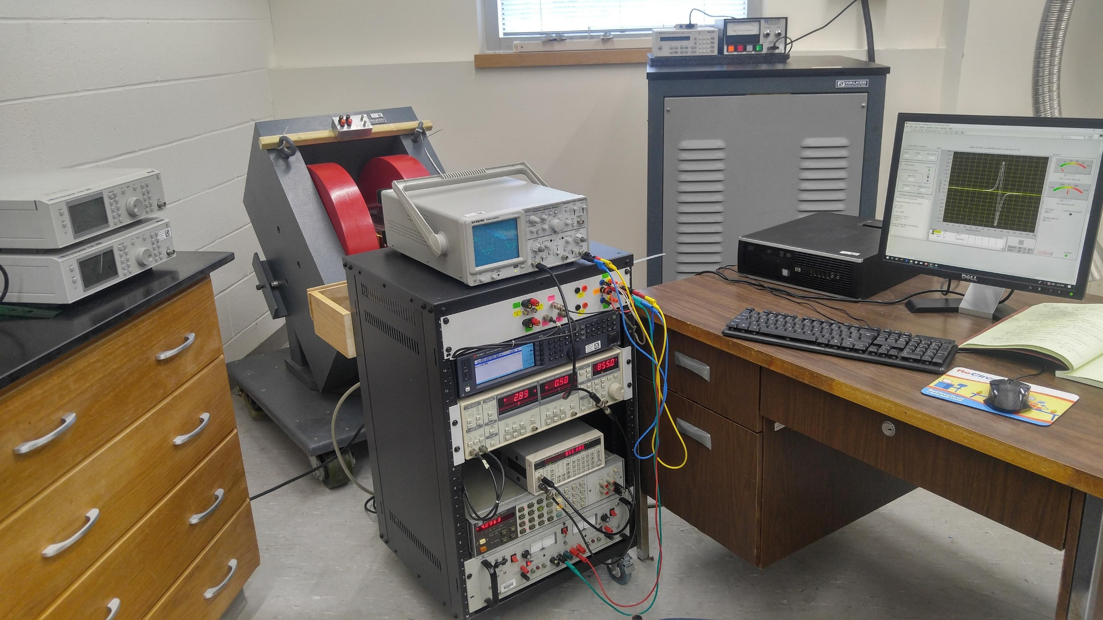
RAMESH BUDHANI
Measurement Capabilities
Vector VSM
Home Built system for transport
9 tesla PPMS
Home Built system for FMR

Slide 20
RAMESH BUDHANI
Ongoing Projects:
DOD Center for Electro-Optics with 2D Materials
(Collaborators: Johns Hopkins University, JHU – Applied Physics Laboratory, Army Laboratories at Adelphi and Aberdeen Proving Grounds).
2. Nanostructures of Magnetic Dirac Metals for RF Electronics (Air Force Office of Scientific Research).
3. Broadband Ferromagnetic Resonance Spectrometer for Temperature Dependent Magnetization Dynamics of Spintronic Heterointerfaces (Air Force Office of Scientific Research).
Ongoing Collaborations:
Department of Physics, Johns Hopkins University.
Center for Quantum Materials – UMD College Park.
Department of Physics, University of Delaware.
Center for Functional Nanomaterials – Brookhaven National Laboratory.
NIST Neutron Research Center.

Slide 21

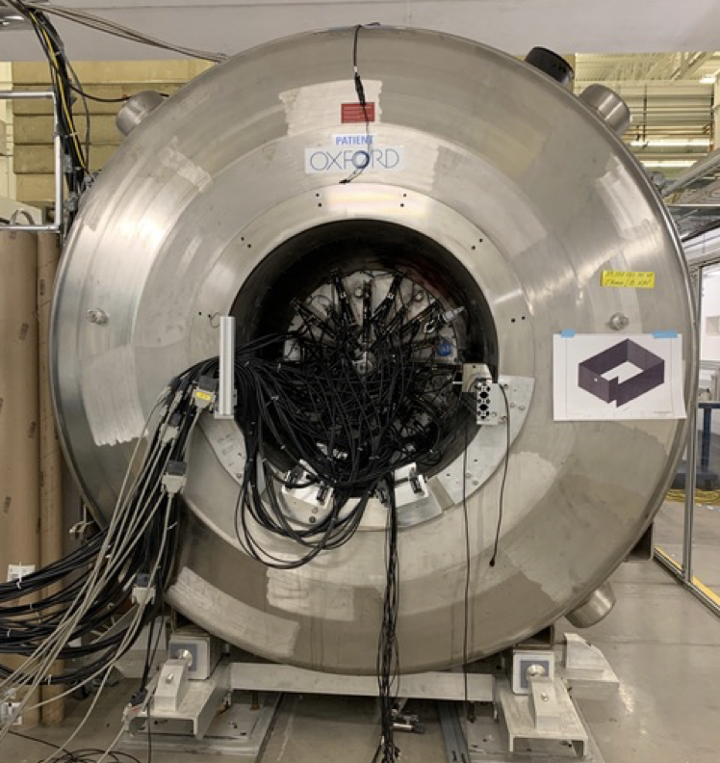
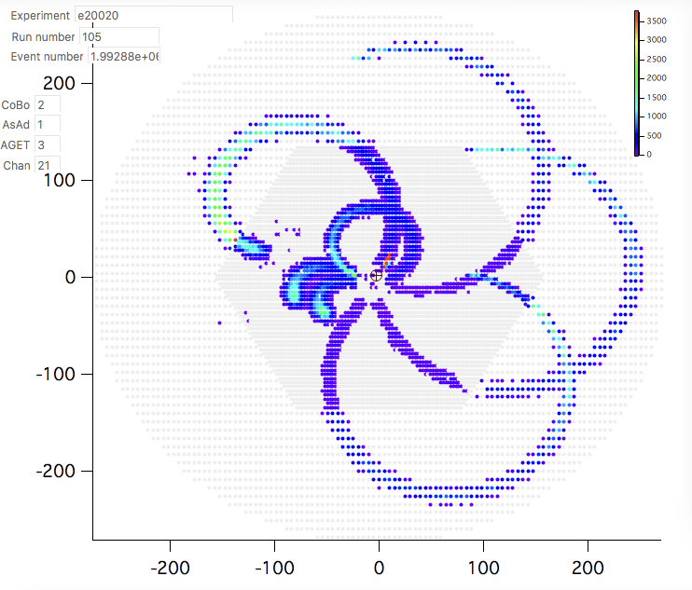
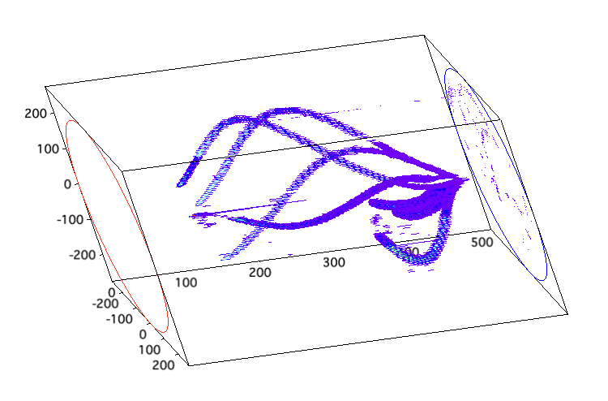
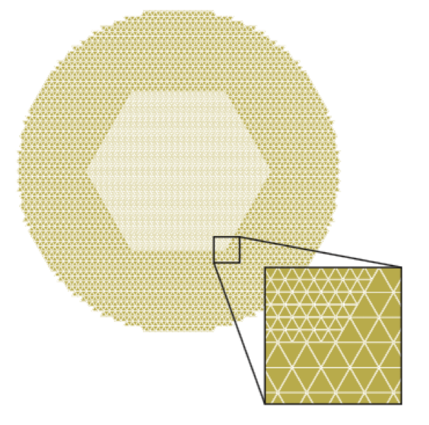
probing THE STRUCTURE OF nuclei with the AT-TPC
(ACTIVE TARGET TIME PROJECTION CHAMBER)
CLEMENTINE SANTAMARIA, ASSISTANT VISITING PROFESSOR
AT-TPC constructed by Michigan State University at the Facility for Rare Isotope Beams (FRIB)
Spokesperson of the experiment : “Study of the four ⍺ decay of ¹⁶O” performed May 2021 with AT-TPC and the brand-new beam line
Successfully saw 5 particle events !
Analysis just started to see if we populated excited states above the 4 ⍺ separation energy to study the 4 ⍺ clustering of ¹⁶O
AT-TPC inside solenoid for experiment at FRIB
Another experiment accepted at the RCNP facility to study the exotic nuclei ¹³Be and ¹⁵Be via (d,³He) reaction (Osaka, Japan)
Physics campaign planned for end of 2022
Need detector tests to check the gas and pressure we can use for the experiment
Writing NSF grant to create a lab to test detector properties in-house at Morgan
AT-TPC detection plane

Slide 22
Nuclear / Accelerator Physics with BNL
Areas of Focus:
sPHENIX – aid in data analysis working on UPC’s
Electron Ion Collider – detector technology and accelerator R&D projects
Advanced materials – development and characterization of next-gen materials for nuclear reactors, detectors, sensors, photocathodes, etc.

Slide 23
Executive Summary: Next generation of physics at Morgan
Vision 2029: T.E.A.M. Physics – Celebrating 75 years of Scholarship & Service in Physics at Morgan State
T.E.A.M. Physics – Teacher Education, Earth Science, Astronomy & Accelerator Physics and Materials
MUSIC model in Physics – eMpowerment, Usefulness, Success, Interest, and Caring
NuMaSS Center – Center for Nuclear, Materials, and Space Sciences
QuEST Center – Center for Quantum Education Science and Technology
Joint PhD program in Integrated Materials by Fall 2024
Focused TT faculty hires in Nuclear Physics to develop research program in Accelerator Physics

Slide 24


Questions
&
Answers ??!!

