Slide 1


Building Radioisotope Research & Education Capacity and Expertise at Alcorn State University
Thomas J. Ondera
Department of Chemistry and Physics

Slide 2
Outline
Introduction:
Radioisotope Research and development
Radiopharmaceutical Applications
Research
Radiochemistry Research & Education Capacity Building for MSI

Slide 3
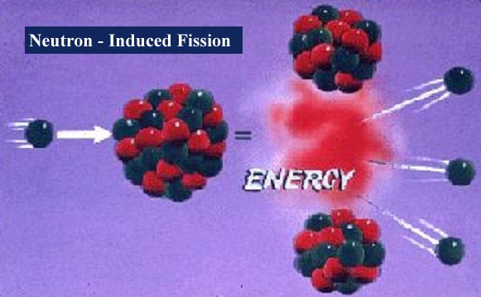
Radioisotope Research & Development
THERAPEUTIC
Organic & Inorganic Chemistry
^{Purification Techniques}
^{Radiolabeling Conditions}
^{Radionuclide Production}
^{Radioanalytical Techniques}
^{Bioconjugate Synthesis}
Stability Under Biological Conditions
DIAGNOSTIC

Slide 4
Radioisotopes for Medical Applications
Physical Properties
Half-lives are relatively short
Diagnostic Therapeutics
^{99m}Tc – 6 hours ¹³¹I – 8 days
¹⁸F – 110 minutes ²²⁵Ac – 10 days
⁸²Rb – 78 sec ⁹⁰Y – 2.7 days
¹¹C – 20 min ¹⁷⁷Lu – 6.7 days
B) Optimal Radioactive Decay Characteristics
1. Diagnostic/Imaging – Minimize radiation dose to tissues in patients
Gamma-rays with E = 60-300 keV
Positron generated photons with E = 511 keV
Minimal Particles Emitted
2. Therapy – Maximize radiation dose to tumor tissue
Particle Emission required
Gamma-ray emission – low level

Slide 5
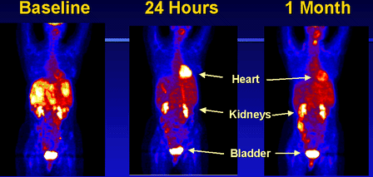
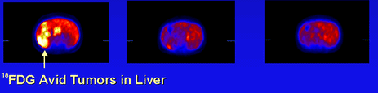
Monitoring Drug Success with ¹⁸FDG Imaging in Cancer
In 1980, BNL scientists first reported high ¹⁸FDG uptake in tumors, leading to FDG/PET for managing the cancer patient

Slide 6
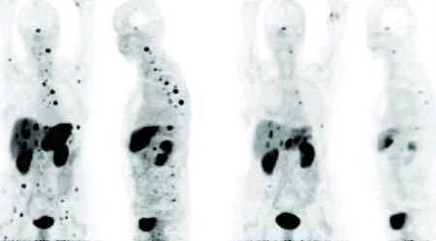
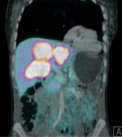
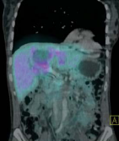
“Remarkable response to Bi-213-DOTATOC observed in tumors resistance to previous therapy with Y-90/Lu-177-DOTATOC”
SNMMI press release June 11, 2012
(alpha therapy worked when beta therapy failed)
Before
After
²¹³Bi DOTA-TOC
Before
After
Case II: Response of multiple liver lesions after i.a. therapy with 14 GBq ²¹³Bi DOTA-TOC
Case I: Shrinkage of liver and bone metastases after i.a. therapy with 11 GBq ²¹³Bi DOTA-TOC
Abbreviated decay chain: ²²⁵Ac→ ²²¹Fr→ ²¹⁷At→ ²¹³Bi
GEP-NET = Gastroenteropancreatic neuroendocrine tumors
Ref. Morgenstern et al. J. Nucl Med 2012; 53 (Supplement 1): 455.
High publicity: Study awarded Society of Nuclear Medicine Image of the year in 2012 (SNMMI press release June 11, 2012)

Slide 7

Research: Radiolabeled Nanostructures
Research Objective:
²²⁵Ac‐labeled AuNPs Functionalized with Bifunctional Chelators for Stable Coordination of Radiometal Targeted Recognition and Therapy of Cancer

Slide 8
Tumor Targeting Properties of AuNPs
Enhanced Permeability and Retention (EPR) effect
Tumor tissue accumulations due to ‘‘leaky’’ blood vessels properties and poor lymphatic drainage—Passive Targeting
Active Targeting
Functionalize with targeting vectors that bind receptors overexpressed on tumor
Tunable shape, size and physico-chemical properties.
Photothermal Therapeutic and Diagnostic advantage

Slide 9
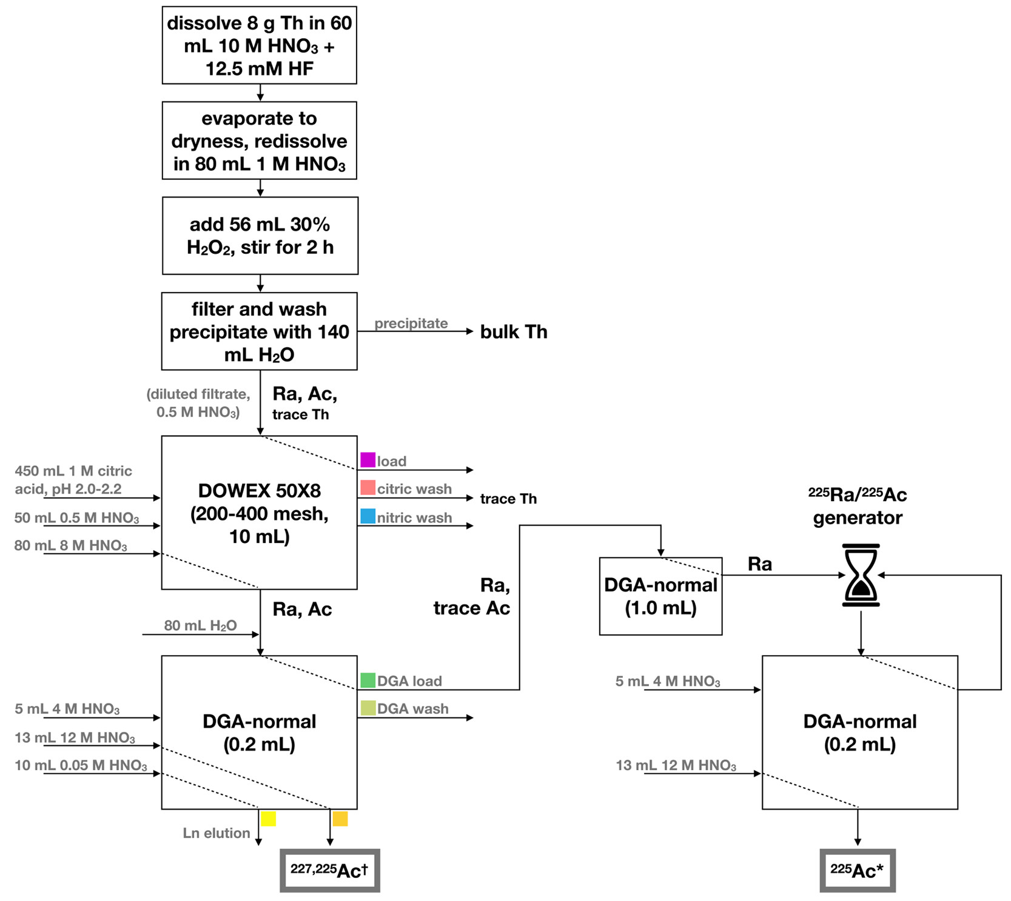
Sample Actinium-225 Production and Purification
²²⁵Ac Production:
Chromatography Column Steps for Purification of ²²⁵Ac
²³²Th(p,x)²²⁵Ac
DOE-Brookhaven National Laboratory
Current world-wide demand of ²²⁵Ac outstrips supply necessitating additional efficient processing methods
Inorg. Chem. 2020, 59, 17, 12156-12165

Slide 10
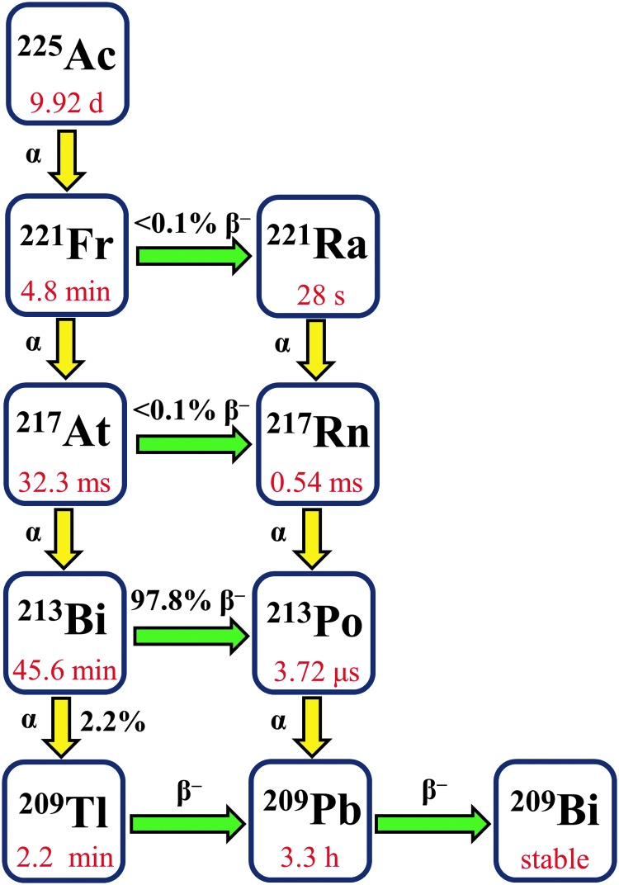
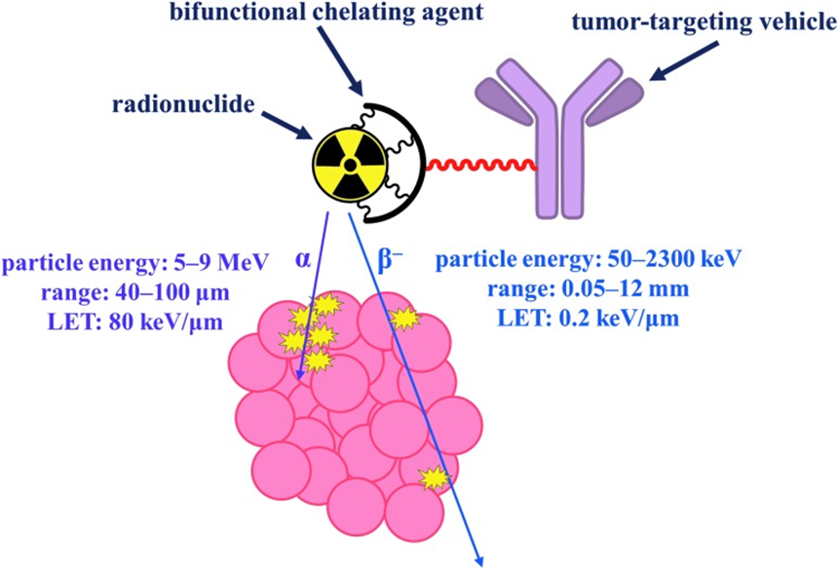
²²⁵Ac For TAT
Targeted radionuclide therapy employing using alpha (α) or beta (β−) particles in a tumor-targeting (Nikki A. Thiele and Justin J. doi: 10.1089/cbr.2018.2494
Challenges:
Poor RCY, RCS due to instability of the chelate arising from the larger ionic radius of ²²⁵Ac ion, and the release of daughter nuclides arising from the α recoil

Slide 11
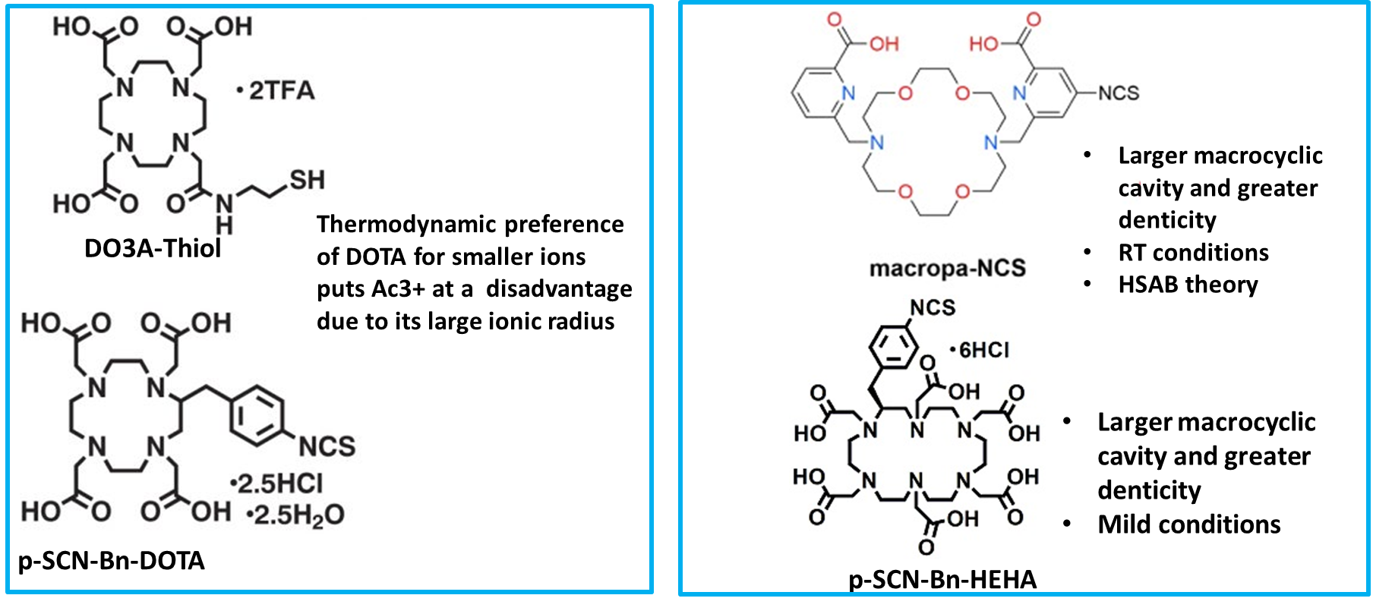
Bifunctional Ligands for Chelation of Actinium
Use AuNPs and its EPR effect/functionalize with cell-internalizing TV: Minimize redistribution of 225Ac and its daughters due to recoil energy associated with alpha emission

Slide 12
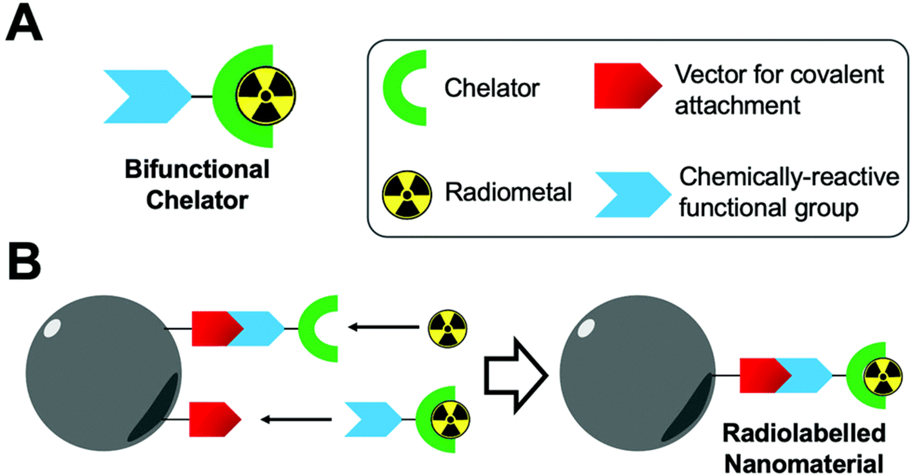
Radiolabeling of NPs using Bifunctional Chelators
Schematic representation of indirect radiolabeling of nanoparticles using bifunctional chelators

Slide 13
Radiochemistry Research & Education Capacity Building for MSI
Radioisotope Research
Radioisotope Education
Technical Assistance in Development of Proposal Ideas
Strengthen Education and Research Opportunities for MSI Students
GRANTS
Proposal Dev Workshops
Collaborations
Internships and Scholarships
DOE LABS
SULI
CCI
FAIR, Radioisotope R & D (RENEW)
SEMINAR SPEAKERS
Strengthening MSI Faculty research within Nuclear Medicine applications
CAREER FAIR DAYS
Research
Radiochemistry/Radiopharmaceuticals
VFP, Access to User Research Facilities
Radiolabeling, Radioanalytical Techniques
Dosimetry

Slide 14
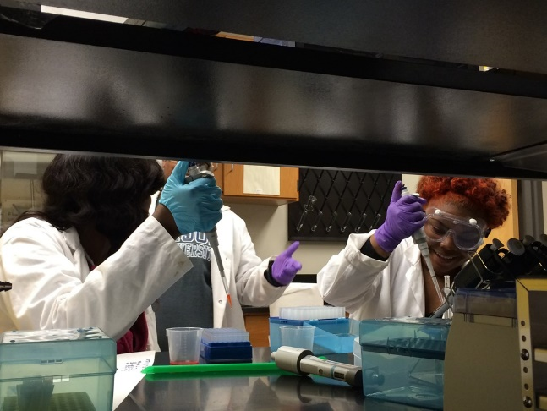
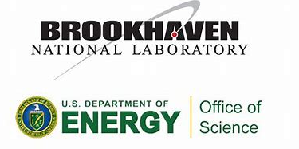
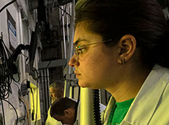
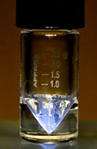

Enhance Research and Education infrastructure at ASU
COLLABORATION
BNL-MIRP TPL
225-Ac
Alcorn State Undergraduate Research
GRANTS
Radiochemistry Course
Radiochemistry Lab
Internships
Expertise

Slide 15
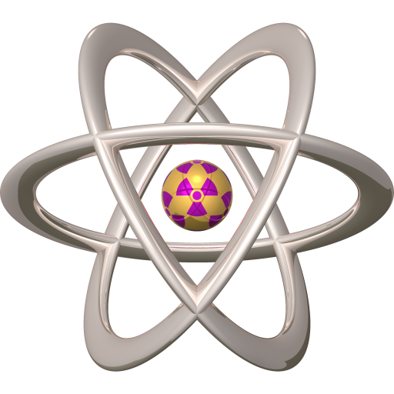
Questions?
Thank You!

