Slide 1
My Experience at BNL
Caroline Esposito
Wellesley College
7/19/23

Slide 2
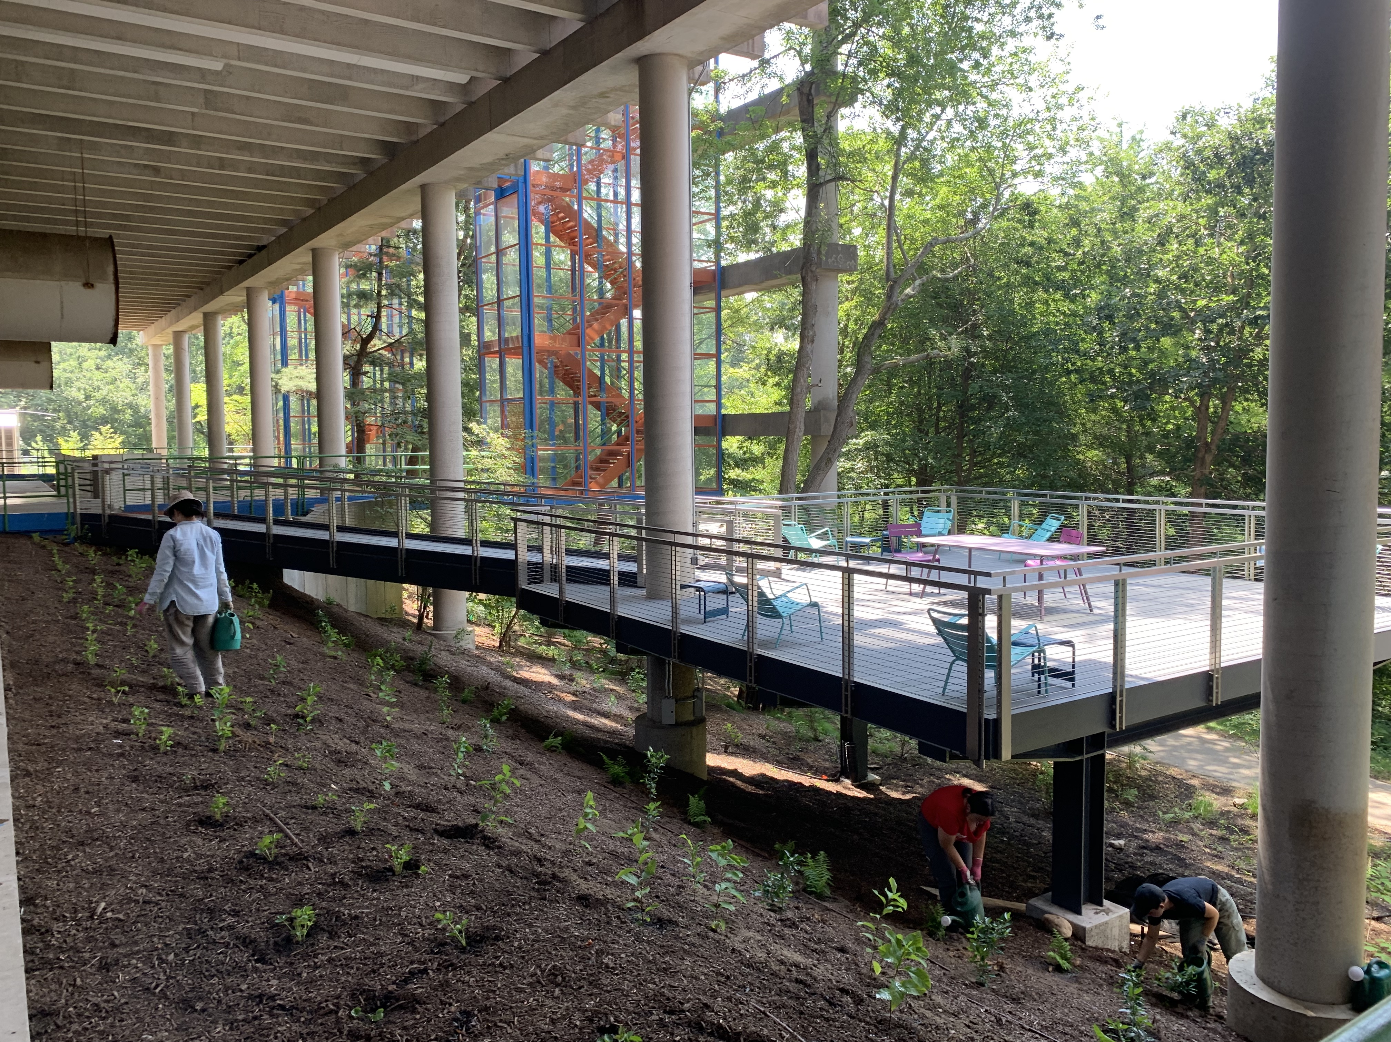
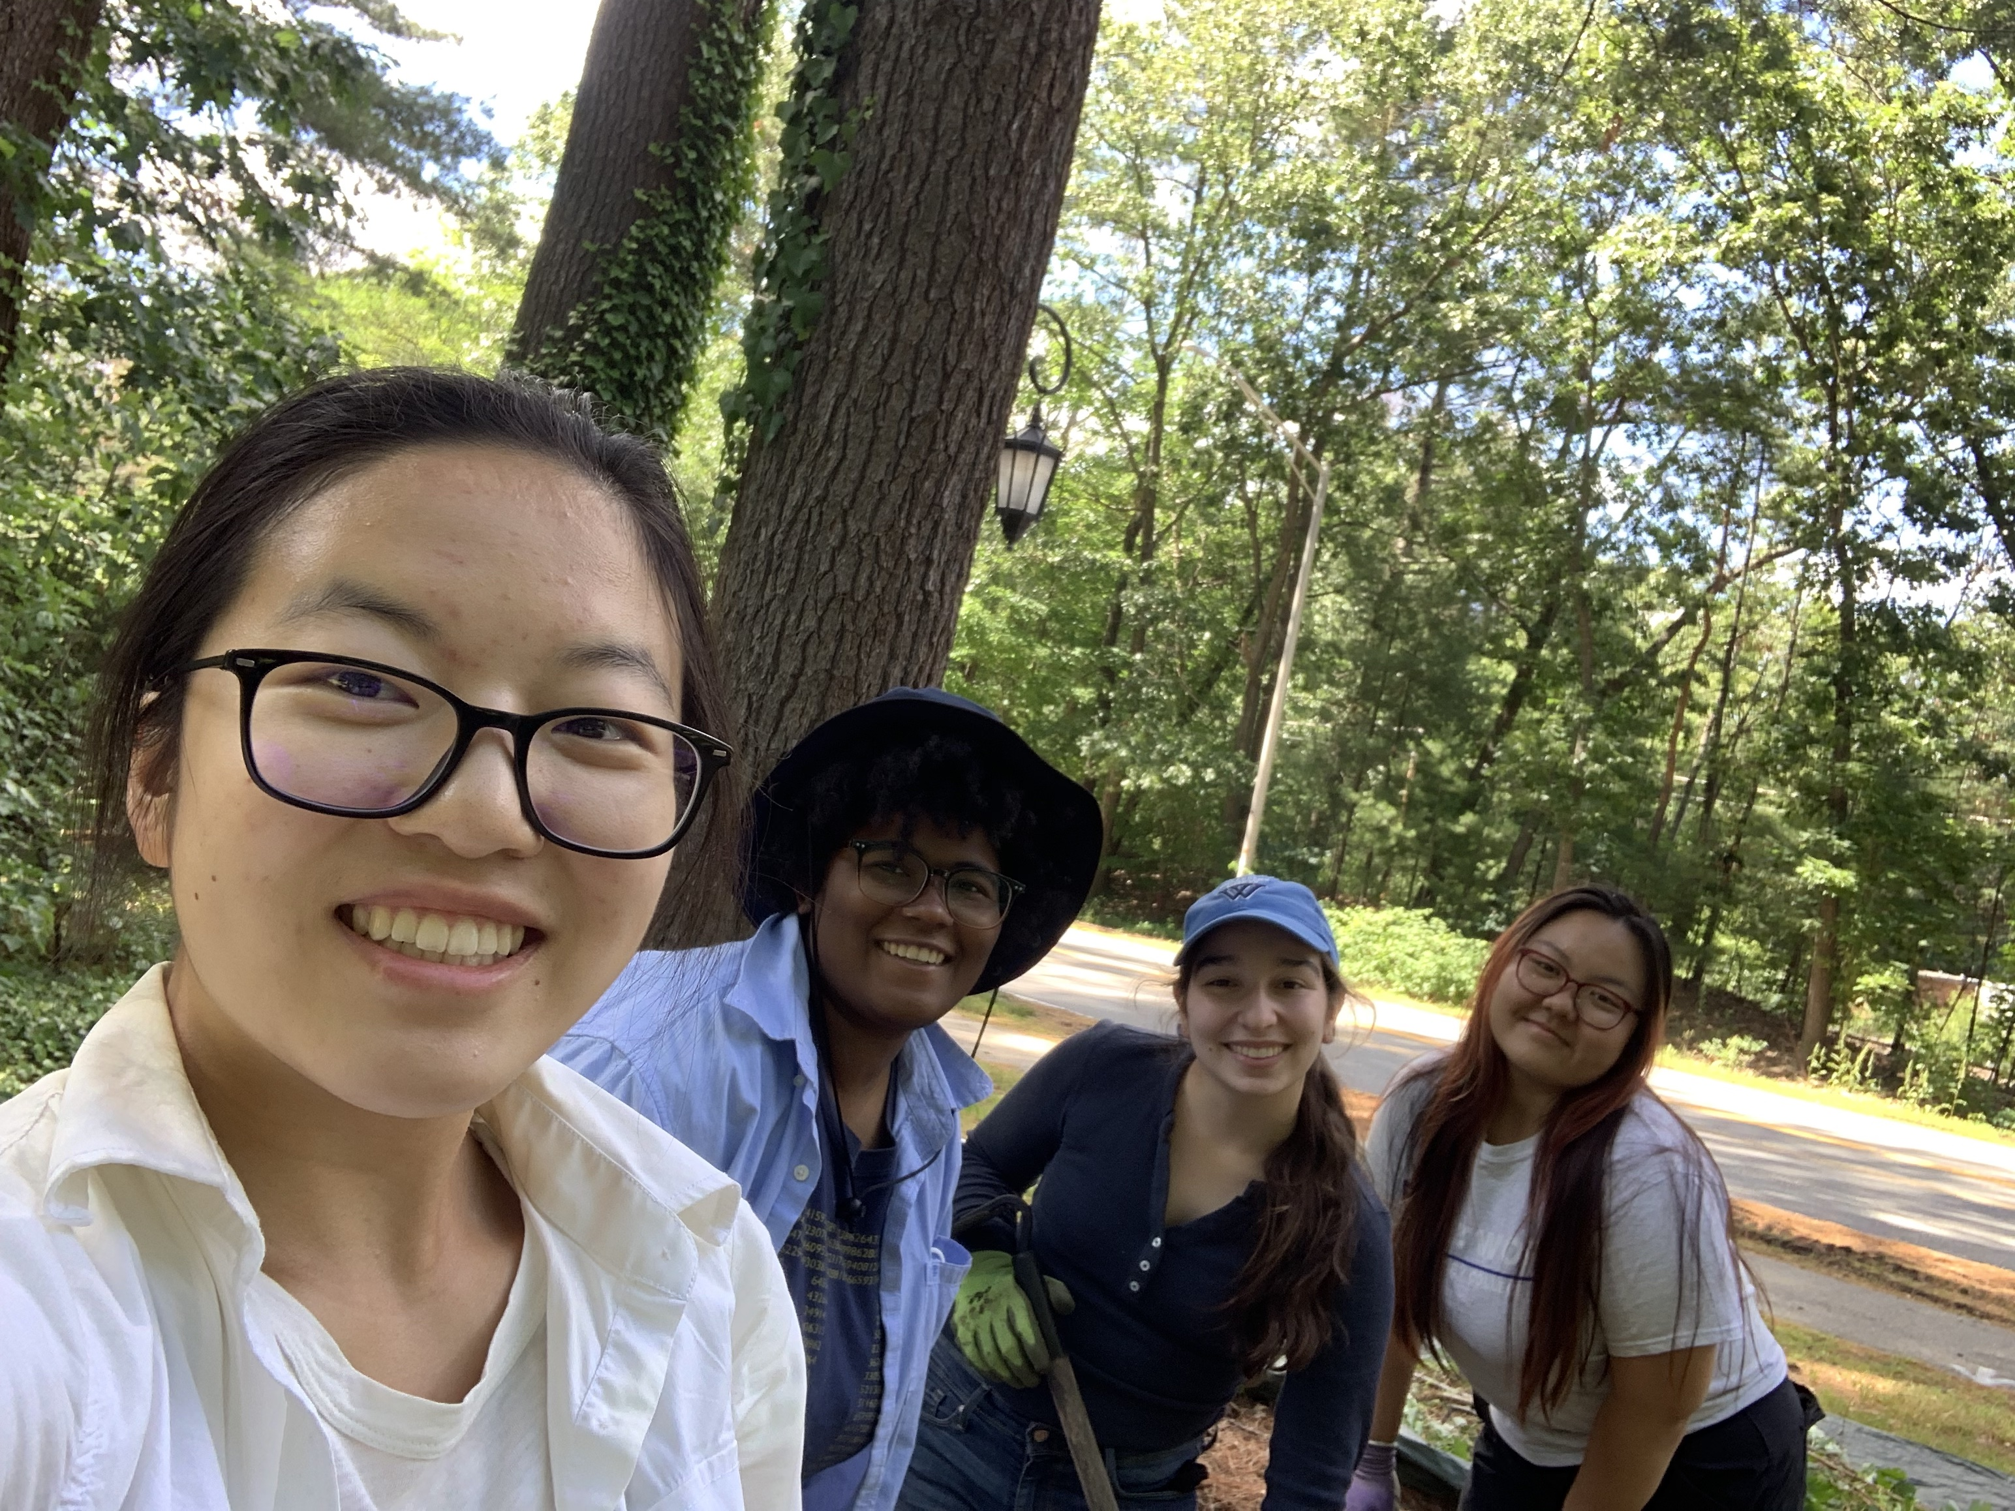
Prior Experiences
Summer internship at the Wellesley College Botanic Garden
Lots of outdoor work, but no formal lab experience
I learned to work hard and rely on my peers
Summer 2021 at Wellesley Botanic Garden

Slide 3
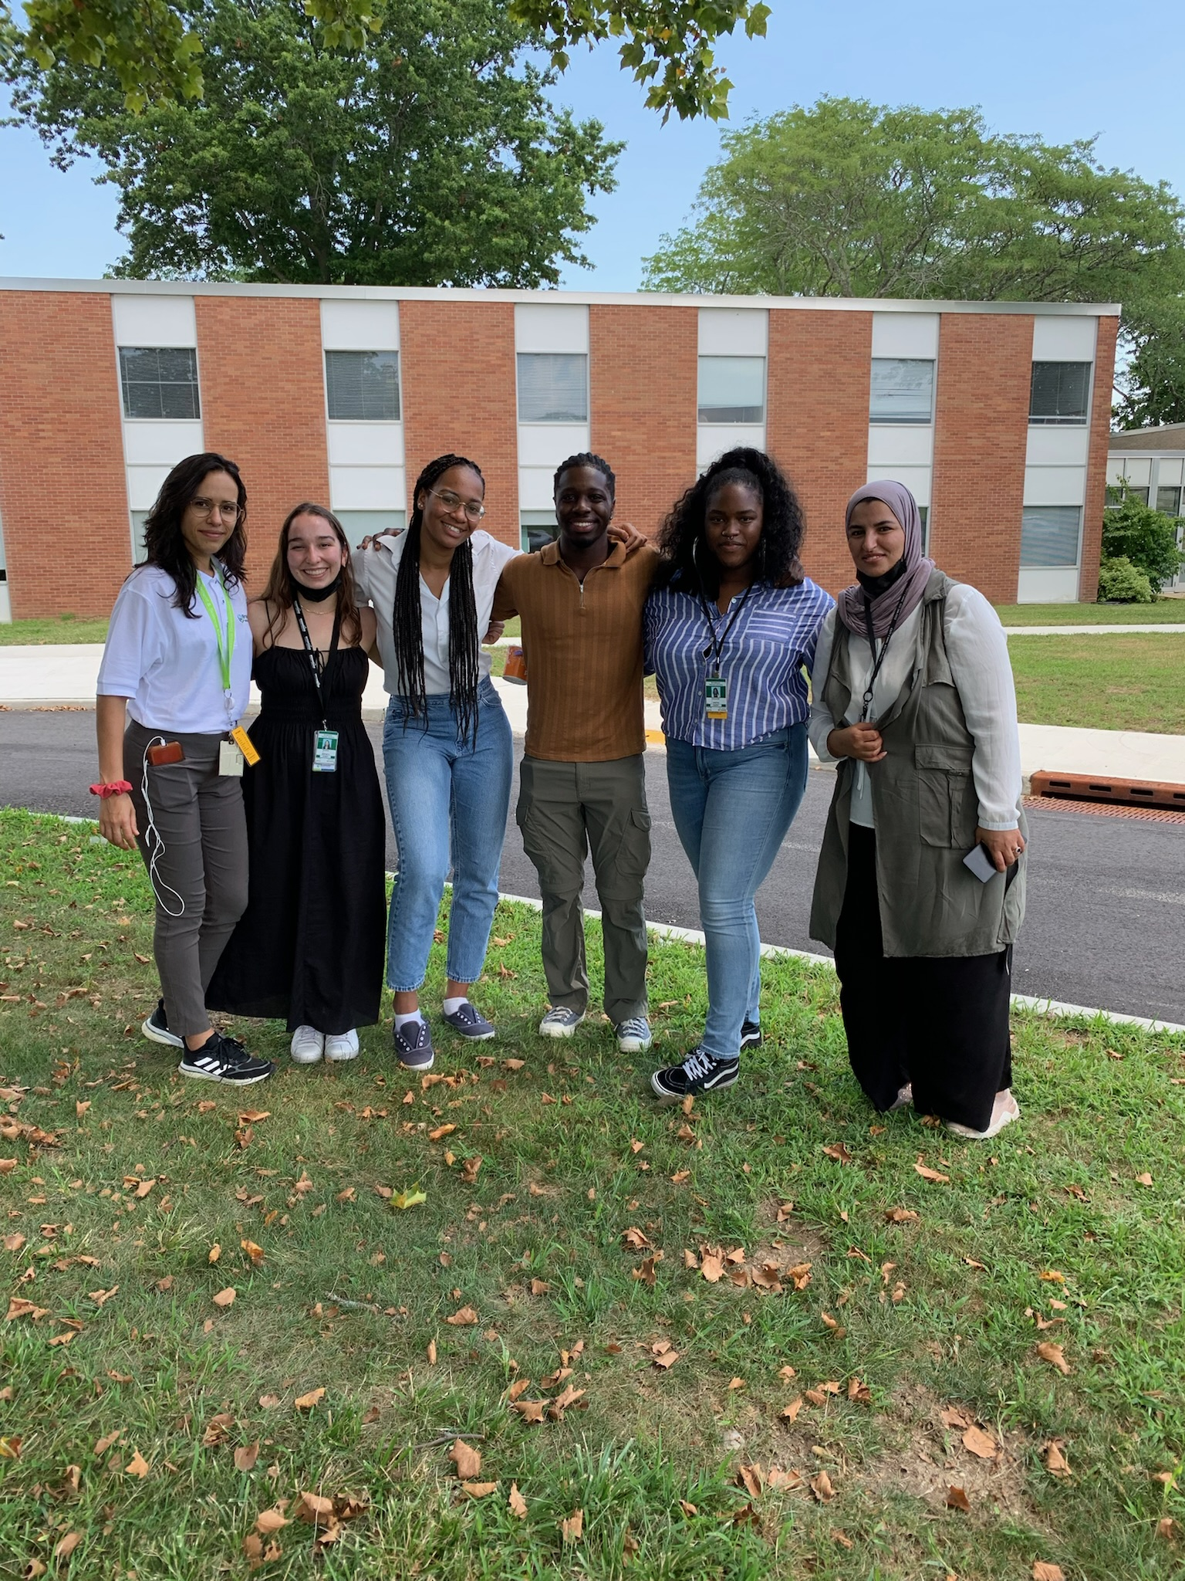
My path in the NPT Program
Working with Dr. McCutchan at the NNDC Studying the decay of ¹⁴²Ba with a Gammasphere array
NPT throughout the school year Calibrating a Gammasphere arrays for future isotope analysis
This Summer with Dr. Mickey Chiu
Testing SiPMs at IR wavelengths for nEXO
And beyond….
NPT Summer Interns ‘22

Slide 4
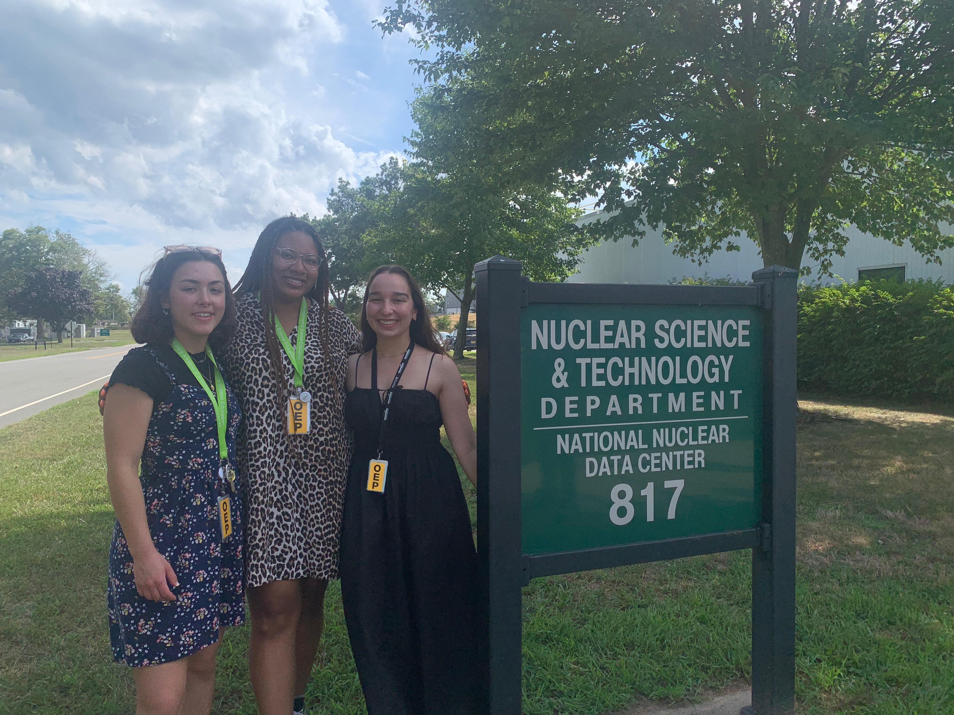
Challenges…and how we faced them!
Trial and error –It’s a learning process!
Our mentors are busy
Time zones and scheduling
Resilience
Independence
Clear communication
NNDC Interns, August ‘22

Slide 5
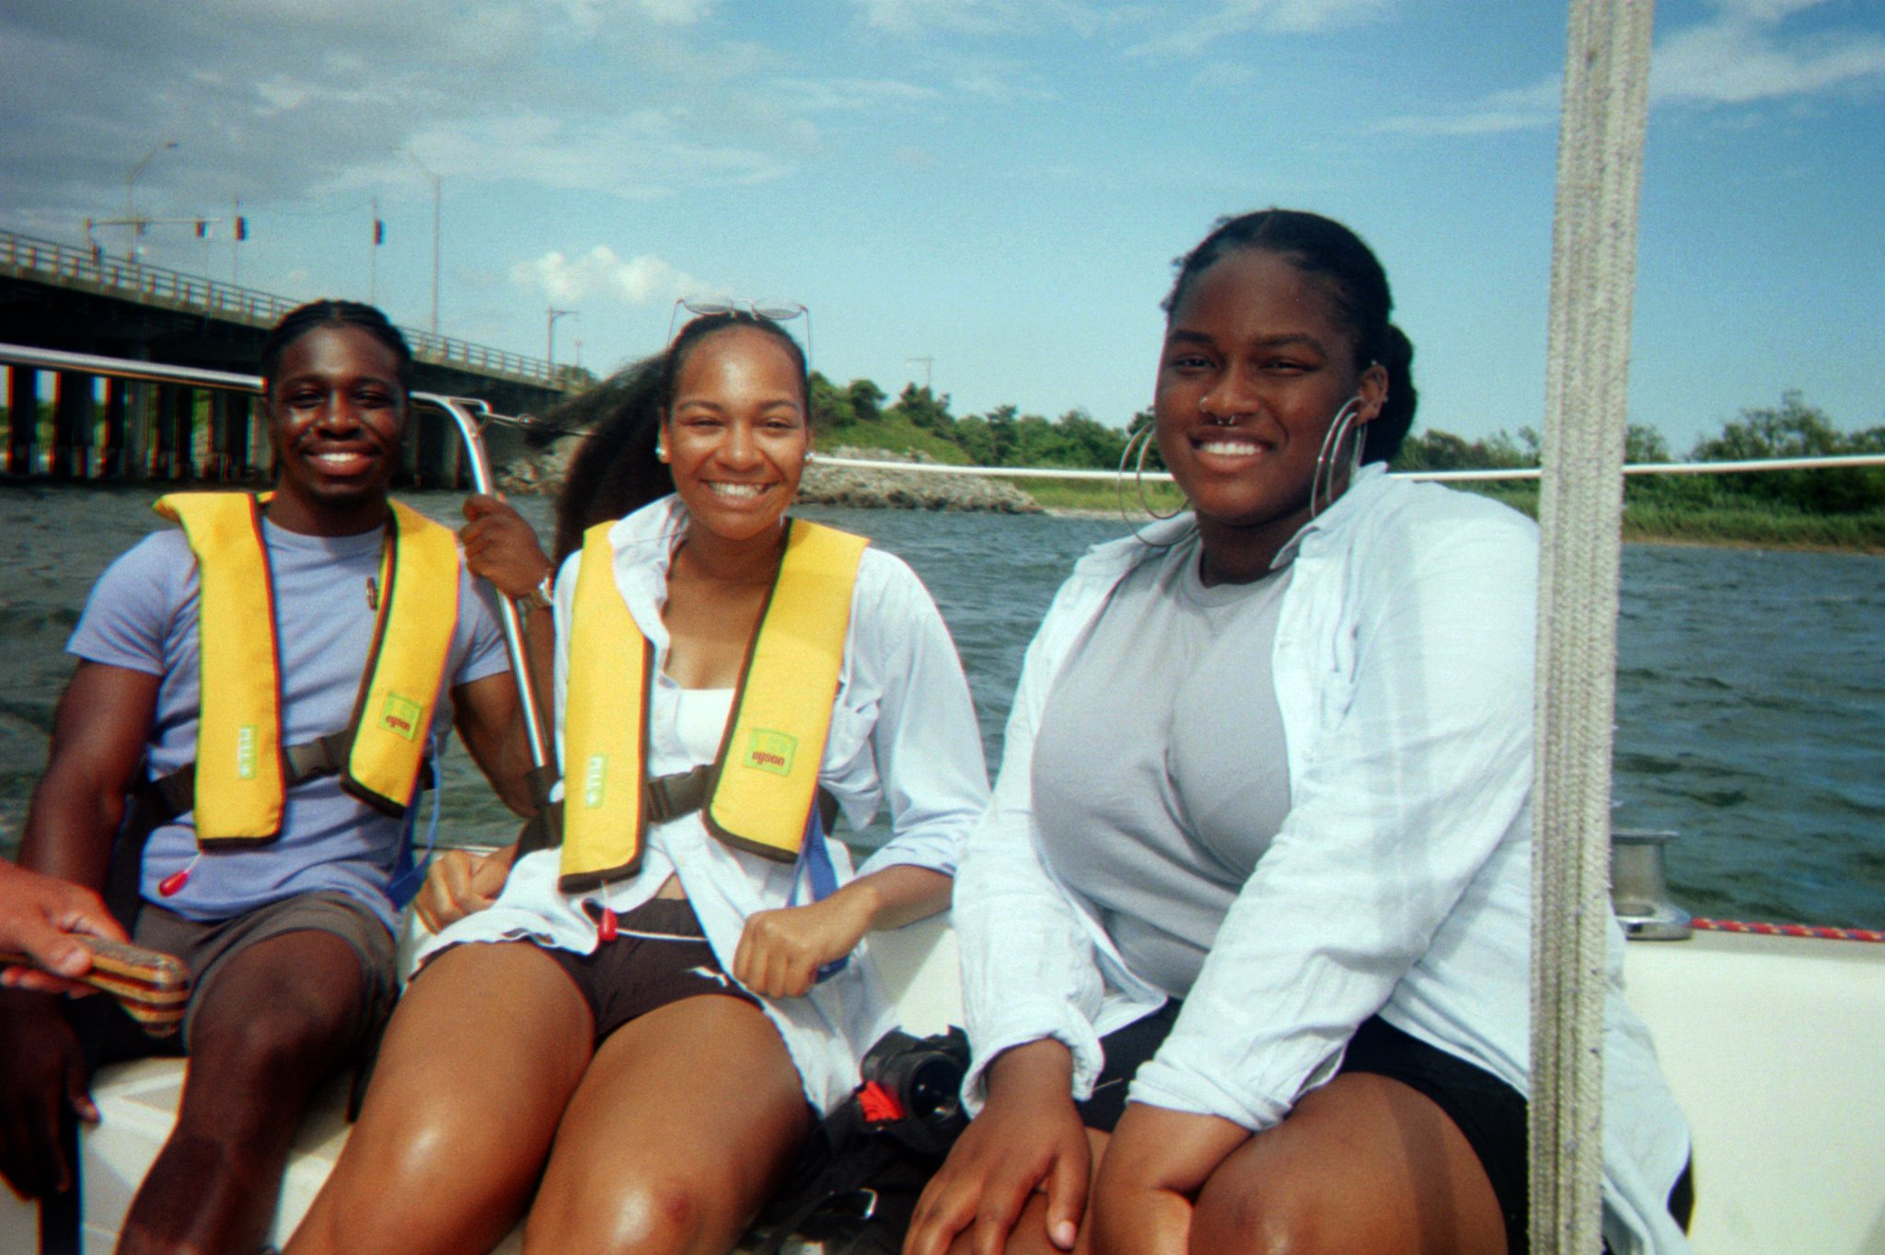
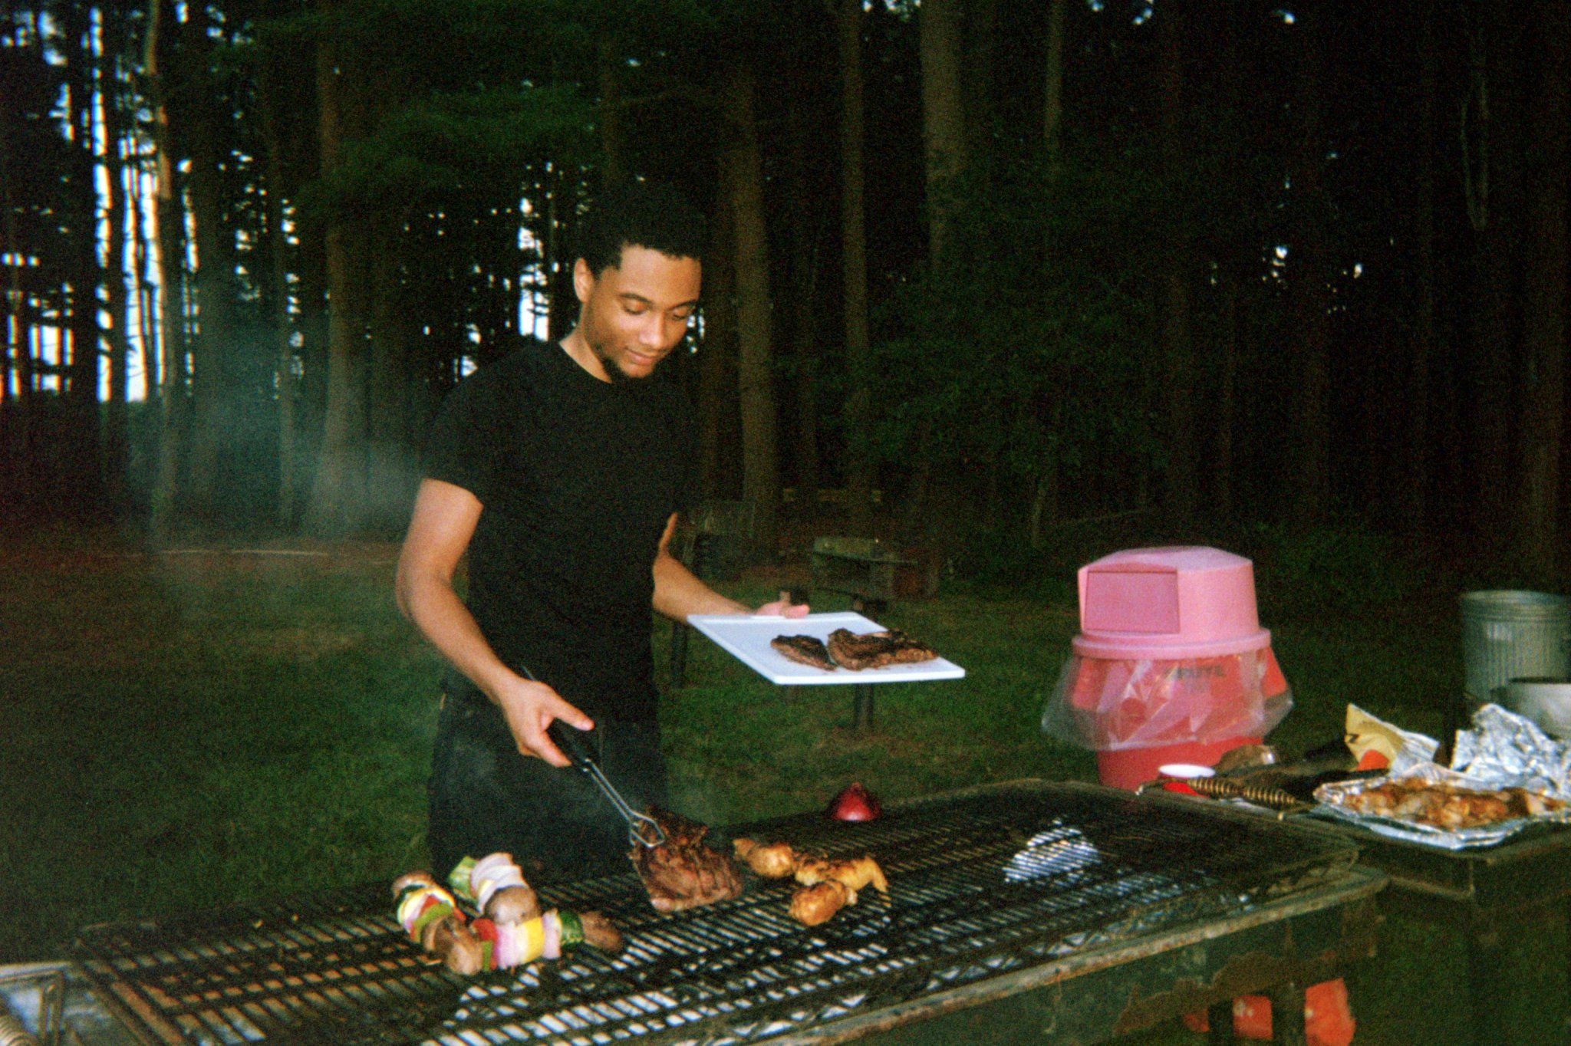
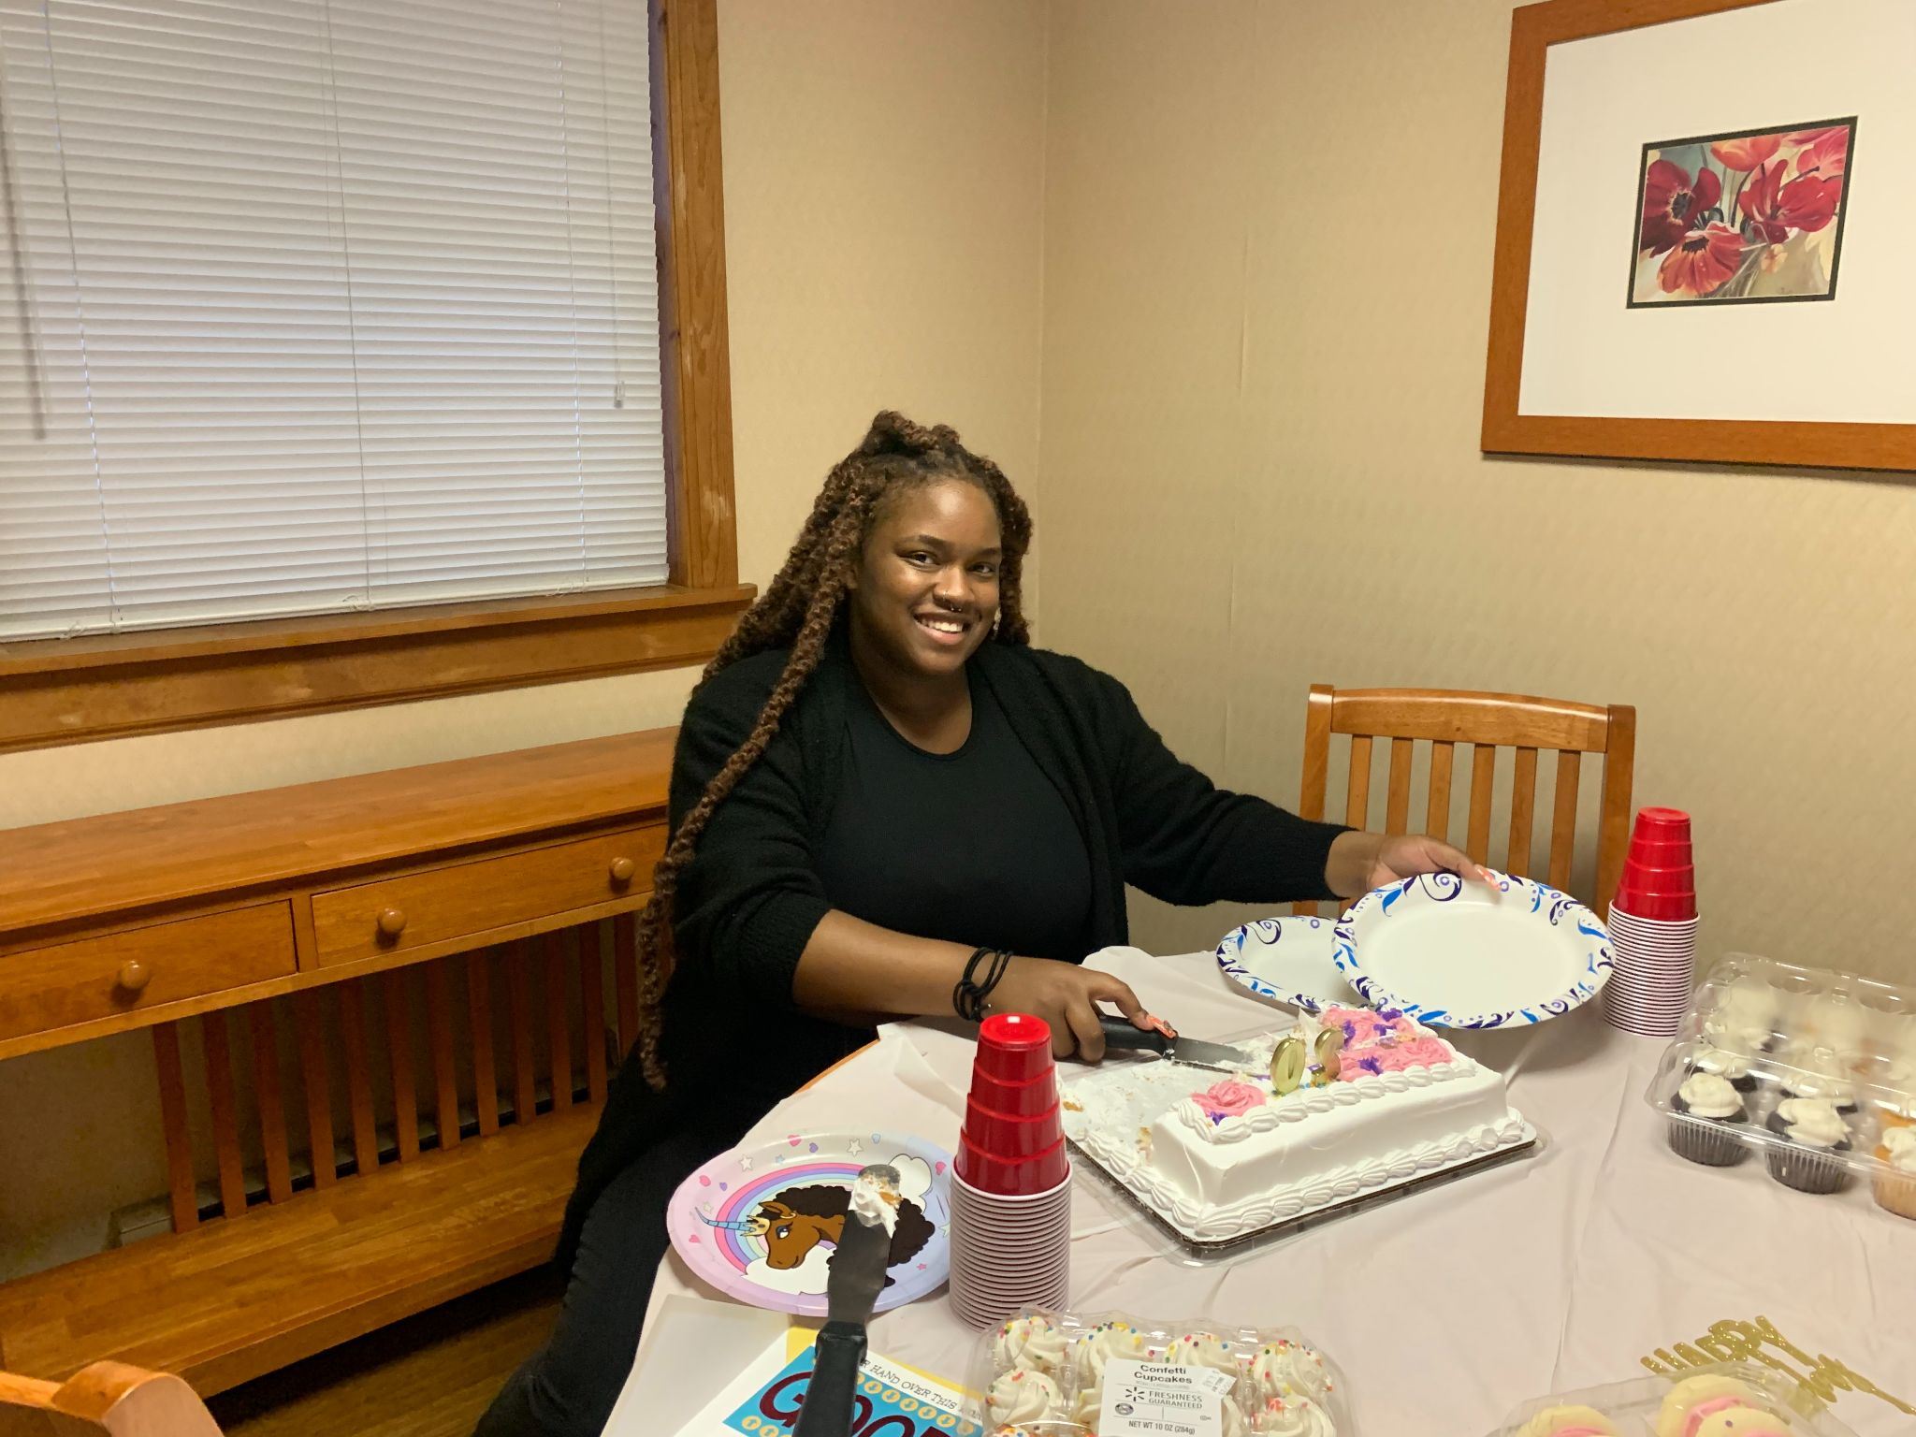
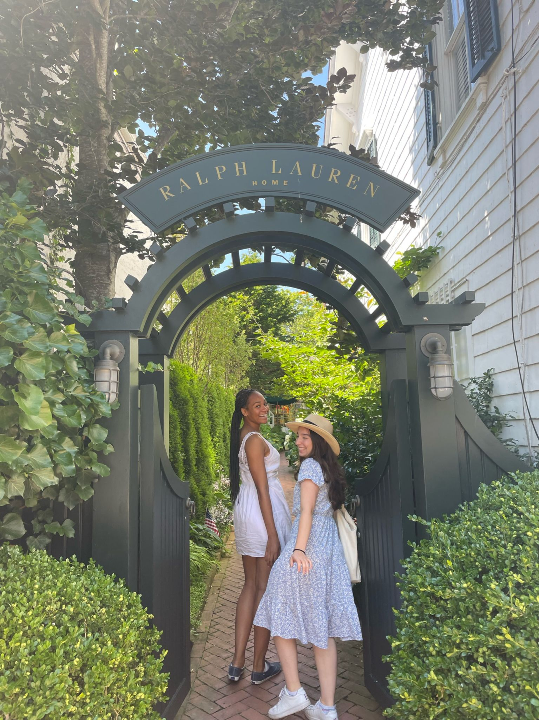
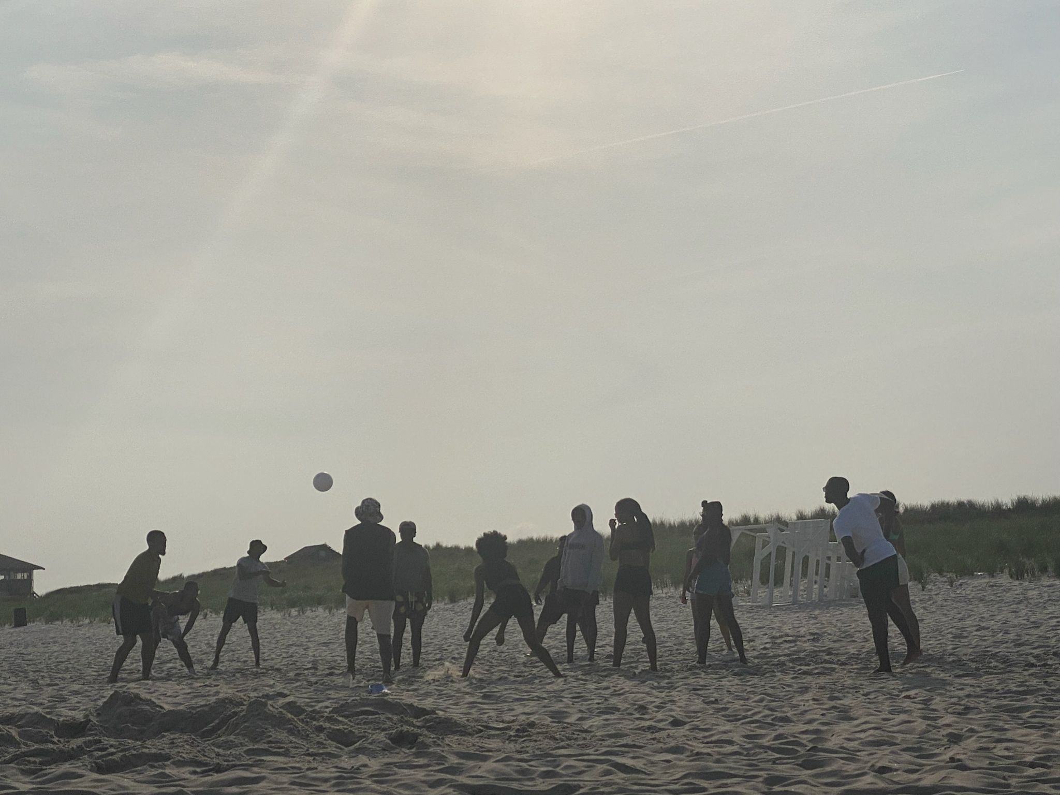
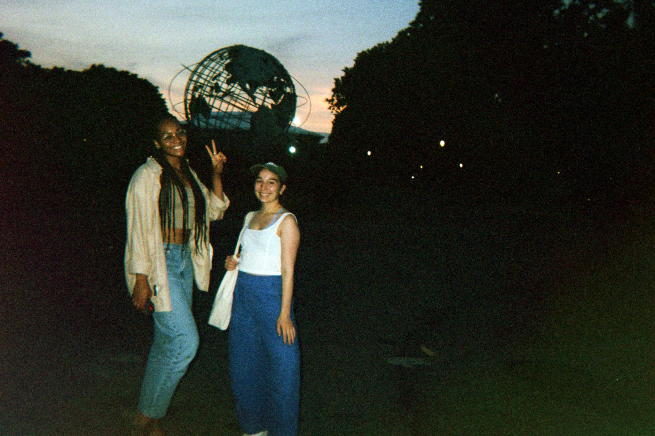
Of course, we didn’t forget to have fun!

Slide 6
Thank you!

