Slide 1
Nuclear Physics Traineeship Student Perspective
Laurynette Griffin
July 19, 2023

Slide 2
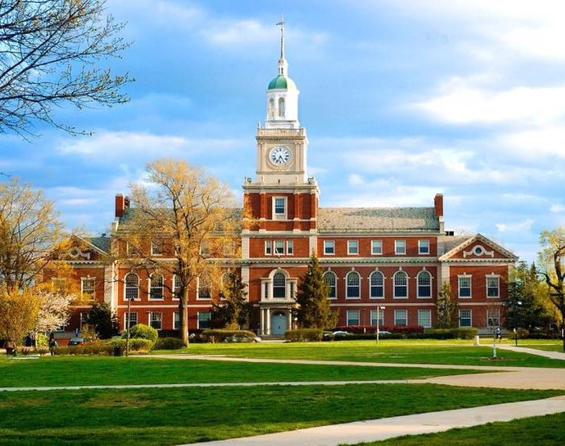
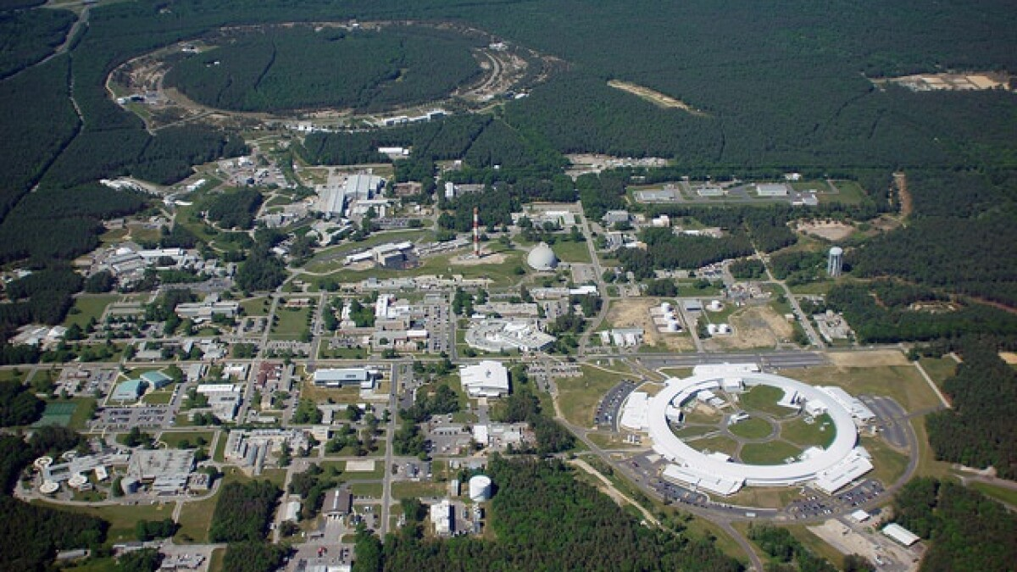
My Journey to NPT
Prior to BNL, I had only had one semester of research through Howard University.
Dr. Stacyann Nelson invited me to join NPT.
I felt very unprepared coming into this new space.

Slide 3
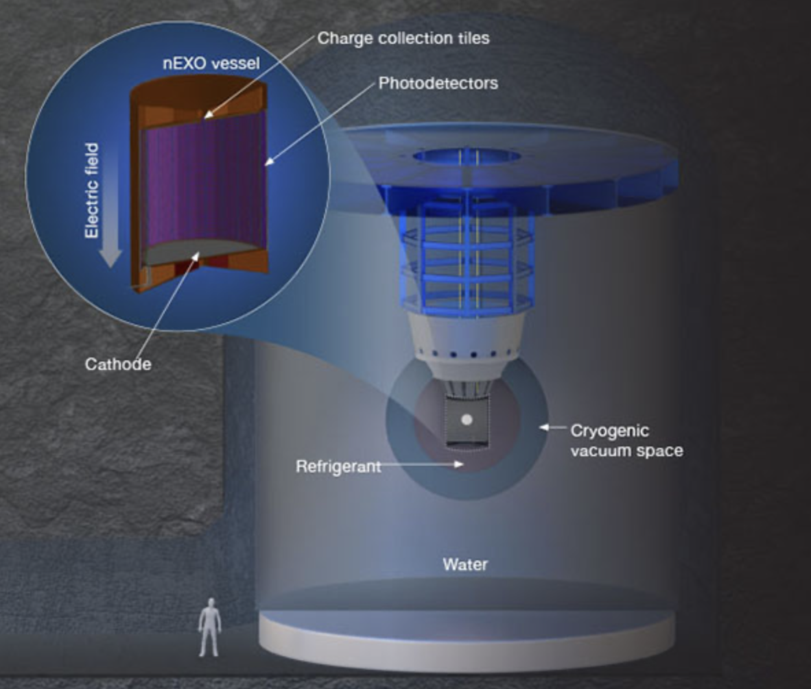
Past and Present Projects in NPT
I have worked on nEXO for over a year.
Summer '22 – Development of the Photon Readout Electronics for nEXO
Fall '22 – nEXO Ba-Tagging using Advanced Electron Microscopy
Spring '23 – Survey of Possible Beyond Standard Model Physics Searches for nEXO
Summer '23 – A Feasibility Study for New Physics in nEXO
Notes:
What is the problem that your research aims to address?
General formatting guidelines
Image/Picture for visual representation or understanding
Bullet points read better than blocks of text; avoid crowding the page with text.
Use sans-serif fonts; avoid decorative fonts.

Slide 4
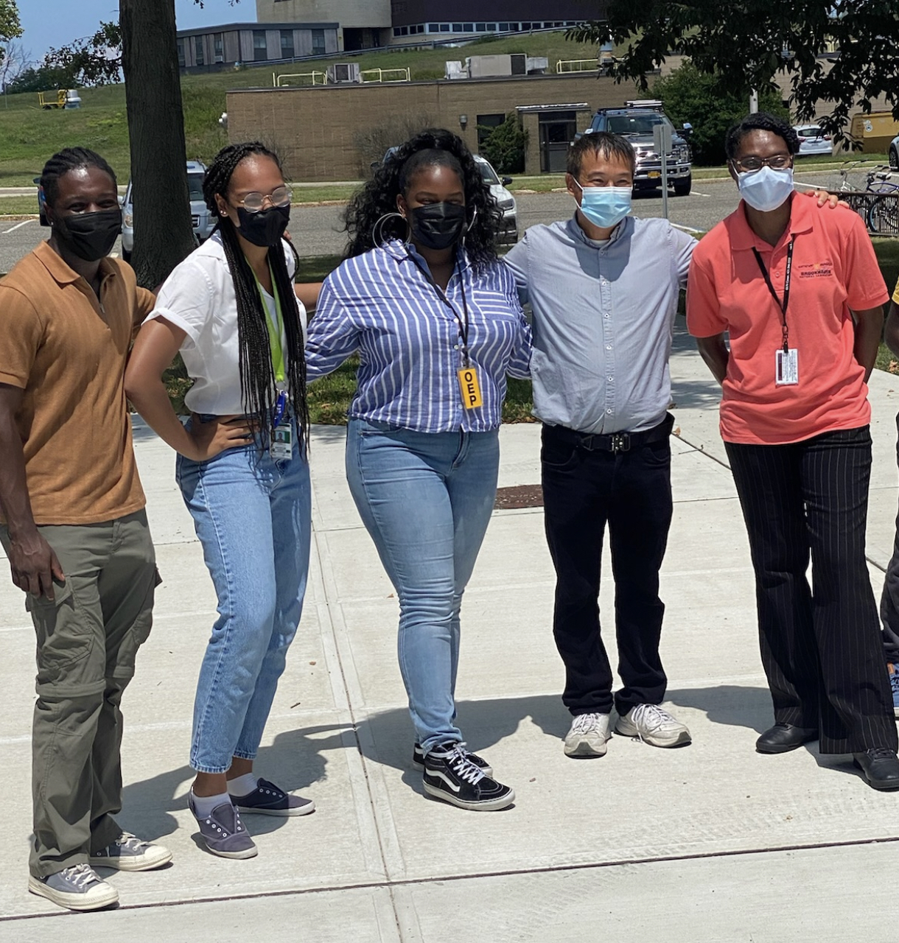
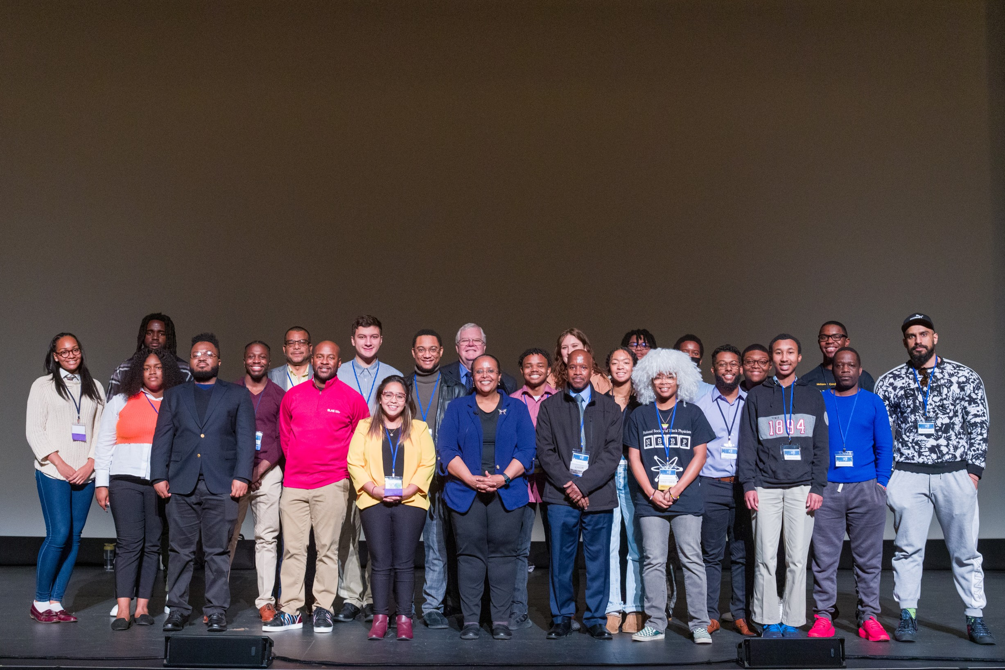
NPT Experiences and Personal Impacts
The flexibility of the program allows me to gain experience in many different areas of one experiment.
Last fall, I was able to attend two conference and participate in poster sessions.
My network has grown at an exponential rate.
This research experience was pivotal in my decision to pursue a Ph.D.

Slide 5
Thank you!

